Slide 1
Overview of Collective Effects and Their Mitigation in Ultra Low-Emittance Light Source Rings
APS–Upgrade (HMBA, 6 GeV)
PETRA IV (HMBA, 6 GeV)
USSR (Ultimate Synchrotron Storage Ring based on 40-cell EBS, HMBA, 6 GeV)
Yong-Chul Chae
LEL 2022 – 3rd Workshop on Low Emittance Lattice Design
ALBA, Barcelona, Spain
June 26, 2022 – June 29, 2022

Slide 2
Overview
Caivty HOMs and Coupled bunch instability
Resistive wall coupled bunch instability: uniform vs trains with gaps
Fill pattern dependent transient effect
Beam loading
Ion effects
Impedance
NEG coating and roughness effect
Realistic chamber aperture vs. Ellipse approximation
USSR (40 cell EBS) Collective Effect
20-mm (y) Elliptic Chamber (ESRF-EBS chamber)
10-mm Round Chamber
Round vs. Elliptic chamber
De-tuning wake
High-Order Momentum Compaction

Slide 3
Rf Cavity Systems
 | Units | ESRF | APS | PETRA III | EBS¹ | APS-U² | PETRA IV³ | USSR⁴
f_{rf} | MHz | 352 | 352 | 500 | 352 | 352 | 500 | 357
V_{rf} | MV | 8 | 9 | 20 | 6.5 | 6.5 | 8 | 5
Cavities |  | 5 x 5-cell | 16 x 1-cell | 12 x 7-cell | 14 x 1-cell | 12 x 1-cell | 24 x 1-cell
Instability Control |  | HOM tuning by temperature control | HOM tuning by temperature control | Longitudinal feedback | HOM damped cavity | Longitudinal feedback | HOM damped cavity | HOM damped cavity
¹EBS Storage Ring Technical Report, September, 2018
²Advanced Photon Source Upgrade Project Final Design Report, May, 2019
³PETRA IV Conceptual Design Report, November, 2019
⁴CremlinPlus Work Package 4.3 Deliverable D4.5, February, 2022 (unpublished report)

Slide 4
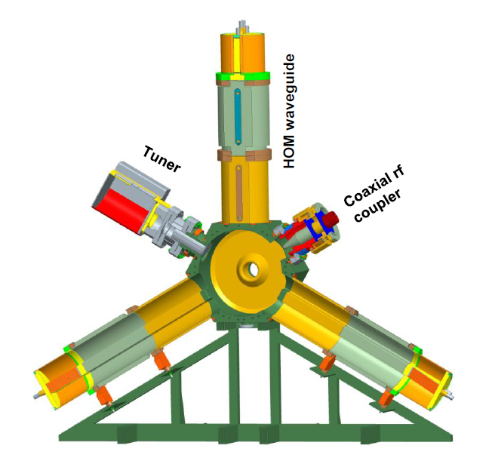
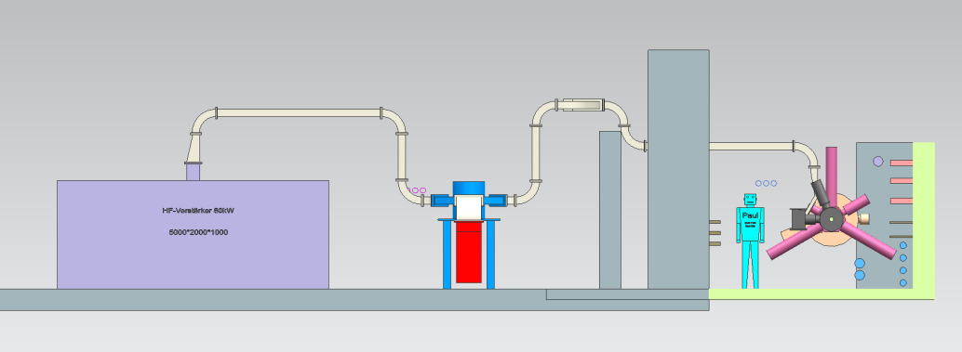
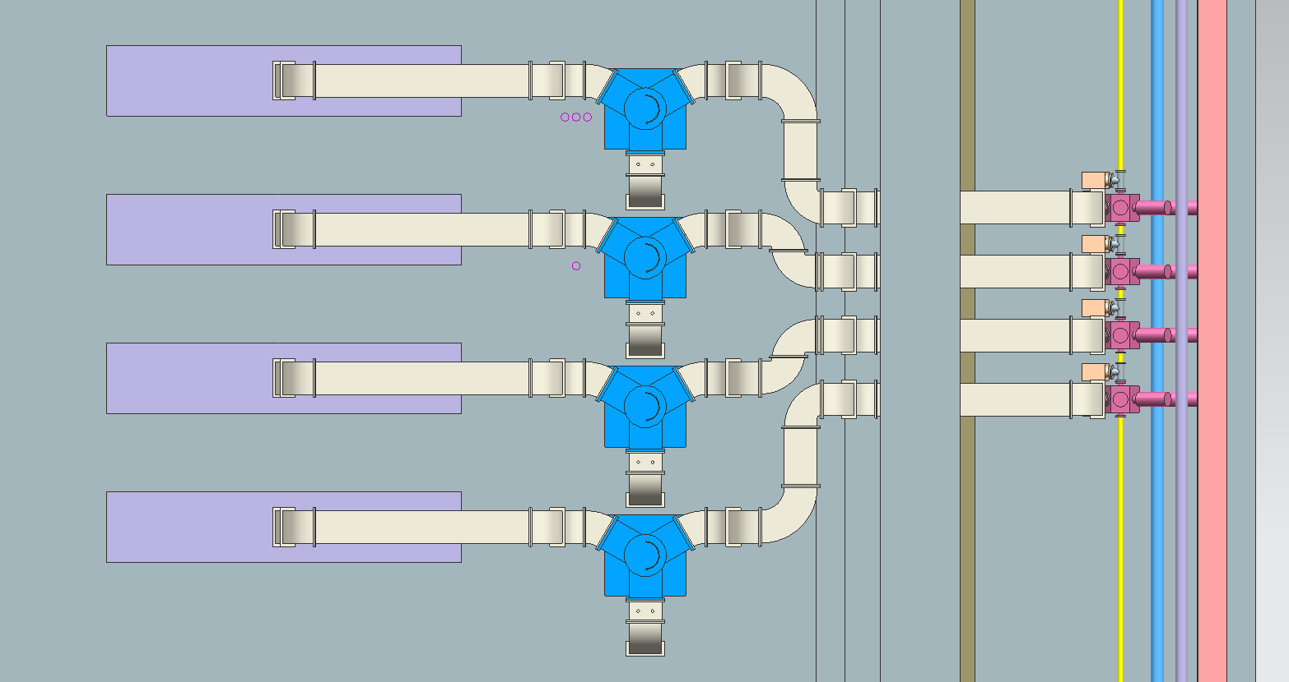
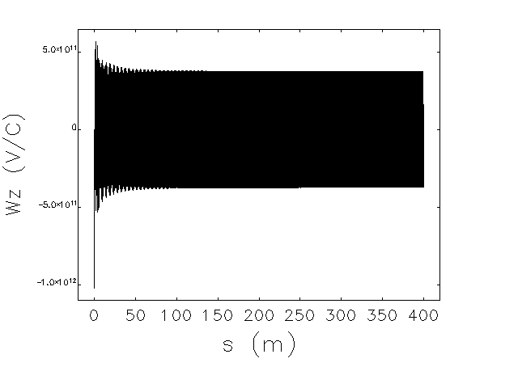
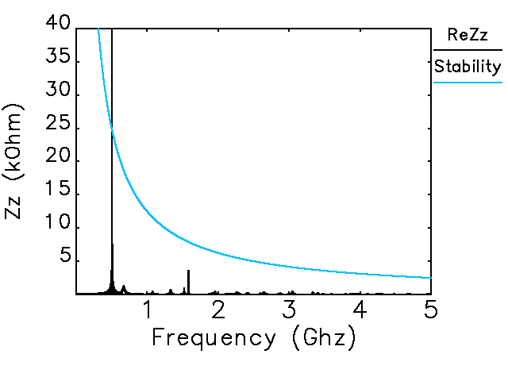
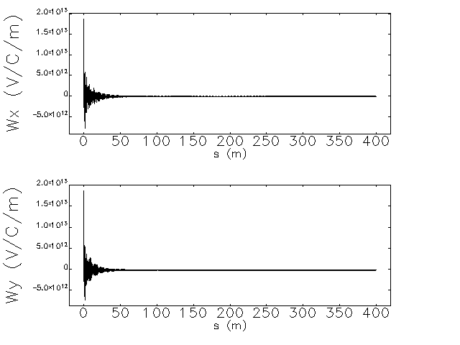
Cavity HOMs
500 MHz HOM-Damped EU-Cavity for PETRA IV
WR-1800 waveguide with reduced hight
80 kW solid state amplifier
Circulator
Circulator load
HOM-Damped EU-Cavity
Courtesy of Ernst Weihreter, HZB
Courtesy of Michael Ebert, DESY
Monopole wake
Dipole wake
Monopole impedance

Slide 5
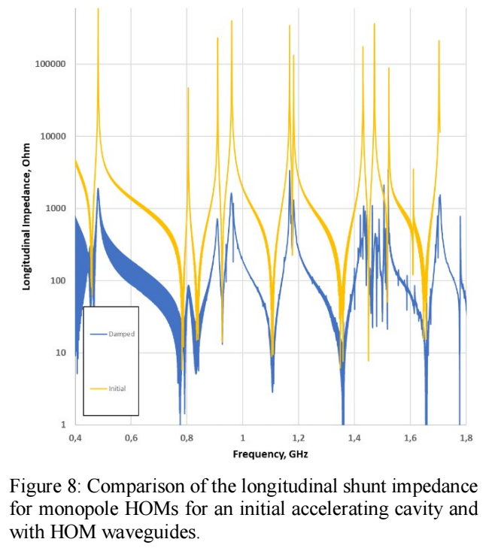
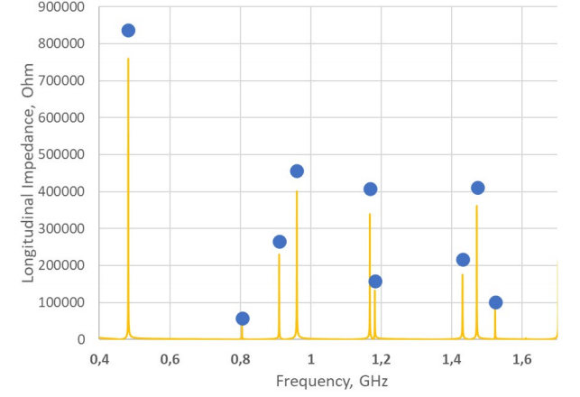
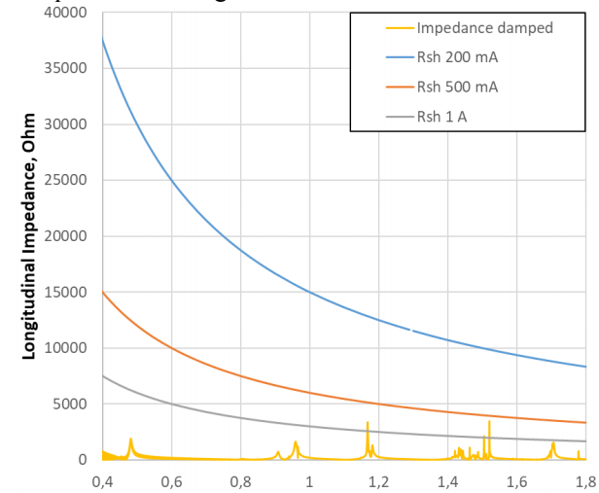
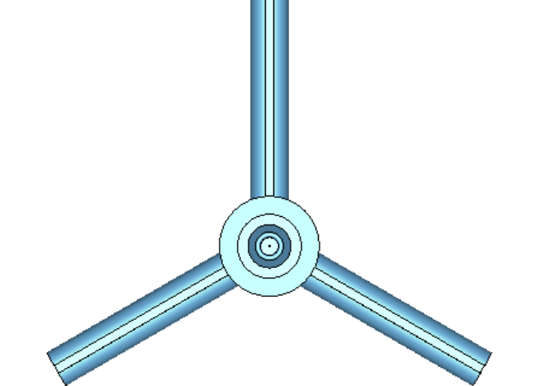
Cavity HOMs
357 MHz HOM-Damped EU-Cavity for USSR
N. Yu. Samarokov, et al, ACCELERATING CAVITIES WITH HOM DAMPING FOR USSR-4 STORAGE RING, RuPAC 2021, pp 367-369

Slide 6
Cavity Fundamental Mode of Large Ring
HOM damped cavity can increase the instability threshold current quite a lot in the MBA-based rings.
However, the limit can be set lower by the fundmenal mode’s impedance, which also induce the coupled-bunch instability.
This becomes issues for the large ring (small revolution frequency) with the harmonic cavity which exhibits the broad bandwidth. ➔ PETRA IV (private communication with M. Zobov, INFN).
PETRA IV has the place holder for the longitudinal feedback cavities at the moment.
μ =
0
0
4
1
3
2
2
3
1
4
0
0
qM
qM+1
qM+2
qM+3
qM+4
(q+1)M

Slide 7
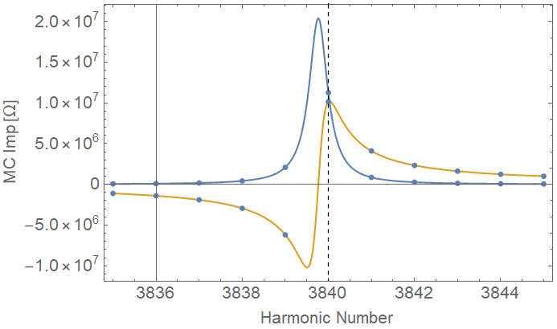
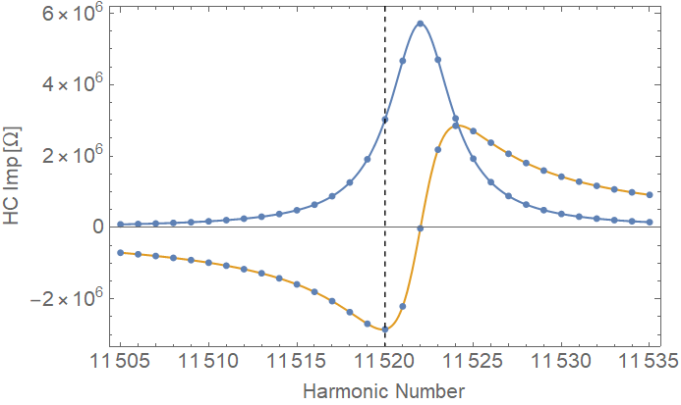
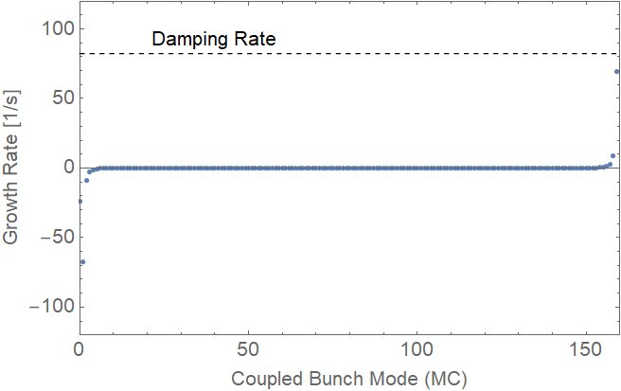
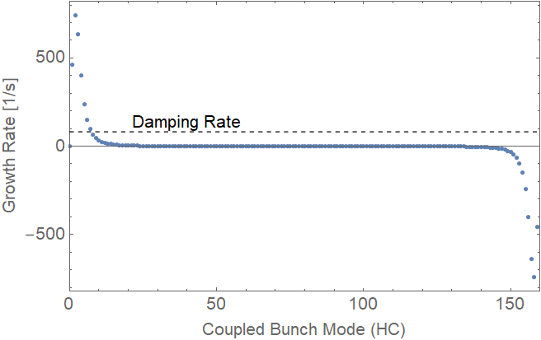
Cavity Fundamental Mode of PETRA IV
Growth rate computed for 500 MHz and 1500 MHz Cavities (C. Li)
500 MHz
1500 MHz
200 mA

Slide 8
Resistive wall – coupled bunch instability
Number of undulator sectors is around 30 in the MBA-based storage rings and its small gap chamber dominates the resistive wall impedance.
Because the lowest-negative-betatron frequency sideband (Δ-1)w₀ determines the growth rate, PETRA IV can be a case study.
Fastest Growing Mode (Ng’s book)
PETRA IV Rigid Bunch Case (m=0, ξ = 0, F’=1)
PETRA IV Bunched Beam Case (m, ξ, F’)
L=2304 m, f₀ = 130.12 kHz, I_{total}=200 mA, M=1920
Tune = (164.18, 68.27)
1/τ = 1600/s >> 50 (Rad damping rate)
We are developing the 500-MHz (250-MHz) bunch-by-bunch feedback with the sufficient damping
σ_{t}=33 ps, τ_{L}=4*σ_{t}=132 ps, α=1.5x10⁻⁵
ω_{ξ}/2π = 8.7 x ξ [GHz], χ = 7.26 x ξ [rad]
Timing mode requires ξ = 5
Mode (m) | Required χ shift to stabilize the mode from F’ | Required chromaticity for PETRA IV
0 | 9 | 1.3
1 | 12 | 1.7
2 | 15 | 2.1
3 | 18 | 2.5

Slide 9
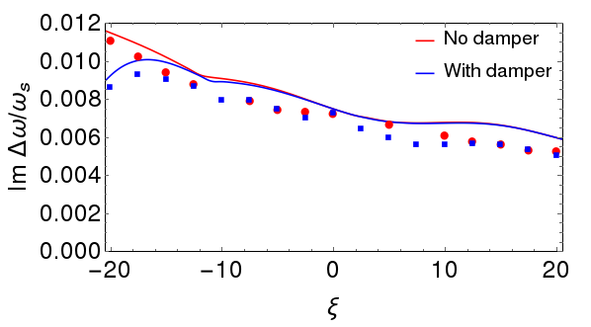
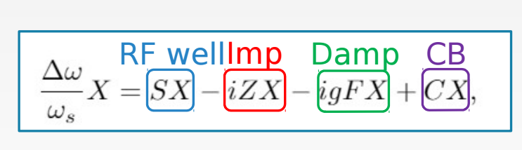
Resistive wall – bunch trains with gaps
Nested Head-Tail (NHT) Code simulation (S. Antipov)
NHT Vlasov Solver
Developed by A. Burov (Fermilab) and S. Antipov (DESY)
Longitudinal distribution is discretized on a set of air-bag rings
Single-bunch + coupled-bunch wakes
Chromaticity
Damper feedback system: both resistive and reactive
Arbitrary longitudinal distributions and filling patterns
It was used to study coupled bunch instability at CERN
We found that it gives a tremendous time saving in dealing with the bunches more than 1000 compared to tracking codes.
Example and benchmark
a destabilizing effect of a transverse HOM in Hi-Lumi LHC, confirmed by PyHEADTAIL tracking code.
NHT solution – solid lines, tracking – dots
S. Antipov et al., PRAB 22, 054401 (2019)

Slide 10
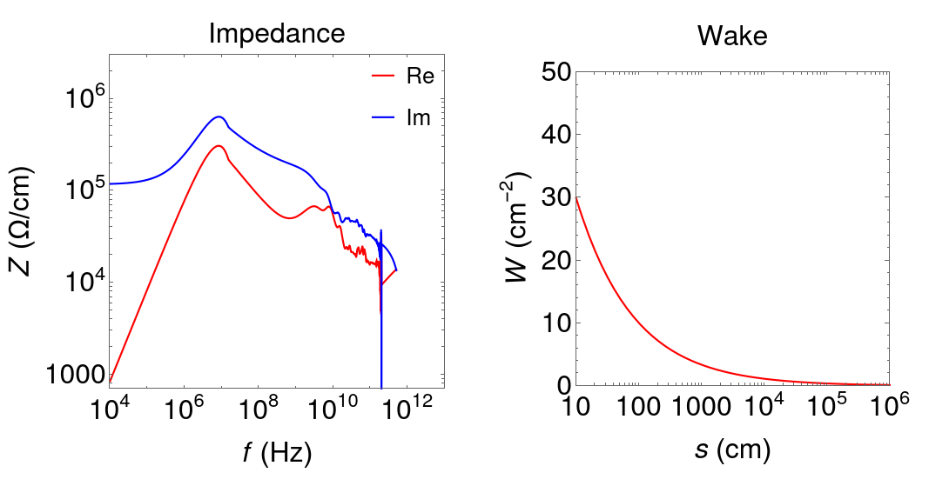
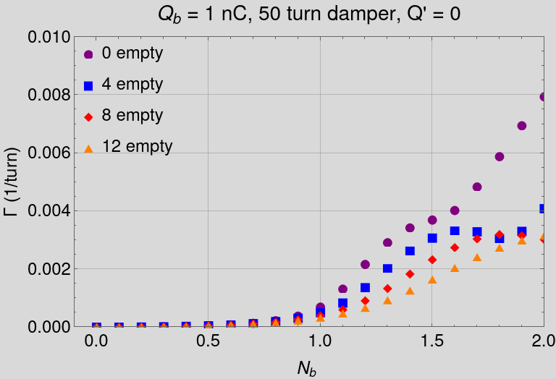
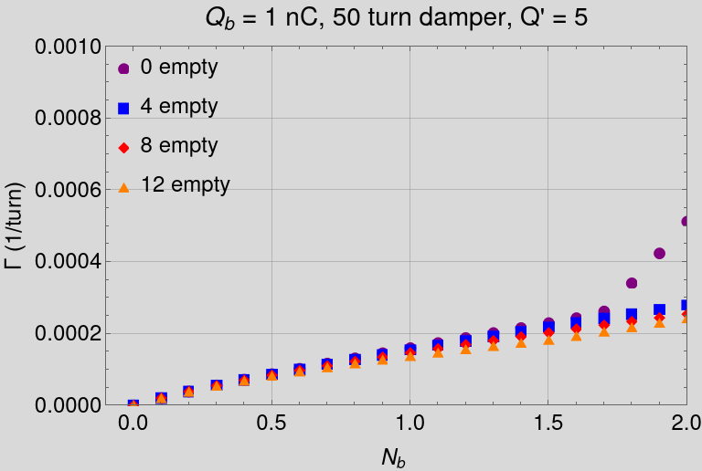
Resistive wall – bunch trains with gaps
Nested Head-Tail (NHT) Code simulation (S. Antipov)
N
24
1920
PETRA IV: No significant difference for different filling schemes with damper

Slide 11
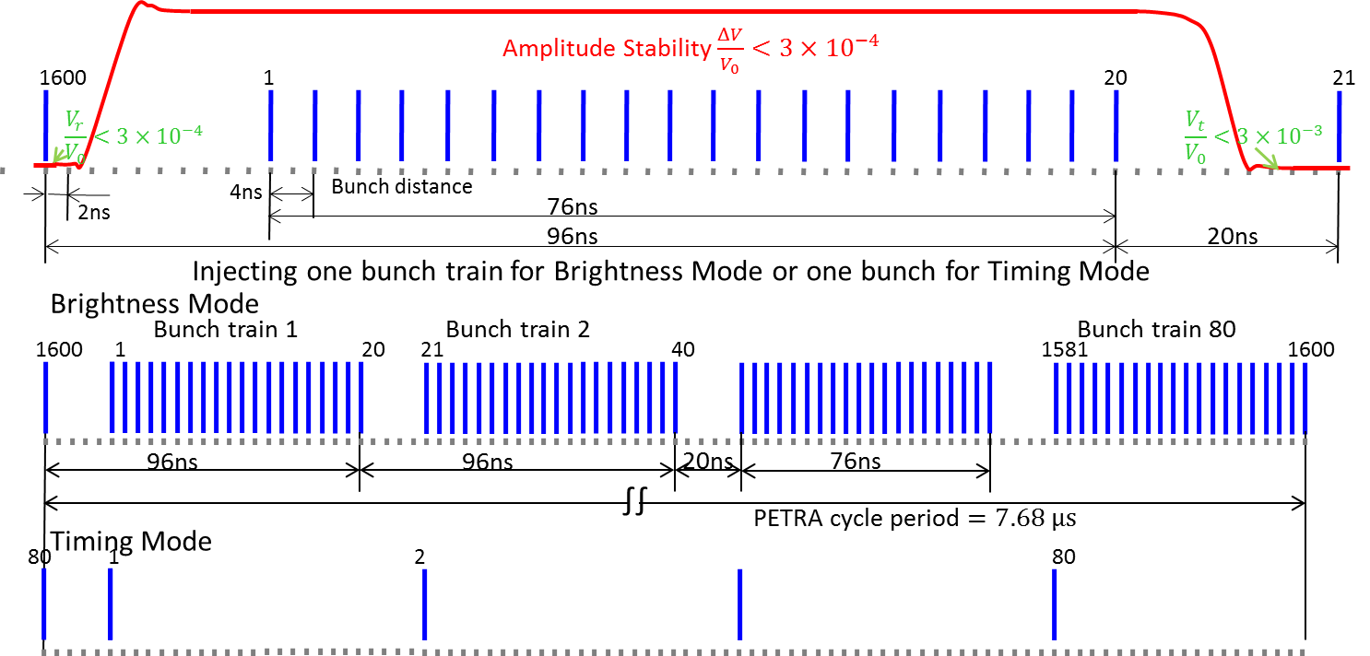
Fill Pattern – Transient Beam Loading
CETA Code Simulation (C. Li)
PETRA IV can operate two different modes of fill pattern
Out of 2x1962 buckets, 1600 bunches in 80 trains which has (20 fill + 4 empty) structure with 4-ns spacing for the brightness mode.
Out of 3840 buckets, 80 bunches in the uniform fill for the uniform mode.
Hybrid mode and ½ filling in consideration.
We use CETA^{[1]} which is a software to study the collective effect recently developed at DESY
^{[1]} Chao Li and Y.-C. Chae, CETA-A CODE PACKAGE BEING DEVELOPED FOR COLLECTIVE EFFECT ANALYSIS AND SIMULATION IN ELECTRON STORAGE RINGS, IPAC 2022, WEPOMS033.
* Contact li.chao@desy.de for the code distribution.

Slide 12
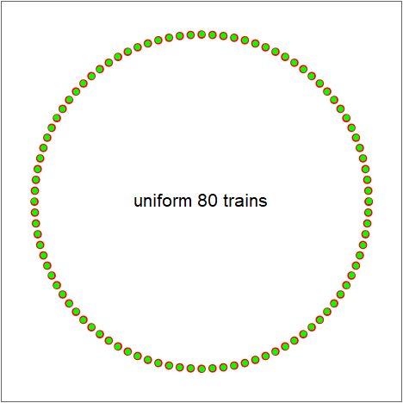
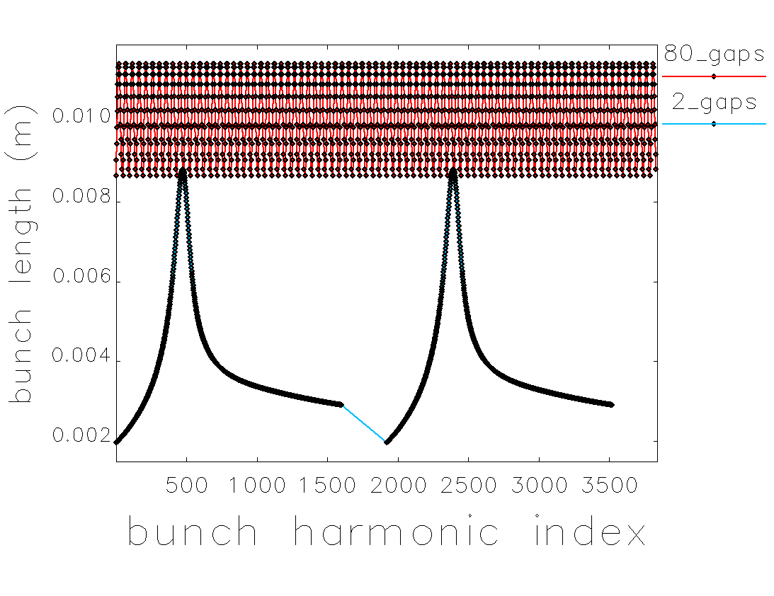
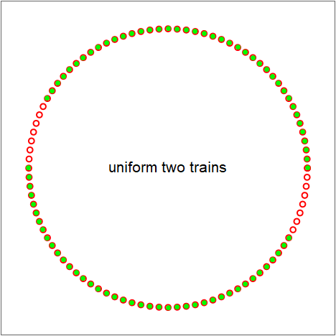
Fill Pattern – Transient Beam Loading
CETA Code Simulation (C. Li)
Long gaps modulate the cavity voltage over the trains.
The 3rd harmonic cavity makes the bunch length very sensitive to the voltage deviation.
The guard bunch scheme works well in regulating the variation. But why do we need the long gaps if it’s not for the hybrid mode requested by users?
1920=80*(20+4)
4 ns spacing
80 bunch trains
1600 bunches.
1920=2*(800+160)
4 ns spacing
2 bunch trains
1600 bunches.

Slide 13

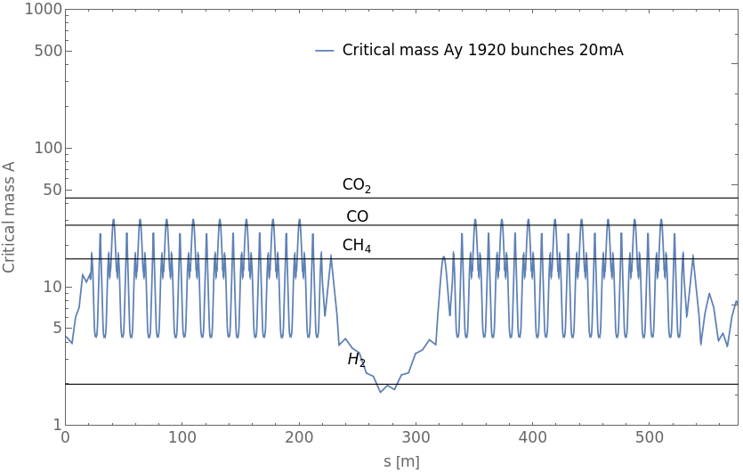
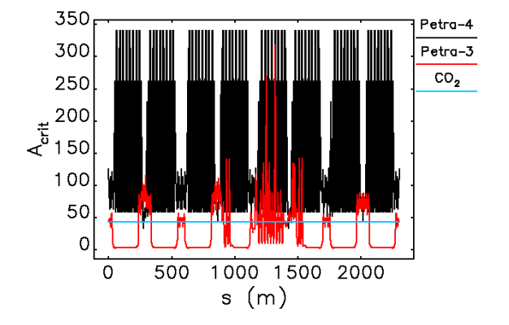
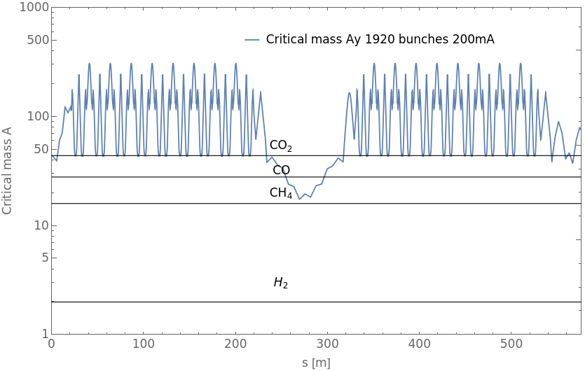
Fill Pattern – Ion Effects (PETRA IV)
H6BA TDR Lattice
20 mA
1920 bunches
H7BA CDR Lattice
100 mA
960 bunches
H6BA TDR Lattice
200 mA
1920 bunches

Slide 14
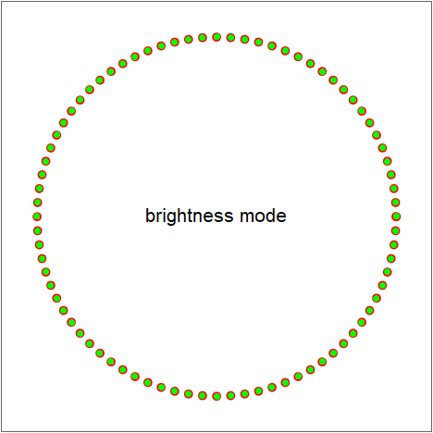
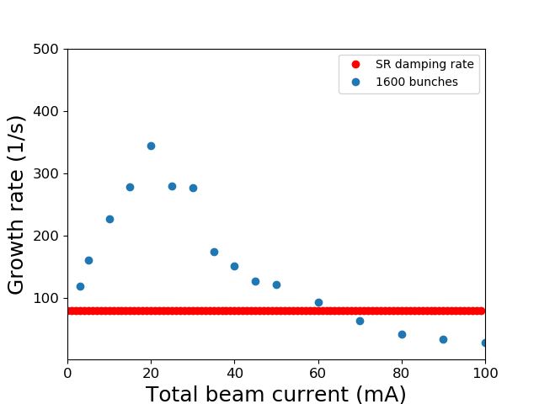
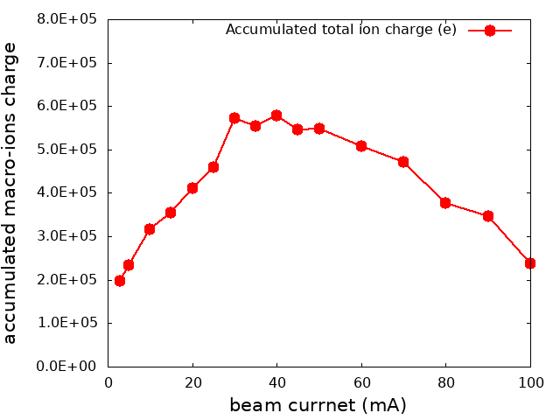
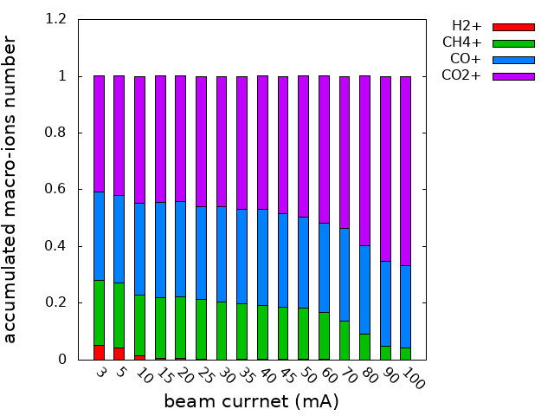
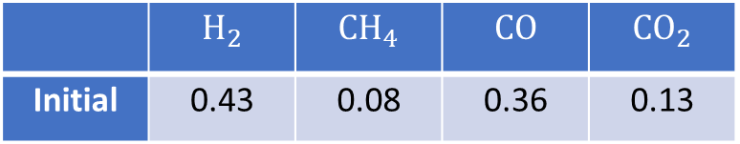
Fill Pattern – Ion Effects (PETRA IV)
CETA Code Simulation (C. Li)
1600 bunches in brightness mode 80x(20+4).
We observed the highest ion accumulation around the 30 mA and the lighter ions are hardly trapped there.
Growth rate is obtained by fitting the amplitude in the range of (0.1,1) rms beam size.
The largest growth rate is roughly 300/s around 20mA.
 | $$H_{2}$$ | $$CH_{4}$$ | $$CO$$ | $$CO_{2}$$
Initial | 0.43 | 0.08 | 0.36 | 0.13

Slide 15
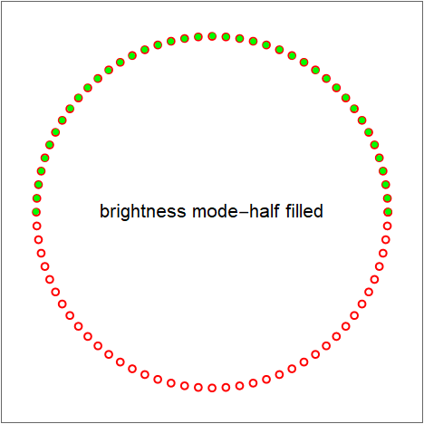
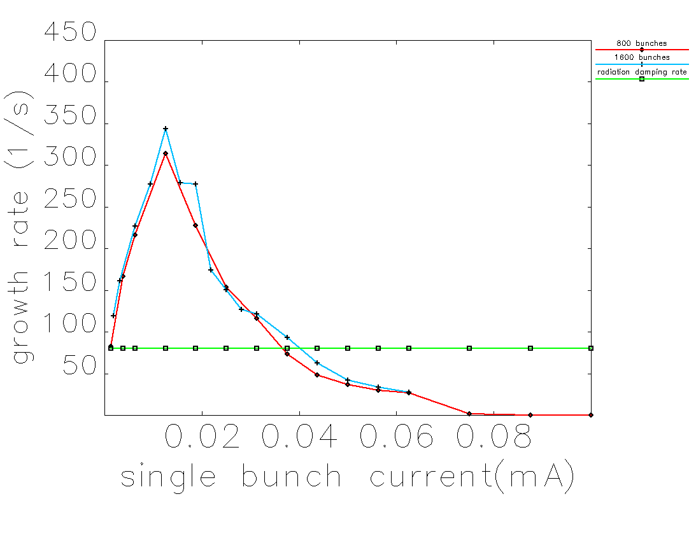
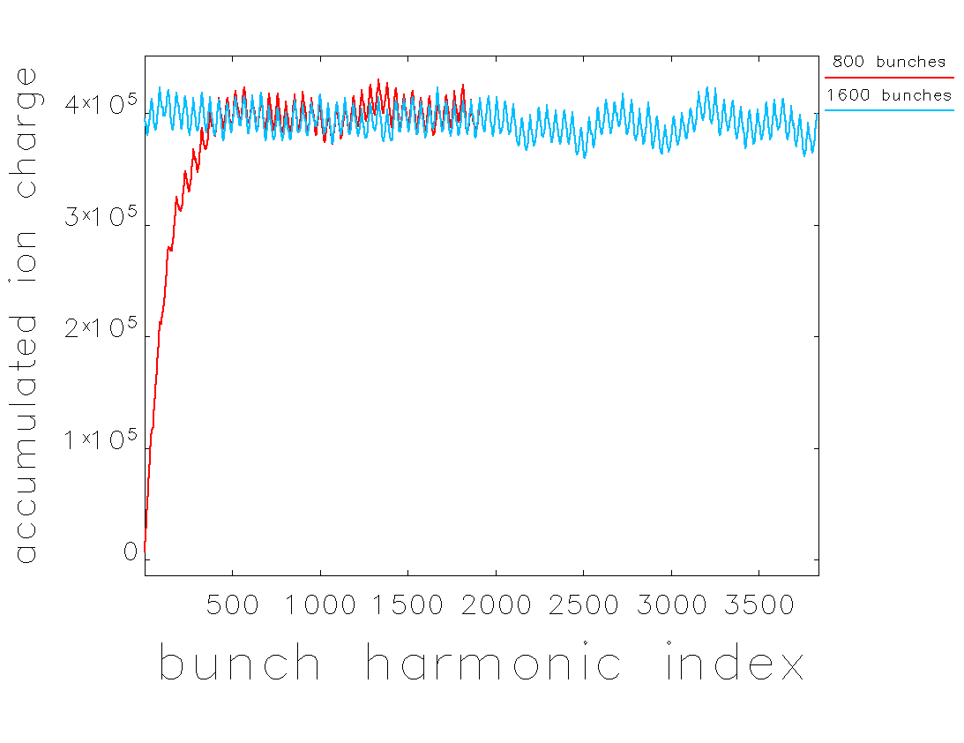
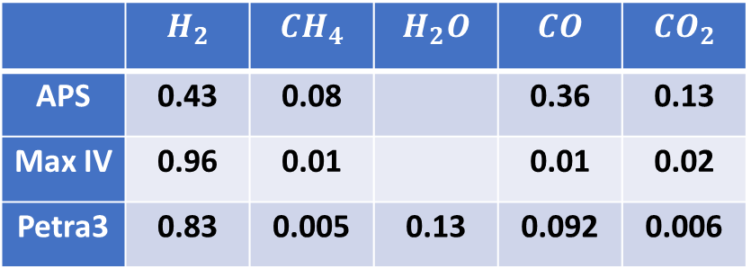
Fill Pattern – Ion Effects (PETRA IV)
CETA Code Simulation (C. Li)
 | $$H_{2}$$ | $$CH_{4}$$ | $$H_{2}O$$ | $$CO$$ | $$CO_{2}$$
APS | 0.43 | 0.08 |  | 0.36 | 0.13
Max IV | 0.96 | 0.01 |  | 0.01 | 0.02
Petra3 | 0.83 | 0.005 | 0.13 | 0.092 | 0.006
We verified that the long gap can clean ions.
However, the amplitude grows until it saturates due to the trapped ions in the train.
As a result, the instability growth rate is the same as the uniform fill.
So we don’t need the long gap to mitigate the ion effects.
If this is the case, we prefer the small gaps to reduce the transient beam loading.
Full
Half fill
Full
Half fill

Slide 16
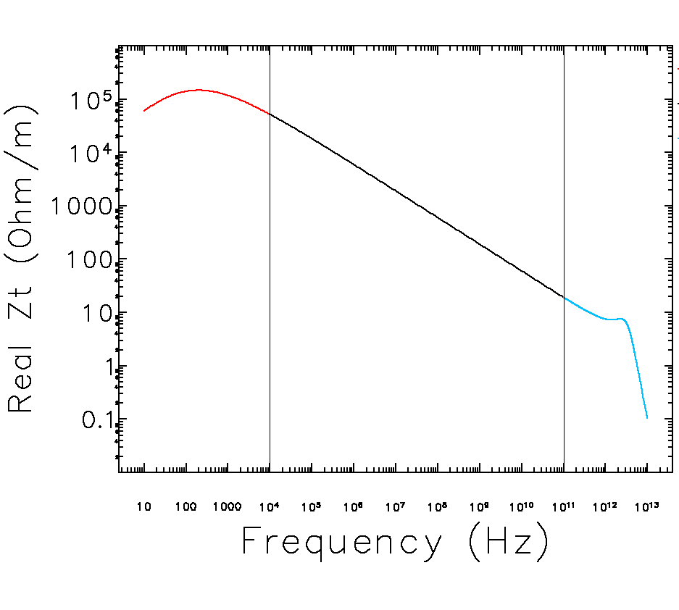
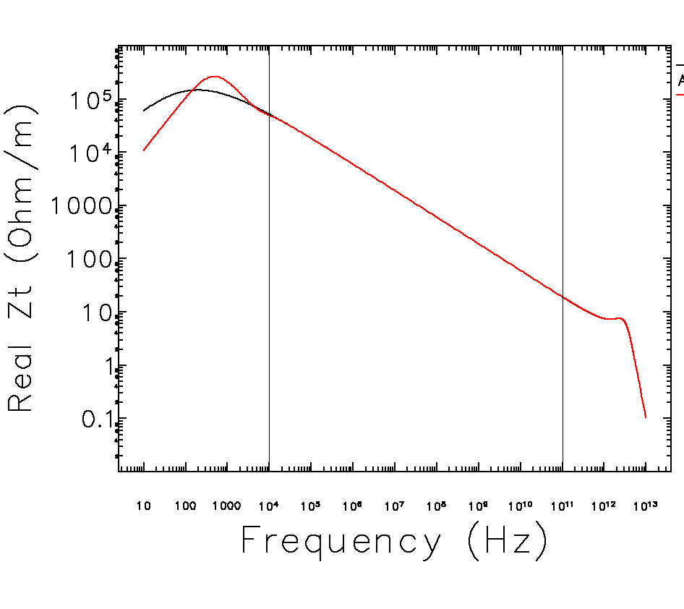
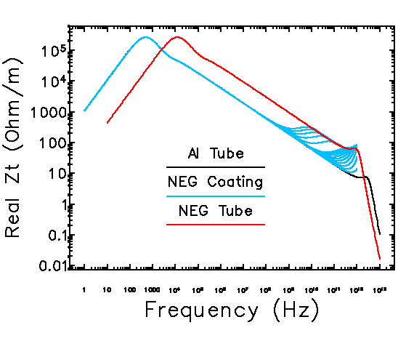
Resistive Wall Impedance - NEG
ImpedanceWake2D (IW2D)
One Layer
Two Layers
Three Layers
Chao‘s
LHC
Zotter
Bane

Slide 17
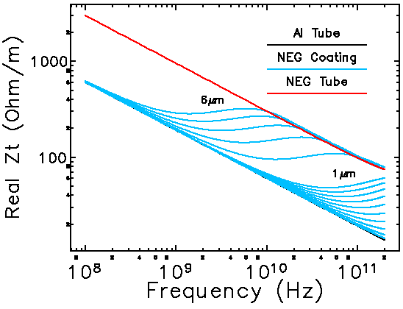
Resistive Wall Impedance - NEG
ImpedanceWake2D (IW2D)
NEG (Non Evaporative Getter) compound (Zr, Ti, V) with resistivity: (41.0, 55.6, 26.1) × 10⁻⁸ Ωm ➔ ρ_{NEG} = 40 × 10⁻⁸ Ωm (theoretical value)
Recent measurement on ρ_{NE}
ρ_{NEG} = 100 × 10⁻⁸ Ωm at 10-GHz with 6 μm coating thickness (DIAMOND) *E. Klukvini-Platia, IPAC 2014, p. 2384.
ρ_{NEG} = ρ_{Al} at 10 GHz with 1 μm coating thickness (APS) * APS-U CDR
We had used the conservative value on ρ_{NEG} = 100 × 10⁻⁸ Ωm with 1 μm coating thickness
M. Miglioriti recently showed that, if the coating thickness is below 200 nm for FCCee, the real part of impedance is independent of its thickness and its conductivity (presentation at USSR Task 4.3 Meeting, June 5, 2021).
We also learned that FCCee is considering 100 – 200 nm NEG coating.

Slide 18
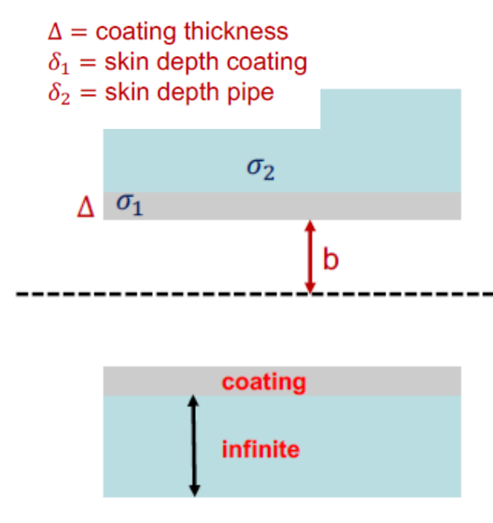
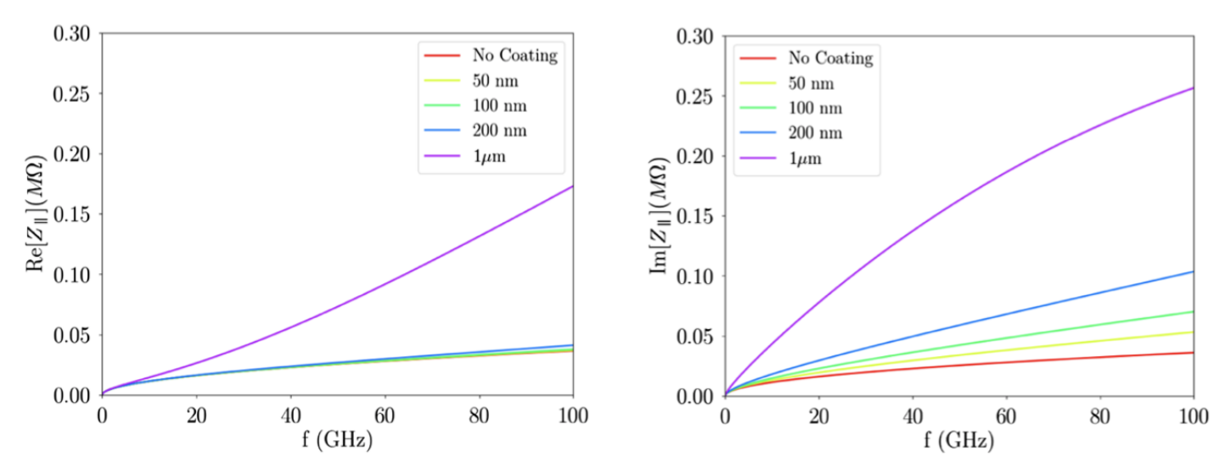
Resistive Wall Impedance - NEG
FCCee study by M. Migliorati (INFN)
M. Miglioriti recently showed that, if the coating thickness is below 200 nm for FCCee, the real part of impedance is independent of its thickness and its conductivity (presentation at USSR Task 4.3 Meeting, June 5, 2021).
We also learned that FCCee is considering 100 – 200 nm NEG coating.
If PETRA IV can adopt the same NEG coating, its effect on the impedance will be greatly reduced including the uncertainty on the NEG resistivity as well as on the roughness effect.

Slide 19
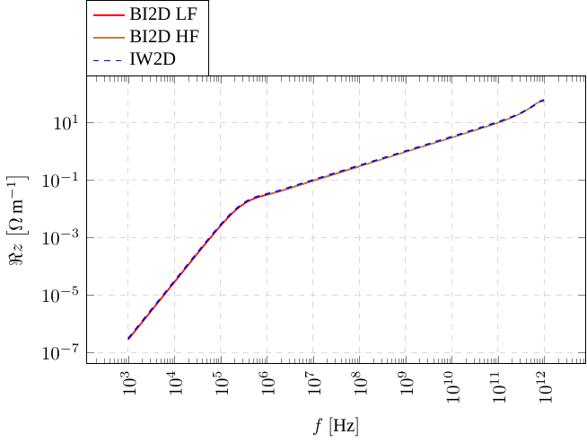
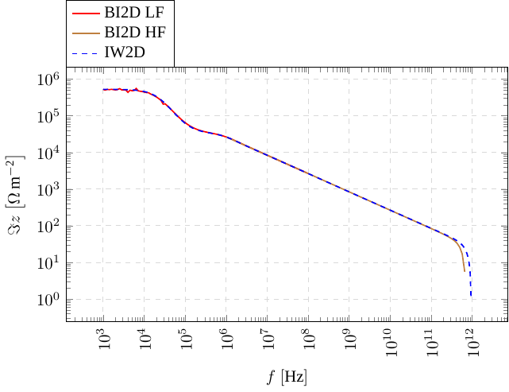
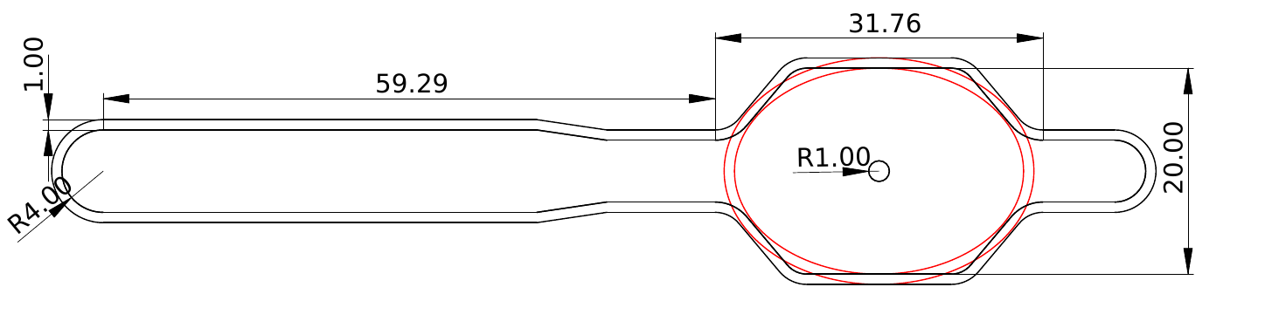
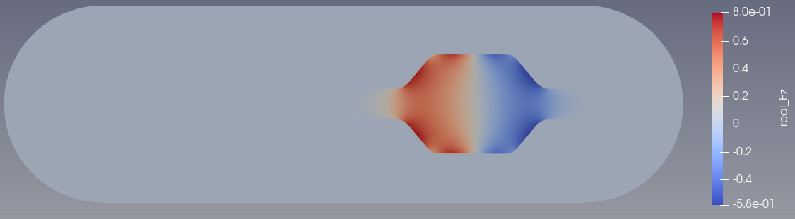
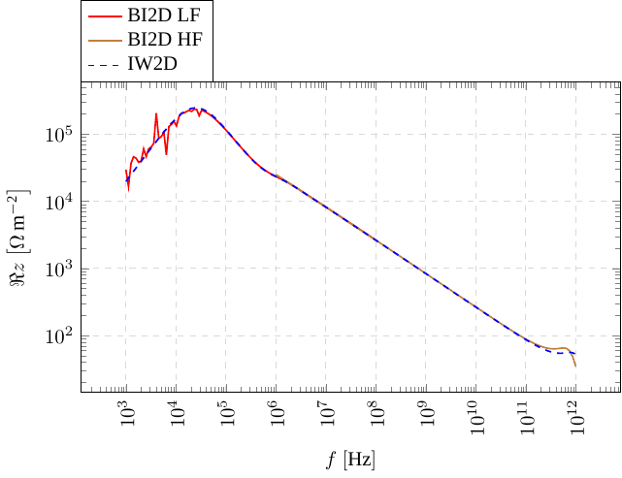
Resistive Wall Impedance – Real Chamber Geometry
USSR Study by S. Matsievskiy (NRC Kurchatov Institute)
M. Matsievskiy recently computed the RW impedance of the vacuum chamber with the realistic cross section. He had used BeamImpedance2D^{[1]} for the task and found that the ellipse is a good approximation to the real chamber.
^{[1]} Niedermayer, Uwe, "Space charge and resistive wall impedance computation in the," Phys. Rev. ST Accel. Beams, vol. 10, no. 18, p. 032001, 2015.
Real
m=0
Imag
m=1

Slide 20
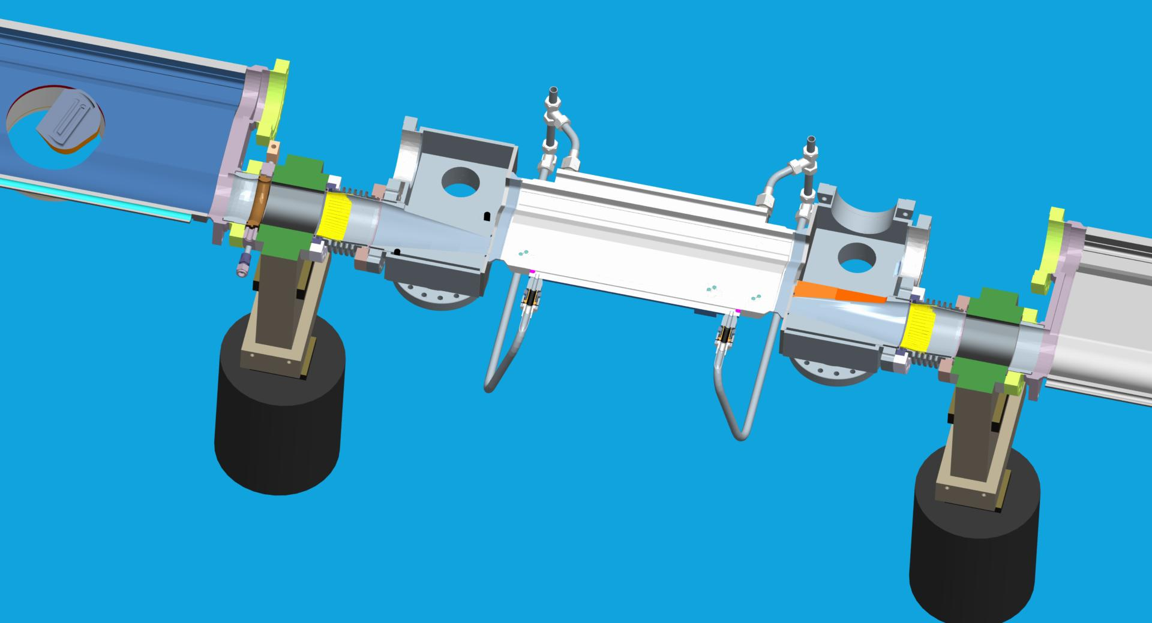
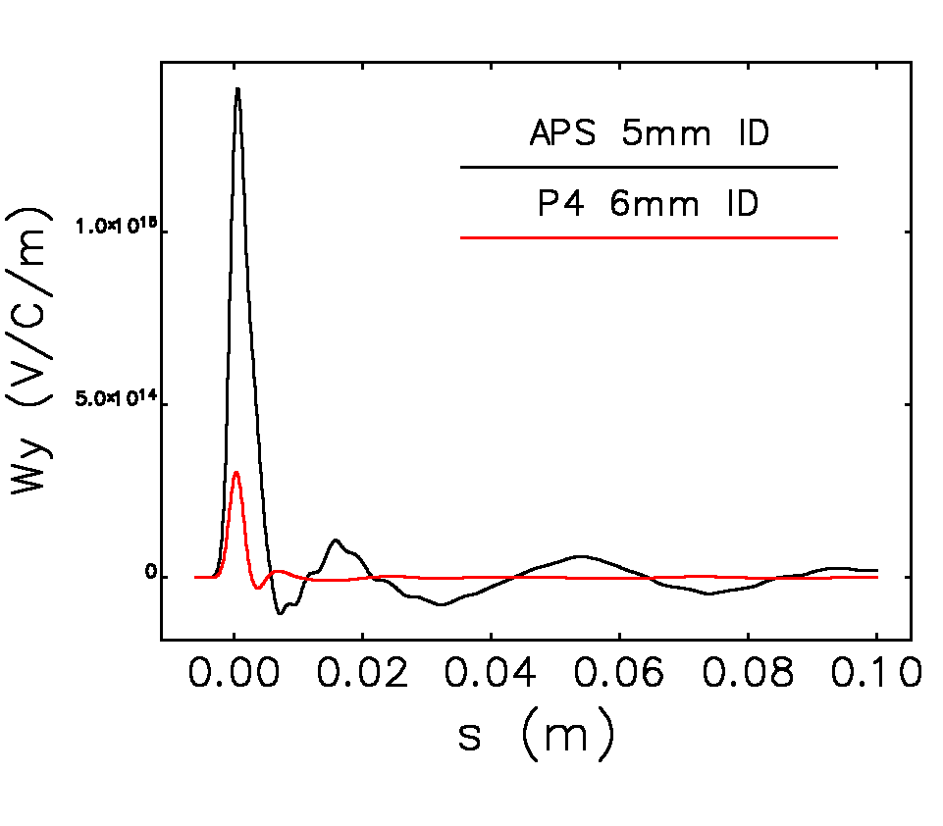
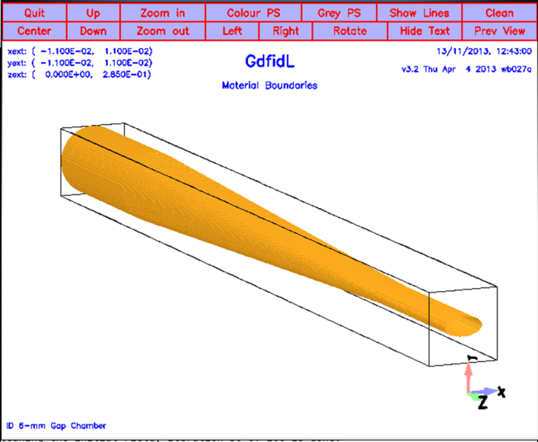
ID Chamber Wake Comparison
Main difference is the ring chamber aperture (APS vs. P4)
Ring: (a,b) = (42 mm, 21 mm) vs. (10 mm, 10 mm)
ID: (a,b) = (18 mm, 2.5 mm) vs. (10 mm, 3.0 mm)
Estimate of Vertical Kick Factor Composition
 | APS (%) | PETRA-4 (%)
Resistive Wall (ID) | 34 | 50
Geometric (ID) | 34 | 8
Resistive Wall (Ring) | 32 | 20
Geometric (Ring) |  | 22

Slide 21
USSR 40 EBS Cells: Aperture Study (20 mm, 10 mm)
6 GeV SR Parameters | EBS | USSR 40 EBS cells | USSR 40 EBS cells + SB
Circumference | 844 m | 1055 m | 1100 m
No. of cells | 32 | 40 | 40
No. of beamlines | 27 ID + 17 BM | 34 ID | 34 ID + 40 BM
Nat. hor. Emittance | 140 pm. rad | 68 pm.rad | 70 pm.rad
Vertical emittance | 5 pm.rad | 5 pm.rad | 5 pm.rad
Energy spread | 0.95 10⁻³ | 0.85 10⁻³ | 0.86 10⁻³
Mom. comp. factor | 8 10⁻⁵ | 5 10⁻⁵ | 6 10⁻⁵
Natural bunch length | 2.9 mm | 2.7 mm | 2.89 mm
Betatron tunes | 76.21, 27.34 | 95.21, 33.34 | 95.21, 33.34
Chromaticity | 6,4 | 12, 7.5 | 7, 6
Energy loss / turn | 2.6 MeV | 2.1 MeV | 2.0 MeV
RF voltage | 6.5 MV | 5.0 MV | 5.0 MV
RF frequency | 352 MHz | 352 MHz | 352 MHz
Harmonic number | 992 | 1240 | 1294
Max total current | 200 mA | 200 mA | 200 mA

Slide 22
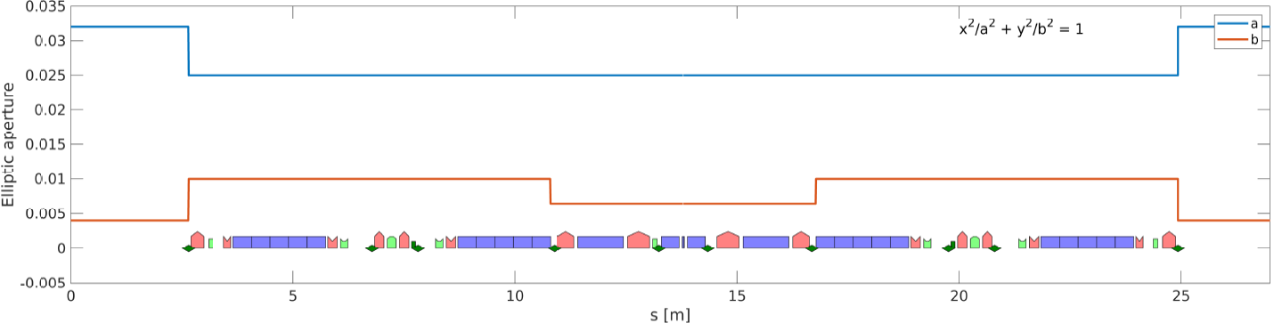


USSR – EBS40 with 20 mm Aperture (y)
Aperture and wake data were provided by L. Cavers, S. White, S. Liuzzo (ESRF-EBS)
To design USSR we scale the wake by 40/32 of EBS32 to EBS40.

Slide 23







USSR – EBS40 with 20 mm Aperture (y)
SBSC
ELEGANT
AT2.0 (ESRF), SBSC (INFN), ELEGANT (APS) showed the good agreement each other.
AT2.0 and SBSC used the 1-mm wake.
ELEGANT used the impedance.
IBS Emittance
Lifetime
Imax (V3=0.0 MV)
|Y (Pass)| vs. Chrom (5 mA)

Slide 24
Small Aperture Option (D < 20 mm) Case Study
PETRA IV CDR lattice is
H7BA type
26.20 m
PETRA III lattice has the ID cells of 23.0 m. So in the PETRA IV, the beamlines have to move.
Because of this, PETRA IV team studied several lattices with 23-m cells (2017-2019).
We found that 23-m cells has highly nonlinear dynamics property and the required the quad strength is 120 T/m. This in turn required the small aperture about D=14 mm.
Question was whether we can still store 2-mA current in the single bunch.
Parameter | PETRA 3 (DW) | H7BA 23 m | H6BA 23 m (DW) | H7BA 25.2 m (DW)
Nat. emittance ε₀ (with DW) | 5100 pm (1280 pm) | 10.3 pm | 25 pm (11 pm) | 15 pm (9.3 pm)
Energy spread σ_{p} (with DW) | 0.82·10⁻³ (1.23·10⁻³) | 0.92·10⁻³ | 0.79·10⁻³ (1.47·10⁻³) | 0.73·10⁻³ (1.44·10⁻³)
Energy loss/turn U₀ (with DW) | 1.3 MeV (5.1 MeV) | 1.33 MeV | 1.96 MeV (8.5 MeV) | 1.37 MeV (4.6 MeV)
Momentum compaction factor α_{c} (with DW) | 1.13·10⁻³ (1.13·10⁻³) | 1.22·10⁻⁵ | 0.98·10⁻⁵ (0.98·10⁻⁵) | 1.46·10⁻⁵ (1.46·10⁻⁵)
Max. gradient g | 17 T/m | 120 T/m | 120 T/m | 100 T/m
Dispersion D_{x} at SF | 750 cm | 3.5 cm | 4.2 cm | 4.2 cm
NL dynamics | +++ | -- | -- | -
Space in cell | +++ | -- | - | o
Dyn. Acceptance A_{x} | +++ | - | -- | +
Position of beamlines | o | - | - | --
J. Keil, Jesteburg Workshop, 07.13.2017

Slide 25
Overview of Collective Effects (23-m Cell Lattice)
Total Current
Requirement: 200 mA for brightness mode and 80 mA for timing mode.
Will use 24 HOM-damped EU-cavities for 500 MHz rf system. ➔ will change if damping wiggler is used to reduce the emittance.
Will use transverse feedback system with sufficient damping against resistive wall instability.
Expect that ion instability will be unlikely because CO (>40%) and H₂ (>40%) will not be trapped.
Single Bunch Current
Requirement: 0.125 mA for brightness mode and 1.0 mA for timing mode.
Will use Landau cavity (bunch lengthening cavity) to reduce the peak current and the high chromaticity to reduce the effective impedance of the ring.
We can store 4.0 mA per bunch (estimate based on the impedance model). ➔ will change if smaller aperture is used.
Radiation safety limits the lifetime > 0.5 h for 100-mA stored beam.
This sets the limit of single bunch less than 2.0 mA.

Slide 26
Impedance Budget (23-m cell)
Strong quadrupols of 120 T/m are forseen for 23-m cell lattice.
If we assume the magnet aperture is the vacuum chamber aperture, D, plus 3-mm (thickness and air gap), then 1 T pole tip field sets D < 14 mm which is much smaller than D = 20 mm of baseline.
We like to know whether D < 14 mm is compatible with the timing mode.
We computed the single bunch current as a function of chamber aperture with following assumptions:
Landau cavity is available for bunch lengthening.
Chromaticity is 5.
Longitudinal dynamics is basically the same as the CDR lattice.

Slide 27

Minimum Aperture for Timing Mode (23 m cell)
Keep the baseline impedance budget scenario unchanged: 1.3 x RW (ID), 1.4 x Geometric Impedance (Ring).
Vary the aperture.
Consider Al (NEG 1.0 μm, CDR) and Cu (NEG < 1.0 μm, 23-m) chamber.
RECALL
Momentum compaction factor = 1e-5
Chromaticity = 5
RESULT for 2 mA in 2304 m PETRA IV ring
Al, Al down to 17 mm
Cu, Al down to 13 mm
Cu, Cu down to 10 mm
10 mm
13 mm
Timing Mode
17 mm

Slide 28



EBS40 with D=10 mm Round Aperture
Case Study for Low Emittance Ring with Strong Quadrupoles
The lower the emittance, the stronger the quadrupole which requires small aperture.
Working Assumptions
the smallest aperture required for the injection is 10 mm.
Geometric impedance is 2 x USSR’s impedance, that is the EBS impedance by 40/32.
Resistive wall of ID impedance is recalculated: Al, N_{ID}=34, L_{ID}=150 m, (a,b)=(5 mm, 3 mm)
Resistive wall of ring impedance is recalculated: Al, L_{Arc}=905 m, (a,b)=(5 mm, 5 mm)
For the first estimate, the chamber is made of Al with 200 nm NEG coating.
Recall
L_{ring}=1054.972 m, f₀=284.2 kHz, Urad=2.094 MeV
V_{rf}=5.0 MV, Bucket=7e-2, f_{s}=894 Hz, h_{rf}=1240
ω_{ξ}/2π=5.3 GHz per unit chromaticity

Slide 29


Round vs. Elliptic Chamber
G. Rumolo’s recent work showedQuadrupole wake can increase the TMCI threshold current^{[1]}
The required |K_{Q}/K_{D}| > 0.5. However, we don’t know how to make |K_{Q}/K_{D}| > 0.5.
Also we found that the theory doesn’t hold for non-zero chromaticity.
In practical impedance of the ring, the quadrupole wake doesn’t have much impact on the TMCI.
Nevertheless, the elliptic chamber has less dipole impedance than the round chamber (80%).
This reduction can be significant in the case small aperture chamber as shown in D=10mm diameter case.
^{[1]}G. Rumolo, Two-particle model for TMCI with detuning impedance , the 8th Low Emittance Rings Workshop, 26-30 October 2020
^{[2]}A. Burov and V. Danilov, “Suppression of Transverse Bunch Instabilities by Asymmetries in the Chamber Geometry”, Phys. Rev. Letters 82, 11, p. 2286, 1999

Slide 30
High Order Momentum Compaction
The Slippage Factor
K.Y. Ng, Physics of Intensity Dependent Beam Instabilities

Slide 31
High Order Momentum Compaction (PETRA IV)
PETRA IV with Harmonic RF system
V1=8.0 MV, 500 MHz, V2=2.3 MV, 1500 MHz
α₀ = 1.48e-5, α₁=2.0e-5
α_{1,crit}=1.2e-4 ➔ far from the critical situation
α₁ = 0.0
α₁ = 2.0e-5
α₁ = 10 x 2.0e-5

Slide 32
Summary
There is an excellent overview of collective effects in diffraction-limited storage ring written by R. Nagaoka and K. Bane ( Journal of Synchrotron Radiation 21(Pt 5):937-960, September 2014)
The HOM damped EU cavity effectively raises the threshold current above 200 mA. For the large ring, the fundamental mode’s cavity impedance can set another limit, especially with the Landau cavity, which has a broad bandwidth.
Resistive wall impedance is the dominant source of transverse coupled bunch instability. The combination of moderate chromaticity and feedback damper can effectively control the growth rate. The study showed that uniform distribution has the most significant growth rate compared to the fill patterns with gaps.
Transient beam-loading effects can make bunch length variation significant. The uniform or trains with small gaps can reduce the impact small. The ion effect can be minimal regardless of the fill pattern if light ions dominate in the vacuum (often with NEG pumping).

Slide 33
Summary (2)
We can minimize the impedance contribution by NEG coating if its thickness can be less than 200 nm without degrading pumping speed compared to 1 μm thick layer.
De-tuning wakes have a negligible effect in determining the single bunch current limit as long as |k_{Q}/k_{D}| < 0.5 regardless of chromaticity.
As the emittance gets lower, the momentum compaction gets smaller. Down to 10 pm, the high order effect is still negligible.
We learned that we can still store 1-2 mA in the bunch with D=10 mm aperture. The current will increase if we replace the chamber material with Cu, which several projects have already adopted.
So far, we didn’t find a show-stopper in collective effects to design the ultra-low emittance storage ring (down to 1 pm).

Slide 34
Thank you for this opportunity of sharing and for your attention!
Acknowledgements
C. Li (DESY) on transient beam loading and ion effect
S. Antipov (DESY) on coupled bunch instability of arbitrary fill-pattern
S. Matsievskiy, V. Rashchikov (NRC KI) on Beamimpedance2D computation
L. Cavers, S. White, S. Liuzzo (ESRF) on ESRF-EBS wake, aperture, lattice data
J. Calvey, K. Harkay, M. Borland (APS) on ion effects and high charge injector chain
H. Chao (Diamond) on high charge booster design
N. Wang, Z. Duan, H. Xu (HEPS) for sharing HEPS impedance, booster and injection simulation results
M. Migliorati (Univ. de Roma Sapienza) for sharing FCCee impedance and simulation results
D. Zhou (KEK) for CSR impedance and simulation results for PETRA IV
W. Bruns for GdfidL and I. Zagorodnov (DESY) for ECHO3D support.
M. Dohlus (DESY) on surface roughness impedance
M. Zobov (INFN) for various useful discussions on collective effects in colliders and light sources

