Slide 1


3rd Workshop on Low Emittance Lattice Design, June 27th-29th Commissioning and Characterization of the Performance of the Multipole Injection Kicker Installed in the SOLEIL Storage Ring
R. Ollier* [1], Ph.D. supervised by L. S. Nadolski
*randy.ollier@synchrotron-soleil.fr

Slide 2
Outline
Introduction
Top-Up Injection at SOLEIL
Current Off-Axis Injection Layout
MIK Off-Axis Injection Layout
MIK Design
MIK Mechanical Assembly
Magnetic Field
Model and Simulations
High Performance Diagnostics
MIK Performance
First Experimental Results
Turn-by-Turn Stored Beam postions
Turn-by-Turn Stored Beam sizes
Heating concerns
Conclusions and Perspectives
1

Slide 3
I. Introduction: R&D on Multipole Injection Kicker (MIK) at SOLEIL
Towards quasi-transparent Top-Up injection in storage rings
MIK for MAX-IV (3 GeV ring, daily operation)
MIK for SOLEIL storage ring (2.75 GeV, R&D purposes)
Key element for the injection system for the upgrade of SOLEIL as a DLSR
2

Slide 4
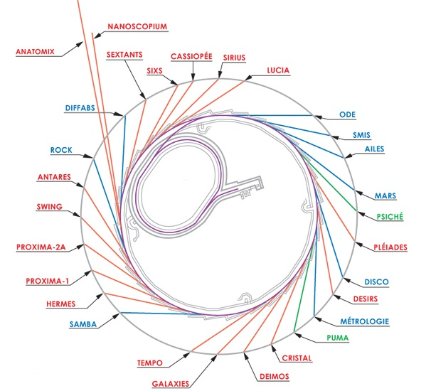
II.a. Current Off-Axis Injection Layout for Top-Up Operation at SOLEIL
Main parameters of the storage ring
Energy (GeV) | 2.75
Circumference (m) | 354
Revolution period (µs) | 1.18
Limiting closed orbit distortions is very challenging !... Even impossible while operating standard off-axis injection…
K1
K2
K3
K4
Stored beam
Thick septum
Injected beam
Thin septum
…But it is strongly requested for beamlines today, and even more critical for 4GLSs
Parameter | Kickers
Pulse duration | 7 µs
Kick | ±7.6 mrad
Peak H-closed orbit distorsion (optimized 2017) | ~31% of σ_{x}
Peak V-closed orbit distorsion (optimized 2017) | ~250% of σ_{z}
BOOSTER 2.75 GeV
LINAC 100 MeV
STORAGE RING 2.75 GeV
Dipole
Ondulator
wiggler
3

Slide 5
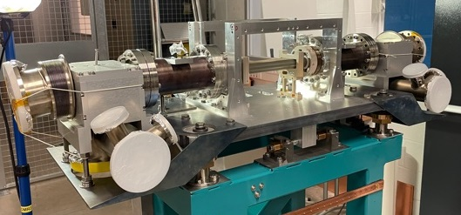
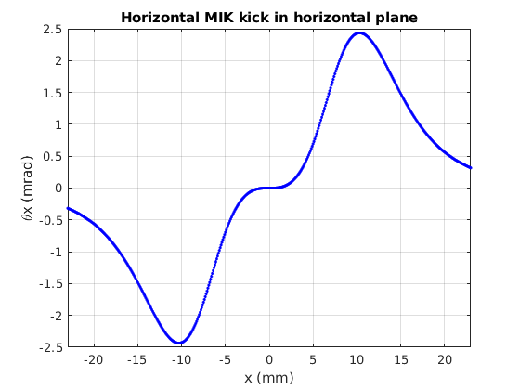
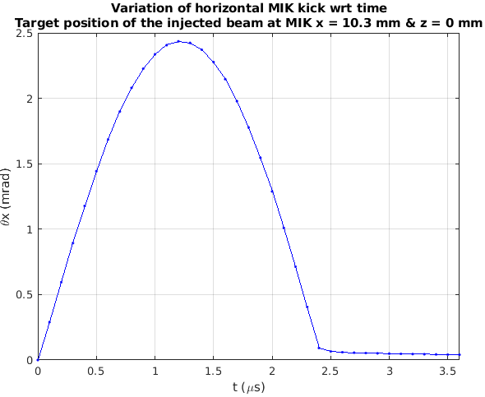
II.b. MIK Off-Axis Injection Layout for Top-Up Operation at SOLEIL
Stored beam
MIK
Thick septum
Injected beam
Thin septum
The installed MIK is a great step towards almost transparent injection
Injected beam
Injected beam
1st turn
10.3 mm
Stored beam
Injected beam
2nd turn
BOOSTER 2.75 GeV
LINAC 100 MeV
Parameter | MIK
Pulse duration | 2.4 µs ⬄ 2 revolution periods
Magnetic length | 0.304 m
Nominal horizontal kick | 2.2 mrad
Target residual closed orbit distorsion | < 2 to 3% of transverse beam size
STORAGE RING 2.75 GeV
Dipole
Ondulator
wiggler
4

Slide 6
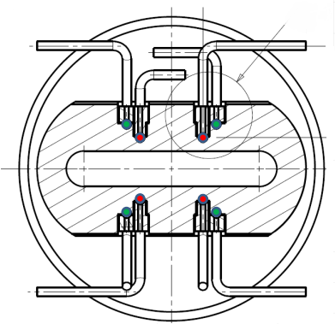
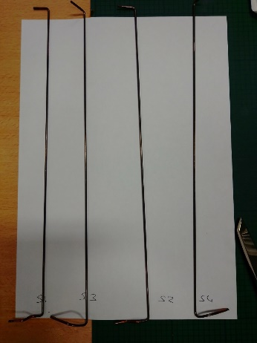
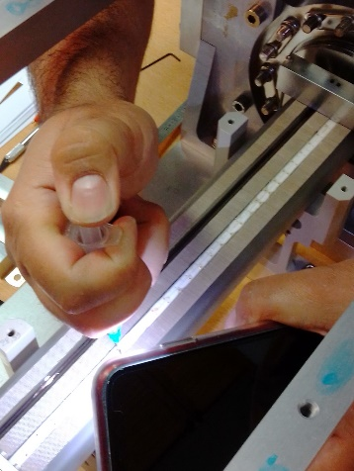
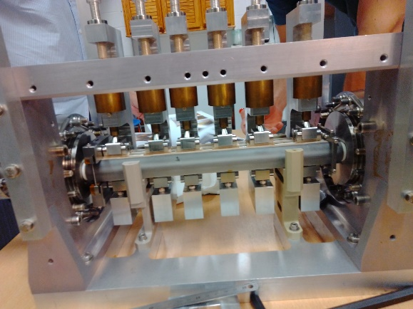
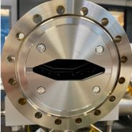
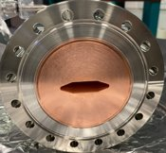
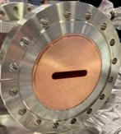
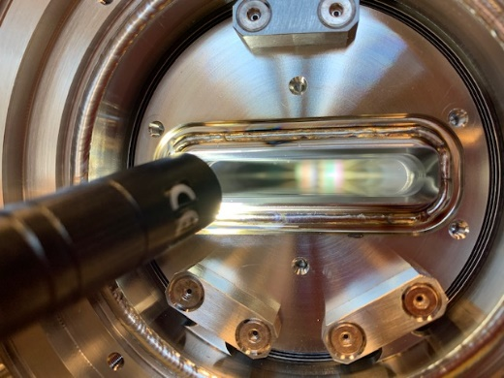
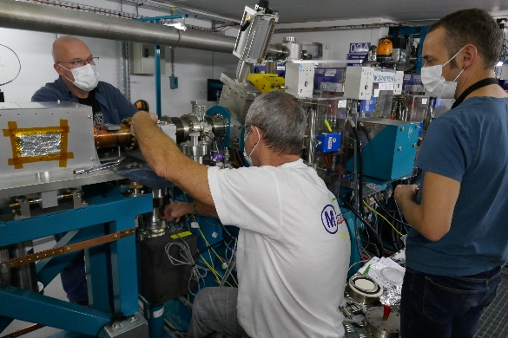
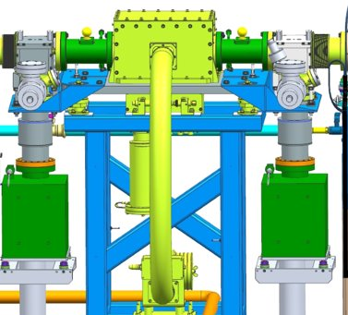
III.a. MIK Mechanical Assembly
2 mm dia. copper conductors
Conductors held in grooves with glued alumina bars
Magnet assembly step with dedicated clamps designed to maintain conductors and alumina bars during glue curing
MIK cross section design
8 mm
Injected beam
Stored beam
46 mm
The MIK is the narrowest horizontal physical aperture of the storage ring
MIK sapphire vacuum chamber with Ti coating (3.5 µm thick)
MIK installation in the storage ring
Taper
Cu-cr-zr
Absorber
MIK
January 2021
5

Slide 7
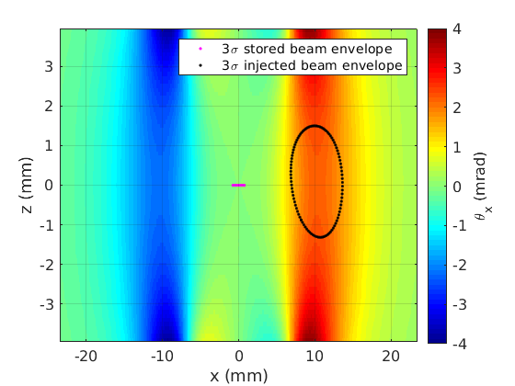
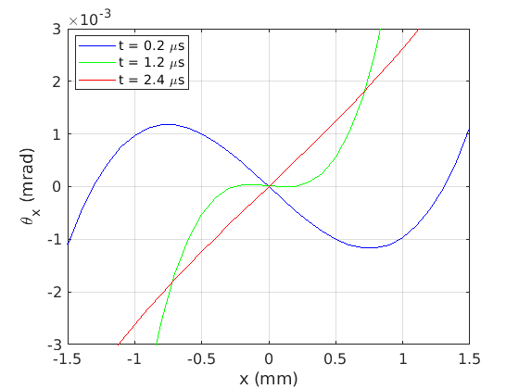
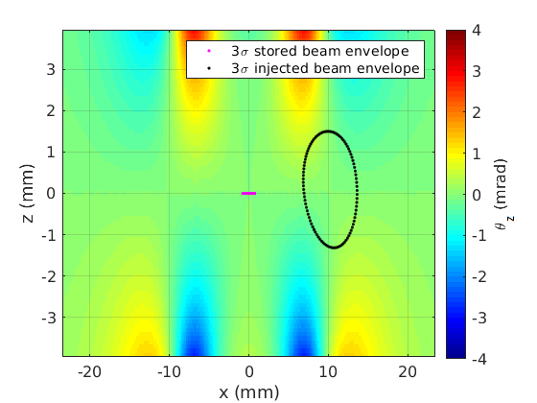
III.b. Magnetic Field
The mechanical design allows to achieve the appopriate magnetic field simulated with Quickfield
t = 1.2 µs
t = 1.2 µs
k₁ = -2.4x10⁻³ m⁻¹
k₁ = 0
k₁ = 2.4x10⁻³ m⁻¹
t = 1.2 µs
6

Slide 8
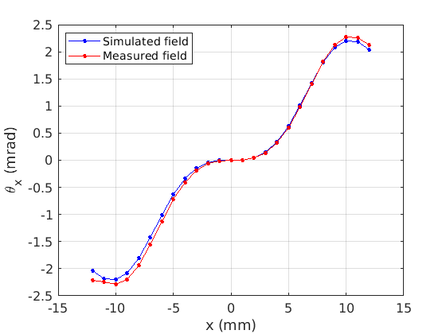
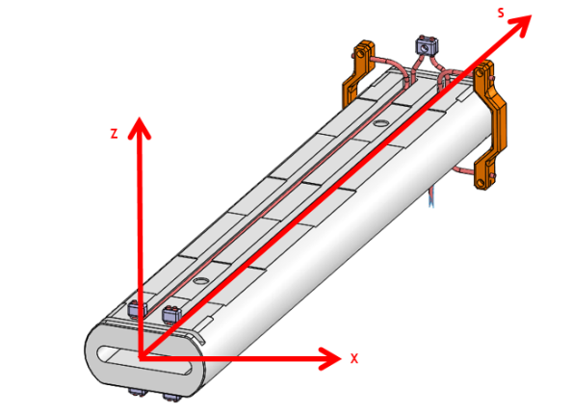
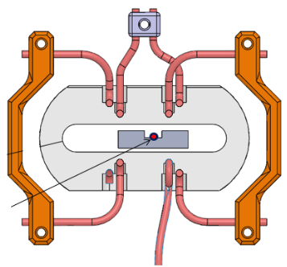
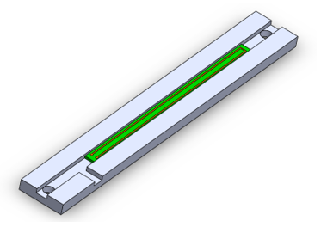
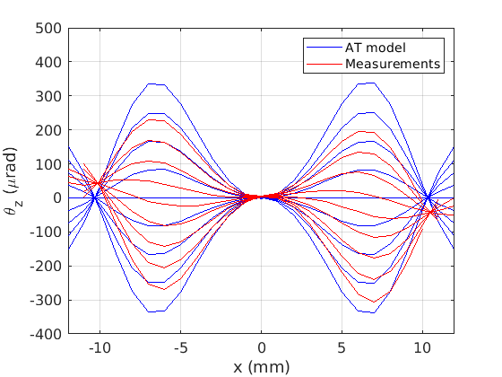
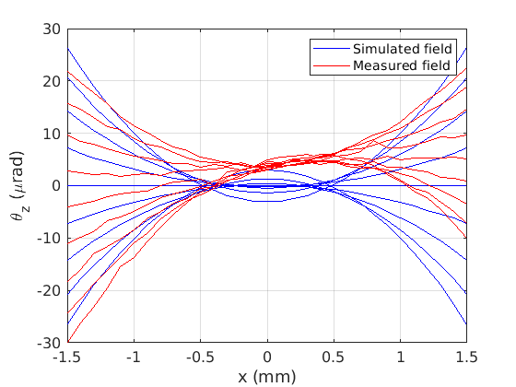
III.b. Magnetic Field
Prior to MIK installation in the storage ring, the magnetic field of the MIK was measured and compared to the simulated field
At z = 0
The magnetic probe, is made in house, and scans the vacuum chamber of the MIK
|z| ≤ 0.8 mm, 0.2 mm steps
|x| ≤ 12 mm, 1.0 mm steps
7

Slide 9
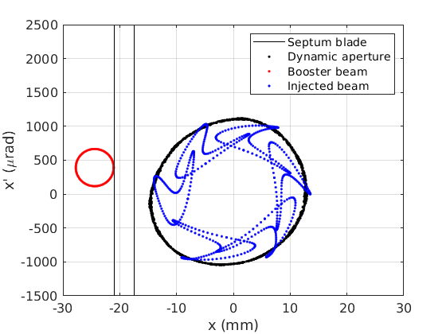
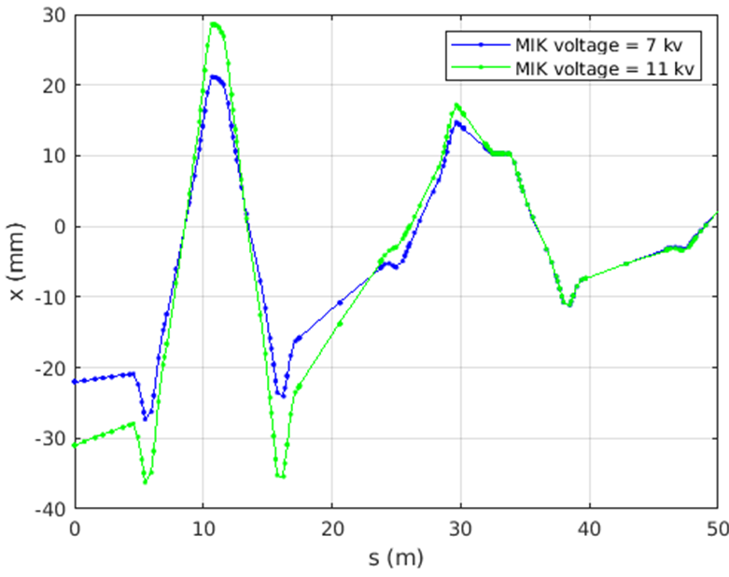
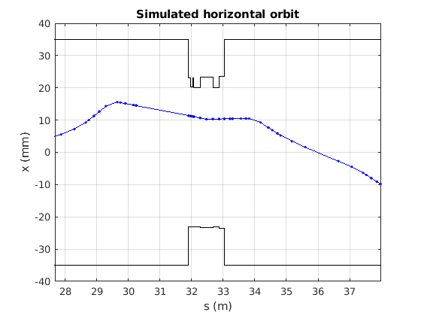


IV. Model of the MIK Injection and Simulations
Refined model of the storage ring and MIK injection scheme using the Accelerator Toolbox:
Determine MIK location
Optimize the MIK injection
Septum blade position
Initial conditions
Losses distribution
Feasibility of active correction
Compare simulated and measured data
Refine model of the storage ring using the TRACY III code:
Estimate Touschek beam lifetime
MIK
Cancelled horizontal deviation
$$\left({\text{x}\text{inj} \atop \text{x}\text{’}\text{inj}}\right)= \left({−31 mm \atop 673 urad}\right)$$
$$\left({\text{x}\text{inj} \atop \text{x}\text{’}\text{inj}}\right)= \left({−22 mm \atop 241 urad}\right)$$
MIK
8

Slide 10
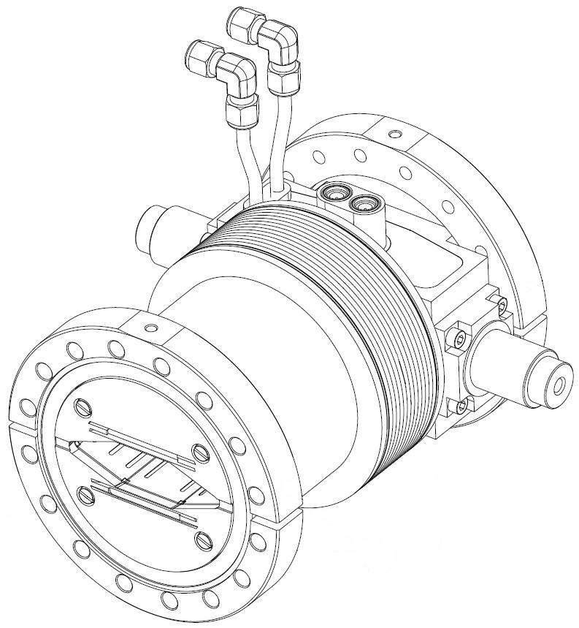
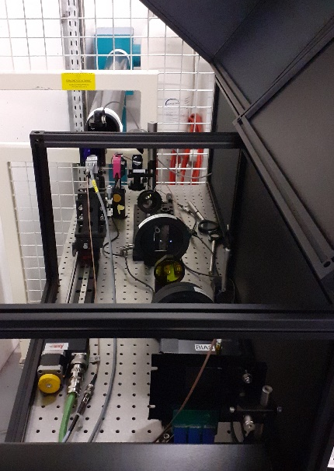
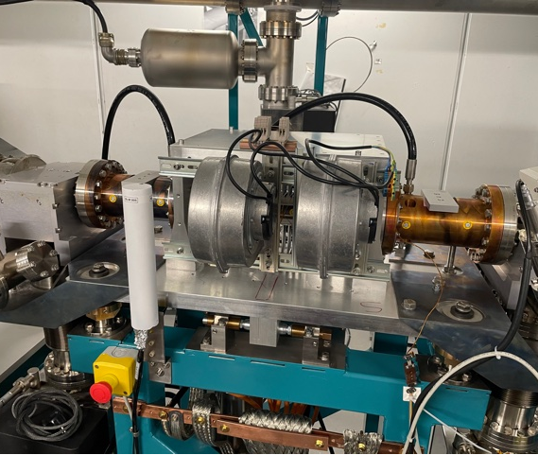
V. High Performance Diagnostics
High performance diagnostics are required:
Small perturbations
Fast varying signals
BPM
KALYPSO camera [2]
BLM
Libera Brilliance +
Micrometer resolution
Turn-by-turn (846 kHz)
Avoid mixing of turns
Linear sensor
Micrometer resolution
Ultra-fast (2.8 MHz)
520-680 nm
80 BLMs
Decay mode (13 Hz)
Injection mode (846 kHz)
Quasi isotropic sensor
9

Slide 11
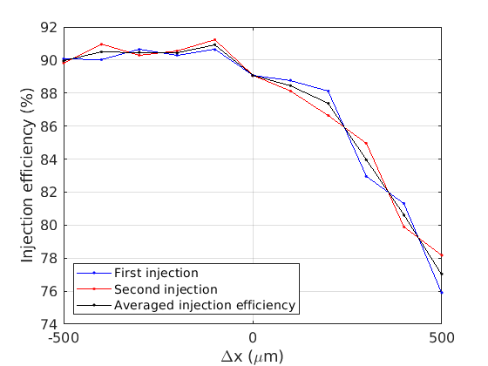
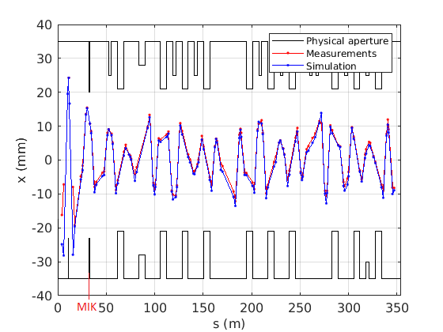
VI.a. First Experimental Results
Very promising early results:
highest reached injection efficiency of 97% at 10 kV
Reduction of the horizontal oscillation amplitude when MIK is switched on
Confirmation by turn-by-turn BPM data
Close to expected simulated values
Stored beam and accumulation
Very enlightening for SOLEIL Upgrade !
Simulating first turn:
Before MIK: free oscillations (~25 mm)
After MIK: minimized injection invariant (Amplitude decreased to ~10 mm)
Steering with septum magnets
10

Slide 12
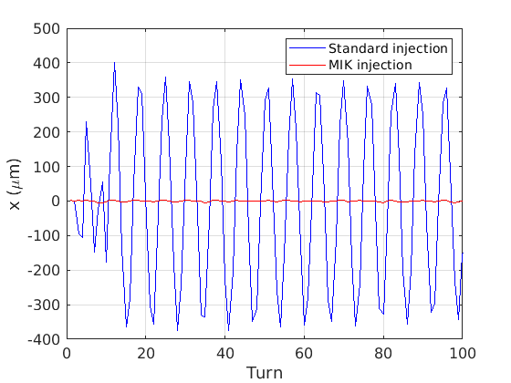
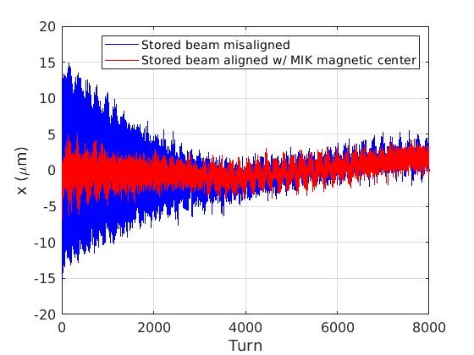
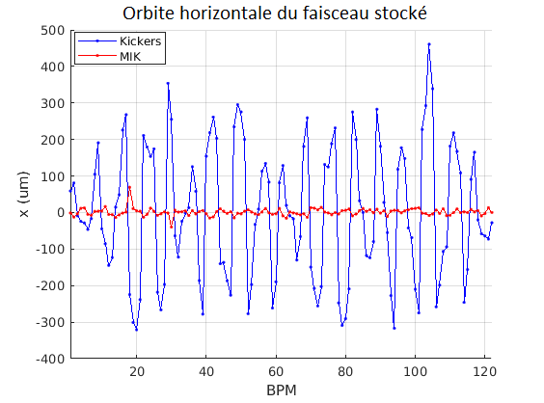
VI.b. Turn-by-Turn Stored Beam Positions
Experimental setup:
MIK and kickers ON/OFF
15 mA, ¼ beam filling mode in bare lattice (104 bunches ⬄ 300 ns)
Low chromaticities (ξ_{x},ξ_{z}) = (0.6, 0.8)
Betatron tunes
nominal (ν_{x},ν_{z}) = (0.156, 0.228)
active correction (ν_{x},ν_{z}) = (0.156, 0.374)
Δx < 2% of σ_{x} (divided by almost a factor 100, in one quarter beam filling mode)
Horizontal plane
β_{x} = 13.3 m
β_{x} = 13.3 m
11

Slide 13
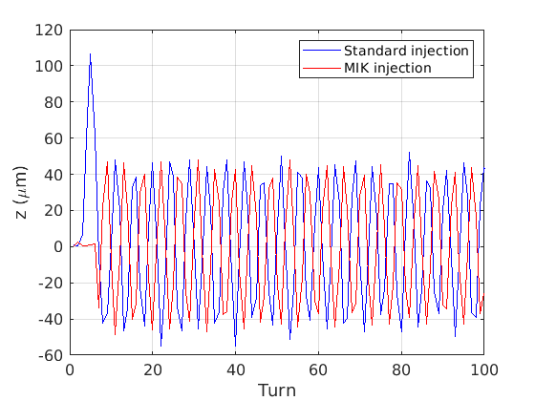
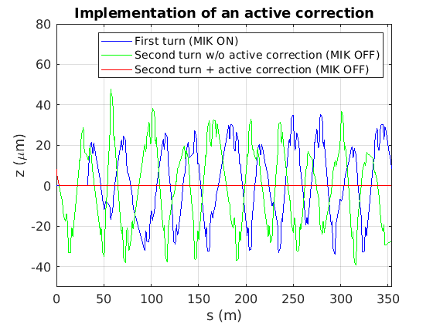
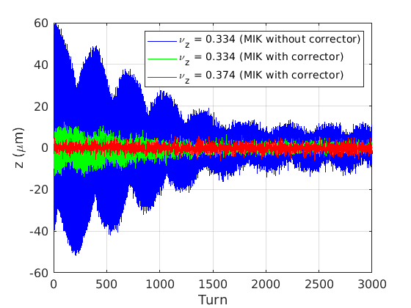
VI.b. Turn-by-Turn Stored Beam Positions
Experimental setup:
MIK and kickers ON/OFF
15 mA, ¼ beam filling mode in bare lattice (104 bunches ⬄ 300 ns)
Low chromaticities (ξ_{x},ξ_{z}) = (0.6, 0.8)
Betatron tunes
nominal (ν_{x},ν_{z}) = (0.156, 0.228)
active correction (ν_{x},ν_{z}) = (0.156, 0.374)
Δz ~ 0 (with active correction, in one quarter beam filling mode).
Vertical plane
β_{z} = 8.6 m
Measurements
Simulated correction
Measurements
Corrector
β_{z} = 12.1 m
MIK
12

Slide 14
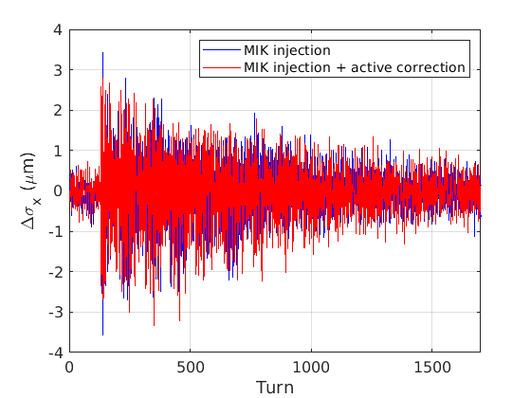
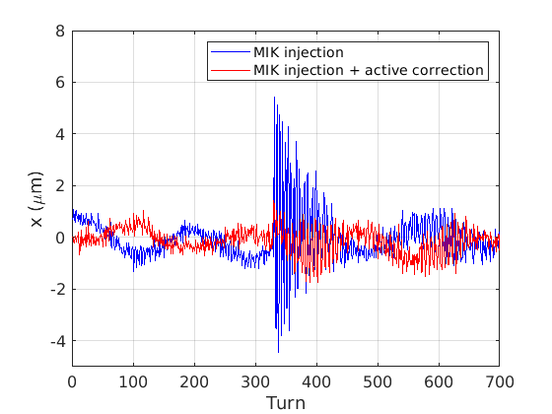
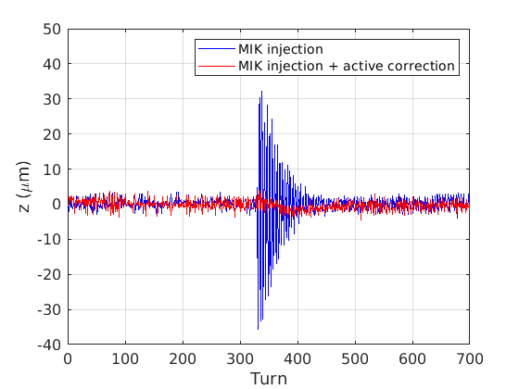
VI.c. Turn-by-Turn Stored Beam Sizes
Experimental setup:
MIK and kickers ON/OFF
100 mA, ¼ beam filling mode in bare lattice (104 bunches ⬄ 300 ns) provides roughly uniform quadrupolar kicks and enough photon flux
Bunch-by-bunch transverse feedback turned on to avoid beam blow up
Low chromaticities (ξ_{x},ξ_{z}) = (0.6, 0.8)
Betatron tunes (ν_{x},ν_{z}) = (0.156, 0.374)
Δσ_{x} = 3.5% of σ_{x} (turn-by-turn measurements with ultra-fast KALYPSO camera, in one quarter beam filling mode)
β_{x} = 1.3 m
β_{z} = 11.4 m
13

Slide 15
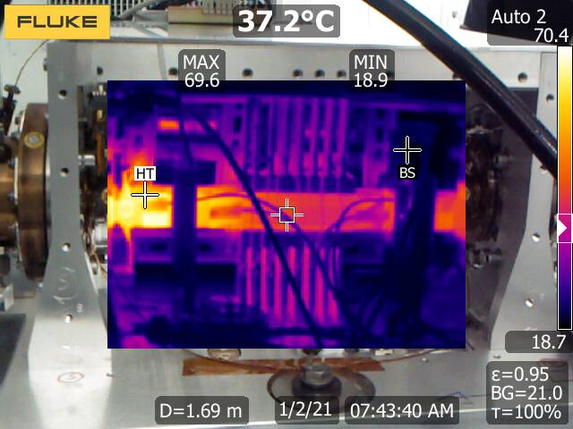
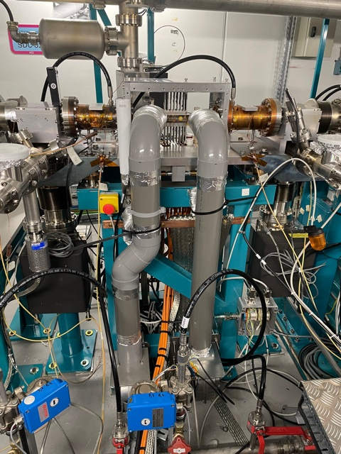
VI.d. Heating Concerns
Maximum heat load estimated 156 W → power density 3.6 W.mm⁻²
Unexpected temperature rise during first current ramp:
130°C at 300 mA
Hot spot on the downstream end of the MIK
Cooling system initially underestimated but eventually improved:
MIK outer frame removed
Three heavy duty forced air turbines
Manageable temperature rise in all filling patterns
e⁻
Simulation studies and beam-based measurements conducted [3]
Current | Filling mode | Fans | Simulated | Upstream | Downstream
500 mA | Uniform (416 bunches) | On | 61°C | 52°C to 69°C | 86°C to 125°C
500 mA | Uniform (416 bunches) | Off | 335°C
110 mA | 8 bunches | On | 72°C | 64°C to 74°C | 113°C to 164°C
110 mA | 8 bunches | Off | 425°C
100 mA | ¼ (104 bunches) | Off | 72°C | 69°C to 72°C | 85°C to 86°C
25 mA | 2 bunches | Off | 107°C | 103°C to 112°C | 136°C to 138°C
14

Slide 16
VII. Conclusions and Acknowledgement
Conclusions and Perspectives
First injection with a MIK was successfully achieved at SOLEIL in April 2021
Fine tuning and characterization of the MIK performance and transparency for the users
Maximum injection efficiency measured 97% (summer 2021)
Closed orbit distortions < 2% σ_{x,z} (including active correction)
Δσ_{x} = 3.5% of σ_{x}
Pilot experiments with selected beamlines (IR, highly sensitive BLs)
Tests of novel injection scheme for the upgrade
Off-energy injection
Longitudinal injection
Acknowledgements
A. Nadji, head of Engineering and Accelerators Division, SOLEIL
SOLEIL MIK project TEAMS, Accelerator Physics Group, P. Lebasque
P. Tavarez and colleagues of MAX IV
P. Kuske and colleagues of Bessy-II
15

Slide 17
A Large Dedicated Team!
MIK Project
Pulsed Magnet Team: P. Alexandre, R. Ben El Fekih, A.Letresor
Mechanical engineering: S. Thoraud, J. Da Silva Castro, P. Prout, C. De Olivera, S. Bonnin.
Vacuum: C. Herbeaux, N. Béchu, S. Morand, A. Rouquié, N. Baron, M. H. Nguyen
Control Systems: G. Renaud, P. Monteiro, X. Elattoui, G. Abeillé
Metrology and Alignment: A. Lestrade, C. Bourgoin, B. Leluan, M. Sebdaoui
Magnetic bench automation: G. Roux
Accelerator Physics: R. Ollier, L.S. Nadolski, M.-A. Tordeux
Radiation Safety: J.-B. Pruvost, T. Brioult, B. Forgeat, F. Justine
Purchases: T. Bucaille, F. Minaeian, A. Desport
Secretaries: S. Podgorny, D. Iorio, C. Payo.
16

Slide 18
References
[1] R. Ollier, et al., “Beam Injection with a Multipole Injection Kicker in the SOLEIL Storage Ring”, submitted to Physical Review Accelerators and Beams.
[2] M. M. Patil, et al., “Ultra-Fast Line-Camera KALYPSO for fsLaser-Based Electron Beam Diagnostics”, in Proc. IBIC’21, Pohang, Rep. of Korea, Oct. 2021, pp. 1–6. https://doi.org/10.18429/JACoW-IBIC2021-MOOB01
[3] A. Gamelin et al., Investigation of RF heating for the multipole injection kicker installed at SOLEIL, in Proc. IPAC’22 (2022)
17

Slide 19
Backup

Slide 20
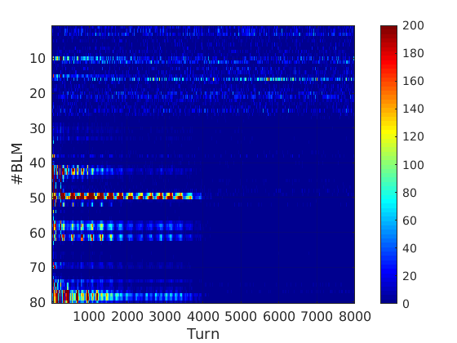
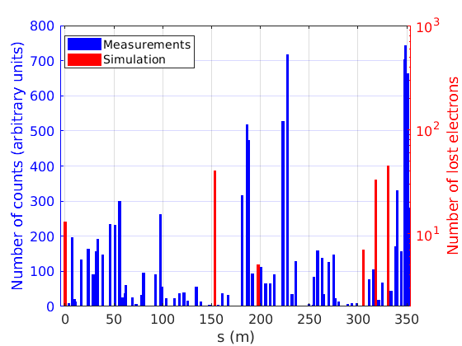
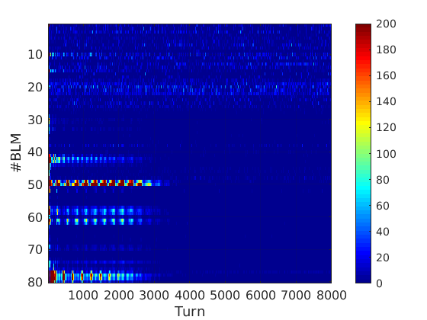
Turn-by-Turn Loss Maps
Experimental setup:
BLM in injection mode
Standard or MIK injections:
104 bunches on-momentum (1 to 2 mA every injection)
Beam killed before new injection
Low chromaticities (ξ_{x},ξ_{z}) = (0.6, 0.8)
Betatron tunes
nominal (ν_{x},ν_{z}) = (0.156, 0.228)
active correction (ν_{x},ν_{z}) = (0.156, 0.374)
Kickers
Max inj. eff. (%) | Kickers | MIK | MIK w/ corr.
w/o superbend | 95 | 97 | -
w/ superbend | 80 | 85 | 85
MIK
MIK

