Slide 1
Swap-out injection using the booster as an accumulator ring at the High Energy Photon Source
1st high energy synchrotron radiation facility in China
Zhe Duan
Institute of High Energy Physics, CAS
2022.06.29
LEL 2022, ALBA, Jun 26-29, 2022

Slide 2
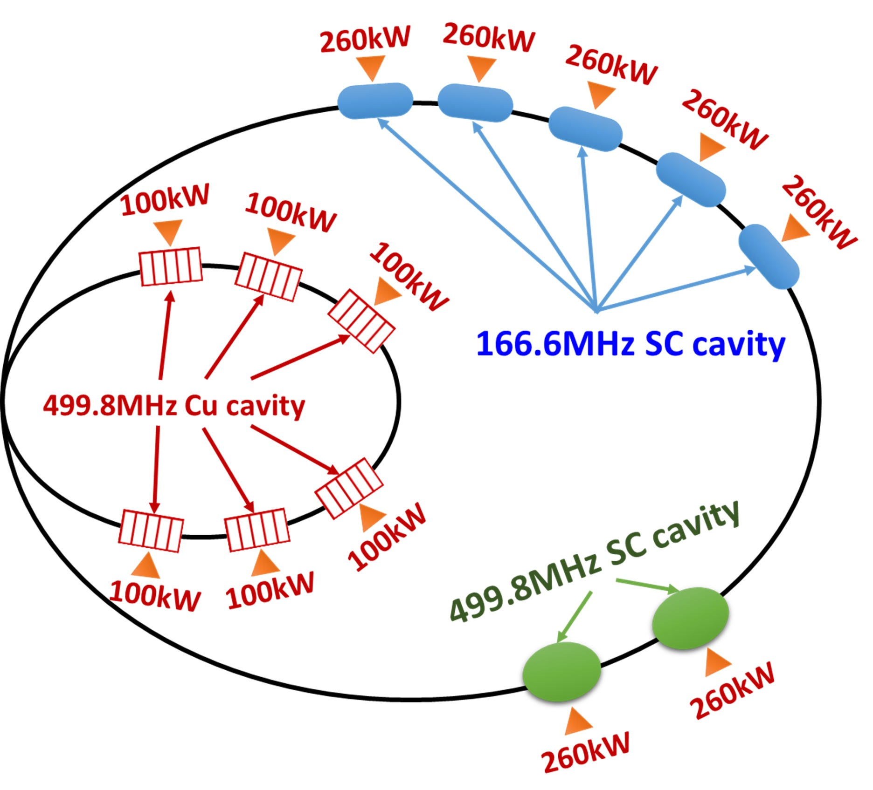
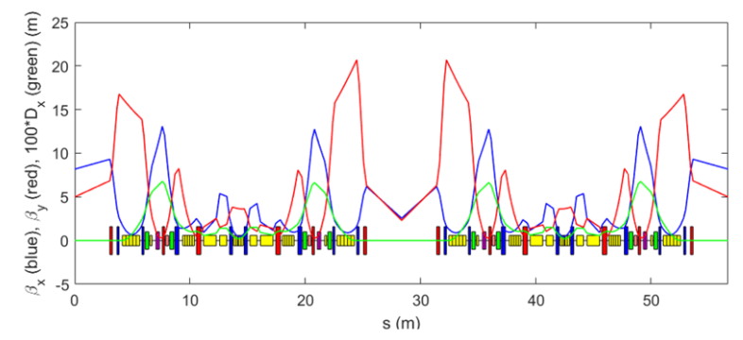
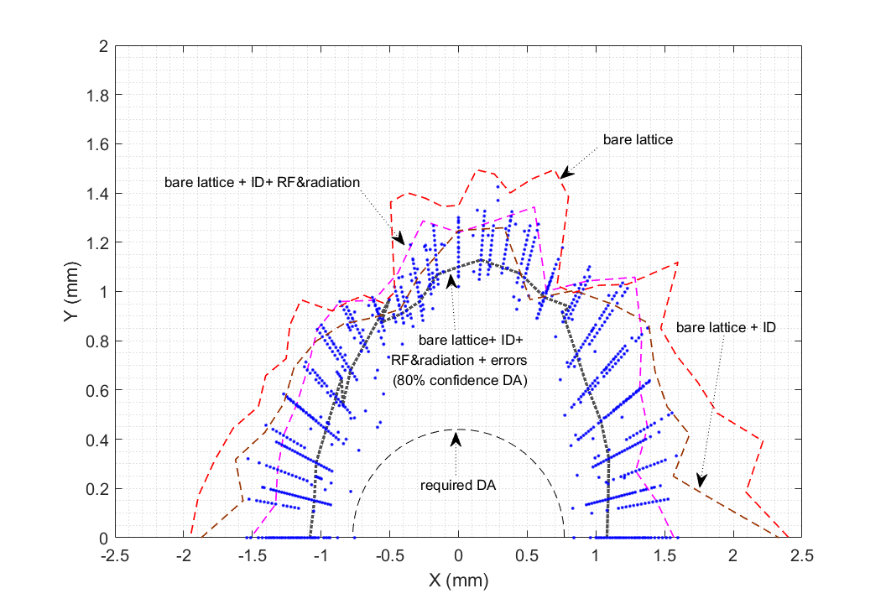
Introduction
SR Lattice, 6GeV, 1360.4m, 34.8pm natural emittance[1]
48 hybrid-7BA cells, w/ BLGs and ABs
interleaved high-β and low-β straight sections of 6 m
An active double RF system in SR to alleviate IBS and increase lifetime, reserve the possibility to test longitudinal injection schemes [2,3] in the future
On-axis swap-out injection as the baseline scheme, to adapt to the very small DA
[1] Y. Jiao, et al., RDTM (2020).[2] G. Xu et al., IPAC’16, WEOAA02; Z. Duan eeFACT’16, TUT2H4; [3] S. C. Jiang and G. Xu, PRAB 21, 110701 (2018)

Slide 3
Filling pattern and key beam parameters
Parameters for lattice w/o IDs | High-brightness mode, 200 mA | High-bunch-charge mode, 200 mA | Units
Beam energy | 6 | 6 | GeV
Number of bunches | 680 | 63
Bunch charge | 1.33 | 14.4 | nC
Bunch spacing | 6 | 72 | ns
rms energy spread | 1.04e-3 | 1.94e-3
Bunch duration (rms) | 114 | 189 | ps
Emittance ratio (ε_{y}/ε_{x}) | 10% | 10%
Horizontal emittance | 34 | 40 | pm∙rad
Lifetime | ~4 | ~1 | hrs
Time between two refills | ~30 | ~8 | s

Slide 4
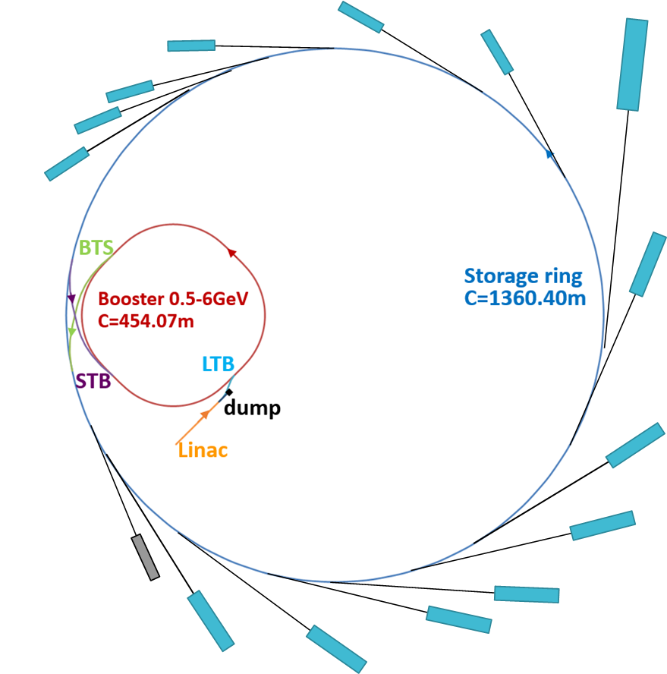
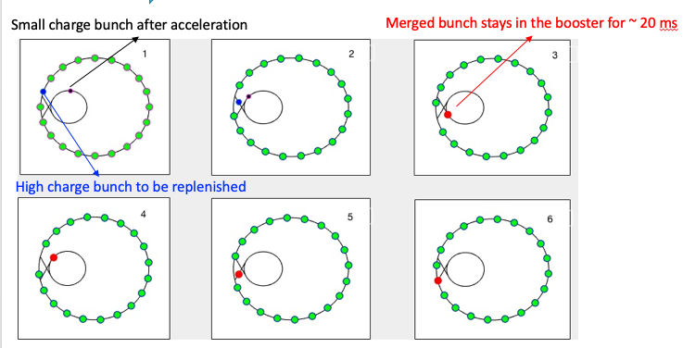
High-energy accumulation in the booster
Major challenge of swap-out injection: a full charge injector
Full charge bunch prepared in an AR, injected into and accelerated in the booster (APS-U)
Bunch recycling w/ a dedicated AR between BR and SR (ALS-U)
Bunch recycling w/ booster serving as a full energy AR (HEPS) [1,2]
FODO cell, 16nm, up to 5nC
500MeV, up to 7nC
[1] Z. Duan, et al., IPAC’18, THPMF052
[2] Y. Jiao et al., J. Synch. Radiat., 25 (2018)1611

Slide 5
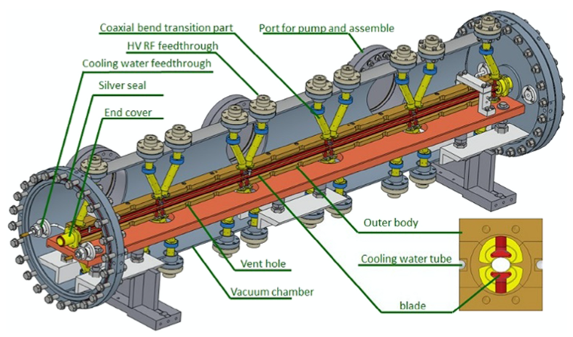
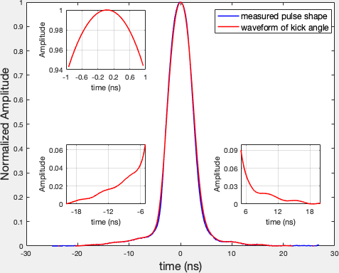
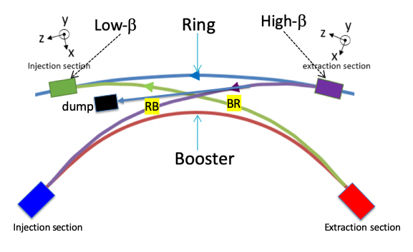
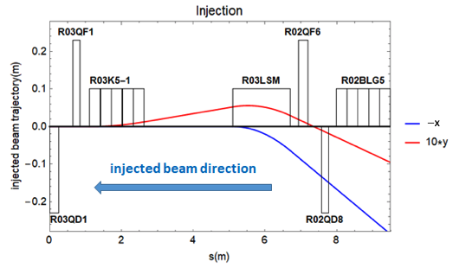
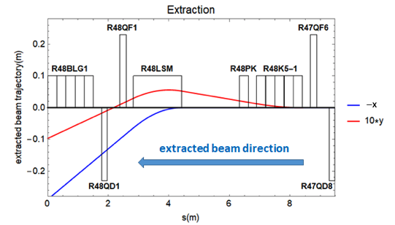
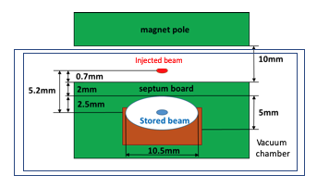
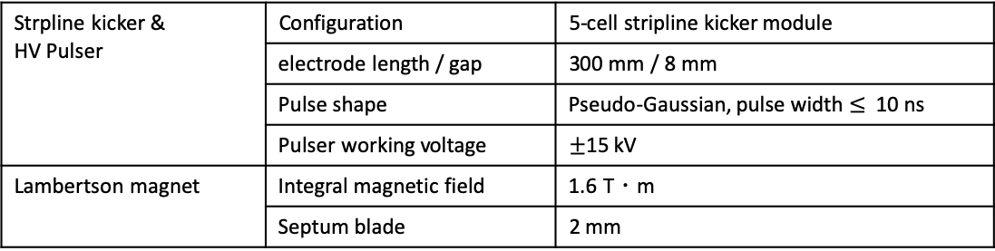
SR injection/extraction
Final design of SR injection/extraction regions
An additional beam dump as a branch of Ring-to-Booster transport line
Ease early commissioning & optional destination of depleted bunches (~1.3nC) for high-brightness mode
State of the art stripline kickers [1-3], solid-state HV pulsers [2] and Lambertson magnets [4] are home developed, in test
5-cell strip-line kicker module
Strpline kicker & HV Pulser | Configuration | 5-cell stripline kicker module
 | electrode length / gap | 300 mm / 8 mm
 | Pulse shape | Pseudo-Gaussian, pulse width $≤$ 10 ns
 | Pulser working voltage | $±$15 kV
Lambertson magnet | Integral magnetic field | 1.6 T・m
 | Septum blade | 2 mm
Min bunch spacing = 6 ns
Measured kicker pulse &
calculated kick angle
Pre-dump kickers
Pre-extraction kicker
Lambertson magnet
[1] J. H. Chen et al., NIM A 920 (2019) 1. [2] L. Wang et al., NIM A 992, (2021) 165040. [3] N. Wang, et al., PRAB 24,034401, (2021) [4] in preparation.

Slide 6
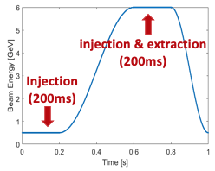
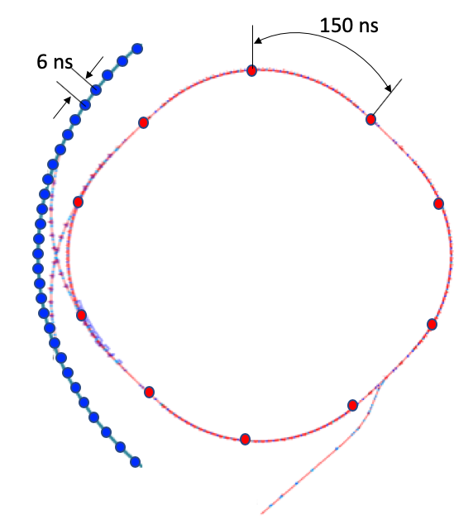
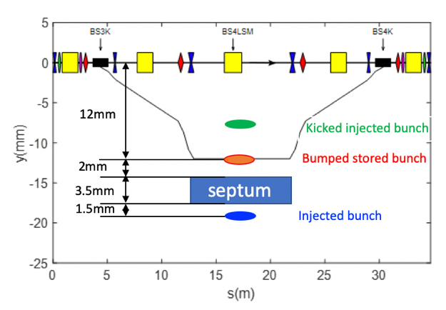
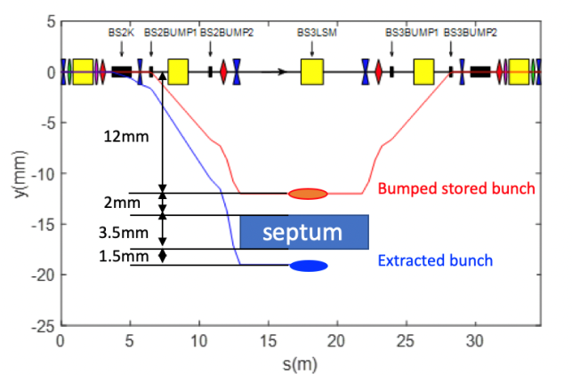
Booster 6 GeV injection and extraction design
Booster operation conditions:
repetition rate <= 1Hz
fills at most 10 bunches
single-bunch injection/extraction
Bunch charge at 6 GeV: 5 nC for high-bunch-charge mode
Booster 6 GeV injection & extraction (in the vertical plane)
Injection: a pair of dipole kickers at pi phase advance
Extraction: single dipole kicker (300 ns pulse width) + 4 bump magnets (1ms pulse width)
6 GeV injection
6 GeV extraction

Slide 7
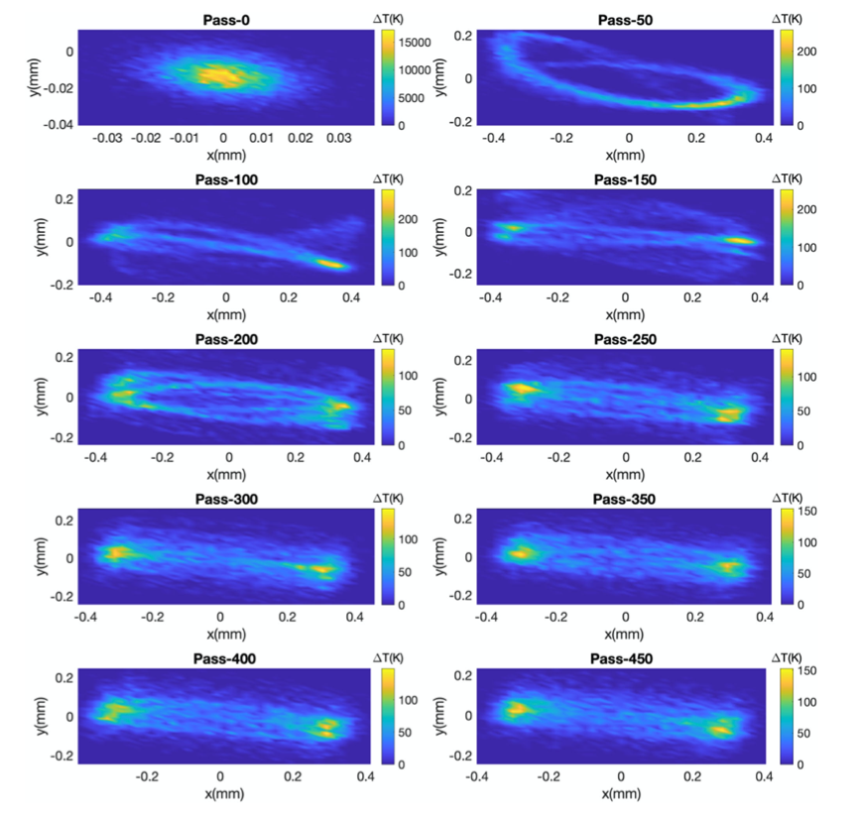
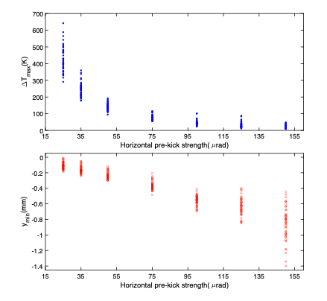
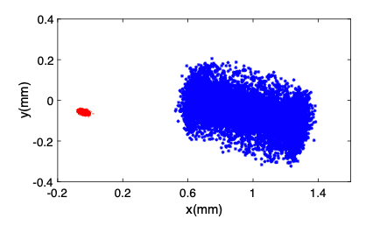
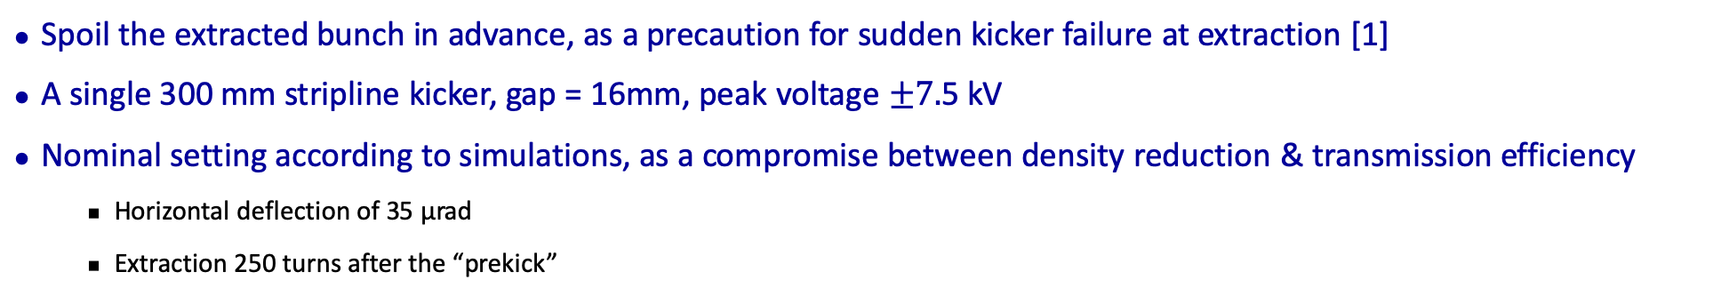
Pre-extraction kicker
Spoil the extracted bunch in advance, as a precaution for sudden kicker failure at extraction [1]
A single 300 mm stripline kicker, gap = 16mm, peak voltage $±7.$5 kV
Nominal setting according to simulations, as a compromise between density reduction & transmission efficiency
Horizontal deflection of 35 μrad
Extraction 250 turns after the “prekick”
Normal condition
Kicker failure
For example, two pulsers no output
Before prekick
500-turns after prekick
[1] Z. Duan et al., Nucl. Sci. Tech 32 (2021) 136

Slide 8
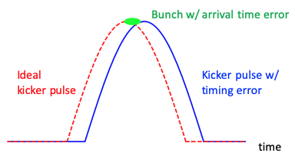
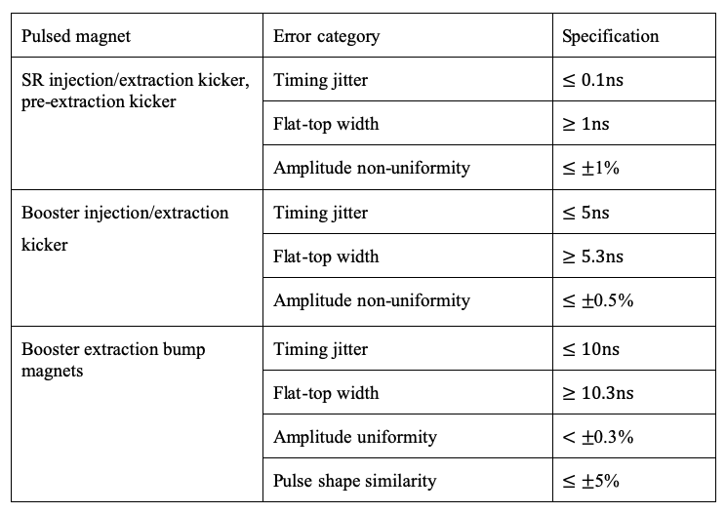
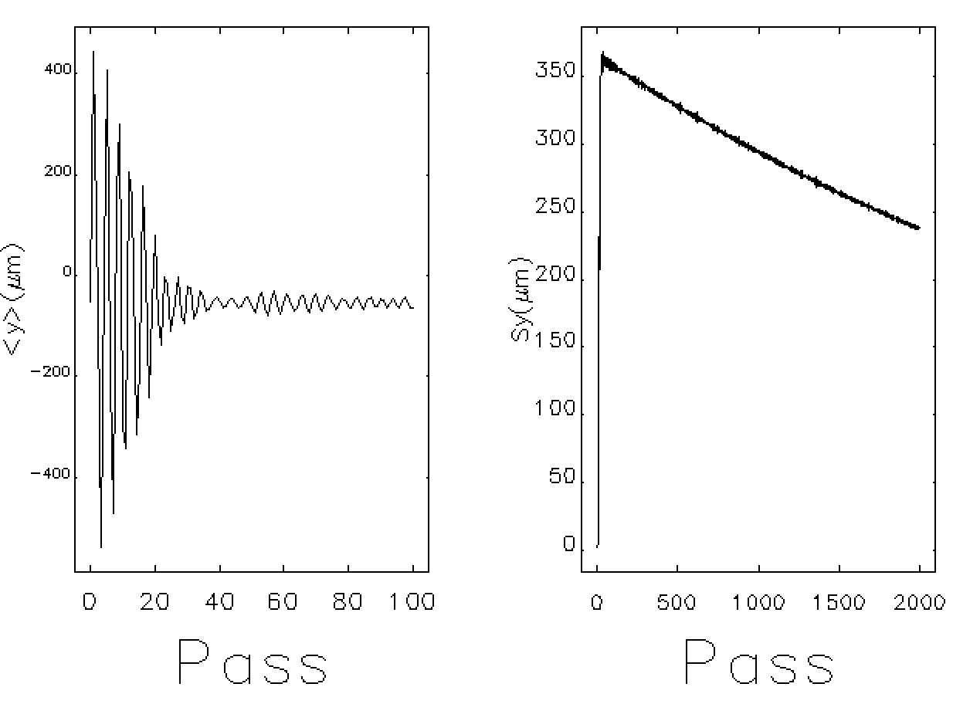
Error evaluation and tolerances of pulsed magnets
Influence on injected/extracted bunch -> trajectory error
The kicker pulse has no absolute “flat-top”
Error sources
Relative amplitude repeatability
Arrival time error & timing jitter
Field non-uniformity
Influence on stored bunches
Residual oscillation
Booster: ensure no loss of stored bunches
Ring: perturbation to user experiments
“Flat-top” region
+ timing jitter
+ amplitude non-uniformity
“good-field” region
+ field non-uniformity
Bunch centroid motion
dies away in ~200 μs
Bunch size & brightness recovers in ~ 100 ms
Measurements show adjacent bunches are also perturbed
User tolerance yet to be discussed

Slide 9
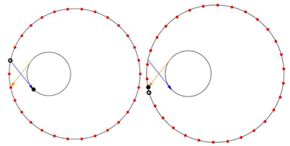
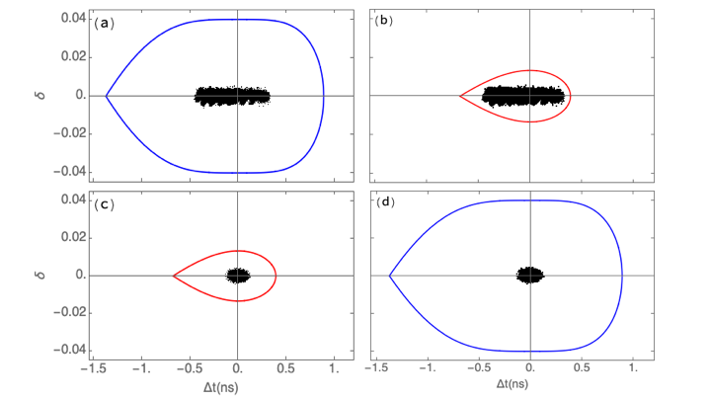
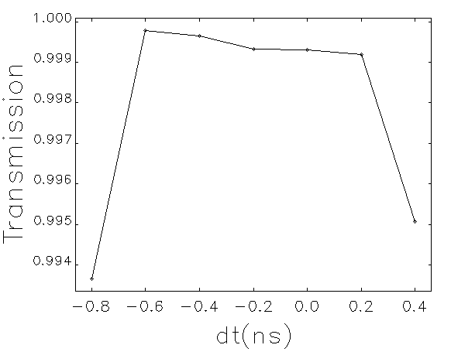
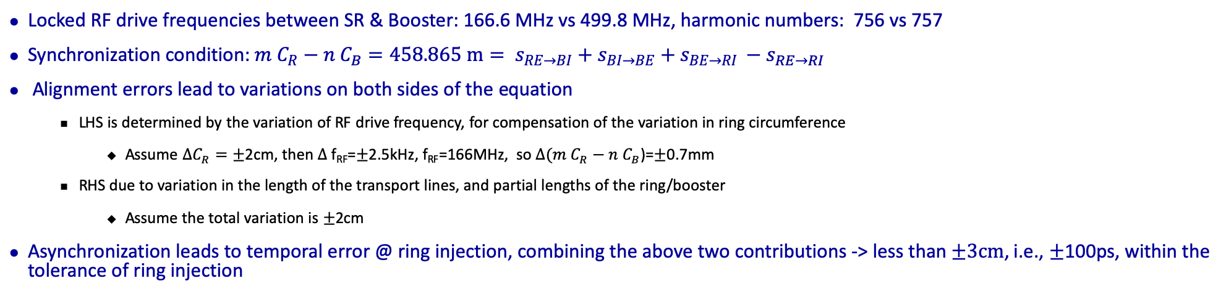
Synchronization
Locked RF drive frequencies between SR & Booster: 166.6 MHz vs 499.8 MHz, harmonic numbers: 756 vs 757
Synchronization condition: $m C_{R}−n C_{B}=458.865 m= s_{RE→BI}+s_{BI→BE}+s_{BE→RI }−s_{RE→RI}$
Alignment errors lead to variations on both sides of the equation
LHS is determined by the variation of RF drive frequency, for compensation of the variation in ring circumference
Assume ${ΔC}_{R}=±$2cm, then $Δ$f_{RF}=$±$2.5kHz, f_{RF}=166MHz, so $Δ(m C_{R}−n C_{B}$)=$±$0.7mm
RHS due to variation in the length of the transport lines, and partial lengths of the ring/booster
Assume the total variation is $±$2cm
Asynchronization leads to temporal error @ ring injection, combining the above two contributions -> less than $±3cm$, i.e., $±$100ps, within the tolerance of ring injection
Ring equilibrium
Booster injection
RF cavities
Booster equilibrium
Ring injection
Main oscillator

Slide 10
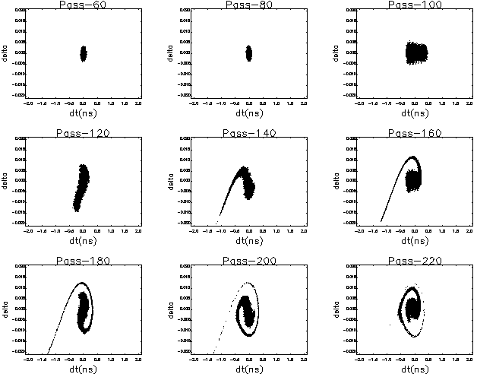
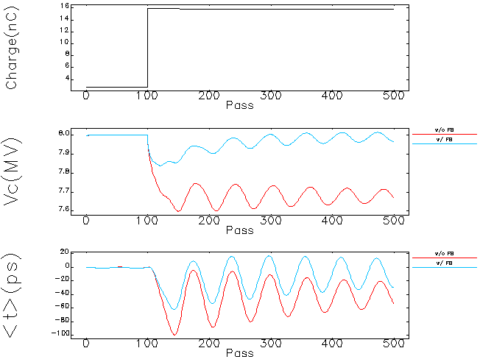
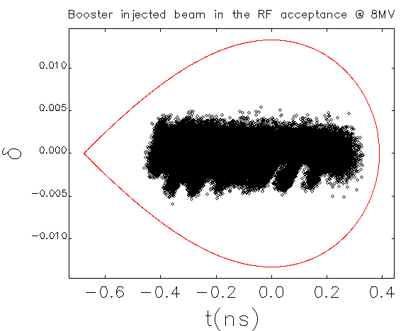
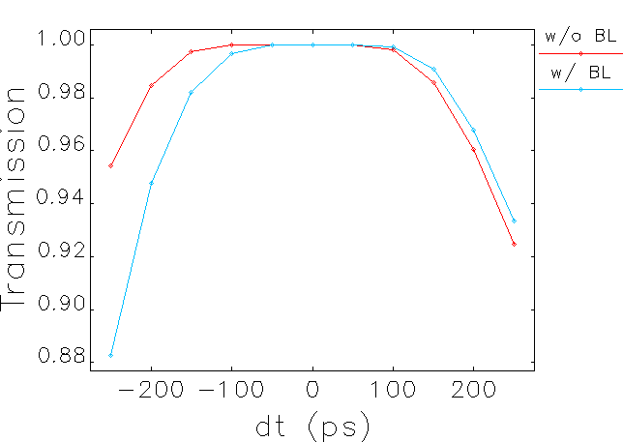
Transient beam loading during booster injection
Transient beam loading leads to a variation of RF voltage & phase, and squeeze the RF acceptance, could lead to beam loss for injected bunch of ~15nC
W/ beam loading & active RF feedback, the transmission efficiency is only moderately lower than the case w/o beam loading
Optimization in the injected bunch arrival time is helpful to improve the transmission

Slide 11
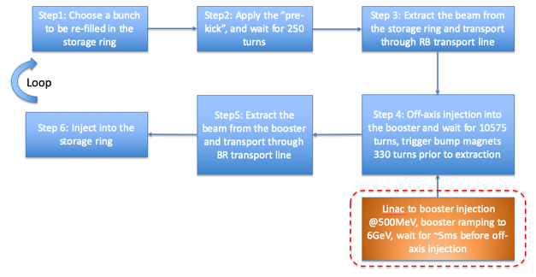
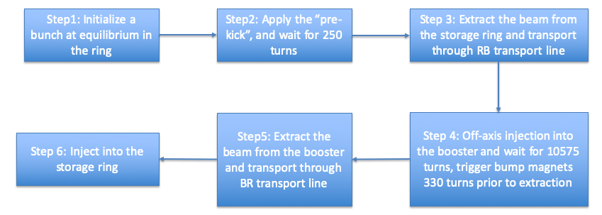
End-to-end simulation of the injection process
(1) Bunch recycling with accumulation in the booster
(2) Bunch recycling w/o accumulation in the booster
To start with, we launched (2) with many random lattice seeds and dynamic error seeds, to get an overall feeling of the transmission efficiency, and identify the main beam loss mechanism
Then, we conducted (1) for some typical cases for comparison.
In the presented simulation results, no dedicated scan of longitudinal phase space deviation is included, in the to-do list.

Slide 12
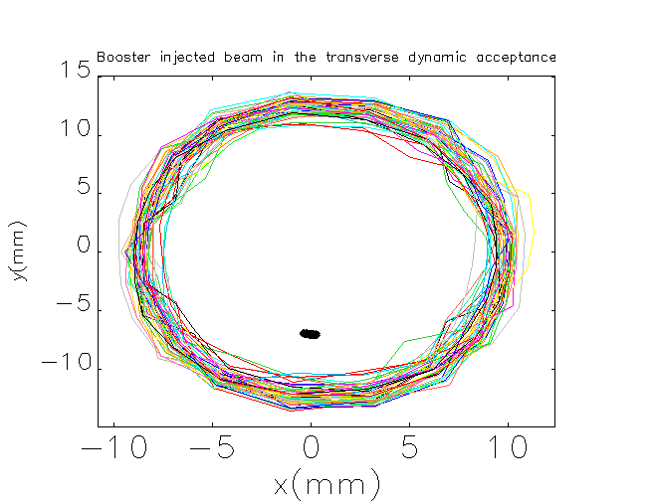
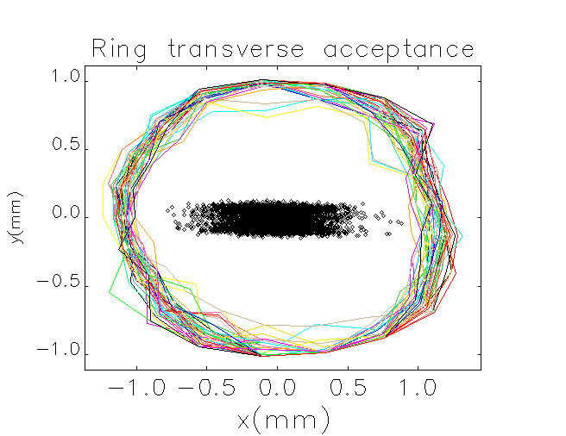
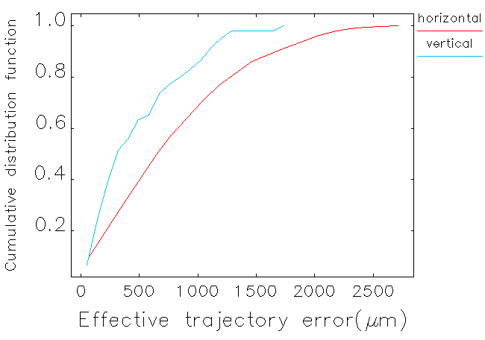
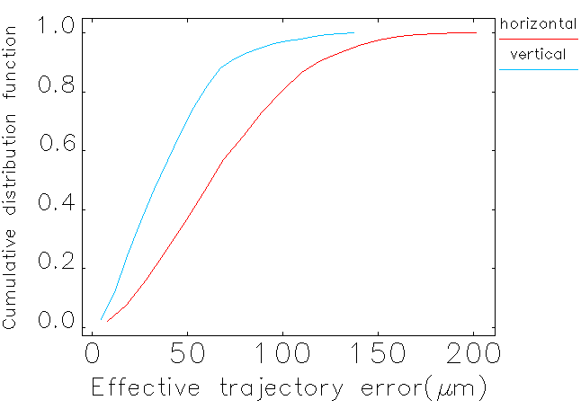
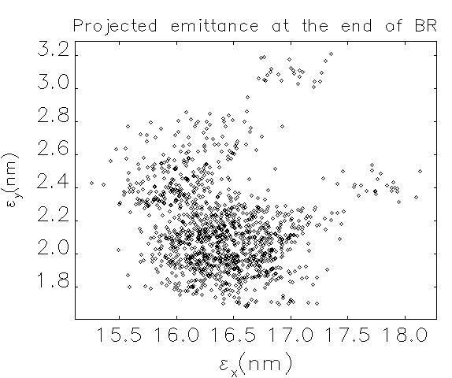
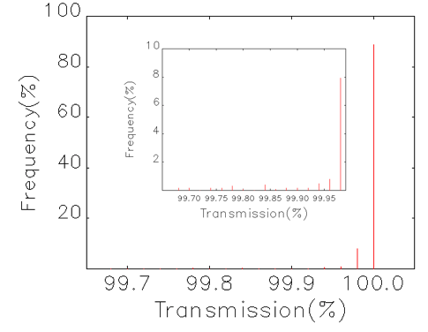
Simulations for high-brightness mode (1.33nC)
Thorough modeling of machine imperfection
Realistic lattice error modeling and correction, 50 random lattice seeds
Kicker amplitude & time jitter, power supply ripple, 25 random jitter seeds
Almost perfect transmission efficiency is anticipated in nominal operation conditions
Booster injection
Ring injection

Slide 13
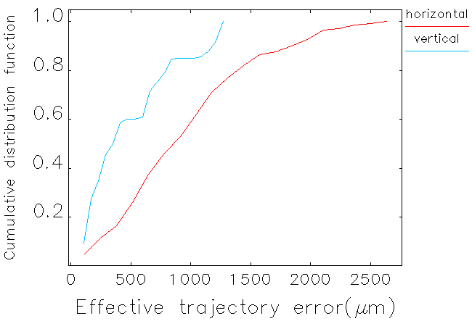
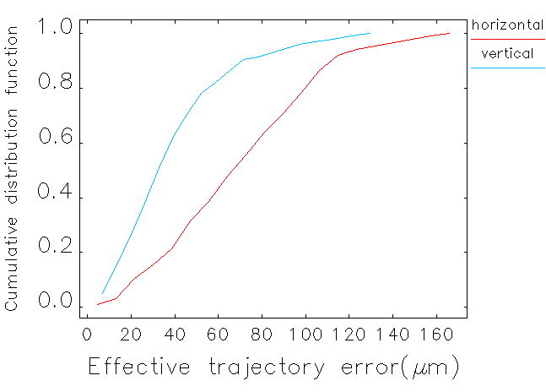
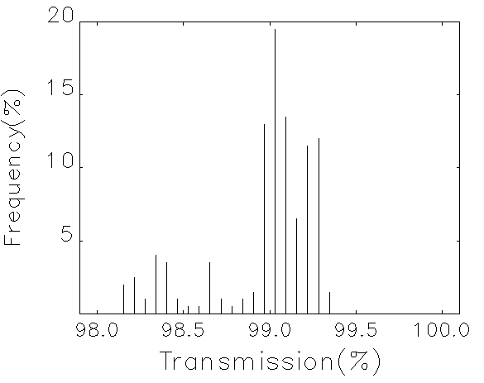
Simulations for high-bunch-charge mode (14.4nC)
Thorough modeling of machine imperfection
Realistic lattice error modeling and correction, 20 random lattice seeds
Kicker amplitude & time jitter, power supply ripple, 10 random jitter seeds
Longitudinal & vertical dipole impedances (see N. Wang’s talk) in ring & booster are modeled as two lumped elements
Booster injection
Ring injection

Slide 14
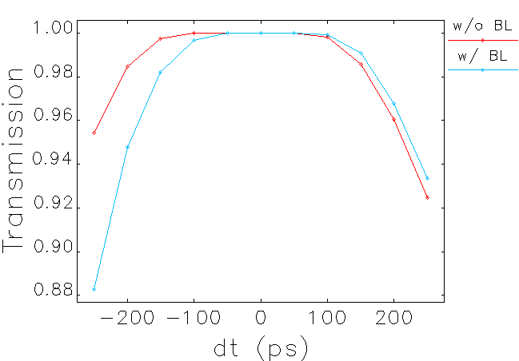
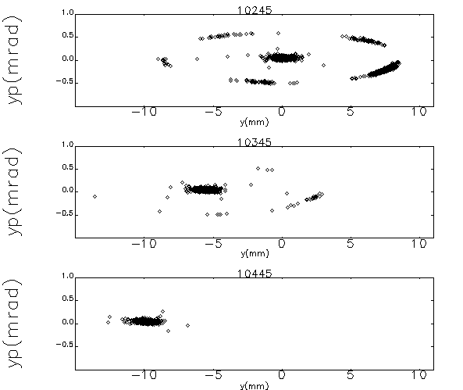
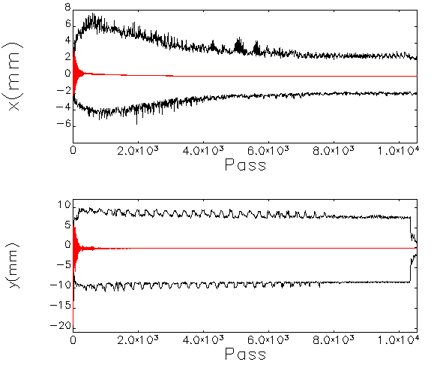
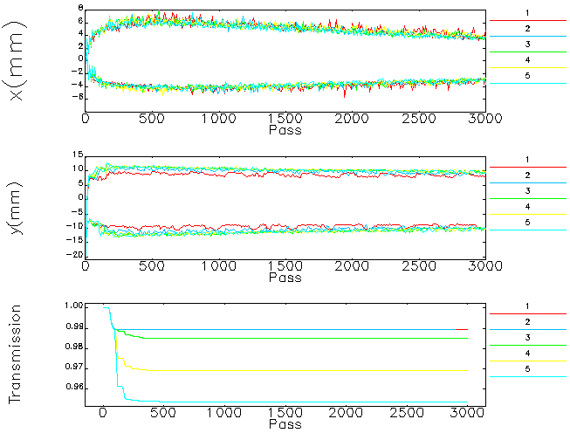
Key beam loss mechanisms and potential mitigations
Booster RF acceptance
Beam loss at high-dispersion region, beam loss monitor could help diagnose
It’s favored to control the RF phase drift within 50 ps
Some injected particles are captured by high-order resonance islands, then get lost as extraction bump rises
Fine tuning of working point, optimization of sextupoles
Residual oscillation can be exacerbated by transverse dipole impedances, no dramatic beam loss using current impedance model.
Ring injection: the shorter injected bunch length is more vulnerable[1]: Bunch lengthening in the booster by RF modulation as potential mitigation[2,3]
[1] Z. Duan et al., IPAC 2019 TUPGW053. [2] H. Xu et al., NIM A, 986 (2021) 164658. [3] P. Liang et al., NIM A, 1034 (2022)166788.

Slide 15
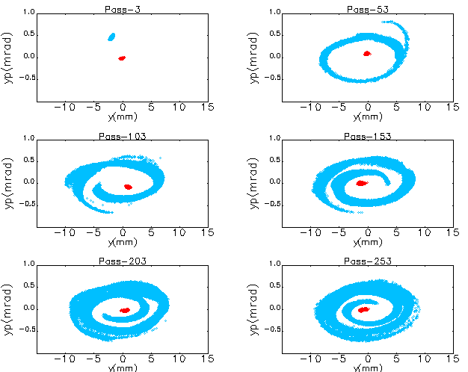
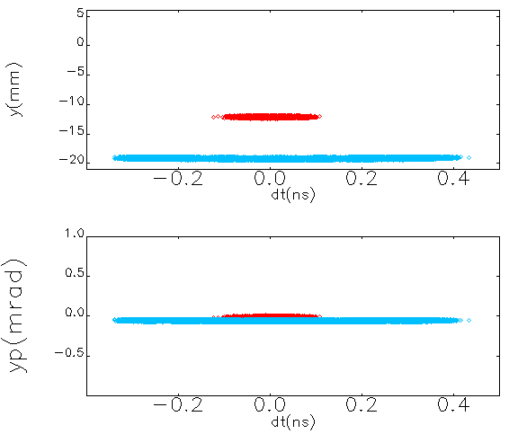
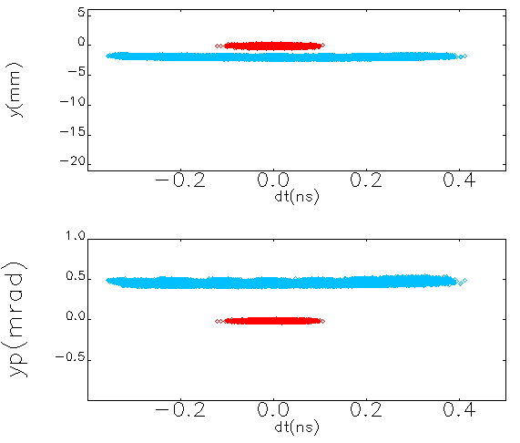
The accumulation w/ stored bunch in the booster
High-charge injected bunch off-axis injection, and merged with a low-charge stored bunch on-axis.
With the stored bunch, the initial <y> becomes smaller
The stored bunch is excited via short range wakefield, but beam loss (if any) occurs in the injected bunch
Pass-0
Pass-1

Slide 16
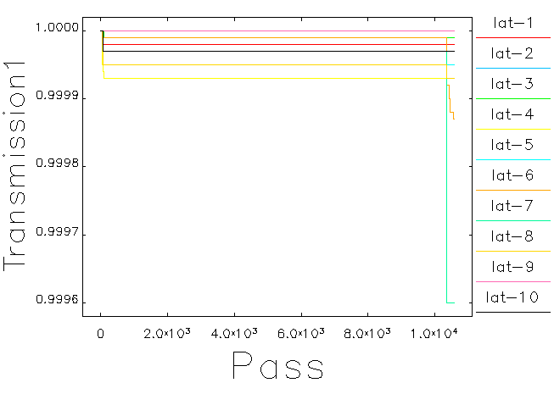



Simulations for high-bunch-charge mode 0->200 mA
Assume the booster stored bunch of 5 nC
The bunch charge accumulation goes like: 0nC -> 5nC -> 10 nC -> 15 nC, to reach a little bit beyond 14.4 nC goal
5nC
Ring -> booster
Merge w/ 5nC
10nC
Ring -> booster
Merge w/ 5nC
~10nC
Booster -> ring
~15nC
Booster -> ring

Slide 17


Simulations for top-up injection of high-bunch charge mode
Assume a ring extracted bunch = 13.14 nC, and a booster stored bunch = 2.75 C
To maintain top-up injection, ring-to-booster transmission better than 98.5%, booster-to-ring transmission better than 99.8%.
Of course, these requirements can be alleviated, if a larger booster stored bunch charge is assumed.
lat-8
Ring -> booster
lat-8
Booster -> ring

Slide 18
Tentative commissioning plan for 6 GeV injection/extraction
Key items | prerequisite | Goal in initial commissioning
1. Booster extraction | Booster capable of providing 6GeV、0.5nC-1nC single bunch | Successfully extraction, beam signal at ICT & BPM @ BR
2. BR transmission | 1. Booster extraction done | 0.5 nC single bunch till end of BR
3. SR injection | 2. BR transmission done | Single bunch till R04BPM02
4. multi-bunch injection | Stored. Single bunch > 0.2 nC, beam lifetime > 1 min. | Inject into arbitrary bucket; inject multiple bunches.
5. Ring extraction | Stable operation w/ beam current > 20 mA, beam lifetime > 10 min | Extraction of single bunch, beam signal at ICT/BPM @RB
6. RB to dump | 5. Ring extraction done | Transmission to the dump
7. RB to booster | 6. RB to dump done | 0.5 nC single bunch till end of RB
8. Booster injection | 7. RB to booster done | Achieve accumulation in booster
Injection/extraction/transport line commissioning
1. Booster extraction
2. BR transport line
3. SR injection
Store in SR
4. Multi-bunch injection
5. SR extraction
6. RB to beam dump
Transmission efficiency
Optimization
SR beam energy : 6GeV
emittance<100pm
Beam current 100mA
7. RB to booster
8. Booster 6 GeV injection
18

Slide 19
Summary
HEPS adopts swap-out injection with the “booster high-energy accumulation” scheme.
The injection and extraction designs have been finalized, hardware manufacture is under way.
Progress in the end-to-end injection simulations:
A near perfect transmission is expected for the high-brightness mode during nominal operations.
A high transmission efficiency for the high-bunch-charge mode with the current impedance model. The existence of the stored bunch in the booster seems not introduce negative effects.
The influence of the horizontal dipole impedance will also be evaluated. A fine scan of longitudinal acceptance is under way.
Other effects like the transient beam loading in the SR injection, will also be studied.
Now we are preparing for the commissioning
Linac commissioning is scheduled to start by late-August, 2022
the booster & ring commissioning is expected to start by mid-2023
Helpful discussions with M. Borland and R. Lindberg regarding elegant simulations are highly appreciated!

Slide 20



HEPS site @ 2021. 12, when infrastructure construction was finished
Linear accelerator @ 2022. 6
Pre-alignment & installation test of one 7BA cell @ 2022. 6
Thank you for your attention!

Slide 21
dump
lost in ring

