Slide 1


Combined Simulations of Space Charge, IBS and Damping for Low-Emittance Rings and beyond…
F. Antoniou, F. Asvesta, H. Bartosik, Y. Papaphilippou, M. Zampetakis
3rd Workshop on Low Emittance Lattice design ALBA, Barcelona, Spain, June 2022

Slide 2
Outline
Introduction
Motivation
Tool implementation
CLIC Damping Rings
The CLIC Complex
SC, IBS and SR Interplay Studies
LHC Ion Injectors Interplay Studies
SPS
LEIR
Summary and Future Work

Slide 3
Outline
Introduction
Motivation
Tool implementation
CLIC Damping Rings
The CLIC Complex
SC, IBS and SR Interplay Studies
LHC Ion Injectors Interplay Studies
SPS
LEIR
Summary and Future Work

Slide 4
Motivation
IBS and SC can limit the performance (luminosity, brightness) of:
Ultra-low emittance rings, e.g., CLIC DRs
Ion accelerators, e.g., LEIR and SPS

Slide 5
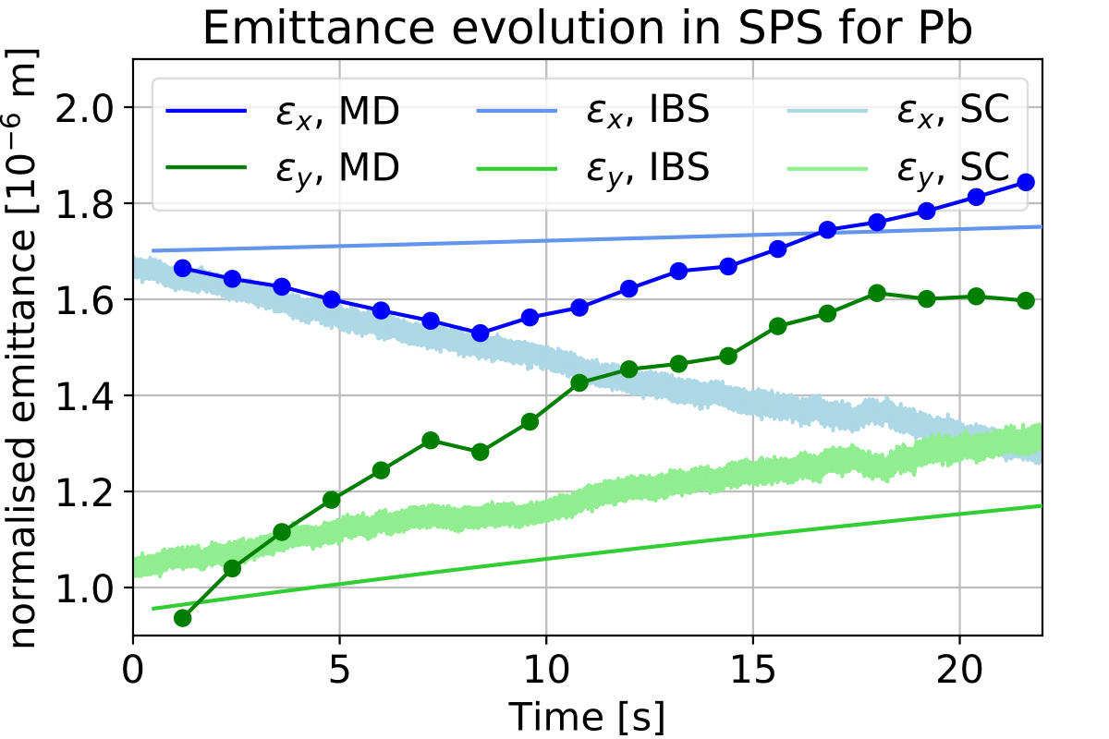
Motivation
IBS and SC can limit the performance (luminosity, brightness) of:
Ultra-low emittance rings, e.g., CLIC DRs
Ion accelerators, e.g., LEIR and SPS
Example 1: SPS (2016)
CERN-ACC-NOTE-2021-0003
Individual IBS or SC simulations cannot explain the experimental observations

Slide 6
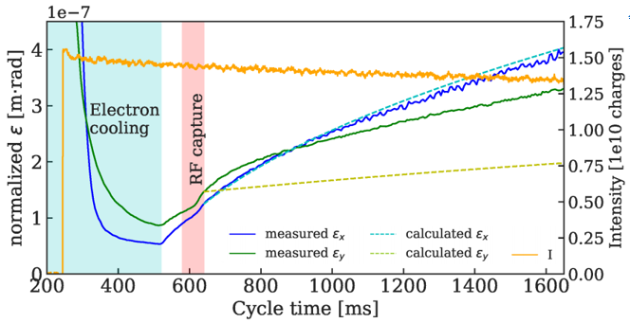
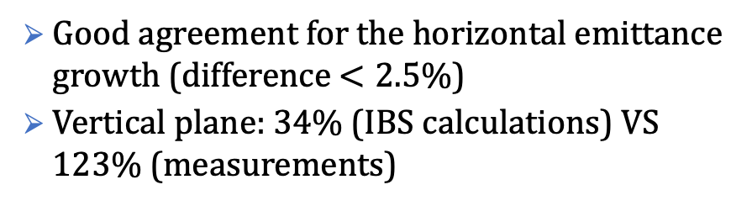
Motivation
IBS and SC can limit the performance (luminosity, brightness) of:
Ultra-low emittance rings, e.g., CLIC DRs
Ion accelerators, e.g., LEIR and SPS
Example 1: SPS (2016)
Example 2: LEIR
CERN-ACC-NOTE-2021-0003
A. Saa Hernandez, “IBS Studies – LEIR”, SCWG meeting
Individual IBS or SC simulations cannot explain the experimental observations
Good agreement for the horizontal emittance growth (difference $<2.5\%$)
Vertical plane: 34% (IBS calculations) VS 123% (measurements)

Slide 7

Motivation
IBS and SC can limit the performance (luminosity, brightness) of:
Ultra-low emittance rings, e.g., CLIC DRs
Ion accelerators, e.g., LEIR and SPS
Example 1: SPS (2016)
Example 2: LEIR
CERN-ACC-NOTE-2021-0003
A. Saa Hernandez, “IBS Studies – LEIR”, SCWG meeting
Individual IBS or SC simulations cannot explain the experimental observations
Good agreement for the horizontal emittance growth (difference $<2.5\%$)
Vertical plane: 34% (IBS calculations) VS 123% (measurements)
Need for tools to study the interplay of the two effects; Not trivial!

Slide 8
Tool Implementation
SC introduces a tune spread; makes the beam susceptible to resonances.
SC was already accurately implemented into tracking codes (i.e., PyORBIT) with various models (frozen, PIC, Slice by slice, etc)
IBS is the multiple small-angle scattering that leads to phase space redistribution
Analytical models, SIRE (Monte-Carlo multiparticle simulation code)

Slide 9
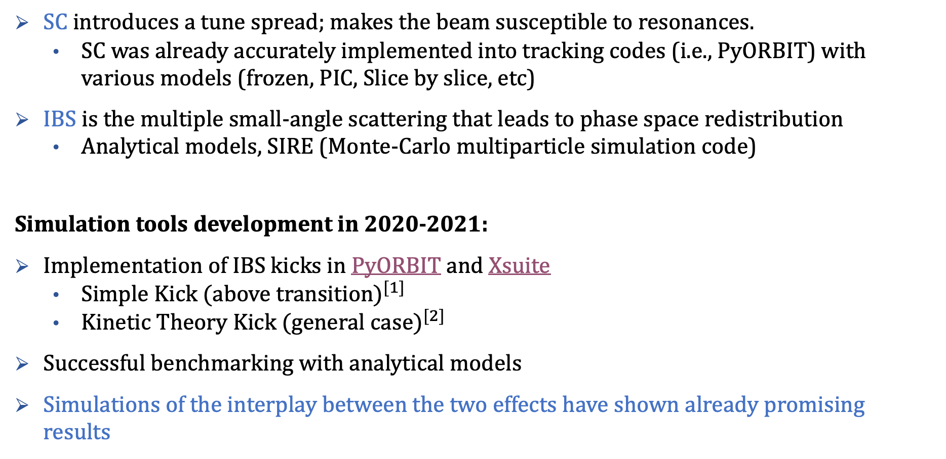
Tool Implementation
SC introduces a tune spread; makes the beam susceptible to resonances.
SC was already accurately implemented into tracking codes (i.e., PyORBIT) with various models (frozen, PIC, Slice by slice, etc)
IBS is the multiple small-angle scattering that leads to phase space redistribution
Analytical models, SIRE (Monte-Carlo multiparticle simulation code)
Simulation tools development in 2020-2021:
Implementation of IBS kicks in PyORBIT and Xsuite
Simple Kick (above transition$)^{[1]}$
Kinetic Theory Kick (general case$)^{[2]}$
Successful benchmarking with analytical models
Simulations of the interplay between the two effects have shown already promising results
[1] R. Bruce, J. M. Jowett
[2] P. Zenkevich, O. Boine-Frankenheim, A. Bolshakov

Slide 10
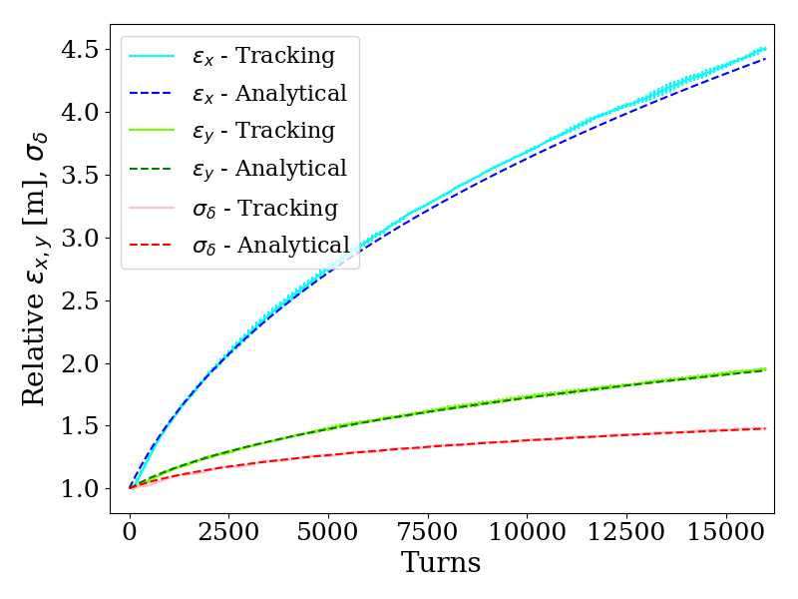
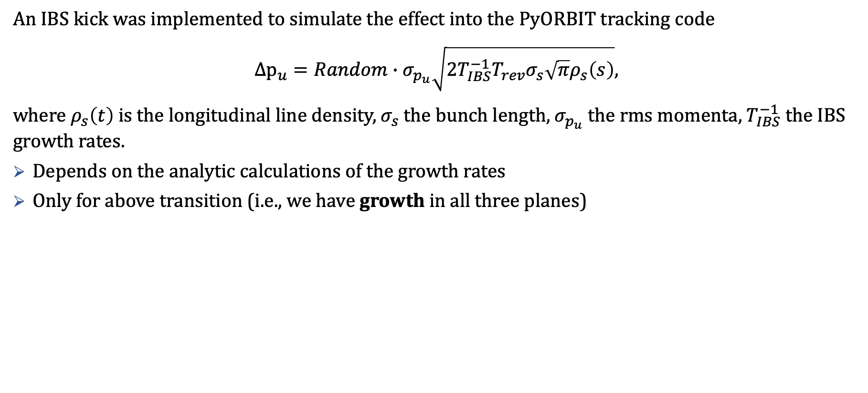
IBS Kicks: Simple Kick
An IBS kick was implemented tο simulate the effect into the PyORBIT tracking code
$${Δp}_{u}=Random∙σ_{p_{u}}\sqrt{2T_{IBS}^{−1}T_{rev}σ_{s}\sqrt{π}ρ_{s}\left(s\right)},$$
where $ρ_{s}\left(t\right)$ is the longitudinal line density, $σ_{s}$ the bunch length, $σ_{p_{u}}$ the rms momenta, $T_{IBS}^{−1}$ the IBS growth rates.
Depends on the analytic calculations of the growth rates
Only for above transition (i.e., we have growth in all three planes)
[1] R. Bruce, J. M. Jowett

Slide 11
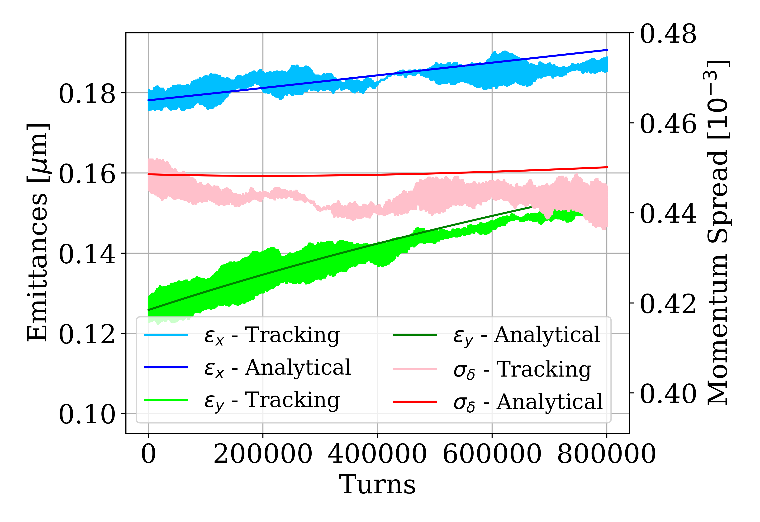
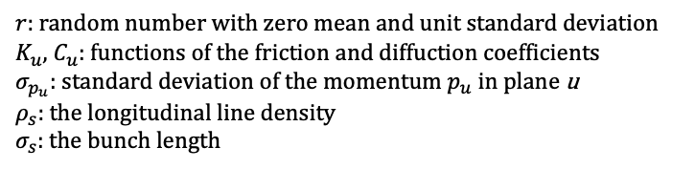
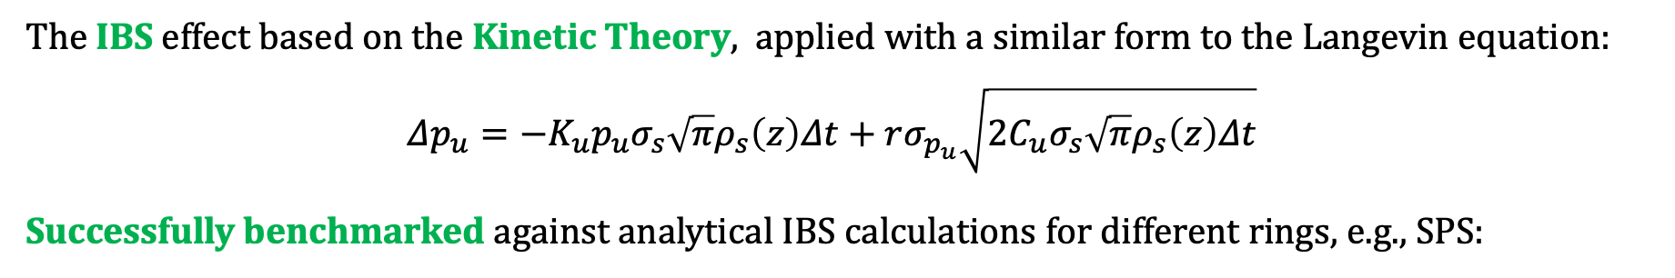
IBS Kicks: Kinetic Theory
The IBS effect based on the Kinetic Theory, applied with a similar form to the Langevin equation:
$${Δp}_{u}=−K_{u}p_{u}σ_{s}\sqrt{π}ρ_{s}\left(z\right)Δt+rσ_{p_{u}}\sqrt{2C_{u}σ_{s}\sqrt{π}ρ_{s}\left(z\right)Δt}$$
Successfully benchmarked against analytical IBS calculations for different rings, e.g., SPS:
*More details and benchmarking cases in the backup slides…
$r:$ random number with zero mean and unit standard deviation
$K_{u}$, $C_{u}:$ functions of the friction and diffuction coefficients
$σ_{p_{u}}:$ standard deviation of the momentum $p_{u}$ in plane u
$ρ_{s}:$ the longitudinal line density
$σ_{s}:$ the bunch length

Slide 12
Outline
Introduction
Motivation
Tool implementation
CLIC Damping Rings
The CLIC Complex
SC, IBS and SR Interplay Studies
LHC Ion Injectors Interplay Studies
SPS
LEIR
Summary and Future Work

Slide 13
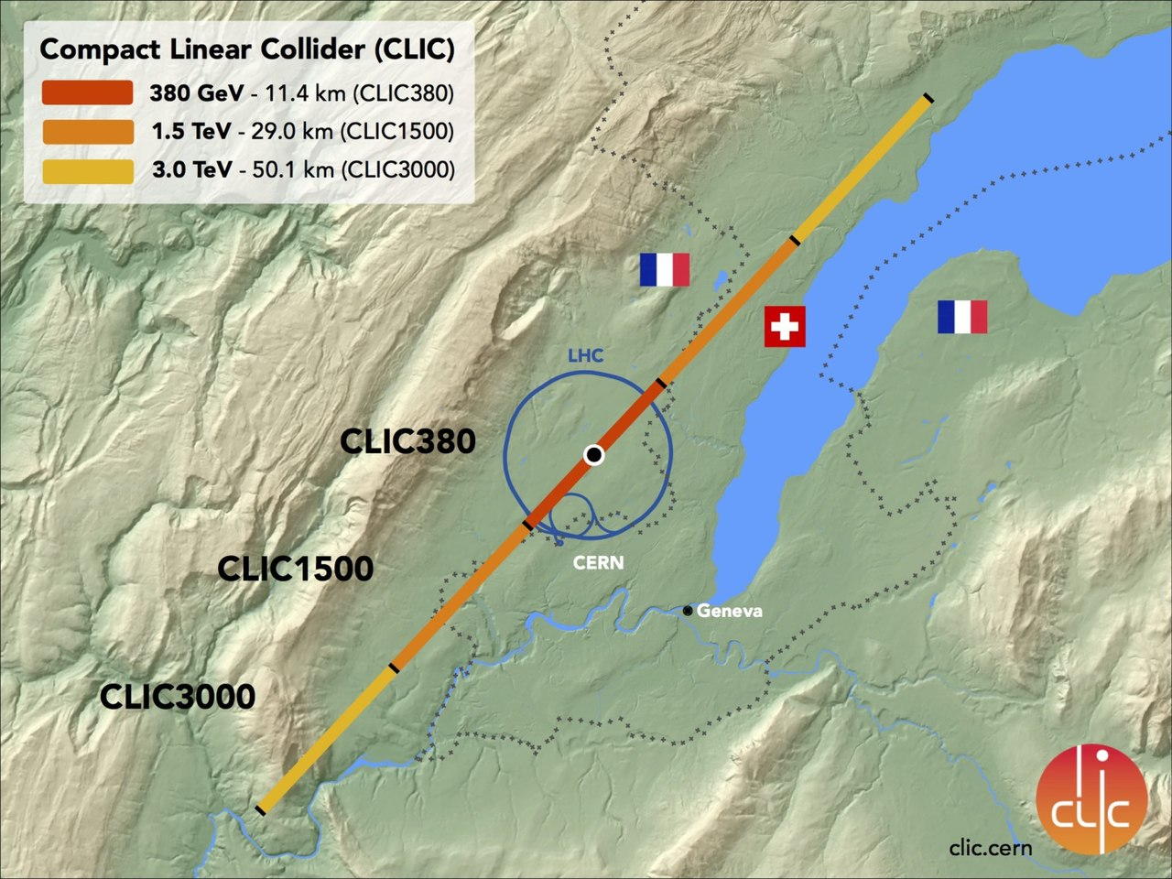
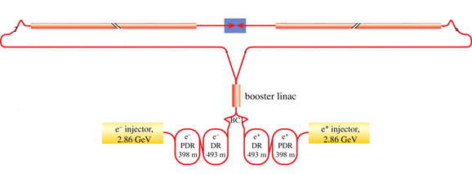
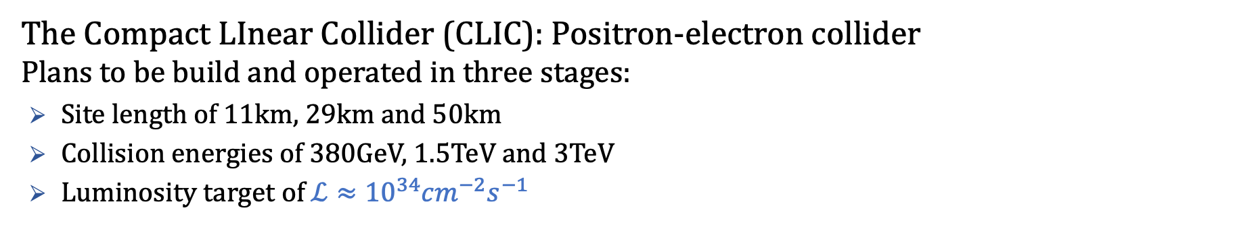
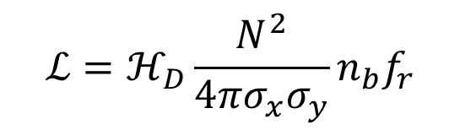
The Compact Linear Collider complex
The Compact LInear Collider (CLIC): Positron-electron collider
Plans to be build and operated in three stages:
Site length of 11km, 29km and 50km
Collision energies of 380GeV, 1.5TeV and 3TeV
Luminosity target of $ℒ≈{10}^{34}{cm}^{−2}s^{−1}$
$$ℒ=ℋ_{D}\frac{N^{2}}{4πσ_{x}σ_{y}}n_{b}f_{r}$$

Slide 14
The Compact Linear Collider complex
The Compact LInear Collider (CLIC): Positron-electron collider
Plans to be build and operated in three stages:
Site length of 11km, 29km and 50km
Collision energies of 380GeV, 1.5TeV and 3TeV
Luminosity target of $ℒ≈{10}^{34}{cm}^{−2}s^{−1}$
$$ℒ=ℋ_{D}\frac{N^{2}}{4πσ_{x}σ_{y}}n_{b}f_{r}$$
Need for ultra-low emittances!!!

Slide 15
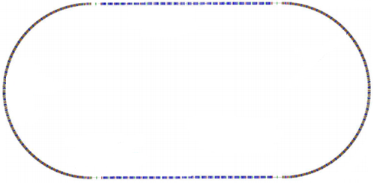

The CLIC DRs*
*Compact Linear Collider Damping Rings
$$\sim 400m$$
Purpose:
Damp the transverse emittances!
by 2 orders of magnitude
In 20ms

Slide 16
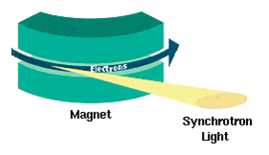
The CLIC DRs*
*Compact Linear Collider Damping Rings
How?
Synchrotron Radiation (SR)
Spontaneous photon emission in bending magnets or insertion devises.
$$\sim 400m$$
Purpose:
Damp the transverse emittances!
by 2 orders of magnitude
In 20ms
*implementation in the backup slides

Slide 17
The CLIC DRs*
*Compact Linear Collider Damping Rings
How?
Synchrotron Radiation (SR)
Spontaneous photon emission in bending magnets or insertion devises.
$$\sim 400m$$
Purpose:
Damp the transverse emittances!
by 2 orders of magnitude
In 20ms
*implementation in the backup slides
At these ultra-low emittances, SC and IBS can become very strong!
Simulations with IBS, SC and SR

Slide 18
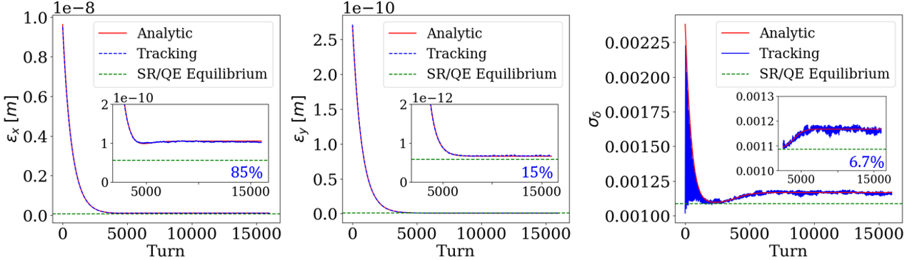
The CLIC DR cycle
Emittance evolution for the nominal cycle, for the ideal CLIC DRs lattice:
Agreement between Analytical calculations (IBS, SR) and Tracking simulation (IBS, SC, SR)
SC does not affect the final steady state

Slide 19
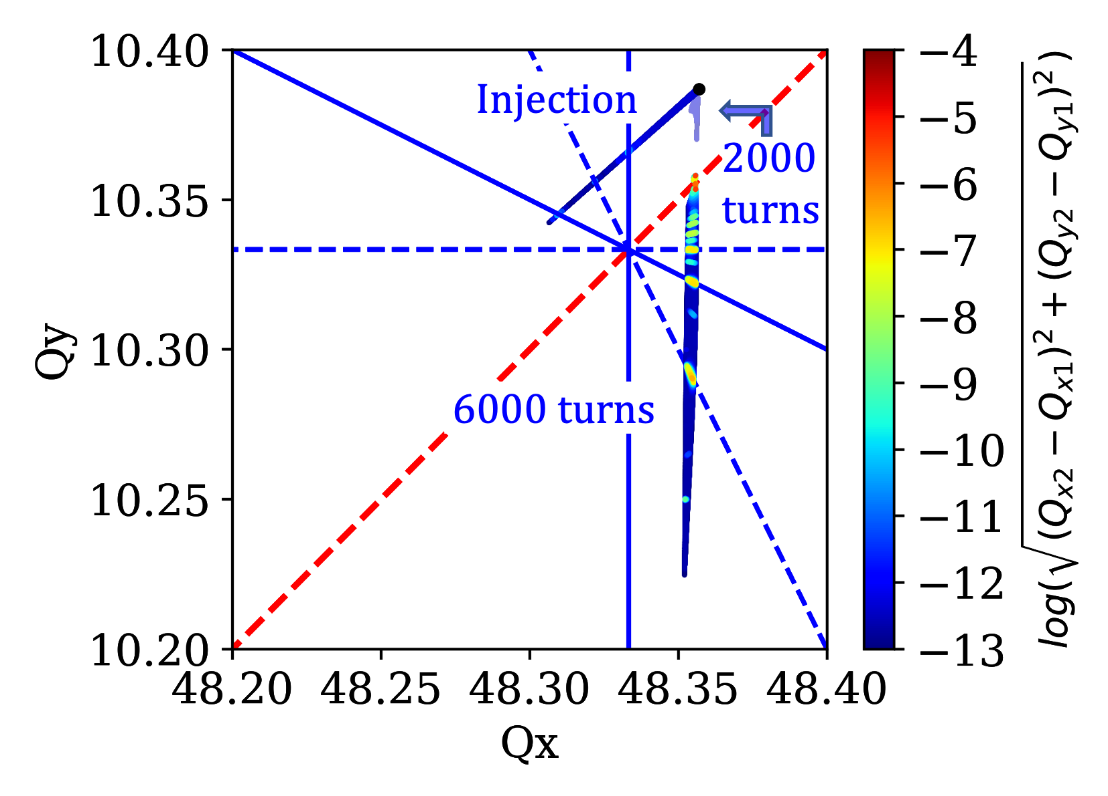

Space Charge Studies – Tune footprint
Το verify that the SC induced tune shift indeed becomes critical for the beam parameters close to equilibrium, tune footprints were evaluated for on-momentum particles.
Large transverse emittances: particles experience large amplitude detuning.
Small transverse emittances: SC induced tune spread becomes dominant.
$${3Q}_{y}$$

Slide 20
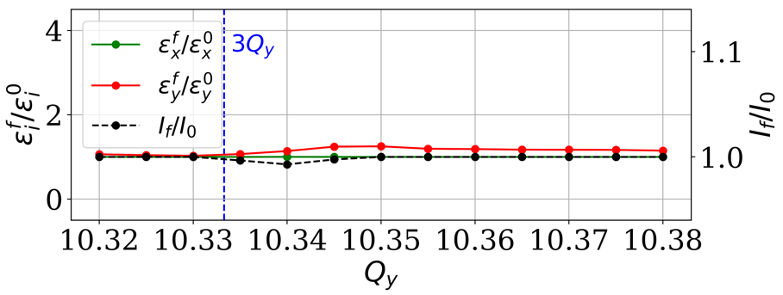


Space Charge Studies
$T_{s}≈150 Turns$ (nominal)
$3Q_{y}=31$ intentionally excited!!!
Nominal synchrotron motion:
Relatively weak response of the beam to the $3Q_{y}=31$ resonance
Fast modulation of the SC force $⇛$ resonance sidebands $⇛$weak diffusion of particle motio$n^{[∗]}$
[*]G. Franchetti, I. Hofmann, “Particle trapping by nonlinear resonances and space charge”

Slide 21
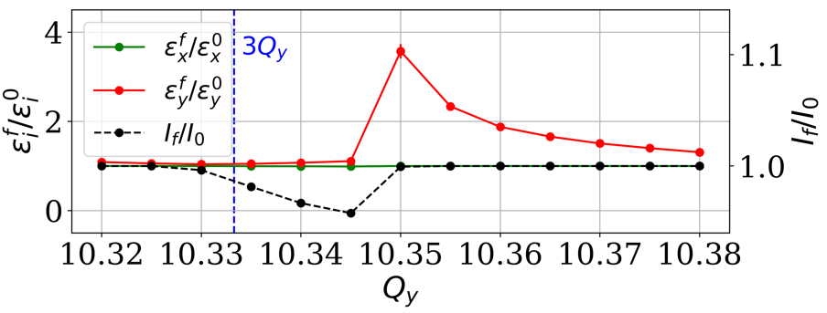
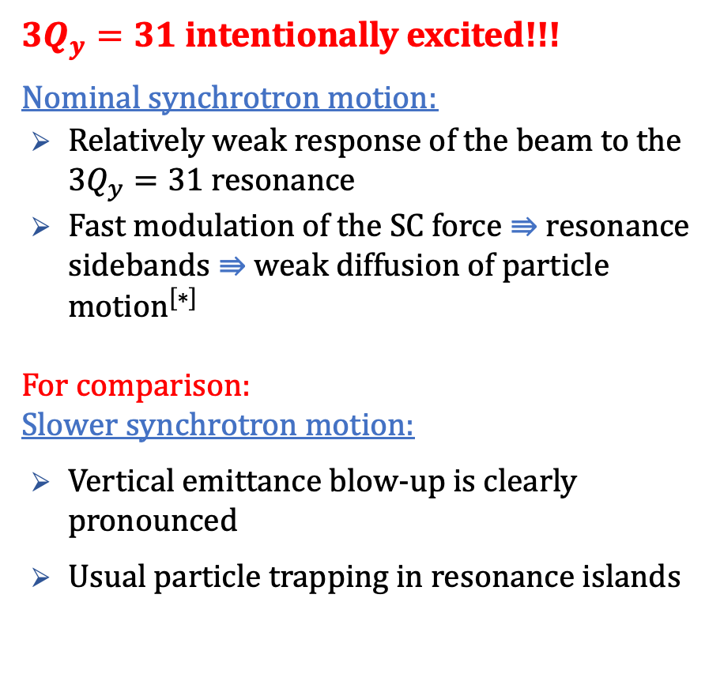

Space Charge Studies
$T_{s}≈150 Turns$ (nominal)
$3Q_{y}=31$ intentionally excited!!!
Nominal synchrotron motion:
Relatively weak response of the beam to the $3Q_{y}=31$ resonance
Fast modulation of the SC force $⇛$ resonance sidebands $⇛$weak diffusion of particle motio$n^{[∗]}$
For comparison:
Slower synchrotron motion:
Vertical emittance blow-up is clearly pronounced
Usual particle trapping in resonance islands
$$T_{s}≈1500 Turns$$
[*]G. Franchetti, I. Hofmann, “Particle trapping by nonlinear resonances and space charge”

Slide 22
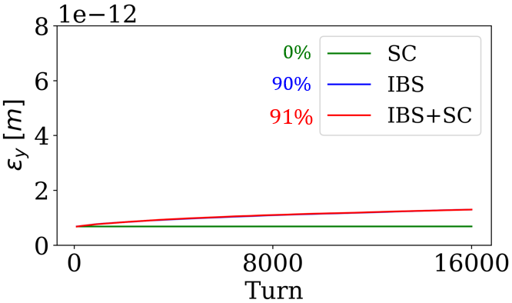
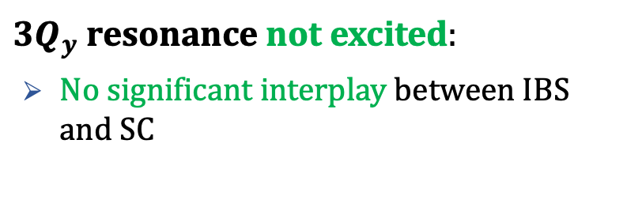

Space Charge Studies with IBS
$3Q_{y}$ resonance not excited:
No significant interplay between IBS and SC
$$Q_{y}=10.35$$

Slide 23
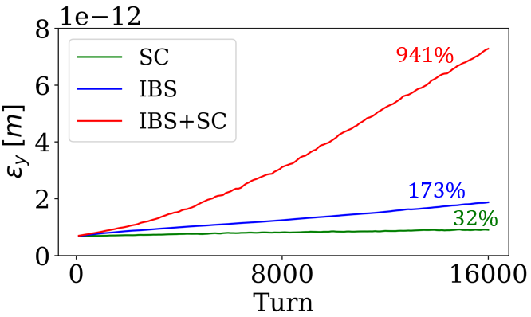
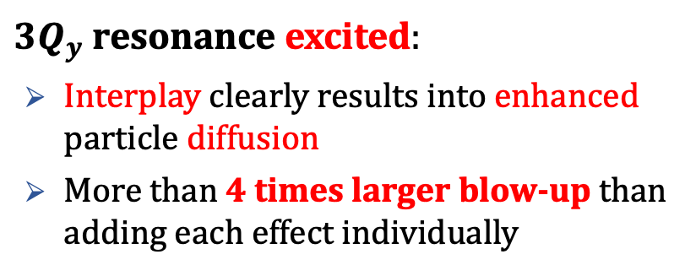

Space Charge Studies with IBS
$3Q_{y}$ resonance not excited:
No significant interplay between IBS and SC
$3Q_{y}$ resonance excited:
Interplay clearly results into enhanced particle diffusion
More than 4 times larger blow-up than adding each effect individually
$$Q_{y}=10.35$$
$$Q_{y}=10.35$$

Slide 24
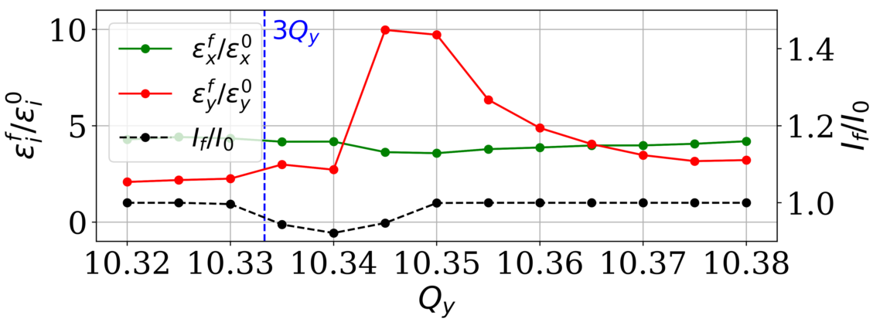
Space Charge Studies with IBS and SR
SC + IBS

Slide 25
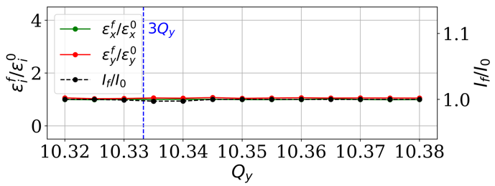
Space Charge Studies with IBS and SR
SC + IBS
SC + IBS + SR
Even in the presence of a strong one-dimensional resonance:
SR mostly cancels the vertical blow-up. Residual blow-up of less than 5%
Less than 1% of particle losses
Good news for the CLIC DRs!!!

Slide 26
Outline
Introduction
Motivation
Tool implementation
CLIC Damping Rings
The CLIC Complex
SC, IBS and SR Interplay Studies
LHC Ion Injectors Interplay Studies
SPS
LEIR
Summary and Future Work

Slide 27
Case 1: SPS MD of 2016
I. John
Observations in operational conditions:
Emittance exchange between horizontal and vertical planes
Large emittance blow-up in both planes
Cannot be explained by standalone space charge or IBS simulations, nor from the sum of them!

Slide 28
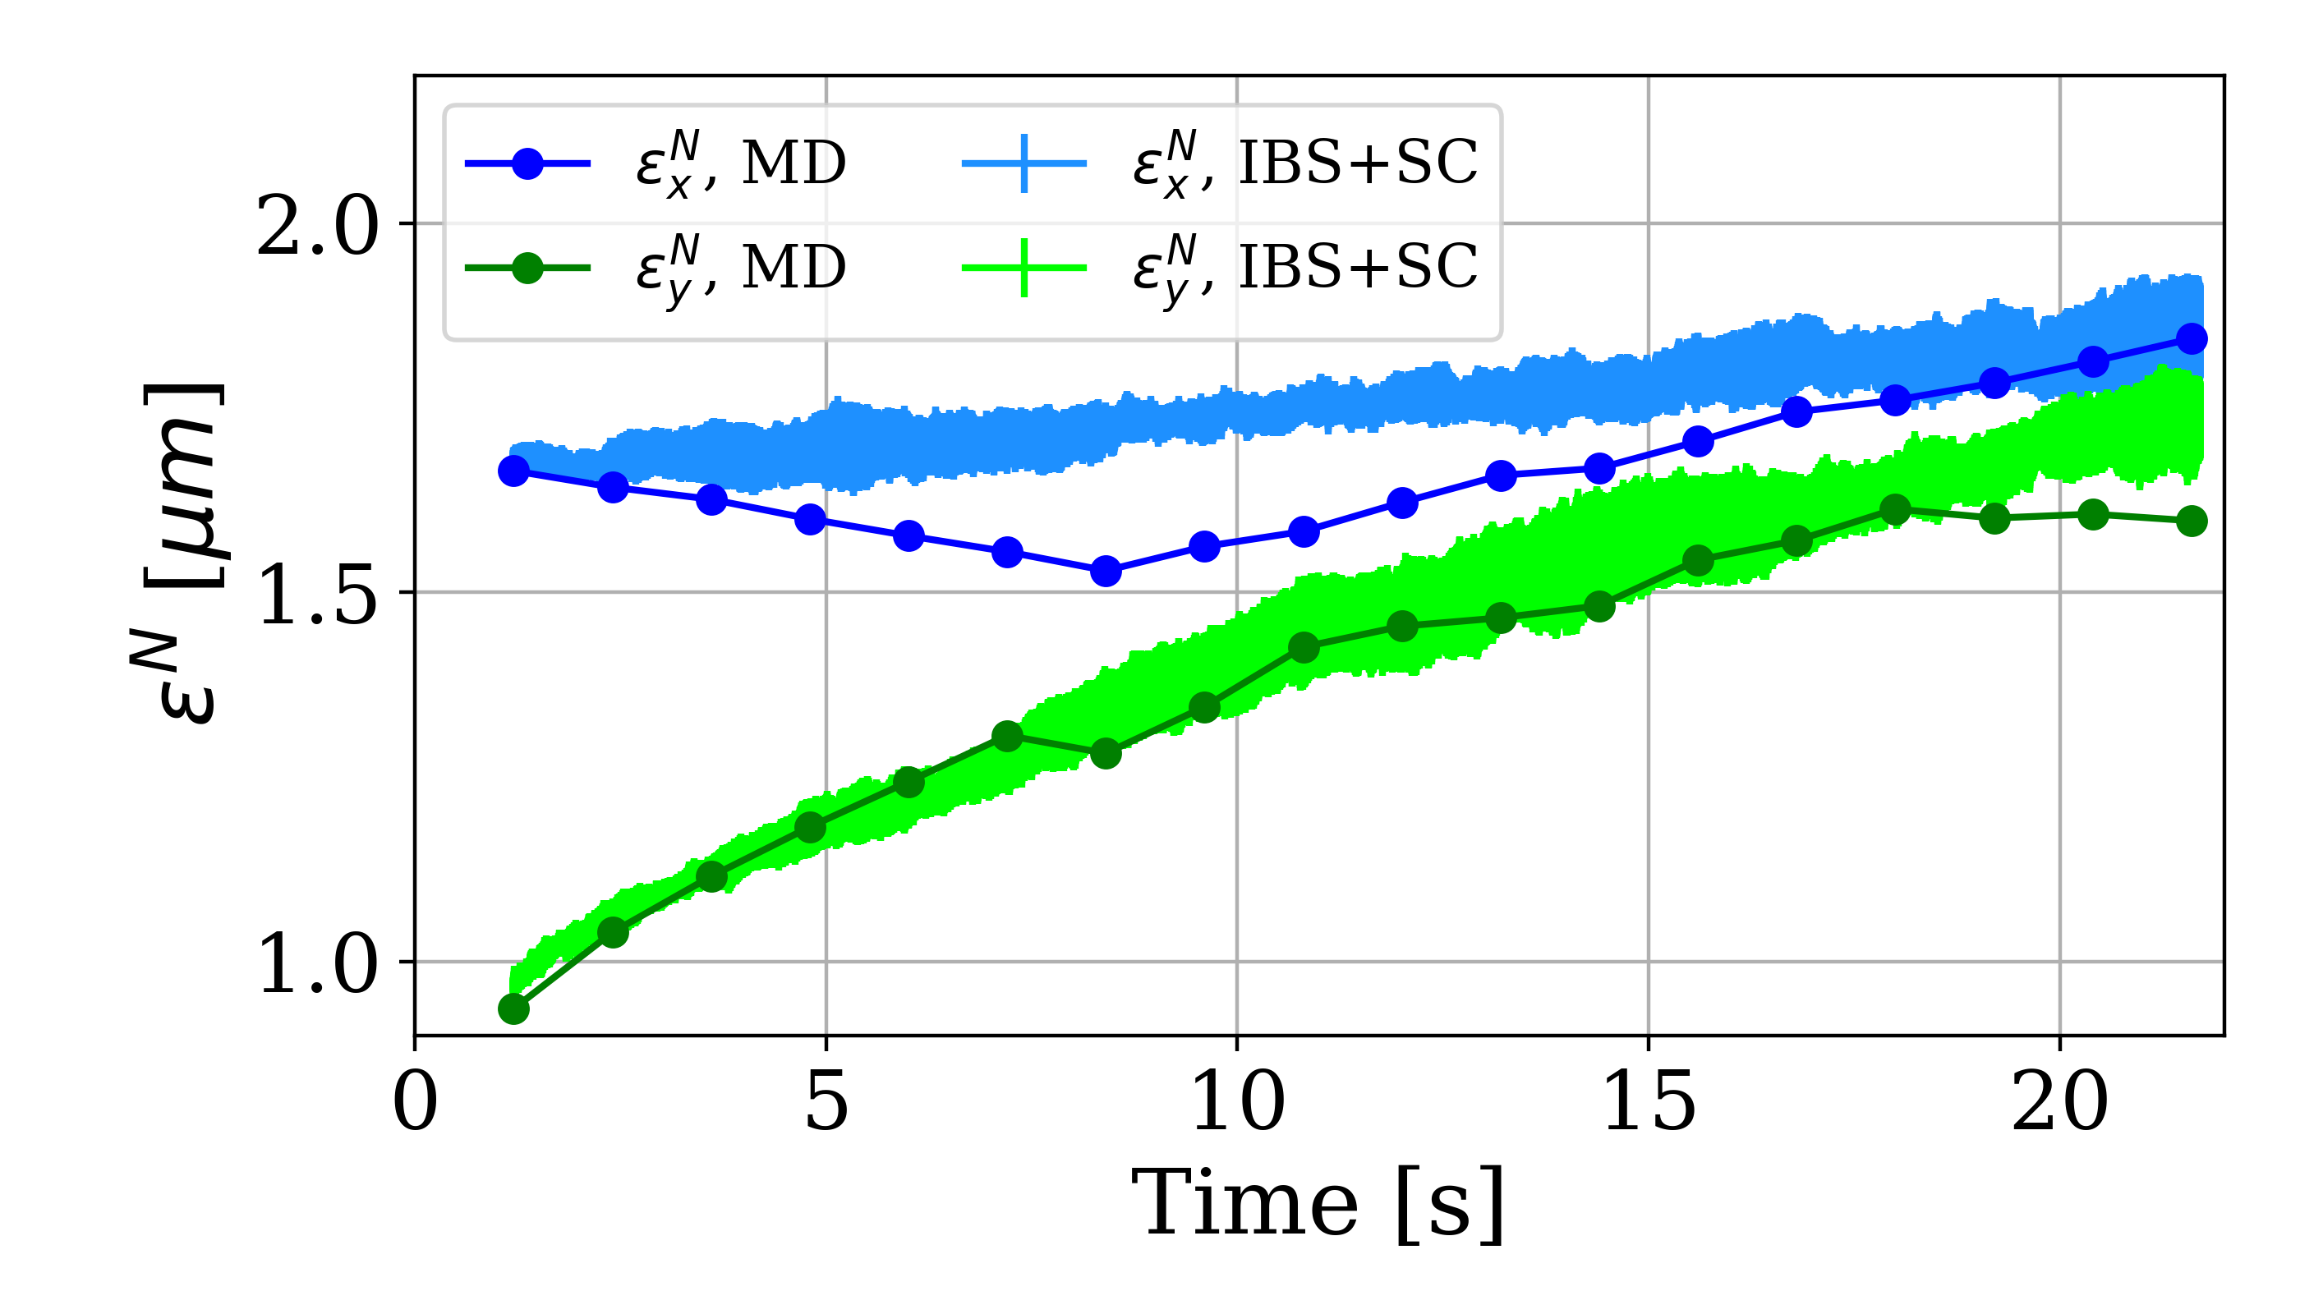
Case 1: SPS MD of 2016
I. John
Observations in operational conditions:
Emittance exchange between horizontal and vertical planes
Large emittance blow-up in both planes
Cannot be explained by standalone space charge or IBS simulations, nor from the sum of them!
Combined simulations were performed to investigate the interplay of space charge and IBS
Quadrupolar error included to induce a 5-10% beta-beating, observed operationally

Slide 29
Case 2: Low intensity studies in LEIR (1/3)
A. Saa Hernandez, “IBS Studies – LEIR”, SCWG meeting
Low intensity studies showed that the vertical emittance evolution could not be explained only by IBS.
Tracking simulations with IBS and space charge were performed: Investigation of the interplay between the two effects close to excited resonances

Slide 30
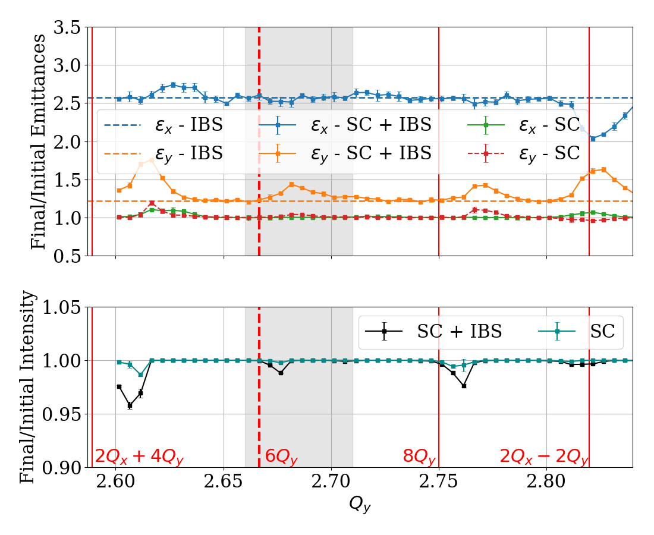
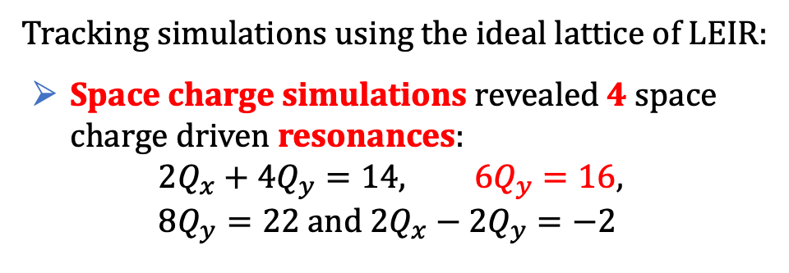
Case 2: Low intensity studies in LEIR (2/3)
Tracking simulations using the ideal lattice of LEIR:
Space charge simulations revealed 4 space charge driven resonances:
$$2Q_{x}+4Q_{y}=14, 6Q_{y}=16, 8Q_{y}=22 and 2Q_{x}−2Q_{y}=−2$$

Slide 31
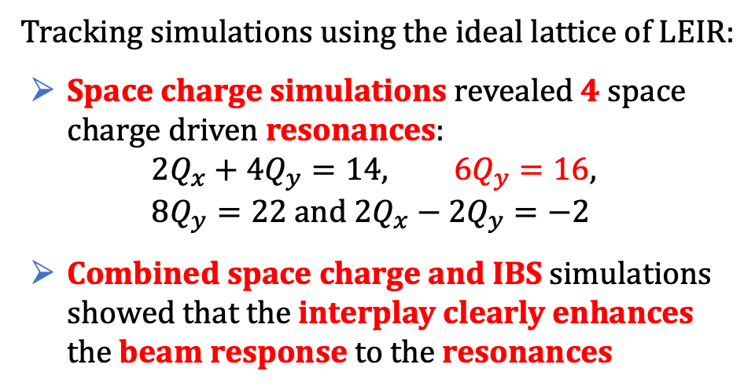
Case 2: Low intensity studies in LEIR (2/3)
Tracking simulations using the ideal lattice of LEIR:
Space charge simulations revealed 4 space charge driven resonances:
$$2Q_{x}+4Q_{y}=14, 6Q_{y}=16, 8Q_{y}=22 and 2Q_{x}−2Q_{y}=−2$$
Combined space charge and IBS simulations showed that the interplay clearly enhances the beam response to the resonances

Slide 32
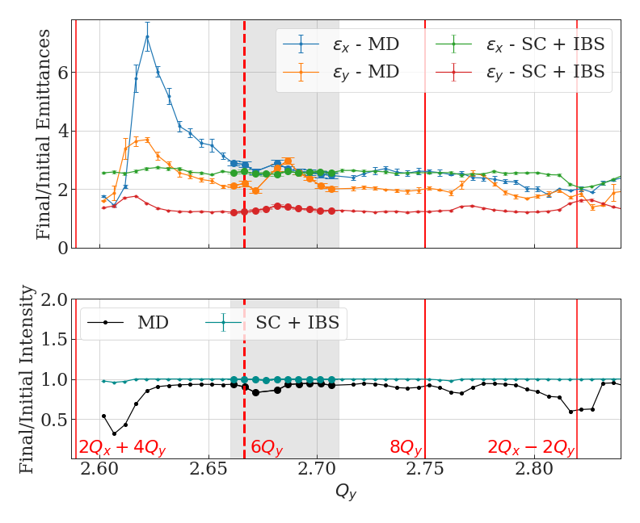
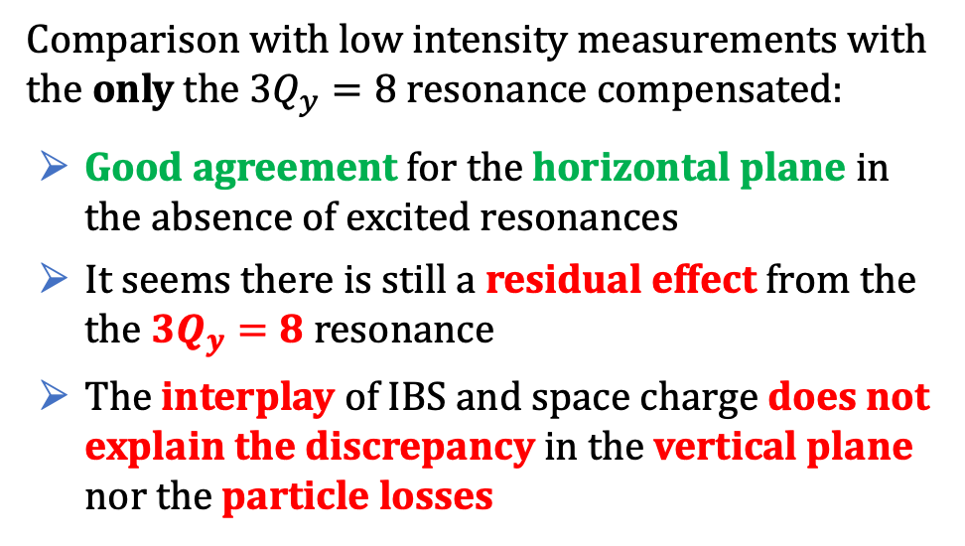
Case 2: Low intensity studies in LEIR (3/3)
Comparison with low intensity measurements with the only the $3Q_{y}=8$ resonance compensated:
Good agreement for the horizontal plane in the absence of excited resonances
It seems there is still a residual effect from the the $3Q_{y}=8$ resonance
The interplay of IBS and space charge does not explain the discrepancy in the vertical plane nor the particle losses

Slide 33
Outline
Introduction
Motivation
Tool implementation
CLIC Damping Rings
The CLIC Complex
SC, IBS and SR Interplay Studies
LHC Ion Injectors Interplay Studies
SPS
LEIR
Summary and Future Work

Slide 34
Summary and Future Work
A Simple IBS kick and a Kinetic Theory kick are implemented in PyORBIT/Xsuite for above and below transition machines. Agreement with analytical calculations
CLIC DRs:
Interplay simulations of SC and IBS for the CLIC DRs showed enhanced particle diffusion in the presence of an excited resonance. SR seems to compensate these effects
Similar studies for different errors are currently ongoing
SPS:
Combined simulation could explain for the first time the experimental observations from 2016, revealing the importance of the interplay between space charge and IBS effects
Further simulations and measurements planned to take all the effects self-consistently into account to further improve this benchmarking
LEIR:
The interplay of IBS and space charge: Clearly enhances the particles' response to the resonances but it cannot explain the generally larger vertical emittance blow-up observed in the machine
Better modelling needs to be developed to include the same resonance components for both measurements and simulations
Thank you!!!

Slide 35
Backup Slides

Slide 36
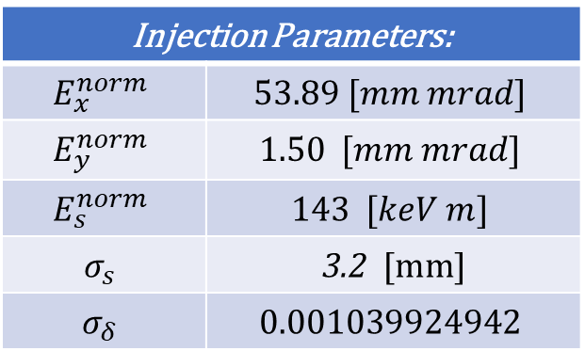
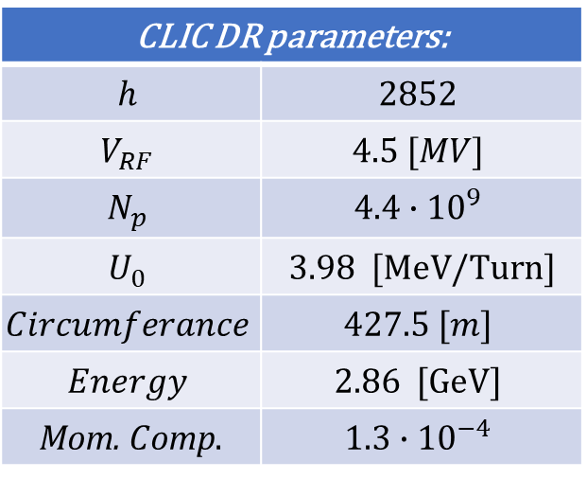
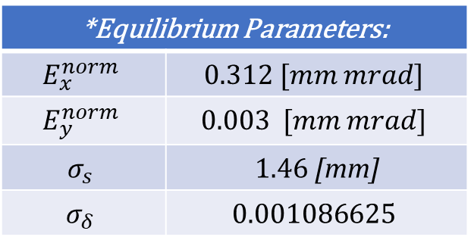
CLIC DRs Parameters
CLIC DR parameters:
$$h$$ | $$2852$$
$$V_{RF}$$ | $$4.5 [MV]$$
$$N_{p}$$ | $$4.4∙{10}^{9}$$
$$U_{0}$$ | $\text{3}\text{.98 [}\text{MeV}\text{/}\text{Turn}\text{]}$
$$Circumferance$$ | $$427.5 [m]$$
$$Energy$$ | $$\text{2.86 [}\text{GeV}\text{]}$$
$\text{Mom}\text{. }C\text{omp}$. | $$1.3∙{10}^{−4}$$
Injection Parameters:
$$E_{x}^{norm}$$ | $$53.89 [mm mrad]$$
$$E_{y}^{norm}$$ | $$1.50 [mm mrad]$$
$$E_{s}^{norm}$$ | $$143 [keV m]$$
$$σ_{s}$$ | $\text{3}\text{.2}\text{ [}\text{mm}\text{]}$
$$σ_{δ}$$ | $$0.001039924942$$
*Equilibrium Parameters:
$$E_{x}^{norm}$$ | $$0.312 [mm mrad]$$
$$E_{y}^{norm}$$ | $$0.003 [mm mrad]$$
$$σ_{s}$$ | $\text{1.46} \text{[}\text{mm}\text{]}$
$$σ_{δ}$$ | $$\text{0.00}\text{1086625}$$
*Only because of SR and QE

Slide 37
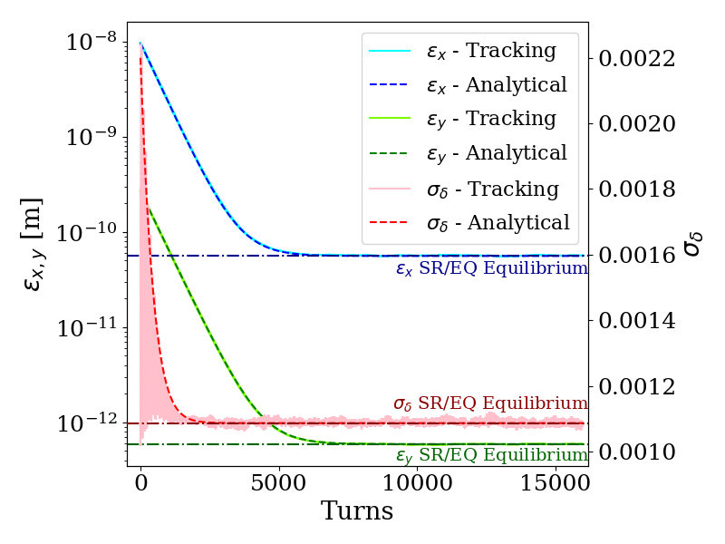

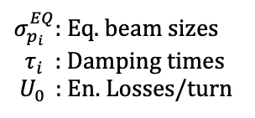
Synchrotron Radiation Implementation
*PyHEADTAIL
Having evaluated the damping times from the radiation integrals, the following kicks are applied in our tracking code:
For the transverse planes:
$$p_{i}^{n+1}=p_{i}^{n}−\frac{2p_{i}^{n}}{τ_{i}}+2σ_{p_{i}}^{EQ}\sqrt{\frac{1}{τ_{i}}}∙Random$$
For the longitudinal plane:
$$p_{z}^{n+1}=p_{z}^{n}−\frac{2p_{z}^{n}}{τ_{z}}+2σ_{p_{z}}^{EQ}\sqrt{\frac{1}{τ_{z}}}∙Random − \frac{U_{0}}{E_{tot}β_{rel}^{2}}$$
$σ_{p_{i}}^{EQ}$: Eq. beam sizes
$τ_{i}$ : Damping times
$U_{0 }$ : En. Losses/turn

Slide 38
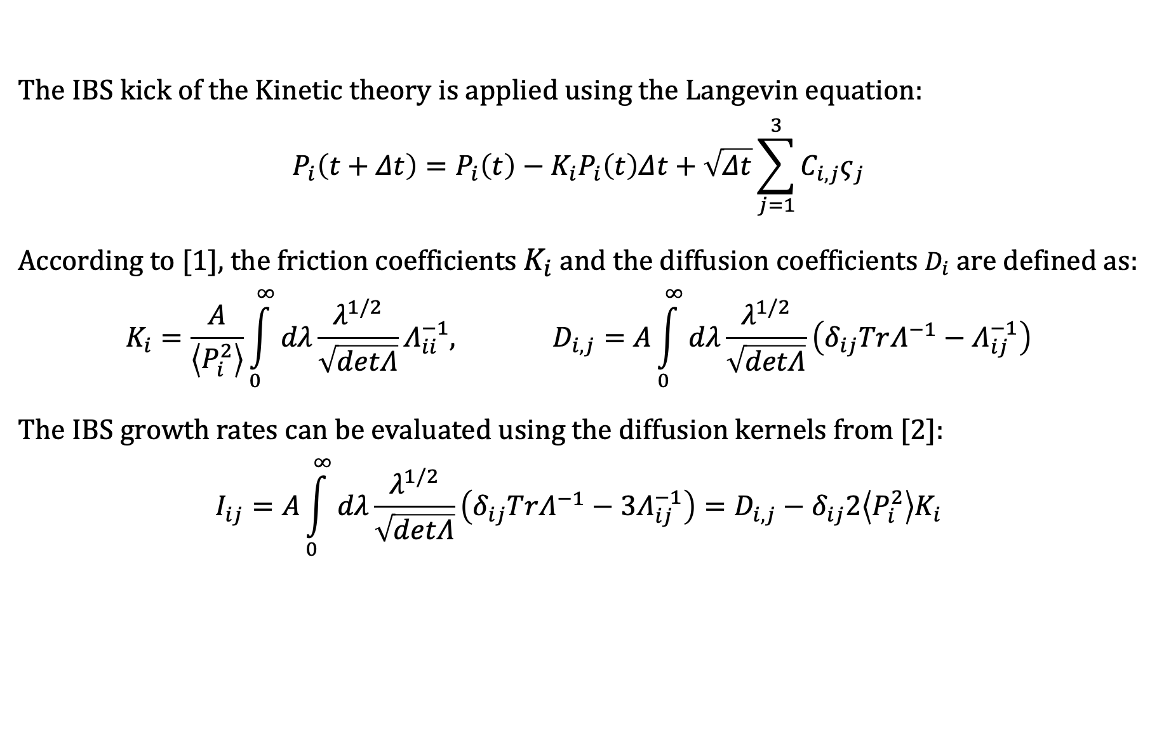

Kinetic theory IBS kick
The IBS kick of the Kinetic theory is applied using the Langevin equation:
$$P_{i}\left(t+Δt\right)=P_{i}\left(t\right)−K_{i}P_{i}\left(t\right)Δt+\sqrt{Δt}\sum_{j=1}^{3}{C_{i,j}ς_{j}}$$
According to [1], the friction coefficients $K_{i}$ and the diffusion coefficients $D_{i}$ are defined as:
$$K_{i}=\frac{A}{\left\langle P_{i}^{2}\right\rangle }\int_{0}^{∞}{dλ}\frac{λ^{1/2}}{\sqrt{detΛ}}Λ_{ii}^{−1}, D_{i,j}=A\int_{0}^{∞}{dλ}\frac{λ^{1/2}}{\sqrt{detΛ}}\left(δ_{ij}TrΛ^{−1}−Λ_{ij}^{−1}\right)$$
The IBS growth rates can be evaluated using the diffusion kernels from [2]:
$$I_{ij}=A\int_{0}^{∞}{dλ}\frac{λ^{1/2}}{\sqrt{detΛ}}\left(δ_{ij}TrΛ^{−1}−{3Λ}_{ij}^{−1}\right)=D_{i,j}−δ_{ij}2\left\langle P_{i}^{2}\right\rangle K_{i}$$
$$C_{ }:function of D$$
$$ς_{ }:Random num.$$
$$i=x,y,z$$
Λ : function of the optics and beam parameters
[1] P. Zenkevich, O. Boine-Frankenheim, A. Bolshakov
[2] J. Bjorken and S. Mtingwa, Part. Accel. 13, 115

Slide 39

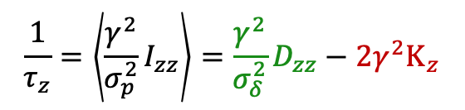
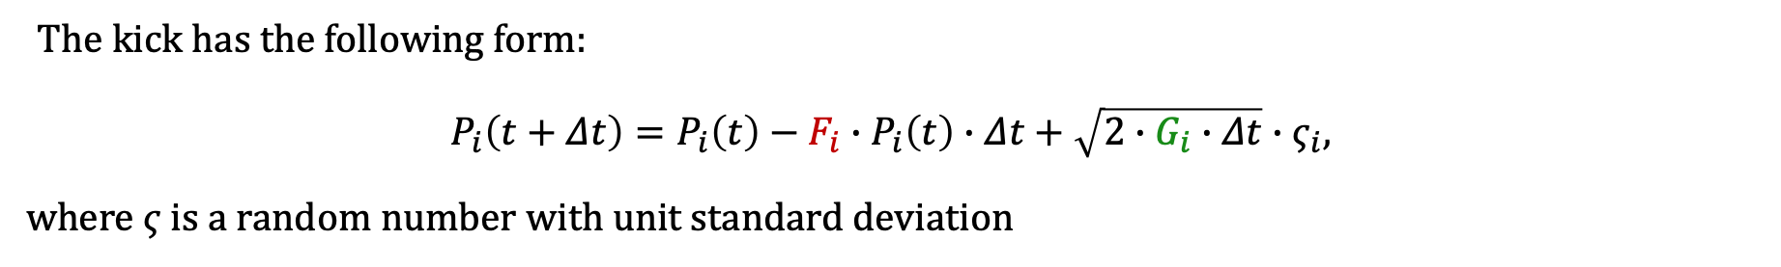

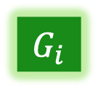
Kinetic theory IBS kick
Substitute the integrals of the growth rates using the relation: $I_{ij}=D_{i,j}−δ_{ij}2\left\langle P_{i}^{2}\right\rangle K_{i}$
$$\frac{1}{τ_{x}}=\left\langle \frac{β_{x}}{ε_{x}}I_{xx}−2γ\frac{β_{x}Φ_{x}}{ε_{x}}I_{xz}+γ_{ }^{2}\frac{Η_{x}}{ε_{x}}I_{zz}\right\rangle =\frac{β_{x}}{ε_{x}}D_{xx}−2γ\frac{β_{x}Φ_{x}}{ε_{x}}D_{xz}+γ_{ }^{2}\frac{Η_{x}}{ε_{x}}D_{zz}−\left(2K_{x}+2γ_{ }^{2}\frac{Η_{x}}{ε_{x}}σ_{δ}^{2}K_{z}\right)$$
$$\frac{1}{τ_{y}}=\left\langle \frac{β_{y}}{ε_{y}}I_{yy}−2γ\frac{β_{y}Φ_{y}}{ε_{y}}I_{yz}+γ_{ }^{2}\frac{Η_{y}}{ε_{y}}I_{zz}\right\rangle =\frac{β_{y}}{ε_{y}}D_{yy}−2γ\frac{β_{y}Φ_{y}}{ε_{y}}D_{yz}+γ_{ }^{2}\frac{Η_{y}}{ε_{y}}D_{zz}−\left(2K_{y}+2γ_{ }^{2}\frac{Η_{y}}{ε_{y}}σ_{δ}^{2}K_{z}\right)$$
$$\frac{1}{τ_{z}}=\left\langle \frac{γ^{2}}{σ_{p}^{2}}I_{zz}\right\rangle =\frac{γ^{2}}{σ_{δ}^{2}}D_{zz}−2γ_{ }^{2}Κ_{z}$$
$$G_{i}$$
$$F_{i}$$
The kick has the following form:
$$P_{i}\left(t+Δt\right)=P_{i}\left(t\right)−F_{i}∙P_{i}\left(t\right)∙Δt+\sqrt{2∙G_{i}∙Δt}∙ς_{i},$$
where $ς$ is a random number with unit standard deviation
$$i=x,y,z$$
[1] P. Zenkevich, O. Boine-Frankenheim, A. Bolshakov
[2] J. Bjorken and S. Mtingwa, Part. Accel. 13, 115

Slide 40
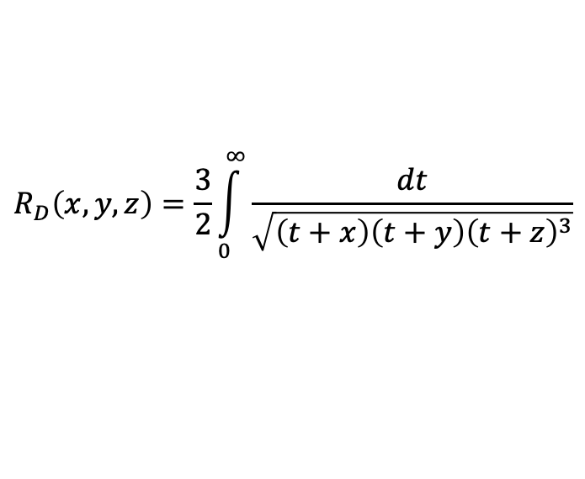
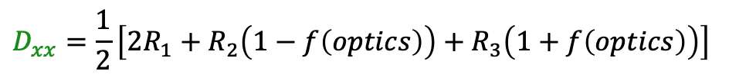
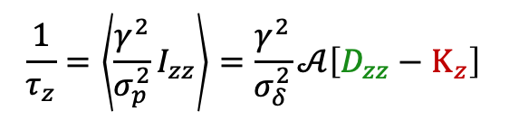
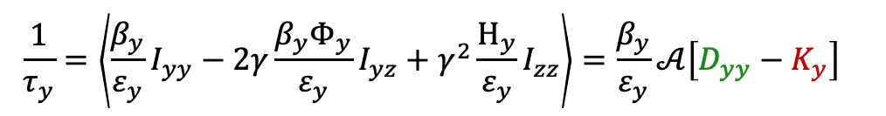
Kinetic theory IBS kick - Nagaitsev
Similarly, using Nagaitsev’s formalism with elliptic integrals:
$$\frac{1}{τ_{x}}=\left\langle \frac{β_{x}}{ε_{x}}I_{xx}−2γ\frac{β_{x}Φ_{x}}{ε_{x}}I_{xz}+γ_{ }^{2}\frac{Η_{x}}{ε_{x}}I_{zz}\right\rangle =\frac{β_{x}}{ε_{x}}𝒜\left[\left[D_{xx}+\left(\frac{d_{x}^{2}}{β_{x}}+Φ_{x}^{2}\right)D_{zz}+D_{xz}\right]−\left[K_{x}+\left(\frac{d_{x}^{2}}{β_{x}}+Φ_{x}^{2}\right)K_{z}\right]\right]$$
$$\frac{1}{τ_{y}}=\left\langle \frac{β_{y}}{ε_{y}}I_{yy}−2γ\frac{β_{y}Φ_{y}}{ε_{y}}I_{yz}+γ_{ }^{2}\frac{Η_{y}}{ε_{y}}I_{zz}\right\rangle =\frac{β_{y}}{ε_{y}}𝒜\left[D_{yy}−K_{y}\right]$$
*Vertical dispersion ignored
$$\frac{1}{τ_{z}}=\left\langle \frac{γ^{2}}{σ_{p}^{2}}I_{zz}\right\rangle =\frac{γ^{2}}{σ_{δ}^{2}}𝒜\left[D_{zz}−Κ_{z}\right]$$
$$G_{i}$$
$$F_{i}$$
Diffusion and Friction coefficients are expressed through elliptic integrals:
$$R_{D}\left(x,y,z\right)=\frac{3}{2}\int_{0}^{∞}{\frac{dt}{\sqrt{\left(t+x\right)\left(t+y\right){\left(t+z\right)}^{3}}}}$$
*Backup slides for all coefficients
For example:
$$D_{xx}=\frac{1}{2}\left[2R_{1}+R_{2}\left(1−f\left(optics\right)\right)+R_{3}\left(1+f\left(optics\right)\right)\right]$$
$$K_{x}=\left[R_{2}\left(1+f\left(optics\right)\right)+R_{3}\left(1−f\left(optics\right)\right)\right]$$
$∗R_{1}=\frac{1}{λ_{1}}R_{D}\left(\frac{1}{λ_{2}},\frac{1}{λ_{3}},\frac{1}{λ_{1}}\right)$, $λ_{i}$ are the eigenvalues of the Λ matrix
S.Nagaitsev, “Intrabeam scattering formulas for fast numerical evaluation”
A. E. Bolshakov, P. R. Zenkevich, “Numerical modelling … of invariants”

Slide 41

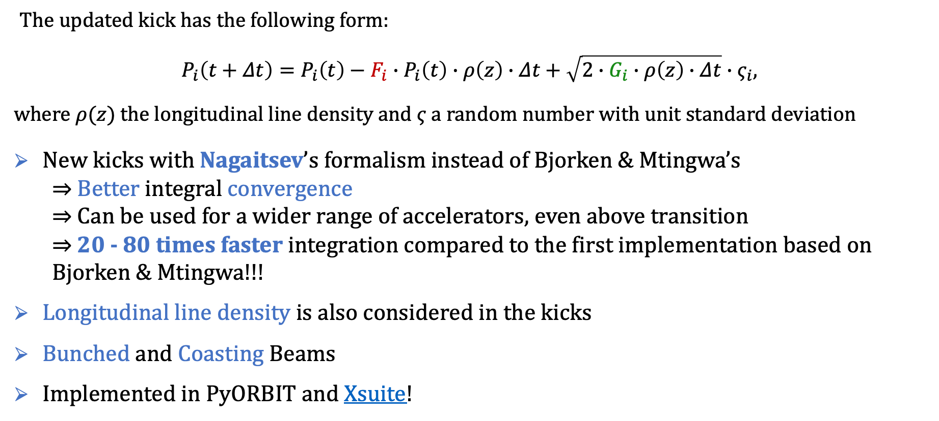
Kinetic theory IBS kick - Updates
The updated kick has the following form:
$$P_{i}\left(t+Δt\right)=P_{i}\left(t\right)−F_{i}∙P_{i}\left(t\right)∙ρ\left(z\right)∙Δt+\sqrt{2∙G_{i}∙ρ\left(z\right)∙Δt}∙ς_{i},$$
where $ρ(z)$ the longitudinal line density and $ς$ a random number with unit standard deviation
New kicks with Nagaitsev’s formalism instead of Bjorken & Mtingwa’s
⇒ Better integral convergence
⇒ Can be used for a wider range of accelerators, even above transition
⇒ 20 - 80 times faster integration compared to the first implementation based on Bjorken & Mtingwa!!!
Longitudinal line density is also considered in the kicks
Bunched and Coasting Beams
Implemented in PyORBIT and Xsuite!
$$i=x,y,z$$

Slide 42
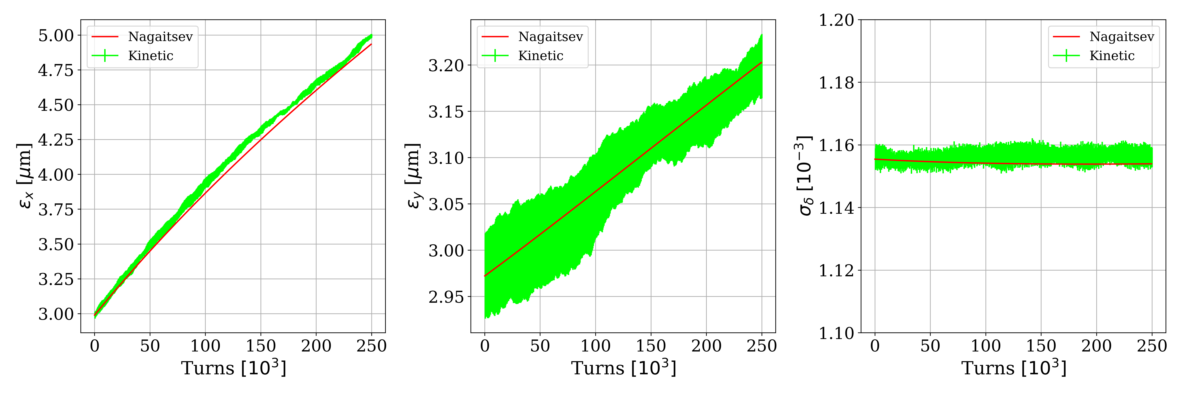

Kinetic IBS kick benchmarking – LEIR
Kinetic IBS kick for LEIR
Bunched (top) and Coasting beam (bottom)
Tracking with kinetic averaged over 3 runs
Very good agreement with analytical calculations

Slide 43

Kinetic IBS kick benchmarking – SPS
~2%
Kinetic IBS kick for SPS in PyORBIT
Tracking with kinetic averaged over 3 runs
Very good agreement with analytical calculations

Slide 44

Kinetic IBS kick benchmarking – CLIC DRs
With the newest implementation, works perfectly even for the CLIC DRs!
Above transition: Diffusion kick is dominant

