Slide 1





Alice Grieco
Department of Crystallography and Structural Biology
Institute of Physical Chemistry Rocasolano, CSIC
agrieco@iqfr.csic.es
AUSE and ALBA Users’ meeting 2022
6th September 2022
Towards deciphering Catalytic Mechanisms by Time-Resolved Serial Femtosecond Crystallography at XFELs

Slide 2
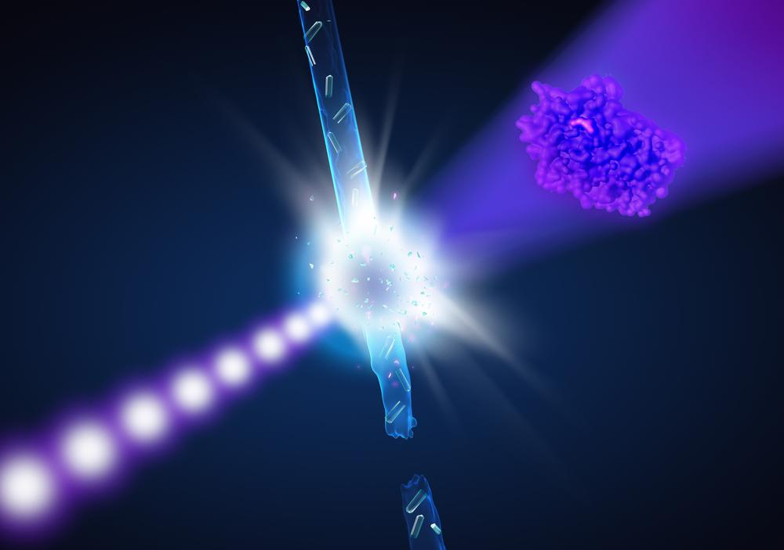
1. Introduction
What’s an XFEL?
Serial Femtosecond Crystallography
Structural Dynamics
2. Project 1:
Toward decihering the Catalytic mechanism of human NQO1
3. Project 2:
Toward revealingthe unique allosteric resistance mechanism of PBP2a of Staphylococcus aureus
4. Conclusions

Slide 3
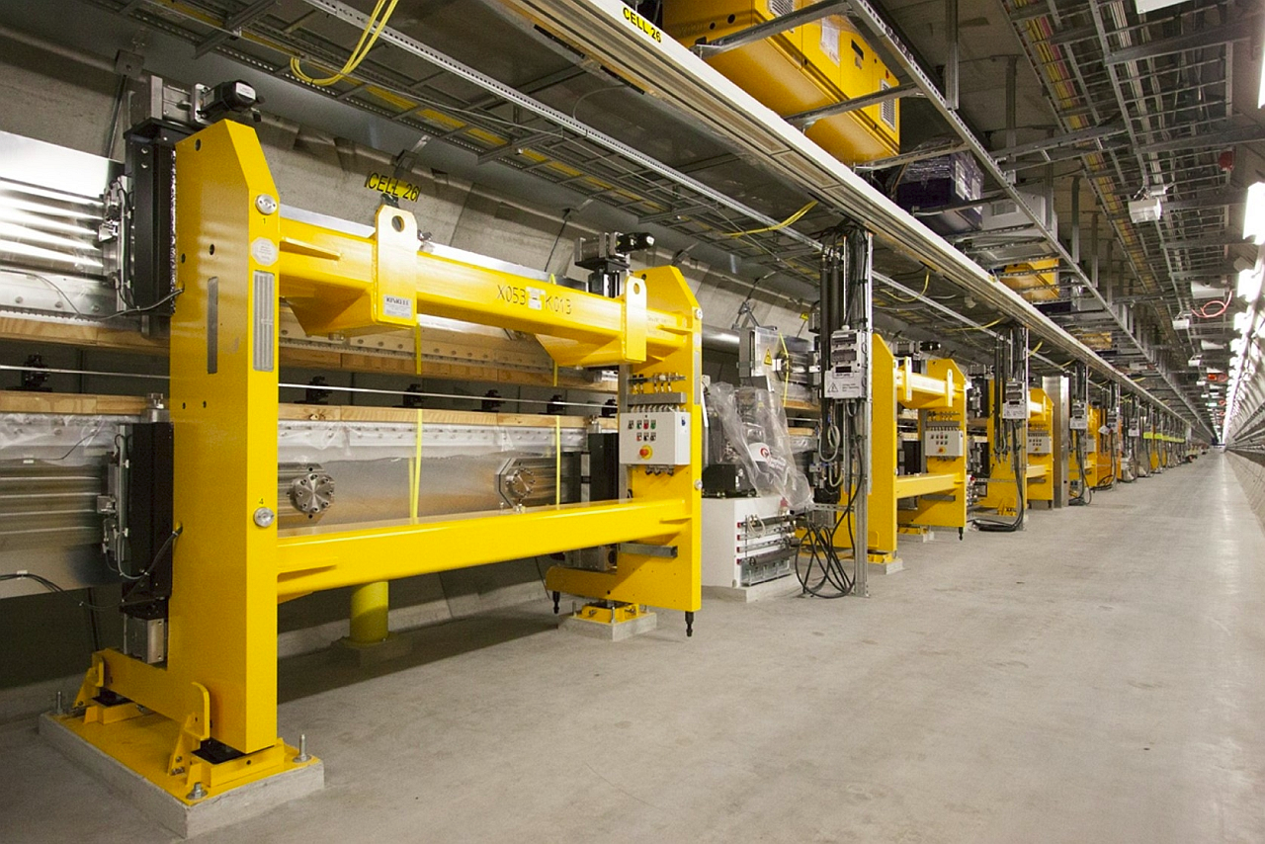
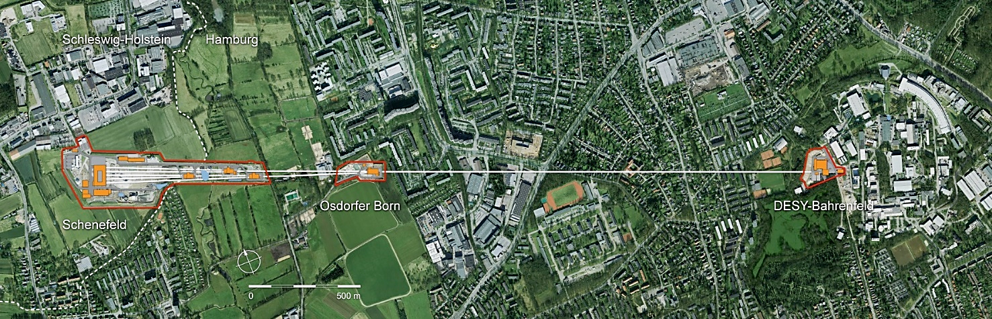

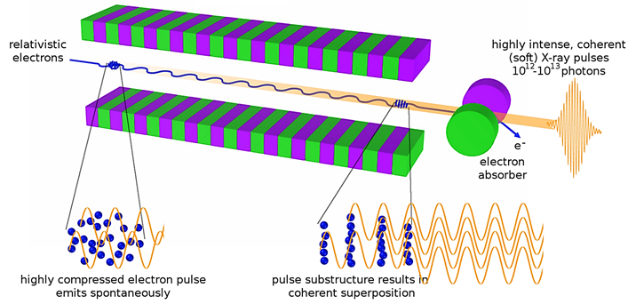
Injector at
DESY campus
Ondulator hall
Linear accelerators ~ 3Km.
Extremely bright X-ray pulses
Ultra-coherent X-rays.
Ultra-short duration (a few fs to 100 fs).

Slide 4
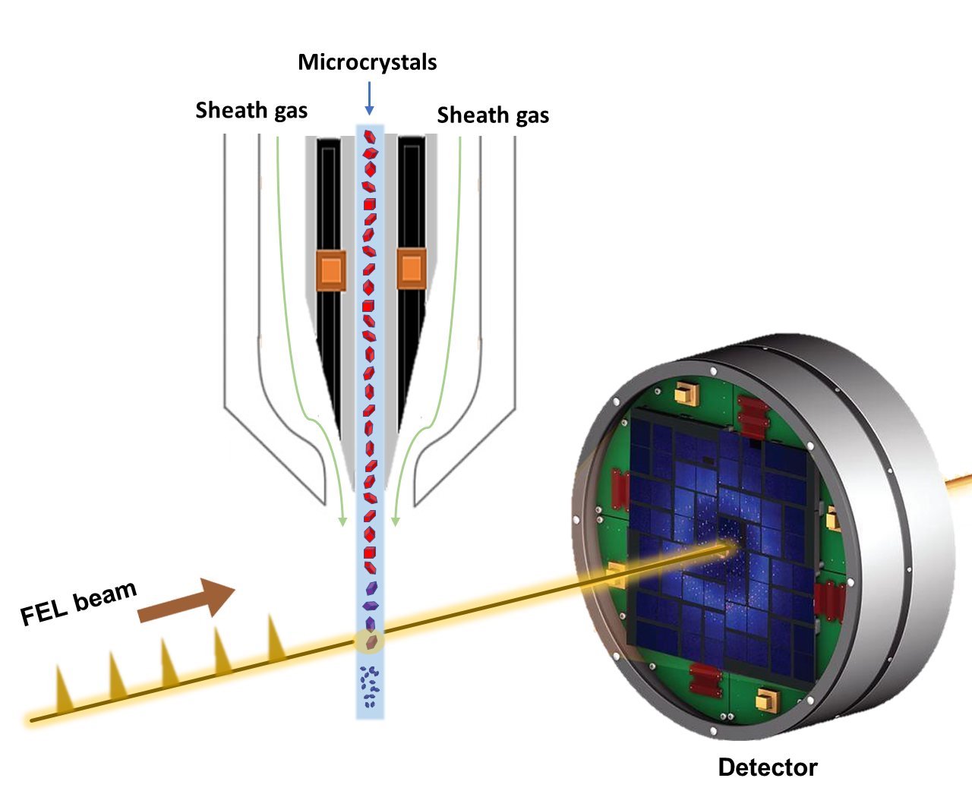
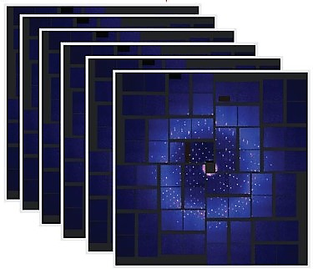
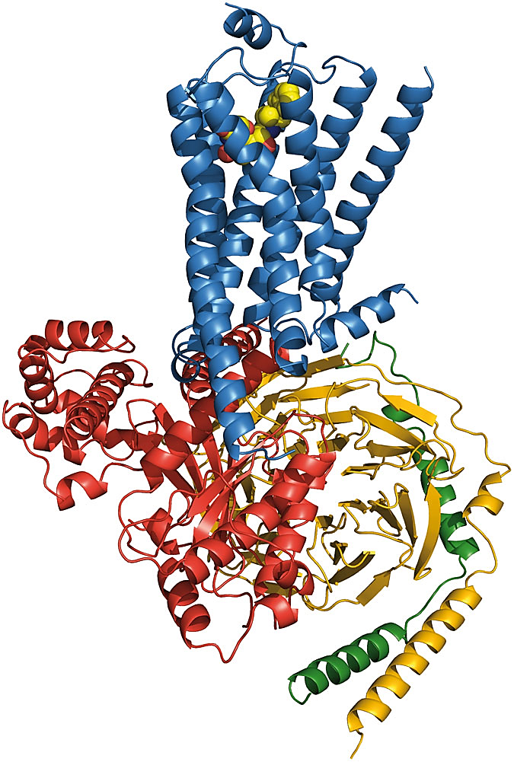
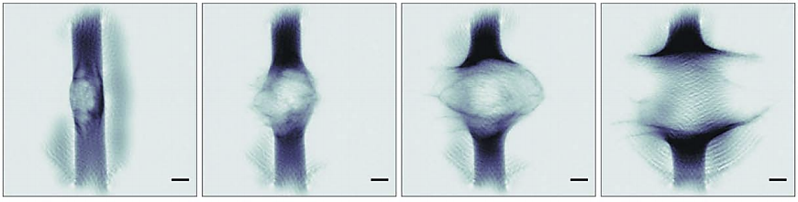
Serial Femtosecond Crystallography (SFX)
Nano/micro-crystals delivered in a serial fashion in random orientations.
Hundred thousands of snapshots.
SFX relies on the diffraction before destruction principle.
Hagemann J. et al., JSR 2020
Figure adapted from Fromme P. et al., JSR 2020
One diffraction pattern per crystal per X-ray pulse.

Slide 5
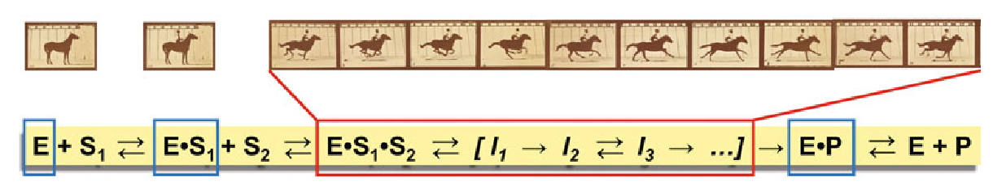
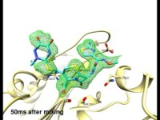
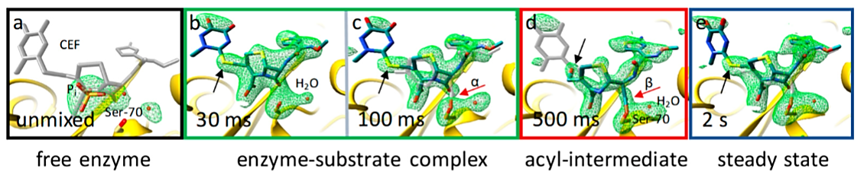
Protein Dynamics with XFELs
In 19th Century: Race-horse first film ever by Edward Muybridge (1878)
Aller et al., 2021
Traditional MX @ synchrotrons:
macro-crystals, 100K, E, E•S₁, E•P; lacks function and dynamics
SFX @ XFEL:
Study entire reaction cycles at room temperature and pressure,
No radiation-induced damage,
time resolution of fs
In 21st Century: Catalytic reaction of β-lactamase C with a β-lactam antibiotic
Olmos JL, et al. BMC Biology 2018
(1)
(2)
(3)

Slide 6
1. Introduction
2. Project 1:
Toward decihering the Catalytic mechanism of human NQO1
3. Project 2:
Toward revealingthe unique allosteric resistance mechanism of PBP2a of Staphylococcus aureus
4. Conclusions

Slide 7
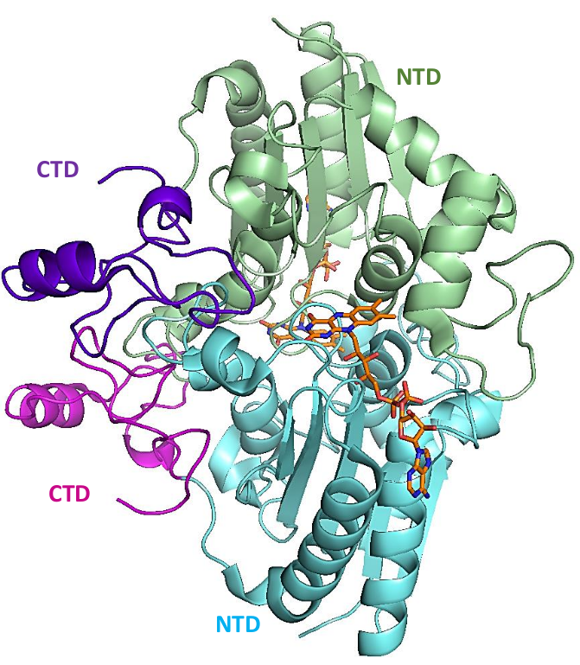
Human NQO1 Protein
NQO1 is a flavoenzyme that displays multiple enzymatic and non-enzymatic functions:
Detoxification
Quinone metabolism
Vitamin K metabolism
Proteasomanal regulation
“Chaperone” function
Activity associated with different pathologies including cancer and cardiovascular and neurodegenerative diseases.
NQO1 forms functional homodimers in which each monomer has a two-domain structure.
Catalysis proceeds via a substituted enzyme mechanism involving a tightly bound FAD cofactor.
Anoz-Carbonell et al. 2020.

Slide 8
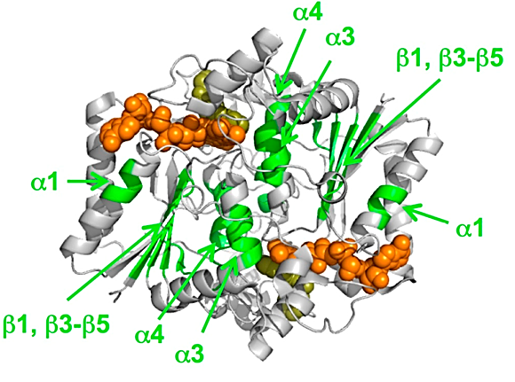
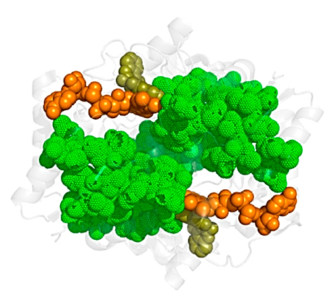
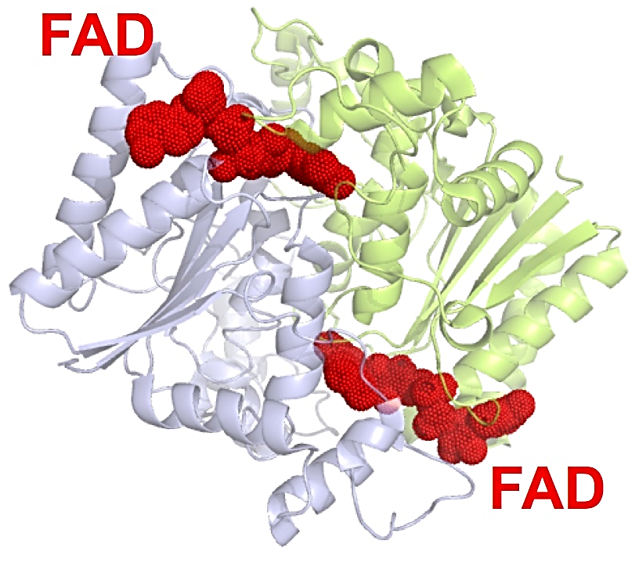
Negative Cooperativity
Pey et al., 2017
NQO1 has a dynamic core that controls the functional and stability effects of ligand binding and their communication across the enzyme dimer.
Negative cooperativity effects suggested to occur in NQO1 by the fact that the two binding sites are not equivalent, showing different binding affinities.

Slide 9
Aim of the project
Using TR-SFX experiments, we are aiming at determining the structure of all intermediates that form during the catalytic mechanism of NQO1 by collecting a series of data sets at time points between 10ms and 2s after mixing the microcrystals with NADH.

Slide 10
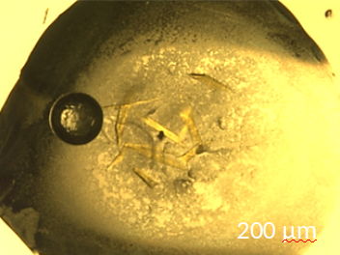
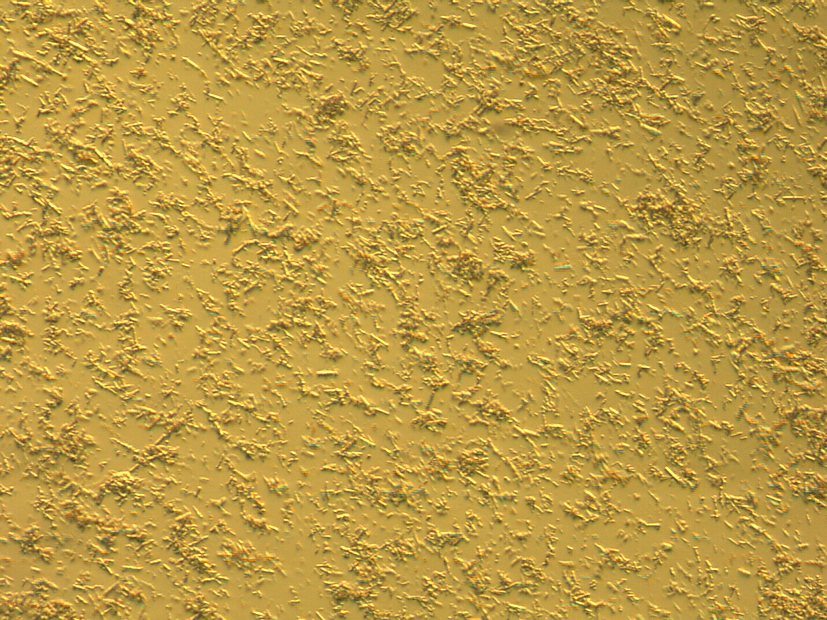
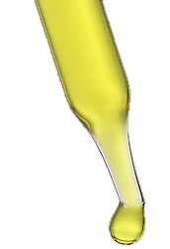
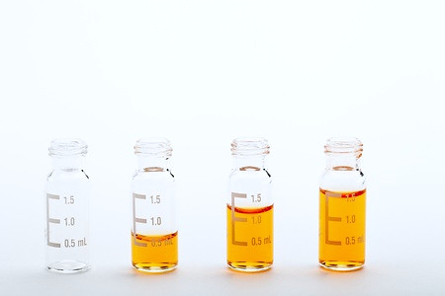
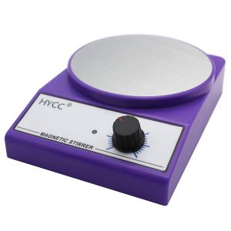
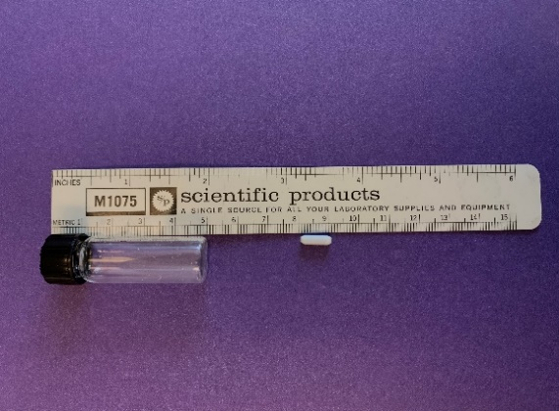
Crystallization of Human NQO1
20 µm
Protein
Glass vial
Magnetic
bar
Precipitant
Stir plate
Microcrystals of NQO1 were optimized using the batch method with continuous agitation
[0.1 M Tris pH 8.5, 0.2 M sodium acetate, 25% PEG 3350.]
Doppler et al., Manuscrit in prepatation

Slide 11
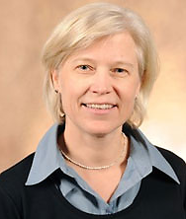
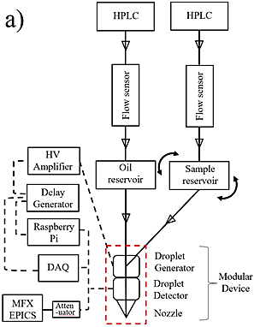
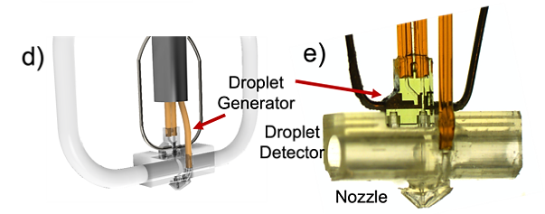
Initial SFX experiment using a Microfluidic Device
Alexandra Ros (ASU)
Simple set-up with 2 inlets
Minimize flow rates for crystal suspension (down to 0.1 µL/min possible)
Sub-nL droplet volumes
Additional bonus: less clogging
LCLS
LW79
LEGO device schematics and picture of assembled LEGO device

Slide 12
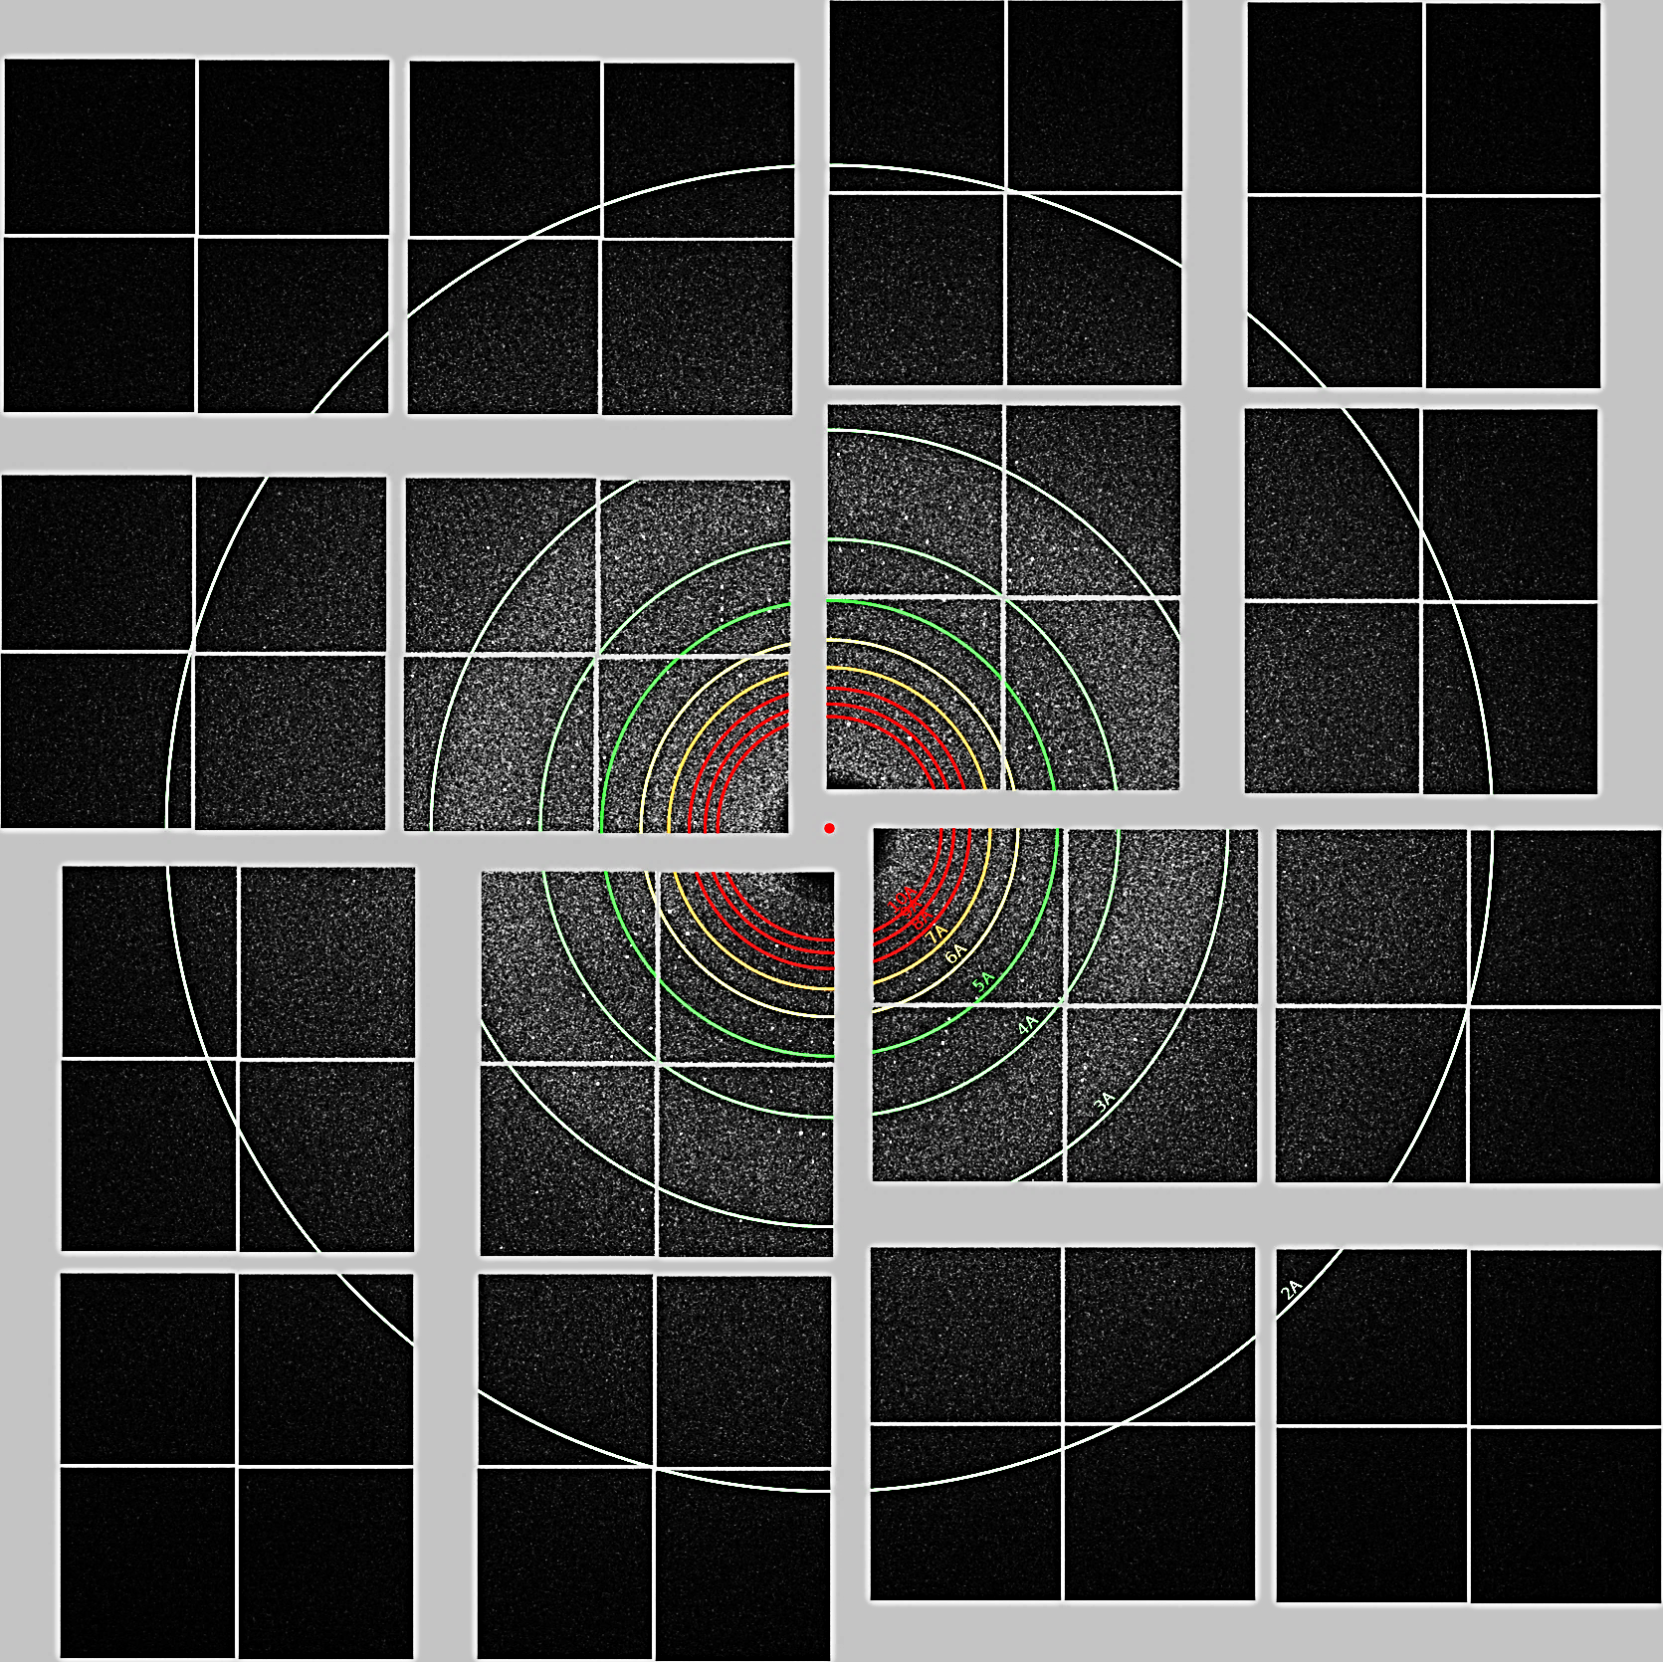
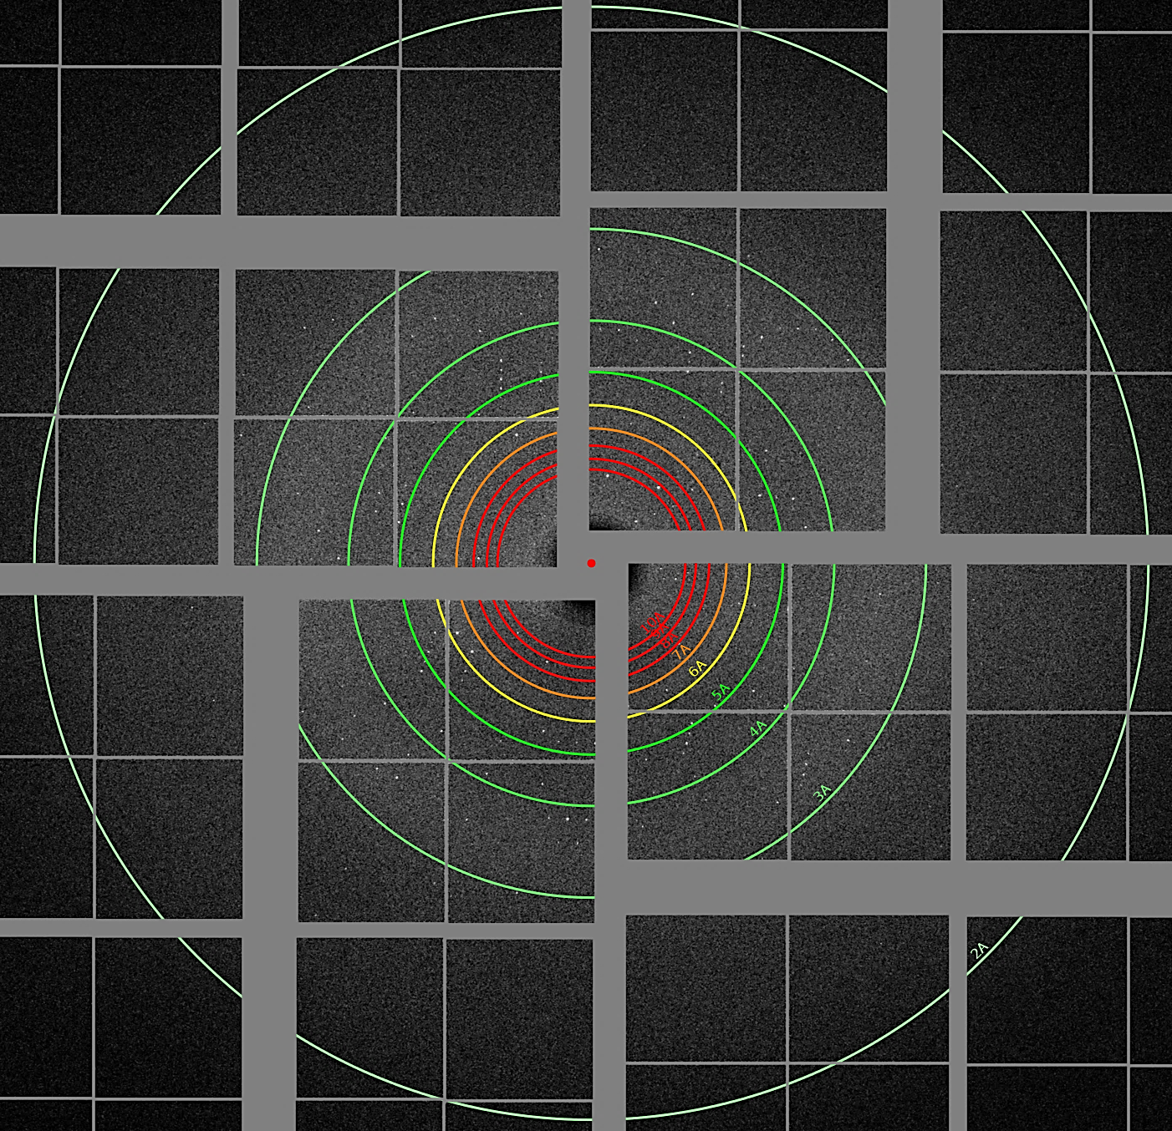
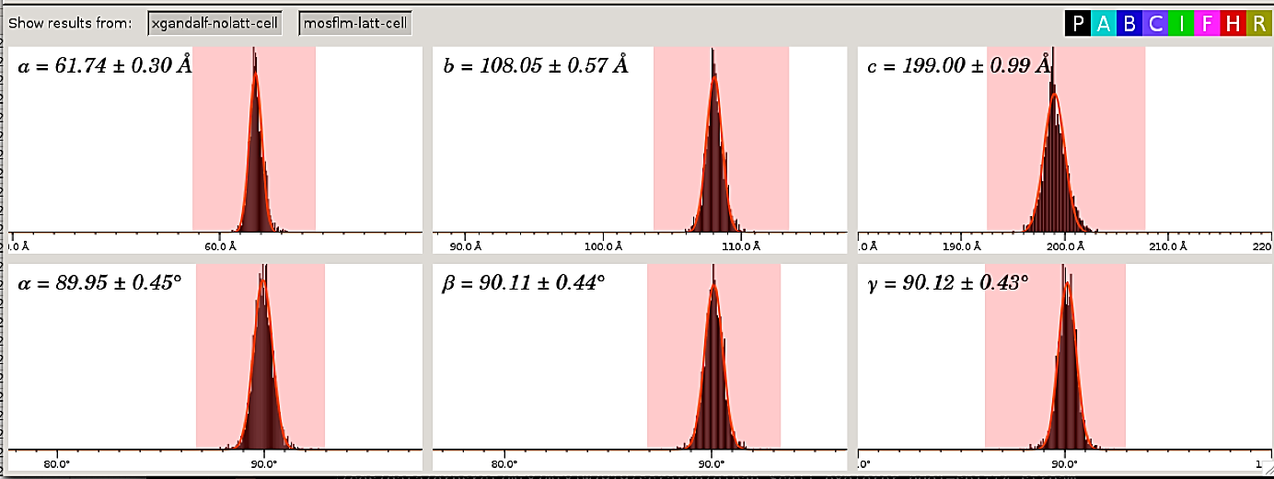
479,075 collected
17,734 successfully indexed, integrated and merged into a P2 1 2 1 2 1 space group
unit cell parameters
a=62, b=108, c=200, α=β=γ=90°

Slide 13
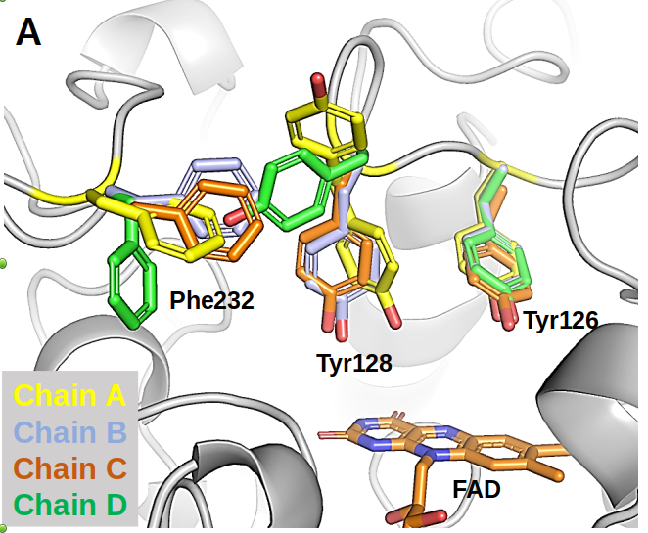
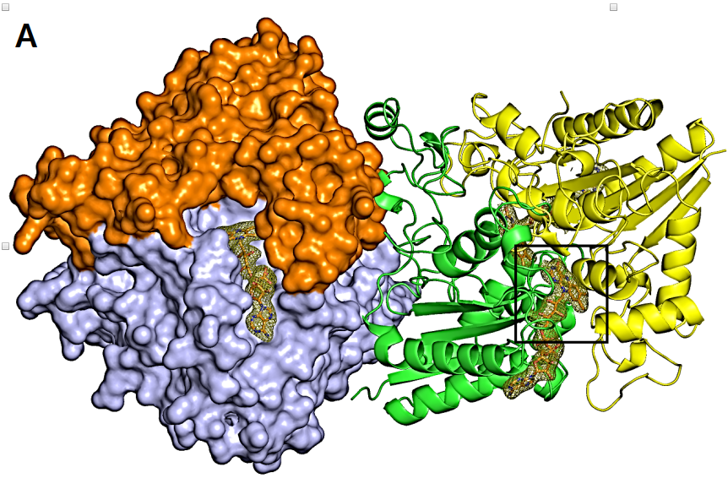
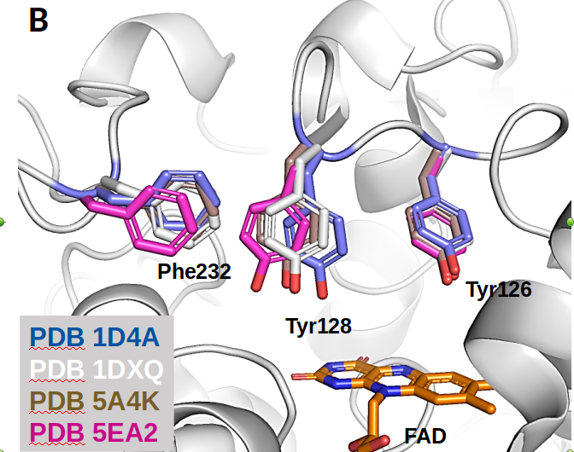
Results
​
The crystal structure of NQO1 was successfully solved for the first time at room temperature to 2.5 Å resolution.
(R work 21,1 % and R free 24.5%)
Doppler et al., Manuscrit in prepatation

Slide 14
Future Work
The proposal LW81 has been accepted in order
to investigate the negative cooperativity of NQO1 with NADH by collecting data sets at different time point using the 3D-printed microfluidic device.

Slide 15
1. What’s an XFEL?
2. Project 1:
Toward decihering the Catalytic mechanism of human NQO1
3. Project 2:
Toward revealingthe unique allosteric resistance mechanism of PBP2a of Staphylococcus aureus
4. Conclusions

Slide 16
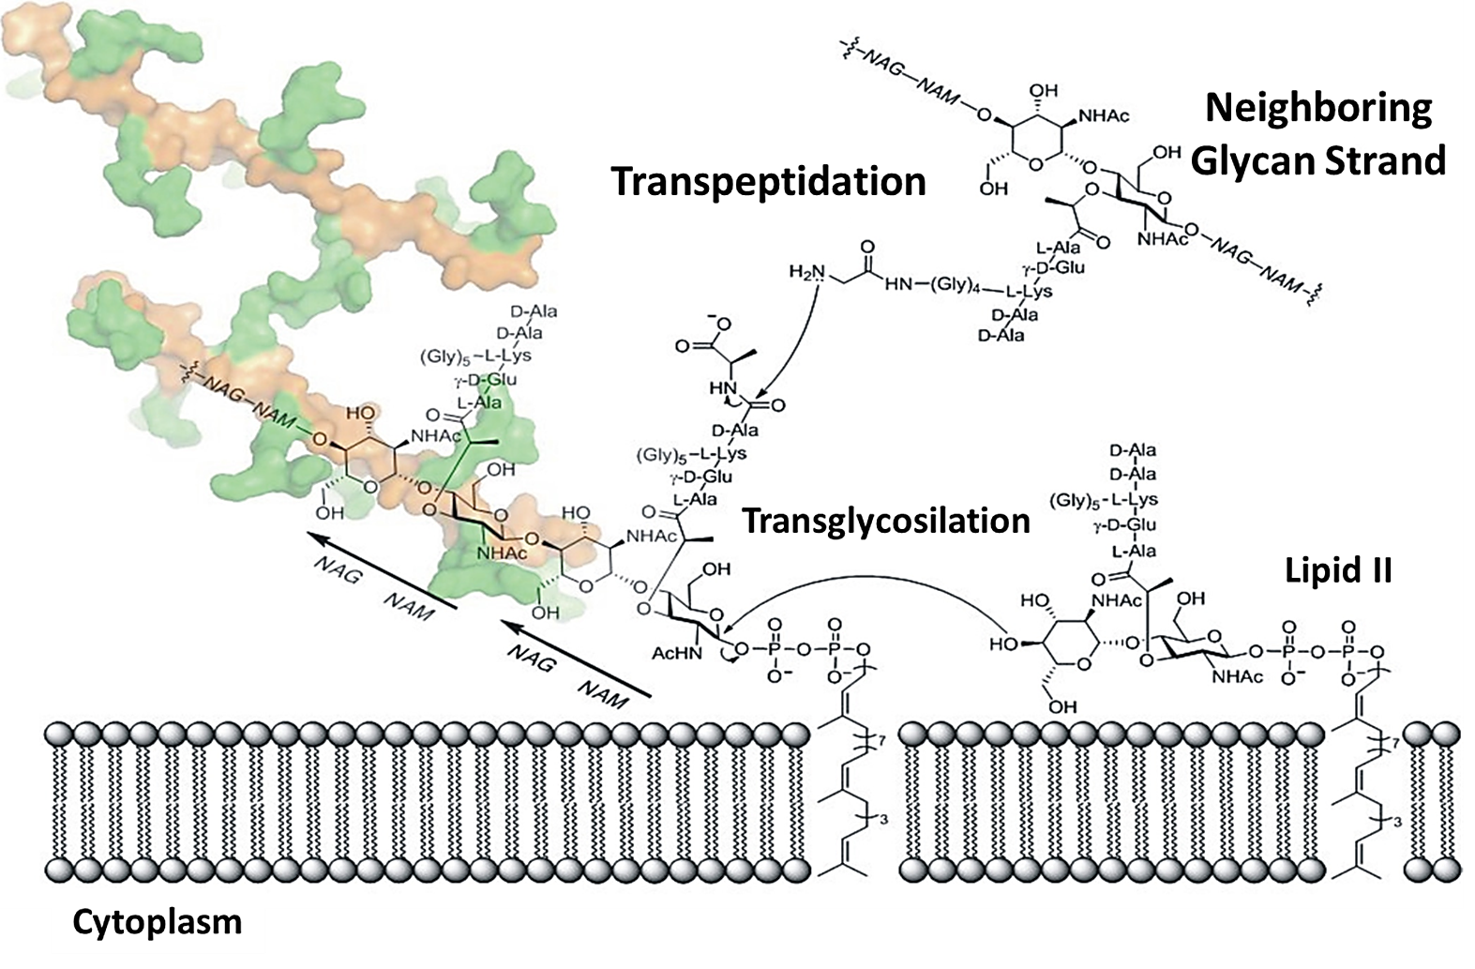
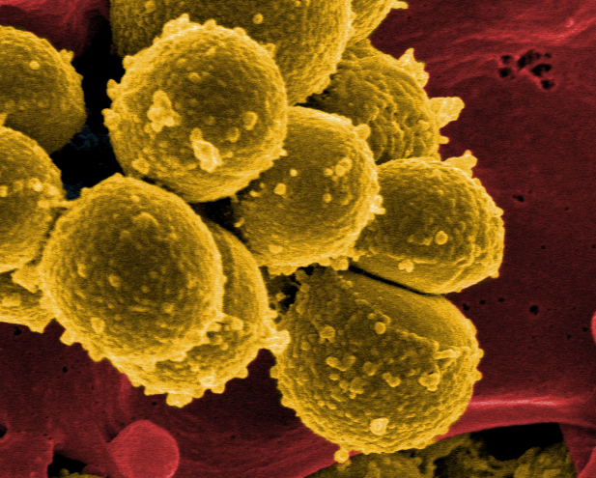
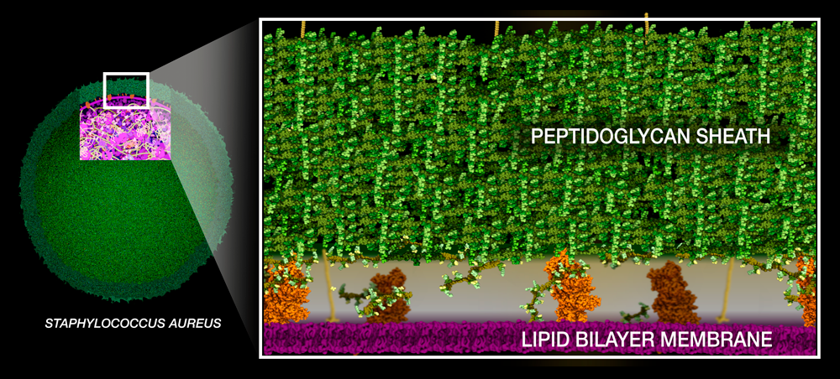

Methicillin-Resistant Staphylococcus aureus (MRSA)
The CDC estimates 323,700 invasive MRSA infections
and 10,600 deaths in the US in 2017.
From ANTIBIOTIC RESISTANCE THREATS IN THE
UNITED STATES, 2019
β-lactam antibiotics are ineffective against MRSA
Penicillin Binding Proteins (PBPs) lead the synthesis of the peptidoglycan sheath.
Llarrull et al. Antimicrob Agents Chemother. 2009.
MRSA is one of the most common causes of healthcare-associated infections.
Causes a range of illnesses, from skin infections to pneumonia and bloodstream infections that can cause sepsis and death.
Second on the list of bacteria of high priority for research and development of new antibiotics by WHO.

Slide 17
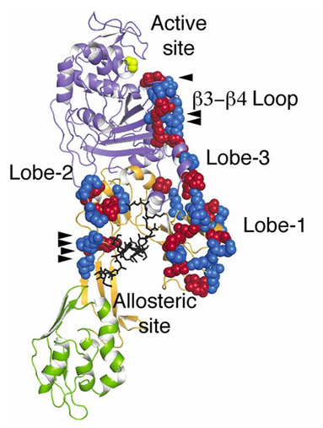
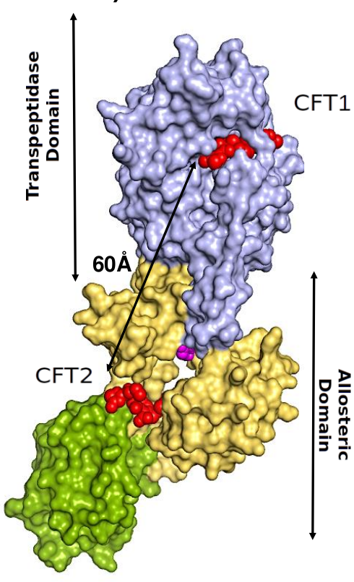
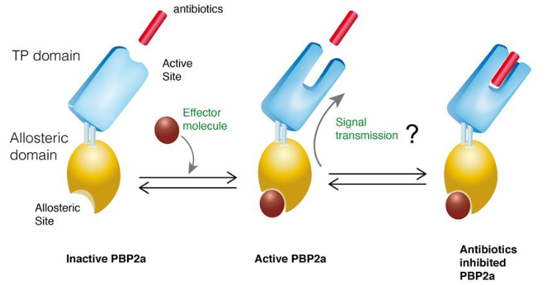
The unique mechanism of resistance of PBP2a
PDB 3ZFZ
A complex network of salt-bridge interactions connects the allosteric site with the 60 Å-far away catalytic site in a manner that resembles to a falling row of dominoes.
Schematic of the proposed allosteric resistance mechanism of PBP2a
Otero et al. PNAS 2013

Slide 18
Aim of the project
We are interested in gaining more insights into the unique allosteric regulation mechanism by determining the crystallographic structures
of the intermediates involved in the reaction of PBP2a with its substrates/inhibitors using the TR-SFX technique at XFELs.

Slide 19
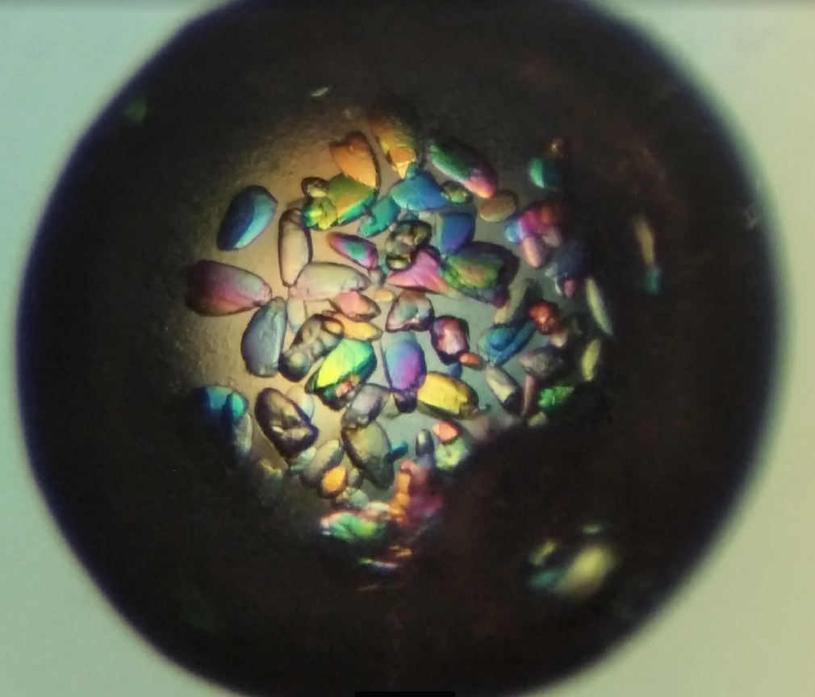
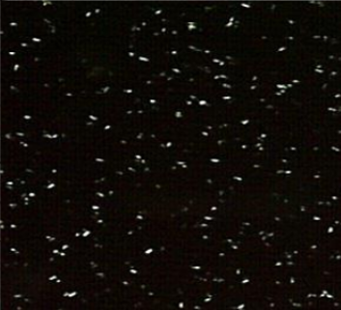
Initial Microcrystallization of PBP2a
0.1 M Hepes pH 7, 25% PEG 1500,
0.880 M NaCl, 16 mM CdCl
0.1 M Hepese pH 7, 25% PEG 550 MME, 0.880 M NaCl, 16 mM CdCl2

Slide 20
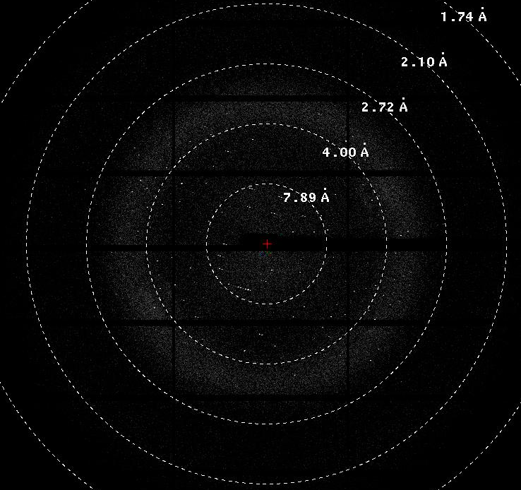
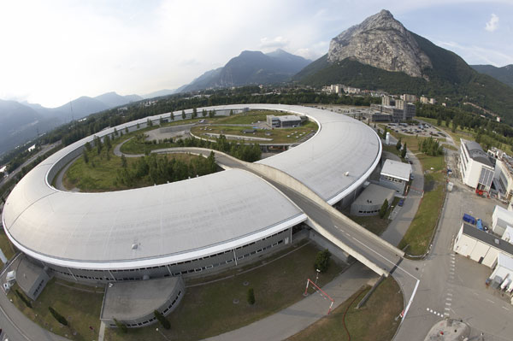

ESRF,
The European Synchrotron
Microcrystals were looped, cryo-protected, and their diffraction quality tested.
Data collection using a raster scan strategy
Diffraction seen up to ~2.2Å.
About 5,000 frames collected and 500 images indexed with CrystFEL.

Slide 21
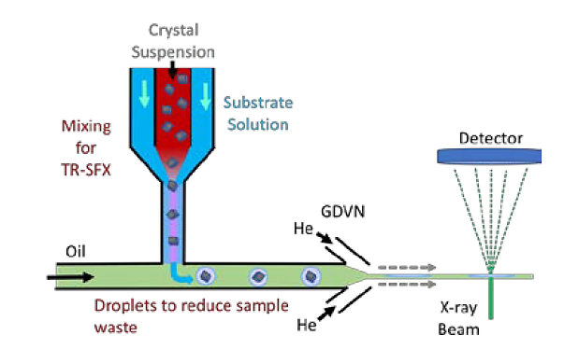
Future work
PBP2a microcrystals will be mixed with antibiotic in the interaction region so that it rapidly diffuses into the crystals and binds to the protein.
Crystal plus substrate will be delivered to the X-ray beam and data sets will be collected at various time delays.
To this end, a PCS proposal (ref. 2967) has been acepted for run 8 for testing sample injection and diffraction at the EuXFEL.

Slide 22
1. What’s an XFEL?
2. Project 1:
Toward decihering the Catalytic mechanism of human NQO1
3. Project 2:
Toward revealingthe unique allosteric resistance mechanism of PBP2a of Staphylococcus aureus
4. Conclusions

Slide 23
Conclusions
TR-SFX with XFELs allow us to explore irreversible reactions and fast conformational changes to study the dynamics of biomolecules in “real time” using nano- or microcrystals.
Protein Dynamics at XFELs will represent a very turning point for drug design against cancer and infectious diseases.
Initial SFX experiments have been carried out for NQO1 protein at LCLS and determined its structure to 2.5 Å resolution.
To further understand the catalytic mechanism of NQO1, TR-SFX experiments in the presence of the substrate NADH at various time delays are required for determining the structure of the intermediates involved in the oxidation process.
Microcrystals of PBP2a have been optimized for TR-SFX experiments with antibiotics to study the conformational changes occurring in the unique allosteric resistance mechanism of PBP2a.
Initial injection and, possibly, SFX experiments will be conducted at the EuXFEL in Fall 2022.

Slide 24




Acknowledgements
Dr. José M. Martín García
Dr. Juan A. Hermoso
All CBE lab members
Dr. Angel Pey
Juan Luis Pacheco
Dr. Alexandra Ros
Dr. Petra Fromme
Programa de Doctorado
en Biociencias Moleculares
Dr. Roeland Boer
Dr. Xavi Carpena
Funding $$$$$$
Dr. Daniele de Sanctis
Dr Shibom Basu
Reference: 2019-T1/BMD-15552

Slide 25
Thanks for your attention

Slide 26
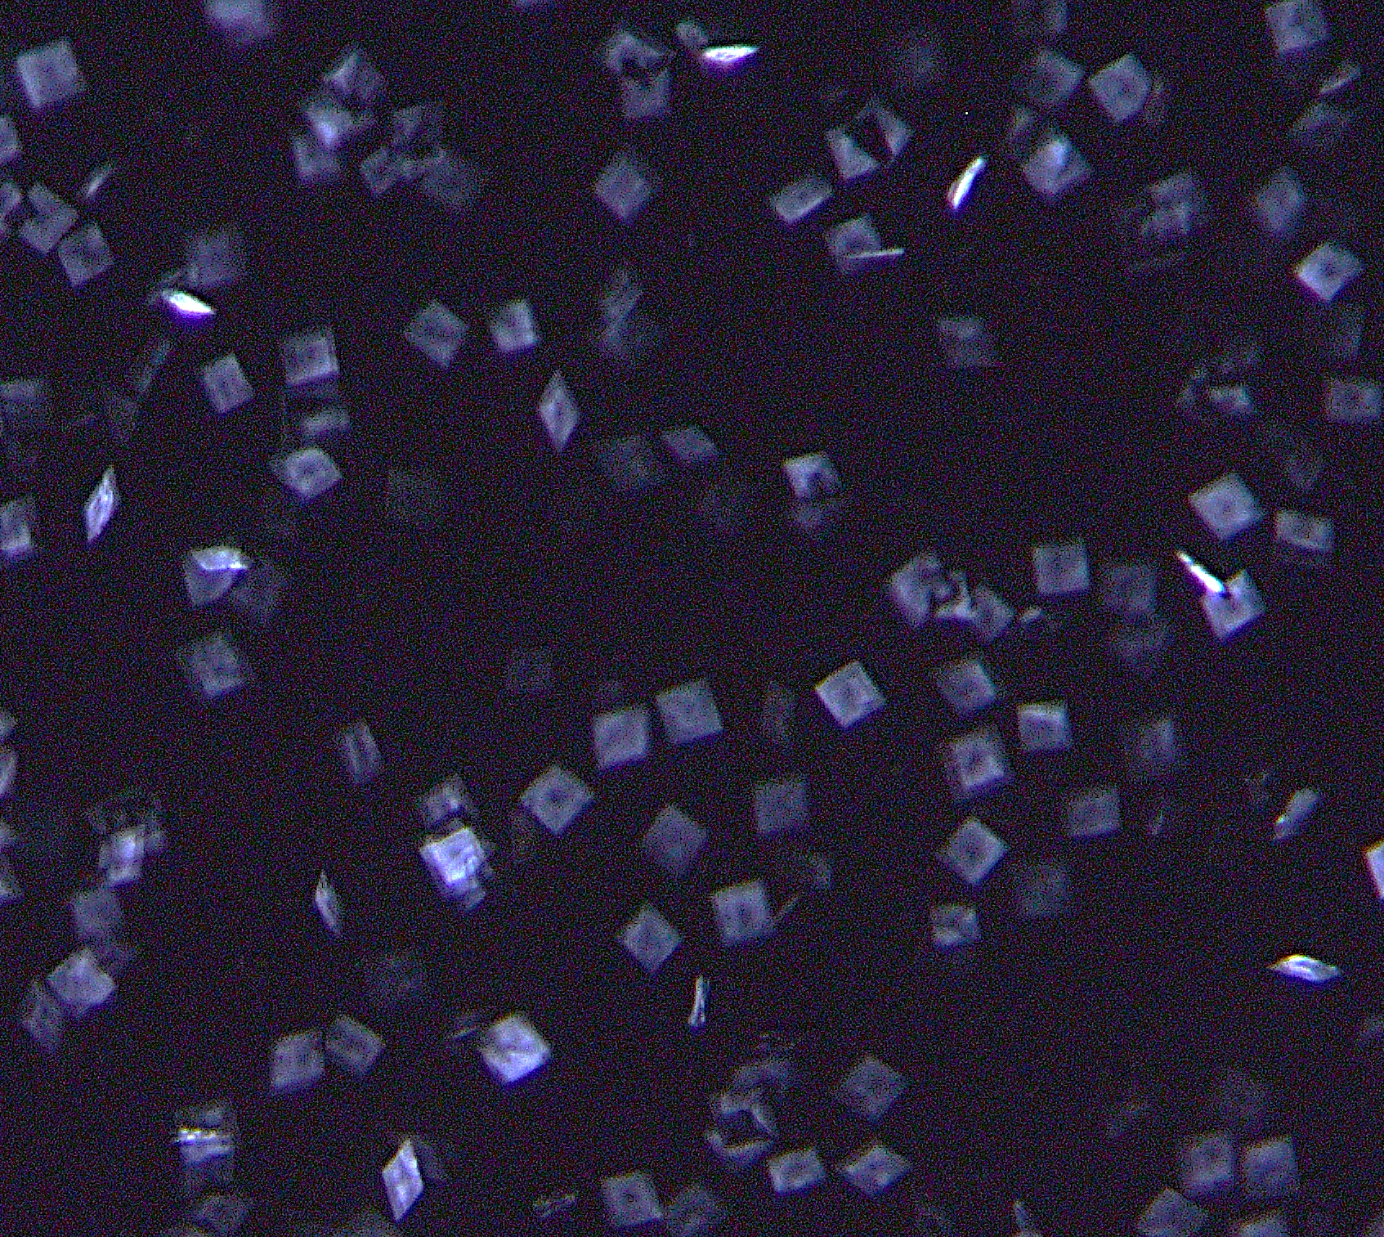
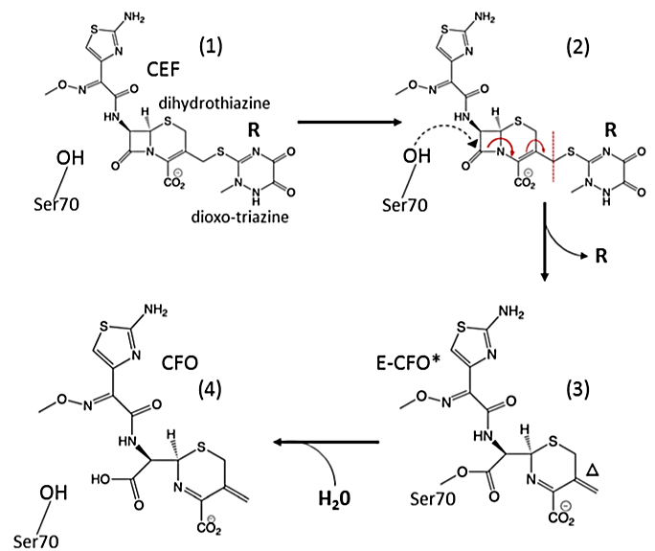
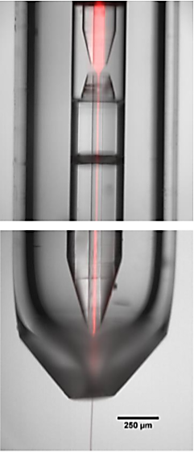
Watching the inactivation of an antibiotic in real time
20μm
Catalytic reaction of an enzyme (β-lactamase C) with a β-lactam antibiotic (ceftriaxone) inside microcrystals using mix-and-inject time resolved SFX
BlaC crystals
Kupitz C, et al. Struct. Dynamics 2016
Olmos JL, et al. BMC Biology 2018
Suraj P, et al. IUCrJ 2021
Antibiotic
Antibiotic
(0)
(1)
(2)
(3)
(1)
....(2, 3, 4)?.....

Slide 27
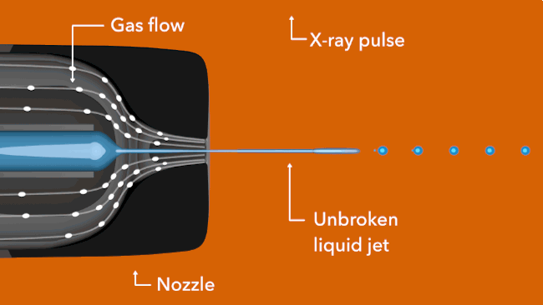
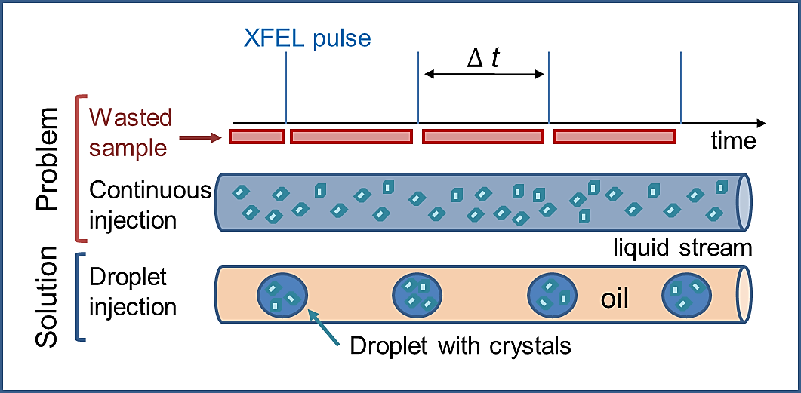
A Microfluidic Device for TR-SFX
High sample consumption
Low hit rate
High risk of clogging
A Major Challenge: Sample Waste
@ LCLS (120 Hz) 95% of sample wasted
@ EuXFEL (10 Hz) 99% of sample wasted
10 mg instead of 1000 mg protein

