Slide 1





Effect of Cd pollution on Se-biofortified wheat: competing interactions and influence on the selenium species stored in the grains
Roberto Boada, Nithyapriya Manivannan, Carlo Marini, Manuel Valiente, Mercè Llugany, Laura Simonelli
roberto.boada@uab.cat
Chemistry Department (Universitat Autònoma de Barcelona)
18th International Conference on X-ray Absorption and Fine Structure
X AUSE Conference & V ALBA User’s Meeting (5–8 September 2022) Barcelona

Slide 2
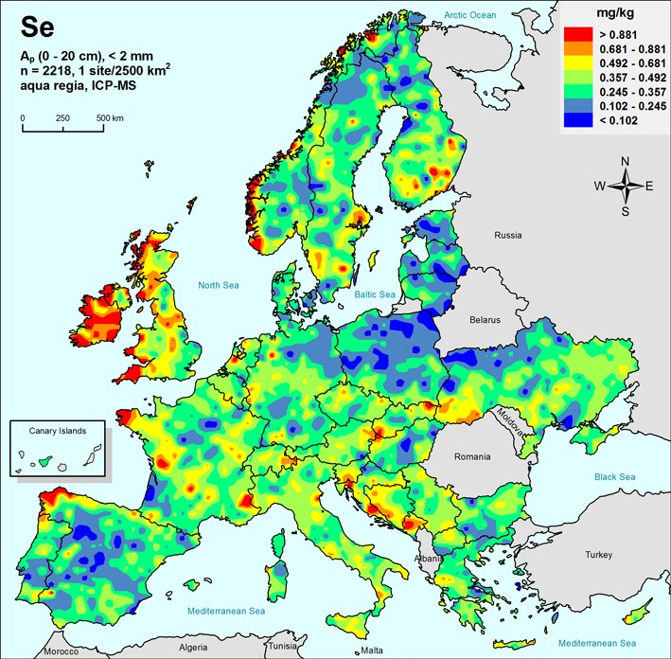








The role of selenium in human health
Se recommended: 50-70 µg/day
Se tolerable upper limit: 400 µg/day
Se deficiency
1 billion people
soil Se deficient <0.5 mg/kg
C. Reimann (2014) ISBN 978-3-510-96846-6
Supplementation
Artificial food enrichment
Se inorganic
Se organic
(bioavailable)
Se bio-fortification of plants
Bio-fortification
Notes:
Health conditions:
Keshan disease // Increased viral virulence // Poorer immune function // Problematic fertility/reproduction // Thyroid autoimmune disease // Cognitive decline/dementia

Slide 3
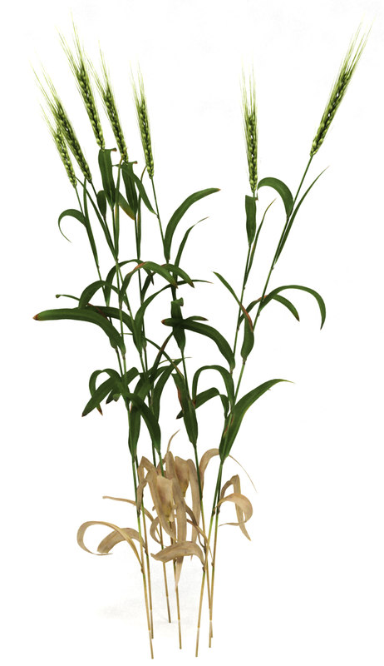
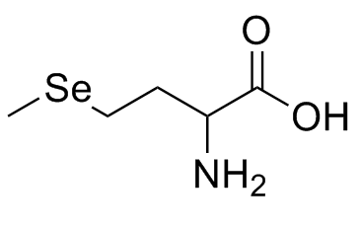
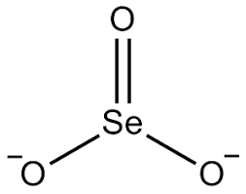
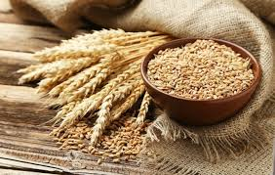
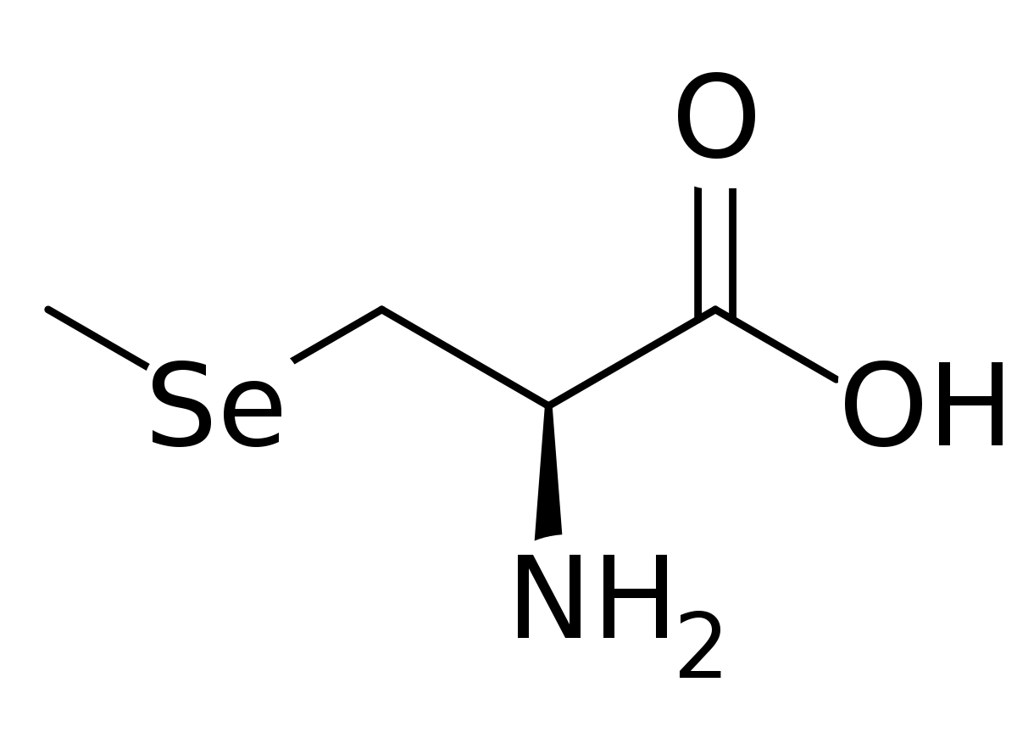
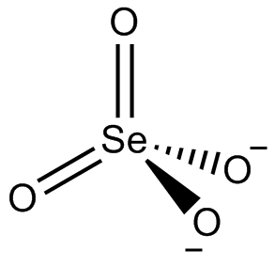
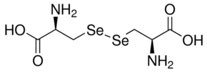
Se-biofortification of wheat
Wheat has the highest Se accumulation capacity among cereals
C-Se-C
Selenomethionine
Selenite
Organic Se
Selenomethylcysteine
Inorganic Se
Selenate
C-Se-Se-C
Selenocystine
wheat (Triticum aestivum)

Slide 4

Se-biofortification studies in our group
Objectives:
Determine which inorganic form of Se is more suitable for Se-biofortification of plants.
Analyse the Se species produced by the Se-biofortification methodology.
Determine the influence of pollutants over the Se-biofortification.
Design the best and most efficient strategy to produce Se-biofortified functional food.
wheat (hydroponic)
assessing Se treatments
microgreens (hydroponic)
functional food
Se-biofortification
wheat (hydroponic)
biostimulants
alfalfa (soil)
foliar Se application
Dairy products
functional food
wheat (hydroponic)
influence of pollutants
wheat (soil)
foliar Se application

Slide 5
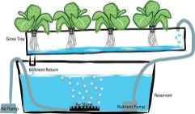


Se-biofortification methodologies
Hydroponic
Soil
Foliar
Controlled parameters ☺
Difficult to scale up ☹
Soil interaction ☹
Soil contamination ☹
Large scale application ☺
  Suitable for hydroponic and soil ☺
  No soil interaction ☺
  Large scale application ☺
  Requires investment ☹

Slide 6
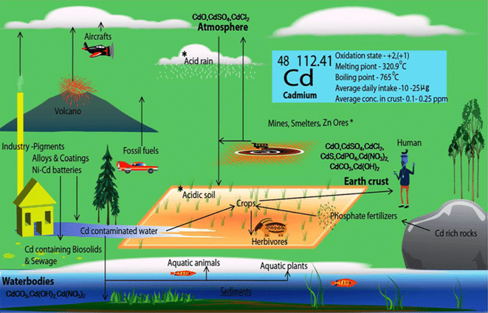
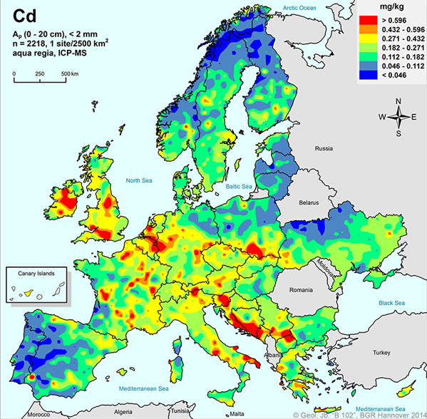
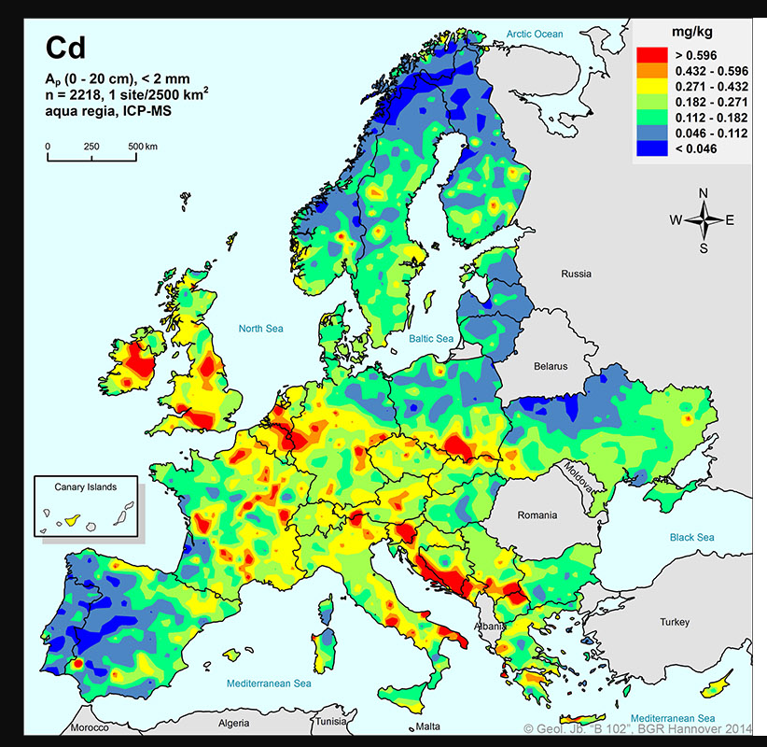
Cd pollution
C. Reimann (2014) ISBN 978-3-510-96846-6
M. T. Javed et al., Cadmium Toxic. Toler. Plants From Physiol. to Remediat. (2019), pp. 495-529.
Competing mechanisms
Selenium biofortification
Pollution
Notes:
https://www.sciencedirect.com/science/article/pii/B9780128148648000206
Concentrations in agricultural soils of around 10-20 µg/g have been reported, whereas the EU regulation recommends a Cd limit of 1-3 µg/g.
1 uM ~ 0.1 ppm
Maximum recommended intake 20-25 ug/day (2.5 ug BW/week)

Slide 7
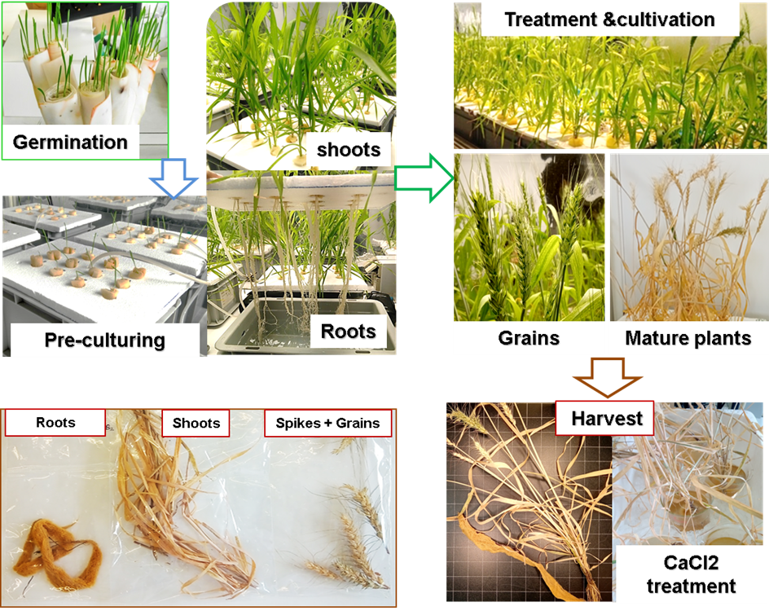
Hydroponic culture conditions
Se (10 µM) | Se (10 µM) + Cd (1 µM)
No Se | Cd
25/75 Se(IV)/Se(VI) | 25/75 Se(IV)/Se(VI) + Cd
50/50 Se(IV)/Se(VI) | 50/50 Se(IV)/Se(VI) + Cd
75/25 Se(IV)/Se(VI) | 75/25 Se(IV)/Se(VI) + Cd
Growing chamber:
Relative humidity: ~70%
Light intensity: 320 μE·m⁻²·s⁻¹
Se and Cd application:
Stage of plant: Vegetative
Hoagland solution changed every 7 days
pH: 6.0±0.2<
Grains

Slide 8
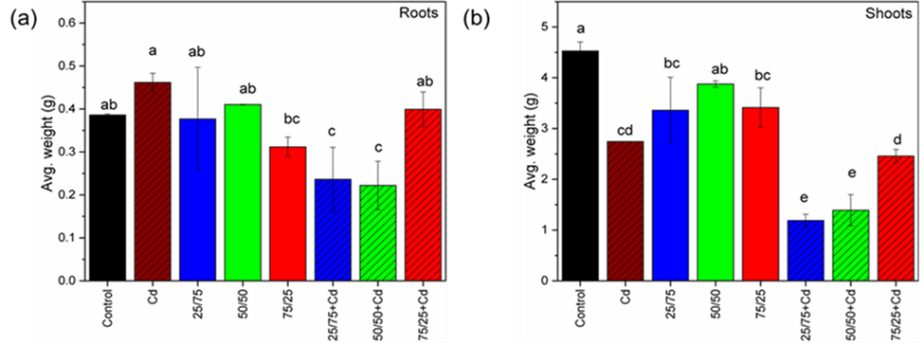
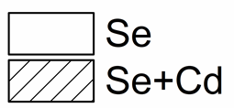
Grain yield
Roots
Shoots
Grains
The overall biomass is affected
Grain yield was reduced by both Se and Cd treatments
Overall no clear trend is seen in terms of Se treatments
Notes:
Selenite is transported by phosphate transport mechanisms, whereas selenate is transported through sulfate transporters

Slide 9
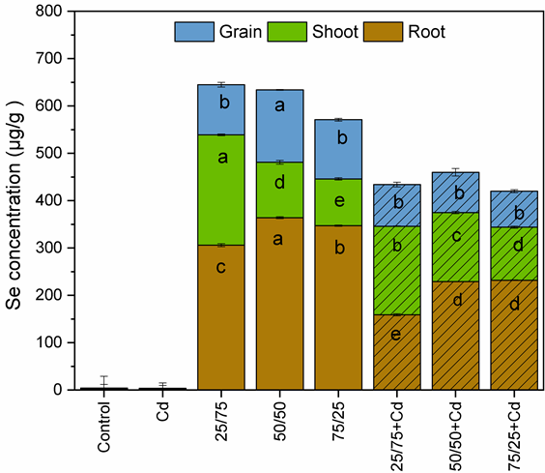
Se accumulation and translocation
Cd reduces Se accumulation in grains, with maximum accumulation in 50/50 treatment without Cd
Se maximum root-to-grain TF with 50/50 and 25/75+Cd
Se root-to-grain translocation is not reduced by Cd presence

Slide 10
Cd accumulation and translocation
Cd accumulation in grains is reduced by Se
Cd roots-to-grains TF increased under Se presence and it is maximized by 50/50

Slide 11
Correlation between Se & Cd accumulation and grain yield
Total grain weight reduces when Se or Cd accumulation increases
For Se+Cd treatment there no much correlation is found with the Se concentration
Notes:
Control

Slide 12
Se K-edge XANES
Roots: Se mainly in organic form
(Complex formation in root exudates and less translocation)
Shoots: Se intermediate and Se(VI) gain spectral weight at expense of organic species when increasing Se(VI) fraction in the treatment (Metabolic activities and translocation in leaves and stems)

Slide 13
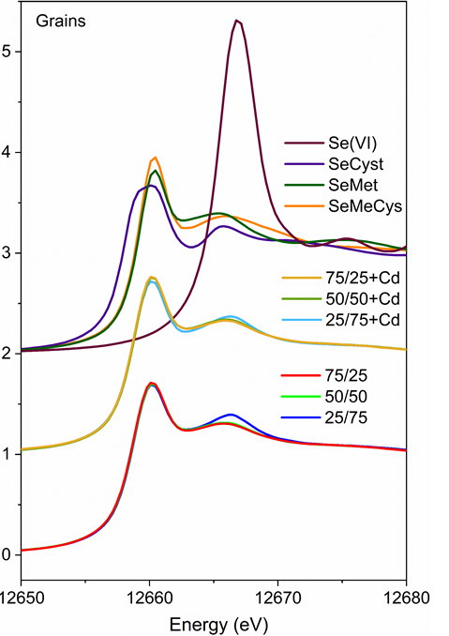
Se K-edge XANES
SeMet and SeCyst were the major species present
SeMeCys is present only in the presence of Cd
(reduced Se concentration due to Cd helps in full conversion of Se species)
References
Inorganic Se
SeCyst
SeMet
SeMeCys
Components weight
Samples

Slide 14
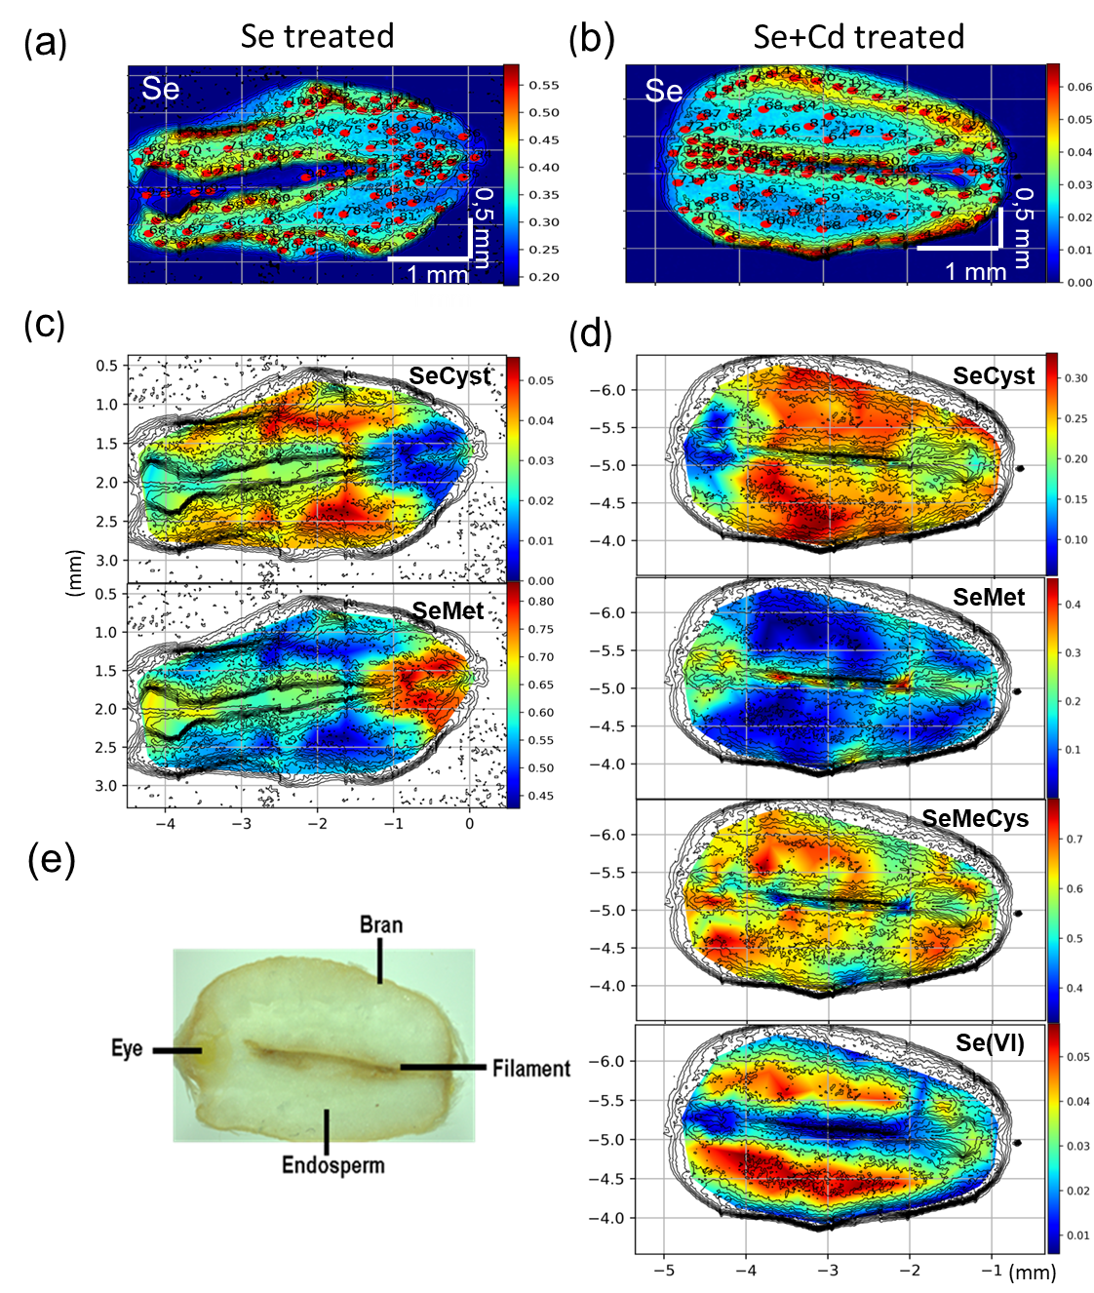
Se species distribution in grains
Se treated
Se+Cd treated
Inorganic Se
SeCyst
SeMet
SeMeCys
50/50
25/75+Cd
SeMet: Filament and eye region
SeMeCys and SeCyst: Endosperm region
SeMet reduces in favour of SeMeCys in the presence of Cd

Slide 15
Conclusions
The overall grain yield was reduced by both Se and Cd presence.
The 50/50 treatment has the highest Se accumulation.
Cd reduces the Se uptake and translocation. Cd translocation is reduced in the presence of Se.
The total grain weight reduces when the Cd accumulation increases.
SeMet and SeCyst were the prominent species present in grains. SeMeCys is present only under Cd presence.
SeMet is mainly distributed in the filament and the eye region whereas SeMeCys and SeCyst are distributed in the endosperm and the bran

Slide 16







Acknowledgements
CLAESS beamline
Dr. Nithyapriya Manivannan
Dr. Laura Simonelli
Dr. Carlo Marini
Dr. Giulio Gorni
Dr. Vlad Martin-Diaconescu
UAB-GTS
Prof. Manuel Valiente
Dr. Montserrat Resina
Manuel Sevilla
UAB-BABVE
Prof. Mercè Llugany
Funding
CTM2015-65414-C2-1-R from MINECO of Spain
P-SPHERE MSCA-cofund (No. 665919)
DOC-FAM MSCA-cofund (No. 754397)
Se4All (H2020-MSCA-RISE-2020, No. 101007630)

