Slide 1
Synthesis of supramolecular nanoarchitectures based on carbonitrile functional groups
Shanmugasibi K. Mathialagan, Sofia O. Parreiras, Cristina Martín-Fuentes, Daniel Moreno, José I. Urgel, Beatriz Muñiz-Cano, Koen Lauwaet, Manuel Valvidares, Miguel A. Valbuena, Pierluigi Gargiani, José I. Martínez, Nazario Martín, Julio Camarero, José M. Gallego, Rodolfo Miranda and David Écija

Slide 2
Introduction Metal organic frameworks
Technology is rapidly progressing towards miniaturization of electronic circuits.
As most electronic devices rely on magnetic storage, nano-magnetism carries a significant importance in the electronic industry.
Low dimensional metal organic frameworks show great potential as new spintronic devices for information processing and storage.
They possess a vast reservoir of properties including exotic quantum phenomenon which can be manipulated, making them promising building blocks for next-generation information devices.
c

Slide 3
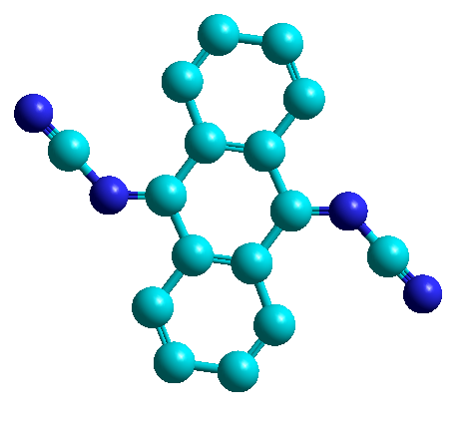
Introduction
- In this work, we have experimentally investigated metal-organic networks consisting DCAAQ (N,N'-(anthracene-9,10-diylidene) dicyanamide) molecules coordinated with Co atoms on Au(111).
- We have synthesized the network and inspected its structure, electronic properties with Scanning tunneling microscopy (STM) and experiments related to magnetic properties were performed at ALBA Synchrotron.
a.
b
b.
c
N,N'-(anthracene-9,10-diylidene)dicyanamide
ChemDraw 17.0.0.206 (121)
Figure 1. Molecular structure (a) Chemical structure of N,N'-(anthracene-9,10-diylidene)dicyanamide molecule (b) Ball & stick model.

Slide 4
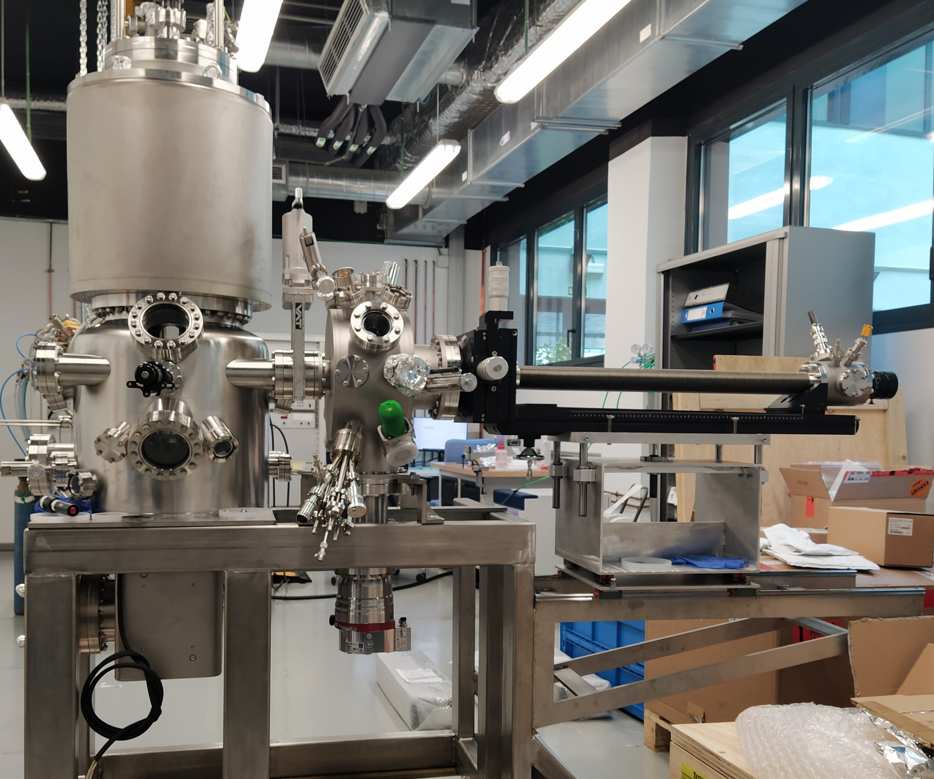
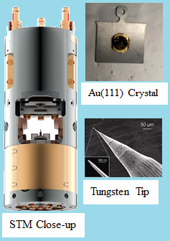
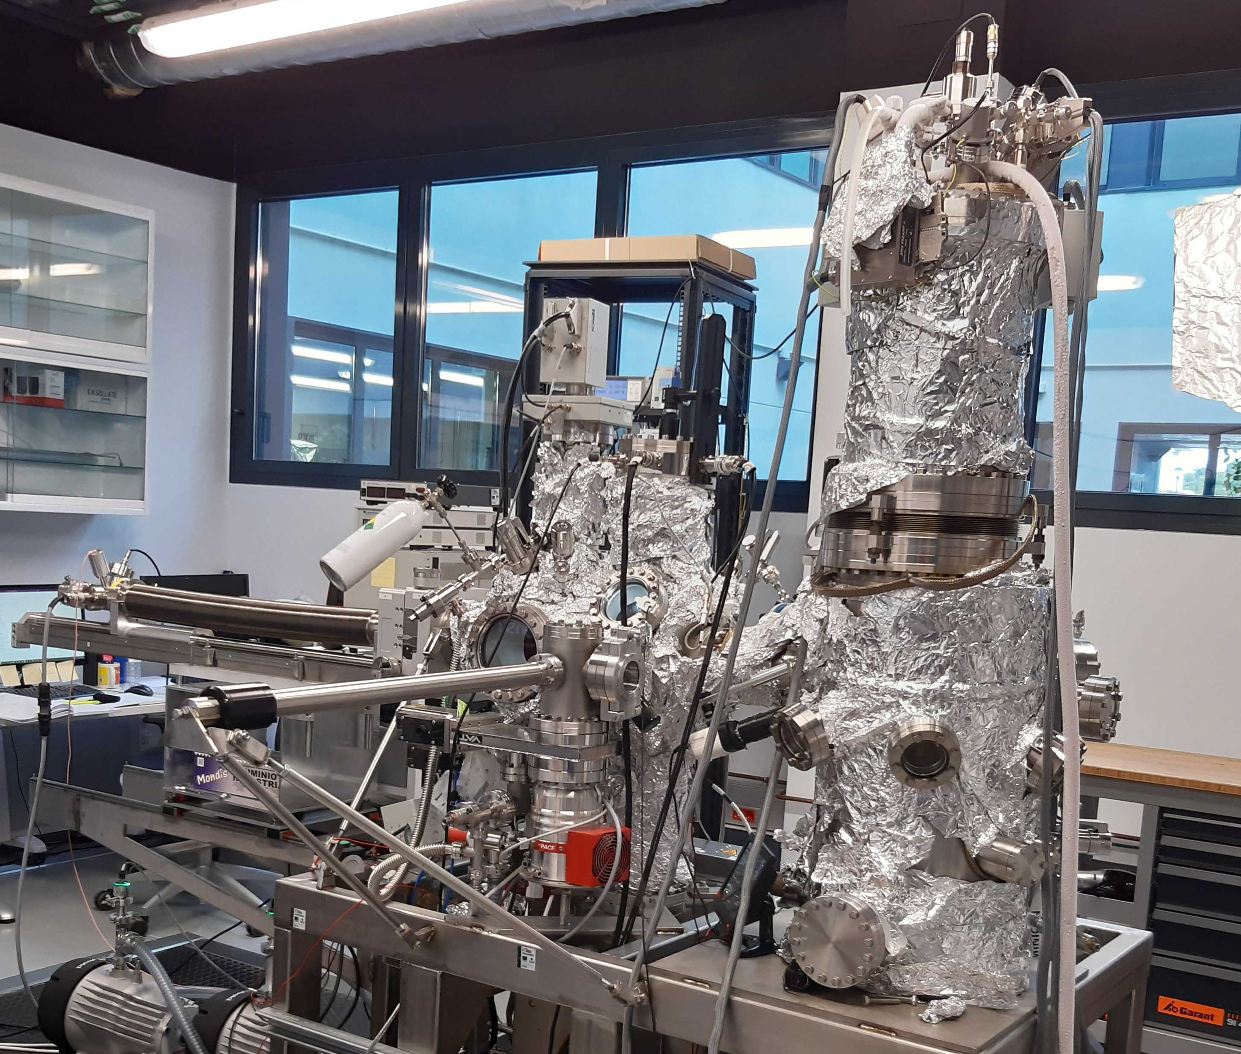
Experimental set-up STM - IMDEA,Madrid.
a
b
c
Polar STM- IMDEA Nanociencia, Madrid
(Non-contact AFM) STM- IMDEA Nanociencia, Madrid
Figure 2. STM setup (a) Polar STM set-up at IMDEA Nanociencia, Madrid (b) Parts of the Polar STM: STM head, Au(111) crystal, Tungsten tip (c) (Non-contact AFM) STM- IMDEA Nanociencia, Madrid.
Topography and Electronic properties measurements were performed with the STMs in IMDEA Nanociencia, Madrid.
The samples were measured at Helium temperature in a UHV environment with a base pressure of the order of 1x10⁻¹⁰ mbar.

Slide 5
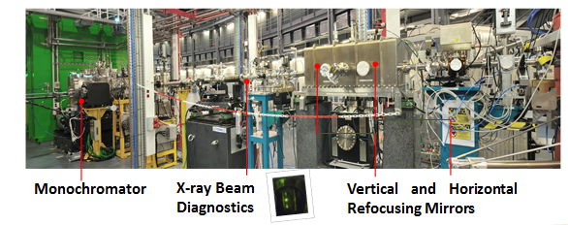
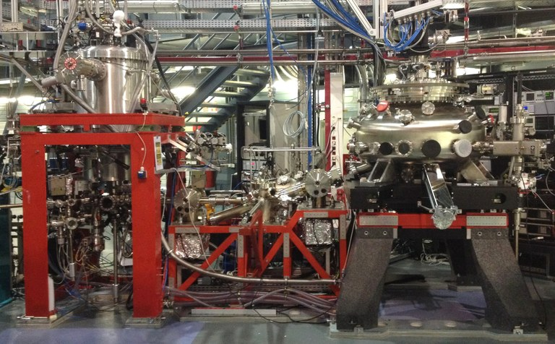
Experimental set-up BOREAS-ALBA
a
b
Figure 3. Boreas beam line setup (a) BOREAS Beam line – ALBA, Barcelona. (b) X-ray Absorption Spectroscopy and magnetic circular dichroism endstation (Hector)
X-ray absorption spectroscopy (XAS), Soft X-ray (magnetic) circular and linear dichroism (XMCD/XLD) measurements were performed in BOREAS beamline.
The samples were measured in a UHV environment with a base pressure of the order of <1x10⁻¹⁰ mbar.

Slide 6
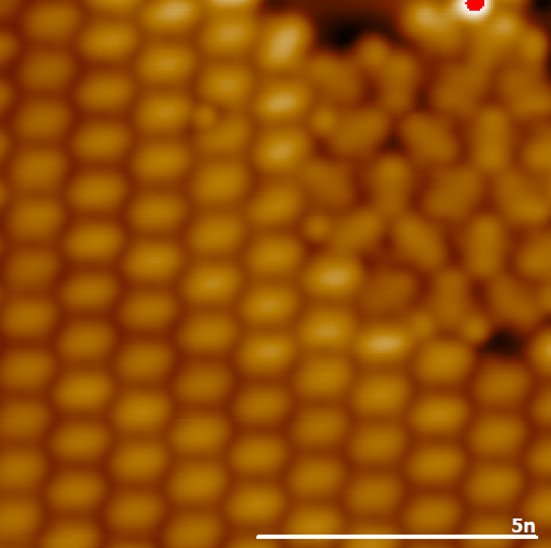
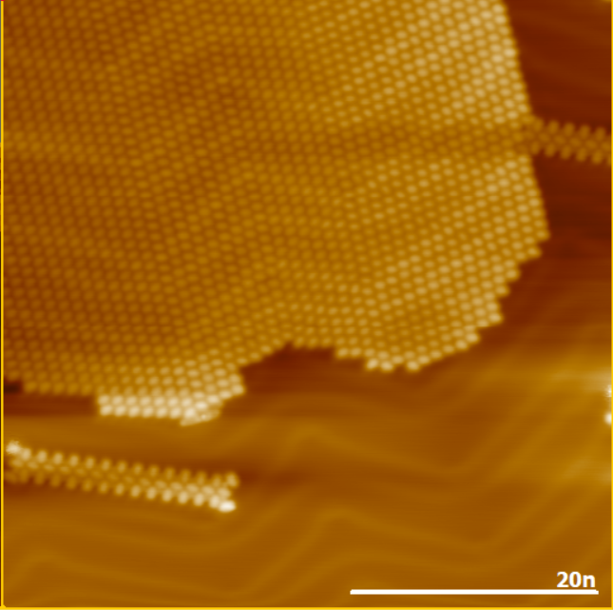
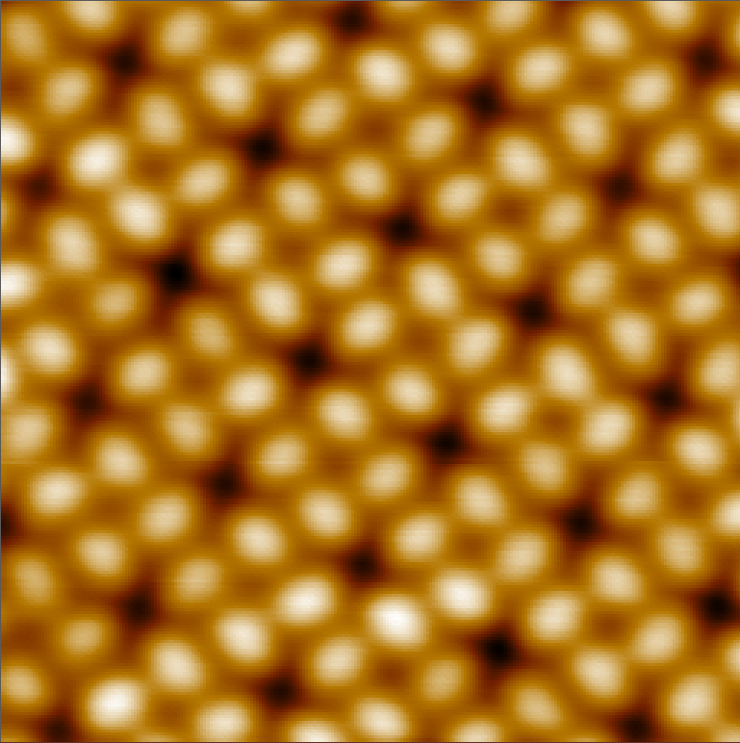
Results Molecular Self-Assembly
b
a
b
c
c
d
Figure 5. Molecular Self-Assembly (a) 10 x 10 nm image showing hexagonal and triangular assemblies (b) 50 x 50nm long-range image showing ) 10 x 10 nm image showing chain-like assembly (c) 4nm x 4nm image showing square assembly.
The sample was prepared by sublimating the molecules at 130 ℃ molecules on Au(111) substrate.
We observe four different types of self-assembly Hexagonal (main phase), Chain, triangular and square.

Slide 7
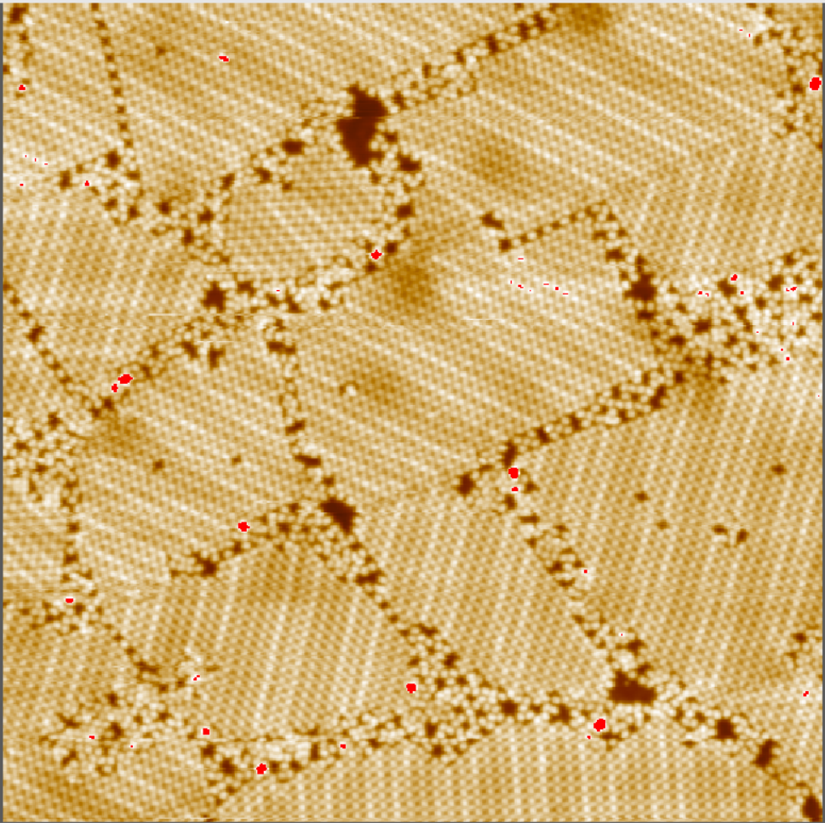
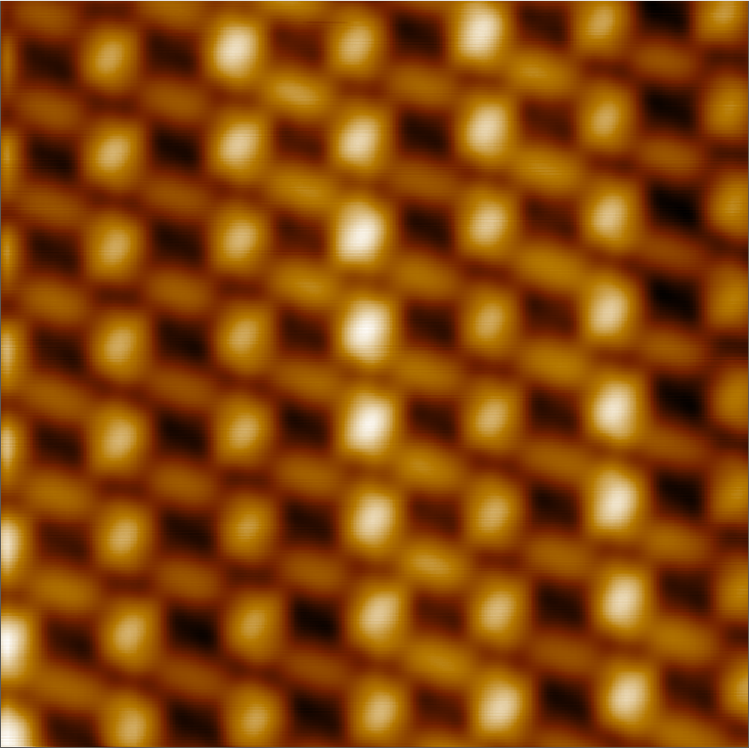
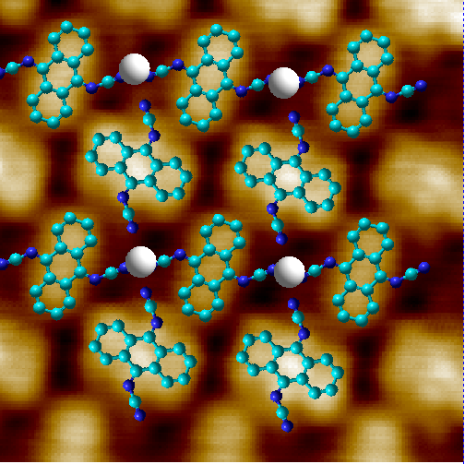
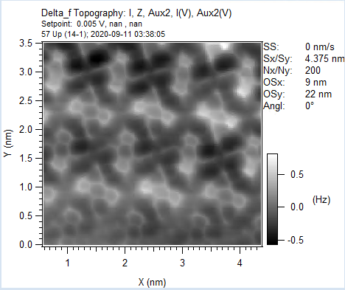
Results Coordinated network: 2-Fold phase
a
b
The sample was prepared by depositing molecules and metal on an Au(111) and annealing at 140℃
We obtain an interesting network of coordinated stripes consisting of 1D stripes formed with two-fold coordinated molecules and mononuclear Co centres
Co-CN distances are distinct in transversal direction and in longitudinal direction.
c
d
Figure 6: Metal-Organic framework long range, short range images (a) N,N'-(anthracene-9,10-diylidene) dicyanamide and Cobalt on Au(111) surface 100 x 100 nm image. (b) 10 x 10nm image (c)3.5nm x 3.5nm image with super-imposed model (d) Non-contact AFM image 4.4nm x 4.4nm

Slide 8
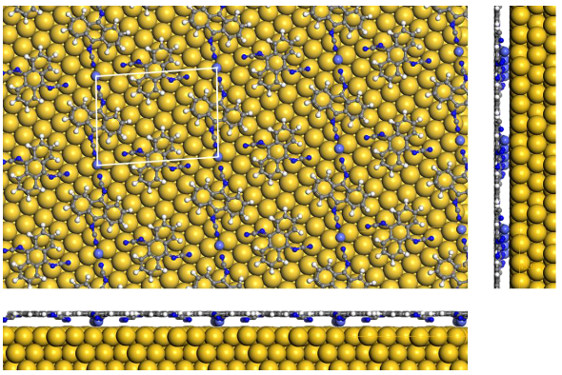
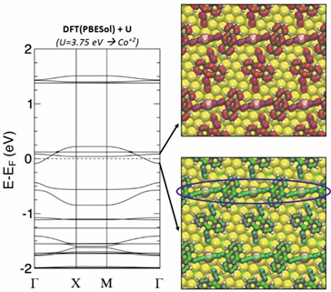
Results DFT Calculations: 2-fold phase
b
c
d
Figure 7. DFT calculation of the Metal-Organic framework (a ) Top and side view of the metal-organic system (b) Computed DFT+U band structure (U = 3.7 eV for Co+2).
- Co-CN distances are (1.8 Å) in transversal direction and (4.27 Å) in longitudinal direction.
- DFT calculations predict metallicity along the 1D chain.

Slide 9
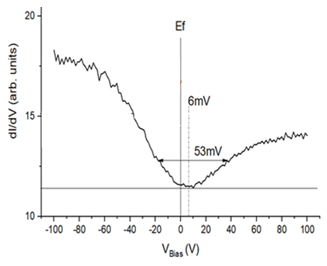
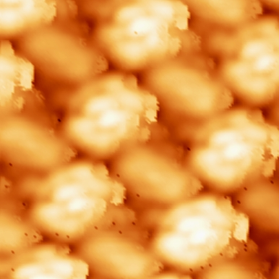
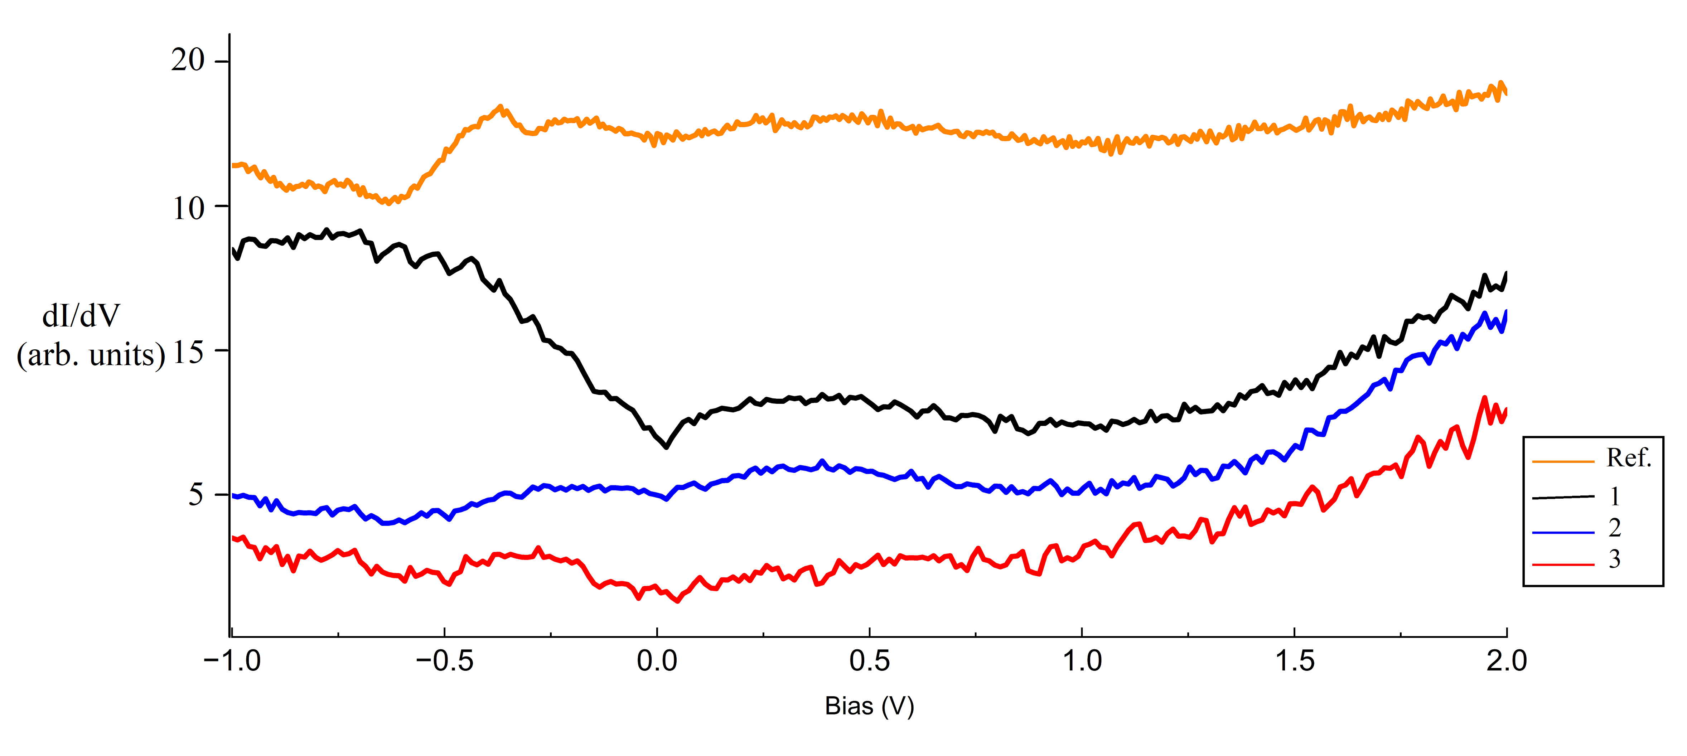
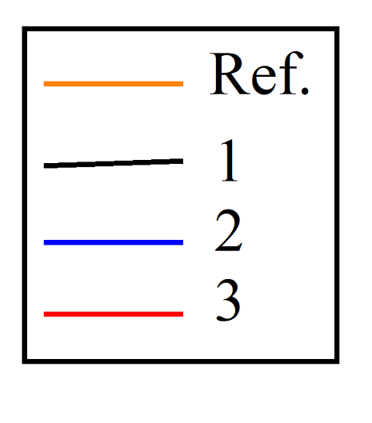

Result- Electronic properties
a
b
Figure 8. Electronic properties long range(a) STM image of the network 3.5x3.5nm image showing spectroscopy locations. (b) Scanning Tunneling Spectroscopy (STS) in range -1V to +2V at different points of the network. Inset graph shows a short range STS of the cobalt centre.
STS reveals no fingerprints, but a profound dip at Fermi, probably of Kondo origin.

Slide 10
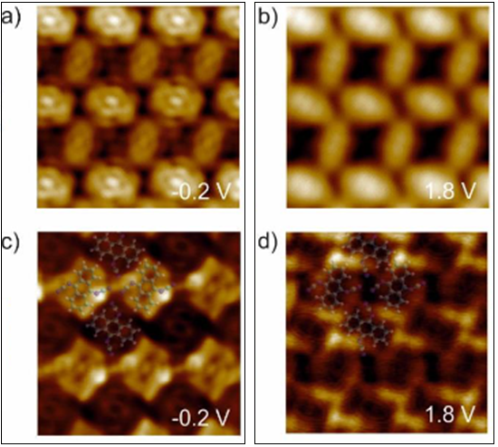
Results - Electronic properties
b
c
f
b
Topography
c
g
dI/dV map
Figure 9. dI/dV maps and constant height images (a,b) STM topography. 3.5 x 3.5nm images (c) dI/dV map corresponding to image (a) obtained at voltage -200mV images
(d) dI/dV map corresponding to image (b) obtained at voltage 1.8V (f) Constant current image 5nmx5nm (g) Constant height image 5nmx5nm.
The bandgap is not clear by STS but dI/dV mapping shows two different electronic states at -0.2V and 1.8V. Bandgap (if any) lower than 0.4eV

Slide 11
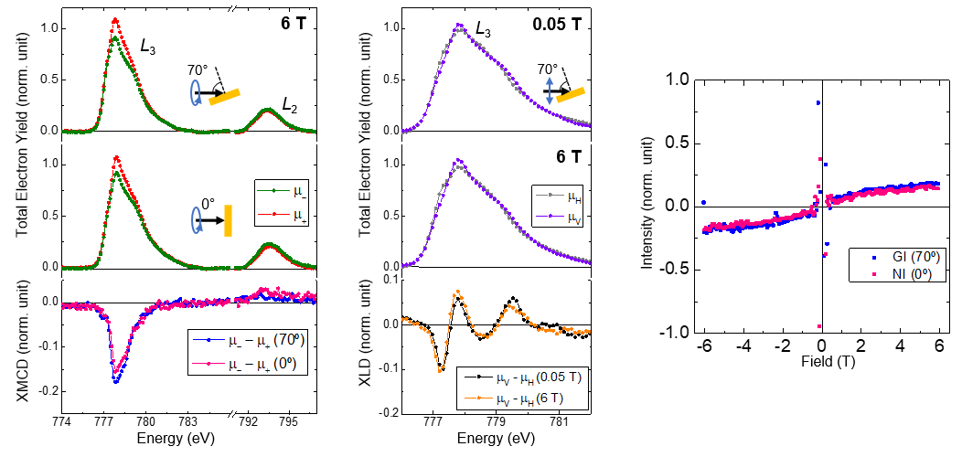
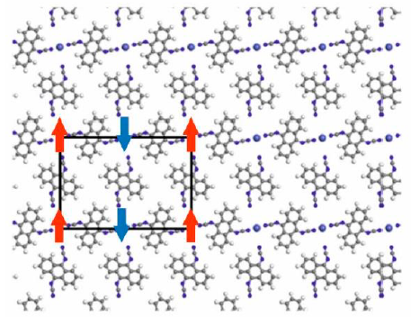
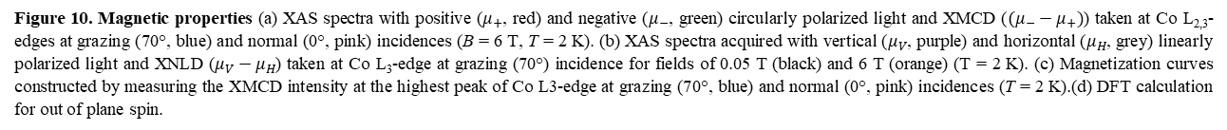
Result - Magnetic properties
a
b
c
d
DFT calculation for out of plane spin
Figure 10. Magnetic properties (a) XAS spectra with positive ($μ_{+}$, red) and negative ($μ_{−}$, green) circularly polarized light and XMCD ($(μ_{−}−μ_{+})$) taken at Co L_{2,3}-edges at grazing (70°, blue) and normal (0°, pink) incidences (B = 6 T, T = 2 K). (b) XAS spectra acquired with vertical ($μ_{V}$, purple) and horizontal ($μ_{H}$, grey) linearly polarized light and XNLD ($μ_{V}−μ_{H}$) taken at Co L₃-edge at grazing (70°) incidence for fields of 0.05 T (black) and 6 T (orange) (T = 2 K). (c) Magnetization curves constructed by measuring the XMCD intensity at the highest peak of Co L3-edge at grazing (70°, blue) and normal (0°, pink) incidences (T = 2 K).(d) DFT calculation for out of plane spin.
The XMCD spectra have a low intensity and are almost isotropic and XLD spectra features a very low charge anisotropy, with around 10% of dichroism.
Magnetization curves present a behavior compatible with paramagnetic or antiferromagnetic, with low intensity and no remanence.

Slide 12
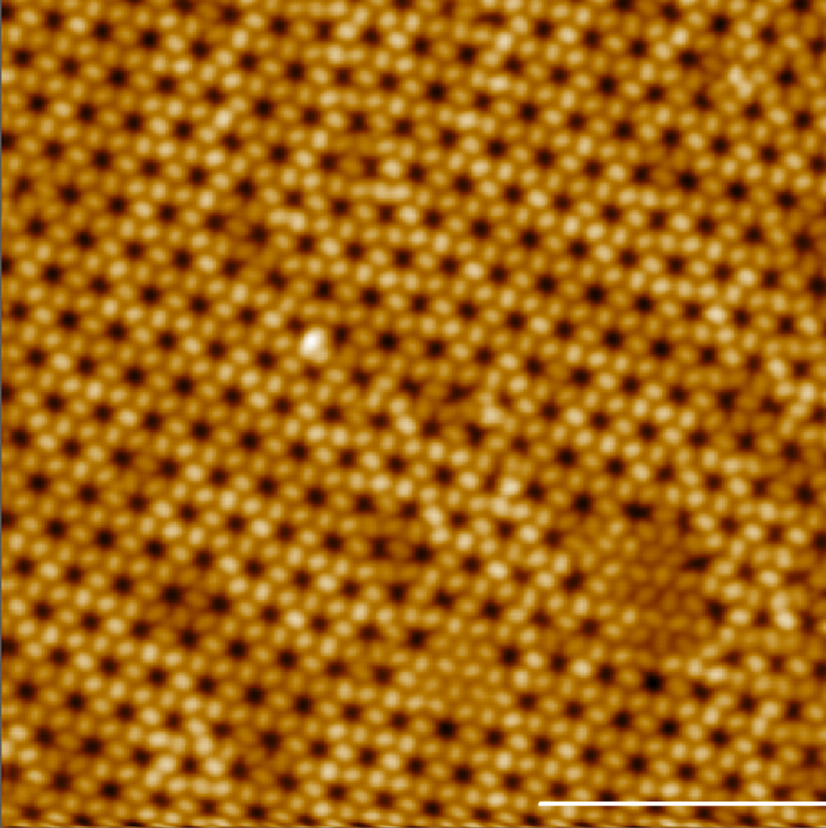
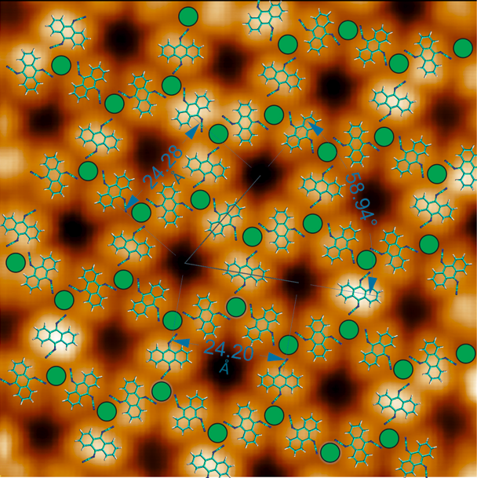
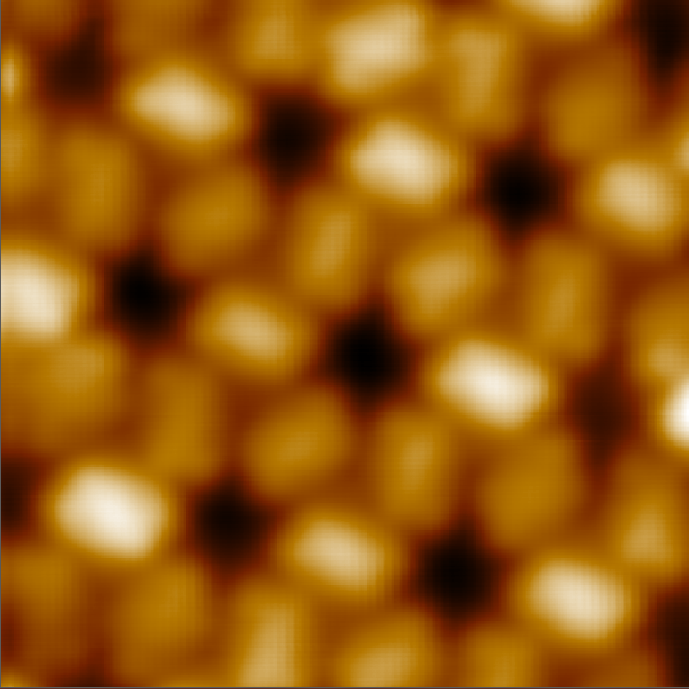
Results Coordinated network: 3 fold phase
a
a
b
The sample was prepared by depositing molecules and metal on an Au(111) and annealing at 140℃
We obtain a symmetric network consisting of three-fold coordinated molecules and mononuclear Co centres.
DFT calculations in progress
b
c
Figure 11. Metal-Organic framework long range, short range images (a) N,N'-(anthracene-9,10-diylidene) dicyanamide and Cobalt on Au(111) surface 40 x 40 nm image. (b) 3.5 x 3.5nm image (c)10nm x 10nm image with super-imposed model.

Slide 13
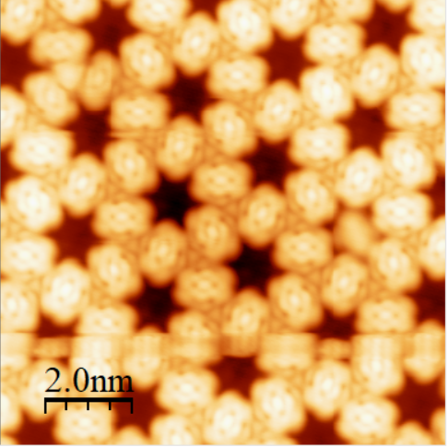
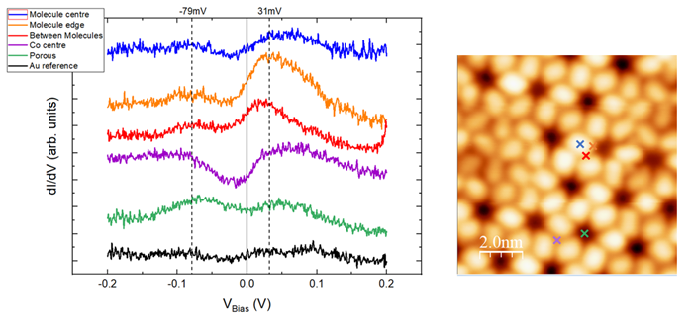
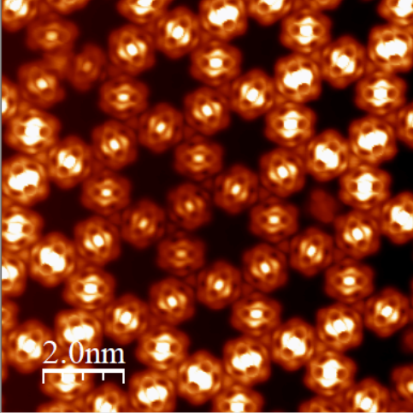
Result- Electronic properties
c
a
b
Constant current
d
Constant Height
Figure 12. Electronic properties short range(a) Scanning Tunneling Spectroscopy (STS) in range -0.2V to +0.2 at different points of the network (b) STM image of the network 3.5x3.5nm image showing spectroscopy locations. (c) Constant current image 5nmx5nm (d) Constant height image 5nmx5nm.
The spectra on cobalt center features a profound dip at Fermi, probably of Kondo origin.

Slide 14
Conclusions
Our results shows formation of two networks based on two-fold and three-fold coordinated molecules with mononuclear Co centers.
STS on the Cobalt atom position in both networks show a wide dip close to Fermi.
XMCD spectra of two-fold phase Co display a low intensity, absence of saturation and no remanence, which is indicative of paramagnetism or antiferromagnetism.
Furthermore, density functional theory complemented by a Hubbard model (DFT+U) predict a antiferromagnetic ground-state, that is compatible with our experimental results.

Slide 15
Perspectives
Both networks will be studied with a Spin ARPES housed in IMDEA nanociencia.
XMCD for 3-fold network needs to be performed to understand how it varies from the other network.
DFT calculations on both networks is a work in progress.

Slide 16
Thank you
Questions!!

