Slide 1



Recent Progress on Synchrotron Radiation Based Operando Characterization of Battery Materials at Alba Synchrotron
Ashley P. Black,ª Giovanni Agostini, ^{b} Carlos Escudero, ^{b} François Fauth, ^{b} Carlo Marini, ^{b} M. Rosa Palacin, ª Alexandre Ponrouch, ª Laura Simonelli, ^{b} Andrea Sorrentino,^{b} Dino Tonti, Ibraheem Yousef ^{b}
a Institut de Ciència de Materials de Barcelona (ICMAB-CSIC)
b CELLS - ALBA synchrotron
ablack@icmab.es
PTI+ TRANS-ENER+
Transición Energética Sostenible

Slide 2

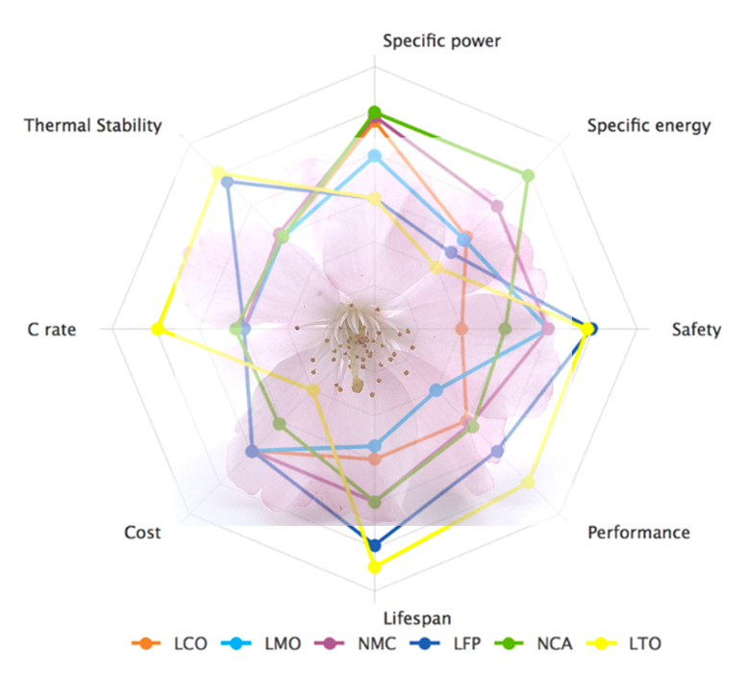

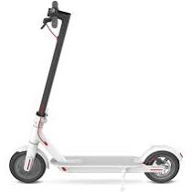
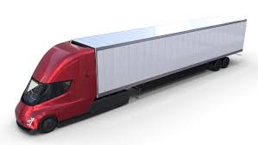
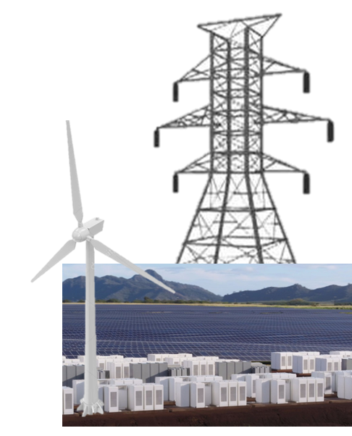

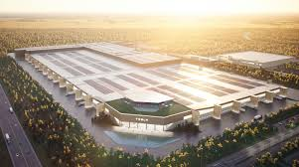
Decarbonization, net zero GHG by 2050… <+1.5°C …
Next generation Li Battery and beyond…
Personal electronics
Transportation
Grid scale electric storage
1.2TWh (2030)
NMC/Li rich
All Solid State
Li Metal
Alternative Anodes, Si,…
Li/S, Li/Air
Na-ion, Na/S, K/S,…
Multivalents, Mg, Ca, Al
Aq. Zn/MnO₂
Organic Battery
$10-20/kWh
20GWh
600GWh
(Global Capacity)
100TWh
100% Renewable by 2050 (100 TWh) 95 gigafactories +125 (80M cars/year)
10% CAGR (compound annual growth rates) sustained for 30 years
Prof. Yet-Ming Chiang, MIT (https://energy.mit.edu) Future of Energy Storage

Slide 3
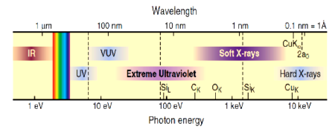
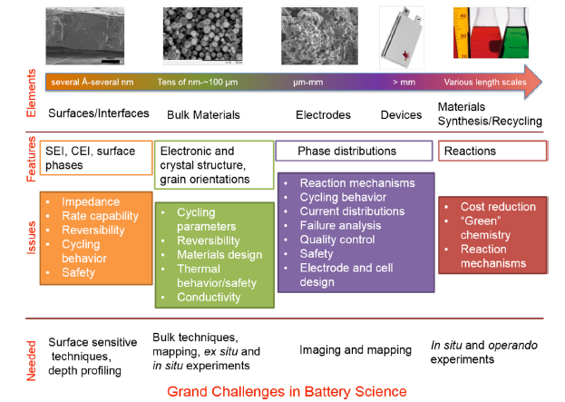
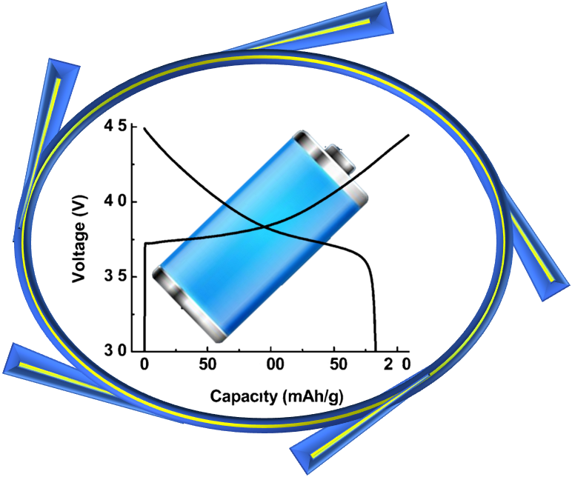
Synchrotron radiation based operando characterization of battery materials
Synchrotron radiation:
Nondestructive analytical techniques
Probing electronic and geometric structures at various length and time scales
Spectroscopy, scattering, and imaging
Ex-situ, in-situ or Operando
F. Lin et al. Chem. Rev. 2017, 117, 13123.

Slide 4
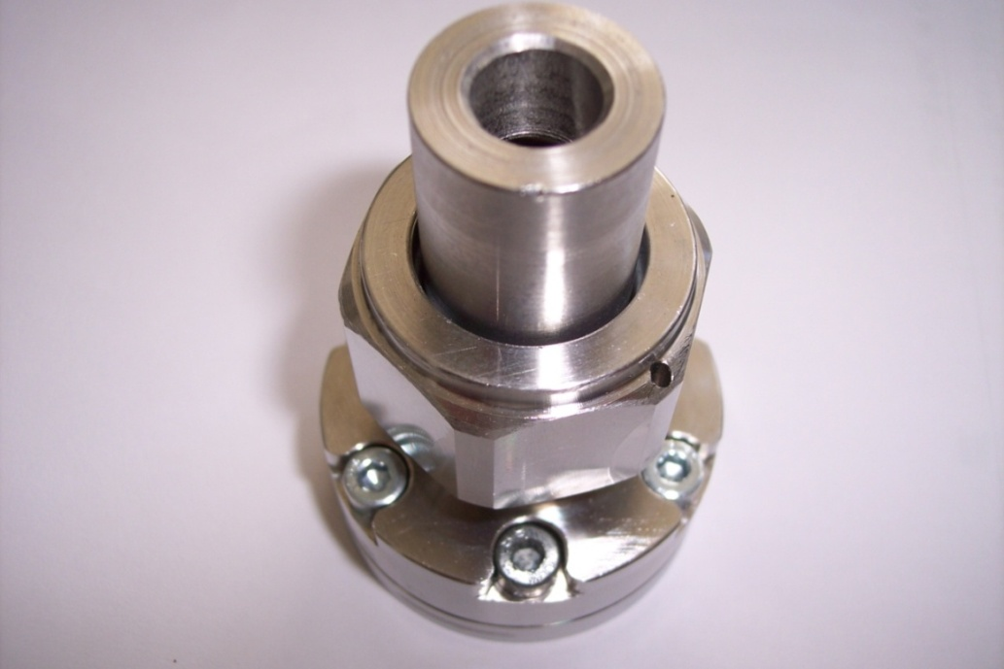
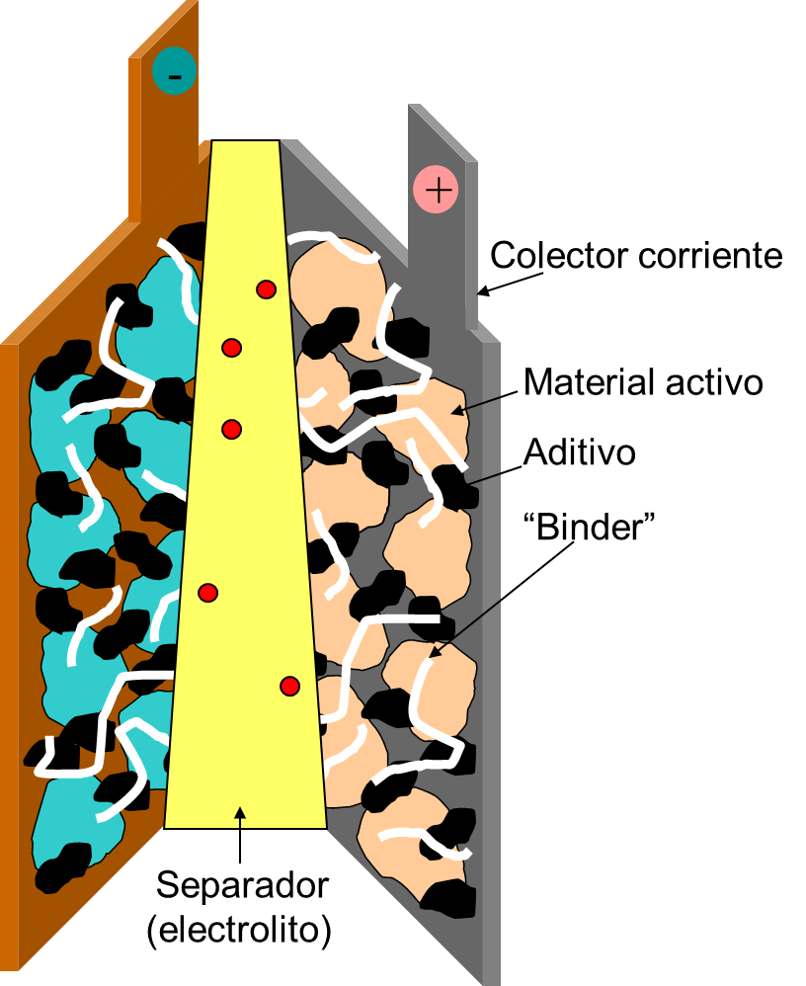
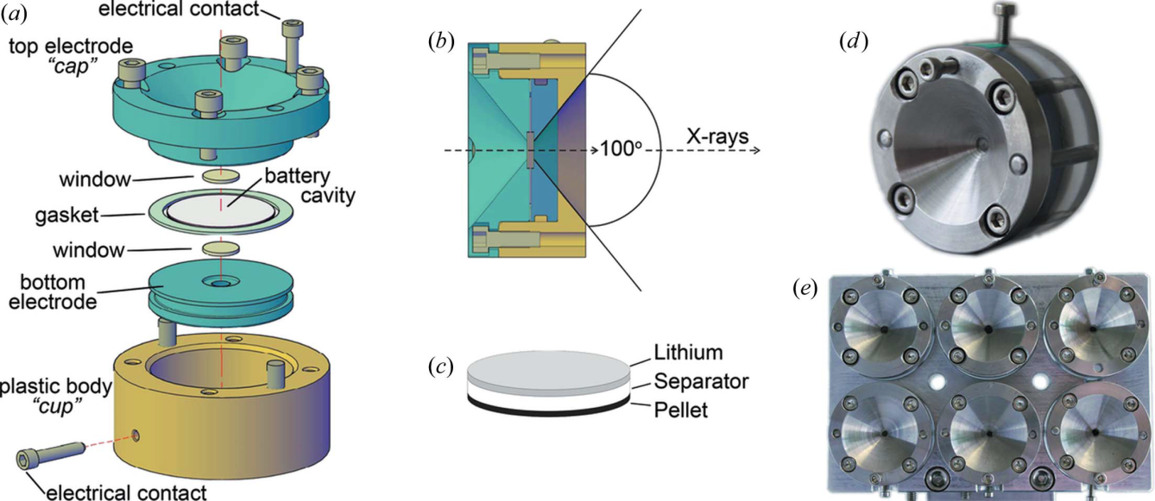
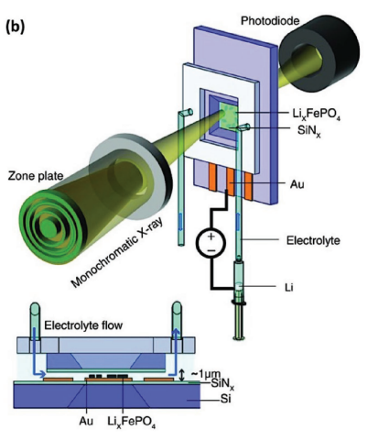
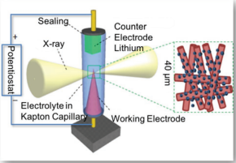
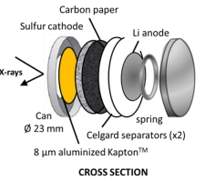
Electrochemical Cell for Operando Studies of Batteries Using Synchrotron Radiation
Compatible with experimental set up but electrochemically efficient
O. J. Borkiewicz et al., J. Appl. Cryst., 45, 1261 (2012), R.E. Johnsen et al., J. Appl. Cryst., 46, 1537 (2013),Ravnsbaek et al., Nano Letters (2014)

Slide 5
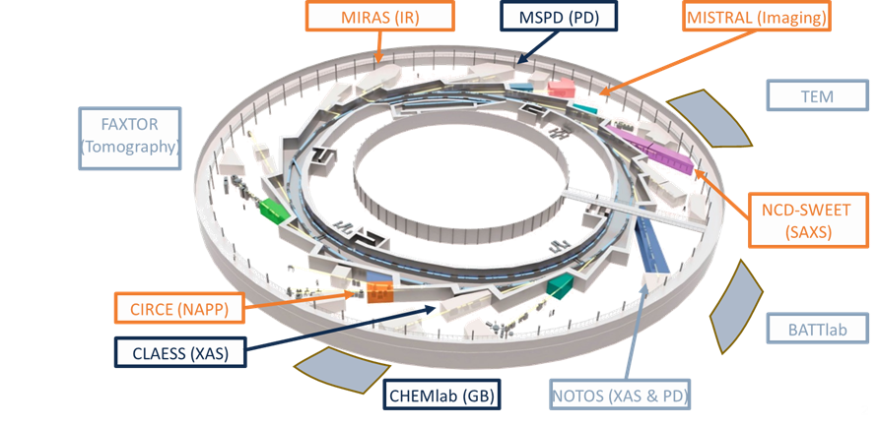
Operando capabilities at Alba Synchrotron
Operando at

Slide 6
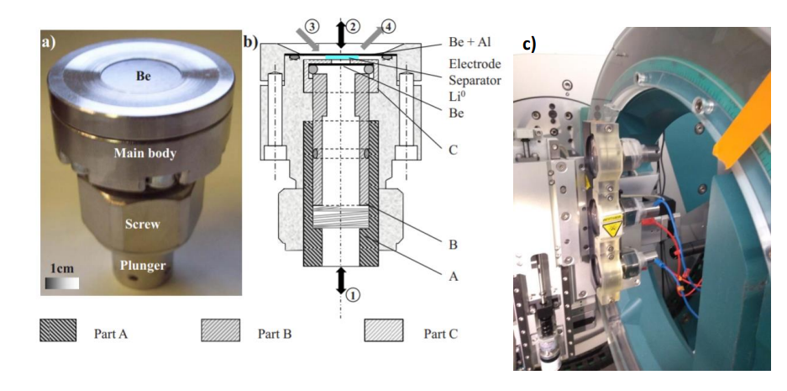
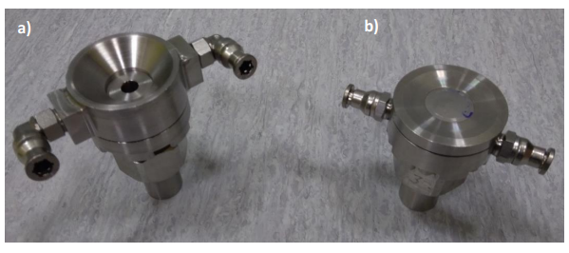
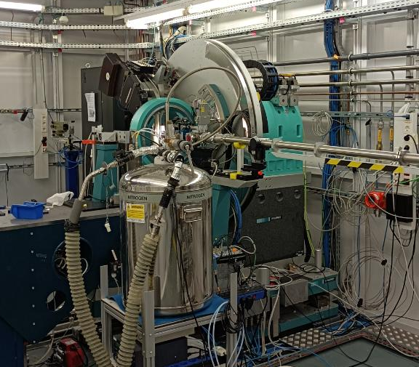
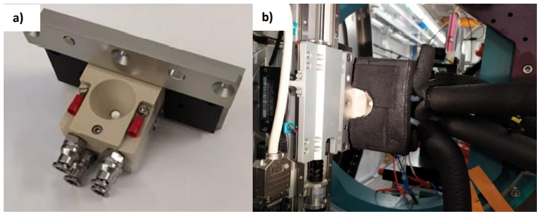
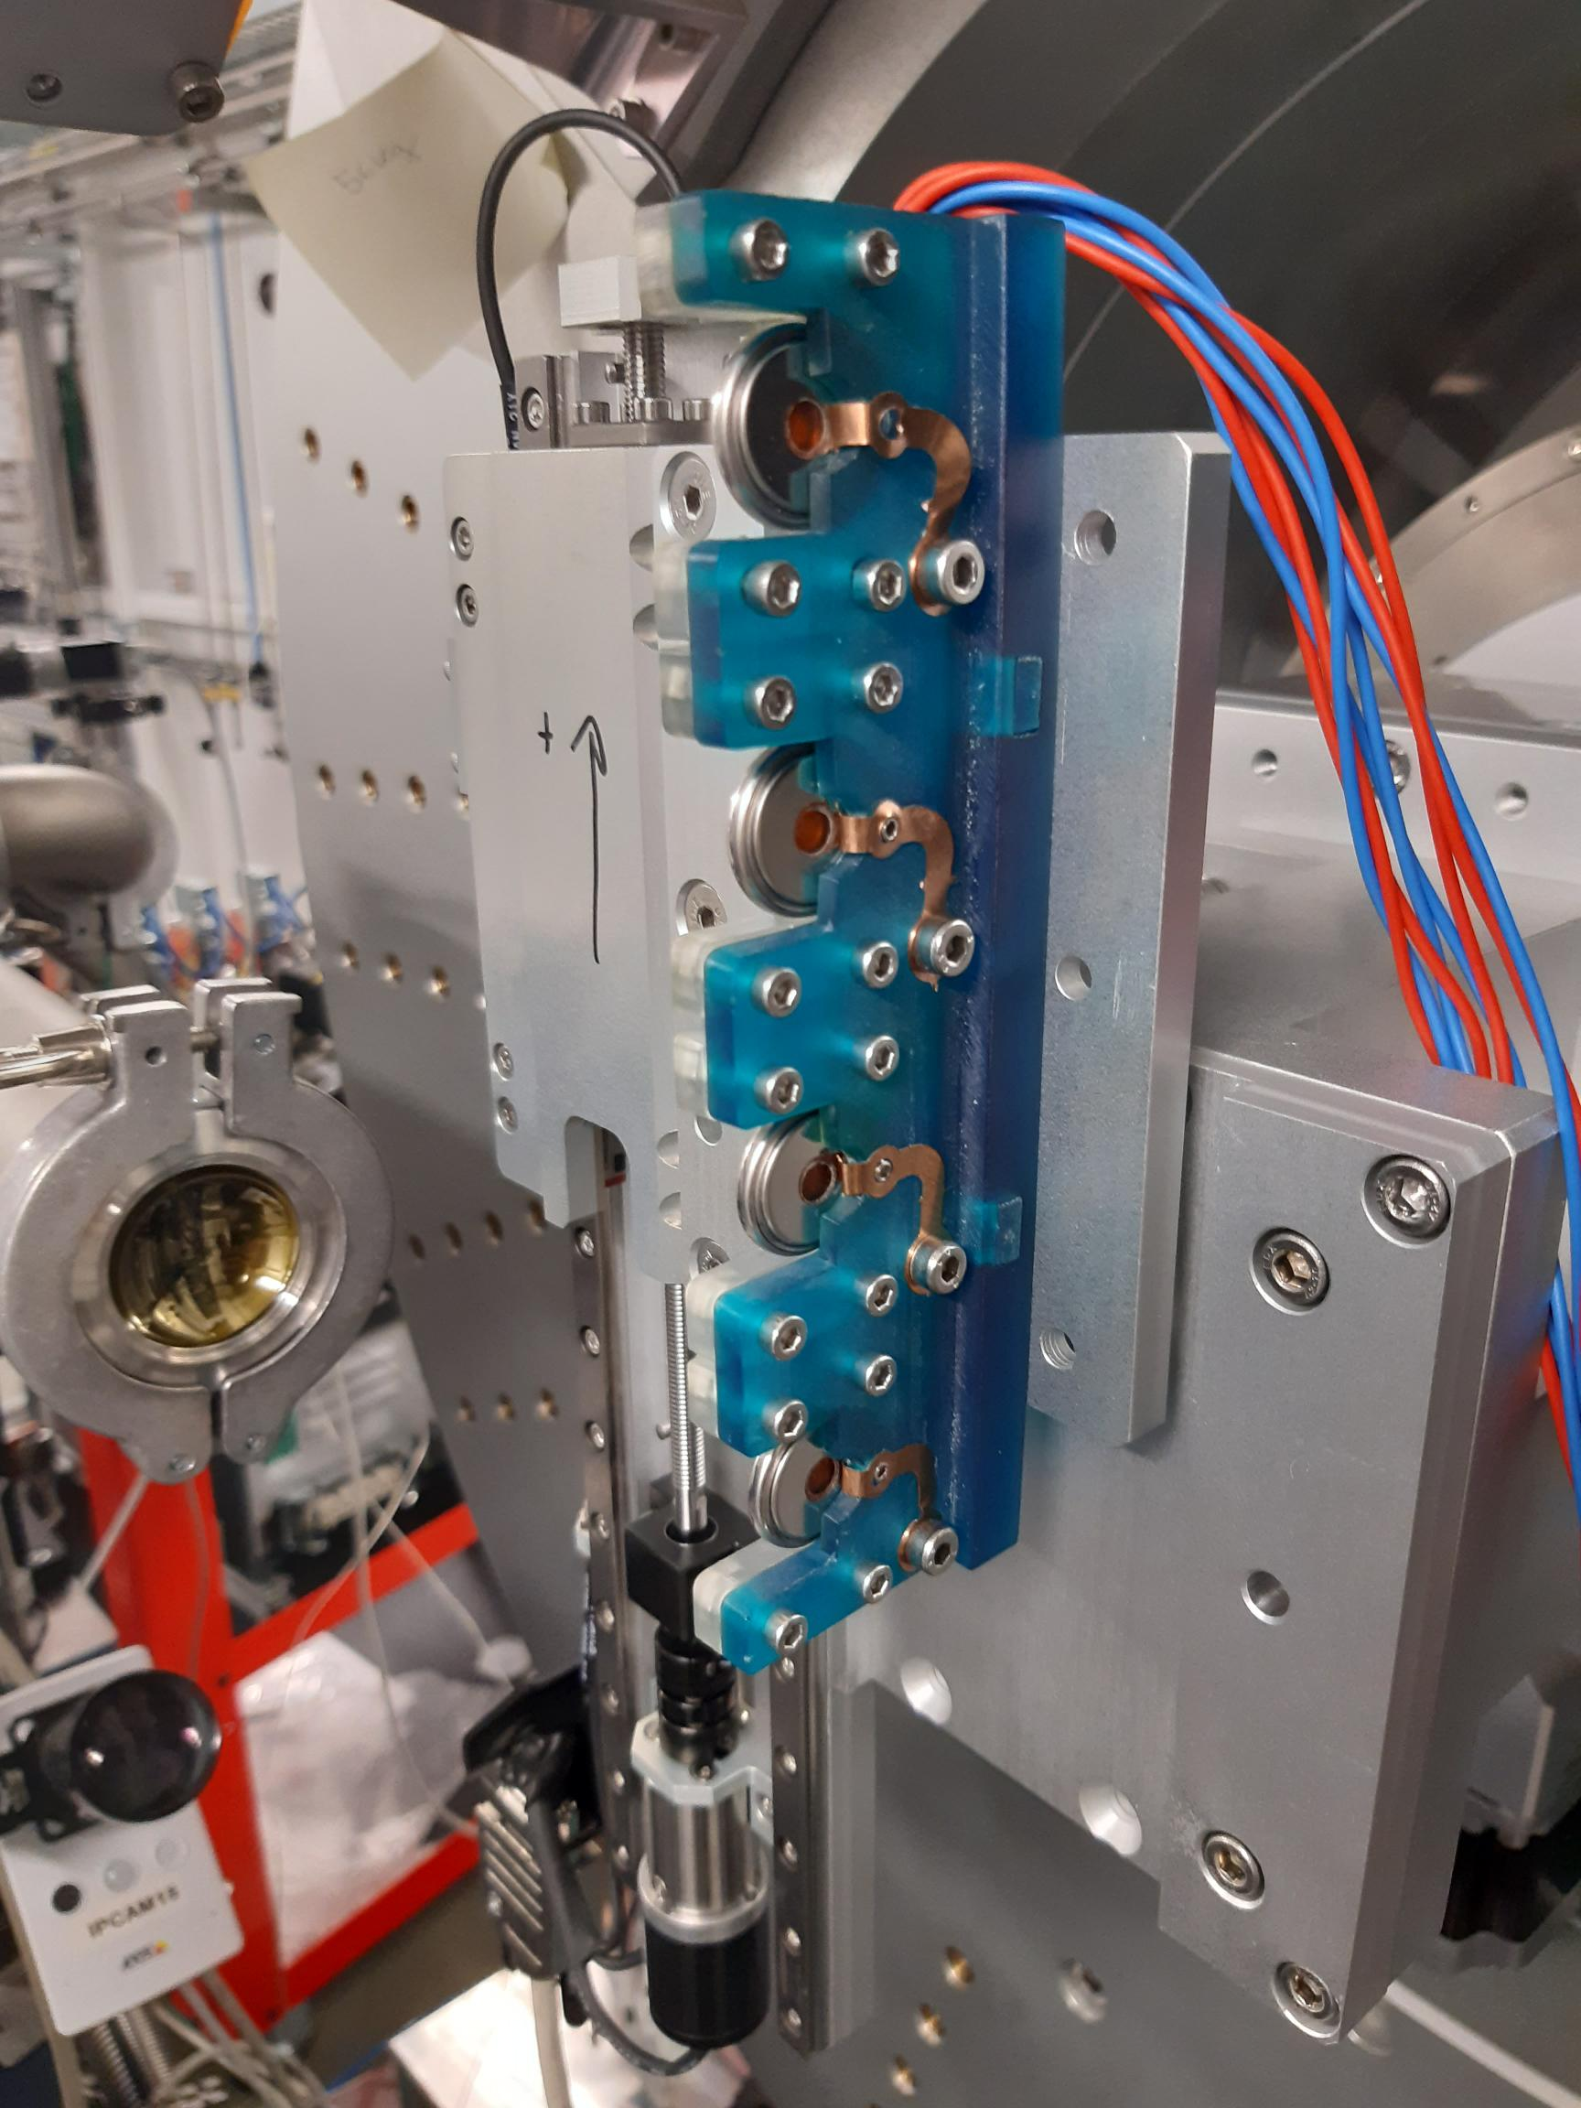
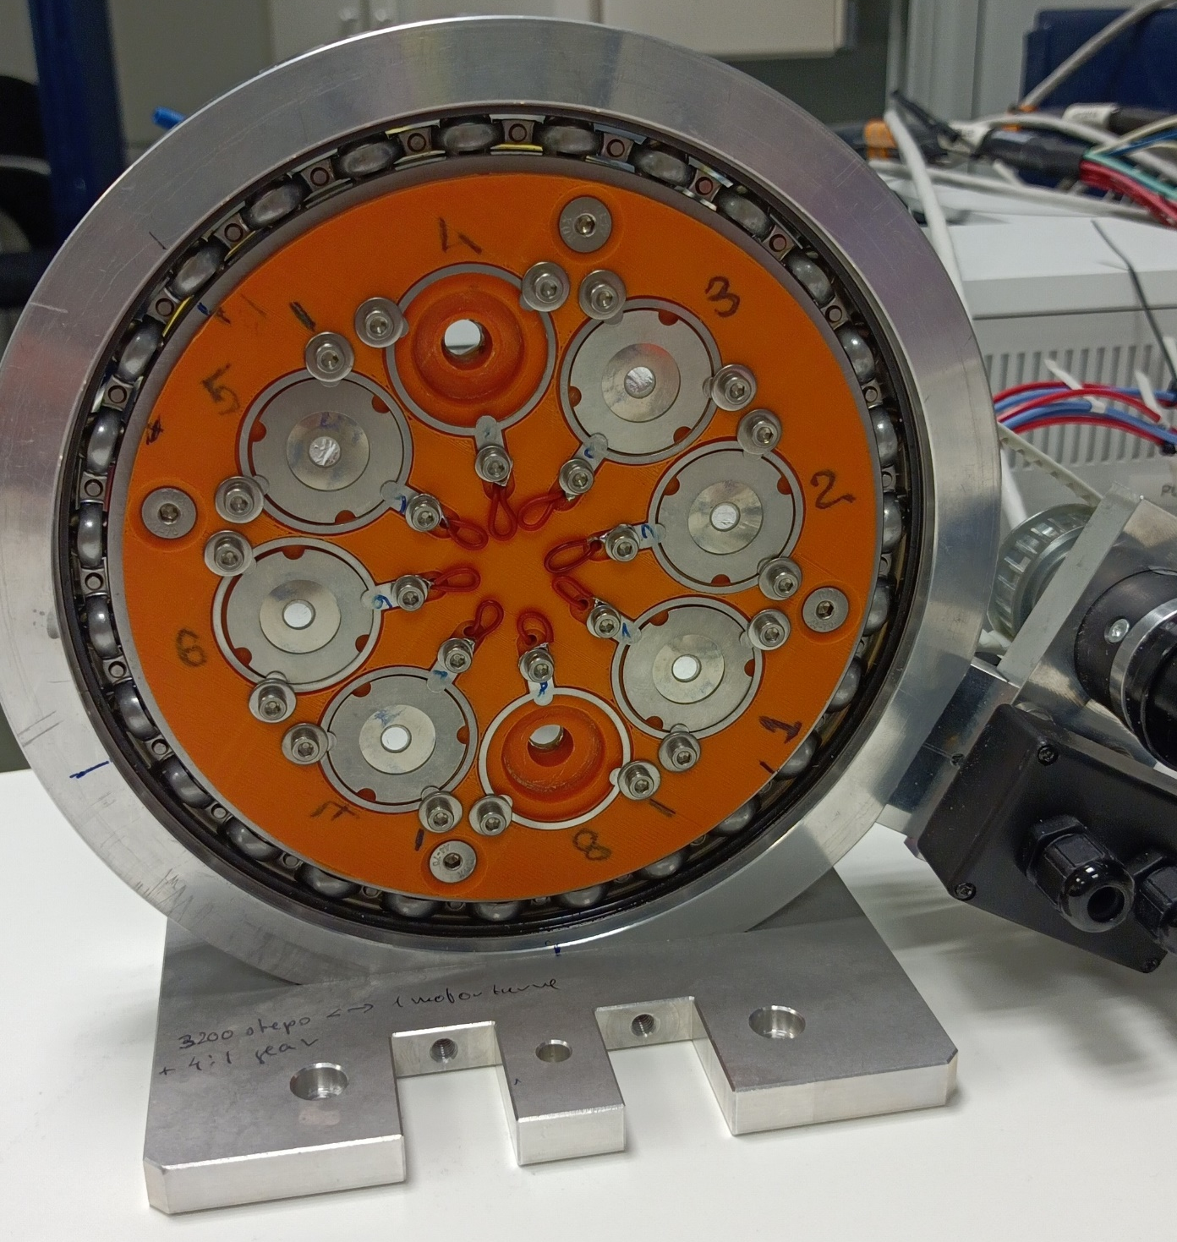
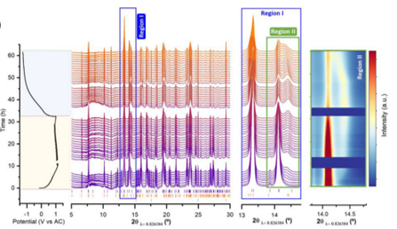
Operando at MSPD (Powder Diffraction beamline)
Thermalized cells
Operando Leriche type cells
LRCS
Glass and Kapton coin cells
Technical Specifications
Energy range | 8 - 50 keV
Flux | ~ 4·10¹² ph/s
Energy resolution | 2·10⁻⁴
Black, A. P. et al. ENERGY STORAGE MATER. Vol.47,2022,354-364. (2022)
Michael Knapp, Helmut Ehrenberg (KIT)

Slide 7
Operando capabilities at Alba Synchrotron
Operando at

Slide 8
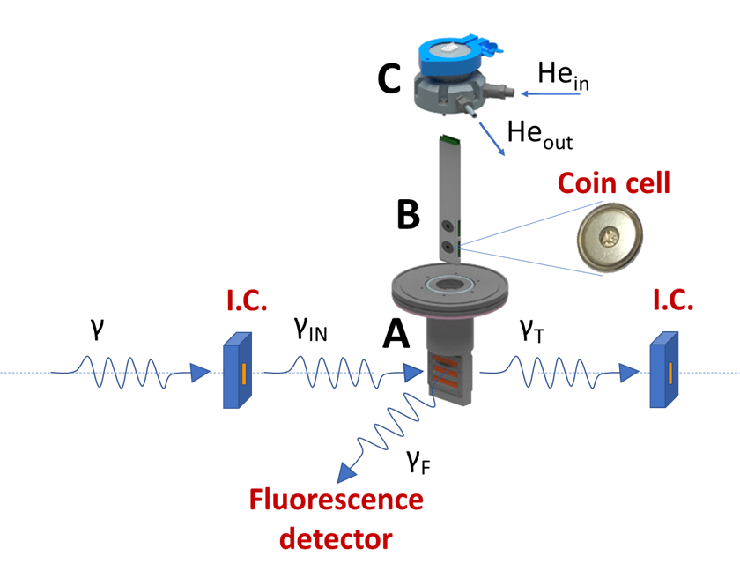
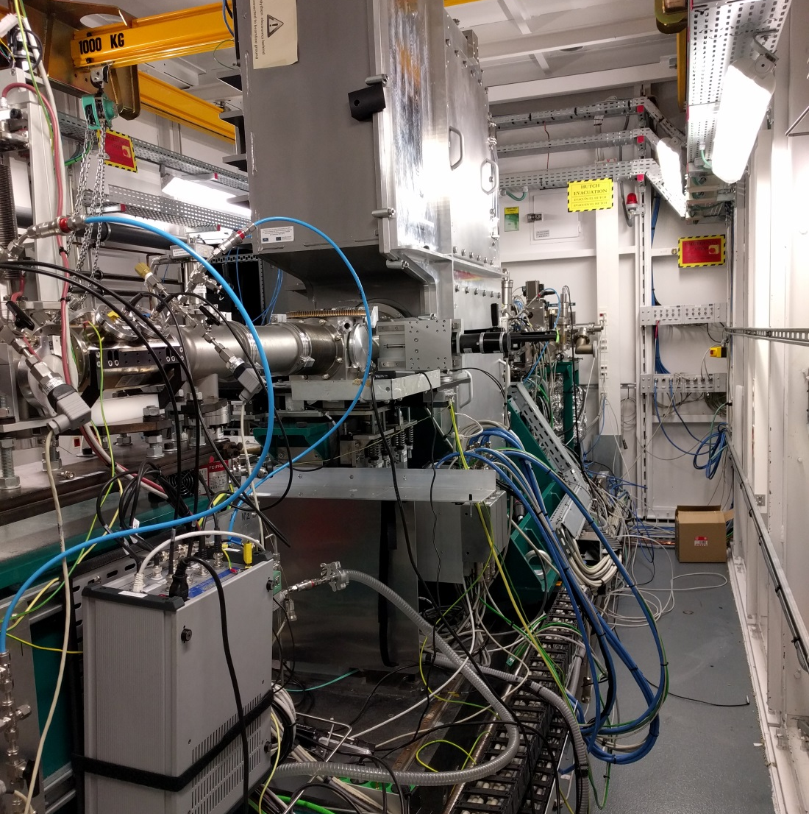
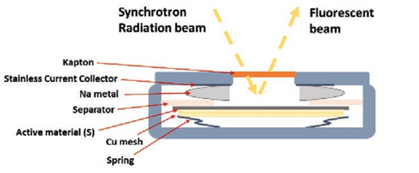
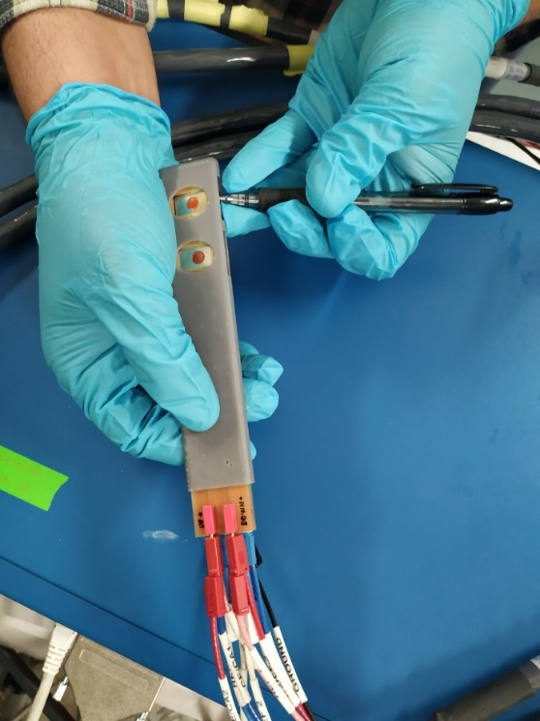
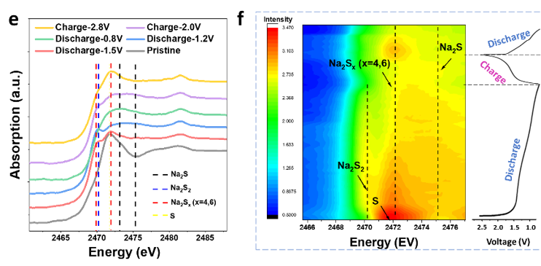
Operando at CLÆSS: the X-ray absorption and emission spectroscopy beamline
Operando conditions accessible at CLÆSS down to the S K-edge
Technical Specifications
Energy range XAS | 2.4 – 63.2 KeV
Energy range XES | 6-22 KeV
Acquisition mode | TR, TFY, PFY, TEY
Spot size | between 200x100 µm² and 8x1 mm (HxV)
1
2
Can Wu et al., Adv. Mater. 2022, 2108363

Slide 9
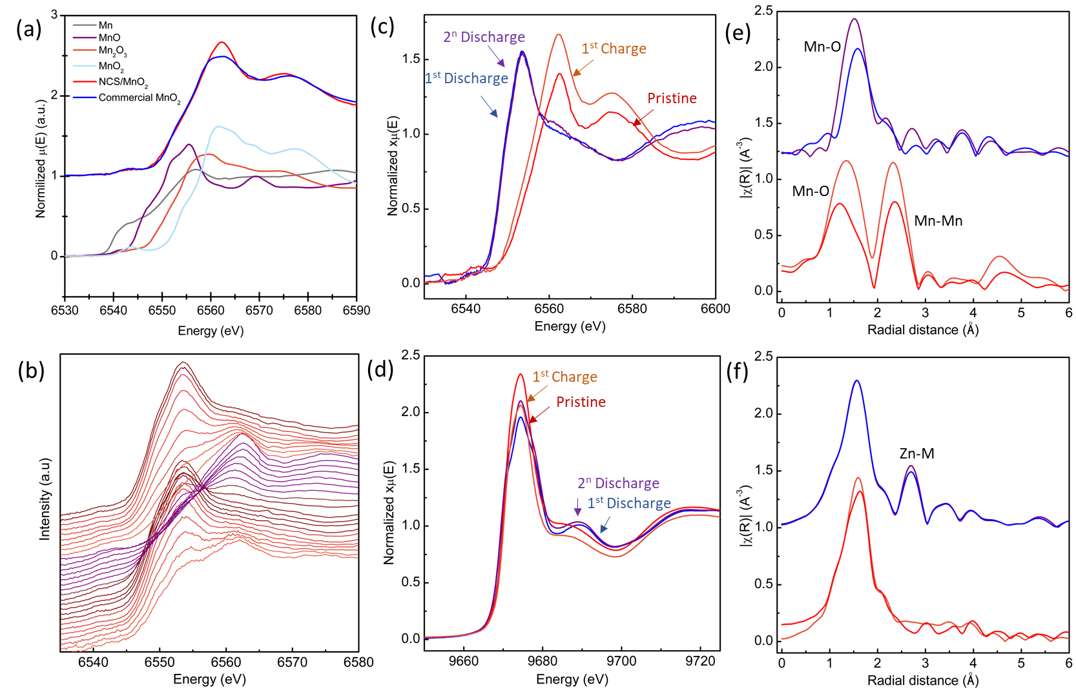
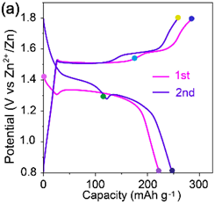
Operando at CLÆSS: the X-ray absorption and emission spectroscopy beamline
Aqueous Zn-MnO₂ batteries
2 M ZnSO₄ with 0.2 M MnSO₄ aqueous electrolyte
Formation of Zn₄(OH)₆SO₄·5H₂O
Wenhai Wangª, Cheng Liuª, Ashley P. Blackª, Vlad Martin-Diaconescu^{b}, Laura Simonelli^{b}, Anna Laromaine,ª Anna Roig,ª Dino Tonti ª

Slide 10
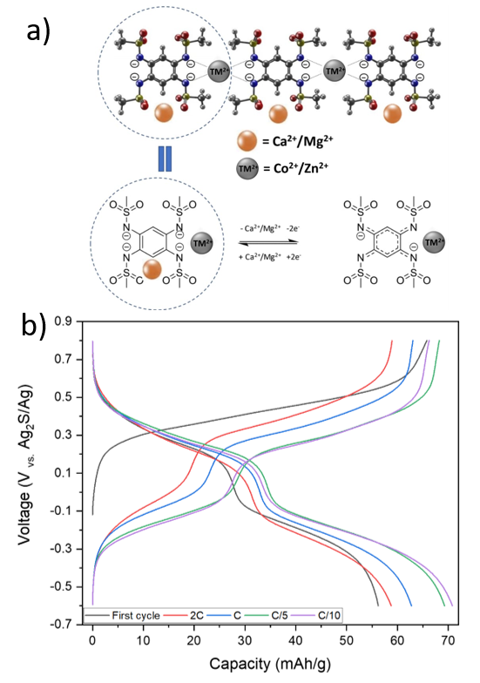
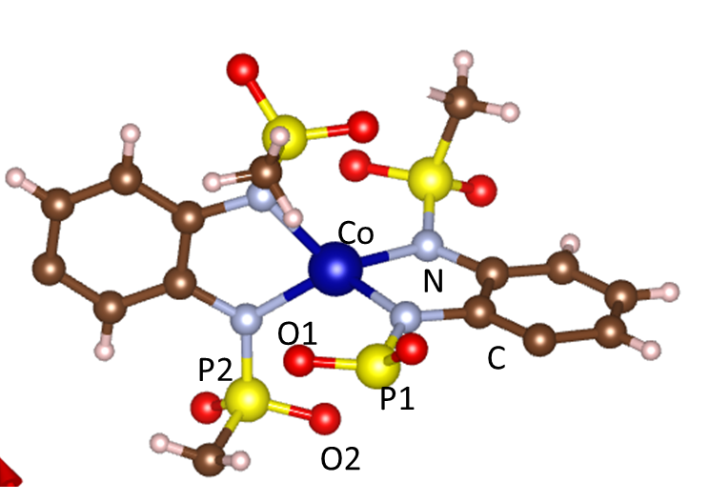
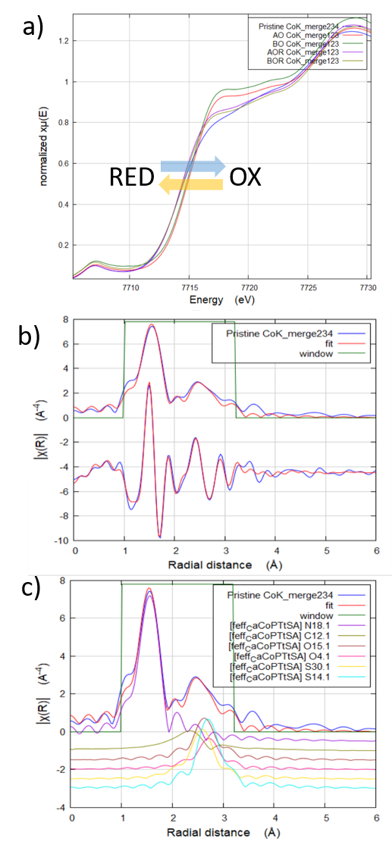
Operando at CLÆSS: the X-ray absorption and emission spectroscopy beamline

Slide 11

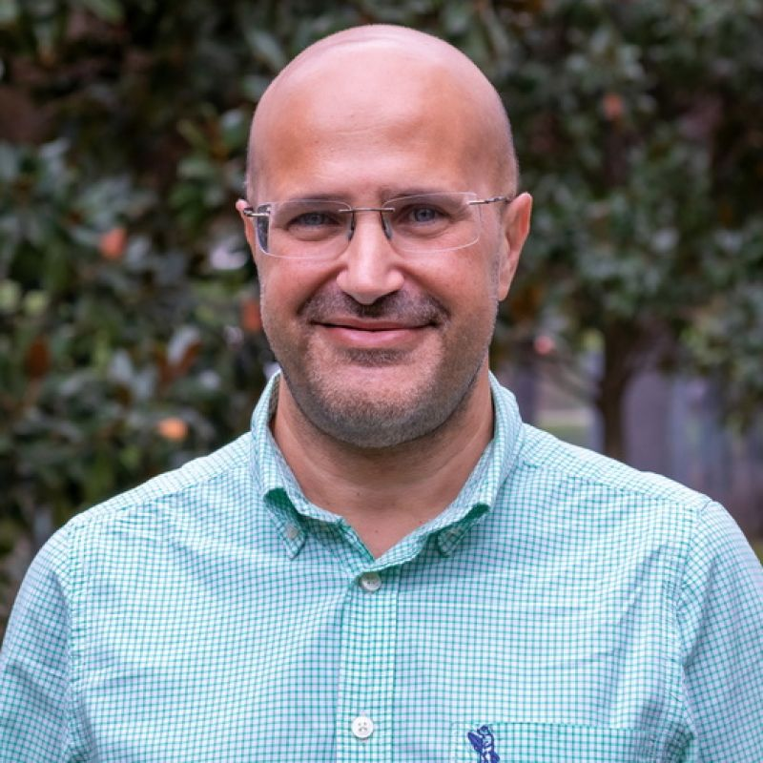
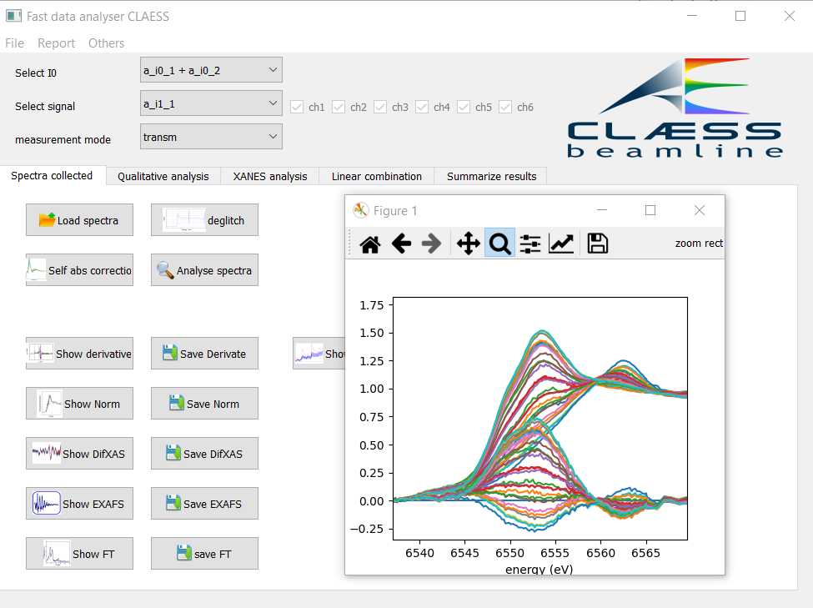
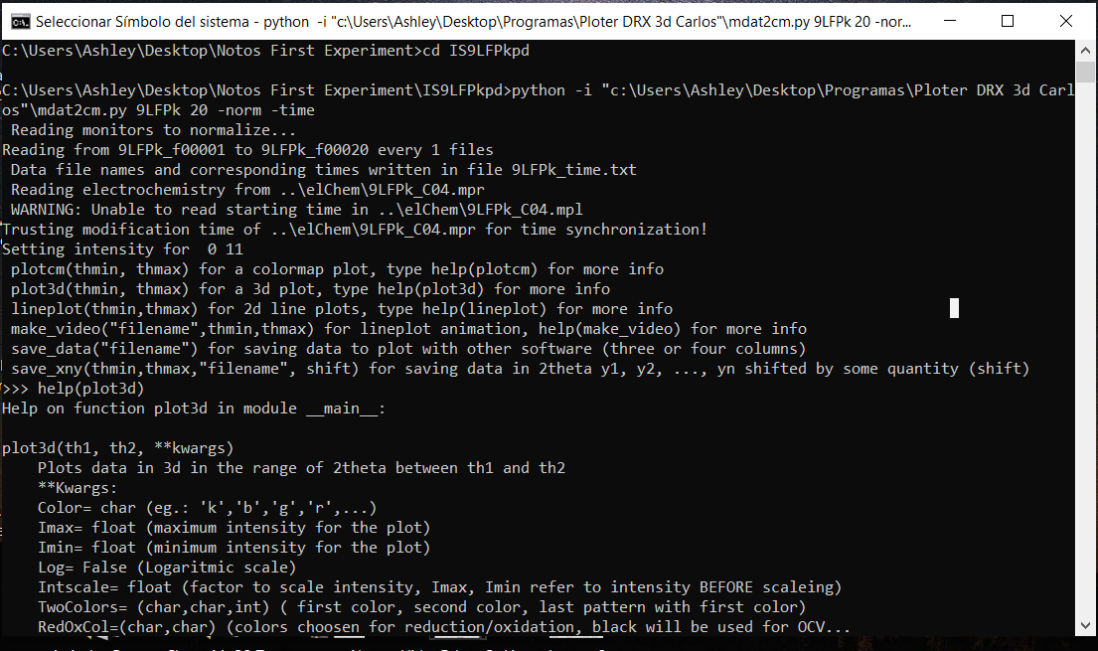

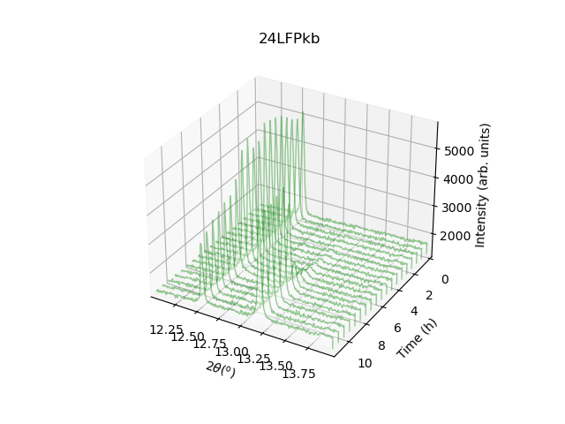
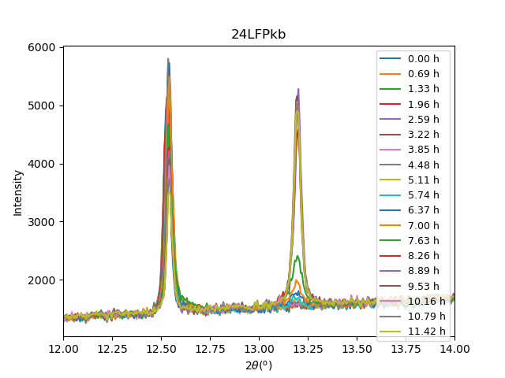
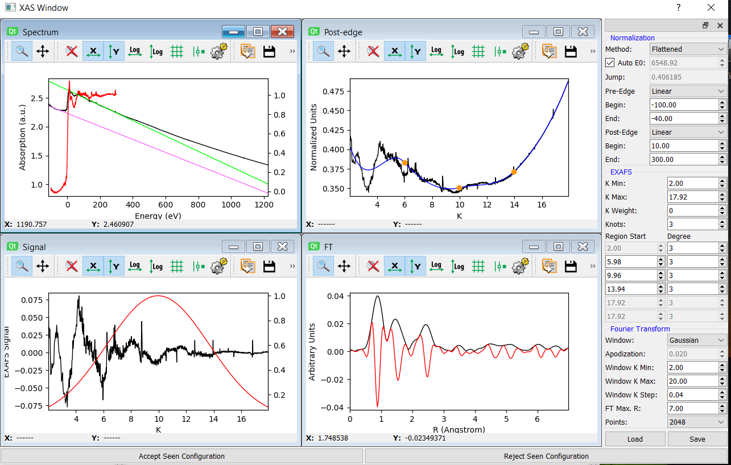
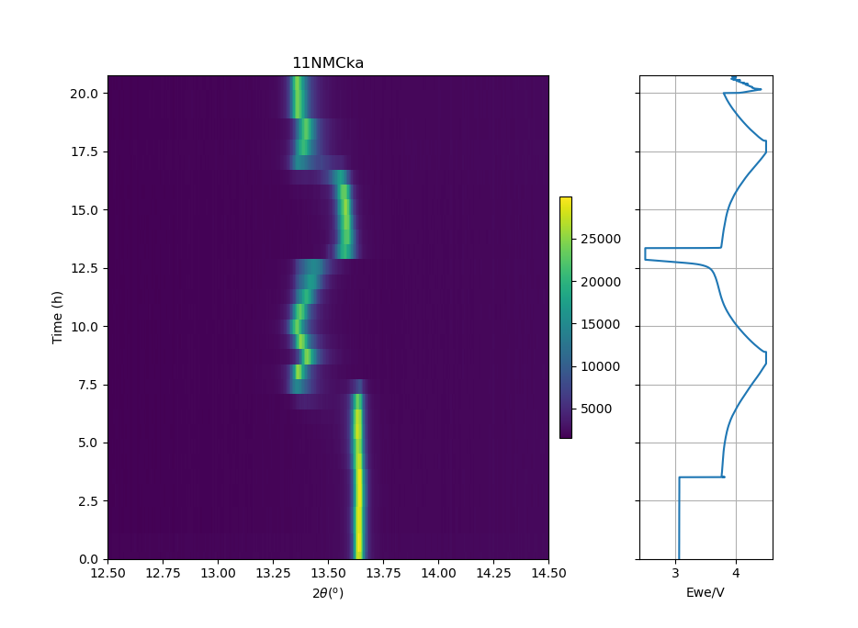
Operando Software development
Fast Data Analyzer (FDA)
Operando Ploter (Oplot)
Carlo Marini
Carlos Frontera
Available at CLAESS and NOTOS
Available at MSPD and NOTOS

Slide 12
Operando capabilities at Alba Synchrotron
Operando at

Slide 13
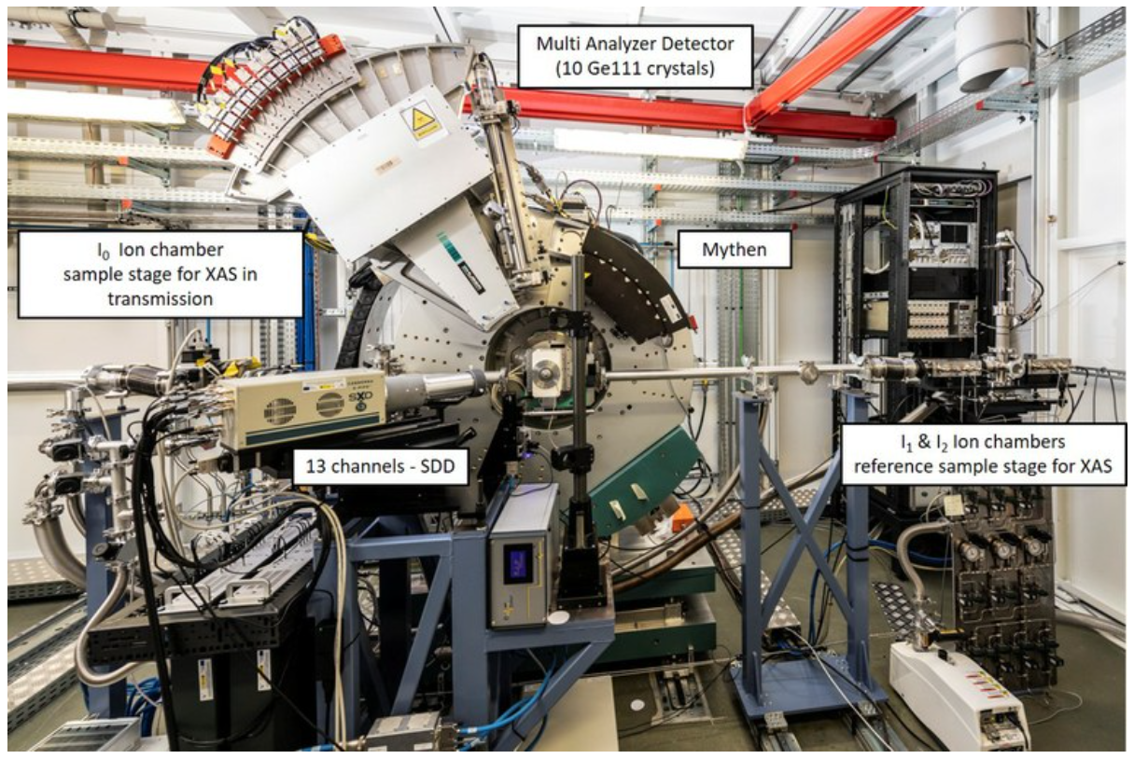
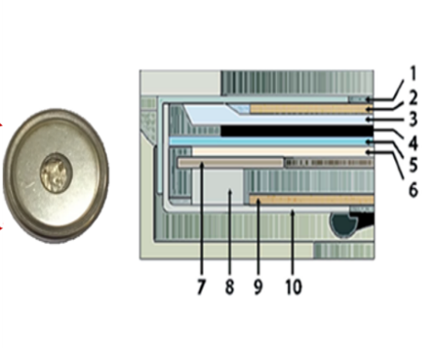
Operando PD+XAS at NOTOS
Operando Cells Leriche type and 2032 CoinCells
Technical Specifications
Monochromator | DCM (Si 111 and Si 220)
Energy range | 4.9 to 30 keV (<Ti K-Edge)
Flux | 10¹¹ ph/s
Spot size | between 100 µm² and 3x1 mm (HxV)

Slide 14
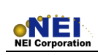
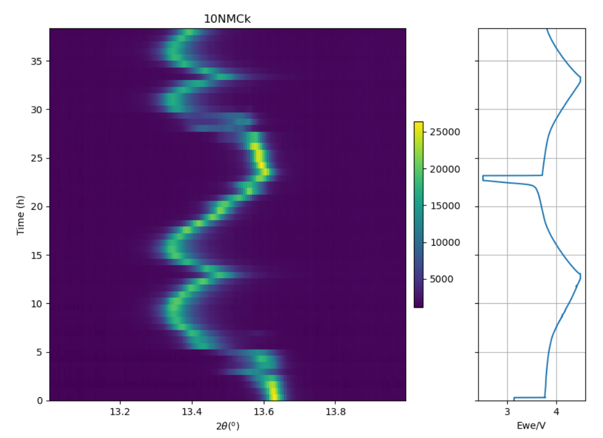
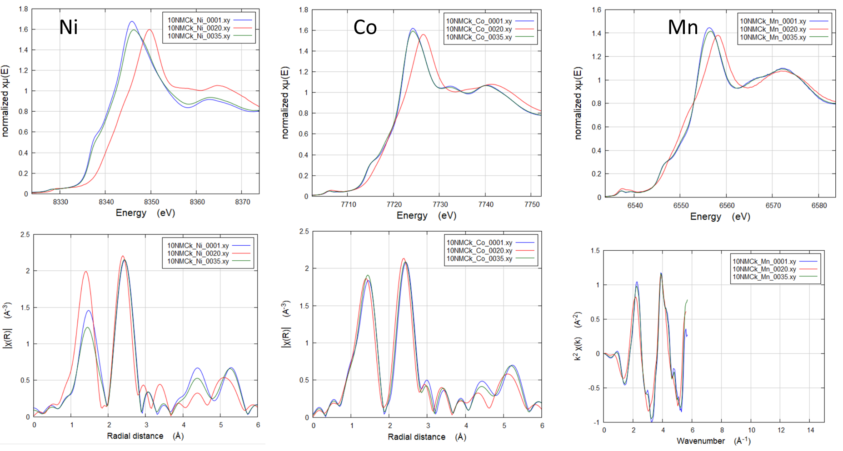
Operando PD+XAS at NOTOS
Cycled vs Li metal (MTI disc) in LP30 electrolyte ( LiPF₆ in EC:DMC)
• Lithium Nickel Manganese Cobalt Oxide (NMC111)
Active Material Loading: 12.9 mg/cm² ± 5%
Capacity: ≥ 170 mAh/g (2.5 – 4.1V @0.1C)
• Lithium Iron Phosphate (LiFePO₄)
Active Material Loading: 7.3 mg/cm² ± 5%
Capacity: ≥ 155 mAh/g (2.7 – 4.3V @ 0.1C)

Slide 15
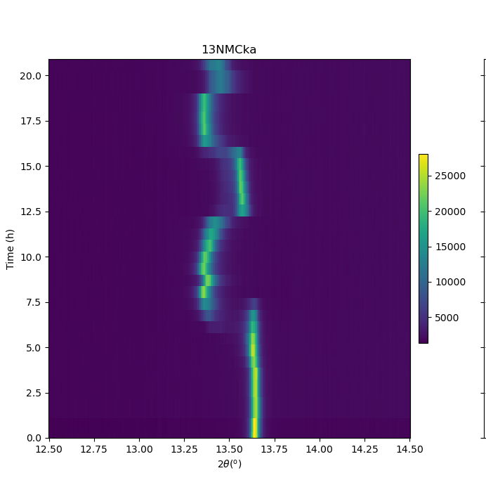
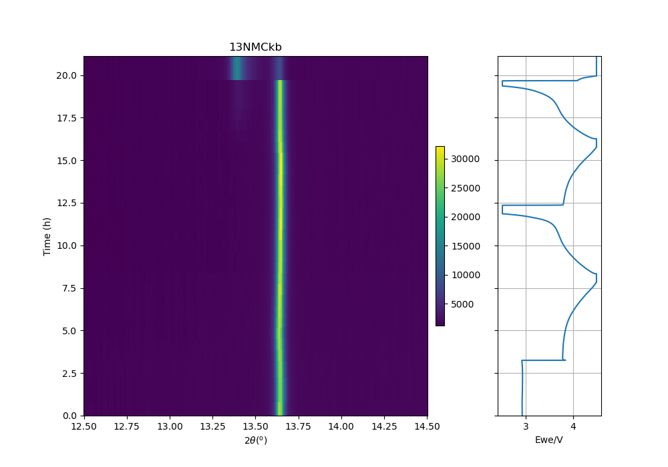
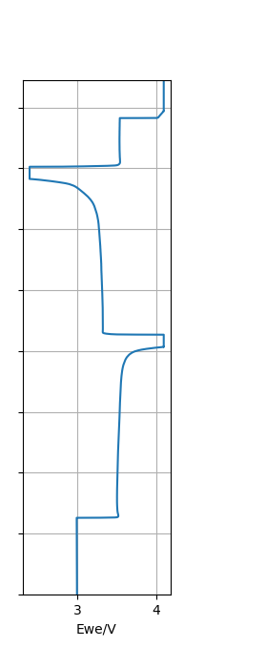
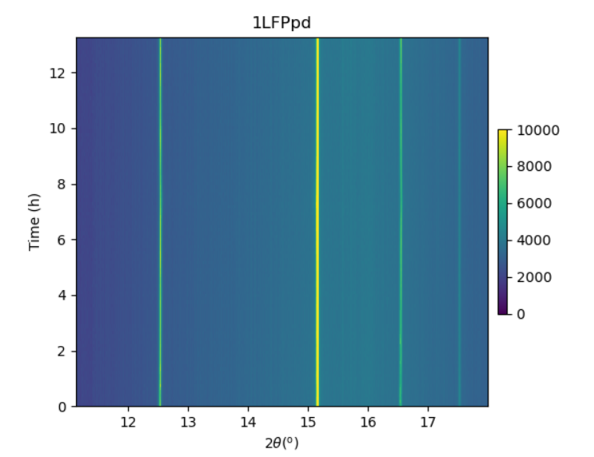
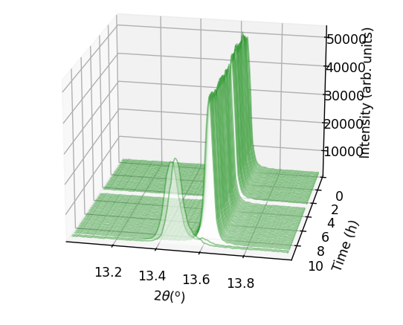
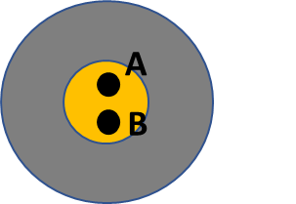

Operando PD+XAS at NOTOS
Cycled vs Li metal (MTI disc) in LP30 electrolyte ( LiPF₆ in EC:DMC)
• Lithium Nickel Manganese Cobalt Oxide (NMC111)
Active Material Loading: 12.9 mg/cm² ± 5%
Capacity: ≥ 170 mAh/g (2.5 – 4.1V @0.1C)
• Lithium Iron Phosphate (LiFePO₄)
Active Material Loading: 7.3 mg/cm² ± 5%
Capacity: ≥ 155 mAh/g (2.7 – 4.3V @ 0.1C)
Point A PD (1min) 11KeV
Point B PD+XAS (318s) Ni K-edge
Beam Inhibition, reversible, independent of cell geometry, time and energy dependent

Slide 16









Operando PD+XAS at NOTOS
At1= 70% (100um Al) vs At2= 90% (250um Al)
A(1minPD+1min Rest)
A(1minPD+1min Rest)
EXAFS
70%
EXAFS
90%
XANES
70%
XANES
90%
B(1min PD + EXAFS Ni (3min))
B(1min PD + XANES Ni (68s))

Slide 17








Operando PD+XAS at NOTOS
At1 70% A(1minPD+1min Rest) + B(1min PD + EXAFS Ni (3min))
At2 90% A(1minPD+1min Rest) + B(1min PD + EXAFS Ni (3min))

Slide 18



Operando PD+XAS at NOTOS
Main Factors
- Photon Energy (Near edge)
- Photon Flux
- Exposure Time/Rest Time
- Number of Points (2-3)
- Spot size (Focus)
• Porosity
• Stack pressure/rigidity
• Electrode wettability
• Electrolyte/electrode ratio
• Electrolyte viscosity and volatility
• Particle size ( nano, micro, meso)
• Stability (Structural, thermal, electrochemical)
• Composition and Solubility
Beam induced inhibition mechanisms
Gasification of the electrolyte dyes out the electrolyte at the measurement spot preventing from electrochemical reaction to occur
Ar (g), CO₂ from electrolyte decomposition

Slide 19
Operando capabilities at Alba Synchrotron
Operando at MIRAS

Slide 20





Operando at MIRAS
Operando infrared microspectroscopy in battery application: Lithium, sodium and calcium reversible intercalation in polyimide homopolymer (PIHOMO) and co-polymer (PI-COPO) positive electrode materials.
Technical Specifications
Source | Bending magnet, edge + constant field
Energy range | 1.2 to 100 µm (Far and middle IR)
Flux | Aprox. 4e⁺¹³ Ph/s
Spot size | 10x10µm²
Operando Cell (ECC-Opto-Std, EL CELL)

Slide 21



Operando at MIRAS
Polyimide as Cathodes for Alkali- (Li⁺, Na⁺) and Alkaline Earth (Ca²⁺, Mg²⁺)-Metal-Ion Organic Batteries
Infrared Spectra (FTIR) of the Polyimide Cathodes
C-N Streching
Skeletal vibration
1100
(C)₃-N Streching
1255
1175
1M NaTFSI
Stretching ternary amide
1M LiTFSI
Ring and CH Stretching
1355
1673
1703
1455
1580
0.5M Mg(TFSI)₂
0.5M Ca(TFSI)₂

Slide 22




Operando at MIRAS
Sample
Sample+CaF₂
Sample+Sapphire
Sample+Glass
Interference pattern due to partial reflection
200µm SrF₂
500µm ZnSe
500µm Si
Feynman, Richard (1985). QED: The strange theory of light and matter. Princeton University Press. ISBN 0-691-08388-6.

Slide 23
Operando at MIRAS
Spatial and Temporal Resolution of Synchrotron Radiation vs Internal Source
Synchrotron Source
Globar Source
Polyimide/LiTFSI in DG /ACC
with ECC-Opto-ELCELL and Si (500µm)

Slide 24


Operando FTIR at MIRAS

Slide 25


Operando FTIR at MIRAS
Polyimide/1M LiTFSI in DG /ACC with ECC-Opto-ELCELL and Si (500µm)

Slide 26

Operando FTIR at MIRAS

Slide 27

Operando FTIR at MIRAS
Fast Operando Infrared Microspectroscopy Maping (5C)

Slide 28
Operando capabilities at Alba Synchrotron
Steps towards In-situ Microscopy at

Slide 29





Steps towards In-situ Microscopy at MISTRAL SOFT X-RAY MICROSCOPY BEAMLINE
Li/O₂ batteries
M.Olivares-Marín, et al.Nano Lett. 2015, 15, 6932−6938
Ca Metal batteries
Technical Specifications
Source | Bending magnet
Energy range | 270-1200 eV
Energy Resolution | Up to 5x10⁺³
Sample support | TEM grid dual-axis tomography
D. S. Tchitchekova, et al. Chem.Mat. 2018 30 (3), 847-856

Slide 30










Steps towards In-situ Microscopy at MISTRAL
Design of microelectrodes compatible with soft X-ray microscopy operating studies in the MISTRAL beamline (similar to the system already commercially available for transmission electron microscopy).
Mask
50nm Si₃N₄ membrane
Si wafer before dicing
Andrea Sorrentino (ALBA)
Dino Tonti (ICMAB)
Francesc Perez-Murano (CNM)
Olga Muntada (CNM)
R. Valcarcel (ALBA)
Victor Fuentes (ICMAB)
Lea Chaptal (ICMAB)
A.Black (ICMAB)

Slide 31







Steps towards In-situ Microscopy at MISTRAL
LiMn₂O₄ Particles
(separation by centrifugation for deposit on electrodes)
-Li
+Li
Mn₂O₄ LiMn₂O₄ Li₂Mn₂O₄

Slide 32
Operando capabilities at Alba Synchrotron

Slide 33



Battery Laboratory at Alba
PTI+ TRANS-ENER+
Transición Energética Sostenible

Slide 34
Acknowledgements
MSPD
François Fauth (Alba)
M. Rosa Palacin (ICMAB)
Raphaelle Houdeville (Alba)
Carlos Frontera (ICMAB)
CLAESS
Laura Simonelli (Alba)
Carlo Marini (Alba)
V. Martin-Diaconescu (Alba
Wenhai Wang (ICMAB)
Cheng Liu (ICMAB)
NOTOS
Giovanni Agostini (Alba)
Carlos Escudero (Alba)
Marine Reynaud (CIC)
Marcus Fehse (CIC)
Joseba Orive (CIC)
MIRAS
Ibraheem Yousef (Alba)
Alexandre Ponrouch (ICMAB)
Damien Monti (Alba)
MISTRAL
Andrea Sorrentino (Alba)
Dino Tonti (ICMAB)
Francesc Perez-Murano (CNM)
Olga Muntada (CNM)
Victor Fuentes (ICMAB)
Lea Chaptal (ICMAB)
PTI+ TRANS-ENER+
Transición Energética Sostenible

