Slide 1
ALBA II Accelerator Upgrade Project
Francis Perez
September 8th, 2022
X AUSE Conference & V ALBA User’s Meeting

Slide 2
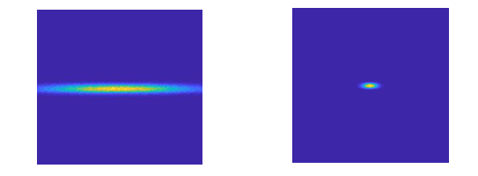
Objective
Upgrade the 3rd Generation ALBA Storage Ring
to a 4th Generation Ultra Low Emmittance Ring: ALBA II
with the aim of doing the it as efficiently as posible,
in terms of cost and time.

Slide 3
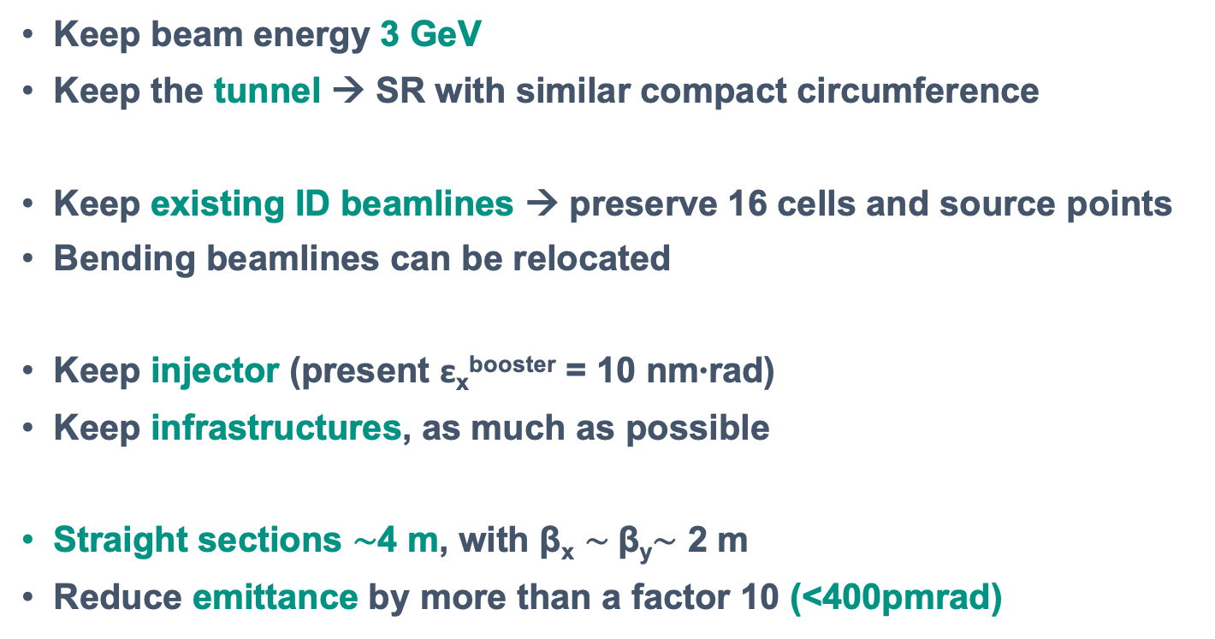
Optimization parameters
Keep beam energy 3 GeV
Keep the tunnel → SR with similar compact circumference
Keep existing ID beamlines → preserve 16 cells and source points
Bending beamlines can be relocated
Keep injector (present ε_{x}^{booster} = 10 nm∙rad)
Keep infrastructures, as much as possible
Straight sections $\sim$4 m, with β_{x} $\sim$β_{y}$\sim$ 2 m
Reduce emittance by more than a factor 10 (<400pmrad)

Slide 4
Present lattice

Slide 5
Proposed solution
From 2x8 double-bend lattice
to 16 multi-bend lattice (6BA)

Slide 6
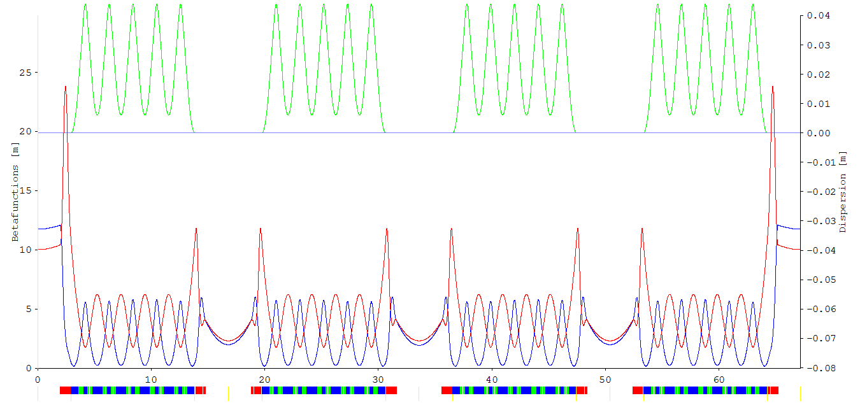
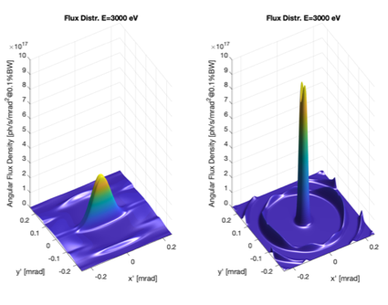
The 6BA lattice
4 fold symmetry
1/4
High beta
required
for Injection
At ID positions, with 100% coupling,
almost round beam
Transversal beam size comparison:
At ID position, today:
σ_{x} = 127 um ; σ’_{x} = 47 urad
σ_{y} = 5.2 um ; σ’_{y} = 4,4 urad
At ALBA II ID position,
with 100% coupling, almost round beam:
σ_{x} = 14.0 um σ’_{x} = 7.1 urad
σ_{y} = 15.1 um σ’_{y} = 6,6 urad

Slide 7
Comparison of some ALBA IDs
Brilliance Horizontal Coherent fraction
100 eV 1 keV 10 keV
100 eV 1 keV 10 keV
vs. Photon Energy

Slide 8
Straigth sections for IDs
308 mm
308 mm
With high betas (β_{x}=11,7 ; β_{y}=10,0)
But 3 will be used for
the Accelerator:
1 for Injection
2 for RF
308 mm

Slide 9
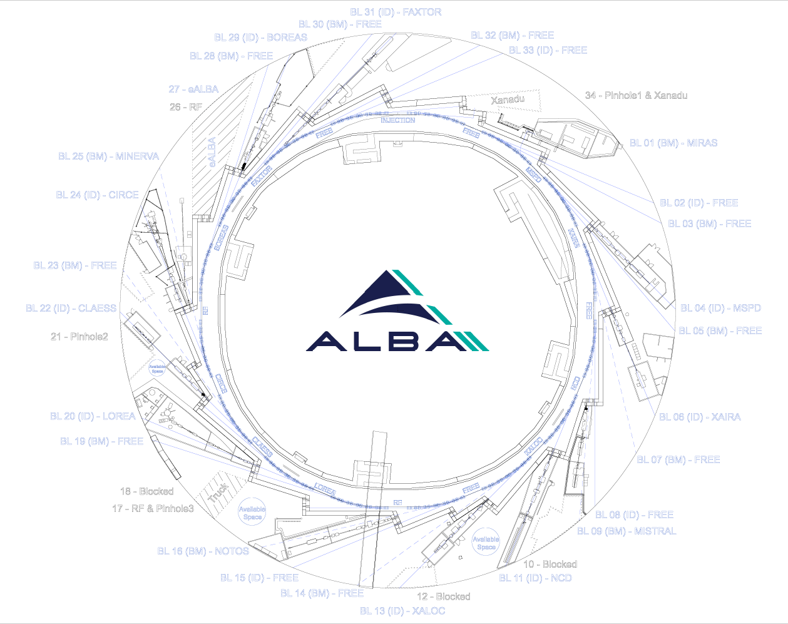
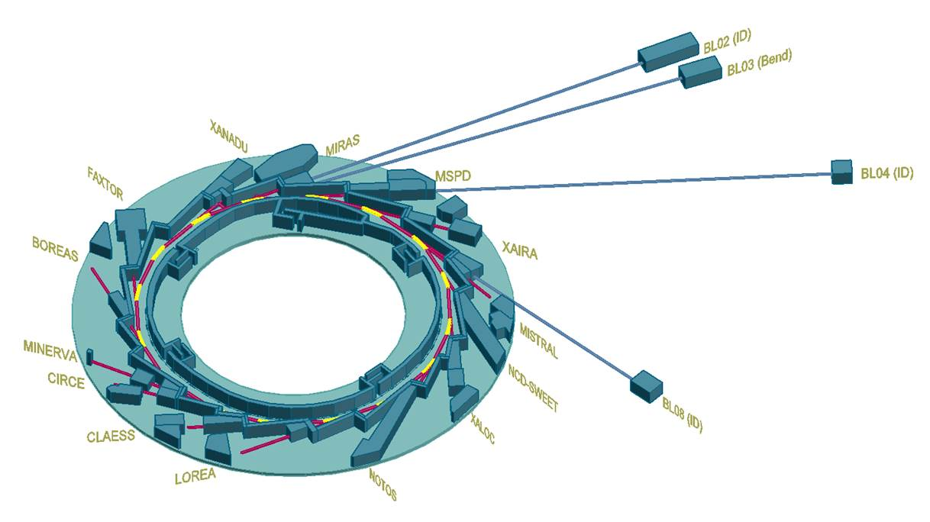
Implementation
Possible long beamlines at BL02-ID , BL03-Bend, BL04-ID, BL08-ID

Slide 10
Bending Ports
BM | BL |  | SuperBend | Comments
SR02_QD_3 ? | 1 | MIRAS
SR02_QD_1 | 3 | FREE | Ok
SR03_QD_1 | 5 | FREE |  | Limited space due to MSPD
SR04_QD_2 | 7 | FREE
SR05_QD_1 | 9 | MISTRAL
 | 10 | Blocked |  | NCD
 | 12 | Blocked |  | Xaloc
SR07_QD_2 | 14 | FREE
SR08_QD_2 | 16 | NOTOS | Ok (-2.5º) | Superbend requires to move BL 480mm
 | 18 | Blocked |  | Truck entrance
SR09_QD_4 | 19 | FREE | Ok
 | 21 | Blocked |  | CLAESS – Used for Pinhole2
SR11_QD_2 | 23 | FREE
SR12_QD_2 | 25 | MINERVA
 | 27 | Blocked |  | eALBA
SR13_QD_3 | 28 | FREE | Ok
SR14_QD_4 | 30 | FREE | Ok
SR15_QD_4 | 32 | FREE | Ok
 | 34 | Blocked |  | Pinhole1 + Xanadu
ID Ports
Straight | BL |  | Comments
SR01 | 2 | FREE
SR02 | 4 | MSPD | 68mm displacement
SR03 | 6 | XAIRA
SR04 | 8 | FREE | 308mm displacement / Large Beta
SR05 | 11 | NCD
SR06 | 13 | XALOC | 68mm displacement
SR07 | 15 | 3SBar
SR08 | 17 | RF | & Pinhole3
SR09 | 20 | LOREA
SR10 | 22 | CLAESS | 68mm displacement
SR11 | 24 | CIRCE
SR12 | 26 | RF
SR13 | 29 | BOREAS
SR14 | 31 | FAXTOR | 68mm displacement
SR15 | 33 | FREE
SR16 | 0 | INJECTION
3x FREE
10x IN USE
3x ACCELERATOR
9x FREE
4x IN USE
6x BLOCKED

Slide 11
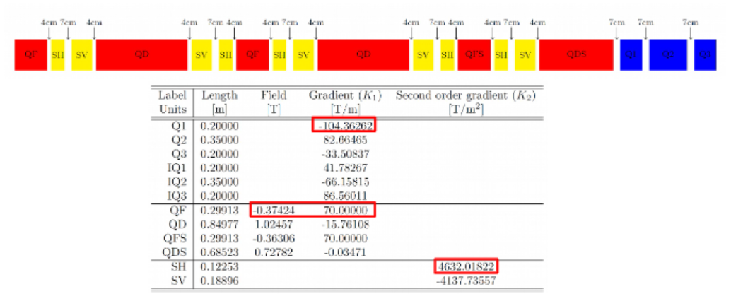
Implementation
Magnets
∼ 600 magnets
With power supplies
Some, permanent magnets?
Vacuum chambers
∼ 270 m vacuum chambers
SS, Cu, NEG coated
Girders
High vibration modes
High precision remote movement
Many others:
Upgrade RF system with SSA and 3rd Harmonic Cavity
New Diagnostics equipment
New Insertion Devices
…

Slide 12



ALBA II Enabling Technology Project
The Ministry gave CELLS a grant of 7.5 M€, for “the development of advanced technologies for ALBA II”.

Slide 13


ALBA II Enabling Technologies
2022- 2025
Design and prototype construction of
Magnets
NEG Coated vacuum chambers
Pulsed magnets
Girder for arc assembly tests
Nano-positioning lab
Superconducting Undulator

Slide 14
ALBA II Enabling Technologies
2022- 2025
The structure of project has been implemented such that will fit in the future ALBA II structure

Slide 15
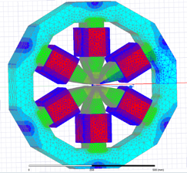
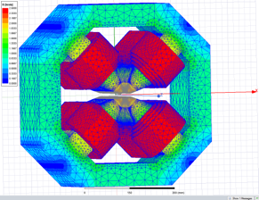
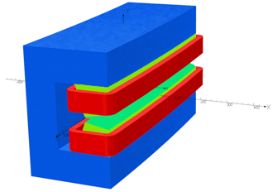
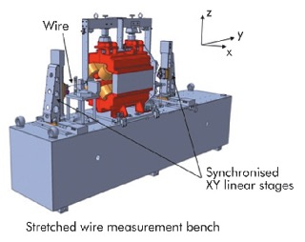
WP1 - Magnets
Magnets design
Prototypes definition
3) Upgrading the Mag Lab
ALBA II Enabling Technologies Project

Slide 16
WP2 - Vacuum
Reviewed requirements
First layout considerations
3) Stablishing collaborations with Max IV
ALBA II Enabling Technologies Project

Slide 17
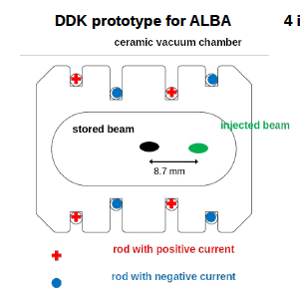
WP3 – Pulsed Magnets
Design done: Novel topology adopted → Double Dipole Kicker (DDK)
Call for tender published in July
3) Stablishing collaboration with SIRIUS
ALBA II Enabling Technologies Project

Slide 18
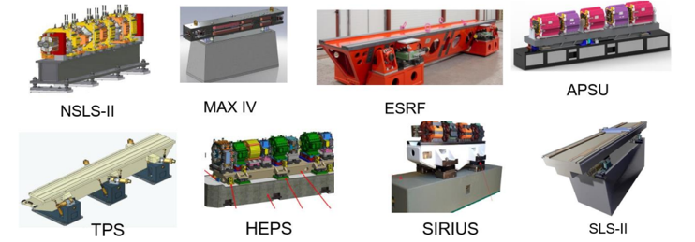
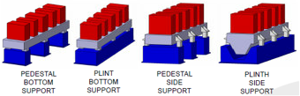
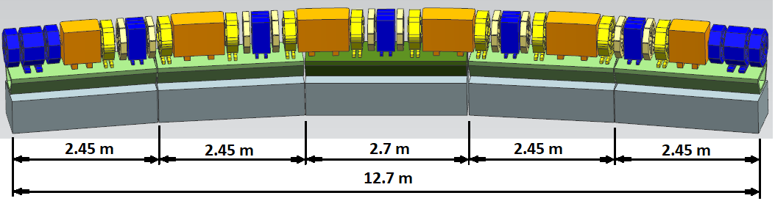
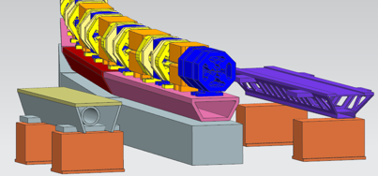
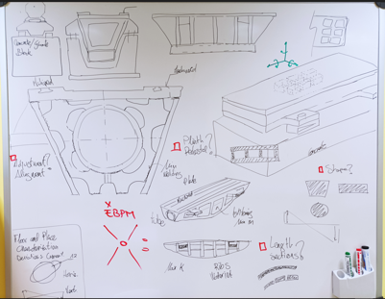
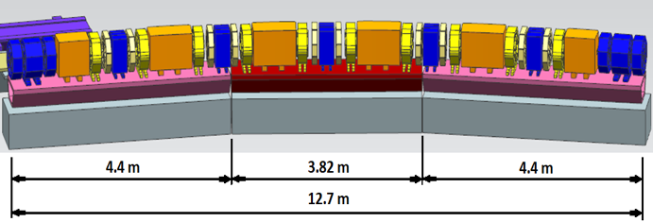
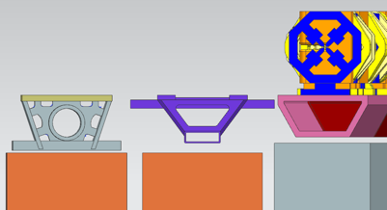
WP4 - Girders
Preliminary Research: evaluating alternatives from other projects.
First general concept designs
ALBA II Enabling Technologies Project

Slide 19
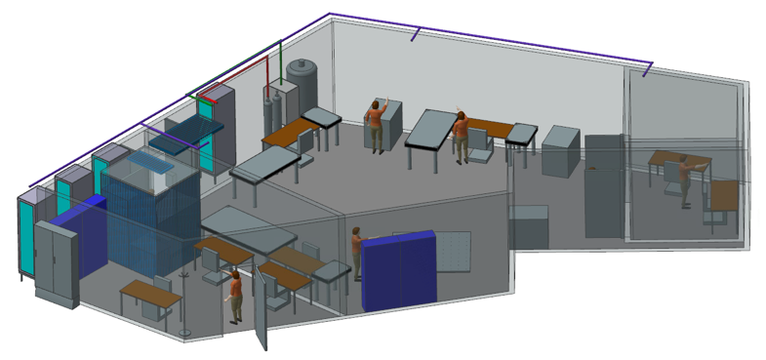
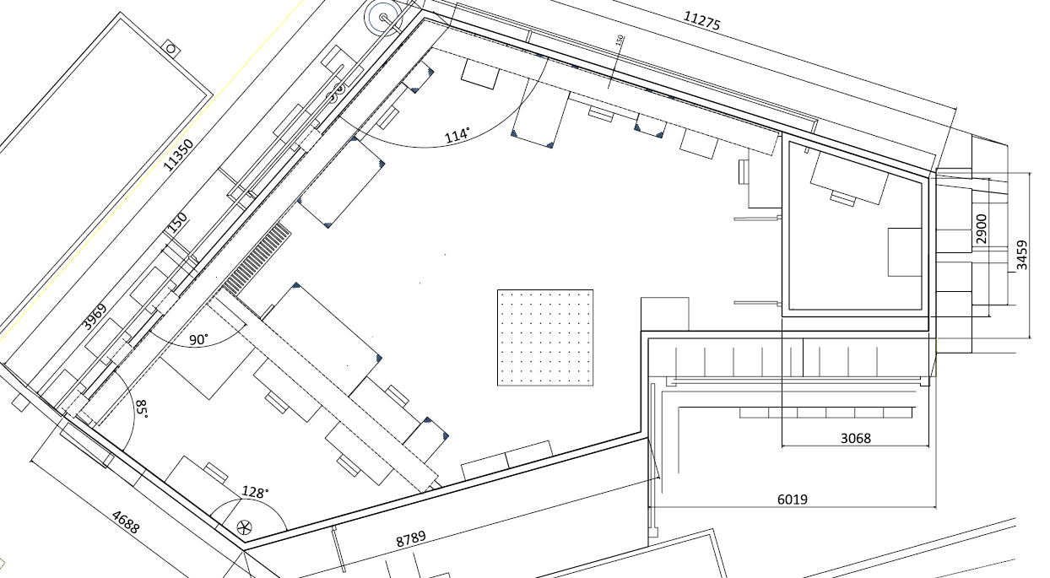
WP5 – Nanoposition Lab
Working on:
Spaces definition and detailing
Construction solutions
Services & Network
Conventional and Mechanical installations
Material:
Furniture, benches, tools, tooling list…
Instrumentation and controllers definition
ALBA II Enabling Technologies Project

Slide 20
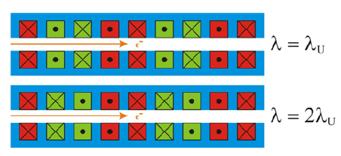
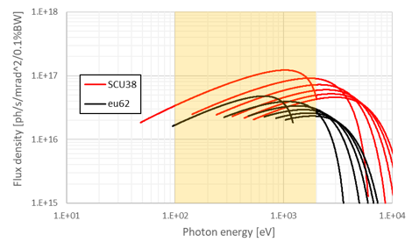
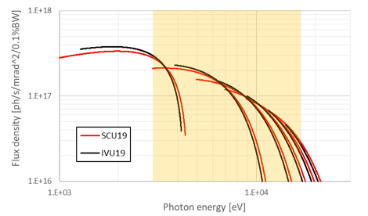
WP6 – Superconducting Undulator
Reviewing state of the art.
Analyzing best case for ALBA II requirements.
ALBA II Enabling Technologies Project

Slide 21
Conclusions
ALBA II is feasible:
emmittance ∼ 150 - 200 pmrad
betas X,Y ∼ 2.0 - 2.5 m
Up to 26 beamlines are feasible:
13 IDs
13 Bendings
Some of these bending positions can be used for up to 3T superbend.
Prototyping for the Acceleraror Upgrade has started.

Slide 22
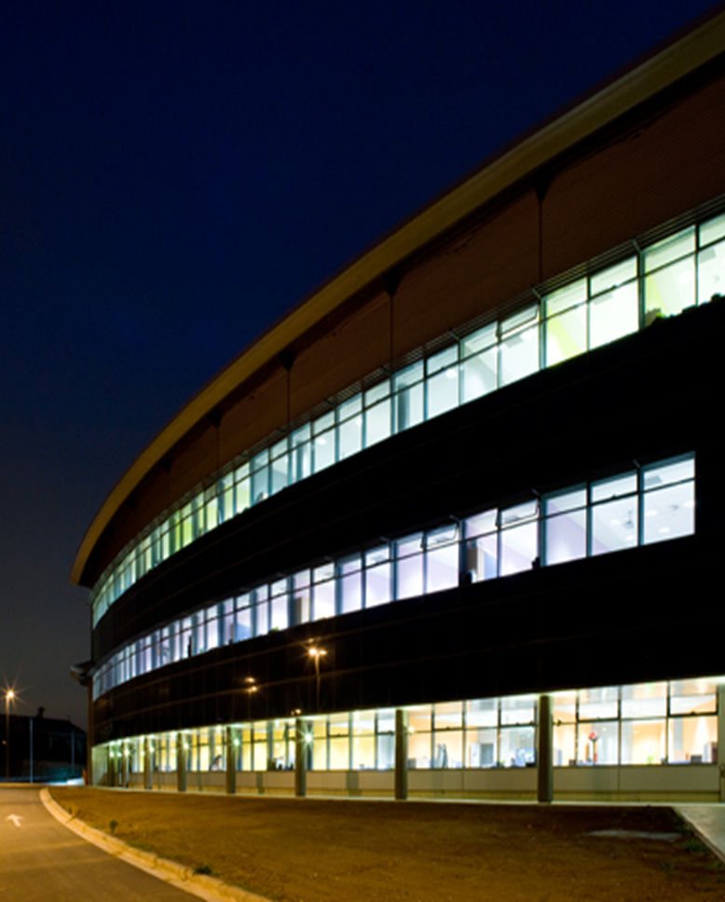
Thanks!
September 8th, 2022
X AUSE Conference & V ALBA User’s Meeting

Slide 23
Beam sizes at emission points

Slide 24
The 6BA lattice has a
main bending of 1T (<1,4T of ALBA)
Propose to add:

Slide 25
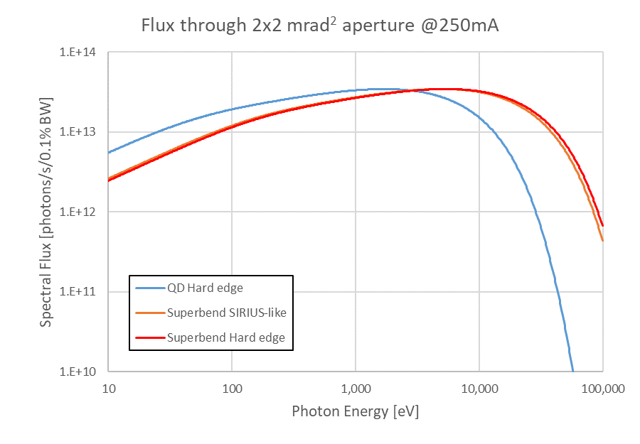
Bendings emission comparison
3.2 T
1 T
For beamlines E_{ph} ≲ 2 keV
it is more favorable the 1T bending

Slide 26
Possible sources
13 IDs
12 small betas
1 high betas
13 bendings
Keep the bending beamlines MISTRAL & MINERVA with 1T bending
Move NOTOS to a 3T bending
4 more possible with 1T bending
5 more possible with either 1T or 3T bending
MIRAS
Could be maintained in the same position, but the mechanical desing of the extraction from the SR has to be investigated.

Slide 27
Accelerator’s Investment
2022 - 2029

