Slide 1
Perspectives of CHEmical and MATerial Sciences (CHEMAT) at ALBA
X AUSE CONFERENCE AND
V ALBA USER´S MEETING 2022
Francois FAUTH
08.09.2022

Slide 2
What’s about : organisation
CHEMAT section is one of the 3 science sections of ExpDIV
(beside Life Science and Electronic and Magnetic Structure)
For each ‘operating’ beamline (under beamline leader supervision)
4 structural staff scientists (at least one max 5 years PostDoc)
half a technician position (from Transversal section of ExpDIV)
half an engineer contact for mechanics, electronics and controls (from other DIVs) externally (fully or partially) funded staff (PhD, PostDoc)
Administratively belonging to the section and scientific review panel :
MSPD and CLAESS (from 2011), NOTOS (from 2022), NCD-SWEET (from 2022), CIRCE-NAPP (0.5 BL, from 2021)
+ laboratories (HP, Chemistry)
-> internal budget sharing
-> proposal review panel
-> safety supervision

Slide 3
What’s about : science and techniques
Scientific topics
All what is neither Life science nor electronics,, magnetism, 2D material science
Energy related materials (Battery, Hydrogen storage, Superconductors)
Catalysis
High Pressure Techniques
Strongly correlated systems (bulk)
Surface/interface (film growth/characterization)
Environmental science
Functional material (MOF, Zeolite, metallurgy, cement)
Polymer, soft condense matter
Cultural heritage
Techniques used
Powder Diffraction (MSPD, NOTOS-PD)
(GI)SAXS/(GI)WAXS (NCD-SWEET)
Hard Xray Absorption spectroscopy XAS/EXAFS/XES (CLAESS, NOTOS-XAS)
Near ambiant Pressure Xray Photoemission spectrocscopy (CIRCE-NAPP)
soft Xray imaging-spectroscopy (MISTRAL)
Infra Red spectroscopy (MIRAS)
Surface and APXPS at 1bar (3SBAR)
Imaging/tomography (Faxtor ?)

Slide 4
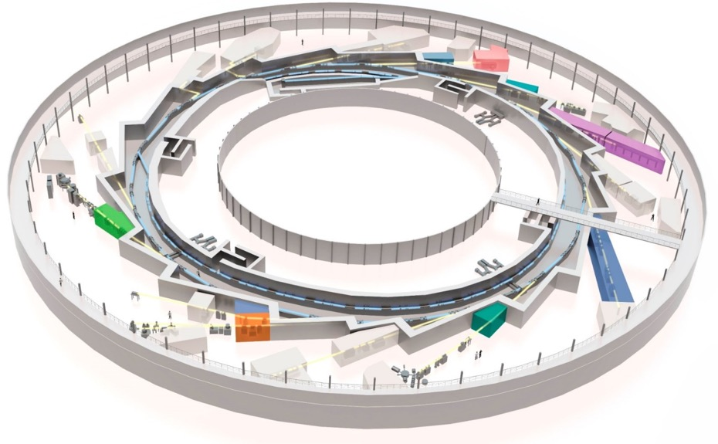
What’s about : science and techniques
Current facilities in CHEMAT section :
BL’s : 4 + 0.5 + 1 + TEM
Labs : CHEMlab HPlab
(BATTLab) (CATlab )
01
04
09
MIRAS (IR)
MSPD (PD)
MISTRAL
(Imaging-Spectroscopy)
Catalysis
Battery
Strongly Correlated Electron
In CAEM TEM
Polymer
Cultural heritage
Cement
31
FAXTOR
(Tomography)
11
NCD-SWEET
(Gi-SAXS)
CHEMAT
full
13
29
XALOC !
BOREAS !
CHEMAT
partial
24
HPlab
CIRCE (PEEM)
In progress
24
CIRCE (NAPP)
BATTlab (GB)
2023
22
CLAESS (XAS)
CATlab
15
16
3SBAR
(Surface, XPS)
NOTOS
(XAS & PD )
CHEMlab (GB)
4

Slide 5
Branding
Tuning Electronic and Chemical Properties by Controlling Atomic Structure of Functional Materials.
using a suite of techniques and services enabling the catalytic role of ALBA
Focused on scientific fields:
Techniques
Services
Energy storage.
Hydrogen circular economy.
Gas (Carbon) sequestration.
High throughput ensemble averaging probes including IR, XAFS, and diffraction.
X-ray microscopy in scanning and full field mode with absorption and phase contrast.
TEM.
Multi-modal approach combination of ex-situ, in-situ, and operando experiments.
Sample preparation tools allowing remote combinatorial approaches.
multi-modal pipelines and access modes for providing solutions for main focus area applications.
Big data gateway for data mining community.
data analytics tools to identify structure-function correlations in multi-modal experiments.

Slide 6
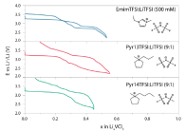
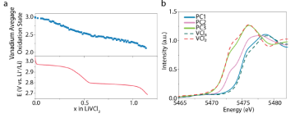
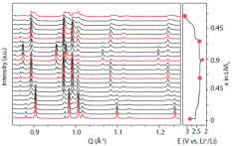
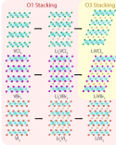
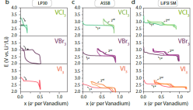
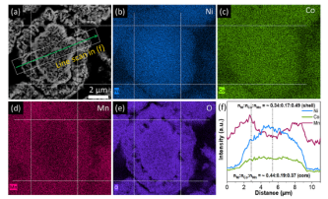
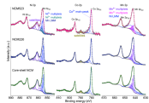
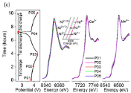
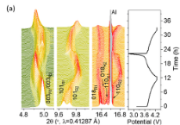
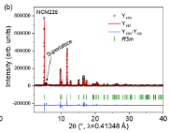
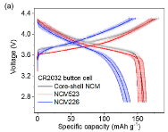
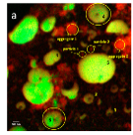
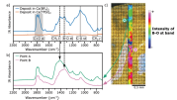
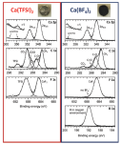
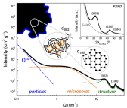
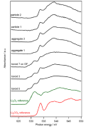
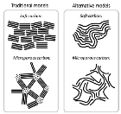
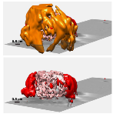
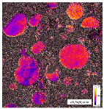
Multi techniques approach
Battery case
Imaging, Tomography
Spectroscopy
(molecule)
Spectroscopy
(electronic configuration)
Diffraction
(crystal structure)
Laboratory
(performance,
discovery)
MIRAS
CLAESS, NOTOS-XAS
MSPD , NOTOS-PD
SEM and EDX
Electrolyte bulk
Computing
Dubouis et al Nat Mat , accepted
SEI
TEM
XPS
Wua et al Nat Mat , Nano Energy 78 (2020)
MISTRAL
CIRCE-NAPP
NCD-SWEET
Saurel et al Nat Mat , Energy Storage Materials 21 (2019)
Tchitchekova et al Nat Mat , Chem Mat 30 (2018)
Olivares-Marin et al Nat Mat , Nano Lett 15 (2015)
Forero-Saboya et al Nat Mat , Energy Environ. Sci 13 (2020)

Slide 7
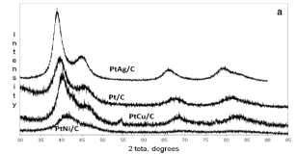

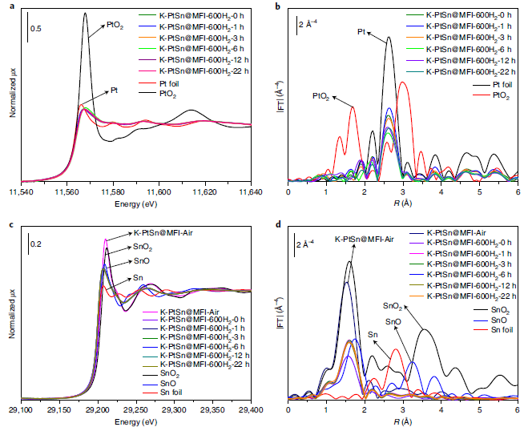
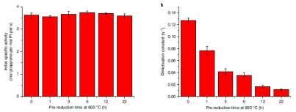
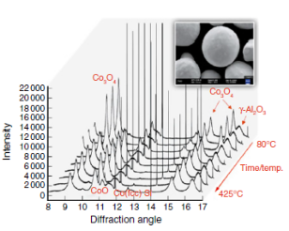
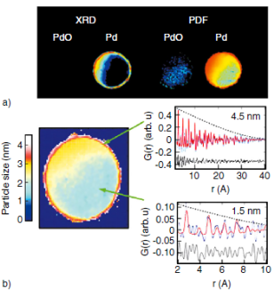
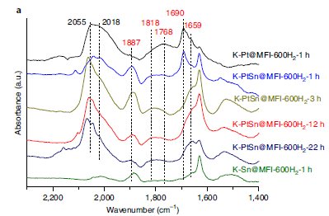
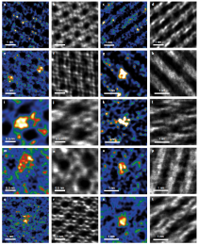
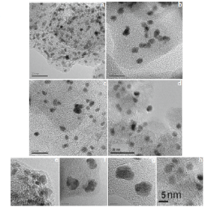

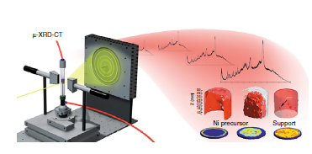
Multi techniques approach
XAS
Local structure around selected element
Chemical/electronicstate
Diffraction
Long/short range structure
Synthesis of bimetallic particles
for optimized catalytic reactions
(H₂, O₂) conversion
Nano size
InSitu XRD
under 5% H₂ flow
Laboratory
Synthesis, calcination, pre treatment (oxidation/reduction)
Sample environment
XRD-CT
PDF-CT
TEM / STEM
Localisation of atoms arrangement
Nanoparticule size distribution
IR (CO Probe)
Interaction with molecule
Computed Tomography XRD, PDF
Liu et al Nat Catalysis 3 (2020)
Guterman et al Nat Mat , J Solid Stat Elctrochem 18 (2014)
Hudspeth et al Oil & Gas Science and Technology hal-01572829

Slide 8
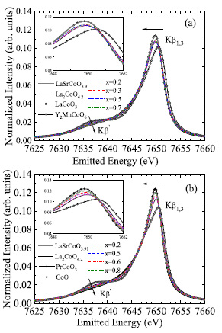
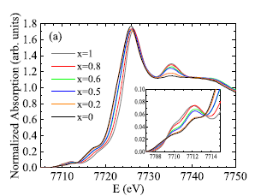
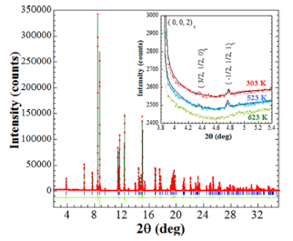
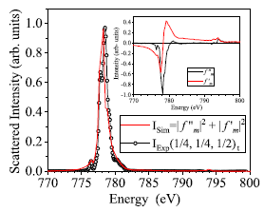
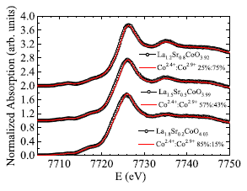
Multi techniques approach
Strongly Correlated Electron case
Inorganic chemistry community, neutron facility users :
UK, France, Germany, Italy, Spain, ….India !
Spain specificity : Partner of ILL, CRG beamline (powder diffraction)
S
Powder diffraction complemented by XAS techniques to determine electronic configuration, spin state
Subias et al (Uni Zaragoza
Co Kβ XES ID26@ESRF
Co XANES and EXAFS BM23@ESRF
Could be performed
on CLAESS
T dependent PD on MSPD
Subias et al (Uni Zaragoza)
Single crystal
…available !
XMCD on BOREAS

Slide 9
Correlation between tools
Essentially for Operando/In Situ
Computing
Link to Database
BigMAP, ICDD,
materialsproject.org
Users
Data processing
Online visualization
Data analysis
Deliver self consistent data
Help in data collection strategy
eg PCA, Tomo
Beamlines
NOTOS
NAPP
FAXTOR
MISTRAL
NCD-SWEET
CLAESS
3SBAR
MIRAS
MSPD
TEM
Laboratory
Sample shipment
In Situ/ Operando
experiments
Sample/cell preparation
Pre treatment
Complementary
Characterization
@ALBA
Optimization conditions
Off line / On line

Slide 10
SWOT
Strengths
Weaknesses
Choices made 15 years ago
Aged instrumentation
No clear prioritization : staff and resource limitation
ID ports limitation requires strong balancing and prioritization of the program
All target scientific field covered
Tools and techniques efficiently used by competent and motivated staff
Solid user community (recurrent users)
High publication yield (1:1)
Threats
Opportunities
Did we miss a community ?
User community perception feeling being left out
Competition (non-)strategic fields
Shutdown imposed by beamlines / machine upgrade
Slight proposal numberdecline
Identify weak/missing tools, target
resource and correct it
ALBA II to enable state of the art characterization tools
New beamline proposals round (3sbar already)
Partnerships allow to extend services
(TEM, BATlab, CATlab)

Slide 11
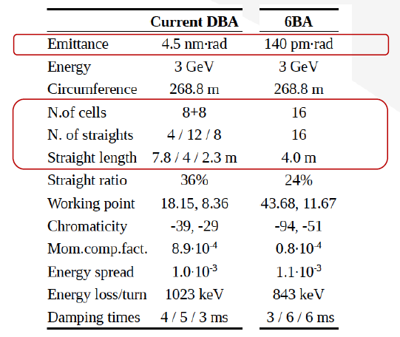

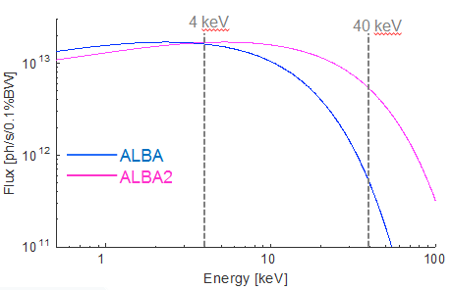
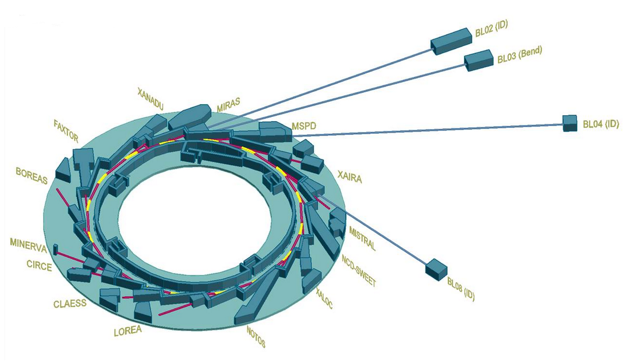
Vision : ALBA II and instruments upgrade
F Perez, ALBA2 day, June 30th, 2021
Improved emittance (30 time smaller)
300 mA (+20 %)
max 13 ID ports, 4 possible long BL’s
Better coherence
Super bend magnets
1 mrad Hor
CALIMA : BioSAXS
(+ WAXS for polymer ?)
NOTOS
MSPD-PD only ?
Imaging (long BL) ?
Source J. Nicolàs

Slide 12
Vision : ALBA2 and instruments upgrade
NCD-SWEET
SAXS/WAXS/GISAXS/GIWAXS
Powder Diffraction
? PDF
? Micro Diffraction
??? polySAXS (BioSAXS)
??? nanoprobe
Energy
storage,transport
MSPD
Scattering
Catalysis
NOTOS
Functional
Cement, MOF, ZIF
CLAESS
3Sbar
XANES/EXAFS (hard)
XES
APXPS (soft/ hard)
medium/far IR/FTIR
??? RIXS, µXAS-µXRF,
??? high ∆E XAS
??? far IR production
Strongly correlated
CIRCE-NAPP
Spectroscopy
Cultural heritage
MIRAS
Surface/Interface
MISTRAL
Environmental
Imaging
Contrast energy imaging (soft)
fast Imaging (hard)
??? CT XRD, CT-PDF
??? Contrast energy imaging (hard)
FAXTOR
Imaging
Polymer
TEM
High Pressure
Labs
? sample preparation
? synthesis
data processing
? data (pre-)analysis
Support
Industrial service
Computing

Slide 13
Vision : ALBA2 and instruments upgrade
essential tool (necessary to the program)
desirable tool (pushing the program to the forefront)
 | PD | μPD | PDF | SAXS/ WAXS | μXAS (+ μXES) | XAS-PD | AP-XPS | IR | TEM | Nanoprobe
 | 10-40 | 20-40 5-30 | 60-80 | 10-25 | (2.4) 6-25 | 4.5-35 (40) | 0.1-4.0 | Far-IR region | Env-TEM | XRD & XAS Undulator (lon g)
 | 3000x1500 | < 5x5 | < 5x5 + unfocus |  | ≤ 5x5 + unfocus | ≥ 500x500 μm
Catalysis
Battery
HP
Strongly Correlated
Packaging, building cement/ancient
Packaging, building polymer
Industry
Capability
E keV
Size µm

Slide 14
Vision : support/service upgrade
Push for InSitu / Operando techniques and High throughput
adapt instruments, develop sample environment (sample environment lab ?)
Incite users to build consortium, go for BAG proposals, fast and remote access
sraight forward experiments (go for BLOM operating them ?)
CHEMlab BATTlab CATLab HPLab to be extended/build
define extent of offered service and equipment …if ASTIP…or not
define integration of user lab activity within user experiment (eg user funded ?) and industrial service
Define scientific/technical support to offer to proprietary research
decorrelate data collection data analyis (create data anaysis team ?)
Push for scientific computing
Raw/pre processed Online data visualisation helping in data collection strategy/decison (Operando)
Remote access to onsite data analysis software (essential for heavy files experiment )
Create link to existing databases ( build new ?)

