Slide 1
Perspectives of Life Sciences at ALBA
Judith Juanhuix
on behalf of all Life Sciences staff
08.09.2022

Slide 2
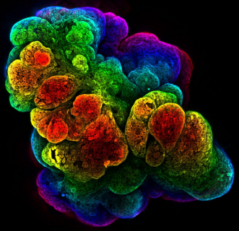
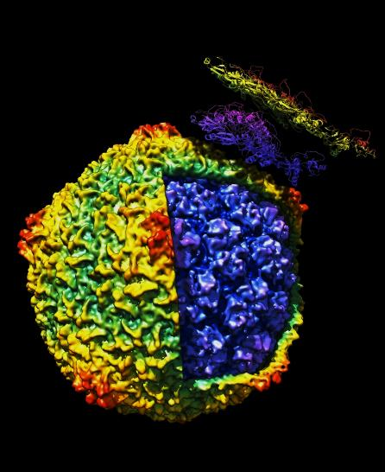
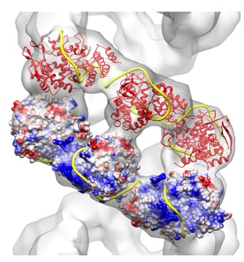
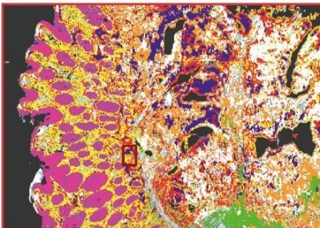
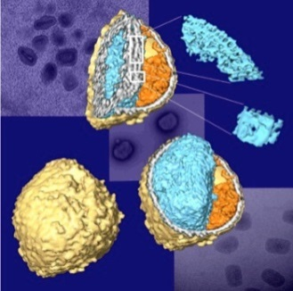
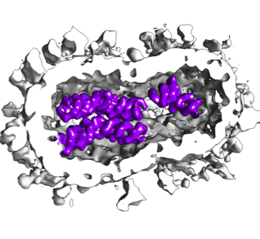
Biological imaging techniques today
(from images to structure + chemistry + function)
5 µm
500 nm
30 nm
5 nm
1 Å
resolution
subμPCXT
subμXRF
BioSAXS
NMR
µPCXT
µFTIR
MX
cryo-3DSIM
cryo-SXT
nanoXRF
cryo-ET
VLM
cryo-SR
CryoEM-SPA
nanoPCXT
sample thickness
cryo FIB-SEM
Tissue
Organoids
Cellular Biology Interactomics Macromolecules
Multimodal imaging across resolution scales is essential to understand biological mechanisms.
Slide: Eva Pereiro
Notes:
Lab-grown mouse mammary gland imaged by 3D confocal (Dr. Harris Univ. Cambridge)

Slide 3
Biological imaging techniques at ALBA today
operational
in development
not in Alba
5 µm
500 nm
30 nm
5 nm
1 Å
resolution
subμPCXT
subμXRF
BioSAXS
NMR
µPCXT
µFTIR
MX
cryo-3DSIM
cryo-SXT
nanoXRF
cryo-ET
VLM
cryo-SR
CryoEM-SPA
nanoPCXT
sample thickness
cryo FIB-SEM
Tissue
Organoids
Cellular Biology Interactomics Macromolecules
Multimodal imaging across resolution scales is essential to understand biological mechanisms.
Slide: Eva Pereiro
Notes:
Lab-grown mouse mammary gland imaged by 3D confocal (Dr. Harris Univ. Cambridge)

Slide 4
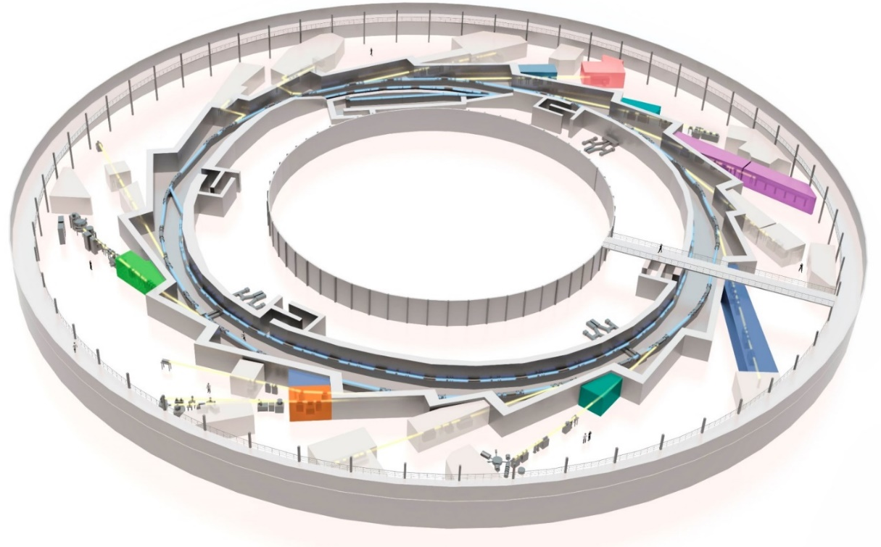
Biological imaging techniques at ALBA today
FAXTOR (PCXT)
MIRAS (IR)
XAIRA (μMX)
MISTRAL (TXM)
cryo-3D SIM
CryoEM-SPA
Macromol
biology
NCD-SWEET
(SAXS)
Cellular
biology
In
construction
XALOC (MX)
Residual
use

Slide 5

MISTRAL: Transmission X-ray Microscope
CCD
capillary condenser lens
sample
central stop
objective zone plate lens
(40nm and 25 nm ZP)
TXM (Transmission X-ray Microscope) capability :
  2D Measured Spatial Resolution ≈ 30 nm half pitch.
  Detector effective Pixel size 16 nm – 8 nm, Field of view 8x8 µm² - 16x16 µm².
  Cryo environment ( ≈ 110 K).
  On-line visible light epifluorescence microscope for correlative low resolution 2D imaging.
Available techniques for bio-samples (with 30 nm spatial resolution):
  Cryo – soft X-ray Tomography (± 70◦ max angular range, typical acquisition time ≈ 5 -10 min.).
  Cryo – X-ray Spectromicroscopy (from Ca L – edge).
Slide: Andrea Sorrentino

Slide 6
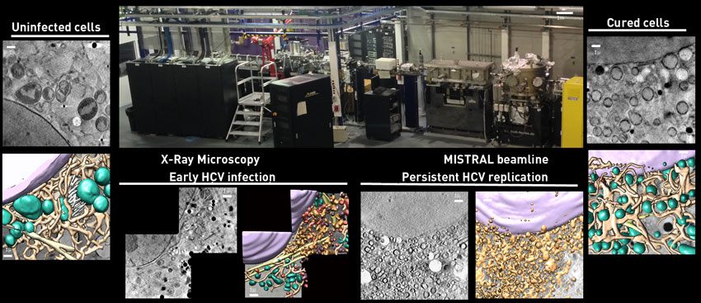
MISTRAL: ultrastructure of HVC infected cells
Hepatitis C infection
Assessment of the reversion of HCV-induced cellular ultrastructural changes direct-acting antiviral drugs
AJ Pérez-Berná, E Pereiro, P Gastaminza
ACS Nano 2016

Slide 7
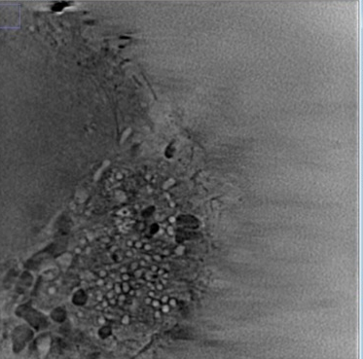
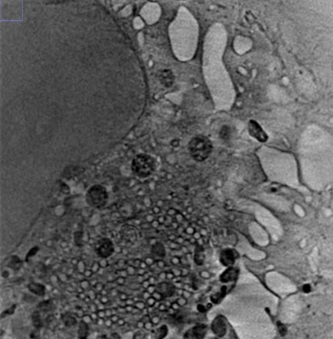

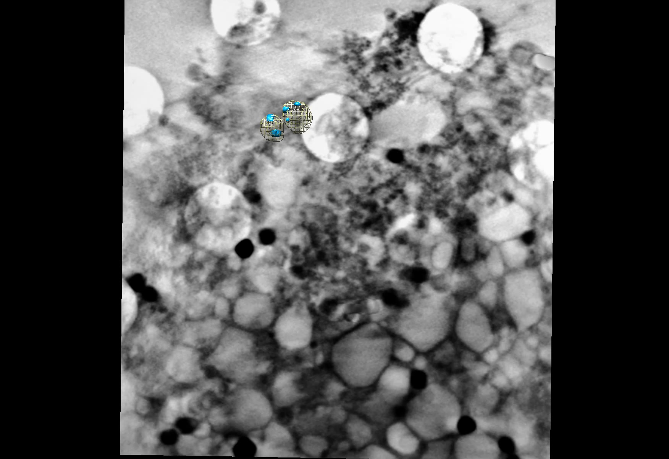
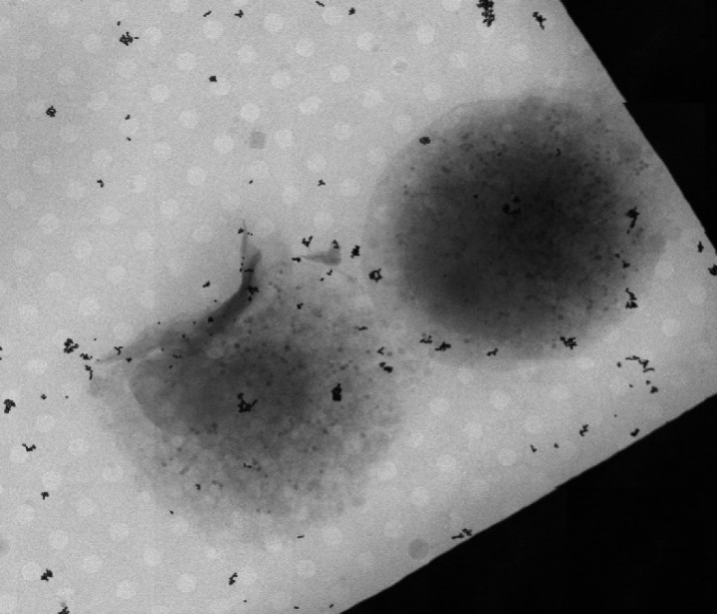
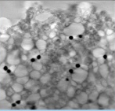
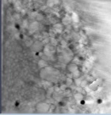
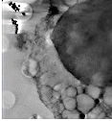
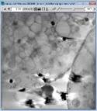
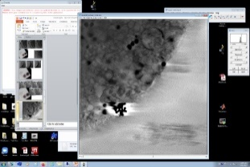
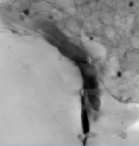
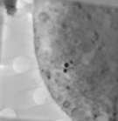
MISTRAL: ultrastructure of SARS-CoV-2 infected cells
Morphology of adenocarcinomic human alveolar basal epithelial cell (A549) infected with SARS-CoV-2
SARS-CoV-2 Intracellular
viral particles
Morphological dysfunction
with abnormal mitochondria
SARS-CoV-2 viral factory
3D reconstruction:
Transparent volumes: vesicles where the replicating complexes are formed.
Blue volumes: the SARS-CoV2 virus
Evolution of cells during infection can be studied
Early state
of infection
Late state
of infection
AJ Pérez-Berná, P. Gastaminza group (CNB-CSIC)
7

Slide 8
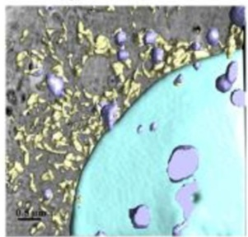
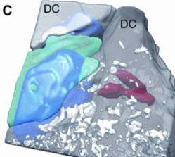
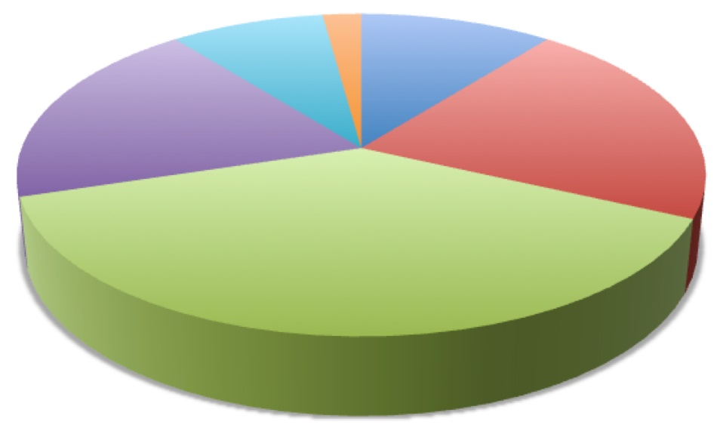
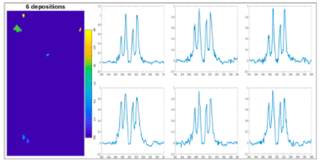
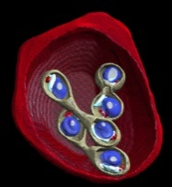
Cell biology at MISTRAL
Cancer research
Chemotherapy
hyperthermia in tumor cells
Mitochondrial dysfunction
Chromatin expression
Immune systems
Cholesterol
T-Cell Migration
T-Cell interaction with pathogens
Primary T-cells
Alzheimer
Nanoparticle:
hyperthermia in tumor cells
Gold coated siRNA
Anti-inflammatory events
Drug delivery
Nano liposomes
1%
5%
10%
19%
21%
Bio mineralization
Cholesterol
Calcium
Hydroxyapatite
Pathogens
HCV
Zika
Mycoplasma
SARS-CoV-2
Plasmodium Falciparum
Babesia divergens
Herpes
Torovirus
Vaccinia
38%
Rotavirus
Trypanosome Brucei
Influenza
Mycoplasma
+Gene Therapy
(Klaus talk)
E. Coli
SARS
Cytomegalovirus
Slide: Ana J. Pérez-Berná

Slide 9
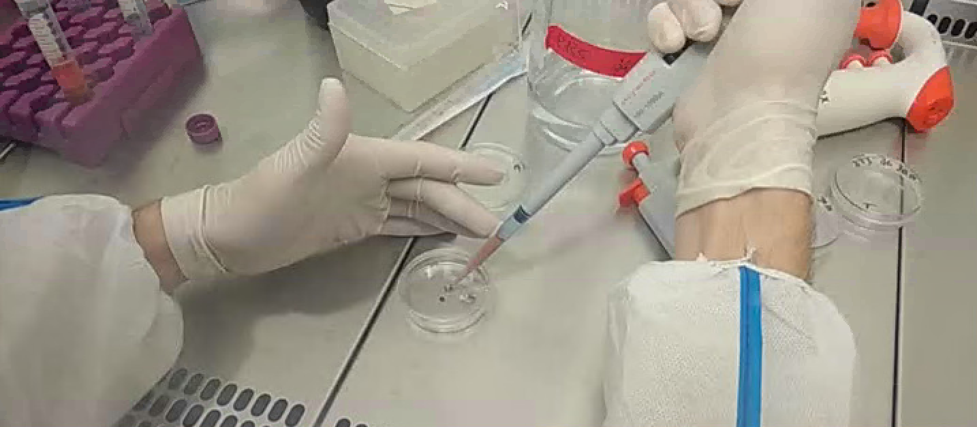
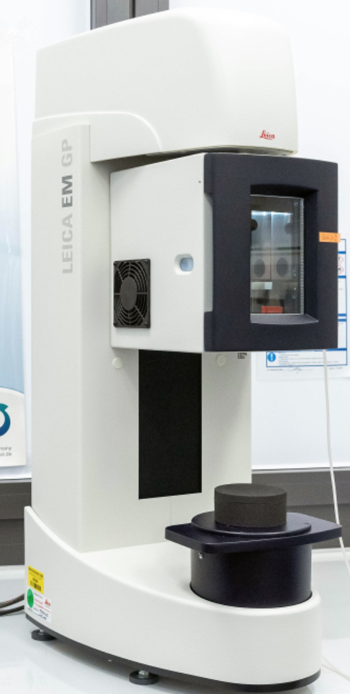
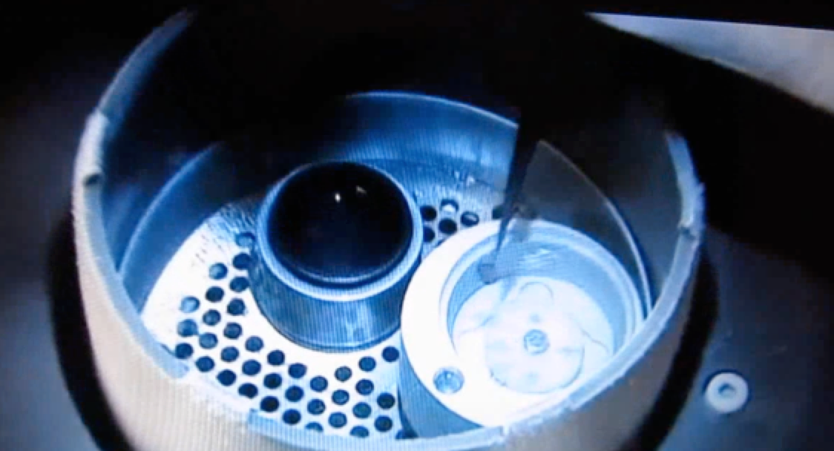
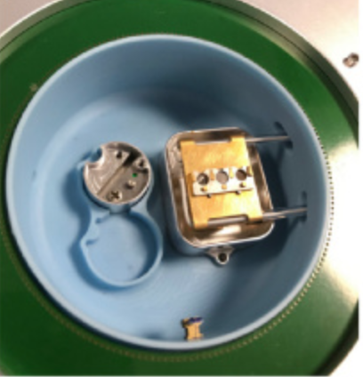
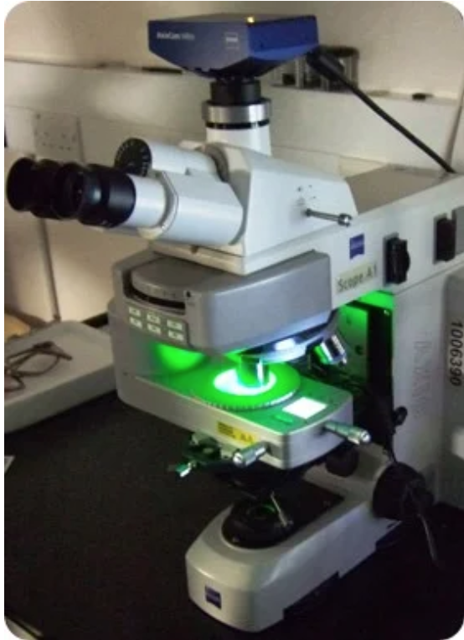
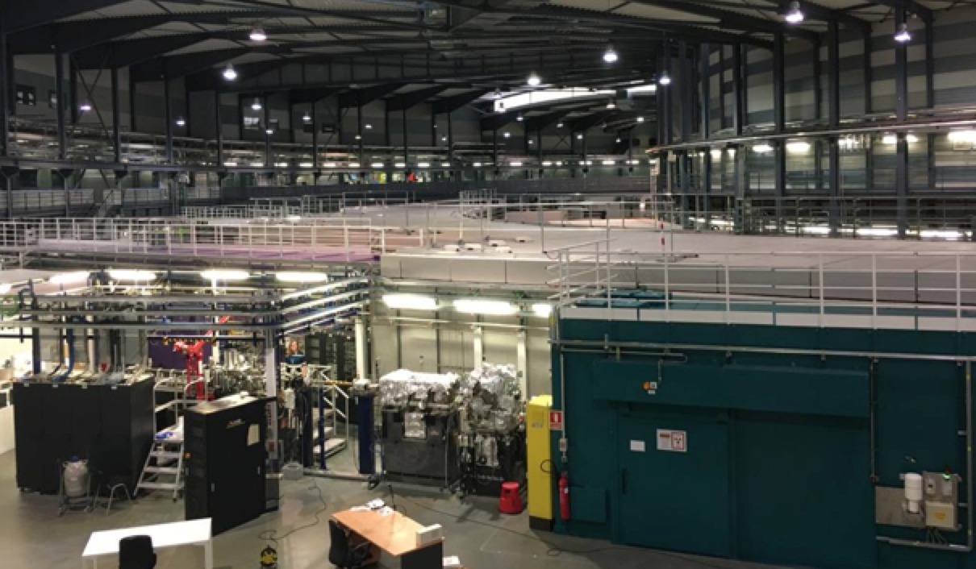
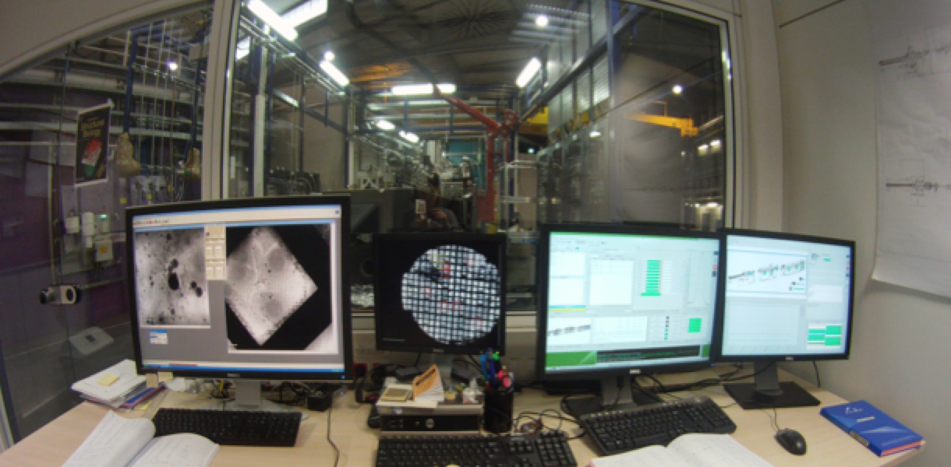
MISTRAL: experiment pipeline
The accession gap to MISTRAL is being reduced by pipelines
Cell culture Platform
1-15 days
Vitrification Platform
4-5 hours
Guided
Data Processing
Sample Screening at Cryo
4-5 hours
Reconstruction
MISTRAL Beamtime
Manual aligment
Asistance during beamtime
Segmentation
Data Processing Support
Images

Slide 10
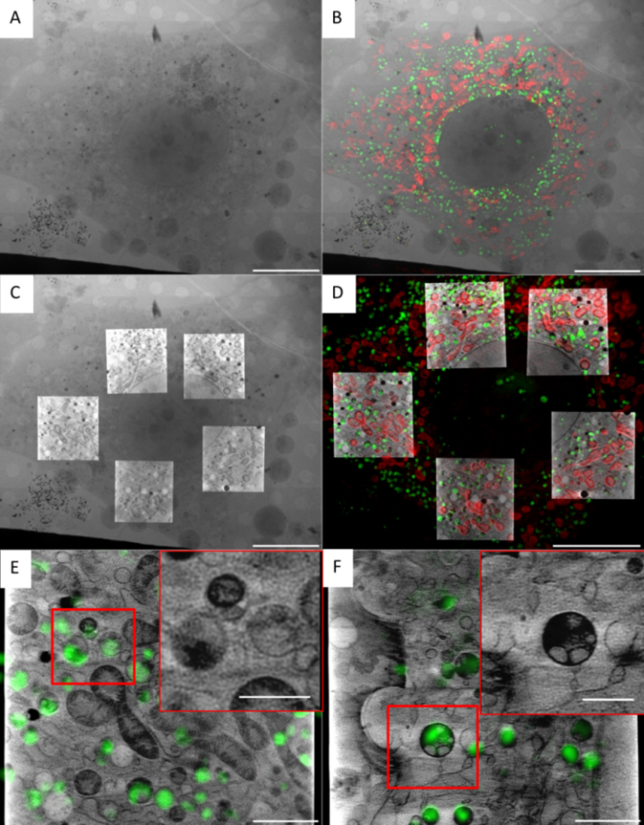
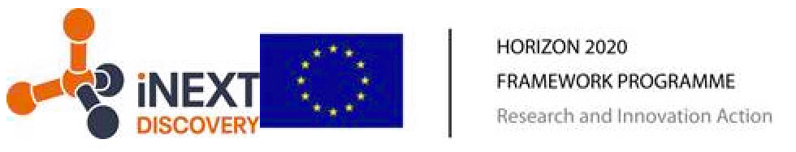
MISTRAL: 3D cryo SIM for CLXM
Determination of the intracellular fate of a designed protein-nanomaterial hybrid that shows great promise in mitigating myocardial fibrosis
Cryo 3D-SIM: visible light 3D super-resolution microscope in cryo conditions
100nm resolution
cryo 3D-SIM is correlated to cryo-SXT
2D Mosaic
& 2D SIM
2D X-ray
mosaic
Identifying specific cellular structures
Follow processes
Evaluating cellular morphological changes
2D X-ray
Mosaic
& SXT
3D SIM
& SXT
Bridge between VLM and SR microscopies
at research centers/hospitals and STX at MISTRAL
Primary
fibroblats
NIH-3T3 cells
Groen et al.
Chem. Sci. 2021

Slide 11
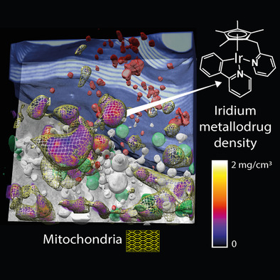
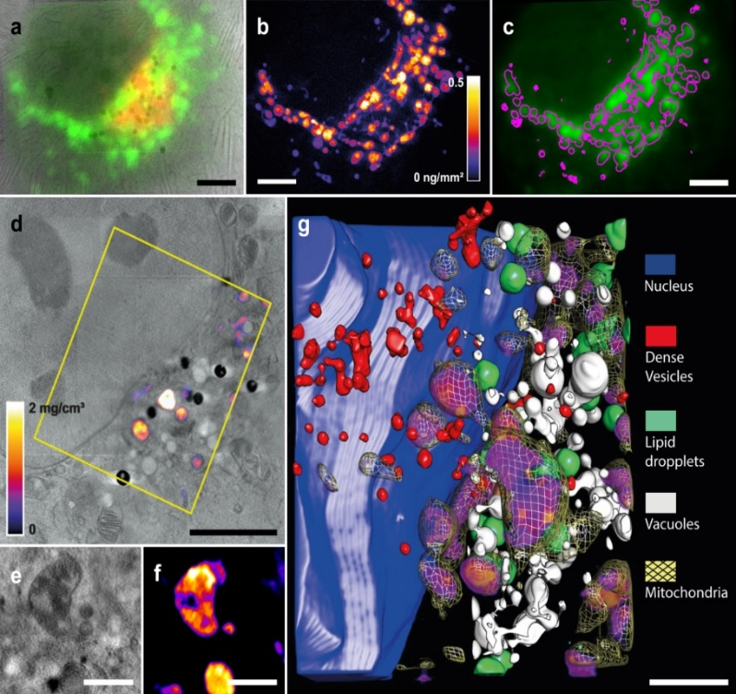
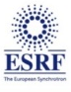


MISTRAL: correlative SXT and 3D-XRF experiments
Iridium half-sandwich complex is a potent anticancer agent but very cytotoxic.
By using 3D cryo soft X-ray and fluorescence tomographies on the same cryo-preserved cell, it is unambiguously localized and quantified in the cell mitochondria.
Knowing the intracellular fate of the compound is mandatory to rationalize its potency and improve metallodrug design.
TXM image and epifluorescence from
mitocondria (green)
Ir distribution from 2D XRF
a+b
5 µm
In selected area, overlap of two reconstructed slices from the cryo-SXT and the XRF tomography
5 µm
slices across the mitochondria from the cryo-SXT and the XRF
JJ Conesa et al. Angew. Chem. (2020)
1 µm
2 µm

Slide 12
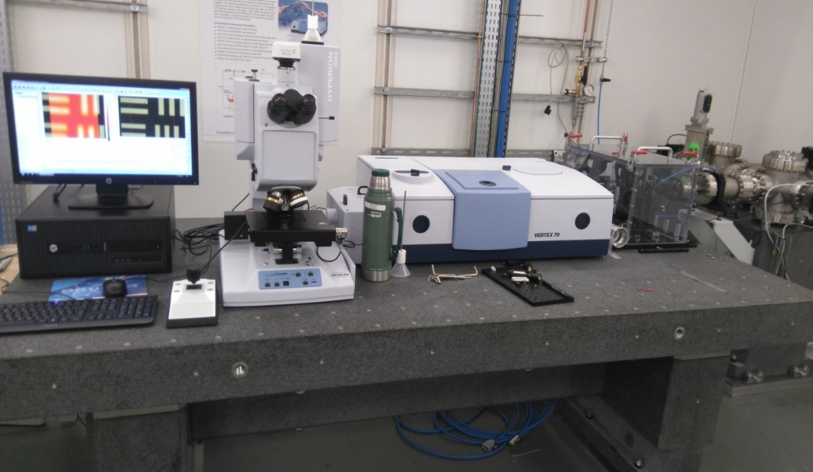
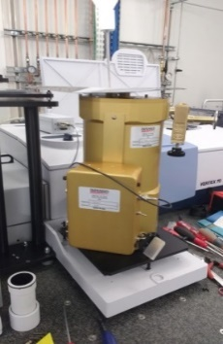
MIRAS beamline: μFTIR
Microscopy Beamline (imaging & spectroscopy).
For material sciences, biosciences, cultural heritage, food, environment.
MCT detector
FPA detector
Entrance of the synchrotron light
DLaTGS
Sample
Matching Unit
Vertex 70 Spectrometer
Hyperion 3000 Microscope
Bolometer
Detectors
Chemical and biochemical composition.
Resolution up to 3x3 µm².
Photon energy range : ~ 1.2 µm to 100 µm.
50 µm HgCdTe (MCT) detector (10000-600 cm⁻¹)
250 µm HgCdTe (MCT) detector (12000-550 cm⁻¹)
64x64 Focal Plane Array (FPA) detector (4000 – 900 cm⁻¹)
TE Cooled DLaTGS detector (12000-350 cm⁻¹)
4.2 K Bolometer detector for Far-Infrared (10 – 660 cm-1)

Slide 13
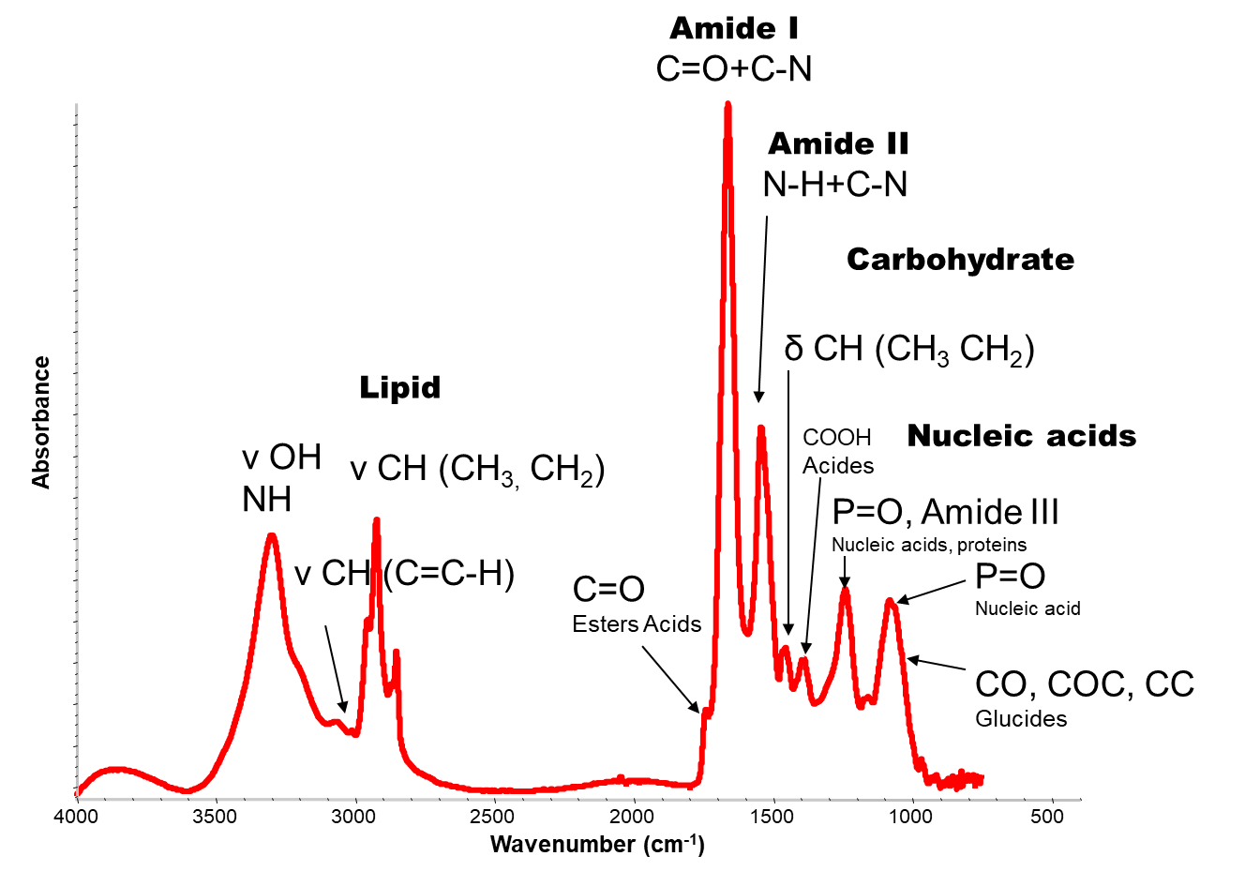
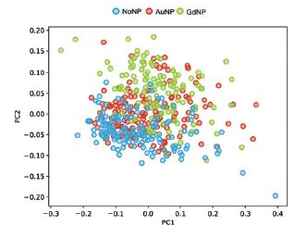
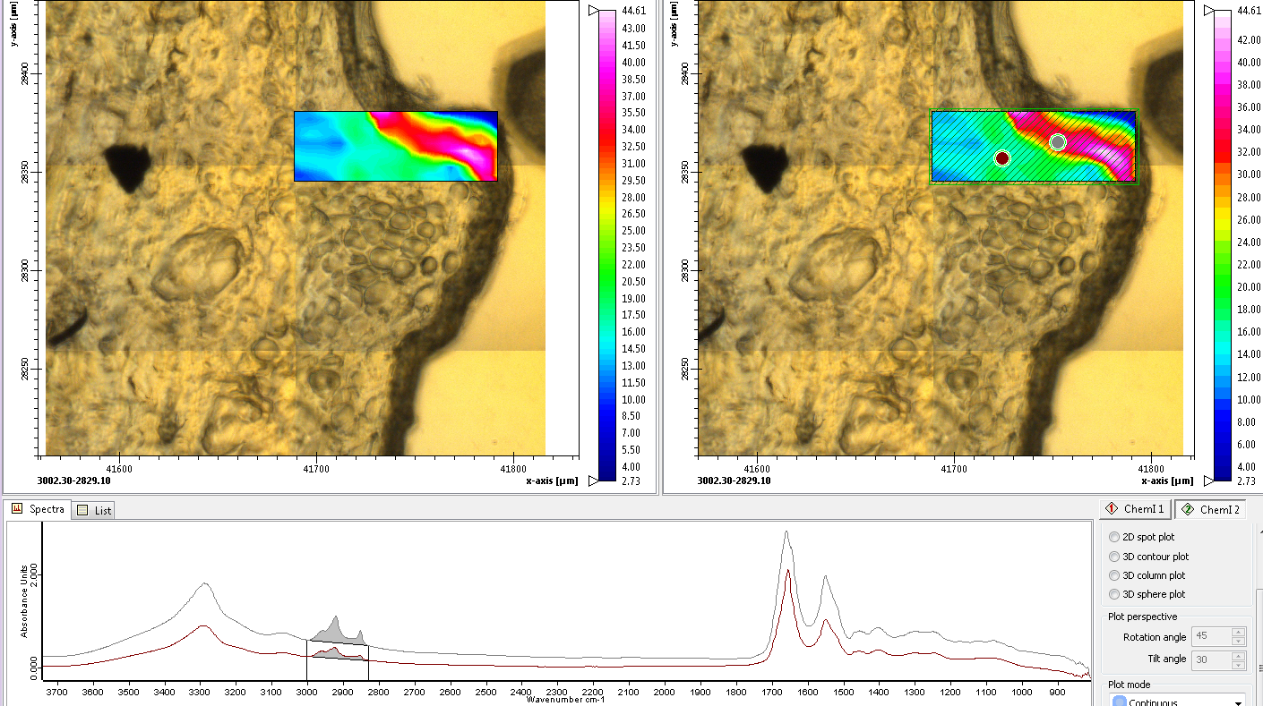
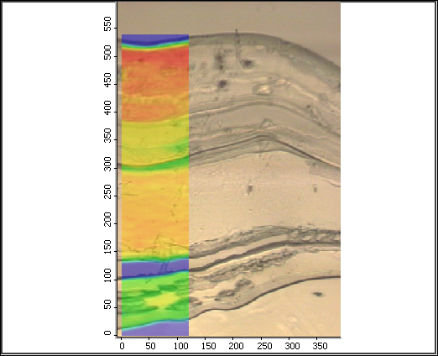
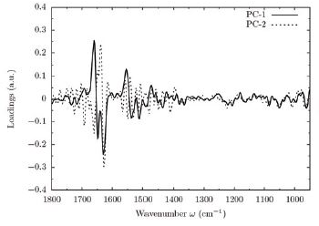
MIRAS: Data output
IR Spectra
IR Chemical imaging
Statistical analysis PCA, HCA, etc..
High
SR-FTIR spectrum of a biological sample
PCA
High absorbance regions
Low absorbance regions
Loadings
Low
I. Yousef et al, SRN, 2017
V. Moner et al, AUSE, 2017
I. Martinez-Rovira et al, Analyst, 2020

Slide 14
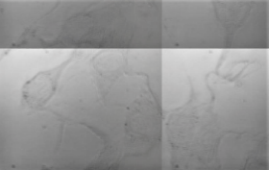
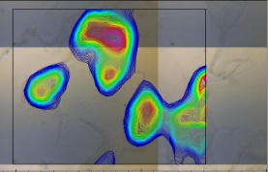
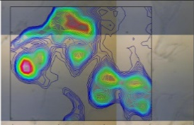
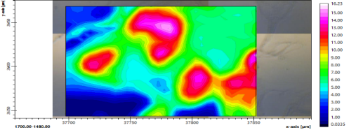
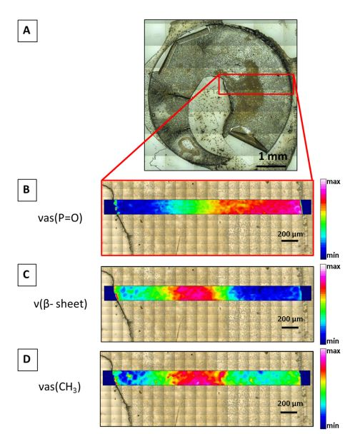
MIRAS: types of biological samples
Single cell analysis
Live cells chamber
Fingerprint of the small anionic molecule Cobaltabis (dicarbollide) uptake in glioma stem cells
Metabolic compounds in brain glioblastoma cell lines after Riluzole treatment
VIS image
Proteins
Lipids
Int. J. Mol. Sci. 2021 doi.org/10.3390/ijms22189937
50µm
Ducic et al, Anal chem 1932, 2021
Tissue Analysis
Live cells setup allows the real time observation of the biochemical rearrangements undergone in living cells upon treatments.
Possibility of a mail-in service for cryopreserved live cells, in which the research groups send the samples
UV-induced cataractogenesis: UV effect on human anterior lens capsule macromolecular composition
Int. J. Mol. Sci. 2021 doi: 10.3390/ijms22105249

Slide 15
Multimodal synchrotron-radiation approach combining FTIR, hard and soft X-ray microscopy on intact astrocytes from a rat model of Amyotrophic Lateral Sclerosis (ALS) disease
MISTRAL+MIRAS: correlative SXT and SR-μFTIR experiments
Mutated Cu–Zn metallo-enzyme SOD1 is known to produce ALS
Cryo-TXM: large aggregates are formed and the number of mitochondria change
Cryo-XRF: Cellular Cu concentration
SR-μFTIR: Amount of antiparallel β-sheet structures, lipid localization and composition
Ducic et al, Anal. Chem. 1460, 2019
Slide: Tanja Ducic
15

Slide 16
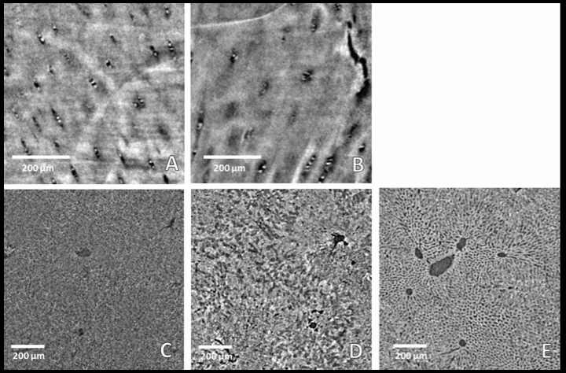


FAXTOR: Phase-Contrast X-ray Tomography
Available techniques:
Propagation based imaging. (1-5 µm, 10-40 keV)
X-ray absorption imaging. (1-10 µm, 10-70 keV)
Grating interferometry
Time resolved radiography.
µ-Computed tomography (3D/4D).
Rat brains
Using µCT/µXRF/SAXS/WAXS
Romano M. et al. Cancers, 2021.
Neuroimaging – spinal cords
Rat livers
Cartilage imaging (human plugs)
Rack A. et al. Instruments, 2020.
Mittone A. et Al, JSR 2020.
land
Stroebel J. et al. Sci. Rep, 2020.
Notes:
As techniques propagation based X-ray phase-contrast and absorption-based imaging will be used on a daily basis. Future extensions including differential phase-contrast imaging can be also foreseen. Different acquisition protocols will be available, from time resolved projection imaging, to static and time resolved computed tomography.

Slide 17
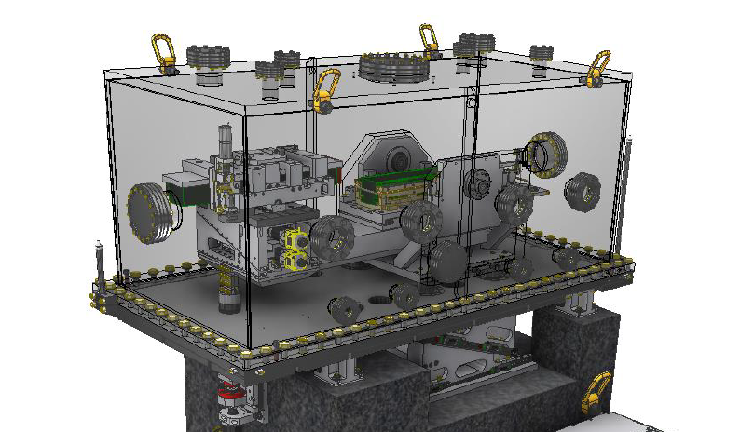


FAXTOR: status
Source: 3-pole wiggler: Received, to be installed
Huches: to be installed fall 2022.
Optics: manufacturing. Optimized for stability, energy resolution
End station: in design phase
In-house design: choppers, precision tables
First users: end 2024
land
Notes:
As techniques propagation based X-ray phase-contrast and absorption-based imaging will be used on a daily basis. Future extensions including differential phase-contrast imaging can be also foreseen. Different acquisition protocols will be available, from time resolved projection imaging, to static and time resolved computed tomography.

Slide 18











Perspective: integrative approach
FTIR transparent windows
Cell Culture
Cells culture medium
Microscope
Si3N4
Gold grids
Attenuated total reflection mode
Cryosectioning
Microscope on Cut-cross section
Embedding (paraffin)
Cryo plunging
Vitrification
Sample stage
2cm thick sample
Fixing or freeze drying
Transmission mode
X-ray Micro-tomography
FAXTOR BL
~10µm thick sample (2D imaging)
SR-FTIR
MIRAS BL
Soft X-ray cryotomography
MISTRAL BL
Live cells (under evaluation/development)
Slide: Ibraheem Yousef
18

Slide 19


XALOC: Macromolecular Crystallograhy
Success story
All MX Spanish groups are using XALOC
80% remote experiments
Screening: 20-30 crystals/hour
Data collection: 7-15 crystals/hour
100
790 PDB entries as per today

Slide 20


XALOC - Upgrades
Instrumentation upgrade
  New detector: 100 Hz, beg 2023
  New Sample changer: fast (20s), 20-30 samp/hour
  Completing crystallization platform
Scientific case is being redefined
  Going to high energies (up to 25-30 keV, need new optics)
  New scientific cases implemented:
In situ diffraction (on plates)
  Allow taking still images for crystal test
  Positioning of the cristallization plate through the robot
  RASTER scan for plates
Jet-based serial crystallography (SSX) setup implemented

Slide 21




XALOC – Jet-based serial crystallography
A High Viscosity Extrusion (HVE) injector has been implemented at XALOC for jet-based SSX
Serial macromolecular crystallography at ALBA Synchrotron Light Source
Jose M. Martin-Garcia, …, X. Carpena
J. Synchrotron Rad. 29, 1130 (2022)
Already available
Just request it in the next call for proposals
Kovalev et al, Nat Comm 11:2137 (2020).

Slide 22


XAIRA: μMX - Scientific cases
BL Instrumentation
Low background
He chamber, beam tailoring
Fixed target
serial crystallography
Beam features
μ-MX
Optimal
native
Phasing
of μ-crystals
(std mount)
Optimal fixed target SX
Time resolved experiments
1×1 µm beam @ 1 Å
Elemental
Deter
mination
Serial native-phasing crystallography
Low Photon Energy
4-14 keV
Chip for fixed-target SSX
Anomalous differences of the intensity ΔI_{E} increase with small xtals and long λ considering
fixed radiation dose
transmission
Owen et al. (2017)
Acta Cryst. D73:373
Wagner et al. (2016) Acta Cryst. D72: 430-439

Slide 23





XAIRA - Beamline Status
Microfocus Macromolecular Crystallography
2.3m-long 19.9mm In-Vacuum Undulator
Beam size of 1 ×1 mm² at 1 Å (full beam 3×1 μm²)
Beam defocusing up to 10×10 mm²
Energy range of 4–14 keV
Novel dual DMM+CC (Mo/B4C+Si111) mono concept
High flux (DMM) and High stability (CC)
Use of interferometers to monitor the optics
Detectot test
6 July 2022
First beam
22 July 2022
End station
He atmosphere at sample to increase I/σI - Low background experiments Compatible with standard, air operation
Fast pixel array detector: Eiger2 XE 9M (frame rates up to 1000Hz)
Automated sample mounting system ISARA2 (29 cryo pucks+3 RT pucks
Si(111)
Mo/B₄C ML
Schedule
First beam: 22 July 2022
EndStation Comm: Summer 2023
First experiments: End 2023

Slide 24


XAIRA - Beamline Status
Optics Hutch installed
In house vertical diff
KB mirrors
Horizontal sec. source slits
Dual Mono
ML+Si(111)
Horizontal prefocusing mirror
Eiger2 XE 9M detector
Isara2 robot
24

Slide 25

XAIRA - Program vision
Optimized fixed-target/oscillation crystallography on microcrystals
Poorly diffracting crystals
Native Phasing of microcrystals
  Optimal conditions for crystals in standard mounting (low background, long λ).
  Multi-crystal approach available.
Time-resolved experiments
Rapid chemical mixing of reactants and microcrystals in microfluidic devices,
Time-resolved native phasing for reactions involving cations?
Refinement coupled with time-resolved WAXS.
Door to SFX at XFELS (using hubs)
Elemental analysis
Coupling with computational biology
  Experimental determination of anomalous sub-structure + Alphafold2 high-res structure
Neutze R. 2014 .Phil. Trans. R. Soc. B369:20130318

Slide 26



CryoEM Platform at ALBA
JEMCA: Partnership to procure, install and run the CryoEM platform
Partners have different beamtime shares
ALBA share (15 + 9%) will be offered to users on the same basis as synchrotron beamlines beam time
Apoferritin map from CryoEM data at ALBA
User operation starting very soon!
Talk in this session by Pablo Guerra
Pablo Guerra, IBMB

Slide 27




CryoEM Platform at ALBA
Glacios Cryo-TEM
200 kV XFEG optics
Autoloader
Falcon 4 detector
Falcon 4 Direct Detector
Large pixel layout
High signal-to-noise ratio
Four times faster than predecessor
Vitrobot System
Cryo-EM sample preparation
EPU 2 Software
Single particle analysis software for sample screening and data acquisition.
08/09/2022
27
27
Pablo Guerra, IBMB
27

Slide 28



BioSAXS
28
28

Slide 29
BioSAXS/CALIMA proposal – scientific cases
Batch mode SAXS
SAXS coupled to chromatography
Time-resolved SAXS
Fiber diffraction
3D scanning SAXS
nLC/MS SAXS
WAXS
Allosteric modulation of macromolecules
Intrinsically Disordered Proteins
Membrane proteins
Amyloid proteins
Domain swapping in diseases
Complex biological assemblies
RNA folding
Microtubules GTPase cycle
Bone arrangement
Brain connectivity
Skin damage
Polymers
29

Slide 30

BioSAXS/CALIMA proposal – optical design
Bending magnet beamline (ALBA) and Superbend (ALBA II)
Fixed sample-to-detector & beamstop, q-range tuned by changing photon energy
2 optical setups:
  Large (standard): ~200-500 μm in size
    Double multilayer monochromator
    Focusing optics with a KB system
    Batch mode, SEC/IEC-SAXS, Fibre diffraction, nLC/MS-SAXS & WAXS
  Microfocus: ~10 μm in size
    Compound Refractive Lenses (CRLs) + Secondary Source Slit (SSS)
    TR-SAXS & 3DsSAXS
Detector
Standard focus
Sample
Microfocus
secondary focusing
Experimental Hutch
Optical Hutch
30

Slide 31
BioSAXS/CALIMA proposal – beam characteristics
Flux at sample
Beam sizes and divergences
 | ALBA (BM) | ALBA-II (superbend)
Standard mode (focus at detector)
Spot at sample position | 532×520 um² 176×198 urad² | 532×590 um² 175×175 urad²
Spot at detector position | 174×76 um² | 23×58 um²
Microfocus mode (focus at sample)
Spot at sample position | 37×15 um² 425×403 urad² | 5.3×11 um² 428×425 urad²
Spot at detector position | 1.30×1.24 mm² | 1.30×1.28 mm²
Gains in ALBA-II
Standard mode: better q resolution (smaller spot at detector)
Microfocus mode: gain x7 H, x40% V
Standard mode: Very competitive with other existing BLs
Microfocus mode: unique capability in BioSAXS BM beamlines
31

Slide 32


…and coupling computational biology with experiments
“Protein structural biology entered a new Era, where predictions will change and guide the way experiments will be designed and hypothesis will be tested” (Joana Pereira, ECM33)
But: “Predictions are exactly that and do not replace experiments”
Exploring generality of experimental conformational changes with AlphaFold predictions
  examine the experimental structures considering dynamics using predictions
Deep network-based synthetic “protein” design (shaping function?)
  Ex. Hallucinating protein assemblies
Need SDM, Methodology sections
Need collaborations/partnerships
Castellví, Uson 2022
doi: 10.1101/2022.04.12.488086
Wicky, Courbet, Baker 2022 doi.org/10.1101/2022.06.09.493773
32

Slide 33

Biological imaging techniques at ALBA today
BioSAXS
FAXTOR (PCXT)
MIRAS (IR)
XAIRA (μMX)
MISTRAL (TXM)
STXM
cryo-3D SIM
Sub-μPCXT
Cryo-nanoXRF
CryoEM-SPA
Macromol
biology
CryoET
Cryo-FIB-SEM
Cellular
biology
In
construction
XALOC (MX)
Computational
Biology
tools
+services

Slide 34

Thanks to all collaborators and ALBA people
Thanks for attention
…hoping for future projects become reality

Slide 35
Engineering
Marta Llonch
XALOC
Nahikari González
Fernando Gil
Alejandro Crisol
Jon Ladrera
Roeland Boer
Controls
Marcos Quispe
Xavi Carpena
Steven Wohl
Albert Castellví
Isidro Crespo
Carles Colldelram
Jordi Andreu
Jose Ferrer
Fulvio Becheri
Electronics
Bernat Molas
MISTRAL
FAXTOR
Eva Pereiro
Alberto Mittone
Ana J. Pérez-Berná
Alberto Mittone
Andrea Sorrentino
Jan Groen
MISTRAL
Tanja Ducic
User Office
Ibraheem Yousef
Martin Kreuzer
EM
XAIRA
OPTICS
Pablo Guerra
Damià Garriga
Núria Verdaguer
Josep Nicolás
Alejandro Enrique
Igors Sics
Ricardo Valcárcel

Slide 36

MISTRAL: correlative SXT and SR-μFTIR experiments
cryo-SXT
lipids
amide I
oxidation
control
HCV replicating cells
Pérez-Berná et al. (in press)

Slide 37

MIRAS BL (FTIR) Current work on Alzheimer disease
Synchrotron X-ray Fluorescence and FTIR signatures for Amyloid Fibrillary and non-fibrillary Plaques.
Álvarez-Marimon et al., ACS Chem. Neurosci. 2021
37

Slide 38
Correlative microscopies
Goal obtain complementary information on the same sample
Requirements
  non-destructive techniques
  correlative approaches at similar resolution with same sample support
  registration/fiducialisation of datasets needed in 2D and 3D
  automatic pipelines for data registration in 2D and 3D
  cryo temperature capabilities required at resolution <1μm
Notes:
A talk on correlative microscopies will come later

Slide 39
Perspectives on imaging biological samples
Efforts required to exploit all possible multimodal and multiscale
information by correlative approaches.
Available techniques should act as seeds to grow correlative strategies.
Future generation facilities should provide correlative microscopy
capabilities to users.

