Slide 1



ALBA Present and Perspectives
Klaus Attenkofer
ALBA Synchrotron
AUSE Meeting – 07-09-22

Slide 2



Science at ALBA: Organized in Three Sections, Grown with the Help of the Collaborators, and Inspired and Made for the User
USERS
COLLABORATORS

Slide 3
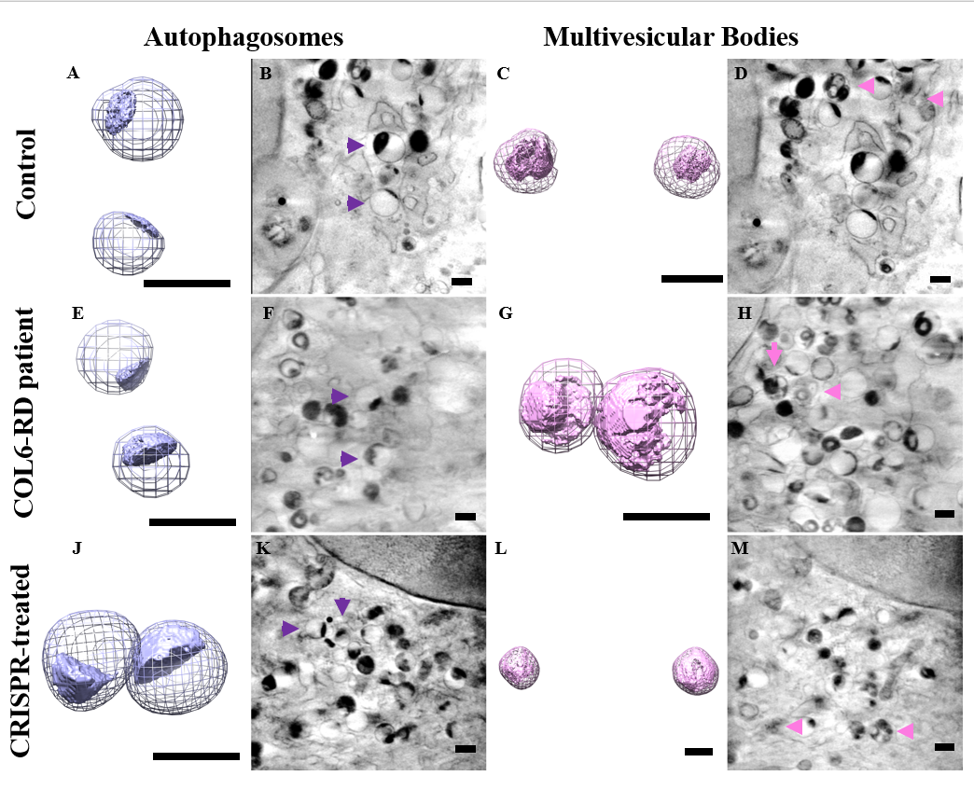
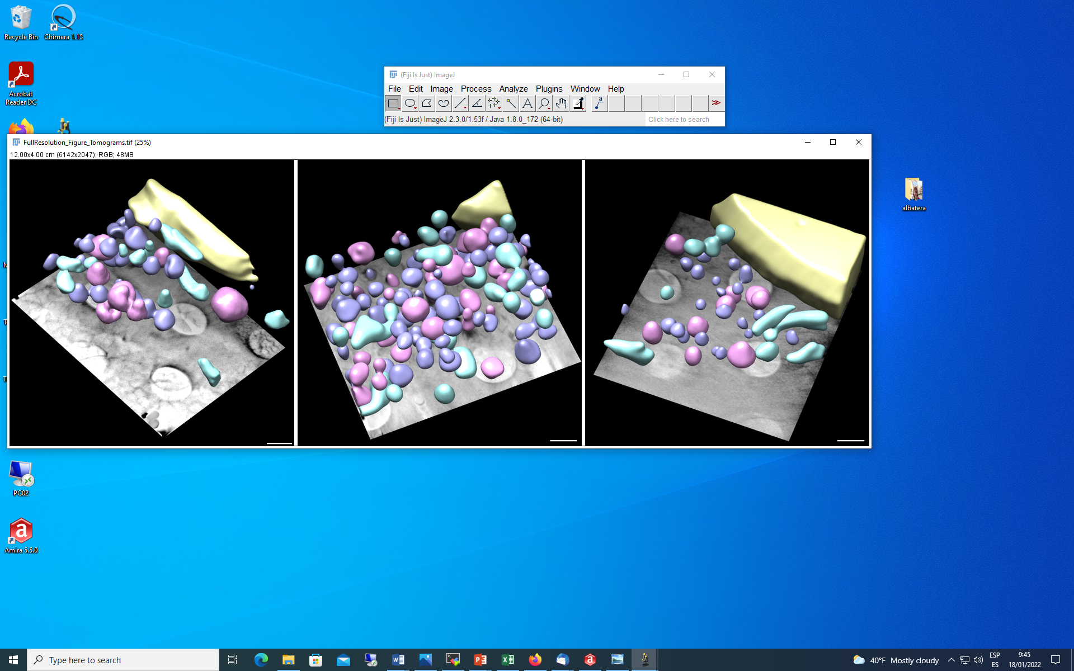
A New Tool to Proof Effectiveness of CRISPR/Cas9 Therapies: X-ray Tomography
Also an important contribution of the X-Ray tomography in the cellular pathologies field is the possibility to develop the proof of concept of the success of gene therapy application in the disease reversion of the cellular and biochemical phenotype of cells harbouring the cellular mutation triggering the disease by application of CRISPR/Cas9.
Control
COL6-RD patient
CRISPR-treated
Enrico Castroflorio, Ana Joaquina Pérez Berná, Arístides López-Márquez, Carmen Badosa, Pablo Loza-Alvarez, Mónica Roldán and Cecilia Jiménez-Mallebrera, “The Capillary Morphogenesis Gene 2 Triggers the Intracellular Hallmarks of Collagen VI-Related Muscular Dystrophy”, Int. J. Mol. Sci. 2022, 23(14), 7651; https://doi.org/10.3390/ijms23147651

Slide 4
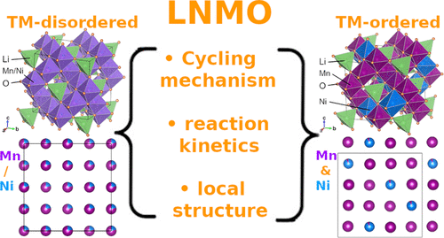
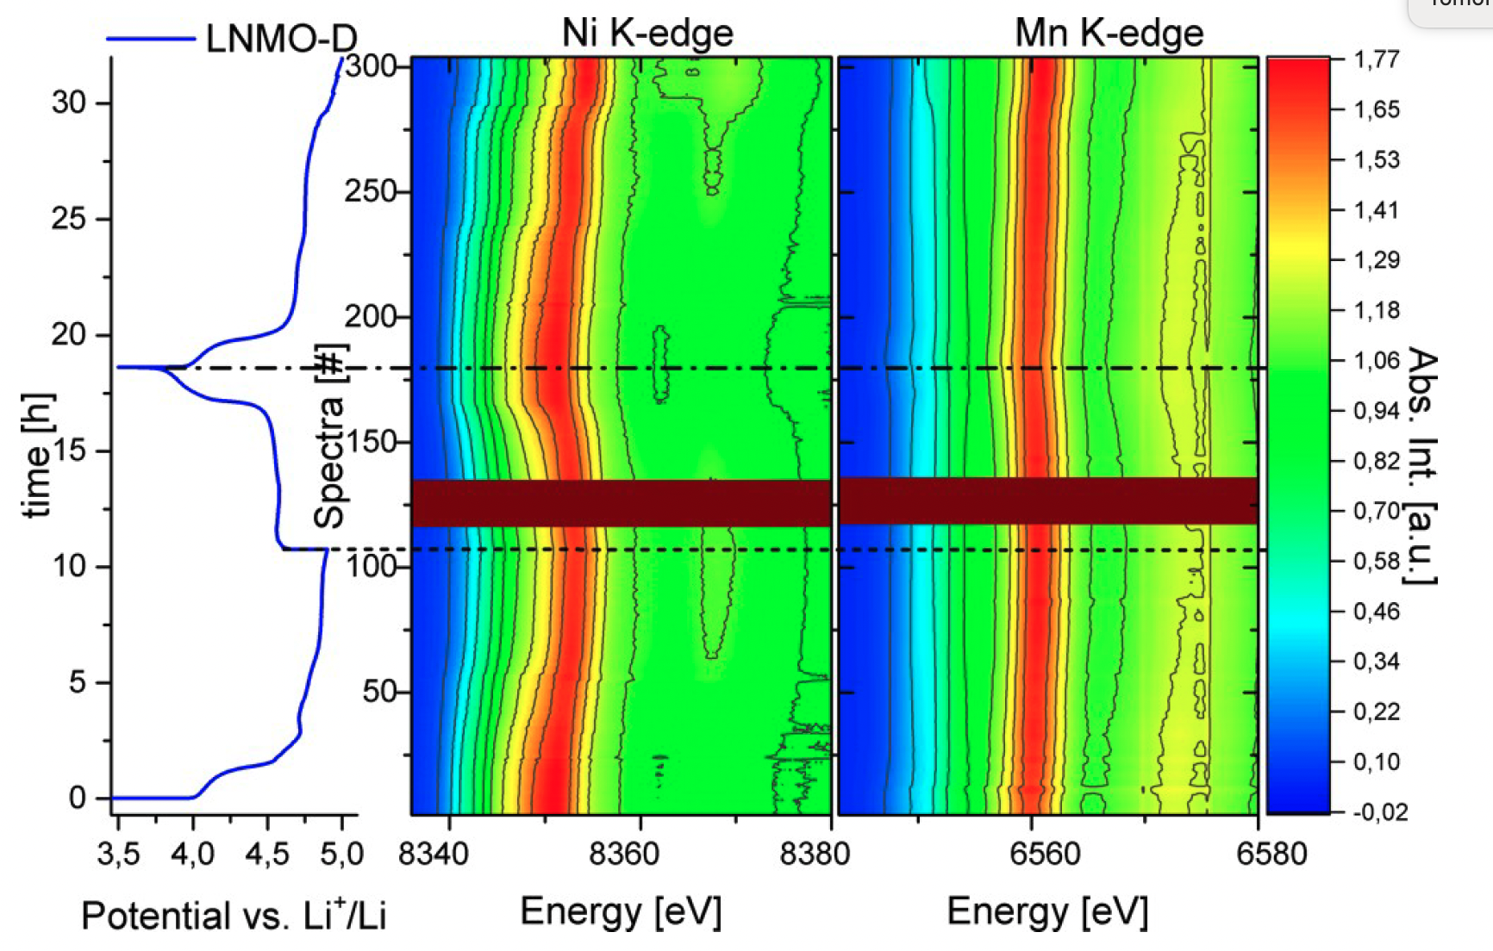
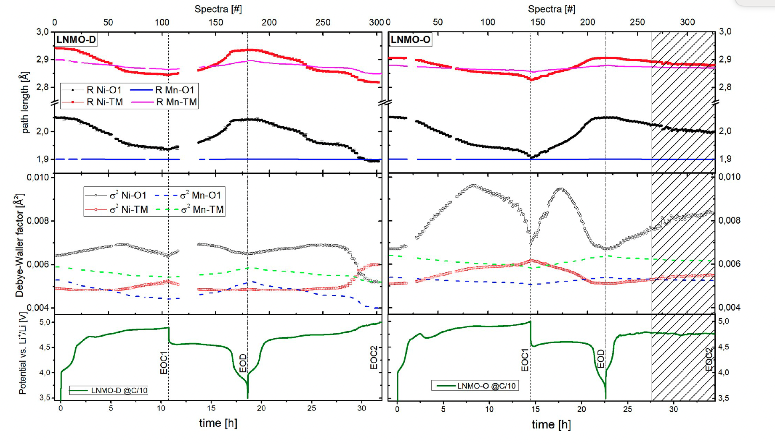
Understanding Electrochemical Cycling of Ordered and Disordered Li-Ni_{0.5}Mn_{1.5}O₄ Using Hard X-ray Spectroscopy. N2
An operando dual-edge X-ray absorption spectroscopy on both transition-metal ordered and disordered Li-Ni0.5Mn1.5O4 during electrochemical delithiation and lithiation confirmed:
redox activity relies predominantly on the Ni2+/4+ redox couple involving a transient Ni3+ phase.
a reversible minority contribution of Mn3+/4+ is also evinced.
While the reaction steps and involved reactants of both ordered and disordered LNMO materials generally coincide, we highlight differences in terms of reaction dynamics as well as in local structural evolution induced by the TM ordering.
disordered
ordered
Marcus Fehse,* Naiara Etxebarria, Laida Otaegui, Marta Cabello, Silvia Mart.n-Fuentes, Maria Angeles Cabañero, Iciar Monterrubio, Christian Fink Elkjær, Oscar Fabelo, Nahom Asres Enkubari, Juan Miguel L.pez del Amo, Montse Casas-Cabanas, and Marine Reynaud, “Influence of Transition-Metal Order on the Reaction Mechanism of LNMO Cathode Spinel: An Operando X‑ray Absorption Spectroscopy Study”, Chem. Mater. 2022, 34, 6529−6540. https://doi.org/10.1021/acs.chemmater.2c01360

Slide 5
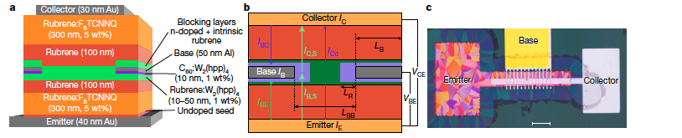
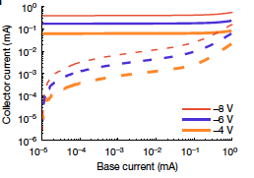
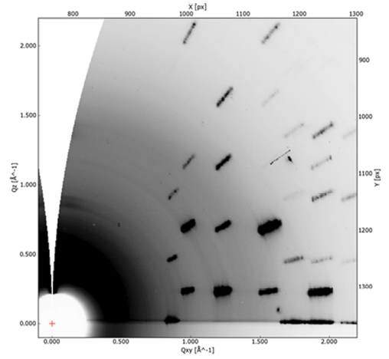
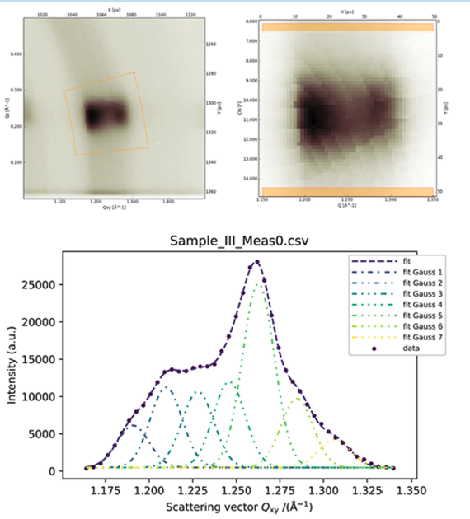
Chemical and Material Sciences: Novel High performance Organic Thin Film Bi-Polar Transistor
Development of organic thin film transistor technology based on rubrene shows high gain (lager than 100).
Performance depends on crystal structure of the different organic thin layers which are strongly impacted by the dopoing concentration
GI-WAXS was used to determine crystal structure, orientation, and broadening ultimately guiding the doping concentration.
Nature | Vol 606 | 23 June 2022
https://doi.org/10.1038/s41586-022-04837-4
07/9/22 AUSE meeting – ALBA Present and Perspectives – K. Attenkofert
Notes:
Take slide out.

Slide 6
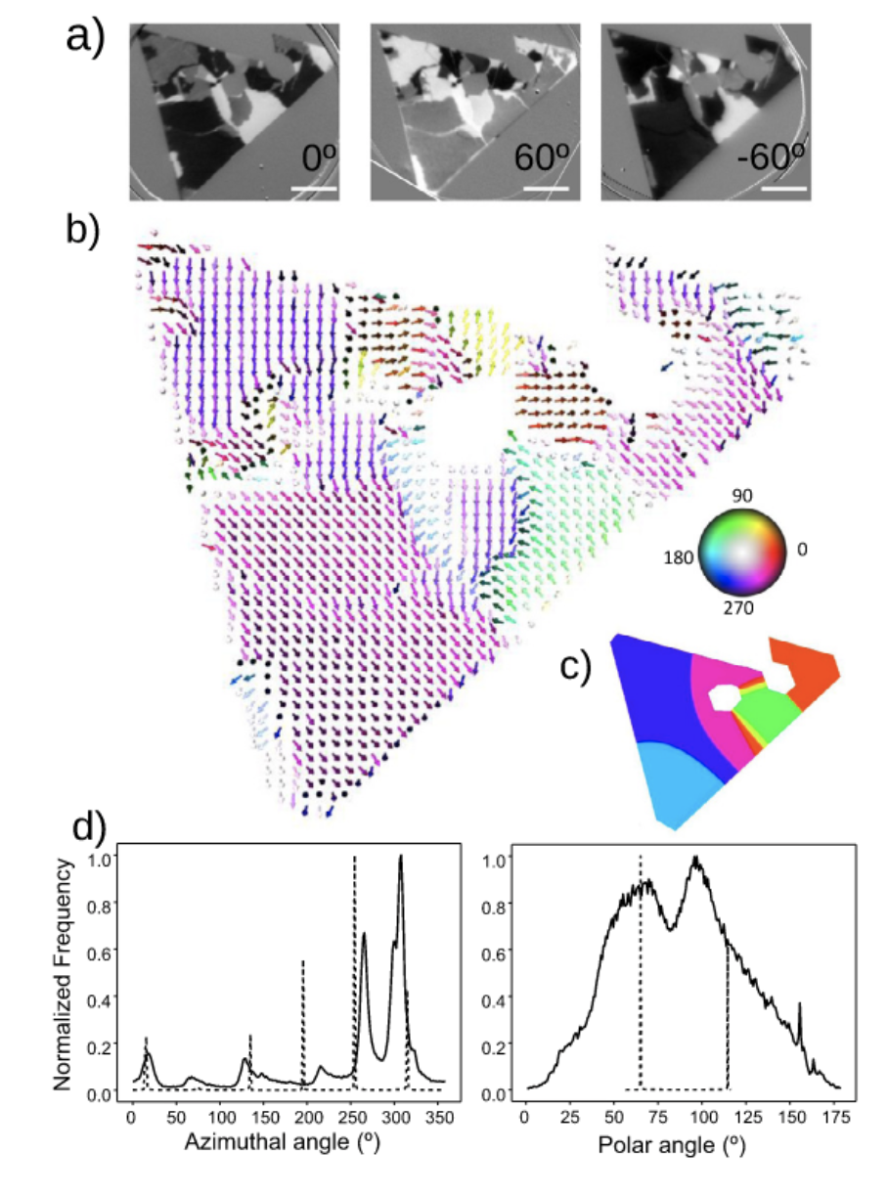
Magnetic Domain Wall Pinning in Cobalt Ferrite Microstructures for Spintronics ApplicationsN2
A detailed correlative structural, magnetic and chemical analysis of (non-stoichiometric) cobalt ferrite micro-metric crystals have been performed by x-ray magnetic circular dichroism combined with photoemission microscopy, low-energy electron microscopy and atomic force microscopy:
The magnetization vector inside the islands was resolved at the nanoscale, as obtained from magnetic images taken at different x-ray incidence angles.
The location of the magnetic domain walls was correlated with the presence of different types of defects as revealed by the different microscopies.
This, together with the results of micromagnetic simulations, suggests that the main source of pinning in these microcrystals are linear structural defects induced in the spinel structure by the substrate steps underneath the islands.
The defects responsible for the pinning of the domain walls are the substrate steps. It should be thus possible to obtain structurally perfect ferrimagnetic crystals with domain sizes limited only by the substrate terrace size
Sandra Ruiz-Gómez, Anna Mandziak, Laura Martín-García, José Emilio Prieto, Pilar Prieto, Carmen Munuera, Michael Foerster, Adrián Quesada, Lucía Aballe, Juan de la Figuera, “Magnetic domain wall pinning in cobalt ferrite microstructures”, Applied Surface Science 600 (2022) 154045. https://doi.org/10.1016/j.apsusc.2022.154045

Slide 7
+ 2200 yearly user visits
225 staff
3400 national users
+300 yearly experiments
ALBA numbers
+2500 publications
3200 international users
+7500 yearly public visits
10 operating Beamlines
+200 trained students
4 Beamlines
In construction
07/9/22 AUSE meeting – ALBA Present and Perspectives – K. Attenkofert

Slide 8
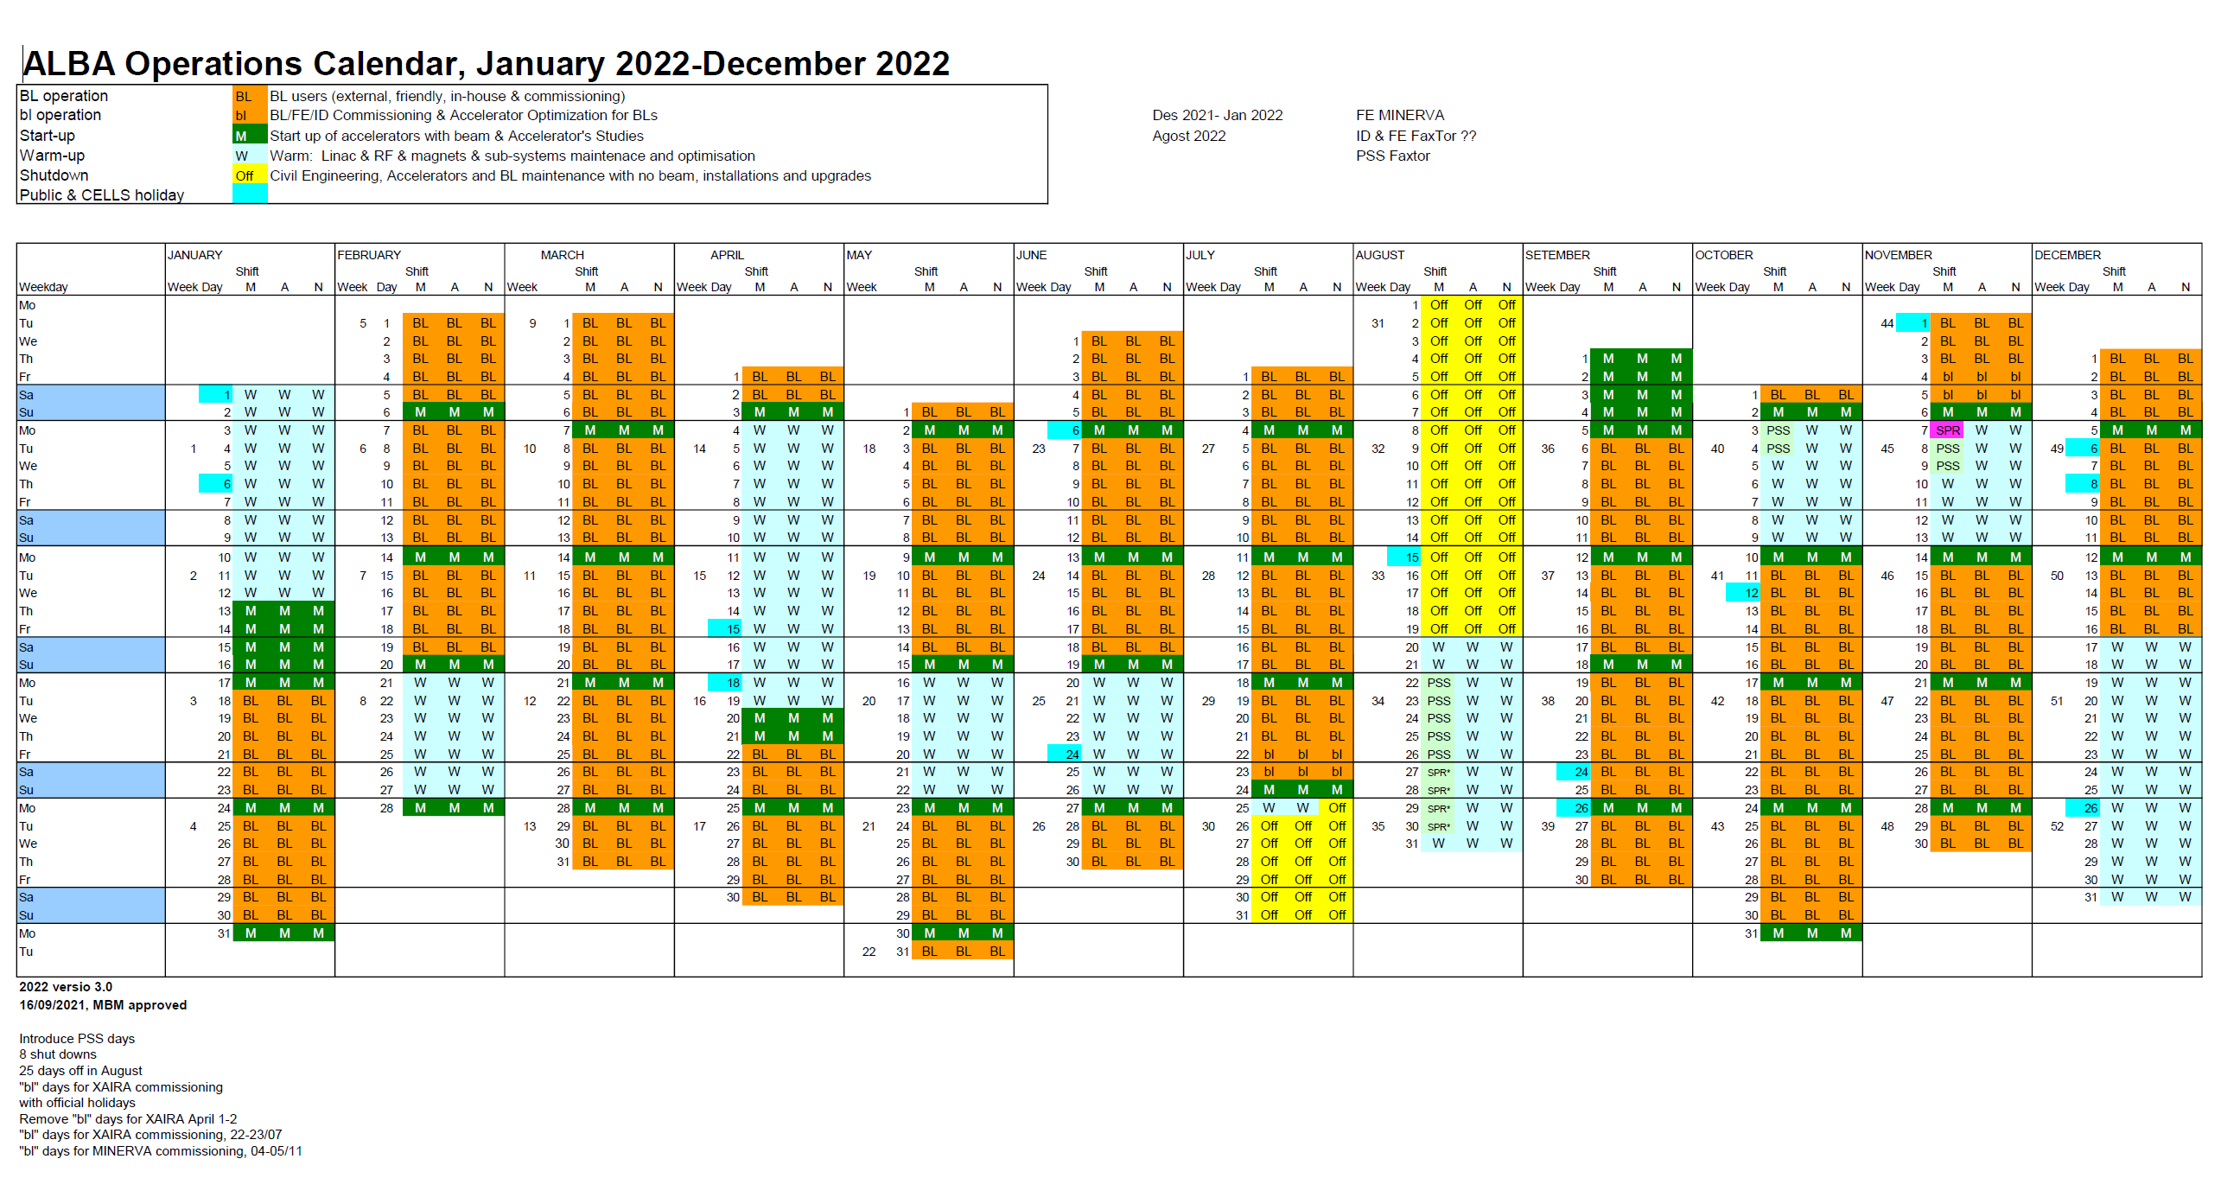
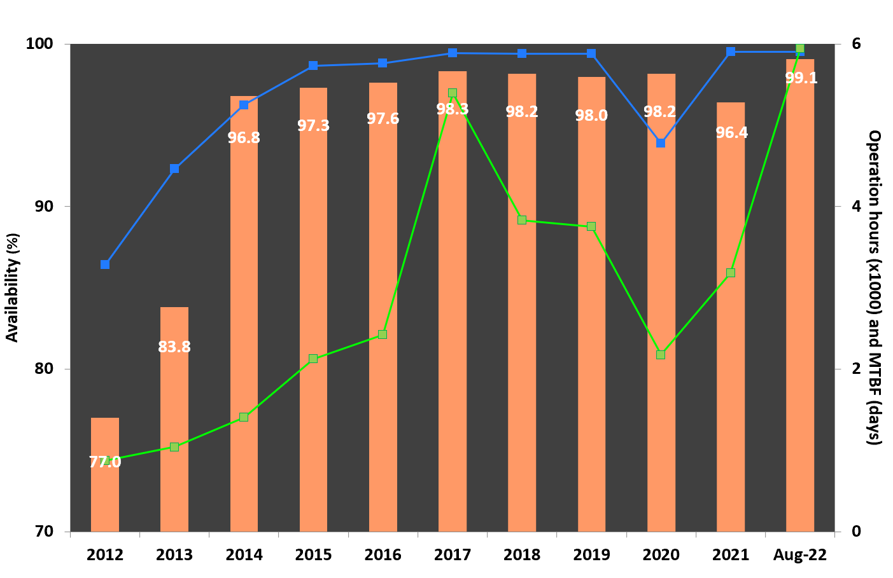
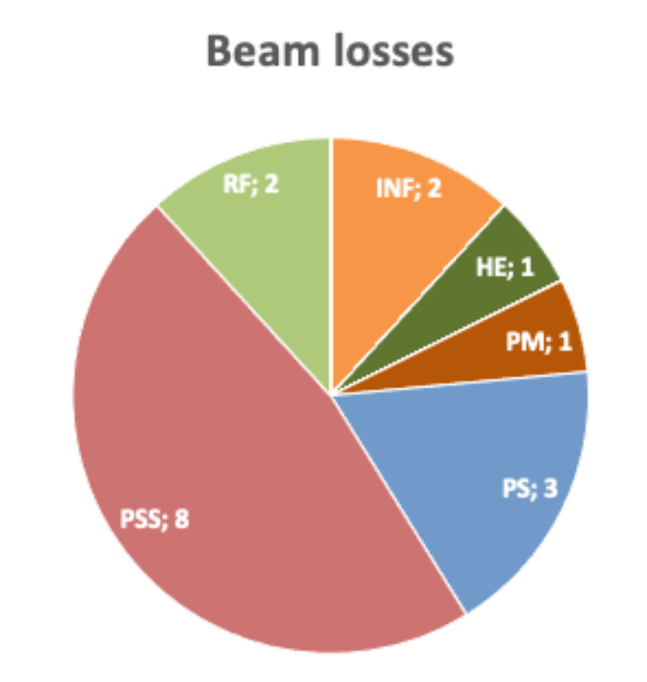
Operation (at 01-09-22)
99.08%
11 out of 22 week runs with no faults

Slide 9
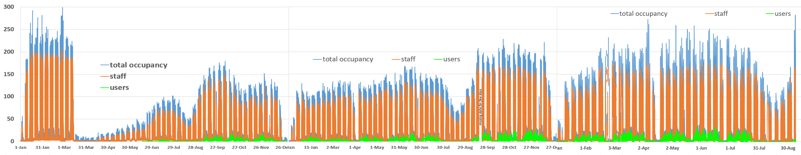
“New normality” at the facility
Percentage of average teleworking at the level of 20% in periods with no restrictions. Increasing teleworking during pandemic wave peaks
Presently no restrictions
Still some positive cases, none of them serious. In total more than 60% of the staff has been infected, only few cases attributable to infection on site.
In 2022 first workshops and meeting with dozens of external participants
2020 2021 2022
07/9/22 AUSE meeting – ALBA Present and Perspectives – K. Attenkofert

Slide 10
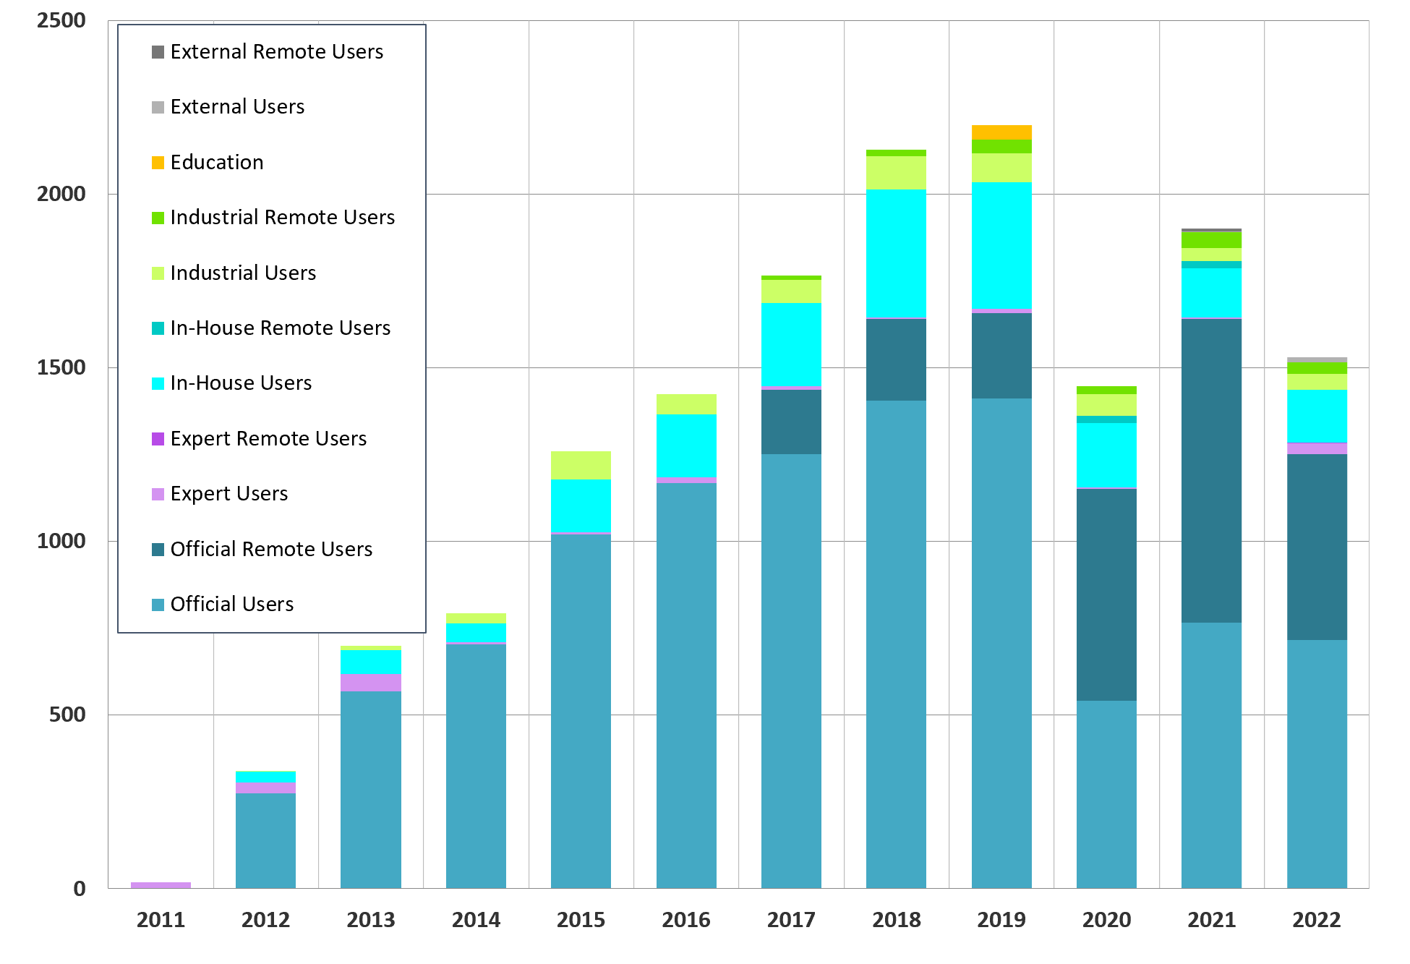
No restrictions for user visits during 2022 38% is using remote access
USER VISITS
End July

Slide 11
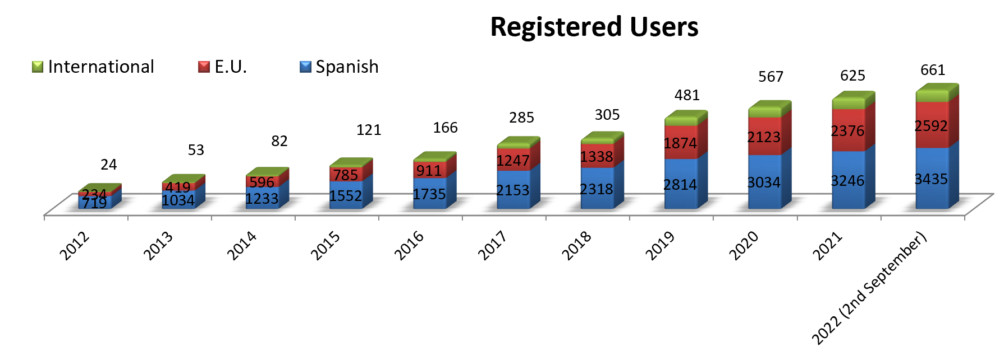
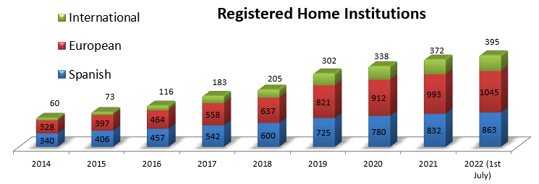
USER Community
+ 3400 national (51%), + 3250 international
+ 860 national (37%), +1440 international

Slide 12
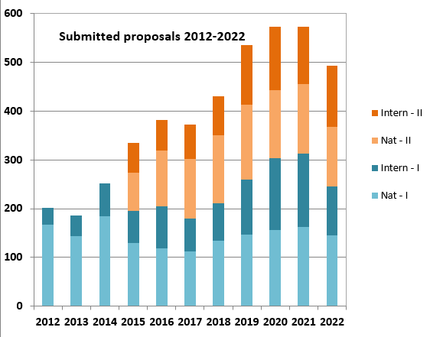
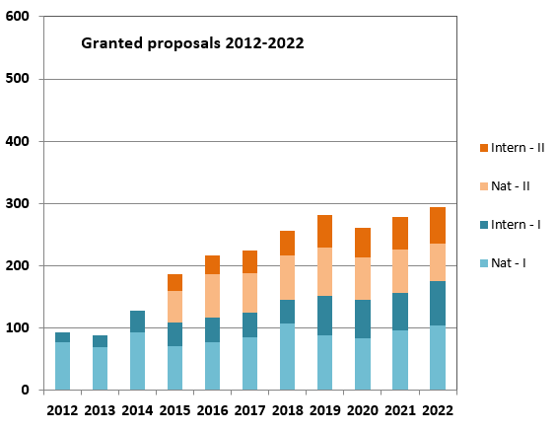
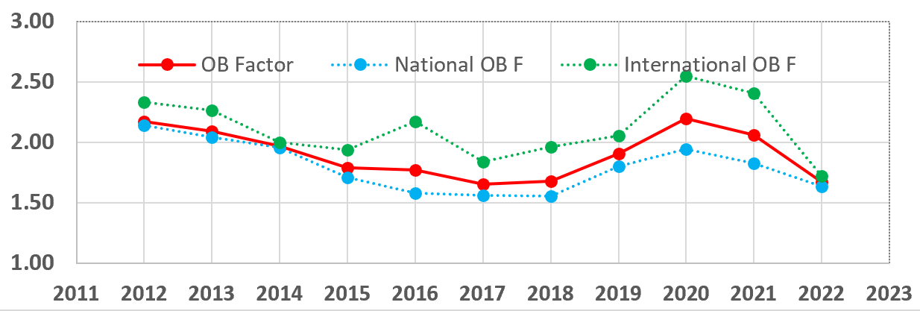
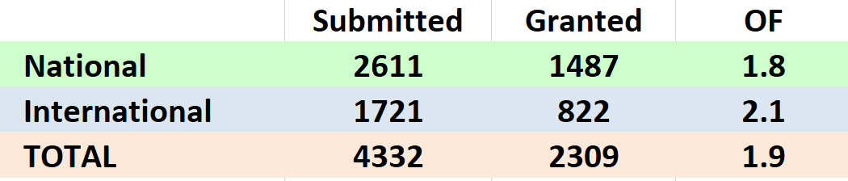
Academic user access
Call 2023-I just closed

Slide 13
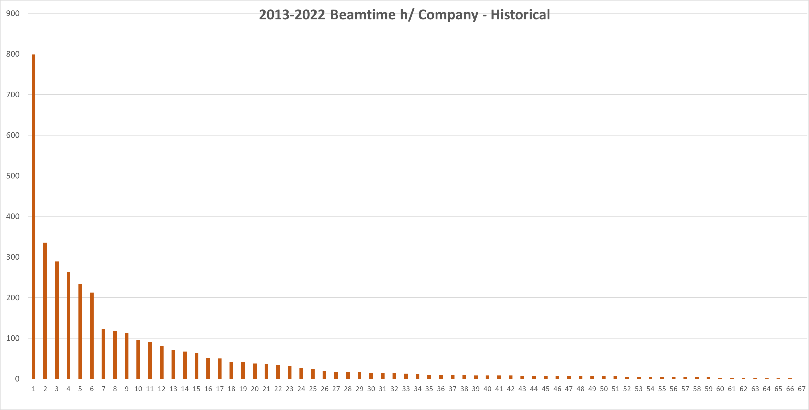
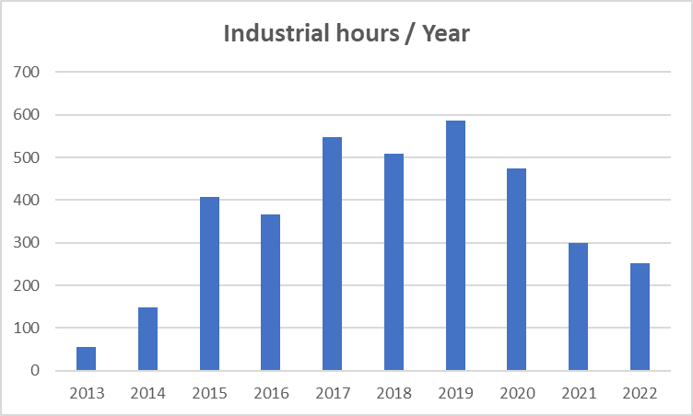
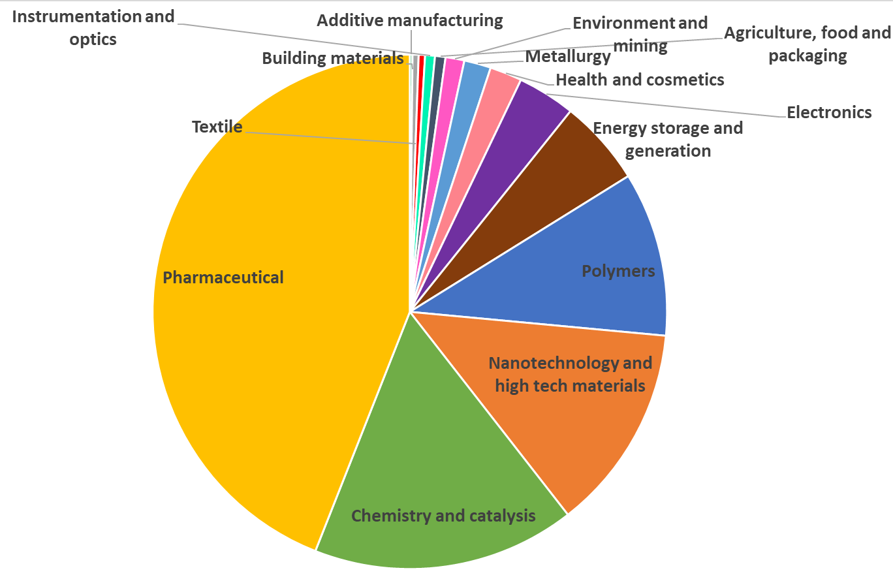
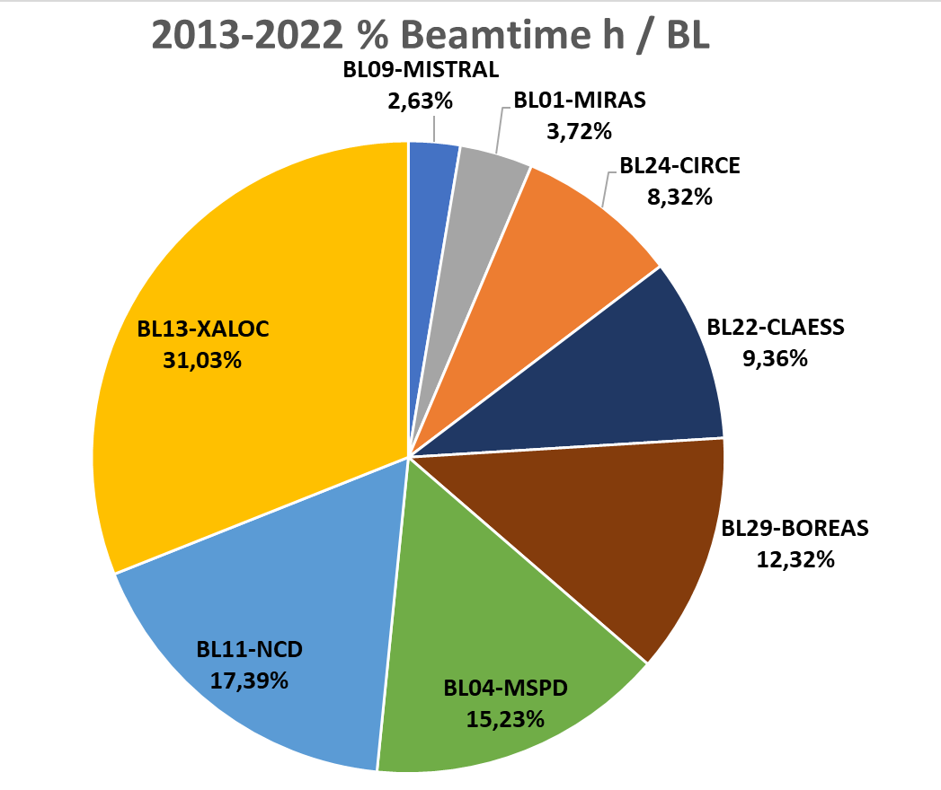
INDUSTRIAL BEAMTIME – HISTORICAL (30-06-2022)
66 different companies
2013-2022 % beamtime h/ind.sector
June 30

Slide 14
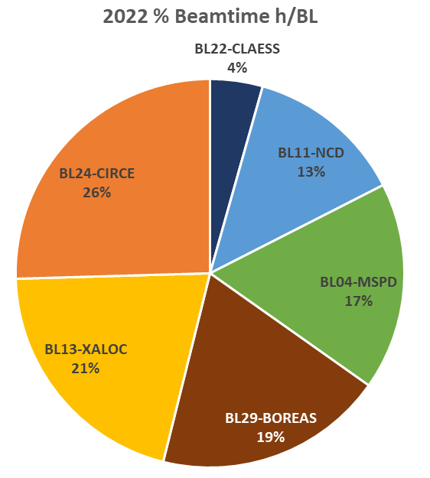
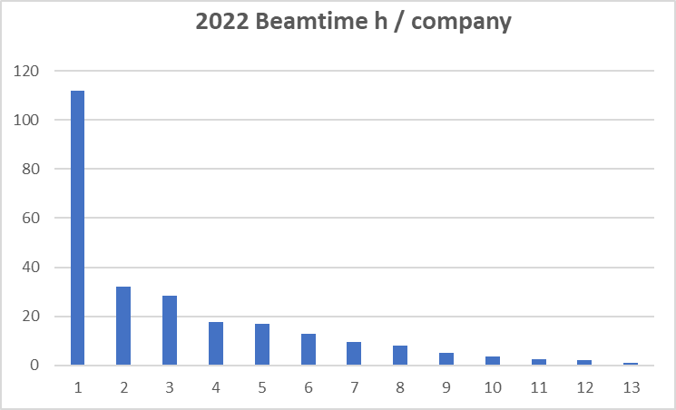
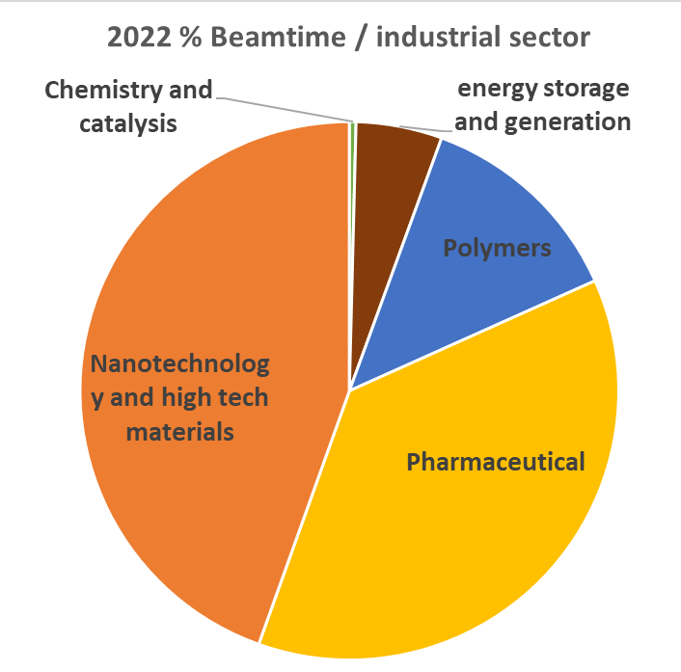
INDUSTRIAL BEAMTIME 2022
(30-06-2022)
251.5h beamtime
13 different companies
2 new customers
ALBA Present and Perspectives
07/9/22 AUSE meeting – ALBA Present and Perspectives – K. Attenkofert

Slide 15
Development of Publications per Beamline
Observations:
MSP is currently extremely well performing with 83 papers in 2021.
Averagely, each beamline publishes 37+ peer reviewed publications over the past 2 years.
Impact factor is constantly increasing and currently is in average 8.3.
User program is extremely healthy thanks to an excellent user community, fully engaged staff, and constantly expanding capabilities!
Time
Time

Slide 16


EU funding for SME access to Light Sources
LEAPS-INNOVATION project
ALBA coordinates TamaTA-INNOV programme to provide continuation to the CALIPSOplus activity
First call open from Nov 11, 2021
12 different facilities participating
6 proposals received from all facilities, 1 for ALBA
07/9/22 AUSE meeting – ALBA Present and Perspectives – K. Attenkofert

Slide 17

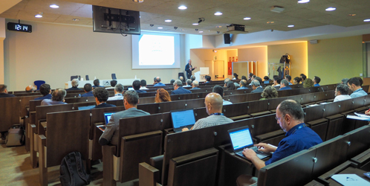
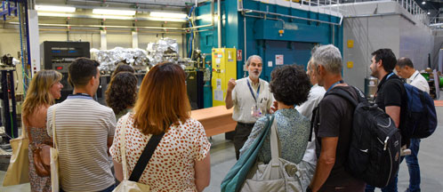
BACK TO FACE TO FACE BUSINESS
Workshops at ALBA:
Workshop: opportunities for the science industry, May 24 (in collaboration with CDTI and Induciencia)
More than 100 B2B meetings organized
Workshop: industrial applications of ALBA Synchrotron in pharmaceutical industry, June 17 (in collaboration with Biocat)
Almost 30 national companies attended
Already one project under discussion
Other outreach activities:
At ALBA:
Visit of “famous brands”
Companies and industrial associations visits with Sabadell council
Safari Tech (on-line)
Visit UA-SUMMIT
Outside ALBA:
IndTech 2022 (Grenoble)
Innovation Forum for Health (Sabadell)
Hub-B30 activities

Slide 18
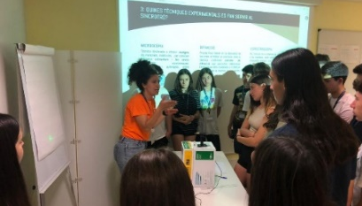
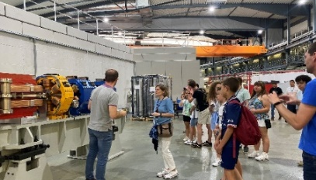

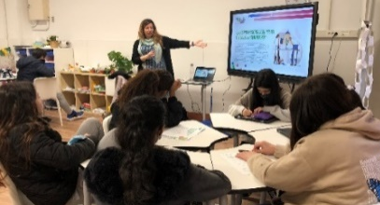

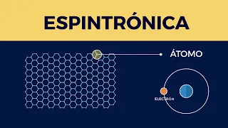

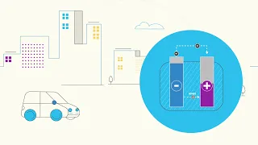
Communications & Outreach
Face-to-face activities are back
High schools hands-on workshop & visits
Guided tours again on-site
“Science in Colors” Scientists at the classrooms to show diversity
New series of videos about experiments
Covid-19: Part I & Part II
Spintronics
Industrial adhesives
Batteries
07/9/22 AUSE meeting – ALBA Present and Perspectives – K. Attenkofert

Slide 19
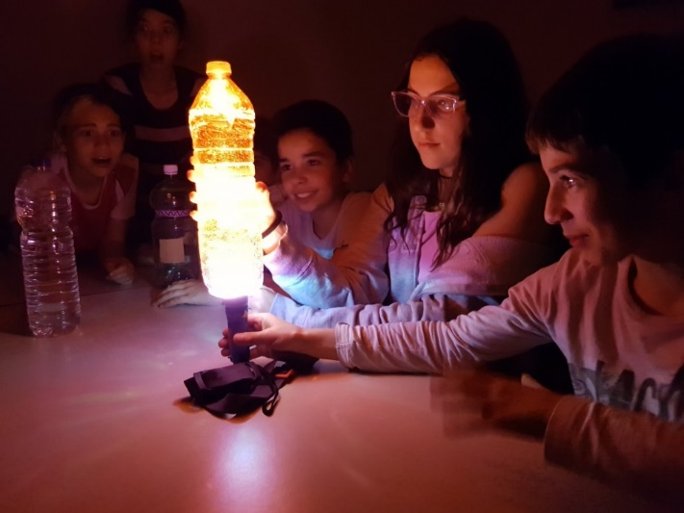
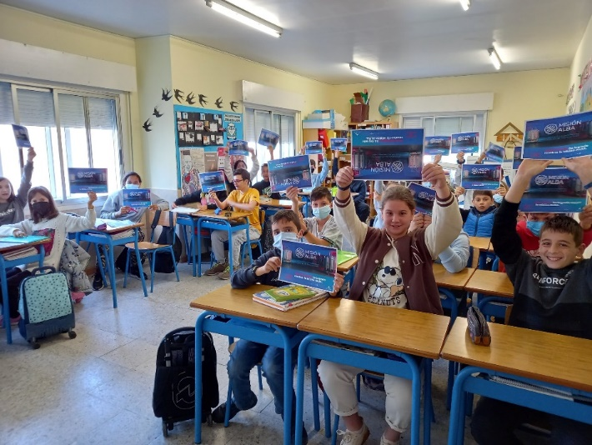
Communications & Outreach
“Accelerating electrons”, the ALBA podcast
1st season with 6 episodes
More than 17.000 listenings from Spain, Mexico, Argentina, USA,…
2nd season from Sept.-Febr.
Mision ALBA 2021-2022
342 primary schools from all Spain
760 classrooms
More than 15.000 students enrolled
Mision ALBA 2022-2023 is open for registration

Slide 20
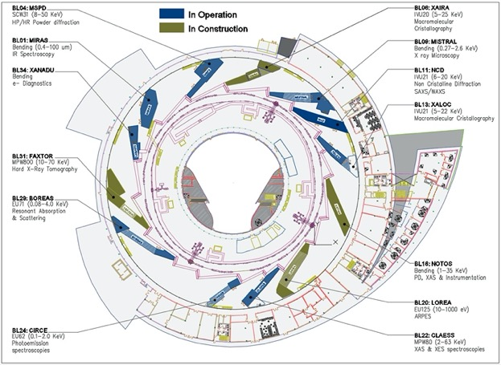
The Provided Techniques:
Alba’s organization: Three scientific sections support the user program:
Life Sciences Section.
Chemical and Materials Sciences Section.
Electronic and Magnetic Structure Section.
Alba is a 3. generation synchrotron source with 10 operating beamlines and 4 in construction.
XAIRA (microfocus/phasing MX beamline)
FAXTOR (full-field imaging beamline)
3Sbar (HEXPAS and surface diffraction beamline)
MINERVA (Industrial metrology beamline)
10 operating beamlines:
MIRAS (IR)
MSPD (PD)
MISTRAL (soft X-ray microsc.)
NCD (SAXS/WAXS)
XALOC (MX)
NOTOS (XAFS + PD)
LOREA (ARPES)
CLAESS (XAFS)
CIRCE(NAPP/PEEM) (NAPP: scientifically represented by CMS)
BOREAS (XMCD, soft X-ray scattering)

Slide 21
Getting the Division Ready for the New Opportunities: Planned Re-org.
Experiments Division
User Office
As it is
Life Science
Chemical and Material Sciences
Electronic and Magnetic Structure of Matter
Instrumentation and Development
Beamline Support
New group
Transferred
FAXTOR
CLEASS
BOREAS
Optics
Technician
MISTRAL
MSPD
CIRCE
Methodology
Floor Coordinator
MIRAS
NCD
LOREA
Minerva
XALOC
NOTOS
Nano-Positioning
XAIRA
3Sbar
TEM - X-ray
New Groups:
3Sbar new beamline project (see talk of tomorrow). Group leader hired; first scientist under evaluation.
Methodology group. Group leader hired; two postdoc positions available through InCAEM.
Nano-Positioning group. Group leader and engineer position available (first interview round was not successful).
TEM – X-ray group. Group leader and scientist position is available through InCAEM.
Notes:
Need update with pictures from new beamlines

Slide 22
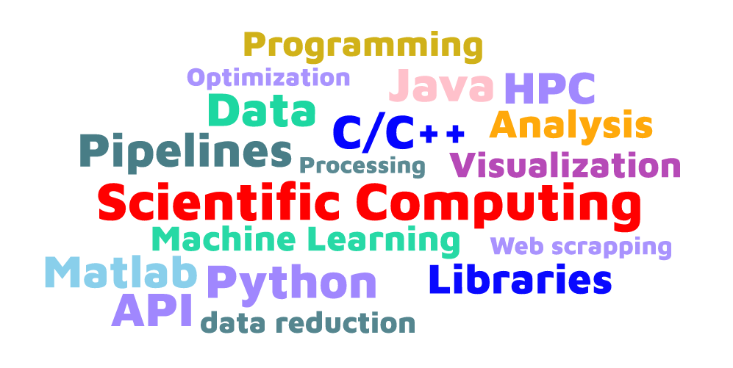
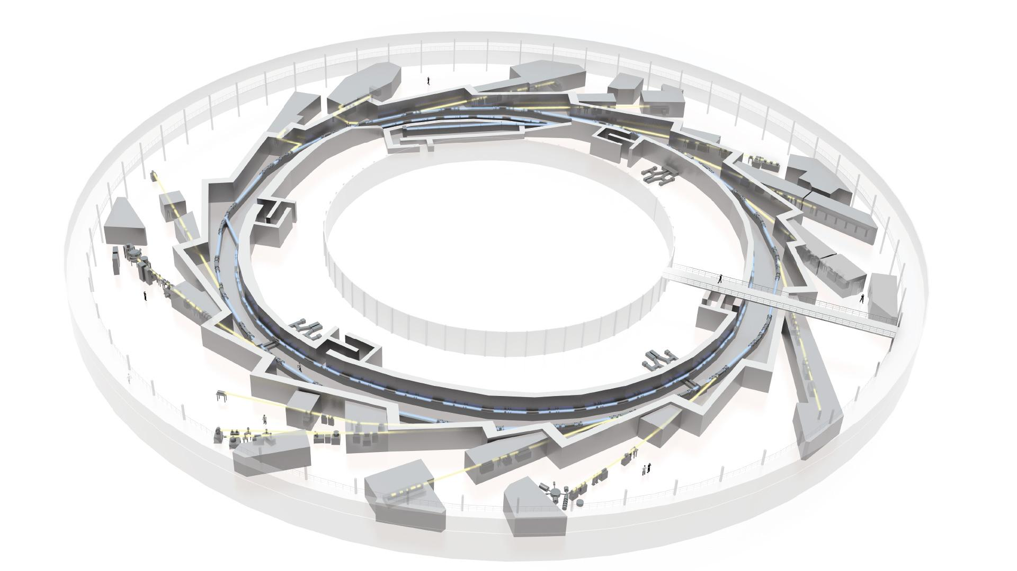



Scientific Data Management
Our missions
Data processing / analysis software
(mainly beamline support)
data
metadata
Data reusability
In synergy with other sections in Computing
Orchestrating FAIR metadata capture (with CT)
Providing provenance tools
Persistent identifiers management (with MIS)
Participate in data catalogue implementation (with MIS)
Data analysis portal (with MIS)
Data management plans
Section created in 2021, growing to 7 people towards the end of 2022
1 section responsible (N.Soler)
6 software engineers
S
S
S
S
S
S
S
Notes:
Nowadays, facilities face, amongst others, the two challenges of having
1) data that grow in volume and complexity
2) that funders enforce the data produced to comply with the FAIR principles
Talk about the engineers and their hybrid science / computing background to make a bridge with Experiments

Slide 23



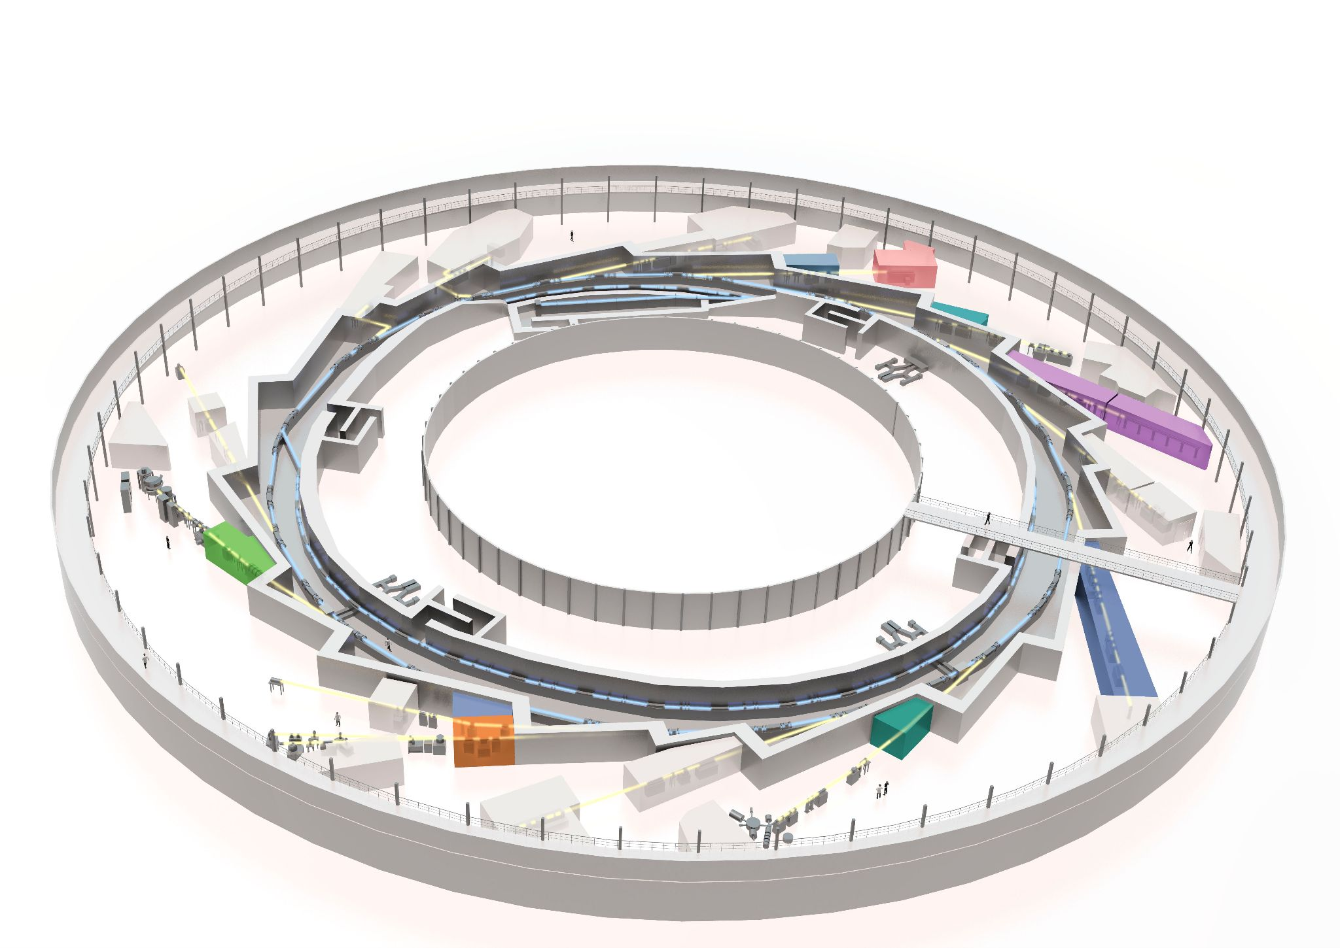






raw and derived data
data analysis
derived data
Expert users
derived
data
portal
Web-browser
or API
data
storage
raw data
data
External
databases
Outside World
metadata catalogue
aggregated
metadata
OAI-PMH
protocol
EOSC data discovery platforms
raw and derived data
Non-expert users

Slide 24
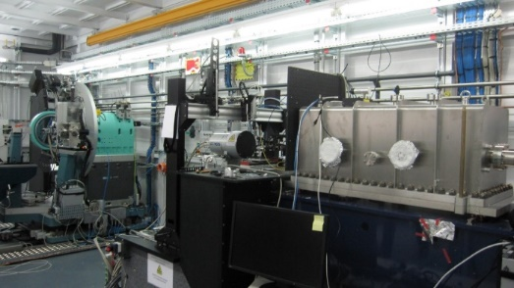
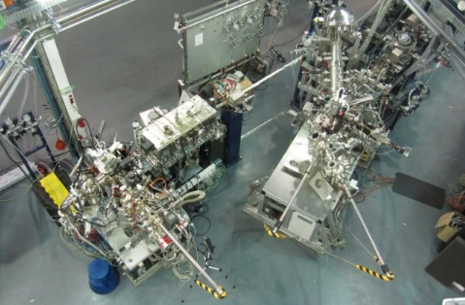
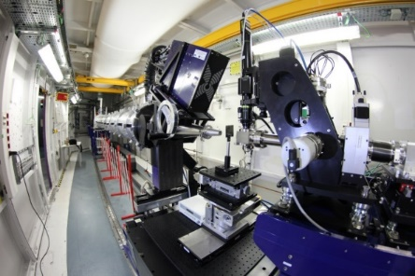
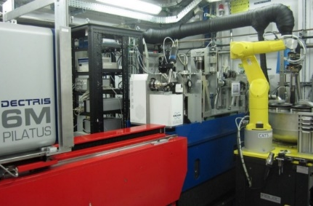
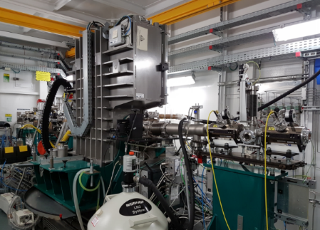
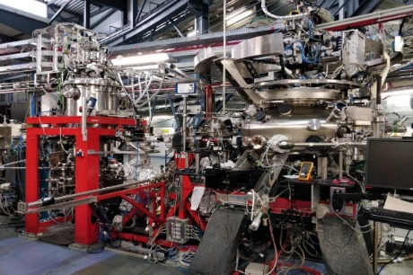
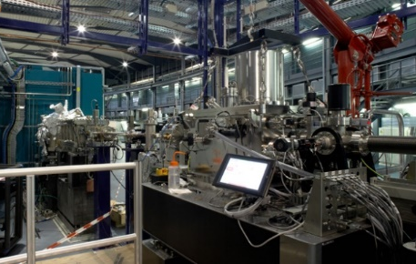
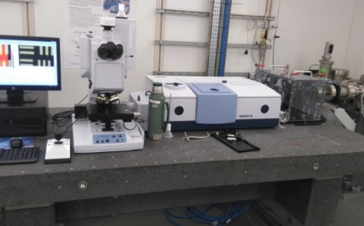
Beamlines in operation (since 2016)
Mainly dedicated to Chemistry, Physics, Condensed Matter
Mainly dedicated to Life Sciences
MSPD: Material Science Powder Diffraction
HP & HR stations
CIRCE: PhotoEmission Electron Microscopy and
Near Ambient Pressure Photoemission
NCD – SWEET, Non crystalline diffraction,
SAXS, WAXS and GISAXS
XALOC, Macromolecular Crystallography
CLAESS: Absorption & Emission Spectroscopies
BOREAS REsonant Absorption and Scattering
MISTRAL, Cryo nano-tomography
MIRAS, IR spectroscopy

Slide 25
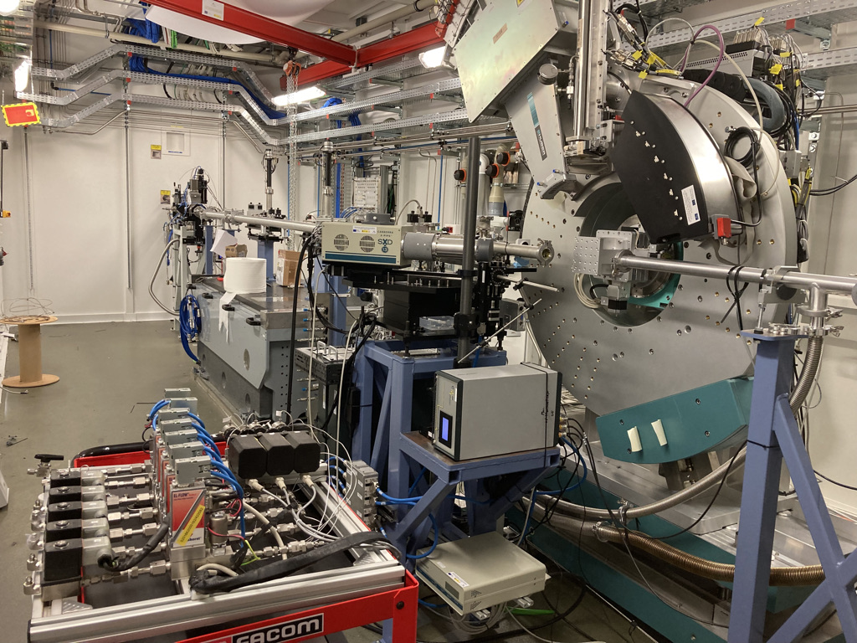

The New Beamlines in Operation
Mainly dedicated to Chemistry, Physics, Condensed Matter
NOTOS: Hard X-ray Spectroscopy and Powder Diffraction optimized for operando experiments
LOREA: Angle Resolved Photo Electron Emission Spectroscopy

Slide 26

LOREA
Optimization of BL in all energy ranges after exchanging of gratings, confirmation of 10-1000eV energy range.
Energy resolution optimised in 10-120eV + 350-800eV ranges.
Soft X-ray ARPES (up to 500eV) demonstrated
VUV and soft X-ray ARPES
72eV
Best energy resolution of photoemission (BL+PES)=8meV (with Pass energy=5meV) at 30eV photon energy (very near to specification).
434eV
VSe₂ measured at 72eV and 434eV
Courtesy of Santiago Blanco – Nanogune – San Sebastian
Stability of energy calibration when changing grating demonstrated (less than 8meV after change)
To be improved: grounding of sample, uncertainty on beam spot size (because of diagnostics difficulty), stability of manipulator and BL never determined with photoemission.

Slide 27




Commissioning plan
Au grid to characterise beam spot size, manufactured in collaboration with ICN2, tested in July, used for experiment with 20µmx20µm flakes.
Energy and angular resolution to be characterised with photoemission in wide energy range to be done in September.
Stability of measurement characterised in July on graphene flakes.
Extension of soft X-ray ARPES to 600eV and resonant ARPES to 800eV in October.
Sample A
Sample B
Linear dispersion of 20µm² graphene flake
200 µm

Slide 28



Νóτος - The Sister of SpLine: Description
Main features
Energy range 4.7 – 27 keV (XAS) / 30 keV (XRD)
Minimum photon flux: 10¹¹(ph/s )
Spot properties on sample at HRPD & XAS station: min 400x400 µm²
Reactive gas system available at ambient pressure
Capillary setup for operando experiments
HRPD&XAS endstation full operative

Slide 29





Combination of XAS and XRD techniques for operando electrochemistry experiment
M. Rosa Palacin and Ashley Black - CSIC- Institut de Ciència de Materials de Barcelona
Commercial (NEI corporation) casted electrodes: LiNi_{0.33}Mn_{0.33}Co_{0.33}O₂
PD at 11 keV
Mn (6539 eV), Co (7709 eV), Ni (8333 eV) k edges
XAS in transmission geometry
1 measurements cycle ≈11 ‘
Mn k edge
Co k edge
Ni k edge
Multi sample stage for coin cell

Slide 30
What is new and will come soon:
Beamline in construction
Collaborations
Instrumentation enabled by collaborations
Laboratory infrastructure
Expanding characterization tool sets

Slide 31



XAIRA - Beamline Status
Microfocus Macromolecular Crystallography
2.3m-long 19.9mm In-Vacuum Undulator
Beam size of 1 ×1 mm² at 1 Å (full beam 3×1 μm²)
Beam defocusing up to 10×10 mm²
Energy range of 4–14 keV
Novel dual DMM+CC (Mo/B4C+Si111) mono concept
High flux (DMM) and High stability (CC)
Use of interferometers to monitor the optics
Detectot test
6 July 2022
First beam
22 July 2022
End station
Low background experiments using He atm, compatible with air operation
Fast pixel array detector: Eiger2 XE 9M (frame rates up to 1000Hz)
Automated sample mounting system ISARA2 (29 cryo pucks+3 RT pucks
Optimal conditions for:
Optics Hutch installed
Oscillation Crystallography on microcrystals
Fixed-target serial crystallography
Native Phasing
Poorly diffracting crystals
Elemental analysis
Schedule
First beam: 22 July 2022
EndStation Comm: Summer 2023
First experiments: End 2023

Slide 32










BL31 - FaXToR
FAXTOR is a beamline that will be dedicated to fast micro-tomography and radiography in the hard X-ray regime, working both in phase and absorption contrast modalities. Monochromatic and filtered white beam radiation will be available at the level of end-station.
Fast Hard X-ray micro-Computed tomography beamline
Fast micro-Computed tomography
Monochromatic/filtered white beam
Absorption/phase-contrast imaging
Energy range: 8-70 keV
0.7 – 15 µm pixel size
BLs in construction
Tomography stage
Detection table (end- station)
ID
Front End
Advances (since last Rector Council)
Optics: Contracts signed, ongoing design.
Hutches: Contract signed, in production phase.
End-station: Contracts signed, ongoing design.
Third scientist to be hired – summer 2022
Schedule (Today):
Starts of installations: Autumn 2022
Starts of commissioning: Summer of 2023
Official starts of user operations: Spring 2024

Slide 33





MINERVA, the ESA BL at ALBA
ALBA - European Space Agency collaboration
ATHENA L-Mission (2032)
Advanced Telescope for High-ENergy Astrophysics
Study the Hot and Energetic Universe (large-scale structure, hot matter before being swallowed by black holes, etc...)
Mission Adoption Review: 2022
Launching: 2032
Large-aperture grazing-incidence Wolter X-ray telescope
Cost ̴1000M€
MINERVA BL
Characterization, alignment and assembly of the X-ray mirror modules of the ATHENA telescope.
Synergies with NOTOS BL and the Optical Metrology lab
ALBA-ESA loan contract: 10 years.
Optical Hutch installation completed (INNOSPEC)
Front End installation completed last winter 2021/2022 (FMB Berlin) .
PSS, vacuum and cables for Front End completed.
Experimental Hutch (clean room environment) in construction.
Call for tender to purchase an hexapod and a laser tracker awarded and contracts signed.
Toroidal mirror (SESO) + multilayer coating (Axo-Dresden) delivered.
Most equipement at Alba and ready for assembly.
Electronics and IT infrastructure + control system in progress
End of Commissioning beamline : March 2023
Today
Multilayer mono
33

Slide 34


3Sbar
A tool optimized for Operando Experiments
3SBar will combine ambient pressure X-ray Photoemission Spectroscopy (AP-XPS) at high pressures(1 bar or more) and surface X-ray diffraction (SXRD) at grazing incidence angles. First beamline designed for ALBA II.
Parameter | Value
Flux at 5 keV | 1.76x10¹³ ph/s
Resolution at 5 keV | 128 meV
Spectral Flux at 5 keV | 6.91 x10¹⁴ ph/s@0.1%BW
Spot size on sample | 1.27 x 3.66 µm² FWHM
Divergence on Sample | 0.76 x 0.30 mrad² FWHM
3Sbar, A beamline optimized for ALBA II:
Small beam (~1µm x ~1µm) with nearly spherical beam size allows horizontal scattering geometry with short nozzle to sample distances of ~ 30 µm (=high pressure).
Surface sensitivity
Total external reflection: X-ray depth control
Signal enhancement!
34
See talk in the afternoon by Juan Velasco

Slide 35
Collaborations

Slide 36
boosting science and innovation in Europe
devising robust roadmaps for the further development of European RIS
offering one voice for advice to European and national decision makers
enabling new ways of cooperation with industry
sharing expertise and resources for technology developments (incl. EOSC)
integrating LPC´s in the development of state-of-the-art technologies
offering a new platform for the education of the next generations of scientists
and engineers
→ providing the instruments for developing new materials for future climate-relevant technologies and advanced health control

Slide 37
Collaboration overview:
Laboratory Infrastructure:
Dedicated battery lab – collaboration partner ICMAB/CSIC, ALBA
Enhanced operando conditions for catalysis lab – collaboration partner ITQ/CSIC , ALBA
Electron Microscopy Center (JEMCA) – collaboration partners: IBMB/CSIC, CRG, IRB, UAB, ICN2, ICMAB/CSIC, UAB, ALBA
Enhanced multimodal microscopy for energy materials: InCAEM (Installació Correlativa In-situ per a Materials Avançats per Energia)– collaboration partners: ICN2, ICMAB/CSIC, UAB, PIC/IFAE, ALBA
In addition Nano-motion laboratory to develop key technologies for ALBA-II
07/9/22 AUSE meeting – ALBA Present and Perspectives – K. Attenkofert

Slide 38

Status of the Different Laboratories (7/7/22):
Courtesy of Joan Casas

Slide 39






PTI+ TRANS-ENER+
Transición Energética Sostenible
2) Colaboración con ALBA – Laboratorio conjunto
Retrasos: negociación ALBA, burocracia, etc.
Estado actual:
adecuación espacio en curso
concurso mobiliario
(ambos financiados por ALBA)
Puesta en marcha: final 2022/inicio 2023

Slide 40






PTI+ TRANS-ENER+
Transición Energética Sostenible

Slide 41




PTI+ TRANS-ENER+
Alta Tecnología Clave en la
Transición en el Ciclo Energético
CSIC’s TransEner Thematic Interdisciplinary Platform
Aim: Development of non-conventional research tools to speed up the application of new energy technologies. Funding: Next Generation EU
Thematic areas
Action: Bench instrumentation for research at ALBA
Coordinator: ICMAB (R. Palacín)
IPs: ICMAB (T. Puig), ITQ (G. Prieto), ITQ (C. Martínez)
Objetive: Construction and set-up of test benches to apply synchrotron radiation in frontier R&D for green energy applications (batteries, superconducting materials and catalysis).
End users: user community of ALBA.
Target beamlines: NOTOS, CLAESS, NCD-SWEET, MIRAS, MSPD.
Budget: 1.3 M€.
CSIC-ALBA Framework agreement under negotiation.
9

Slide 42




PTI+ TRANS-ENER+
Alta Tecnología Clave en la
Transición en el Ciclo Energético
CATALYSIS INSTRUMENTATION INSTALLED AND COMMISIONED AT NOTOS
GUI
Flow capillary cell featuring rotating/tumbling functions for operando XRD/XAS studies of gas-solid catalytic processes at high temperature and pressure (T=RT-700ºC, P=1-20 bar). Operative since July 2022.
9

Slide 43









Access to Microscopes (to be ready during 2021): - priority to researchers from owner institutions - a fraction open to all users via competitive calls - other institutions can apply for participation Aiming at future development, also participating to DREAM European platform
From ESFRI 2018 roadmap document
Actual DREAM partners
Existing e-beam for material science
Running e-beam project for material science
Existing e-beam for biology
Running e-beam project for biology

Slide 44






JEMCA
ERDF funding through the Catalan government
Funding for collaborative actions between different Catalan institutions
Purchasing & Installing 2 (S)-TEM microscopes
Life Sciences
Material Sciences
Collaboration Partners:
Available time: (for general user program 15%+9%)
200 keV Glacios cryo-TEM (ThermoFisher Scientific)
Autoloader for 12 samples
Falcon 4 direct electron detector
On-the-fly processing up to 2D classification
60-300 keV STEM (Thermo Fisher Spectra 300)
double aberration corrected (probe and image)
HR EELS detector
ULTRA X EDX detector
4D STEM and DPC with segmented and pixelated STEM detectors
Notes:
Present staff involved in the running of the BL with position and function
For scientists indicate, since when and filed of competence Former scientists and post docs can be indicated
Idea is to evaluate the human ressource, field of competence, personal rolling, seniority

Slide 45



JEMCA: First Commissioning Results
Life Sciences
Material Sciences
Apoferritin sample, vitrified on-site
2050 movies acquired (~9 h)
~290k particles after 3D classification
Reconstruction up to 2.1 Å resolution
First sub atomic resolution on Si 110 specimen
Notes:
Present staff involved in the running of the BL with position and function
For scientists indicate, since when and filed of competence Former scientists and post docs can be indicated
Idea is to evaluate the human ressource, field of competence, personal rolling, seniority

Slide 46
Operation of the Microscopes
Microscopes operated by dedicated staff from IBMB & ICN2
Ongoing work to include operation of the microscopes within the User program.
With the present agreements most of the time (76%) dedicated to operation for the partners of the collaboration.
Simplified access through the User Office
Paid access
The difference (External users + ALBA time) will go to external users: academic or industrial.
Academic proposals through a competitive call, evaluated by a scientific panel. Waived fee.
Spanish Users expenses will be covered by ALBA like for beamtime

Slide 47

Operations Calendar 2023
Operating 219 d/year
Mo to Fr
8h/day

Slide 48
Operation of the Microscopes
EM01 Cryo-TEM
Commissioning is completed
2022 OCT-DEC open to partners of the collaboration
From JAN 2023 open to external users
Call for external users to open at the beginning of OCT’22
Check our web page for details
EM02 METCAM
Commissioning is ongoing
2023 JAN-JUN open to partners of the collaboration
From JUL 2023 open to external users
Call for external users to open at the same time that synchrotron call

Slide 49



More Microscopes: InCAEM
What is InCAEM:
Focused on correlative imaging and microscopy on all relevant length-scales up to the atomic resolution of energy related materials.
The partners: ICN2, ICMAB/CSIC, UAB, PIC/IFAE, ALBA
Main trusts:
HRTEM under operando conditions.
STM/AFM platform (3 instruments).
Data analytics (deep learning) thrust.
Multimodal TEM/Xray group.
Timeline:
Project is funded.
Hiring and pilot projects are starting.
Availability of instruments in 2024.
See talk Thursday morning by Jordi Arbiol

Slide 50

Status
Working on:
Spaces definition and detailing
Construction solutions
Services & Network
Convenctional and Mechanical installations
Material:
Furniture, benches, tools, tooling list…
Instrumentation and controllers definition
WP5 NanoLab

Slide 51

Questions welcome

