Slide 1
ALBA II - Science
Attenkofer
08.09.2022

Slide 2
What Approach to Science, We Want to Apply
ALBA II is developed around three fields, important to the everyday’s life of all of us, namely health, energy, and information technology, but is about a methodology which can be applied to many more problems.
What’s about this talk:
The process to develop the science case.
What ALBA II stands for.
Why do we need ALBA II: Scientific examples
AUSE/ALBA-user meeting 2022

Slide 3
What does ALBA II Stand For
What is ALBA II:
ALBA II is a unique opportunity to reshape reliable services, we will provide to the user community including applied and commercial communities, by adjusting these services to the changing needs of the community and ultimately the society.
What does ALBA II stand for:
ALBA II willstrengthen the existing user program by significantly improving
The microscopy/imaging capabilities,
the multimodal capabilities,
the operando capabilities
and the high throughput capabilities.
What is ALBA II providing:
Upgrading the accelerator complex,
Adding new beamlines (including bending magnet beamlines and non X-ray based probes)
Upgrading and tuning the program of existing beamlines,
Adding staging and laboratory capabilities (typically with partners from the community),
Developing data analytics approachs to facilitate multimodal approaches and extend the reach to applied fields and the industrial sector.
Adjusting access policies and review criteria.
AUSE/ALBA-user meeting 2022

Slide 4
How does the Mission Statement Translates into ALBA’s Strategy?
The planning process is based on the existing community and focuses on the strength of the existing community, instrumentation and especially staff.
ALBA will also in future provide broad access to X-ray and microscopy tools independent of the area our users are working on
In addition, ALBA will develop focus areas with increased services allowing fast progress for societal challenges. This focus areas are:
Health.
Energy.
Information technology.
In this areas, we will go the step further by:
Proven and baselined multimodal methodologies.
Extend services in the sample preparation and pre-characterization area.
Provide full developed data pipelines (with full data provenance) with theory and simulation support and connectivity to big data world.
AUSE/ALBA-user meeting 2022

Slide 5
The Three Pillars of the Process
The Section Reviews
Workshops & Colloquium
Call for New Instruments
Goal:
Mission verification.
Strategy review.
Gap Analysis.
Service review.
Stakeholders:
International experts.
National user community representatives.
SAC expert.
Goal:
Identification of grand challenges.
Identification of needs.
Creating awareness in community.
Organizing community.
Stakeholders:
Spanish community.
International experts.
ALBA employees.
AUSE.
Goal:
Identification of instruments and services
Grouping key-players around proposed instruments.
Stakeholders:
Spanish and international community.
ALBA employees.
AUSE.

Slide 6
How doe the Pillars Work Together?
Players:
Experts of existing or potential community under ALBA moderation.
Bottom-up process involving all beamline scientists moderated by management and reviewed by international experts and Spanish community members.
All Community members, this includes: Spansih, International, and ALBA staff; strong encouragement to choose Spanish spokesperson
Workshops & Colloquium
The Section Reviews
Workshops & Colloquium
Workshops & Colloquium
The Section Reviews
Workshops & Colloquium
Workshops & Colloquium
The Section Reviews
Workshops & Colloquium
Grand Challenges as defined by experts of the community.
Define the necessary tools and dependencies.
Make suggestions for new tools and services
Workshops & Colloquium
The Section Reviews
Analyze strength of existing program.
Refine mission statement to specifics of section building on existing program.
Develop strategy to achieve mission goals.
Provide gap and SWOT analysis.
Call for New Instruments
Workshops & Colloquium
Grand Challenges as defined by experts of the community.
Define the necessary tools and dependencies.
Make suggestions for new tools and services
Call for New Instruments
Call for New Instruments
Identify instruments suggested by the community.
ALBA Management under advise of SAC (including AUSE) selects Instruments
ALBA Management under advise of SAC selects cases and refines Mission and Strategy
White Paper
Selection Citeria
Science Case
Plan
Mission & Strategy
Mission & Strategy
Science Case
New Instruments and Upgrades

Slide 7
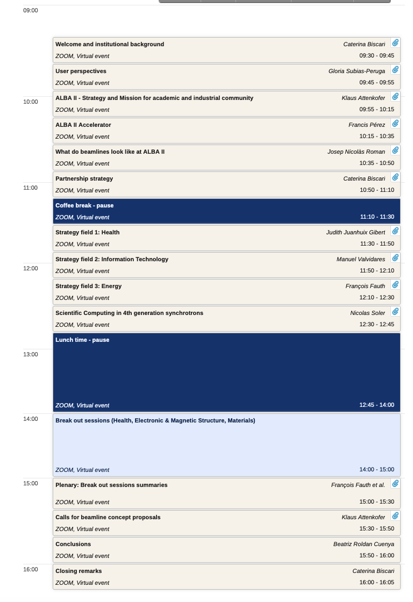
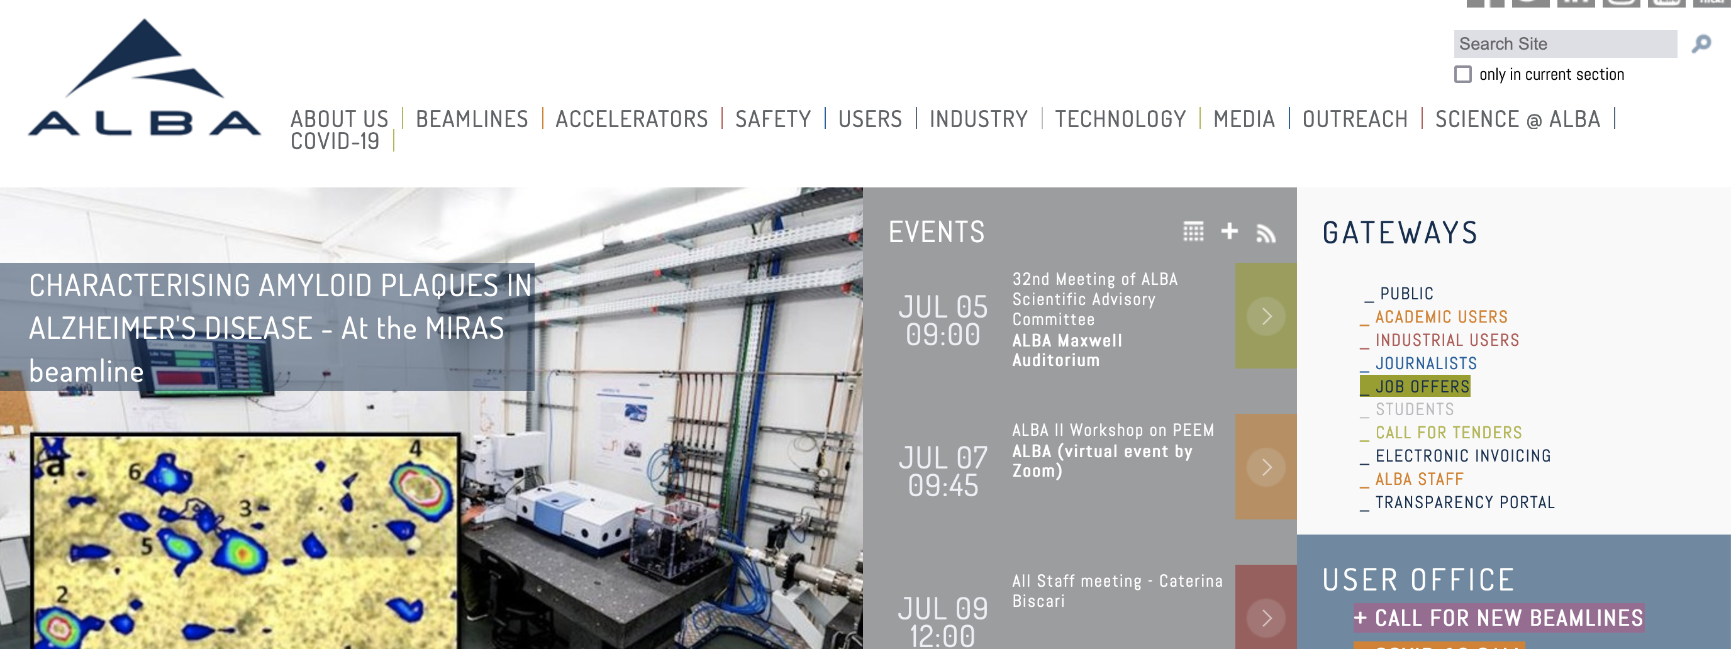
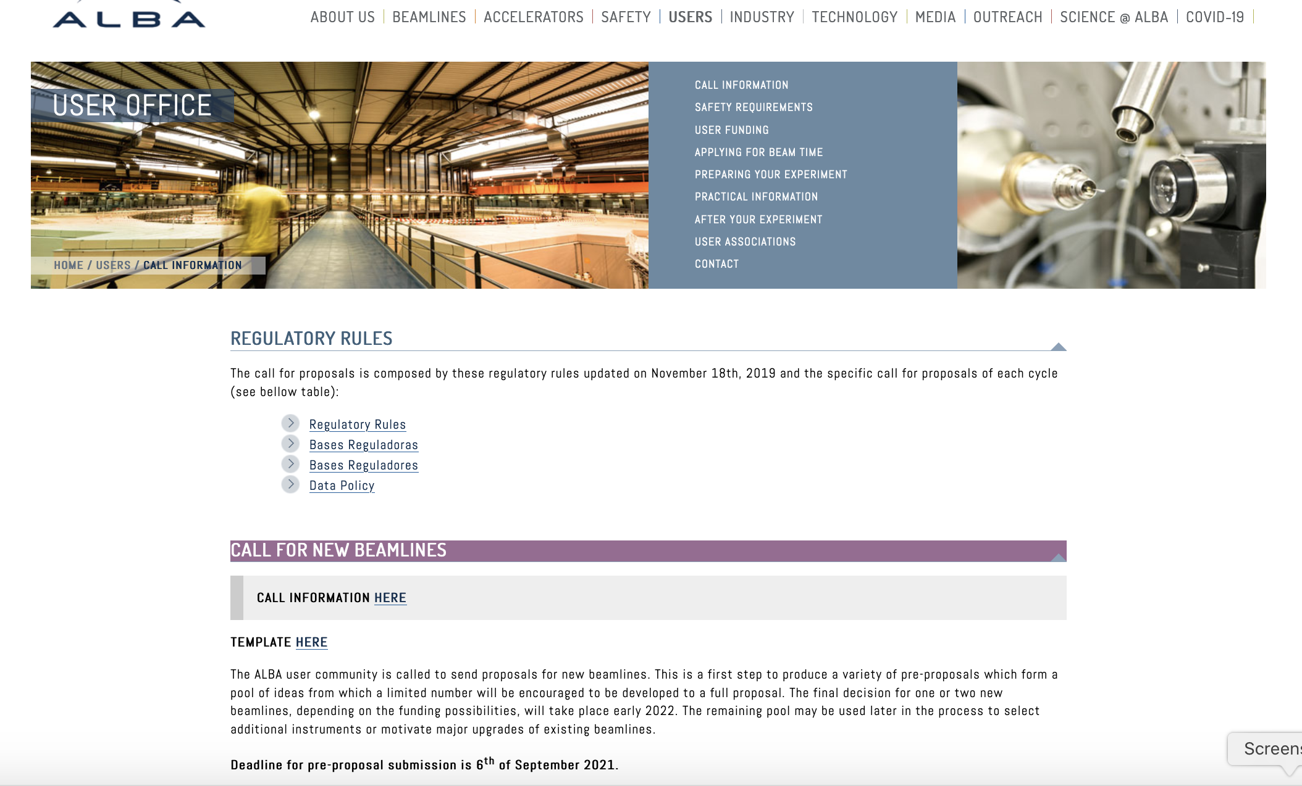
The Workshop and Colloquium Program.
The ALBA II day:
Goals:
Creating awareness in the community.
Inviting the community to participate.
Disseminating general information to project and process.
Launching first instrument call.
Documentation:
Web-page with recordings and slides.

Slide 8
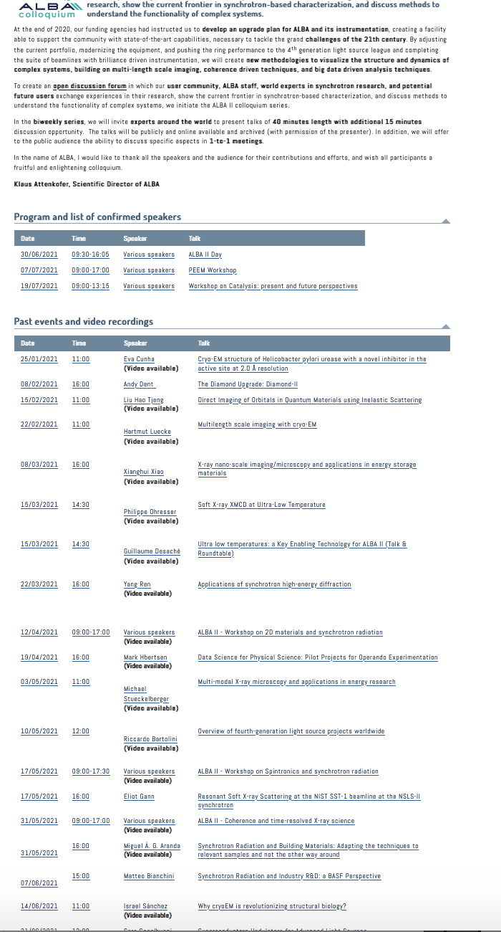
The Workshop and Colloquium Program.
The Colloquium Program:
Staff can suggest speakers (mostly by division director).
Every 2 weeks on Mondays one talk.
Most talks are recorded and available.
Program grows “organically” and covers wide fields of interest.

Slide 9
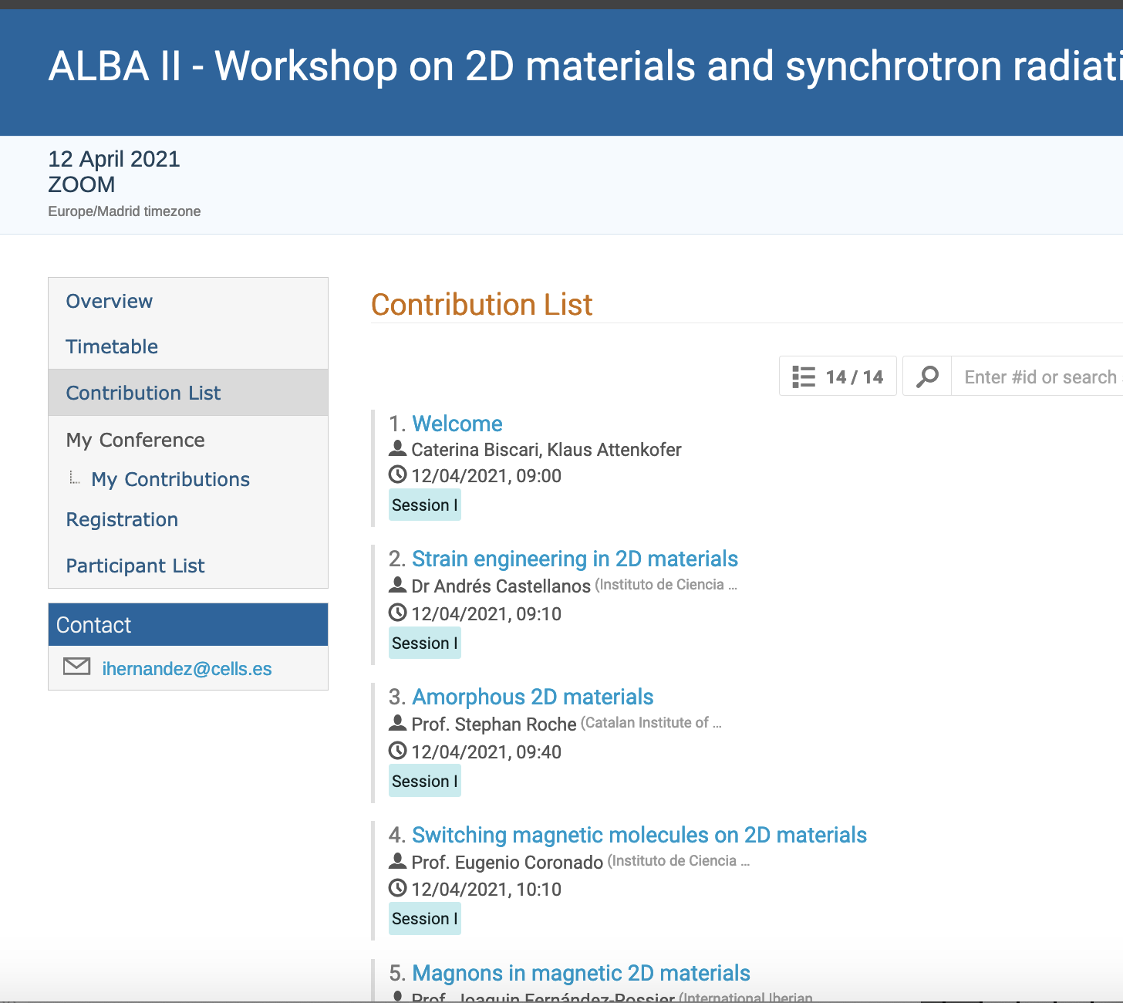
The Workshop and Colloquium Program.
The Workshop Program:
Anybody from staff can organize a workshop.
Typically, ideas for workshops are created during section review preparation.
Typically, workshop program follows scheme, otherwise no restrictions.
Minimum formal requirements to make the organization easy and efficient.
Each workshop has to present a workshop report.
Workshop report has:
Abstract with clear definitions of area and goal.
Collection of talk abstracts from speakers with grand challenge and instruments or services which can solve this grand challenge.
Conclusion.

Slide 10
The Section Reviews.
The areas of review:
Structural Molecular Biology (focus area: health).
Cellular Biology (focus area: health).
Chemical and Material Sciences (focus area: batteries, catalysis).
Electronic and Magnetic Structure (focus area: sustainable information technology).
General goals of the review:
Provides ownership to the section team by creating mission and strategy in a bottom up approach.
Is there a clear defined vision for the reviewed area which
Brands ALBA giving it a unique role within the competitors.
Matches the societal needs of the next 2 decades.
Reflects the expected needs of the Spanish community.
Are the risks understood and is the strategy appropriate to fulfil the mission?
Documentation:
Webpage with all talks.
Written review documentation (about 30 pages).
Review report.

Slide 11
Focus Area: Life Sciences More by Judith
Multi-length Scale Approach To Understand Behavior Of Biological Systems
using a suite of techniques and services enabling the catalytic role of ALBA
Focused on scientific fields:
Techniques
Services
Drug development
Membrane proteins
Structure-based enzymology
Crystallization
Specialized sample preparation
Nanobody production facility
MX
BioSAXS
CryoEM
Tailored to objectives
Tailored to the gap for accessing services
Proximity
From classical to new services
Notes:
This slide would be great if you can create. I suggest that you make a first go and we can iterate next week together.
Perhaps this will be the last slide which you should make.

Slide 12
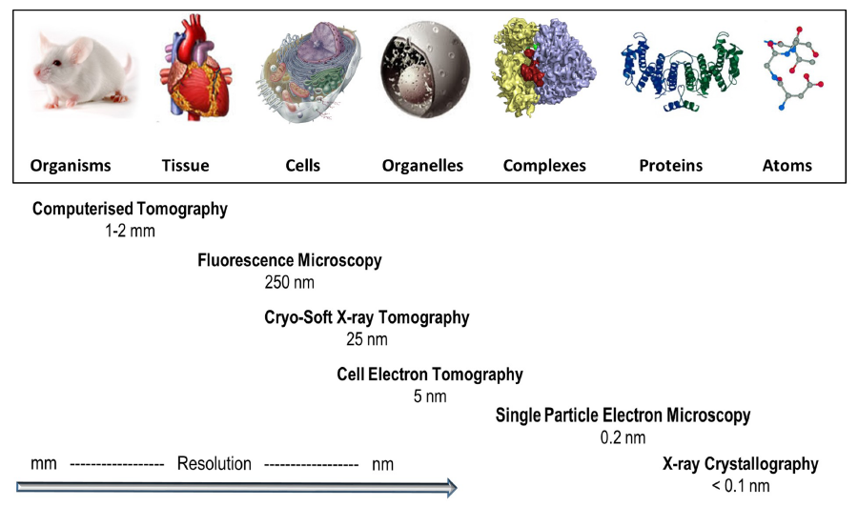
Health Strategy at a Glance
ALBA to provide the X-ray and electron- tools and the “missing links”
Aiming at a continuous path from genotype to fenotipe structural studies
ALBA embedded within their strategic partners provides leading capabilities
BioSAXS
FAXTOR
STXM
XALOC
MIRAS
MISTRAL
XAIRA
Computational
Biology
Cry-EM/SPA
BioSAXS
1 nm
Computational
Biology
From Harkiolaki et al. DOI:10.1042/ETLS20170086 ; CC BY 4.0 modified
Notes:
Smaller pic, answer to the mission statement
Put computational biology in the gap, al bionanoprobe. Prepare the ground for the vision, so put future tools
Genotype (molecular) to Fenotype (cellular)

Slide 13
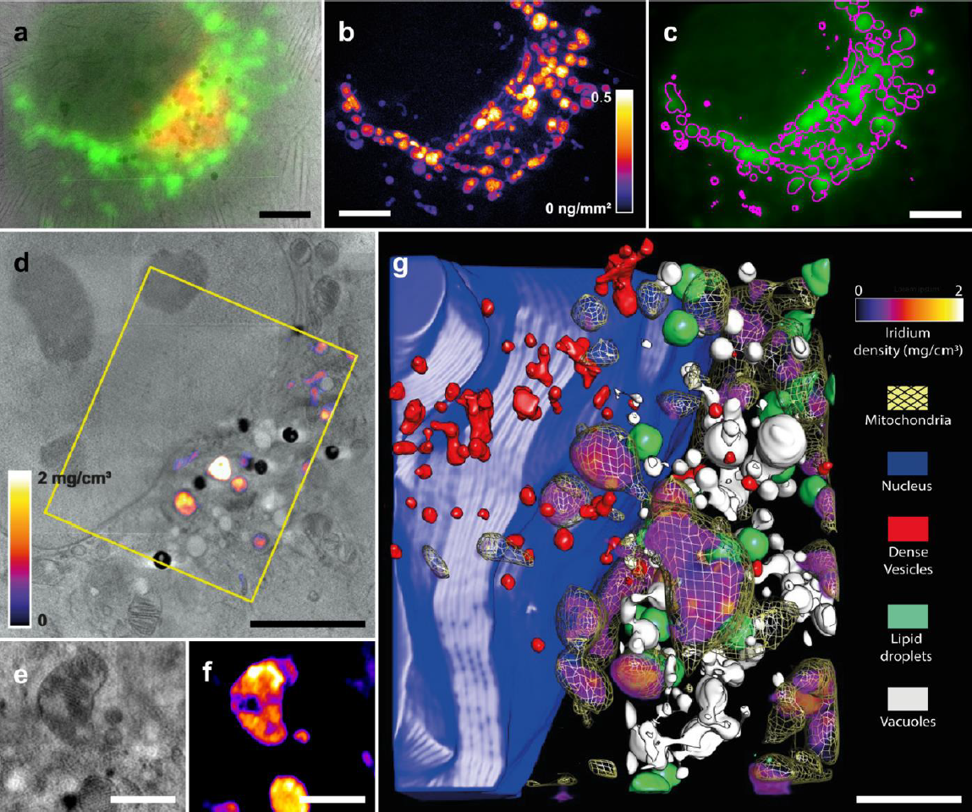
Correlative Microscopy is Key for Structural Cellular Biology.
Correlative microscopy is not only key to identify the individual organelles and their activities but also allows is the enabler technology to multi length scale imaging.
Specific example: Prove of functionality of a new Ir-based cancer drug (breast cancer MCF7 cells) promising relatively low side effects. The tools used:
Soft X-ray full field microscopy: cell morphology.
Epifluorescence signal: identification of mitochondria (green) and acidic organelles (green).
2D XRF (nano probe): Ir distribution.
ALBA II has the potential to provide:
Improved microscopy: bio nano probe and potentially cryo-EM with cryo-FIB.
Imaging processing and statistical analysis: Data analytics and improved imaging pipelines.
Improved lab infrastructure: sample preparation
Conesa et al. Angew. Chem. 59, 1270-1278, 2020
Notes:
Smaller pic, answer to the mission statement
Put computational biology in the gap, al bionanoprobe. Prepare the ground for the vision, so put future tools
Genotype (molecular) to Fenotype (cellular)

Slide 14
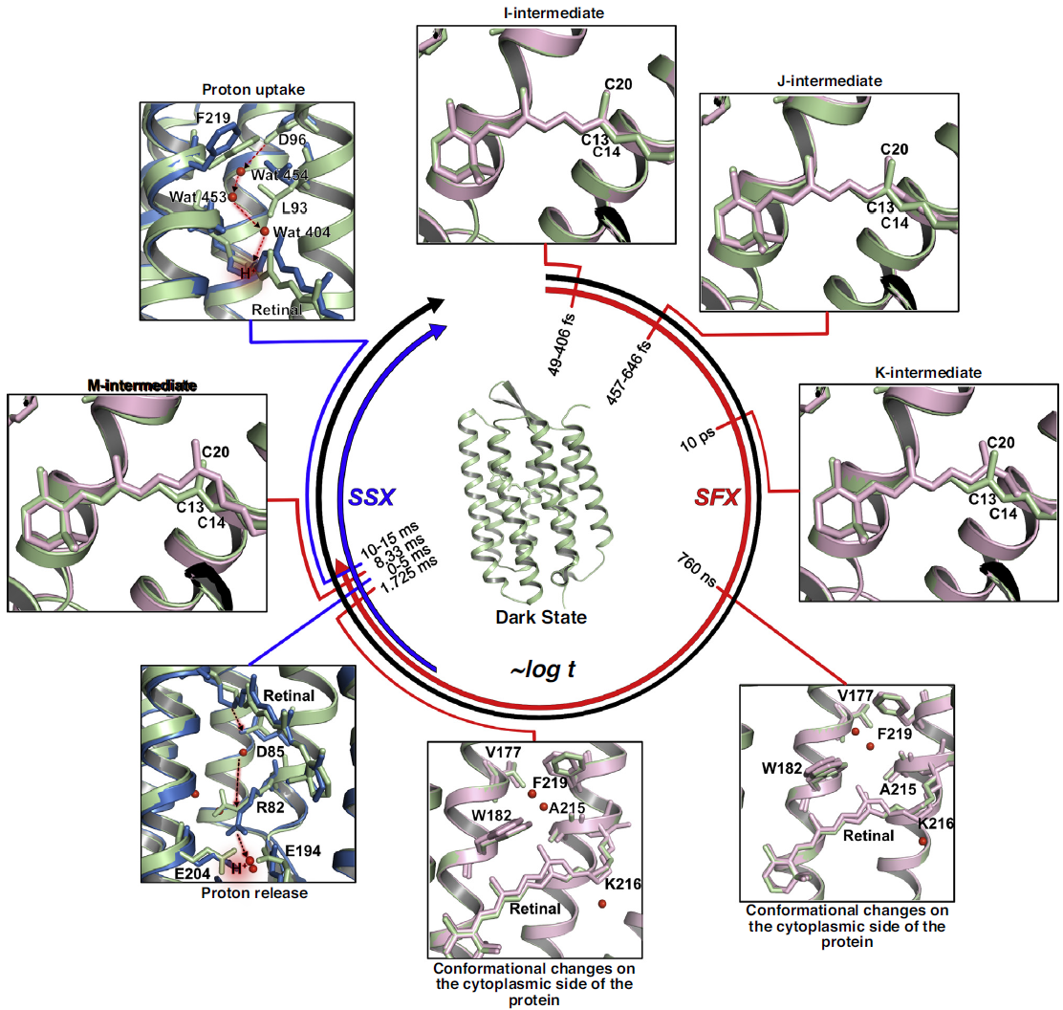
High-resolution diffraction, imaging, low resolution and data analytics are key to future structural Molecular Biology..
The combination of high resolution diffraction and imaging tools (MX as well as cry-EM) with overall shape probes (bio-SAXS) and time resolved scattering is seen to be key for deriving high resolution structural modal and the understanding of their functionality in the biological environment.
Specific example shows the different states of bacteriorhodopsin (bR) captured using both time-resolved synchrotron serial crystallography (TR-SSX; Weinert, 2019) and time-resolved serial femtosecond crystallography using XFEL source (TR-SFX; Nogly et al., Science 361, eaat0094, 2018, Nango et al. Science 354, 1552–1557, 2016). Time scale goes from fs–ms, with (SFX) measurements in red and (SSX) in blue.
ALBA II has the potential to provide:
Improved emittance: promoting micro-MX and the correlated techniques including time resolved MX.
Data analytics: benefitting from Alpha-Fold allows the multi-model and big data approach.
Improved microscopy: Cryo-EM
Notes:
Smaller pic, answer to the mission statement
Put computational biology in the gap, al bionanoprobe. Prepare the ground for the vision, so put future tools
Genotype (molecular) to Fenotype (cellular)

Slide 15
Focus Area: Energy More by Francois
Tuning Electronic and Chemical Properties by Controlling Atomic Structure of Functional Materials.
using a suite of techniques and services enabling the catalytic role of ALBA
Focused on scientific fields:
Techniques
Services
Energy storage.
Hydrogen circular economy.
Carbon sequestration.
High throughput ensemble averaging probes including IR, XAFS, and diffraction.
X-ray microscopy in scanning and full field mode with absorption and phase contrast.
TEM.
Multi-modal approach combination of ex-situ, in-situ, and operando experiments.
Sample preparation tools allowing remote combinatorial approaches.
multi-modal pipelines and access modes for providing solutions for main focus area applications.
Big data gateway for data mining community.
data analytics tools to identify structure-function correlations in multi-modal experiments.
Notes:
This slide would be great if you can create. I suggest that you make a first go and we can iterate next week together.
Perhaps this will be the last slide which you should make.

Slide 16
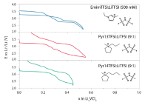
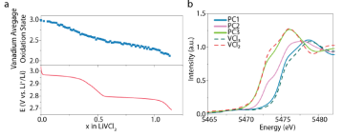
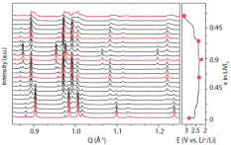
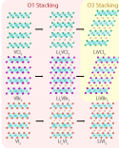
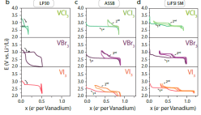
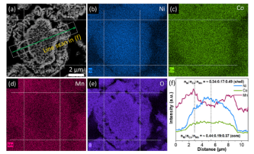
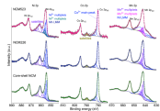
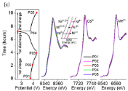
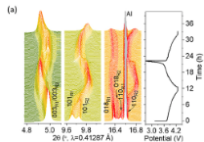
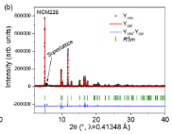
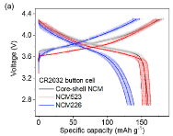
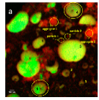
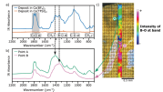
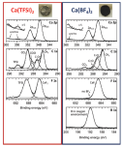
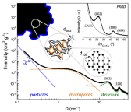
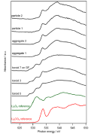
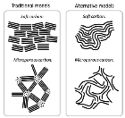
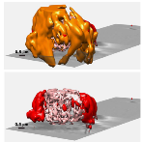
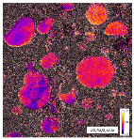
Energy Strategy at a Glance
Imaging, Tomography
Spectroscopy (molecule)
Spectroscopy (electronic configuration)
Diffraction (crystal structure)
Laboratory
(performance, discovery)
MIRAS
CLAESS, NOTOS-XAS
MSPD , NOTOS-PD
SEM and EDX
Electrolyte bulk
Computing
Dubouis et al Nat Mat , accepted
SEI
TEM
XPS
Wua et al Nat Mat , Nano Energy 78 (2020)
MISTRAL
CIRCE-NAPP
NCD-SWEET
Saurel et al Nat Mat , Energy Storage Materials 21 (2019)
Tchitchekoav et al Nat Mat , Chem Mat 30 (2018)
Olivares-Marin et al Nat Mat , Nano Lett 15 (2015)
Forero-Saboya et al Nat Mat , Energy Environ. Sci 13 (2020)
Notes:
It would be great if you can conclude this with a slide which graphically explains what is your branding and how the different tools contribute to this.
This is a very difficult slide but I think you really know what you want to say if you can make this one.
FF I have made something for battery example based on multitechniques . I do not feel competent producing the same for catalysis. I would hence supply Highlight of catalysis and gas sequestration examples This slide is pretty dense and long time will be spent on it
https://www.albasynchrotron.es/en/media/news/new-synthesis-procedure-to-optimize-the-catalytic-performance-of-platinum-based-materials
https://www.albasynchrotron.es/en/media/news/researchers-design-a-nanotechnology-based-system-that-can-transport-methane-at-lower-pressure-and-cost

Slide 17
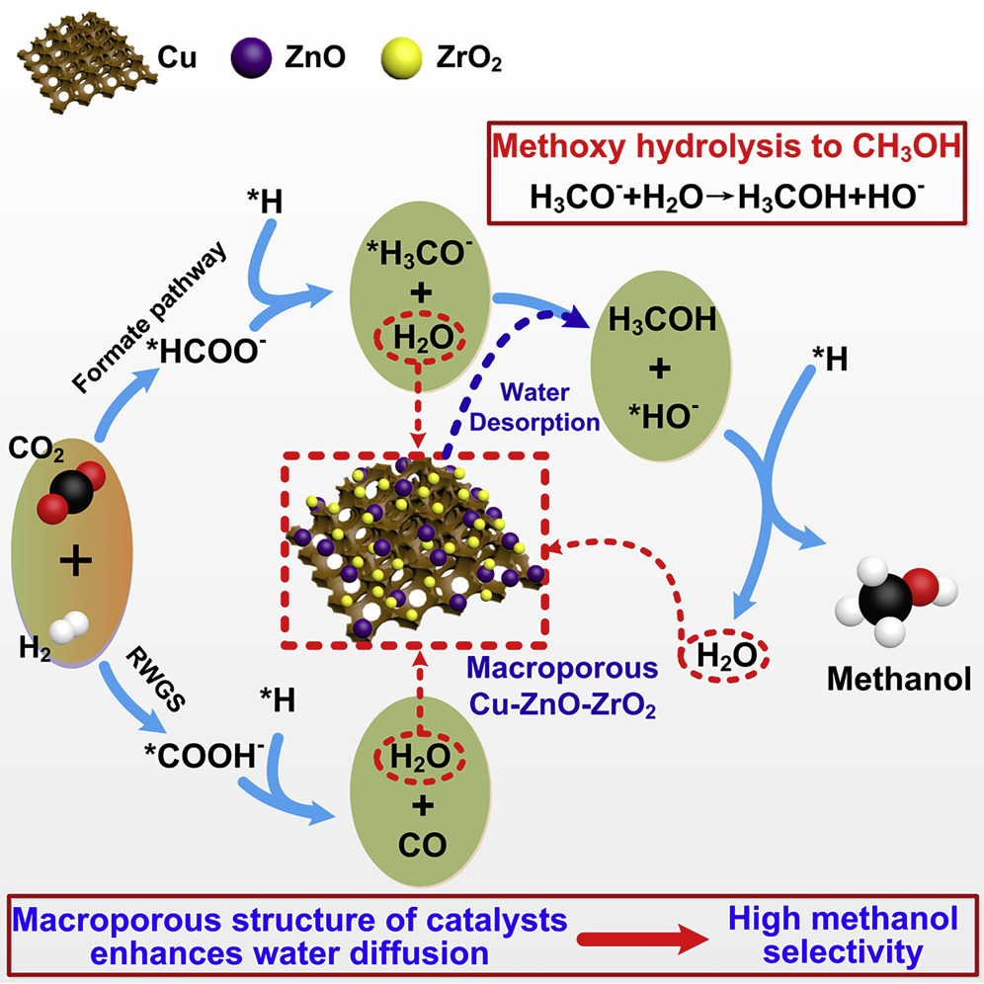
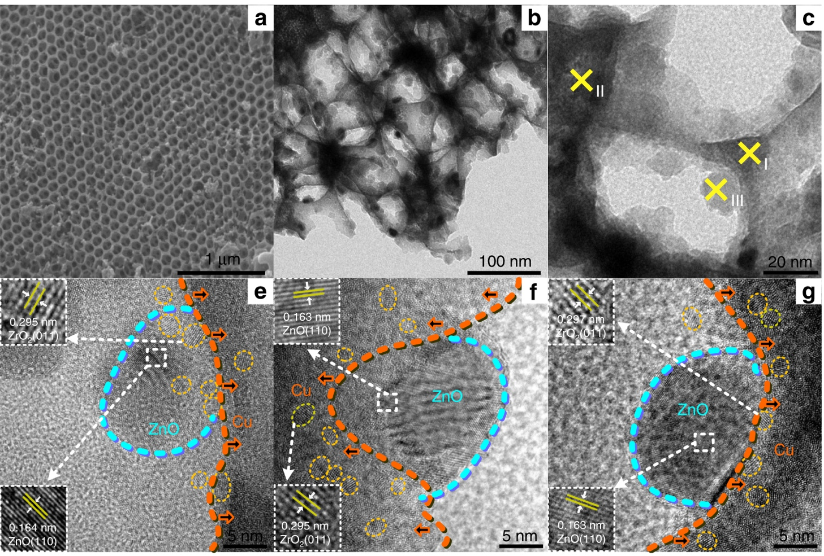
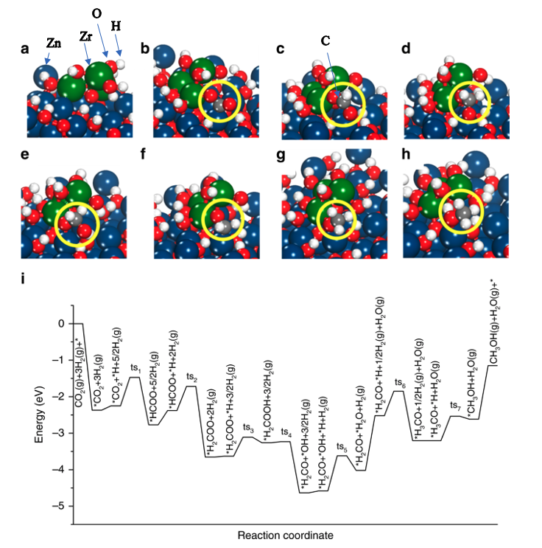
Identification of Active Site of Complex Catalysts
Multimodal approach under operando conditions combining imaging on the different length scales with ensemble averaging spectroscopic tools is key to “understand” how catalysts work. High throughput and fast structural characterization is key to impact the high TRL developments.
Specific example: macroporous Cu-ZnO-ZrO₂ (CZZ) catalysts for Methanol production from CO₂:
Simple cartoon to explain the key steps of the reaction pathway.
TEM showing the morphology and different interfaces of the catalyst.
Reaction pathway and corresponding structural models showing the complex changes during the reaction based on DFT calculations.
ALBA II has the potential to provide:
Improved microscopy: operando TEM, nano probe and micro-spectroscopy/diffraction.
Data analytics: enabling multi modal approach.
Operando focus: reliable fast operando experiments
Goal has to be to refine the existing often cartoon like models by visualizing the structural changes throughout the reaction pathway.
https://doi.org/10.1016/j.chempr.2019.10.023
https://doi.org/10.1038/s41467-019-09072-6).
Notes:
It would be great if you can conclude this with a slide which graphically explains what is your branding and how the different tools contribute to this.
This is a very difficult slide but I think you really know what you want to say if you can make this one.
FF I have made something for battery example based on multitechniques . I do not feel competent producing the same for catalysis. I would hence supply Highlight of catalysis and gas sequestration examples This slide is pretty dense and long time will be spent on it
https://www.albasynchrotron.es/en/media/news/new-synthesis-procedure-to-optimize-the-catalytic-performance-of-platinum-based-materials
https://www.albasynchrotron.es/en/media/news/researchers-design-a-nanotechnology-based-system-that-can-transport-methane-at-lower-pressure-and-cost

Slide 18
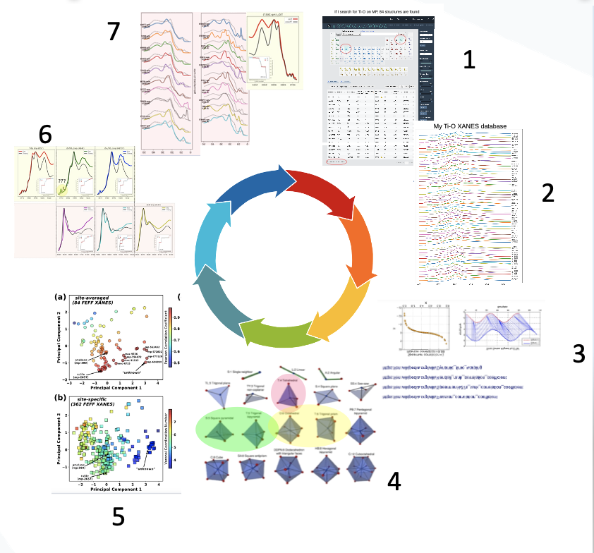
The Importance of Data Analytics
Steps:
Identification of all known structures (database).
Calculating spectra of all structures and specific sites.
Defining metric to compare and rate results
Define “descriptors” to describe structure
Test descriptors and metric on calculated data
Measure reference spectra and compare with simulated spectra.
Refine calculations (choose appropriate code)
Structure –Spectrum correlation
Site – Spectrum correlation
Enabling technologies provided by ALBA II:
Data analytics competence.
High throughput facilities to create training sets and make systematic testing of the tools.
Computation capabilities (by partnerships and databases).
Big data capabilities.
Notes:
It would be great if you can conclude this with a slide which graphically explains what is your branding and how the different tools contribute to this.
This is a very difficult slide but I think you really know what you want to say if you can make this one.
FF I have made something for battery example based on multitechniques . I do not feel competent producing the same for catalysis. I would hence supply Highlight of catalysis and gas sequestration examples This slide is pretty dense and long time will be spent on it
https://www.albasynchrotron.es/en/media/news/new-synthesis-procedure-to-optimize-the-catalytic-performance-of-platinum-based-materials
https://www.albasynchrotron.es/en/media/news/researchers-design-a-nanotechnology-based-system-that-can-transport-methane-at-lower-pressure-and-cost

Slide 19
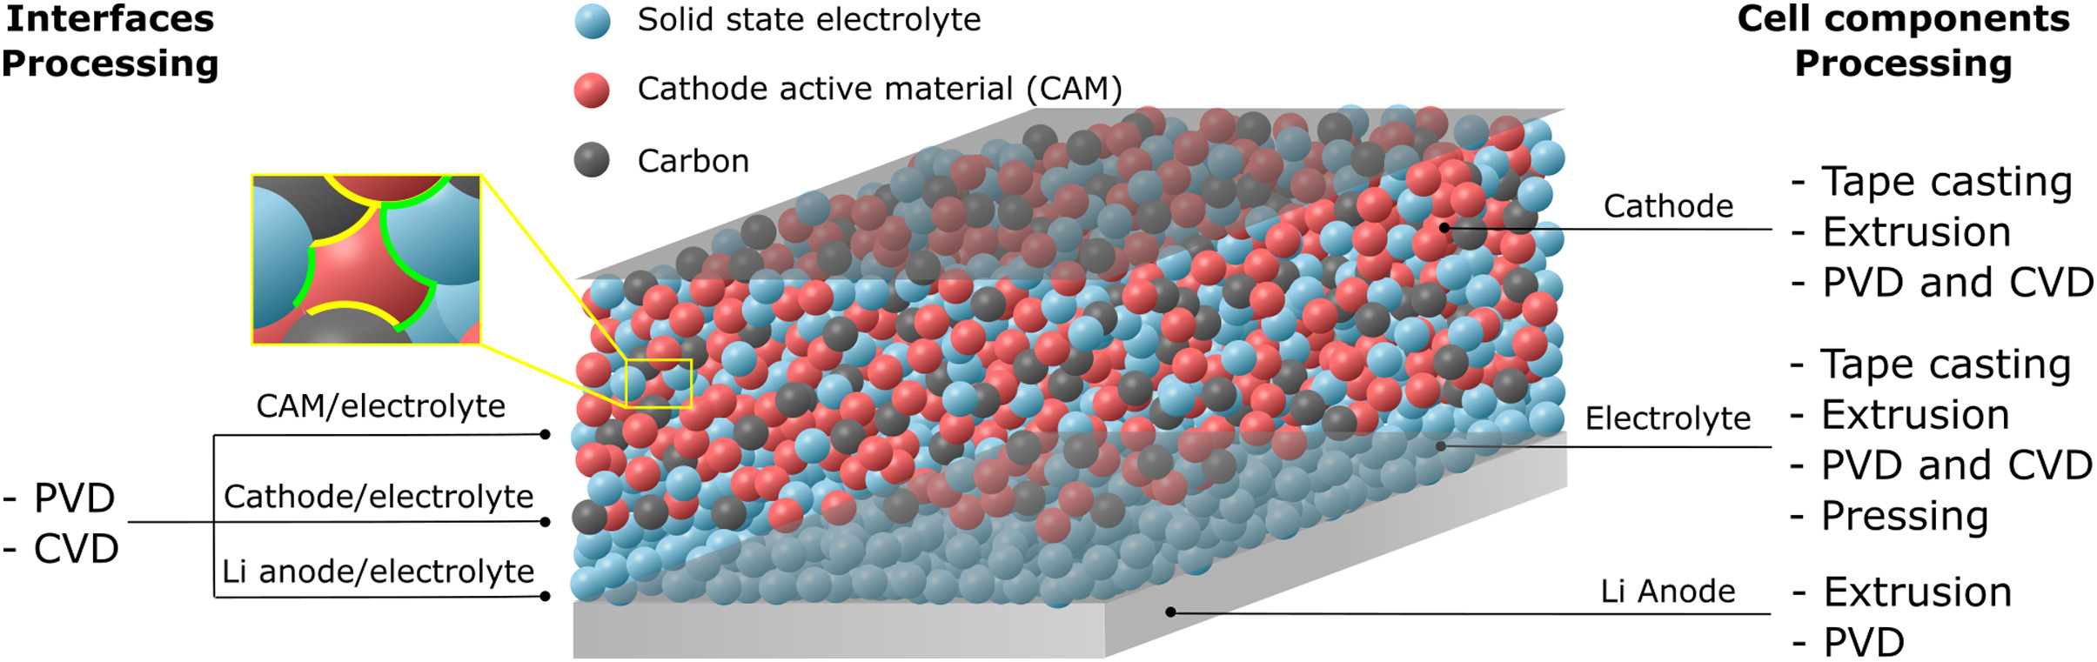
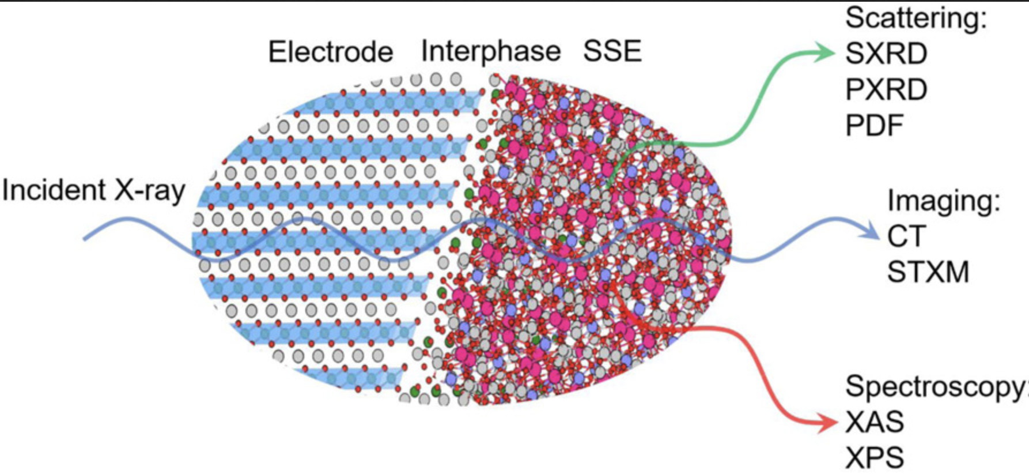
Optimizing Interfaces is Key to Make Better Batteries
Same can be said as already explained in context with catalysis:
Multimodal approach under operando conditions combining imaging on the different length scales with ensemble averaging spectroscopic tools is key to “understand” how the battery works. High throughput and fast structural characterization is key to impact the high TRL developments.
Specific example: Development of high power density solid state electrolyte Li batteries:
The battery has a large number of different interfaces which all define the performance but also the reliability.
ALBA II has the potential to provide:
Improved microscopy: operando TEM, nano probe and micro-spectroscopy/diffraction.
Data analytics: enabling multi modal approach.
Operando focus: reliable fast operando experiments
https://doi.org/10.1016/j.jpowsour.2021.229919
Notes:
It would be great if you can conclude this with a slide which graphically explains what is your branding and how the different tools contribute to this.
This is a very difficult slide but I think you really know what you want to say if you can make this one.
FF I have made something for battery example based on multitechniques . I do not feel competent producing the same for catalysis. I would hence supply Highlight of catalysis and gas sequestration examples This slide is pretty dense and long time will be spent on it
https://www.albasynchrotron.es/en/media/news/new-synthesis-procedure-to-optimize-the-catalytic-performance-of-platinum-based-materials
https://www.albasynchrotron.es/en/media/news/researchers-design-a-nanotechnology-based-system-that-can-transport-methane-at-lower-pressure-and-cost

Slide 20
Focus Area: Information Technology More by Manuel
Resolving and Manipulating the Electronic and Magnetic States, and its Spatial and Dynamic Characteristics in Quantum Materials.
using a suite of techniques and services enabling the catalytic role of ALBA
Focused on scientific fields:
Techniques
Services
Spintronics and Spinorbitronics.
Topological materials.
Materials discover.
Device physics.
Materials growth and device fabrication.
XAS, XMCD, XMLD, XLD, XRMS.
ARPES (including Spin-ARPES).
X-ray microscopy and coherent imaging with chemical, magnetic, spin/orbital- momentum contrast.
TEM.
Structural and functional characterization tools.
Sample preparation tools allowing remote combinatorial approaches.
multi-modal pipelines and access modes for providing solutions for main focus area applications.
Computational modeling tools for understanding impact of structure and environment on topological entanglement.
Notes:
This slide would be great if you can create. I suggest that you make a first go and we can iterate next week together.
Perhaps this will be the last slide which you should make.

Slide 21
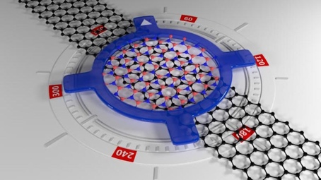
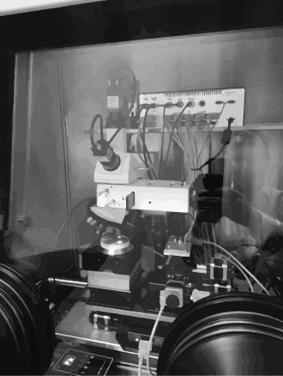
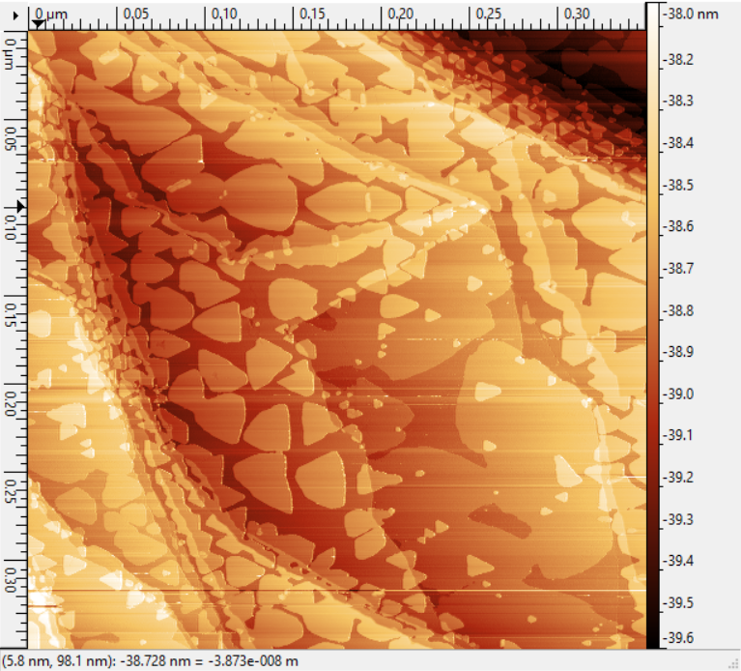
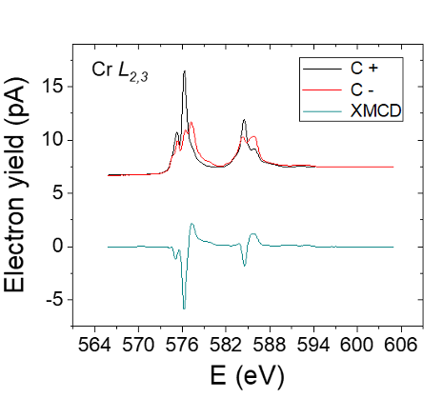
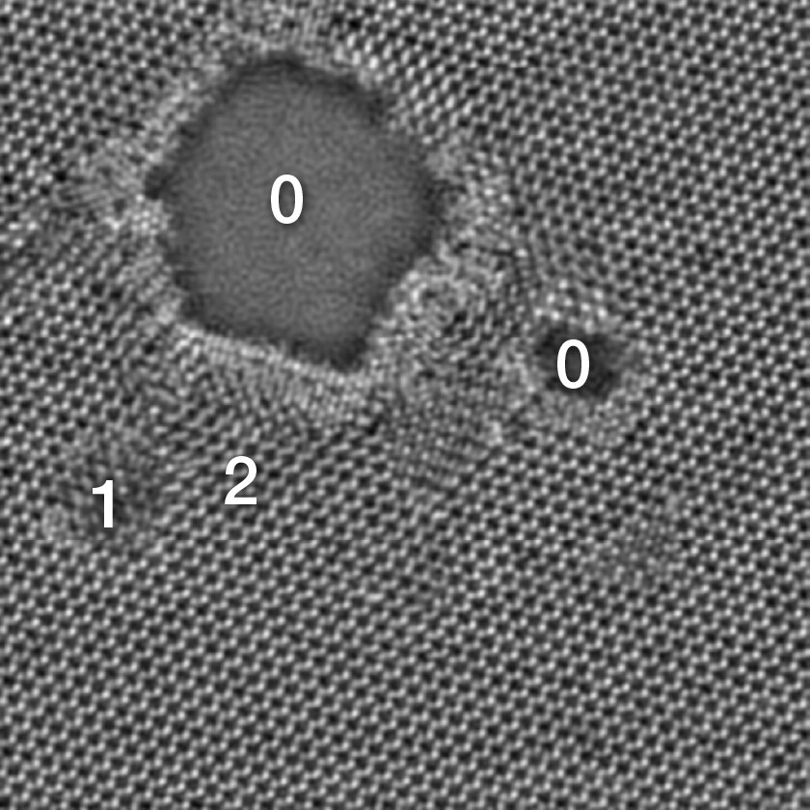
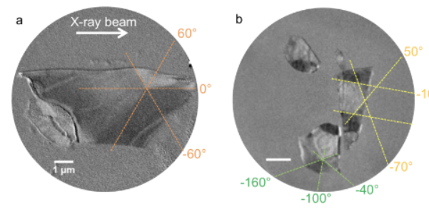
Our Goal at a Glance
example: 2D-VdW materials
MBE, 2D Materials and VdW Foundry at MS Lab, offline bl equipment, as a complement & bridge to user facilities
Challenges addressed and advantages:
air sensitive / short duration
repeatibility / efficiency / on-the-go experiment adjustments
Deeper partnership (projects, shared PhDs, short and mid term stays related to experiments and projects)
Raman
STM
twistronics
VdW transfer setup
-ALBA to provide the X-ray & electron- tools, enhanced sample preparation capabilities enabling pre-experiment preparation, mid-term visitor missions/collaborations and deeper partnerships
-Aiming at a multi-modal approach from meso to nanoscale, from surface to bulk-like
-ALBA embedded within their strategic partners provides leading capabilities
Microscale* averaged electronic & magnetic properties
Micro to nanoscale imaging
Atomic imaging
LOREA: ARPES
BOREAS - XMCD
CIRCE, MISTRAL & BOREAS
HR-(S)TEM
ARPES in twisted BLG,
Soleil, Sci Reports 2016
*Sub-micron to nano scale if a nano-focusing upgrade is considered
Defects in a MoS2
imaged with
high-resolution STEM
Spectra, ThermoFischer
Cr XMCD in CrCl3 sl,
ArXiv 2020
PEEM, Multilayer flakes of
CrTe2 VdW, ACS AMI 2020
 | Resolution | complementary x-ray + SPM, TEM imaging capabilities
XTM MISTRAL | 20-30 nm | fast ; 2D imaging ; 3D tomo ; bulk (only C+ BM)
PEEM CIRCE | 20-30 nm (<10nm possible) | fast; 2D; part 3D (shadow tech.) ; surface, mod. Field & LN temp
Coh. Imag. BOREAS | 25 nm (3-5 nm possible) | slow (reconst. or scanning) 2D ; 3D possible; LHe ; Hig field
Notes:
It would be great if you can conclude this with a slide which graphically explains what is your branding and how the different tools contribute to this.
This is a very difficult slide but I think you really know what you want to say if you can make this one.

Slide 22
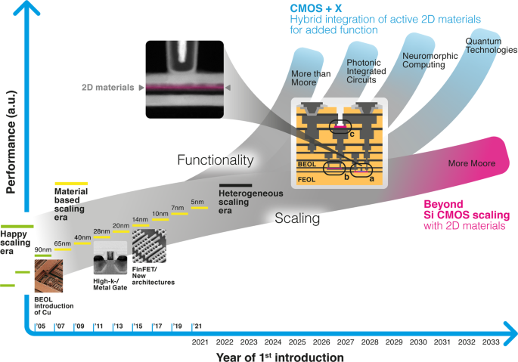
Where Does Information Technology Stands
The section will focus on the development of characterization suites optimized for device characterization. This will not only benefit the high TRL levels (including CMOS) but also is essential for many basic topics for which the observable effect is depending on electric fields and currents.
ALBA II has the potential to provide:
Improved microscopy: TEM, nano probe, coherent based tomography and aberration corrected PEEM.
Improved emittance: enabling micro spectroscopy (ARPES and XMCD).
Improved infrastructure: enabling to perform efficient and successful experiments with high end samples.
Notes:
It would be great if you can conclude this with a slide which graphically explains what is your branding and how the different tools contribute to this.
This is a very difficult slide but I think you really know what you want to say if you can make this one.

Slide 23
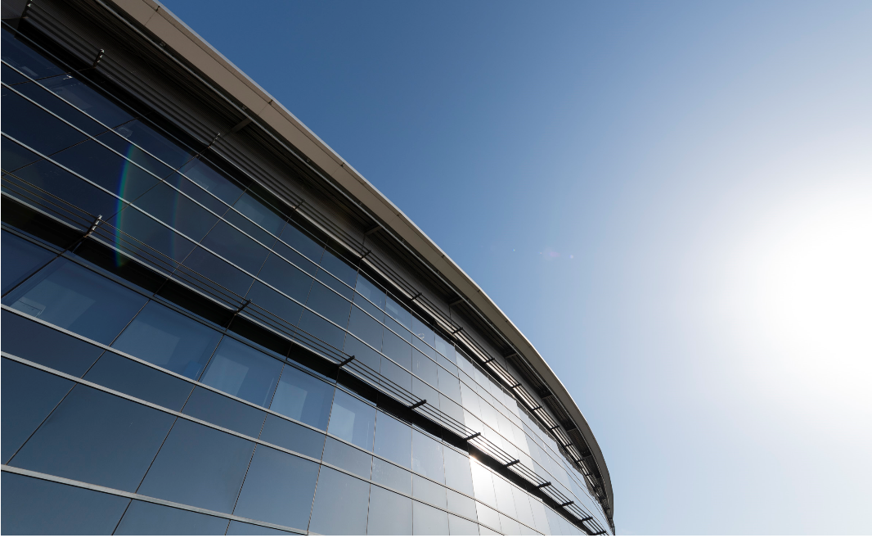
Thank you for the attention!
Any questions?
Foto Sergio Ruiz

