Slide 1
The future beamlines at ALBA 2
Josep Nicolas
8th setember 2022

Slide 2
ALBA2 vs ALBA
ALBA
ALBA-2
 | Size (σ) | Divergence (σ’)
Horizontal | 132 µm | 48.5 µrad
Vertical | 7.7 µm | 5.9 µrad
 | Size (σ) | Divergence (σ’)
Horizontal | 14.0 µm | 7.1 µrad
Vertical | 15.1 µm | 6.5 µrad

Slide 3
Contents
There are 14 beamlines in operation or in construction
What is the impact of the ALBA-2 upgrade on the
existing beamlines?
There are ports for 11 new beamlines, including 4 long BLs
What opportunities does ALBA-2 bring to the
new beamlines?
30) BM (3.2T)
32) BM (3.2T)
Faxtor
28) BM (3.2T)
Boreas
MSPD
Xanadu
Miras
02) ID
Minerva
Current beamlines
23) BM (1T)
Circe
Available ports
4
03) BM (3.2T)
CLAESS
04) ID
Xaira
5) BM (1T)
20
Lorea
7) BM (1T)
Mistral
NCD-sweet
Notos
08) ID
3sBar
Xaloc
14) BM (1T)

Slide 4
Brilliance and coherence
Comparison of the brilliance emitted at ALBA, ALBA-II and the diffraction limit for a SXR and a HXR undulator
For soft x-rays brilliance does not improve very much, because it is already very close to the diffraction limit.
The coherent fraction is large.
For hard x-rays brilliance improves a lot, but it is still far from the diffraction limit.
The coherent fraction is smaller.
Long beamlines still allow for higher degree of coherence, but at the expense of flux.

Slide 5
Angular flux density (hard x-ray undulator)
ALBA
ALBA-2
4.4E17
Simulation of the angular flux density emitted by IVU21 (XALOC)
ph/s/mrad²@0.1%BW
ph/s/mrad²@0.1%BW
0.9E17
For hard x-Ray BLs the emission cone is dominated by the electron beam size,
Although the integrated flux does not change, it is concentrated in a narrower cone.

Slide 6
The Benefit of brilliance
Low brilliance: photon flux is distributed in a large/collimated or small/diverging beam
Sample
Detector
Optics
High brilliance: The same photon flux is are distributed in a small and collimated
Sample
Detector
Smaller spot
Higher flux density ( ~40 times)
More collimated
More intense
Smaller spot in detector (= Higher coherence distance on sample)
More beam accepted.
Lower aberrations
Optics

Slide 7
Improvement of performance at HXR undulator BLs
Simulations of the beam on sample for XAIRA
ALBA
ALBA-2
1
x48
 | Flux | ratio | Fluxdens | ratio | Size | Brilliance at detector | ratio
ALBA | 4.5E+12 | 1 | 9.8E+11 | 1 | 2.9x1.4 | 2.3E+19 | 1
ALBA-2 | 1.6E+13 | x3.5 | 2.7E+13 | x28 | 0.6x0.7 | 1.1E+21 | x48

Slide 8
Angular flux density (soft x-ray undulator)
ALBA
ALBA-2
4.8E16
ph/s/mrad²@0.1%BW
3.1E16
ph/s/mrad²@0.1%BW
Simulation of the angular flux density emitted by EPU (LOREA)
Soft x-ray BLs are benefited, but brilliance is not improved so much, since they are already close to the diffraction limit

Slide 9
Improvement of performance at SXR undulator BLs
SXR undulator beamlines already accept the full divergence, the only improvement in flux density comes from the reduced horizontal source size.
Spot size at CIRCE-PEEM sample
Flux on sample for BOREAS
2.6E+11 ph/s/µm²
28x3µm²
2.2E+12 ph/s/µm²
3x3µm²
 | Flux | ratio | Fluxdens | ratio | Size
ALBA | 4.5E+12 | 1 | 9.8E+11 | 1 | 28x3
ALBA-2 | 1.6E+13 | x3.5 | 2.7E+13 | x12 | 3x3

Slide 10
Coherence for Soft X-Rays
The real benefit for soft x-ray beamline is transversal coherence (higher coherent flux fraction)
Diffraction limited spot size (nanoprobe)
Increased correlation length for diffraction.
Fourier-Transform limited pulse length.
High contrast (or SNR) in interference, holography, ptychography, speckle, etc.
Not all these features are required (or exploited) by our SXR beamlines as they are today.

Slide 11
Bend v superbend
ALBA2 offers the option of having 3.2T superbends (in addition to 1T Dipoles)
Source | Critical Energy
ALBA BM | 8.4 keV
ALBA2 1.0T BM | 6.0 keV
ALBA2 3.2T BM | 19 keV
Miras
Minerva
Notos
Mistral

Slide 12
Wiggler source
For Wiggler sources, the source is smaller but the angular distribution is preserved.
ALBA
ALBA-2
Source size
Simulation of the MPW80 (CLAESS) at 4keV
Divergence

Slide 13
New beamlines
Among the available ports there are options for four long beamlines,
> 150 m long.
What specific beamlines and sci. cases will be built is yet to be decided.
(see C. Biscari’s talk)
Here we explore some opportunities brought by the available length and source characteristics.
Typical applications include
1) HXR Tomography
2) Enhanced coherence for HXR
Imaging, ptycho, ph.contrast.
Diffraction, scattering….
3) Nanoprobes
30) BM (3.2T)
32) BM (3.2T)
28) BM (3.2T)
02) ID
23) BM (1T)
Available ports
4
03) BM (3.2T)
04) ID
5) BM (1T)
7) BM (1T)
08) ID
14) BM (1T)

Slide 14




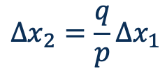
1) HXR tomography
$$Δx_{1}$$
$$Δx_{2}$$
$$p$$
$$q$$
Source
$$Δx_{2}=\frac{q}{p}Δx_{1}$$
sample
Detector
Large source, short BL
Small source, long BL
Resolution proportional to object distance.
FOV proportional to distance to source.
Coherence (phase contrast) depend on distance to source

Slide 15
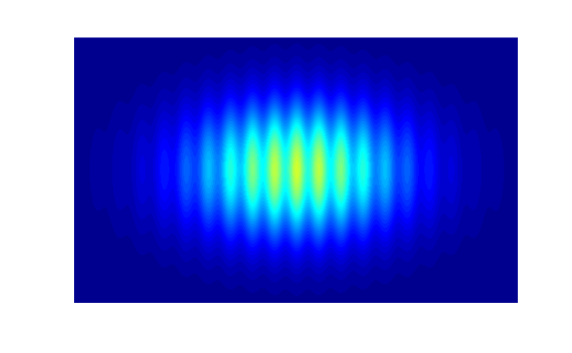
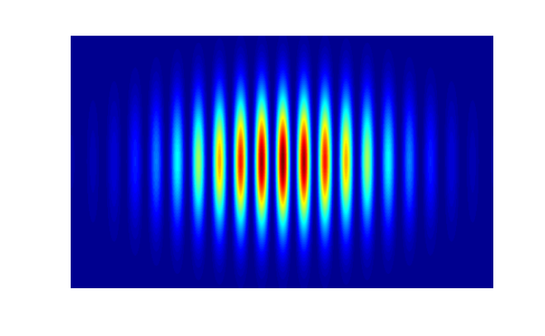

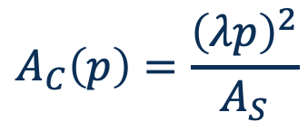


2) Enhanced coherence
$$A_{C}\left(p\right)=\frac{{\left(λp\right)}^{2}}{A_{S}}$$
Correlation length increases with distance
J. Goodman “statistical optics” Ch. 5
Pinhole
$$A≤A_{C}$$
$A_{S}$ area
Coherence based experiment
Incoherent Source
$$p$$
Coherent Source
Most basic example: Young’s Double slit interference
Low coherence
High coherence

Slide 16





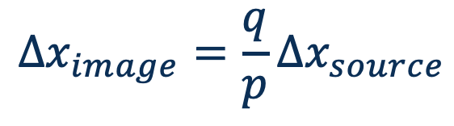
3) Nano-probes
Geometric optics resolution proportional to object distance (p)
$$Δx_{source}$$
Source
$$p$$
$$q$$
$$Δx_{image}$$
sample
$$Δx_{image}=\frac{q}{p}Δx_{source}$$
Optical
element
Optical elements could be:
KB mirrors, capillaries (mirrors), Fresnel zone plates, CRLs, Kinoforms,

Slide 17
Refocusing optics
Mirrors (KB)
Capillaries
Zone plates
Reflective
High quality surface
No energy dependence (if no ML)
High efficiency
Curvatures below ca. 10 m not measurable with enough uncertainty.
Heavy, bulky
Reflective
Unknown surface quality
No energy dependence
High efficiency
Light and compact, reach high curvatures
Only one company (400 nm demonstrated) or research projects
Transmission/Diffractive
Consolidated solutions for SXR. (not so much for HXR)
Resolutions down to 25 nm
Low efficiency
Energy dependent, presence of background light
Working distance < 15 mm, but very compact.

Slide 18
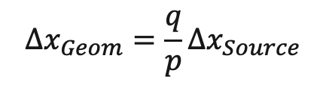
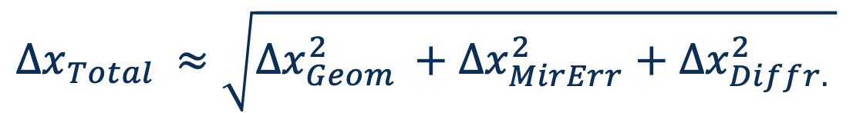
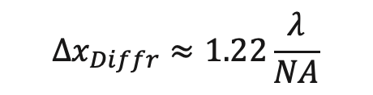

Nano-focusing
Independently of the focusing device, there are several contributions to the achievable spot size
$$Δx_{Total }≈\sqrt{Δx_{Geom }^{2}+Δx_{MirErr}^{2}+Δx_{Diffr. }^{2}}$$
The source is finite. (few µm) and needs to be strongly demagnified.
The only term that depends on p
Errors of mirrors (or lenses)
Aberrations
Deformations
Difficult optics (strong curvature, low error tolerance)
The mirror or lens is finite in size, and limits the N.A.
Depends on λ
$$Δx_{Diffr}≈1.22\frac{λ}{NA}$$
$$Δx_{Geom}=\frac{q}{p}Δx_{Source}$$
$$Δx_{MirErr}=2qσ_{SlopeErr}$$
Having reflectivity in the full mirror length often requires graded multilayers
It requires just distance
It depends on technology
It is the fundamental limit

Slide 19
Nanoprobe at soft x-ray (265 eV)
40 m beamline
150 m beamline
B
A
FZP
Parameter | 40 m | 150 m A | 150 m B | FZP 40 m
Achievable Resolution | 140 nm | 70 nm | 80 nm | 30 nm
Working distance (opt-sample) | 35 mm | 25 mm | 41 mm | 2 mm
Mirror Length | 60 mm | 150 mm | 250 mm | --
Min. Radius | 1.0 m | 1.0 m | 1.6 m | --
Fraction of beam accepted | 55% | 25 % | 45% | --
Flux density Ratio | x1.0 | x4.4 | X7.8 | --

Slide 20
Nanoprobe at hard x-ray (12 keV)
Parameter | 150 m
Achievable Resolution | 40 nm
Working distance (opt-sample) | 57 mm
Mirror Length | 86 mm
Min. Radius | 28.8 m
Fraction of beam accepted | 7%

Slide 21
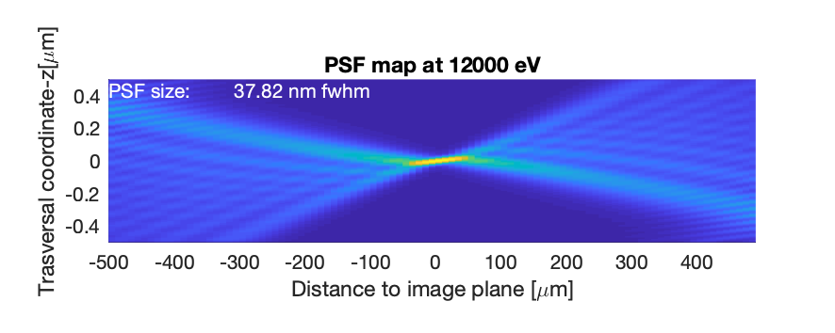
Nanoprobe at hard x-ray (12keV)

Slide 22
Final remarks
Low emittance brings higher flux and flux density at sample and detector for hard x-ray undulator beamlines.
Soft x-ray beamlines will obtain mostly higher coherence flux.
Long beamlines allow for higher coherence also for hard x-rays (but not higher coherent fraction)
Coherence and beamline length, they both allow for higher spatial resolution, either by wave-optics based techniques, or by nanoprobes
Achievable probe sizes are limited by:
  State of the art on optical devices for soft x-ray
  Length of beamline for hard x-rays
  Available space around the sample (always)
  Stability, vibrations, drifts… which become very, very, very challenging.

