Slide 1



Call for proposals of ALBA II long Beamlines
Caterina Biscari

Slide 2






What’s next?
It depends on the funding opportunities
The situation is fluid
2020 2030
Operation and consolidation of partnerships
New BLs at ALBA
Start long BLs
ALBA II
Partner participation can boost and accelerate the programs
Partners will have dedicated access according to their contribution
(see JEMCA example)

Slide 3
Funding scenario
Projects to be prepared for MRR funds or ordinary budget
Full
ALBA II project
In execution
Project ready
Not yet funded
Prototyping and preparing new technologies - 7.5 M€
BL 3Sbar – 10 M€
CALIMA BL - 7 M€
Series of conventional accelerator systems
Long BLs
ALBA II needs User Community

Slide 4
There is a non-null probability to be assigned funds for
starting the construction of long BLs next year
We will be ready
Opening the call for Long BLs next week

Slide 5
List of available ports for ALBA II (in green)
BM | BL |  | Super Bend | Comments
SR02_QD_3 ? | 1 | MIRAS
SR02_QD_1 | 3 | FREE | Ok
SR03_QD_1 | 5 | FREE |  | Limited space due to MSPD
SR04_QD_2 | 7 | FREE
SR05_QD_1 | 9 | MISTRAL
 | 10 | Blocked |  | NCD
 | 12 | Blocked |  | Xaloc
SR07_QD_2 | 14 | FREE
SR08_QD_2 | 16 | NOTOS | Ok (-2.5º) | Superbend requires to move BL 480mm
 | 18 | Blocked |  | Truck entrance
SR09_QD_4 | 19 | FREE | Ok
 | 21 | Blocked |  | CLAESS – Used for Pinhole2
SR11_QD_2 | 23 | FREE
SR12_QD_2 | 25 | MINERVA
 | 27 | Blocked |  | eALBA
SR13_QD_3 | 28 | FREE | Ok
SR14_QD_4 | 30 | FREE | Ok
SR15_QD_4 | 32 | FREE | Ok
 | 34 | Blocked |  | Pinhole1 + Xanadu
Straight | BL |  | Comments
SR01 | 2 | FREE
SR02 | 4 | MSPD | 68mm displacement
SR03 | 6 | XAIRA
SR04 | 8 | FREE | 308mm displacement / Large Beta
SR05 | 11 | NCD
SR06 | 13 | XALOC | 68mm displacement
SR07 | 15 | 3Sbar
SR08 | 17 | RF | & Pinhole3
SR09 | 20 | LOREA
SR10 | 22 | CLAESS | 68mm displacement
SR11 | 24 | CIRCE
SR12 | 26 | RF
SR13 | 29 | BOREAS
SR14 | 31 | FAXTOR | 68mm displacement
SR15 | 33 | FREE
SR16 | 0 | INJECTION

Slide 6
Total available photon sources
13 IDs
12 low beta (10 in use) 2 for long beamlines
1 high beta 1 for medium-length beamline
13 bendings (4 in use)
Keep the bending beamlines MISTRAL & MINERVA with 1T bending
Change NOTOS bending to a 3T Superbend
4 more possible with 1T bending
5 more possible with either 1T or up to 3T bending 1 for long beamline
MIRAS – IR Beamline - could be maintained in the same position. Mechanical design of the extraction from the SR has to be investigated

Slide 7
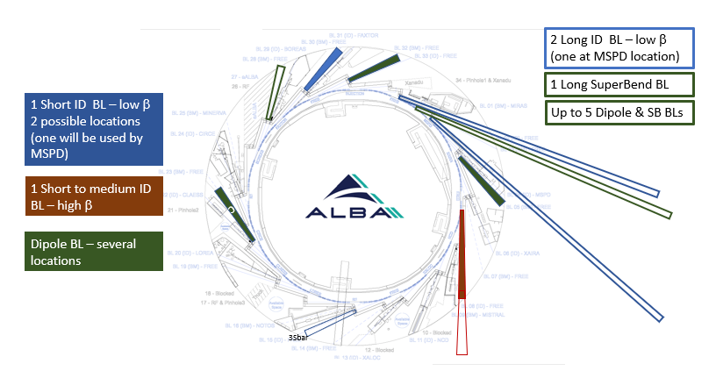
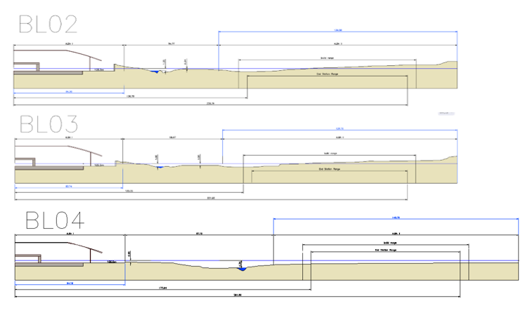
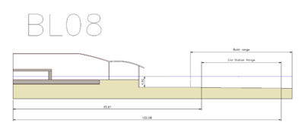
Long BLs layouts
New position for MSPD
Port | D_{min} (m) | D_{max} (m) | Source | β_{x}, β_{y}, D_{x} (m)
2 | 133 | 150 | ID | 2.0, 2.4, 0.0
3 | 140 | 160 | SB | 1.0, 5.0, 0.018
4 | 173 | 200 | ID | 2.0, 2.4, 0.0
8 | 35/60 | 56/200 | ID | 11.8, 10.0, 0.0
D refers to distance from source to sample

Slide 8
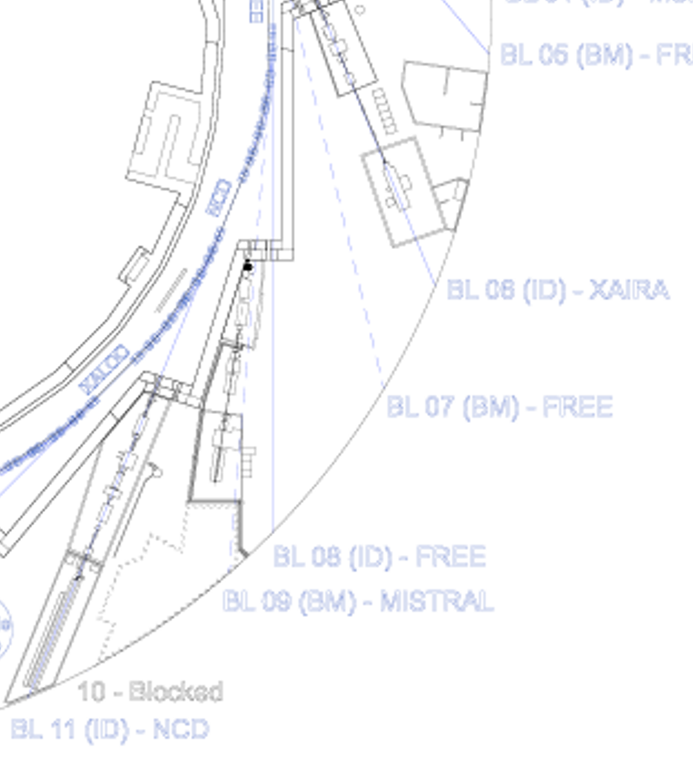
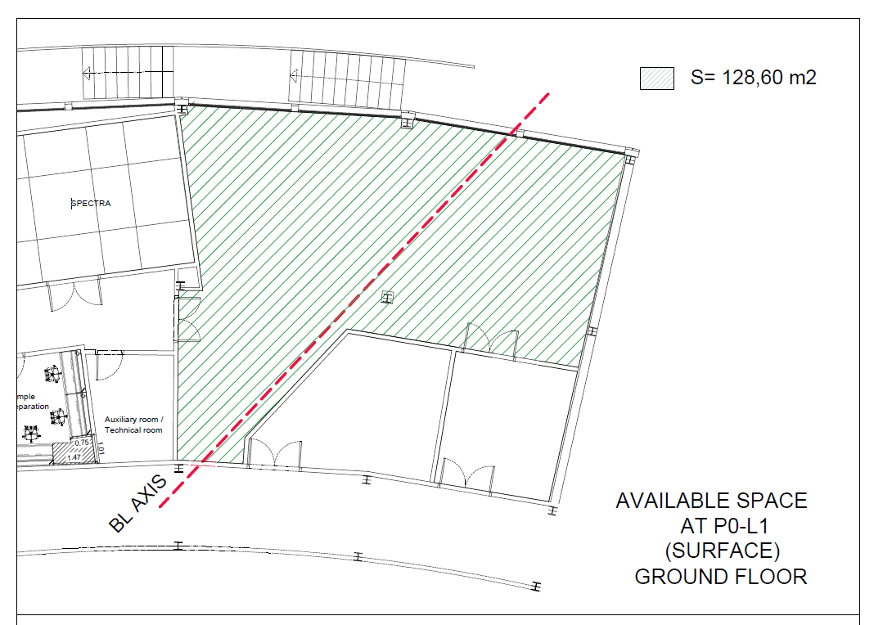
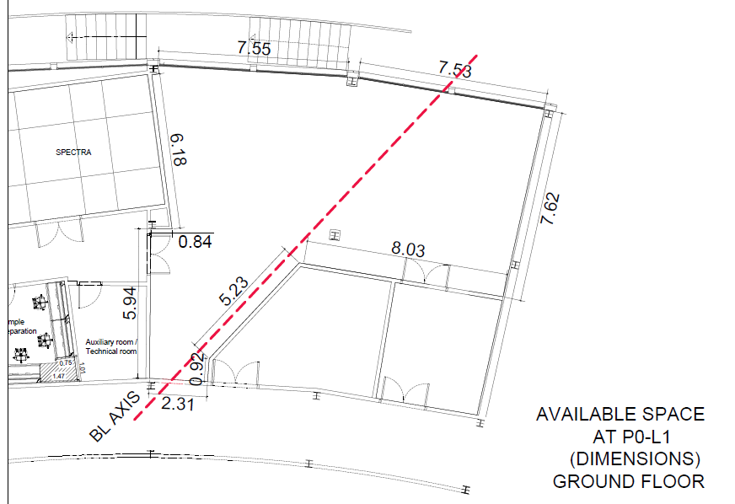
BL port 8
Port | D_{min} (m) | D_{max} (m) | Source | β_{x}, β_{y}, D_{x} (m)
8 | 35/60 | 56/200 | ID | 11.8, 10.0, 0.0
Photon source: ID
Beam size x2 with respect to other ID sections
Beam divergence x 0.5 with respect to other ID sections
Space inside the experimental hall
Space inside ALBA building near JEMCA
Space outside ALBA up to 200 m from source but with ground slope: experimental station should be high with respect to ground
JEMCA

Slide 9
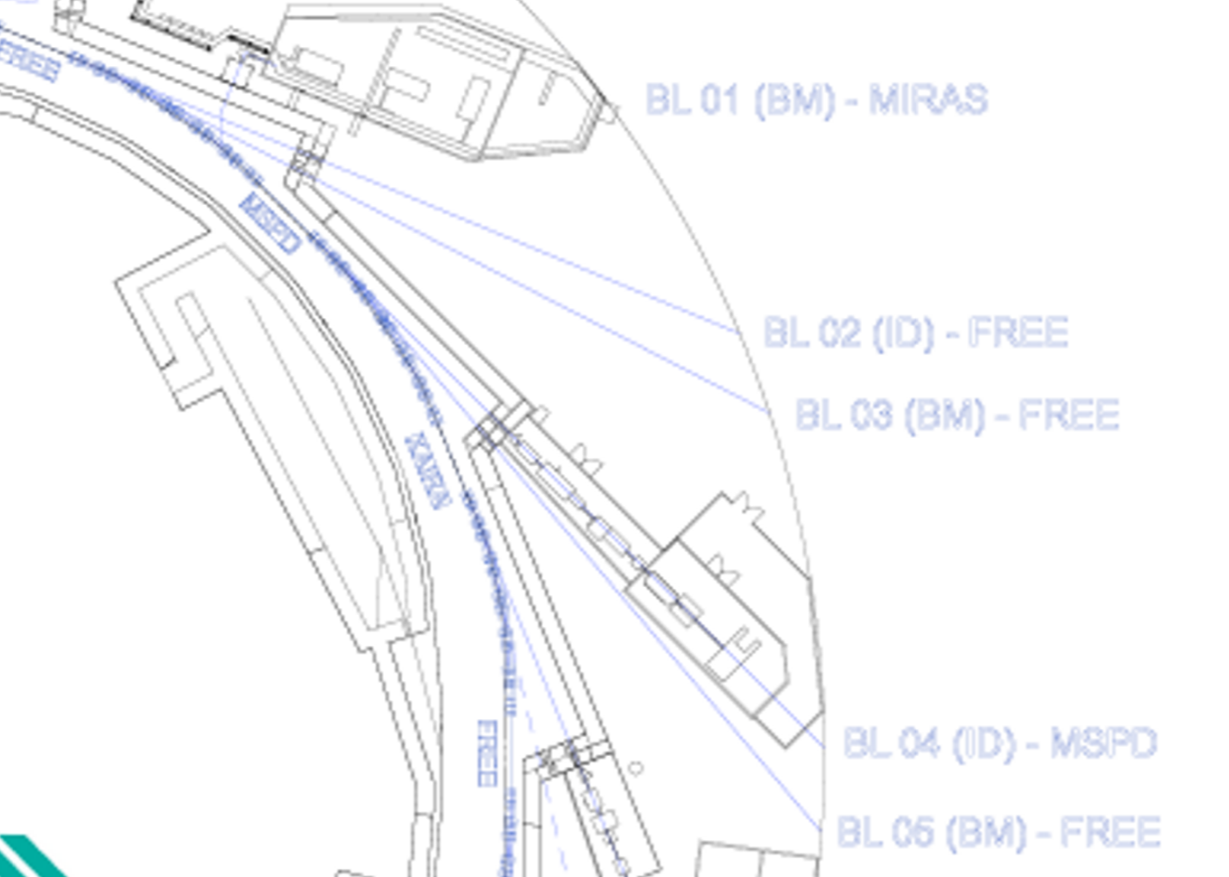
BL ports 2 and 4
Port | D_{min} (m) | D_{max} (m) | Source | β_{x}, β_{y}, D_{x} (m)
2 | 133 | 150 | ID | 2.0, 2.4, 0.0
4 | 173 | 200 | ID | 2.0, 2.4, 0.0
Photon source: ID
Beam size and divergence small on both planes
Space inside the experimental hall
Space outside ALBA from 130 (port2) and 170 m (port4) from source in the new plots
Port 4 occupied now by MSPD. Planning MSPD upgrade and reallocation on port 33

Slide 10
BL ports 3
Port | D_{min} (m) | D_{max} (m) | Source | β_{x}, β_{y}, D_{x} (m)
3 | 140 | 160 | SB | 1.0, 5.0, 0.018
Photon source: Superbend up to 3 T
Beam size and divergence small on both planes
Space inside the experimental hall
Space outside ALBA from 140 m on from source in the new plots
Port 4 occupied now by MSPD. Planning MSPD upgrade and reallocation on port 33

Slide 11
First phase for new BLs calls (2021-2022)
ALBA II Day – 30/05/2021 – Reaching the community
Instrument Pre-proposal call – Summer 2021 – 19 preproposals received on September 2021
Choice of three candidates for 14BL, fitting framework criteria, by Instrument Review Panel – Mid October 2021
Proposals received at ALBA – 7 January 2022
Proposal reviews by experts received at the end of January
Presentation of proposals to SAC and ALBA – 31 January 2022
Decision on choice on 14BL by ALBA Director - mid February 2022

Slide 12
New call is a continuation of 2021 brainstorming:
ALBA II Day – 30/05/2021 – Reaching the community
Instrument Pre-proposal call – Summer 2021 – 19 preproposals received on September 2021
Choice of three candidates for 14BL, fitting framework criteria, by Instrument Review Panel – Mid October 2021
Proposals received at ALBA – 7 January 2022
Proposal reviews by experts received at the end of January
Presentation of proposals to SAC and ALBA – 31 January 2022
Decision on choice on 14BL by ALBA Director - mid February 2022

Slide 13
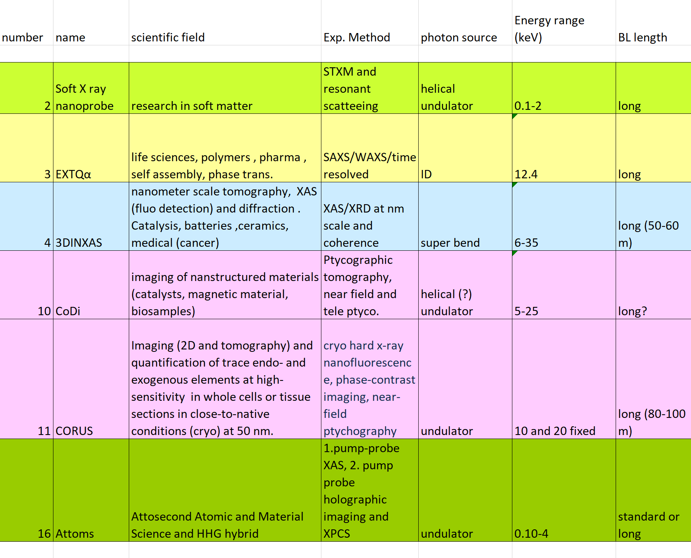
Long BL Preproposals in 2021
ALBA team will contact 2021 proposers checking their interest in presenting again the proposal, with the updated and more detailed information at hand

Slide 14
Call for new BL Endstations
2022-2023 – Second Phase
8 Sept 2022 - Call for pre-proposals for Long Beamlines Endstations announced at ALBA User meeting
15 Sept 2022 – Call open
24 October 2022 – Scientific meeting (key note speakers to set up the scene, presentation and discussion of preproposals)
30 November 2022 – Call closed
20 December 2022 – ITRP evaluation – Invitation to prepare proposals
mid March 2023 – Proposals submission
mid April 2023 – Evaluation of proposals
end April 2023 – Priority list for first Endstations
The calendar may be adjusted depending on funding opportunities

Slide 15
Call for new BL Endstations
Four beamlines
Each beamline may have more than one endstation, including one on the ALBA experimental hall
Different scientific cases can coexist in the same beamline
Template will be provided with range of key parameters for the four options
Encourage the proposals with partnership for special instruments
Criteria for evaluation will be made public in the call

Slide 16
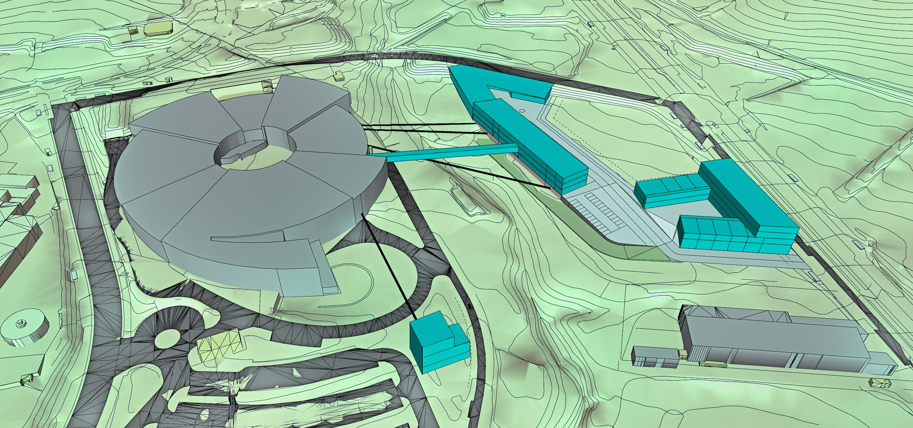
Questions welcome

