Slide 1

Magnets design for ALBA II
Jordi Marcos on behalf of ID, Magnets and Front Ends section
3rd November 2022

Slide 2
Outline
Upgrade plans at ALBA
Internal organization
ALBA II magnets requirements
ALBA II magnets design
Conclusions

Slide 3

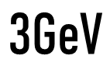
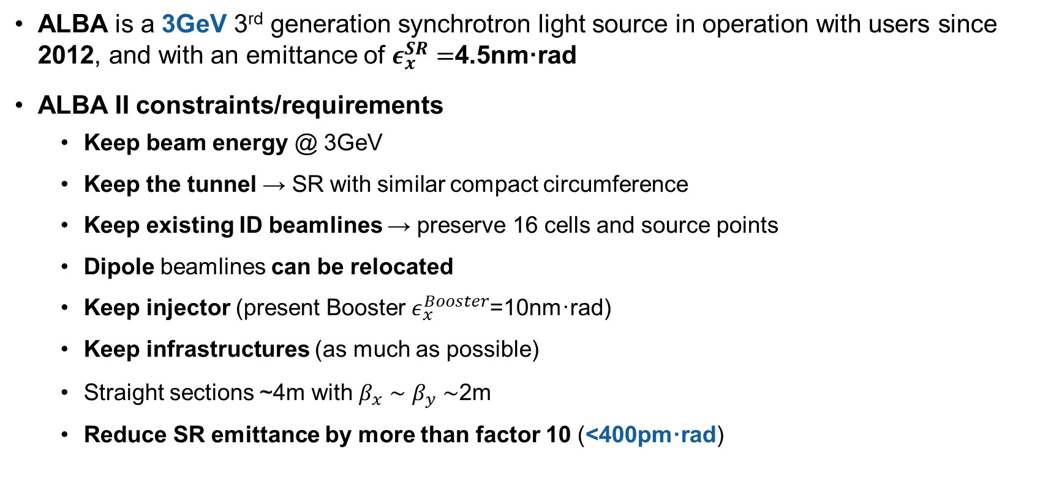
Upgrade plans at ALBA
ALBA is a 3GeV 3rd generation synchrotron light source in operation with users since 2012, and with an emittance of $ε_{x}^{SR}=$4.5nm·rad
ALBA II constraints/requirements
Keep beam energy @ 3GeV
Keep the tunnel → SR with similar compact circumference
Keep existing ID beamlines → preserve 16 cells and source points
Dipole beamlines can be relocated
Keep injector (present Booster $ε_{x}^{Booster}$=10nm·rad)
Keep infrastructures (as much as possible)
Straight sections ~4m with $β_{x}∼β_{y}∼$2m
Reduce SR emittance by more than factor 10 (<400pm·rad)

Slide 4


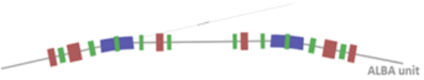
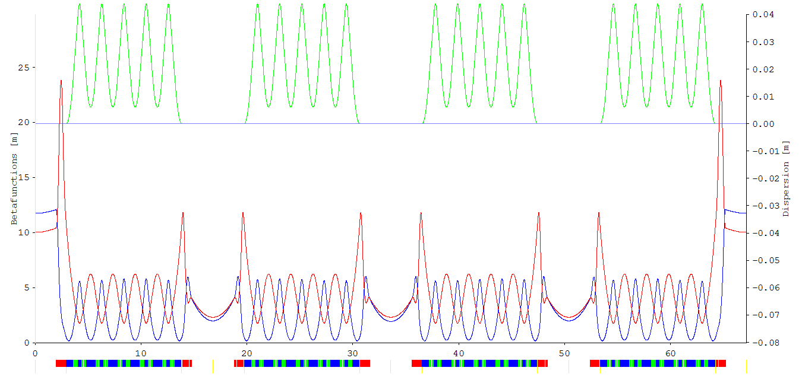
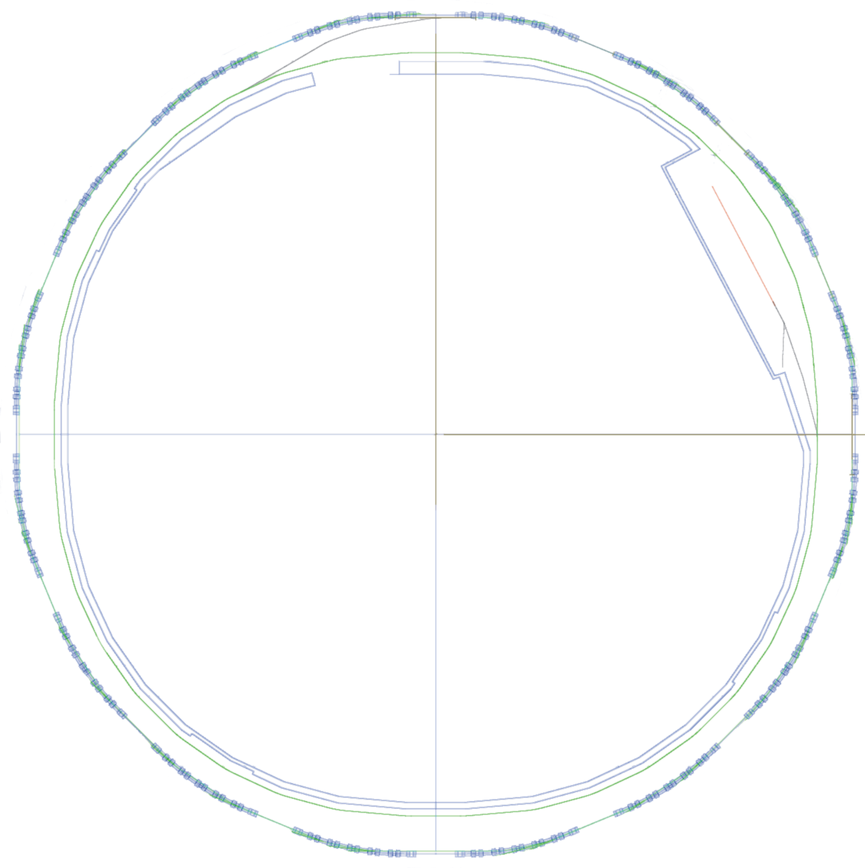
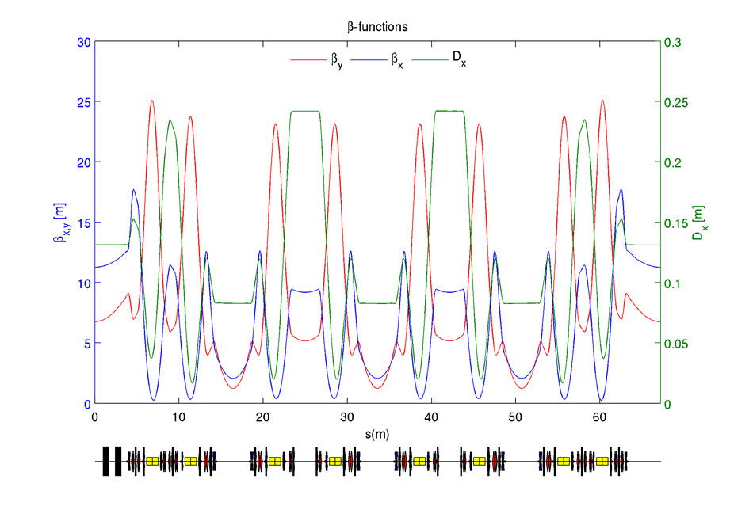

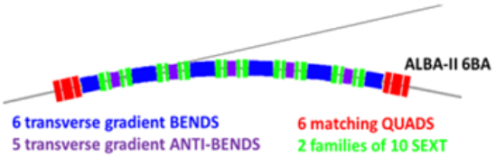
Upgrade plans at ALBA
 | ALBA
Energy | 3 GeV
Circumference | 268.8 m
Symmetry | 4-fold
Lattice | 8×2-DBA cells
Emittance | 4.5 nm·rad
Nº of cells | 8+8
# of straights | 4 / 12 /8
Straight length | 7.8 / 4.0 / 2.3m
ALBA II
3 GeV
268.8
4-fold
16×6BA cells
140 pm·rad
16
16
4.0 m

Slide 5
Upgrade plans at ALBA
The tentative cost for the upgrade is 120M€, to be added to ALBA budget along 10 years (increase of 30% on average)
The upgrade project is still not funded, but we have received the approval (Dec 2020) from our Governing Body to start a design study
The project’s White Paper is foreseen to be issued by the end of 2022
In parallel, a 4-year project (ALBA01) devoted to the development of prototypes and funded with 7.5M€ is already ongoing
Development of magnets (1.76M€), vacuum chambers, girders, IDs and nanopositioning systems for BL optics & instrumentation

Slide 6
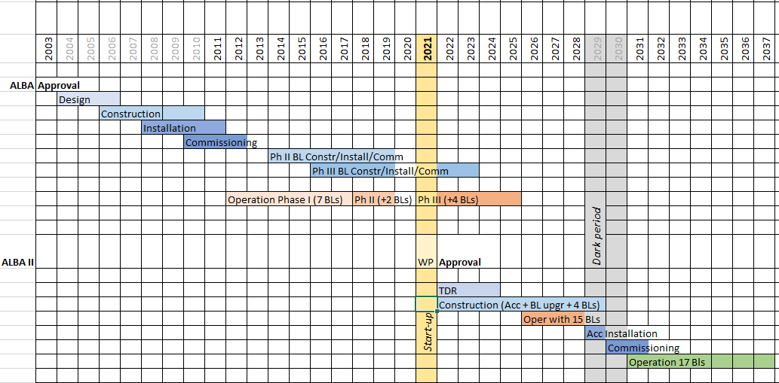


Upgrade plans at ALBA
ALBA II White Paper (Dec ‘22)
Tentative ALBA II timeline
Project ALBA01
“Enabling advanced technologies for ALBA II”

Slide 7
Internal organization
The team that designed the magnets for original ALBA accelerator (Magnets and Injector section) ceased to exist after the start of ALBA operations on 2012.
Since then, the internal demands on magnetic design have been covered by Insertion Devices and Front Ends (IDFE) section, in charge of ID design and acceptance, and which operates the Magnetic Measurements laboratory at ALBA.
When at the beginning of 2021 arose the necessity to design the magnets for ALBA II Storage Ring, it was assigned to IDFE section, that has been renamed Insertion Devices, Magnets, and Front Ends (IDMAFE) section.

Slide 8

Internal organization
During the last 1.5 year the IDMAFE Section has been rearranged and expanded in order to be ready to deal with the challenge of designing, supervise the manufacturing, and test the magnets for ALBA II
Insertion Devices and Front Ends Section
2021
J | F | M | A | M | J | J | A | S | O | N | D
2022
J | F | M | A | M | J | J | A | S | O | N | D
3
4
3
4
5
new FE responsible
sick leave
new ID & magnets staff
new ID & magnets staff
3 persons since 2005
3

Slide 9

Internal organization
On top of the section’s own personnel, we have the support from people from other sections
Insertion Devices, Magnets and Front Ends Section
Support operator
Maintenance and lab activities
Jordi Marcos
Manuel Rodríguez
IDs & Magnets Group
FEs Group
Mechanical engineers
Valentí Massana
Raquel Monge
ID maintenance and lab developments
José Ramón García
Andrea Fontanet
Starting Jan 2023
ALBA II magnets mechanical design
Starting Jan 2023

Slide 10
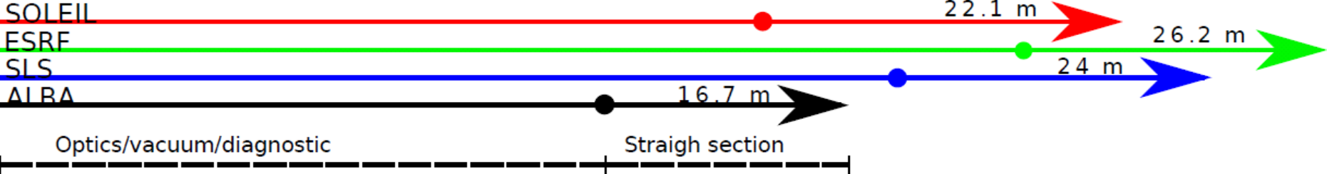
ALBA II magnets requirements
diagram courtesy M. Carlà (Acc. Division)
Space requirements for ALBA II are particularly tight:
16 straight sections in 268m → 16.7m per cell
In ALBA II every straight section will be 4m
The space left for magnets/diagnostics/vacuum is 16.7m – 4m = 12.7m

Slide 11
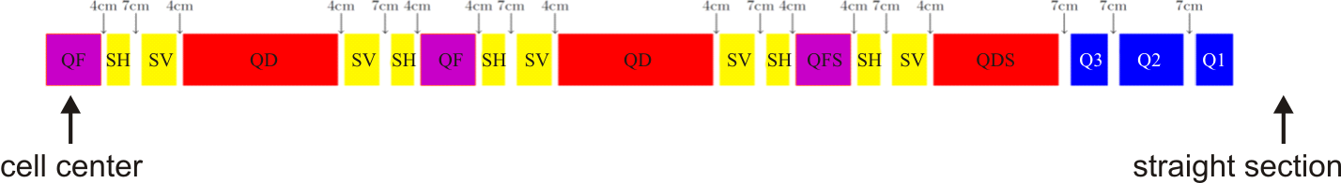
ALBA II magnets requirements
ALBA II lattice is based in 16 identical 6BA cells, with 9 magnet types, for a total of 592 individual magnets (currently 264 magnets at ALBA SR)
Distances between magnets’ effective lengths
Half 6BA unit cell
Yoke-to-yoke distances will be larger by at least 1cm
Code | Magnet description | Types | # per cell | # in SR
 | Bend with trans grad | 2 (QD, QDS) | 6 | 96
 | Antibend with trans grad | 2 (QF, QFS) | 5 | 80
 | Quadrupoles | 3 (Q1, Q2, Q3) | 6 | 96
 | Sextupoles | 2 (SH, SV) | 20 | 320
 | Total | 9 | 37 | 592

Slide 12

ALBA II magnets requirements
Beam dynamics group has defined a primary set of requirements (field/gradient strengths and lengths) for the magnets of ALBA II lattice:
Magnet description | Types | Length [m] | Field [Tesla] | Gradient (K₁) [T/m] | 2nd order grad (K₂) [T/m²]
Bending with transversal gradient | QD | 0.8669 | 1.009 | -15.41
 | QDS | 0.6310 | 0.819 | 2.03
Antibending with transversal gradient | QF | 0.2972 | -0.394 | 70.05
 | QFS | 0.2972 | -0.425 | 70.05
Quadrupoles | Q1 | 0.2000 |  | -31.54
 | Q2 | 0.3500 |  | 83.16
 | Q3 | 0.2000 |  | -109.83
Quadrupoles (injection) | IQ1 | 0.2000 |  | 44.70
 | IQ2 | 0.3500 |  | -69.61
 | IQ3 | 0.2000 |  | 89.71
Sextupoles | SH | 0.1042 |  |  | 4936
 | SV | 0.1823 |  |  | -4084
Relationship between gradients and pole-tip field:
quadrupoles: $B_{tip}≃K_{1} r$
sextupoles: $B_{tip}≃K_{2} r^{2}$
Different current settings for quadrupoles adjacent to injection straight (and equivalent straights)

Slide 13

ALBA II magnets requirements
Quick comparison with other LER projects:
Facility | ALBA II | ESRF-EBS | APS-U | Diamond II | Elettra 2.0 | PETRA IV | BESSY III | SLS 2.0 | ALS-U | SOLEIL-U | MAX IV upgrade
Aperture [mm] |  | 25.2 (quad) 38.4 (sext) | 26 (quad) 28 (sext) | 24 | 26 (quad) 30 (sext) | 26 | 25 | 21 (quad) 22 (sext) | 20 (quad) 24 (sext) | 16 | 11
Quad term [T/m] | 110 | 90 | 80 | 85 | 62 | 92 | <65 | 98 | 105 | 140 | 234
Sext term [T/m²] | 5000 | 3200 | 2500 (ST) 3500 (VP) | 3850 | 2850 | 4300 | <4000 | 5850 | 5000 | 8000 | 33600
Yoke-to-yoke distance [cm] | ~6 QD-sext ~8 quad-quad | 4.7 dip-quad 7.5 quad-sext 6 oct-quad | 5 | ¿? | 5-7 | ¿? | 10 | ¿? | 7.5 | ¿? | ¿?
Sources:
ESRF: EBS Storage Ring Technical Report (Sep 2018)
APS: Advanced Photon Source Upgrade Project, Final Design Report (May 2019)
Diamond: Diamond II Conceptual Design Report (May 2019)
Elettra: Elettra 2.0 Technical Design Report (2021)
SLS: SLS 2.0 Magnet Specification SLS2-SA81-007-9 (Dec 2020)
SOLEIL: Synchrotron SOLEIL upgrade Conceptual Design Report (Jul 2021)
ALS: Status of the Advanced Light Source Upgrade Project (Dec 2019)
BESSY III: BESSY III & MLS II – Status of the development of the new photon science facility in Berlin (IPAC2021)
PETRAIV: Conceptual Design Report (Nov 2019)
MAX IV: High gradient magnets for a future diffraction limited light source at MAX IV (1st PerMaLIC Workshop, Sep 2021)

Slide 14
ALBA II magnet design
In order to start designing the magnets taking the input from Beam Dynamics, we have made a series of choices…
Beam Dynamics input
Magnet technology
EM
PM
EM-PM hybrid
SC
General design
(yoke dimensions, coils, PM blocks, etc)
Detailed design and pole profile optimization
Magnet aperture definition
Other factors:
Tunability
Complexity
Capital costs
Energy efficiency
…
Vacuum system considerations
Mechanical integration considerations

Slide 15

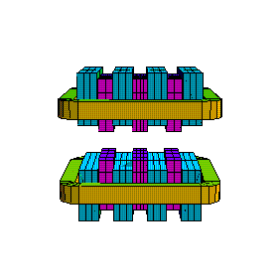
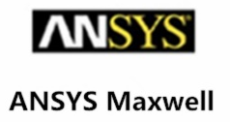
ALBA II magnet design
We are using several tools to carry out simulations:
OPERA: accepted as a benchmark for magnetic simulations among a significant part of accelerator magnets community. License available at ALBA (but without support)
RADIA: free access software from ESRF. Originally developed for undulators, it has been successfully used by ESRF and SOLEIL (among others) to simulate electromagnets for their upgrade projects. Particularly well suited to implement optimization procedures
ANSYS: used by Engineering division at ALBA to carry out thermomechanical simulations. We recently purchased Maxwell package to carry out low frequency EM simulations using the same environment, allowing synergies between the two simulation groups
The usage of different simulation tools will allow us to:
Work in parallel
Cross-check of results (if needed)
Exploit the strengths of each simulation environment
RADIA

Slide 16
ALBA II magnet design
One of the first decisions to be taken is the technology to be used for the magnets: electromagnetic (EM) designs or permanent magnet (PM)-based ones?
Several facilities already in operation (SIRIUS, ESRF-EBS) have used PM technology for some selected magnet types, and some of the on-going projects (SLS 2.0, SOLEIL-U) foresee an extensive use of pure PM magnets (>30% of the total) in their lattices.
Which approach shall we use for ALBA II?
PM main drivers
Space → more compact lattice
Simplicity & Capital costs → no need of power supplies, cables, cooling water…
Operation costs → no electrical power
Maintenance → according to ESRF-EBS experience, no action required after 2 years of operation
PM main challenges
Tunability → the loss of tunability of the lattice has to be replaced by means of correctors or hybrid designs
Thermal stability → so far, well under control using NiFe shunts
Radiation damage → there are still some doubts on long term stability of these magnets installed in small aperture Storage Rings

Slide 17
ALBA II magnet design
At this stage, we consider unfeasible to adopt a pure PM design for the main magnets at ALBA II (QD and QDS), given that it would require a complete reworking of the lattice to recover the missing flexibility.
In particular, it is doubtful that we could find the space to fit the octupoles that would be required for quadrupole correction (both normal and skew), even taking into account that PM designs are more compact.
Another challenge for the adoption of PM technology at ALBA is that, as far as we know, no serial production of a large batch (>100) of PM magnets with the strict tolerances required by a low emittance facility has been outsourced to industry yet.
Facilities using PM technology (SIRIUS, ESRF-EBS, SLS 2.0, SOLEIL-U) have relied or will rely on in-house resources for magnets assembly and characterization. Nowadays this is not a realistic option for ALBA II.

Slide 18
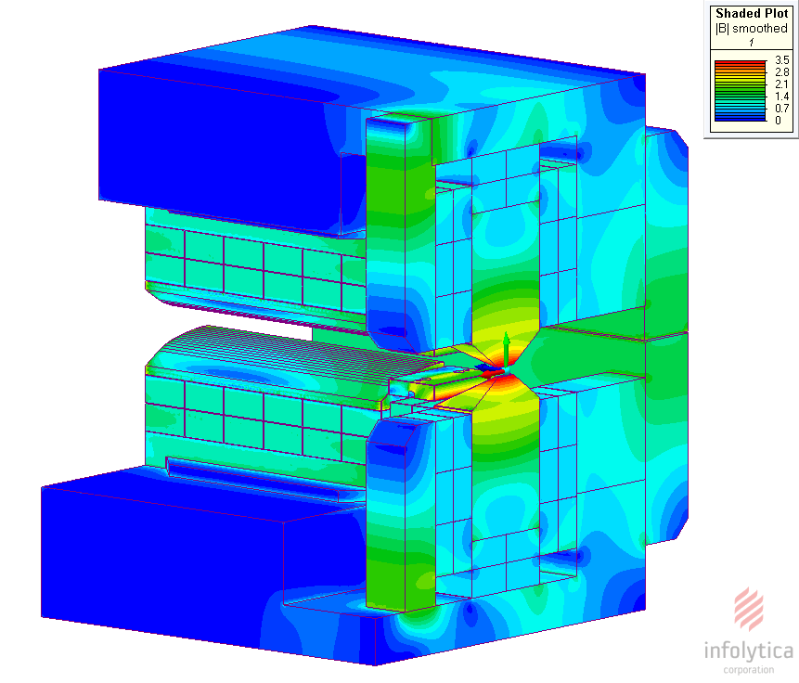
ALBA II magnet design
For all these reasons, we have adopted conventional EM technology for the baseline design of ALBA-II SR magnets, and have given the maximum priority to it.
However, we want to explore in parallel more innovative designs (e.g. hybrid EM-PM magnets) for QD and QDS magnets.
One clear candidate to introduce PM are the modified QD dipoles (superbends) that will be necessary to feed dipole BLs requiring photon energies above 4keV
An undergraduate student has just started a 5-months stay at ALBA to investigate the application of PM designs to ALBA II magnets
SIRIUS 3.2 Tesla BC magnet (superbend)
available at wiki-sirius.lnls.br

Slide 19
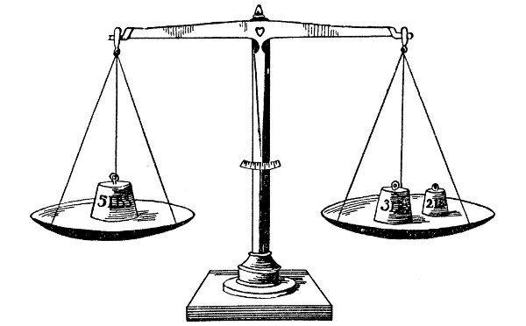
ALBA II magnet design
At the initial stage of the design, one of the most important parameters of the magnet to be established is the size of its aperture radius, r₀
We must find a compromise between the pros and cons of decreasing r₀
PROS
The required excitation currents are smaller
The magnet will operate more efficiently at a lower saturation level
The power consumption will be smaller
CONS
The impact of the geometrical errors (ε) on the multipolar content will be higher (they scale as ε/r₀), making the manufacturing more difficult (and expensive)
The constraints on the mechanical design of the vacuum system will become more stringent
Beam impedance and vacuum chamber conductance issues will be more challenging
r₀
r₀

Slide 20
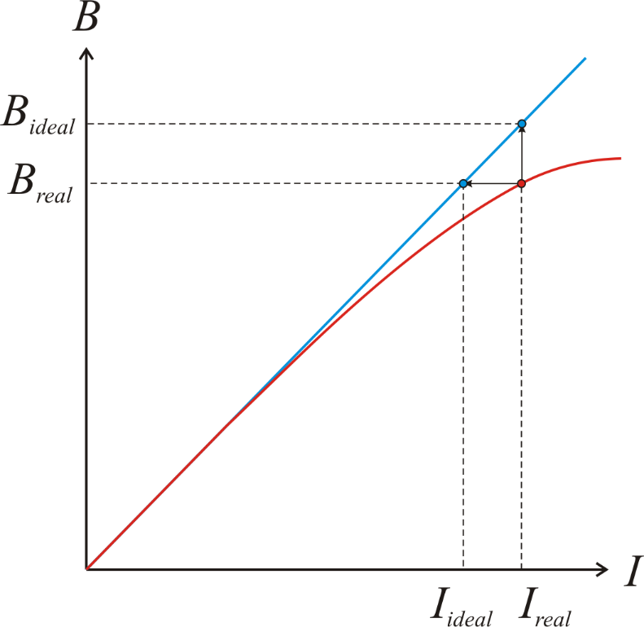
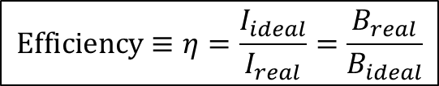
ALBA II magnet design
One of the main control parameters to evaluate the overall performance of a given design (defined in terms of aperture, yoke geometry, material, current density, etc) has been the magnetic efficiency, defined as the ratio between the real magnet’s current and the ideal one corresponding to an infinite permeability yoke
Efficiency gives a measurement of the degree of saturation of the iron yoke
Ideal transfer function (μ=∞)
$$\text{Efficiency}≡η=\frac{I_{ideal}}{I_{real}}=\frac{B_{real}}{B_{ideal}}$$
Real transfer function (finite μ and saturation)

Slide 21
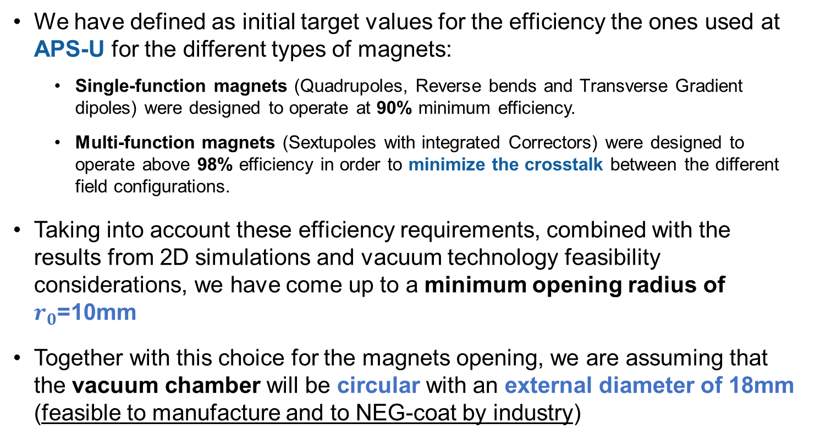
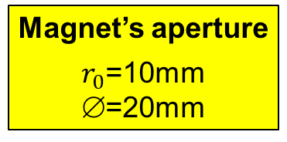


ALBA II magnet design
We have defined as initial target values for the efficiency the ones used at APS-U for the different types of magnets:
Single-function magnets (Quadrupoles, Reverse bends and Transverse Gradient dipoles) were designed to operate at 90% minimum efficiency.
Multi-function magnets (Sextupoles with integrated Correctors) were designed to operate above 98% efficiency in order to minimize the crosstalk between the different field configurations.
Taking into account these efficiency requirements, combined with the results from 2D simulations and vacuum technology feasibility considerations, we have come up to a minimum opening radius of $r_{0}$=10mm
Together with this choice for the magnets opening, we are assuming that the vacuum chamber will be circular with an external diameter of 18mm (feasible to manufacture and to NEG-coat by industry)
$η_{single}$>90%
$η_{multi}$>98%
Magnet’s aperture
$r_{0}$=10mm
∅=20mm
Vacuum chamber
∅_{ext}=18mm
∅_{in}=16mm
thickness=1mm

Slide 22
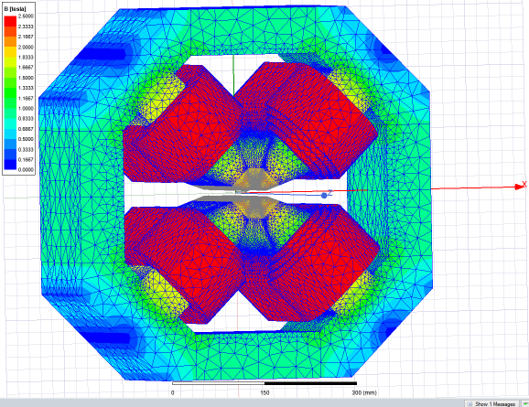
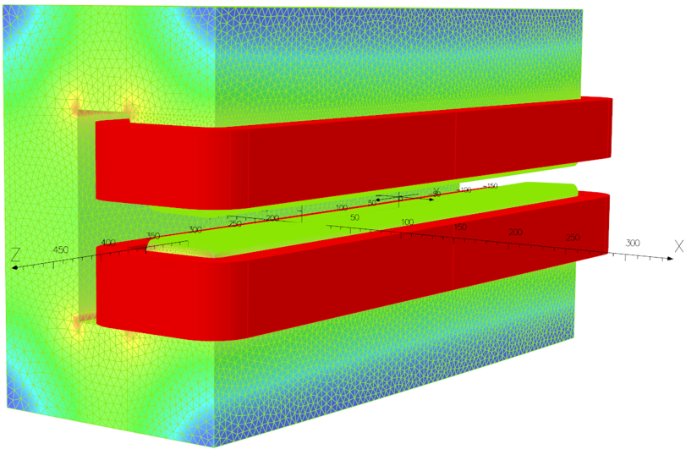
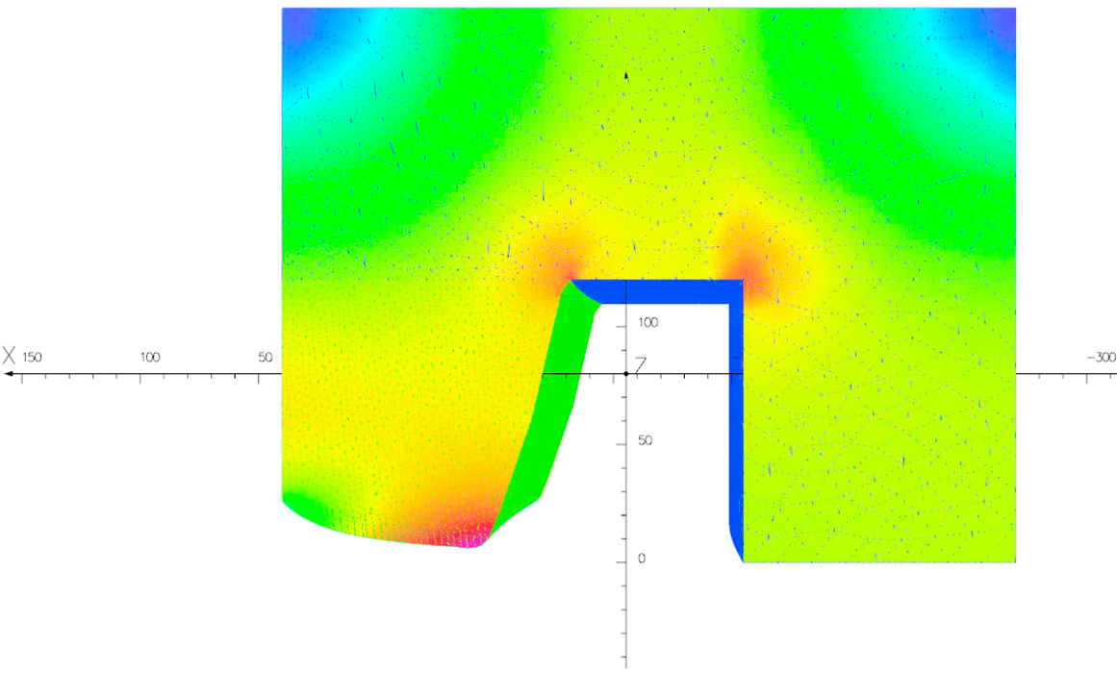
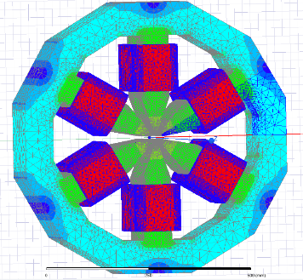
ALBA II magnet design
We have worked out a preliminary set of 3D models for all main magnet types (overall dimensions without pole profile optimization)
 | Bore diameter [mm] | Min. pole vertical distance [mm] | Effective Length [mm] | Iron Length [mm] | Width [mm] | Height [mm] | Current [Amp·turn] | Efficiency [%]
QUAD (Q3) | 20 | 10 | 200.0 | 190.6 | 484 | 484 | 5000 | 90
ANTIBEND QF/QFS | 27.8 | 10 | 297.2 | 282.5 | 540 | 540 | 5860 | 91
BEND QD | 20 | 12.2 | 867 | 833.4 | 310 | 470 | 8130 | 99
BEND QDS | 20 | 12.2 | 631 | 602.6 | 227 | 342 | 6573 | 99.8
SEXTUPOLE (SH) | 24 | 7.0 | 104.2 | 96.2 | 514 | 514 | 2450 | 95
SEXTUPOLE (SV) | 26 | 7.6 | 182.0 | 174.0 | 514 | 514 | 2460 | 98

Slide 23
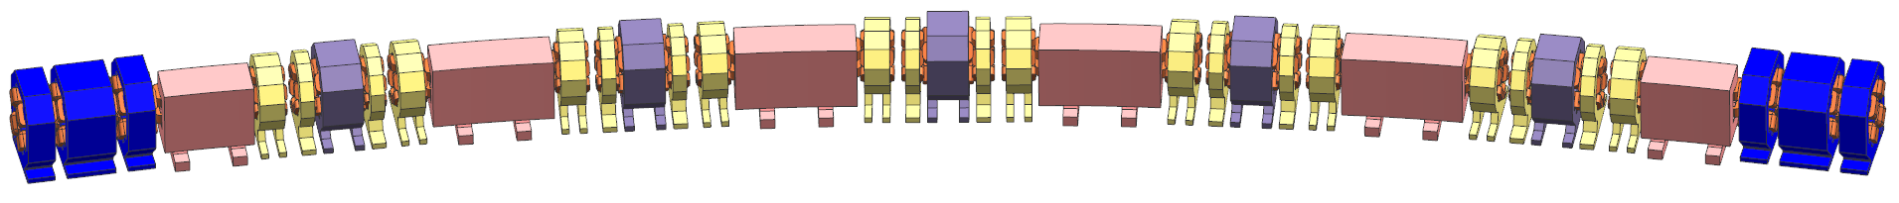
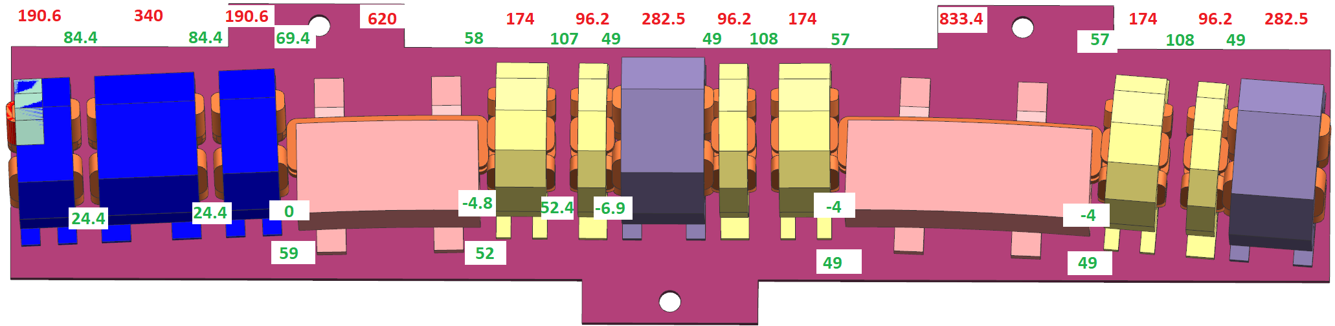
ALBA II magnet design
These preliminary models have already been integrated into the general layout.
The detected interferences will be used to further refine the designs.
images courtesy J. Boyer (Eng. Division)
yoke length
yoke-to-yoke distances
coil-to-coil distances

Slide 24
ALBA II magnet design
Funding to be defined
End of ALBA01 prototyping project
Tentative timeline
2022 |  |  |  | 2023 |  |  |  | 2024 |  |  |  | 2025 |  |  |  | 2026
EM prototype magnets design
CFT
EM prototypes manufacturing
Validation at ALBA
Series production
PM prototype magnets design
PM prototypes manufacturing
Validation at ALBA
CFT

Slide 25
Conclusions
The baseline design of magnets for ALBA II assumes EM technology for all of them.
The design is moving at good pace, and we expect to launch the CfT for the production of prototypes by Apr 2023.
In parallel, we are giving our first steps to study the feasibility of PM designs for some particular types of magnets (QD, QD-superbend, and QDS).
We are more than open to collaborate with other facilities at any level (design, magnetic characterization, etc).

Slide 26
Conclusions
Questions?

Slide 27
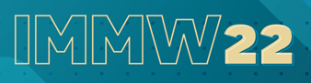
Questions?

