Slide 1






Cherenkov Diffraction Radiation as a potential Beam size measurement technique
M. Bergamaschi¹, V.V. Bleko², M. Billing³, L. Bobb⁴, J. Conway³, R. Kieffer¹, A.S. Konkov² P. Karataev⁵, R.O. Jones¹, T. Lefevre¹, J.S. Markova², S. Mazzoni¹, Y. Padilla Fuentes³, A.P. Potylitsyn², J. Shanks³
1. CERN, Geneva, Switzerland 2. Tomsk Polytechnic University, Tomsk, Russia 3. Cornell University, Ithaca, New York, USA 4. Diamond Light Source, Oxfordshire, United Kingdom 5. John Adams Institute at Royal Holloway, University of London, Egham, United Kingdom

Slide 2
Outline
Development of non-invasive beam size monitor for CLIC
From the emission of Diffraction radiation in Slits to Cherenkov Diffraction Radiation in longer dielectric
Experimental set-up on CESR
Experimental results obtained in 2017
Perspectives and outlook for beam instrumentation
M. Bergamaschi, TWEMLSF, ALBA

Slide 3
Motivation to develop Incoherent Cherenkov Diffraction Radiation
Suppress Synchrotron radiation → cleaner signal
DR and SR are emitted at similar angles
Looking for a physical process emitted at larger angles
Larger aperture slits (>500 um)
Difficult as DR will provide less photons
Looking for a physical process providing more photons
‘Generating Cherenkov diffraction radiation in longer dielectric’
M. Bergamaschi, TWEMLSF, ALBA
Ref: A.P. Potylitsyn et al, Diffraction radiation from charged particles, STMP 29 (Springer Berlin Hedeilberg 2010)

Slide 4
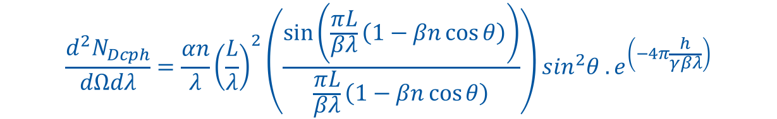
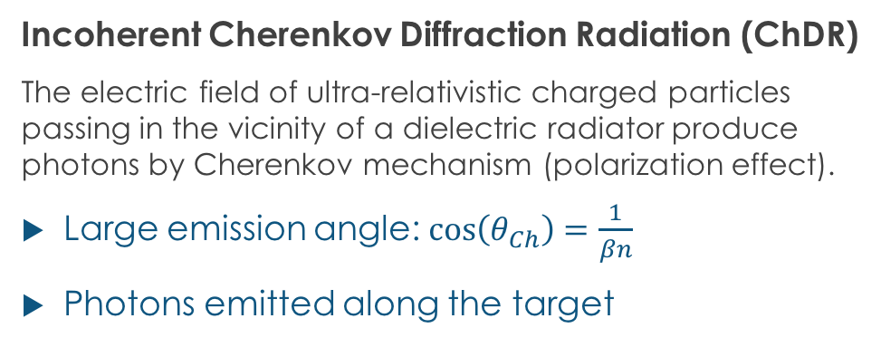

Incoherent Cherenkov Diffraction Radiation
Dielectric
Incoherent Cherenkov Diffraction Radiation (ChDR)
The electric field of ultra-relativistic charged particles passing in the vicinity of a dielectric radiator produce photons by Cherenkov mechanism (polarization effect).
Large emission angle: $\cos\left(θ_{Ch}\right)=\frac{1}{βn}$
Photons emitted along the target
Cherenkov DR
photons
E Field
h
Vacuum
$$θ_{Ch}$$
For a cylindrical geometry
L
Cherenkov emission
Exponential decay
of the particle field
$$\frac{d^{2}N_{Dcph}}{dΩdλ}=\frac{αn}{λ}{\left(\frac{L}{λ}\right)}^{2}\left(\frac{\sin\left(\frac{πL}{βλ}\left(1−βn\cos{θ}\right)\right)}{\frac{πL}{βλ}\left(1−βn\cos{θ}\right)}\right)\sin^{2}θ .e^{\left(−4π\frac{h}{γβλ}\right)}$$
α, fine structure constant
β, normalised beam velocity
γ, beam relativistic factor
θ, angle of observation
M. Bergamaschi, TWEMLSF, ALBA
Ref: A.P. Potylitsyn et al, Diffraction radiation from charged particles, STMP 29 (Springer Berlin Hedeilberg 2010)

Slide 5
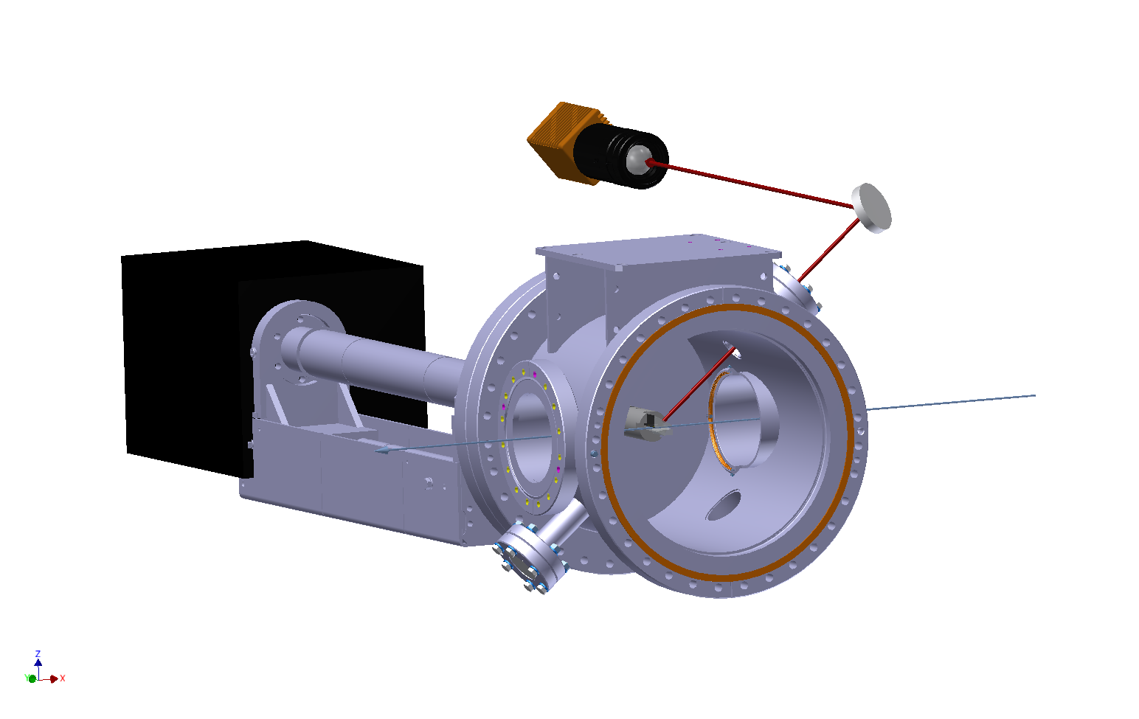
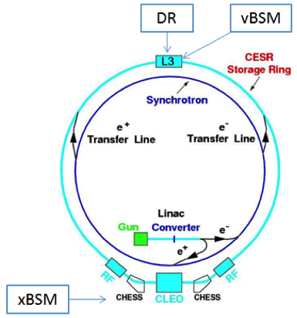
Experimental set-up on CESR (1/2)
Re-using the DR vacuum chamber and optical system
ChDR
Camera
ChDR
One bunch
2.5nC
Target
M. Bergamaschi, TWEMLSF, ALBA

Slide 6
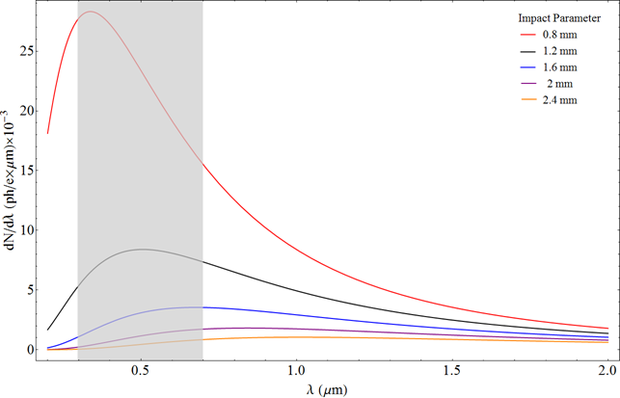
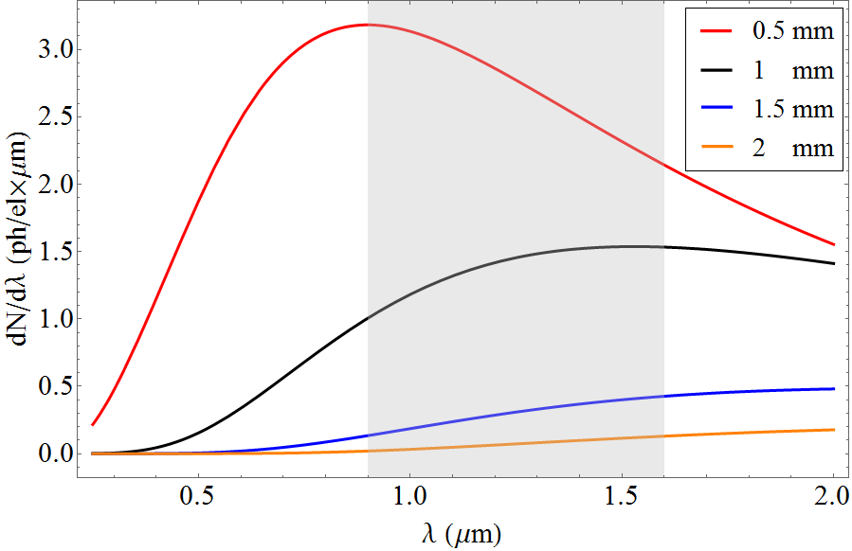
Experimental set-up on CESR (2/2)
Design a 2cm long SiO2 (n=1.46) Cherenkov Diffraction Radiation target
Testing with 5.3GeV e⁻ / e⁺ and measuring in visible (0.3-0.7um) – October 2017
Testing with 2.1GeV e⁻ and measuring in IR (0.9-1.7um) – April 2017
λ= 400±10nm
λ= 600±10nm
‘The red curve as been scaled down by 1/3 for better presentation
M.V. Shevelev and A.S. Konkov, JETP 118, 501 (2014)
M. Bergamaschi, TWEMLSF, ALBA

Slide 7
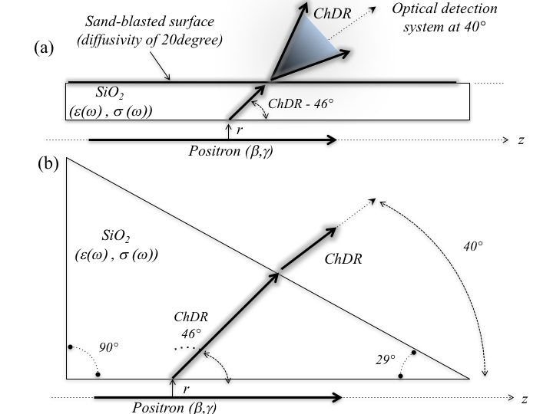
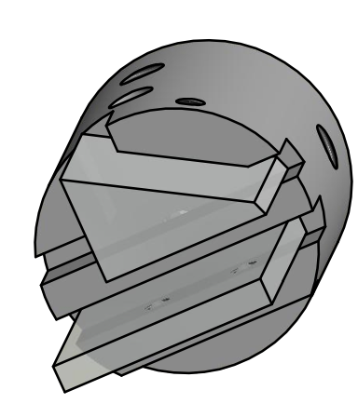
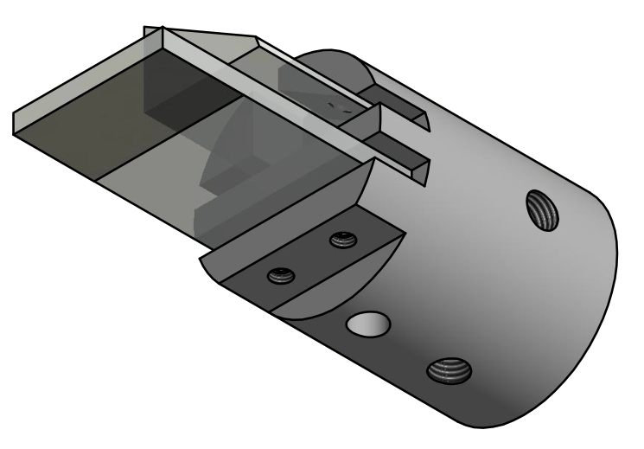
Cherenkov radiators
Two different geometries have been tested
Prismatic radiator
Flat radiator (simpler and cheaper)
Prismatic target for polarization studies
M. Bergamaschi, TWEMLSF, ALBA

Slide 8
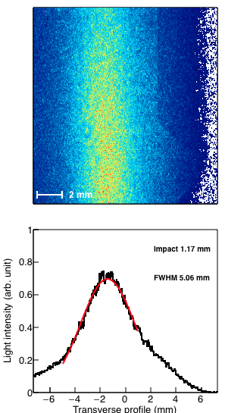
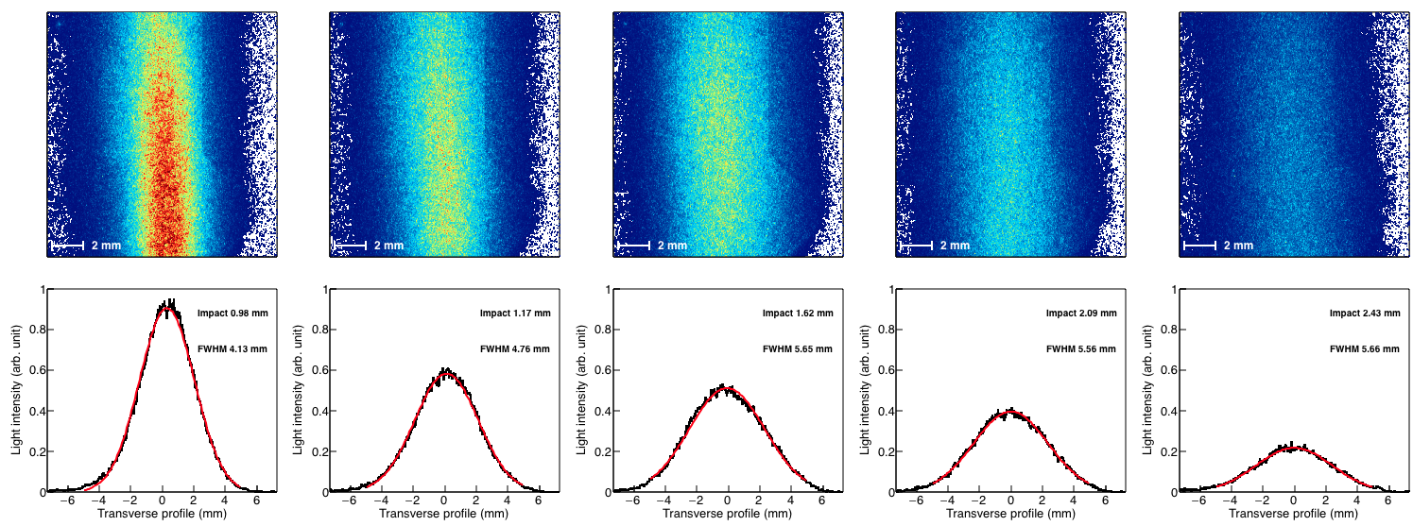
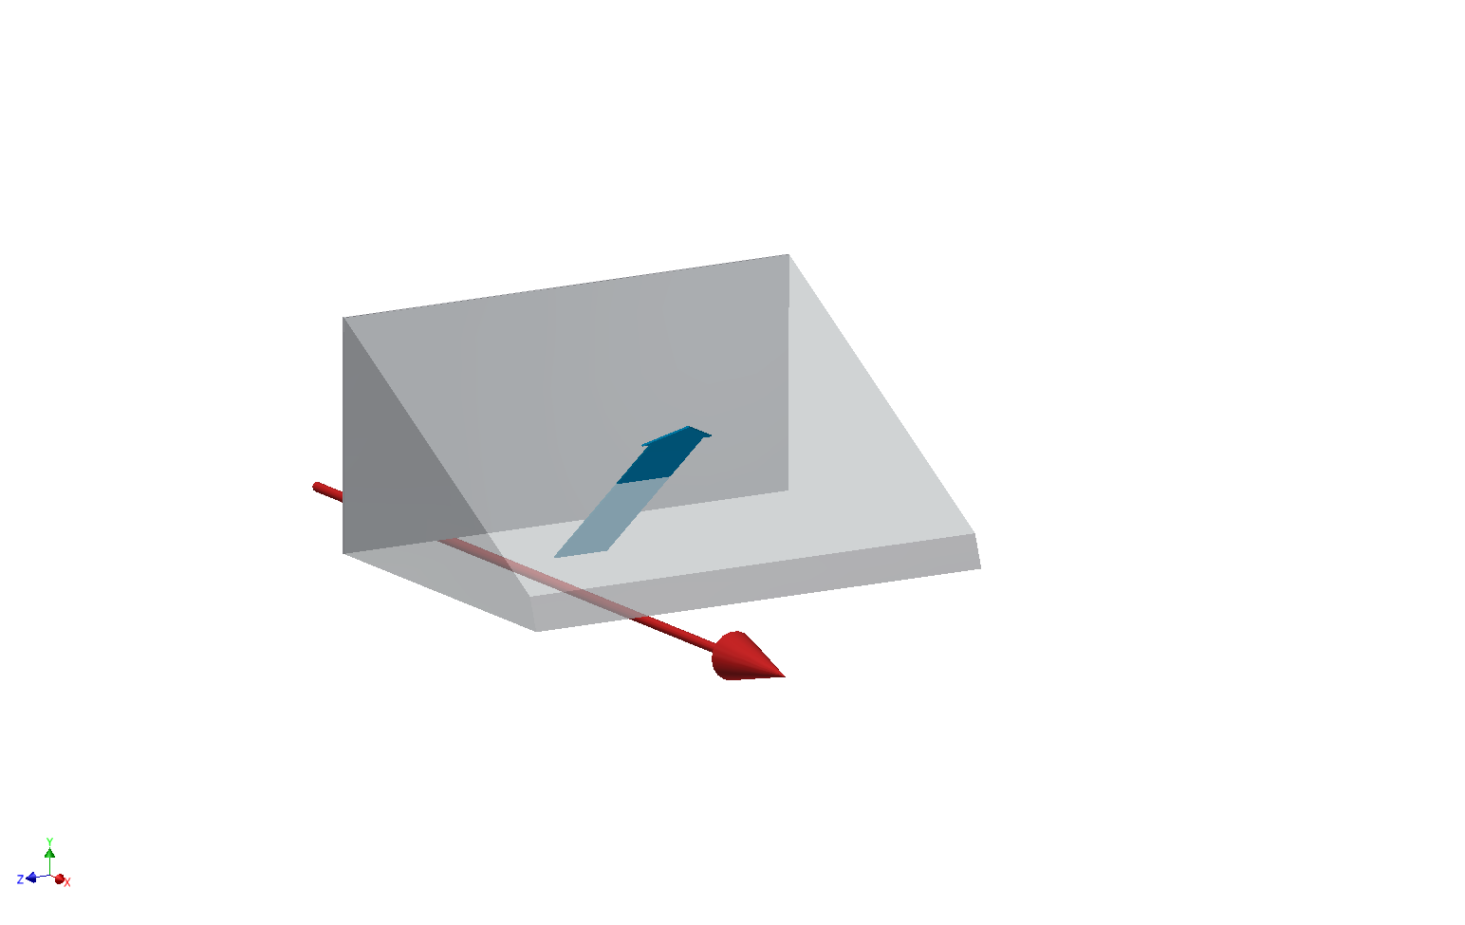
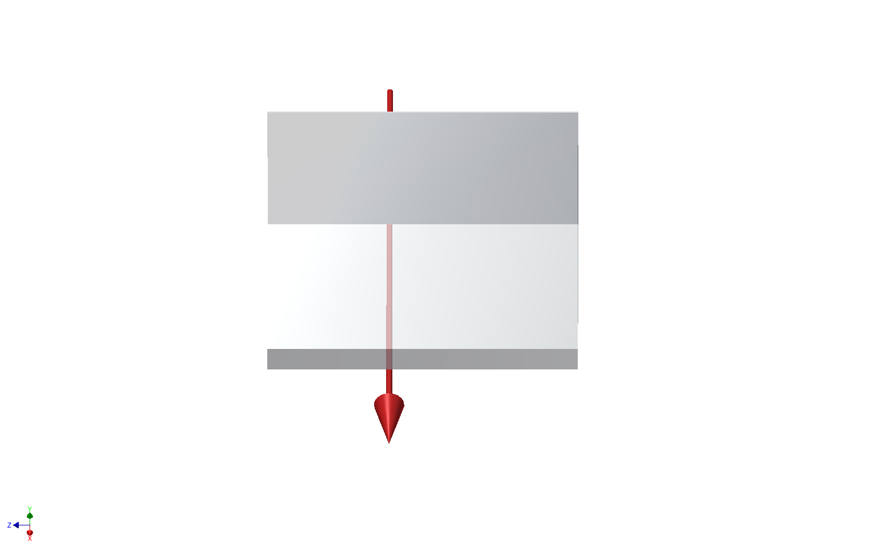
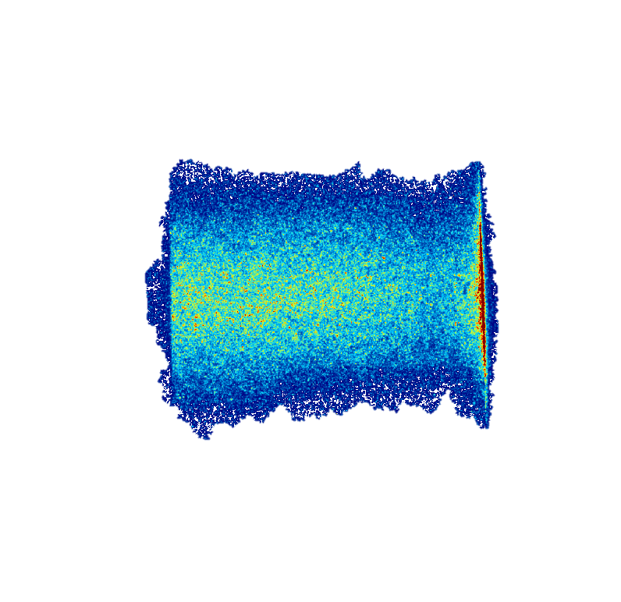
Experimental data : Positron at 5.3GeV
Measuring the horizontal Beam size :
Horizontal polarization
Vertical polarization
Cherenkov
Diffraction
Radiation
Positron Beam
Positron Beam
‘Vertically polarized photons give the best spatial resolution (σ_{y}=2mm)’
M. Bergamaschi, TWEMLSF, ALBA

Slide 9
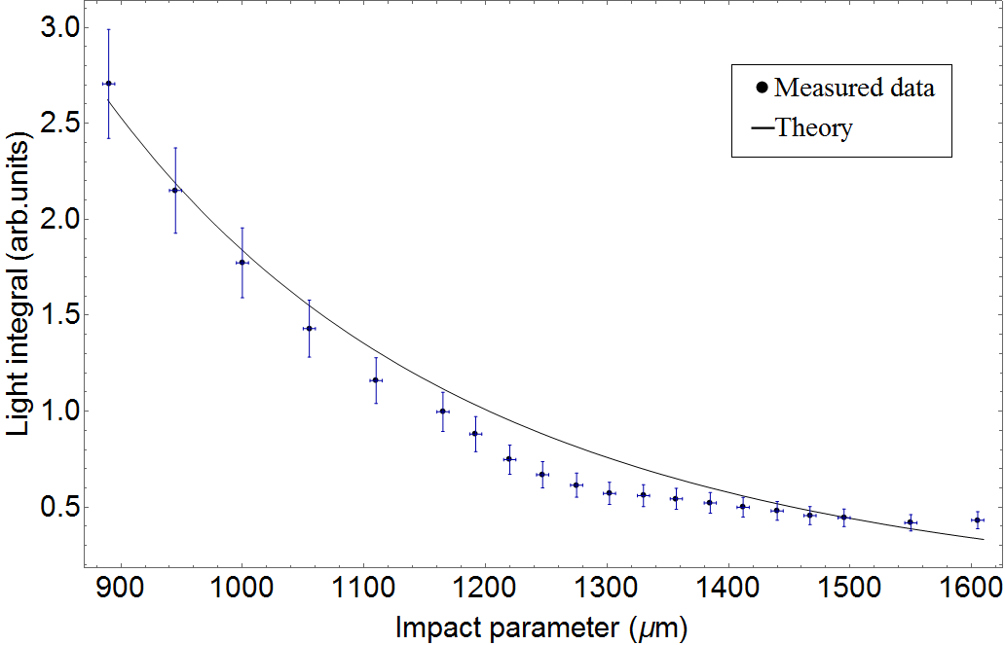
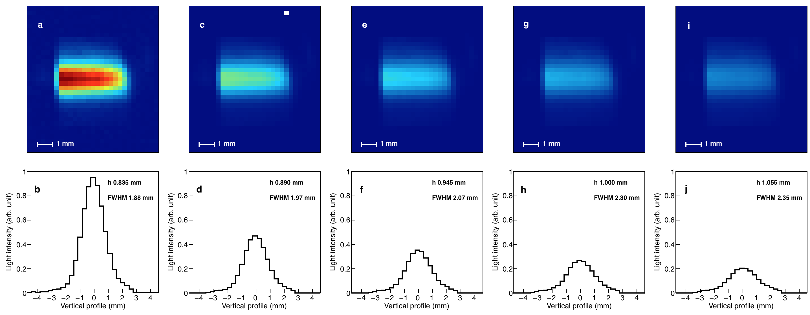
Experimental data : Electron at 2.1GeV
Steering the beam vertically
No wavelength filter – no polarizer
‘Cherenkov photons yield increasing strongly for smaller impact parameter’
M. Bergamaschi, TWEMLSF, ALBA

Slide 10
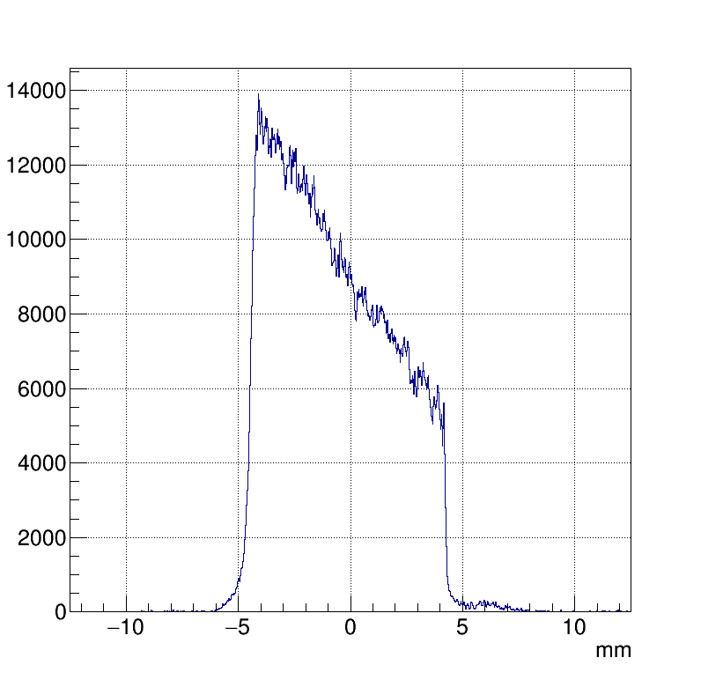
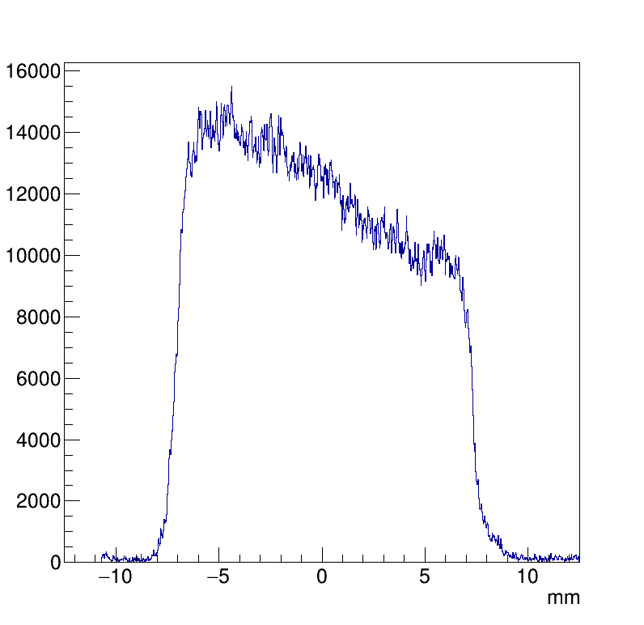
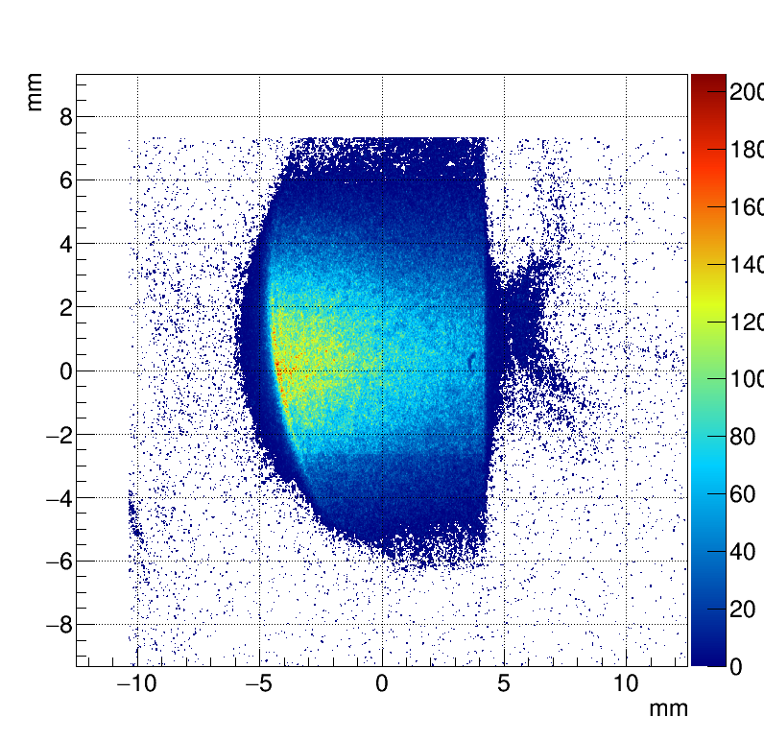
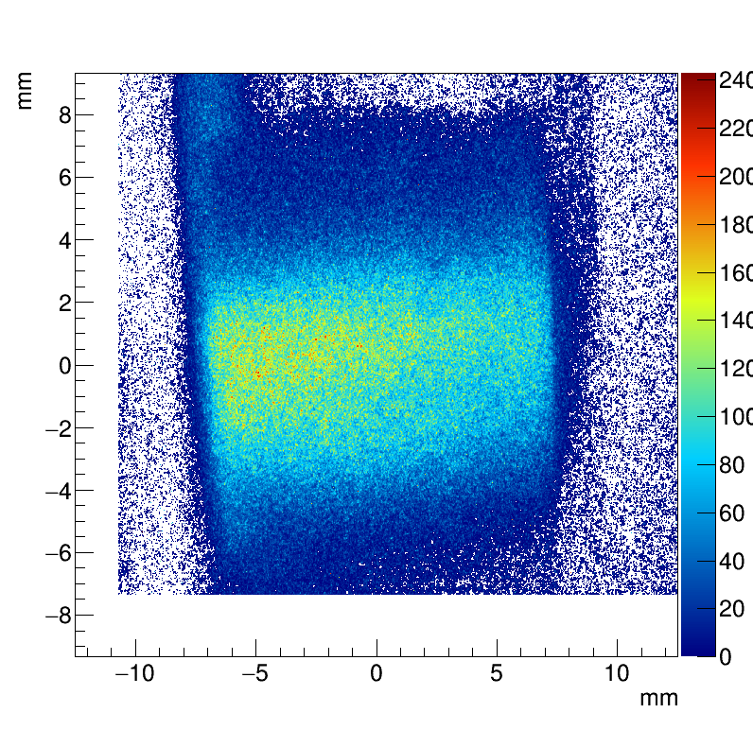
Experimental data : Positron at 5.3GeV
Rotating the target :
ChDR @600±10nm ; h_{mean} = 1.5mm
α = 4.28 deg (74mrad)
α = 0.98 deg (17mrad)
1.5mm
350um
Target angle, α
Positrons
λ= 600nm
‘Measuring the Beam tilt angle with respect to the surface of dielectric
as the light intensity strongly depends on the impact parameter’
M. Bergamaschi, TWEMLSF, ALBA

Slide 11
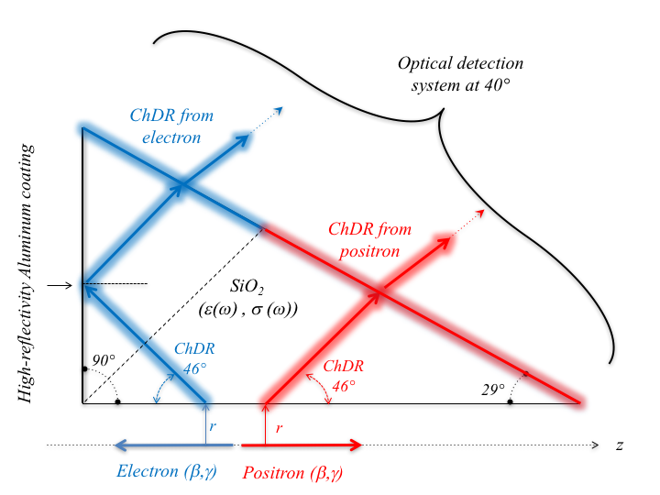
Experimental data : Measuring counter-propagating beams
(a)
Measuring counter-propagating beams using the prismatic target
M. Bergamaschi, TWEMLSF, ALBA

Slide 12
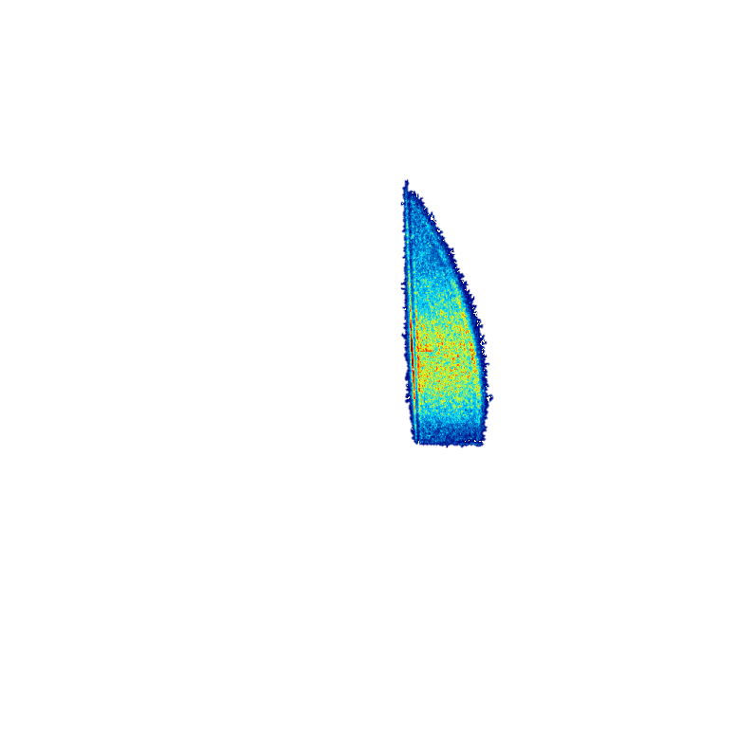
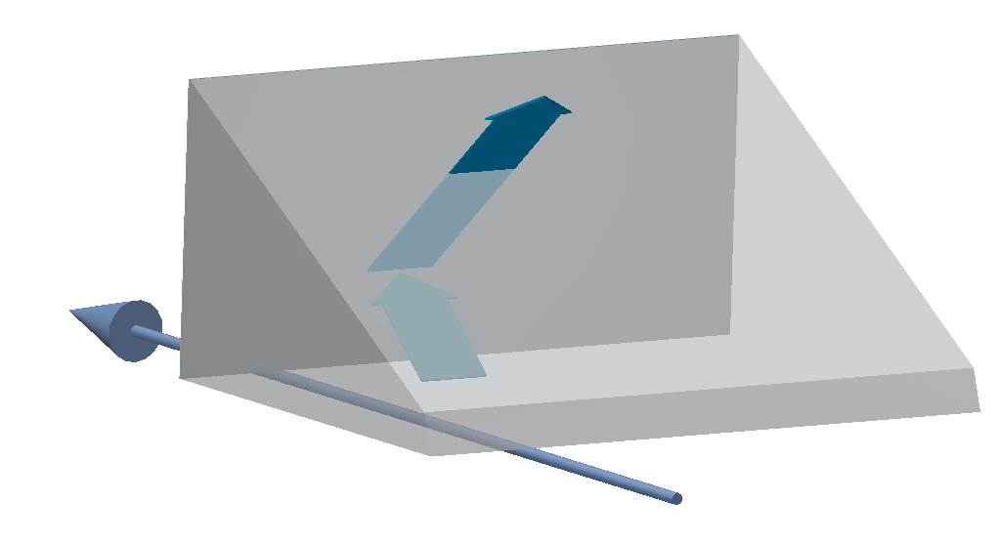
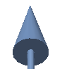
Experimental data : Measuring counter-propagating beams
(a)
Imaging both beams with the prismatic target
Cherenkov
Diffraction
Radiation
Electron Beam
Images from e⁻ is truncated due to the limited aperture of the current detection system
Electron Beam
Cherenkov
Diffraction
Radiation
Positron Beam
Positron Beam
The photons produced by electrons and positrons appear on a different part of the target and give the possibility to high directivity beam measurements (measured more than 60dB)
M. Bergamaschi, TWEMLSF, ALBA

Slide 13
Summary
Incoherent ChDR has been studied in IR and visible range for beams propagating at a distance of 1-3mm from the edge of the dielectric
The light is polarized and emitted in a narrow cone angle, different from SR angle providing excellent S/N ratio
The number of photons scales linearly with the length of the radiator and exponentially with the impact parameter
e.g. for 5.3GeV and h=1.5mm, measured 10⁻³ photons/turn/particle
Qualitative concept proved for mm beam size
M. Bergamaschi, TWEMLSF, ALBA

Slide 14
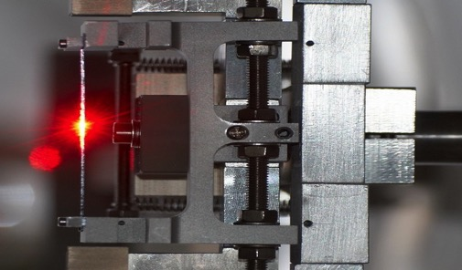
Perspectives for beam instrumentation
Imaging system for relativistic beam
What is the the smallest beam size measurable ?
The Cherenkov diffraction PSF should be smaller than transition radiation PSF
→ possible tests in 2018 with micron beam sizes on ATF2
What is the smallest the beam tilt angle measurable ?
A non linear response depending on wavelength, beam energy and impact parameter
Measuring counter-propagating beams with very high directivity : BPM for FCC, HE-LHC, …
A Beam Position Monitor for Crystal collimator on LHC
A Beam Position Monitor in Dielectric Wakefield acceleration
M. Bergamaschi, TWEMLSF, ALBA

Slide 15
Thanks for your attention
M. Bergamaschi¹, V.V. Bleko², M. Billing³, L. Bobb⁴, J. Conway³, R. Kieffer¹, A.S. Konkov² P. Karataev⁵, R.O. Jones¹, T. Lefevre¹, J.S. Markova², S. Mazzoni¹, Y. Padilla Fuentes³, A.P. Potylitsyn², J. Shanks³
1. CERN, Geneva, Switzerland 2. Tomsk Polytechnic University, Tomsk, Russia 3. Cornell University, Ithaca, New York, USA 4. Diamond Light Source, Oxfordshire, United Kingdom 5. John Adams Institute at Royal Holloway, University of London, Egham, United Kingdom

Slide 16
Back-up slides

Slide 17
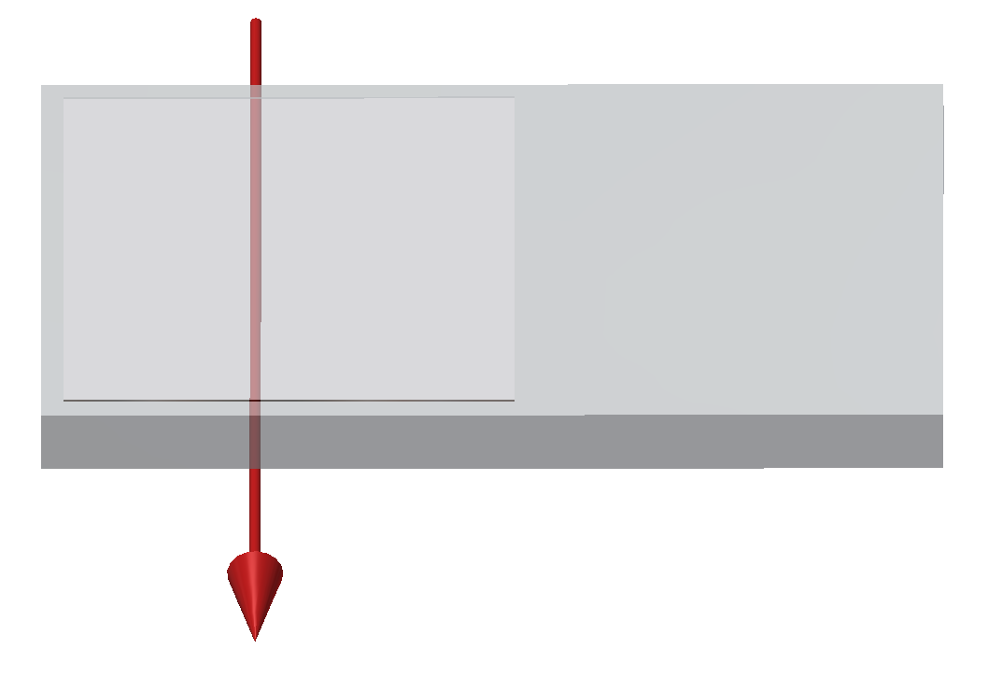
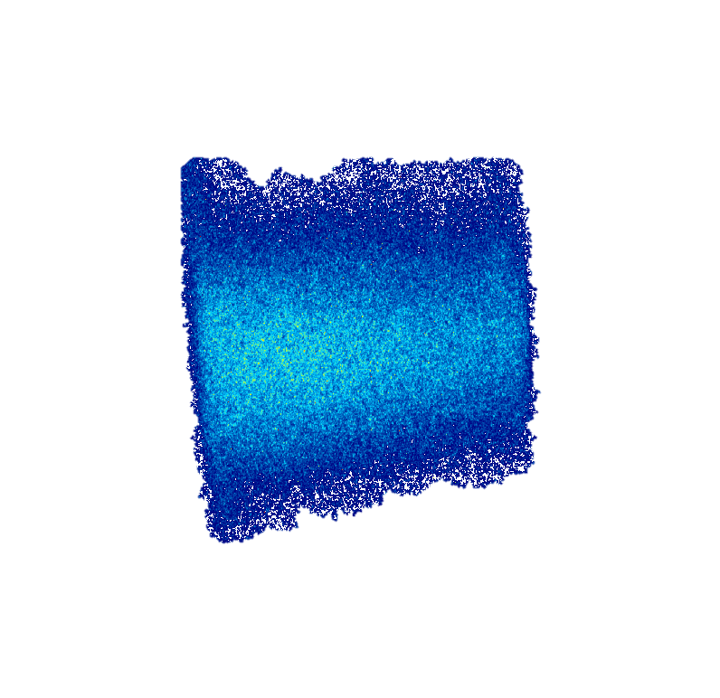
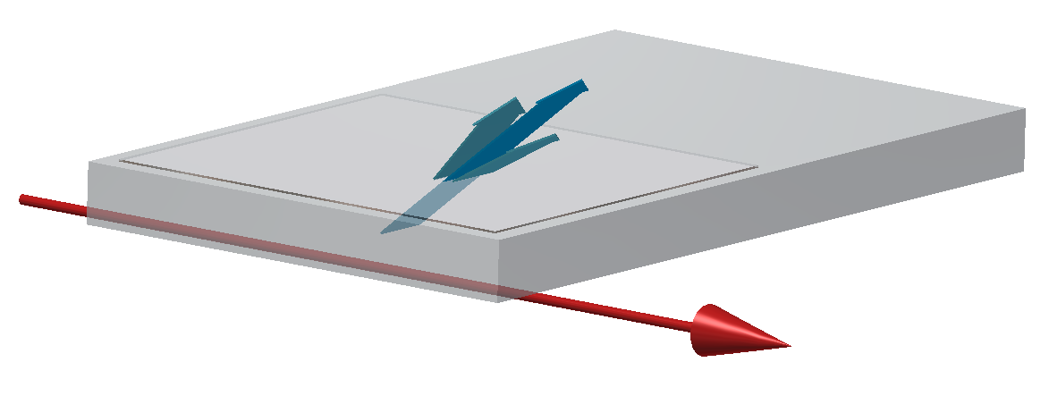
Experimental data : Positron at 5.3GeV
Imaging the Flat radiator (diffusive coating to extract the photons out of the target)
Cherenkov
Diffraction
Radiation
Cherenkov
Diffraction
Radiation
Positron
Beam
Positron
Beam
‘Cherenkov photons emitted all along the target surface’
M. Bergamaschi, TWEMLSF, ALBA

Slide 18
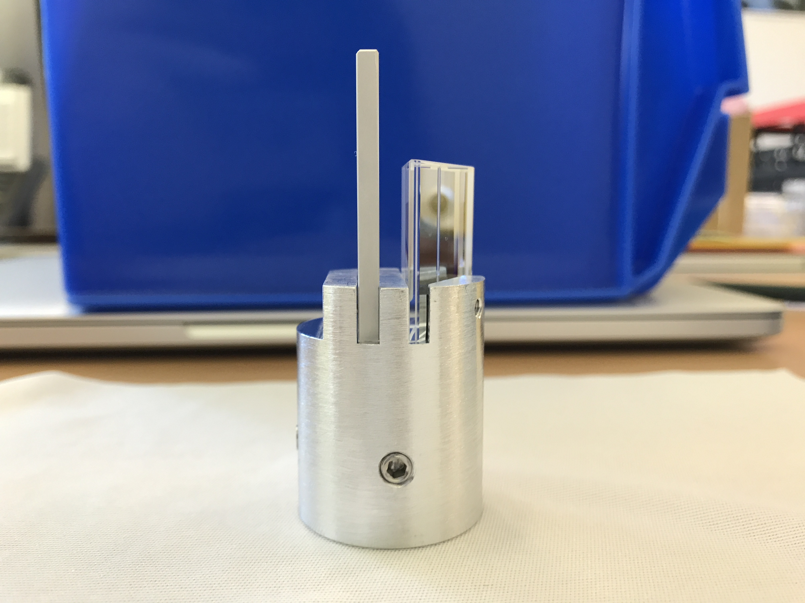
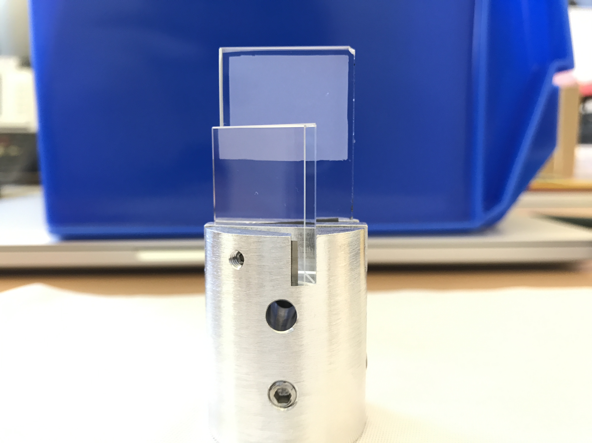
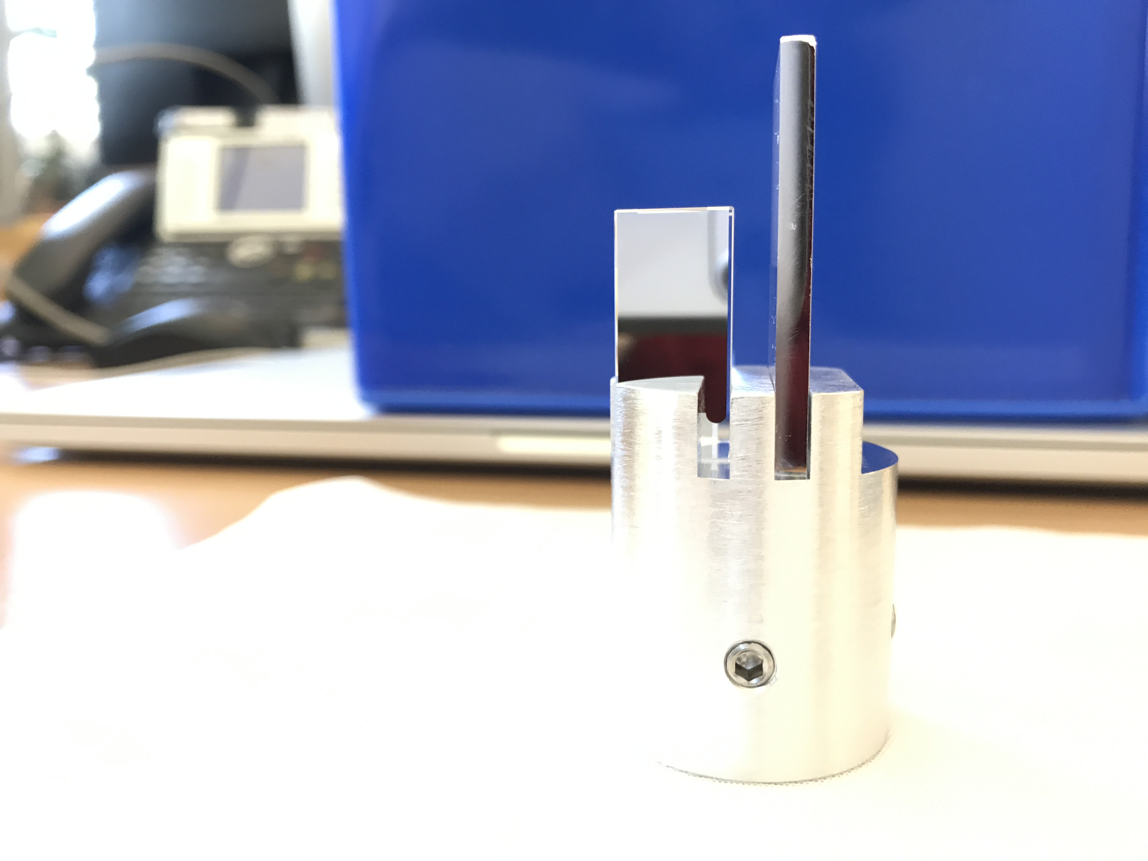
Cherenkov radiators (2/2)
Pictures of the radiators
Depolished
& Coated
Depolished
Area - no coating
Polished
& Coated
T. Lefevre, LER 2018, CERN

Slide 19
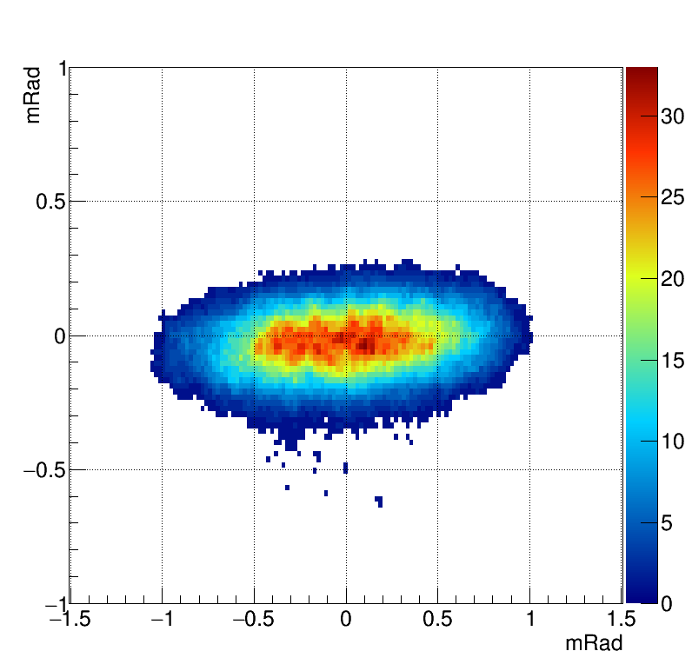
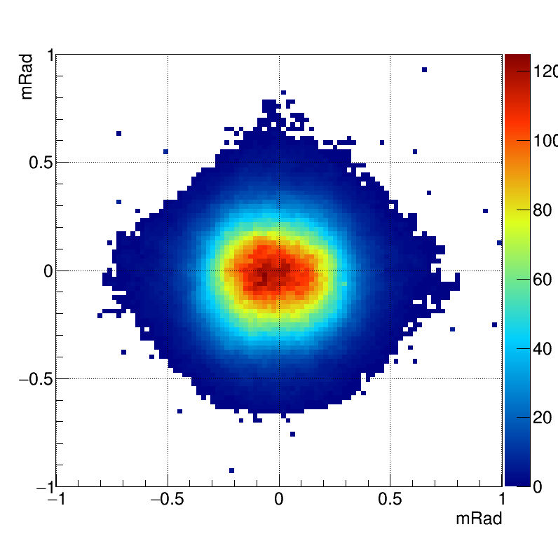
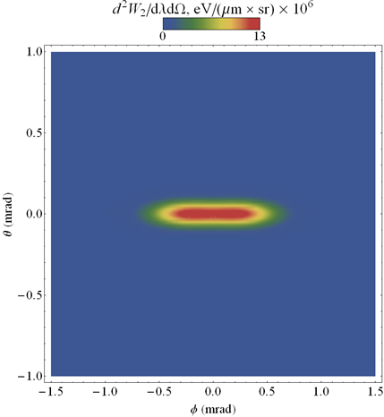
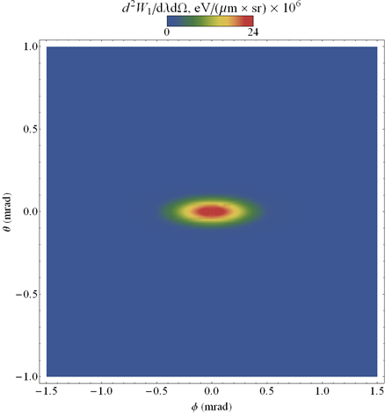
Experimental data : Positron at 5.3GeV
Angular distributions with Prismatic radiator : Comparison with simulations
Horizontal polarization
Vertical polarization
Measurements
Simulations
M. Bergamaschi, TWEMLSF, ALBA

Slide 20
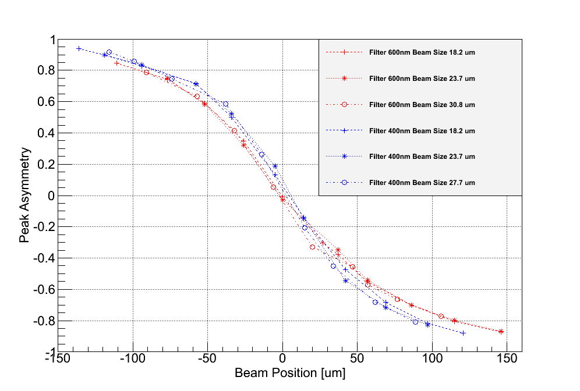
Incoherent Diffraction Radiation on CESR (4/6)
Steering the beam through the slit
Conditions: wavelength 400/600 nm, beam size: 16.2/23.7 um, slit width 0.5mm
Offset
Different sensitivity depending on the wavelength
T. Lefevre, LER 2018, CERN

Slide 21
Cherenkov radiators (2/2)
Pictures of the radiators
Depolished
& Coated
Depolished
Area - no coating
Polished
& Coated
M. Bergamaschi, TWEMLSF, ALBA

Slide 22
Experimental data : Positron at 5.3GeV
Imaging the prismatic target at wavelength of 600±10nm
Cherenkov
Diffraction
Radiation
Cherenkov
Diffraction
Radiation
Positron Beam
Positron Beam

Slide 23
Experimental data : Positron at 5.3GeV
Steering the beam vertically
Wavelength 600±10nm
Vertical Polarization component
h= 0.96mm 1.17mm 1.52mm 2.09mm 2.43mm
Cherenkov photons yield increasing strongly for smaller impact parameter

Slide 24
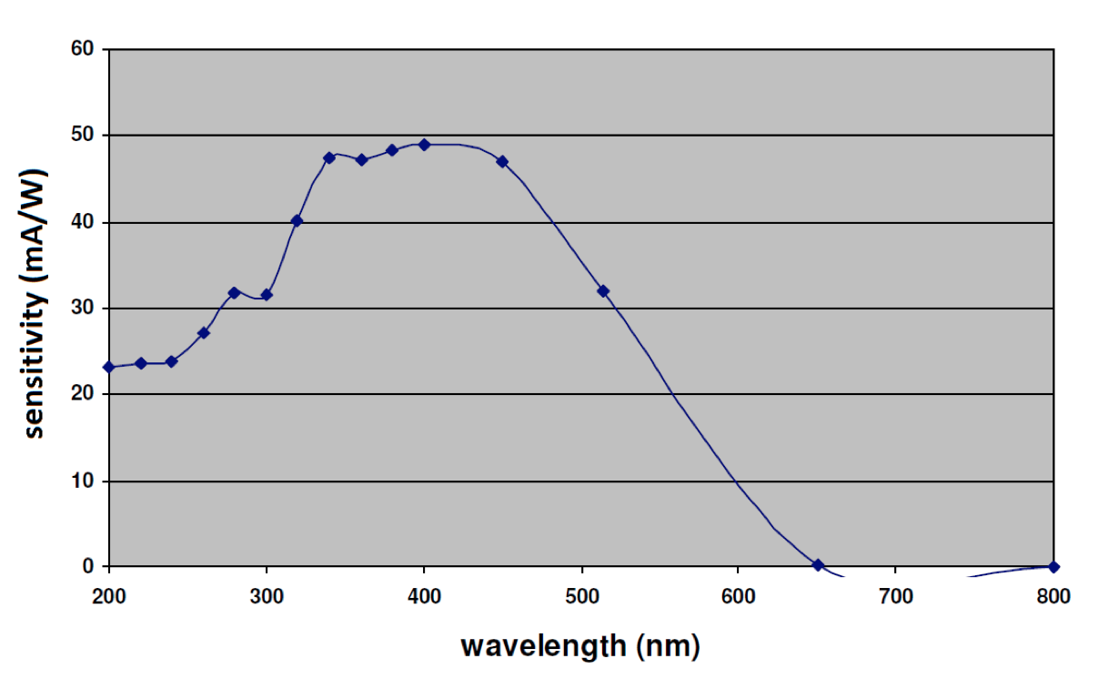
Experimental set-up on CESR (2/2)
Design a 2cm long SiO2 (n=1.46) Cherenkov Diffraction Radiation target
Testing with 5.3GeV e⁻ / e⁺ and measuring in visible (0.3-0.7um) – October 2017
λ= 400±10nm
λ= 600±10nm
Gated and intensified camera
M.V. Shevelev and A.S. Konkov, JETP 118, 501 (2014)
M. Bergamaschi, TWEMLSF, ALBA

Slide 25
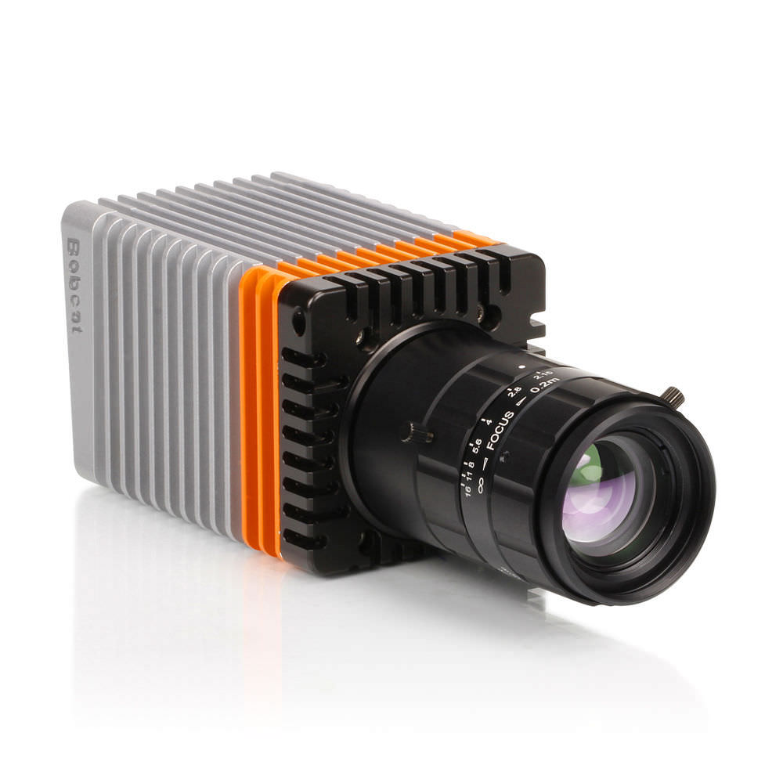
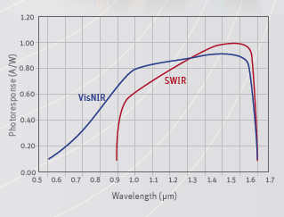
Experimental set-up on CESR (2/3)
Design a 2cm long SiO2 (n=1.46) Cherenkov Diffraction Radiation target
Testing with 2.1GeV e⁻ and measuring in IR (0.9-1.7um) – April 2017
Xenics Bobcat 640 GigE
Cooled InGaAs 640x512 pixels : 20um pixel pitch
QE up to 80% at 1.6um
14bit ADC
1us-40ms integration window
‘The red curve as been scaled down by 1/3 for better presentation
M.V. Shevelev and A.S. Konkov, JETP 118, 501 (2014)
M. Bergamaschi, TWEMLSF, ALBA

Slide 26
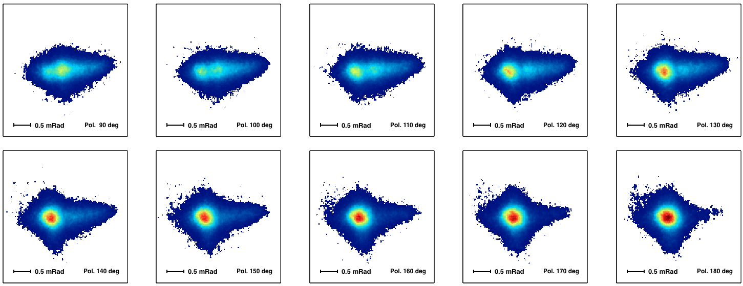
Experimental data : Positron at 5.3GeV
Prismatic target : Angular distribution and polarization study
Impact parameter fixed , 600±10nm wavelength, Polarization Scan

Slide 27
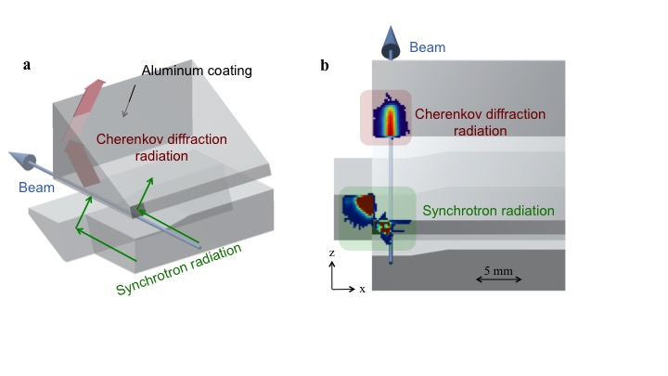
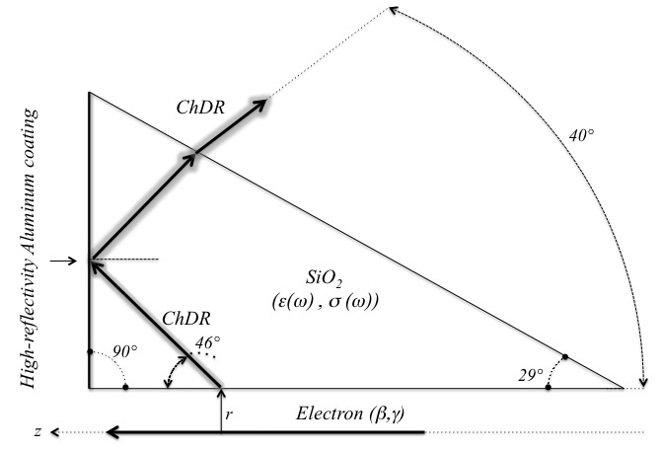
Experimental data : electron at 2.1GeV
Prismatic target for the detection of electrons

Slide 28
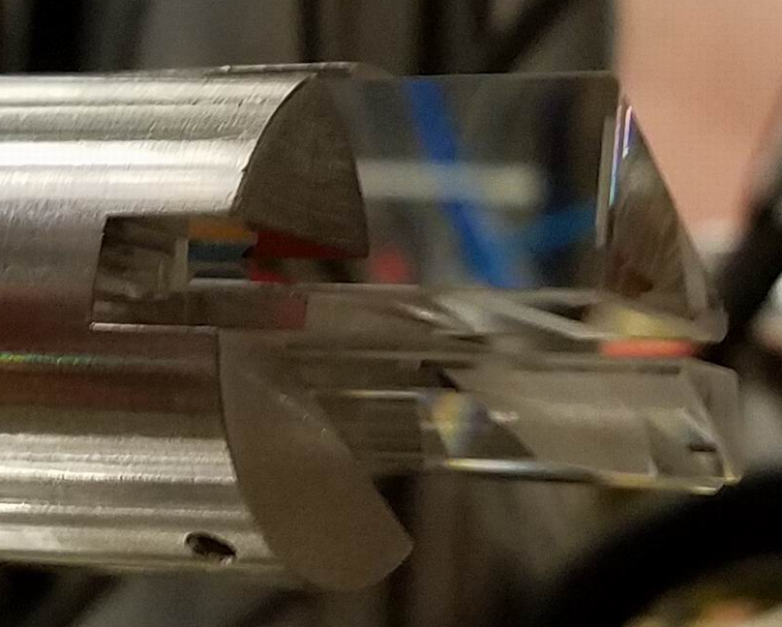
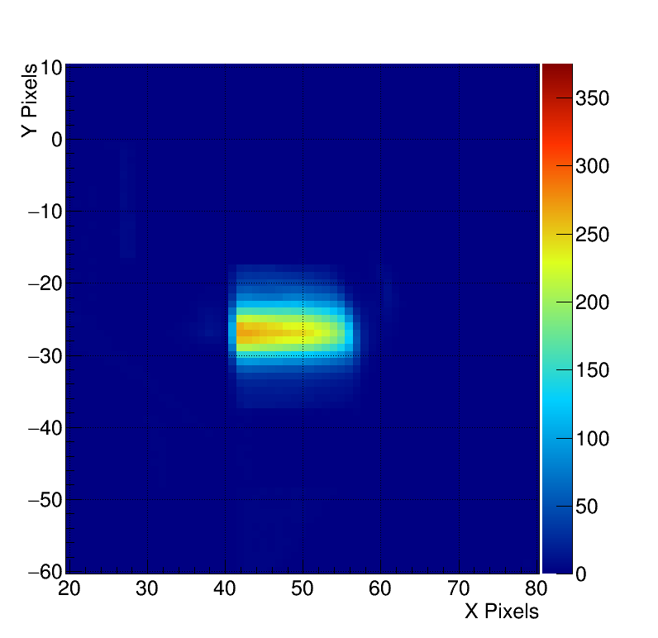
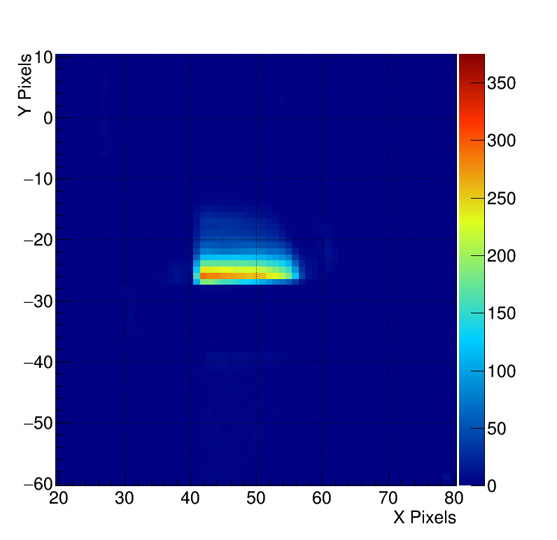
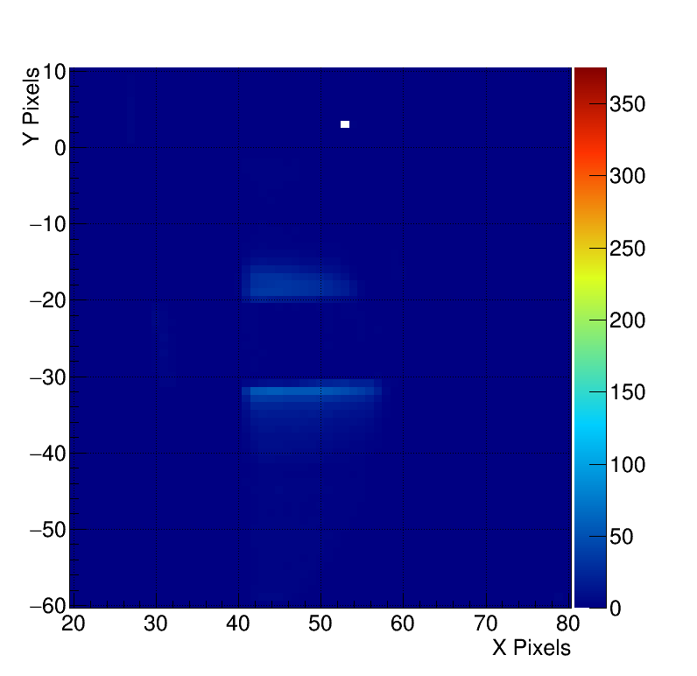
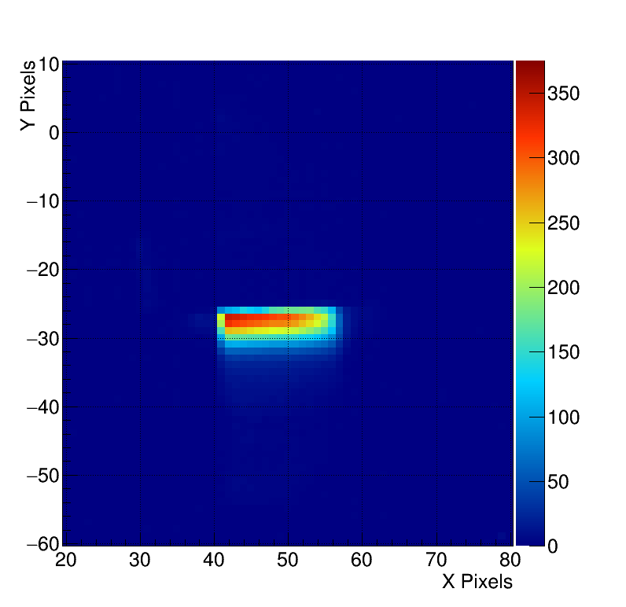
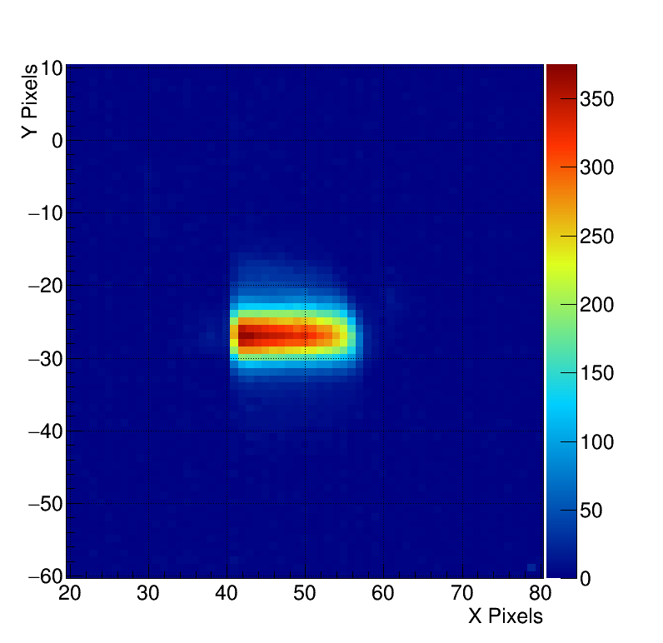
Experimental data : electron at 2.1GeV
Optically polished ChDR target insertion passing over a 3mm de-polished strip on the surface.
Diffusive surface =>We loose the highly directional ChDR emission.
3mm Strip
Target Movement
3mm Strip

Slide 30
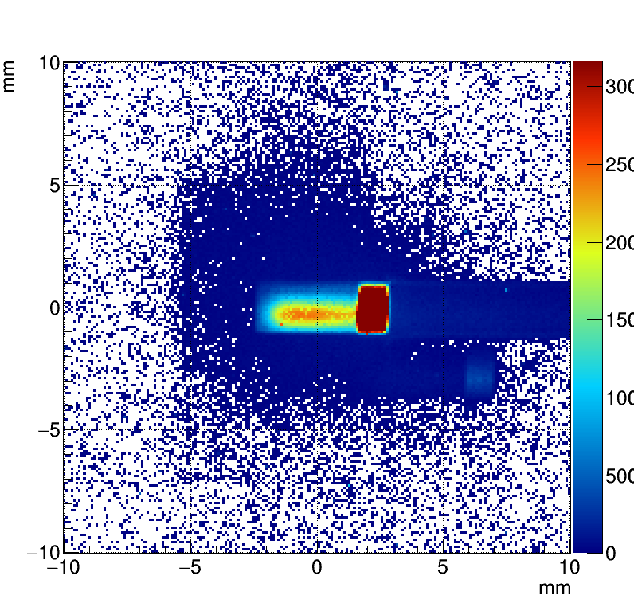
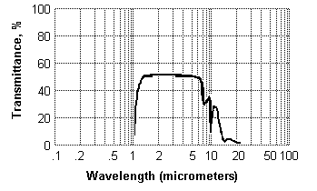
Perspectives on radiator’s shapes and material
Prismatic or flat targets ? Something else ?
BPM using flat target – possibly using long(er) target
Imaging system requiring to select the appropriate polarization
How thick should a target be ? cm/mm/um ?
ChDR is mainly emitted within the first atomic layer of the dielectric since the beam field decreases as it penetrates inside the material
Testing different materials for different applications / wavelength
ChDR
Beam
Silicon
Diamond
M. Bergamaschi, TWEMLSF, ALBA

Slide 31
Conclusions
Incoherent Cherenkov Diffraction Radiation looks promising for Beam diagnostic applications on both high-energy leptons and hadrons
After CESR, several beam tests prepared at CERN/CLEAR and possibly at KEK/ATF2 and Diamond in order to continue the R&D
Optimisation of the radiator geometry for a given application
Best shape/configuration for light extraction and polarization selection
Motivation to study the Beam dynamic involved in the emission of ChDR
ChDR is the emission of wakefield in a dielectric materiel
Coherent and incoherent emissions should lead to very different beam dynamic effects
Some work on-going on the simulation/theoretical sides (Tomsk Univ.)
Simulations of coherent ChDR is being studied with codes such as Particle studio, Magic or Vsim for different applications (Dielectric acceleration and THz source)
M. Bergamaschi, TWEMLSF, ALBA

Slide 32


Slide 33

ChDR measurements at CERN
Previously named CTF3-CALIFES, the new CERN electron beam test facility CLEAR is being commissioned at present.
Beam: 130-220MeV electrons
Up to 0.5nC per bunch, trains available 1-100 bunches.
CLEAR Proposal online: https://clear.web.cern.ch/sites/clear.web.cern.ch/files/documents/CLEAR_proposal.pdf
End of 2017 two ChDR experiments foreseen, in the infrared range:
Under vacuum, using CVD diamond radiator.
In-air, using crystalline silicon radiator.

Slide 34





1. Diamond ChDR on CLEAR at CERN
CVD diamond radiator under vacuum.
Goal: Comparison between OTR, Cherenkov, and ChDR light emission.
Already tested cameras on that setup:
Ueye (visible range) =>Nice images, but inappropriate wavelength for diffraction radiation studies at 200 MeV
Onca-MWIR-InSb (2-5um) =>Bad SNR
Gobi-LWIR(8-15um) =>Bad SNR (bolometer)
To be tested soon:
Bobcat-SWIR(0.8-1.6um) Might be the right one for this measurement.
ChDR
e- Beam
h
Al coating
TR screen
ChDR radiator
Ueye image
Ueye
Onca
Gobi
Bobcat

Slide 35


Experimental set-up at Califes@CERN
CALIFES : 200MeV electrons – up to 15nC per bunch train
15x2x1.2mm Diamond crystal with one face cut and Al Coated to reflect the ChDR photons on a FIR Camera (microbolometer, 16bit, 8-14um)
Measuring and comparing Transition, Cherenkov and Cherenkov Diffraction radiation

Slide 36

2. Silicon ChDR on CLEAR at CERN
In-air spectral-angular measurement of ChDR in an half silicon wafer radiator.
Detector: PDA10 InGaAs (0.9-2.6um) single pixel photodiode mounted on a motorized Goniometer.
Set of bandpass filters used to select wavelength (BW 30nm).
e- Beam
ChDR
Si Radiator

Slide 37

2. Silicon ChDR on CLEAR at CERN
Installation on going in CALIFES

Slide 38


Cherenkov radiation (1/2)
‘Equivalent to the supersonic boom but for photons’
Threshold process: Particles go faster than light β > 1/n
n is the index of refraction
β is the relative particle velocity
θ_{c} is the Cherenkov light emission angle
d the length of the cherenkov radiator
The total number of photons proportional to the thickness of the Cherenkov radiator
Almost no dependency on beam energy

Slide 39


Cherenkov radiation (2/2)
Emitted (measurable) power spectrum depends on the materiel transparency (Tr(λ))
Silicon
Diamond
SiO2
Al2O3
CVD SiC

Slide 40

…Using beam parameters of LHC

Slide 41
e.g. Positioning of Crystal collimator in LHC or FCC

Slide 42


e.g. Positioning of Crystal collimator in LHC or FCC
LHC collimators are equipped with electrostatic BPM to allow their alignment with a resolution better than 10microns in10-20seconds at a distance of few mm from the beam
LHC collimator aperture
(≈1mm) at 7TeV
Equipped with BPM button
on both end of the jaw (1m long)
42

Slide 43

e.g. Positioning of Crystal collimator in LHC or FCC
LHC collimators are equipped with electrostatic BPM to allow their alignment with a resolution better than 10microns in10-20seconds at a distance of few mm from the beam
Crystal collimators are now seriously considered as the future primary collimators in LHC and FCC
Investigating the use of Cherenkov Diffraction Radiation as way to measure the position of the crystal with respect to the beam
43

Slide 44
e.g. Cherenkov Diffraction Radiation
ChDR Photons spectrum in Silicon for LHC (7TeV protons) and different impact parameters
h=1mm
h=2mm
h=3mm
Photon
Spectrum (a.u)
Peaking @1-3um
Silicon – n=3.45
Photon spectrum only calculated over the transmission bandwidth of
corresponding material
Wavelength (m)

Slide 45
e.g. Cherenkov Diffraction Radiation
Number of ChDR photons and ChDR power spectrum as function of beam Energy (LHC-FCC)
1m Si crystal and impact parameter h = 2mm
LHC 7TeV
Photon
Spectrum (a.u)
Better to Detect
in the FIR
FCC
N_{ph}
per proton
450GeV
7TeV
50TeV
Nph=300
Nph=11500
Nph=39000
LHC 450GeV
Wavelength (m)
Proton Beam Energy (MeV)

Slide 46
e.g. Positioning of Crystal collimator in LHC or FCC
3mm long Silicon Crystal and 7TeV protons
Emitted Photon power for h=1mm (typical for primary collimators) ≈ 5watts for full LHC beam
2808 nominal bunches (1.1E11 protons)
Wavelength
[1-20um]
Photon Power (W)
Impact parameter (m)

Slide 47
e.g. Positioning of Crystal collimator in LHC or FCC
3mm long Silicon Crystal and 7TeV protons
Emitted Photon power for h=1mm (typical for primary collimators) ≈ 5watts for full LHC beam
2808 nominal bunches (1.1E11 protons)
Photon Power (W)
In current design (i.e. parallel crystal faces), a large fraction of the power would be totally reflected (16,9°) and possibly absorbed
Impact parameter (m)
θ_{c}=73.1°
Crystal outer face built with different angle or with a high roughness to diffusive the light out
Measuring infrared photons coupled in a optical fiber
θ_{TotR}
π/2 − θ_{c} < θ_{TotR}

Slide 48
ChDR for Beam cooling ?

Slide 49

ChDR for Beam cooling ?
During normal operation, LHC luminosity drops over a fill due to beam losses
Synchrotron Radiation cooling time is 21hours
Particle energy lost by SR is approximately 7keV per turn (80MeV.s⁻¹) with a critical energy at 42eV
Effect of SR Transverse beam cooling is not visible on the peak luminosity

Slide 50
ChDR for Beam cooling ?
Cool the beam transversely in 4-5 hours to maintain the peak luminosity constant : Gain in integrated luminosity

Slide 51

ChDR for Beam cooling ?
Assuming a ring shaped radiator, the energy lost by one proton in a 1m long Diamond radiator as function of impact parameter h
To be compared to 7keV energy lost per turn by SR
Energy lost
per turn (eV)
CVD Diamond
Impact parameter h (m)

Slide 52
ChDR for Beam cooling ?
Radiating and Cooling
Turn 1 ------------------------------------------> Turn n
Acceleration
Acceleration
It requires that Particle recoils opposite to its direction of propagation
Assuming this is true (or partially true), the emittance of the beam would then decrease down to an equilibirum emittance – What would that be ?
Assumed that radiator is thin enough so that there is no coherent emission

Slide 53
ChDR for Beam cooling ?
Time evolution of the LHC beam emittance at 7TeV for different impact parameter h
Emittance
reduction Δε
h=1mm
h=1.5mm
h=2mm
Time (h)
Assuming 10x 1m long Diamond radiators

Slide 54

ChDR for Beam cooling ?
Damping time as function of beam energy (h=1.5mm)
LHC@450GeV (weeks)
LHC@7TeV
(≈5hours)
Damping time = the time it would take particle to lose half of its energy
Damping time (h)
FCC (minutes)
Beam energy (MeV)
Assuming 10x 1m long Diamond radiators

Slide 55
ChDR as source of Radiation ?
T. Lefevre, 7th Channeling Conference, Sirmione, 2016

Slide 56


ChDR as source of Radiation ?
Beam energy | 3 GeV
Beam current | 200mA
Ring Circonference | 220m
bending magnet photon flux

Slide 57
ChDR as source of Radiation ?
Beam energy | 3 GeV
Beam current | 200mA
Ring Circonference | 220m
ChDR from a 1cm long
diamond radiator
bending magnet photon flux
Flux (photons/s/0.1%BW)
h=1mm
h=2mm
h=3mm
Wavelength (m)

Slide 58
ChDR as source of Radiation ?
bending magnet photon flux
1cm long
diamond
Several orders of magnitude difference
≈10⁷-10⁸
Flux (photons/s/0.1%BW)
h=1mm
h=2mm
h=3mm
Wavelength (m)
Beware, this is the ChDR photon flux produced and not extracted (x10⁻³) !
If interested in longer wavelength (FIR/THz) – use larger impact parameter

Slide 59

ODRI experiment at KEK ATF2
Experiment installed at ATF2 in February 2016, in the laser-wire previous location where vertical beam can be focused to < 1um
Notes:
Installation in Feb 2016

Slide 60


ODRI experiment at ATF2
The target as 4 slits for DR (50 to 201 µm)
A couple of vertical and horizontal mask slits can be inserted 13 cm upstream the target
TARGET
ODR
Masks
e- Beam
Synchronous Imaging and Angular acquisition for position filtering in angular

Slide 61


ODRI at ATF2
Direct Image of the ODRI
2D Angular distribution of the ODRI

