Slide 1
Synchrotron Radiation monitors in Hadron Machines
E. Bravin¹, S. Mazzoni¹, T. Mitsuhashi^{1,2}, M. Palm¹, F. Roncarolo¹ & G. Trad¹
¹ CERN Beam Instrumentation group, Geneva (CH)
² KEK, Tsukuba (JP)
Topical Workshop on Emittance Measurements for Light Sources and FELs, ALBA, 29-30 January 2018

Slide 2
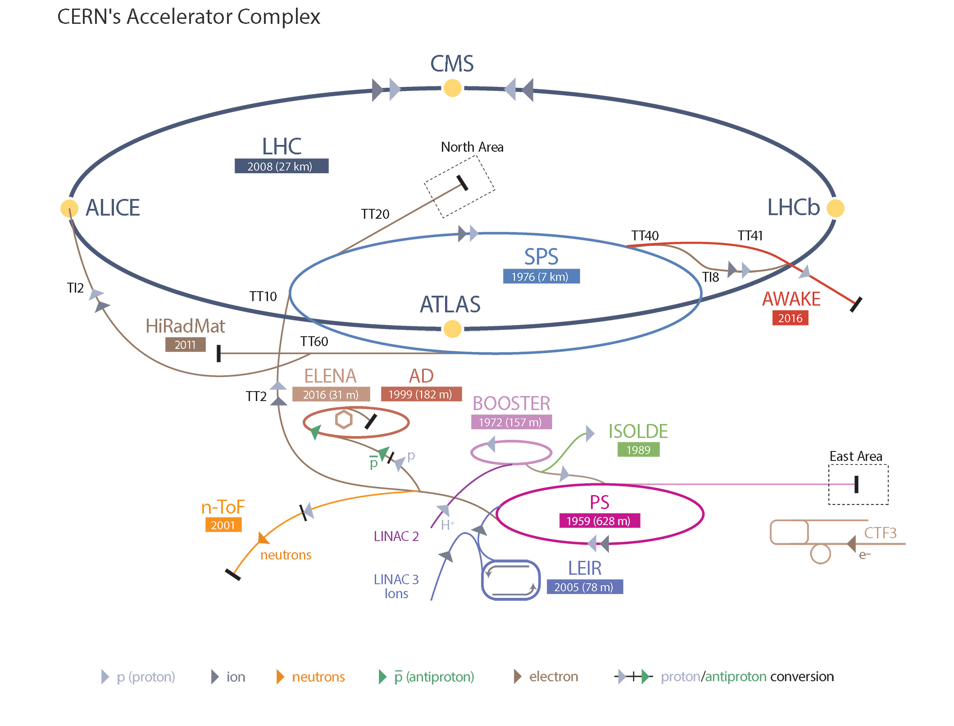
Outline
SRM for transverse & longitudinal profile, Halo measurement:
Imaging
Interferometry
(Single photon counting)
SRM for transverse profile:
Imaging
Slit scan

Slide 3
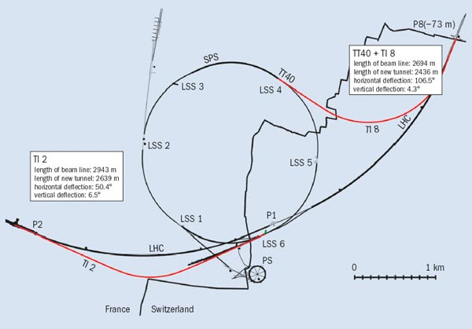
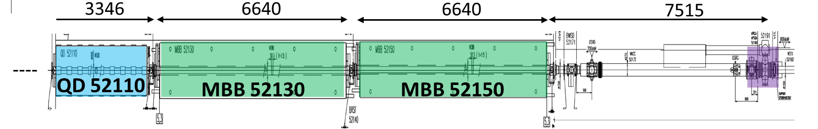
SPS LSS5

Slide 4
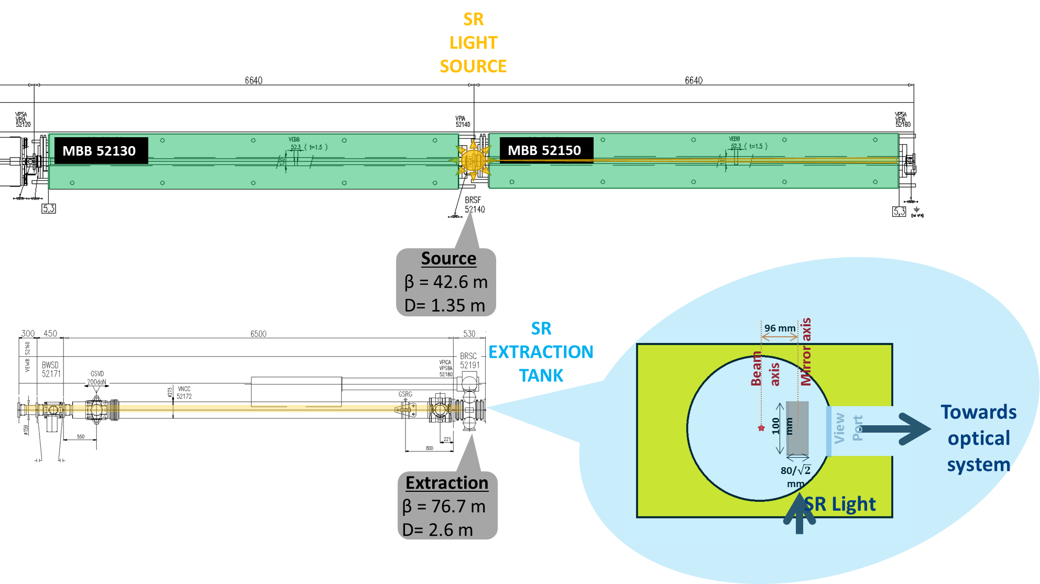
Super Proton Synchrotron
Challenges: bunch by bunch profile measurements over 288 bunch, 25 ns train
Energy: from 26 to 450 GeV in 4.3 s.
Visible SR monitoring: edge radiation extracted to optical system with mirror @ 68 mm from beam axis
SR sent to IMAGING and SLIT SCAN instruments

Slide 5
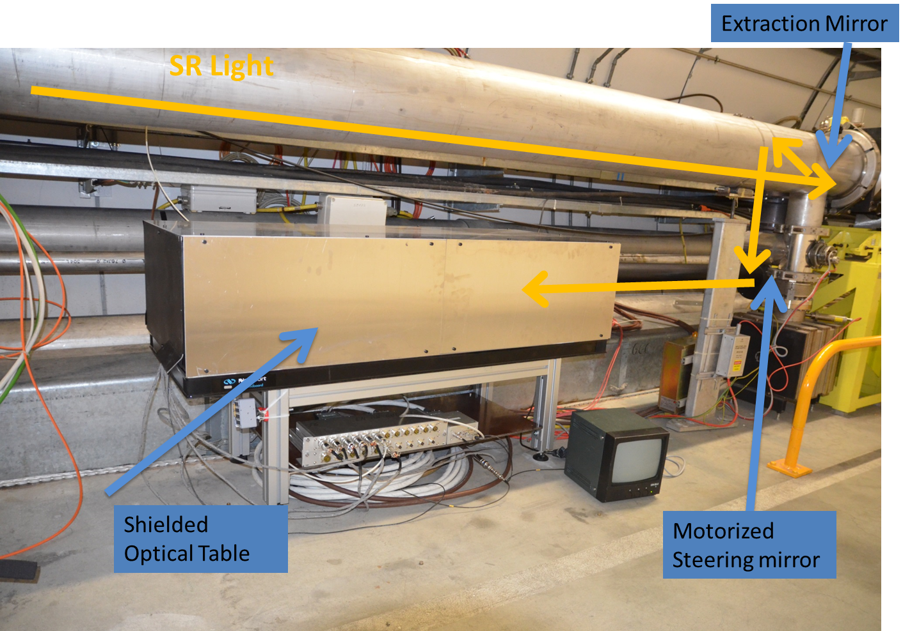
SPS BSRT

Slide 6
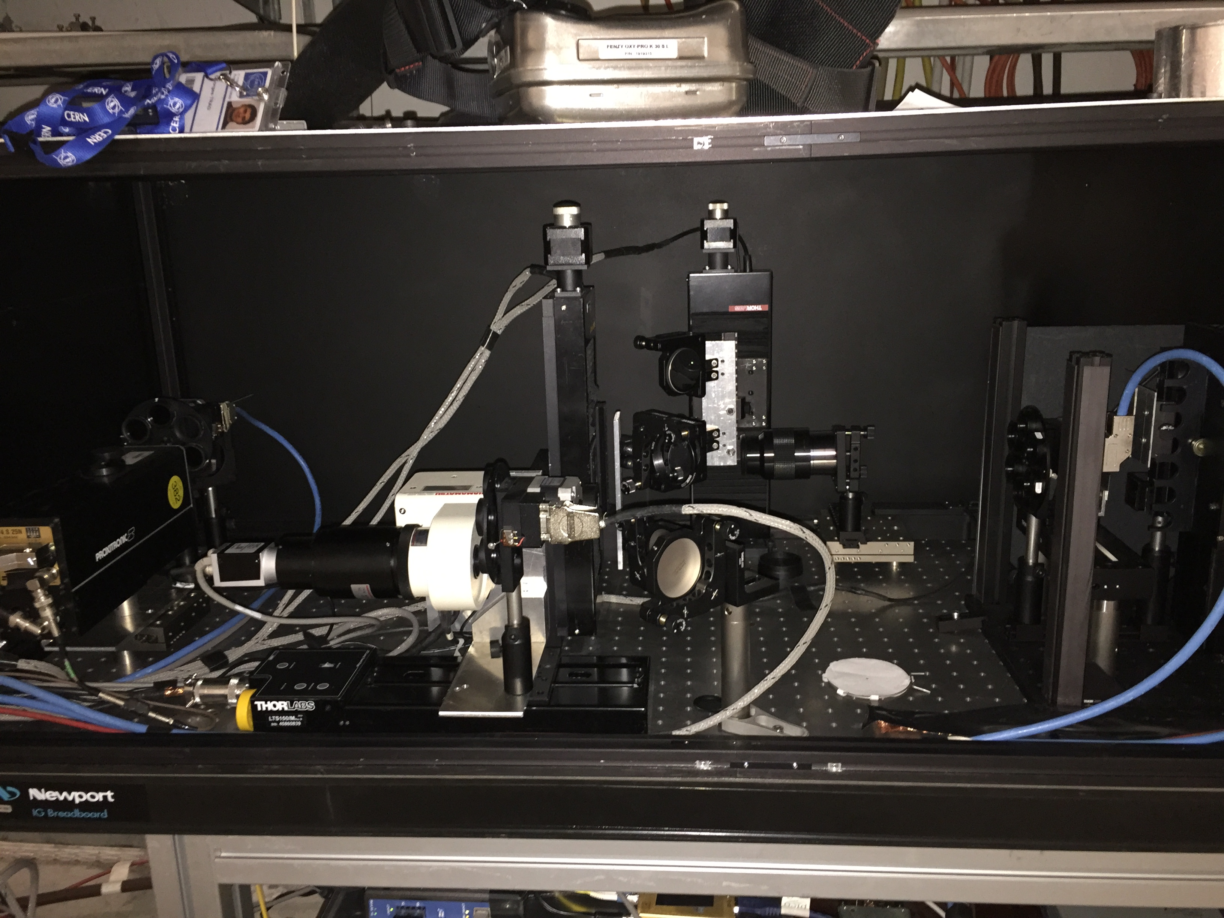
SPS BSRT

Slide 7
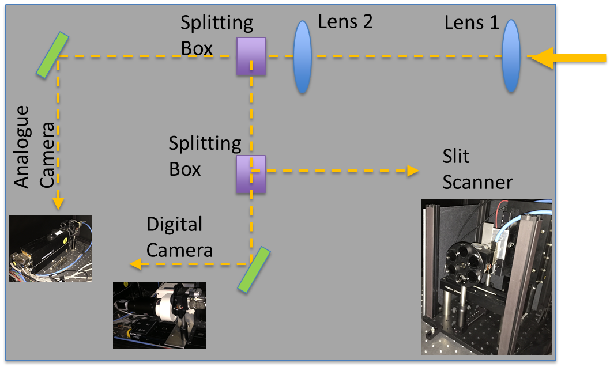
SPS BSRT

Slide 8
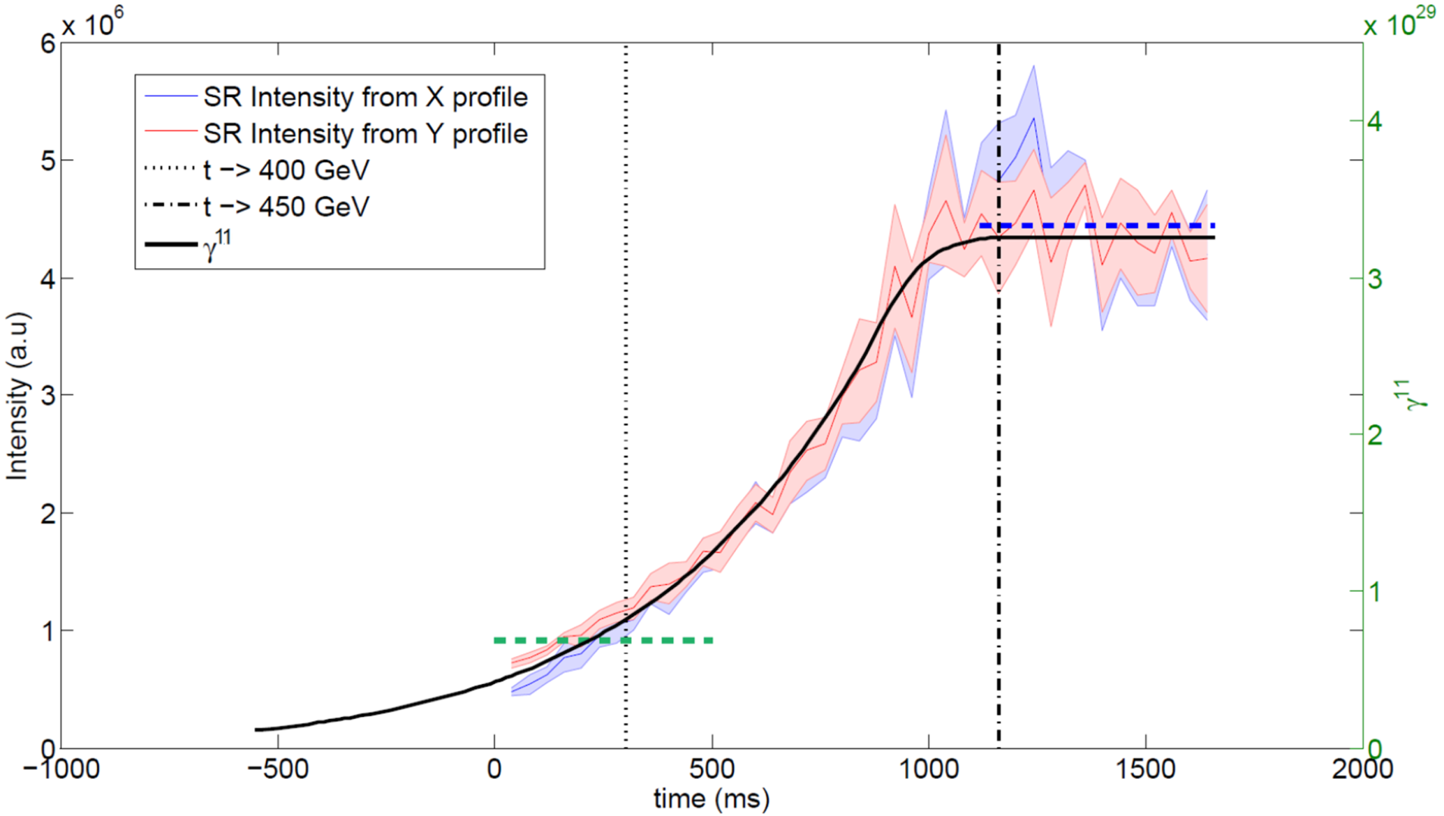
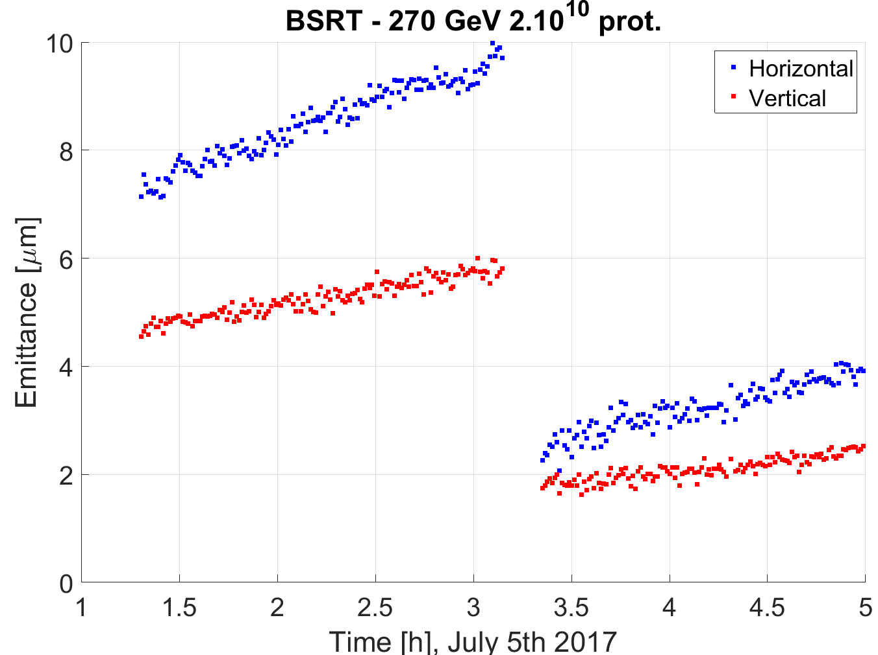
SPS BSRT
SR intensity -> γ¹¹, detectable > 270 GeV
Typical size: 700 μm (σ)
Good radiation tolerance for digital camera. Routinely used in all SPS coast at 270 GeV to monitor emittance change for dynamic studies related to crab cavity test feasibility
fps: 20 (analogue) to 300 (digital): at the limit for single bunch measurement

Slide 9
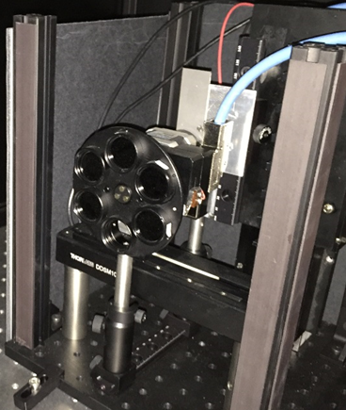
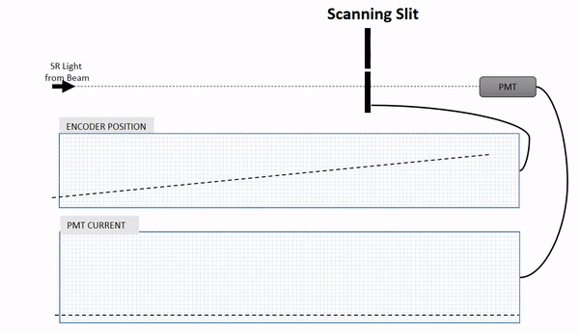
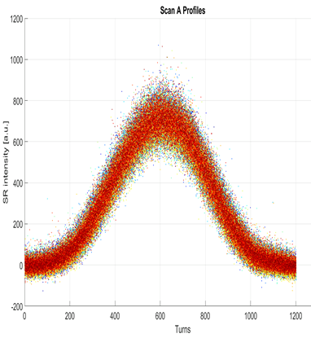
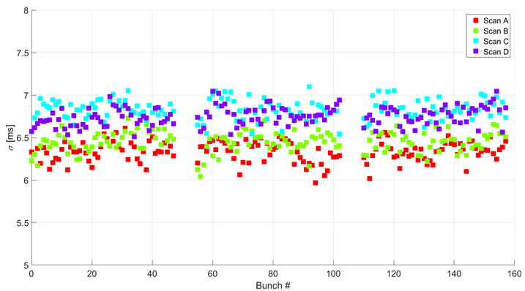
SPS slit scan
Working
Principle
PMT
500 mm/s
SR
Fast moving slits to sample SR beam image
Photons passing through the slit are detected with a photomultiplier tube
Bunch by Bunch beam size in <50 ms => 4 measurements at SPS Flat Top
Profiles
Beam size

Slide 10
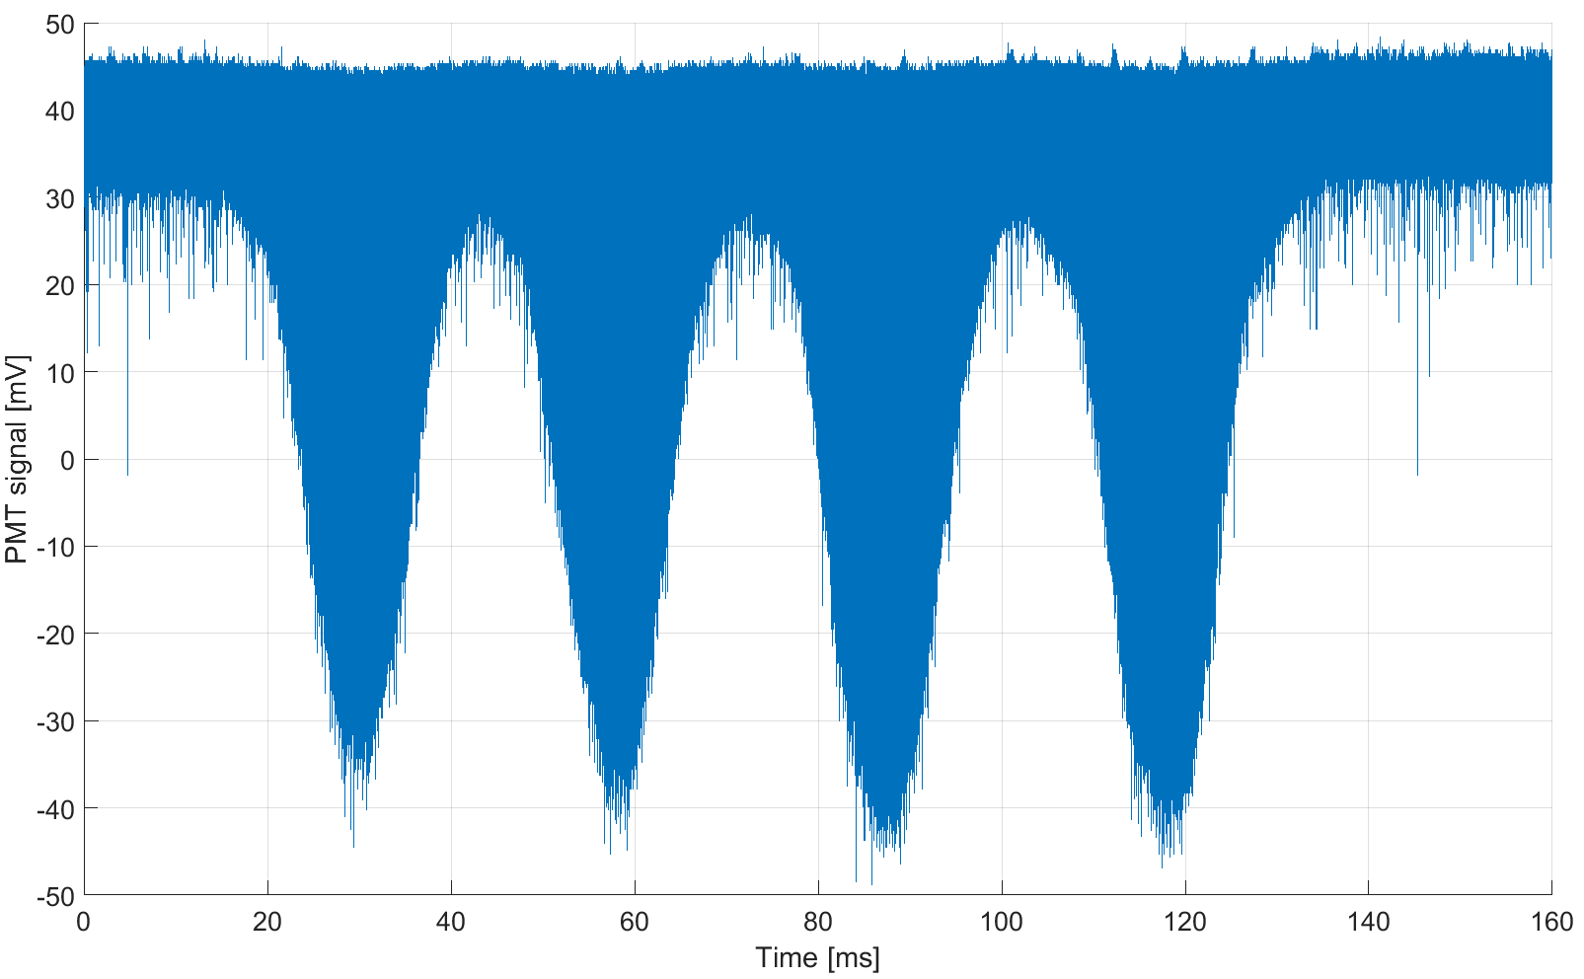
SPS slit scan

Slide 11
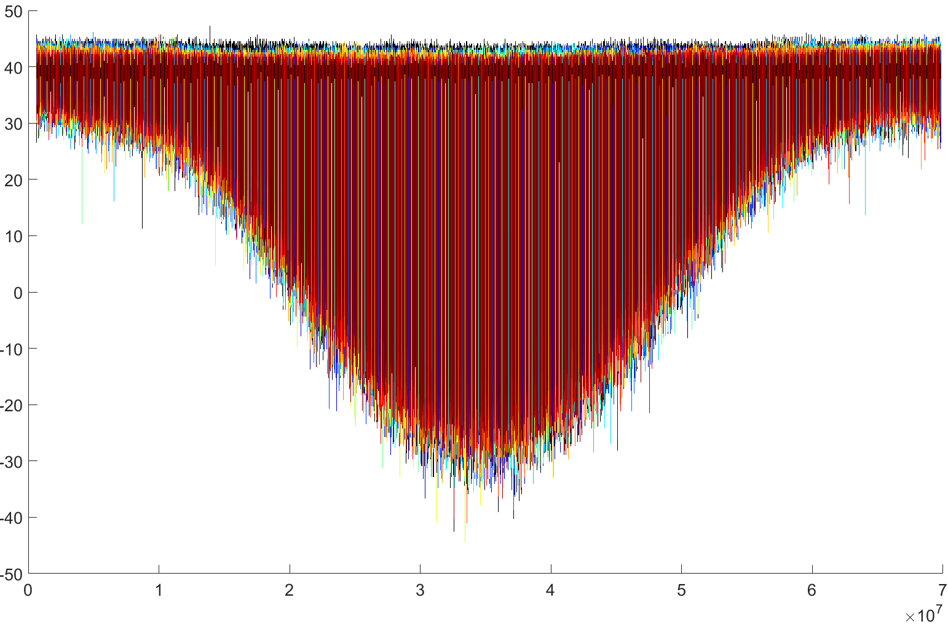
SPS slit scan
PMT Voltage [mV]
Samples

Slide 12
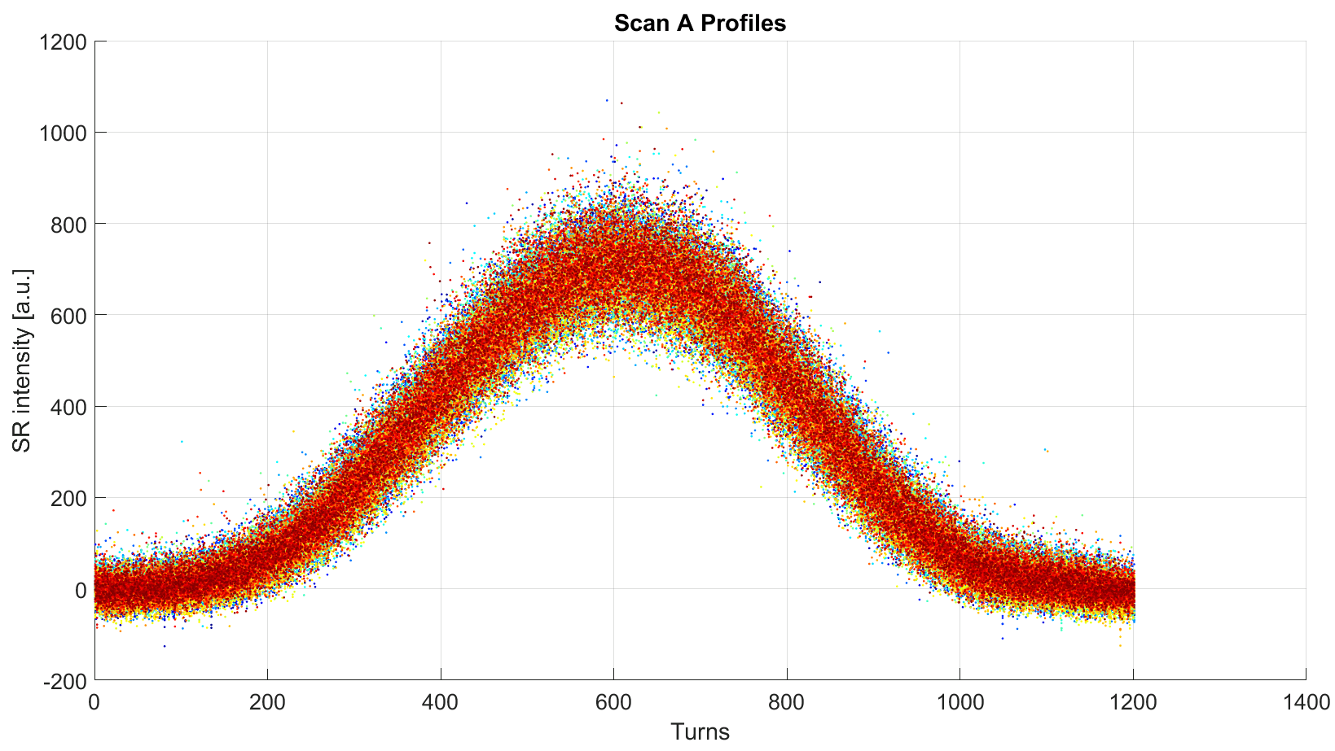
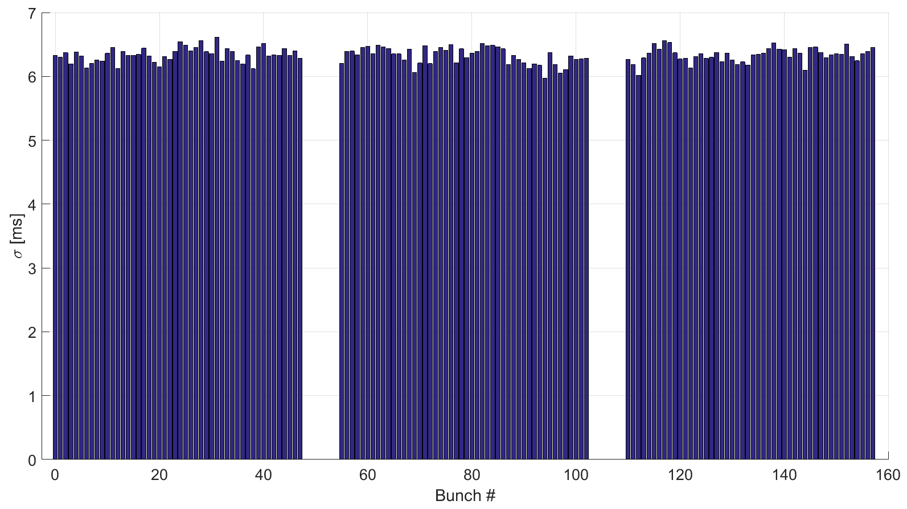
SPS slit scan
This allows BbyB profile reconstruction for emittance estimation

Slide 13
SPS summary
In 2017, while waiting for SW to exploit the BSRT for routinely beam size measurement in the SPS:
successfully tested digital cameras
successfully demonstrated slit scanner as a viable alternative
Assess whether to invest in a readout system and faster motors to make it operational.
FESA server:
1st release implementing basic functionalities just saw the light
to be heavily tested (not possible with beam, only lab).
development to be continued to reach operational level

Slide 14

The Large Hadron Collider

Slide 15
The Large Hadron Collider
LHC Beam parameters [p+]
Energy [GeV] | 450-7500
Gamma | 479-7460
Transv. Norm emittance [μm rad] | 3.75
RMS bunch length [ps] | 250
Max number of bunches | 2808
Min bunch spacing [ns] | 25
Bunch population [p+] | 1.1x10¹¹
Approx. beam size at flat top [μm] | 310-400
LHC POINT 4

Slide 16
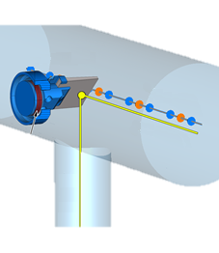

SRM in the LHC: source
In-vacuum extraction mirror
Low Energy : Undulator main Light source
Int. Energy : Undulator + D3 Edge
High Energy : D3 Edge + D3 core
Dipole
D3, Length = 9.45 m
Bend.angle = 1.58 mrad
Radius curv.= 6 km
Undulator
2 periods of 68cm
B= 5 T cte

Slide 17
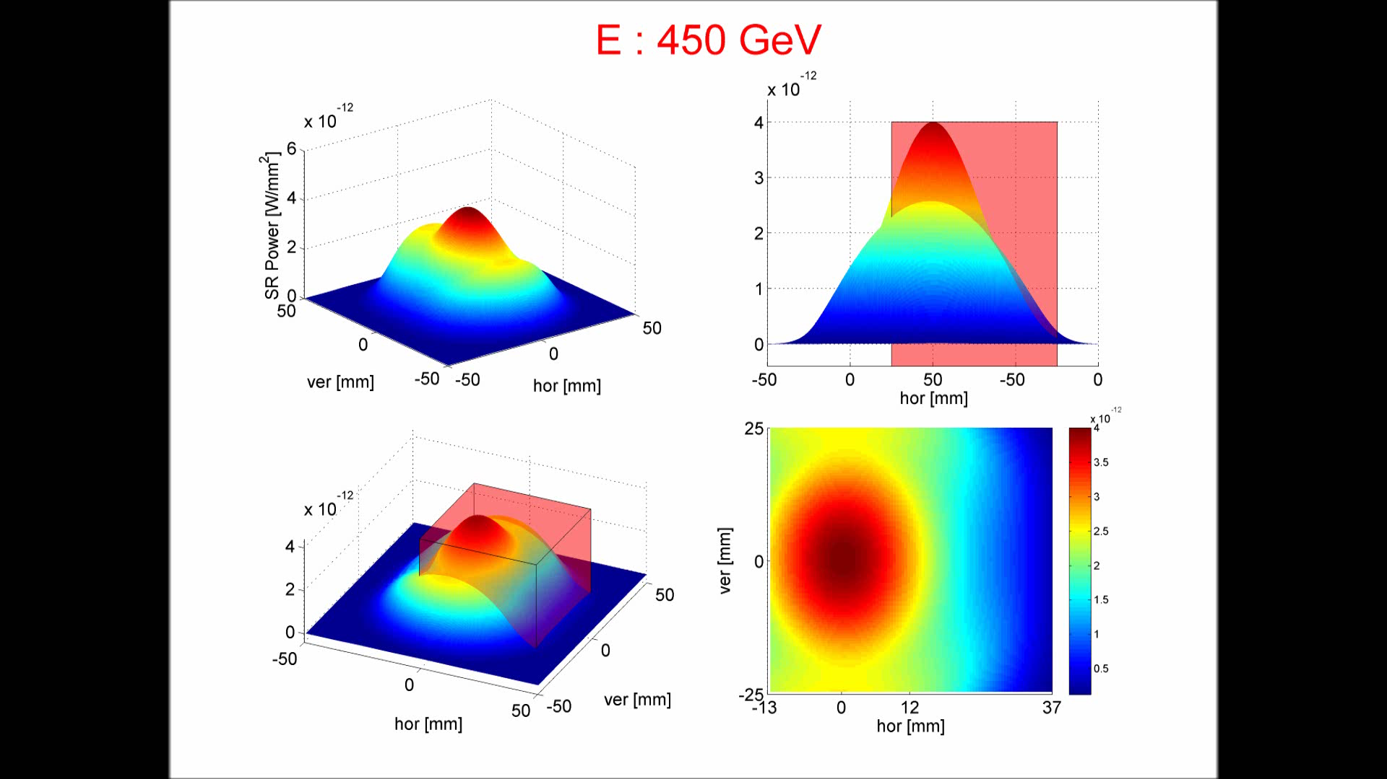
LHC SR source
PhD thesis of G. Trad
LHC SR power (in units of W/mm² per proton) at the extraction mirror, for different beam energies
E<800 GeV 1st harmonic emitted by undulator (light cone centred at (0,0))
800 GeV <E<1400 GeV external lobes from undulator radiation
1.4 TeV<E<1.7 TeV Edge light emitting at (0,0)
>1.8 TeV dominating source is the Dipole Core

Slide 18
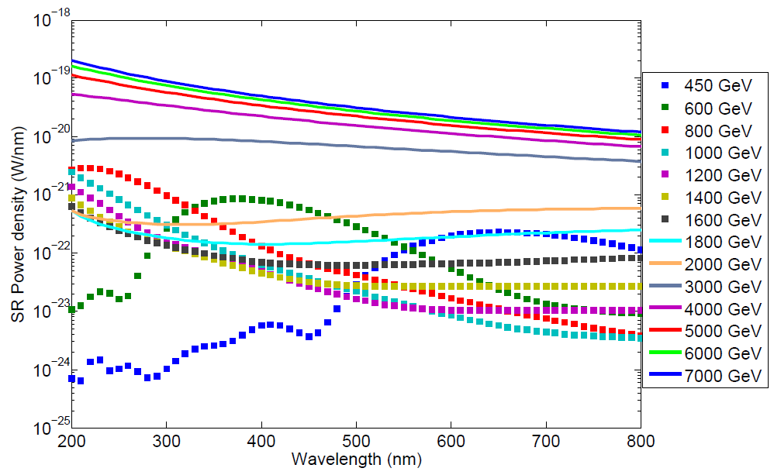
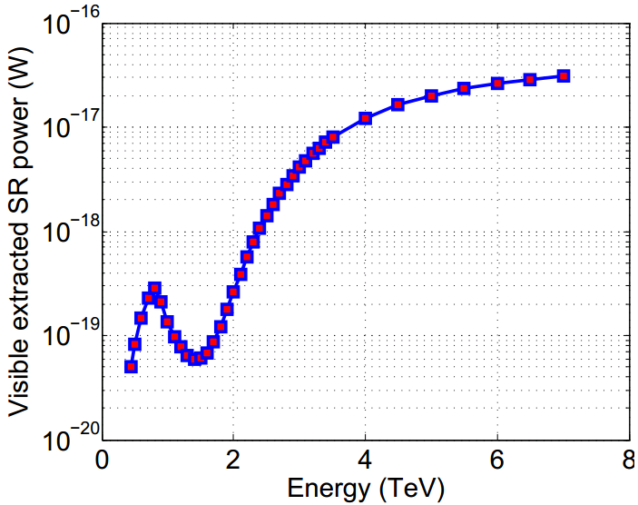
LHC SR source
SR power (visible)
Visible spectrum

Slide 19
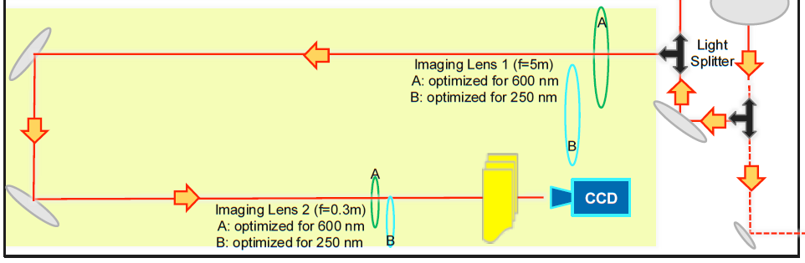
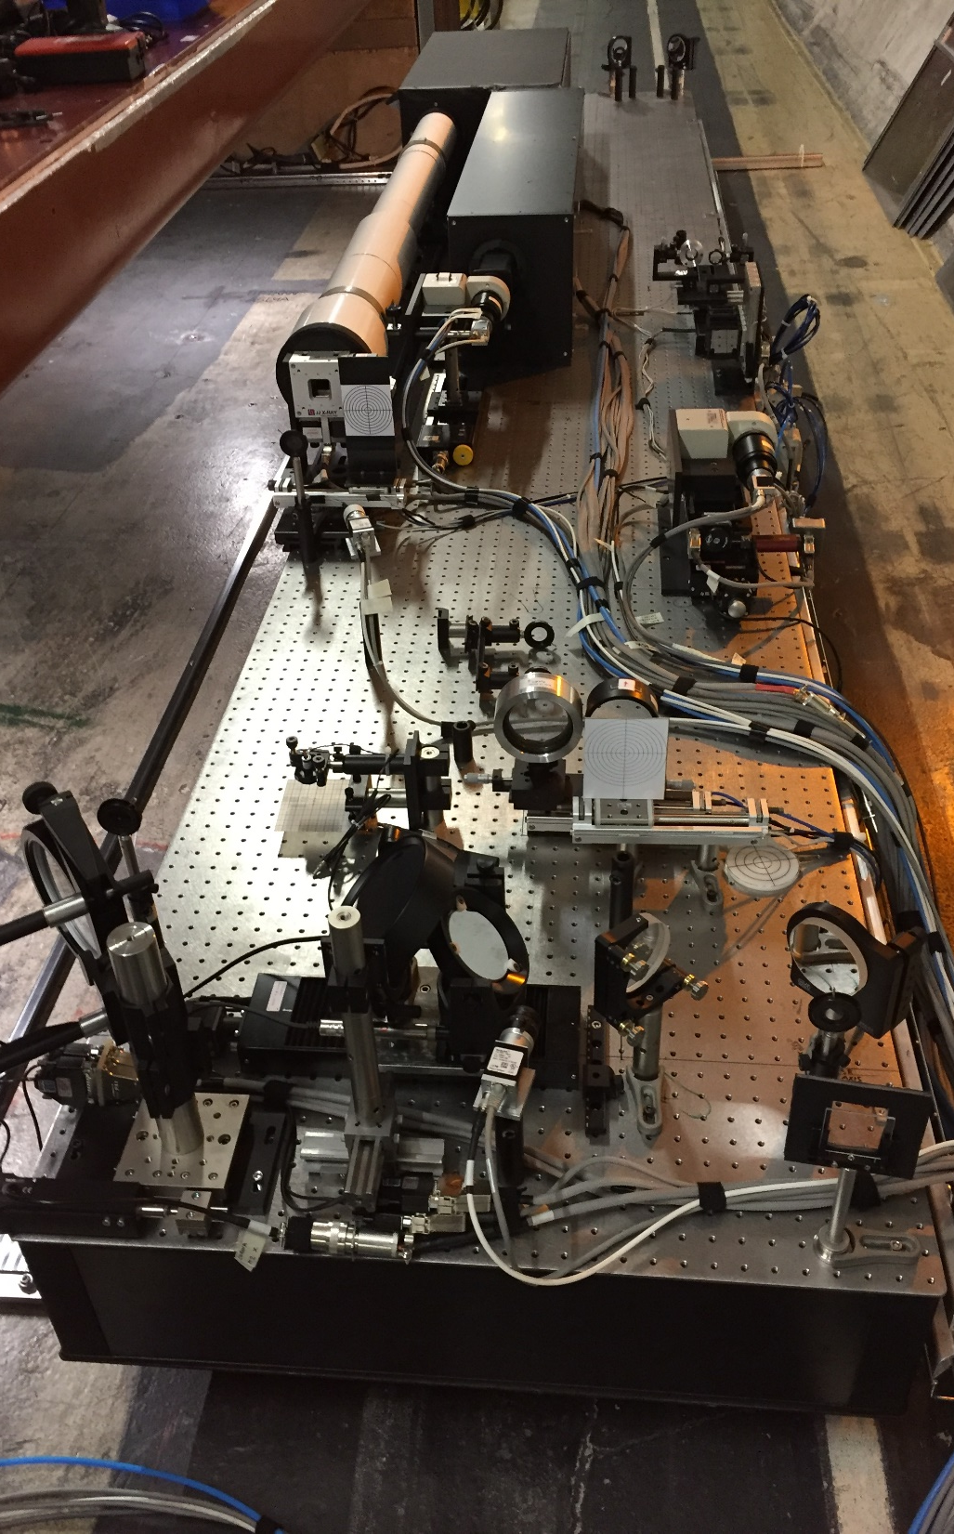
LHC BSRT: imaging
BSRT is the only instrument measuring continuously beam size bunch by bunch (not during ramp) in the LHC.
Optical line optimized for 600 nm (injection) and 250 nm (high energy)
BSRT does not provide an absolute beam size, it needs to be cross calibrated w.r.t. Wirescanners (3 in 2017)

Slide 20
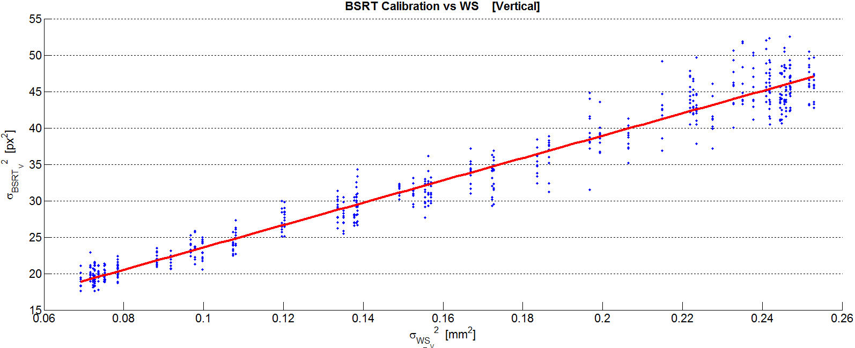
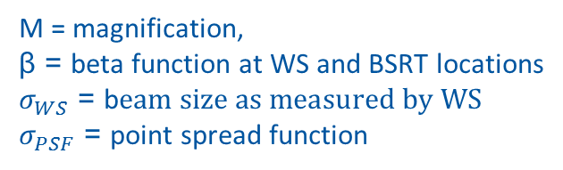
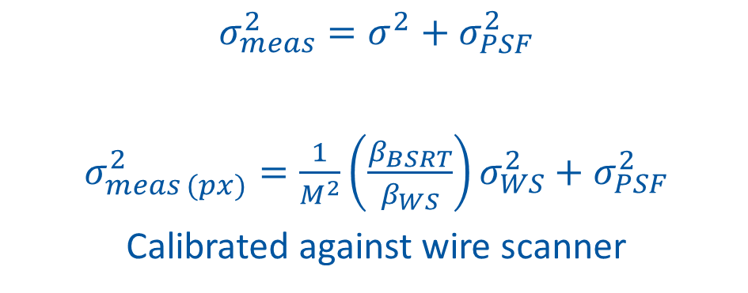
LHC BSRT calibration
$σ_{meas}^{2}=σ^{2}+σ_{PSF}^{2}$
$σ_{meas (px)}^{2}=\frac{1}{M^{2}}\left(\frac{β_{BSRT}}{β_{WS}}\right)σ_{WS}^{2}+σ_{PSF}^{2}$
Calibrated against wire scanner
M = magnification,
β = beta function at WS and BSRT locations
$σ_{WS}$ = b$eam size as measured by WS$
$σ_{PSF}$ = point spread function

Slide 21
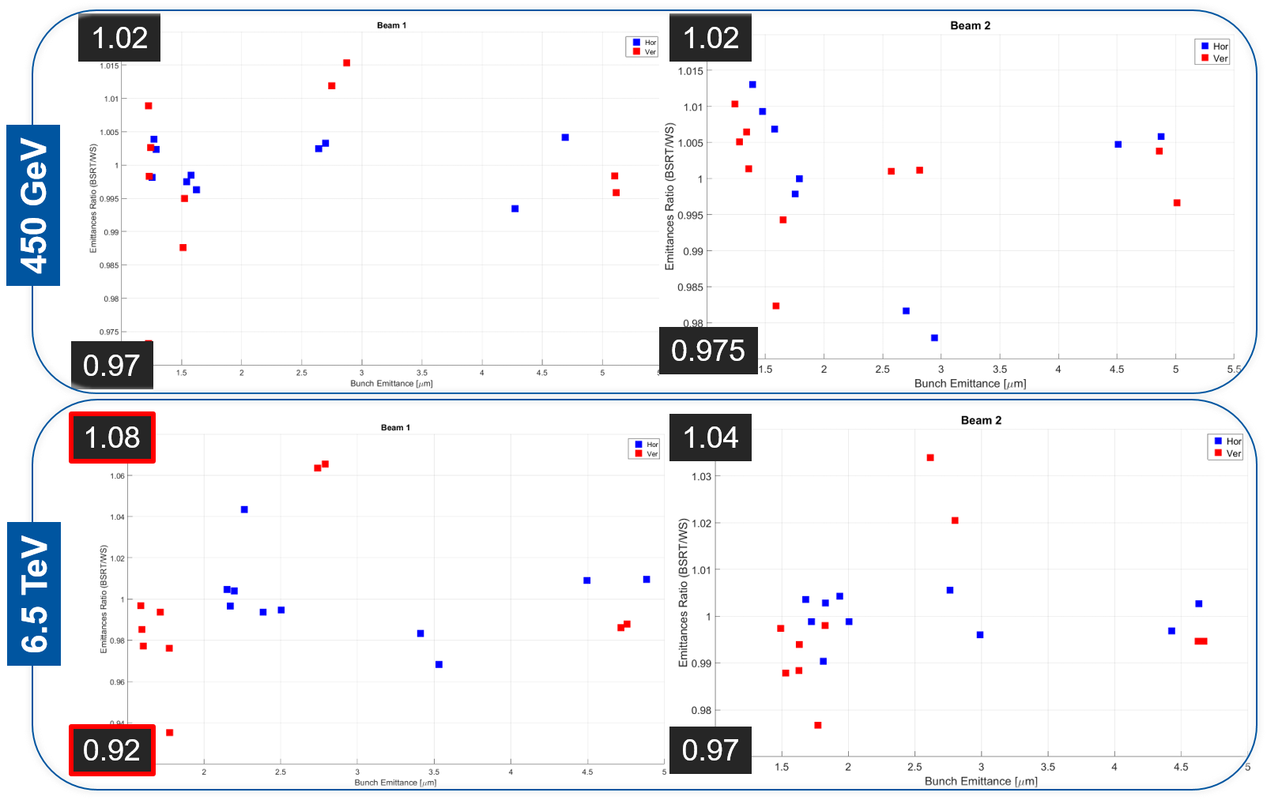
LHC BSRT calibration

Slide 22
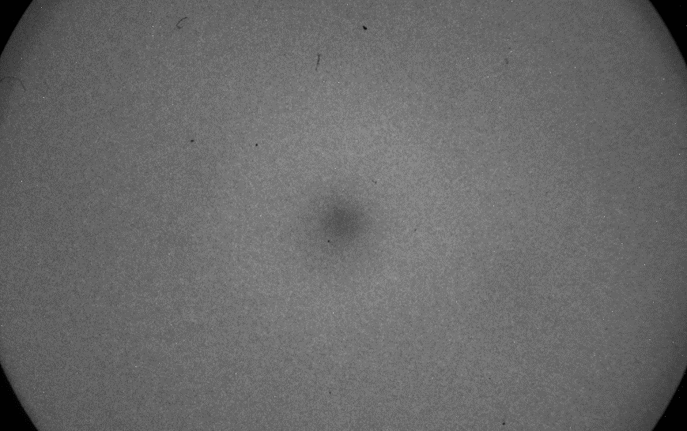
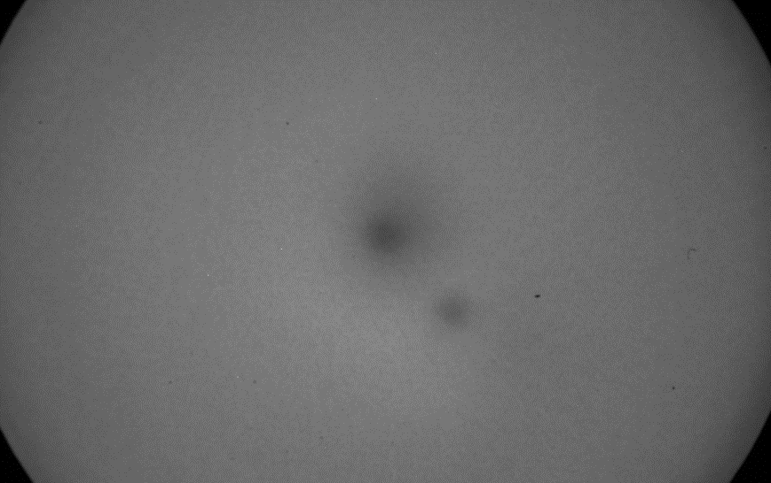
BSRT: issues
Ageing of the I.I. June
Ageing of the I.I. September
Clear effect of ageing:
Reduction of sensor sensitivity, deforming the sensor response.
Mitigation
Working point optimized to increase I.I. lifetime (attenuate SR input and MCP gain at the cost of SNR)
Change of working point
SW compensation of the non uniformity
Ongoing investigations with Hamamatsu to identify source (photocathode or MCP)

Slide 23
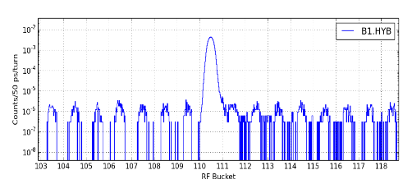
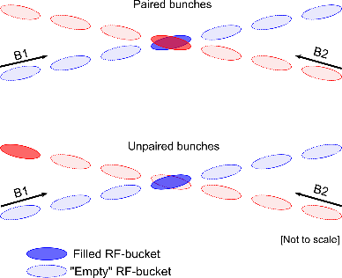
LHC Intensity and longitudinal profiles
Filled
DCCT: Total number of particles in the ring
FBCT: Number of particles per nominal bunch
BSRL: Measure the longitudinal distribution of particles in the LHC with a sufficiently high dynamic range to quantify the relative population in nominally empty buckets.
Luminosity calibration
Injection quality
Origin of background signal at IPs
Requirements: A dynamic range of 5 orders of magnitude, and a time resolution of 100 ps
Ghosts
Satellites
Satellites
Ghosts

Slide 24
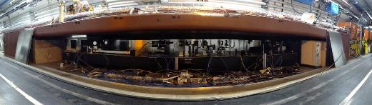
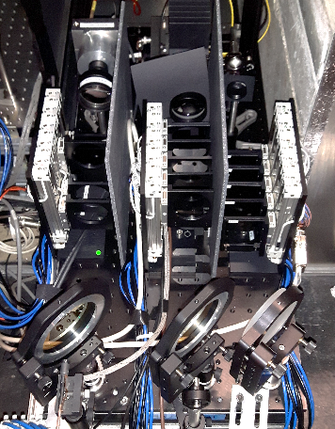
LDM layout
Synchrotron light
BSRA
Abort gap
monitor
BSRL
System A
System B
Fibre
Hybrid
Collimator
Lens
BP-filter
BSRL+BSRA
BSRT
Filters
Filters

Slide 25
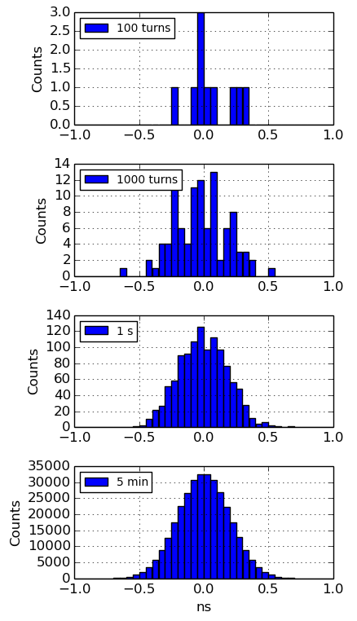
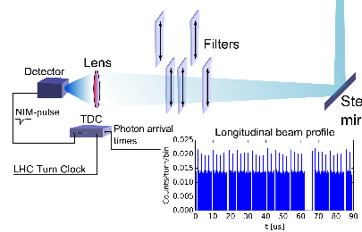
LHC LDM principle
Time-correlated single photon counting
Resolution: 50 ps
1.780.000 bins per histogram
5 minutes integration time for 10⁵ dynamic range

Slide 26
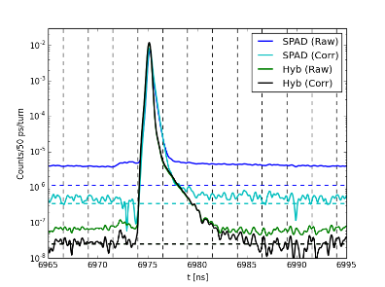
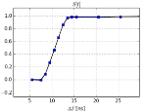
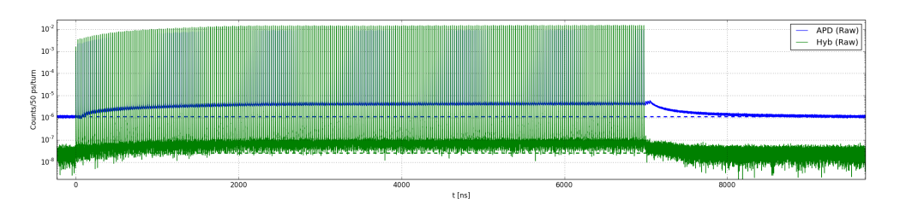
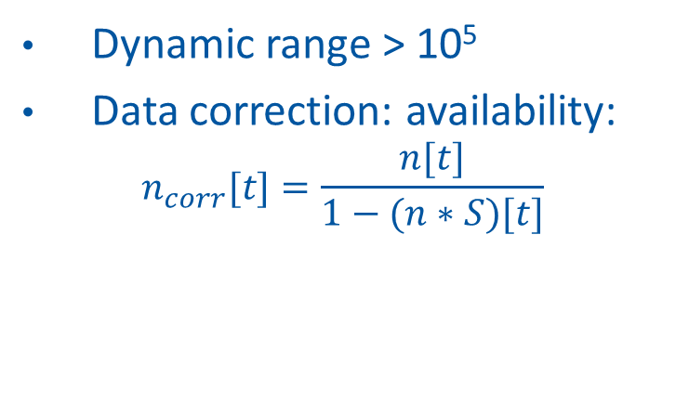
LHC LDM detector and data treatment
Last pulse: raw and corrected data
Dynamic range > 10⁵
Data correction: availability:
$$n_{corr}[t]=\frac{n[t]}{1−(n∗S)[t]}$$
2.5 ns
Lab test: LHC-like pulse train (pulsed sub-ns laser)
Raw data
>10⁵
SPAD
x100
Hybrid
Signal level at end of “abort gap”

Slide 27
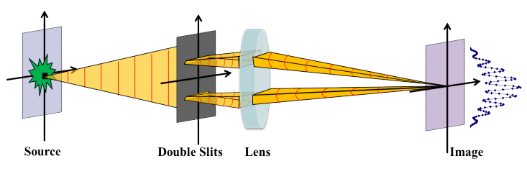
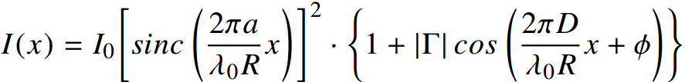
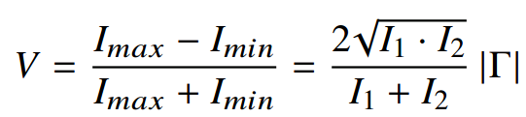
R&D instruments: BSRI
I₁
D
I₂
R
The spatial coherence of the SR is probed by measuring the fringe visibility and calculating the first order degree of mutual spatial coherence Γ at the slits plane
Fringe Visibility:

Slide 28
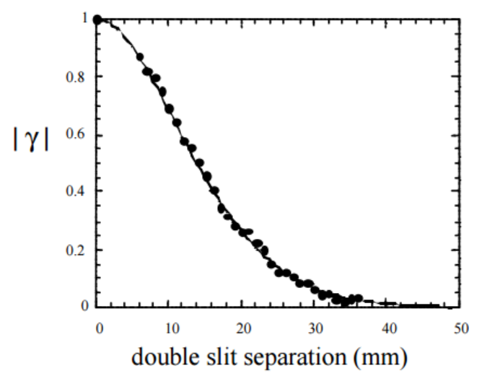
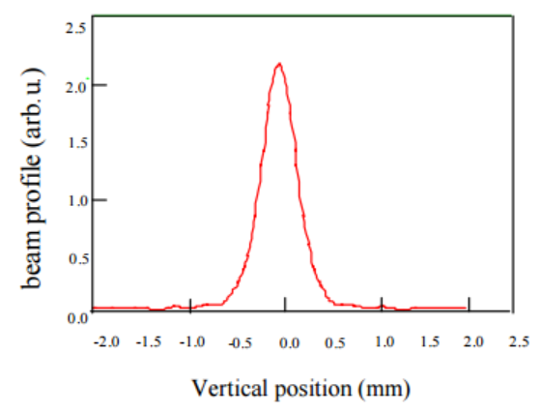
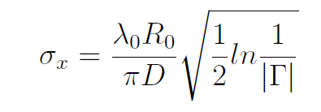
BSRI principle
SR Interferometry
The beam size is derived based on the Van Cittert-Zernike theorem, where the degree of coherence Γ is the Fourier transform of the intensity distribution of the source
Inverse Fourier Transformation,
Obtain beam profile
Slit Separation Scanning Mode
f(x) is obtained by applying an inverse Fourier transf. of the resulting curve Γ(D)
Fixed Slit Separation
(Hyp. Gaussian)

Slide 29
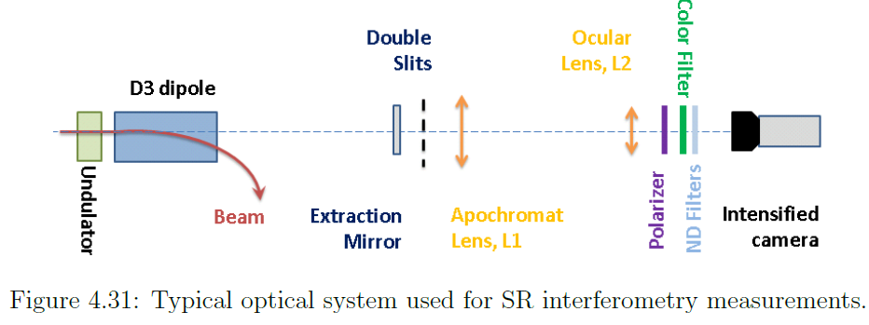
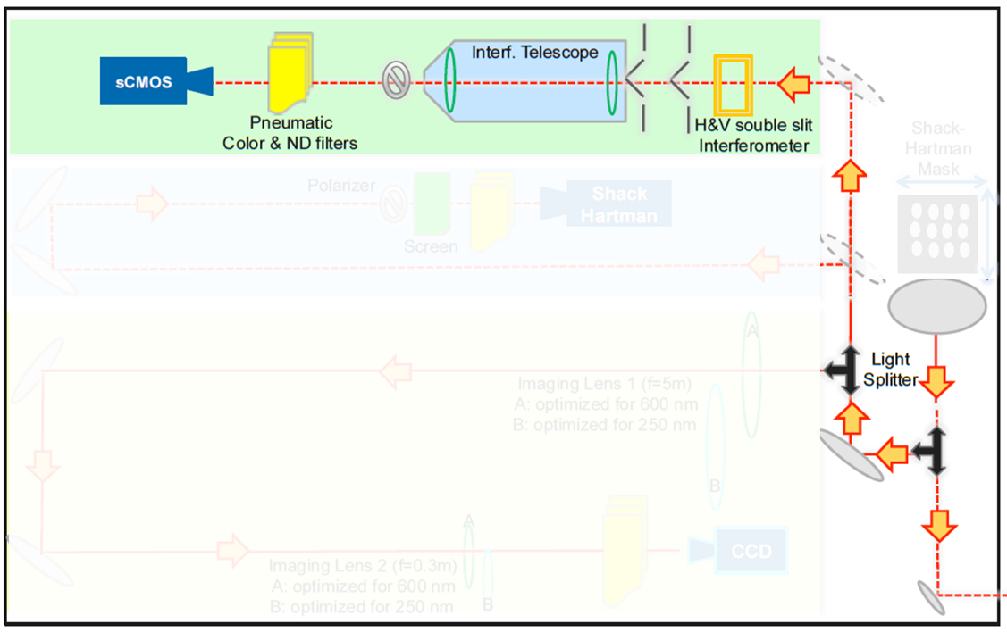
BSRI layout
Linear
Polarizer
Intensified
sCMOS
ND & bandpass
Filters
Eyepiece
f~30mm
Focusing
Lens
f~800mm
Slits
Assembly
D3
Beam
Undulator
sCMOS sensor
Optical coupling to Image Intensifier
HQ Linear Polarizer (polymer polarizing film between two high-precision glass substrates with flatness better than λ/6) motorized rotational stage allowing IN/OUT movement.
Motorised Apochromat Lens and eyepiece
Slit width and distance can be adjusted

Slide 30
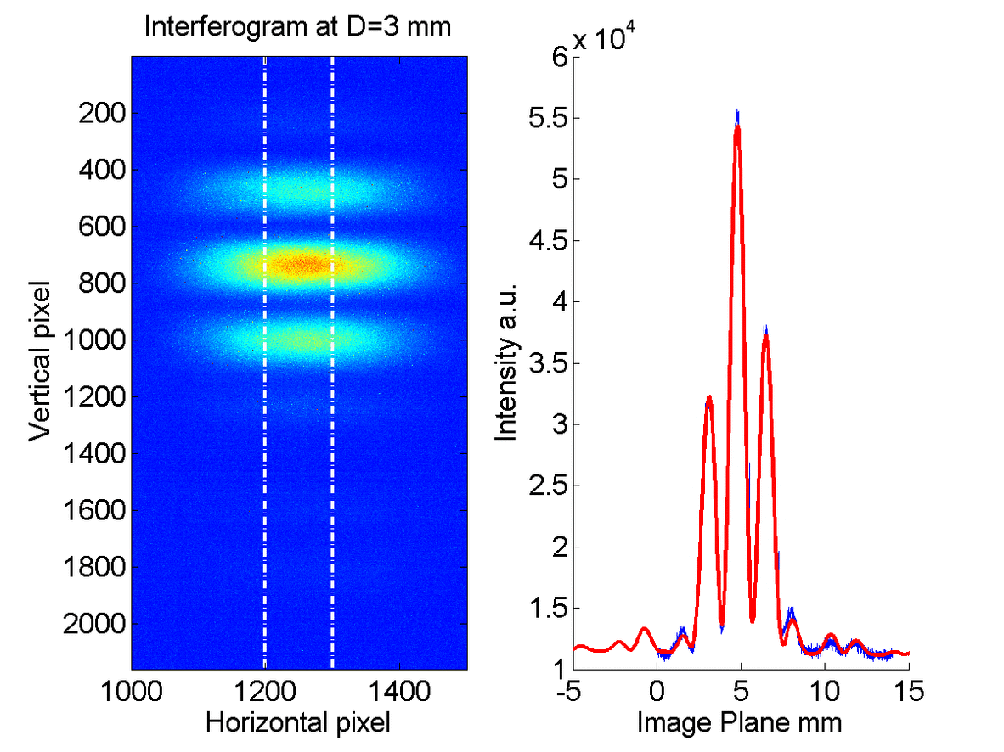
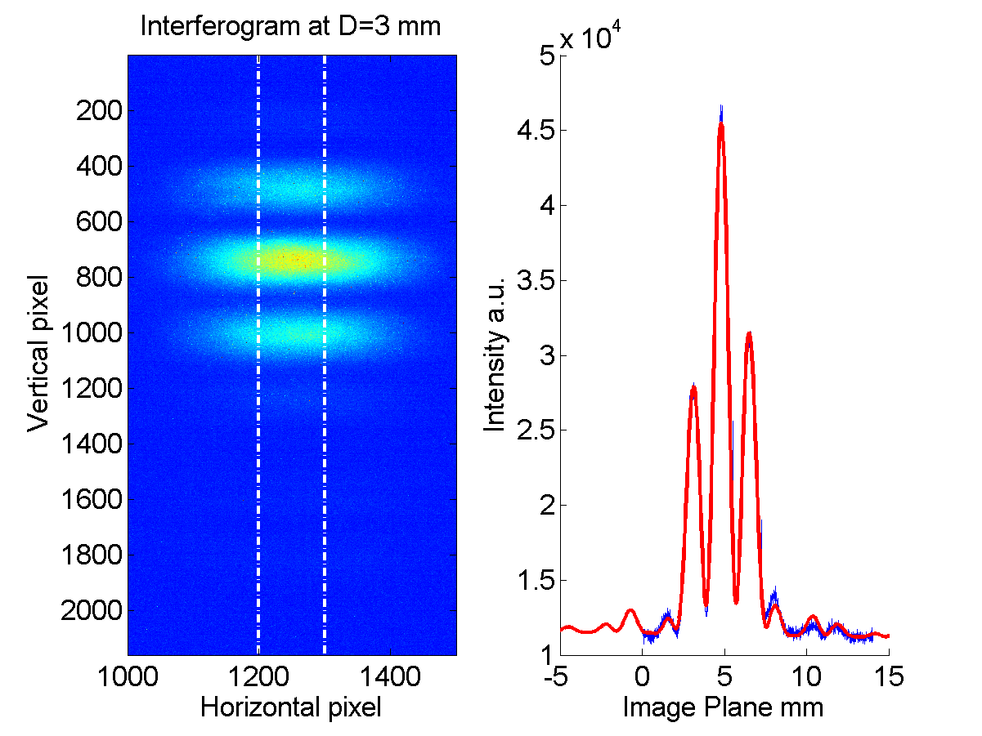
BSRI example
Slit scan from 3 to 21 mm. Bunch 0 (left), bunch 1785 (right). Emittance blow-up on bunch 1785
Bunch 0
Bunch 1785

Slide 31
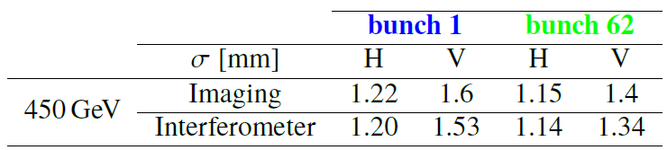

BSRI comparison w imaging
At Injection Energy
Good agreement with Imaging
Discrepancies with the imaging values are ~5%
At Flat Top Energy
Beam size from the interferometer larger by a factor of ~1,3.
However, relative bunch by bunch size measured via interferometry is compatible with Imaging.

Slide 32
Conclusion
SR monitors present in SPS and LHC
Various experimental challenges: radiation, energy ramp, distance from the source
LHC & SPS BSRS and BSRT routinely used for bunch by bunch emittance measurement
Commissioning of LHC BSRI ongoing. High energy discrepancy w ws and imaging under investigation.

Slide 34



