Slide 1
Volker Schlott for Michael Böge, Paul Scherrer Institut
Requirements from the LS BD Community for the Emittance Measurements Scientists
Topical WS on Emittance Measurements for LS, Monday Jan 29th 2018
Topical W

Slide 2
Longitudinal Emittance
Transverse & longitudinal emittances are
important indicators for the achieved performance
of a Synchrotron Radiation Light Source !
Longitudinal Emittance (short excursion – not so important for SRLS)
  … is determined by the RF system and the applied effective voltage
  … can be tuned by using n-th harmonic RF systems
    → lengthening of bunches to increase the Touschek lifetime
    → shortening of bunches at the expense of lifetime
    (can become more important for time resolved experiments)
  … emittance measurements (e.g. using streak cameras)
    → allow the fine tuning of the n-th harmonic system (powered or passive)
    → provide a judgement on the performance of the RF system
    (additional to lifetime measurements)
Page 2
Notes:
2

Slide 3
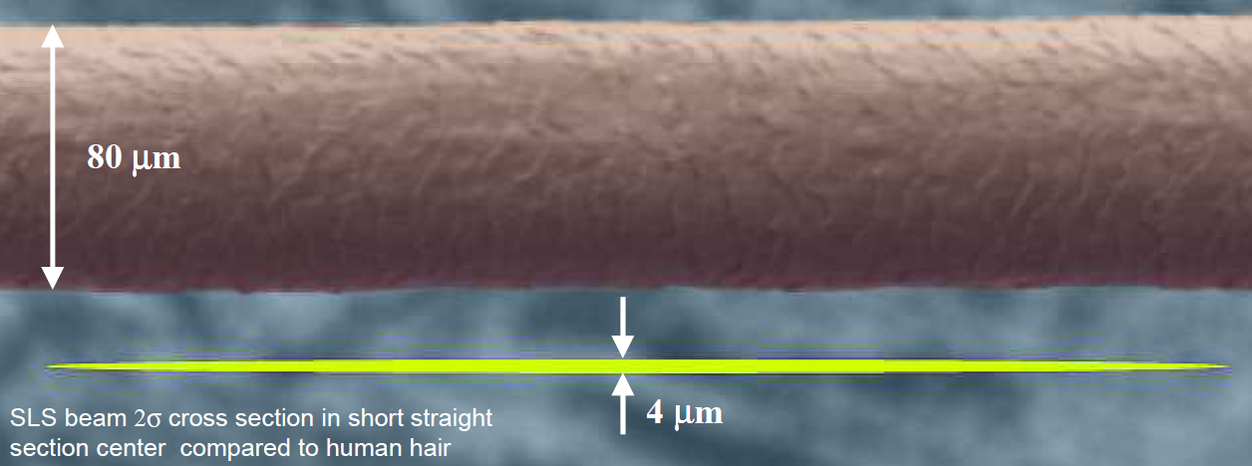
Horizontal Emittance
Horizontal Emittance
  … is mainly determined by the ideal optics and the operated insertion devices in a SRLS
  → for 3rd generation SRLS horizontal ε is rather large: nmrad
  → DL-SRLS (generation 3+) have comparable horizontal and vertical emittances
  … the measurement allows to judge whether the design goals have been achieved
  → for DL-SRLS it will require high resolution beam size monitors in both planes
  → for longitudinal gradient bends (SLS-2 LGBs) a horizontal position measurement
  in the LBG center may also be important
SLS beam
SLS -2 beam
Page 3
Notes:
3

Slide 4
Vertical Emittance
Vertical Emittance
  … is strongly depending on the alignment tolerances of a LS
  … without quantum effects, the vertical emittance could be zero in an ideal storage ring
Coupling Control as primary goal for a SRLS to minimize vertical emittance…
  … requires excellent alignment of all magnetic components and girders
  → element to element alignment tolerances < 30 μm (2σ) are achievable
  → girder to girder alignment tolerances < 50 μm (2σ) are achievable
  → monitoring of girder positions (ground motions) with HLS & HPS
  → remote alignment (even) with stored beam to minimize corrector strength
  … requires knowledge about BPM roll errors (often caused by electronics)
  → avoid fake vertical dispersion measurements
  … requires correction techniques to reduce betatron coupling and spurious vertical dispersion
  → model-based corrections of measured coupled orbit response matrices
  and measured coupling terms
  → skew quadrupoles are used as correctors
Page 4
Notes:
4

Slide 5
Requirements on Emittance Measurements I
Reliable and High Resolution Emittance Measurements…
  … are required to judge continuously the success of the optimization process
  → systematic (model-based) correction schemes are limited by
  deficiencies of the LOCO (linear optics from closed orbits) machine model
  and the BPM resolution
  → empirical tuning (e.g. random walk) of skew quadrupoles rely on
emittance measurements without a machine model
  … would ideally be required at different locations in the storage ring
  → resolution is depending on optical functions at the monitor location
  → for modern LS with few pmrad vertical emittance and small beta functions < 10 m
  beam sizes of a few μm (smaller beam size changes) need to be resolved
Operational Aspects…:
  → beam lifetime is increased to the desired value (on user demand) by introducing
  a “customized” vertical dispersion (zero dispersion in the straights)
  → emittance monitor allows such emittance control and potential emittance feedback
Page 5
Notes:
5

Slide 6
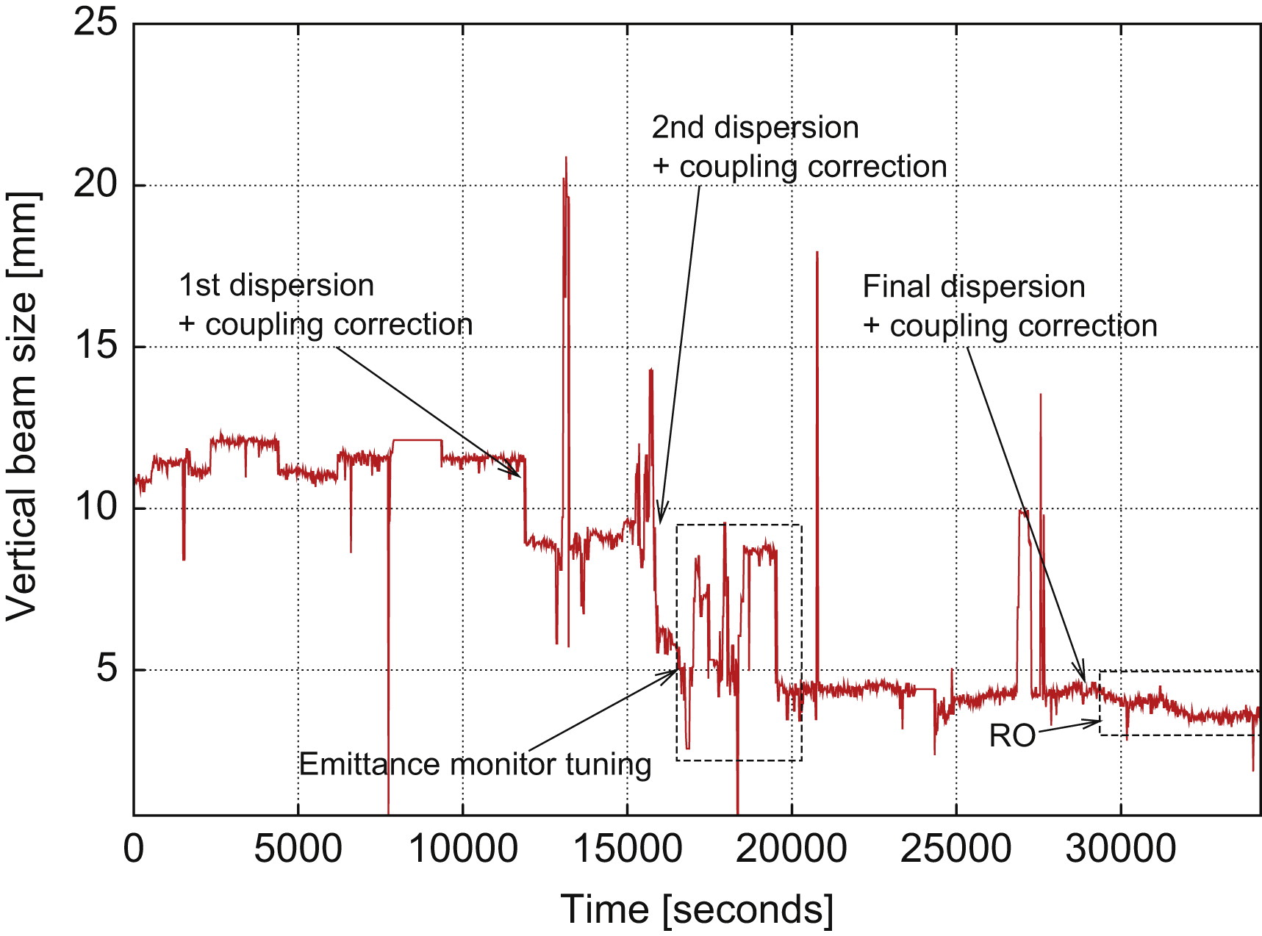
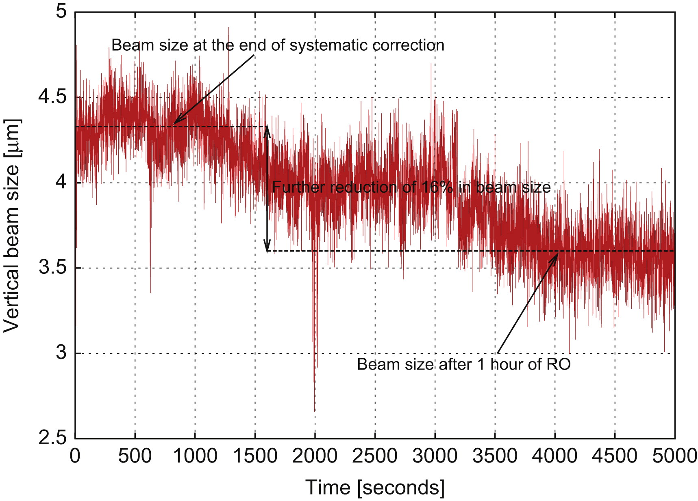
Example of Emittance Optimization
Example: SLS Vertical Emittance Optimization
Iterative Minimization Procedure
→ BPM roll error corrections
→ beam-based girder alignment
→ dispersion & coupling corrections
→ beam size monitor tuning
→ random walk optimization
M. Aiba, et al., Ultra Low Vertical Emittance at SLS Through
Systematic and Random Optimization, NIM-A 694 (2012) 133-139

Slide 7
Requirements on Emittance Measurements II
Reliable and High Resolution Emittance Measurements…
  … should ideally provide horizontal and vertical emittances simultaneously
  → allows determination of local coupling
  which can be measured by fitting the major / minor axes to the beam ellipse
  … should ideally be very sensitive (but also with high dynamic range)
  → for determination of emittances at low or single bunch currents
  during LS start-up or at early stage of commissioning
  … should ideally allow time resolved emittance measurements
  → on specifically manipulated pilot bunches without disturbing the
  main bunch train during user operation
  → on isolated cam-shaft bunches used for time resolved experiments
  … should ideally provide measurement bandwidth of several hundred Hz to kHz
  → to fight fast emittance transients due caused by ID movements or
  deliberate fast orbit manipulations (e.g. large local bumps for polarization switching)
  → to allow brilliance (beam size) feedbacks rather than “only” keeping lifetime constant
Page 7
Notes:
7

Slide 8
Requirements on Emittance Measurements III
Reliable and High Resolution Emittance Measurements…
  … should ideally be fully integrated with a fast orbit feedback
  → control the same set of skew quadrupoles for local coupling control,
  avoiding undesired crosstalk of independent FBs working on the same actuators
  … need to be as reliable as BPMs in a common feedback loop
  → poses quite strict requirements on complexity of monitor designs and
  and constraints on the stability of beam size measurement algorithms
  → requires exception handling procedures as for BPM based orbit feedbacks
  … should have low complexity and cost: the more beam size monitors, the better!
  → emittance is a global ring property measured at only some selected locations
  → ideally use many emittance monitors like BPMs (beam centroid) in the response
  matrix measurements, which eases the determination of local optics parameters
… so don’t forget about “cheap emittance monitors”, which may not provide
the ultimate resolution but quite valuable information for DL-LS operation
Page 8
Notes:
8

Slide 9
Summary
High resolution fast emittance monitors will have to become reliable working horses in a LS. They will be used in fast feedback loops in order to auto-tune the emittance (the 2nd order orbit correction). Control of complex RF bucket manipulations for bunch lengthening or on-axis injection schemes necessitates
excellent longitudinal emittance measurements as well.
Thank You :-)
Page 9
Notes:
9

