Slide 2
Beam Size Monitoring at the ESRF:
Comparison of different X-ray based techniques
Friederike EWALD
Topical Workshop on Emittance Measurements for Light Sources and FELs
29th – 30th January 2018, Barcelona (ALBA)

Slide 3

Contents
Current status of X-ray based beam size monitoring
Simple projection of X-rays
Pinhole Camera (imaging)
X-ray Lenses (imaging)
Prospects and challenges for ESRF-EBS
EBS beam parameters/implementation of DIAG X-ray beam ports
Evaluation of beam size monitoring techniques for ESRF-EBS

Slide 4
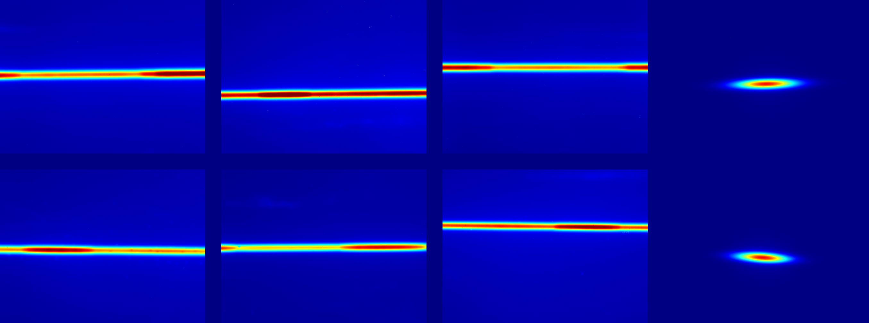
Existing Emittance Monitors at the ESRF
X-ray sources = Bending magnet radiation
X-ray imaging
D11
Pinhole, Lens
18
19
20
21
22
17
23
16
24
D9
15
25
14
26
13
12 X-ray Projection Monitors
3 Pinhole Cameras
X-ray Lens (XRL, removed)
27
X-ray projection
12
28
11
29
10
30
31
ID25
9
8
32
7
1
6
3
2
5
4
(ID30 – Undulator radiation)

Slide 5
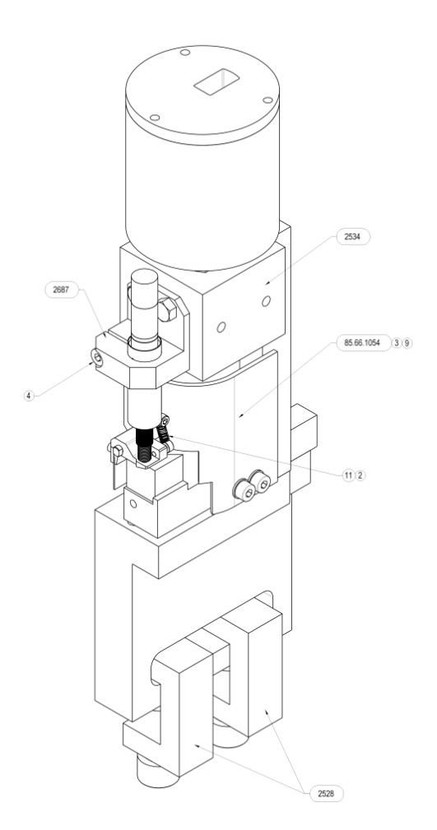
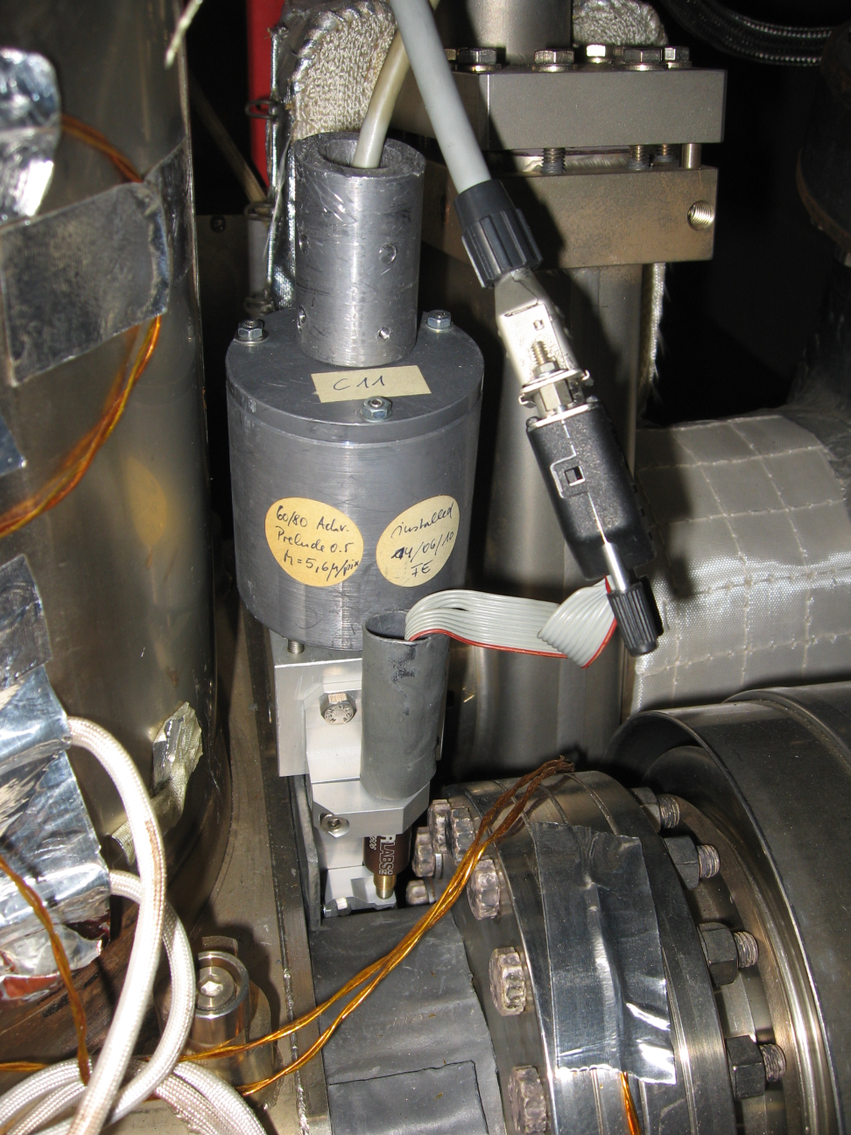
Dipole radiation X-ray Projection Monitors
Simple measurement of the X-ray beam projected from the source point in a bending magnet onto a scintillator screen
E_{PEAK} ~ 160 keV
σ ‘ _{SYNC RAD} = 17.5 μrad
Firewire control
Cu-absorber
(35 mm)
X-rays
CCD & lenses in Pb shielding
Detector
Dipole
Actuator for scintillator (focusing)
Electrons
Scintillator
Scintillator: Lu_{1.8Y.2SiO5:Ce} (“PreLude”) 500 μm
Focusing via motorised scintillator screen
Double Achromat
CCD: Flea (Point Grey Research)
Pb - shielding

Slide 6
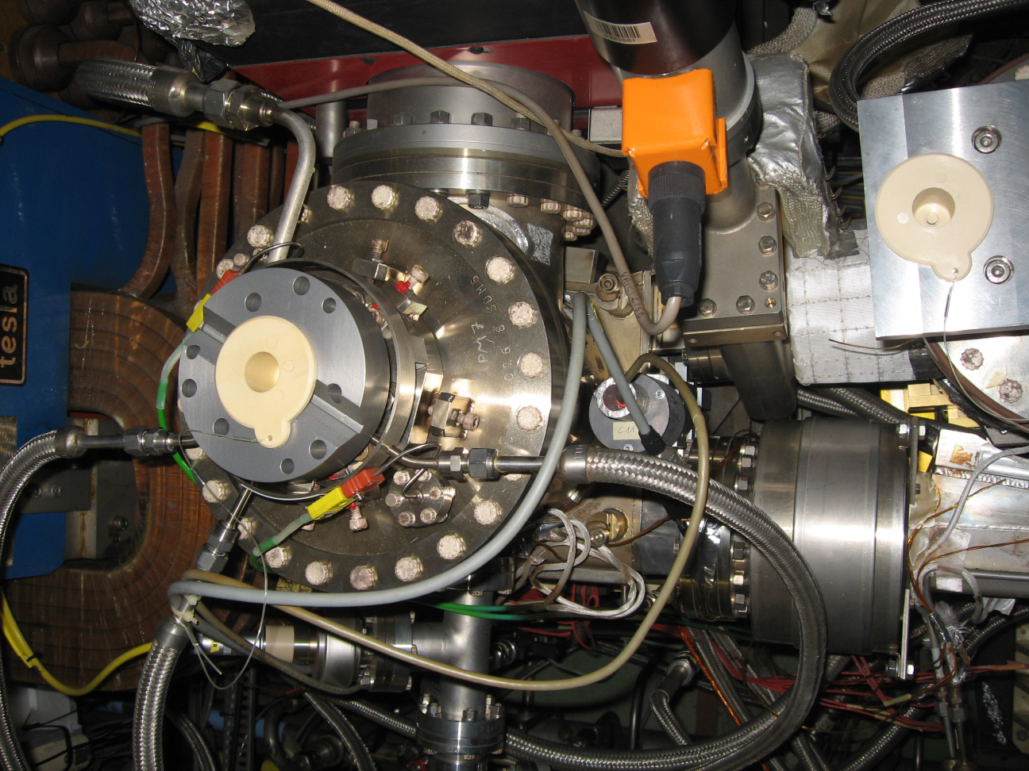
X-ray projection monitors – View from the top
Crotch absorber vessel
Vacuum pipe
X-rays
Bending Magnet
Detector
Vacuum pipe Electrons

Slide 7
X-ray projection monitors – Synchrotron Radiation vs. Electron Beam Size
Total beam size on screen: Σ ²_{tot} = εβ − 2εα D + εγ D² + σ’²_{ph} D²)
electron beam size and divergence
divergence of synchrotron radiation
Synchrotron radiation

Slide 8
X-ray projection monitors – Comparison of data and model
<ε_{z}>_{meas} = (20 ± 3) pm
< ε_{z} >_{mod} = (20 ± 3) pm
<ε_{z}>_{meas} = (3 ± 1) pm
< ε_{z} >_{mod} = (2 ± 0.3) pm
Detector Name (cell)
Alignment critical at low emittance
Deconvolution obligatory

Slide 9
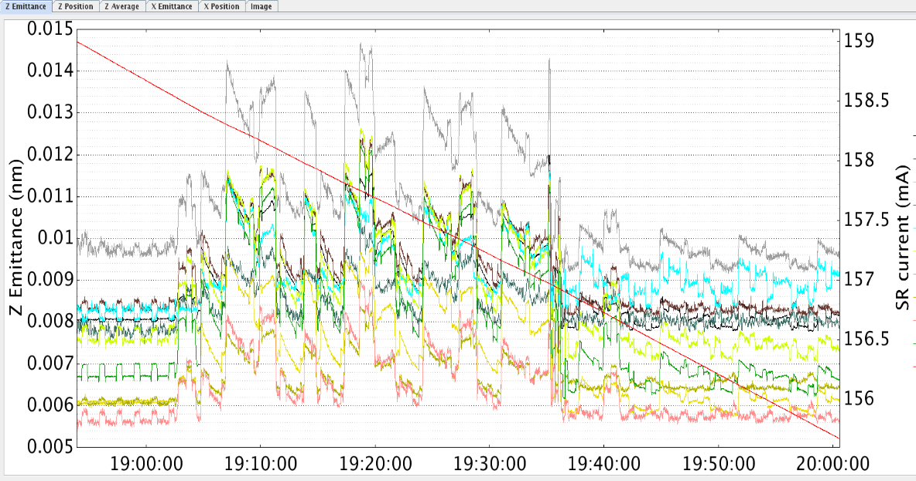
Monitoring of 14 vertical emittance values during USM

Slide 10
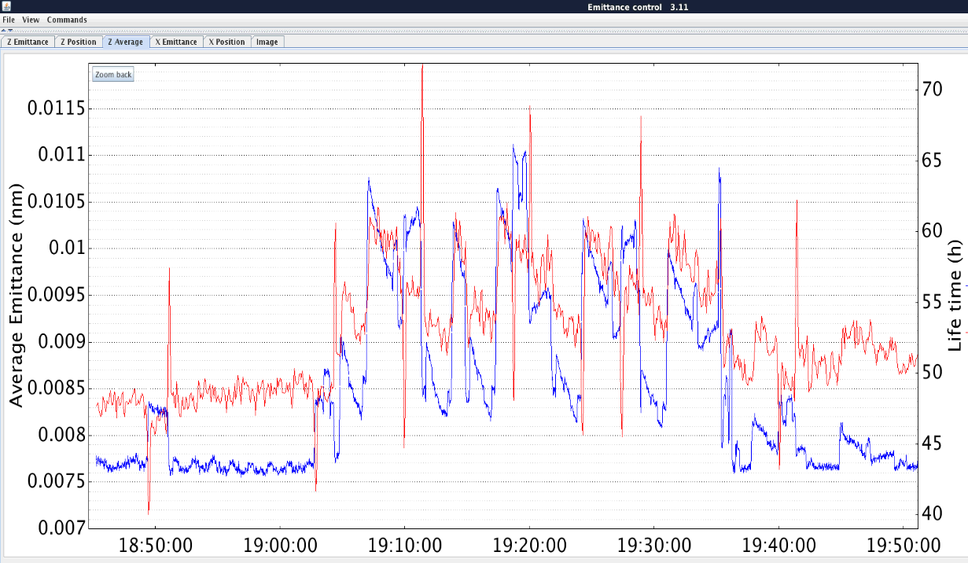
Average vertical emittance monitoring
Average <ε_{z}> very sensitive to small emittance changes (Δε ≈ 0.2 pm !)
Average ε_{z}
Lifetime (Libera)
0.5 pm
Average vertical emittance serves for manual or automatic correction of the machine during operation.
Time

Slide 11
Contents
Current status of X-ray based beam size monitoring
Simple projection of X-rays
Pinhole Camera (imaging)
X-ray Lenses (imaging)
Prospects and challenges for ESRF-EBS
EBS beam parameters/implementation of DIAG X-ray beam ports
Evaluation of beam size monitoring techniques for ESRF-EBS

Slide 12
X-ray pinhole = Image formation through a small aperture
Vacuum
Air
Beam profile on screen
Electron beam
profile
3 mm Al (watercooled)
Σ = M · σ
σ
Mirror
Dipole
Pinhole
V = 10um
H = 50um
e-beam
Fluorescent screen
Lens
d
D > d
CCD
Pinhole magnification M = D / d

Slide 13
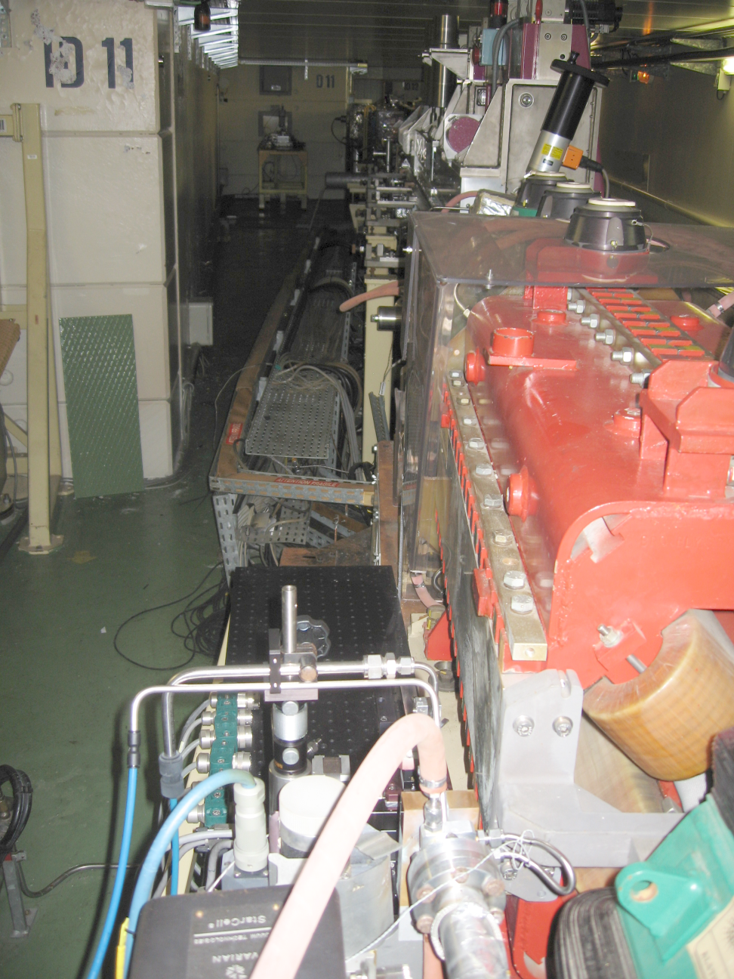
Scintillator & CCD camera ~16 m downstream of pinhole
X-ray path in air
Pinhole
~ 4 m from source
Al window

Slide 14
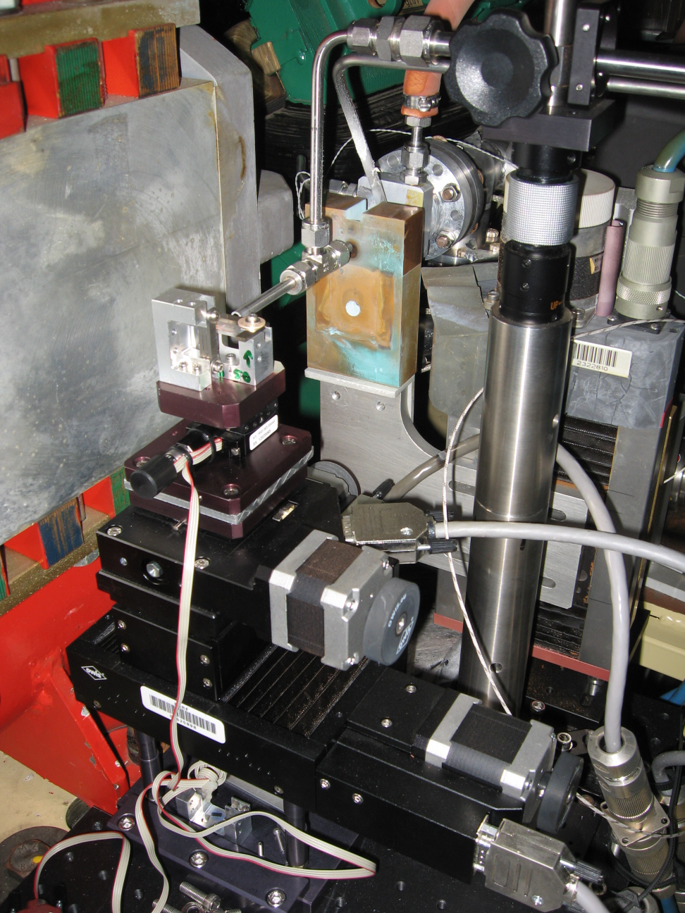
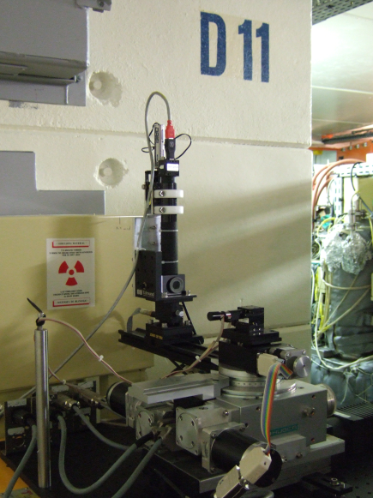
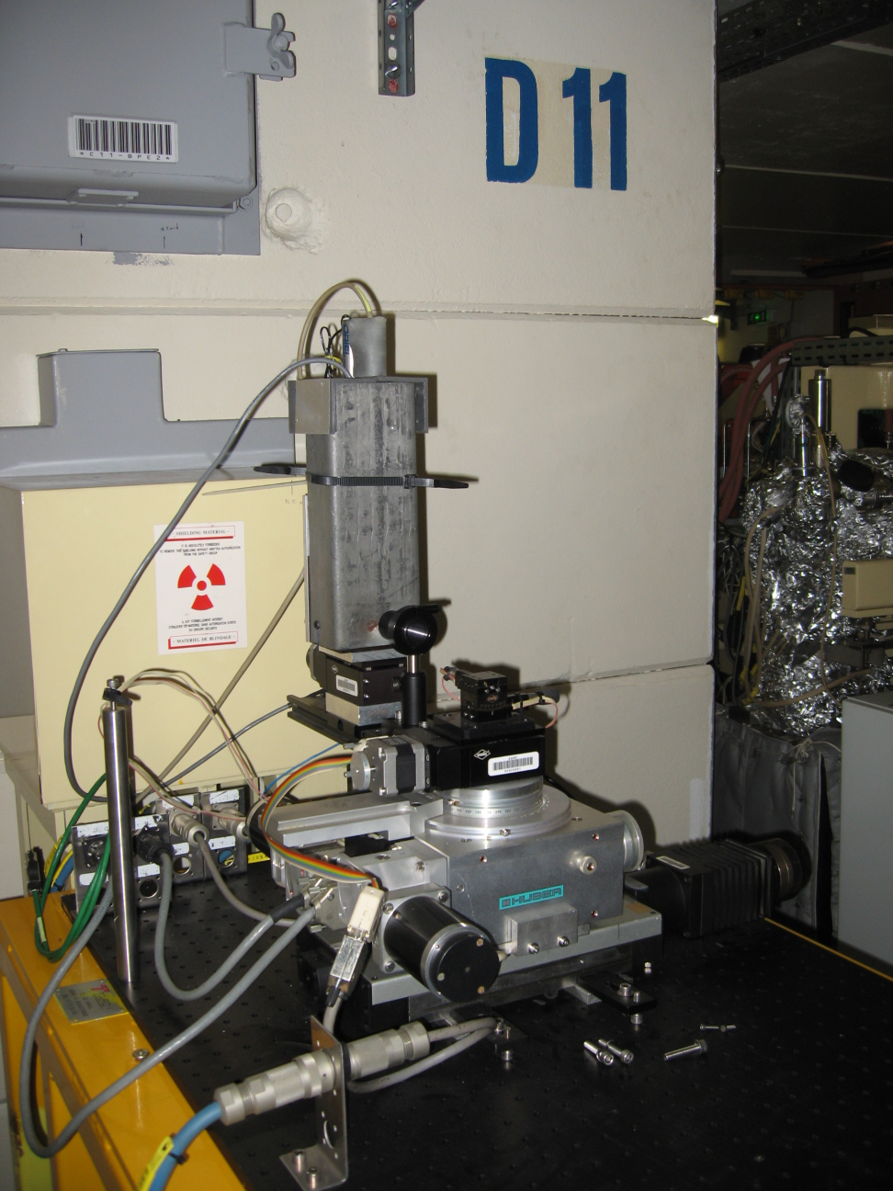
Pinhole area Detection area
Al-window
Pinhole
N₂ flushed pipes
Cu-attenuator

Slide 15
Pinhole Resolution
Electron Beam profile
Pinhole
Screen
Point Source
M = D / d
d
D
1. projection shadow (upper limit of pinhole size)
2. diffraction from pinhole (minimum pinhole size)

Slide 16
Resolution of X-ray pinhole camera
Geometric shadow of the pinhole Diffraction from pinhole
Minimum between both effects leads to minimum resolvable source size and emittance :
@ D11:
σ_{min} = 6 μm with A_{opt} = 10 μm
ε_{z, min} = 1 pm
@ ID25:
σ_{min} = 5 μm with A_{opt} = 10 μm
ε_{z, min} = 0.5 pm

Slide 17
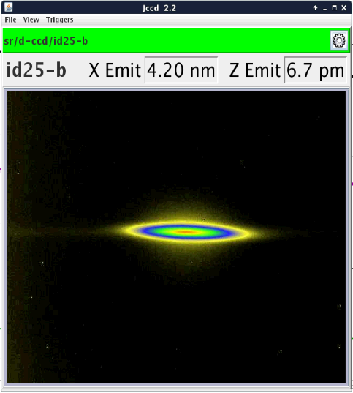
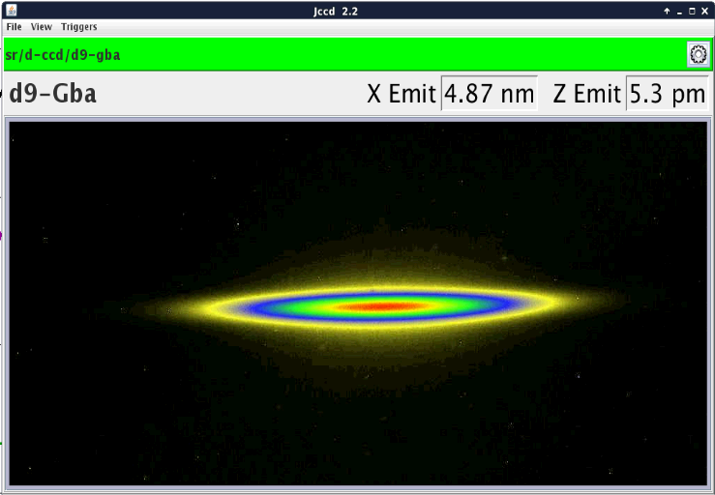
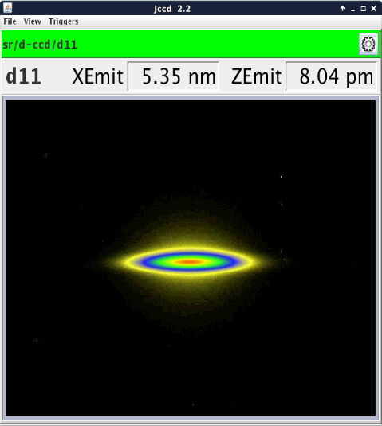
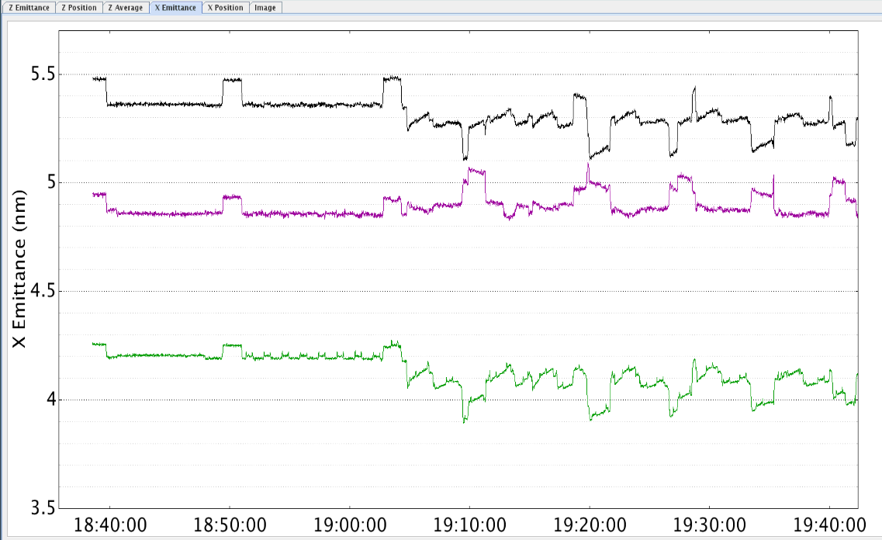
X-ray Pinhole Screenshots

Slide 18
Contents
Current status of X-ray based beam size monitoring using
Simple projection of X-rays
Pinhole Camera imaging
X-ray Compound Refractive Lenses
Prospects and challenges for ESRF-EBS
EBS beam parameters/implementation of DIAG X-ray beam ports
Evaluation of beam size monitoring techniques for ESRF-EBS

Slide 19
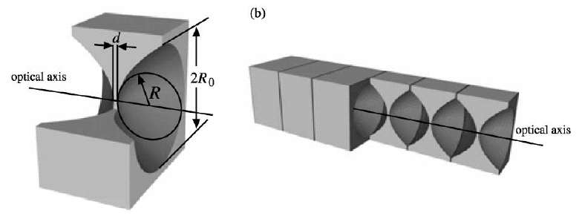
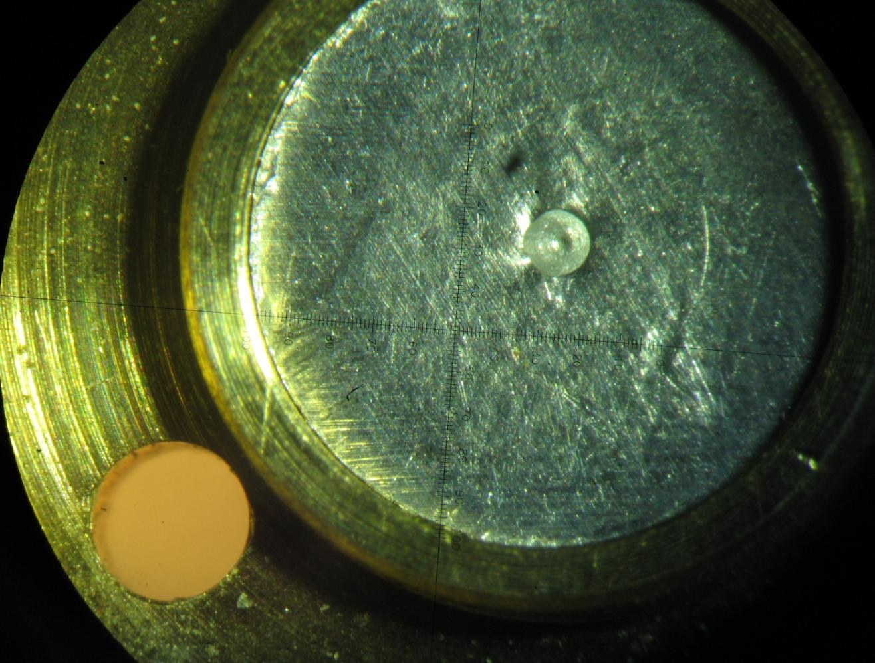
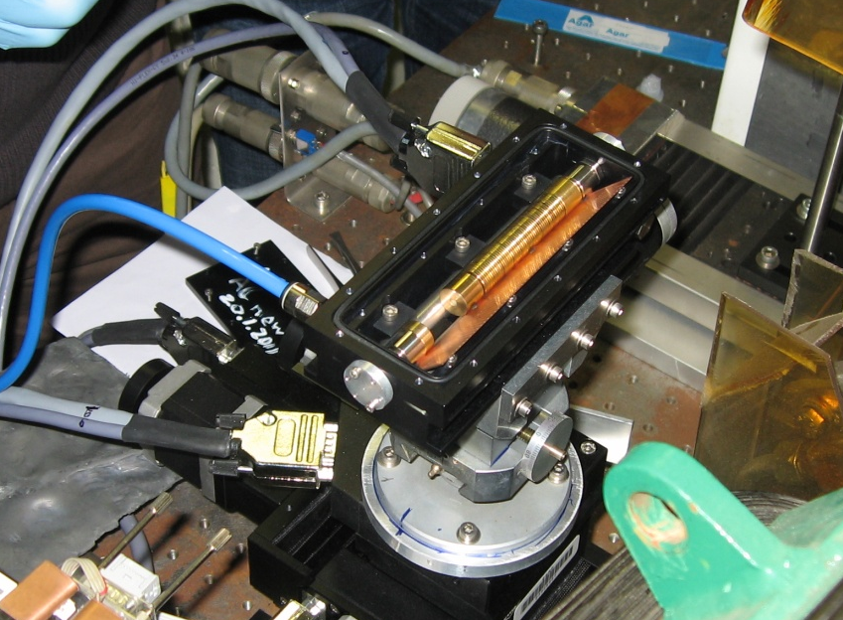
X-ray Lens = Image formation with stack of parabolic concave lenses
n_{Al} << n_{air} for X-rays
Lens material: Aluminium
Image from [1]
the lens
Focal length of CRLs (thin lens approximation):
R… Radius of curvature
N… Number of lenses
d… Index of refraction (real part)
E… Photon energy
2 mm

Slide 20
X-ray Lens = Image formation with stack of parabolic concave lenses
Electron beam
profile
Vacuum
Air
Beam profile on screen
3 mm Al (water cooled)
Σ = M σ
σ
monochromator
Dipole
CRL
e-beam
L1
L2
CCD
CRL magnification M = L2 / L1

Slide 21
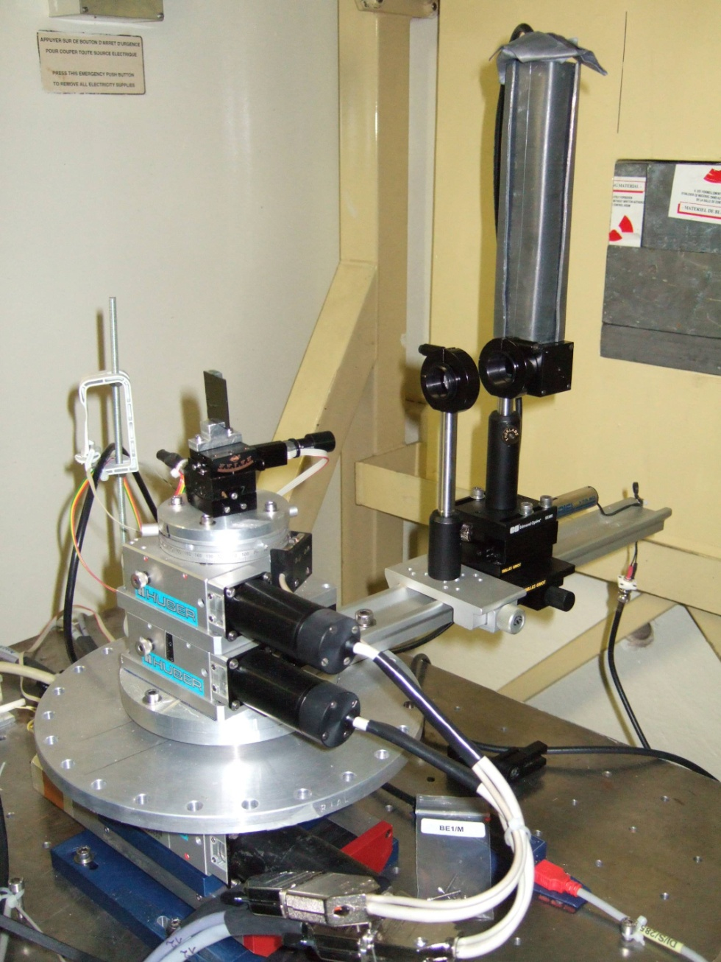
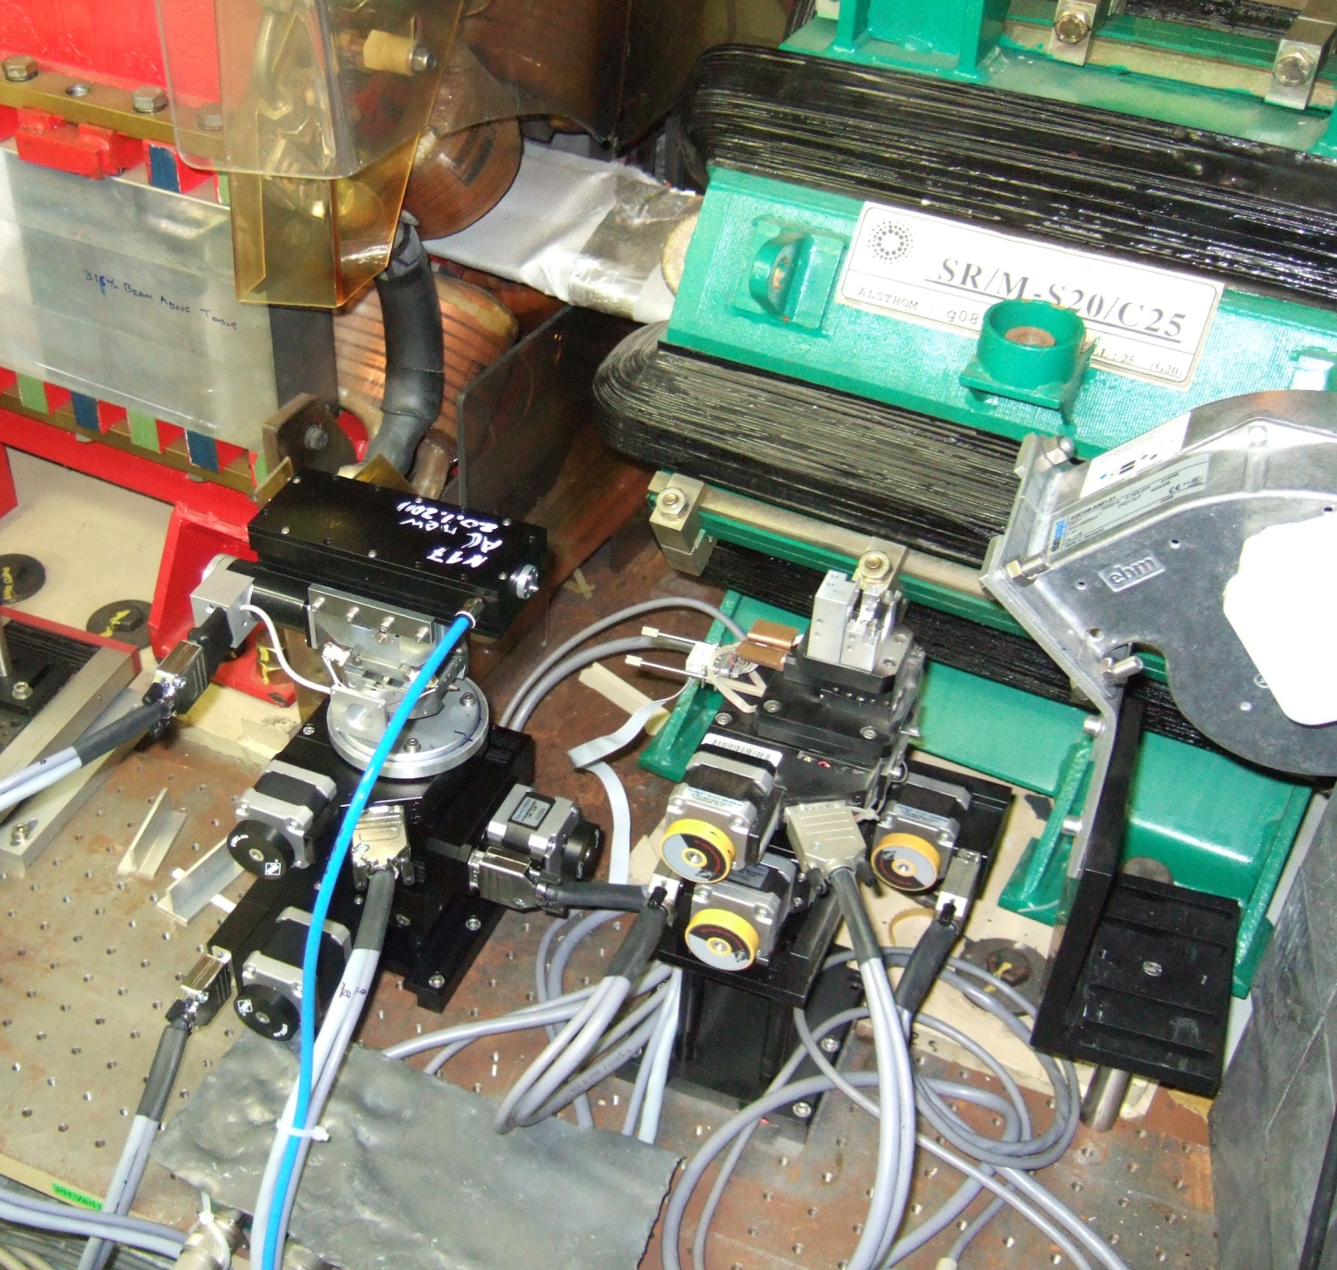
Emittance beamline D11 equipped with CRLs
Si(111) monochromator
(Laue configuration)
CRL
Scintillator,
Lenses,
CCD
Pinhole

Slide 22
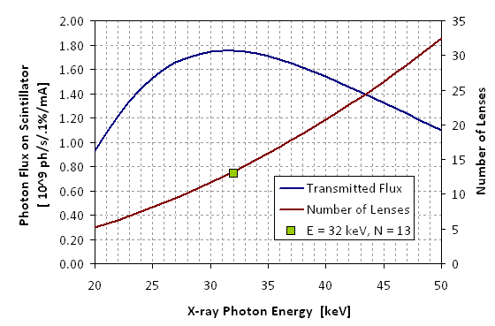
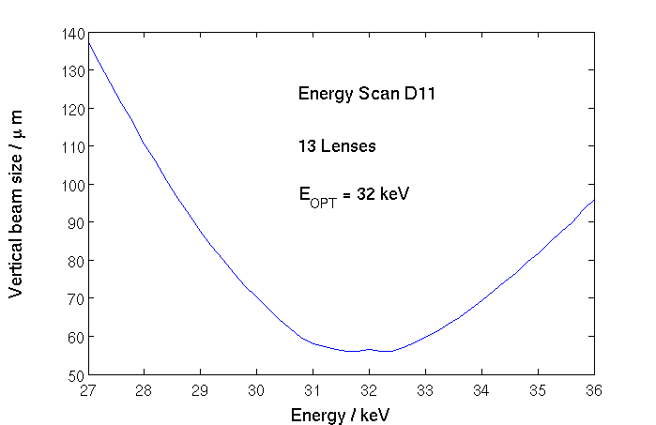
Choosing the number of lenses
focal length (thin lens approximation):
f = R/2Nδ N... number of single lenses
d... index of refraction real part
32 keV
→ for example 13 lenses at E_{opt} = 32 keV (used at emittance beamport D11)

Slide 23
XRL for emittance measurement at ESRF ( now removed )
Transverse resolution determined by diffraction on lens aperture :
σ_{min} = 0.75 · L₁ /D_{eff} [1]
D_{eff} ...... effective aperture of the lens determined by geometric aperture, absorption
and surface/shape imperfections.
Diffraction limited resolution of lens at beam port D11 ( calculated using [2] or [3] ):
σ_{min} = 3.3 μm
ε_{z,min} = 0.3 pm
[1] B. Lengeler et al. / Nuclear Instr. Meth. in Phys Res. A 467-468 (2001) 944-950
[2] B. Lengeler et al. /J. of Appl. Phys. 84 (1998) 5855
[3] http://purple.ipmt-hpm.ac.ru/xcalc/xcalc_mysql/crl_par.php

Slide 24
Comparison Pinhole – CRL (at beamport ID25)

Slide 25
Contents
Current status of X-ray based beam size monitoring using
Simple projection of X-rays
Pinhole Camera imaging
X-ray Compound Refractive Lenses (CRL)
Prospects and challenges for ESRF-EBS
EBS beam parameters/implementation of DIAG X-ray beam ports
Evaluation of beam size monitoring techniques for ESRF-EBS

Slide 26
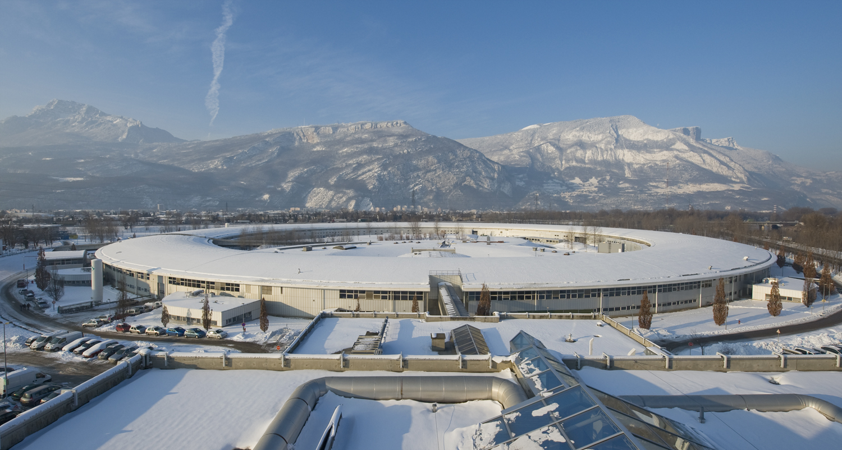
Challenges and prospects for emittance measurement for ESRF-EBS
ESRF
ESRF – EBS
2019
2020
Horizontal emittance
30
ε_{x} = 4000 pm
ε_{x} = 130 pm
Vertical emittance
ε_{z} < 1 pm !!!

Slide 27
ESRF-EBS
Wish list for the perfect emittance beamline/source point location:
pinhole close to source = high magnification factor
strong B-field = high photon flux
high beta-function
ideally 2 locations with different dispersion for energy spread measurement

Slide 28
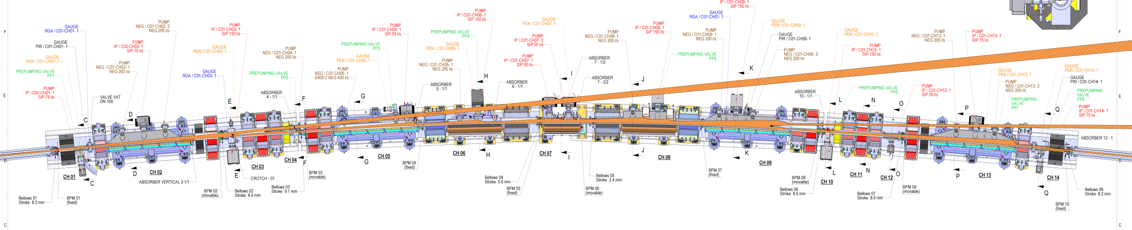
EBS emittance beam port positions:
Screen
M = 4.35
D = 16.35 m
d = 3.76 m
Source 2: DQ1D
(3x)
Pinhole/lens position 1: close to BPM03
Source 1: DL1A_5
(2x)
Pinhole position 2:
close to diagnostics drift section DR37
5.4 m
28

Slide 29
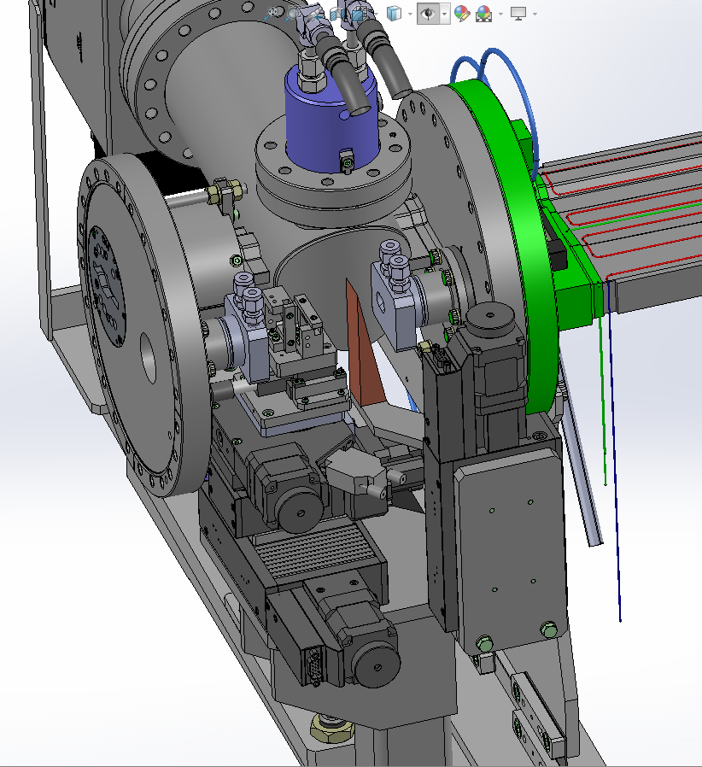
Mechanical Assembly for Emittance ID beam port
Electrons
X-rays

Slide 30
Emittance – Challenge: small beam sizes
Small emittance + Small beta-function → Small source beam size
Horizontal emittance : 130 pm
 | Expected for ESRF EBS |  |  |  | Pinhole | CRL
 | σ_{x} [μm] | σ_{z} [μm] |  |  | σ_{min} [μm]
 | (ε_{x} = 130 pm) | coupling 4% (ε_{z} = 5 pm) | coupling 1% (ε_{z} = 1.3 pm ) | coupling 0.1% (ε_{z} = 0.13 pm )
 |  | USM conditions |  | Perfect machine
DL1A_5 βz = 16.64 m | 15 | 9 | 4.7 | 1.5 | 5 | 3
DQ1D βz = 3.81 m | 19 | 4 | 2.2 | 0.7 | 6 | 2.5

Slide 31
X-ray Fresnel diffraction from a slit
Dipole
Monochromator
Observation
plane
Slit
d
D
Optimum slit size for obtaining a
« simple » double-lobed diffraction pattern [1]:
Simulations with SRW for the ESRF low emittance lattice:
d = 3.76 m D = 16.35 m
E_{beam} = 6 GeV A = 200 mA
E_{ph} = 40 keV e_{x} = 0.11 pm
a = 26 μm
[1] M. Masaki et al., “X-ray Fresnel diffractometry for ultralow emittance diagnostics of next generation synchrotron light sources”, PR Special Topics – Accelerators and Beams, 18, 042802 (2015)

Slide 32
X-ray Fresnel diffraction from a slit
Simulations with SRW for the ESRF low emittance lattice:
a = 26 um

Slide 33
Summary
Simple X-ray projection monitors can be a nice way of implementing a multitude of small, cheap and robust emittance monitors for the vertical plane, but with limited resolution.
The X-ray pinhole is a very robust method for emittance measurement with a very good resolution.
However, for the ultra small vertical emittances expected for ESRF-EBS its resolution is not sufficient.
X-ray compound refractive lenses have a slightly improved theoretical resolution limit, but even they will not able to resolve electron beam sizes of < 3 um.
X-ray Interference techniques may be the solution to measure the smallest expected vertical emittance of < 1 pm.

Slide 34
Not adressed here:
Damage induced by ozone production (X-rays + O2 → O3 → corrosion)
Degradation of CCD /CMOS cameras due to radiation → Test and choice of cameras
Very small source sizes mean also very small image sizes → VIS-imaging has to be designed in consequence.
Vibration (electron beam and beamline elements) will start to be a problem at ultra small beam sizes.

Slide 35
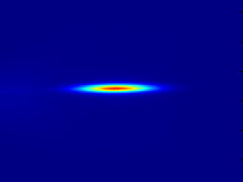
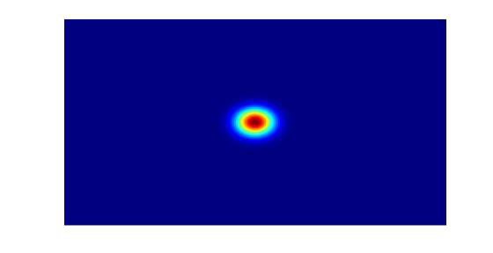


Thank you for your attention !
For more information on the ESRF-EBS upgrade:
ESRF website
Technical design report “Orange book”:
http://www.esrf.fr/home/about/upgrade/upgrade-programme-documentation/orange-book.html
Articles on selected topics on the ESRF-EBS blog : http://ebs.esrf.fr/

