Slide 1
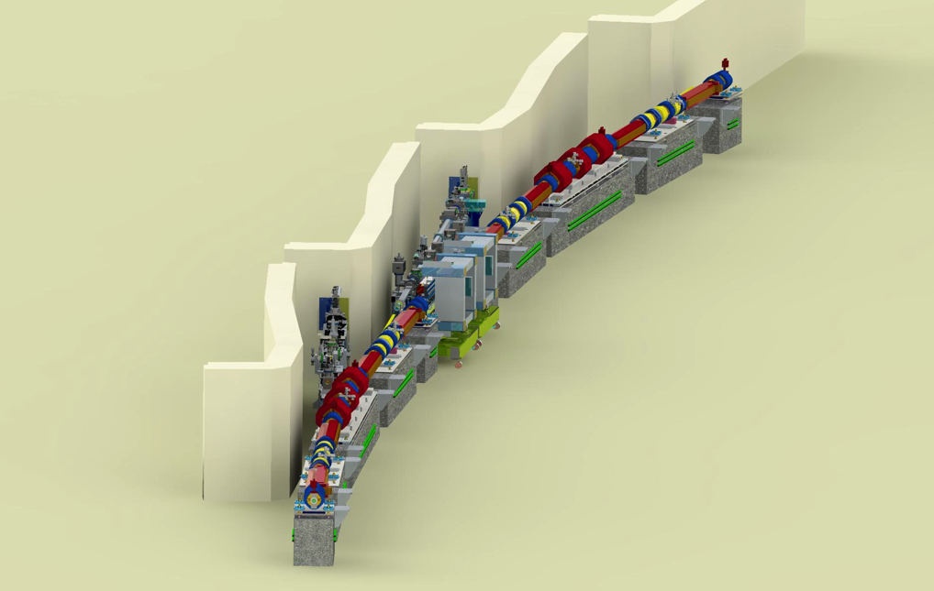
PLANNED X-RAY DIFFRACTION DIAGNOSTICS FOR APS-U EMITTANCE MEASUREMENTS
Source
Bingxin Yang and Soonhong Lee
Advanced Photon Source
Argonne National Laboratory
Emittance Measurements for Light Sources and FELs
January 29-30, 2018
Notes:
Univ of Chicago Review, Aug. 30, 2010
1

Slide 2
Outline
Emittance monitor specifications
Right x-ray source is half the success
Design of x-ray diffraction apertures
Simulation of diffraction profiles and estimation of beam size monitor performance
Key features of optical / mechanical design
Summary

Slide 3
APS-U Storage Ring Emittance Monitor
Expected storage ring emittance*
Operating Mode | Horizontal Emittance | Vertical Emittance | Beam Current
Timing Mode | 31.9 pm | 31.7 pm | 200 mA
Brightness Mode | 44 pm | 4.2 pm | 200 mA
Initial Commissioning Mode |  |  | 25 mA
Beam Instability? | 1000 pm | 500 pm
Low emittance ratio study (1%)? |  | 0.4 pm
* Two planned operating modes for user operation
Emittance monitor operating requirements*
Horizontal Emittance | Vertical Emittance | Beam Current
25 – 1000 pm | 0.4 – 500 pm | 20 – 200 mA
* Planned bandwidths: 0.1 – 1 Hz for absolute beam size monitor; 1 – 10 Hz for relative beam size monitor.

Slide 4
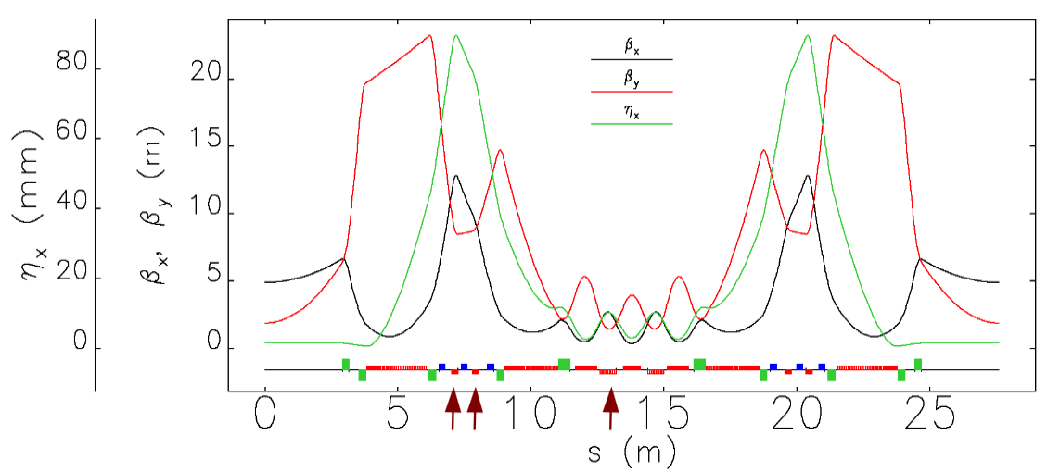
X-ray Source for Beam Size Monitor
SR emittance will be calculated from measured beam sizes. Choosing proper x-ray source is a critical step to the successful emittance monitor! The APS-U storage ring chamber has two light ports, looking at 7 – 8 x-ray source points:
ID port: insertion devices + bend magnet sources B:M1 and A:M1
BM port: M4, Q8 (too weak), M3, and optional three-pole wiggler
3PW
ID
A:M1
A:M4
B:M3
B:M1
APS-U storage ring lattice functions.

Slide 5
X-ray Source for the Emittance Monitor
Minimum source sizes for APS-U user operations*
Port | ID |  | BM
Source | A:M1/B:M1 | ID | M4 | 3PW | M3
X-size from emittance | 7.2 | 12.5 | 5.0 | 6.4 | 4.7
X-size from energy-spread** | 0.4 | 0.9 | 8.0 | 11.0 | 4.9
Horizontal beam size (X) | 7.2 | 12.6 | 9.4 | 12.8 | 6.8
Vertical beam size (Y)* | 9.1 | 2.8 | 4.3 | 3.2 | 4.5
* Minimum emittances in user operations are 31.9pm / 4.2pm in horizontal / vertical planes.
** Nominal electron beam energy spread is 0.136%.
[Observations]
At the BM port, the source sizes are dominated by contributions from beam energy spread, making pure emittance measurement difficult!
At the ID port, the vertical ID source size is small, difficult to measure!
The B:M1 is 7.7 m upstream of A:M1, farther away from the x-ray optics!
The A:M1 source is ideal for emittance measurement!

Slide 6
APS-U Storage Ring Beam Size Monitor
Expected electron beam sizes at A:M1 source point*
Operating Mode | Horizontal Beam Size | Vertical Beam Size | Beam Current
Timing Mode (User Op) | 7.3 μm | 25.1 μm | 200 mA
Brightness Mode (User Op) | 8.5 μm | 9.1 μm | 200 mA
Initial Commissioning Mode |  |  | 25 mA
Beam Instability? | 41 μm? | 100 μm
Low emittance ratio study (1%?) |  | 3 μm
* Two planned modes for user operation
Beam size monitor operating range requirements*
Horizontal Beam Size | Vertical Beam Size | Beam Current
6.5 – 41+ μm | 3 – 100+ μm | 20 – 200 mA
* Planned bandwidths: 0.1 – 1 Hz for absolute beam size monitor; 1 – 10 Hz for relative beam size monitor.

Slide 7
X-ray Diffraction Optics
The x-ray optics is a 0.1-mm tungsten foil with six apertures:
  Aperture spacing is 0.5 mrad (3.3 mm), making separate images at detector
  The apertures are located 6.56 m from the source
  Apertures may be put into two function groups.
Absolute beam size monitor (ABSM): obtain beam sizes by analyzing x-ray diffraction profiles, operating in 0.1 – 1 Hz range. Three apertures cover different beam size ranges:
  Monochromatic x-ray pinhole camera (15 keV): for 8 – 100+ μm beam sizes.
  Wide-aperture Fresnel diffractometer (8 keV): 4 – 14 μm
  Young’s double slits interferometer (8 keV): 2 – 6 μm
Relative beam size monitor (RBSM): obtain beam size information by monitoring x-ray diffraction peak intensities, operating at 1 – 10+ Hz:
  Double-slits collimator for horizontal beam size (15 keV): 4 – 100 μm
  Double-slits collimator for vertical beam size (15 keV): 4 – 100 μm
  X-ray beam position monitor (15 keV) for maintaining collimator alignment

Slide 8
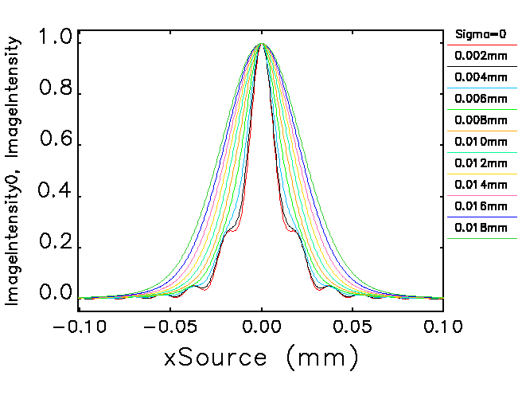
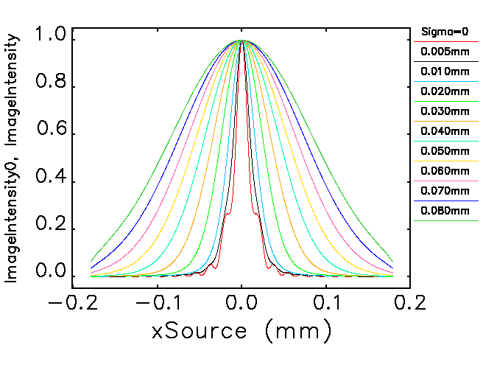
15-keV X-ray Pinhole Camera: Geometry
Today, most x-ray pinhole-camera emittance monitors use white beams. But the monochromatic beam has several unique advantages:
Diffraction profiles can be more precisely modelled, resulting in more accurate beam size data.
Photon energy can be chosen in a opaque region for tungsten, making the pinhole slits easier to make, and with a better optical quality.
Source distance | Pinhole | Image distance | M | Source sizes
6.6 m | 34 μm × 34 μm | 13.4 m | 2.6 | 8 – 100 μm
Pinhole camera profiles for source size 2 – 18 μm (left panel) and 5 – 80 μm (right panel)

Slide 9
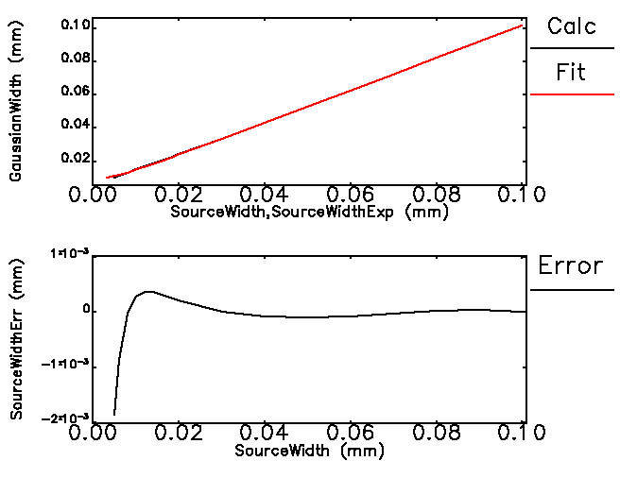
15-keV X-ray Pinhole Camera: Data Analysis
For small sources, full diffraction profiles get best curve-fitting results.
Shortcut for larger beam sizes (> 8 μm): Fit 60% of the peak data to a Gaussian curve. The resulting peak width σ_{G} can be “corrected for resolution effect” using the following expression:
with
0.001
-0.002
X-ray absorption by tungsten is strong at 15 keV. A 50-μm foil has less than 0.01% transmission.
The resolution-corrected source sizes carry an error below 1 μm for source size < 8 μm

Slide 10
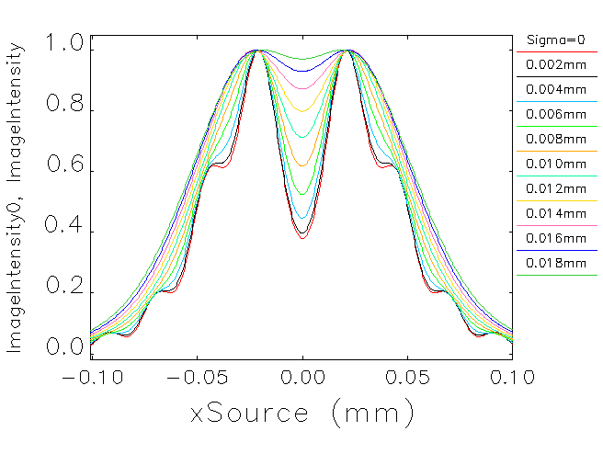
8-keV X-ray Fresnel Diffractometer
If we widen the diffraction aperture to include the second Fresnel zones, the diffraction profile will have a center minimum. The entire profiles can be used for image analyses to extract beam size information.
Source distance | Pinhole | Image distance | M | Source sizes
6.6 m | 70 μm × 70 μm | 13.4 m | 2.6 | 4 – 14 μm
Fresnel diffractometer profiles for source size 2 – 18 μm

Slide 11
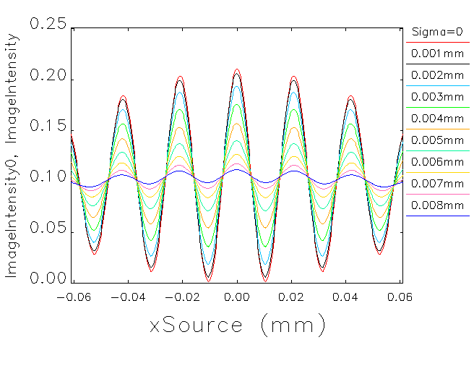
8-keV Young’s Interferometer (Vertical)
For very small beam sizes, a pair of double slits will be used to make a Young’s Interferometer, which produces sinusoidal interference fringes.
Full diffraction profiles will be used for image analyses.
Expect longer integration time
If necessary, a larger slit spacing can be used for even smaller beam sizes
Source distance | Slits | Image distance | M | Y-Beam sizes
6.6 m | 2 × 8 μm 80 μm spacing | 13.4 m | 2.6 | 2 – 6 μm (0.2 – 1.8 pm)
Young’s interference pattern from two 8-μm slits with 80-μm spacing

Slide 12
Relative BSM: Double-Slits Collimator
One-dimensional 15-keV x-ray pinhole camera:
Pinhole-slit width is chosen to maximize the peak intensity at the detector.
The slits’ length increases the x-ray flux by five fold (relative to a pinhole).
Detector slits width is chosen to balance good resolution and good signal level.
Source distance | Pinhole slits | Detector distance | Detector slits | M | Source sizes
6.6 m | 34 μm × 150 μm | 13.4 m | 10 μm × 400 μm | 2.6 | 4 – 100 μm
Concept of the APS-U relative beam size monitor

Slide 13
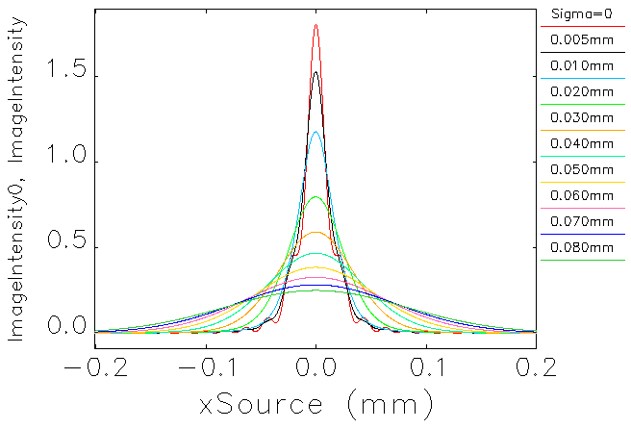
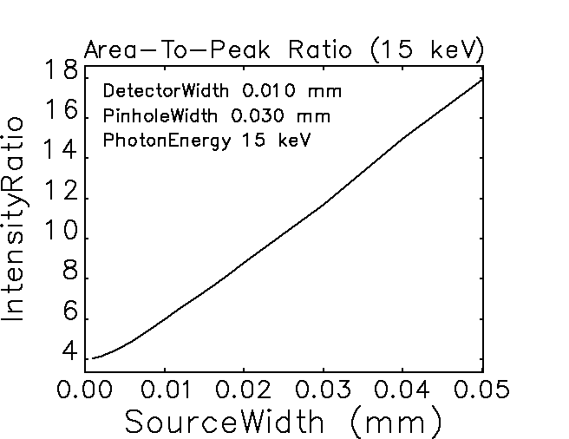
Relative BSM: Two Modes of Operations
Scanning mode: scanning a narrow slit across the pinhole image
  A slow, but accurate absolute beam size monitor, free from degradation by x-ray imaging detectors
  Beam size obtained by fitting the entire intensity profile ➔ Reliable calibration
Intensity mode: measure area and peak signal intensities
  In user operations, the area-to-peak intensity ratio will be used to monitor beam size /emittance variations for emittance feedback system.
Relative Beam Size Monitor detector slits scanning profiles and peak intensity depends on source sizes.

Slide 14
RBSM: Alignment Requirements
In the vertical plane, the pinhole slits needs to be centered in the BM x-ray fan.
In both horizontal and vertical planes, the two-slit collimators need to be aimed precisely at the source. Any misalignment will cause detector signal drop, which may be misinterpreted as source size increase.
To keep detector centered within top 2% of the peak intensity, we need to center the collimator within 1 μm from the source center.
Relative Beam Size Monitor detector slits scanning profiles indicate alignment requirements.

Slide 15
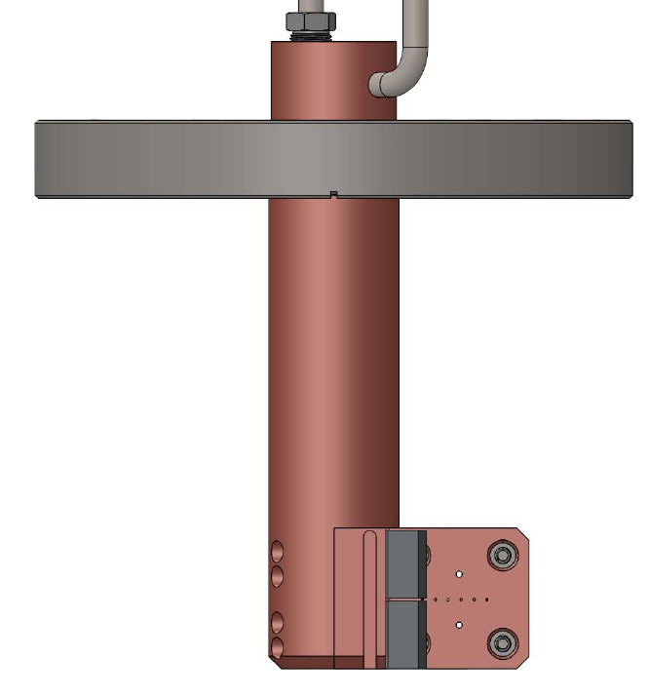
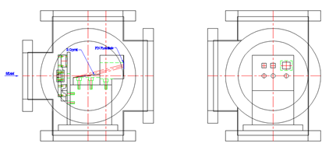
X-ray Beam Position Monitors
XBPM1 is for centering the bend magnet fan vertically on the aperture array
  Photoemission XBPM design integrated with the aperture holder (@6.56 m)
  Resolution of several microns is more than adequate for BM fan height of 500 microns.
XBPM2 is for aligning the source, pinhole slits, and the detector slits on the same straight line.
  Large pinhole (300 μm × 200 μm) between XBPM1 blades
  15-keV mono and 2-D position-sensitive detector to readout source point position
  Centering beam in the XBPMs centers the beam in the relative beam size monitors!
Si(111) crystal
Si-PIN photodiode
XBPM1 Ta blades
BEAM
X-ray apertures
Detector Slits
XBPM1 (for beam angle) is mounted on the x-ray aperture holder.
XBPM2 (for source point) shares the same mono and support with the RBSM detectors.

Slide 16
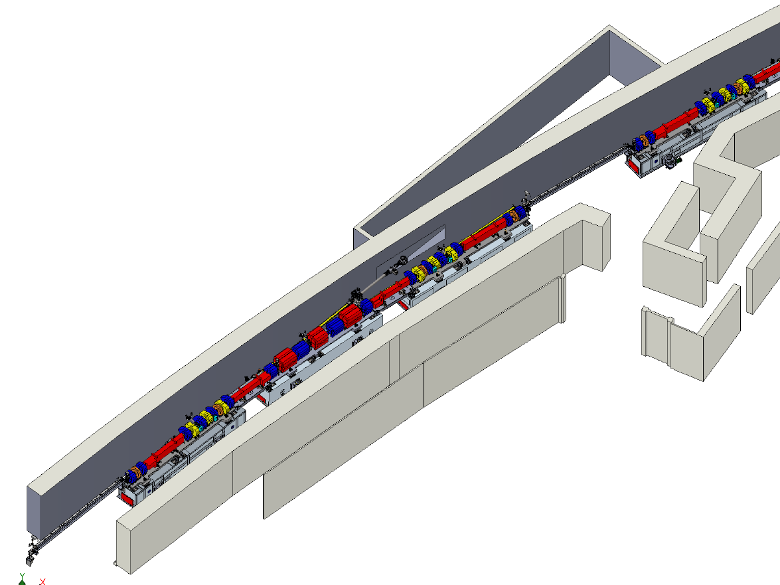
Implementation: Optics & Mechanics
Beam Size Monitor will use S38A:M1 as the source, sharing the same straight section with the RF cavities in S37ID.
Enclosure’s radiation shielding managed 37-ID Front End.
Windows, monochromators, detector and cameras (18.5 – 20 m)
Radiation enclosure equivalent to 37-ID front end
Photon shutter and valve
X-ray apertures (10.40 m)
A:M1 source (3.84 m)
RF Cavity (Z = 0 m)

Slide 17
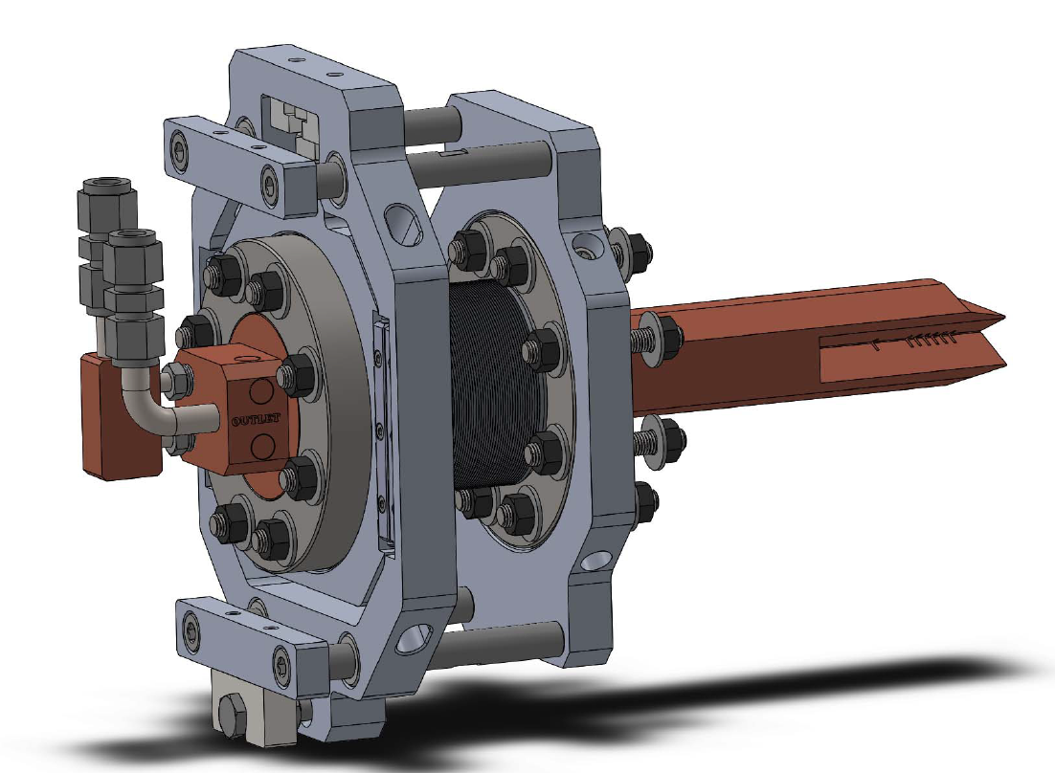
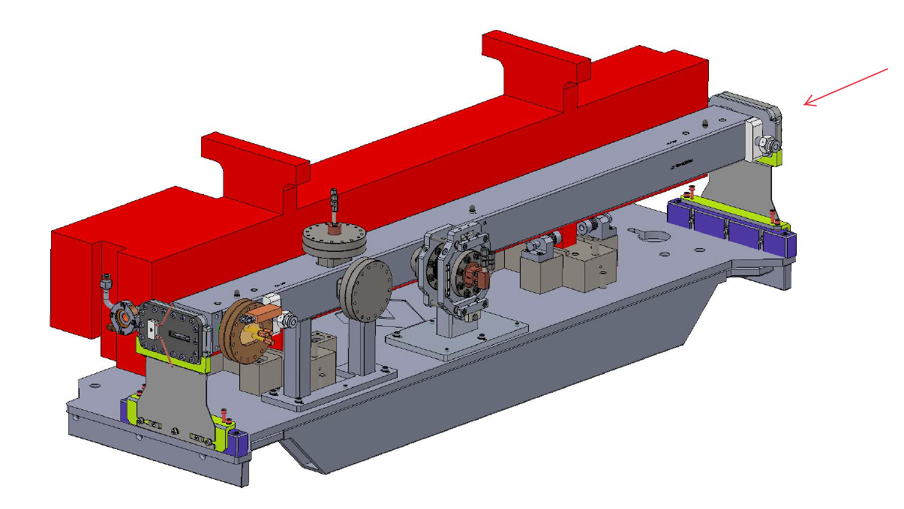
Mechanical Design: Vibration Control
“Vibration-free” mounting for the pinhole apertures:
Water-cooled absorber incepts ~75% beam power, lowers aperture flow req.
Water-cooled x-ray apertures are mounted rigidly on the storage ring chamber.
Reduce chamber flexing by placing support column under the apertures.
Estimated RMS vibration amplitude < 0.1 μm. XBPM handles slow motion.
Water-Cooled Pinhole Apertures (6.56 m from source)
X-ray Beam
Water-Cooled GlidCop absorber
Power Absorber (>75%)
Old Support Column
New Support Column

Slide 18
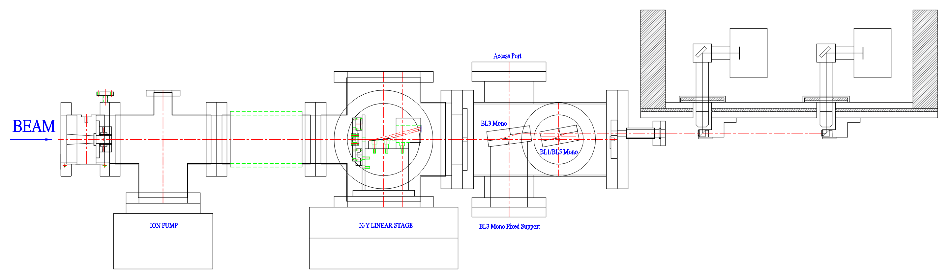
X-ray Optics Design
Coherence preservation is the most important consideration:
Place transmission optics (window, lens, filters,…) at the very end.
Place reflective optics (mirrors, monochromators,…) at the very end.
X-ray photons travel in vacuum in the first 92% of the beamline. Its wavefront only disturbed by diffraction apertures. Aperture edge perfection is important.
Si(111) Mono
15-keV Mono
sCMOS-1
sCMOS-2
Be Window
I0 Monitor
Detector slits
Si-PIN PD
8-keV Mono
YAG-1
YAG-2
Mono Be Window
1.5 M
To preserve coherence, the first window is placed 1.5 M upstream of the last YAG screen

Slide 19
Summary
The A:M1 source is very important to successful APS-U storage ring emittance diagnostics:
  Low dispersion allows for clean emittance measurements
  Larger beam sizes relax resolution requirements (>2x)
An array of six x-ray diffraction apertures will be used:
  For absolute beam size measurements, we will use a pinhole camera, a wide aperture Fresnel diffractometer and a Young’s double-slit interferometer.
  For relative beam size changes, 1-D double-slit collimator will be used to monitor normalized peak intensities.
Coherence preservation is the most important concern.
The diagnostics cover all expected storage ring beam conditions, including extremely small vertical beam emittance (< 0.4 pm). Upgrade to 0.1-pm is possible with different set of double slits.

