Slide 1
Use coherent optical transition radiation for measurements of the transverse beam size
A. Potylitsyn, L. Sukhikh
Tomsk Polytechnic University
G. Kube
Deutsches Elektronen Synchrotron

Slide 2
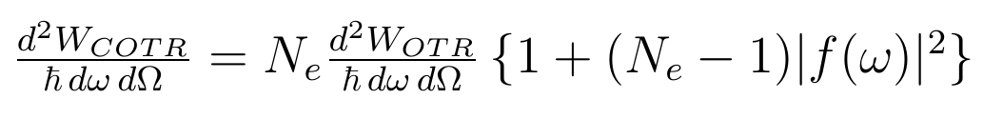

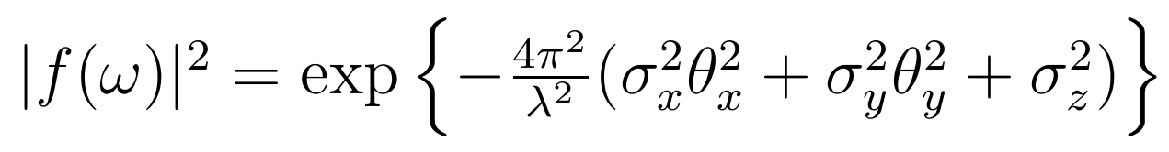

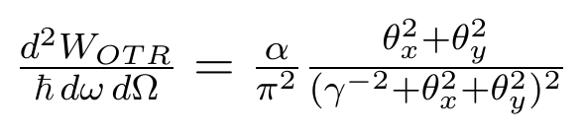
Spectral-angular distribution of COTR from a bunch
- bunch population
Ultra-relativistic case (γ >> 1)
- rms sizes of a bunch

Slide 3
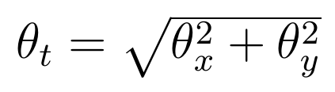


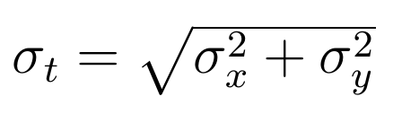

COTR angular dependence
For large emission angles
COTR is suppressed exponentially, but OTR – as a power one
At the angle
intensity of the COTR and OTR are equal

Slide 4
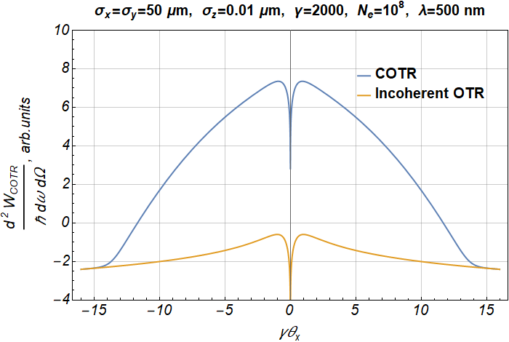

Angular distribution of COTR

Slide 5
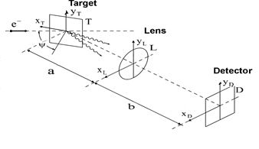
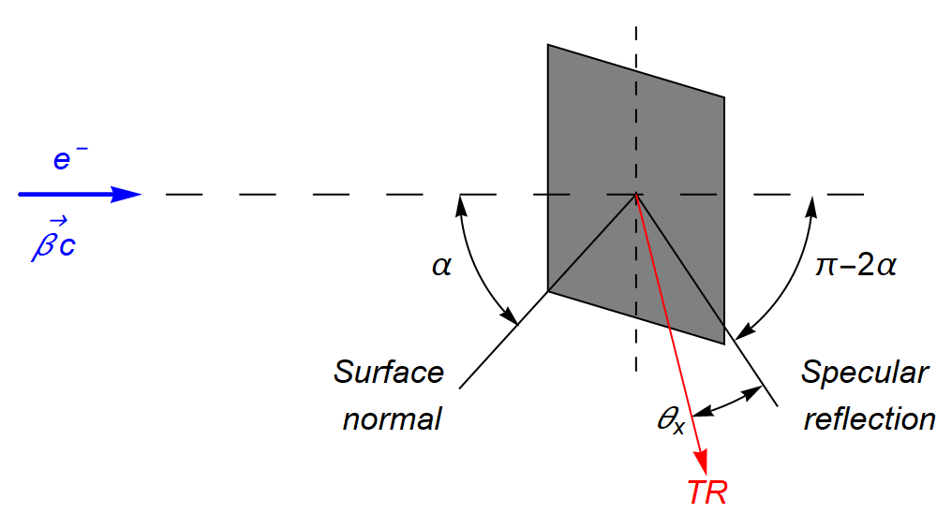
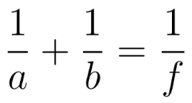
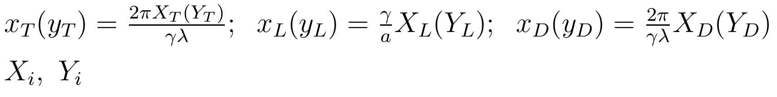
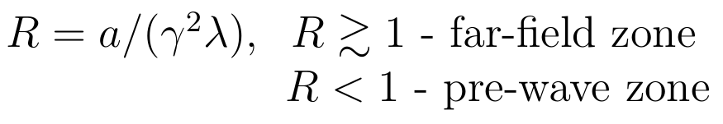
OTR optical system
Lorentz-factor γ >> 1
Wavelength λ
Focusing condition →
f is the lens focus distance
Dimensionless variables
- coordinates on the surface of the target (i → T), lens (i → L) and detector (i → D)
Far field is characterized by the parameter R:

Slide 6

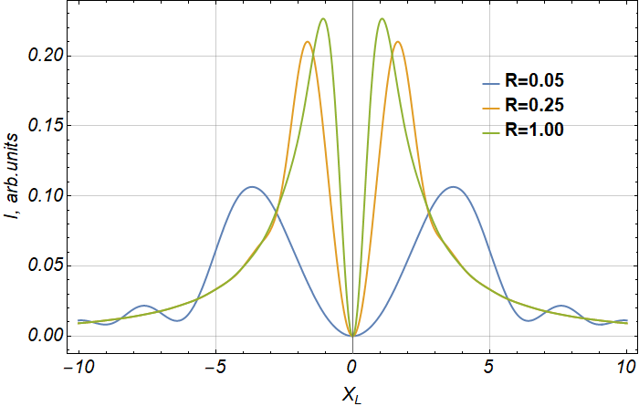
Pre-wave zone
TR field on the lens surface:
TR intensity distribution on the lens surface

Slide 7
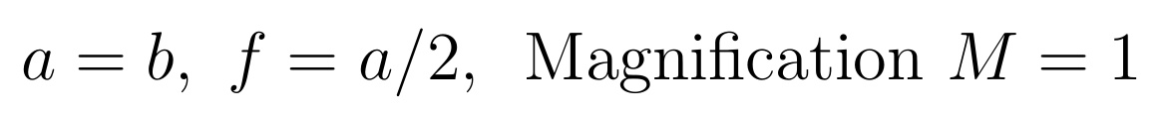
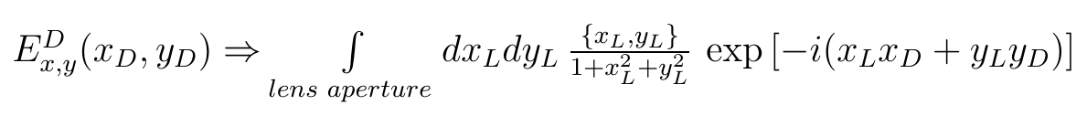
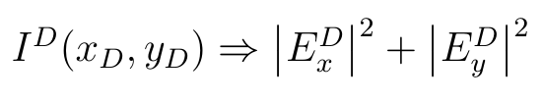
Fields on the detector surface
In the far-field zone:

Slide 8
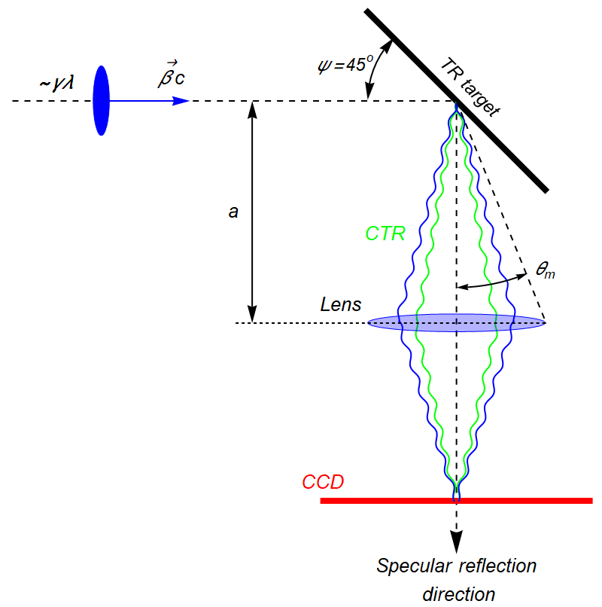
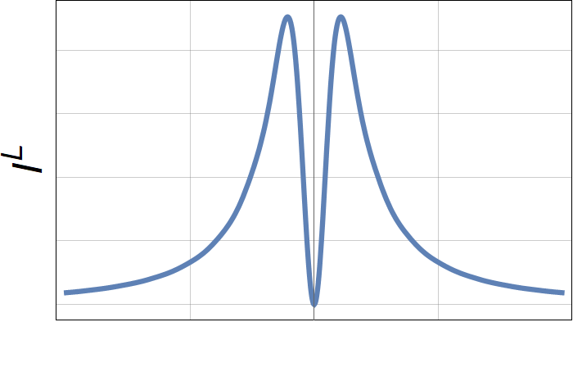
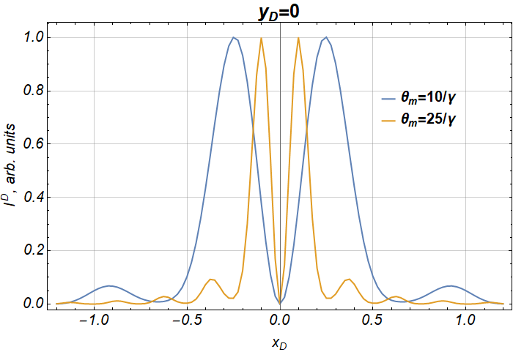
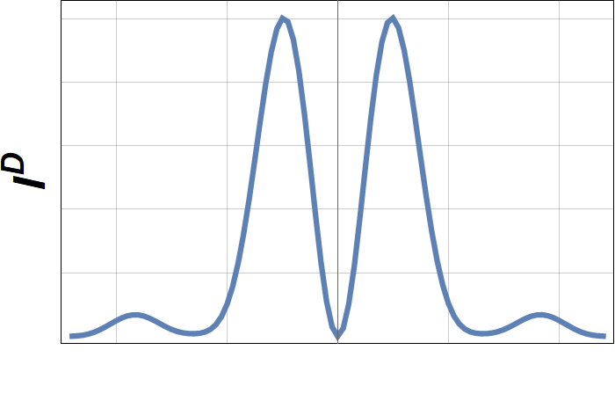
Point spread function
(OTR case, on-axis light collection)
θ_{m}>> 1/γ
Lens Aperture
CCD

Slide 9
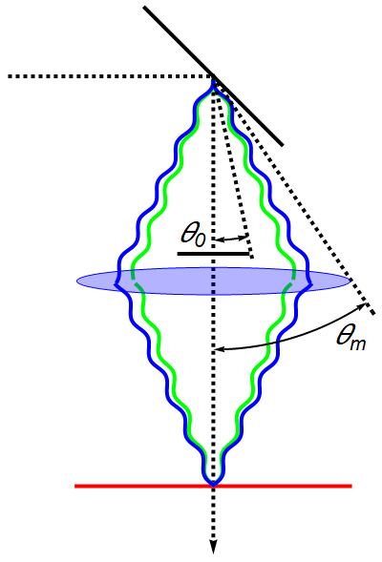
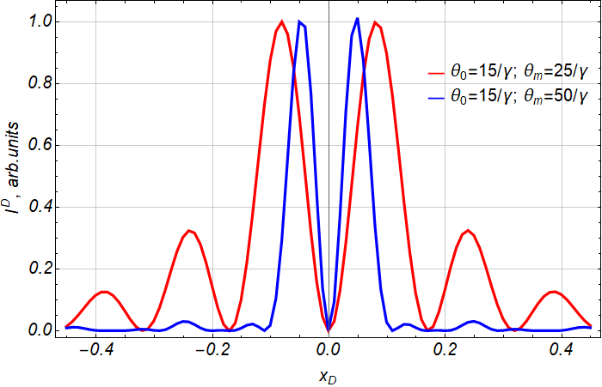
OTR point spread function
(on-axis light collection + mask)
Mask
CCD
Lens Aperture

Slide 10
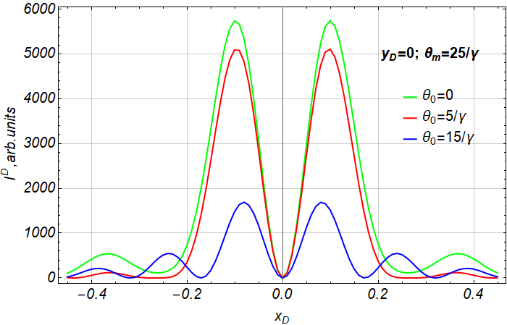
OTR PSF for different masks

Slide 11
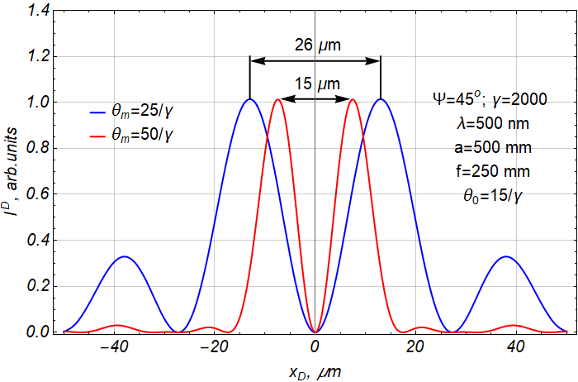
Space distribution of OTR on the CCD (M=1)

Slide 12
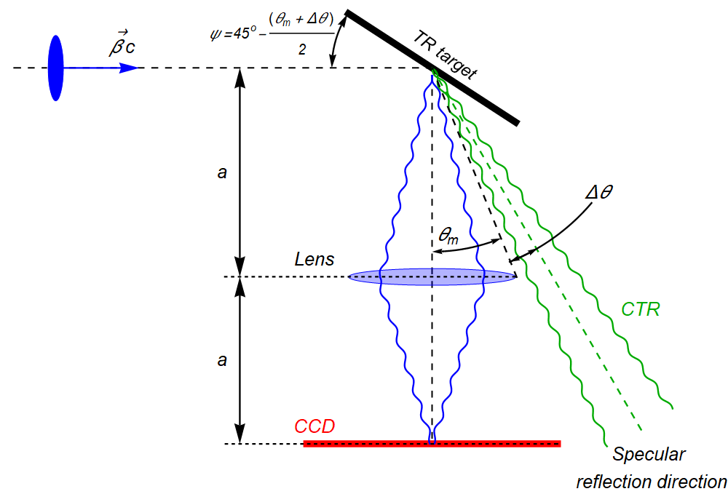
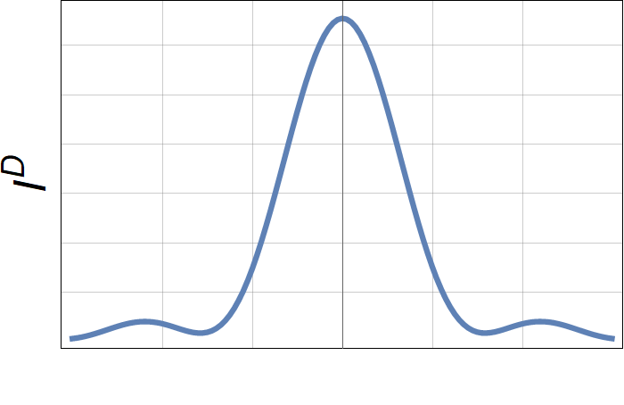
Point spread function
(OTR off-axis case)
θ_{m}>> 1/γ
Δθ
Lens Aperture
CCD

Slide 13
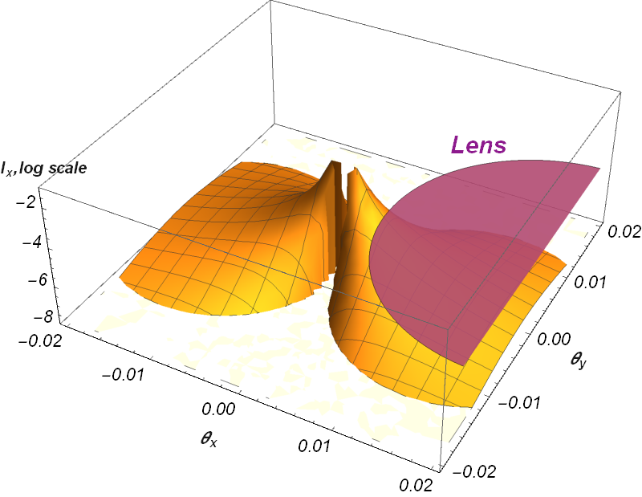

Overlapping of the OTR pattern by a lens

Slide 14
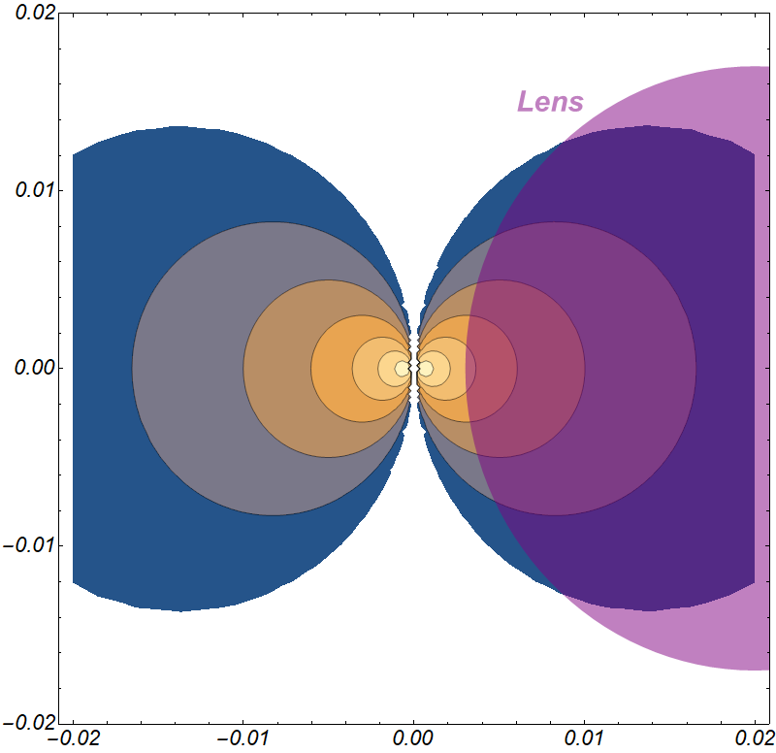
Displacement of a lens
θ_{m} + Δθ
θ_{m}

Slide 15
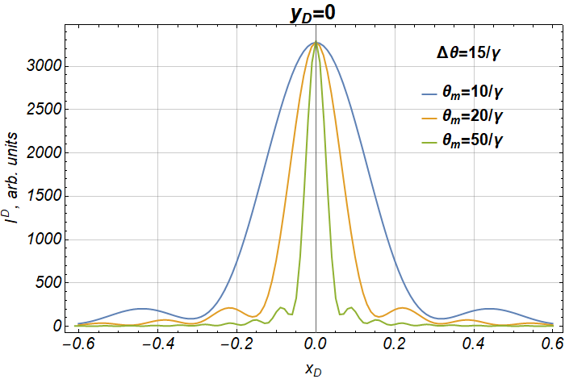
OTR off-axis PSF

Slide 16
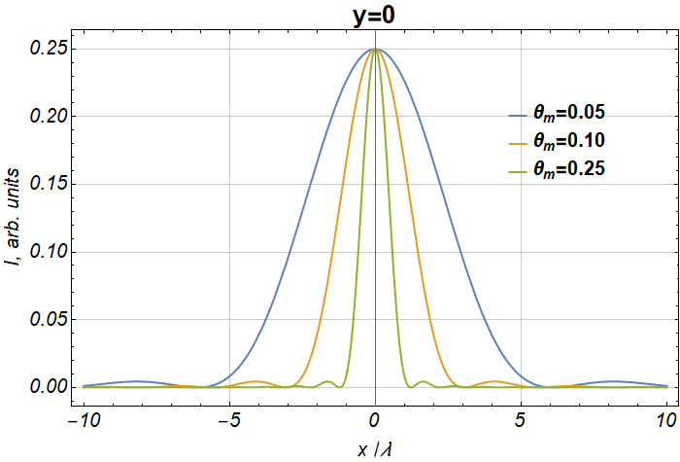
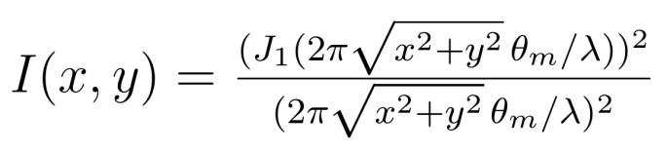
Airy distribution

Slide 17
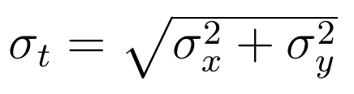
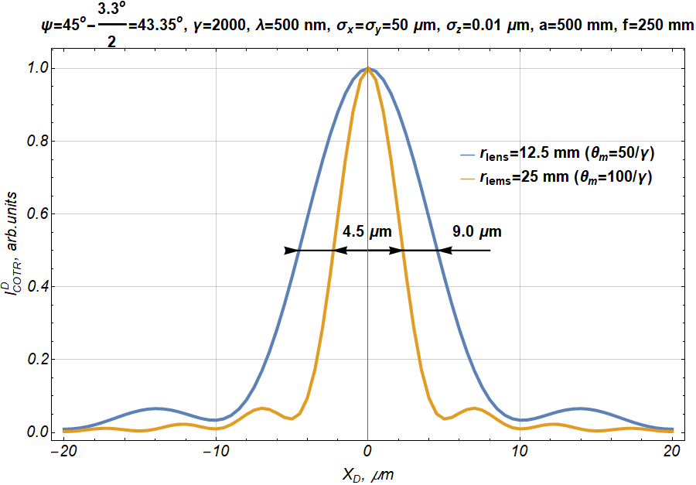

Space distribution of OTR photons (off-axis case) on the CCD (M=1) from a beam with
$→$0

Slide 18



Focused off-axis OTR yield (γ = 2000)

Slide 19



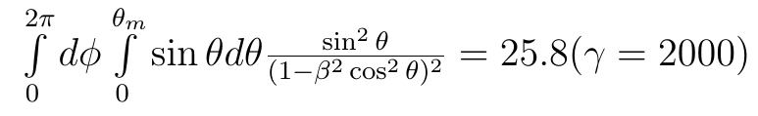


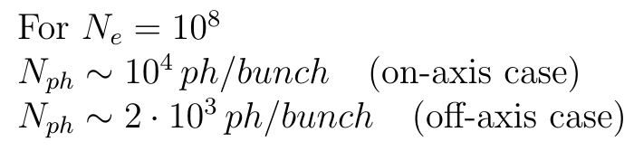
OTR photons yield
A number of OTR photons with wavelengths ,
is the filter bandwidth
exact formula
Ultrarelativistic approximation →
Accuracy is better than 3%

Slide 20
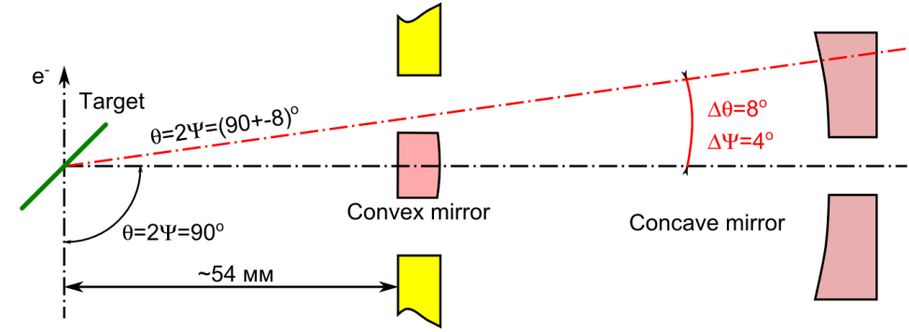


Schwarzschild objective
$$\sim γ^{−1}\sim 0.5 mrad$$
$$Ψ={45}^{o}$$
CCD

Slide 21
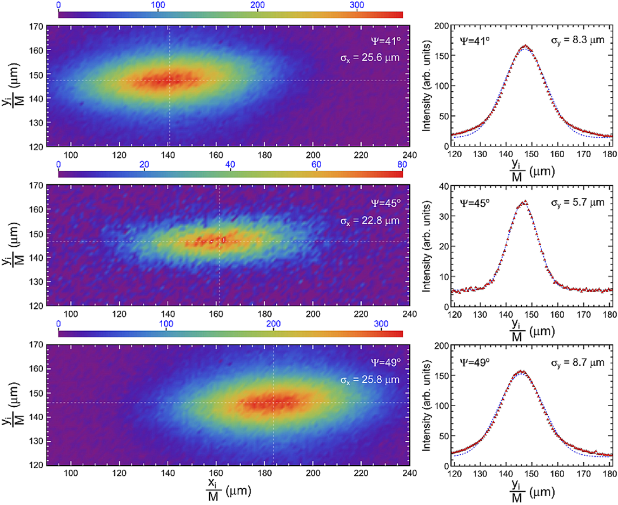
OTR pattern measured by the Schwarzschild objective (data are not published yet)
off-axis
on-axis
off-axis

Slide 22
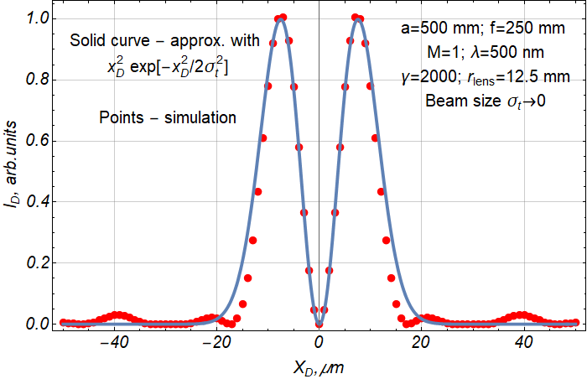
PSF for OTR on-axis lens
Simulation of transition radiation based beam imaging from tilted targets/L. G. Sukhikh, G. Kube and A. P. Potylitsyn/PR AB 20, 032802 (2017)

Slide 23
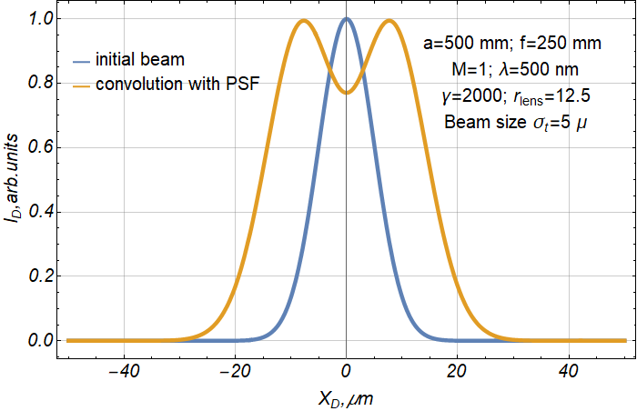
Beam image (OTR on-axis lens)

Slide 24
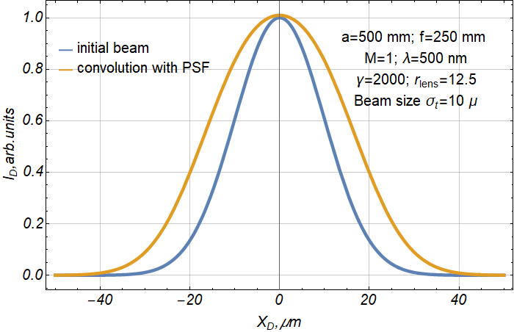
Beam image (OTR on-axis lens)

Slide 25
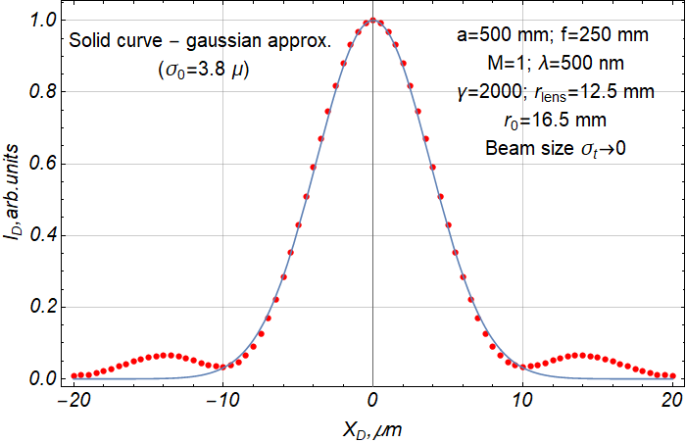
PSF for OTR off-axis lens
r₀ is the distance between lens axis and OTR minimum on the lens surface

Slide 26
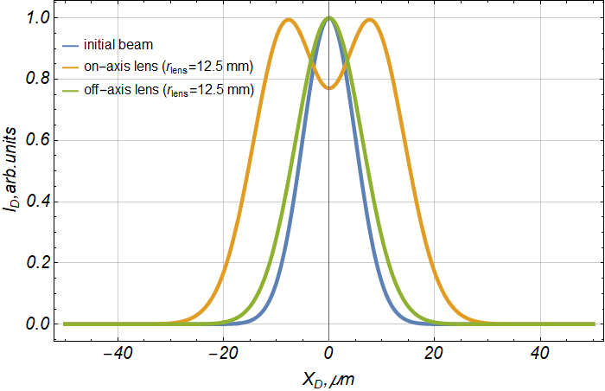
Beam images (σ^{t} = 5μ)

Slide 27
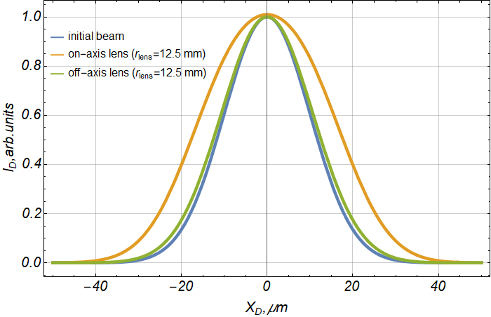
Beam images (σ^{t} = 10μ)

Slide 28
Summary
For large emission angles COTR is suppressed strongly and the photon yield is caused by OTR process only;
OTR photon yield collected by a lens with a large aperture (~100/γ) displaced at the angle θ₀ ≤ 10/γ with respect to the specular reflection direction (off-axis lens) is about one order of magnitude less than for on-axis geometry;
PSF for the off-axis lens possesses the single-maximum shape closed to the gaussian distribution (in contrast with on-axis geometry);
geometry with off-axis light collection can provide more precise beam profile measurements in comparison with the traditional scheme;
off-axis light collection geometry can be used for spatial separation of COTR photons in order to measure a transverse beam size if and

