Slide 1
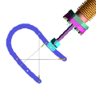
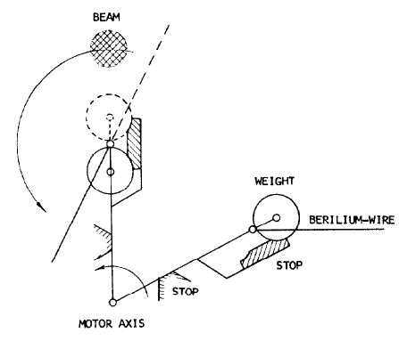
Beam size measurements using Wire Scanners
at Synchrotron Light Sources and FELs.
or
Wire scanners for Electron Beams (excluding Hadron Beams)
Kay Wittenburg
Topical Workshop on Emittance Measurements for Light Sources and FELs; ALBA Synchrotron , January 29 - 30, 2018
U. Vogel; The Measurement of AGS spatial Beam Density distribution by means of flipping Targets,
IEEE NS-16 No, 3 (1969)

Slide 2
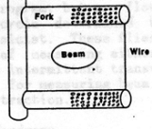

Agenda
1 Introduction
History
Signal generation
What is Special on Wire Scanners for Electron Beams?
Wire Scanner in SR e-rings
Wire Scanners in Electron Linacs and FELs
Experiences
Vibrations: Problems and Solutions
4 Wire scanners with long bunch trains (in SC FELs)
Long pulse trains (or CW) requirements
5 Measurements with wire scanners at FELs
Detector Issues
Wire Issues
Profile, Tails and Halo
Comments
06 Summary
Outlook

Slide 3
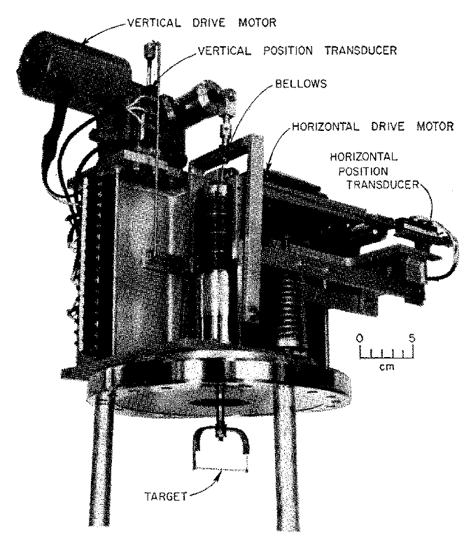

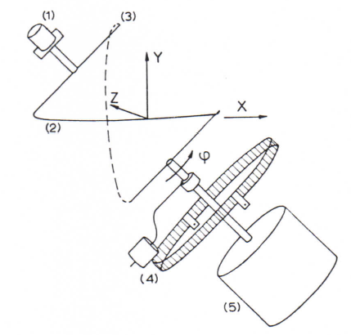
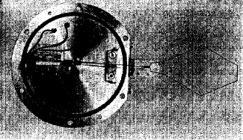
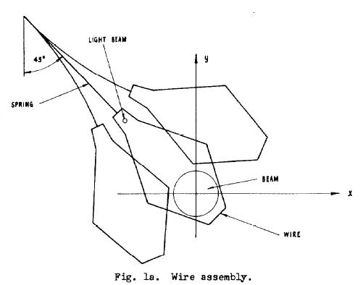
Introduction
Histrory
Linear Scanner
My first references:
Daryl Reagan ; SCANNING ELECTRON BEAM PROFILE MONITOR.SLAC-PUB-0186, Apr 1966. 9pp. Published in Rev.Sci.Instrum.37:1190-1191,1966
G. Hortig; A Beam Scanner for two Dimensional Scanning with one rotating Wire; NIM 30 (1964) p. 355-356
J. Takacs; Beam Scanner for the Oxford electrostatic tandem Accel.; IEEE-NS 12 Nr. 3 p 980 (PAC 1965)
Rotating Scanner

Slide 4

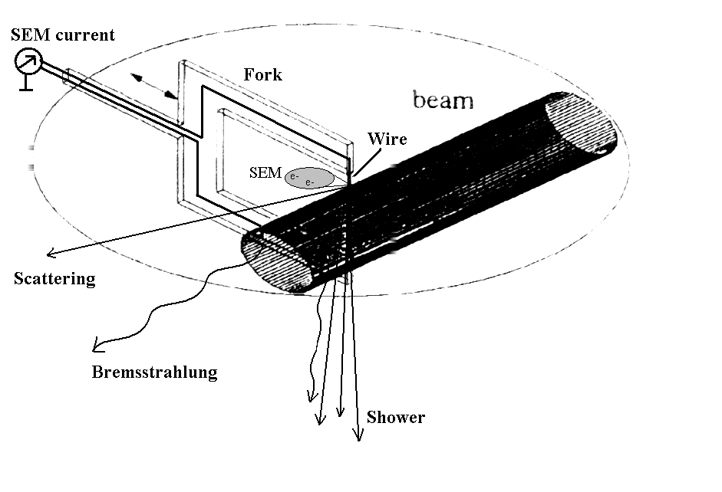
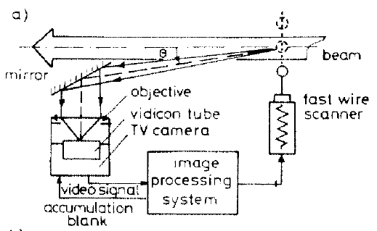
Introduction
Signal generation
by
Scattering
Bremsstrahlung
Shower
Secondary Emission (SEM)
Television (OTR, Scintillation)
For low energy beams SEM is the preferred readout method since secondary particles may not penetrate the beam pipe wall and are therefore hard to use. At high energy beams (short bunches) SEM might be disturbed by electromagnetic noise. Therefore the detection of secondaries outside the vacuum is the better choice.
ON POSSIBILITIES OF TV BEAM DIAGNOSTICS TECHNIQUE USING OPTICAL RADIATION FROM THE FLYING WIRE SCANNER. V.P. Novikov et al., EPAC1990

Slide 5
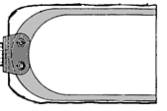

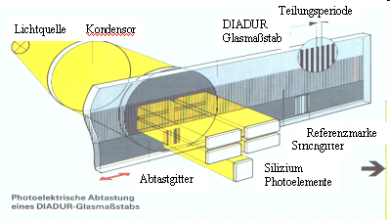
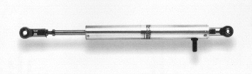
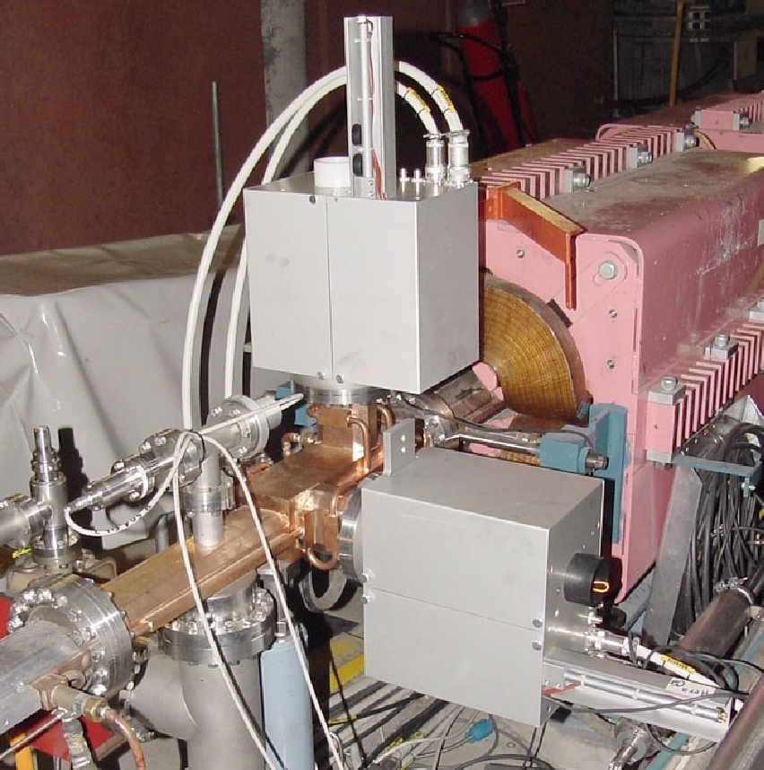
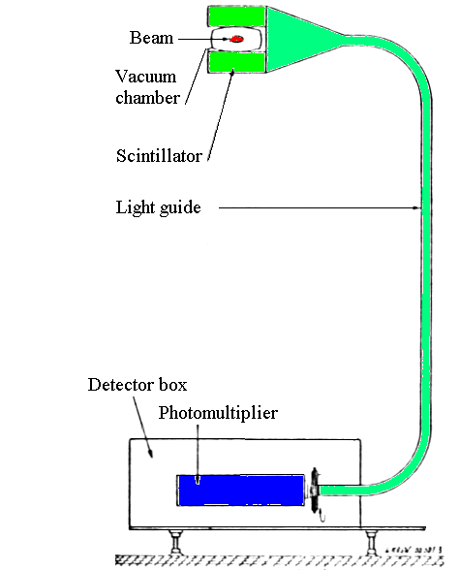
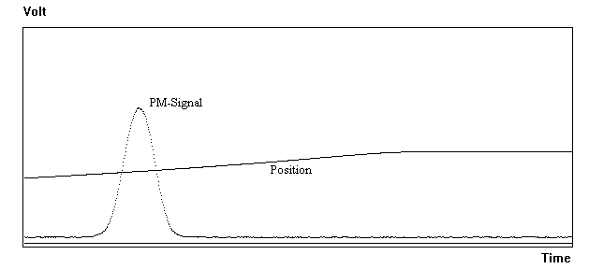
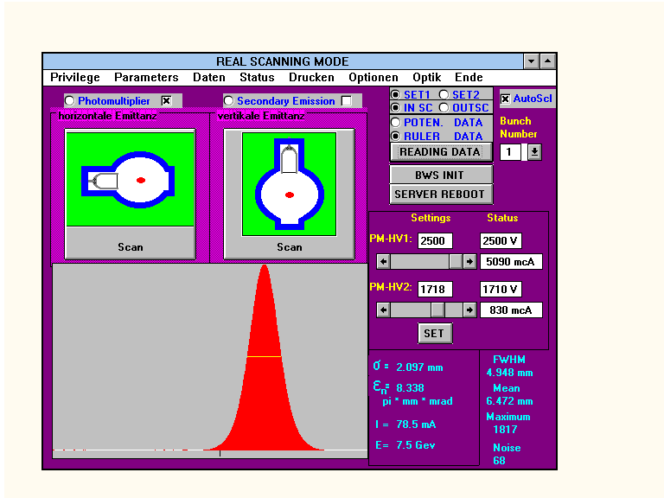

Introduction
1) Scanner
2) Detector (often PMT)
3) Position Measurement
5) Everything is connected
4) Software (Control System)
Profile generation
0.1 micron position resolution is possible
Potentiometer

Slide 6

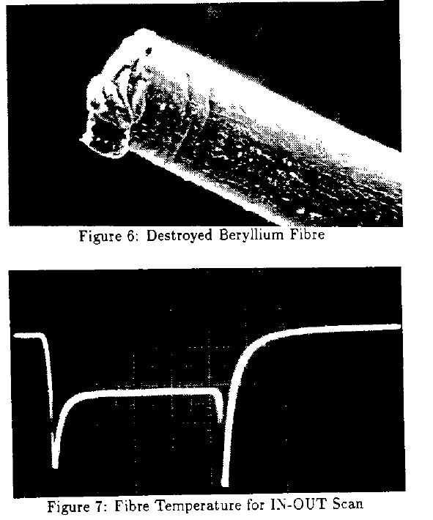
What is Special on Wire Scanners for Electron Beams?
Small Beam Sizes (<< 100 μm) -> High Resolution required
Small Beam Sizes -> High local energy deposition in wire
Small Scattering Angle 1/γ -> Detector Positioning for good Signal
Short Bunches -> Strong Higher Order Modes in Wire Chamber
Rings and SC FELs: High Bunch Rate -> Thermal Heating of Wire
Red: Major Problems in e-rings
Almost no wire scanners in e-ring based SR sources exist (couldn’t find any reference). Known problems in DORIS, LEP, HERA-e:
WIRE SCANNERS AT LEP.
B. Bouchet, etal., CERN-SL-91-20-DI-15, May 1991. 1991 IEEE Particle Accelerator Conference, San Francisco, CA, 6 - 9 May 1991.

Slide 7

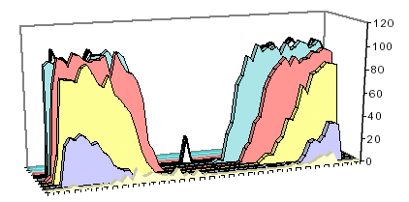
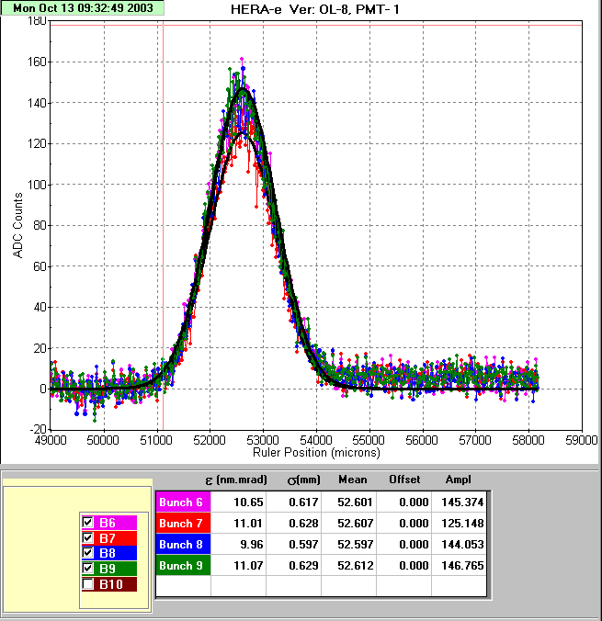
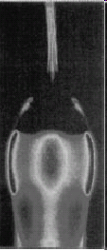
What is Special on Wire Scanners for Electron Beams?
No Wire Scanner in SR e-rings
Light intensity
Higher Order Modes
LEP: Digitized video recording of an 8 μm carbon wire scanning a 0.8 mA beam. The light intensity is plotted along the vertical axis (arbitrary units)...RF heating led to (huge) thermal glowing before the beam interacts with the wire. DORIS, HERA-e: Observation: Carbon wires just vanished without using the scanner…
time
Wire
length
QUARTZ WIRES VERSUS CARBON FIBERS FOR IMPROVED BEAM HANDLING CAPACITY OF THE LEP WIRE SCANNERS. C. Fischer, etal, CERN-SL-96-09-BI, May 1996.
beam
Some solutions
SPS and LHC: Ferrites etc. in vacuum tank. LEP, HERA-e: Quartz fibers (non-conducting) but still low (not at design) beam current.
σ ≈ 1mm
Problem: Sublimation and heating
A 30 μm Quartz wire, used in a LEP wire-scanner monitor, after scans through 7mA beams. The thickness of the top part, traversed by the beam, is a few microns.

Slide 8
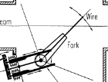
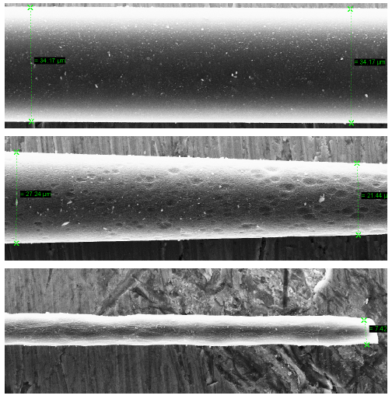
What is Special on Wire Scanners for Electron Beams?
No Wire Scanner in SR e-rings
Single bunch FELs: f_{Bunch} ≤ 60 Hz
Bunch rep. rate: kHz > f_{bunch} > MHz
Thermal Heating of the Wire
Energy deposition according to dE/dx.
Many details (incl. cooling mechanism) discussed in: Beam Interaction with Thin Materials: Heat Deposition, Cooling Phenomena and Damage Limits, M. Sapinski, 2012 Beam Instrumentation Workshop (BIW12)
Sublimation of material: Fiber fracture at three distances from the beam impact location: 1 mm (upper plot), 0.5 mm (middle plot) and at beam center location (bottom plot).
Some solutions
LEP, HERA-e: Limited beam current (few mA).
SPS and LHC: Very fast Scanner (v=20m/s). Less resolution.
HERA-e: Large beams (in perpendicular direction)
All solutions are not applicable to ring based SR sources. => Almost all rely on SR-Monitors
Carbon Fiber Damage in Particle Beam
M. Sapinski, et al, HB2010,

Slide 9
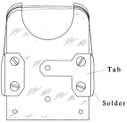
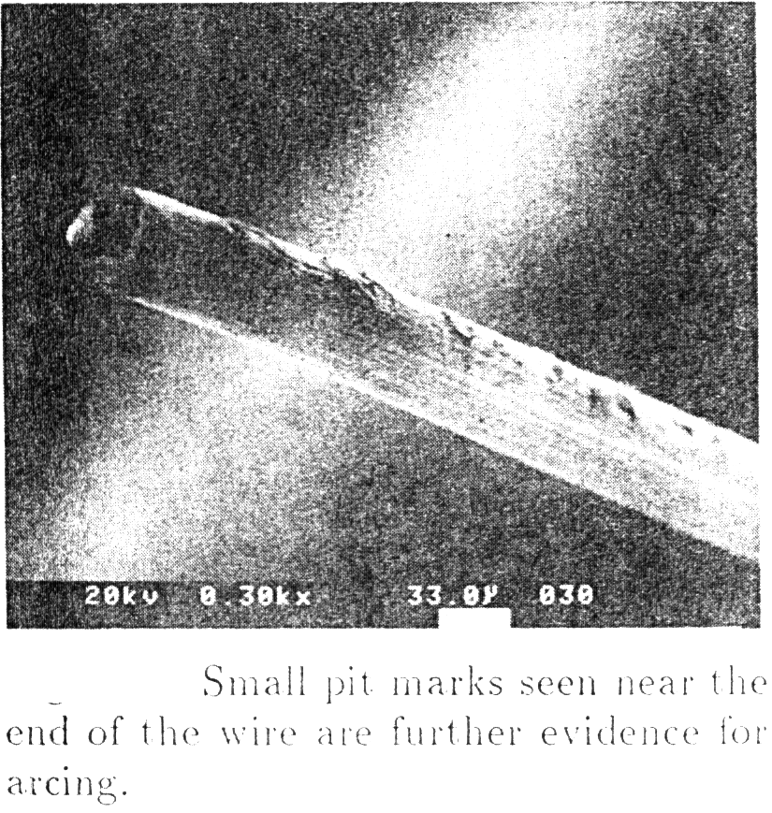
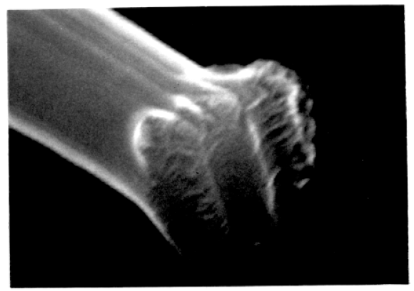
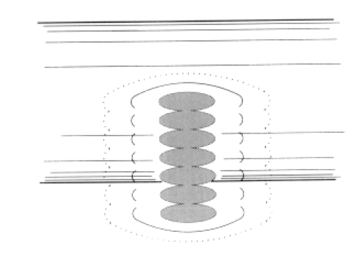
Wire Scanners in Electron Linacs and FELs
Experiences at
SLC:
Slow Scans, < 1 micron/step, 60 Hz bunch rate:
Fifty wire scanners are in use at SLC ... A large number of failures of the 50 μm wire used in the scanners have occurred. Studies of these show strong electro-magnetic fields produced by the beam to be the probable cause. The problem has been cured with the adoption of a ceramic mounting scheme ... (uncertain).
The evidence at SLC (focus) is that carbon fibres are broken by beams of approximately 10¹⁰ electrons with σ_{x} x σ_{y} < 3 µm².
Wire breakage in SLC wire profile monitors. Field, C.; McCormick, D.; Raimondi, P.; Ross, M.; SLAC-PUB-7832 (1998)
Failed 4 µm carbon wire with inset showing the progression of successive beam pulses scanning across the wire. This wire was broken at the point of intersection with a beam of 3 x 10⁹ particles/µm².

Slide 10
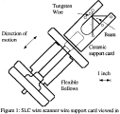
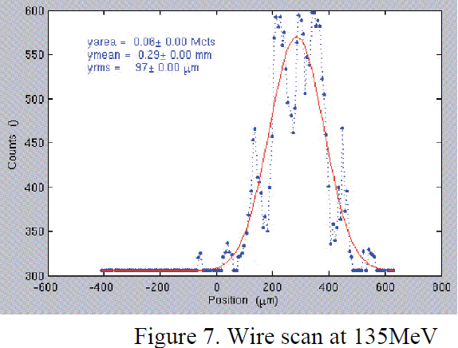
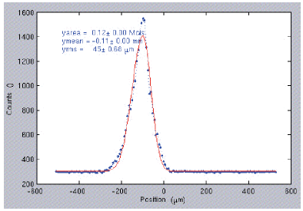
Wire Scanners in Electron Linacs and FELs
Vibrations: Experiences at
LCLS I
The LCLS wire scanners use 20-micron Tungsten wires driven by a stepper motor / leadscrew actuator … with a step size of 5 microns. The wire vibration was found to be unacceptable and 10X gear reducers were added, reducing the vibration, but decreasing the maximum scan speed. With the reducers, the step size is now 0.5 microns.
BEAM MEASUREMENTS AT LCLS
J. Frisch,et al, SLAC-PUB-15018 (BIW08)

Slide 11

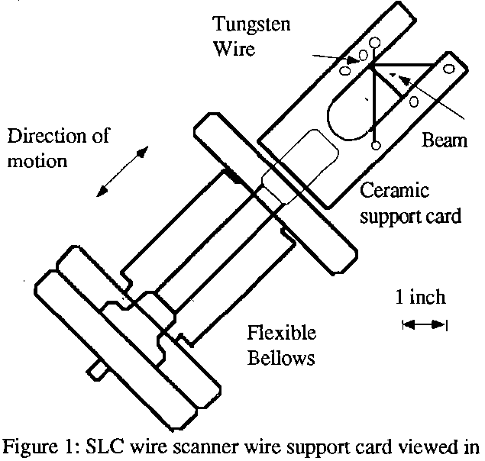



Vibrations of the support
Vibration
SLAC-Pub-5556 (1991)

Slide 12

Vibrations of the support
Vibration
SLAC-Pub-5556 (1991)

Slide 13
Vibrations of the support
Vibration
SLAC-Pub-5556 (1991)

Slide 14

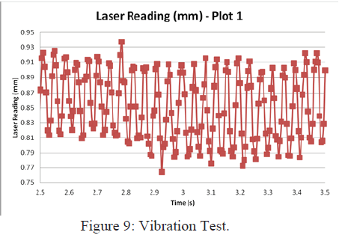
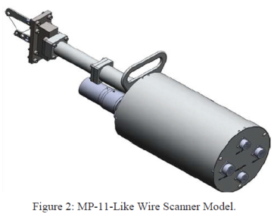
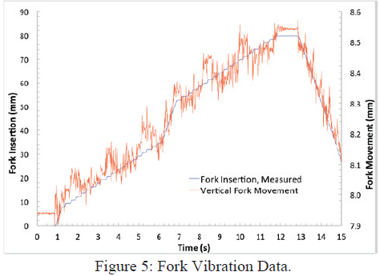
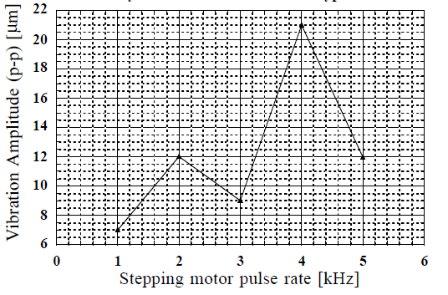
Wire Scanners in Electron Linacs and FELs
Vibrations: Experiences at
LANCE and SNS (Protons)
Mechanical Design and Evaluation of the MP-11-like Wire Scanner Prototype
Sergio Rodriguez Esparza, et al., IPAC12
KEKB Linac (Electrons)
A METHOD FOR MEASURING VIBRATIONS IN WIRE SCANNER BEAM PROFILE MONITORS N. Iida, et al.,
APAC98
=> Vibration amplitudes of many μm!

Slide 15
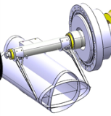
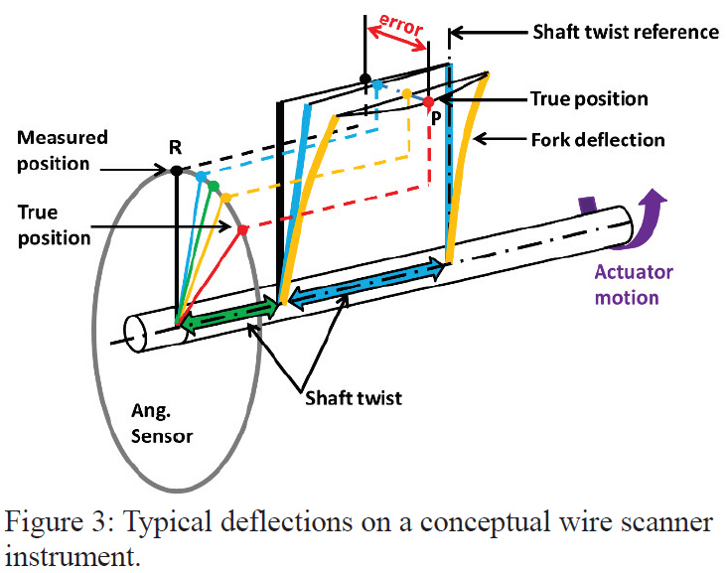
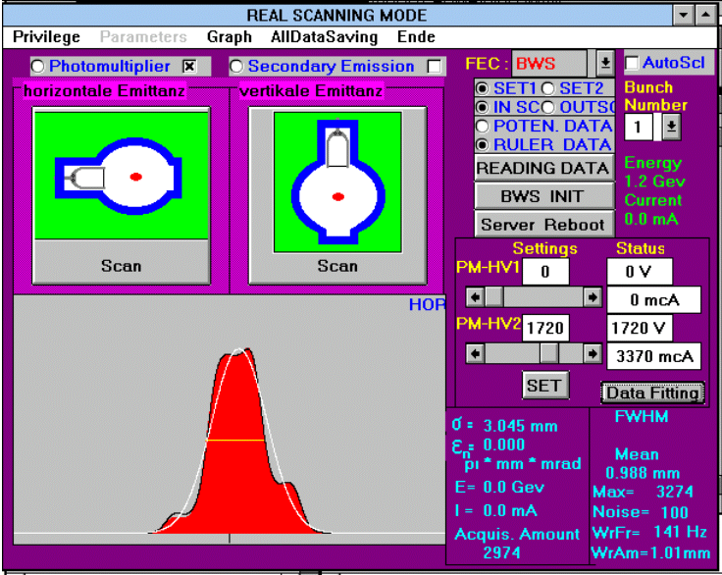
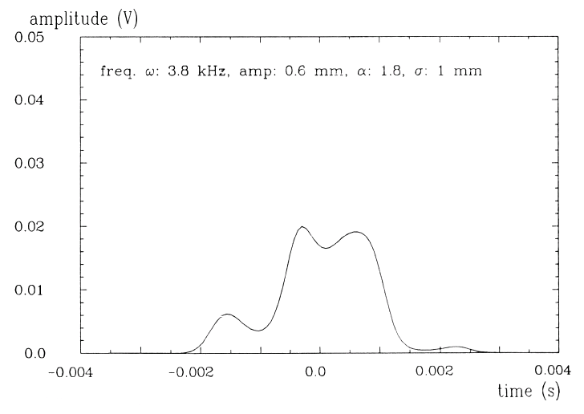
Wire Scanners in Electron Linacs and FELs
Vibrations: Experiences at (for completeness)
LHC (Proton Synchrotron)
Very fast scanner (20m/s). The vibration of the thin carbon wires used has been identified as one of the major error sources on the wire position accuracy.
Vibration measurements of a wire scanner – Experimental setup and models
Juan Herranz, Ana Barjau, Bernd Dehning Mechanical Systems and Signal Processing, Volumes 70–71, March 2016, Pages 974-994
DESY III (Proton Synchrotron)
Swinging wire due to not well stretched/fixed wire.
Simulation of swinging wire + Gaussian (unpublished):

Slide 16

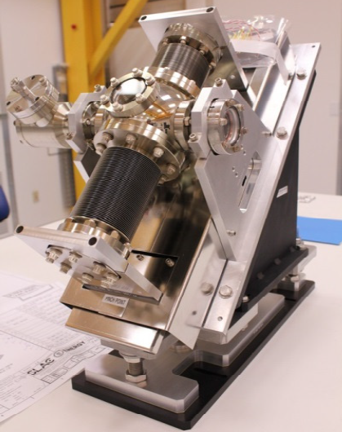
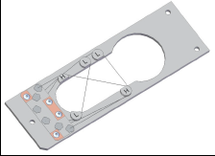
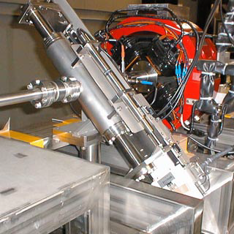
Wire Scanners in Electron Linacs and FELs
Vibrations: Solutions at
LCLS II (high speed)
- The carriage moves smoothly on a linear slide integrated into a dc linear servo motor assembly
- The wire card is held at both ends rather than cantilevered as in the old design
- The low vibration design allows for wire speeds up to 1 m/s, high wire speeds are essential to prevent wire breakage from the high power electron beam with a 1 MHz repetition rate.
- The wires may typically range from 10 µm carbon filaments to 30 µm tungsten wire. Different materials and thicknesses according to how great a beam loss signal we wish to generate.
Performance of the New Fast Wire Scanner at the LCLS
P. Krejcik, et al IBIC2015
Wire Scanners for Small Emittance Beam Measurement in ATF
Hayano, H , LINAC2000
ATF (low speed)
- Furthermore a vibration of the wire mount is reduced by using this double support stage compared with a single end support.
- The scanning speed is low, ~500µm/sec. With clock speed for the stepping motor more than 150 Hz reduce the vibration amplitude from 0.3 to 0.2 µm p.p.

Slide 17

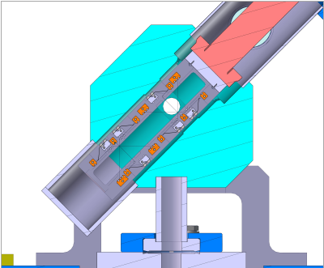
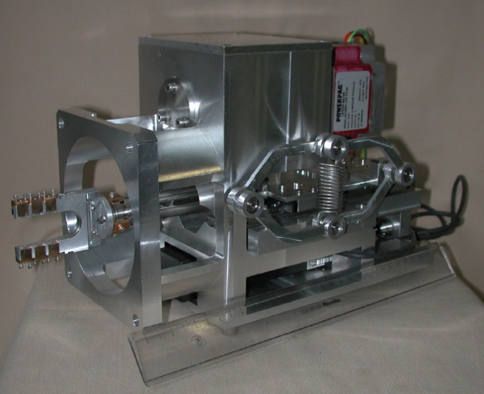
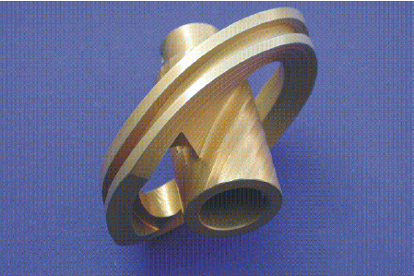
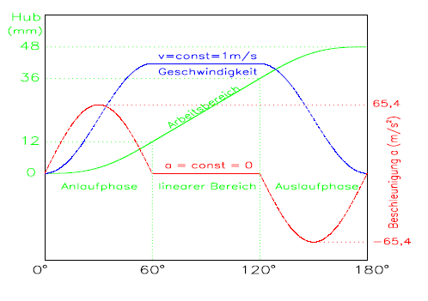
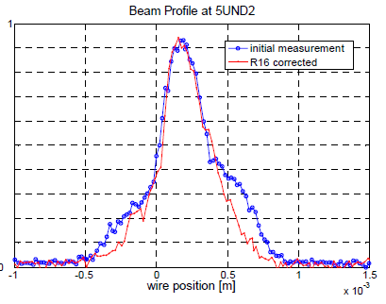
Wire Scanners in Electron Linacs and FELs
Vibrations: Solutions at
SWISS FEL (low speed):
- Single end support: Wire-vibration measurements showed 1.3 µm (rms) of the wire in the motor speed range 0.1-6.0 mm/s with the exception of the motor speed range 0.5-0.6 mm/s where an anomalous wire vibration - 2.1-1.6 µm was observed. Narrow resonances are a unavoidable feature in a stepper-motor driven linear-stage
First Experimental Results of the Commissioning of the SwissFEL Wire-Scanners
Gian Luca Orlandi
IBIC 17
FLASH (low + high speed):
- 2 scanners at 90⁰ at all positions.
- DC Motors, optimized acceleration curves
- Successful use of LEP Wire Scanner design (Scanners used from HERA)
- Vibrations were never observed on the beam profiles.
TESLA Report 2002-08
Prototyp eines Wirescanners für TTF II
N. von Bargen, et al.

Slide 18
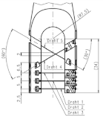
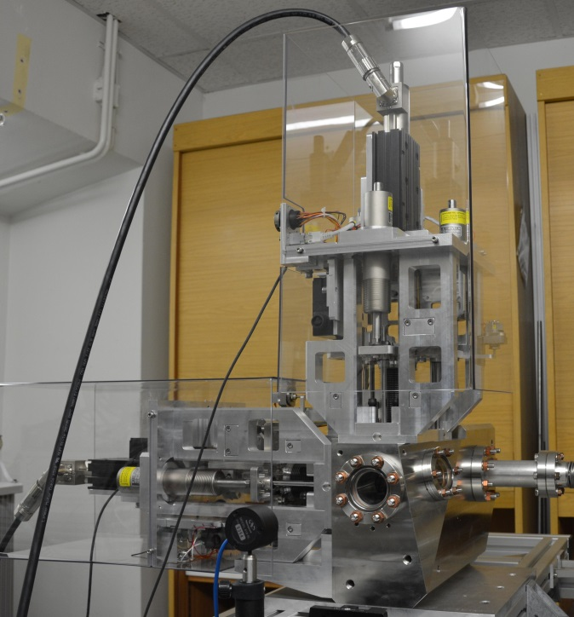
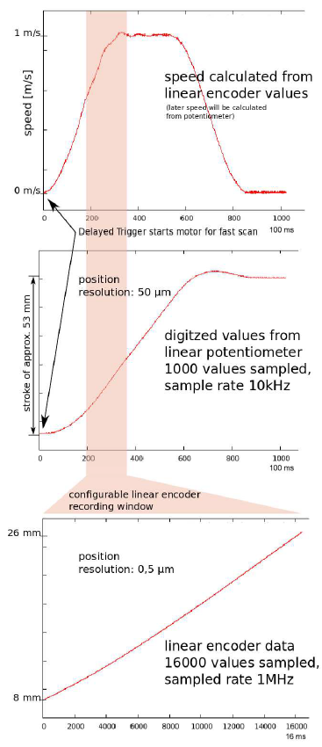
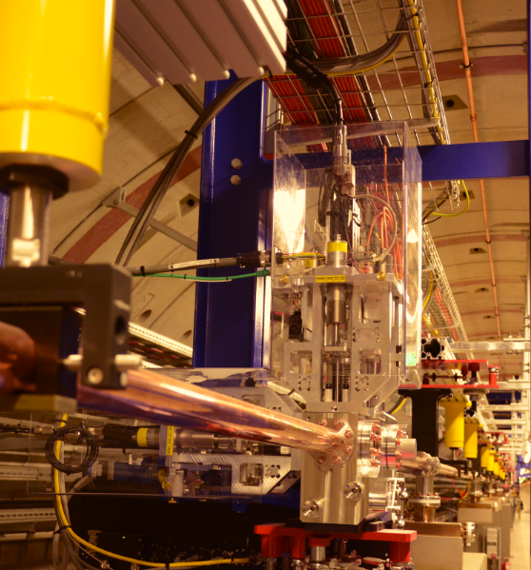
Wire scanners with long bunch trains (in SC FELs)
Long pulse trains (or CW) req.
European XFEL
- High wire speeds (1 m/s) are essential to prevent wire breakage from the high power electron beam with 4.5 MHz repetition rate (220 ns, 2700 bunches/pulse (650 μs)) with charge up to 1 nC/bunch.
- Linear DC Motors, 90⁰ arrangement (E-XFEL) to prevent vibrations
- Resolution of ≈ 1 μm required since beam size goes down to 10 μm -> optical encoder
- Triggerable: A fast scan is performed by receiving a pre-trigger 60 ms before arrival of the first bunch. Upon reception of a trigger the motor controller starts the motor after a pre-defined delay with a jitter of < 1 μs (± few bunches).
Wire Scanner Installation into the MicroTCA Environment for the European XFEL, Timmy Lensch, et al., IBIC 2014,

Slide 19




Wire scanners with long bunch trains (in SC FELs)
Long pulse trains (or CW) requirements
Bunch rate vs. thermal load
Calculations have shown, that a Tungsten wire will survive while crossing about 100 bunches (2 σ) of 1 nC each. A 1 m/s scanner moves 0.2 microns/200 ns (1 bunch, 5 MHz) => scan of 20 μm beam size. Surviving larger beams require
a reduced bunch rate (additional cooling (e.g. heat transport along the wire) helps at very low rep. rates).
or a Carbon wire
or higher speed
or reduced bunch current
Thermal Load on Wirescanners
Lars Fröhlich
DESY Technical Note 2006-02
More references on temperature calculations:
B. Cheymol, Effects of Energy Deposition Models and Conductive Cooling on Wire Scanner Thermal Load, Analytical and Finite Element Analysis Approach, HB2016
Mariusz Sapinski: BIW2012, HB2010, DIPAC2009, BIW2008, CERN-BE-2009-028, CERN-AB-2008-030
K. Wittenburg, Conventional Wire Scanners at TESLA, Tesla Report 2000-18

Slide 20





Measurements with wire scanners at FELs
Detector issues
First beam test result of a prototype wire scanner for the KEKB injector linac and BT lines, T. Suwada et al., KEK-Preprint-97-184
Linac: Almost no SR-background!
Typical: Scattered electrons are detected downstream by scintillators. A few: Bremsstrahlung by γ-Detectors (but background due to residual gas)
For higher energies: much smaller angle! Find best detector location: Monte Carlo simulations (Geant, Fluka, …): The detector might be located some tens or even hundreds of meters behind the scanner!
Entries in the vacuum pipe versus distance z
1000 cm
Estimation of the signal from the wire scanner in the TTF
By Sergei Striganov, et al, TESLA-99-08
Monte Carlo calculation of the secondary particle distribution at the scintillation counter.
Wire scanner system for FLASH at DESY. U. Hahn, et al., NIM.A592:189-196,2008.

Slide 21




Measurements with wire scanners at FELs
Detector issues
Find best detector location: Monte Carlo simulations necessary!!!
Detector efficiency dependence on: Location, energy, real installations (magnets and fields), beam center position (!!!), …
Wire scanners for TTF2 (unpublished)

Slide 22



Measurements with wire scanners at FELs
Detector issues
Signal depends on detector location:
Design and experimental tests of free electron laser wire scanners , G. L. Orlandi, et al, Phys. Rev. Accel. Beams 19, 092802 (2016)

Slide 23




Measurements with wire scanners at FELs
Wire issues
Signal depends on wire material and wire diameter:
Application of Beam Loss Monitors at SwissFEL, C. Ozkan et al., IBIC 17
Wire scanner system for FLASH at DESY. U. Hahn, et al., NIM.A592:189-196,2008.
3 different wires: extended dynamic range

Slide 24








Measurements with wire scanners at FELs
Profiles, Tails, Halo and Emittance
LCLS
European XFEL
Performance of the New Fast Wire Scanner at the LCLS
P. Krejcik, M.L. Campell, et al., IBIC2015
ADC saturation
First Beam Halo measurements using Wire Scanners at the European XFEL
S. Liu, et al., FEL2017

Slide 25


Measurements with wire scanners at FELs
Profiles, Tails, Halo and Emittance
XFEL
xFEL: Quadrupole scan with
wire scanners (Aug. 2017)
Horizontal plane:
emittace_norm: 1.4725e-06 m rad emittace_norm_err: 1.7959e-07 emittace_geom: 5.4960e-11
Vertical plane emittace_norm: 2.5920e-06 m rad emittace_norm_err: 7.2711e-07 emittace_geom: 9.6744e-11 emittace_geom_err: 2.7139e-11

Slide 26




Measurements
unpublished
Comment I
Signal source; Detector
Often Photomultiplier tubes with scintillators or optical fibers are used:
For long bunch trains: Beware of depletion (and saturation) of the PMT! Ensure enough capacitances at the last stages to store enough charges.
Photocathode: Trialkaline, linear at high peak input
Diamond detectors under study (High Dynamic Range Diamond Detector Readout System for the CERN’s Beam Wire Scanners Upgrade, J.L. Sirvent et al, IBIC2015)

Slide 27




Measurements
Comment II
Influence of Wire Diameter
A reference from 1988 shows “… the effect is very small until the beam size is actually less than the wire diameter.”
…
“If necessary, this error can be largely removed by multiplying the measured beam size by the relevant beam size correction factor, as given in figure 3.”
To my knowledge no one has recalculated this….
Analysis of the lnfluence of Fibre Diameter on Wirescanner Beam
Profile Measurements, Quentin King SPS/ ABM/Note/88-02 March 1988

Slide 28


Measurements
Comment III
Multi-shot measurement:
Always correct the measured signal to the beam position and to the bunch current.
A very good BPM with resolution of 1 μm and a single bunch current monitor next to wire scanner is helpful.
These corrections have to be implemented into the control system application of the wire scanner, otherwise it will be forgotten.

Slide 29


Summary
Have you noticed the about 30 different designs of wire supports in that corner? Their designs are mainly driven by the beam parameters.
No wire scanners in ring based SR sources
An X design (hor. + vert. simultaneously at 45 deg.) reduces the number of scanners but is sensitive to vibrations.
Slow scans (μm/s) are the tool in low rep. FELs.
Fast scans (≥1m/s) are required in high rep. and CW FELs
Typical resolution of better 10 μm is achieved, with precise MC simulation one might achieve real < 1 μm, but for very small beam sizes there is a limit on the wire size: diameter + precision.
Outlook: … a new approach to wirescanners design based on nanofabrication technologies opening new possibilities in term of wire shape, size, material and thickness with potential for sub-micron resolution and increase flexibility for instrumentation designers….
A NANOFABRICATED WIRESCANNER WITH FREE STANDING WIRES: DESIGN, FABRICATION AND EXPERIMENTAL RESULTS.
M. Veronesea,et al, Preprint submitted to Nuclear Instruments and Methods in Physics Research Section A, November 20, 2017, and IBIC17

Slide 30

End

Slide 31




A DUAL WIRE BEAM SCANNER.
A. Mcilwain, NIM136,1976

Slide 32



A SCANNING SECONDARY EMISSION PROFILE MONITOR.
By W.R. Rawnsley, et al., PAC 1987)
H.F. Wegner, I.L. Feigenbaum;
High Current beam Scanner, PAC 1967,

