Slide 1
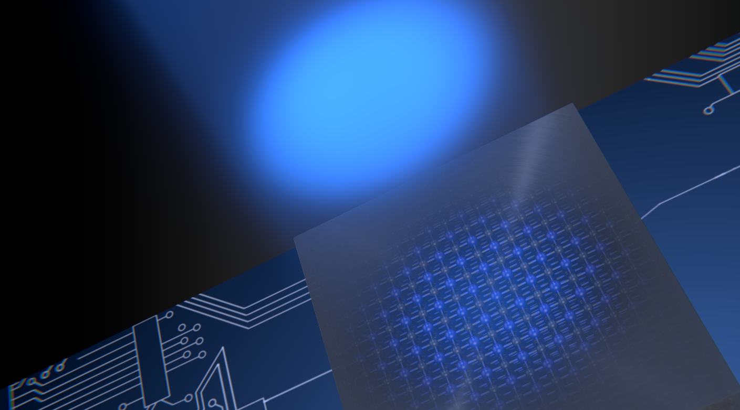


Paris 2017
Understanding quantum materials by their non-equilibrium dynamics
Simon Wall
ICFO – The Institute for Photonic Science
Barcelona
Spain
Notes:
Insulator-metal phase transitions have a huge promise for future technologies because very large changes in material properties, such as the conductivity, or optical can occur. Some materials can also effect this change very rapidly. However, the mechanisms behind many of these transitions are still poorly understood. They key interactions are between the electrons and the phonons which control how the energy imparted by light is redistributed in the material. Today I am going to talk about how we can watch dynamics of the insulator-metal phase transitions in order to try and understand how and why these phase transitions occur in two contrasting systems.

Slide 2
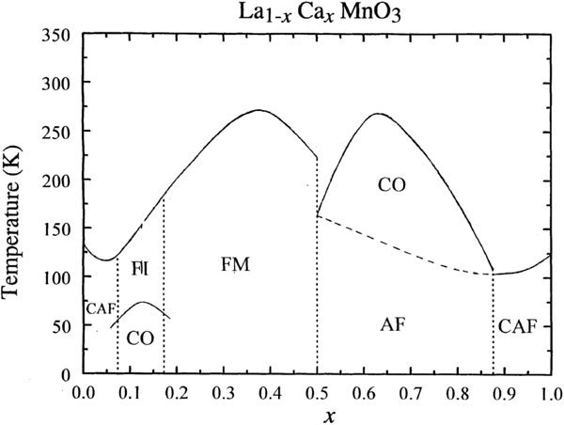
Quantum Materials
Cuprates
Wahl, Nat. Phys. (2012)
Initial phases are anti-ferromagnetic insulators
CDW
Suggests Mott-Hubbard physics and strong electronic correlation
Charge density wave states emerge with doping
Manganites
Suggests Peierls-like physics and strong electron-phonon coupling
Do electron-electron or electron-phonon interactions dominate the physics of quantum materials?
Millis Nature (1998)

Slide 3
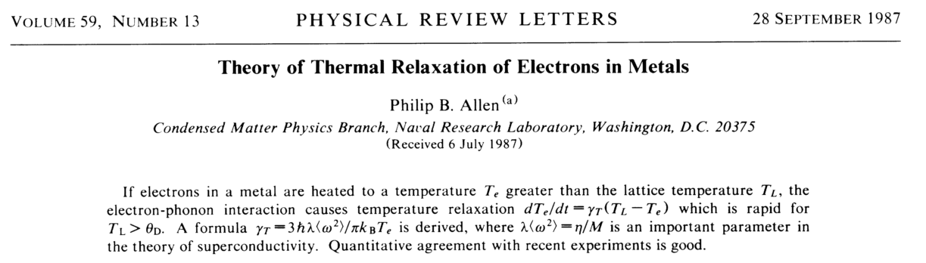
How can ultrafast help?
Requirement: Source to transfer energy to electrons (and thermalize) before energy is transferred to the lattice – femtosecond timescale
n
n
n
E
E
E

Slide 4
Probing material dynamics
Measuring reversible dynamics using Pump-Probe technique
F = 1 kHz, T = 1/F = 1 ms
Stroboscopic technique.
Laser fires a pulse at a constant repetition rate
Δt
Δt
t
Measure one delay many times
Pump
Probe
sample
X = 2c Δt
Notes:
How we probe what happened in the femtosecond timescales

Slide 5
Probing femtosecond dynamics
Measuring reversible dynamics using Pump-Probe technique
F = 1 kHz, T = 1/F = 1 ms
Δt
Δt
t
Measure one delay many times
Move delay and repeat
Pump
Probe can be:
Optical pulse
X-rays
Electrons…
Probe
sample
X = 2c Δt
Notes:
How we probe what happened in the femtosecond timescales

Slide 6
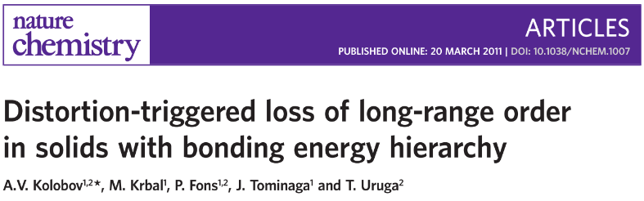
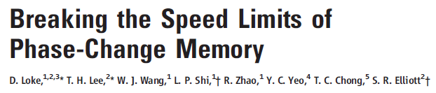
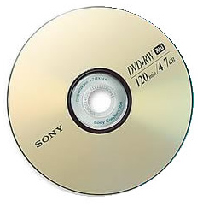
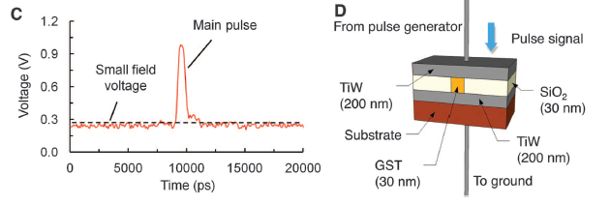
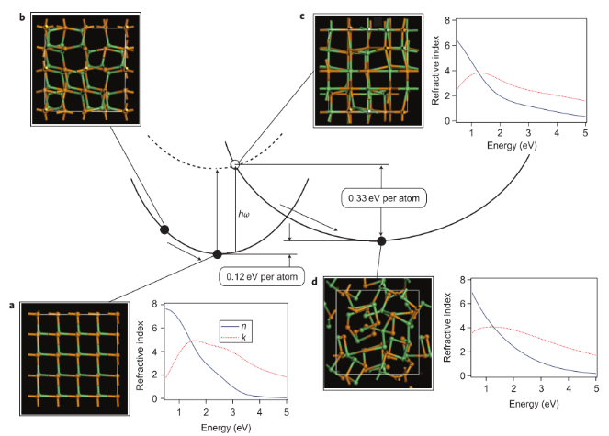
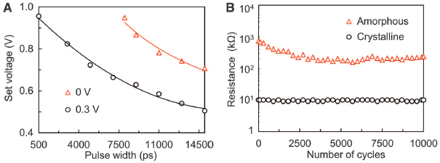
Ge₂Sb₂Te₅
Non – quantum material with light-induced insulator-metal transition

Slide 7
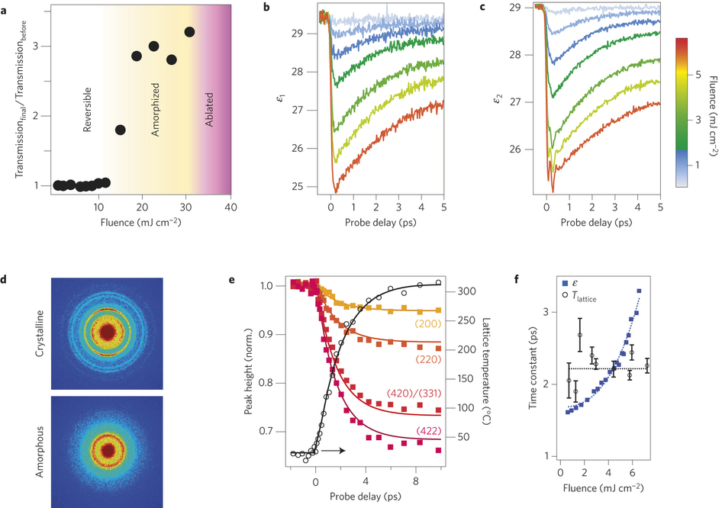
Crystalline-Amorphous Phase Transformation
Crystalline
Amorphous
Transformation can occur with a single 35 fs laser pulse
Transformation quasi-reversible
L. Waldecker et al. Nature Materials. 14, 991 (2015)

Slide 8
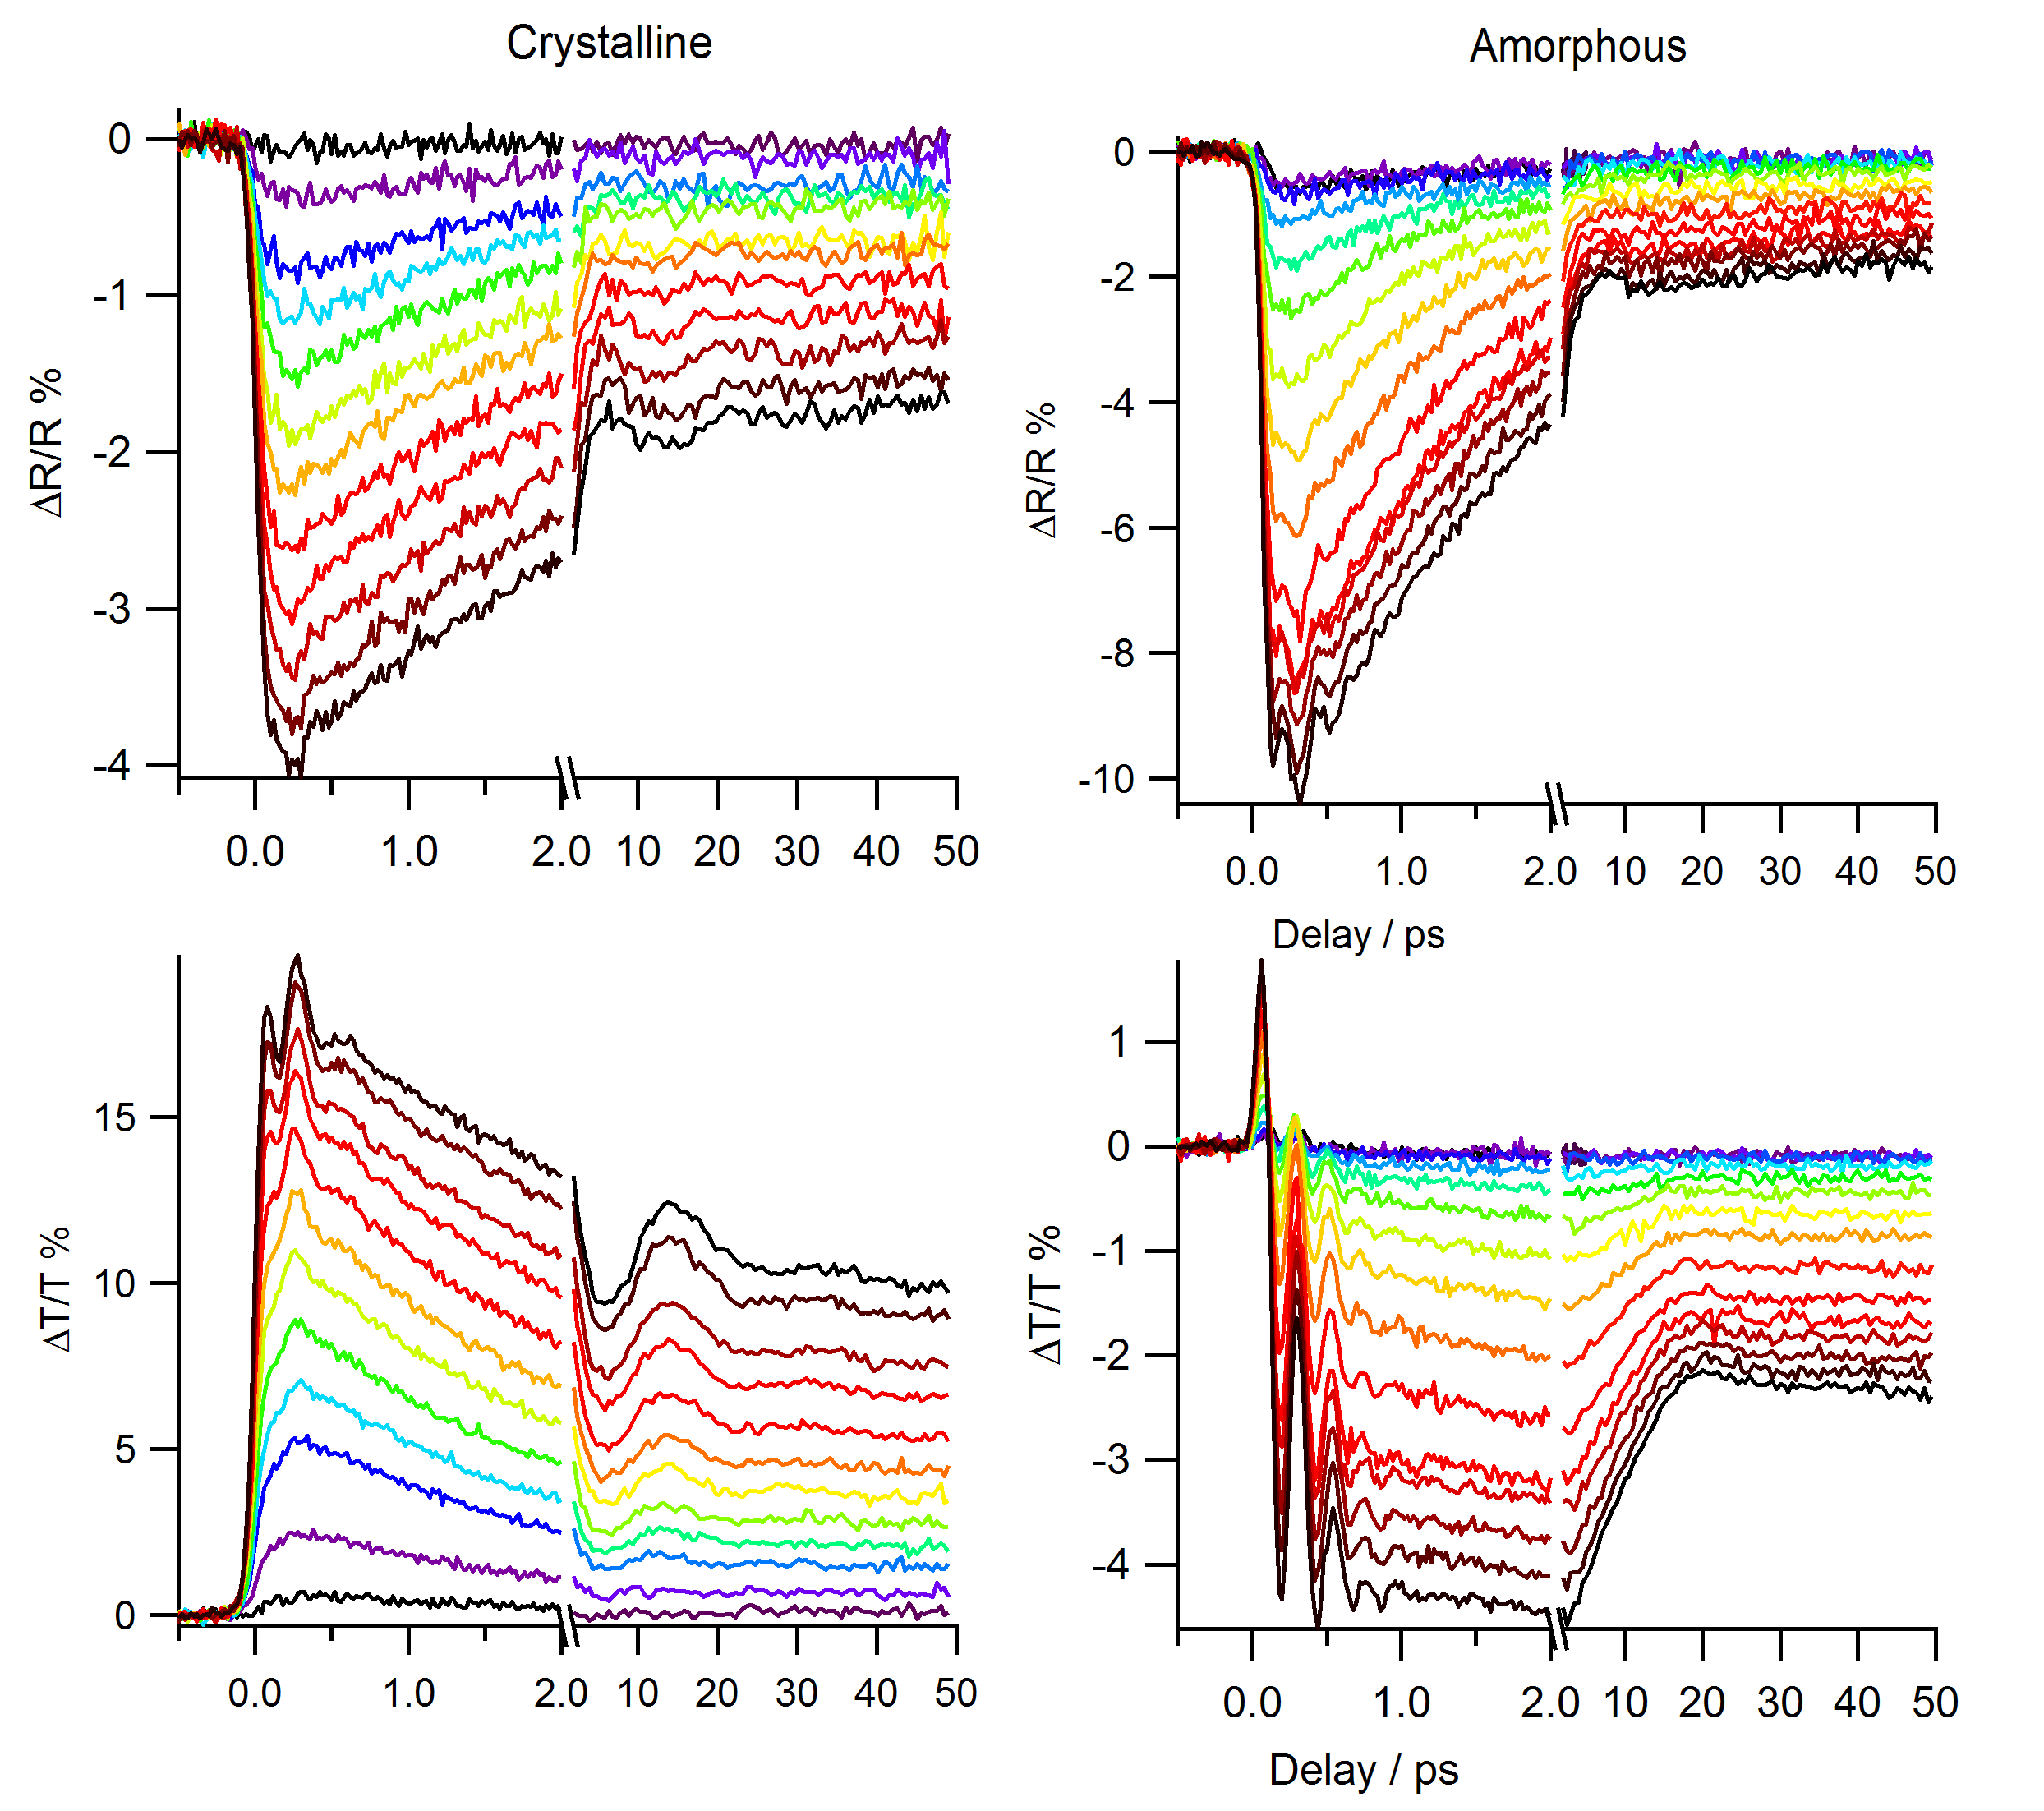
Reversible Femtosecond dynamics
Crystalline
Amorphous
0.05 mJ/cm²
Picosecond recovery dynamics + long lived component
Acoustic phonon (breathing of the film)
(Special) Coherent optical phonons
6 mJ/cm²
Delay / ps
Delay / ps
Delay / ps
Delay / ps

Slide 9

Ultrafast processes in a semiconductor
CB
Photo-excitation creates a charge distribution in the conduction band
$$ℏω$$
VB

Slide 10
Ultrafast processes in a semiconductor
(A semiconductor perspective)
CB
Photo-excitation creates a charge distribution in the conduction band
Electrons thermalize
Electrons cool to the minimum of the conduction band emitting phonons and heating the lattice
Is the band structure rigid?
VB

Slide 11
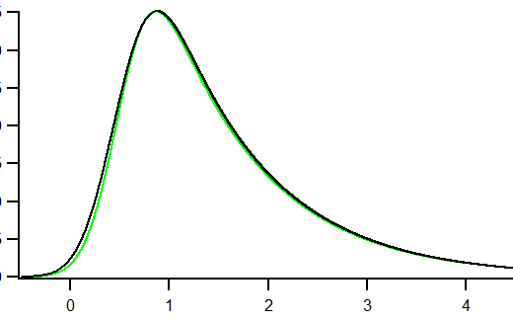
Ultrafast processes in a semiconductor
CB
Change in charge distribution can apply a force on lattice – Strongly Coupled Optical Phonons
Anti-bonding
e
Bonding
SCOP
VB
Amplitude/population
Force/electrons
Phonon
lattice
Time

Slide 12
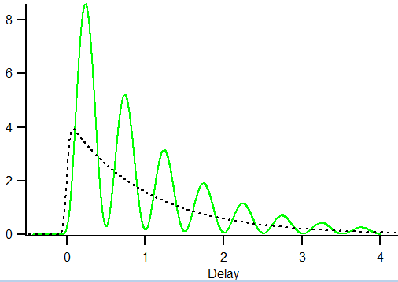
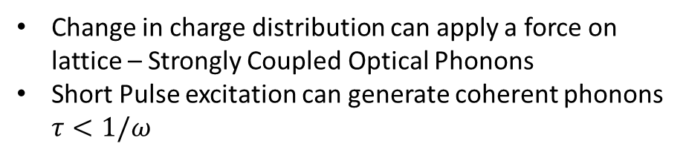
Ultrafast processes in a semiconductor
CB
Change in charge distribution can apply a force on lattice – Strongly Coupled Optical Phonons
Short Pulse excitation can generate coherent phonons $τ<1/ω$
Anti-bonding
e
Phonon
Bonding
SCOP
VB
Amplitude/population
Force/electrons
lattice
Time

Slide 13
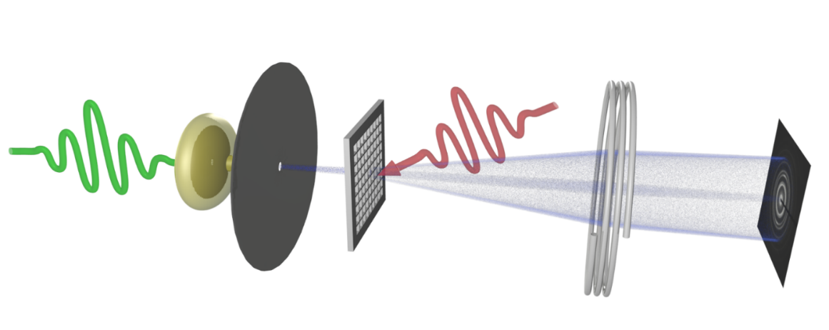
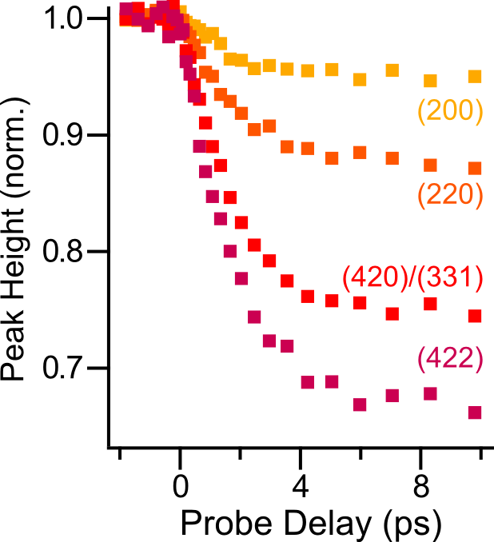
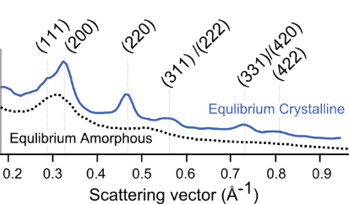
Measuring the Structure
Pump Laser
30 fs VIS laser pulse
80 kV
Sample on
TEM grid
Electron Lens
L. Waldecker et al. J Appl. Phys. 117, 044903 (2015)
L. Waldecker et al. Nature Materials. 14, 991 (2015)

Slide 14
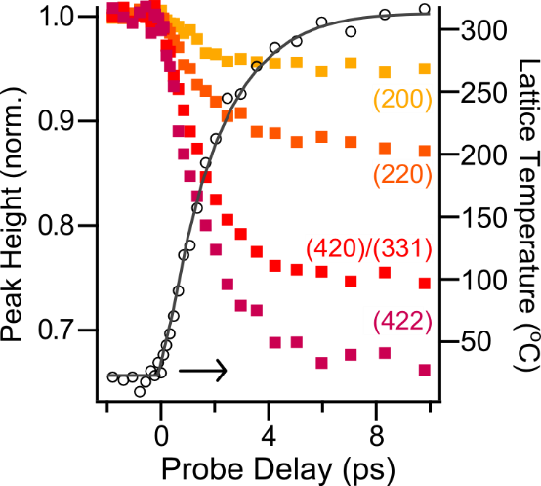
Measuring the Structure
Pump Laser
30 fs VIS laser pulse
80 kV
Sample on
TEM grid
Electron Lens
L. Waldecker et al. Nature Materials. 14, 991 (2015)

Slide 15
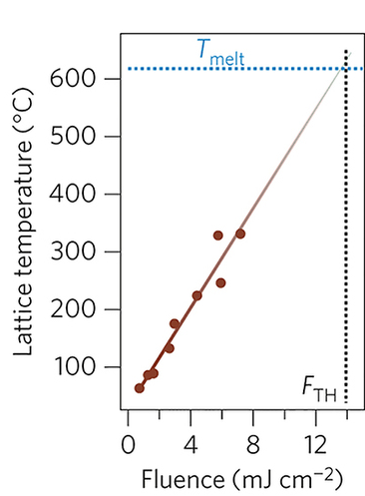
Measuring the Structure
Pump Laser
30 fs VIS laser pulse
80 kV
Sample on
TEM grid
Electron Lens
L. Waldecker et al. Nature Materials. 14, 991 (2015)

Slide 16
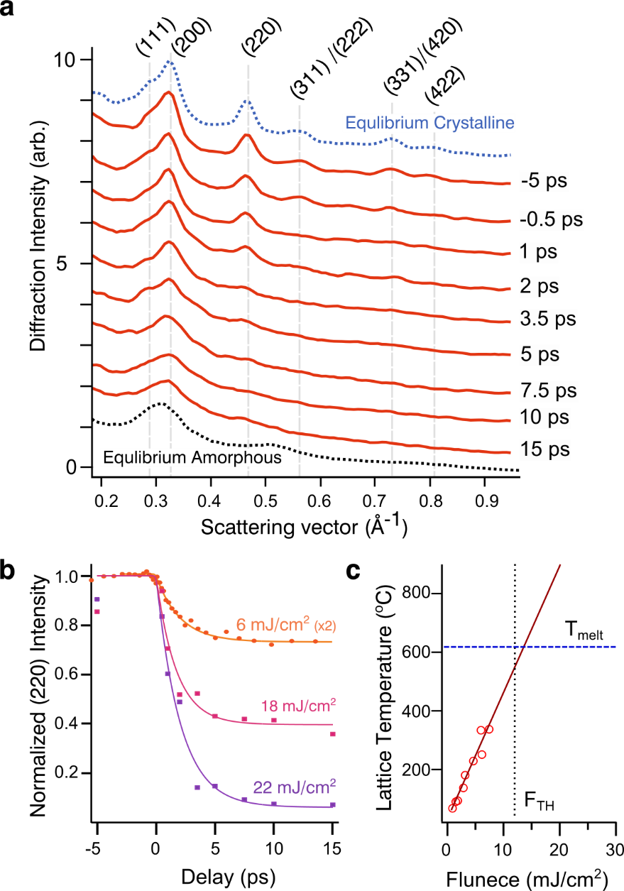
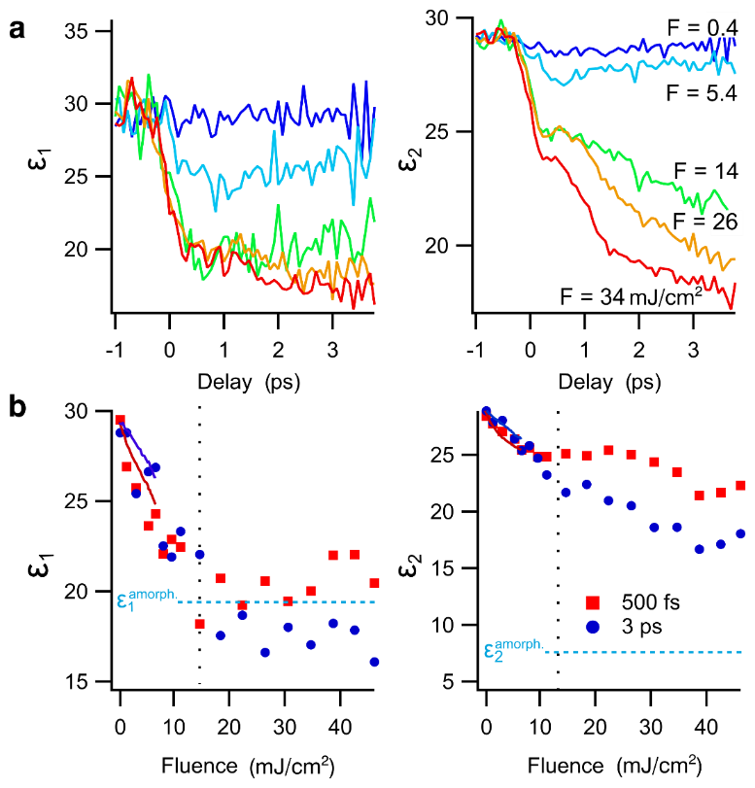
Above Threshold Dynamics
Lattice response remains thermal
Melting occurs in ~ 5ps
Resulting phase is a liquid
Amorphization occurs during rapid cooling
L. Waldecker et al. Nature Materials. 14, 991 (2015)

Slide 17
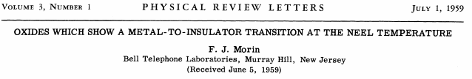
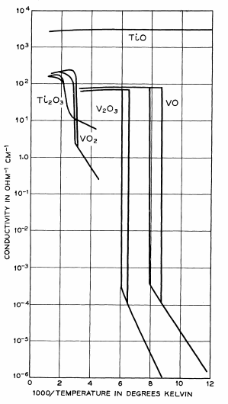
VO₂
Metallic Rutile R-phase
Insulating Monoclinic M₁-phase
V ions “pair and twist”

Slide 18
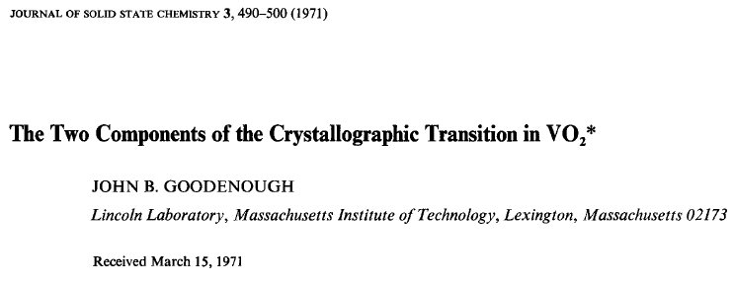
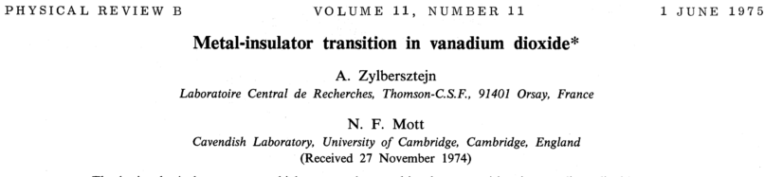
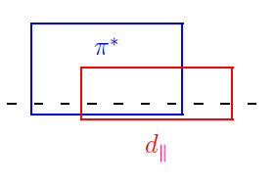
Controversial Topic
V 3d
V 3d
V 3d//
V 3d//
E_{f}
E_{f}
R
M₁
R
Monoclinic metal
Mott insulator

Slide 19
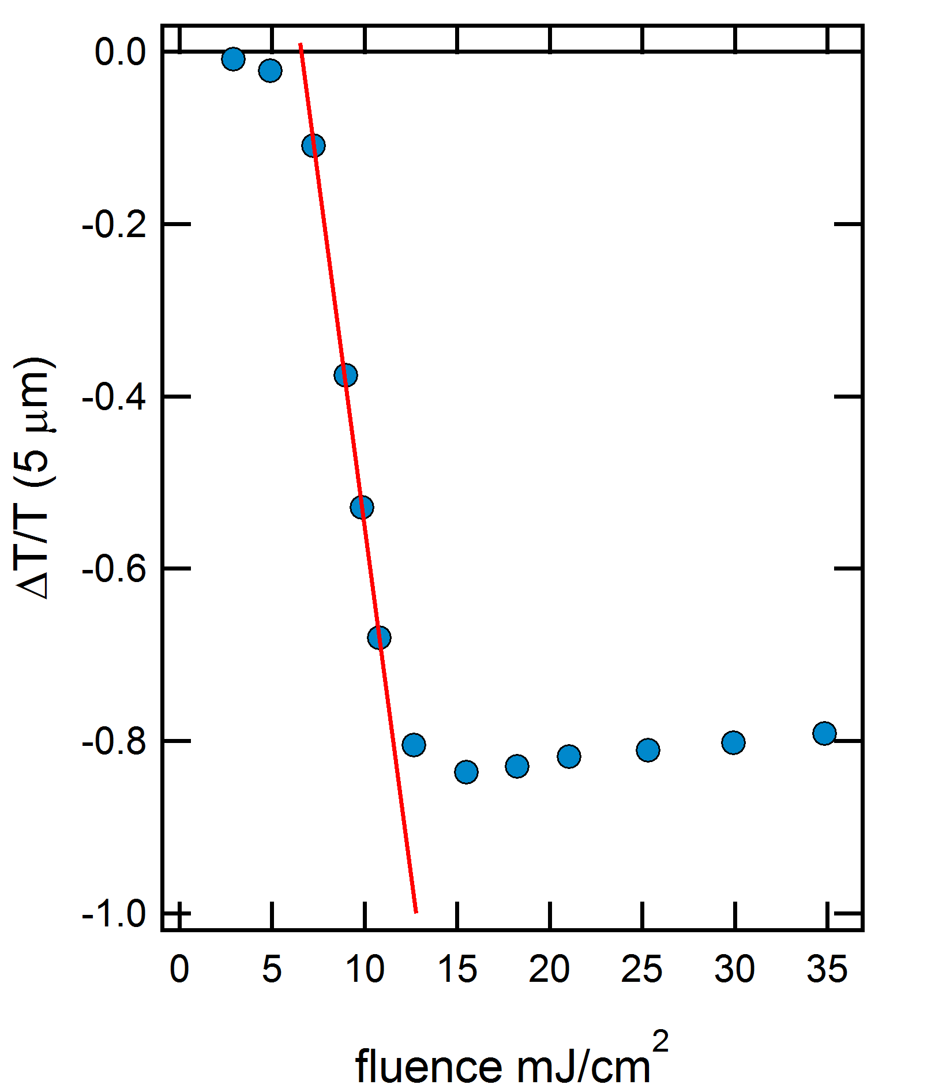
The Photoinduced Phase Transition in VO₂
Pump: 800 nm
Probe: 5 µm
Delay: 1 ps
Sample: Thin film
Light can drive the insulator-metal transition
Below threshold – Material remains monoclinic
Threshold – Start of metallization
Saturation – Complete transformation
Thermal diffusion restores monoclinic insulating phase in ~1 ns
1
2
3

Slide 20
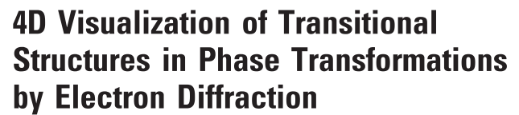
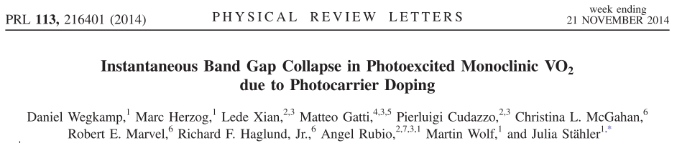
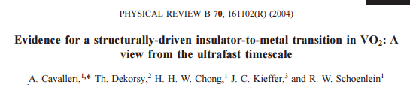
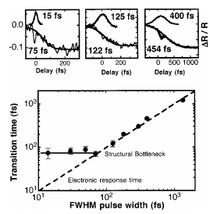
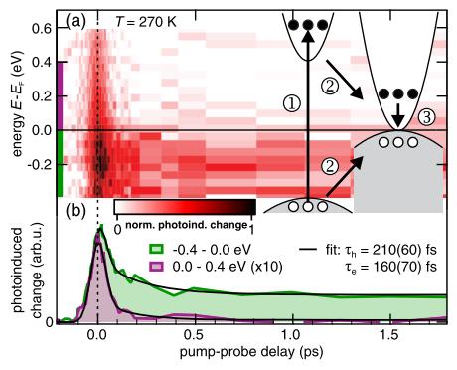
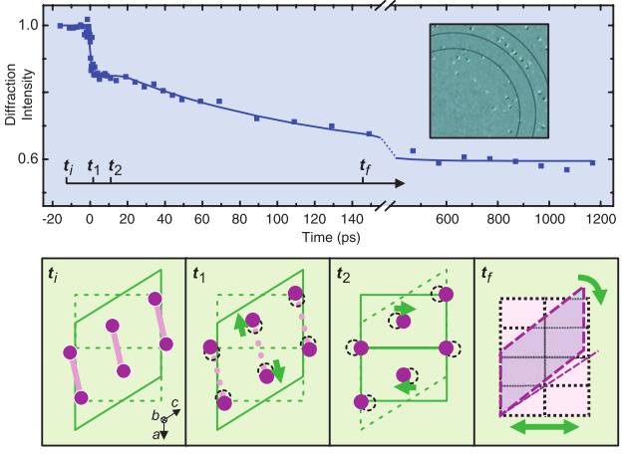
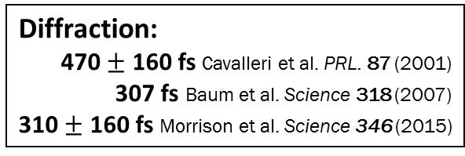
Timescale for the Phase Transition
Optical:
75 fs = ½ period of one A_{g} Raman active phonon
Diffraction:
470 $±$ 160 fs Cavalleri et al. PRL. 87 (2001)
307 fs Baum et al. Science 318 (2007)
310 $±$ 160 fs Morrison et al. Science 346 (2015)
Photoemission:
Instantaneous gap collapse

Slide 21
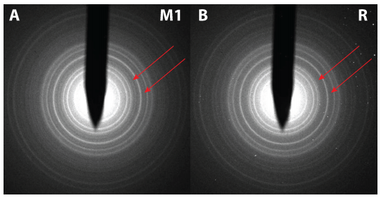
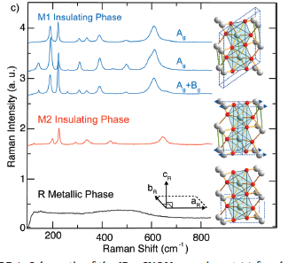
Identifying a Phase
Average atomic positions –Bragg peaks
Phonon modes – Raman Spectrum
Morrison et al. Science (2015)
Jones et al. Nano letters (2010)

Slide 22
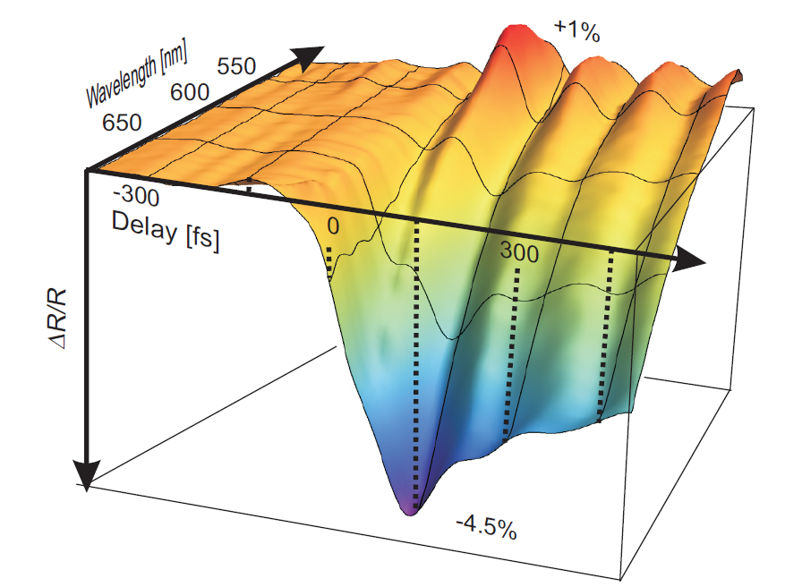
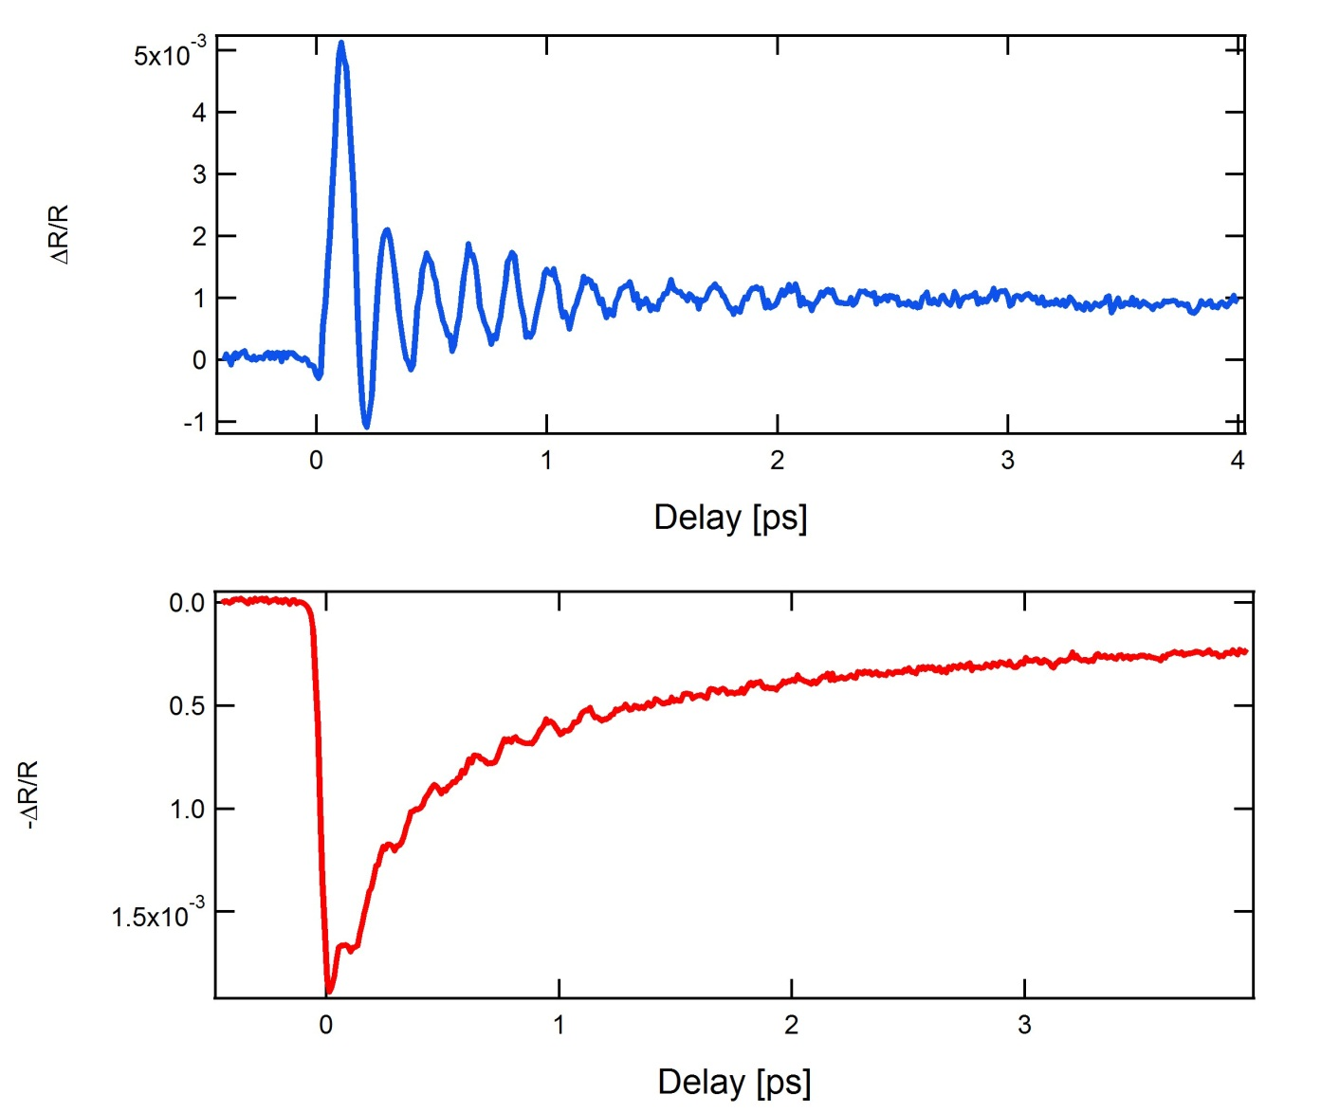
M₁ Phase Response to Photoexcitation
Experimental Details
Pump: 800 nm
Probe: White light
Pump fluence: < F_{TH}
Sample: Thin film
T = Room Temperature
525 nm
800 nm
S. Wall et al. Nature communications 3 721 (2012)

Slide 23
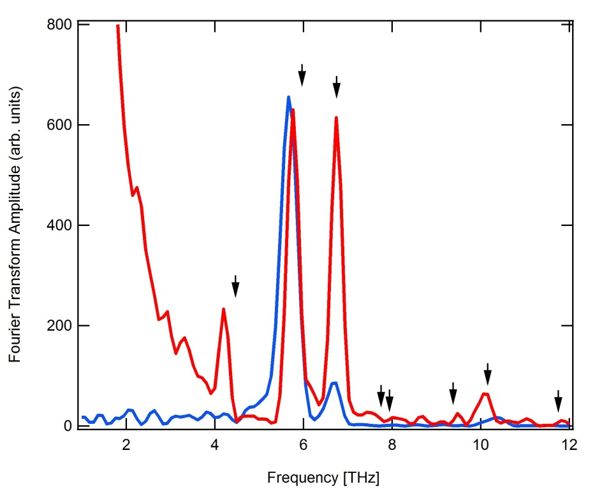
M₁ Phase Response to Photoexcitation
525 nm
5.6 THz
6.7 THz
800 nm
S. Wall et al. Nature communications 3 721 (2012)

Slide 24
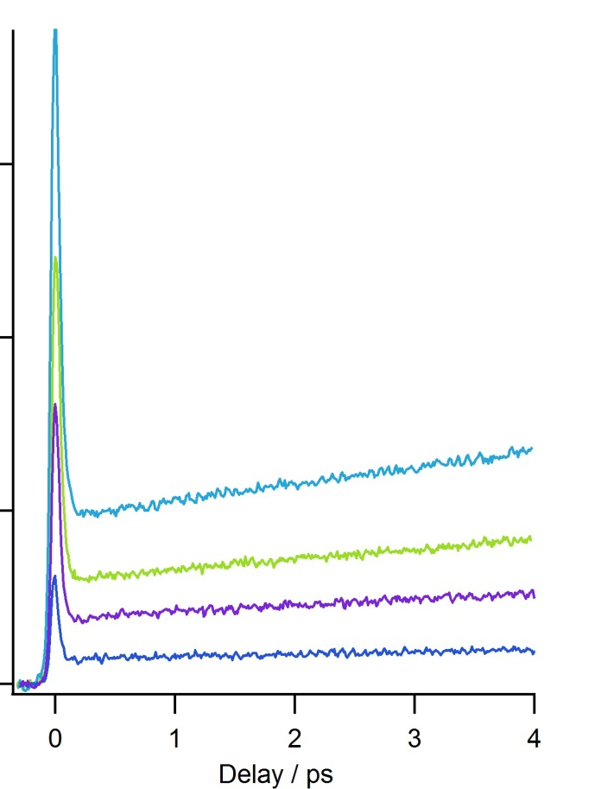
R Phase Response to Photoexcitation
Experimental Details
Pump: 800 nm
Probe: White light
Pump fluence: < F_{TH}
Sample: Thin film
T = 400 K
No oscillations – as expected
S. Wall et al. PRB 87 115126 (2013)

Slide 25
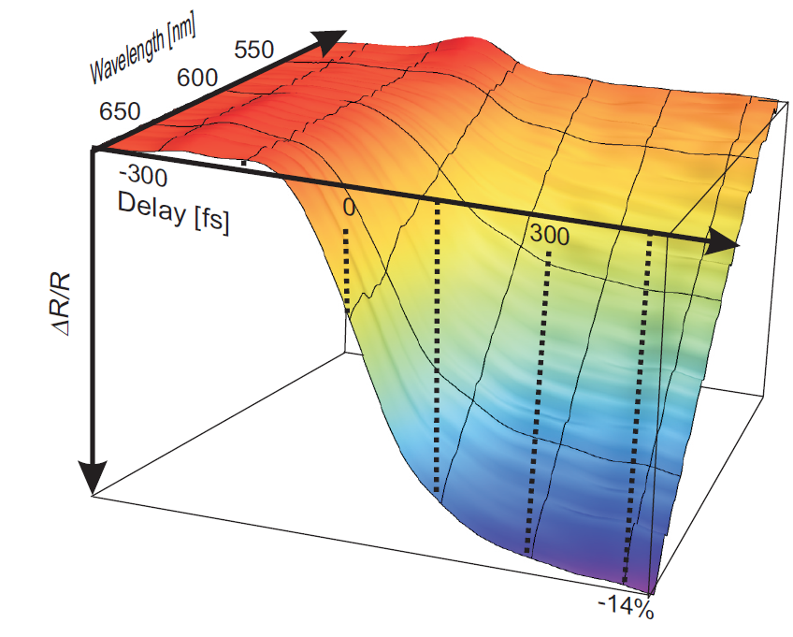
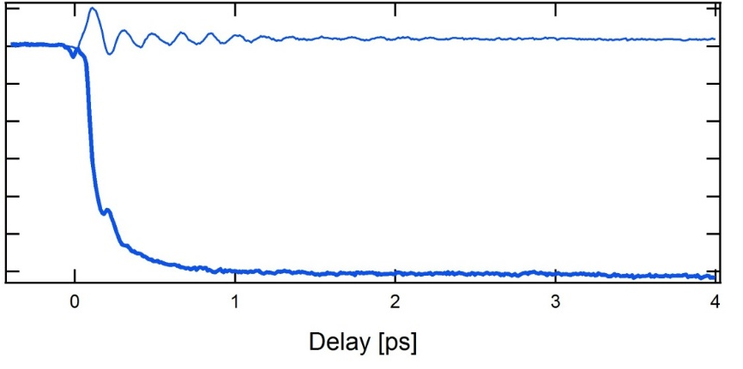
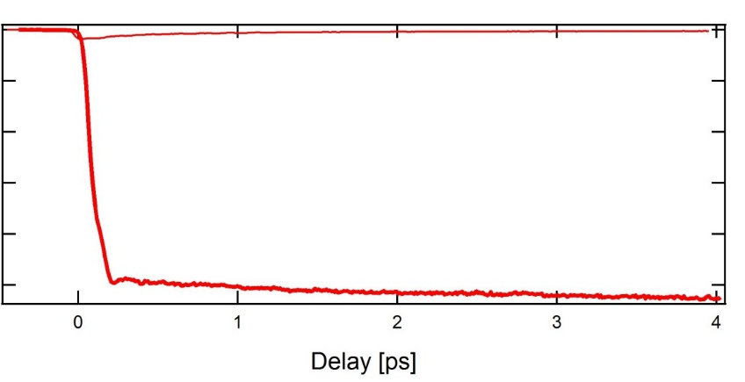
Phase change dynamics
525 nm
ΔR/R
800 nm
F< F_{TH}
F> F_{TH}
S. Wall et al. Nature communications 3 721 (2012)

Slide 26
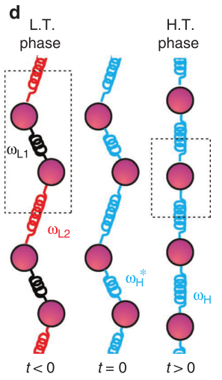
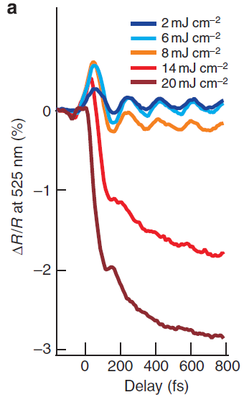
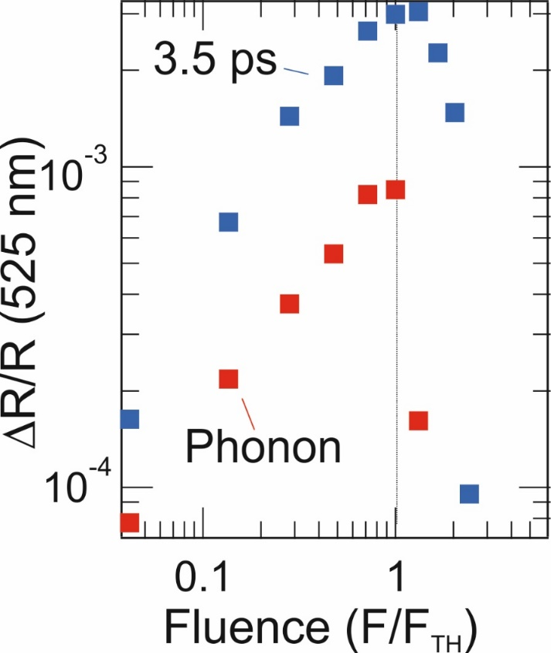
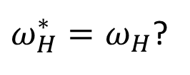
Phase Change Dynamics
$ω_{H}^{∗}=ω_{H}$?
S. Wall et al. Nature communications 3 721 (2012)

Slide 27


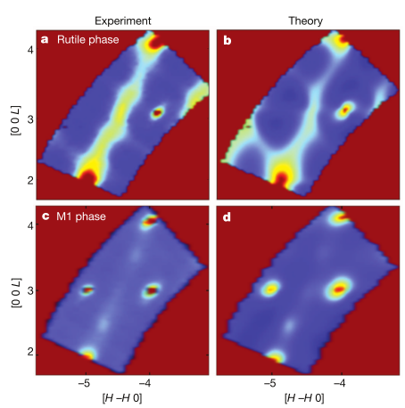
Measuring Phonons With X-rays
Bragg peaks
Thermal diffuse scattering
+
+ …
Response dominated by low frequency modes
Vibrations of uncorrelated Vanadium ions
Budai et al. Nature 515, 535 (2014)

Slide 28
Time-Resolved TDS
D. Zhu et al. Phys Rev B. 92, 054303 (2015)

Slide 29
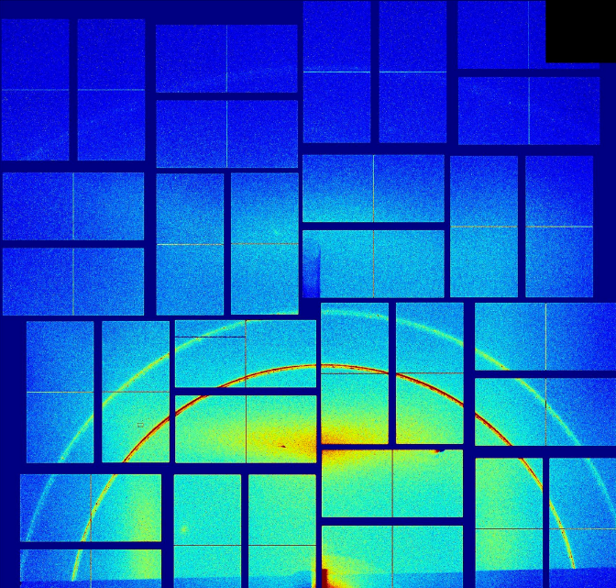
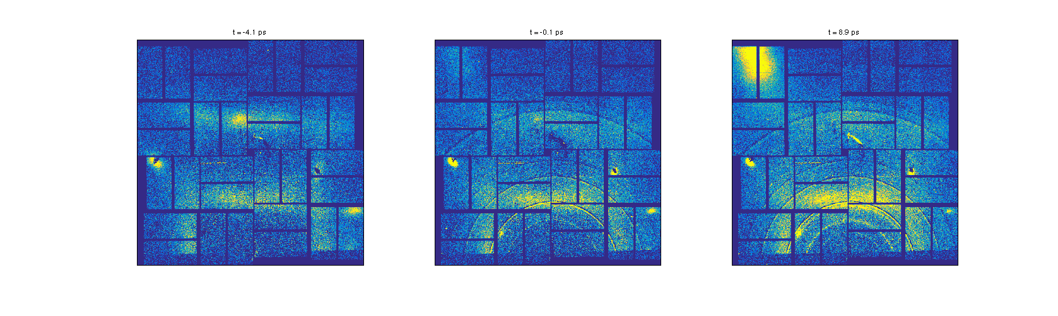

Time-Resolved TDS F>F_{TH}
Low Temperature
High Temperature
Transient change

Slide 30
Time Resolved TDS F>F_{TH}
0 fs
4 ps
8 ps

Slide 31

Fluence Dependence
0 fs
Diffuse Scattering
B
A
Bragg “Peak”
Diffuse scattering associated with random vanadium dimer oscillations only appears at the phase transition

Slide 32

Time Dependence
A
B
B
A
Rutile like vibrations emerge after ~50 fs
Lattice thermalization time may be as fast as electron thermalization!

Slide 33

Spin dynamics in manganites
LaMnO₃ – Parent compound for magnaites
Static Jahn-Teller distortion in ab-plane below T_{JT} = 780 K
A-type anti-ferromagnetism T_{N} = 140 K
b
a
J>0
S Wall et al PRL 103 09742 (2009)
Notes:
Start with the parent compound. Does not exhibit dynamic phase transition, but is a cleaner compound in the sense that we know a lot about it.
Explain structure + Magnetic state.
AF = Pauli
F = Hund

Slide 34


Coherent Phonons in LaMnO₃
Out-of-phase bending
8.8 THz
36.3 meV
293 cm⁻¹
Jahn-Teller
Stretching
14.9 THz
61.5 meV
497 cm⁻¹
S Wall et al PRL 103 09742 (2009)

Slide 35

Phonon-Magnon Coupling
Anharmonic decay of to acoustic phonons:
Bend
JT
Anharmonic decay of to magnons:
Bend
JT
Energy transfer between phonons and spins in ~250 fs
Are electrons or phonons more effective at driving demagnetization?
S Wall et al PRL 103 09742 (2009)
Notes:
As a result we expect to see some coupling between lattice and the structure and this is seen in the dynamics.

Slide 36
Phonon-Magnon Coupling
e
Energy transfer between phonons and spins in ~250 fs
Are electrons or phonons more effective at driving demagnetization?
SCOP
spin
lattice
Notes:
As a result we expect to see some coupling between lattice and the structure and this is seen in the dynamics.

Slide 37
Measuring Antiferromagnetic Dynamics
Ferromagnetism breaks time-reversal symmetry
Left/right circularly polarized light absorbed differently
Magnetic dynamics can be monitored by tracking the L/R absorption
Anti-ferromagnetism modifies periodicity
Resonant scattering can measure long range spin order

Slide 38



Measuring Antiferromagnetic Dynamics
La_{1.5}Sr_{0.5}MnO₄ (¼, ¼, ½) magnetic peak
Absorption
Diffraction
Intensity

Slide 39


Measuring Antiferromagnetic Dynamics
La_{1.5}Sr_{0.5}MnO₄ (¼, ¼, ½) magnetic peak
Absorption
Diffraction
Intensity
70 ps experimental resolution
H. Ehrke et al. PRL 106, 217401 (2011)

Slide 40

Measuring Antiferromagnetic Dynamics
La_{1.5}Sr_{0.5}MnO₄ (¼, ¼, ½) magnetic peak
Absorption
Diffraction
Intensity
LCLS measurements
300 fs (experiment limited) + 1.8 ps (diffusion?)
Phonons?

Slide 41


Measuring Antiferromagnetic Dynamics
Sr₂IrO₄
Ir edge 11 keV
Completely suppress magnetic order in ~300 fs
M Dean et al. Nature Materials 15 601 (2016)

Slide 42
Measuring Antiferromagnetic Dynamics
Sr₂IrO₄
Ir edge 11 keV
Resonant Inelastic X-ray Scattering (RIXS)
Measure energy and momentum of scattered photons
Short-range spin correlations are unperturbed by photoexcitation
Phonons excited by pump pulse
Phonons responsible for demagnetization?
M Dean et al. Nature Materials 15 601 (2016)

Slide 43

Nanoscale femtosecond dynamics
How can we image the role of spatial inhomogeneity on the dynamics?
Liu et al. Physical Review B 91 245155 (2015)

Slide 44





Holographic imaging
Field and intensity in the far field
$$E= ℱ\left(A\right)+ℱ\left(R\right)$$
$$I= {\left|ℱ\left(A\right)\right|}^{2}+ℱ\left(R\right){ℱ\left(A\right)}^{∗}$$
$+ℱ\left(A\right){ℱ\left(R\right)}^{∗}+{\left|ℱ\left(R\right)\right|}^{2}$
Fourier transform of the recorded signal
$$ℱ^{−1}\left(I\right)=ℱ^{−1}\left({\left|ℱ\left(A\right)\right|}^{2}\right)+A⋆R+ …$$
Auto correlation at centre of FT
$$R≈δ(x−d)$$
75 nm thick VO₂ (PLD)
$$A\left(x−d\right)$$
1 μm Au
100 nm Si₃N₄ (amorphous)
Cross correlation offset by d

Slide 45

Holographic imaging
3 reference holes to increase S/N

Slide 46
Holographic imaging
Advantages
Aberration free
Easy working environment
Stable to vibrations
Image in a “single shot”

Slide 47


Imaging phase transitions statically

Slide 48



Towards femtosecond dynamics
Laser induced damage!
X-ray induced damage!

Slide 49
Conclusions
Ultrafast physics can disentangle and probe the interaction of multiple degrees of freedom
A range of techniques are required to understand the process that occur on the femtosecond timescale
Ge₂Sb₂Te₅ – Fast thermal transition via intermediate liquid state
VO₂ – Ultrafast structural transition suggesting dominate electron-phonon coupling
Manganites and irridates – Demagnetization of AFMs can be very fast, is non-equilibrium spin lattice coupling the key?
First steps to nanoscale femtosecond dynamics via X-ray holography

Slide 50




Funding

Slide 51





Cr₂O₃
Room temperature anti-ferromagnet insulator (T_{N}=308 K)
100 % doped version of Ruby (Al₂O₃:Cr), same structure as V₂O₃
Centro-symmetric above T_{N}.
Magnetic symmetry breaks time and space inversion.
$E^{(2)}=χ_{e}^{(2)}$EE
$M^{(2)}=χ_{m}^{(2)}$EE
$$χ_{e}^{(2)}=c_{p} l(T)$$
$$χ_{m}^{(2)}=c_{M_{1}}+c_{M_{2}}l^{2}(T)$$
$$l>0 ∀ T<T_{N}$$

Slide 52






Magnetic Second Harmonic Generation
Colour Filter
Fundamental
Cr₂O₃
Polarizer
$$_{e/m}^{ (2)}=\left(\begin{matrix}_{e/m}^{ (2)} & {−χ}_{e/m}^{ (2)} & 0 \\ 0 & 0 & 0 \\ 0 & 0 & 0\end{matrix} \begin{matrix}0 & 0 & 0 \\ 0 & 0 & 0 \\ 0 & 0 & −χ_{e/m}^{ (2)}\end{matrix}\right)$$
$$I_{θ}^{SHG}∝{{(χ}_{e}^{ (2)}\sin{3\left(θ\right)− }χ_{m}^{ (2)}\cos{3\left(θ\right))}}^{2}$$
$$χ_{e}^{(2)}=c_{p} l(T)$$
$$χ_{m}^{(2)}=c_{M_{1}}+c_{M_{2}}l^{2}(T)$$
V Sala et al. PRB 94 014430 (2016)

Slide 53

Optical Measurement of Demagnetization
Pump with 3 photon energies
Quick drop in SHG signal (< 70 fs)
Rapid recovery – wavelength dependent 400 fs at 1.8 eV, 300 fs at 3 eV
Long lived state >> 400 ps
Can we interpret this as magnetic dynamics?
V Sala et al. PRB 94 014430 (2016)

Slide 54


Optical Measurement of Demagnetization
t = 2 ps
$$χ_{e}^{(2)}=c_{p} l(T)$$
$$χ_{m}^{(2)}=c_{M_{1}}+c_{M_{2}}l^{2}(T)$$
System has demagnetized by Δl/l = 0.75%
Independent of pump wavelength
V Sala et al. PRB 94 014430 (2016)

Slide 55
Polarization Dependence
t = 0 ps
Early response is not magnetic
Dependent on pump wavelength

Slide 56


Phonon Response?
$$χ_{e}^{\left(2\right)}\left(ω\right)=c_{p}\left(ω\right) l(T)$$
SHG process is resonantly enhanced
Resonance enhanced by the crystal field
Crystal field perturbed by phonon modes
Cr₂O₃ supports A_{g} and E_{g} vibrations
High frequency results in incoherent excitation
M. Fiebig PRL 73, 2127 (1991)

Slide 57


A_{g} Mode
Mode preserves symmetry
3 eV pump
$$_{e}^{ (2)}=\left(\begin{matrix}_{e}^{ (2)} & {−χ}_{e}^{ (2)} & 0 \\ 0 & 0 & 0 \\ 0 & 0 & 0\end{matrix} \begin{matrix}0 & 0 & 0 \\ 0 & 0 & 0 \\ 0 & 0 & −χ_{e}^{ (2)}\end{matrix}\right)$$
$$_{e}^{′ (2)}=\left(\begin{matrix}{Aχ}_{e}^{ (2)} & {−Aχ}_{e}^{ (2)} & 0 \\ 0 & 0 & 0 \\ 0 & 0 & 0\end{matrix} \begin{matrix}0 & 0 & 0 \\ 0 & 0 & 0 \\ 0 & 0 & −Aχ_{e}^{ (2)}\end{matrix}\right)$$

Slide 58


E_{g} Mode
Mode breaks symmetry
1.8 eV pump
$$_{e}^{ (2)}=\left(\begin{matrix}_{e}^{ (2)} & {−χ}_{e}^{ (2)} & 0 \\ 0 & 0 & 0 \\ 0 & 0 & 0\end{matrix} \begin{matrix}0 & 0 & 0 \\ 0 & 0 & 0 \\ 0 & 0 & −χ_{e}^{ (2)}\end{matrix}\right)$$
$$_{e}^{ (2)}=\left(\begin{matrix}{Aχ}_{e}^{ (2)} & {−Bχ}_{e}^{ (2)} & 0 \\ 0 & 0 & 0 \\ 0 & 0 & 0\end{matrix} \begin{matrix}0 & 0 & 0 \\ 0 & 0 & 0 \\ 0 & 0 & −Cχ_{e}^{ (2)}\end{matrix}\right)$$

Slide 59

Cr₂O₃ magnetization dynamics
A_{1g} phonon decay
Phonons drive demagnetization in Cr₂O₃
Demagnetization rate depends on phonon mode
E_{g} ~400 fs, A_{g} ~ 300 fs
Timescales consistent with manganites and irridates
Magnetisation
V Sala et al. PRB 94 014430 (2016)

