Slide 1
Magnet design for revised SPring-8-II lattice
Shinichi Matsubara
on behalf of Magnet team
Low Emittance Ring - Permanent Magnets Workshop -TRIESTE, Nov 14-15, 2023

Slide 2
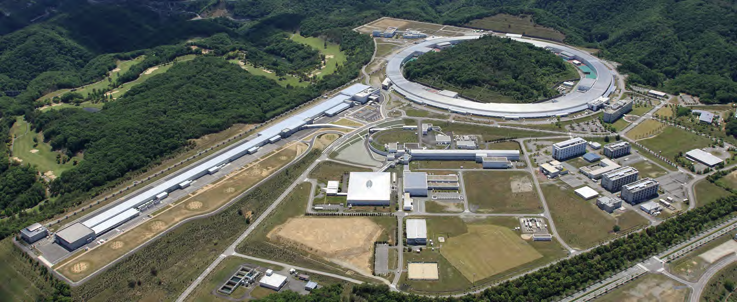
Milestone of SPring-8
SR facility
"SPring-8"
XFEL, "SACLA"
Beam injection
2020: Beam injection from the SACLA linac
to the storage ring of SPring-8
Shutdown old injector
→ Reduction of power consumption
2014: SPring-8-II CDR
2019~: Construction start of a 3 GeV light source, NanoTerasu in Japan
Design and developments for SPring-8-II have been extensively applied, except for permanent magnets.
2022~: Design restart of SPring-8-II
Low Emittance Ring - Permanent Magnets Workshop -TRIESTE, Nov 14-15, 2023

Slide 3
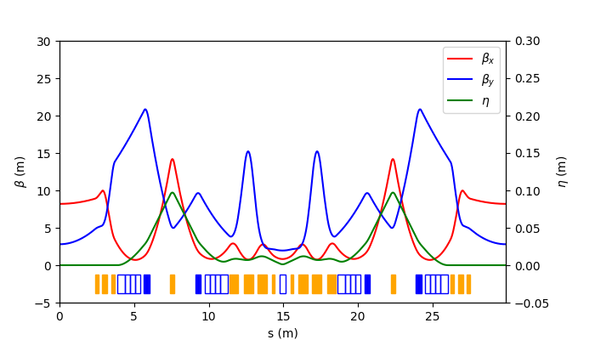
Revised parameters of SPring-8-II
 | SPring-8-II |  | SPring-8
 | Revised design | Previous design (CDR in 2014)
Energy [GeV] | 6 |  | 8
Stored current [mA] | 200 | 100 | 100
Circumference [m] | 1435.43 |  | 1435.95
Effect. Emittance [nm rad] | 0.111 0.05 w/DWs | 0.15 | 2.7
Five-bend achromat lattice
Four longitudinal Gradient Bends (LGB) and a normal bend magnets
DQ-combined function magnets
Extra damping by damping wigglers in addition to undulators
Energy savings
New!
New!
SPring-8-II
achromat optics
Low Emittance Ring - Permanent Magnets Workshop -TRIESTE, Nov 14-15, 2023

Slide 4
Magnet configuration of a unit cell
44 unit-cells + 4 long-straight-cells
LGB
DQ
DQ
LGB
NB
LGB
DQ
DQ
LGB
B5
B4
B3
B2
B1
← Beam
Configuration of magnets for a unit cell
(Five-bend achromat lattice)
Name |  | #/normal cell | Type
Dipole | Normal | 1 | Permanent magnet
Normal Bend | Four segmented LGB | 4
DQ-combined function | DQ Combined function | 4 | To be decided soon
Quadrupole |  | 16 | Electromagnet
Sextupole |  | 10
Octupole |  | 4
Low Emittance Ring - Permanent Magnets Workshop -TRIESTE, Nov 14-15, 2023

Slide 5
Magnet list
Name |  | #/normal cell | Total # | Max. field | Gap/ Bore dia. [mm]
Dipole | Normal | 1 | 44 | 0.953 [T] | 25
 | LGB | 4 | 176 | 0.615 [T] | 25
 | DQ-combined function | 4 | 176 | 0.259 [T] 23.8 [T/m] | 56
Quadrupole |  | 16 | 704 | 53.9 [T/m] | 34
Sextupole |  | 10 | 440 | 2,693 [T/m2] | 42
Octupole |  | 4 | 176 | 80,000 [T/m3] | 50
Injection part
Dipole | DC septum | - | 2 | 1.4 [T] | 10
Dipole | Pulse septum | - | 1 | 1.4 [T] | 4
PM
EM
Low Emittance Ring - Permanent Magnets Workshop -TRIESTE, Nov 14-15, 2023

Slide 6
Design strategy of permanent magnet
Radiation durability
Sm₂Co₁₇ permanent magnet after proper annealing
Permeance coefficient as large as reasonably possible
Compensation of temperature dependence
Magnetic shunt with Fe-Ni temperature compensation alloy
Pole gap field temperature dependence < ±5×10⁻⁵ /K
The target range is comparable to the stability of electromagnets.
Magnetic field adjustment
Tunable magnetic shunt with movable iron plates
Correction for individual fabrication errors and long-term demagnetization
Field monitoring for demagnetization
Observation slot in the return yoke for measuring the magnetic field strength correlated to the pole gap field
High-precision NMR probe
Low Emittance Ring - Permanent Magnets Workshop -TRIESTE, Nov 14-15, 2023

Slide 7
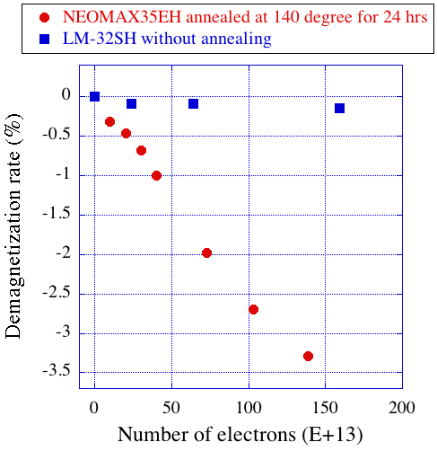
Radiation damage tests: Nd vs SmCo
Bizen and their team measured the radiation damage for Nd-Fe-B magnet.
In their setup, 8 GeV electron bunches hit magnet for hours.
The same experimental setup for SmCo
A magnet with annealing is known to be less demagnetized.
Measured radiation damage was quite different.
Blue: Sm₂Co₁₇ without annealing
Red: Nd-Fe-B with annealing [*]
[*] T.Bizen et al., NIMA 574 (2007) 401.
Low Emittance Ring - Permanent Magnets Workshop -TRIESTE, Nov 14-15, 2023

Slide 8
Two major manufacturers of Sm₂Co₁₇ in Japan
Manufacturer | TOKIN, LM-32SH |  | ShinEtsu, R32HS
Model name | Specification | Measured | Specification | Measured
Remanence B_{r} [T] | 1.12 ~ 1.20 | 1.16 1.17 1.17 | 1.10 ~ 1.18 | 1.12 1.12 1.12
Coercivity H_{cJ} [kA/m] | > 1,592 | 1,729 1,990 2,210 | > 1,751 | 1,881 1,898 1,922
Maximum Energy Product (BH)max [kJ/m³] | 223 ~ 256 | 251 251 256 | 223 ~ 263 | 232 233 235
Thermal coefficient [/K] | -4 x 10⁻⁴ |  | -4 x 10⁻⁴
Low Emittance Ring - Permanent Magnets Workshop -TRIESTE, Nov 14-15, 2023

Slide 9
Temperature distribution
Temperature distribution inside the current SPring-8 storage-ring
RF cavity
Shutdown period
Difference of 3 K
Difference of 2.5 K
Long straight cell
Position in the storage-ring
1 month
Four long straight cells:
Few magnets in the long straight cells
The temperature changes depending on positions and time.
Low Emittance Ring - Permanent Magnets Workshop -TRIESTE, Nov 14-15, 2023
Notes:
2, 14, 26, 38cell

Slide 10
Normal bend magnet
Sm₂Co₁₇ (TOKIN, LM-32SH)
Magnetic flux density :0.95 T
(SPring-8-II bend magnet maximum)
Adjustment range : >10%
Magnet shape: large permeance coefficient
Pc (3 ~ 5)
Gap-ﬁeld strength variation
1.12
1.10
1.08
1.06
1.04
1.02
1.00
0.98
0.96
0.94
Magnetic shunt alloy
Prototype
Iron
B [T]
14%
BL = 0.95T x 0.4m
Sm₂Co₁₇
0 50 100 150 200 250
Position of outer plate [mm]
Outer plate for magnetic field adjustment
Low Emittance Ring - Permanent Magnets Workshop -TRIESTE, Nov 14-15, 2023

Slide 11
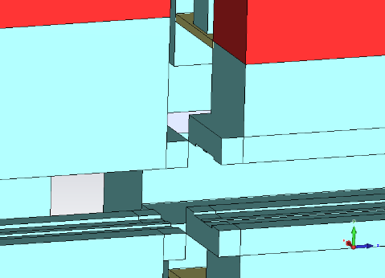
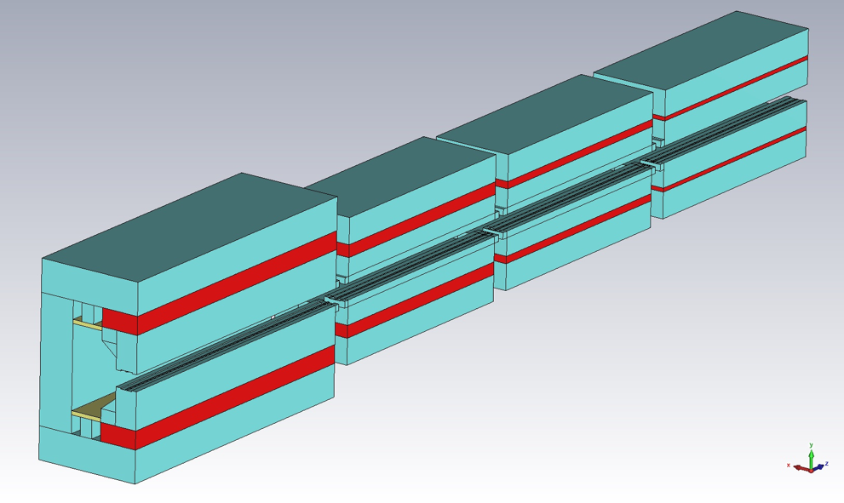
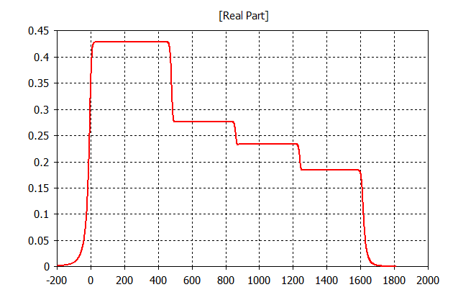
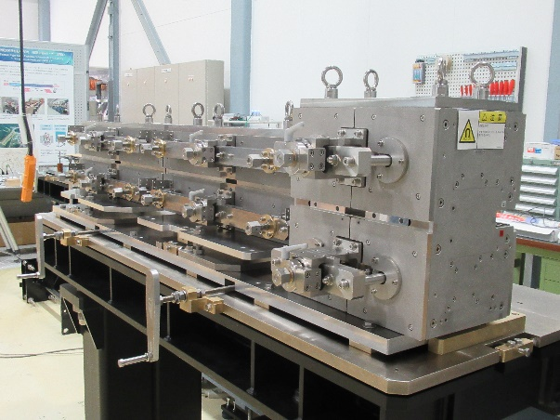
Design of LGB magnet
Spacing between segments
Nose structure
Shunt plate (iron)
d
Longitudinal axis Z
c
b
a
a
B_{y} [T]
LGB-B1
Nose structure
b
c
d
Prototype
e⁻
PM: Sm₂Co₁₇
Longitudinal position Z [mm]
Smooth field transition between segments without field drops
Same gaps for all segments to avoid complicated field distribution and minimizing PM volumes.
Low Emittance Ring - Permanent Magnets Workshop -TRIESTE, Nov 14-15, 2023

Slide 12
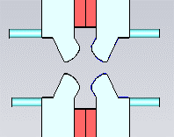
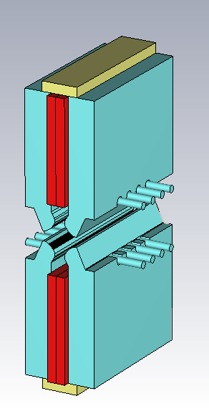
DQ-combined function magnet
B = 0.259 T
B’ = -22.8 T/m
（B’/B = 88.0[m⁻¹] ）
B’L = 7.98 T
L_{eff} = 0.35 m
Shunt alloy (Fe-Ni)
Quadrupole shape
Field adjustment
Splitable in half
Adjustment bolts
Beam axis
x= ~10 mm
The arrangement of two permanent magnets is simple and less prone to multipole errors.
PM (Sm₂Co₁₇)
Low Emittance Ring - Permanent Magnets Workshop -TRIESTE, Nov 14-15, 2023

Slide 13
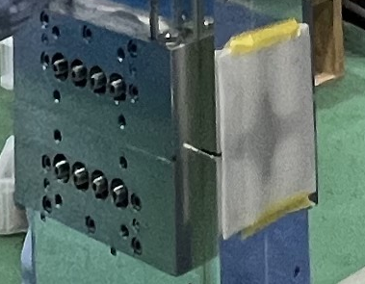
Magnetic field adjustment
・Magnetic field adjustment with adjustment bolts
・ 2% magnetic field adjustment
・ The target individual difference :
< ±0.2%.
Full-insertion of bolts
Adjustment bolts
Evacuation of bolts
Low Emittance Ring - Permanent Magnets Workshop -TRIESTE, Nov 14-15, 2023

Slide 14
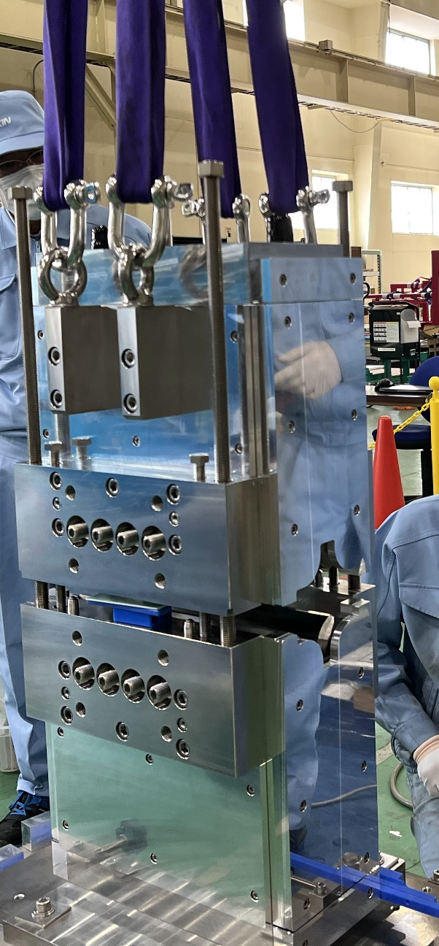
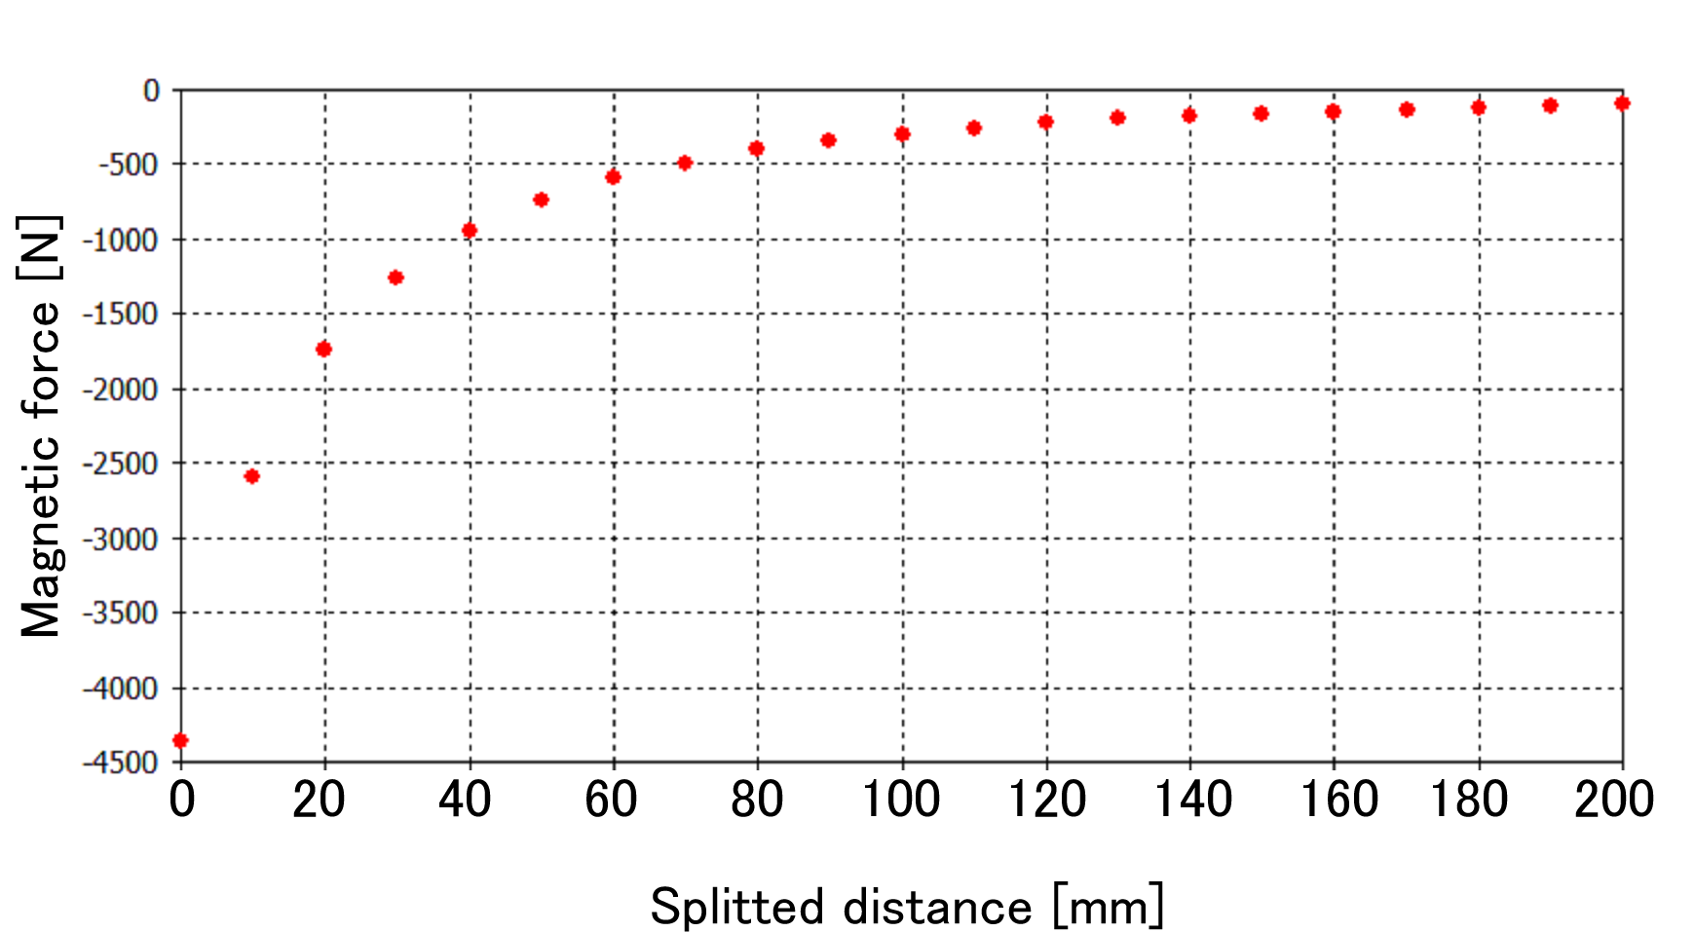
Magnetic force for splitting
Magnetic force for splitting with simulation
Guide bolt
Side-screw →
Opening about 30 mm by using side-screws
before lifting with a crane.
The load was 2.8 kN at splitted distance of 30 mm.
The weight of the lifted half body is 180 kg.
Low Emittance Ring - Permanent Magnets Workshop -TRIESTE, Nov 14-15, 2023

Slide 15
Field gradient stability with splitting
Slight decrease of B’ was observed at the first to third splitting.
← Measured at the factory
Different Hall sensor
↑
Measured in the SPring-8 site
After repeated splitting, B’ became constant within 0.1%.
We think the decrease of B’ is related to the hysteresis. We will investigate it.
Low Emittance Ring - Permanent Magnets Workshop -TRIESTE, Nov 14-15, 2023

Slide 16
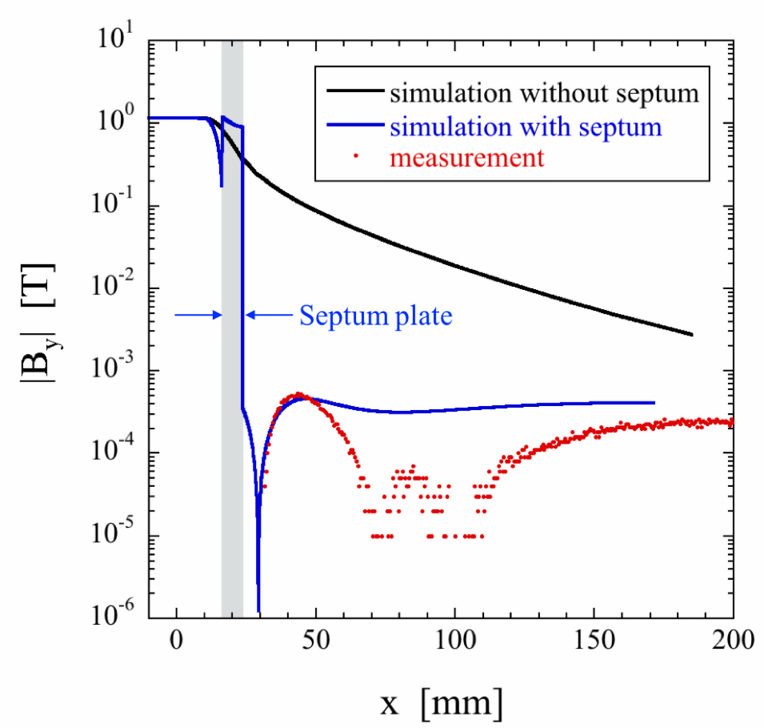
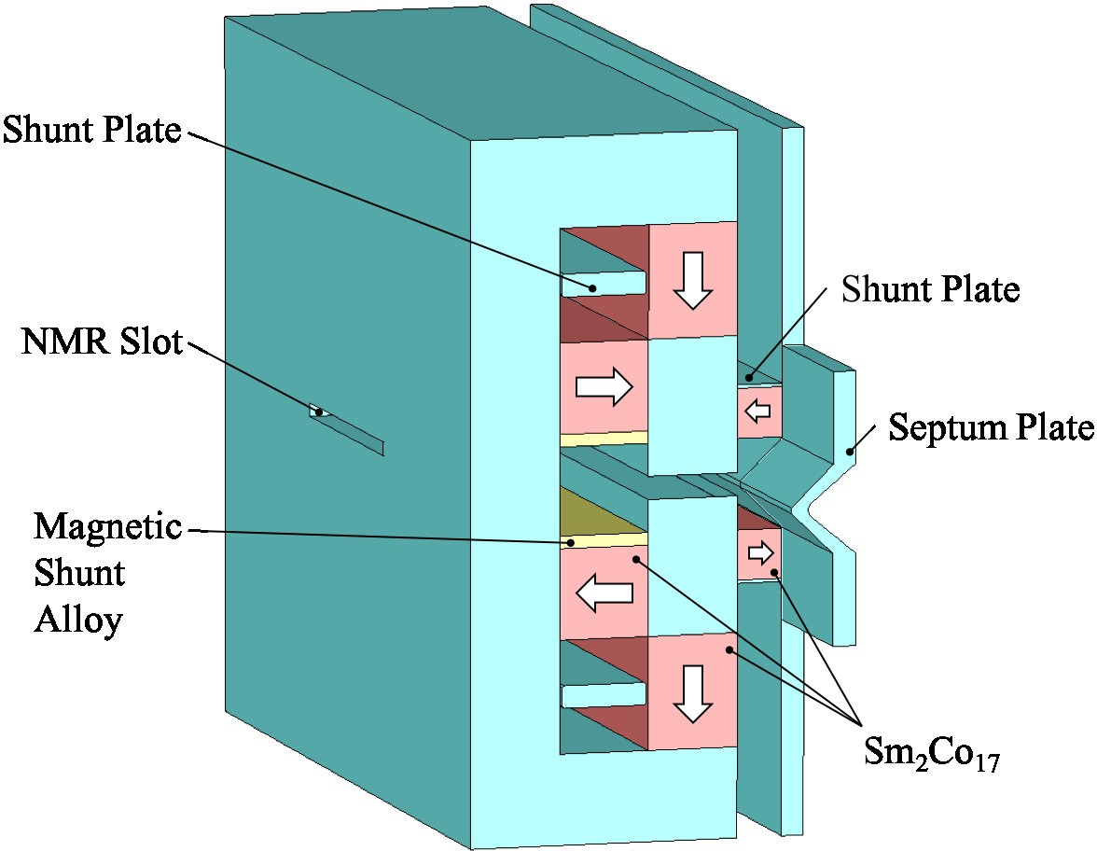
DC septum magnet
Minimize the leakage magnetic field
Additional PMs
for canceling out the field out of septum
Large Pc for prevention of demagnetization
B = 1.4 T
Pole gap : 10 mm
Pole length : 0.4 m
7 mm thick
Additional PMs
[*] T. Taniuchi et at., Phys. Rev. Accel. Beams 23, (2020) 012401.
Low Emittance Ring - Permanent Magnets Workshop -TRIESTE, Nov 14-15, 2023

Slide 17

DC septum magnet
Field monitoring slot
Inserted NMR probe
upper shunt plate
The gap ﬁeld strength can be varied by moving the shunt plates inside the return yoke.
Lower shunt plate
Variable ranges : 4%
Low Emittance Ring - Permanent Magnets Workshop -TRIESTE, Nov 14-15, 2023
Notes:
DCseptum_20191211.pdf

Slide 18
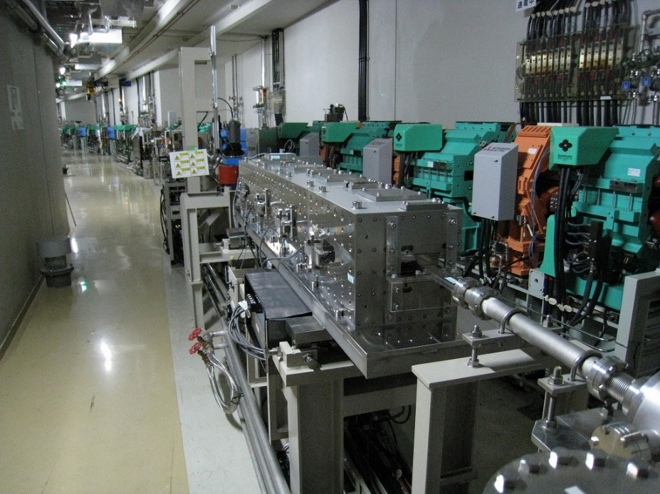
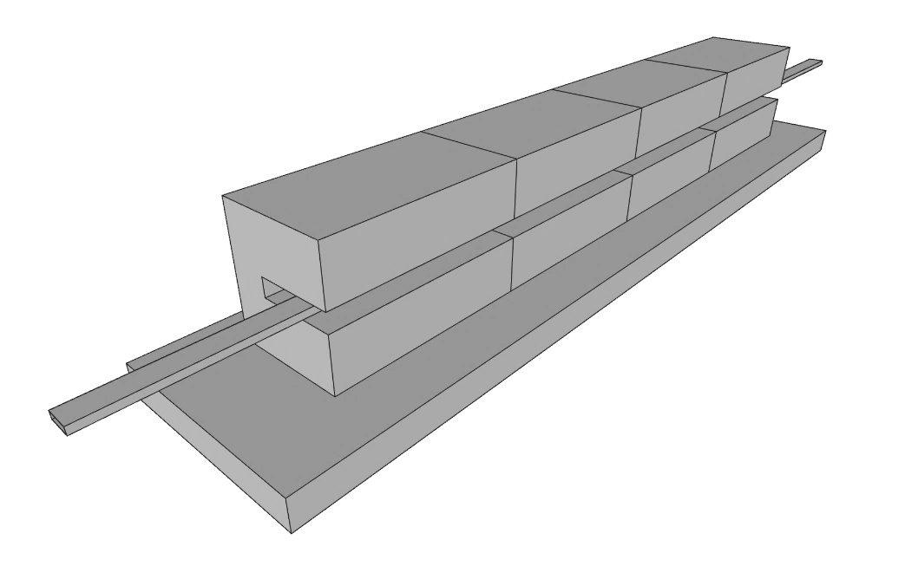
3-year operation at the ring injection
4 segments（Nd×2, SmCo×2）
B = 1.1 T, BL = 2.3 T・m
Gap length 17 mm
Storage ring
Seg.4
Seg.3
Seg.2
~5,000 Gy
Seg.1
PM-based
bend magnet →
Beam
All PMs were not annealed.
Beam
Segment | Seg.1 (SmCo) | Seg.2 (Nd) | Seg.3 (SmCo) | Seg.4 (Nd)
Demagnetization ratio | -0.48% | -0.03% | -0.02% | -0.05%
PM-based bend magnet had been operated at injection part in 2018-2021.
For the 3 years, there was commissioning of the beam injection from SACLA with a significant beam loss of tens of %.
Significant demagnetization was observed only in the most upstream segment.
Low Emittance Ring - Permanent Magnets Workshop -TRIESTE, Nov 14-15, 2023

Slide 19
Closing
Design of SPring-8-II restarted.
Detailed design of the magnets are in progress for the revised SPring-8-II lattice.
We will prepare revised prototype magnets in 2024.
Procurement of components will begin in 2025.
Low Emittance Ring - Permanent Magnets Workshop -TRIESTE, Nov 14-15, 2023

Slide 20
SPring-8-II schedule (planned)
FY2023 | FY2024 | FY2025 | FY2026 | FY2027 | FY2028
Here
SPring-8 user operation
Shutdown
Lattice optimization
Prototype
Procurement
Design,
Fabrication,
Test
Fabrication/Assembly/Test/Tuning…
Acc removal
Hardware design
Construction
Design revision
3 GeV Ring
NanoTerasu
Commissioning
Low Emittance Ring - Permanent Magnets Workshop -TRIESTE, Nov 14-15, 2023

