Slide 1
ALS-U HBEND: Magnetic Design
Jin Young Jung, Chuck Swenson
Mechanical Engineer
LBNL Engineering Division/ALS-U Magnetics
November 14, 2023

Slide 2
Contents
Design objective
Baseline magnetic design for HBEND magnet
Magnetic field adjustment
Magnetic field tuning
Magnetic cross talk analysis
HBEND magnet summary

Slide 3
Design Objective Summary
To achieve magnetic field requirement for 2.0 GeV and 1.9 GeV operation in compact space.
To be able to tune the magnetic field.

Slide 4
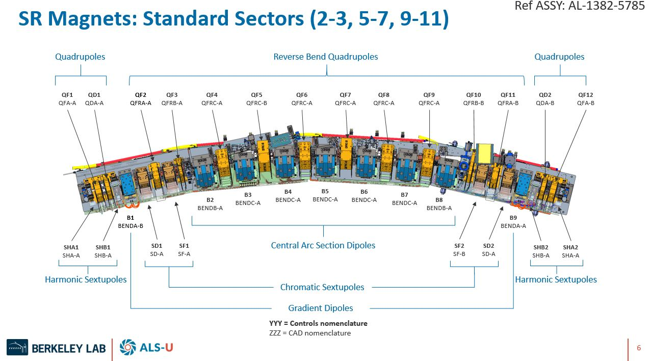
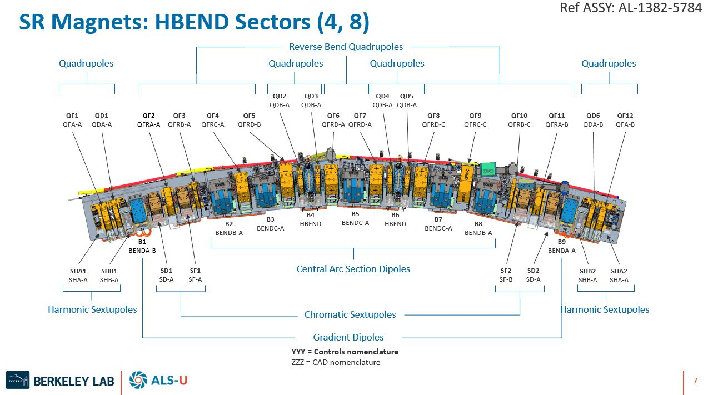
SR standard arc section
SR HBEND arc section
HBEND magnet
There are 12 sectors in ALS-U.
Among them, there are 2 HBEND sectors.
There are two HBEND magnets in a HBEND sector.

Slide 5
HBEND Dipole Magnet Specifications
effective dipole length (m) | 0.135
bend angle (deg) | 3.76305
integrated dipole (T-m) | -0.43833
dpole field (T) | -3.2468
* From lattice requirement document (AL-1006-5344)
Effective multipoles in Gauss (from ESD)
n | value (G)
1 | -32468.3
2 | 45.2
3 | -27.1
4 | -95.2
5 | 199.0
6 | 34.8
7 | -44.3
Multipoles are calculated at radius of 3 mm at x = 0.
Multipoles are integrated on beam trajectory.
Expected errors are calculated.
Multipole requirements are summarized in ESD document. (AL-1207-7066)

Slide 6
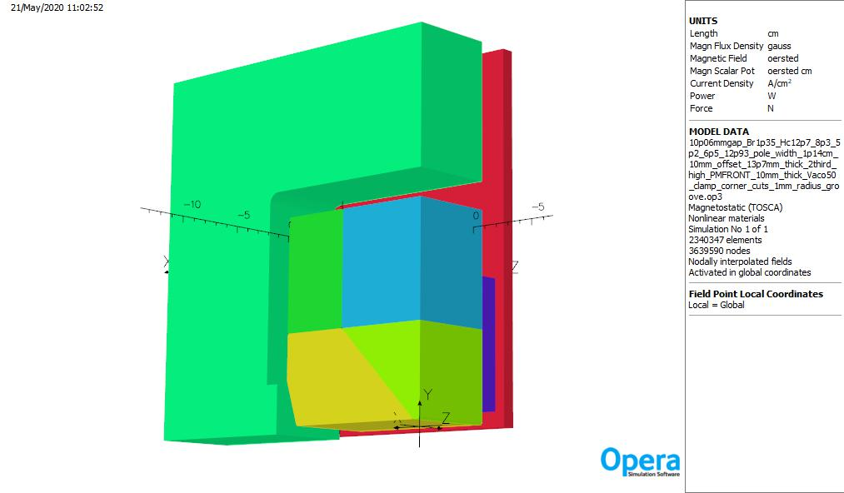
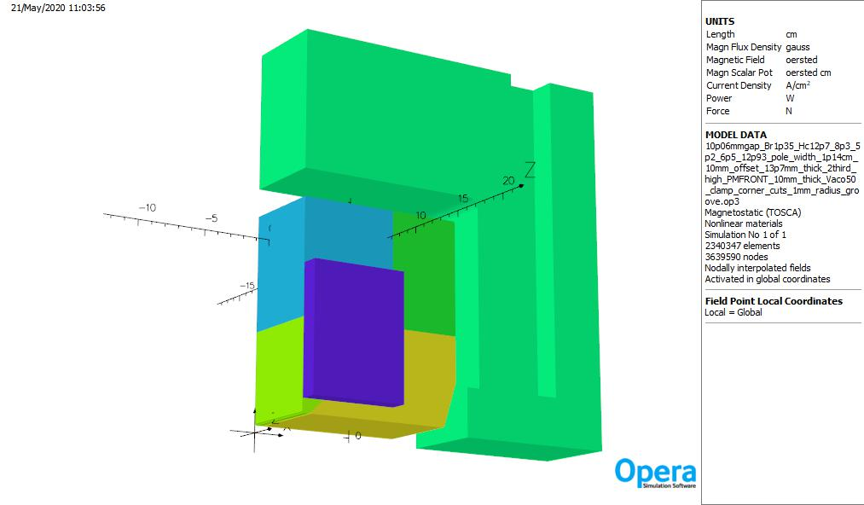
Baseline magnetic model for HBEND (1/8th model)
Cobalt field clamp
1006 steel yoke
Cobalt iron pole
Axial PM
10.06 mm full gap at x=0, pole to pole magnet length : 129.3 mm
Magnetic gap is acceptable for vacuum integration.
Red arrow denotes magnetic direction of permanent magnet.
Main PM : Br=1.35 T, Hc=12.7 kOe, Hcj=25 kOe (minimum specification of Hitachi, NMX-U47EH)
(NMX-U47EH : Br: 1.35 ~ 1.42 T, Hc ≥ 12.7 kOe, Hcj ≥ 25 kOe)
Axial PM : Br=1.24 T, Hc=11.6 kOe, Hcj=32 kOe (minimum specification of Hitachi, NMX-U41EH)
(NMX-U41EH : Br: 1.24 ~ 1.31 T, Hc ≥ 11.6 kOe, Hcj ≥ 32 kOe)
* VAC has similar material.

Slide 7
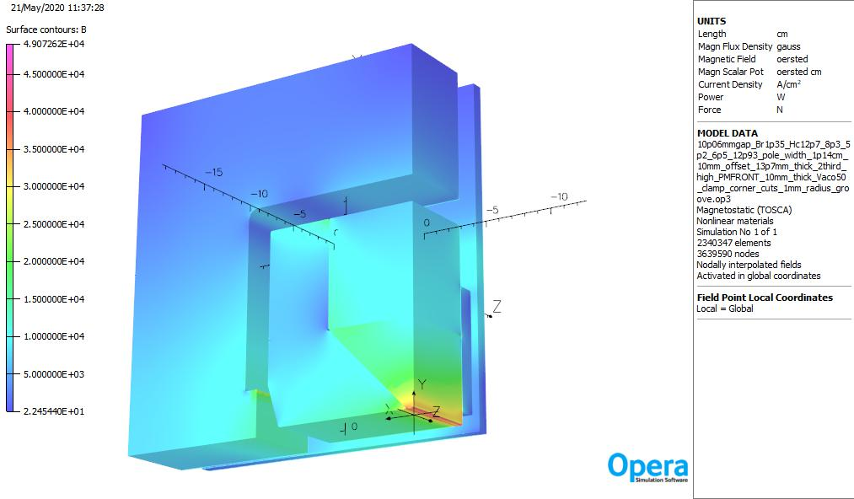
Magnetic simulation meets requirements
Magnet
Center
Field clamp region
10.06 mm full gap at x=0, pole to pole magnet length : 129.3 mm
Effective dipole length : 135 mm
Physics requirement=> dipole field : -3.25 T, integrated field : -0.44 T-m (2 GeV)
Simulated effective dipole field : -3.25 T, integrated field : -0.44 T-m
Requirement for 1.9 GeV operation can be met by moving axial PM. (see slide #13)
There is no demagnetization in PM block.

Slide 8
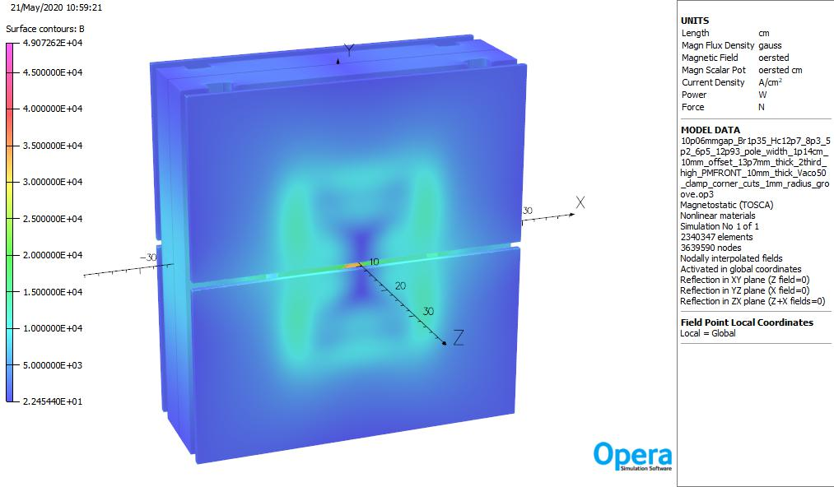
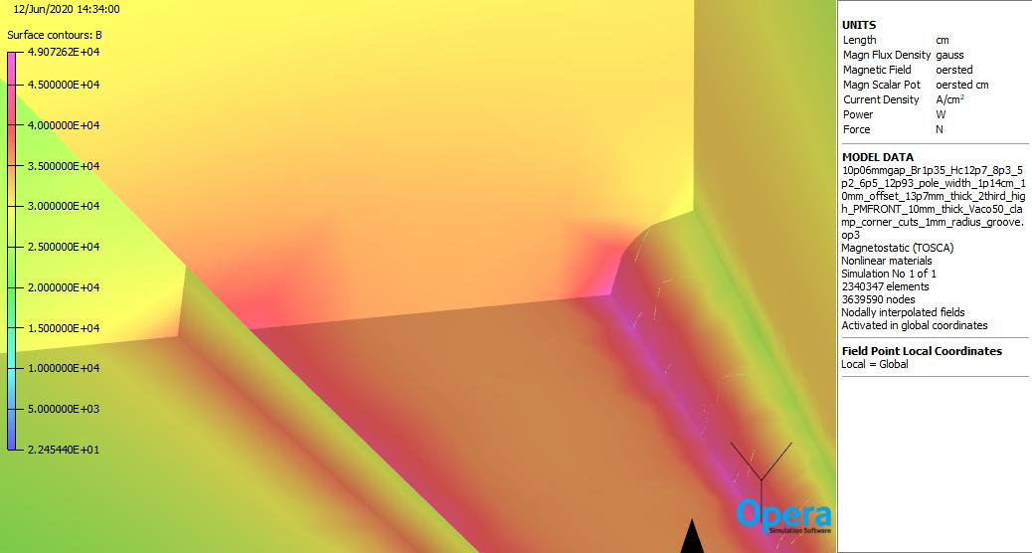
Magnetic simulation meets 2 GeV requirement
Exterior of magnet is shielded.
1/8th view
10.06 mm full gap at x=0, pole to pole magnet length : 129.3 mm
Effective dipole length : 135 mm
Physics requirement=> dipole field : -3.25 T, integrated field : -0.44 T-m
Simulated effective dipole field : -3.25 T, integrated field : -0.44 T-m
Magnetic simulation meets 2 GeV requirement.

Slide 9
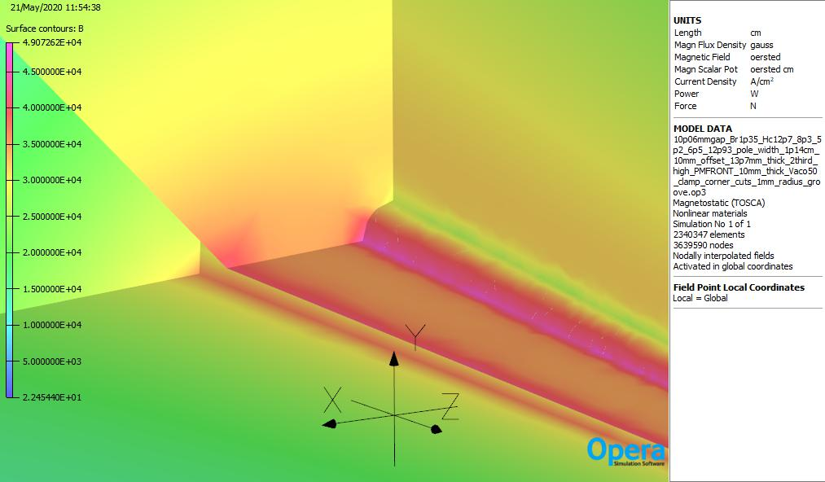
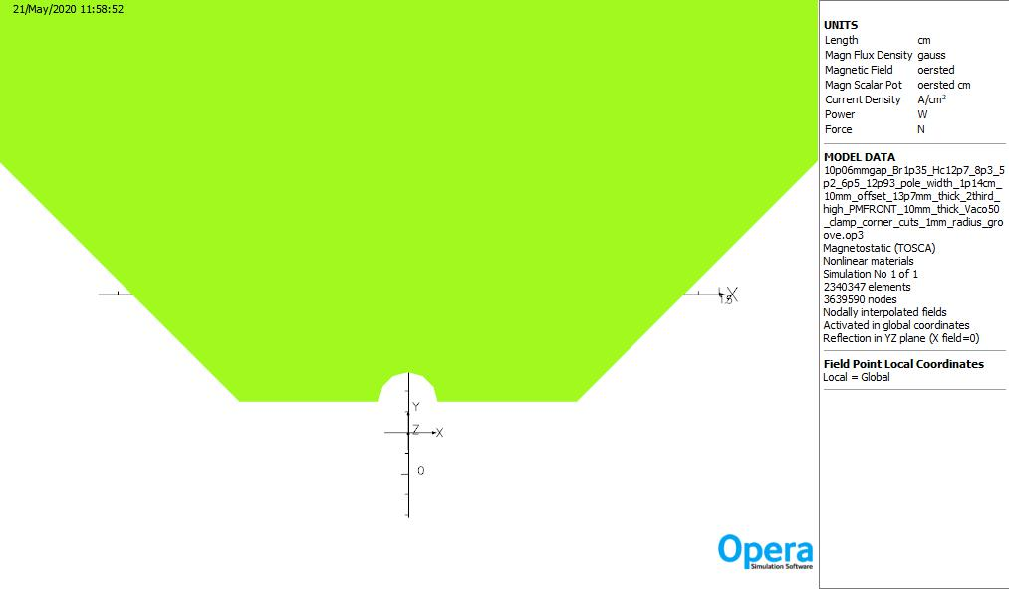
Pole face for reduced sextupole (10.06 mm gap, 1 mm radius pole groove)
Cobalt iron pole
10.06 mm gap, 1 mm radius pole groove
By field at center : -32468.3 G
Center sextupole field : -28.2 G
Effective sextupole field : -2.5 G
1 mm radius pole groove

Slide 10
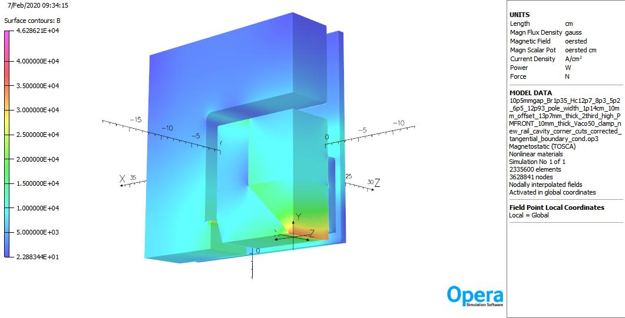
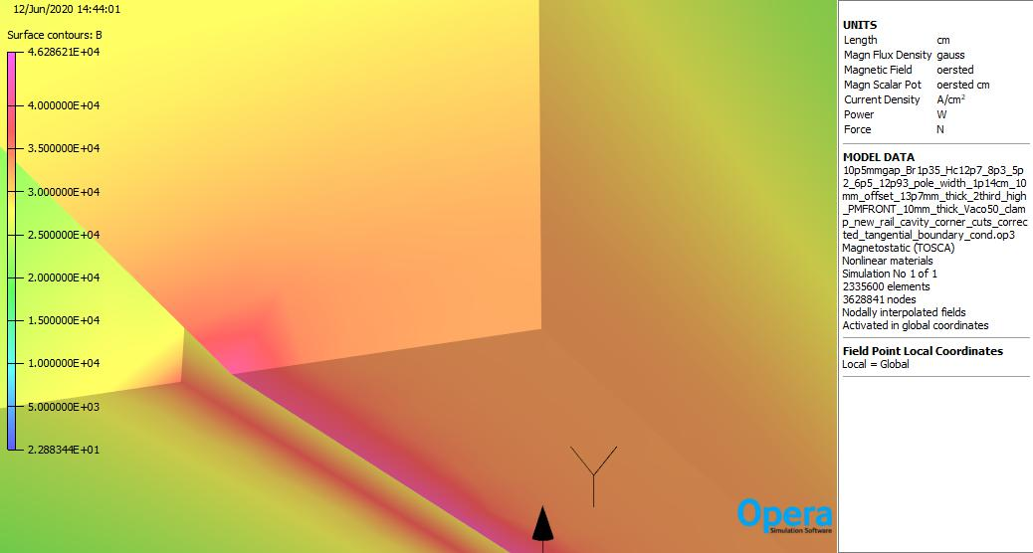
Previous baseline HBEND magnet
10.5 mm gap
By field at center : -32477.8 G
Center sextupole field : 335.5 G
Effective sextupole field : 323.4 G
10.5 mm gap, no pole shaping
By field at center : -32477.8 G
The field distribution makes higher sextupole field.
No pole shaping

Slide 11
Multipoles for previous baseline HBEND magnet
center multipoles
n | A_n (G) | B_n (G) | C (G)
1 | 0 | -32477.8 | 32477.759
2 | 2.39E-12 | -3E-12 | 3.844E-12
3 | -1.29E-13 | 335.5014 | 335.50136
4 | 4.74E-12 | -6.4E-12 | 7.982E-12
5 | 2.02E-12 | 49.30806 | 49.308056
6 | 2.38E-12 | -3.5E-12 | 4.205E-12
7 | 2.43E-12 | -2.16866 | 2.1686591
8 | -6.33E-12 | 4.49E-12 | 7.764E-12
9 | 2.90E-12 | 0.872553 | 0.8725527
10 | 6.04E-12 | 1.12E-11 | 1.273E-11
effective multipoles
n | A_n (G) | B_n (G) | C (G)
1 | 0 | -32477.8 | 32477.76
2 | 0 | -38.6558 | 38.65579
3 | 0 | 323.3959 | 323.3959
4 | 0 | -22.56 | 22.55999
5 | 0 | 44.44416 | 44.44416
6 | 0 | 0.784398 | 0.784398
7 | 0 | -2.64651 | 2.646509
8 | 0 | 1.497826 | 1.497826
9 | 0 | 1.345017 | 1.345017
10 | 0 | -0.5758 | 0.575798
Unacceptable to beam dynamics
10.5 mm gap
Effective length : 13.4953 cm
By field at center : -32477.8 G
Center sextupole field : 335.5 G
Effective sextupole field : 323.4 G
Effective quadrupole field : -38.7 G => -1.29 T/m (focusing)

Slide 12
By field in x for 10.06 mm gap with 1 mm radius pole groove
10.06 mm gap, 1 mm radius pole groove
By field at center : -32468.3 G
The flat field distribution makes lower sextupole field.
New gap is acceptable for vacuum.

Slide 13
Multipoles for modified pole face HBEND magnet
center multipoles
n | A_n (G) | B_n (G) | C (G)
1 | 0 | -32468.3 | 32468.308
2 | -5.04E-12 | -4.7E-12 | 6.865E-12
3 | 2.71E-12 | -28.1853 | 28.185331
4 | 3.55E-12 | -5.2E-12 | 6.321E-12
5 | 3.32E-12 | 197.6733 | 197.67334
6 | 4.42E-12 | -3.2E-12 | 5.447E-12
7 | 6.23E-13 | -47.2283 | 47.228296
8 | -3.62E-12 | 3.87E-12 | 5.295E-12
9 | 4.40E-13 | 3.914821 | 3.9148211
10 | 5.24E-12 | 1.17E-11 | 1.283E-11
effective multipoles
n | A_n (G) | B_n (G) | C (G)
1 | 0 | -32468.3 | 32468.308
2 | 0 | 40.32068 | 40.320678
3 | 0 | -2.49846 | 2.4984592
4 | 0 | -81.4064 | 81.406402
5 | 0 | 168.9747 | 168.97472
6 | 0 | 28.7646 | 28.764604
7 | 0 | -45.9278 | 45.927782
8 | 0 | -11.7707 | 11.770706
9 | 0 | 15.62933 | 15.629328
10 | 0 | 7.272643 | 7.2726429
10.06 mm gap, 1 mm radius pole groove
Effective length : 135 mm
Center sextupole field : -28.2 G
Effective sextupole field : -2.5 G
Effective quadrupole field : 40.32 G => 1.34 T/m (defocusing)
Neighboring quadrupole magnet is QDB which is defocusing.
Since By field distribution is flatter, it is not possible to make lower quadrupole field while keeping sextupole field low.
Effective n=5 term : 168.97 G (larger than baseline model)
Simulation by physics group shows that the multipoles are fine for beam physics.

Slide 14
Vertical movement of axial PM for 2 GeV and 1.9 GeV operation
front PM offset (mm) | integral dipole field (T-m) | bending angle (deg) along trajectory
1 | -0.442149 | 3.80179
5 | -0.440758 | 3.78424
10 | -0.438335 | 3.76349 | 2 GeV operation
20 | -0.434119 | 3.72752
30 | -0.430687 | 3.69863
40 | -0.427864 | 3.67350
50 | -0.424257 | 3.64300
60 | -0.419515 | 3.60229
66 | -0.416348 | 3.57547 | 1.9 GeV operation
70 | -0.414548 | 3.55898
80 | -0.410894 | 3.52783
By moving axial PM vertically, magnetic field can be adjusted.
Baseline 2 GeV operation is at ~10 mm axial PM offset away from pole face.
1.9 GeV operation is at 66 mm axial PM offset away from pole face.
Axial PM

Slide 15
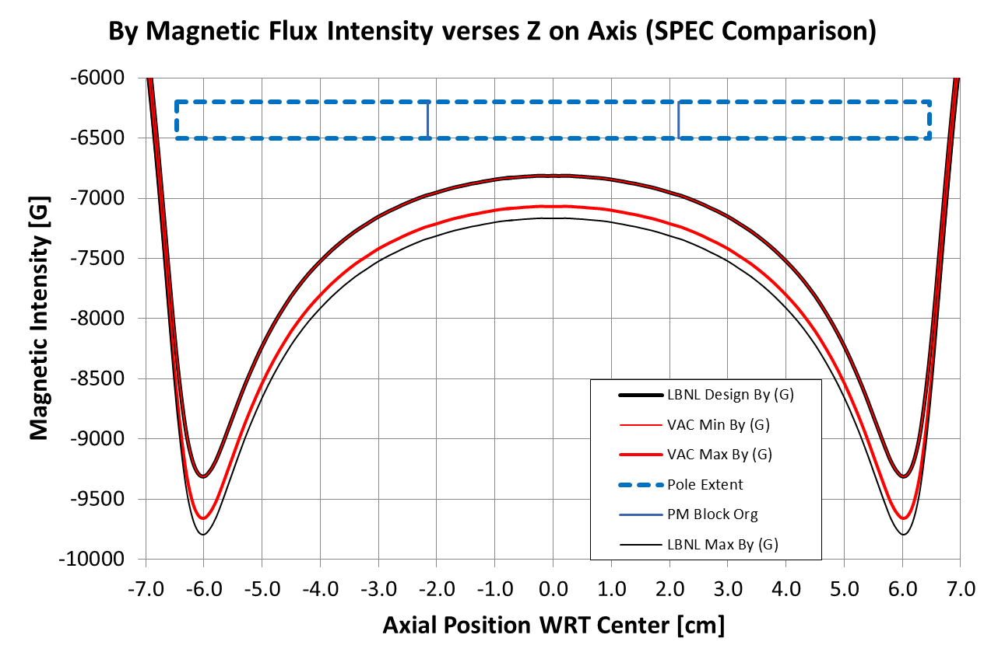
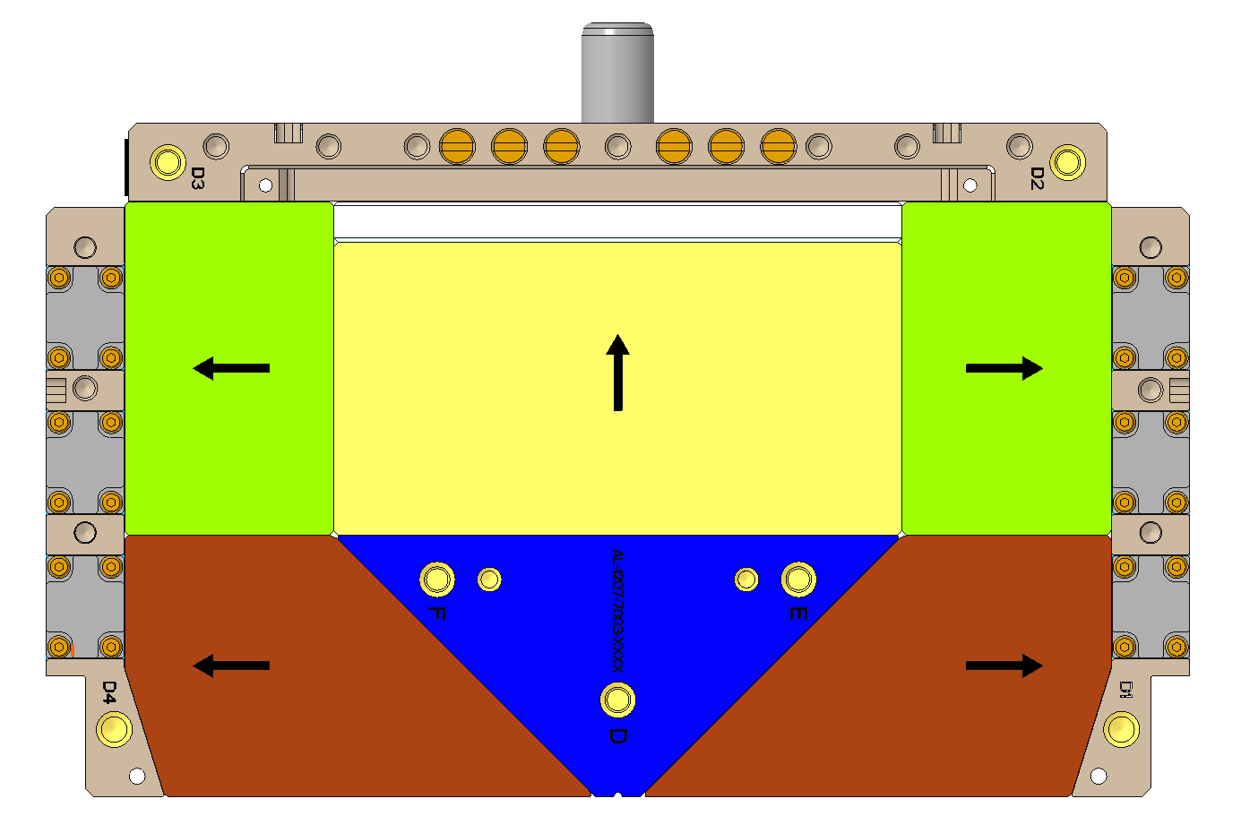
Identification of Referenced HBEND Core Components
Magnetic field tuning is needed due to magnetization and construction errors.
Interface Spacer (non magnetic)
Vertical PM Block
Lower Core Assembly
The HBEND design specifies material performing at the minimum allowed magnetization performance.
The interface spacers are deployed to compensate for a PM material batch that is too strong.
Vertical PM block is cut to adjust magnetic field.
The thickness of the the interface spacer is specified to adjust for the magnetic properties of the PM batch utilized for the HBEND core.

Slide 16
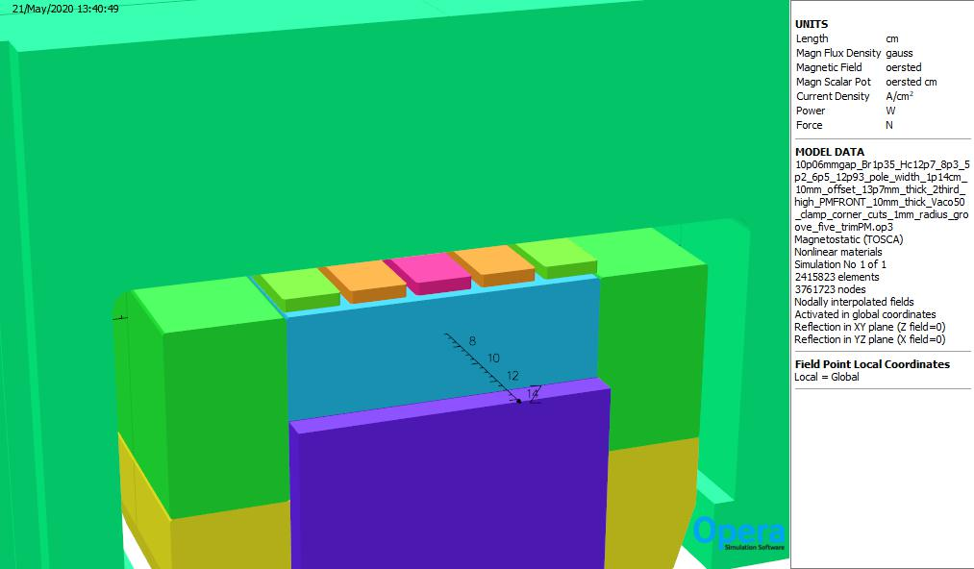
Effect of tuning PM on top of main PM assembly
# of tuning PM | integral dipole field (T-m) | integral dipole field increase (%)
baseline | -0.438335 | -
1 | -0.438781 | 0.102
3 | -0.439639 | 0.298
5 | -0.440419 | 0.476
opposite porality
# of tuning PM | integral dipole field (T-m) | integral dipole field increase (%)
baseline | -0.438335 | -
1 | -0.437891 | -0.101
3 | -0.437009 | -0.302
5 | -0.436295 | -0.465
Tuning PM
By applying tuning PM on top of main PM assembly, magnetic field can also be adjusted.
Red indicates magnetic polarity of tuning PM.
Depending on the number of tuning PM and polarity, the integral dipole field can be changed by +0.48 % and -0.47 %.
Introduction of tuning blocks allows the correction of construction errors.

Slide 17
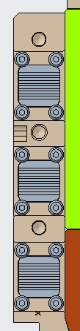

Ferromagnetic Compensation
TR-P2-L
TR-P1-L
TR-P1-R
TR-P2-L
Ferromagnetic Rod Shim Kit
(6X/Core)
Laminated Ferromagnetic Shim Kit
(2X/Core)
TR-P3-L
TR-P3-L
SP-P1-L
SP-P1-R
SP-P2-L
SP-P2-R
SP-P3-L
SP-P3-R
Ferromagnetic Solid Rod
(4X/Core)
When the magnetic properties of the PM batch are below specification, using ferromagnetic shims (low carbon steel), magnetic field can be adjusted higher.

Slide 18
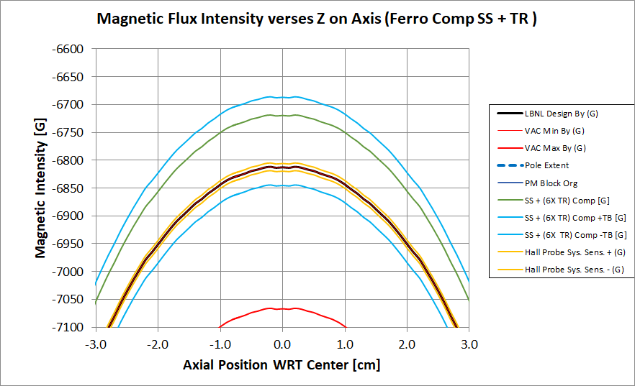
Ferromagnetic compensation enhances the tuning range of the HBEND .
Machining of vertically polarized blocks to adjust for too strong a PM Core magnetization
Ferromagnetic compensation range to correct for core strength that is too weak.
Additional range of +/- field/integral available from PM tuning blocks.
NOTE: The Hall probe measurement uncertainty is shown in YELLOW.
ON AXIS B_{Y} FIELD OF A BARE HBEND CORE ASSEMBLY
3
2
3
1
VAC magnetic property :
Core PM: Br > 1.34 T, Hc > 12.75 kOe,
Hcj > 27.52 kOe
axial PM: Br > 1.3 T, Hc > 12.38 kOe,
Hcj > 31.48 kOe

Slide 19
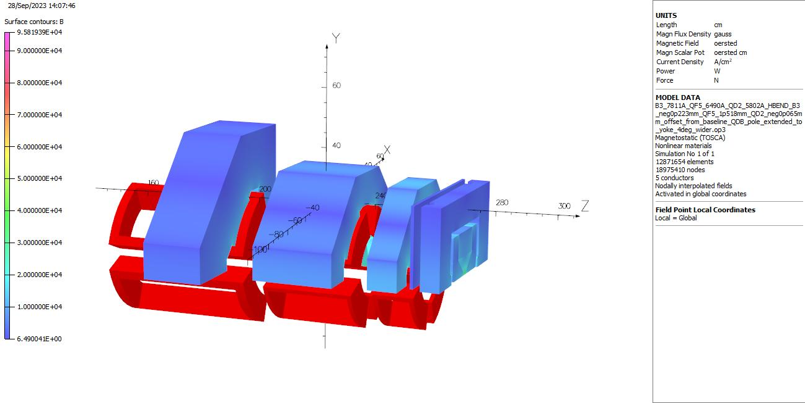
Magnetic cross talk to neighboring magnets
dipole magnet
quadrupole magnet
Cobalt iron clamp
HBEND magnet
To reduce the calculation time, mid plane symmetry is used and symmetric boundary condition is used for both ends.
Cobalt iron is used for field clamp to minimize magnetic cross talk between neighboring magnets.
For earlier design, magnetic field calculation shows that the bending angle is reduced by 0.16 % due to the cross talk between magnets even with field clamp.
Stronger grade axial permanent magnet is used for increasing the dipole field integral (Br: 1.3 T, Hc: 12.2 kOe).
Due to the proximity effect on magnets, dipole and quadrupole magnets are repositioned laterally from physics coordinates to meet the integral field requirements. Currents are changed from the free space calculations, too.
If necessary, by using the magnetic field adjustment method, it can meet the bending angle requirement.

Slide 20
HBEND magnet summary
HBEND magnetic design meets physics requirements.
Satisfied bend angle requirement at 2.0 GeV and 1.9 GeV.
Pole shape modified to decrease sextupole fields.
Method of field adjustment allows temperature compensation.
Design incorporates mechanisms to correct magnetization and construction errors.
Magnetic forces during assembly are analyzed. (See backup slides)
Magnetic deformation due to magnetic force for axial PM assembly and clamp has been analyzed and it is not an issue. (See backup slides)
Magnetic cross talk to neighboring magnets are analyzed.
Stronger grade axial permanent magnet is used for meeting dipole integral requirement.

Slide 21
Backup

Slide 22
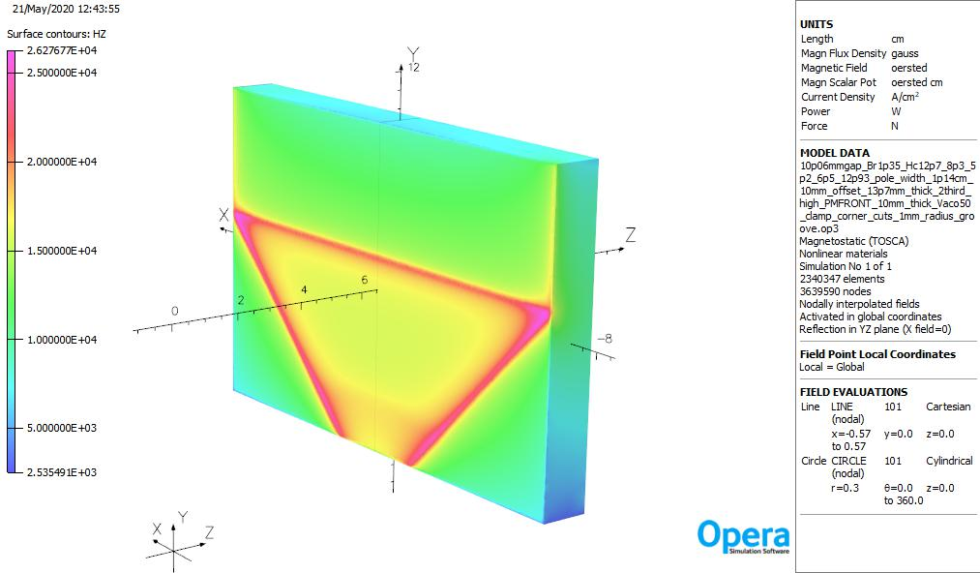
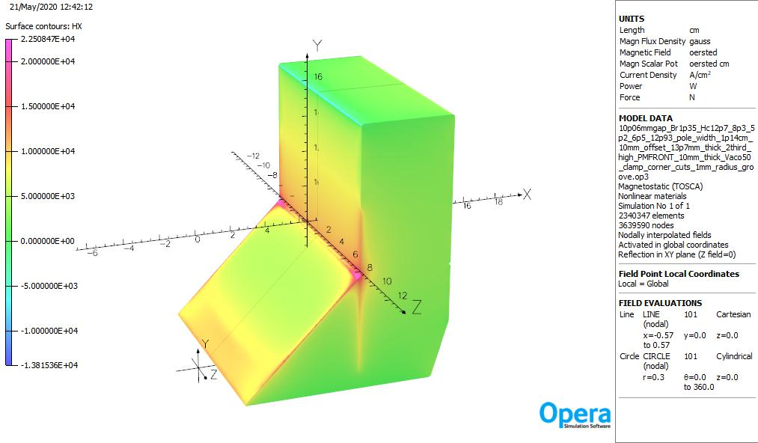
No demagnetization in permanent magnet materials
Hx field (reverse field) for side PM
Hz field (reverse field) for axial PM
Main PM => maximum Hx=22.5 kOe
Since Hcj for main PM is 25 kOe, there is no demagnetization for main PM.
Axial PM => maximum Hz=26.3 kOe
Since Hcj for axil PM is 32 kOe, there is no demagnetization for axial PM.
Introduced corner chamfers to minimize demagnetization effect.
Design also has a gap between the axial adjuster magnets and pole. (0.5 mm gap)

Slide 23
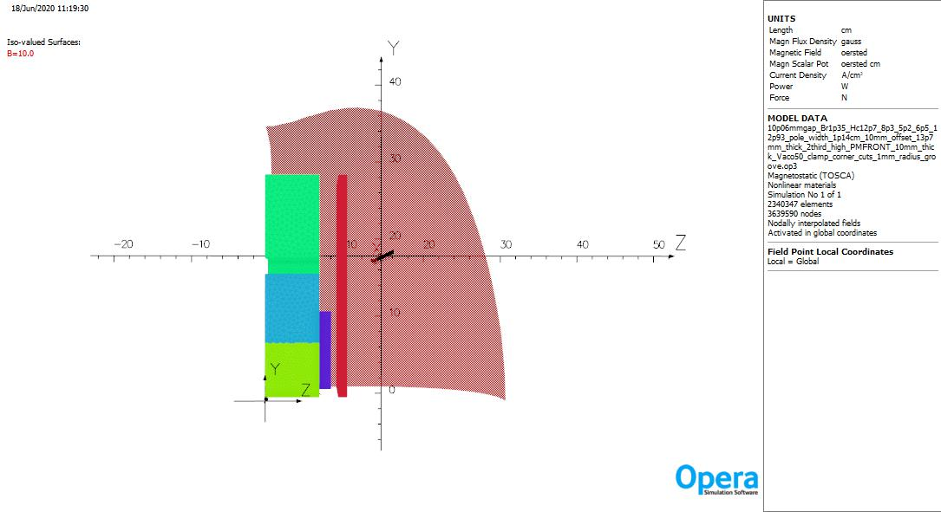
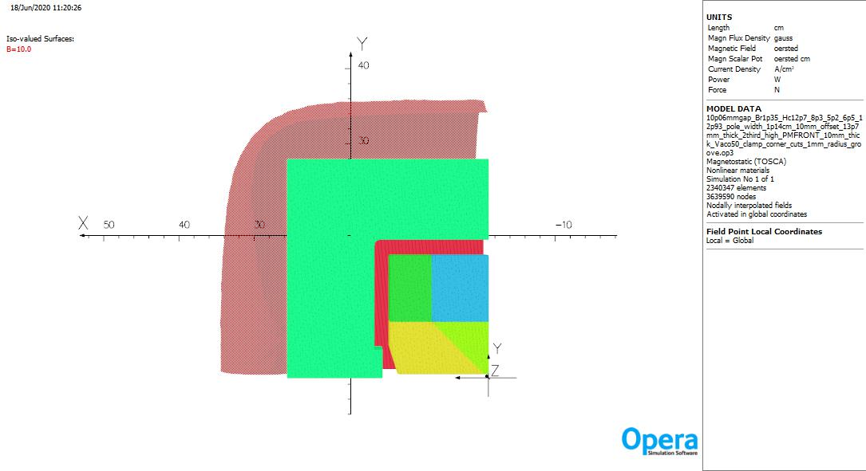
Fringe field (10 G surface)
Fringe field (10 G surface) view from x
Fringe field (10 G surface) view from z

Slide 24
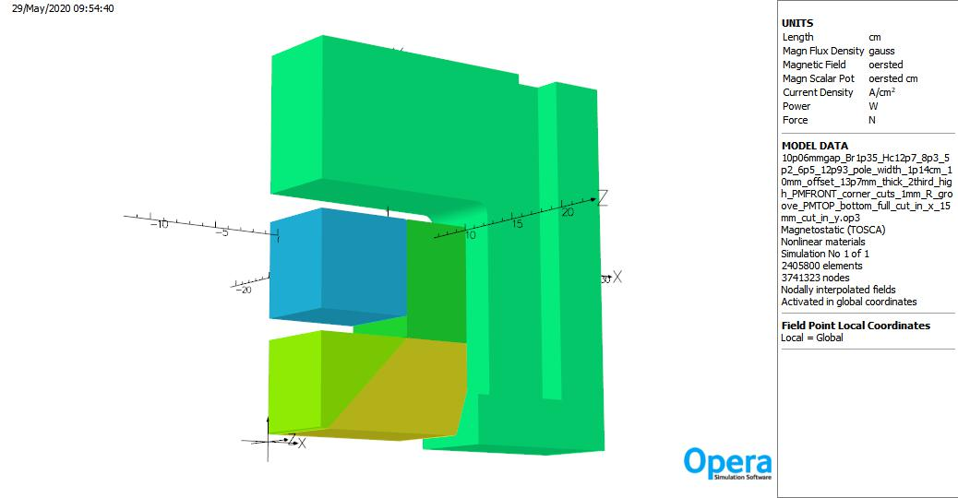
Construction resolution of variability in Br in PM materials
Top PM Block
Engineered gap
Core PM block material: NMX-U47EH (Br: 1.35 ~ 1.42 T) => Br value has about 5 % range.
Br is typically batch dependent based on chemistry and processing variables. (Br is stable within a batch.)
The magnetic design uses the minimum Br value for all PM materials.
Production magnet blocks will likely have Br higher than the minimum value.
Br will be measured on test blocks to characterize batch.
Engineered gap is calculated based on batch properties.
Enables machining of adjusted height of top PM blocks. Gap will be filled with non magnetic alloy.

Slide 25
Effect of top PM bottom cut
top PM bottom cut (mm) | B field (G) | integrated field (T-m) | bending angle (deg) | change in B field (%) | change in integrated field (%)
0 | -32468.3 | -0.438335 | 3.76349 | - | - | baseline
5 | -31797.9 | -0.430169 | 3.69353 | -2.06 | -1.86
10 | -31231.1 | -0.423070 | 3.63287 | -3.81 | -3.48
15 | -30723.0 | -0.416370 | 3.57599 | -5.38 | -5.01
20 | -30213.4 | -0.410204 | 3.52309 | -6.95 | -6.42
25 | -29782.3 | -0.404512 | 3.47348 | -8.27 | -7.72
15 mm top PM bottom cut makes 5.01 % integrated field reduction.
Depending on measured Br value of magnet blocks, top PM cuts are to be adjusted.

Slide 26
Magnetic force

Slide 27
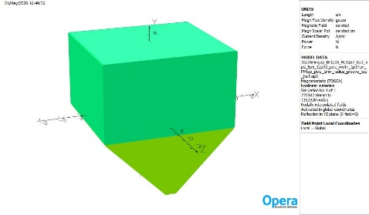
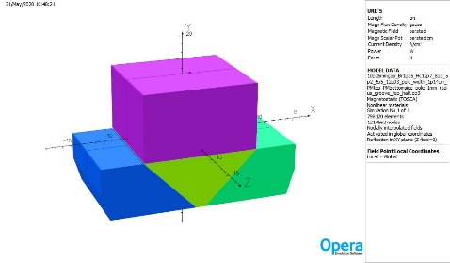
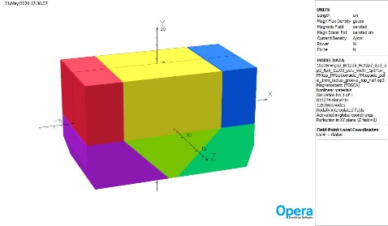
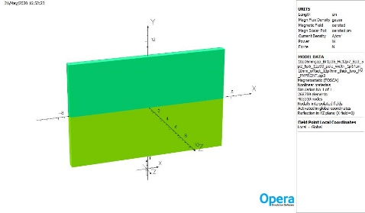
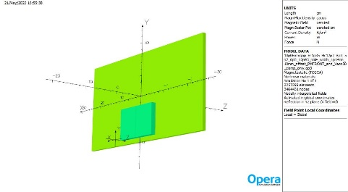
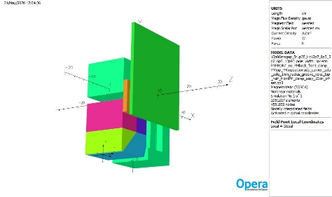
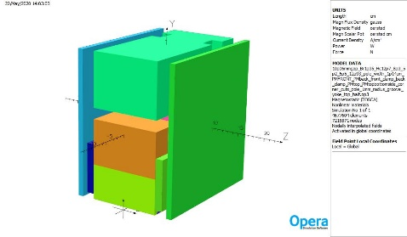
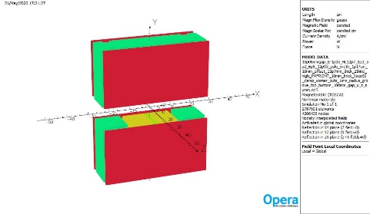
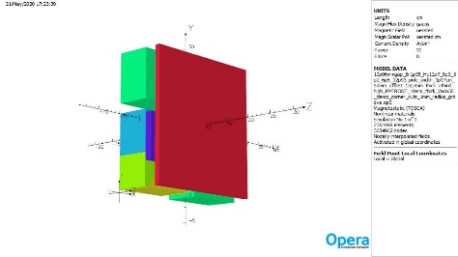
Magnetic force model during assembly
Case 1
Case 2
Case 3
Case 4
Case 5
Case 6
Case 7
Case 8
Case 9

Slide 28
Magnetic force during assembly (Case 1 ~ Case 3)
Case 1
pole and top PM
 | top PM
force in x (N) | 0.00
force in y (N) | -3228.23
force in z (N) | 0.00
Case 2
pole, top PM and bottom side PM
 | bottom side PM
force in x (N) | 651.09
force in y (N) | -1600.45
force in z (N) | 0.00
Case 3
pole, top PM, top and bottom side PM
 | top side PM
force in x (N) | -184.86
force in y (N) | 5492.91
force in z (N) | 0.00

Slide 29
Magnetic force during assembly (Case 4 ~ Case 6)
Case 4
front PM1 and 2
 | front PM (upper PM)
force in x (N) | 0.00
force in y (N) | 860.62
force in z (N) | 0.00
Case 5
front PM clamp assembly
 | clamp
force in x (N) | 0.00
force in y (N) | 0.00
force in z (N) | -310.15
Case 6
front PM clamp assembly onto yoke core, no back PM clamp assy
y offset (cm) | front PM clamp assembly Fy (N) | front PM clamp assembly Fz (N) | front PM Fy (N) |  | front PM Fz (N)
0 | 308.29 | -971.68 | 608.78 |  | 1452.14
5 | 1451.23 | -2033.16 | 2395.47 |  | 22.95
10 | 144.56 | -2765.49 | 1075.00 |  | -985.35
15 | -143.41 | -2596.40 | -2.47 |  | -820.28
20 | -291.59 | -2020.11 | -278.30 |  | -545.96
25 | -464.45 | -714.49 | -468.55 |  | -69.15
30 | -40.48 | -6.38 | -42.29 |  | 366.50

Slide 30
Magnetic force during assembly (Case 7 ~ Case 9)
Case 7, front PM clamp and back PM clamp are assembled
 | front clamp 1 (next to magnet)
force in x (N) | 0.00
force in y (N) | -253.07
force in z (N) | -2266.55
Case 8, assembly of top and bottom half
y separation (cm) | top half assembly Fy (N)
0.00 | -29023.44
0.50 | -17964.63
1.00 | -13284.08
2.00 | -8126.08
5.00 | -2764.20
10.00 | -741.93
15.00 | -194.78
20.00 | -18.21
Case 9, movement of axial PM assembly
y offset (mm) | front axial PM assembly Fy (N) | front axial PM assembly Fz (N) | front clamp Fy (N) | front clamp fz (N)
0 | -562.65 | 1622.59 | -16.19 | -654.45
5 | -160.14 | 1501.90 | -16.18 | -617.29
10 | 126.56 | 1406.61 | -16.23 | -606.01 | baseline
20 | 590.82 | 1220.62 | -17.62 | -675.96
30 | 960.05 | 1036.48 | -19.14 | -860.34
40 | 1273.46 | 864.75 | -20.43 | -1145.73
50 | 1618.93 | 638.55 | -21.62 | -1497.58
60 | 1774.69 | 20.66 | -22.49 | -1866.58
70 | 1333.08 | -255.35 | -22.30 | -2210.34
80 | 1228.58 | -369.54 | -20.61 | -2546.39
Magnet core force for final assembly : -17762.43 N
(magnet core : pole, top PM, top and bottom side PMs)

Slide 31
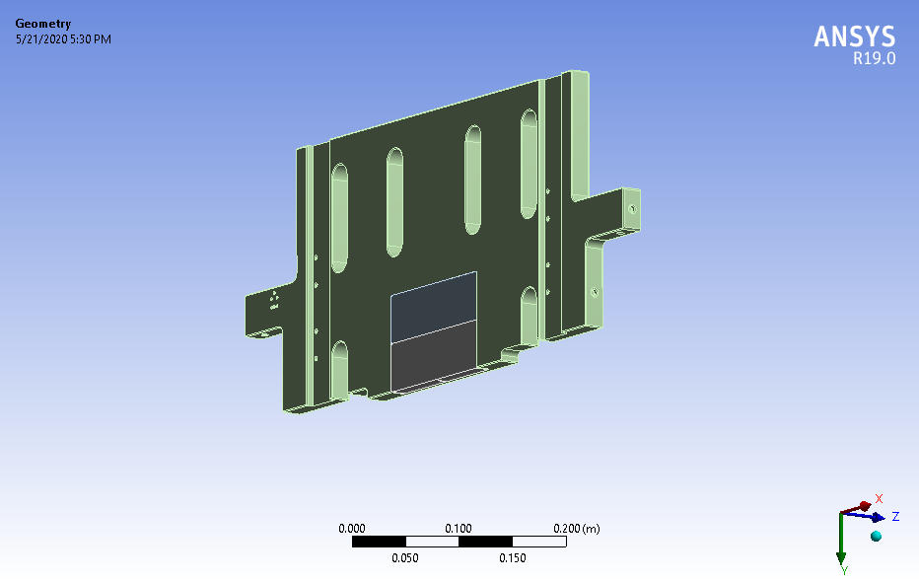
Geometry for structural calculation of axial PM assembly
Aluminum holder plate
Axial PM
Axial permanent magnets are glued on the Aluminum holder plate.

Slide 32
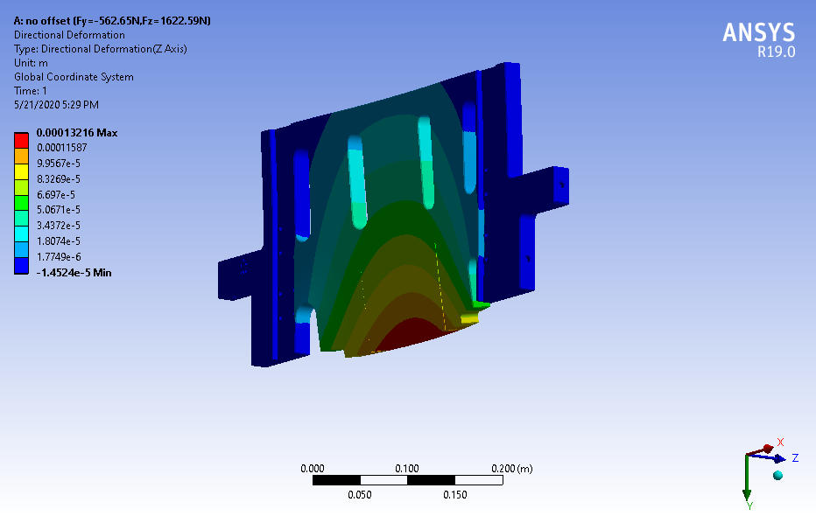
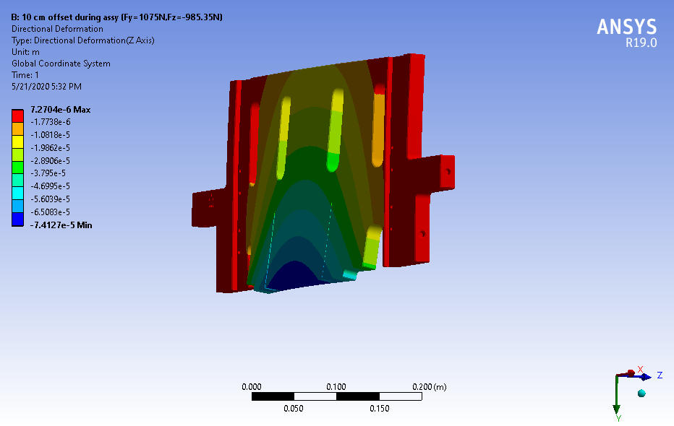
Structural calculation of axial PM assembly under magnetic force
Fy = - 562.65N
Fz = 1622.59 N
Fy = 1075 N
Fz = -985.35 N
No axial PM offset after final assembly (case 9)
(It sees the maximum value of positive Fz.)
Maximum deformation in z direction : 0.13 mm
10 cm axial PM offset during assembly (case 6)
(It sees the maximum value of negative Fz.)
Maximum deformation in z direction : 0.07 mm

Slide 33
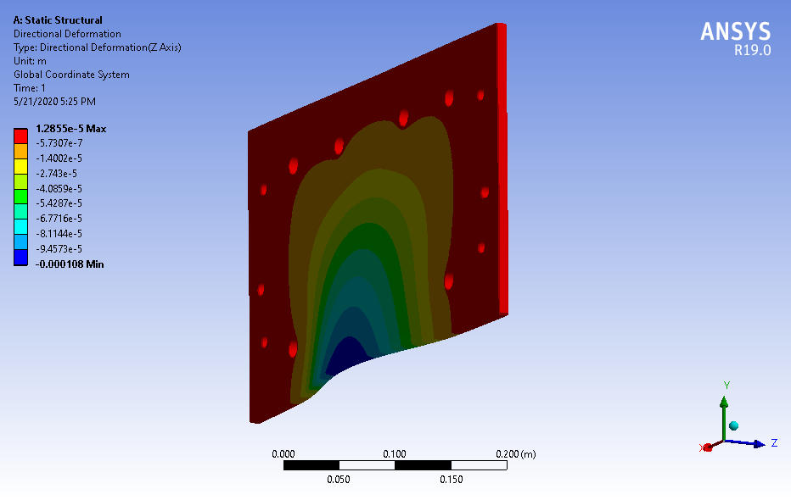
Structural calculation of field clamp under magnetic force
Fy = 144.56 N
Fz = -2765.49 N
Maximum magnetic force for field clamp (case 6)
Maximum deformation in z direction : 0.11 mm

