Slide 1



Magnetic Design of the HEPTO Dipole-Quadrupole for Diamond-II
Alex Hinton, Ben Shepherd (STFC Daresbury Laboratory)
Abolfazl Shahveh (Diamond Light Source)
Tadej Milharcic, Mirko Kokole, Jure Počkar (Kyma S.p.A.)
Low Emittance Ring – Permanent Magnet Workshop, Trieste
14-15/11/2023

Slide 2
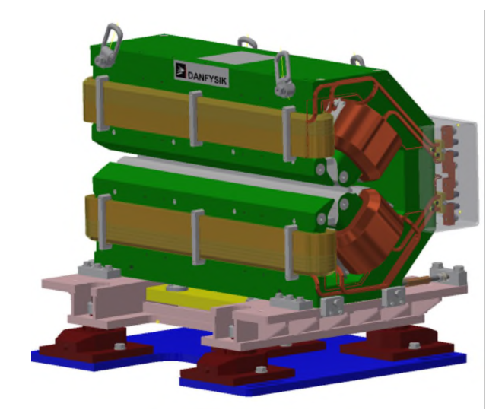
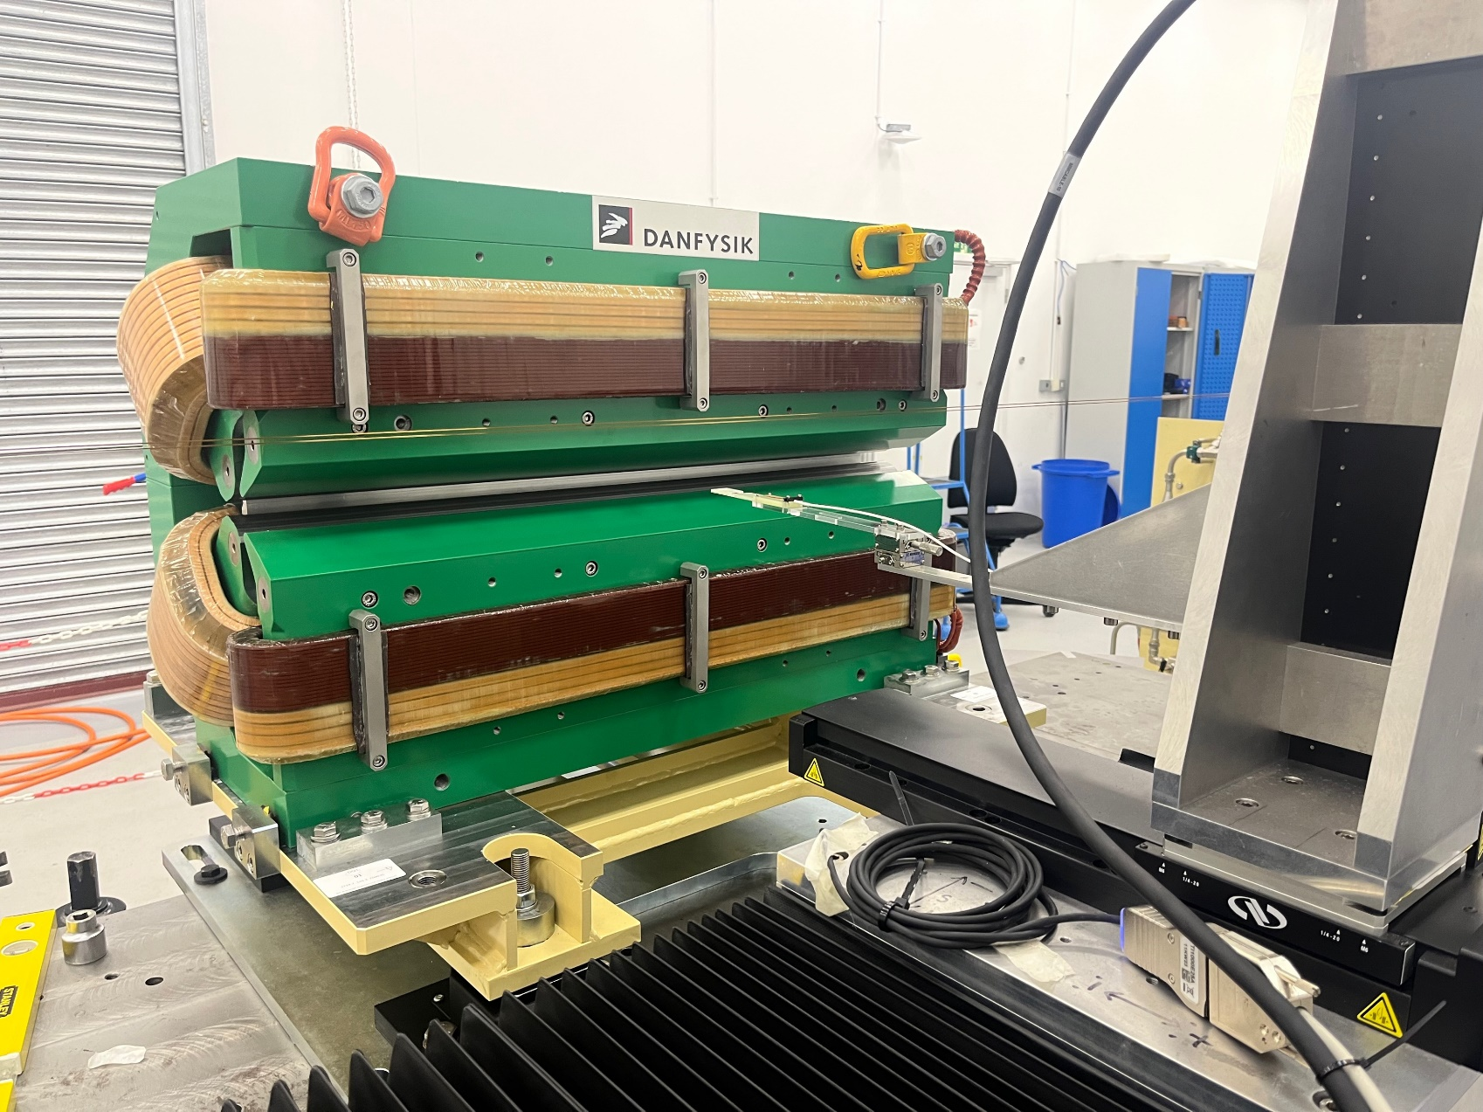
Introduction
Fourth generation synchrotron light sources make use of multi-bend achromat lattices to reduce beam emittance and increase radiation brightness.
Lattices require combined function dipole-quadrupole (DQ) magnets.
Diamond-II upgrade will require 48 DQ magnets drawing 2.3 kW each.
Can permanent magnets achieve the same purpose with negligible power?

Slide 3
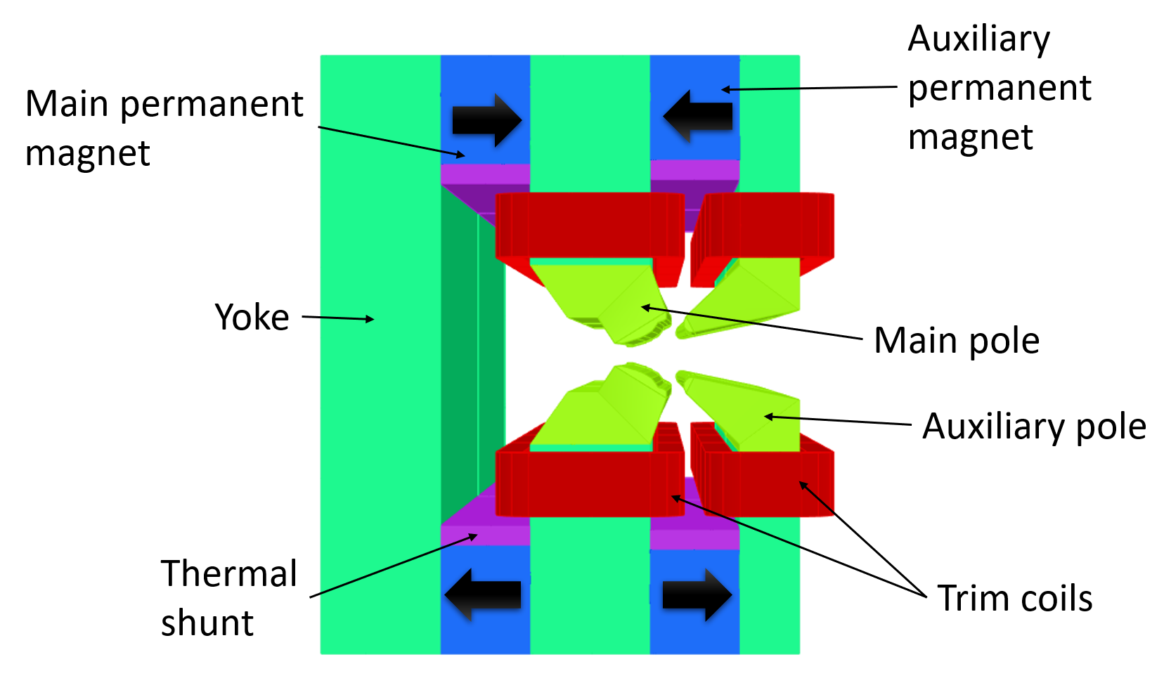
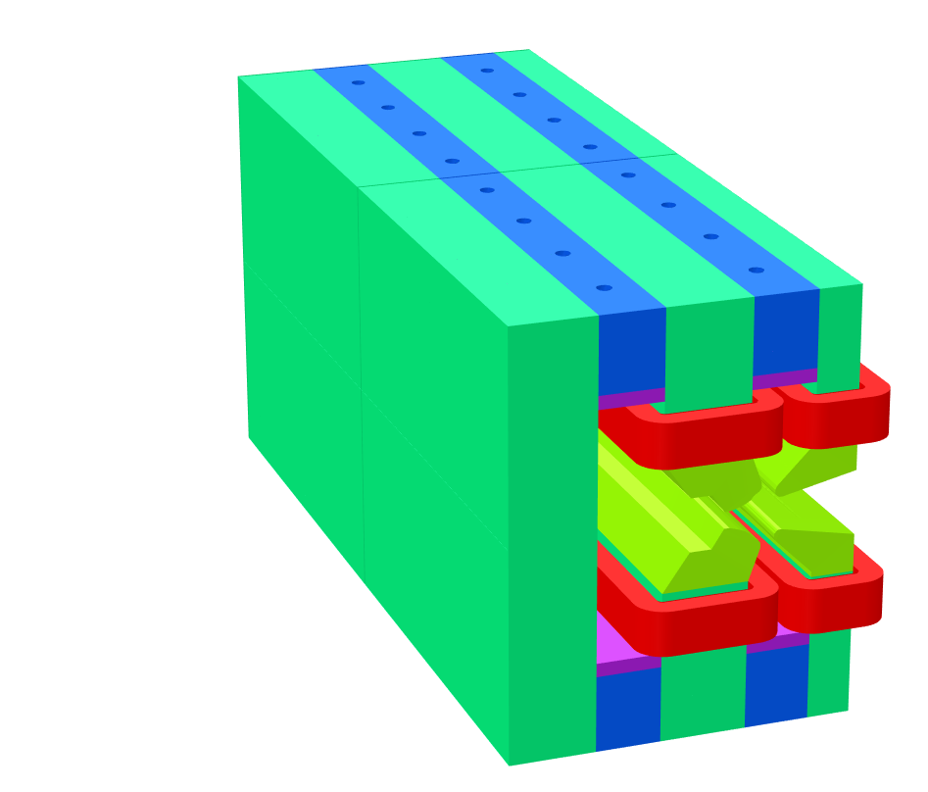
Design Overview
Hybrid Electromagnet-Permanent Magnet Tuneable Optics (HEPTO).
Dipole = 0.7 T, Gradient = 33 T/m.
Effective length = 0.870 m.
Main source of field = NdFeB permanent magnet blocks
Dipole and gradient fields require independent tuning of ±2.5% for commissioning purposes.
Field tuning achieved by air-cooled trim coils.
Yoke and poles made from XC06 low-carbon steel.
400 mm
831 mm
320 mm

Slide 4
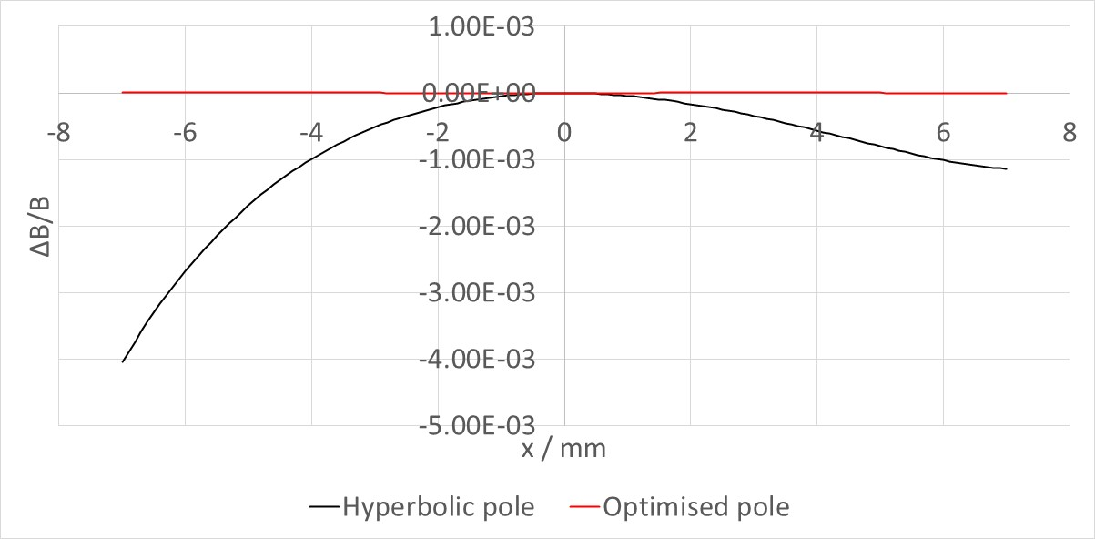
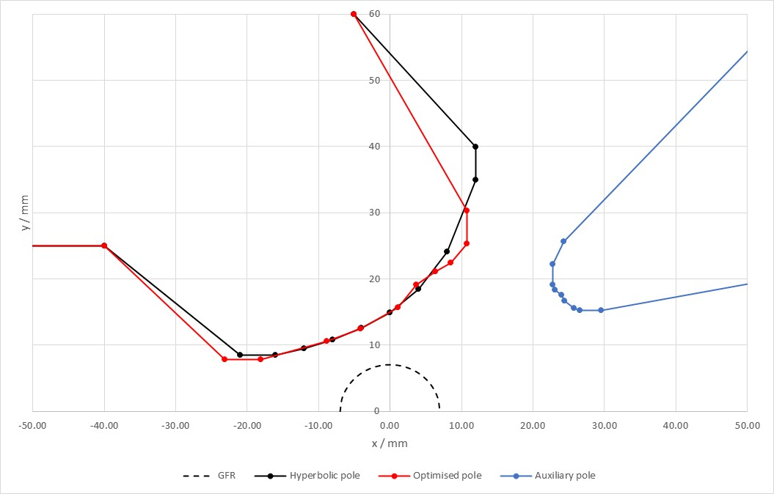
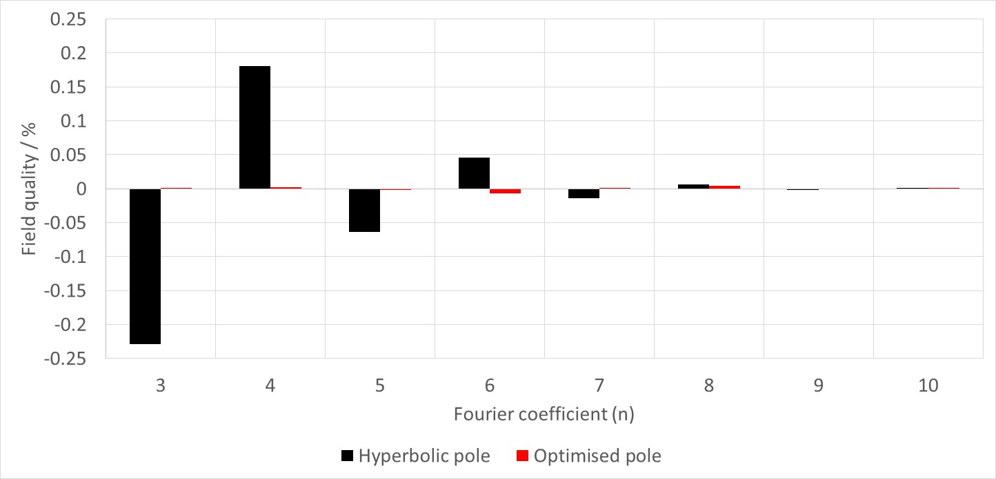
Pole Shape Optimisation
Pole tip design optimised in Opera 2D.
Pole shaping algorithm used to minimise multipole errors [1].
Required field quality ΔB/B < 5x10⁻⁴.
[1] G. Le Be, J. Chavanne and P. N'gotta, “Shape optimization for the ESRF II magnets,” in IPAC 2014: Proceedings of the 5th International Particle Accelerator Conference, 2014.

Slide 5
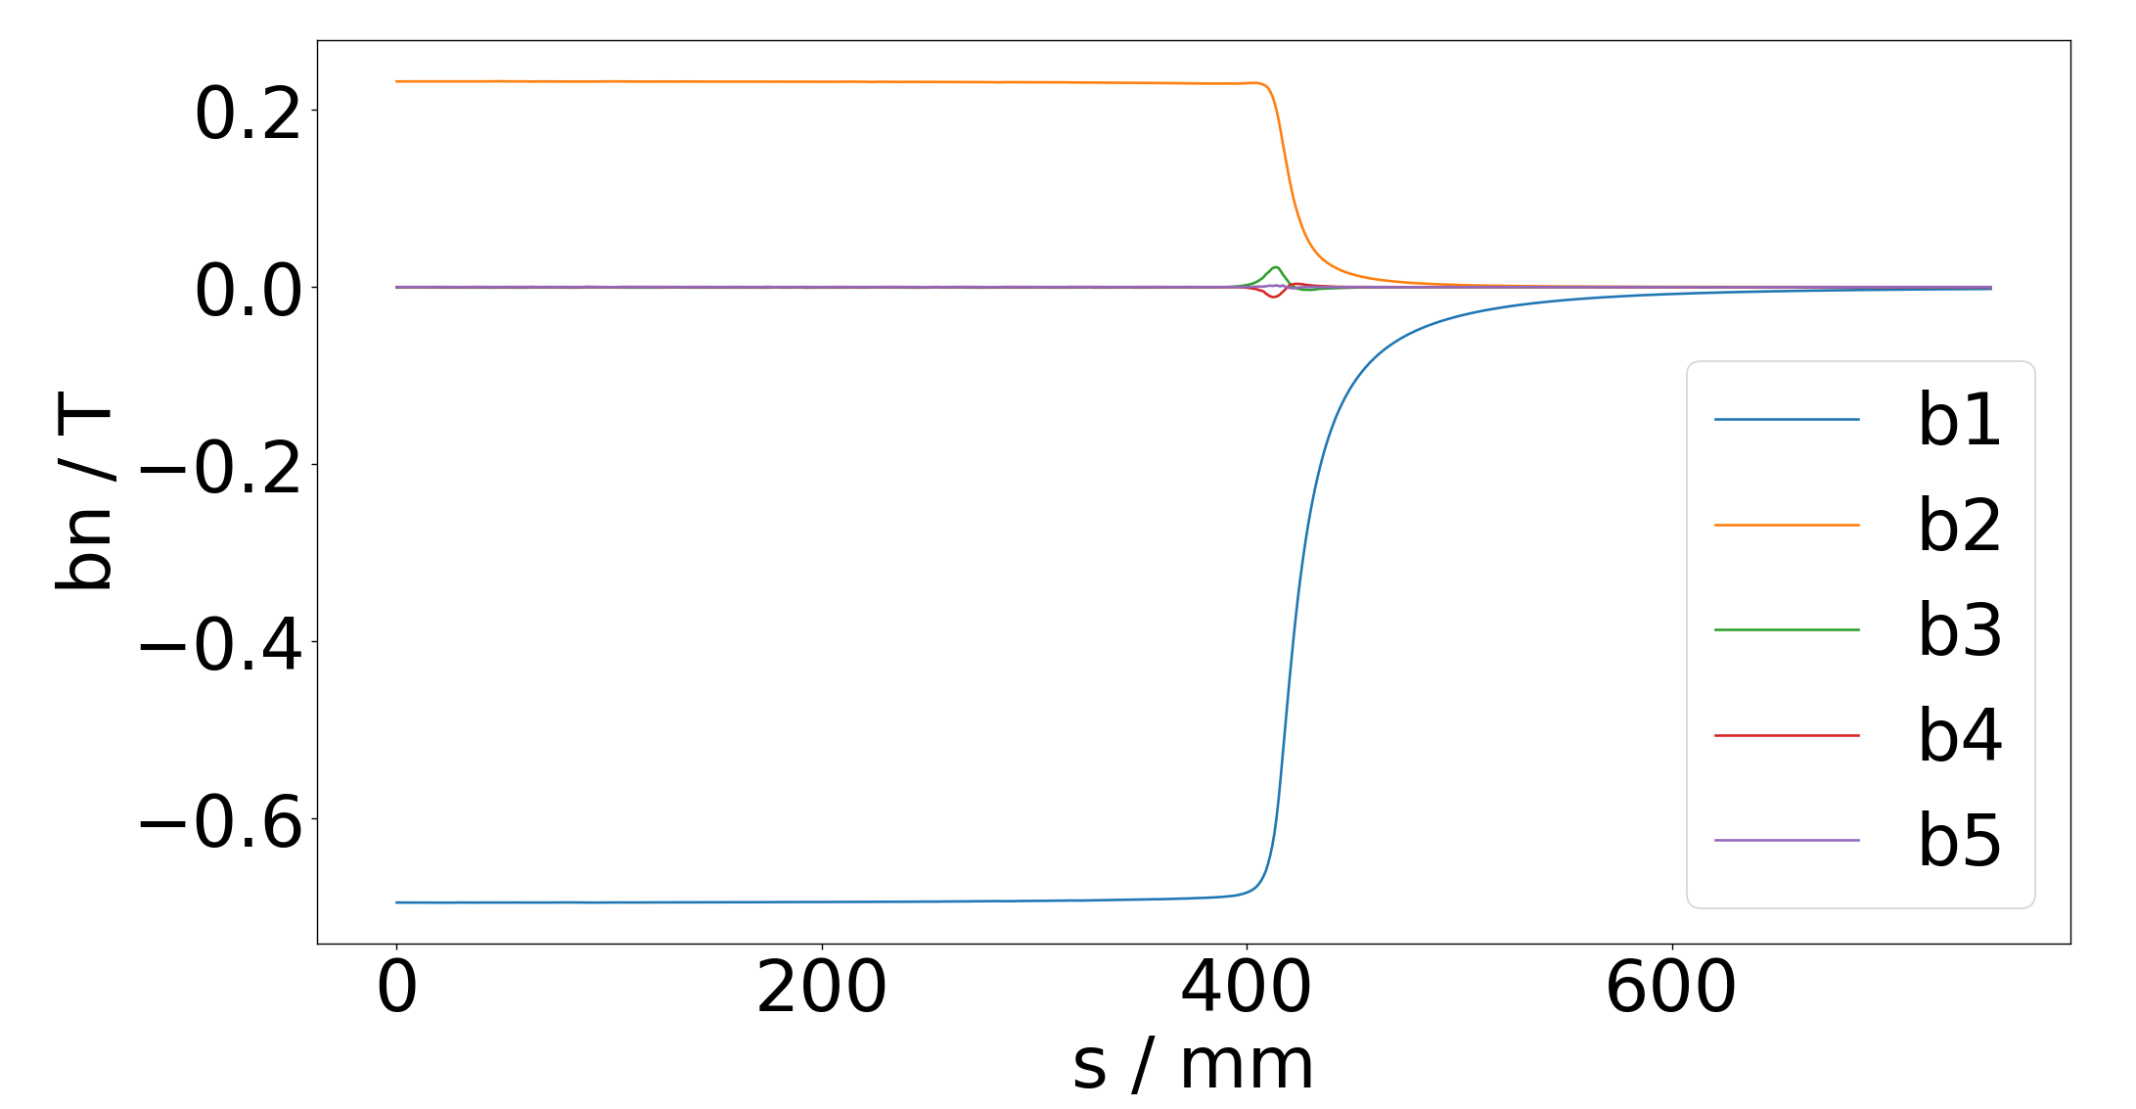
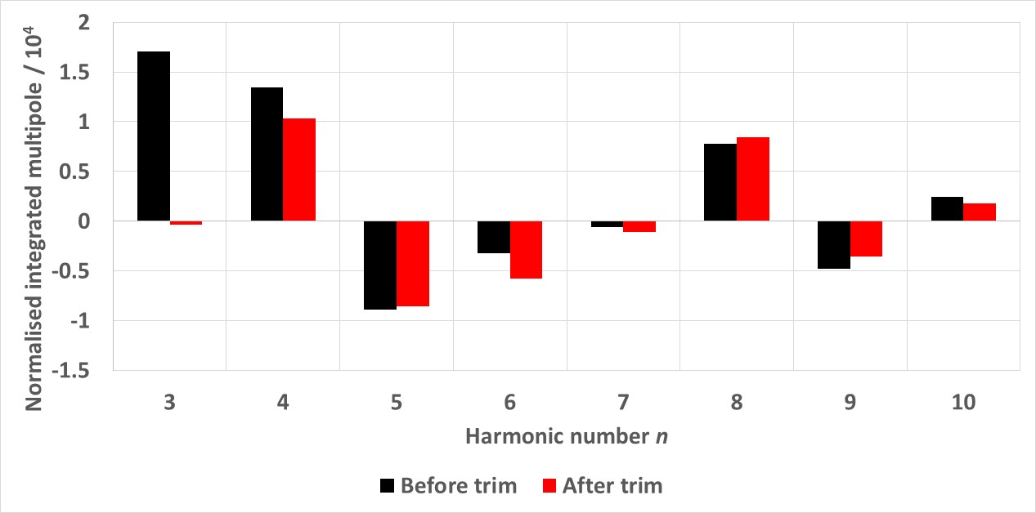
3D Field Quality
Integrated field quality assessed in Opera 3D.
Pole tips curved to follow beam trajectory and give constant dipole field.
Effective length of quadrupole shorter than dipole.
Central gradient increased and pole profile adjusted slightly to give target field integrals.
Trim coils reduce integrated sextupole, octupole terms.
Pole ends not chamfered - non-zero central sextupole component.

Slide 6
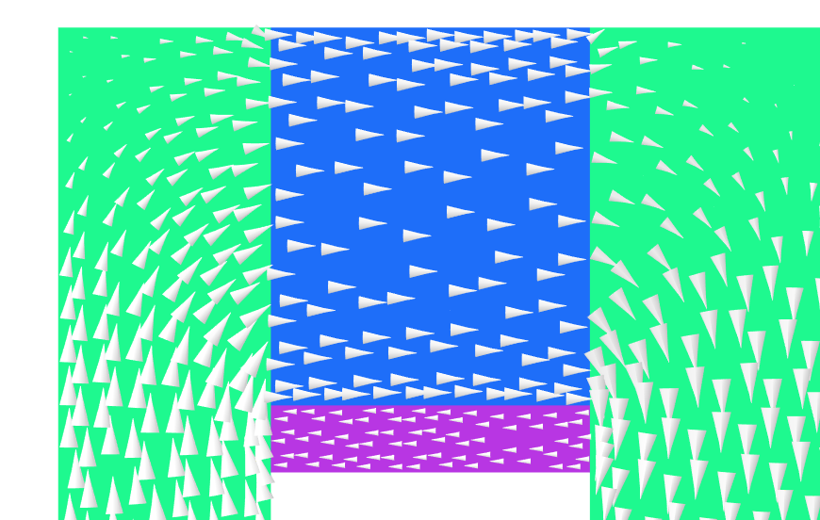
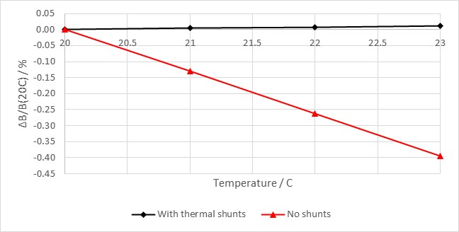
Permanent magnet
Steel yoke
Thermal stability
Flux vectors
Permanent magnet strength decreases with increased temperature.
FeNi shunts used to provide improved thermal stability.
Shunt has negative temperature coefficient; as temperature increases, saturation polarisation decreases.
Dipole thermal stability from -0.131% / degree without shunt to +0.004% / degree with shunt
0.01% variation typical in electromagnets due to power supply fluctuation.
FeNi shunt

Slide 7

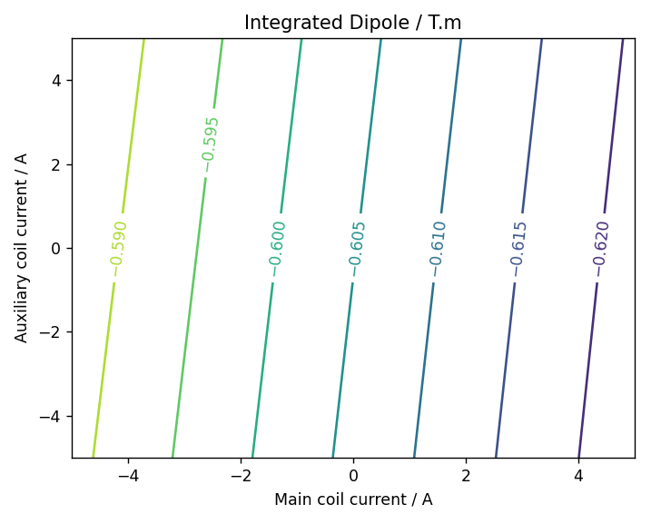
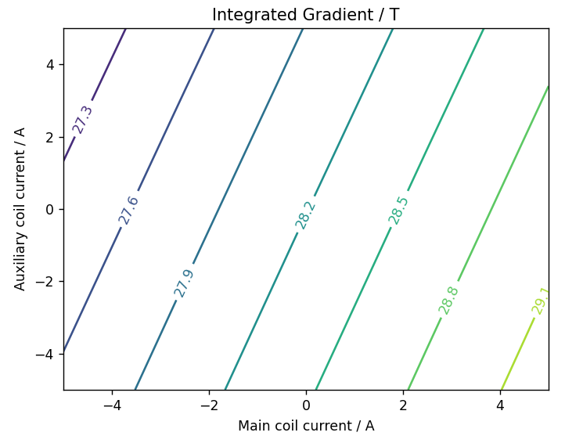
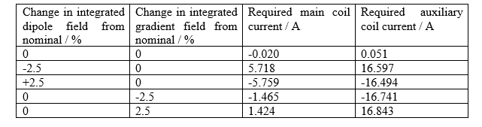
Tuning Range
Main coil
Auxiliary coil
Air cooled coils used to independently trim dipole and quadrupole fields by ±2.5%.
Currents limited to 5 A to allow air cooling.
Tuning is inefficient due to permanent magnets in magnetic circuit.
Required tuning range cannot be achieved with air-cooled coils.

Slide 8
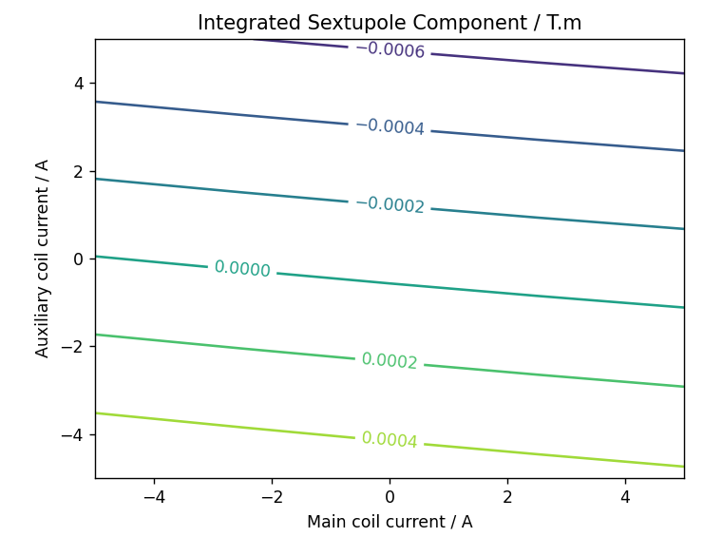
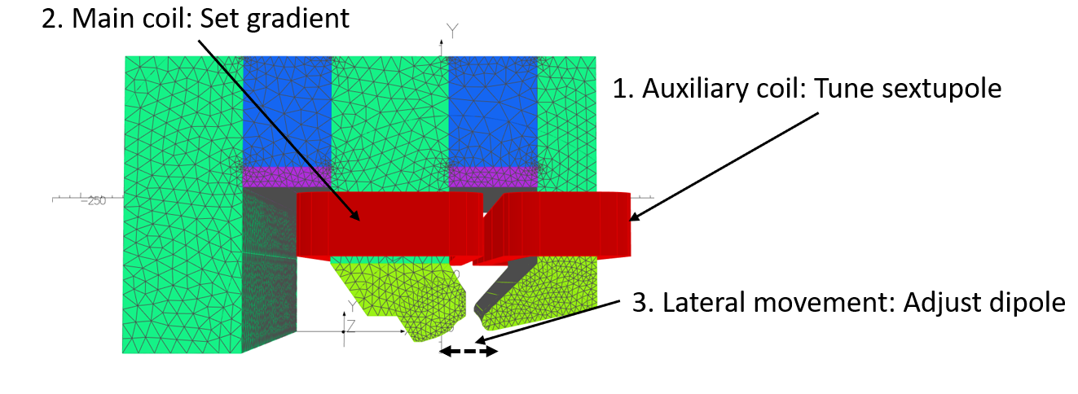
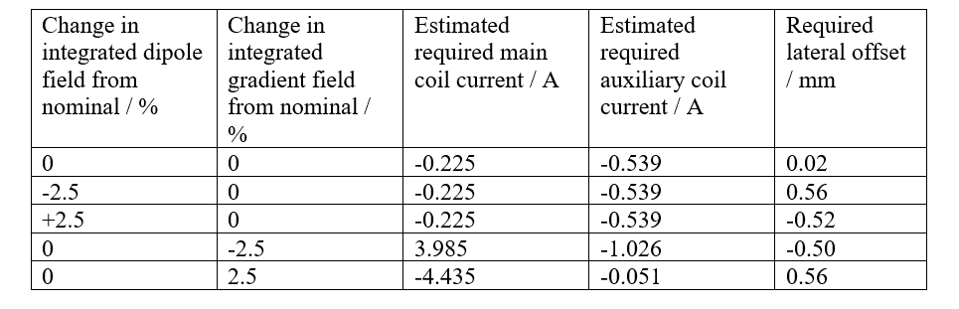
Mechanical Tuning
Main and auxiliary coils cannot achieve independent field tuning in isolation.
Lateral movement of magnet can tune on-axis dipole independent of gradient without coil currents.
Auxiliary coil used to tune sextupole field component.
Main coil used to tune gradient.
With ±1mm lateral movement of magnet in-situ, required tuning can be achieved with air-cooled coils.

Slide 9
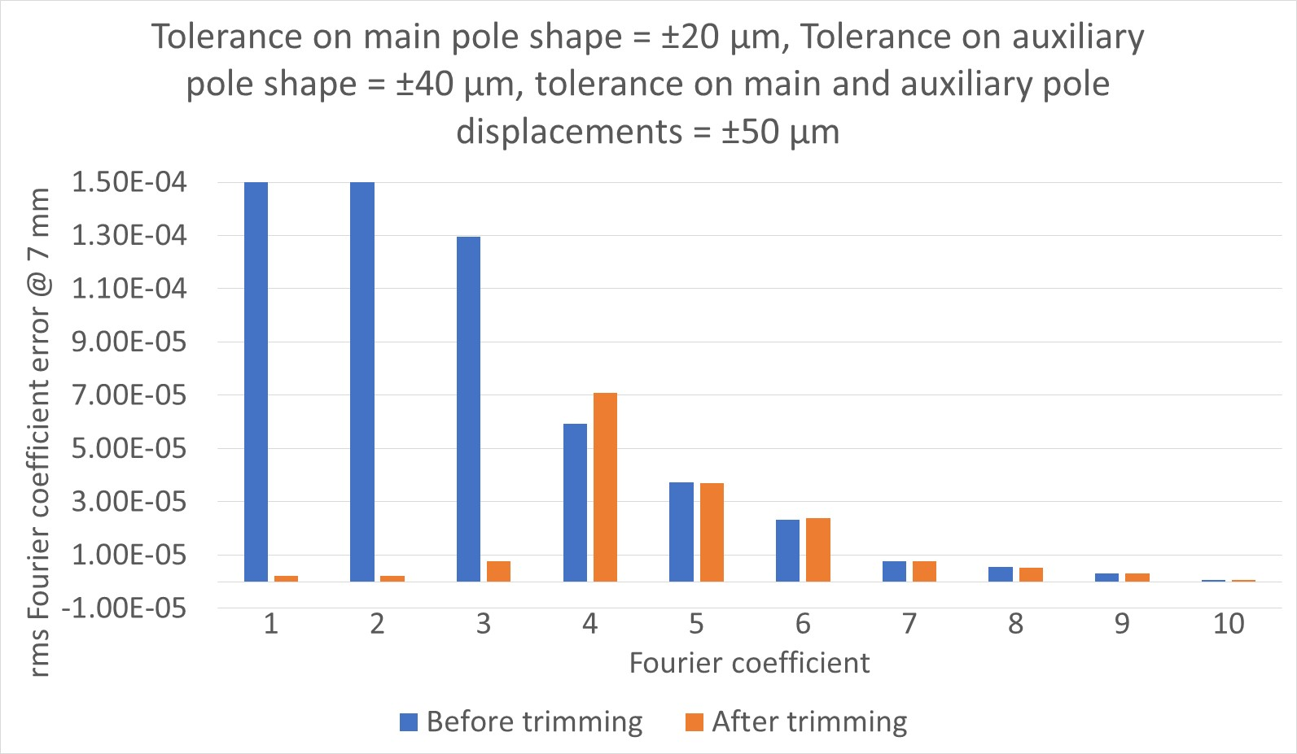
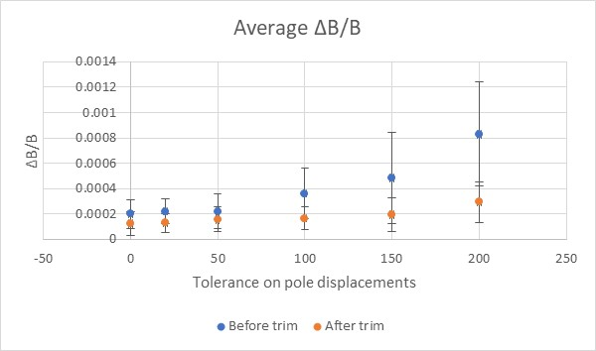
Tolerance Studies
Required field quality ΔB/B < 5x10⁻⁴.
Sextupole component < 10⁻³.
Machining and assembly tolerances will negatively impact field quality compared to nominal magnetic design.
Auxiliary coil can trim undesired sextupole component introduced by tolerances.
Modelling shows required machining tolerances of ±20 μm on main pole, ±40 μm on auxiliary pole.
Displacement tolerances < 200 μm.

Slide 10
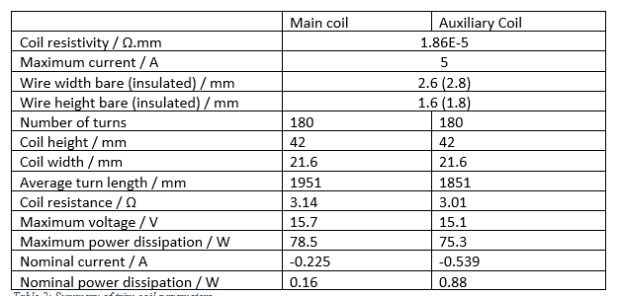
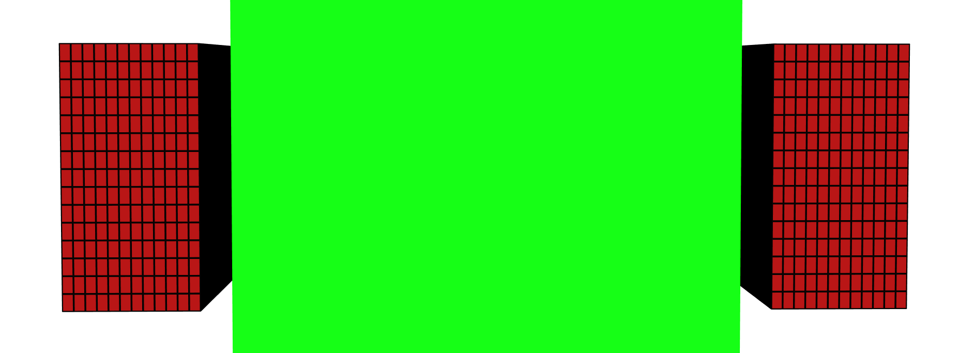
Final Coil Design
Coils wound from solid insulated copper wire.
Air cooled coils – no need for water cooling infrastructure.
Some current expected at nominal operation to trim fields (account for magnetisation and machining tolerances).
Nominal power dissipation of equivalent electromagnet = 2.3 kW.
Bipolar power supply required for field tuning.
Coil cross-section
Yoke

Slide 11

Assembly and Forces
Large attractive magnetic forces between permanent magnet blocks and steel yoke.
Forces need to be considered during assembly of magnet to prevent injury or damage to the magnet.
Forces between poles in assembled magnet could cause deformation and hence reduced field quality.
Movement of components must be prohibited.
0.7 kN
40 kN
30 kN
5 kN
0.3 kN
30 kN

Slide 12
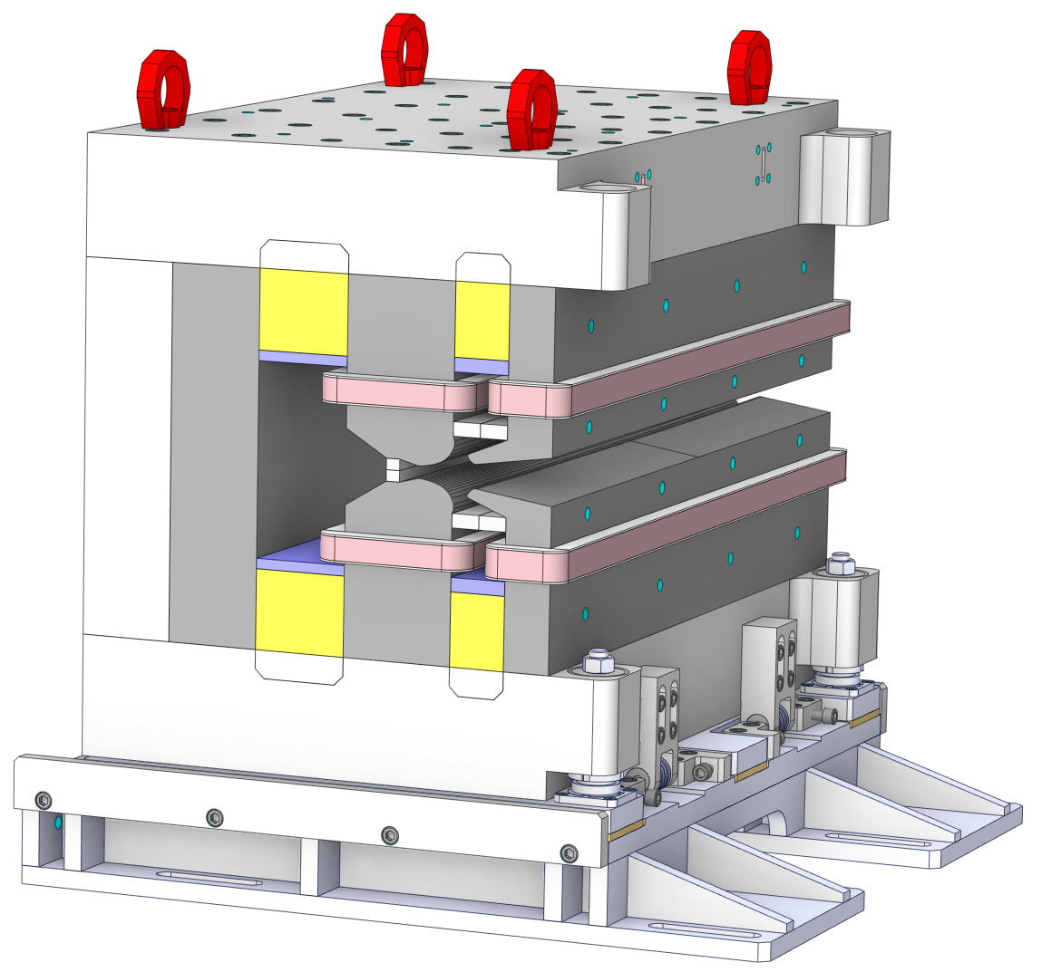
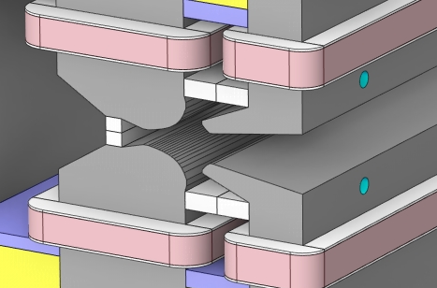
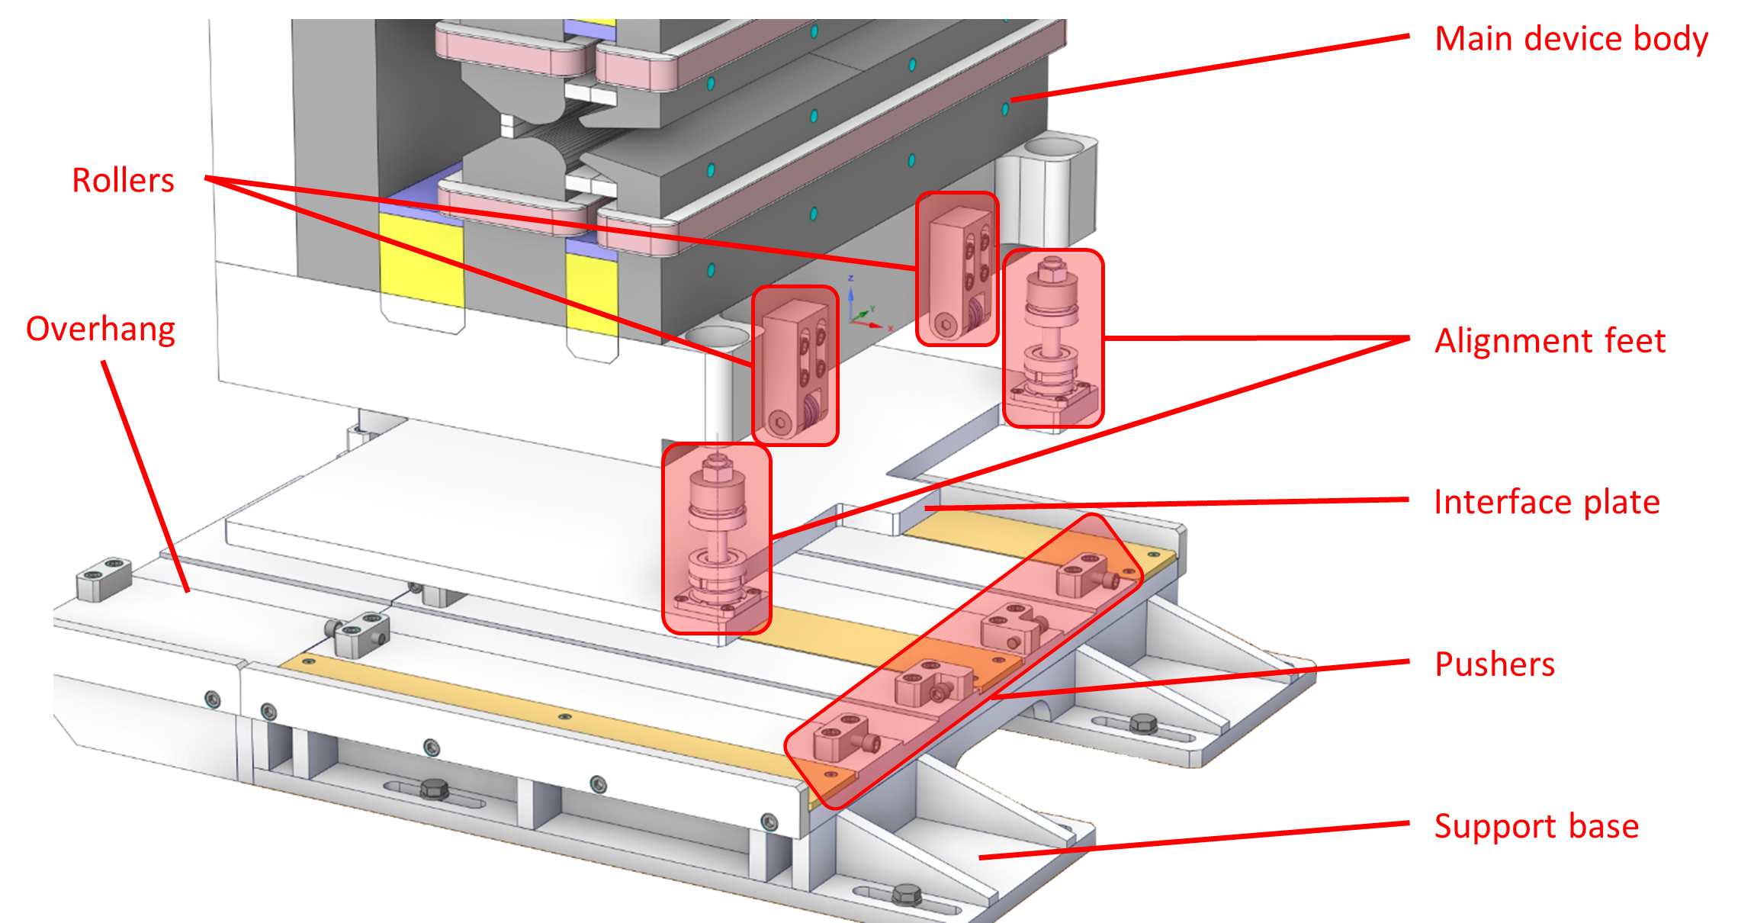

Mechanical Design Overview
Conceptual mechanical design for assembling and mounting magnet produced by Kyma.
Aluminium C-shape support frame.
Device can be inserted around vacuum chamber.
Gap spacers control separation of poles subject to attractive forces.
Support base allows adjustment of displacement and angular alignment.
Can in-situ lateral adjustment be achieved?

Slide 13
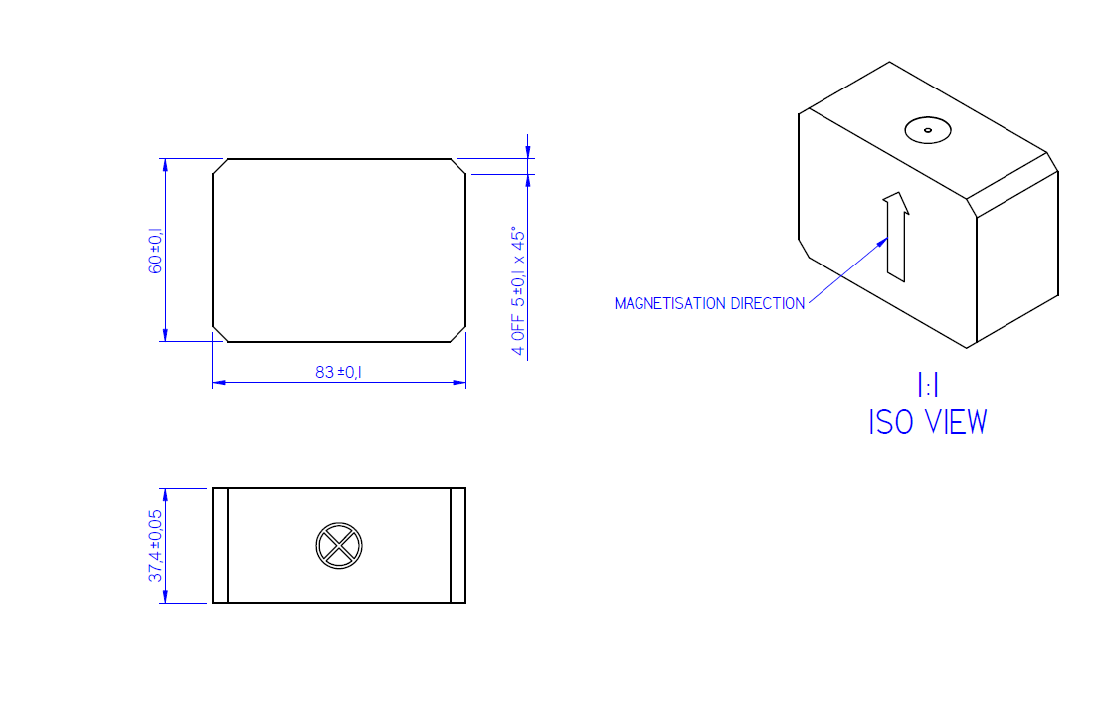
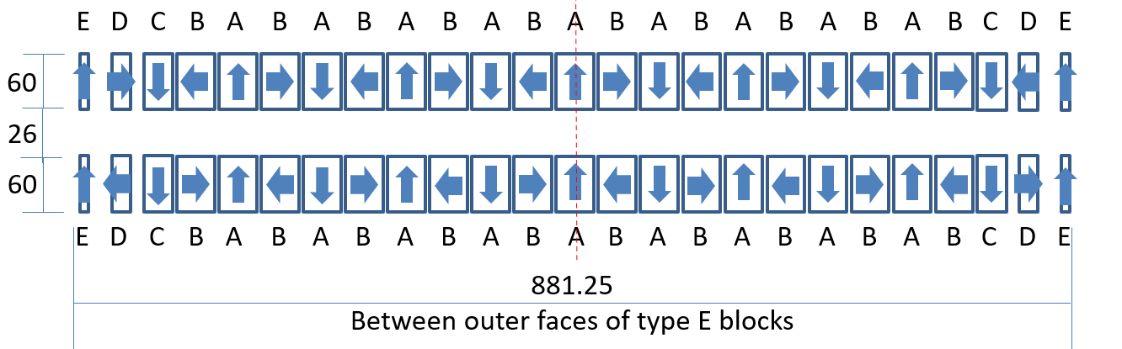
Recycling Magnets
Permanent magnet material is expensive and has long lead times!
Can spare undulator magnet blocks be used to build the HEPTO prototype?
Sets of different size NdFeB blocks available
Br = 1.3 T ±1%

Slide 14
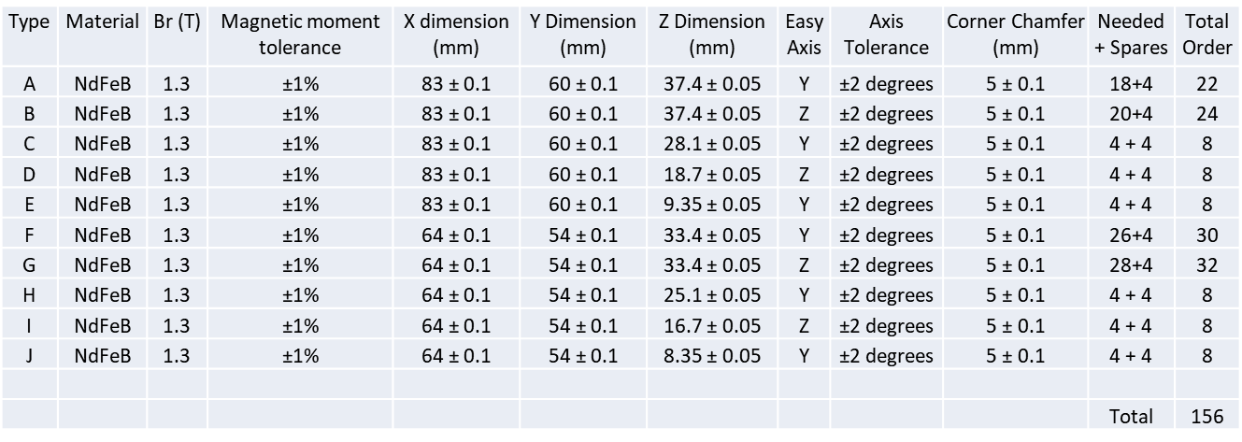
Magnet Dimensions
Dimensions of available magnets are fixed – cannot achieve optimised magnet dimensions of original design.
Need to find a combination of magnets that will fit the geometry and give the desired field strength.
Volume of PM material in original model = 1.4E7 mm³.
Total volume available from undulator blocks = 1.9E7 mm³.

Slide 15
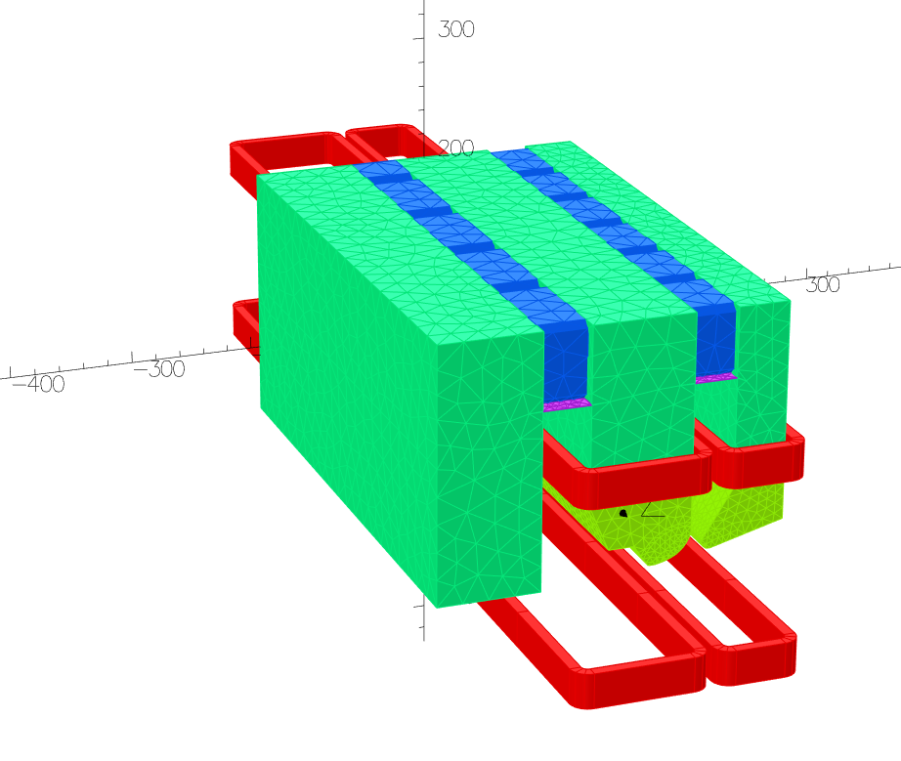
First Attempt
Replace main and auxiliary permanent magnet blocks with type B and G magnets.
B = -0.4123 T.
G = 21.220 T/m.
Fields weaker than targets.
Fields will be even weaker with optimised thermal shunt dimensions.
Main pole half gap limited to ~13.5 mm.
9 * type B
12 * type G
1 thermal shunt layer

Slide 16
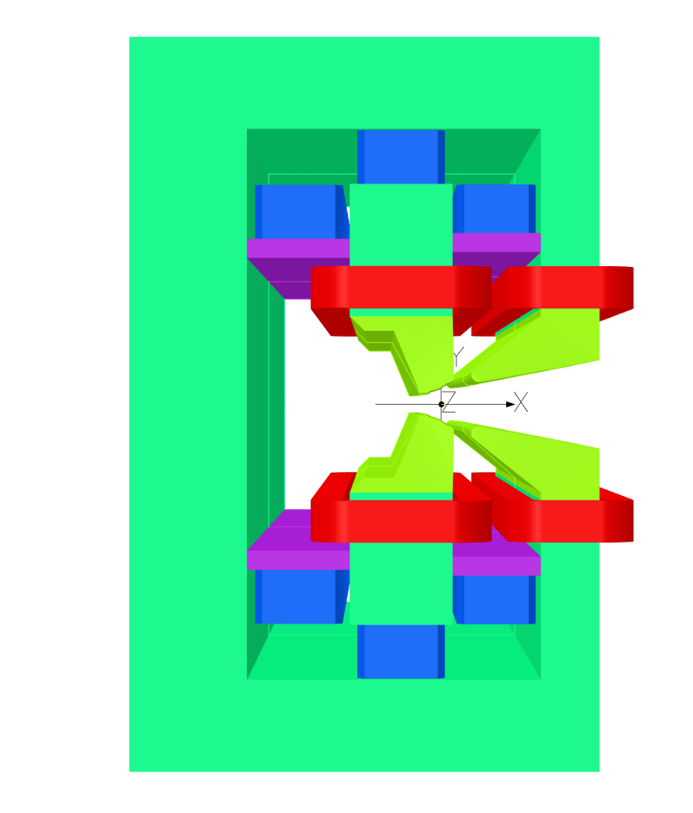
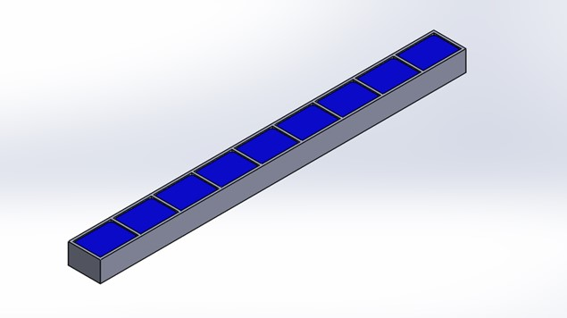
Updated Design
Type F PM (2 x 12)
Type A PM (2 x 9)
Permanent magnet blocks located above and below main pole arms.
Increased flux into main pole.
Larger yoke provides mechanical support.
Pole shaping required to achieve combination of target dipole and quadrupole.
PMs housed in “ice-cube tray”.
Type B PM (2 x 9)

Slide 17
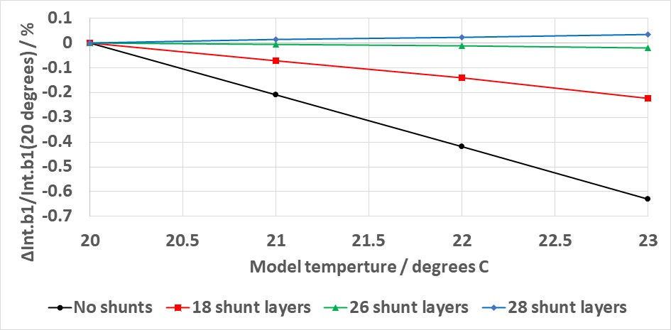
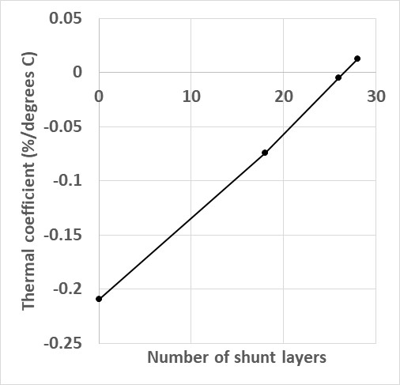
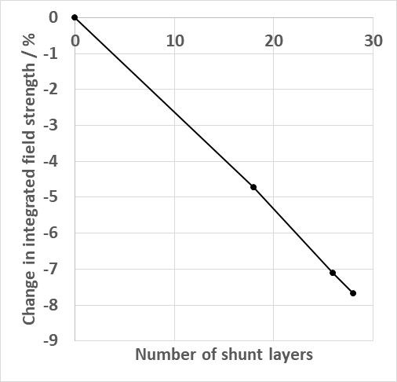
Thermal Stability
Br thermal coefficient = -0.108 % / degree.
Number of 0.5 mm thick thermal shunt layers adjusted to reduce changes in field strength with temperature.
Optimal thermal stability achieved with 26 shunt layers.
Thermal coefficient = -0.005 % / degree.
More shunt material results in weaker fields.
Field strength increased by making pole narrower at expense of field quality.

Slide 18
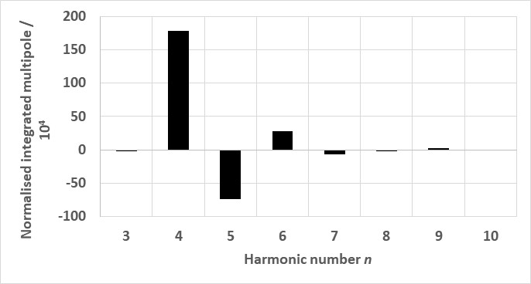
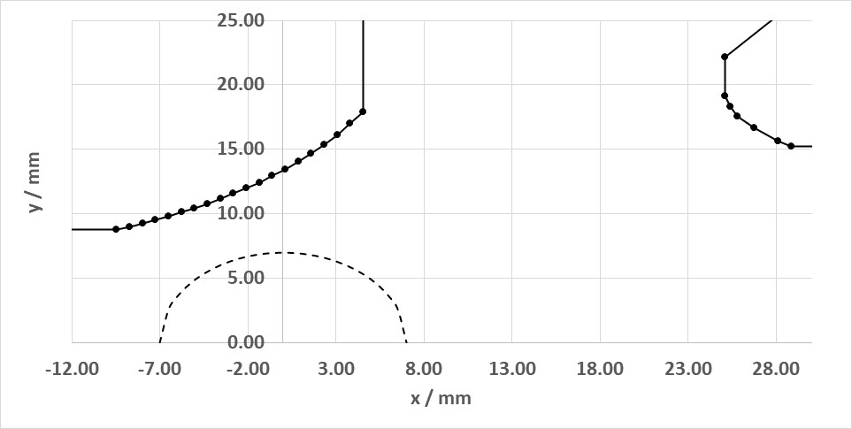
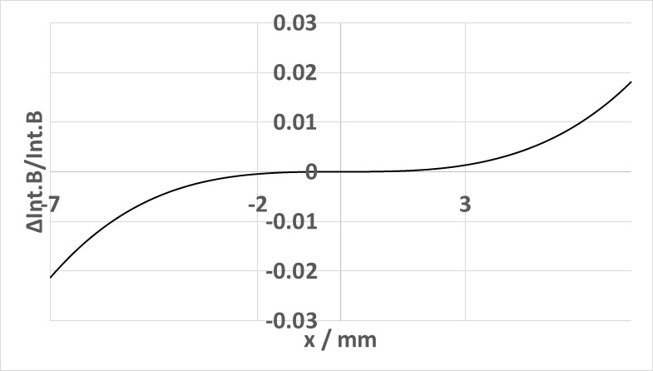

Pole Shape Optimisation
Can optimise basic pole shape parameters to achieve target integrated dipole, quadrupole and sextupole.
Poor control over higher order harmonics.
$$y= \frac{h^{2}}{2(x−dx)}$$

Slide 19
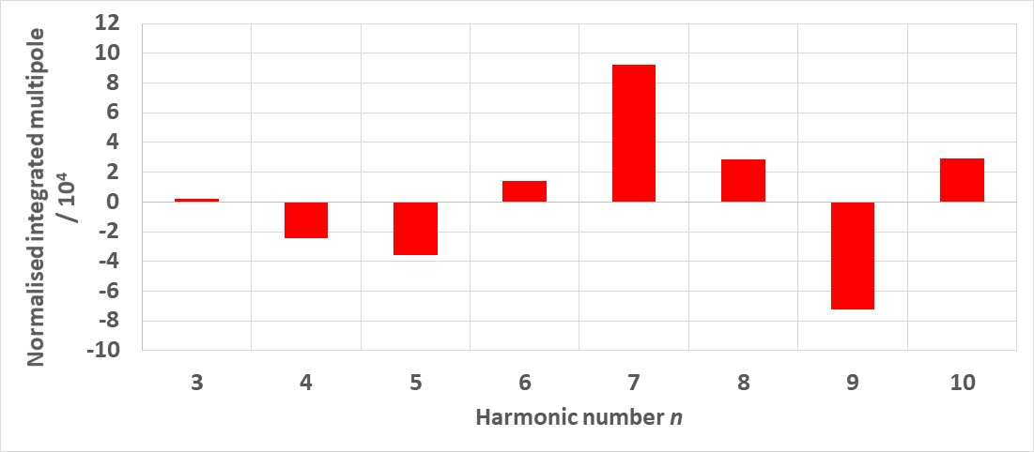
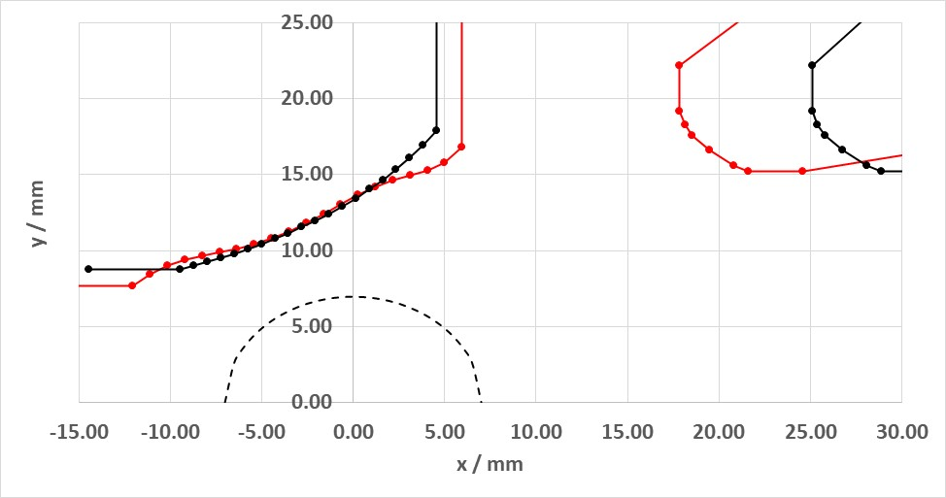
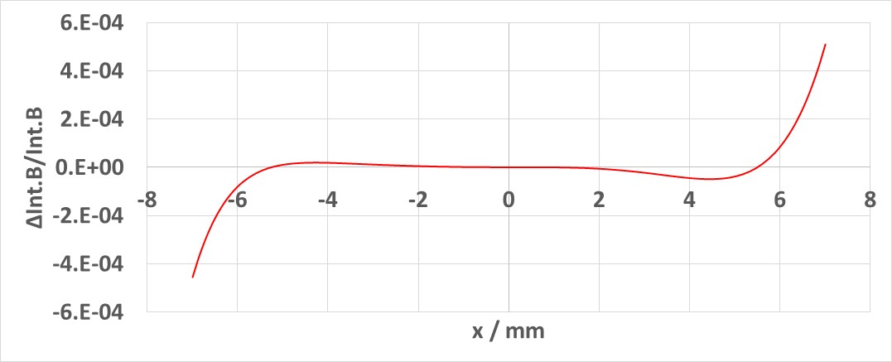
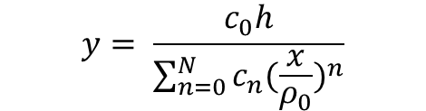


Pole Shape Optimisation
$$y= \frac{h^{2}}{2(x−dx)}$$
$$y= \frac{B_{0}h}{B_{0}+B^{′}x}$$
$$y= \frac{c_{0}h}{\sum_{n=0}^{N}{c_{n}{(\frac{x}{ρ_{0}})}^{n}}}$$
Further pole shaping required to minimise error harmonics.
New way of parameterising main pole face whilst maintaining half gap (h).

Slide 20
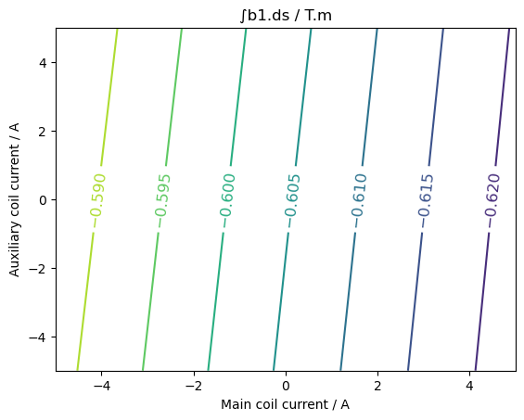
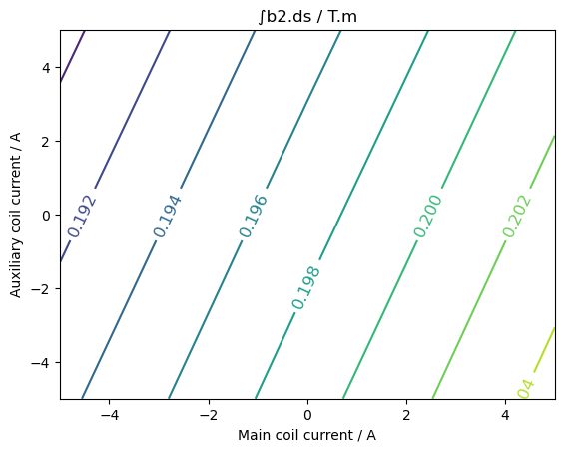
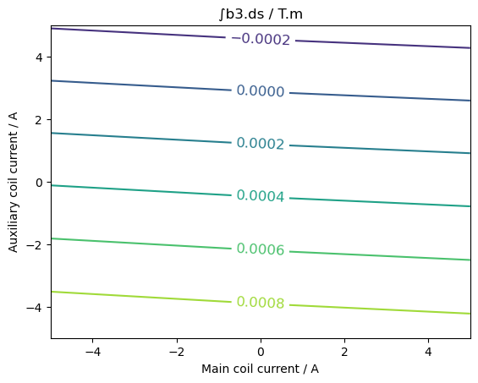
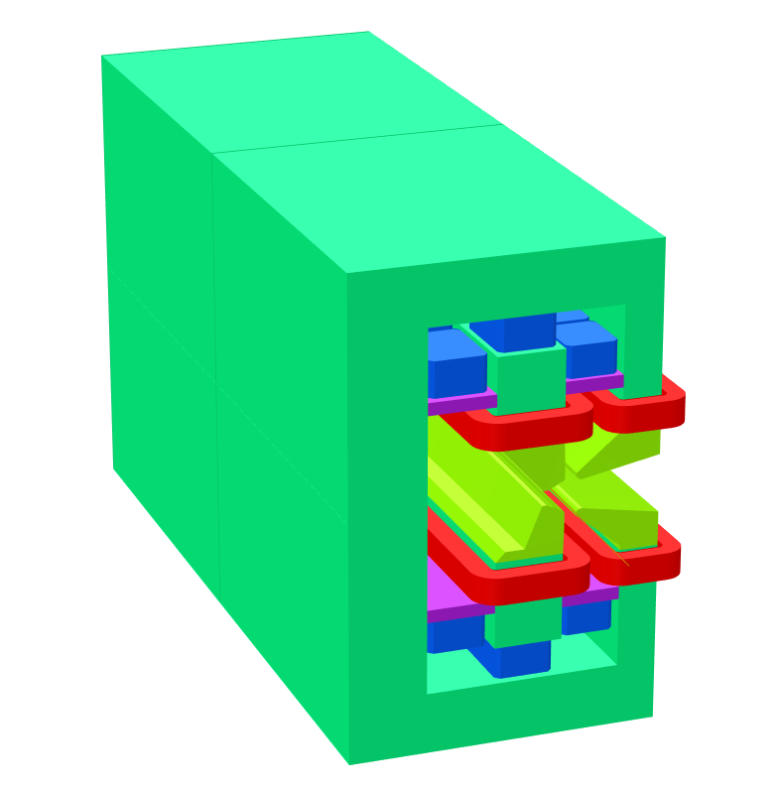
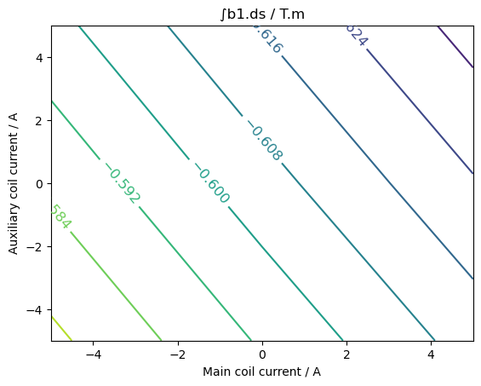
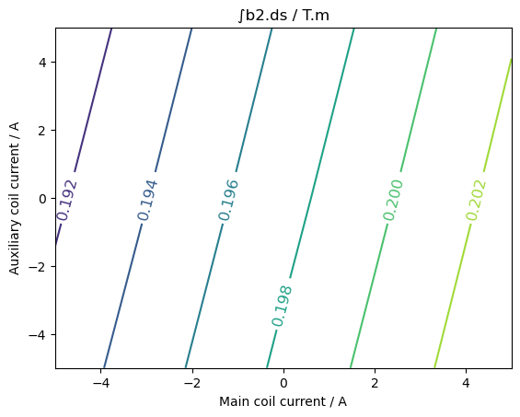
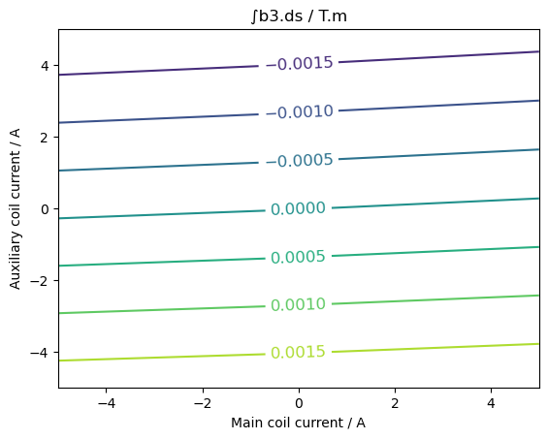
Field Tuning
Version 1
Version 2

Slide 21
Tuning Range
Change in gradient of dipole tuning in version 2 design.
Independent tuning of dipole and gradient in range ±2.5 % achievable with coil currents < 5 A.
Required tuning can be achieved without lateral movement – simpler mechanical design.
No lateral movement = no control over sextupole during tuning.
Larger currents required for tuning with lateral shift.
Either way, required tuning range can be achieved with same air cooled trim coil design.

Slide 22
Conclusions and Future Planning
The initial magnetic design of the HEPTO DQ was completed.
Nominal power requirement per magnet (for field trimming) < 2 W.
Maximum power requirement per magnet (5 A per coil) = 150 W.
Equivalent electromagnet requires 2.3 kW + water cooling.
A second iteration of the design is underway to use recycled undulator PM blocks as the field source in a prototype magnet.
The required tuning range of ±2.5% can be achieved using air cooled trim coils.
Once the mechanical design is completed, the prototype magnet will be constructed and tested to validate its performance.

Slide 23
Thank you
Acknowledgements:
Ben Shepherd (STFC)
Alfie Shahveh (Diamond Light Source)
Tadej Milharcic, Mirko Kokole, Jure Počkar (Kyma)
Facebook: Science and Technology Facilities Council
Twitter:@STFC_matters
YouTube: Science and Technology Facilities Council

