Slide 1



Update on measurement and operation of a ZEPTO tunable permanent magnet quadrupole on Diamond Light Source
Alex Bainbridge
ASTeC, UKRI-STFC Daresbury Laboratory
Low Emittance Ring – Permanent Magnets Workshop
14-15 November 2023
Trieste, Italy

Slide 2

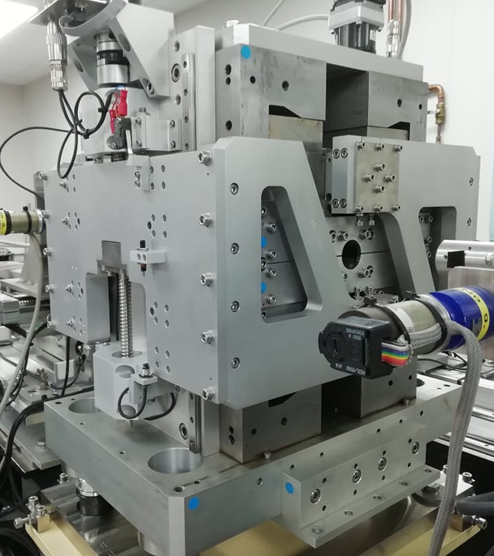
Agenda
1 Introduction to ZEPTO
Development and motivation of ZEPTO tuneable permanent magnet technology.
2 Magnet assembly
Challenges of assembling a tuneable permanent magnet with strong forces present.
3 Lab measurement results
Gradients and compensation of magnetic centre movements.
4 Installation on Diamond
Gradients and compensation magnetic centre movements.
5 Beam based measurements and operations to date.

Slide 3
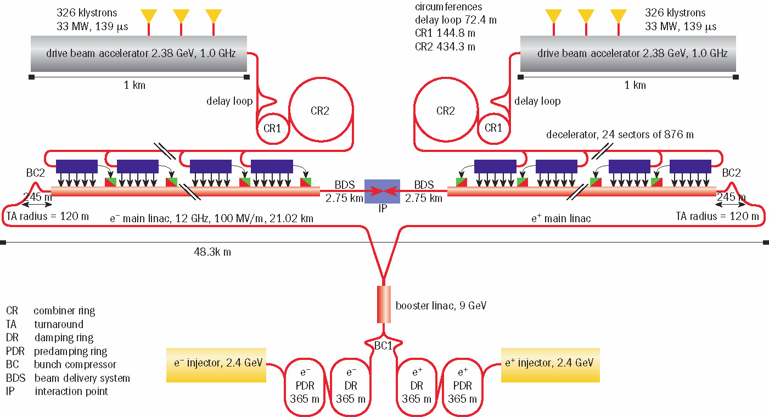
The original motivation- CLIC
42000 quadrupoles
ZEPTO (Zero Power Tuneable Optics) project started as a collaboration between CLIC (Compact Linear Collider) and STFC Daresbury Laboratory.
Aim is to save power and costs (both financial and environmental) by switching from resistive electromagnets to permanent magnets.
288 dipoles
288 dipoles
333 dipoles
333 dipoles

Slide 4
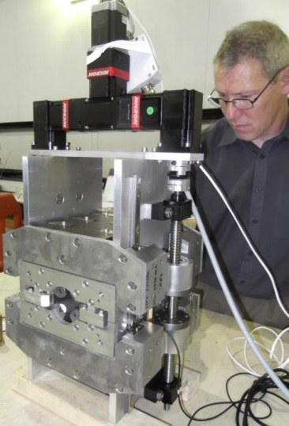
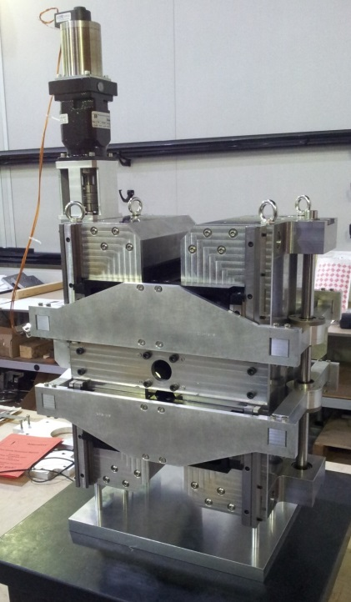
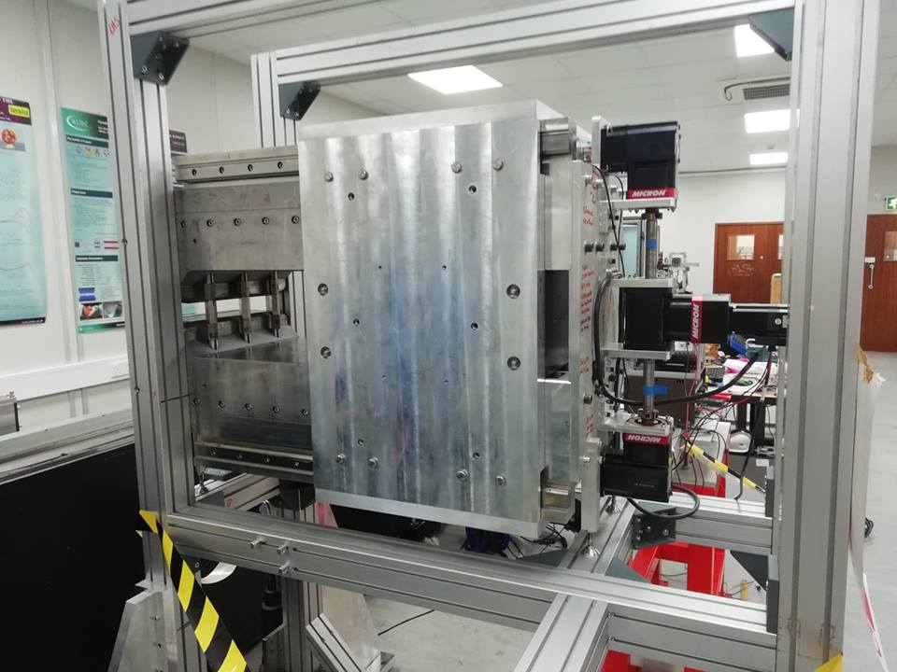
Zero Power Tuneable Optics (ZEPTO)
Project 1: High strength quad
B gradient from 60 – 15 T/m
Shepherd et al, Journal of Instrumentation, Vol 9, T11006, 2014
Project 2: Low strength quad
B gradient from 43 – 3.5 T/m
Shepherd et al, IPAC’14, Dresden, Germany, paper TUPRO113.
Project 3: Wide range dipole
B adjustable from 1.1 T to 0.45 T
Bainbridge et al., IPAC’17, Copenhagen, Denmark,, paper THPIK105.
The ZEPTO project created 3 prototypes for CLIC.
All were designed, constructed and measured at STFC Daresbury Laboratory.
All use NdFeB magnet blocks attached to a motion system, with fixed steel poles defining the field shape.
2017-2019
2012 - 2014

Slide 5
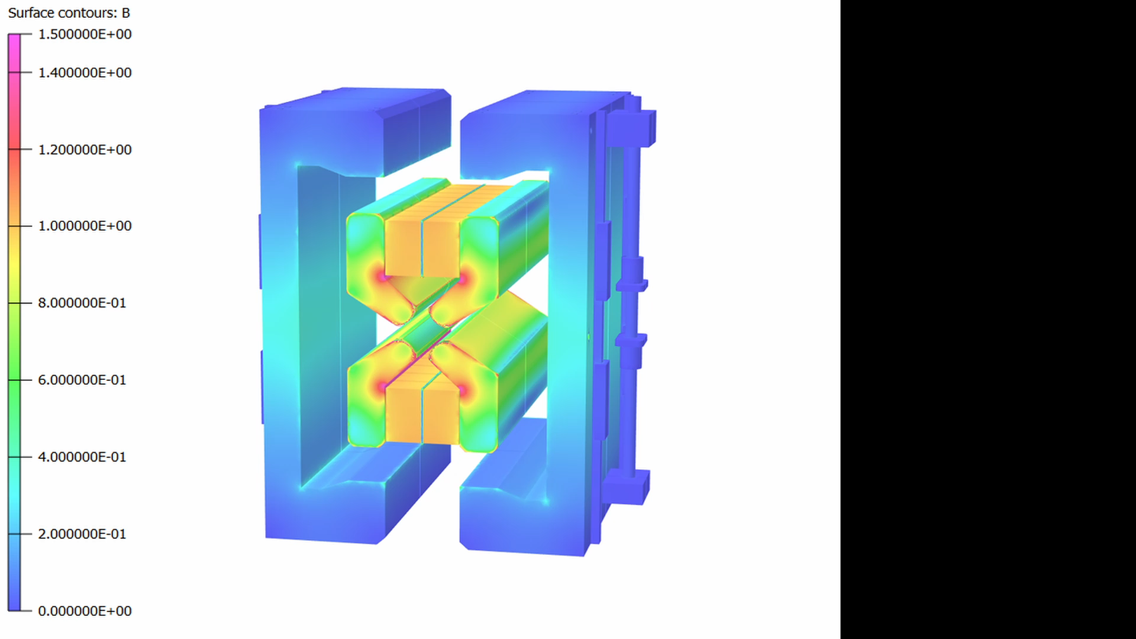
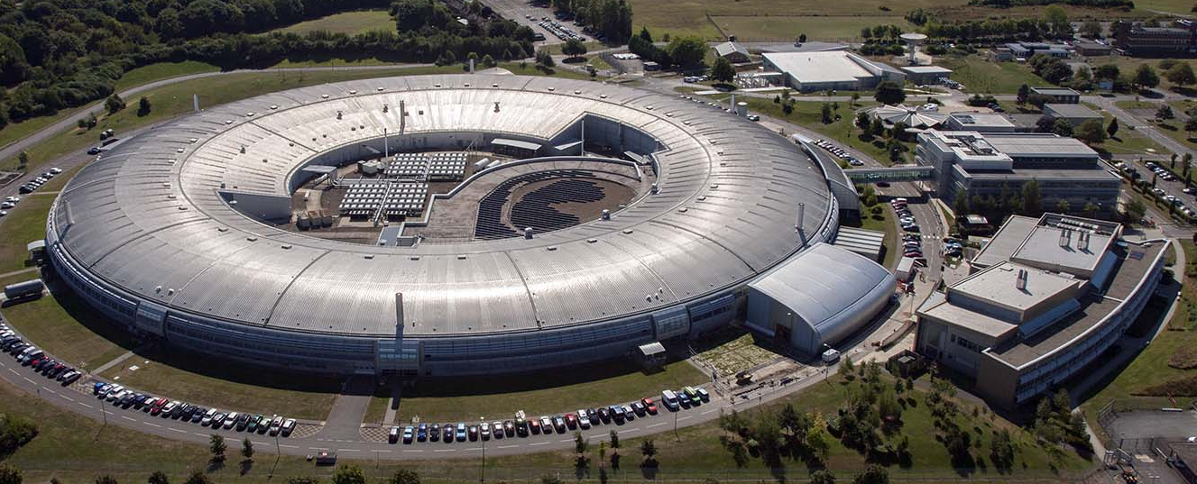
New technology demonstrator
We want to show that the benefits of ZEPTO technology are not limited to CLIC, and can be used as an energy saving `drop-in' replacement for electromagnets on accelerators such as existing light sources.
So we developed a new ZEPTO quadrupole for the booster-to-storage ring section of Diamond Light Source.
Contours B (T)
1.4
1.4
1.2
1.2
1.0
1.0
0.8
0.8
0.6
0.6
0.4
0.4
0.2
0.2
0

Slide 6
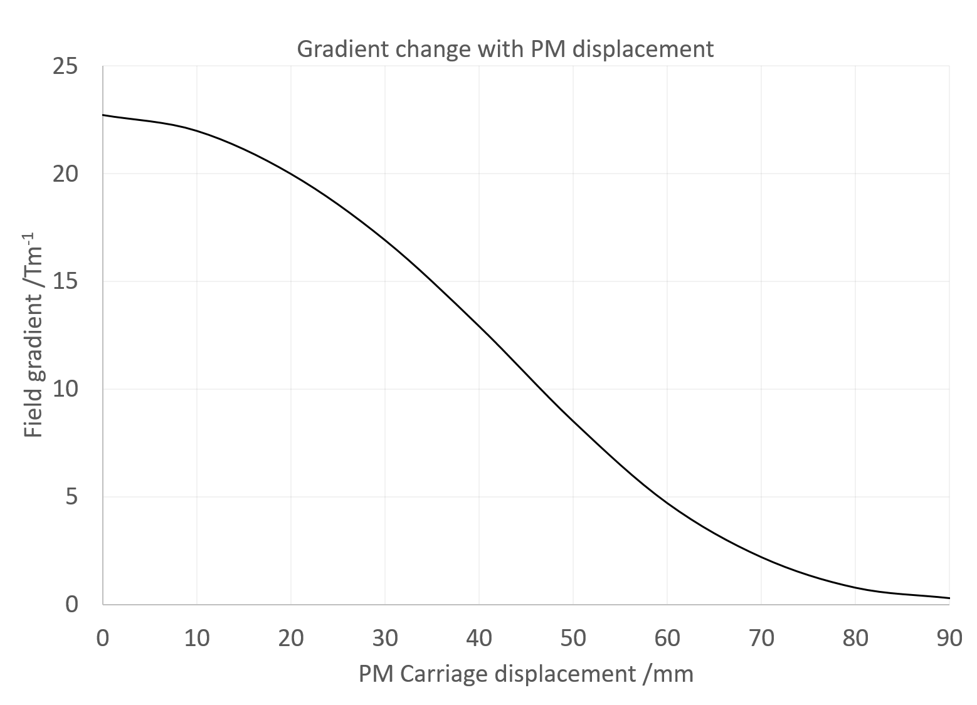
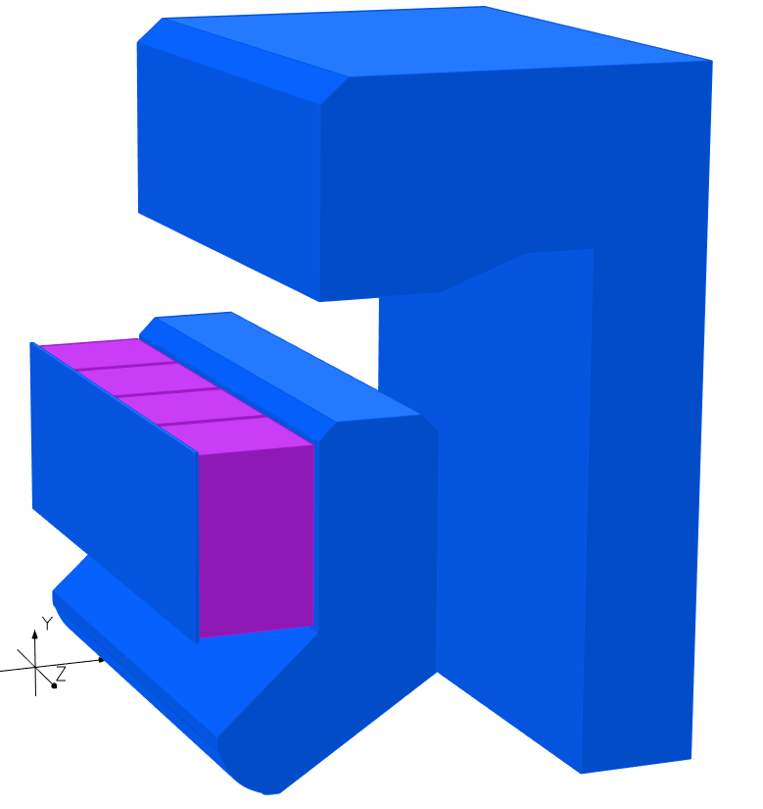
New technology demonstrator
SmCo blocks attached to vertical motion system with 90mm movement range and 1 µm precision
OPERA 3D model
Fixed “inner yoke” defines the quadrupole field
Fixed “outer yoke” can steer flux away from the beam, allowing the gradient to be adjusted
Simulations predicted a gradient tuning range from 23 T/m down to 0.35 T/m
The outer yoke acts as a short circuit for the flux, allowing the magnet to be ‘turned off’.
32 mm aperture
No magnetic contact between yokes, the gap between is filled with aluminium for rigidity

Slide 7
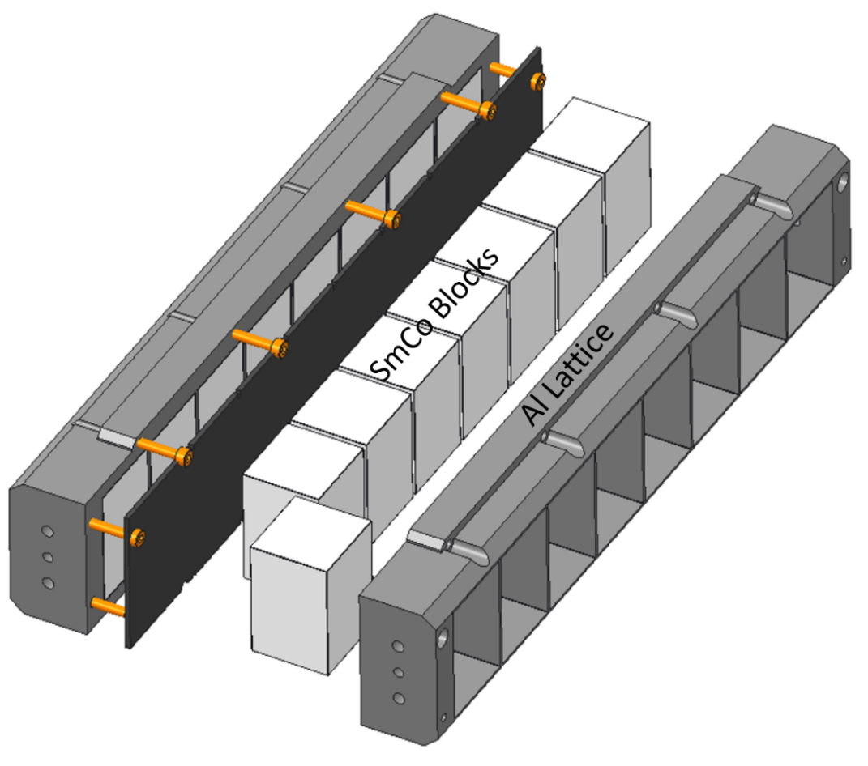
Permanent magnets
Previous ZEPTO magnets used large NdFeB blocks to produce the magnetic flux, which are difficult to manufacture and handle.
New magnet uses a “carriage” with a number of smaller blocks set into an aluminium latticework.
Advantages over larger single blocks which include:
Blocks are easier and cheaper to manufacture.
Damaged single blocks may be replaced instead of the entire carriage.
Variation in block BH curves may be compensated.
Modular magnet "families" may be created by strategic removal of blocks.
The gaps between blocks do not affect field quality as the flux must pass through a steel pole before reaching the beam.
300 mm
50 mm
33 mm
We use SmCo instead of NdFeB for improved radiation hardness and temperature stability.
No thermal shunts are needed

Slide 8
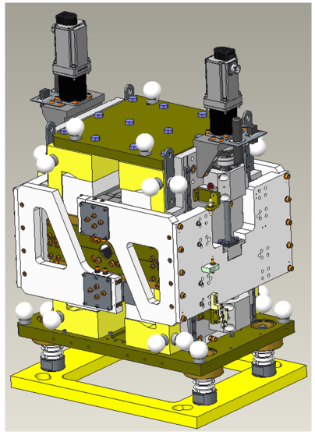
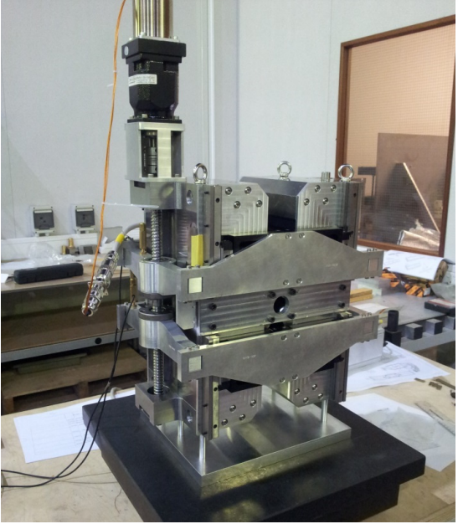
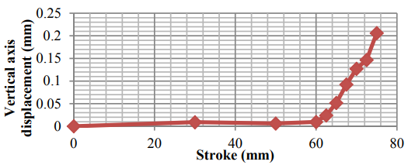
Dual motor system
Motor
PM Carriage
Ball screw
In previous ZEPTO quadrupoles field measurements revealed the magnetic centre moving as function of magnet block position, mostly vertically, due to unexpectedly magnetic components.
Expecting this, each magnet carriage now has a dedicated motor and associated driving ball screw to help compensate.
Look-up table can be applied to either carriage position to compensate and restore the magnetic centre to the geometric centre.
Carriage holder
Shepherd et al, IPAC’14, Dresden, Germany, paper TUPRO113.

Slide 9
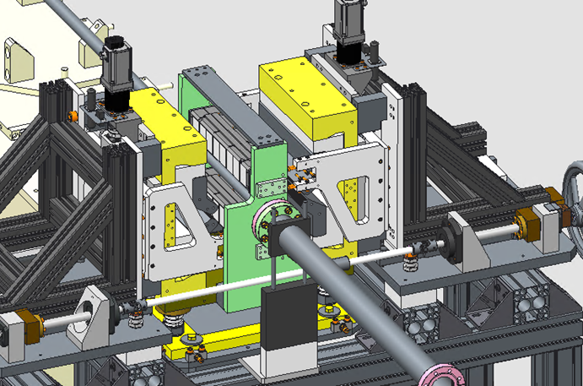
Split design
Pre-bolted inner and outer yokes
Temporary PM carriage holder
Electromagnetic quadrupoles can typically be split for installation around an existing vacuum vessel – previous ZEPTO quadrupoles could not.
The new version may be split about the vertical axis and reassembled around an existing vacuum system using a dedicated assembly frame.
This allows replacements or repair to be conducted without needing to keep the accelerator offline for the additional time needed to restore the quality of the vacuum.
Vacuum chamber
Rail
Yoke supports

Slide 10
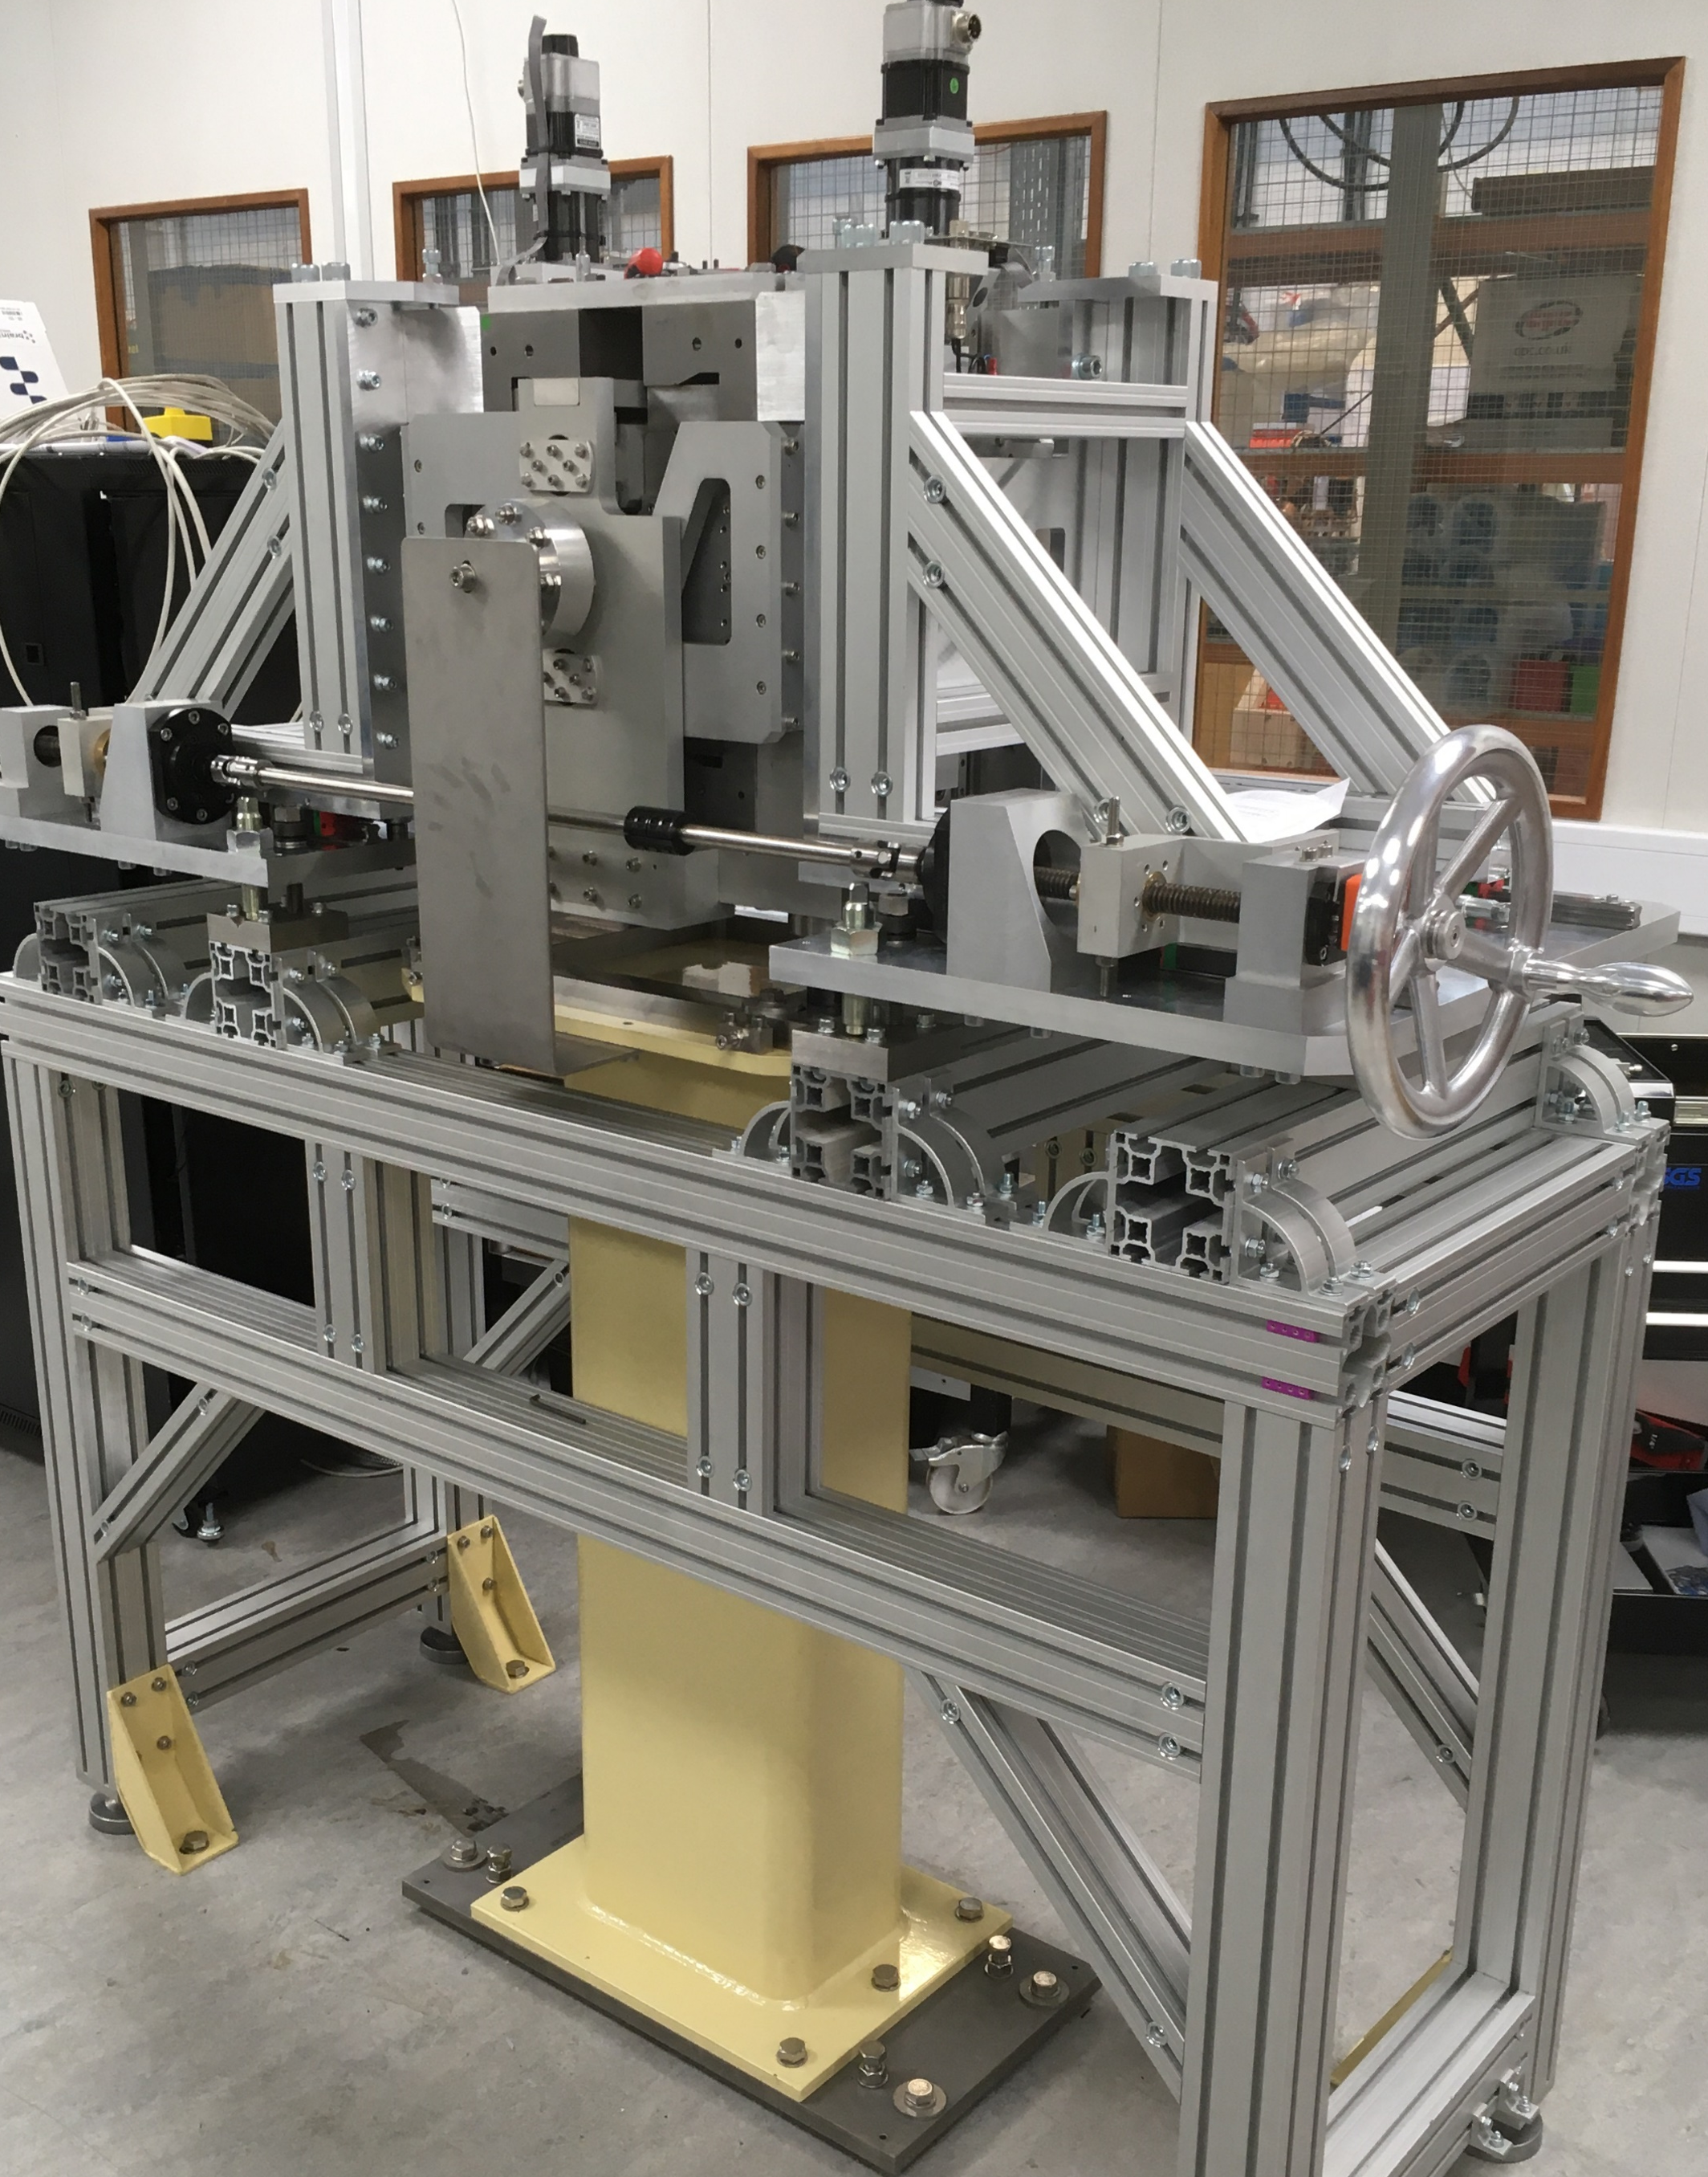
Split design
Electromagnetic quadrupoles can typically be split for installation around an existing vacuum vessel – previous ZEPTO quadrupoles could not.
The new version may be split about the vertical axis and reassembled around an existing vacuum system using a dedicated assembly frame.
This allows replacements or repair to be conducted without needing to keep the accelerator offline for the additional time needed to restore the quality of the vacuum.

Slide 11
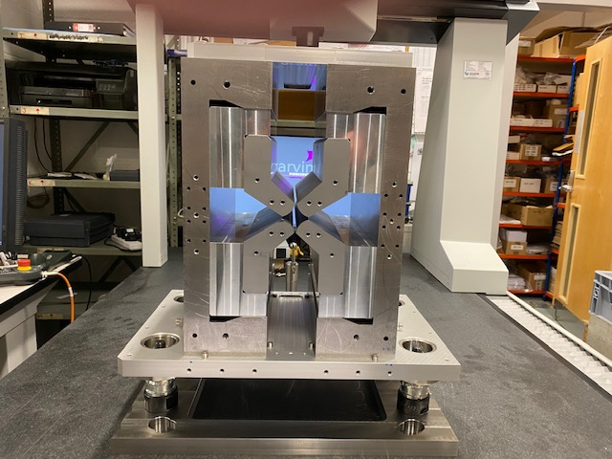
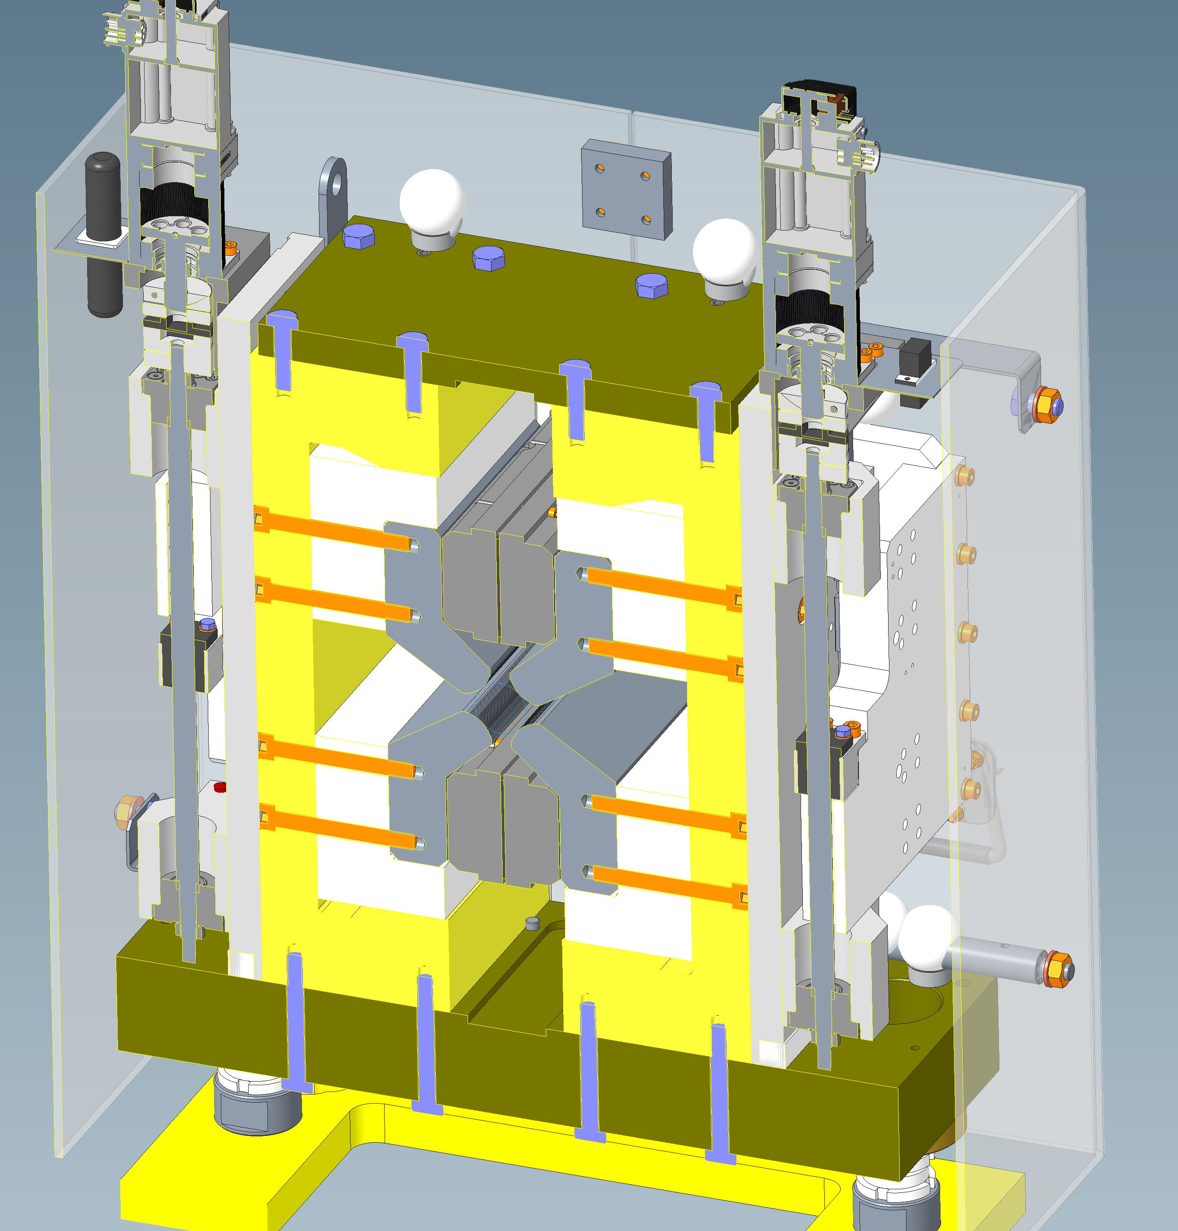
Construction
To ensure that the inner yoke structure is properly positioned, both yokes were pre-assembled with Aluminium spacers before final machining.
Wire erosion used to achieve <30 µm precision on pole tips, regardless of tolerances of initial manufacture.
Dowel system should ensure repeatability of assembly
400 mm
300 mm

Slide 12
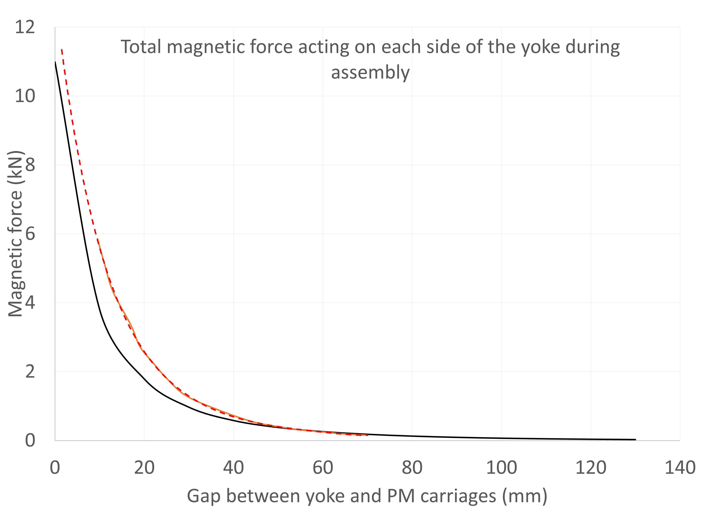
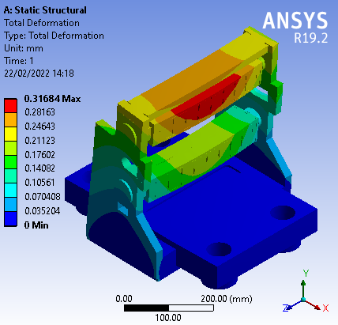
Assembly forces
Forces between the PM blocks and steel yokes must be calculated in advance and managed during assembly!
A Hall probe was used to measure the flux density entering the steel yoke for as much of the approach as possible, and from this an estimate of the actual force was derived
Simulated
Estimated
Extrapolated

Slide 13
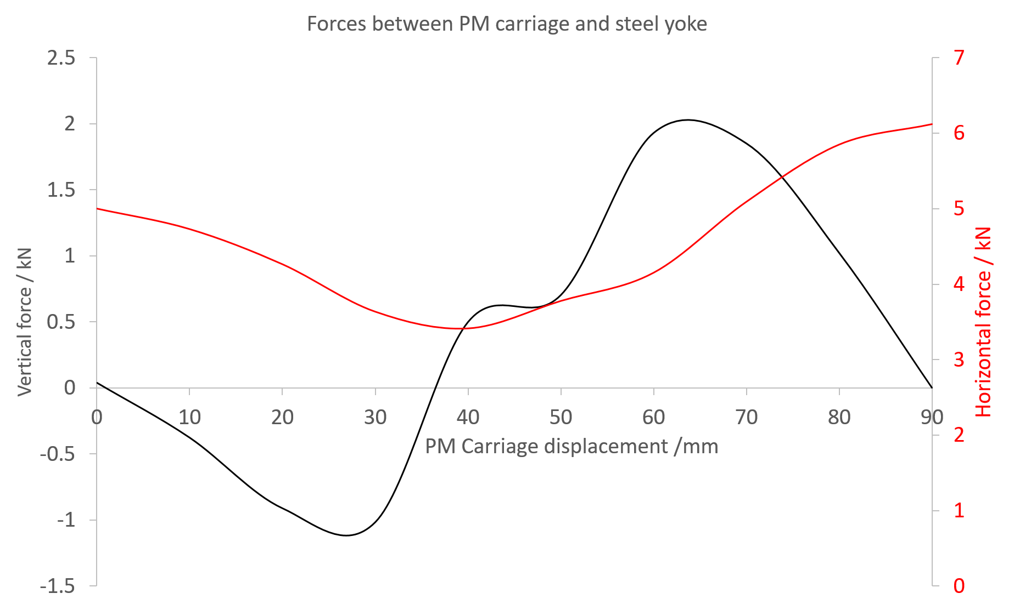
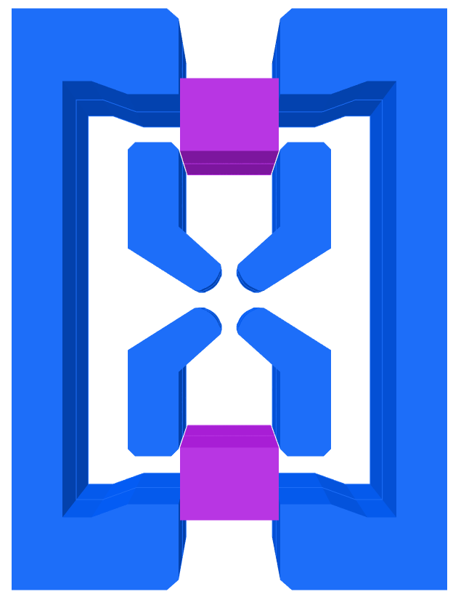
Operational forces
Horizontal forces are balanced on each side of carriages but act on the steel yoke, causing a movement risk to components.
FY
FX
The simulated magnetic forces are a function of PM block position and are highly complex
FY
FX

Slide 14
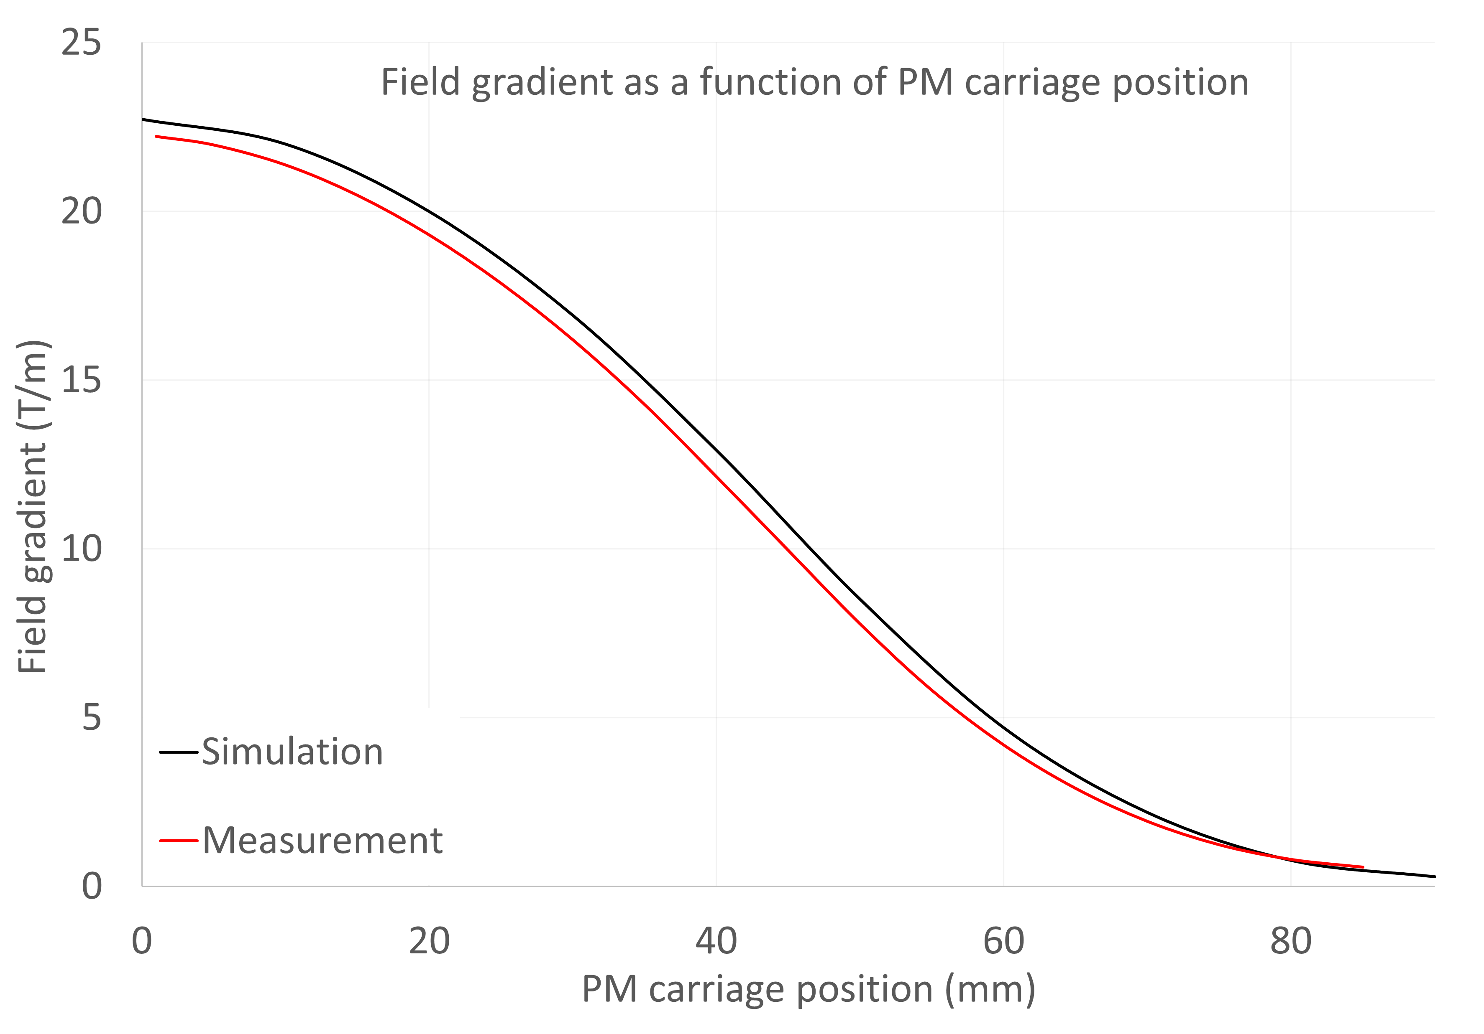
Gradient vs gap
Some variation between simulated and measured gradients observed.
Gradient lower than predicted but still within requirements (19 to 0.5 T/m normal operation)
Actual range of sweep is 1-85 mm (instead of 0-90 mm) due to limit switch positions.
Tuneability 22.37 to 0.47 T/m
Predicted range was 22.72 T/m to 0.3 T/m

Slide 15
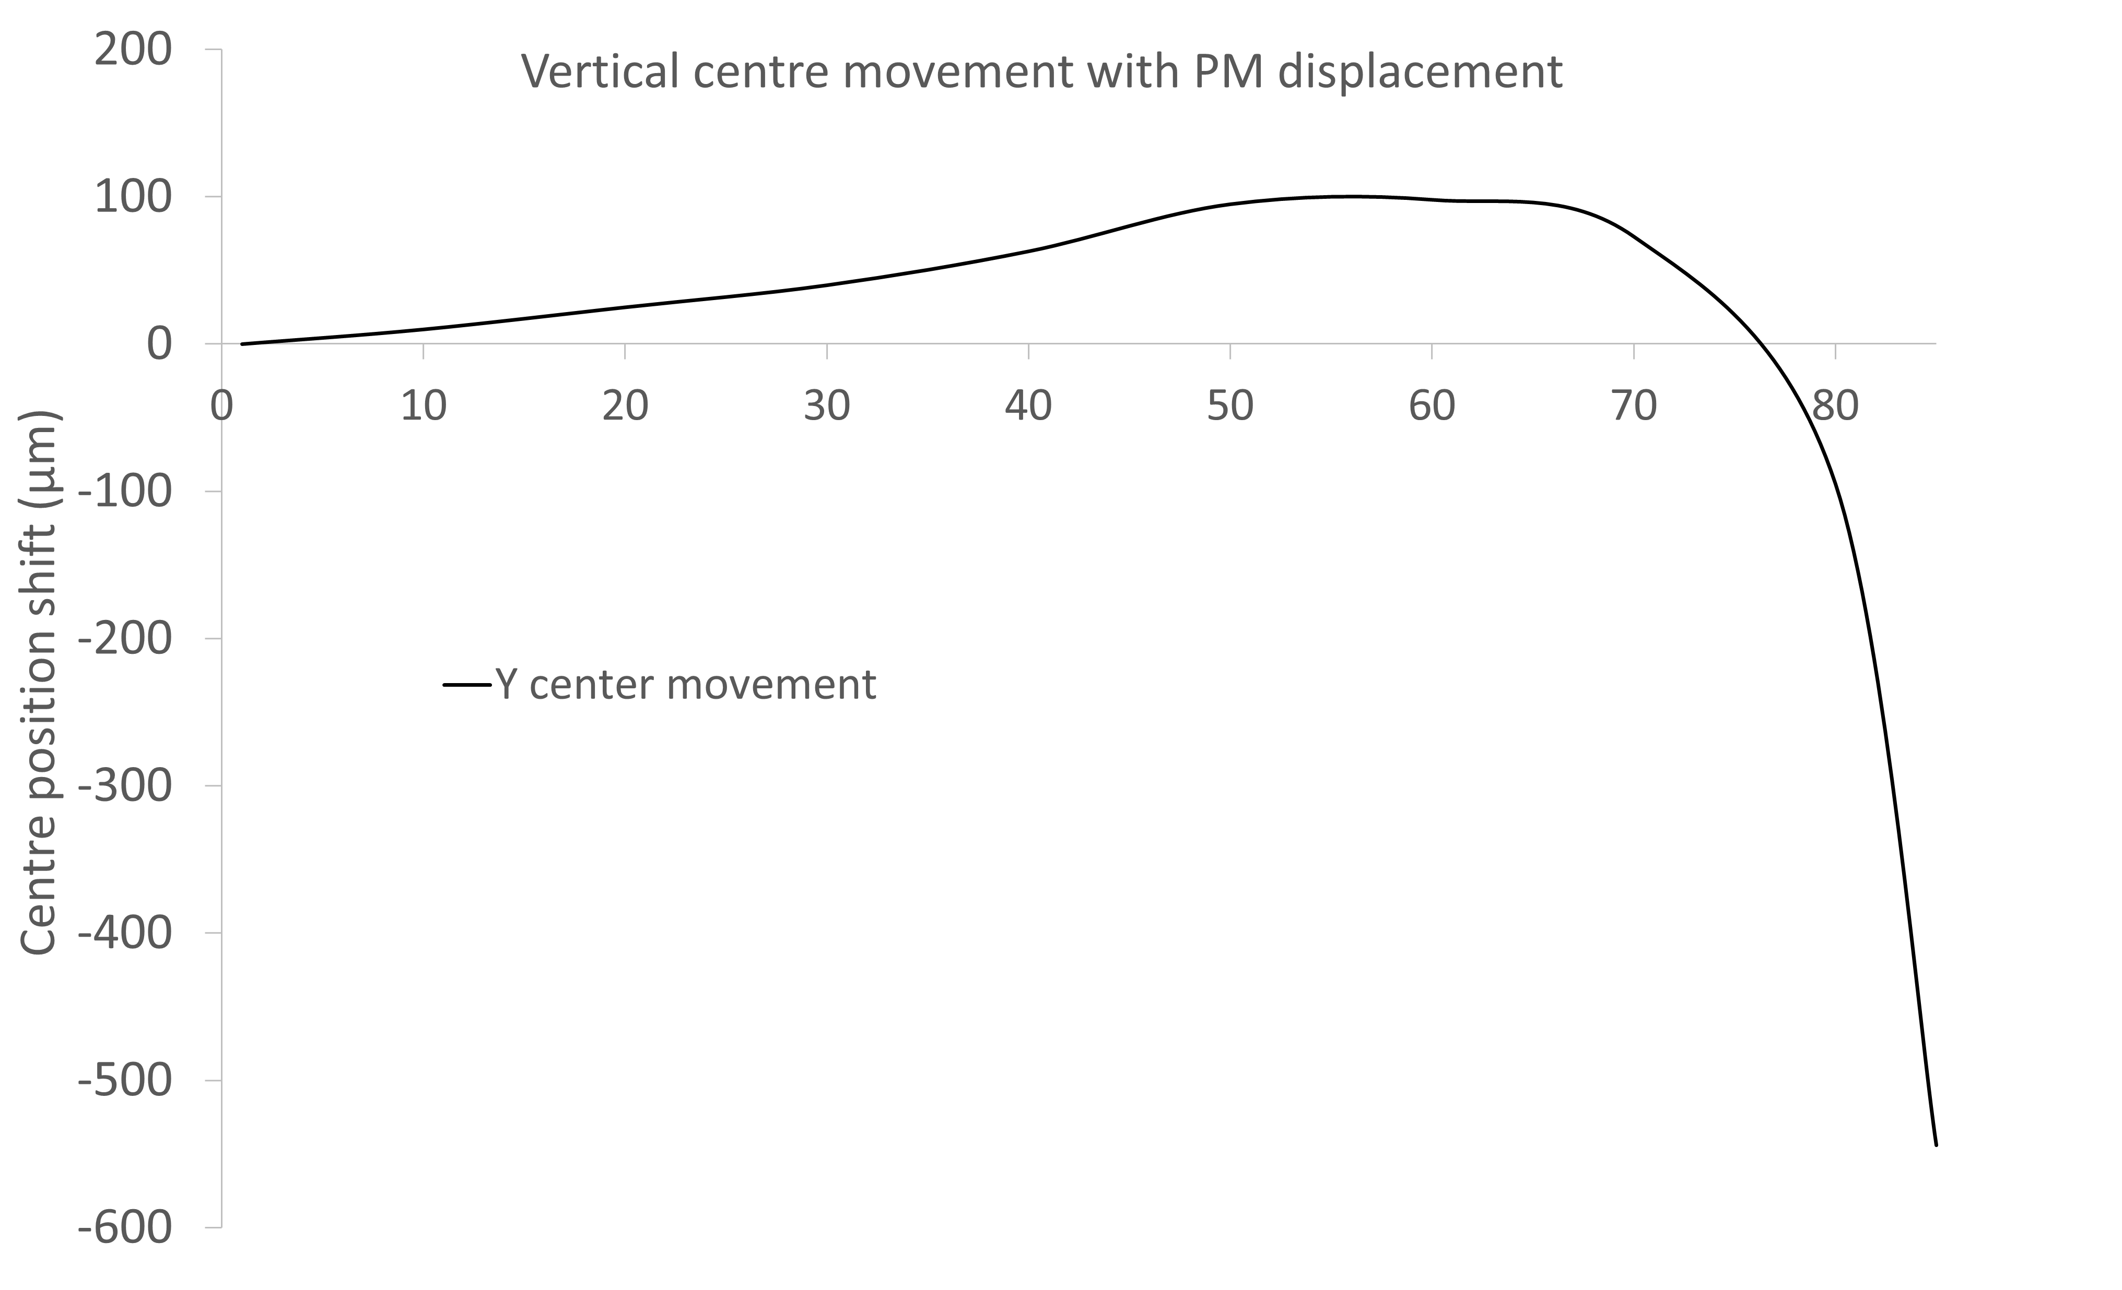
Vertical centre position
Movements in Y centre observed as a function of carriage position.
Y centre slowly rises as gap enlarges and then suddenly starts to drop.
Cause of movement and direction reversal unknown – magnetic materials in pedestal? Uneven motion?

Slide 16
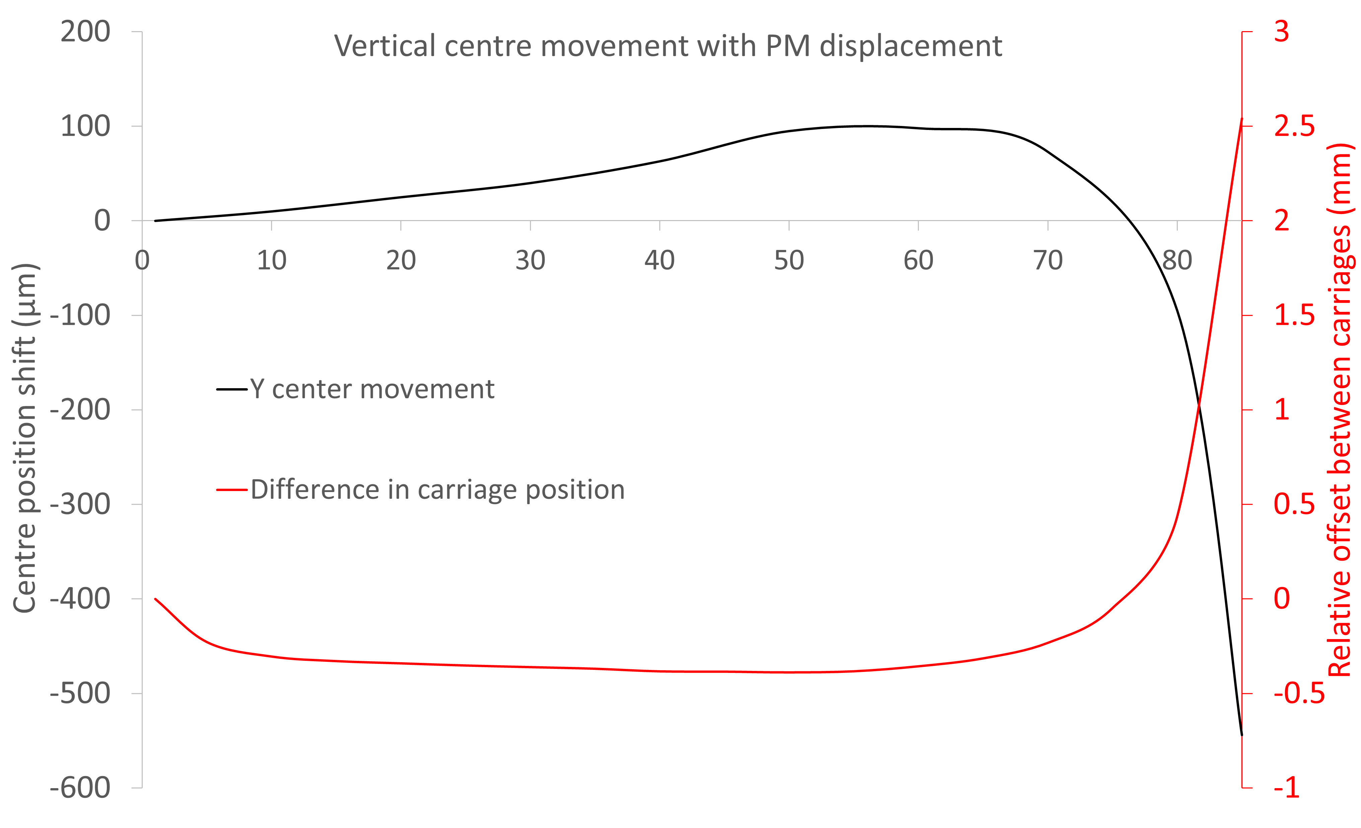
Vertical centre position
By offsetting the bottom carriage position from the top carriage position we have found this is correctable!
Works with either carriage, but resulting look-up table is slightly different.

Slide 17
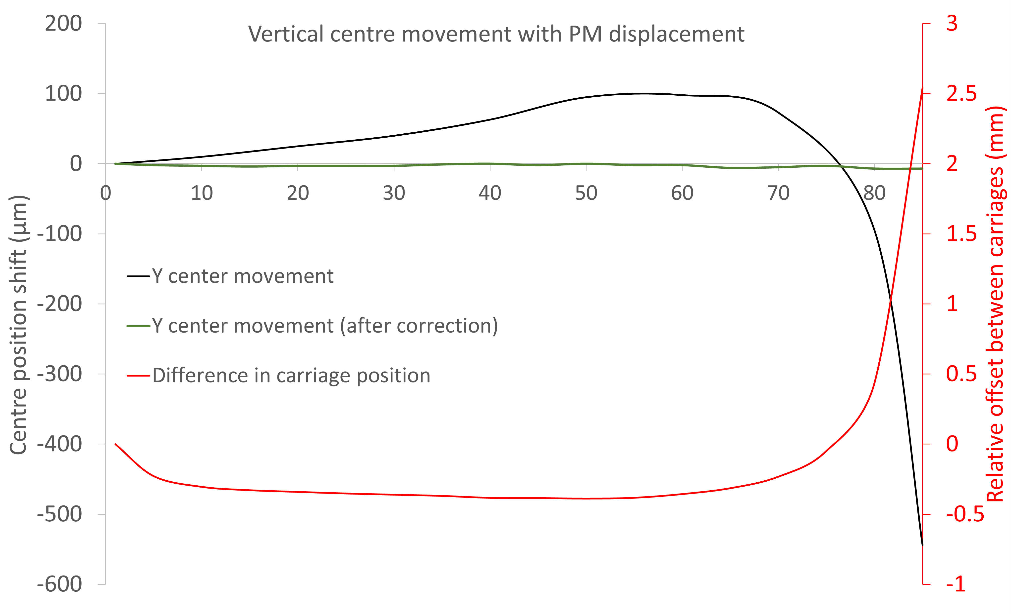
Vertical centre position
By applying the look-up table we can effectively counter all vertical movement of the magnetic centre!
Dataset shown has 7 µm drop in centre position, with 5 µm drop expected from temperature variation alone (contraction of magnet pedestal).

Slide 18
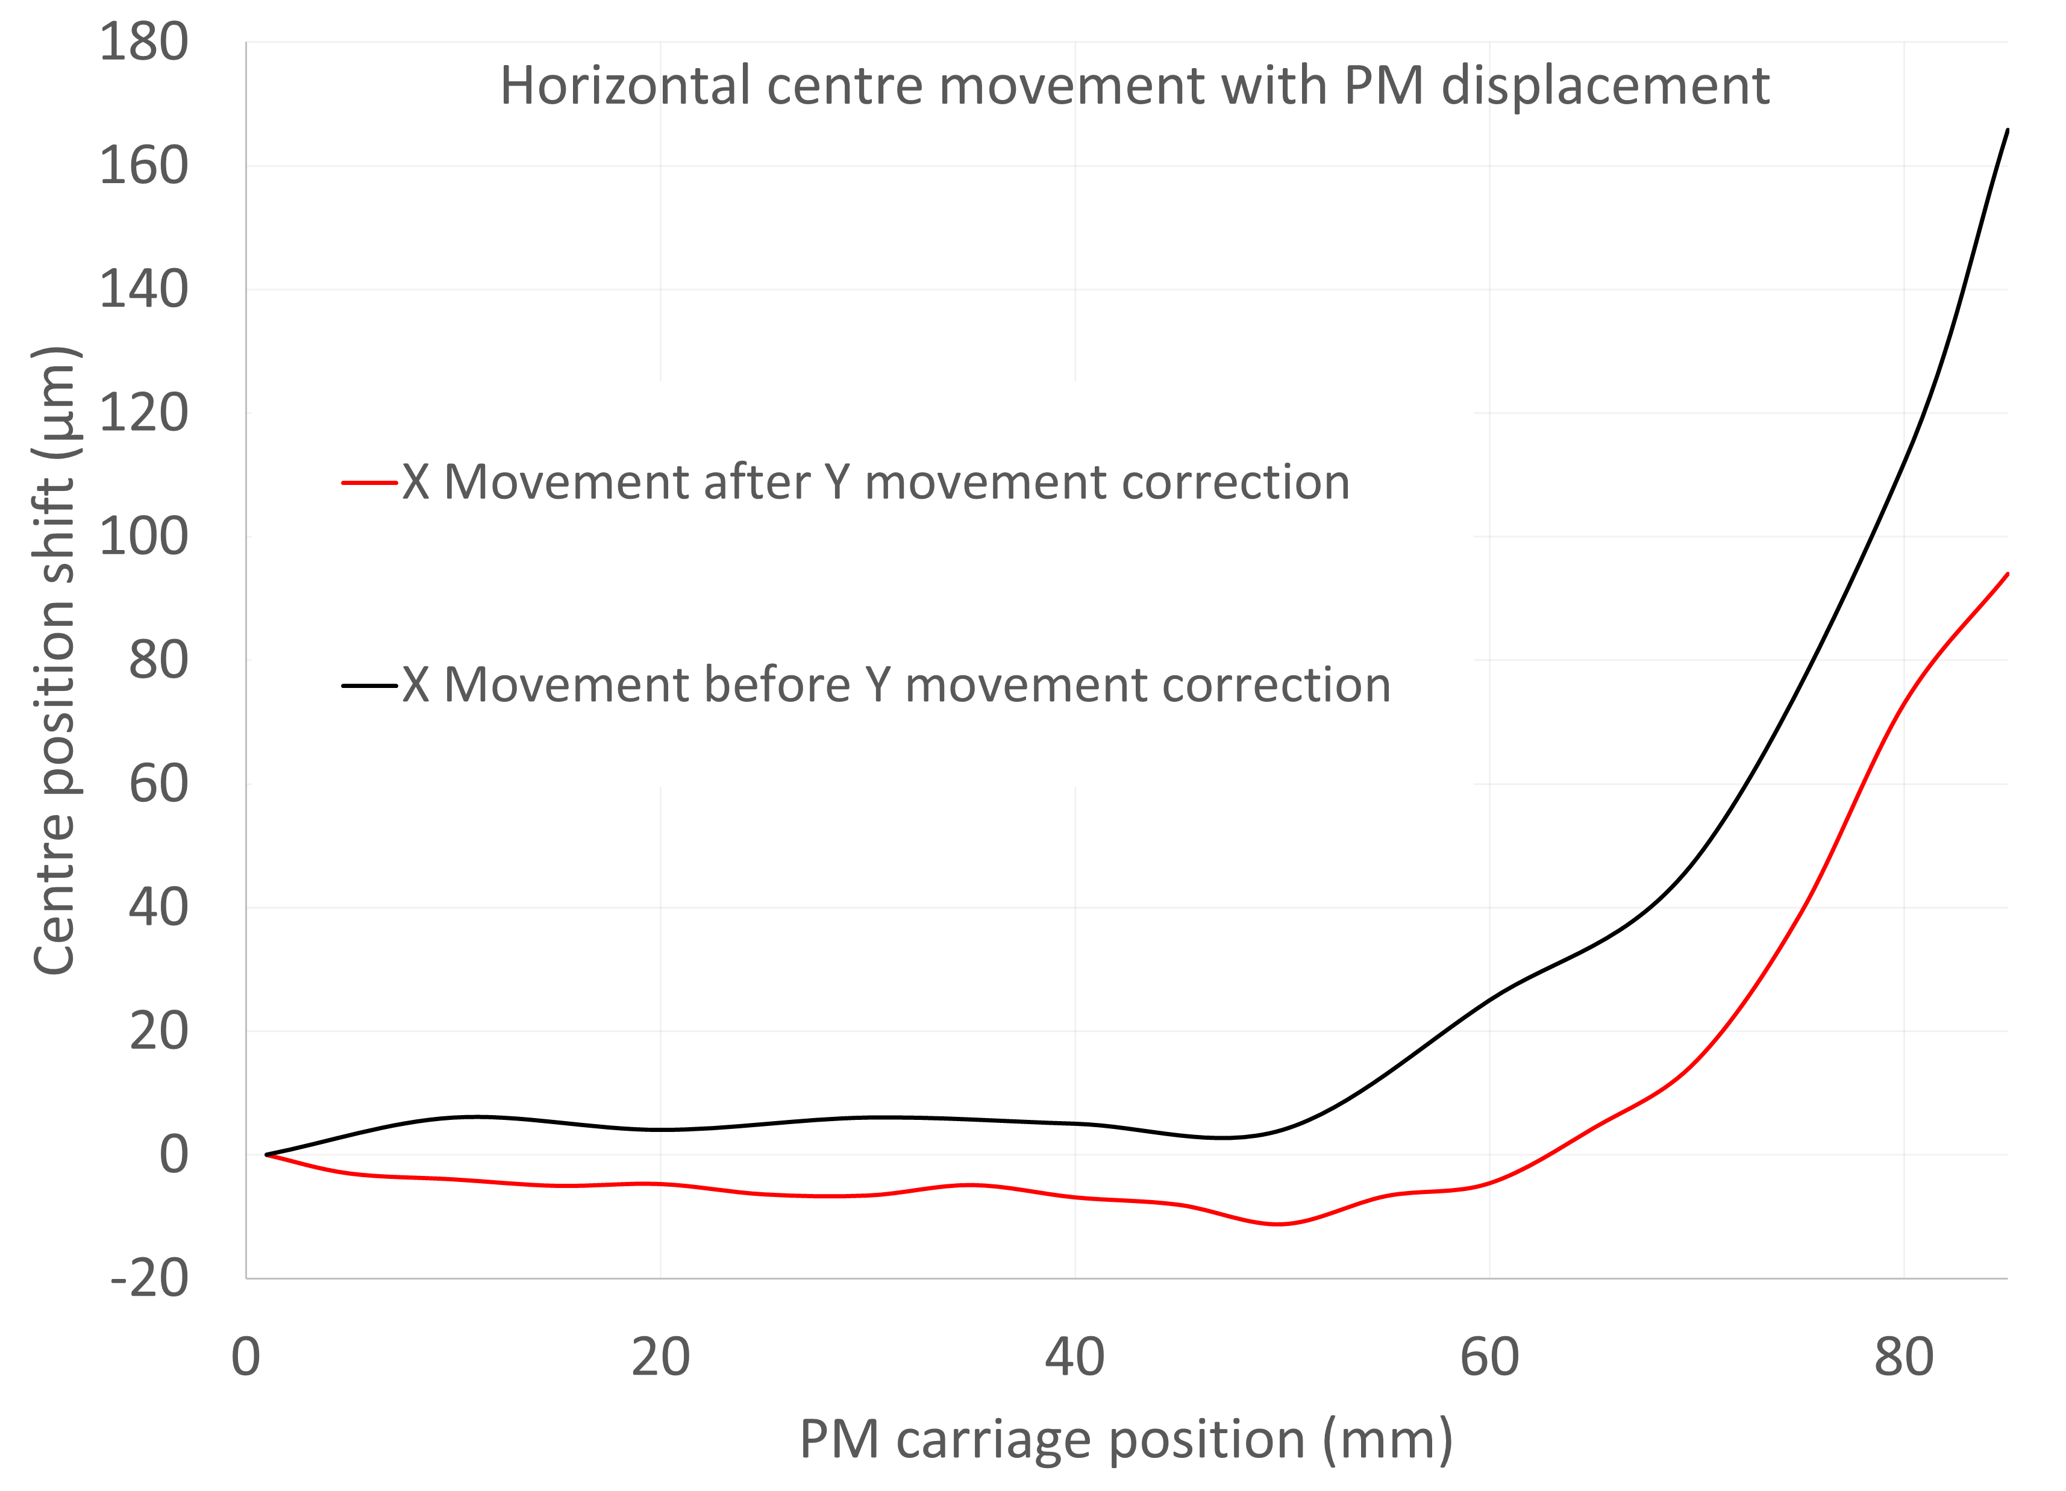
Horizontal centre position
Movements in X centre also observed as a function of carriage position.
This is more of a problem – cannot be countered by offsetting magnet carriages!
Further concerns about the repeatability of the position – are parts sticking/slipping with changes to magnetic forces?

Slide 19
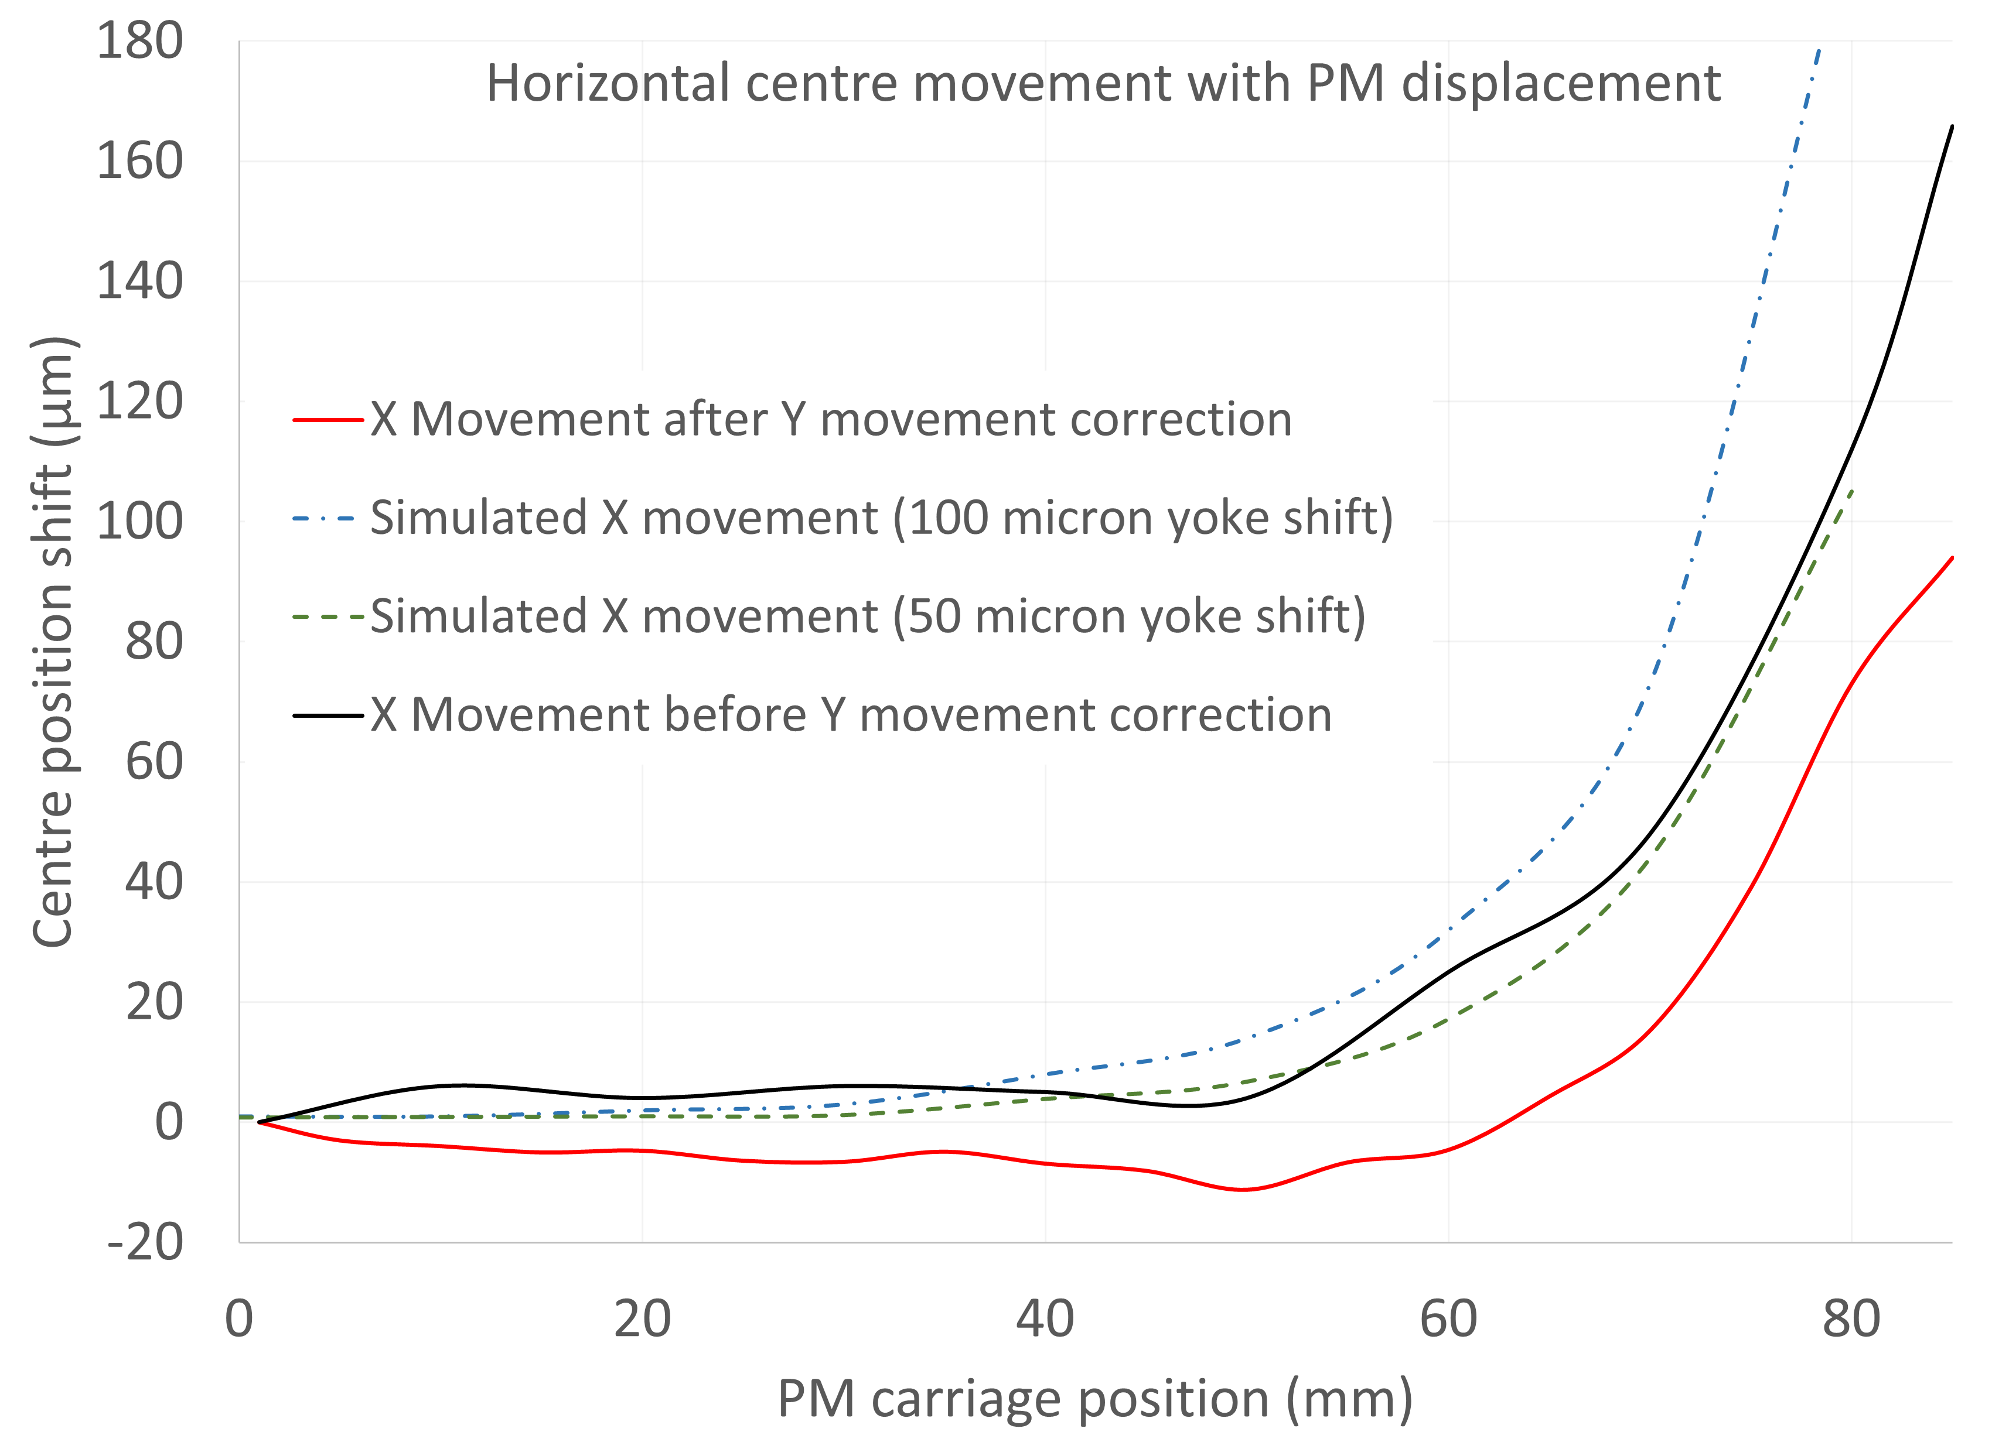
Horizontal centre position – one explanation
Can replicate trend by offsetting one half of outer yoke – Assembly issue?

Slide 20
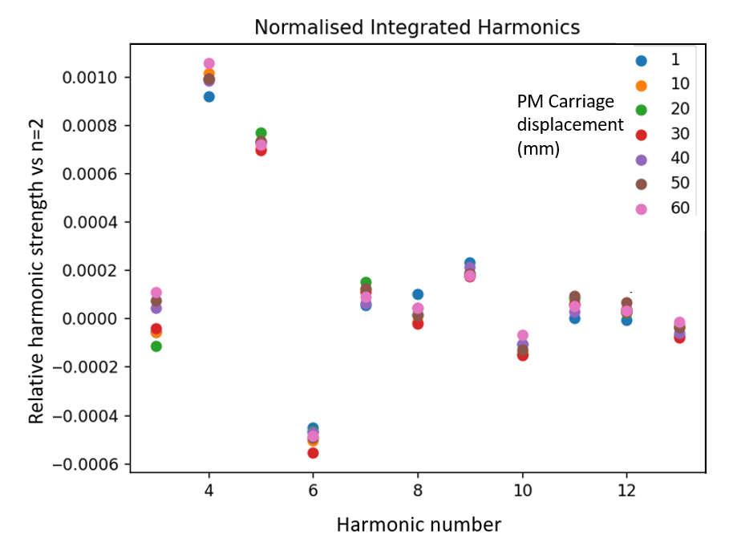
Harmonic measurements
Harmonics were measured by moving the Hall probe in a circular pattern at several positions along the length of the magnet.
Harmonics are reasonably consistent with PM carriage position.
The octupole harmonic is expected in this case due to the loss of a symmetry axis.

Slide 21
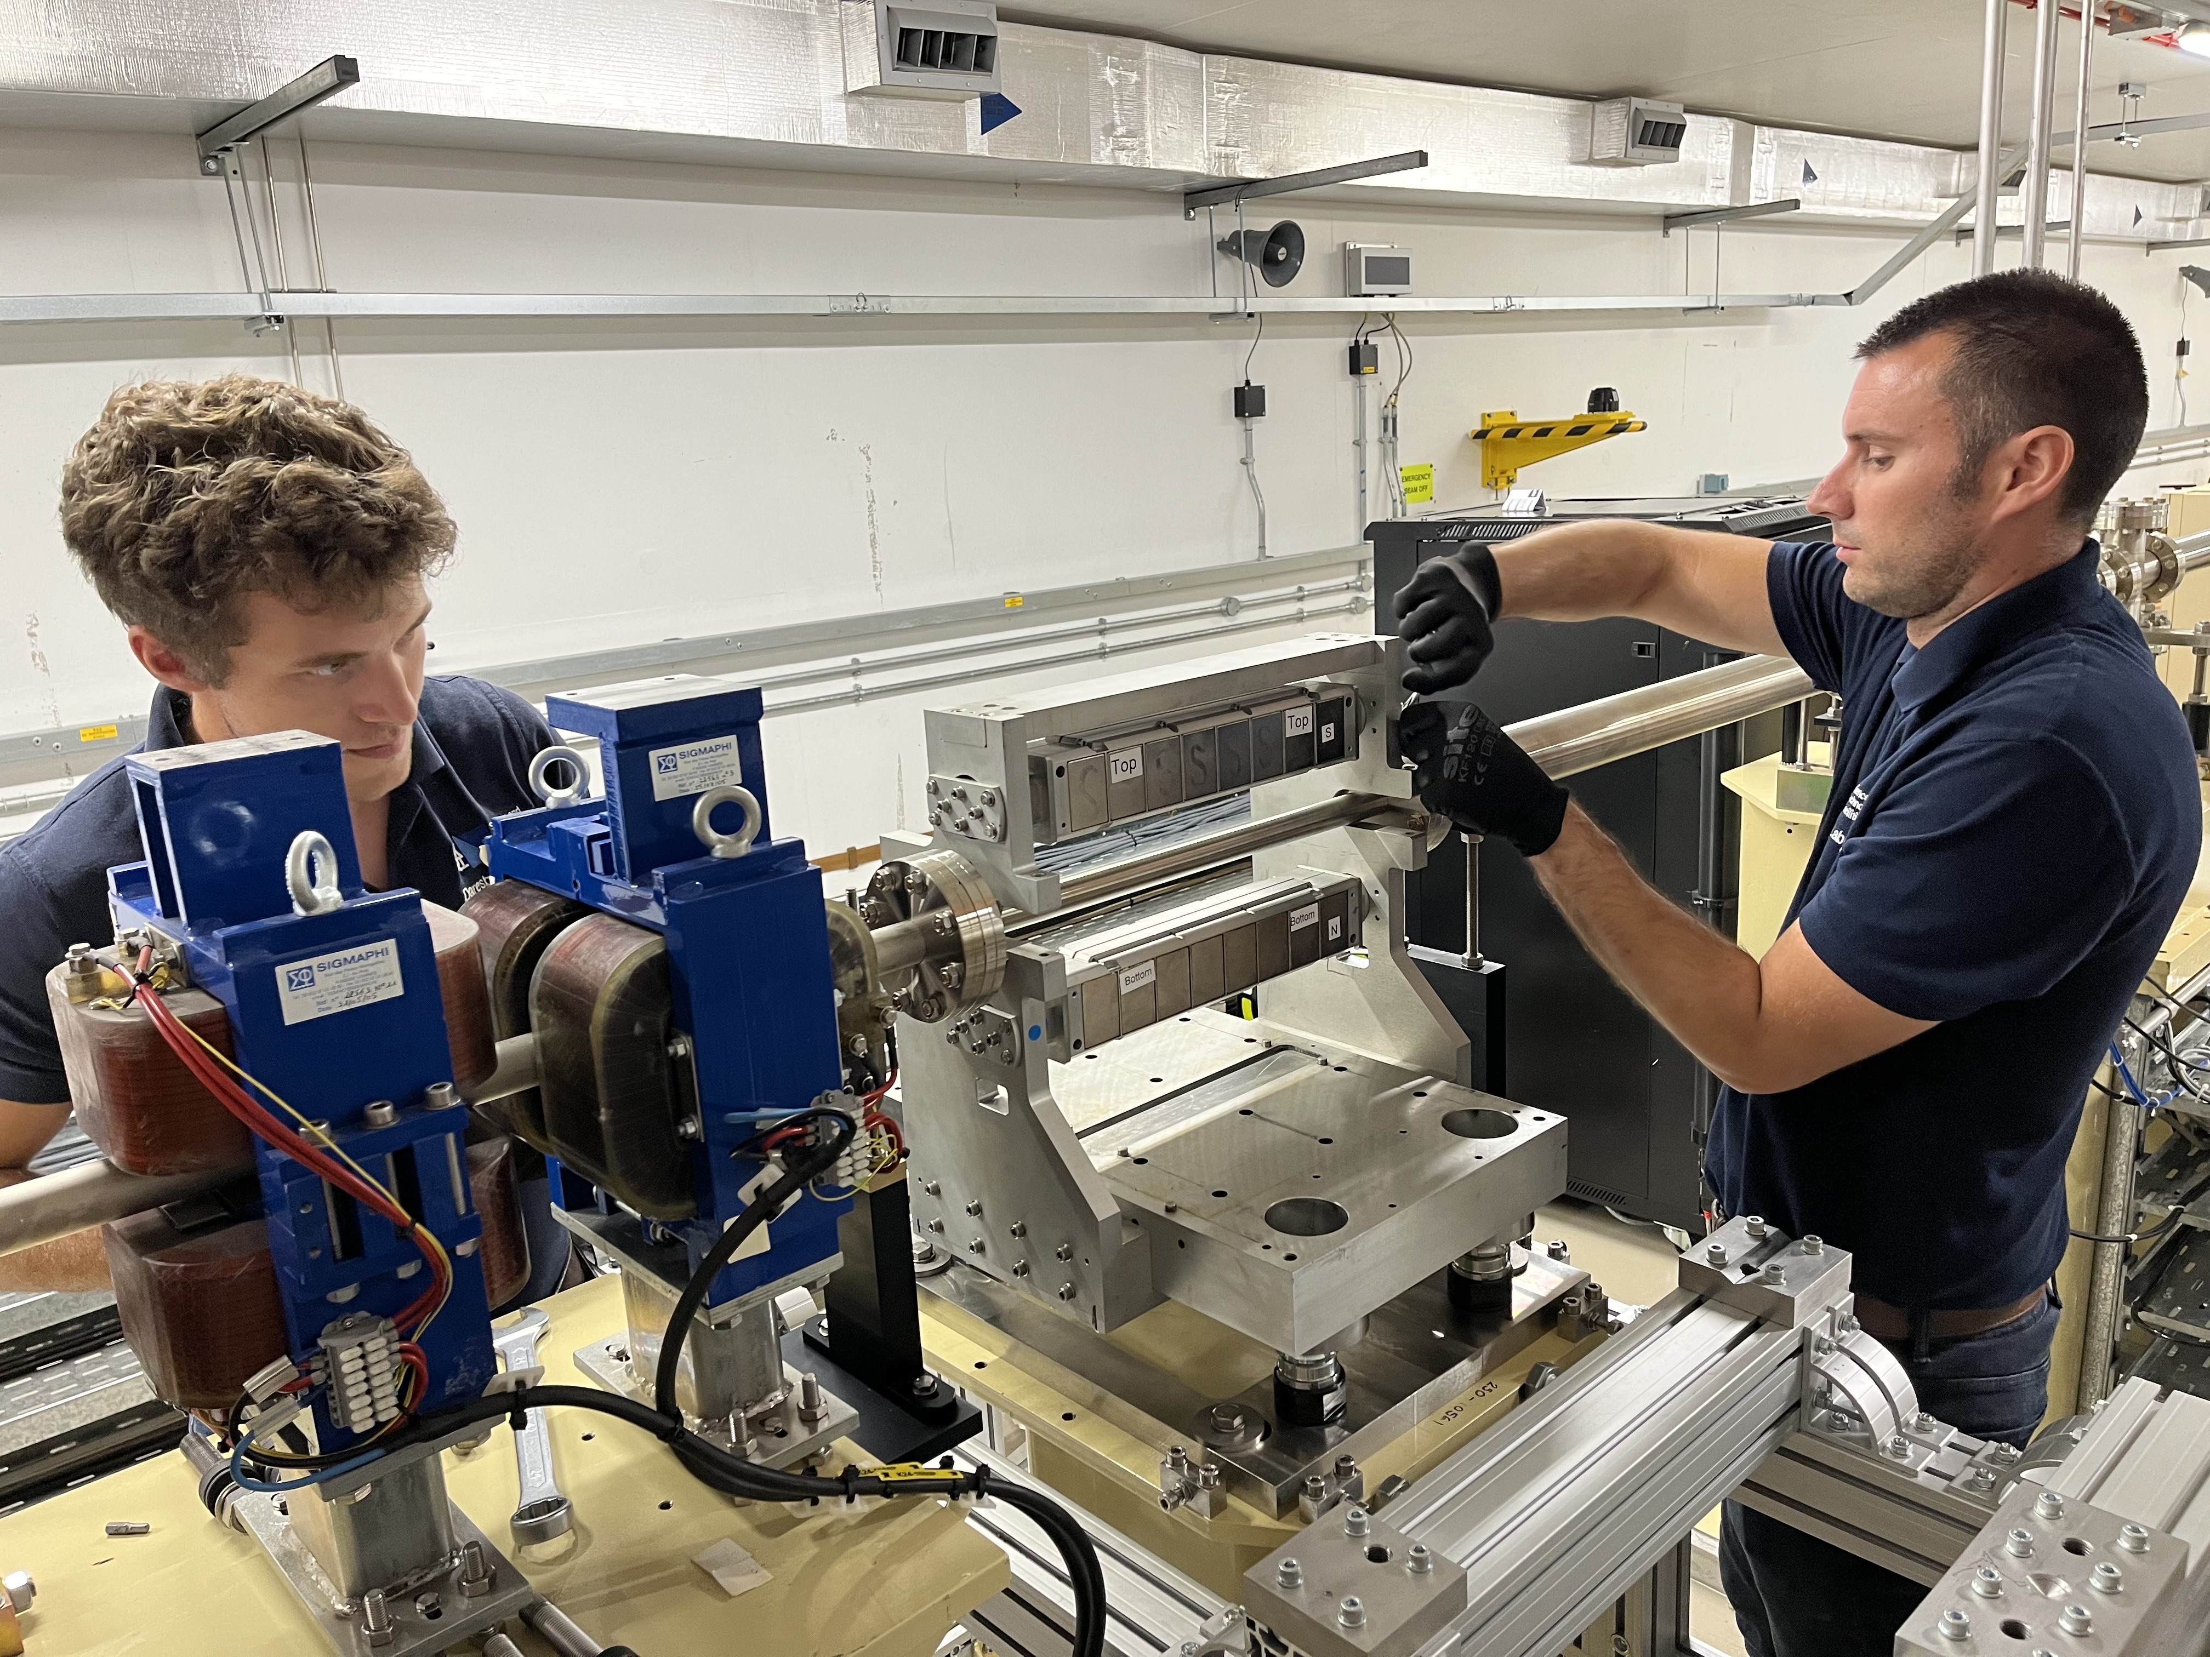
Installation on Diamond
The magnet was installed on the Diamond BTS line in August 2022.
It is located 1.5m downstream form an EM quad that has now been switched off.
The installation was done without breaking the vacuum, something that would have been impossible with previous designs.

Slide 22
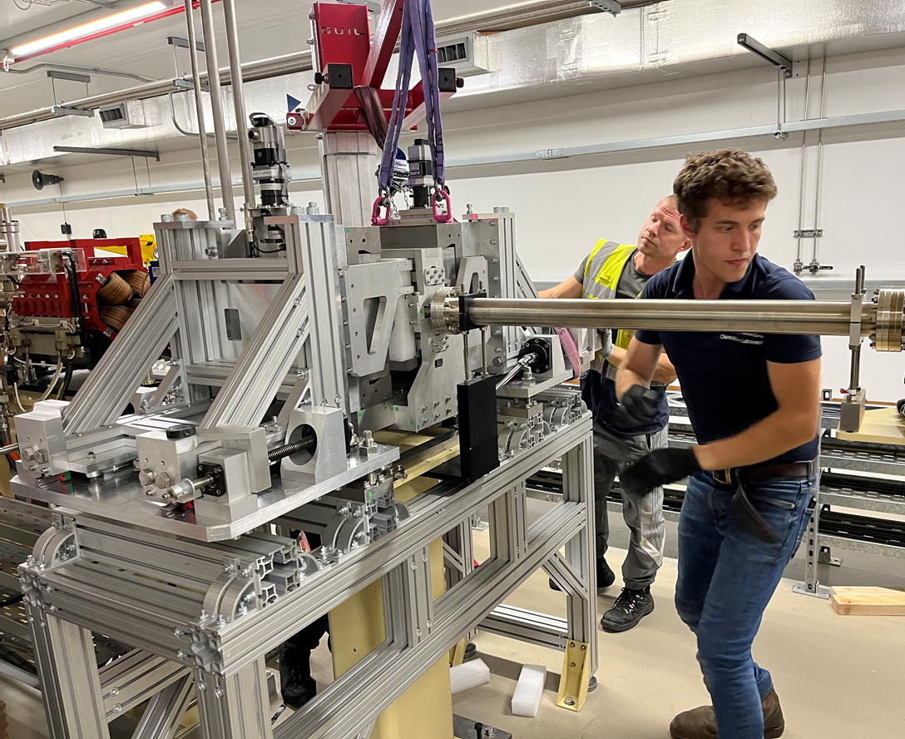
Installation on Diamond
The magnet was installed on the Diamond BTS line in August 2022.
It is located 1.5m downstream form an EM quad that has now been switched off.
The installation was done without breaking the vacuum, something that would have been impossible with previous designs.

Slide 23
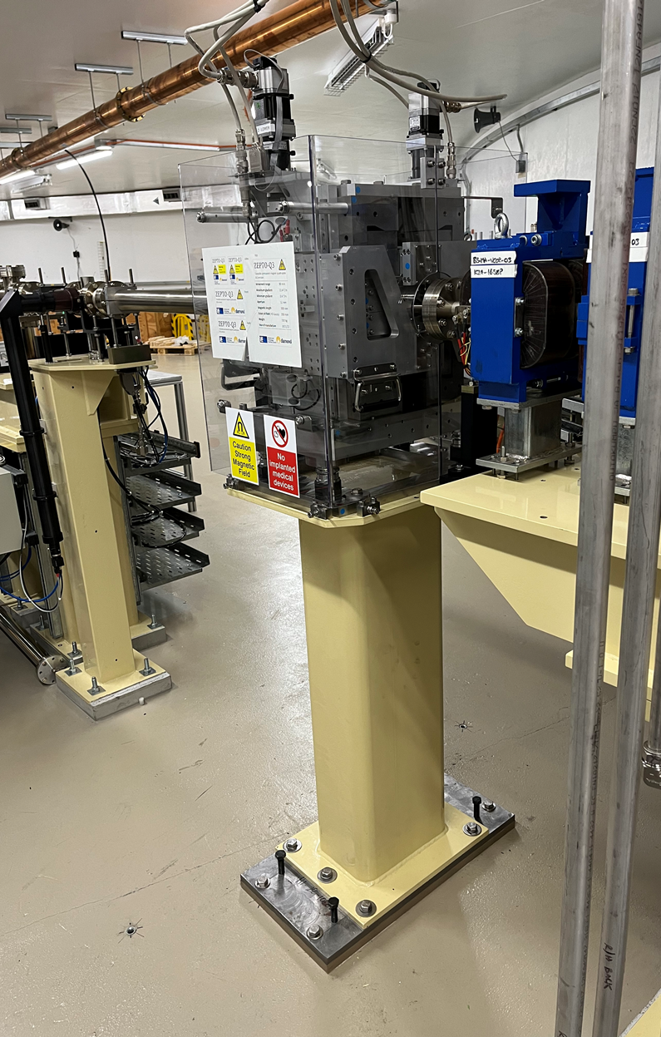
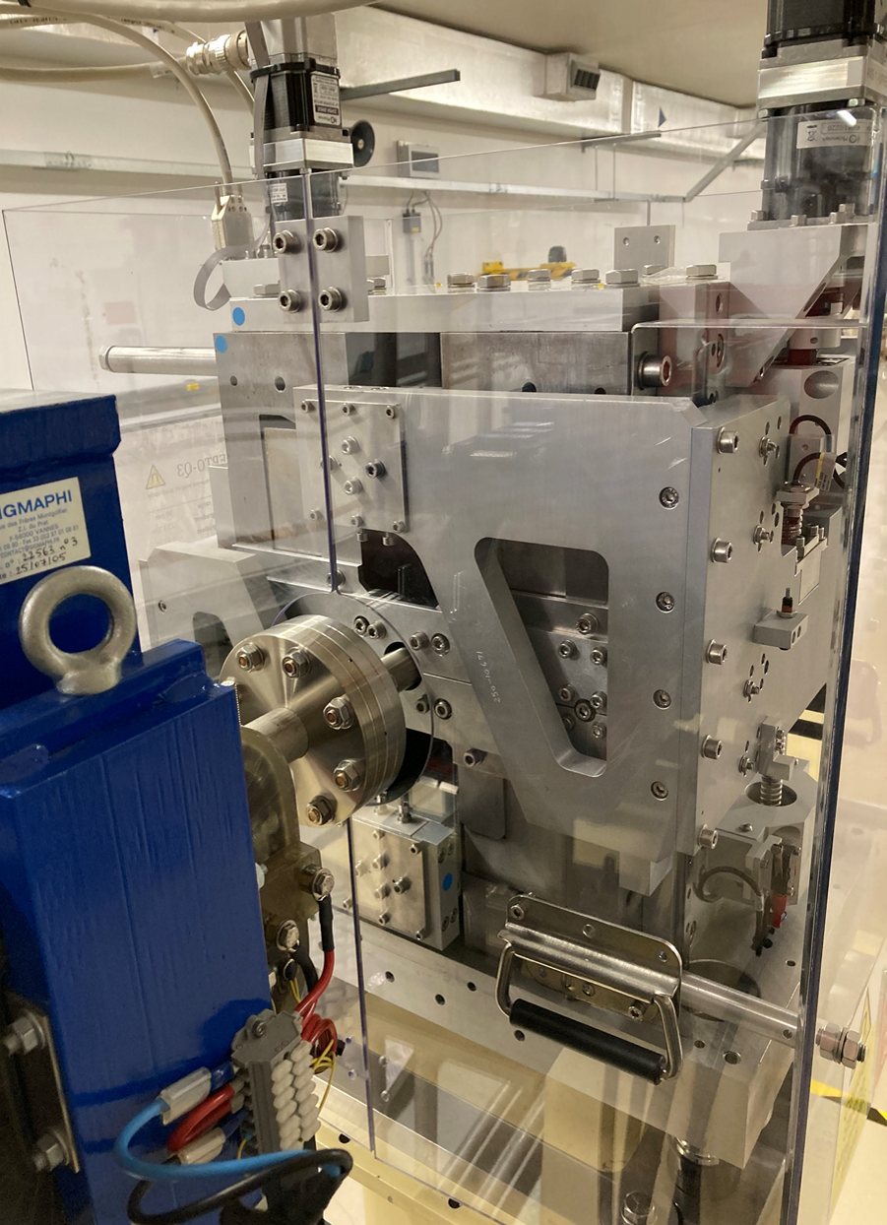
Installation on Diamond
The magnet was installed on the Diamond BTS line in August 2022.
It is located 1.5m downstream from an EM quad that has now been switched off.
The installation was done without breaking the vacuum, something that would have been impossible with previous designs.

Slide 24
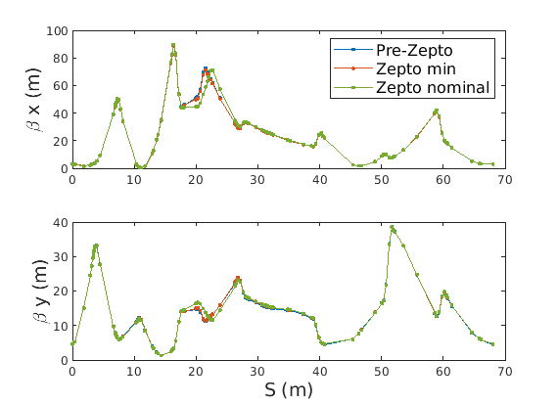
Restoring injection
ZEPTO is 1.5 m downstream of the magnet it replaces, some disruption to the lattice is unavoidable. The ZEPTO gradient can be reduced to <0.5 T/m, but not to true zero field.
New lattice settings minimised the differences. The beta functions are well corrected, with only some minor differences around the ZEPTO magnet.
Injection efficiency ~70% both before and after installation (actually slightly better after….)

Slide 25
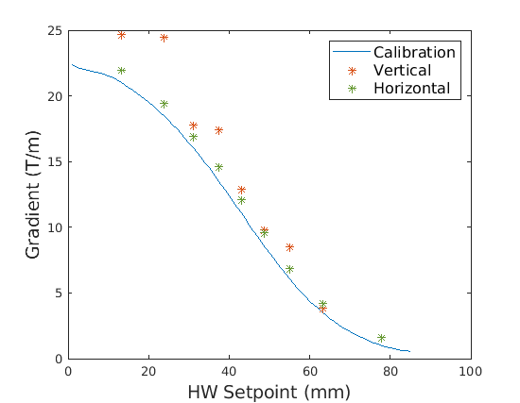
Beam based gradient measurements
Beam based measurements were used to check gradient in X and Y planes. (upstream corrector adjusted to offset through magnet and resulting kick measured)
Although this method is somewhat crude, the Horizontal plane shows good agreement with Lab based measurements, though ~0.6 T/m higher.
The vertical plane agrees less well, but the same issue was seen attempting to do the same with the electromagnet – suggests sensitivity of BTS to vertical changes rather than ZEPTO issue.

Slide 26
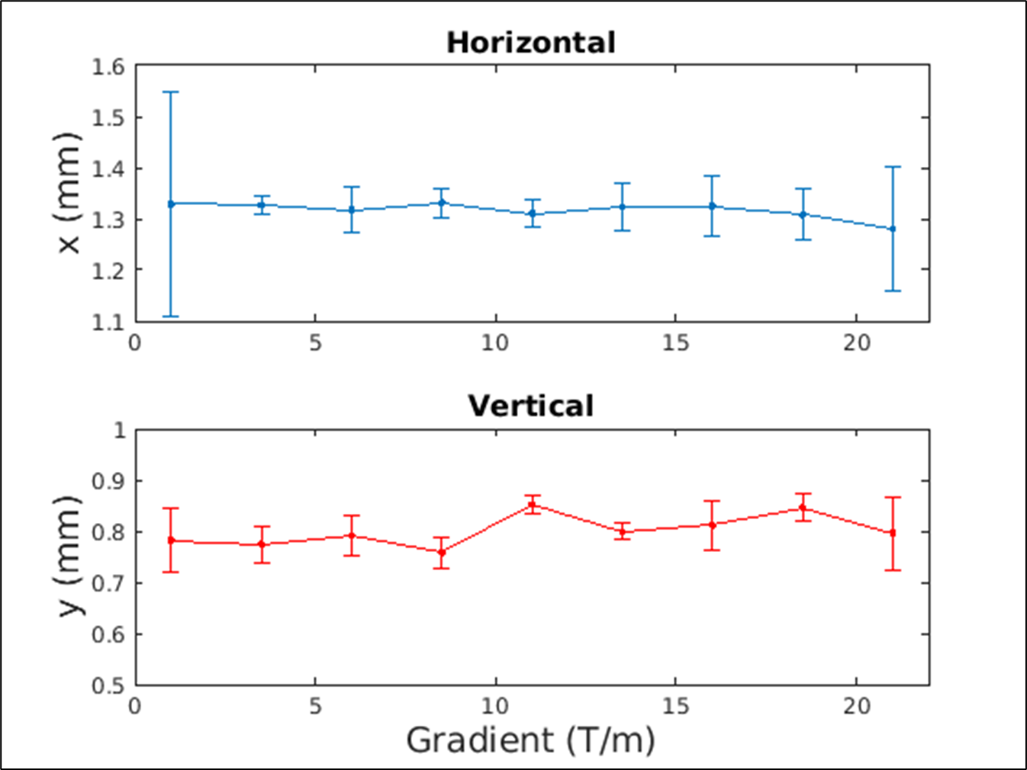
Beam based magnetic axis measurements
Beam-based measurements of the magnetic axis position of ZEPTO checked at axis movement against gradient.
Results show that any changes in axis position as the gradient is adjusted are small and unlikely to cause adverse effects.
These measurements use the lookup table developed in lab measurements to correct vertical movement of the axis.

Slide 27
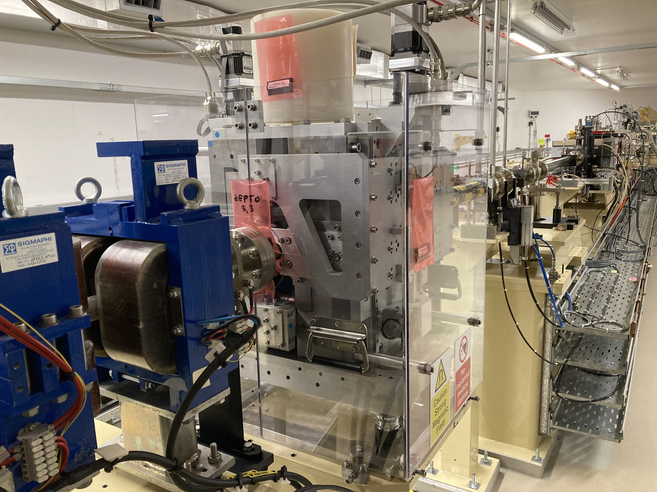
Current status
Magnet is currently still operating on the BTS line replacing the electromagnetic quad, and saving 136 kg of CO2 per year.
The radiation dose being received is being measured by a moderated TLD to detect neutrons and 4 TLDs that monitor γ radiation.
Between 8th Feb and 25th July accumulated doses were 25 mSv of neutron and 22 Sv of γ on the highest reading TLD (11 Sv on next highest)
The magnet was briefly set to minimum and EM turned back on to investigate motor stalls, turned out to be an issue with the control system!

Slide 28
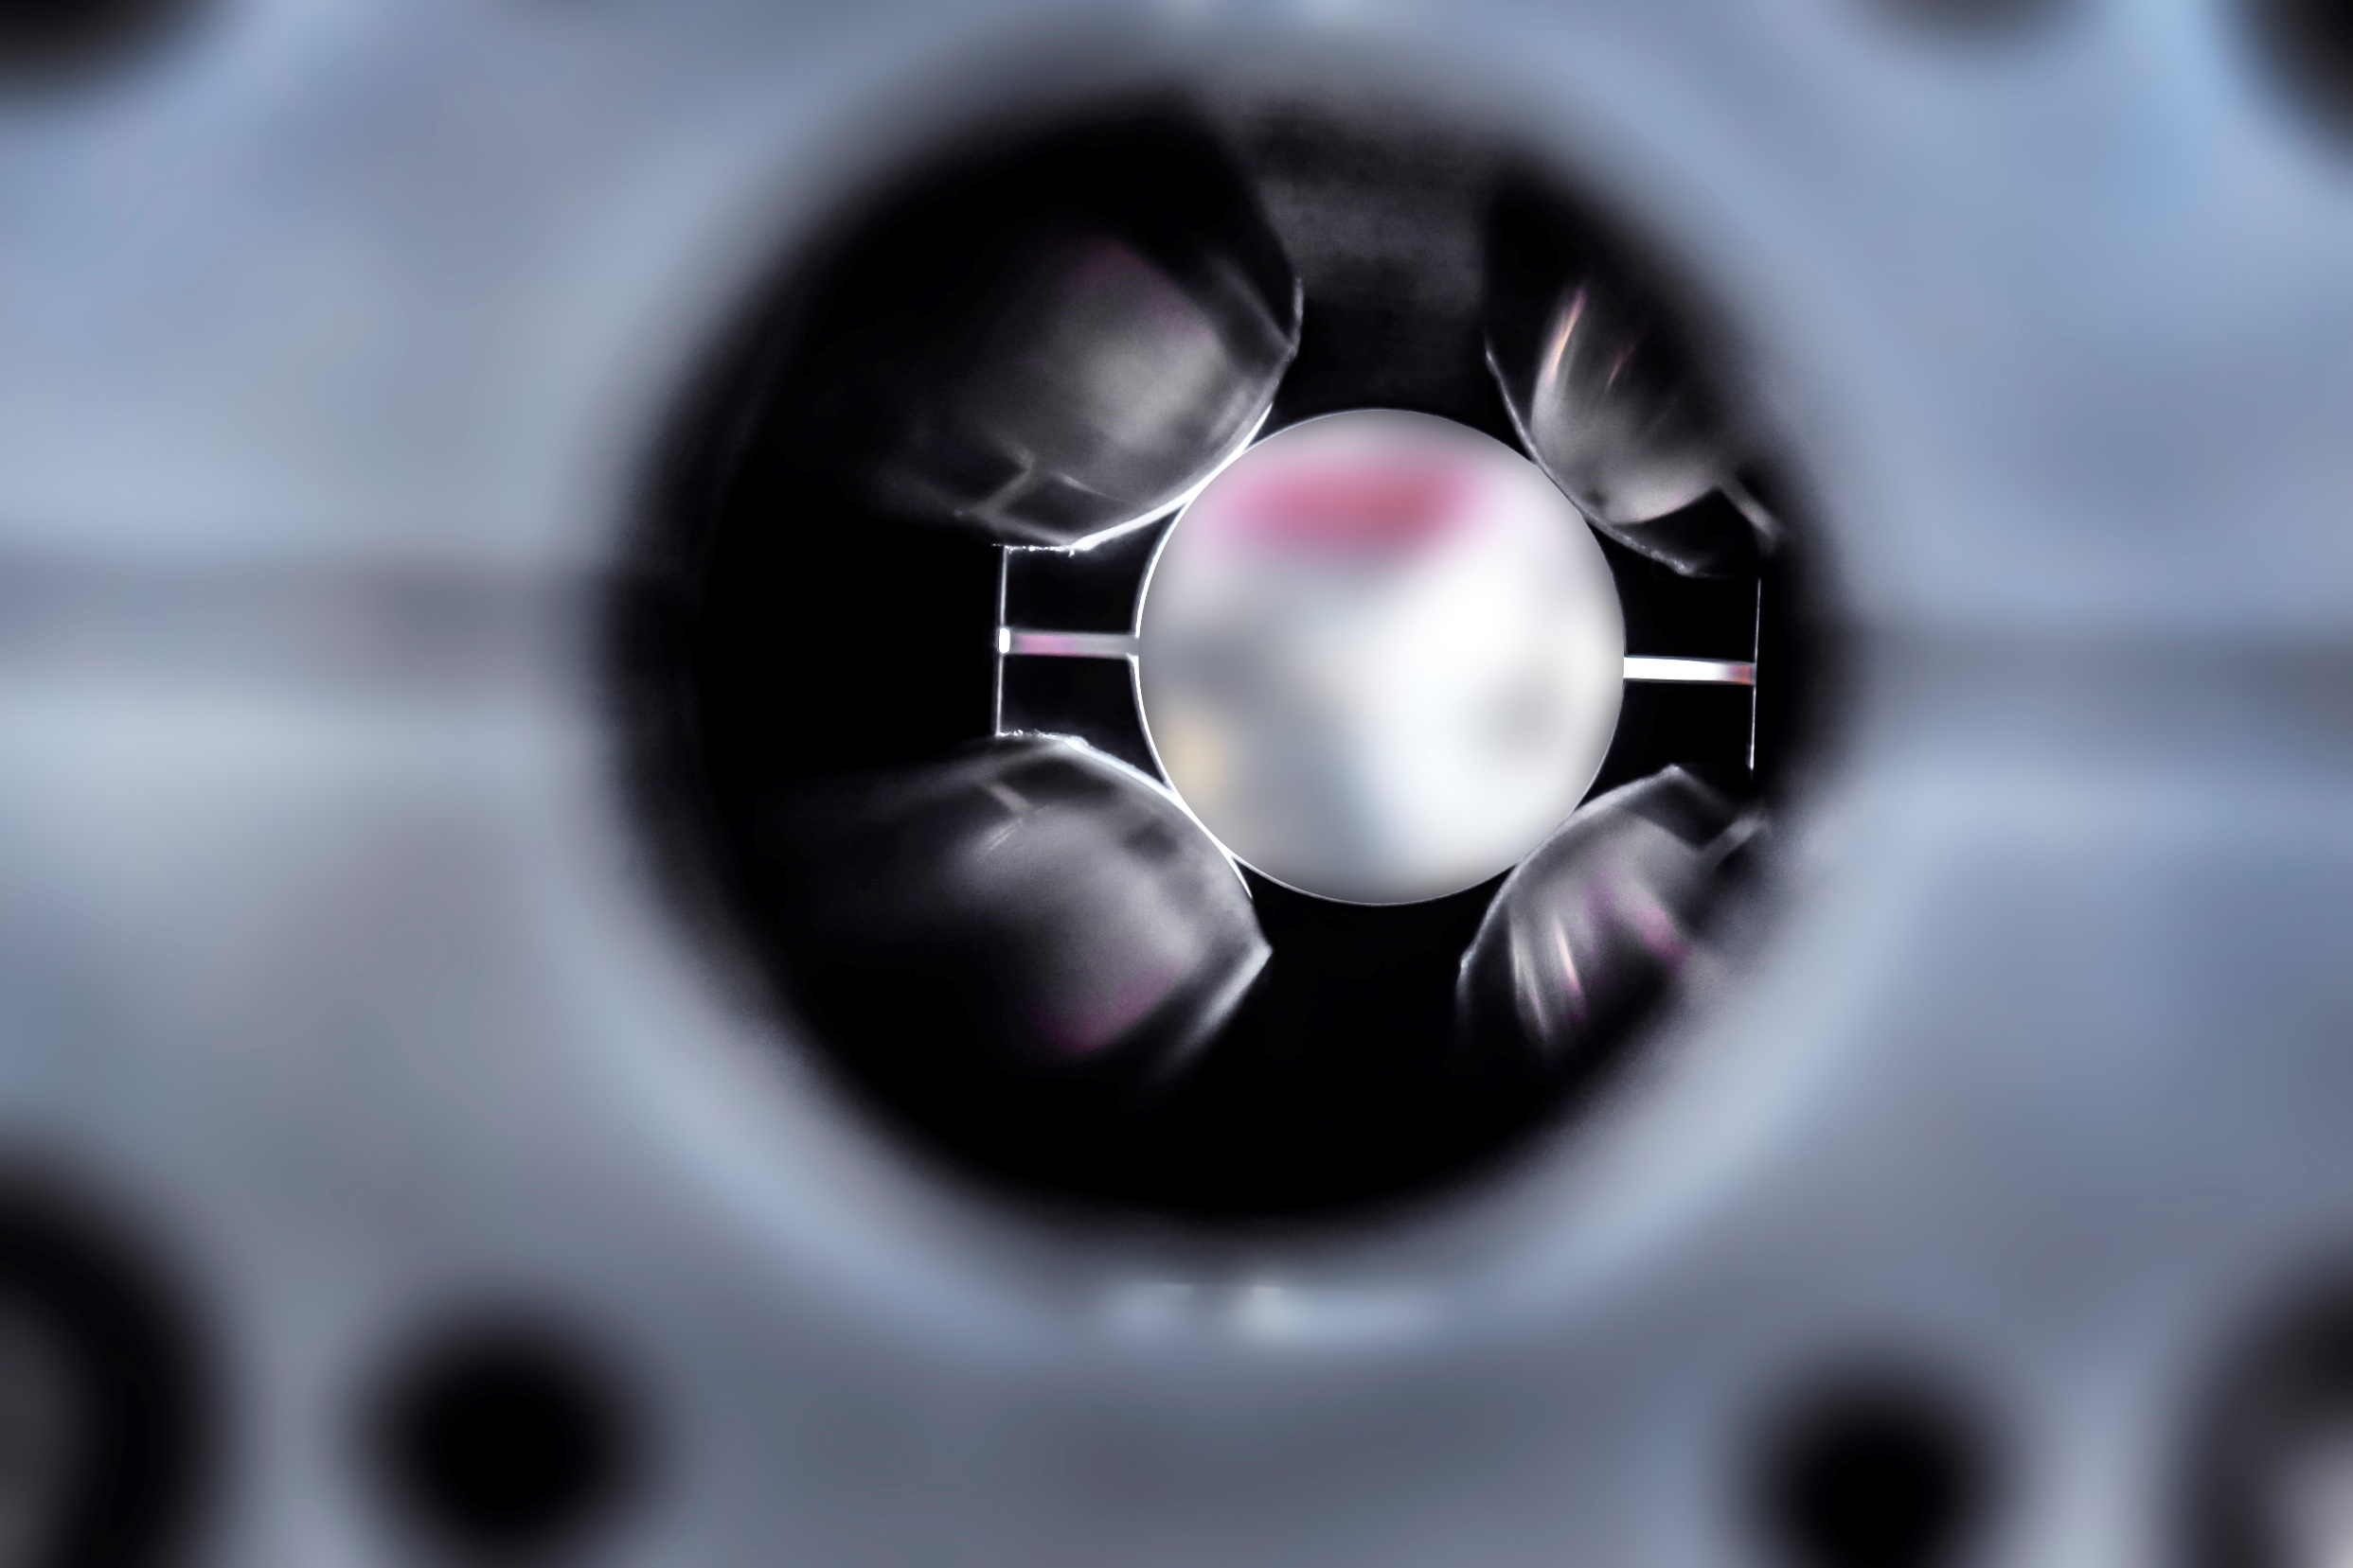
Conclusions
We have built a new ZEPTO quadrupole prototype with several evolutions over the original prototypes.
We have successfully demonstrated that it is possible to build a ZEPTO magnet that can be split and installed around an existing beam pipe.
We have shown that it is possible to keep the vertical magnetic centre position stable by individually moving the magnet blocks according to a look-up table.
The magnet has been successfully installed and operated on the BTS line of Diamond Light Source.
Its still going a year later and appears to have survived in the environment for a year. Paper in preparation….

Slide 29




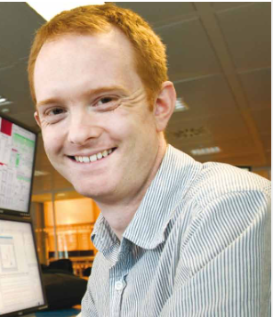


Acknowledgements
The team behind ZEPTO DLS prototype:
Ben Shepherd
Alex Bainbridge
Nick Krumpa
Alex Hinton
Ian Martin
Rick Fielder
Walter Tizzano
Group Leader & ZEPTO co-inventor
Design & Modelling
Mechanical engineering
Measurements
Diamond AP Leader
Beam based measurements
Diamond project lead
+ Thanks to Alex Headspith, Callum Otter, Ryan Cash, Mike Liptrot, Paul Hindley and Mike Lowe
  This work was funded by the STFC Proof of Concept Fund

Slide 30



Thank You
Science and Technology Facilities Council
@STFC_matters
Science and Technology Facilities Council

