Slide 1
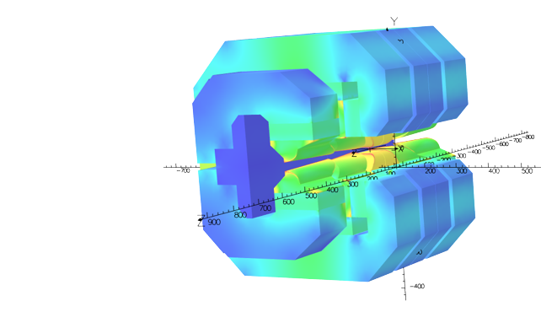





VADER: Variable Aperture Dipole for Elettra Ring
M. Domínguez, F. Toral (CIEMAT), Y. Papaphilippou, Axel Poyet (CERN), Emanuel Karantzoulis (Elettra), Raffaella Geometrante (Kyma)

Slide 2
Summary
Where we started: CLIC Prototype
What we were asked for: VADER Specs
What we did: New Design
Where we are: Current Status
What we expect: Next steps

Slide 3
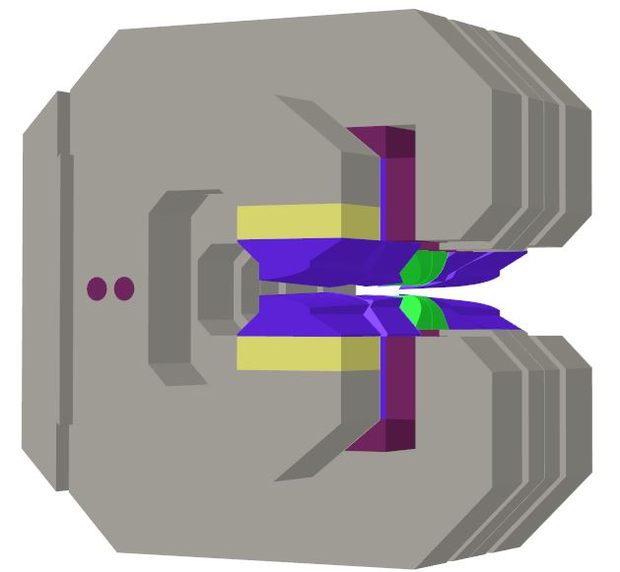
Where we started: CLIC Prototype
Combined Function:
Longitudinal gradient with trapezoidal shape (2.3 T Peak)
Transverse gradient 11 T/m
CLIC DRs Main Bending Magnet (Prototype)
Dimensions:
0.65 x 0.68 x 0.56 m
Weight: 1.2 T
Steel 1010
Flux concentration
Armco
Hyperbolic pole tips profile
Field trimming
Fe-Co (Vacoflux)
Flat pole tip profile
SmCo in LF
NdFeB in MF and HF

Slide 4
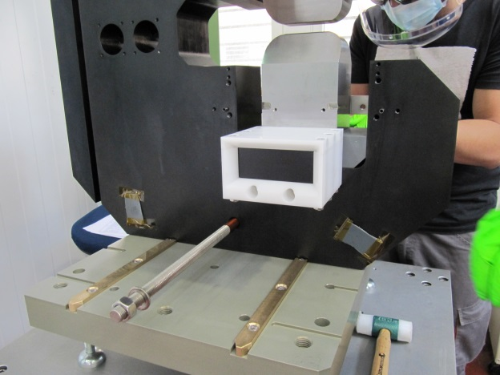
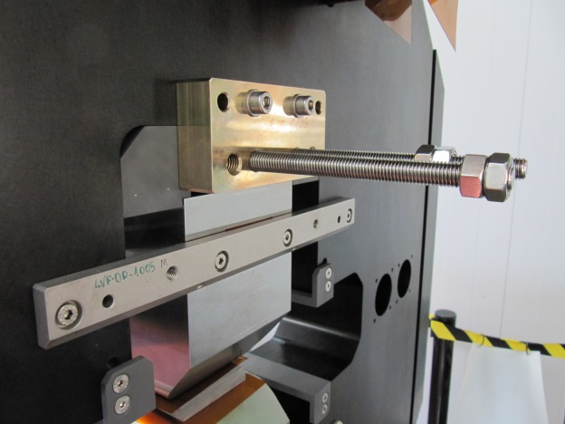
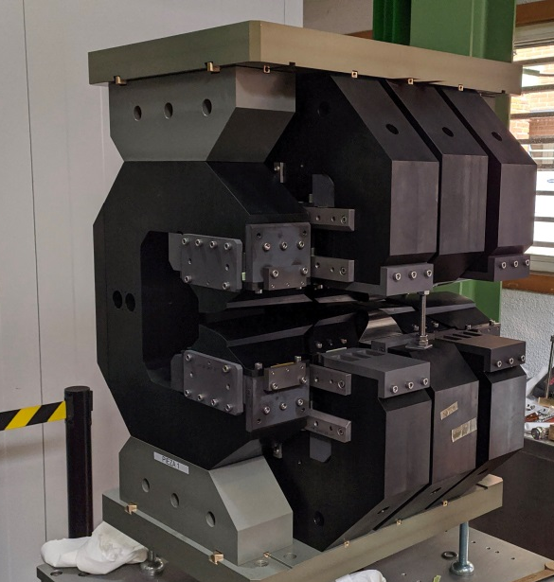
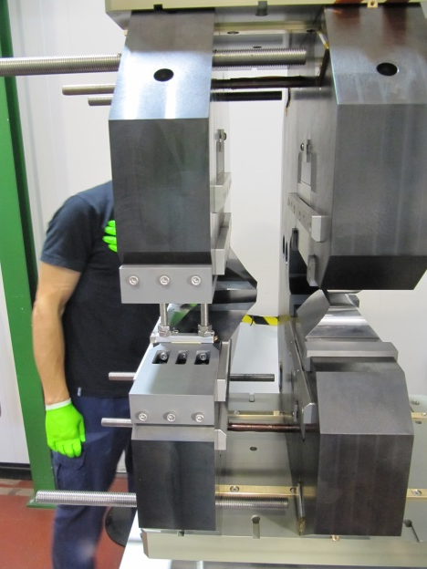
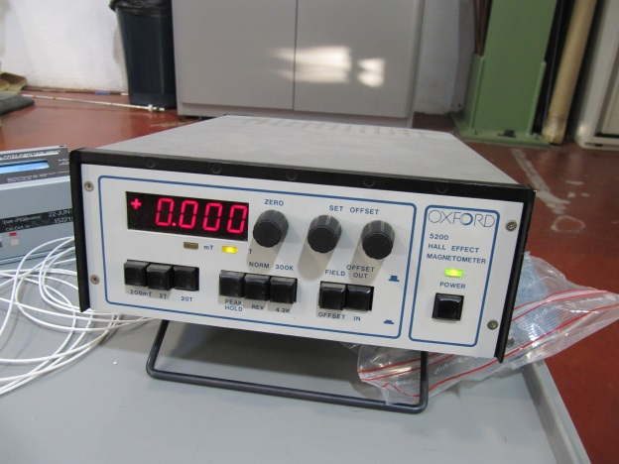
Where we started: CLIC Prototype
Notes:
Once the preliminary assembly was done and everything was checked, the final assembly, with the permanent magnets, started

Slide 5
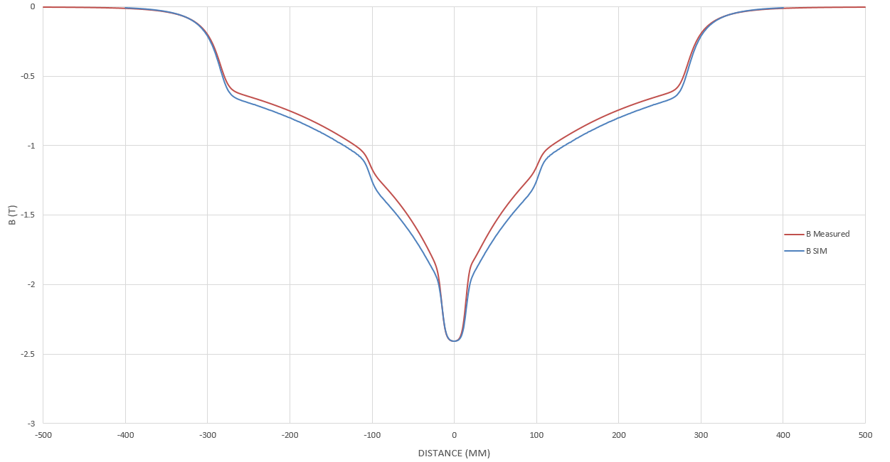
Where we started: CLIC Prototype
Proof of concept: First accelerator magnet with longitudinal trapezoidal gradient! Key factor in terms of beam emittance reduction
Very good field quality achieved
Quadrupolar component achieved
Trapezoidal longitudinal field achieved… …With an issue
Explaining theory: missing anneal in the LF and MF poles (Armco)
Two new annealed poles produced and installed in one of the LF modules
Test bench results showed exactly the same issue as before
The permanent magnet volume is increased around 30%,reaching the demanded field peak of 2.3T with a magnet gap of 19mm (17+2mm)

Slide 6
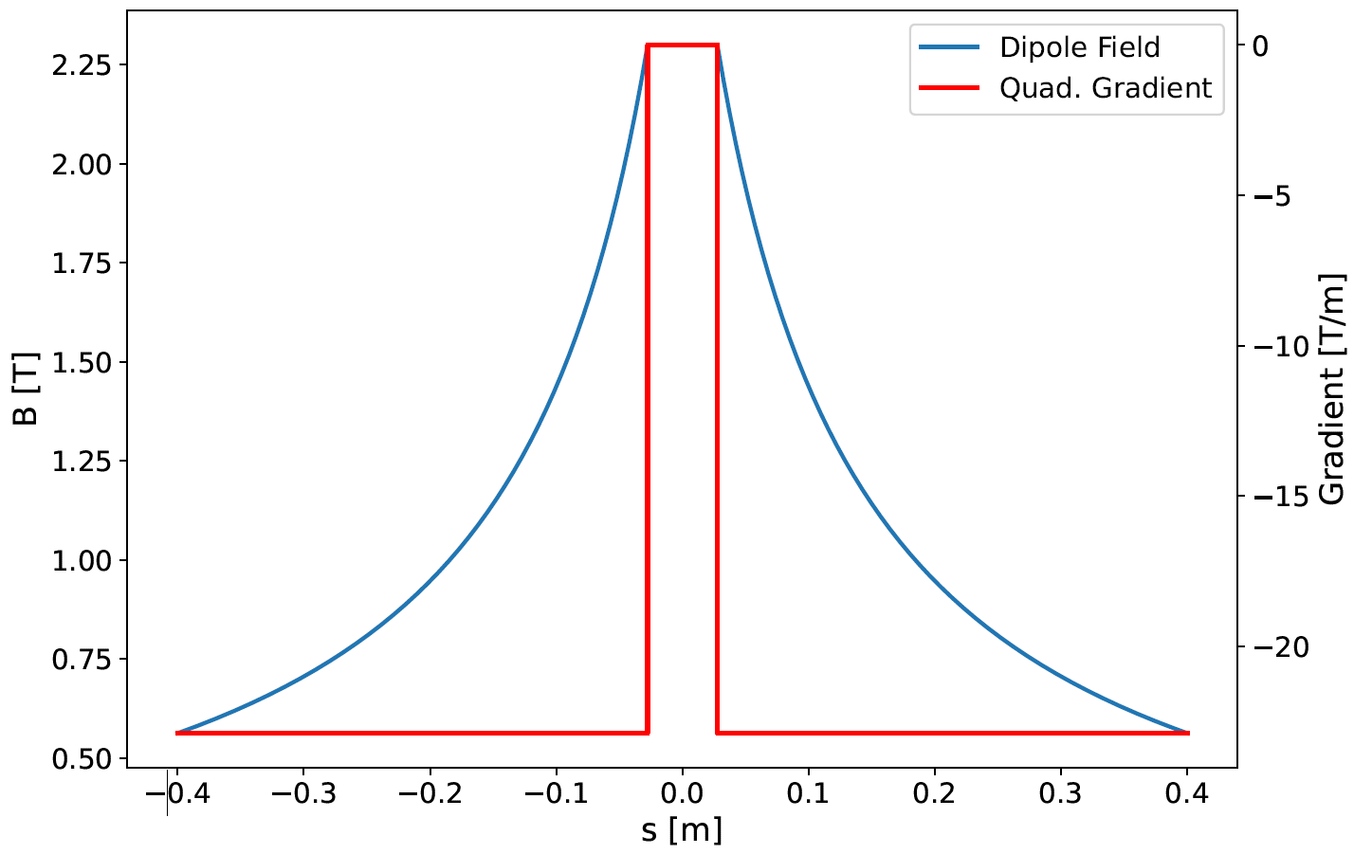
What we were asked for: VADER Specs
Task 7.3 within I.FAST WP7: High Brightness Accelerators for Light Sources
Funds from Horizon 2020 Innovation Pilot Project for Particle Accelerators, ranked 3rd in the Prototypes proposals category
VADER joint project was born:
Magnet Specs
Magnetic & Mechanical Design
Production & Assembly
 | CLIC Prototype Specs | VADER (Variable Aperture Dipole for Elettra Ring) Specs
Magnet Gap (mm) | 13 | 19
Max Field (T) | 2.3 | 2.3
Transverse G (T/m) | 11 | 23
Field Quality (Units 1E-4) | ≈ 1 | ≈ 1
Magnet Length (cm) | 56 | 80
VADER optimal field profiles

Slide 7
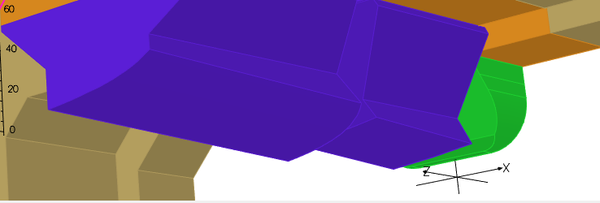
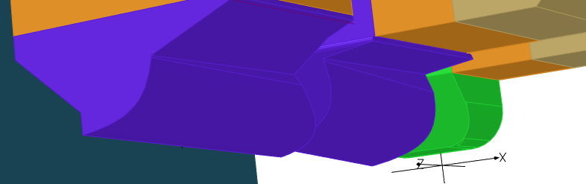
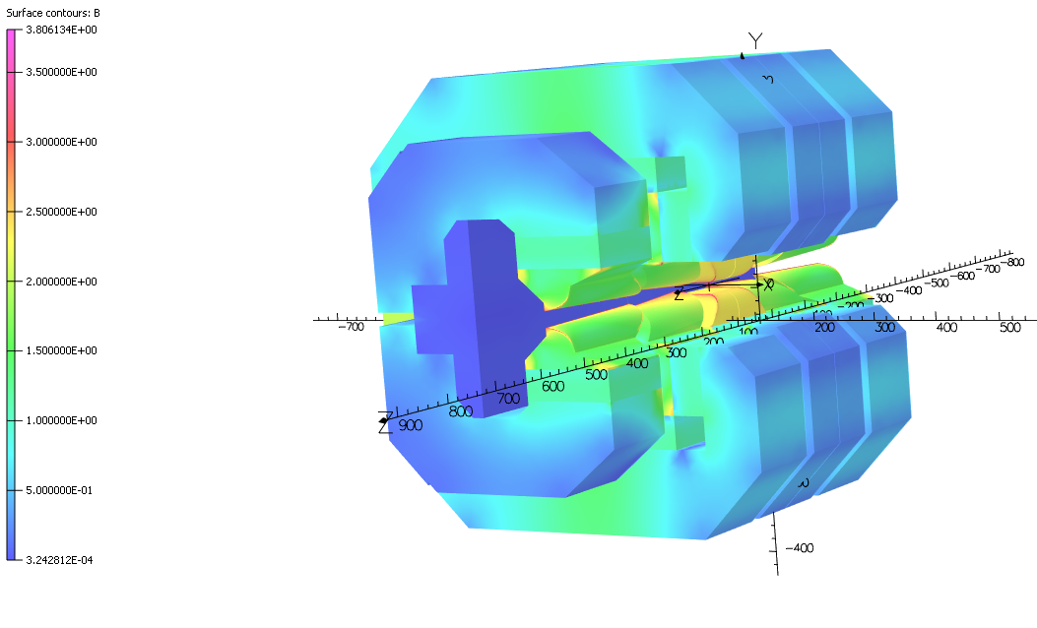
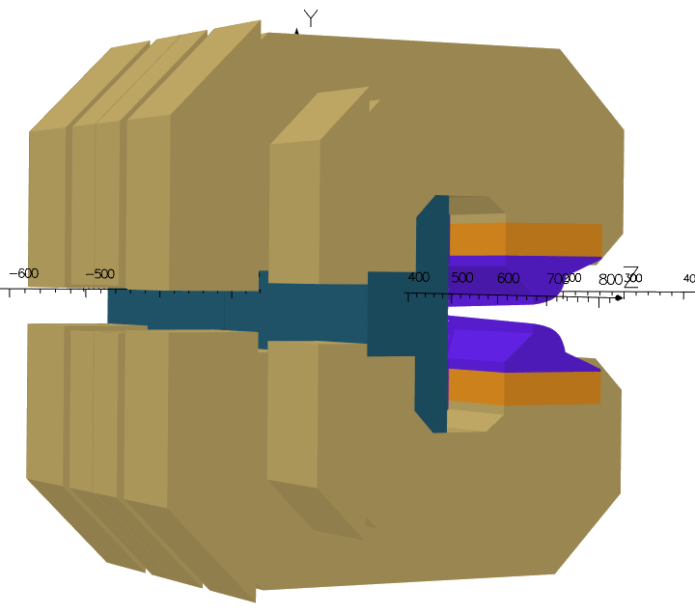
What we did: New Design
Minor changes in the philosophy, major changes in the poles (90% of the design time)
All NdFeB permanent magnet blocks, including LF modules
The permanent magnet volume is increased around 40%, reaching the demanded field peak of 2.3T with a magnet gap of 19mm (17+2mm)
New field trimming design implemented
Yoke completely split in two parts supported by an aluminium block
Sliding parts perform the regulation
Higher/better regulation than the CLIC prototype
CLIC poles
VADER poles

Slide 8
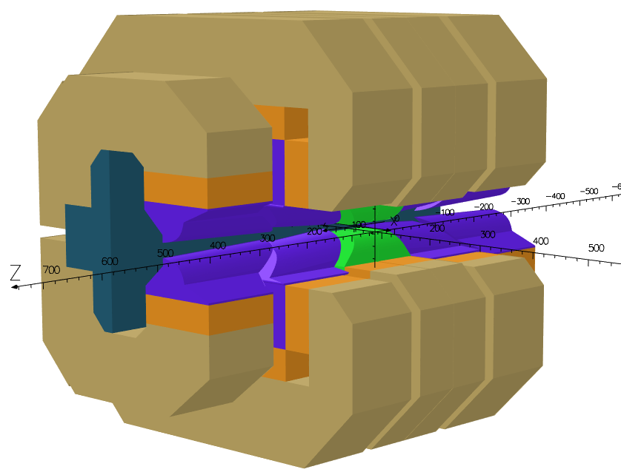
What we did: New Design
VADER Overview
Combined Function
Longitudinal gradient with trapezoidal shape (2.3 T Peak)
Transverse gradient 23 T/m
Dimensions:
0.65 x 0.68 x 0.80 m
Weight: 1.5 T
Steel 1010
Armco
Field trimming
Hyperbolic pole tips profile
Fe-Co (Vacoflux)
Flat pole tip profile
Flux concentration
NdFeB in LF, MF and HF

Slide 9
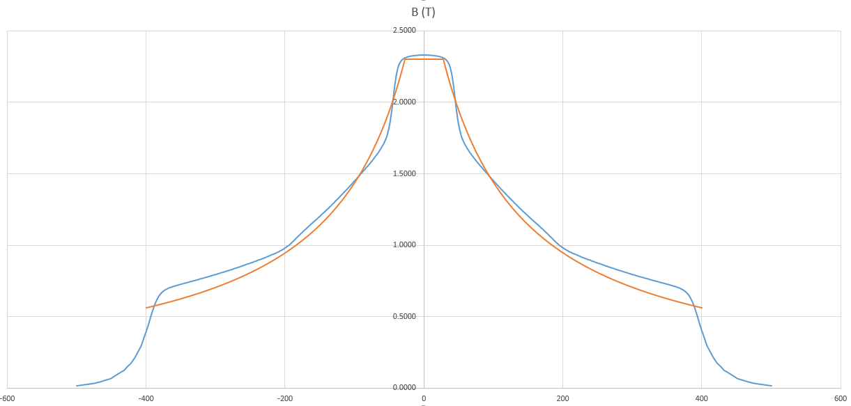
Where we are: Current Status
The field quality is still very good. Comparable to the CLIC prototype
Longitudinal gradient profile achieved
Transverse gradient difficult to reach, the present design is 19 T/m
Meeting with CERN pending to check the viability of the present design

Slide 10
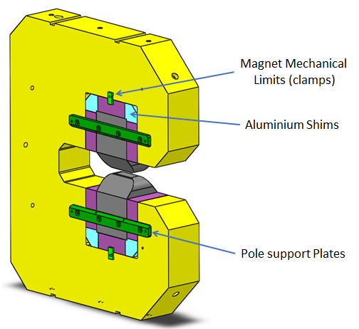
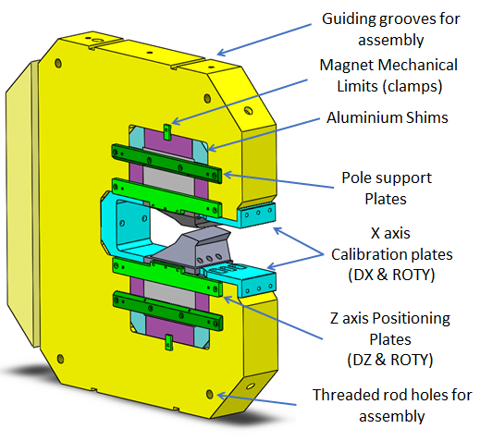
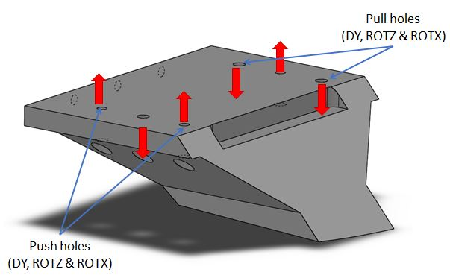
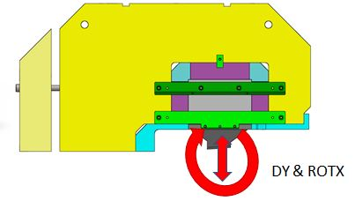
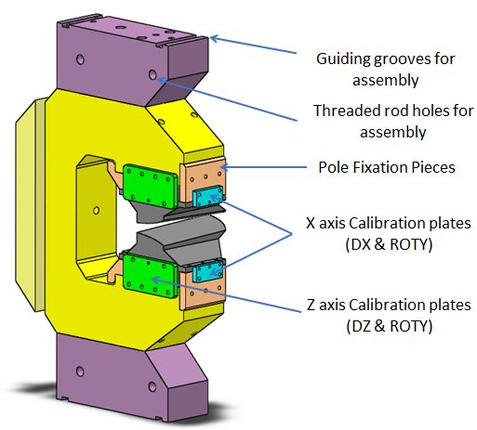
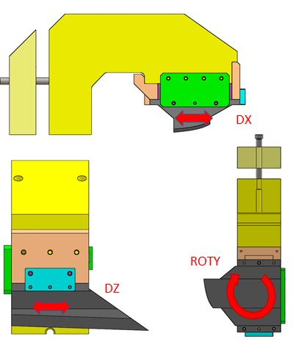
What we expect: Next steps
Mechanical Design

Slide 11
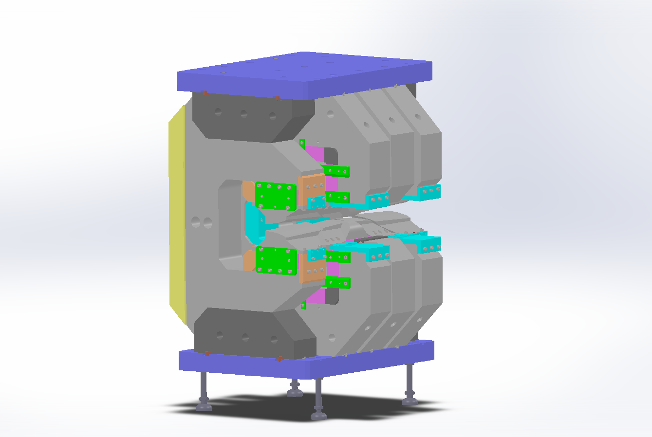
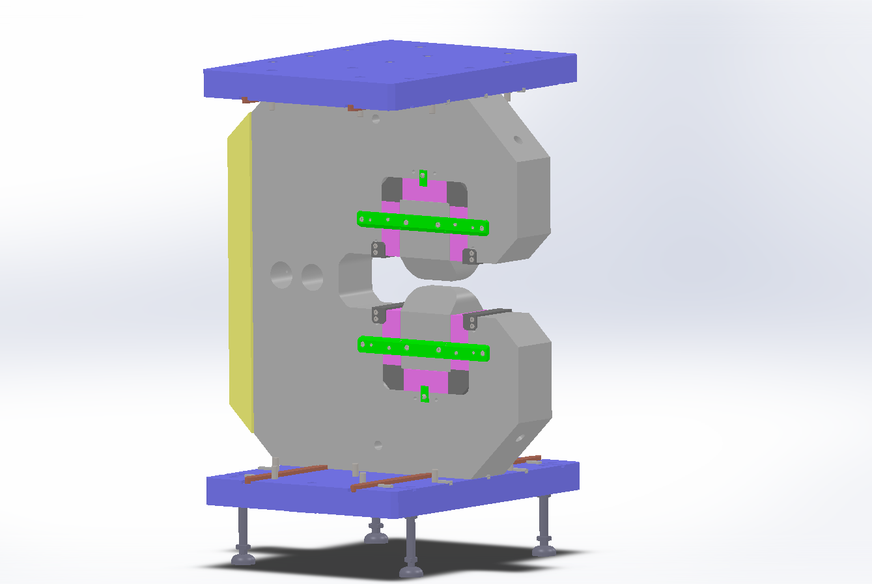
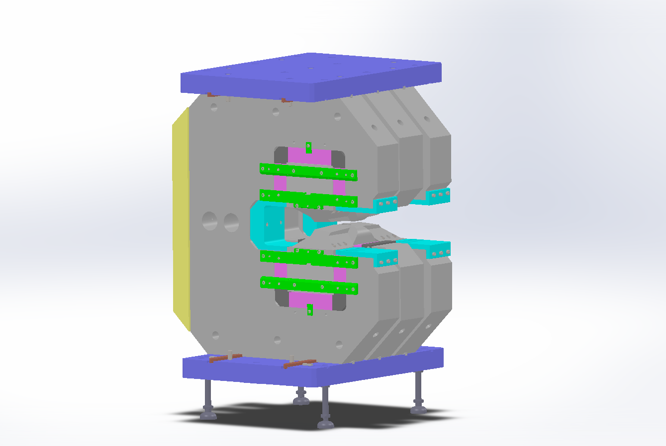
What we expect: Next steps
Mechanical Design:

Slide 12



Thank you for your attention!

