Slide 1
Qualification and Alignment of Permanent Magnets at CERN
Mariano Pentella on behalf of TE-MSC-TM (mariano.pentella@cern.ch)
Date: 16/11/2023

Slide 2
Outline
Introduction
Manufacturing process
Qualification of the PM blocks
Polarity check during the magnet assembly
Magnetic measurements of PM magnets
Fiducialization of PM magnets
Summary and conclusions
Mariano Pentella, CERN, TE-MSC-TM
Low Emittance Rings – Permanent Magnets Workshop 16 November 2023

Slide 3
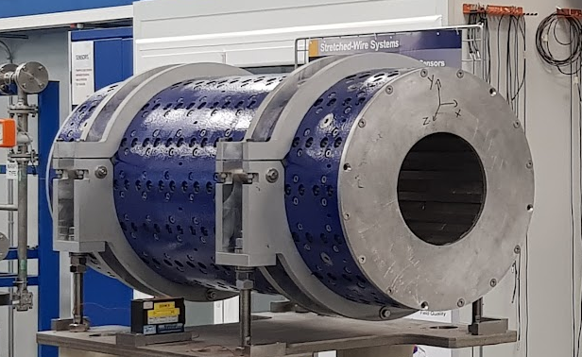
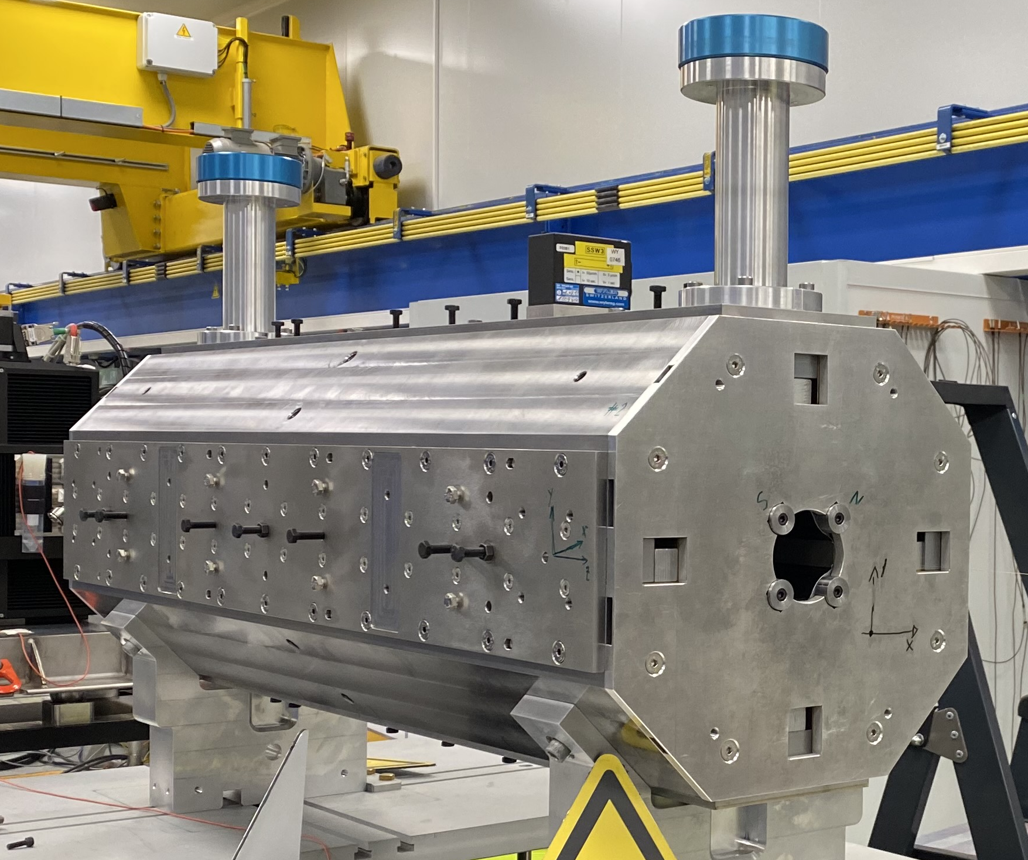
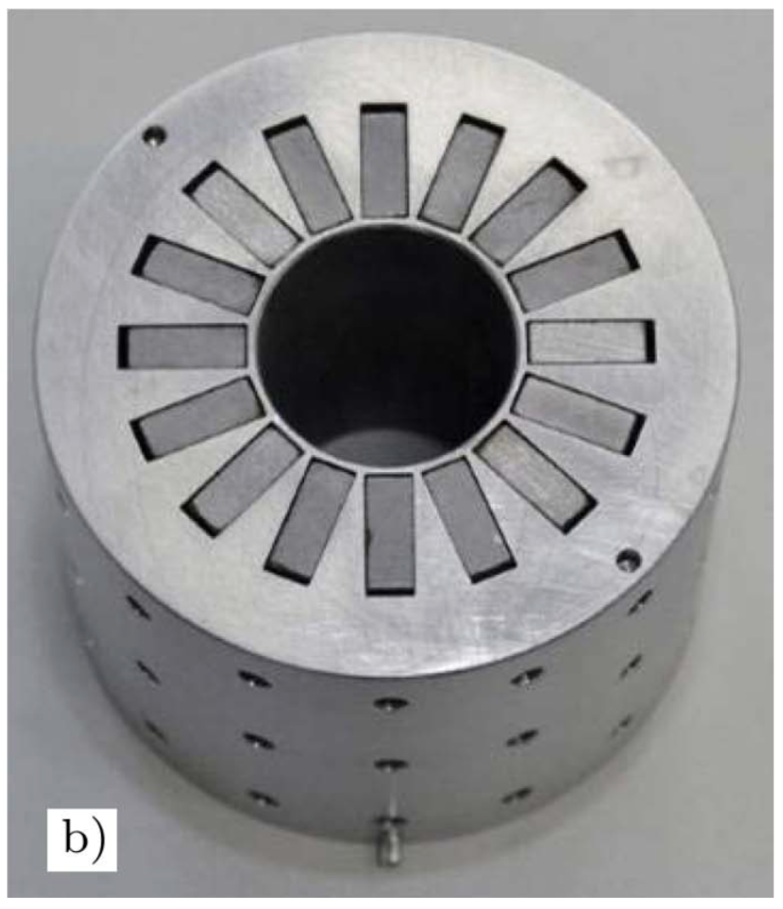
Introduction
Permanent magnets (PM) are used at CERN for low-energy machines or small detector magnets needing low magnetic fields (~0.5 T) or high gradients in small apertures
This measure determines magnets with compact design and highly reliable (no water leaks or electric failure), with zero power consumption
Their operation is cheaper than electromagnets because they don’t need power converters and water cooling circuits (pumps)
FASER 1-m dipole magnet
AD target quadrupole unit
Linac4 DTL quadrupole
Mariano Pentella, CERN, TE-MSC-TM
Low Emittance Rings – Permanent Magnets Workshop 16 November 2023

Slide 4
Manufacturing process
When do we perform magnetic measurements?
Reception of the PM blocks
Qualification of the PM blocks
Magnet assembly
Magnetic measurement and fiducialization
Installation
Polarity check
Field quality, magnetic axis
Acceptance measurements
Mariano Pentella, CERN, TE-MSC-TM
Low Emittance Rings – Permanent Magnets Workshop 16 November 2023

Slide 5
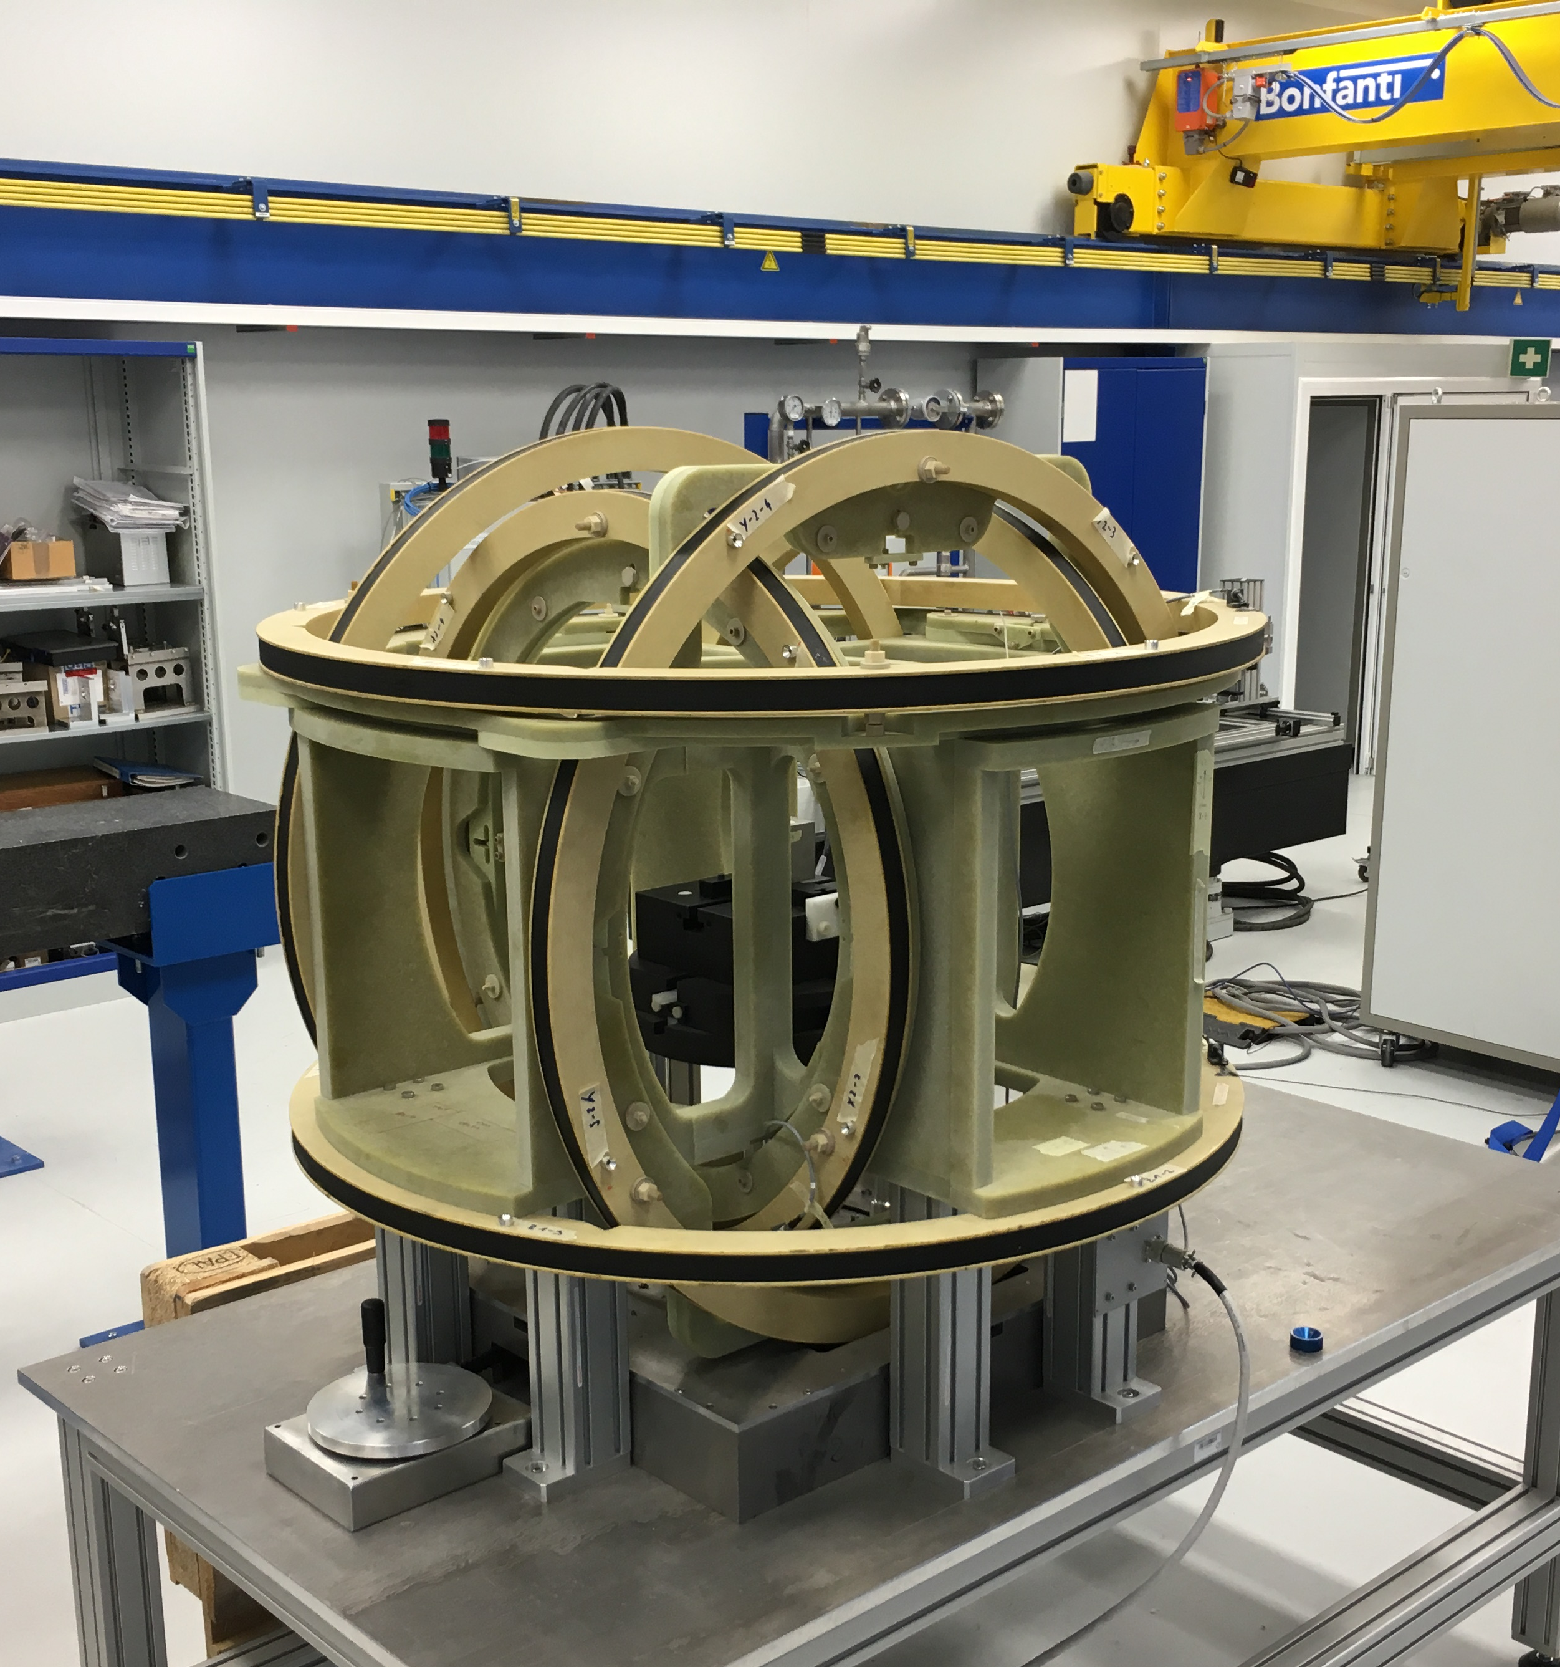
Qualification of the PM blocks - 1
Qualification of the PM blocks is performed in a rotating sample magnetometer
The magnetometer at CERN consists of a 3-axial Helmholtz’s coil system used in passive mode
Verification of block magnetization/magnetic moment (module and field direction)
The huge coil surface makes the system sensitive enough to measure small fridge magnets (with 10 % uncertainty)!
Calibrated against a PTB reference sample
Parameter | Value
Absolute accuracy magnetic moment | 3.3 Am²
Absolute accuracy angle | 1.31°
Coil sensitivity | ~3000 m²
Coil geometrical surface | ~0.56 m²
Some key parameters of the Helmholtz’s coil system
Helmholtz’s coil system in use at CERN
PTB - Physikalisch-Technische Bundesanstalt, german national metrological institute
Mariano Pentella, CERN, TE-MSC-TM
Low Emittance Rings – Permanent Magnets Workshop 16 November 2023

Slide 6
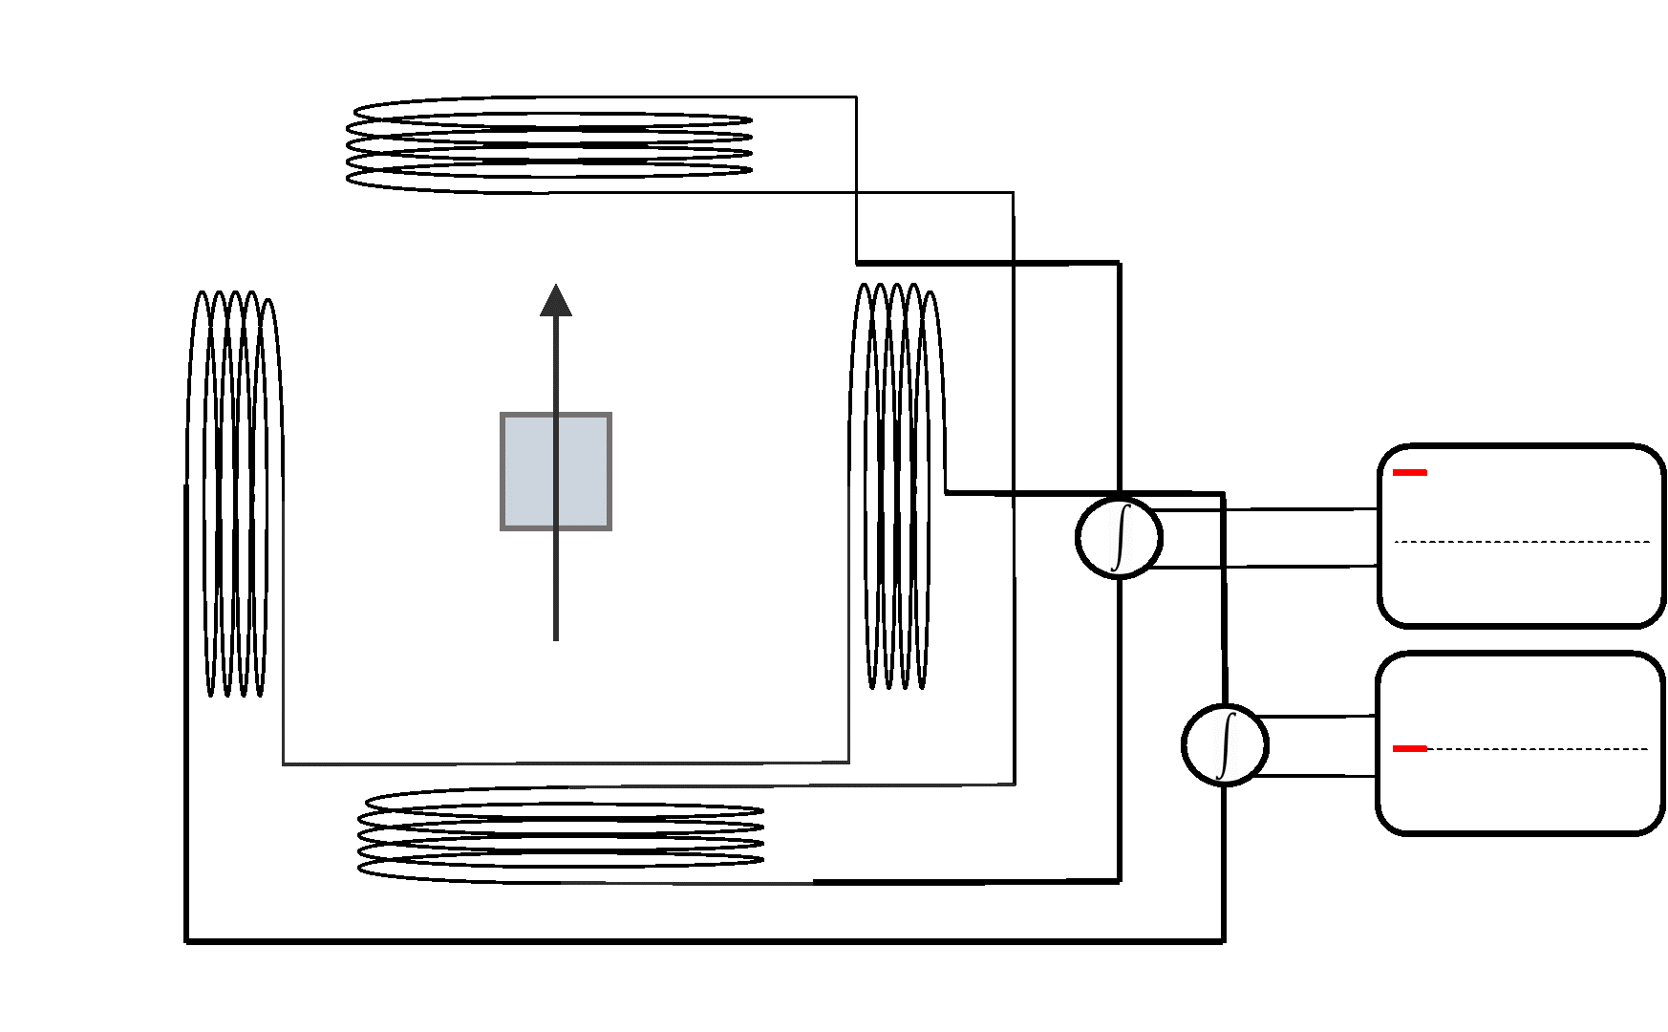
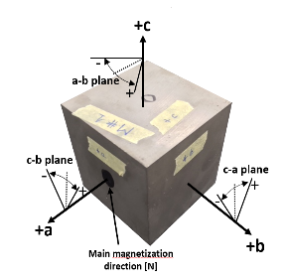
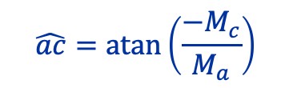
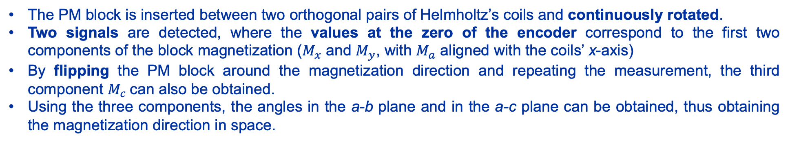
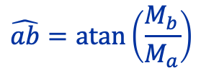

Qualification of the PM blocks - 2
The PM block is inserted between two orthogonal pairs of Helmholtz’s coils and continuously rotated.
Two signals are detected, where the values at the zero of the encoder correspond to the first two components of the block magnetization ($M_{x}$ and $M_{y}$, with $M_{a}$ aligned with the coils’ x-axis)
By flipping the PM block around the magnetization direction and repeating the measurement, the third component $M_{c}$can also be obtained.
Using the three components, the angles in the a-b plane and in the a-c plane can be obtained, thus obtaining the magnetization direction in space.
$$M=\sqrt{M_{a}^{2}+M_{b}^{2}+M_{c}^{2}}$$
$$\hat{ab}=\operatorname{atan}\left(\frac{M_{b}}{M_{a}}\right)$$
$$\hat{ac}=\operatorname{atan}\left(\frac{{−M}_{c}}{M_{a}}\right)$$
PM block angle convention
Mariano Pentella, CERN, TE-MSC-TM
Low Emittance Rings – Permanent Magnets Workshop 16 November 2023

Slide 7
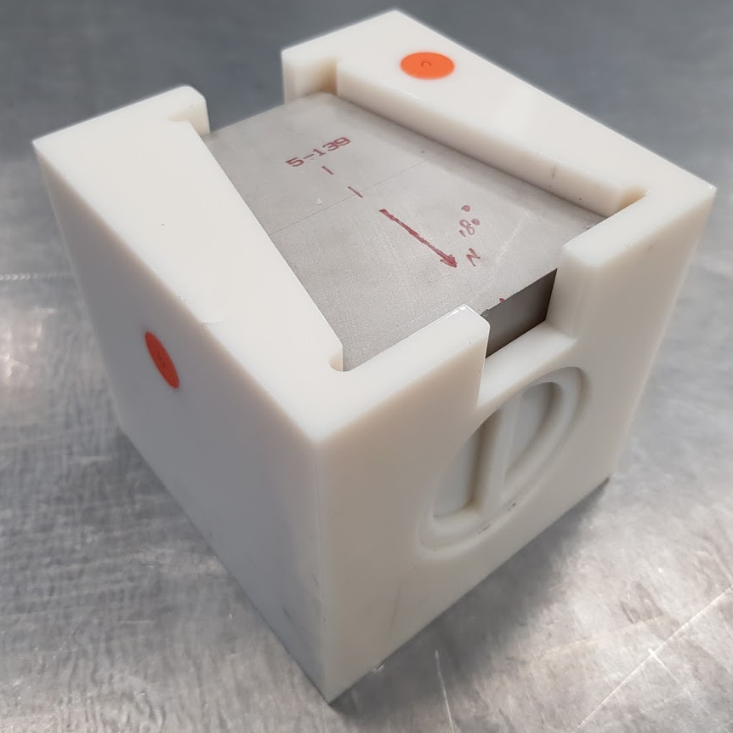
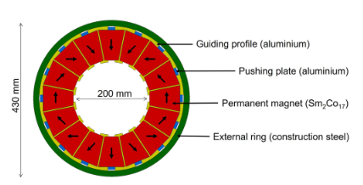
Qualification of the PM blocks - 3
Example – Magnetic qualification of 690 PM blocks for the FASER detector magnets
FASER magnet PM block
 | Value | Std. | Max. deviation
Magnetic moment | 331.44 Am² | 0.6 % | 2 %
Angle ab - nominal | -0.23° | 0.40° | 1.46°
Angle ac | 0.58° | 0.49° | 1.83°
Cross-section of FASER magnet
Measurement results
Mariano Pentella, CERN, TE-MSC-TM
Low Emittance Rings – Permanent Magnets Workshop 16 November 2023

Slide 8
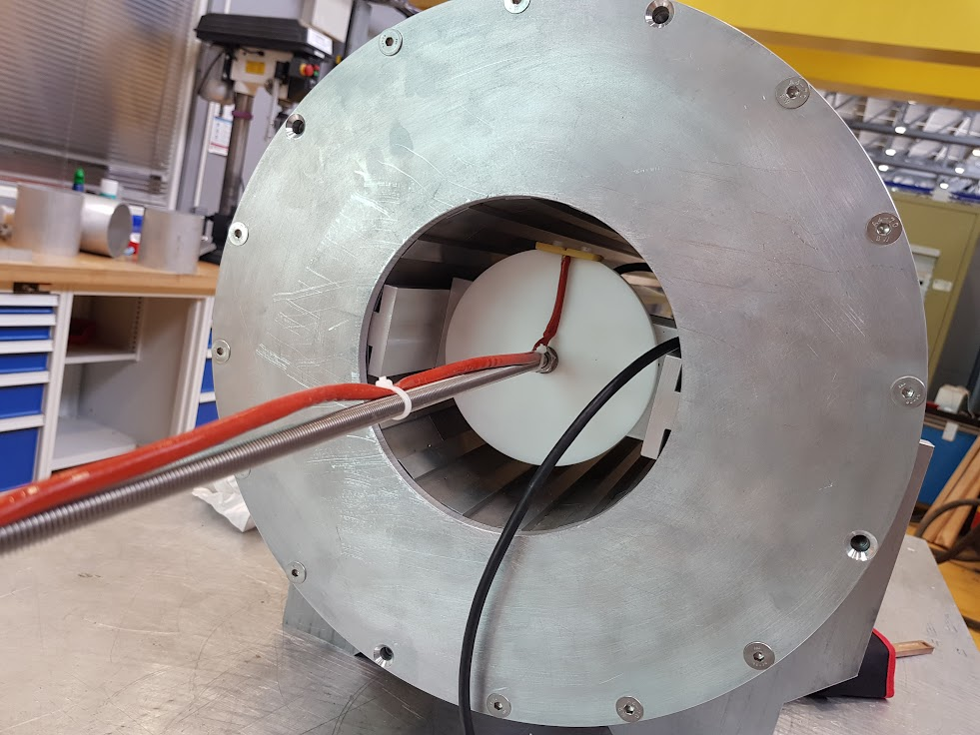
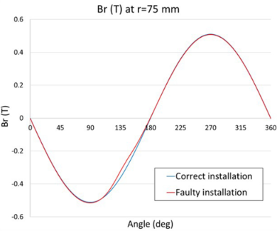
Polarity check during magnet assembly
Verification of the field polarity when installing the PM blocks
If one of the blocks is installed with the wrong polarity, a distortion in the field distribution will be clearly visible
Rotating Hall sensor measurement setup used for the polarity check during the FASER magnet assembly
Mariano Pentella, CERN, TE-MSC-TM
Low Emittance Rings – Permanent Magnets Workshop 16 November 2023

Slide 9
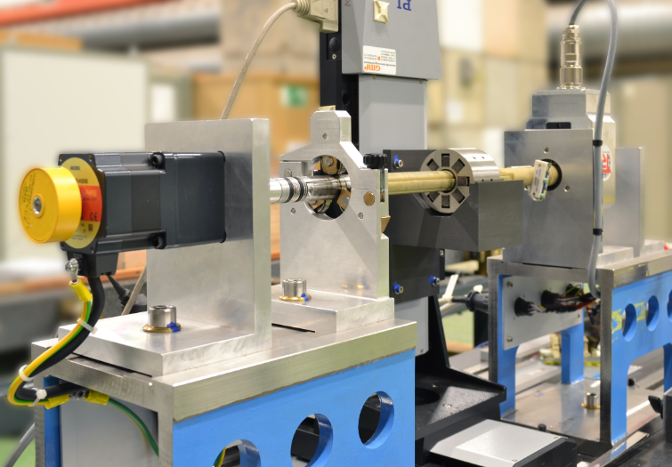
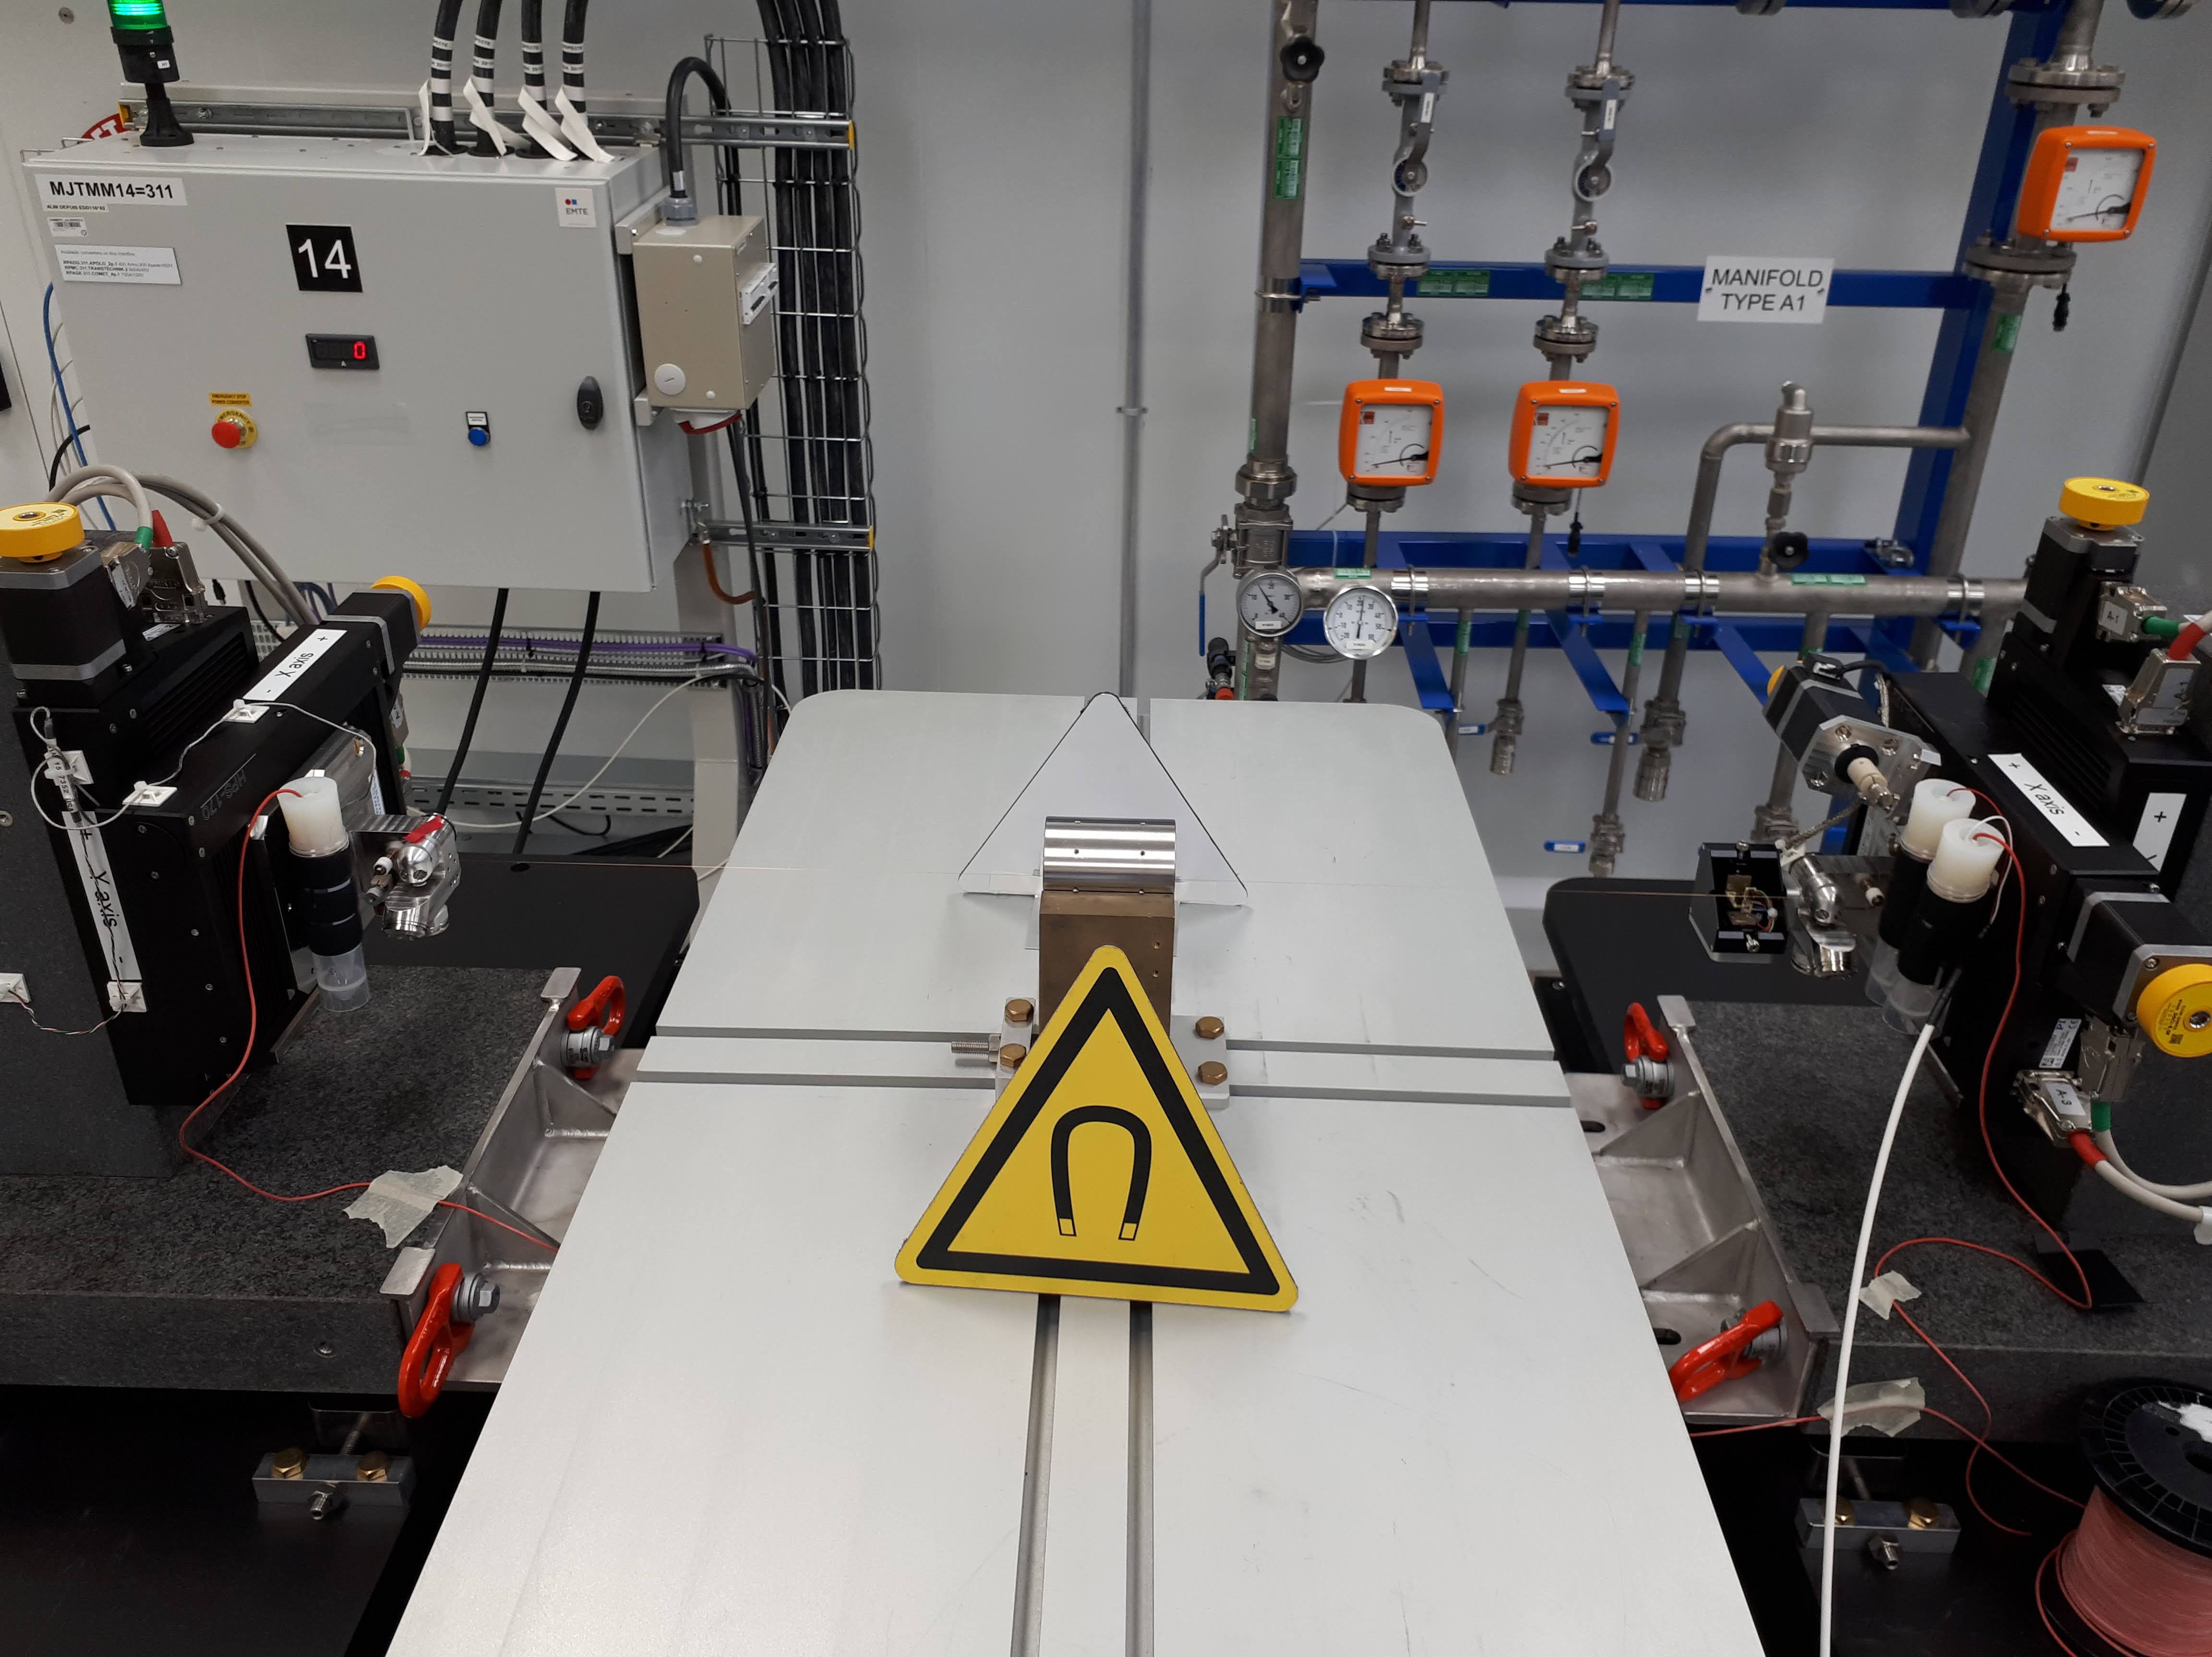
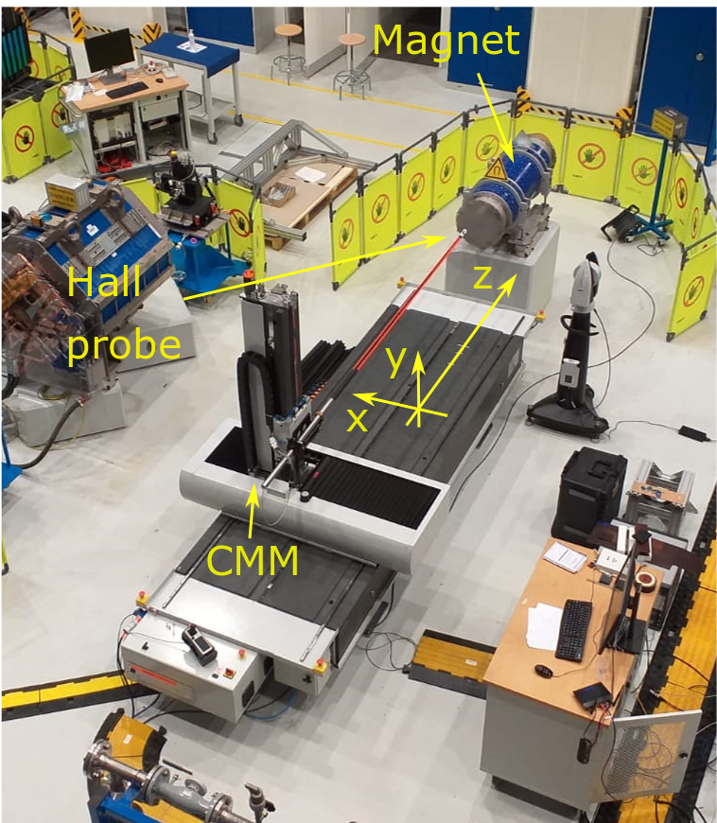
Magnetic measurements of PM magnets- 1
Qualification of PM magnets aims to verify the magnet field quality and to identify the magnetic axis in a given mechanical reference frame (fiducialization)
A large spectrum of measurement techniques can be used to assess the magnet field quality
Rotating coil system
Stretched/Oscillating Wire system
3D Hall mapper system
Mariano Pentella, CERN, TE-MSC-TM
Low Emittance Rings – Permanent Magnets Workshop 16 November 2023

Slide 10
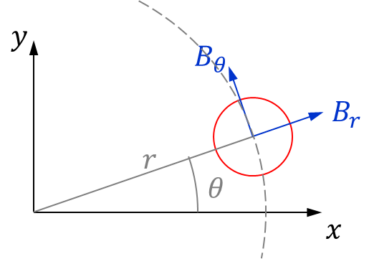
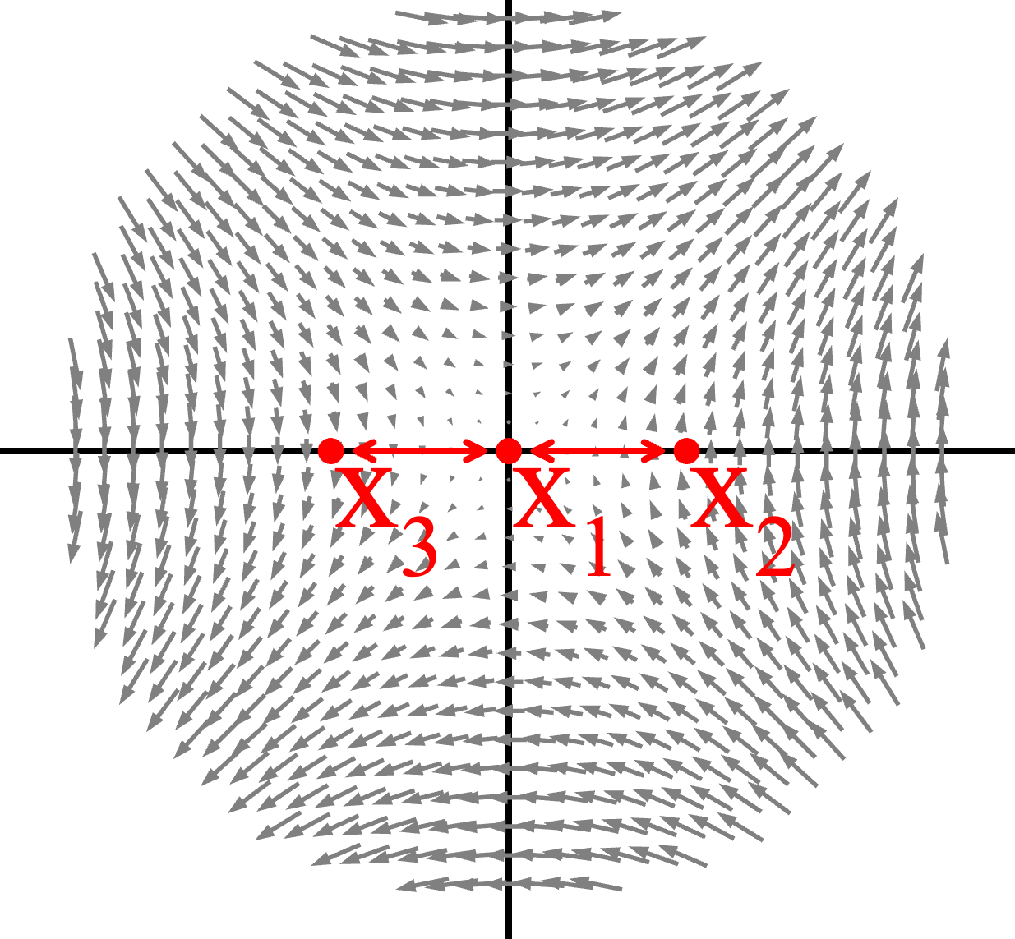
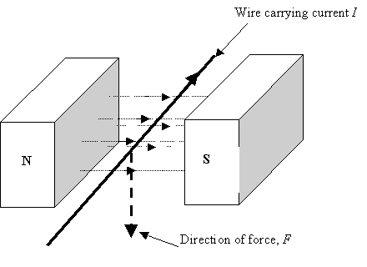
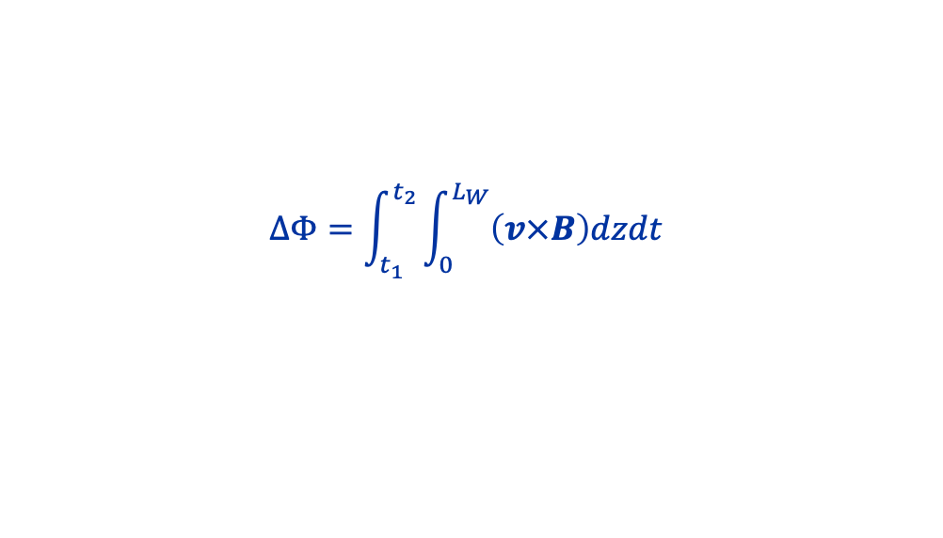
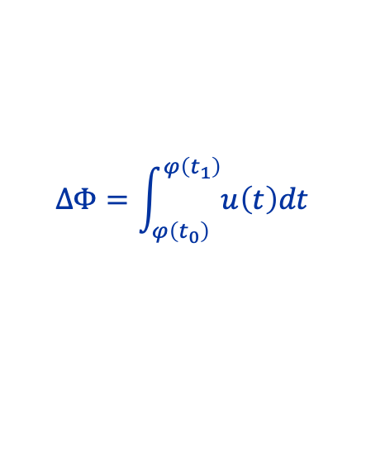
Magnetic measurements of PM magnets- 2
Rotating coil system
Stretched wire system
Oscillating wire
A coil is rigidly rotated inside a magnetic field. The rotation determines an induced voltage at the coil terminals
A wire is rigidly spanned through the magnet aperture, with a return wire closing the loop.
The loop deformation due to the wire movement determines a flux variation and therefore, an induced voltage at the loop terminal
A wire is kept in position inside the magnet aperture. A small current with a sinusoidal waveform is applied, with a frequency much lower than the first wire resonance frequency. The interaction between the current and the field determines vibrations arising from the Lorentz’s force
$$F=q\left(v×B\right)=I\left(t\right)B(z)$$
$$ΔΦ=\int_{φ\left(t_{0}\right)}^{φ\left(t_{1}\right)}{u\left(t\right)dt}$$
Return wire
$$ΔΦ=\int_{t_{1}}^{t_{2}}{\int_{0}^{L_{W}}{\left(v×B\right)dzdt}}$$
Mariano Pentella, CERN, TE-MSC-TM
Low Emittance Rings – Permanent Magnets Workshop 16 November 2023

Slide 11
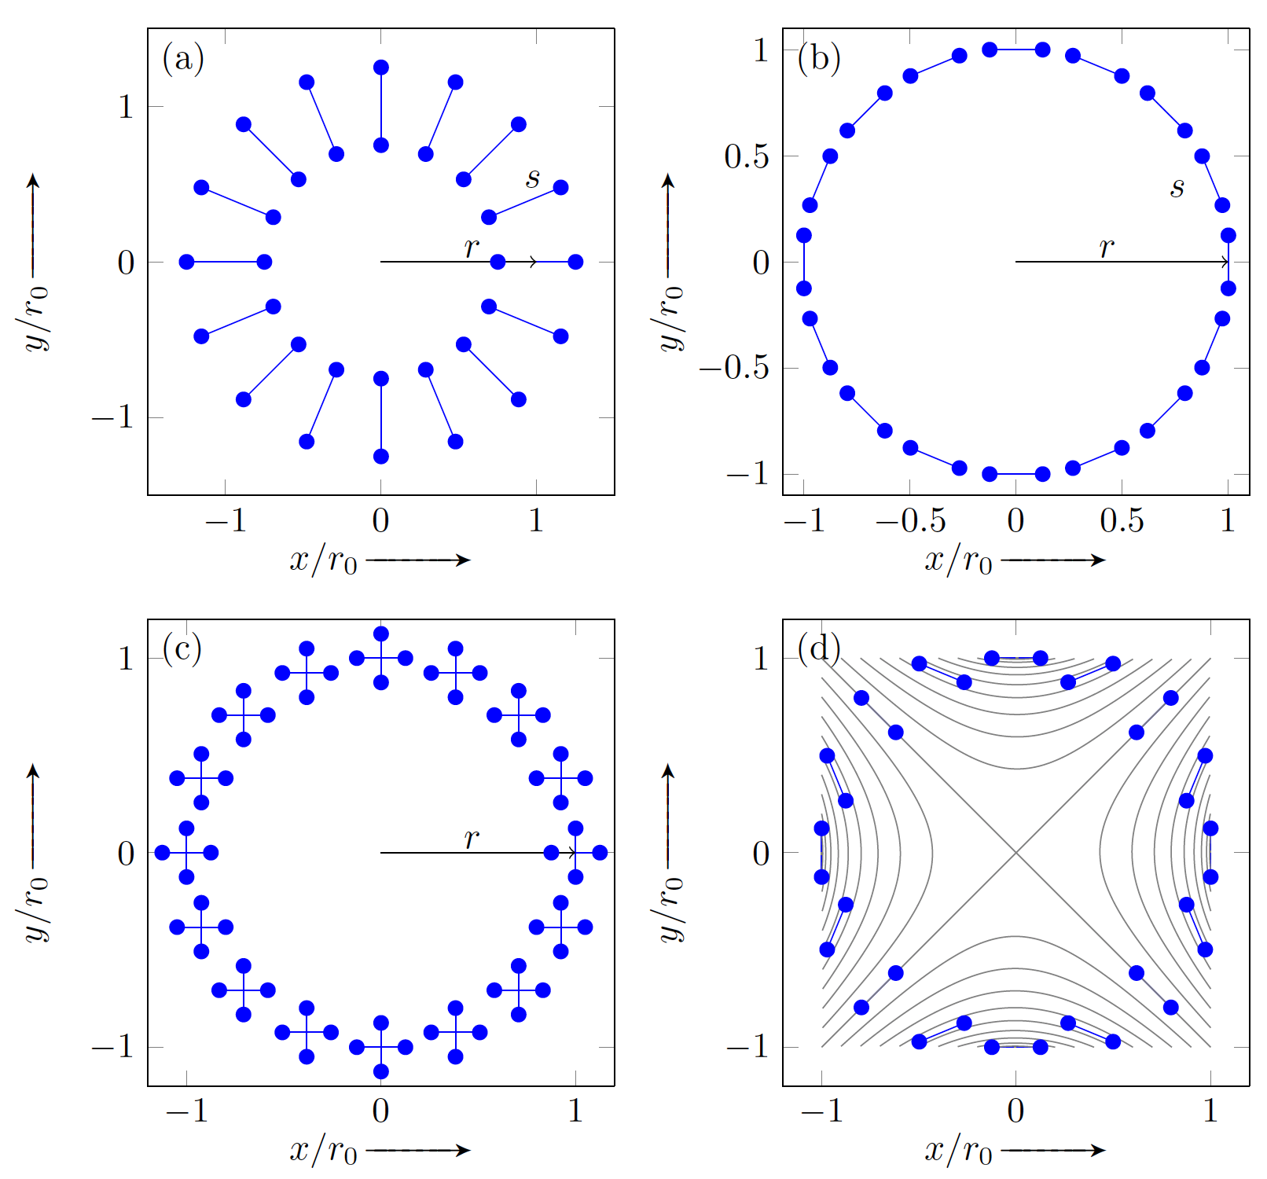
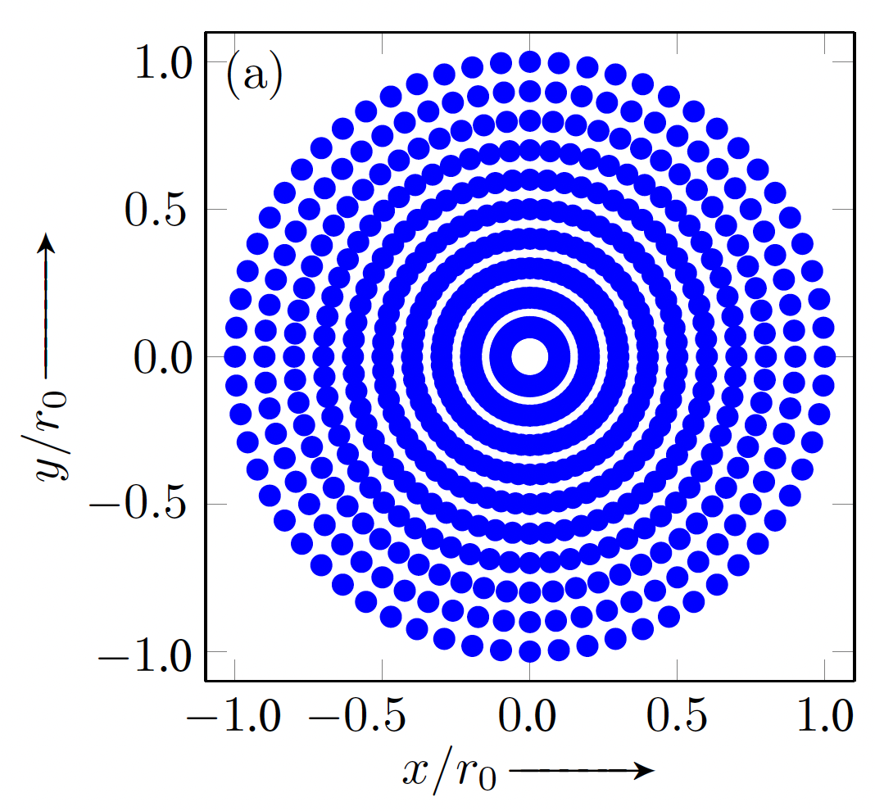
Magnetic measurements of PM magnets- 3
Field quality
Field values acquired on the generator of a cylindrical domain. Rotating coils do this intrinsically.
Cylindrical domains simplify the data processing, because Fourier’s analysis can be carried out.
Rotating coil system
Stretched wire system
Oscillating wire
Mariano Pentella, CERN, TE-MSC-TM
Low Emittance Rings – Permanent Magnets Workshop 16 November 2023

Slide 12
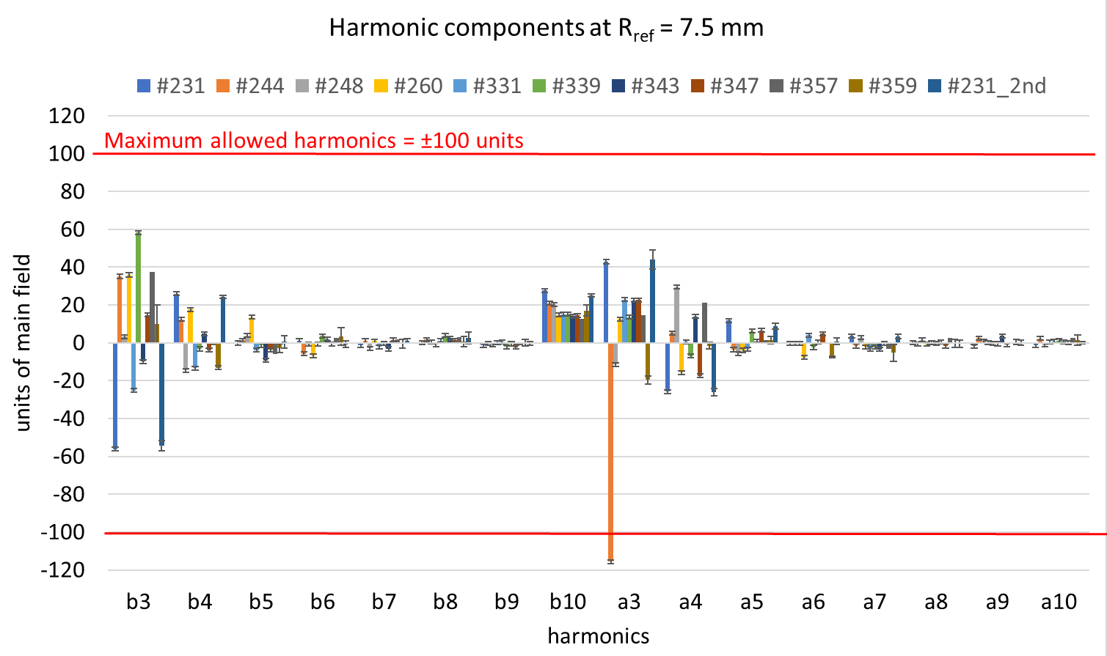

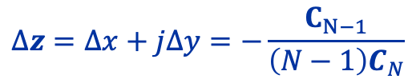
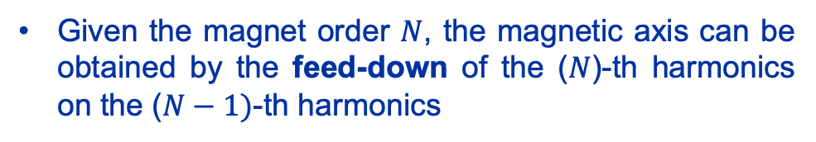
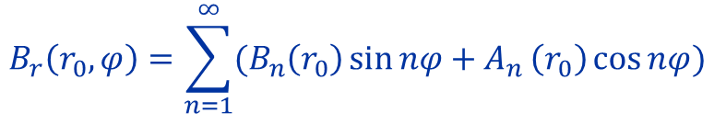
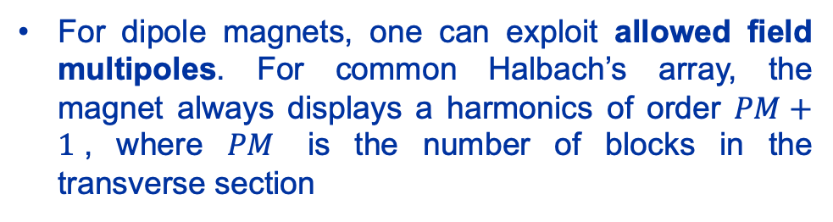
Magnetic measurements of PM magnets- 4
Field quality
Analysis of the field quality relies on the classic field multipole expansion, around a circumference of radius $r_{0}$
$$B_{r}\left(r_{0},φ\right)=\sum_{n=1}^{∞}{(B_{n}\left(r_{0}\right)\sin{nφ}+A_{n}}\left(r_{0}\right)\cos{nφ})$$
Given the magnet order $N$, the magnetic axis can be obtained by the feed-down of the ($N$)-th harmonics on the ($N−1)$-th harmonics
$$Δz=Δx+jΔy=−\frac{C_{N−1}}{\left(N−1\right)C_{N}}$$
$$C_{N}=B_{N}+jA_{N}$$
For dipole magnets, one can exploit allowed field multipoles. For common Halbach’s array, the magnet always displays a harmonics of order $PM+1$, where $PM$ is the number of blocks in the transverse section
Measured field harmonics for some spare PMQ DTL80 units (Linac4)
Mariano Pentella, CERN, TE-MSC-TM
Low Emittance Rings – Permanent Magnets Workshop 16 November 2023

Slide 13
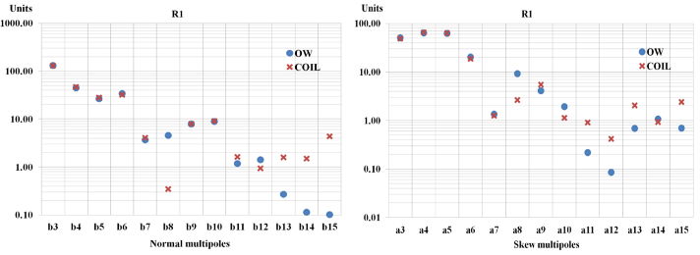
Magnetic measurements of PM magnets- 5
Field quality
How to choose the optimal magnetic measurement system among the many available solutions?
The aperture radius plays a key role: for small aperture diameters (<20 mm), the optimal solution is the oscillating wire (OW)
Rotating coils of these dimensions have problems of mechanical instabilities, low bucking factors, low signal-to-noise ratio
The stretched-wire technique suffers from the reduced wire span (low signal-to-noise ratio)
Comparison between oscillating wire and rotating coil system on a Linac4 unit, having an aperture diameter of 7.5 mm
As the aperture diameter increases, stretched-wire (SSW), and rotating coils are the best solutions.
SSW allows for greater flexibility, being adaptable to different aperture diameters and magnet lengths
The rotating coil works best when its design is fine-tuned on the magnet to be measured (up to 1-1.5 m length).
Mariano Pentella, CERN, TE-MSC-TM
Low Emittance Rings – Permanent Magnets Workshop 16 November 2023

Slide 14
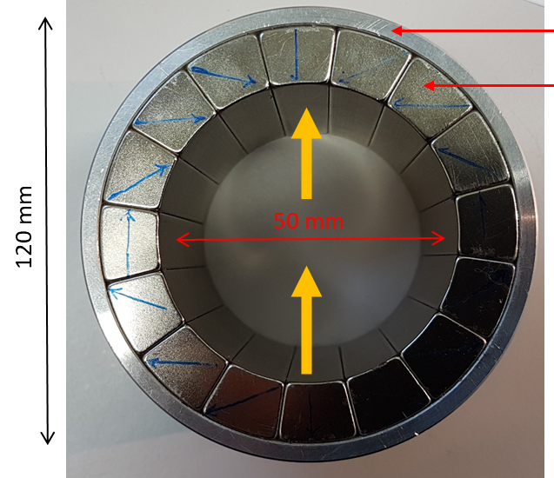
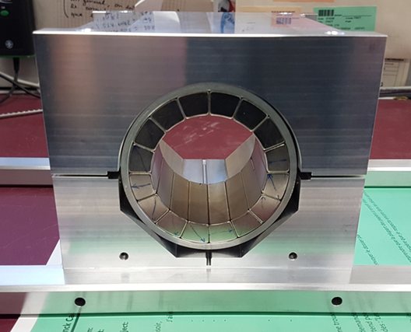
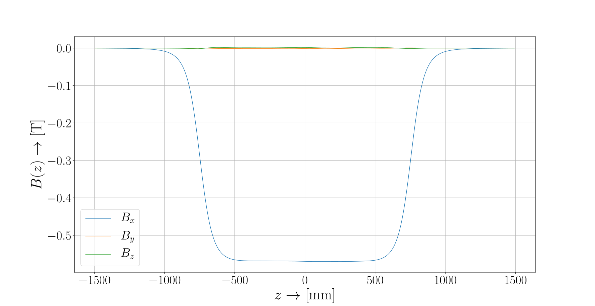
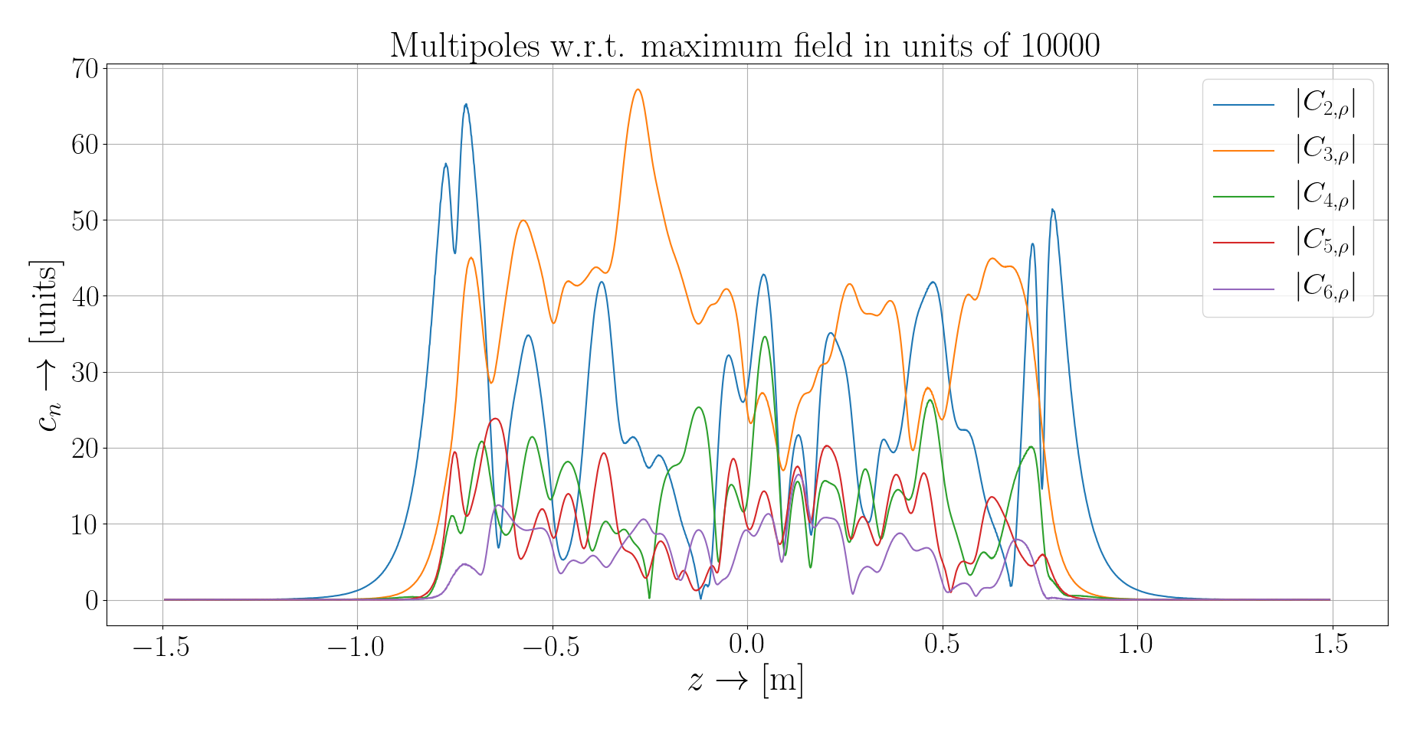
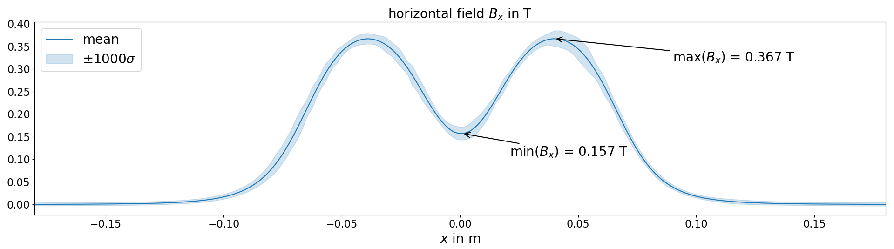
Magnetic measurements of PM magnets- 6
3D-Hall mapper
A 3D-Hall mapper is a valid alternative to the solutions proposed so far
We gain extra information such as longitudinal profile and longitudinal dependency of the field multipoles
Integrated field harmonics measured by SSW
PM quadrupole (above) and longitudinal field map (below), with two magnet units assembled in a series
Longitudinal main field map (left) and field harmonics as a function of the longitudinal position (right), for the FASER 1.5-m unit
Mariano Pentella, CERN, TE-MSC-TM
Low Emittance Rings – Permanent Magnets Workshop 16 November 2023

Slide 15
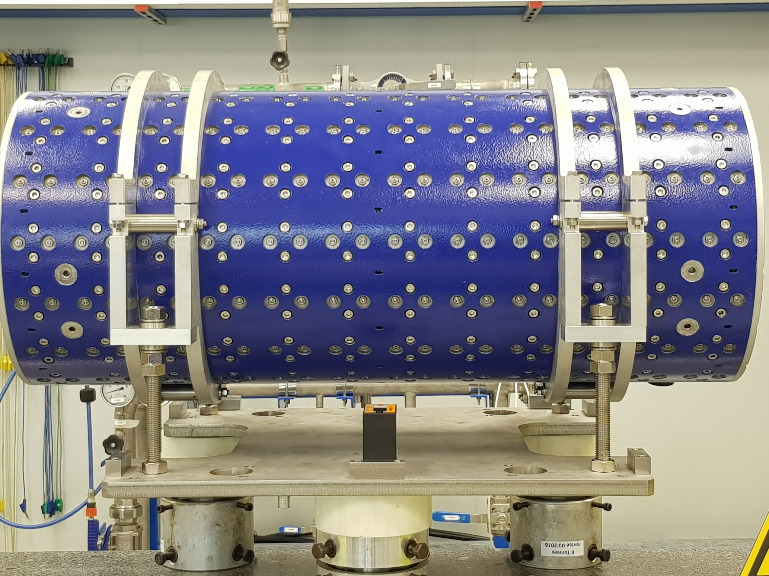
Fiducialization of PM magnets- 1
Option 1
Fiducialization consists of expressing the position of the magnetic axis and the roll angle in a reference frame integral to the magnet’s mechanical structure. The standard fiducialization approach is to identify the frame by measuring a set of reference points on the magnet surface, called fiducials
y
Measurements performed by SSW
Magnetic axis found iteratively
Frame with y-axis aligned with gravity
z-axis from stage B to stage A. Origin in stage B
z
y
Roll angle positive orientation
θ
x
Tilt sensor
Magnet fiducials
FASER magnet unit
Mariano Pentella, CERN, TE-MSC-TM
Low Emittance Rings – Permanent Magnets Workshop 16 November 2023

Slide 16
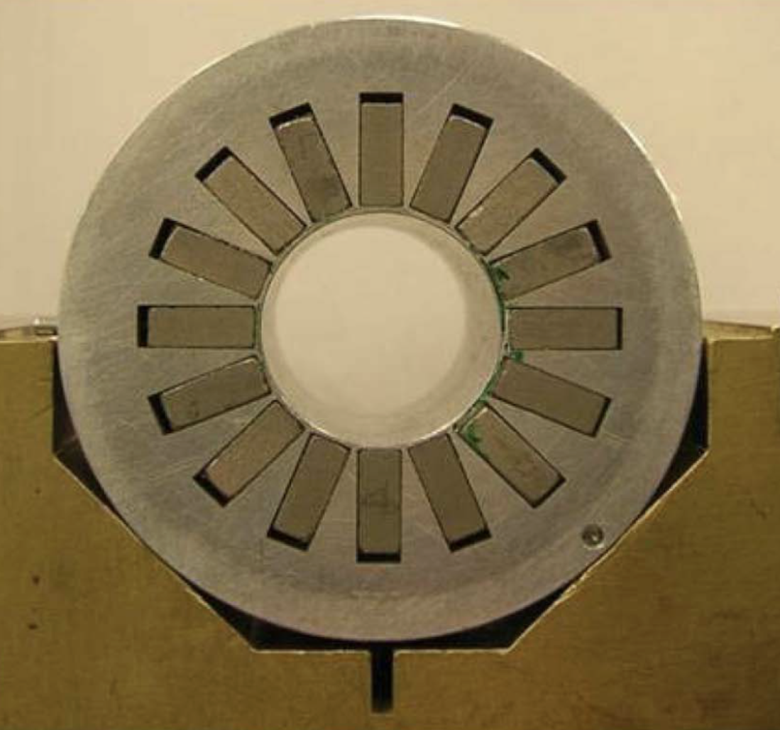
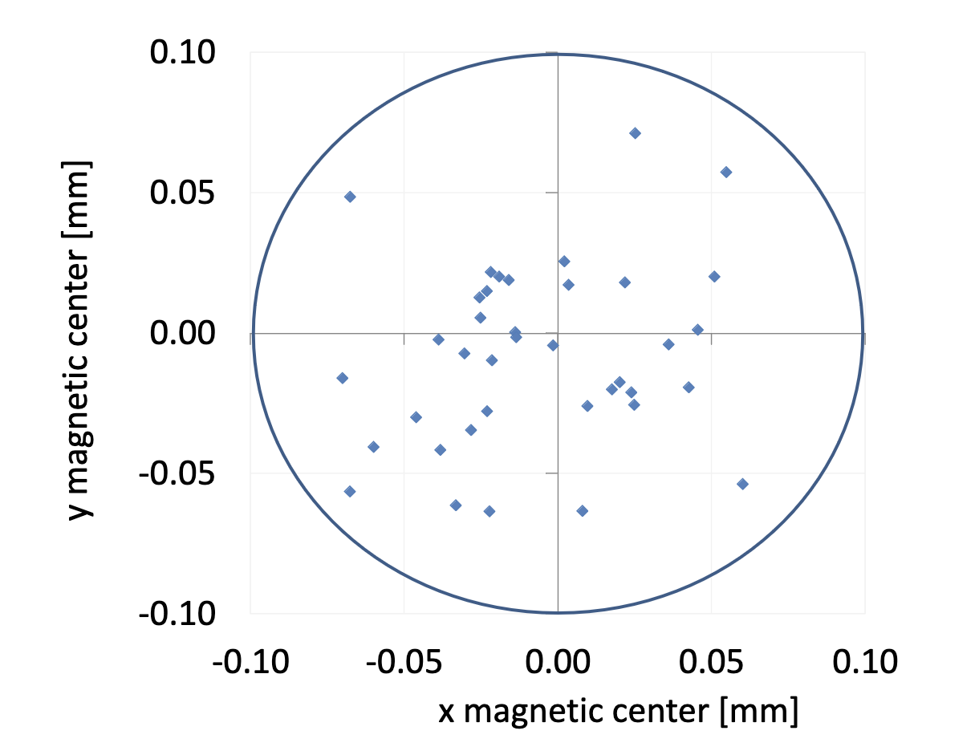
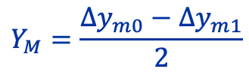
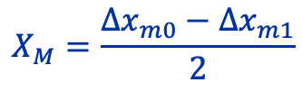
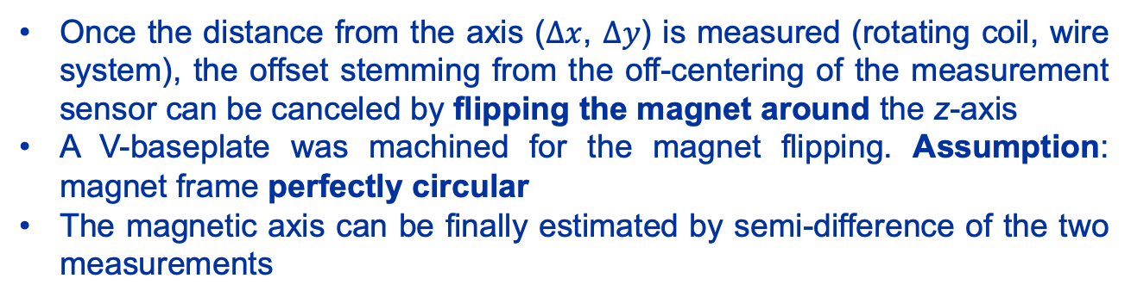
Fiducialization of PM magnets- 2
Option 2
For small-sized magnets, such as the ones for Linac4, there are no magnet fiducials to exploit for the fiducialization. The mechanical frame is defined with two reference pins for the alignment of the field with gravity and the configuration in focusing/defocusing mode.
Once the distance from the axis ($Δx$, $Δy$) is measured (rotating coil, wire system), the offset stemming from the off-centering of the measurement sensor can be canceled by flipping the magnet around the z-axis
A V-baseplate was machined for the magnet flipping. Assumption: magnet frame perfectly circular
The magnetic axis can be finally estimated by semi-difference of the two measurements
y
x
$$X_{M}=\frac{{{Δx}_{m0}−Δx}_{m1}}{2}$$
Magnetic axis of all series tested PM quadrupoles for Linac4
$$Y_{M}=\frac{{{Δy}_{m0}−Δy}_{m1}}{2}$$
Linac4 magnet unit
Reference pins
Mariano Pentella, CERN, TE-MSC-TM
Low Emittance Rings – Permanent Magnets Workshop 16 November 2023

Slide 17
Summary and conclusions
Qualification and fiducialization of PM magnets is a process that requires several steps throughout the magnet assembly
Qualification of PM blocks is performed at CERN using a 3D Helmholtz’s coil system in passive mode
A large range of measurement solutions can be adopted for the magnetic measurements, mainly depending on the aperture radius
For low-energy machines, such as Linac4, given the low aperture radii, the oscillating wire proved to be the best solution for field harmonics and was used to cross-validate rotating coil measurements
For large-aperture magnets (detector magnets), fiducialization is performed in the standard way and relies on reference points suitably installed on the magnet surface
For small-aperture magnets, fiducialization can be performed by flipping the magnet around the longitudinal axis to compensate for the off-centering of the measurement system. The measured center can then be expressed in the magnet’s external frame if the reference surface is precisely machined.
Mariano Pentella, CERN, TE-MSC-TM
Low Emittance Rings – Permanent Magnets Workshop 16 November 2023

Slide 18
Acknowledgements
I wish to thank my present and past colleagues from the TE-MSC-TM (MM) section for their contribution to the magnetic measurements of PM magnets and the definition of standard procedures for their qualification throughout the past decade.
Mariano Pentella, CERN, TE-MSC-TM
Low Emittance Rings – Permanent Magnets Workshop 16 November 2023

Slide 19
References
C. Petrone, “Wire methods for measuring field harmonics, gradients and magnetic axes in accelerator magnets”, Ph.D. Thesis, 2013
G. Golluccio, “High-Performance Measurement Systems for Characterizing and Monitoring Particle Accelerator Magnets”, Ph.D. Thesis, 2012
D. Caiazza, “Metrological performance enhancement of wire methods for magnetic field measurements in particle accelerators”, Ph.D. Thesis, 2017
M. Liebsch et al., “Inference of Boundary Data from Magnetic Measurements of Accelerator Magnets”, Ph.D. Thesis, 2023
P. Thonet et al., ”Design and manufacturing of three permanent magnet dipoles for FASER experiment”, IEEE Transactions on Applied Superconductivity, 2022
P. Thonet, “Design and Manufacturing of Two High Gradient Quadrupoles Based on Permanent Magnets for the CERN Antiproton Decelerator”, IEEE Transactions on Applied Superconductivity, 2022
D. Tommasini et al., “Design, manufacture and measurements of permanent quadrupole magnets for Linac4”, IEEE Transactions on Applied Superconductivity, 2011
L. Fleig et al., “Combination of Measurement Data and Domain Knowledge for Simulation of Halbach Arrays with Bayesian Inference”, IEEE Transactions on Magnetics, 2023
M. Buzio et al., “Magnetic qualification of permanent magnet quadrupoles for CERN's Linac4”, IEEE Transactions on Applied Superconductivity, 2012
P. Arpaia et al., “A polyvalent harmonic coil testing method for small-aperture magnets”, Review of Scientific Instruments, 2012
Mariano Pentella, CERN, TE-MSC-TM
Low Emittance Rings – Permanent Magnets Workshop 16 November 2023

Slide 20
Thanks for your attention Any questions?
Mariano Pentella, CERN, TE-MSC-TM
Low Emittance Rings – Permanent Magnets Workshop 16 November 2023

Slide 21
Backup slides
Mariano Pentella, CERN, TE-MSC-TM
Low Emittance Rings – Permanent Magnets Workshop 16 November 2023

Slide 22
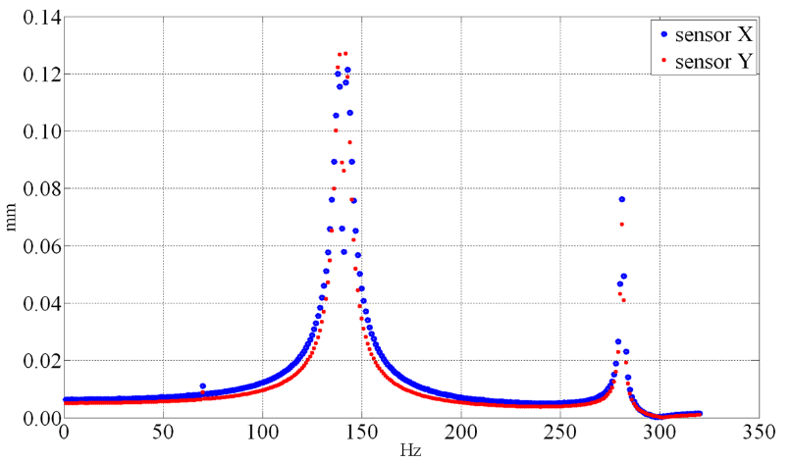
Oscillating wire operational frequency
Mariano Pentella, CERN, TE-MSC-TM
Low Emittance Rings – Permanent Magnets Workshop 16 November 2023

Slide 23
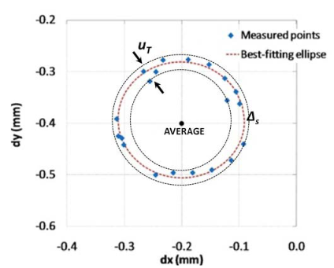
Uncertainty in the fiducialization of Linac4 magnets
2 μm difference between axes of the two ellipses
10 μm overall axis uncertainty
Mariano Pentella, CERN, TE-MSC-TM
Low Emittance Rings – Permanent Magnets Workshop 16 November 2023

