Slide 1
BNL Permanent Magnet Technology Developments Based on ‘CBETA’ experiences
(NSLS2 upgrade, CEBAF Energy Upgrade, Permanent Magnet Proton FLASH Therapy Facility, LHeC)
Dejan Trbojevic
Abstract: A recent developments in the permanent magnet technology at Brookhaven National Laboratory (BNL), based on the successful Cornell University and BNL Electron Test Accelerator (”CBETA”), are presented: 1. The permanent magnets for the NSLS2 upgrade, 2. Prototype of the permanent magnets for the Jefferson National Laboratory energy upgrade, 3. Building and testing of a part of the fast-cycling permanent magnet synchrotron for the proton ‘FLASH’ therapy facility using funds provided by the grant by the Stony Brook University Hospital and by the BNL Laboratory Directed Research and Development – LDRD, and 4. Combined function design of the permanent magnets for the future LHeC.

Slide 2
Outlines
Introduction
Previous Successful Experience – Permanent magnets for ‘CBETA’ presented by the PI of the project
NSLS2 energy upgrade for the very low emittance light source: build and test a proof of principle combined function permanent magnet with G_{d}=130 T/m and B_{y}=0.5T and 0.25T (magnet design by Stephen Brooks-CAD-BNL)
Prototype of the combined function permanent magnet for the CEBAF upgrade (Stephen Brooks –CAD-BNL)
An approved Scientific grant from the Stony Brook University Hospital and LDRD from BNL to develop the ‘FLASH’ permanent magnet proton therapy facility design presented by the PI of the project
Design of the permanent magnet single arc Energy Recovery accelerator for the future LHeC.
Summary

Slide 3
1. Introduction:
Significance of Permanent Magnet Technology development - Sustainability
‘Green Energy’ future Accelerators and Colliders
  single permanent magnet beam lines for CEBAF upgrade and LHeC ring to accelerate electrons – no electric power required
Future 3rd and 4th Generation Light sources
  Light sources could be built by the combined function permanent magnets
Wigglers
Medical Applications: Fast cycling proton synchrotrons, beam transfer lines, permanent magnet gantries
Wind turbines
Hybrid and electric cars
…

Slide 4
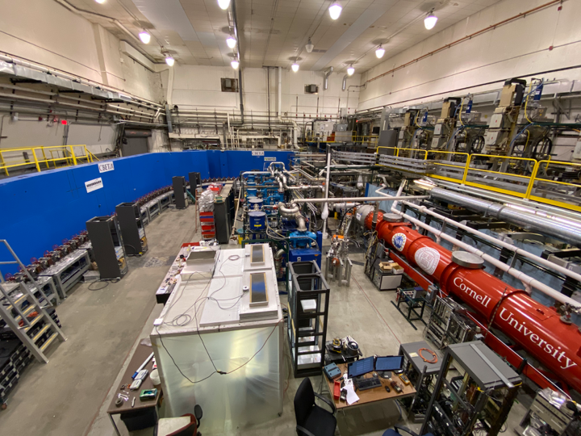
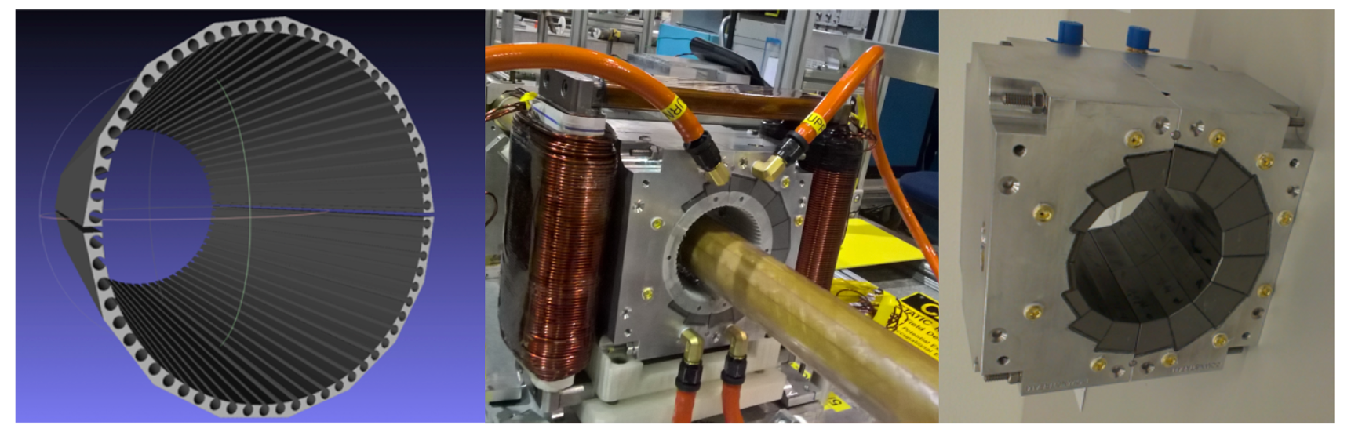
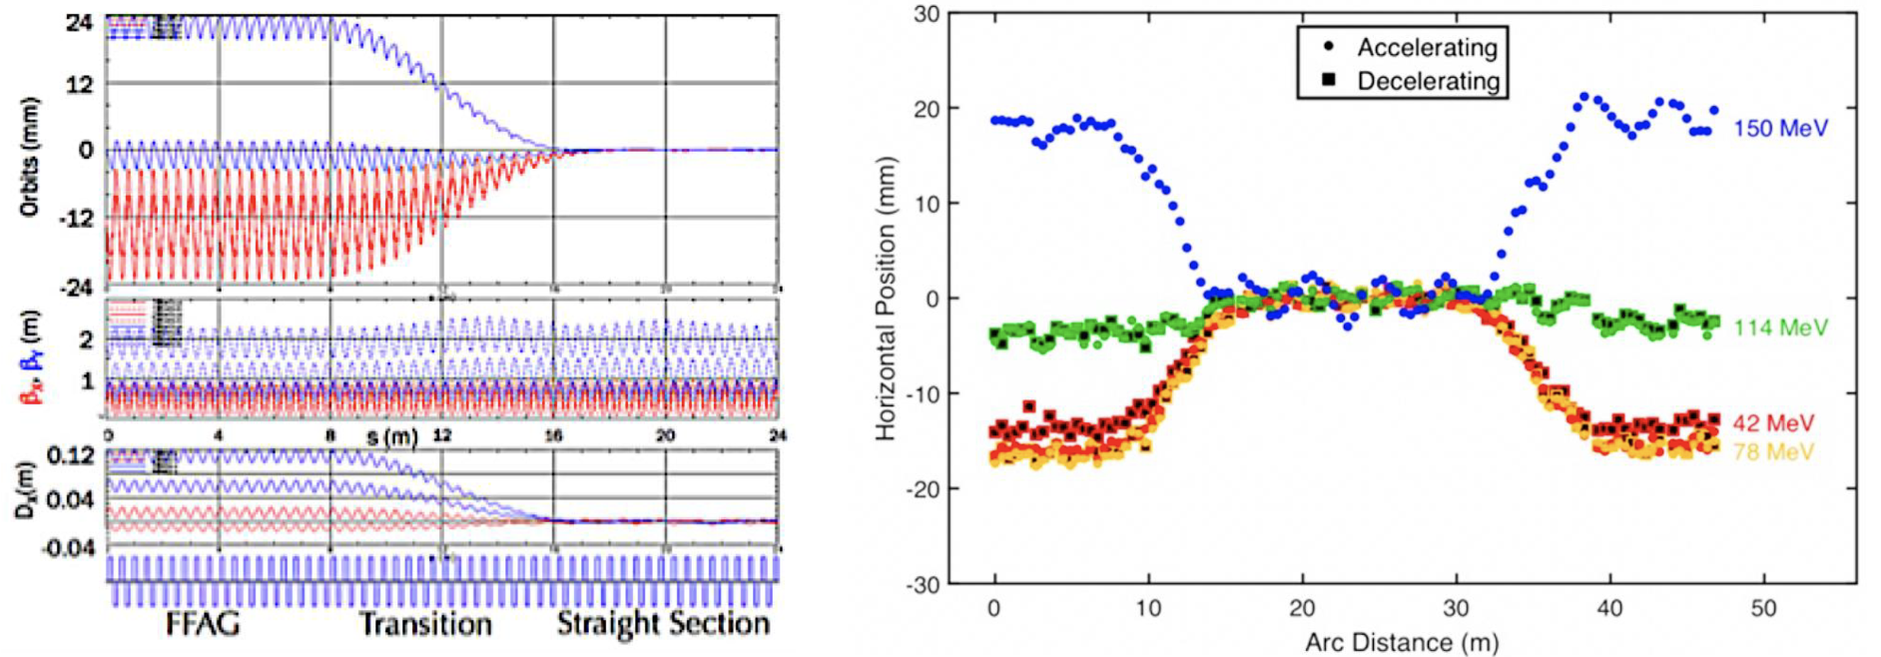
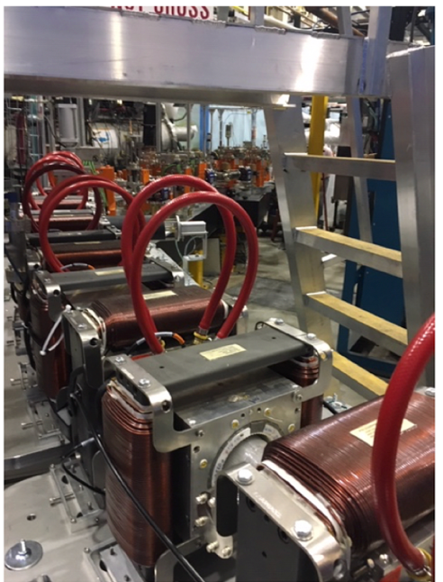
1. Permanent Magnet Fixed Field Accelerator
Proof of Principle provided by ‘CBETA’ : Cornell University & Brookhaven National Laboratory Electron Test Accelerator
Development of the new permanent magnet technology
Full proof of principle for the Non-scaling Fixed Field Alternating Gradient Accelerator
Multiple energy orbits merged into a single straight-line orbit

Slide 5
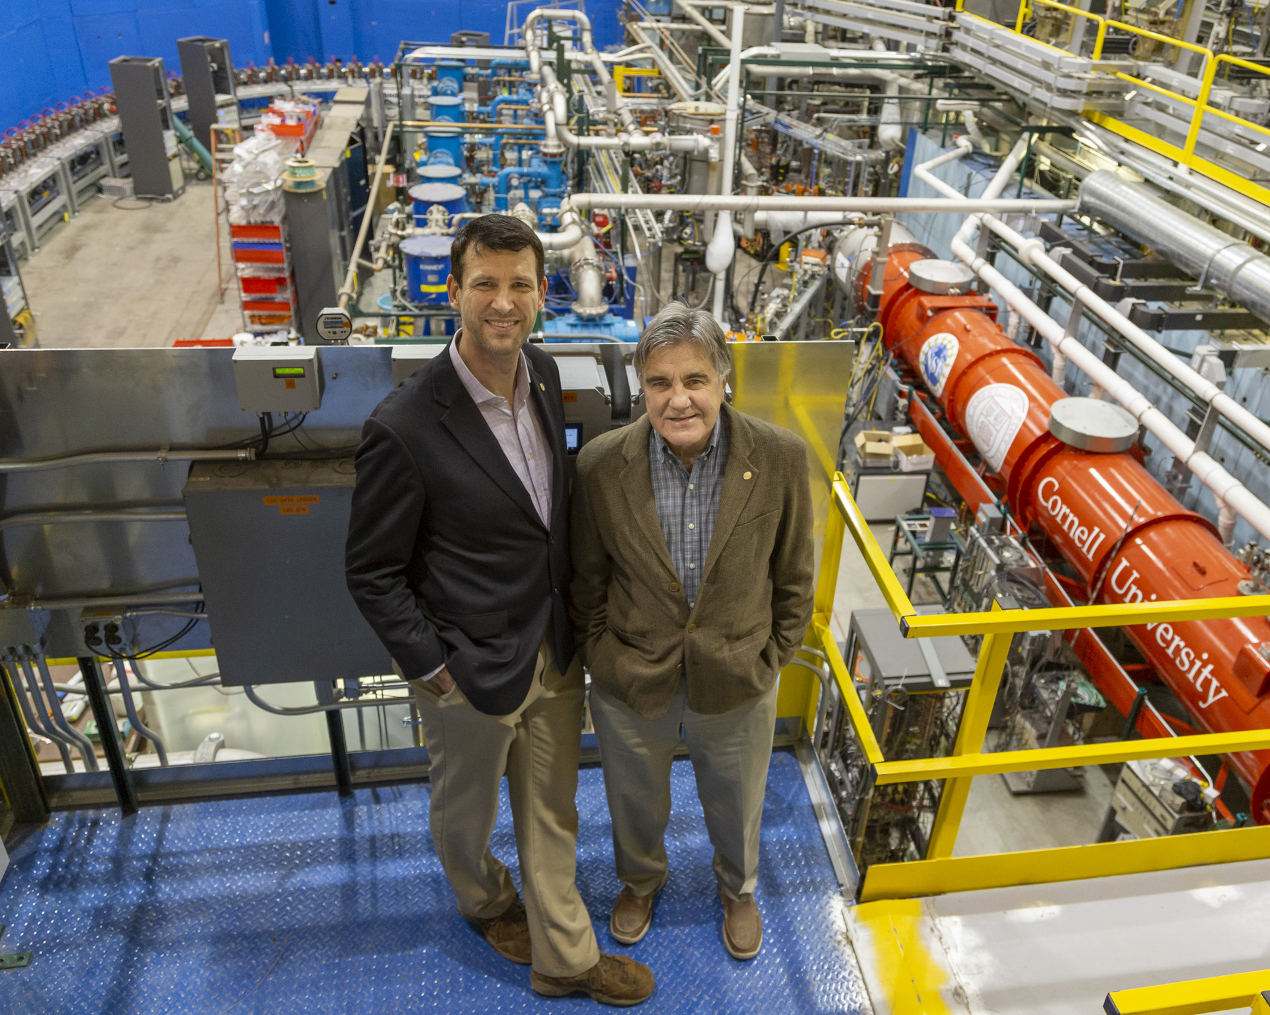

1. CBETA Spring 2019

Slide 6
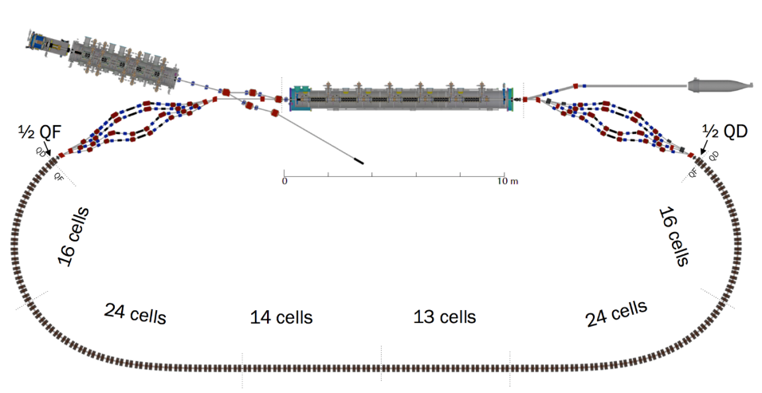
1.1 What is ‘CBETA’
Cornell DC gun, 2nC peak
100mA, 6MeV SRF injector (ICM), 1.3GHz
320mA, 6-cavity SRF CW Linac (MLC), 1.3GHz
4 Spreaders / Combiners with electromagnets
FFA cells with permanent magnets, 3.8 energy aperture, 7 beams
SRF Injector
600kW beam stop
Main Linac
Beam Stop
DC source
Spreaders
Permanent Magnet FFA

Slide 7
1.1 Novelties in CBETA
ENERGY RECOVERY MULTITURN LINAC WITH WITH 4 TURNS DURING ACCELERATION AND THREE TURNS DURING ENERGY RECOVERY
SUPERCONDUCTING RF : INJECTOR AND MAIN LINAC CRYOMODULE
NON-SCALING FFAG – MULTI ENERGY SINGLE BEAM LINE
FFA Gradient ARCS
              TRANSITION FROM ARC-TO-STRAIGHT
              STRAIGHT SECTION WITH MULTI-ENERGY TRANSFER
PERMANENT HALBACH TYPE COMBINED FUNCTION MAGNETS

Slide 8
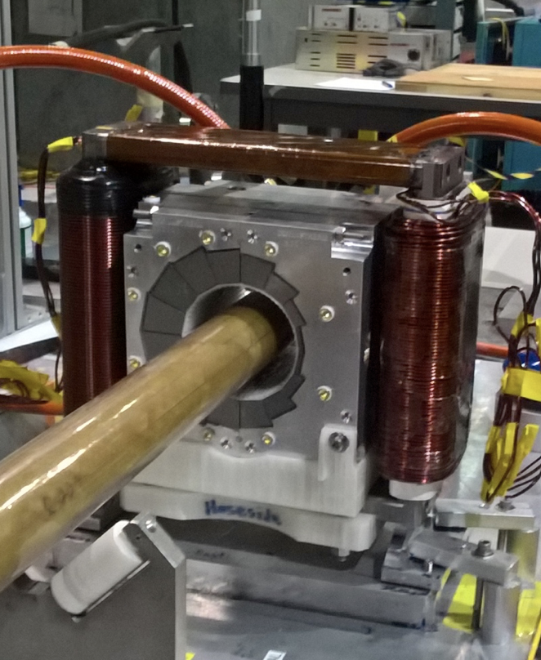
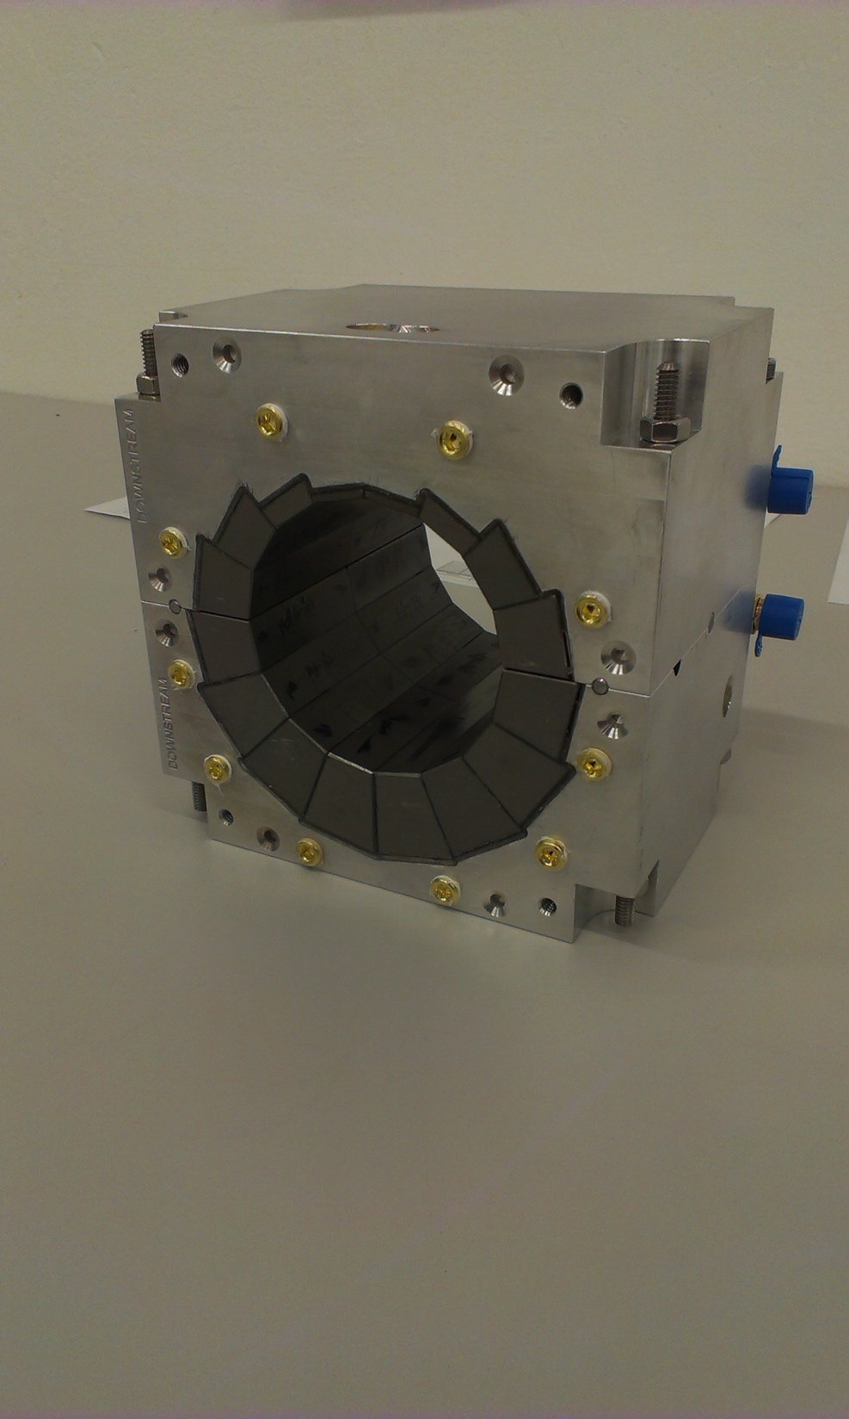
1.2 Permanent Combined Function Magnet Design
The Dipole corrector magnets are made of iron frame with opposite copper windings – this is a vertical dipole corrector
Halbach design made of NdFeB material
This is a combined function magnet: dipole + quadrupole
It is measured by the rotating coil at BNL
3D printed multipole corrector pack inside
Window frame corrector coil outside
Temperature stabilised by water (orange hoses)

Slide 9
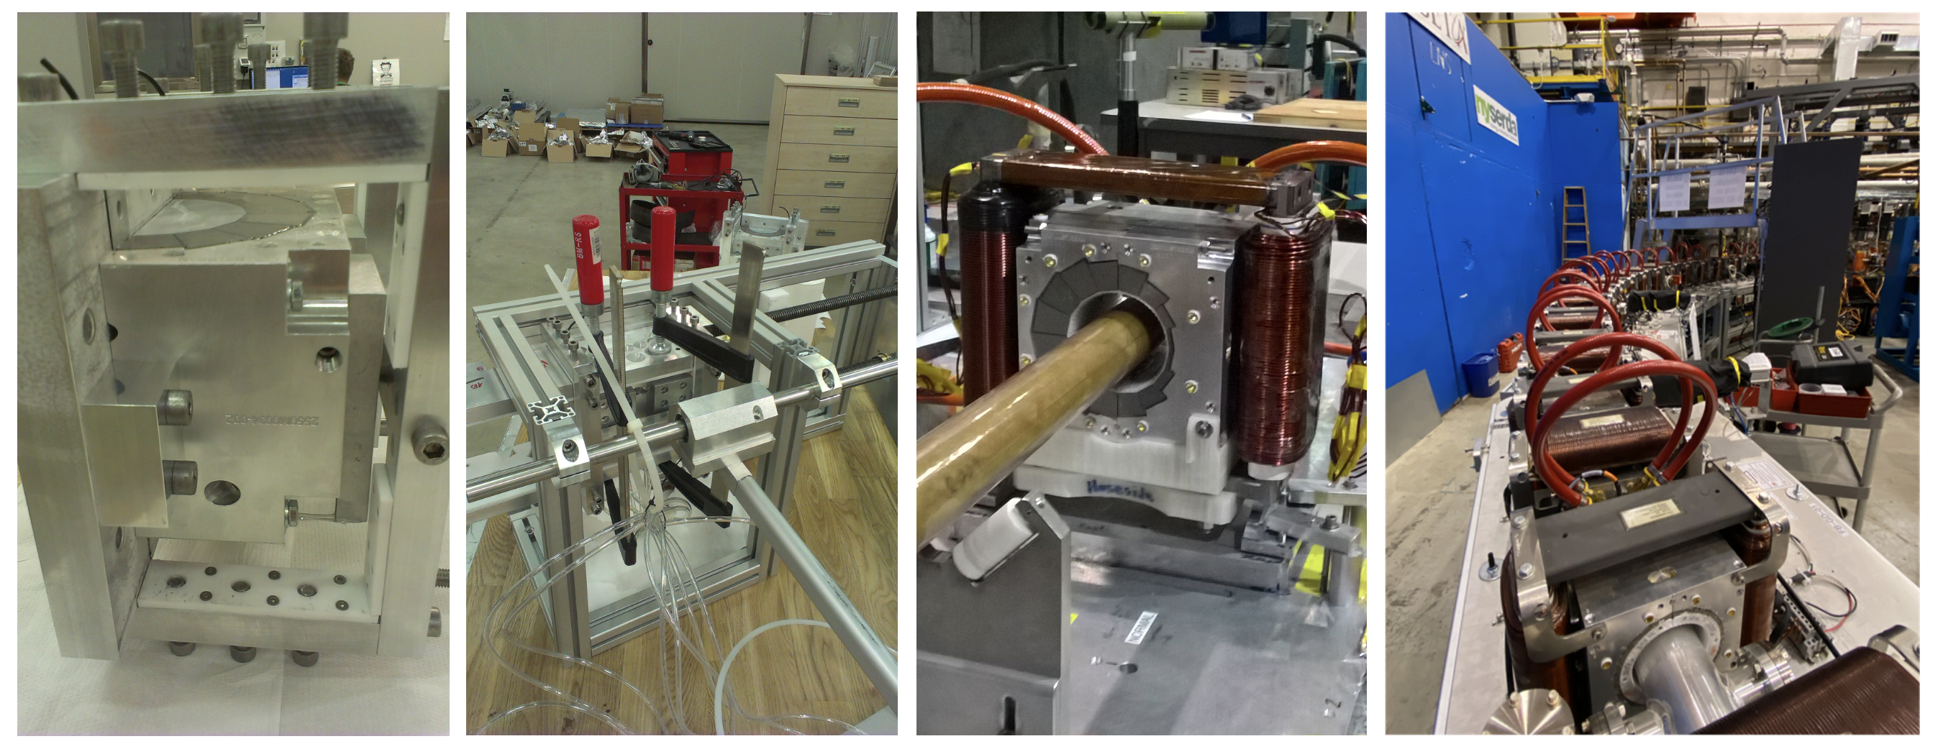
1.2 New permanent magnet technology is established
At BNL Stephen Brooks developed magnetic field correction method by inserting around vacuum chamber‘ harmonic’ iron wires
Exceptional company ‘KYMA’ in Sežana Slovenia and Trieste measured and assembled the permanent Magnets
Temperature stabilization is achieved by 25C constant water flow

Slide 10
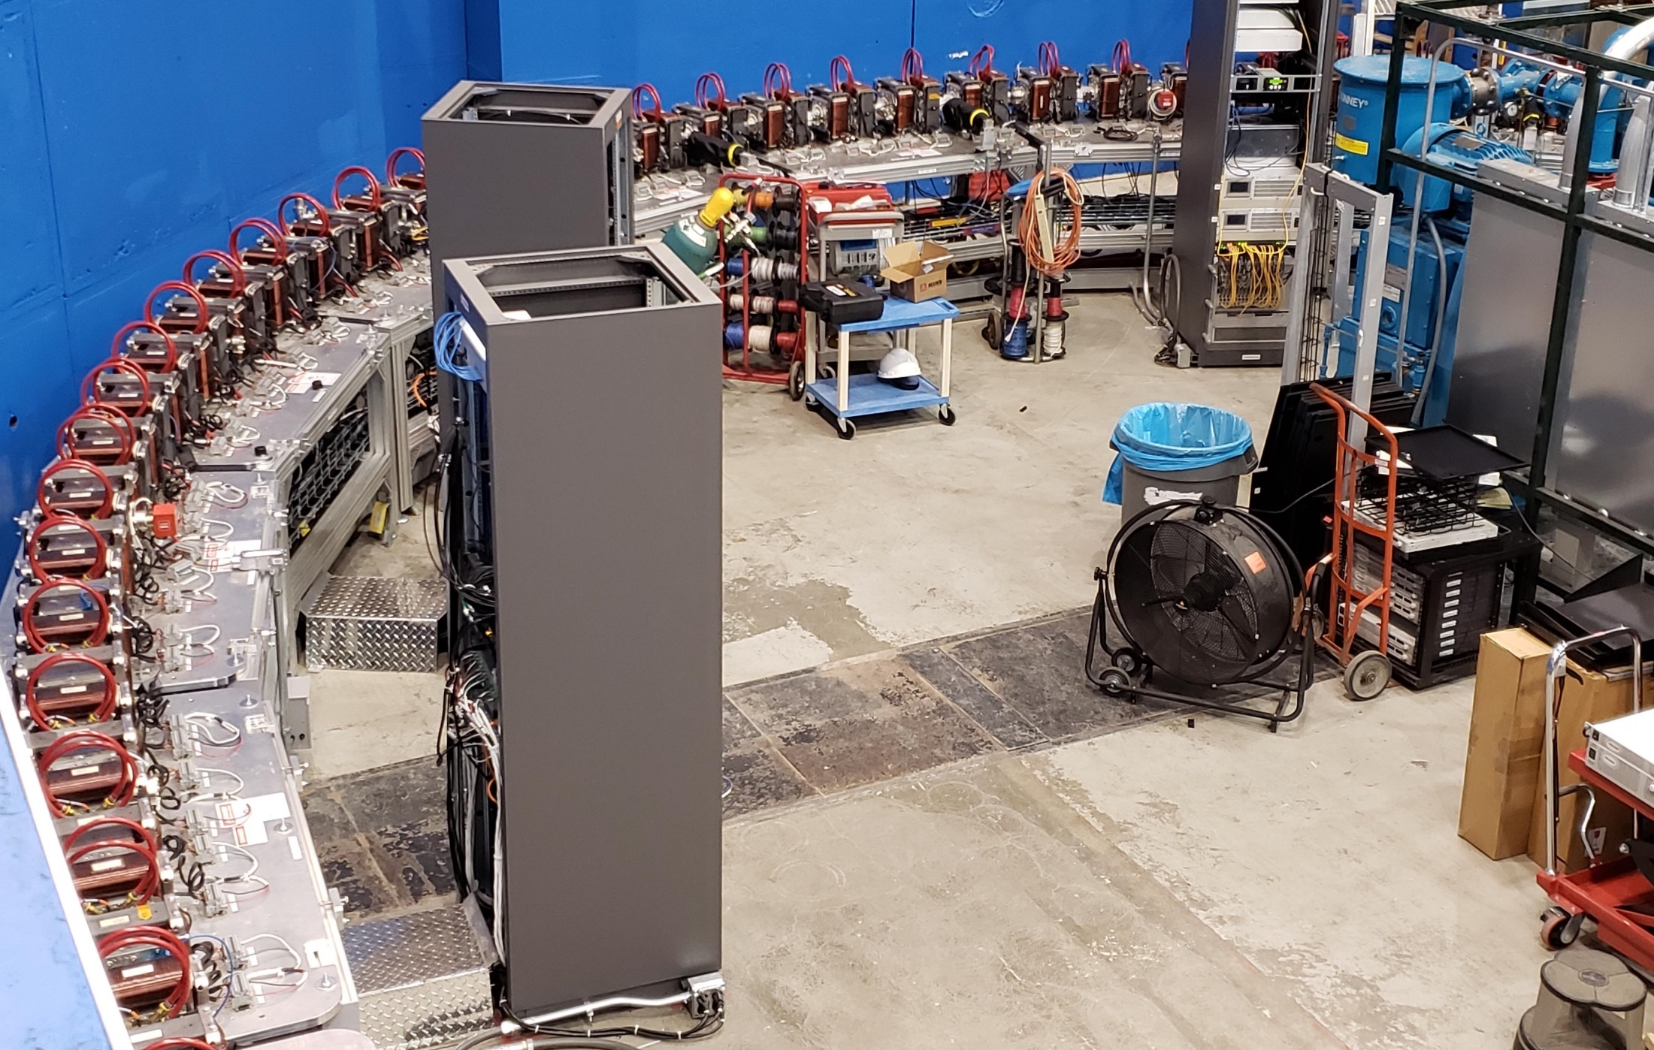
1.3 Fixed-Field Return Arc

Slide 11
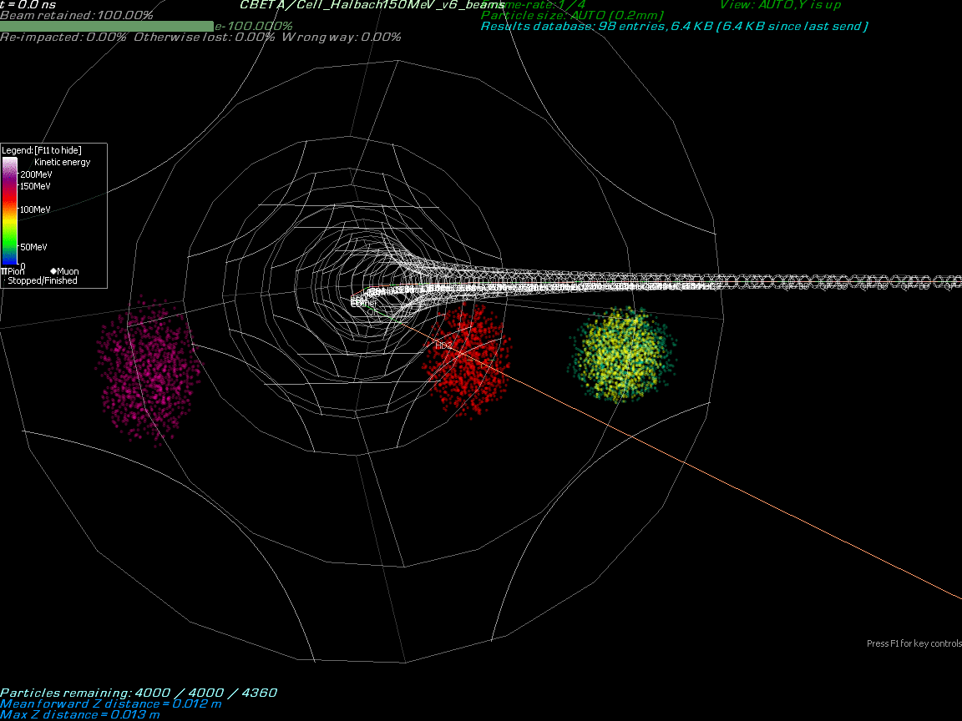
By Stephen Brooks

Slide 12
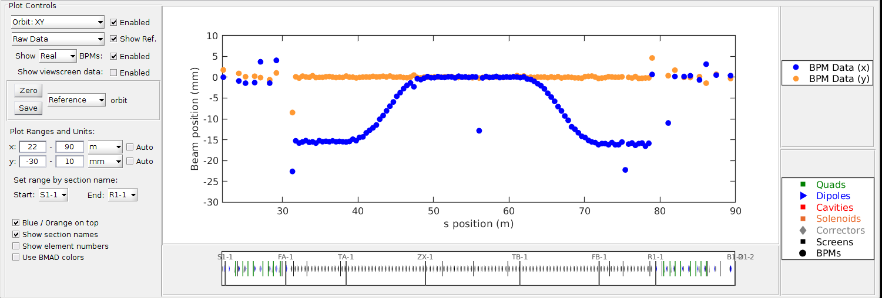
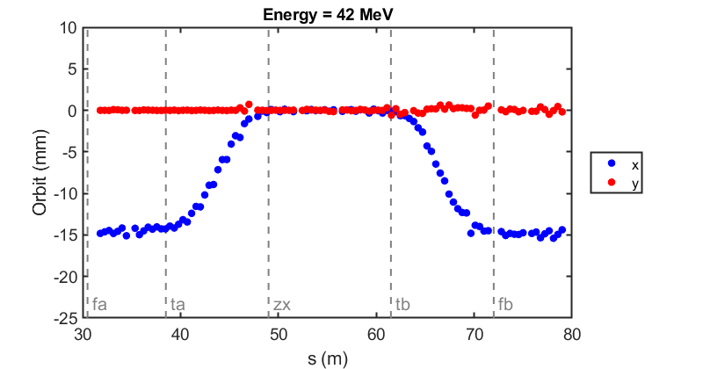
1.3 Commissioning results: orbit correction in fixed-field loop
The very first beam through the fixed-field loop on May 7, 2019
Corrected beam using section-by-section local SVD (did not converge for whole FFA)
(June 12, 2019)

Slide 13
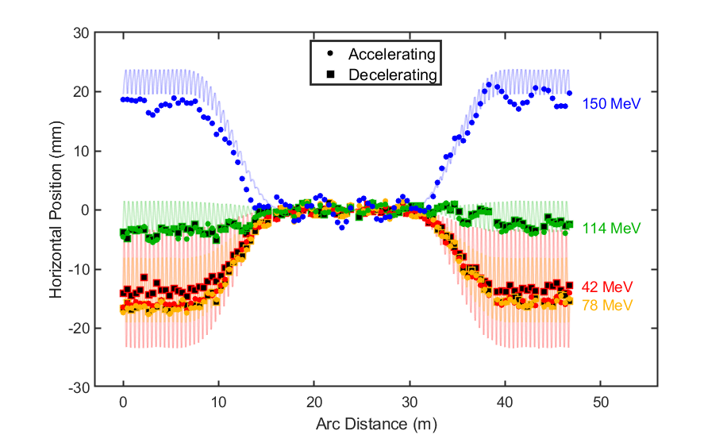
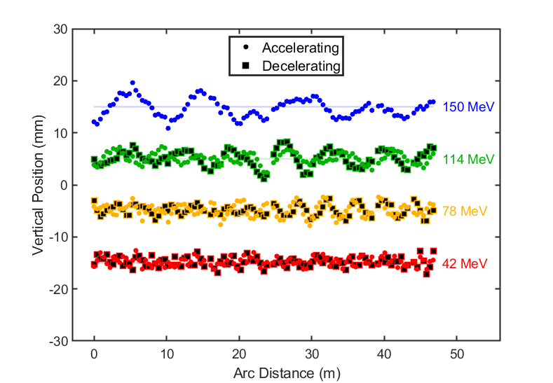
1.3 Seven turns ERL operation with corrected turns 1,2,3

Slide 14
1.4 Achieved Results with Permanent Magnet ERL
First multi-turn SRF ERL
Full Proof of Principle for the Non-Scaling Fixed Field Alternating Gradient Concept
Proof of Principle for the ARC to Straight Merging
Established new permanent magnet technology for the superb quality Halbach-type combined function magnets
Opened door for application to Light sources and electron-positron and electron ion colliders with permanent magnets
Established energy saving measures: Energy Recovery, SRF, and permanent magnets.

Slide 15
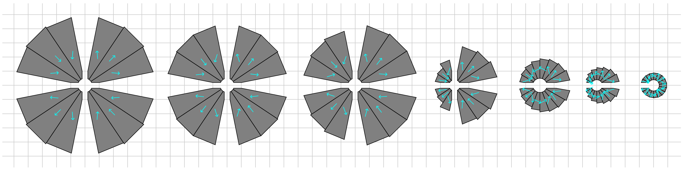
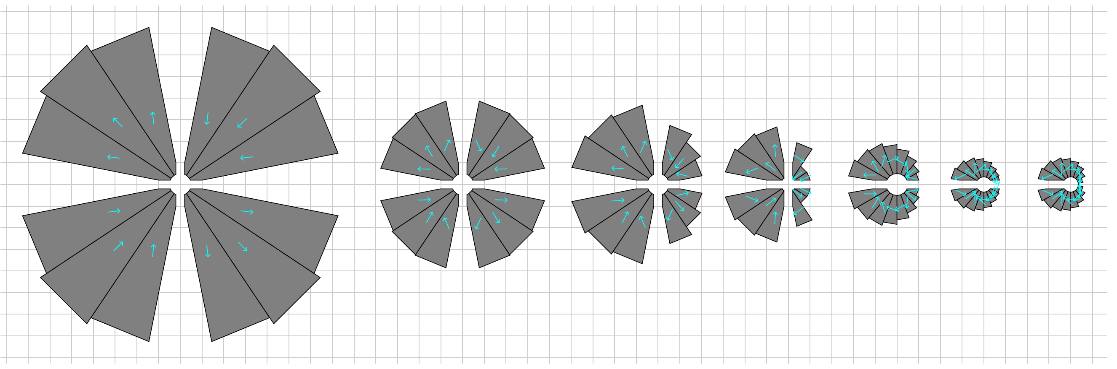
2. Newest Permanent Magnet Designs For Light Sources
A square dimensions are 1 cm
Comparisons of the displaced Halbach with open gap with Combined Function Focusing magnet by keeping the beam more towards the center of the aperture
Comparisons of the displaced Halbach with open gap with Combined Function Defocusing magnet by keeping the beam more towards the center of the aperture

Slide 16
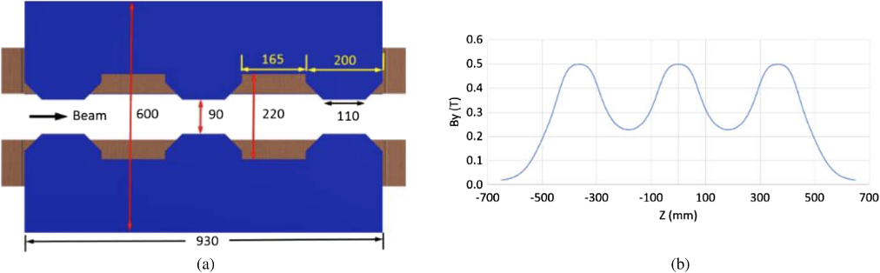
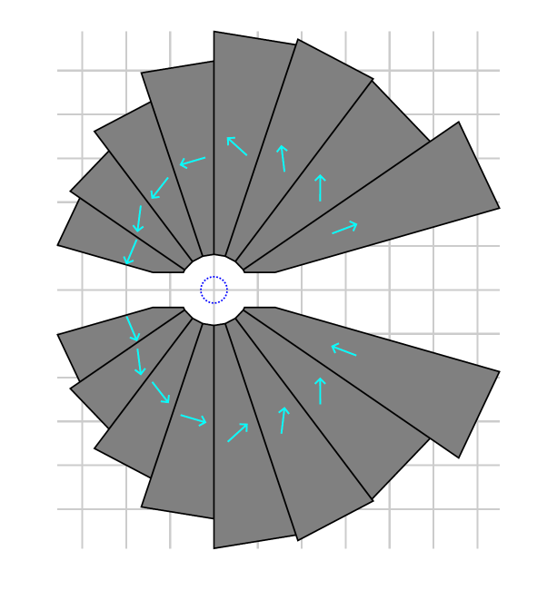
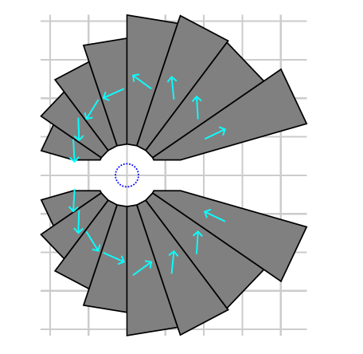
2. NSLS2 Magnet Development
G. Wang et All, “Complex bend. II A new optics solution”, Phys. Rev. Accel. and Beams 22, 110713(2019)
G_{d}=130 T/m B_{y}=0.25 T
G_{d}=130 T/m B_{y}=0.5 T

Slide 17
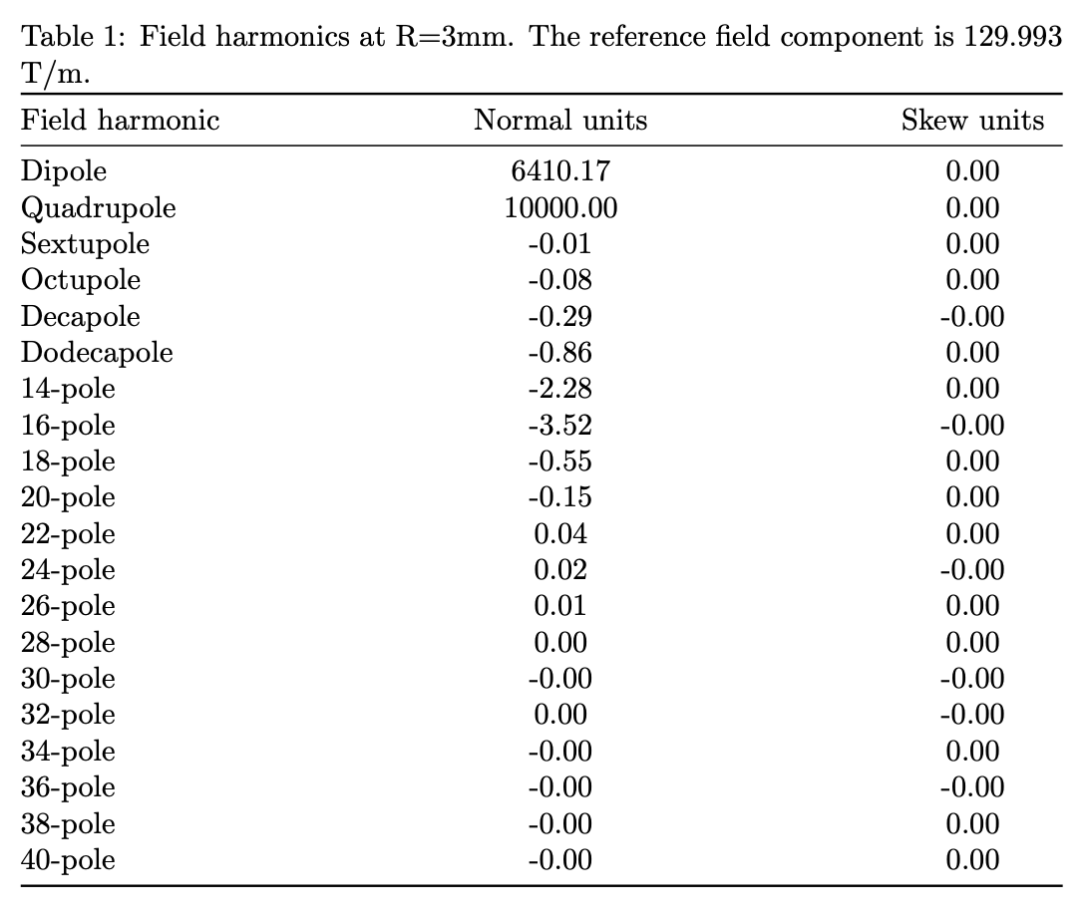
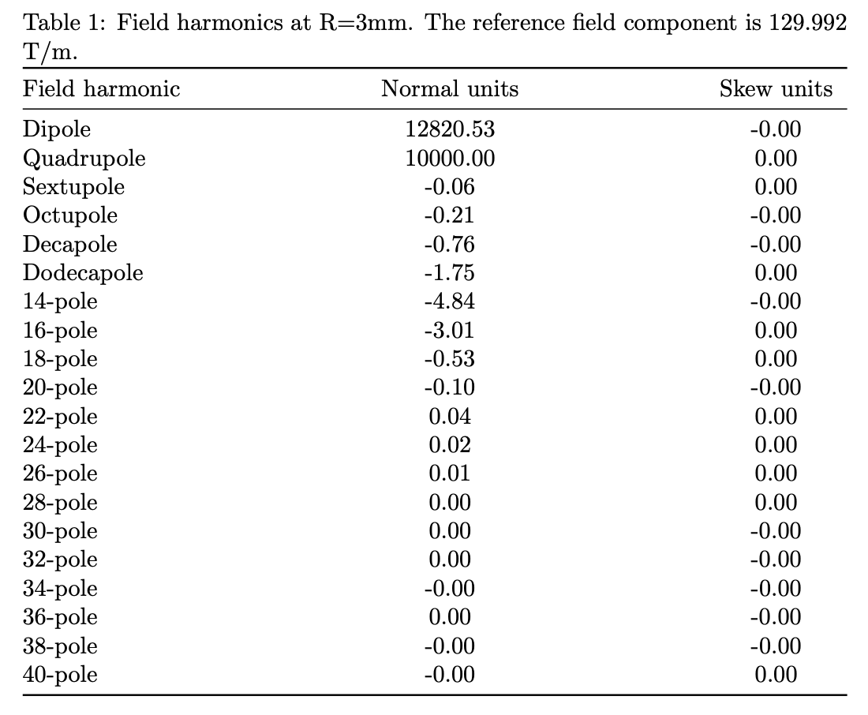
Magnetic Multipoles in the combined function magnet
G_{d}=130 T/m B_{y}=0.25 T
G_{d}=130 T/m B_{y}=0.5 T

Slide 18
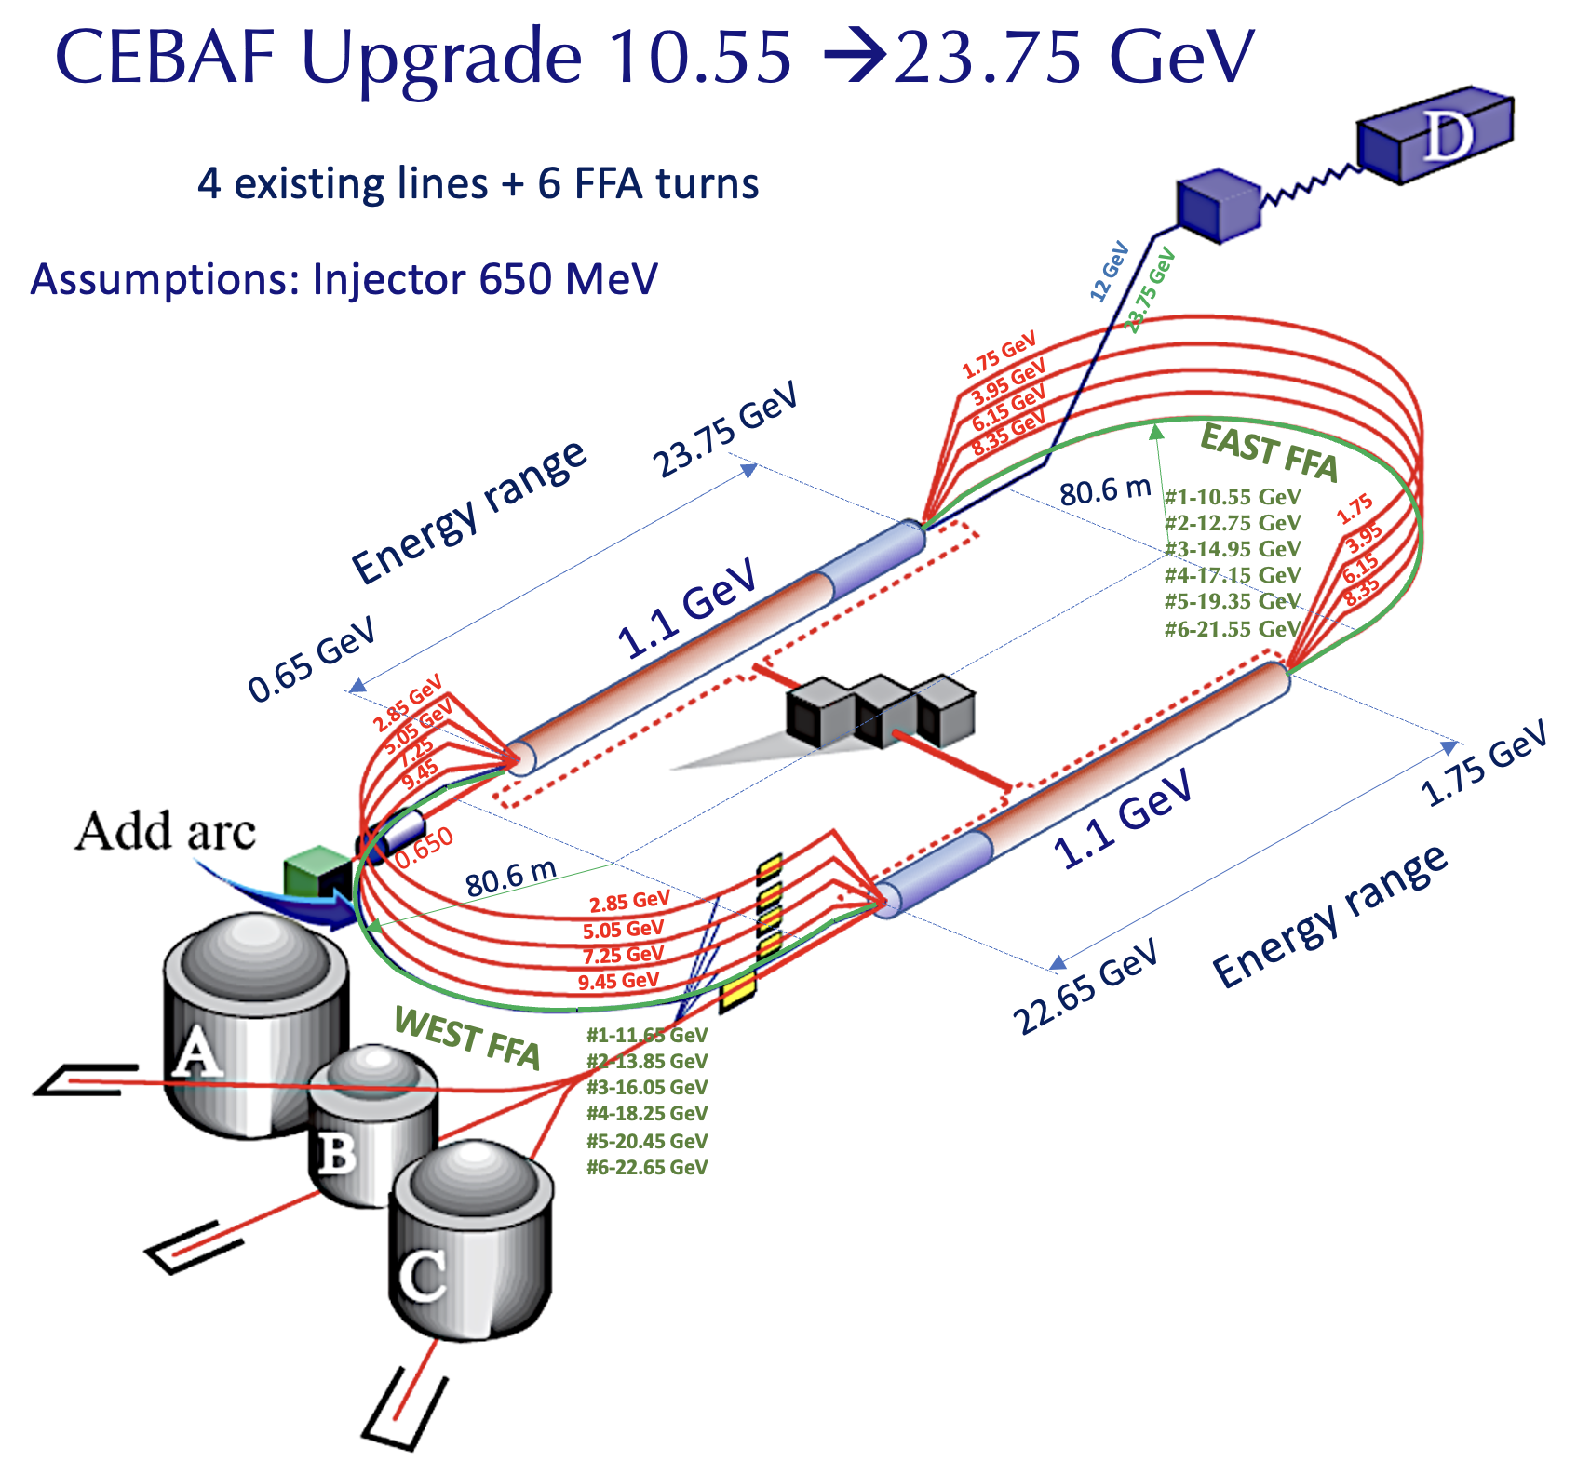
3. CEBAF Energy Upgrade 12→22 GeV

Slide 19
Recent Long-Range plan for Nuclear Physics in USA
[https://nuclearsciencefuture.org/wp-content/uploads/2023/10/NSAC-LRP-2023-v1.2.pdf]
Although beam energy is not a challenge for nuclear physics facilities, it is important to develop more efficient and cost-effective accelerators, a goal shared with the high-energy physics community.
…The subsequent phase is an energy upgrade of CEBAF to more than 20 GeV. Recently, the Cornell Brookhaven Electron Test Accelerator (CBETA) facility demonstrated eight-pass recirculation of an electron beam with energy recovery employing arcs of fixed-field alternating gradient magnets. This exciting new technology could enable a cost-effective method to double the energy of CEBAF, allowing wider kinematic reach for nucleon femtography studies in the existing tunnels and with no new cryomodules required.
Another example in which nuclear science affects therapy is FLASH radiotherapy (RT), a technique involving the delivery of ultrahigh-dose-rate radiation to the target. FLASH-RT has been shown to reduce radiation-induced toxicity in healthy tissues without compromising the anticancer effects of treatment compared with conventional radiation therapy. Incorporating FLASH-RT into routine clinical radiotherapy for electrons, photons, and protons will require the continued development of accelerator and detector devices, likely leveraging nuclear physics techniques.

Slide 20
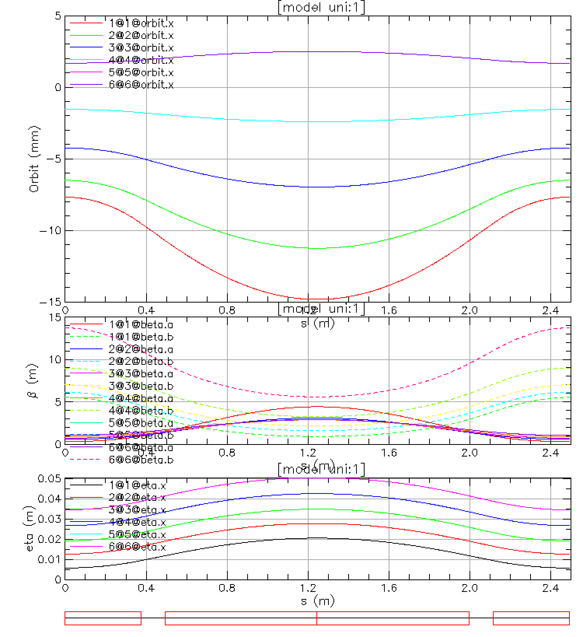
3.1 Lattice Functions in a Cell for the WEST-FFA arc
Permanent Magnet Properties:
Focusing Combined Function
Magnet QF
GF= -73.26375 T/m
QLF= 1.5 m
θ_{F}=-0.023180154
B_{F}=1.07218 T
B_{FMAX}=-1.25 T
Defocusing Combined Function
Magnet BD
GD= -73.26375 T/m
BLD= 0.7511 m
θ_{D}=-0.023180154
B_{D}= -0.71375 T
B_{DMAX}=-1.755 T
Total Synchrotron Radiation Lost
In the West Arc from five passes:
E_{LOSS}=373.7 MeV
E=21.9 GeV
E=19.7 GeV
E=17.5 GeV
E= 15.3 GeV
E=13.1 GeV

Slide 21
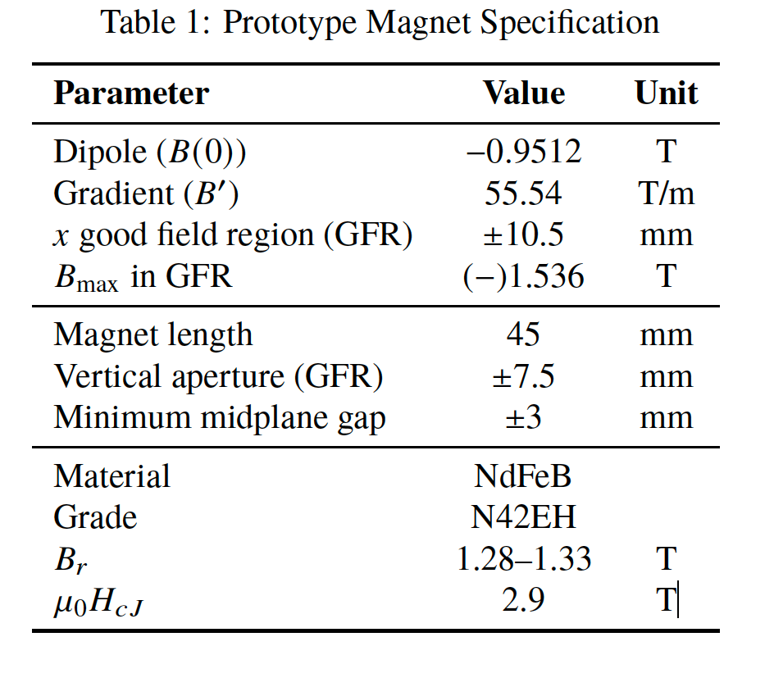
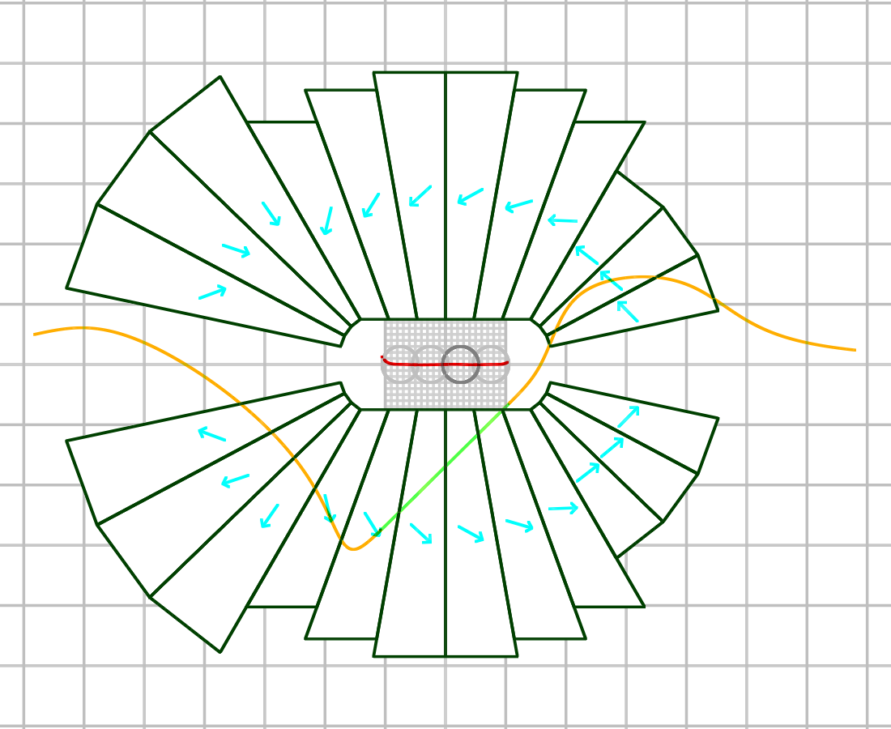
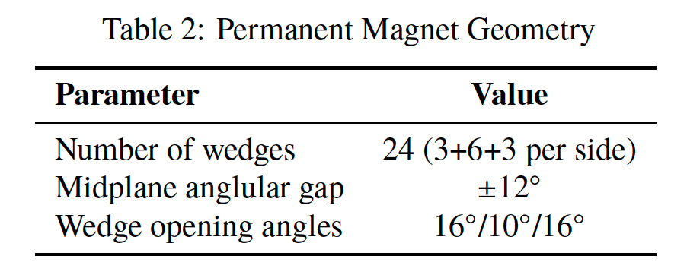
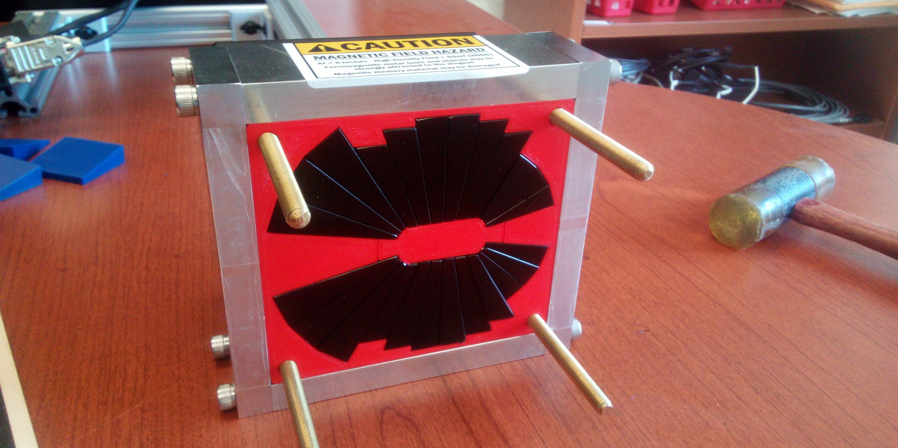
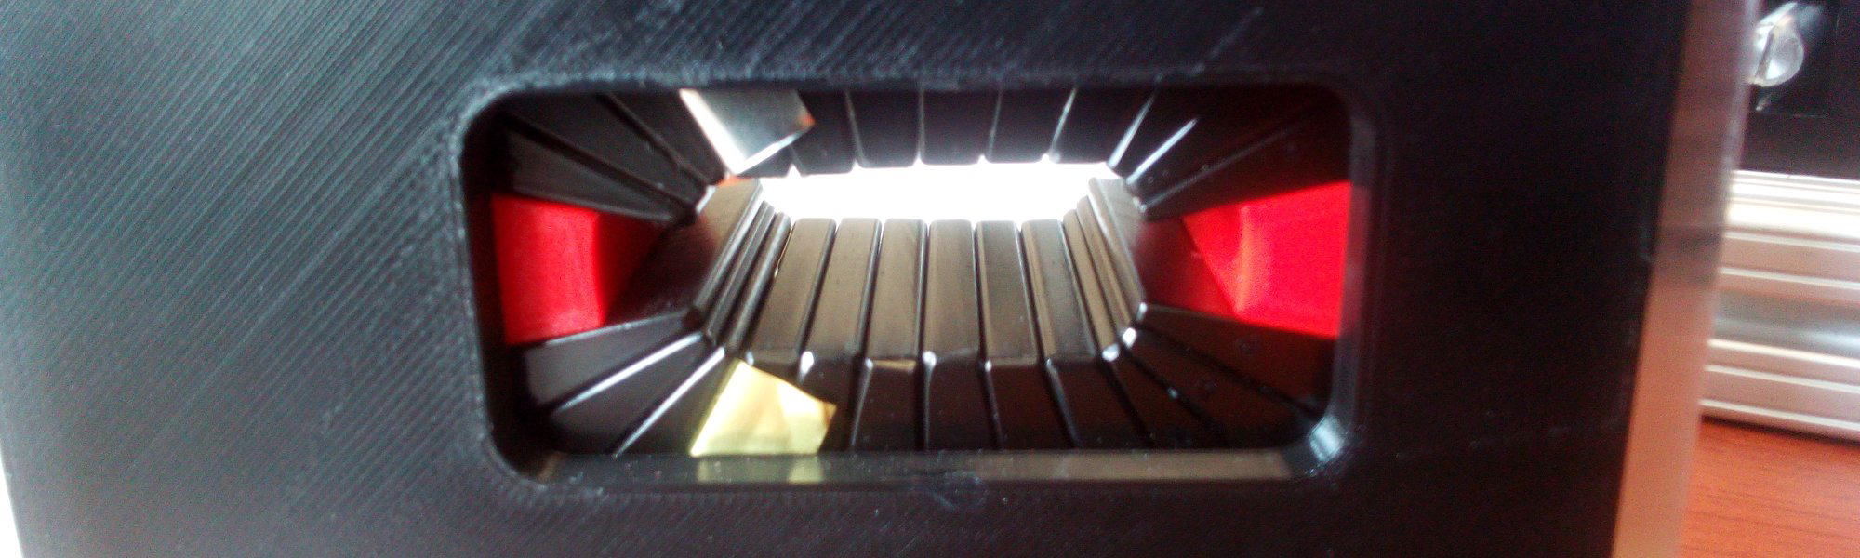
3.2 OPEN-MIDPLANE GRADIENT PERMANENT MAGNET
WITH 1.53 T PEAK FIELD (S. Brooks, WEPM128, IPAC 2023)
( )
Magnet Design
10.9 cm
9.7 cm

Slide 22
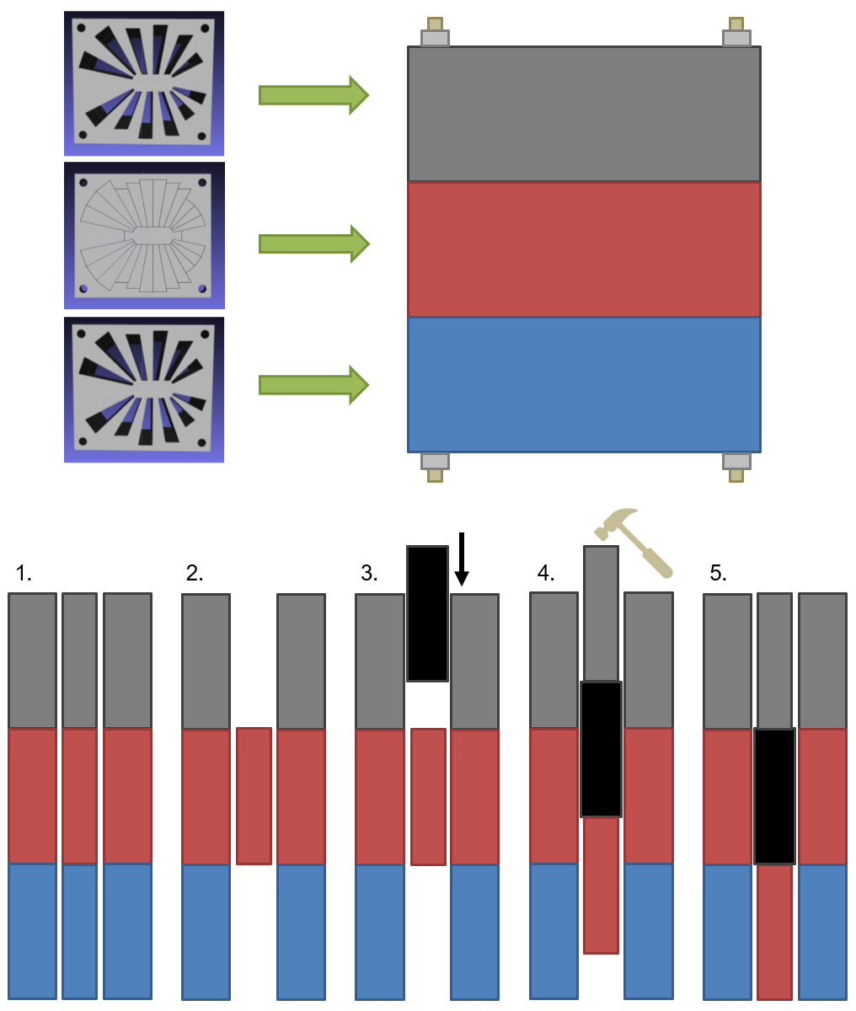
3.3 Magnet Assembly Procedure

Slide 23
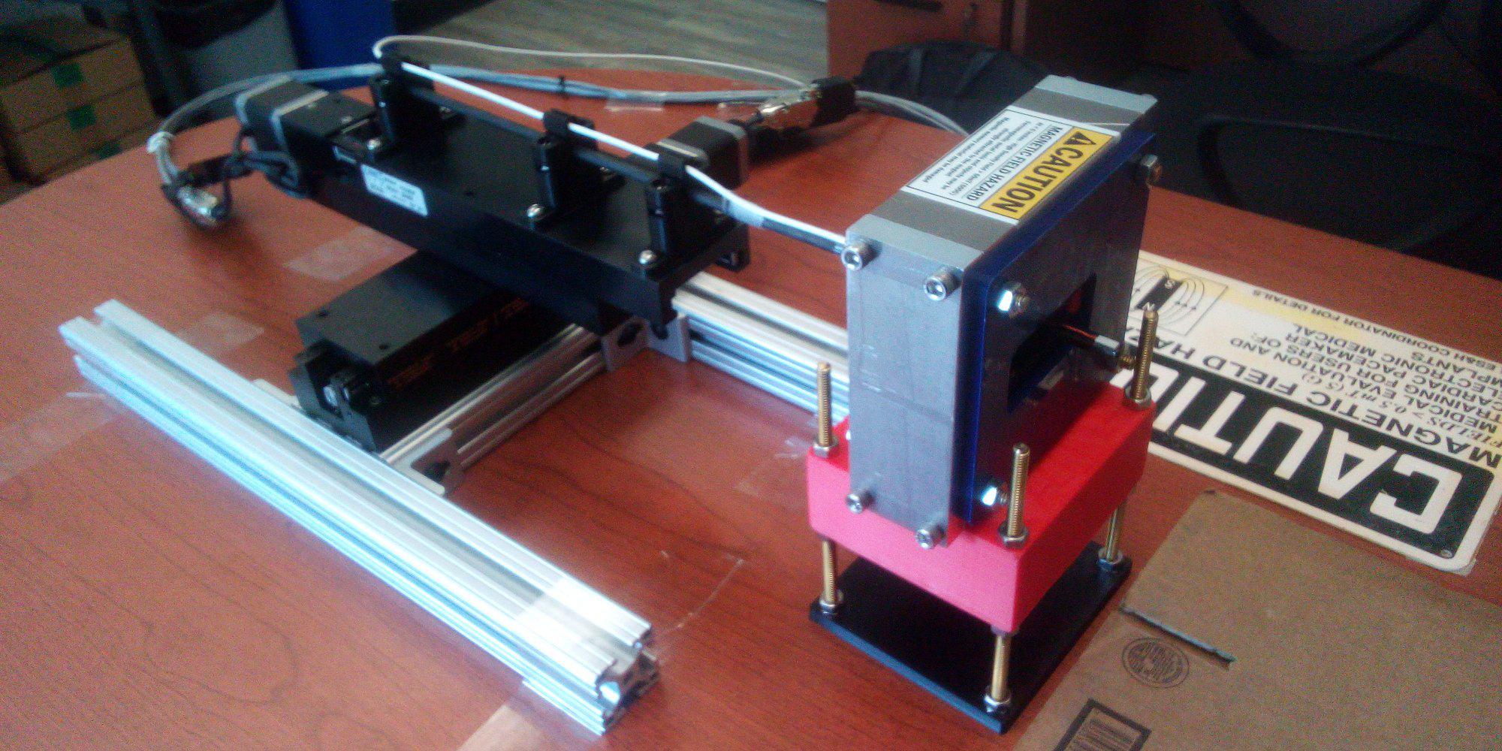
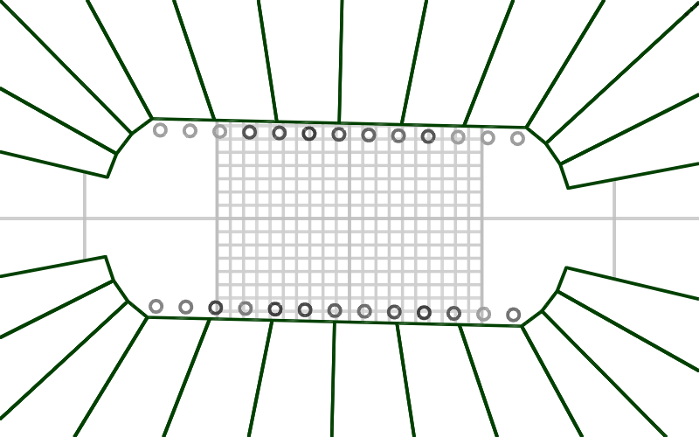
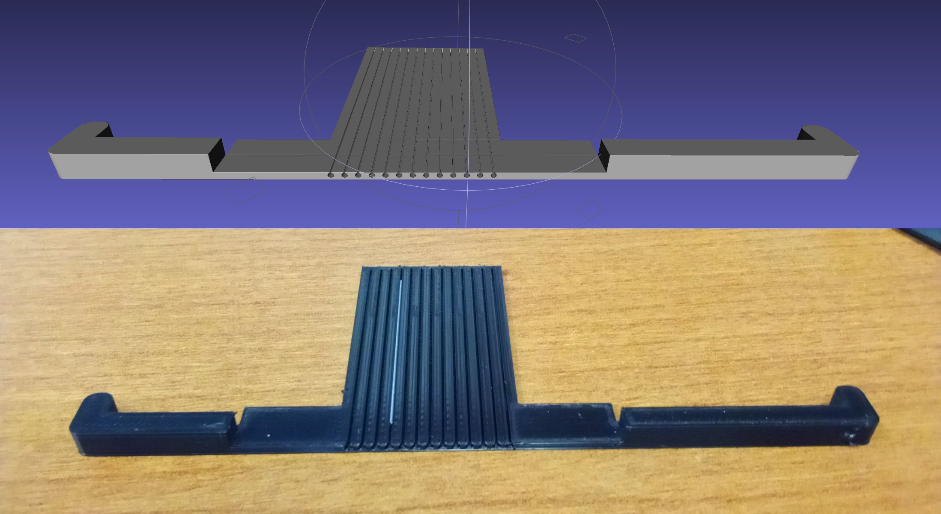
3.3 Magnetic Measurements and Corrections

Slide 24
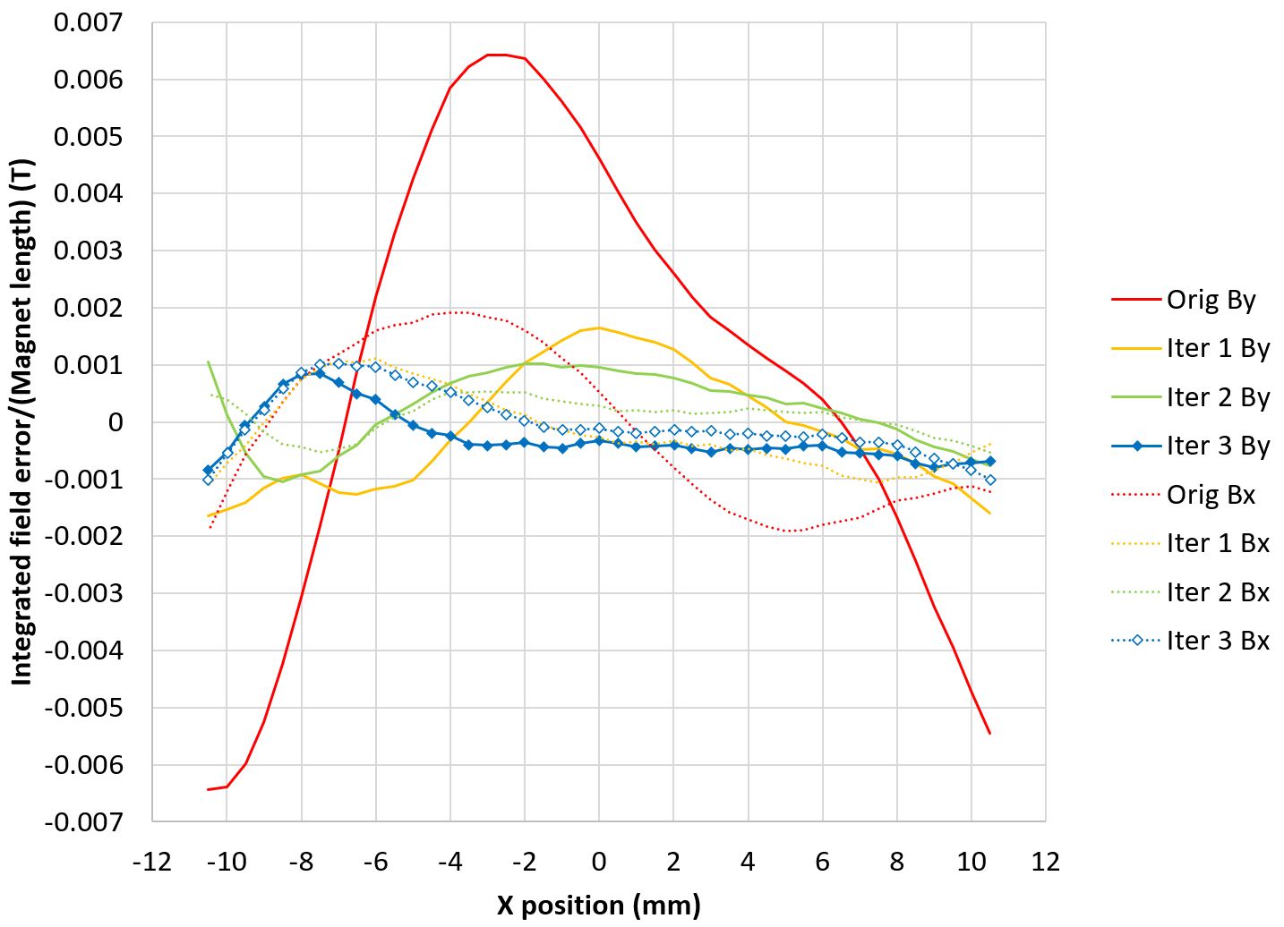
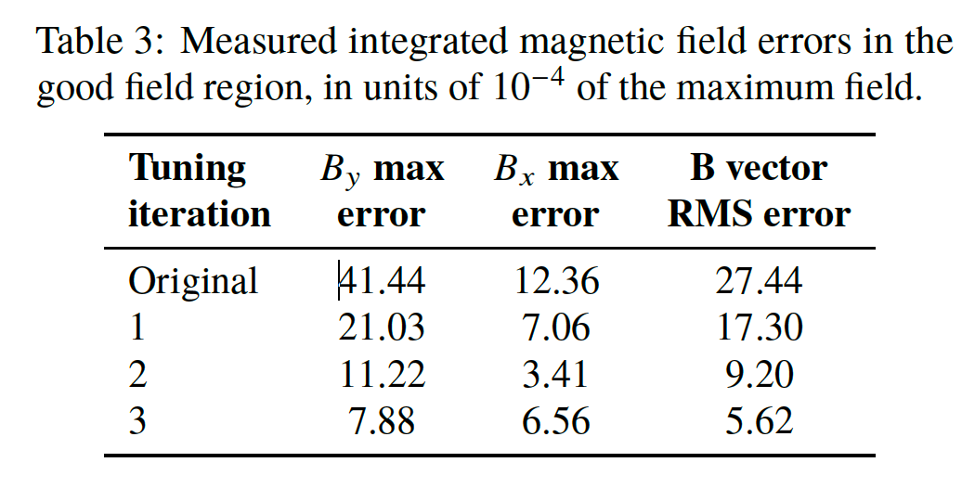
3.4 Measurement Results Before and After Corrections

Slide 25
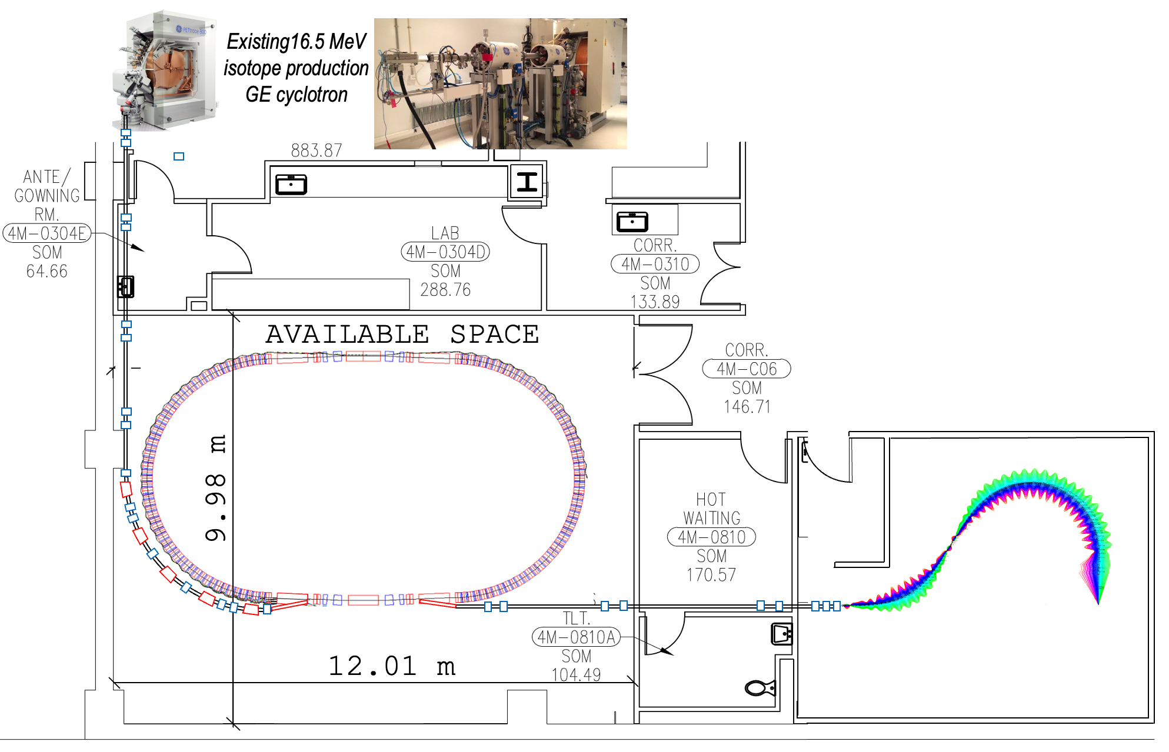
4. Permanent Magnet Proton ‘FLASH’ Therapy Facility
Stony Brook University Hospital
Radiation Oncology

Slide 26
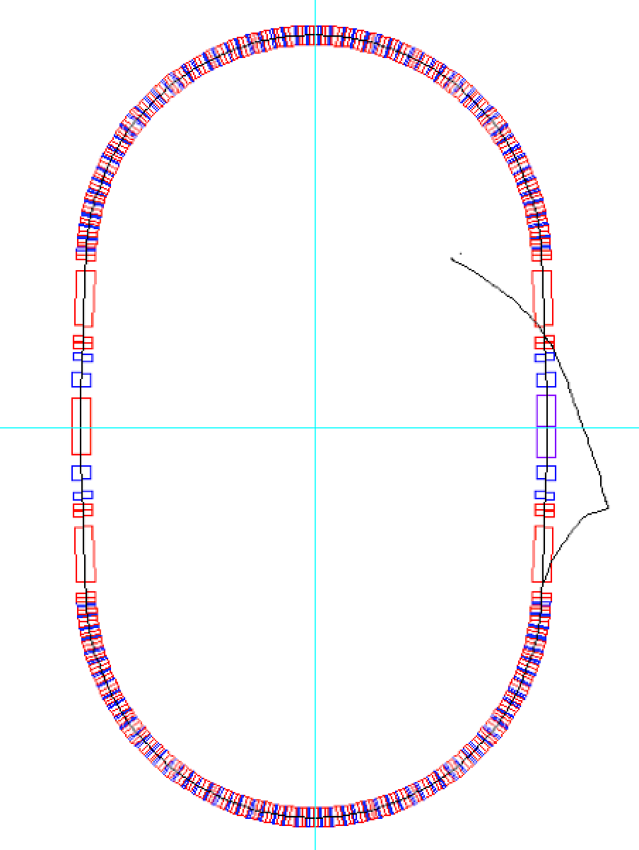
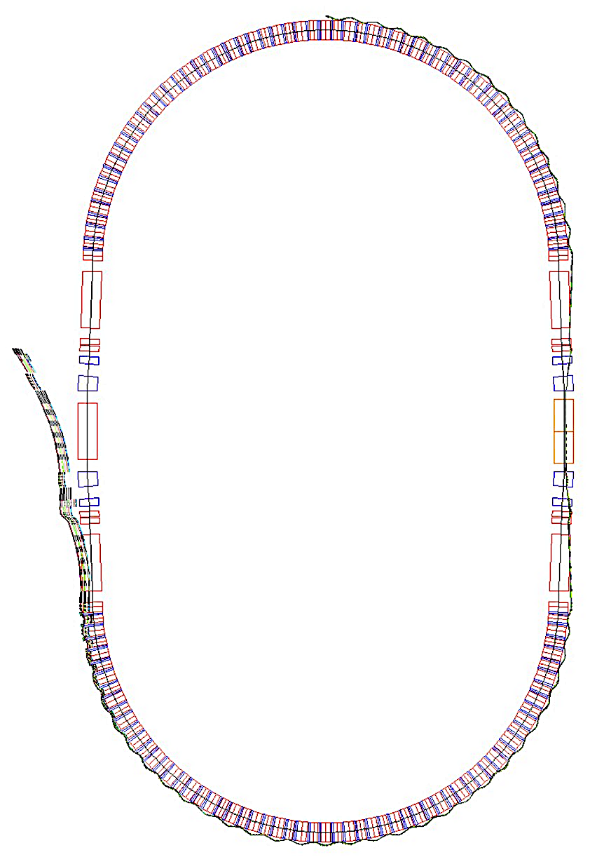
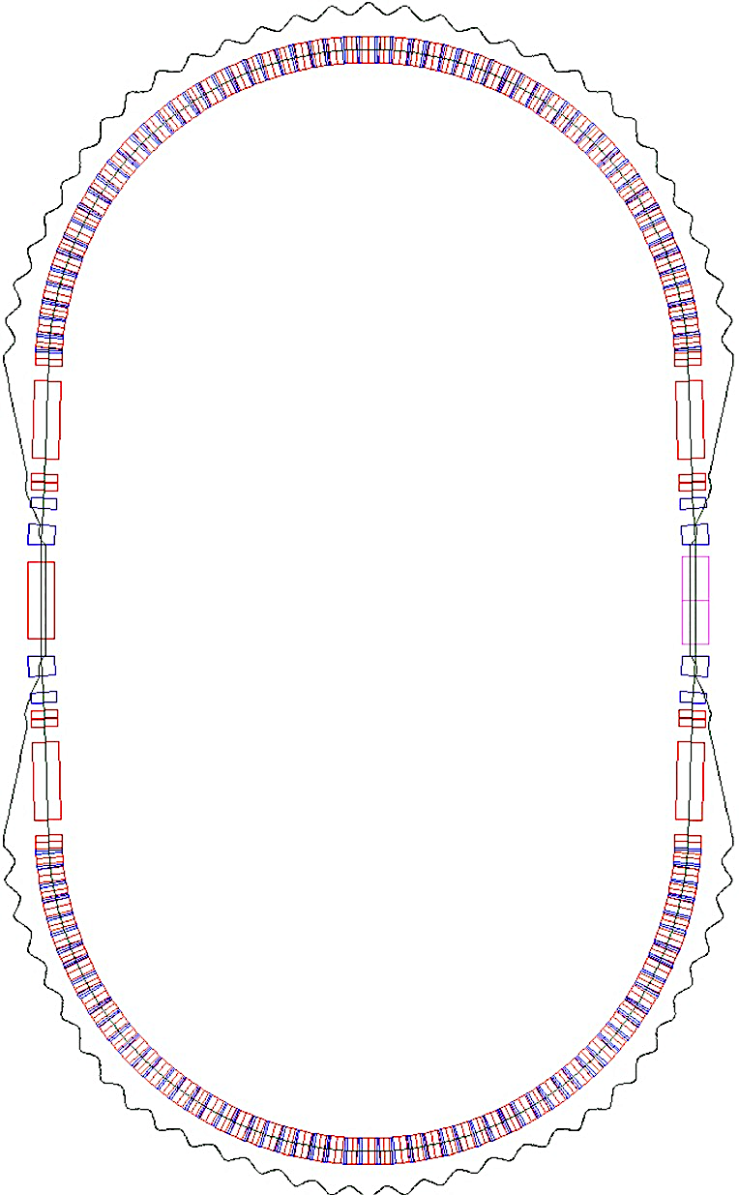
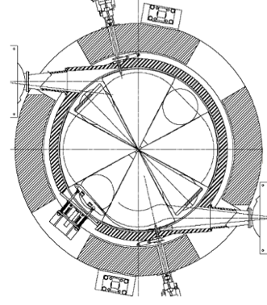



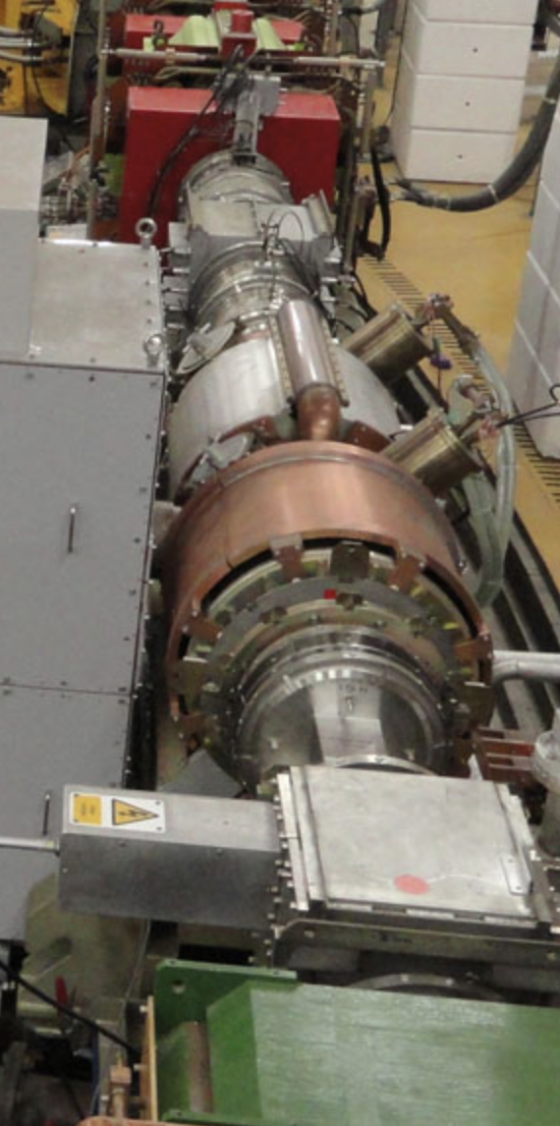
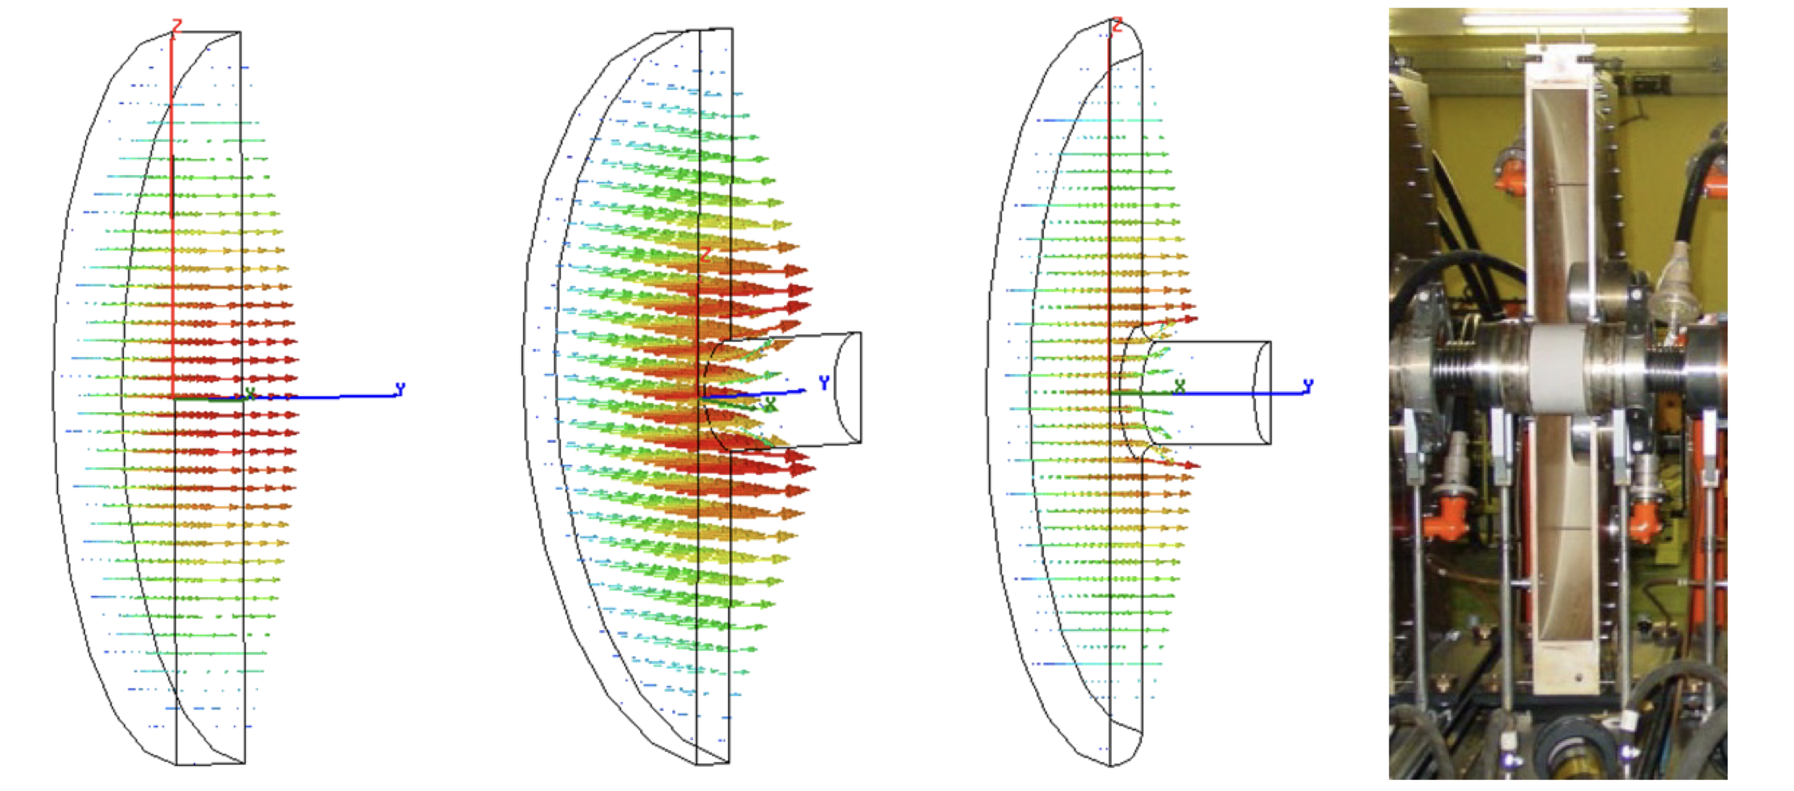
4.1 Permanent Magnet Fast Cycling Synchrotron
Cyclotron 10 MeV
Magnified injection
orbit
Magnified extraction
orbit
2.7 m
5.68 m
Protons orbit at δp/p=+50%
Pill Box RF cavities for Phase Jump Acceleration
High Power Cavities
In Rutherford Lab for Very High Intensity
Proton beams.

Slide 27
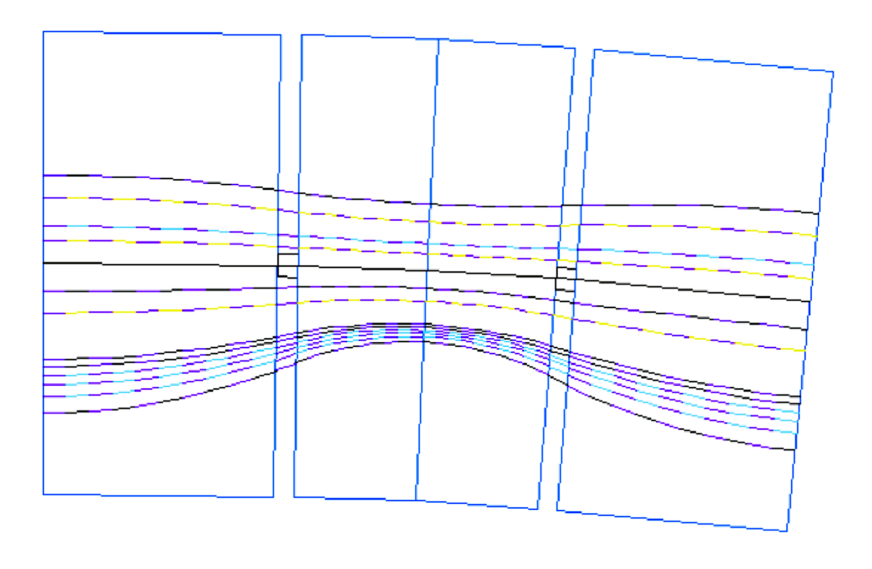
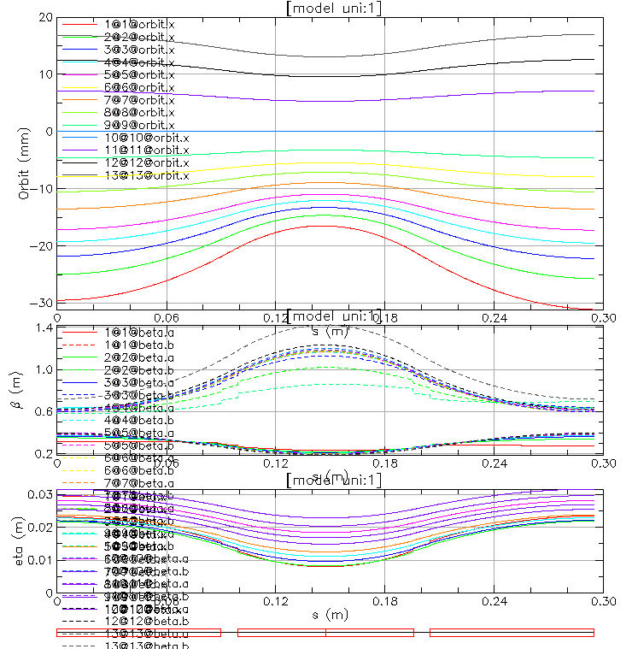
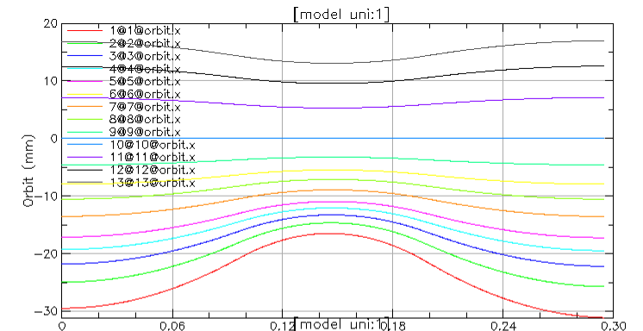
4.2 Orbits in the permanent magnets in FFA synchrotron
Orbits and betatron functions
250 MeV
19.6 mm
202 MeV
150 MeV
100 MeV
70 MeV
50 MeV
25 MeV
10 MeV
-33.2 mm
250 MeV
110 MeV
10 MeV

Slide 28
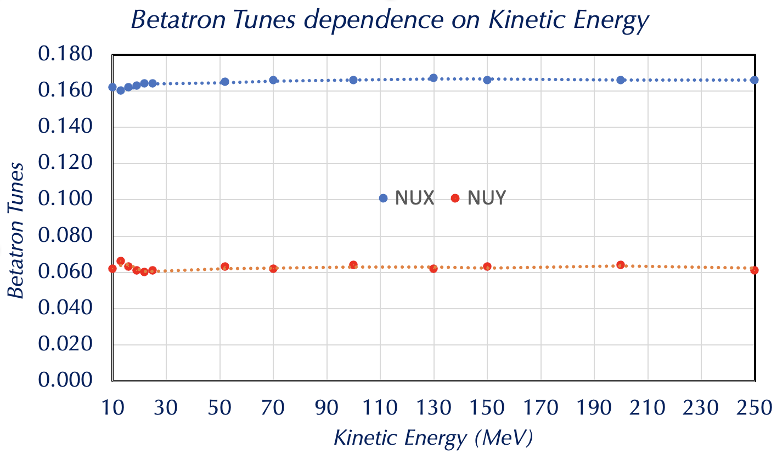
4.3 Tunes Dependence on Energy

Slide 29
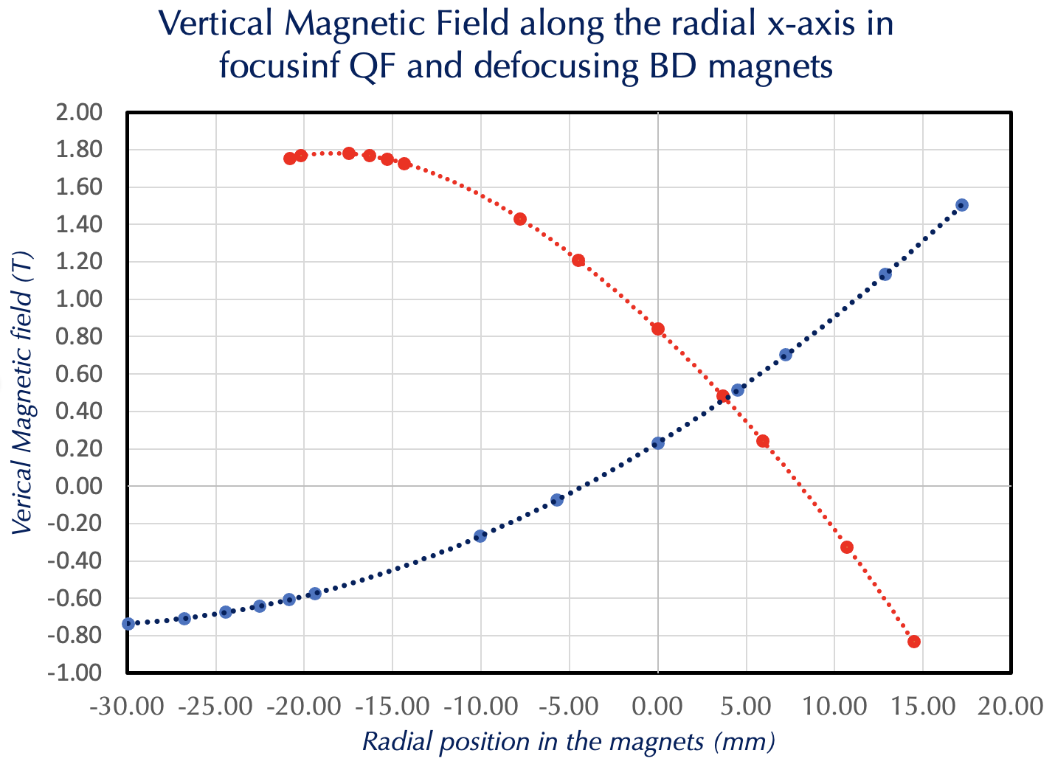
4.4 Vertical magnetic field along the radial x-axis in focusing and defocusing variable field function magnets

Slide 30
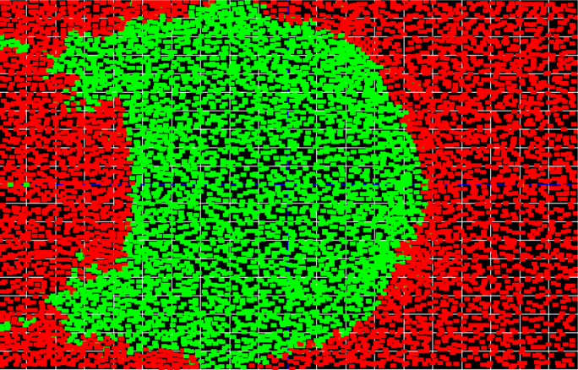
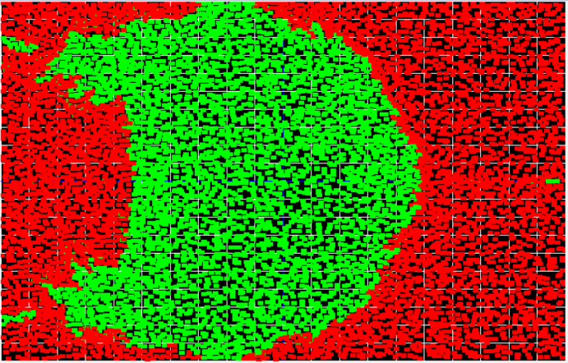
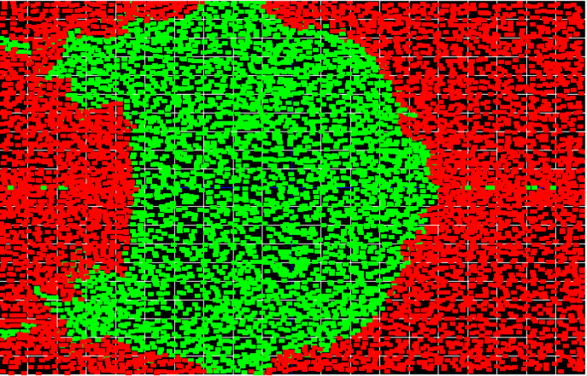

4.5 Dynamical Aperture after1000 turns
The energy E_{k}=10 MeV
Energy 18 MeV
2.0 cm
2.0 cm
6 mm
12 mm
8.9 mm
4.46 mm
-2.0 cm
25.27 mm
-2.0 cm
25.47 mm
-2.5 cm
2.5 cm
-2.5 cm
2.5 cm
Energy 50 MeV
Energy 250 MeV
2.0 cm
2.46 mm
1.1 mm
5.3 mm
2.26 mm
-2.0 cm
25.95 mm
-2.5 cm
2.5 cm

Slide 31




4.6 Prototype of the Permanent Magnet Design with variable magnetic field for the Fast-Cycling Proton Synchrotron
The length of the focusing magnet 18 cm
The length of the defocusing magnet 9.652 cm
~12.5 cm
~11 cm
~13 cm
~14 cm
β_{x}∼ 0.4 m
β_{y}∼ 1 m
Input beam is assumed to come from the 10 MeV cyclotron measured emittance ~5 π mm mrad
Magnet is ready to get assembled
At Injection kinetic energy is 10 MeV
γ = 1.010657 γ β = 0.14484
σ_{x} =1.517 mm
σ_{y} =2.398 mm

Slide 32


4.7 Transfer beam lines with combined function permanent magnets providing proton energy range of 70-250 MeV

Slide 33

4.8 Permanent magnet proton gantry

Slide 34




4.9 Proton Gantry Permanent Combined function Magnets

Slide 35


5. FFA LHeC Recirculator with Energy Recovery
Two 8.5 GeV linacs replace two 10 GeV linacs from the original LHeC design
Linac 1
8.5 GeV
Recovery:
51.5 GeV
34.5
17.5
500 MeV Injector
60 GeV
IP
Recovery:
43.0 GeV
  26.0 GeV
  9.0 GeV
Linac 2
8.5 GeV
500 MeV Dump
LHC
Acceleration:
  17.5 GeV
  34.5 GeV
  51.5 GeV
Total power consumption for six arcs in the present LHeC design is 7.1 MW to be compared to the permanent magnet arcs requiring only very small power for correction magnets.

Slide 36



5. FFA LHeC Recirculator with Energy Recovery
Lattice functions in a single FFA Cell
E=51.5 GeV
E=51.5 GeV
E=34.5 GeV
E=17.5 GeV
E=34.5 GeV
E=17.5 GeV

Slide 37


5.1 LHeC FFA Arc Magnet Design for 60 GeV
Defocusing magnet:
L_{BD} = 0.696 m
G_{D} =106.605 T/m
B_{D} = -0.16343 T
B_{Dmax} = -0.532 T
4.5 cm
2 cm
1cm
4 cm
3.2 cm
Focusing magnet
L_{QF} = 2.15 m
G_{F} = -61.9214 T/m
B_{F} = -0.16343 T
B_{Fmax} = -0.272 T
4.1 cm
2 cm
1.4 cm
Dejan Trbojevic – Low Emittance Ring - Permanent Magnets Workshop -TRIESTE, Nov 14-15, 2023
37

Slide 38
6. Summary
Recent permanent magnet designs and prototype developments at BNL are shown with four different areas of interest:
  NSLS2 upgrade – combined function permanent magnets
  Combine function magnets for the doubling the energy of CEBAF from 12 to 22.5 GeV
  Permanent magnets with variable transverse field for the fast-cycling proton synchrotron
  Combined function permanent magnets for the large energy range fixed field transfer beam lines
  Combined function permanent magnets for proton gantry
  Combined function permanent magnet design for the LHeC
Permanent magnets’ future is very very promising as it is directly connected to sustainability a word recently widely used in accelerator physics and future colliders

