Slide 1
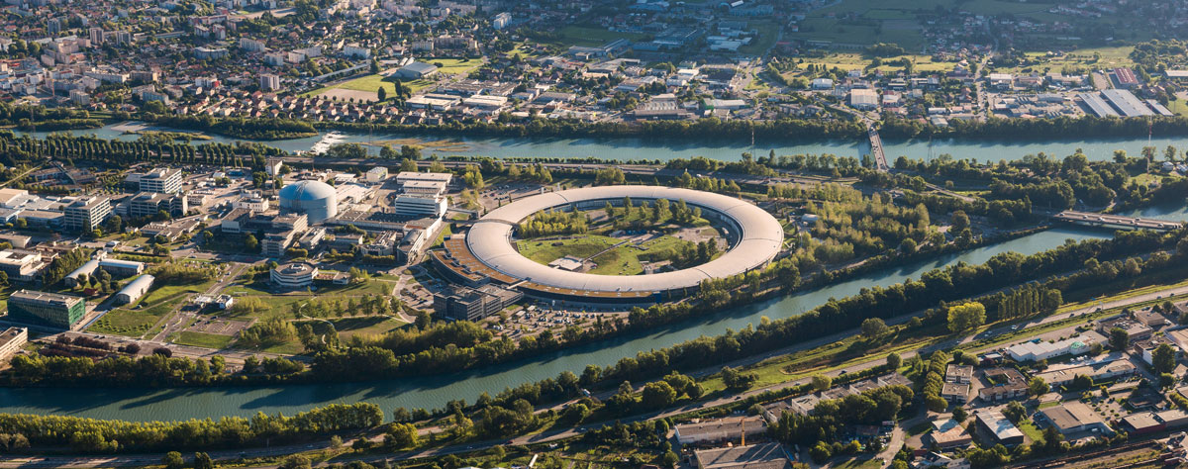


Workshop on Permanent Magnets for Low Emittance Rings
Trieste, Italy, 14th and 15th November 2023
CHALLENGES WITH THE PERMANENT MAGNETS DIPOLES DEVELOPMENT FOR ESRF-EBS
Chamseddine BENABDERRAHMANE
On behalf of Insertion Devices and Magnets Group
bchams@esrf.fr

Slide 2
OUTLINE
Introduction
Motivation
Design and Prototype
Procurement of PM and mechanical parts
Dipole assembly and magnetic measurements
Commissioning and Operation
Conclusion

Slide 3
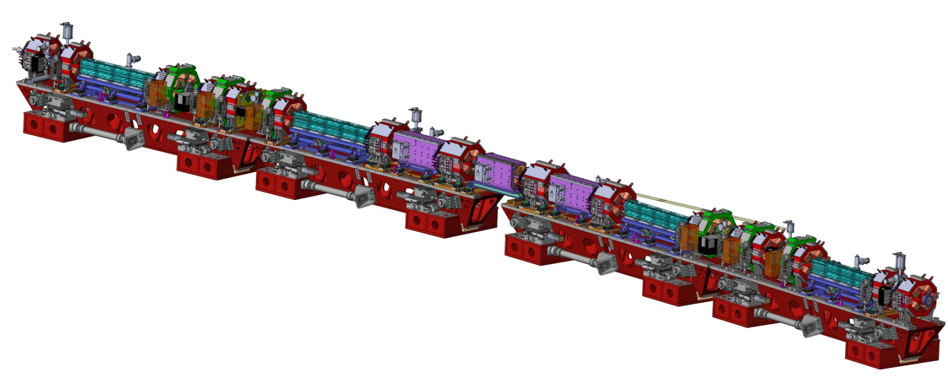
Introduction
Magnet layout in one cell
Octupole
Combined dipole-quadrupole
Sextupole
Permanent magnet dipole
with longitudinal gradient (DLs)
High gradient quadrupole
Moderate gradient quadrupole

Slide 4
OUTLINE
Introduction
Motivation
Design and Prototype
Procurement of PM and mechanical parts
Dipole assembly and magnetic measurements
Commissioning and Operation
Conclusion

Slide 5
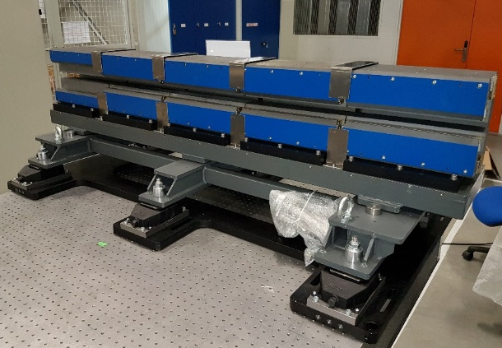
Motivation
PM dipole have advantages over electromagnet one
Compact devices
No power supply and no cooling systems
Better reliability (no water and power supply failures)
Less control systems, cables and noise
Important reduction in operation cost
Challenges for permanent magnet Dipoles
Magnetic field design
Magnetic field tuning and shimming
Temperature dependence
Demagnetization risks
Series production

Slide 6
Motivation
Demonstrates feasibility of low cost permanent magnet dipole production
Low procurement cost
Energy efficient, no running cost
Full control on the dipole assemblies
In house experience in permanent magnet assemblies
In house experience in magnetic measurement
Magnetic tuning
Add a new experience in terms of large series of magnet assemblies and tuning

Slide 7
OUTLINE
Introduction
Motivation
Design and Prototype
Procurement of PM and mechanical parts
Dipole assembly and magnetic measurements
Commissioning and Operation
Conclusion

Slide 8
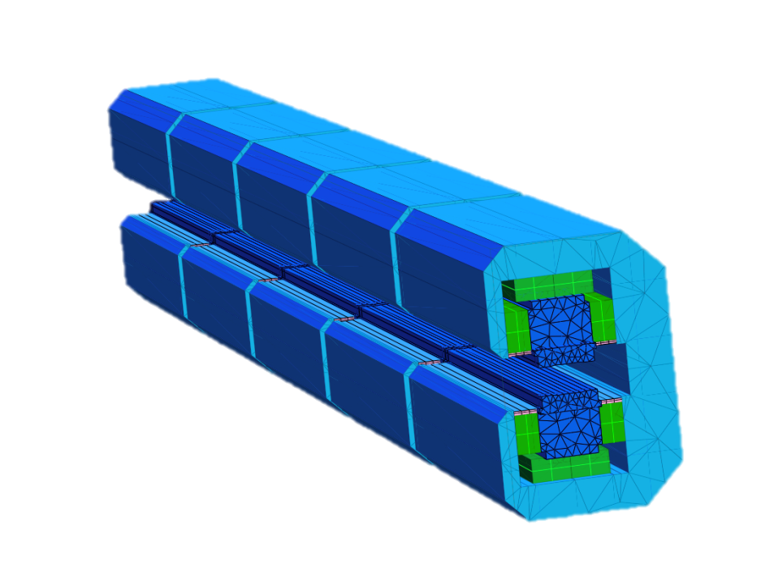

Design and prototype
 |  | DL1 | DL2
Strength | T | 0.67 – 0.17 | 0.54 – 0.17
Dipole
Gap | mm | 25.5 – 30.5
Iron length | mm | 1788
Permanent magnet |  | Sm₂Co₁₇
Iron |  | Pure iron
Number of dipoles |  | 128
244 mm
183 mm
Vertical field vs. longitudinal position
Courtesy of J. Chavanne

Slide 9
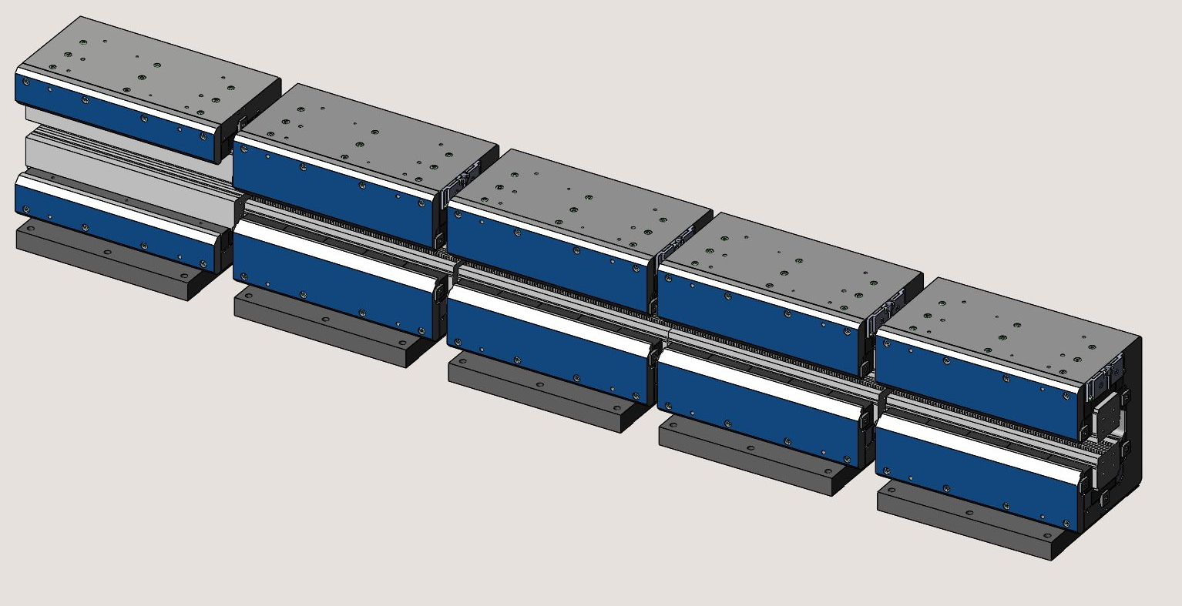
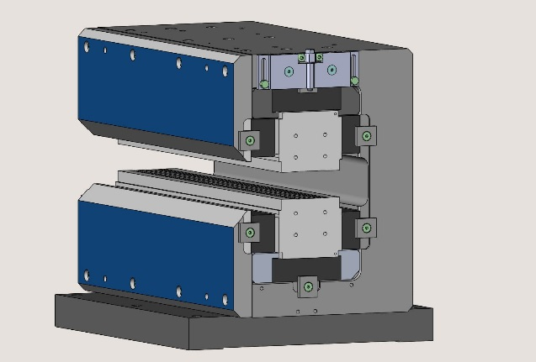
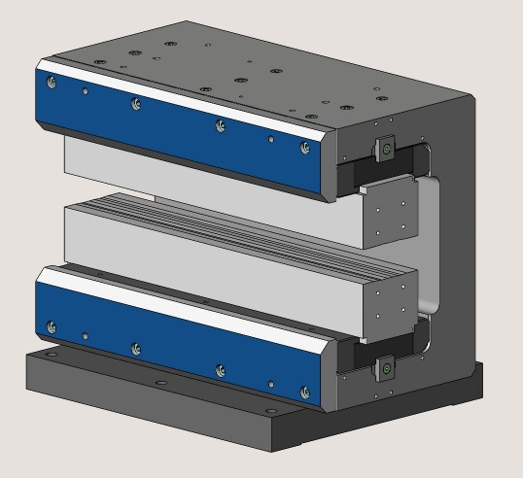
Design and prototype
Motivation
DL1 | M5 | M4 | M3 | M2 | M1
Top magnet | 16 | 0 | 0 | 0 | 8
Side magnet | 20 | 20 | 16 | 12 | 0
M3
M4
M5
M1
DL2 | M5 | M4 | M3 | M2 | M1
Top magnet | 10 | 0 | 0 | 0 | 8
Side magnet | 20 | 20 | 16 | 12 | 0
M2
Quarter Top magnet for field adjustment
Top magnet
Side magnet
Pole for M1
Yoke
Pole for M2 to M5

Slide 10
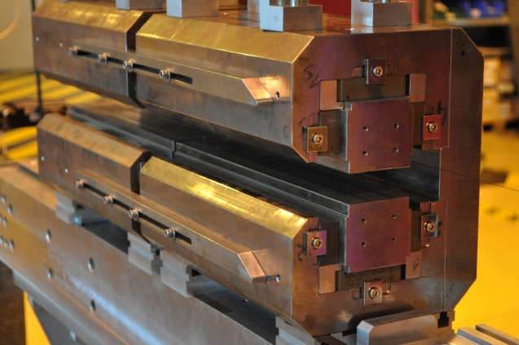
Design and prototype
Prototypes to confirm calculated performance and
to define the series production process
Permanent magnet assembly
Magnetic field strength and quality
Longitudinal field integral fringe
Temperature compensation
Two modules with 0.62 T and 0.41 T

Slide 11
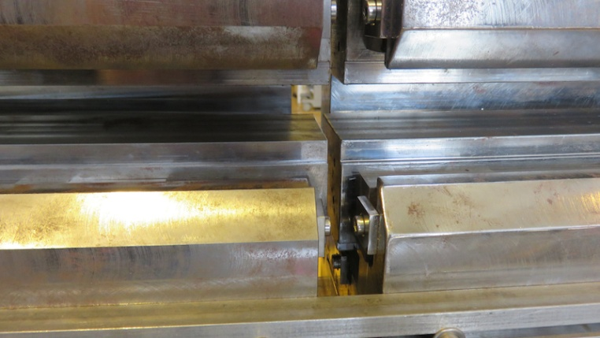
Design and prototype
PM assembly needs special tools
Easy and fast mechanical correction
Shimming required to reach targeted field
Longitudinal gap to be defined for flat field
Tolerance: ΔB/B < 10⁻³ @13 mm
Module 1 with 20 µm shims (Hall probe meas.)
g_{s}
Flat field at longitudinal gap g_{s} = 4 mm

Slide 12
Design and prototype
Material | dB/dT
Sm₂Co₁₇ | 3.3 10⁻⁴
Nd₂Fe₁₄B | 10⁻³
Dominated by PM material temperature coefficient
PM devices with fixed field should be compensated
Compensated by passive Fe-Ni shunts
dB/B < 10⁻⁵/C after compensation
PM block
Yoke
Pole
Special Fe-Ni shunt
(low Curie temperature)
THERMOFLUX (VACUUMSCHMELZE)
dB/B/dT after compensation:< 40 ppm/C
Field integral measurements on PM DL modules NdFeB PM, Sm₂C0₁₇ PM

Slide 13
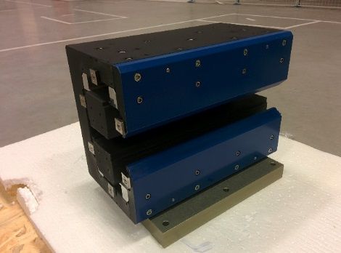
Design and prototype
Four DL modules tested
Nominal field integral
Temperature stability
Br=1.067 T
Prototype module
Nominal field integral
Excellent agreement between measurements and simulations
Measured values are 0.2 ~ 1 % above targeted values
Easy field integral reduction using soft iron shunts
Temperature stability after compensation:< 40 ppm/C

Slide 14
OUTLINE
Introduction
Motivation
Design and Prototype
Procurement of PM and mechanical parts
Dipole assembly and magnetic measurements
Commissioning and Operation
Conclusion

Slide 15
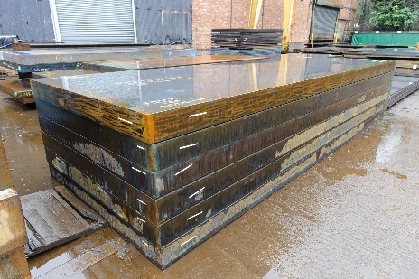
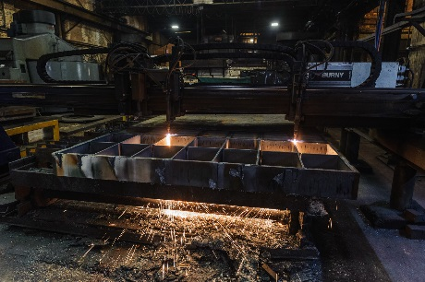
Procurement of PM and mechanical parts
Permanent magnet procurement
Sm₂Co₁₇ permanent magnet
Around 6000 kg of permanent magnet (15130 blocks)
Produced by Magsound (China)
Sorting of magnets before delivery
Low carbon steel raw material
Mechanical parts procurement
660 assembled empty modules to be delivered to ESRF
3 CFTs for the mechanical parts
(Raw material, Cut and annealing, Machining)
440 modules by AMF (UK) and 220 by Cecom (Italy)
Flame cut
Machining and assembly
Page 15

Slide 16
OUTLINE
Introduction
Motivation
Design and Prototype
Procurement of PM and mechanical parts
Dipole assembly and magnetic measurements
Commissioning and Operation
Conclusion

Slide 17
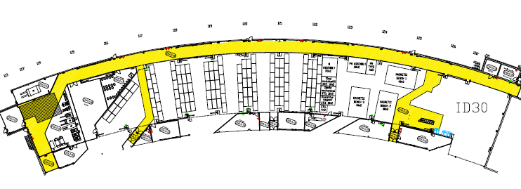
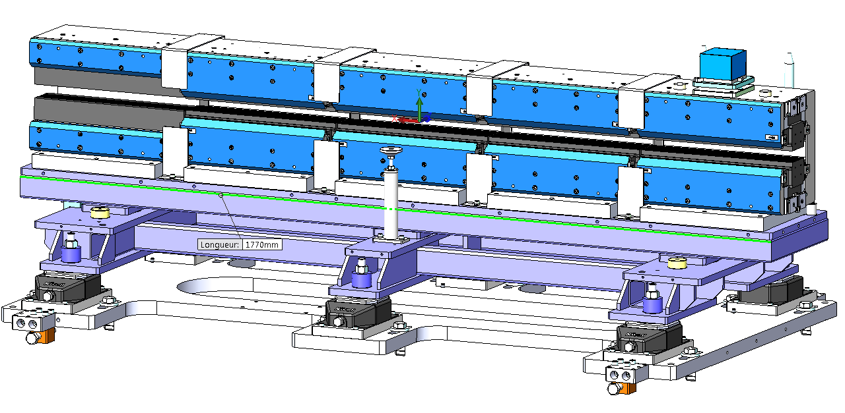
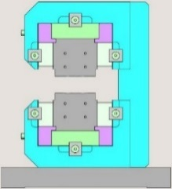
Dipole assembly and magnetic measurements
Implementation in Chartreuse Hall
Chartreuse Hall
Dedicate area for dipole assembly (300 m²)
Page 17

Slide 18
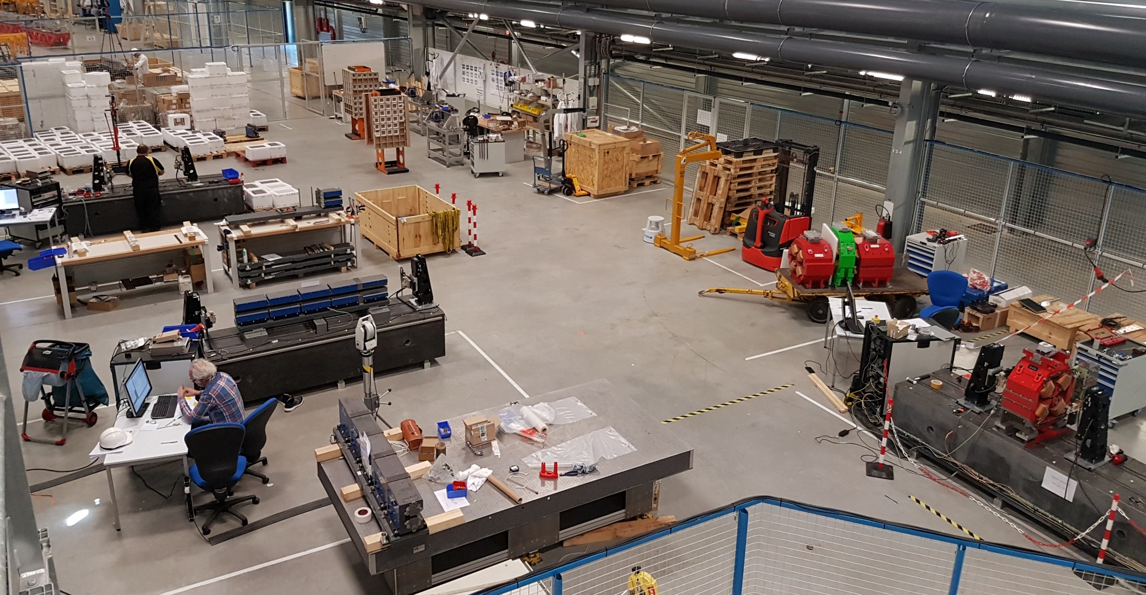
Dipole assembly and magnetic measurements
1
2
3
4
Dipole assembly area
Page 18

Slide 19
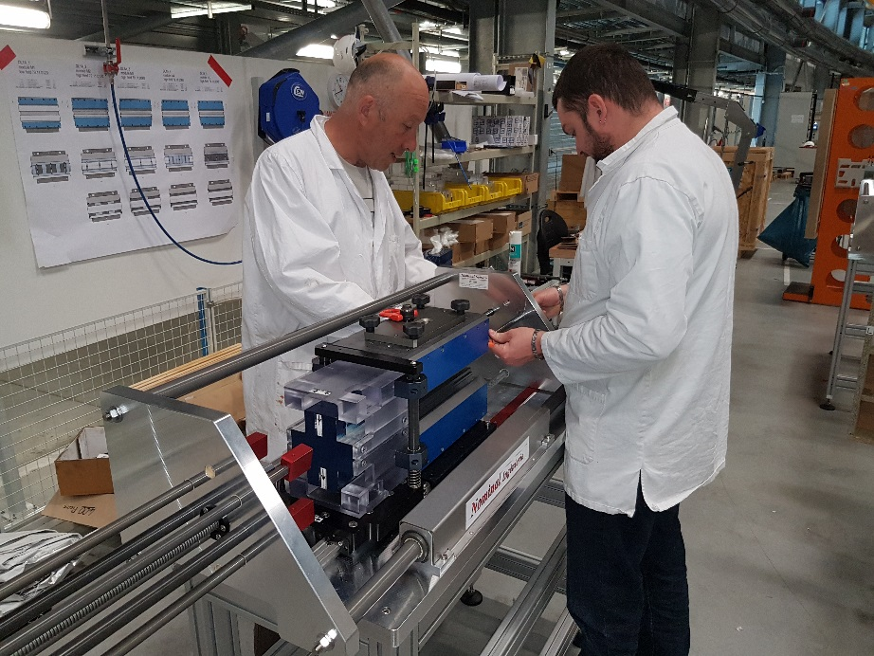
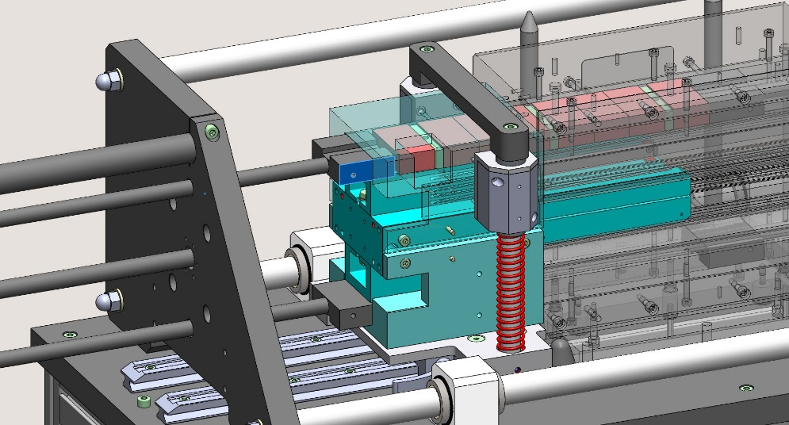
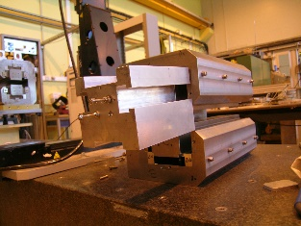
Dipole assembly and magnetic measurements
Modules assembly
Installation of the module on the assembly tool
Assembly of the permanent magnets in the module
Alignment of the poles
Installation of the thermal shims
Storage of the modules in the assembly area
Easy to use tooling
Management of magnetic forces
Robustness for long term use
One assembly tool for each dipole type
Courtesy of F. Villar
Page 19
Page 19

Slide 20
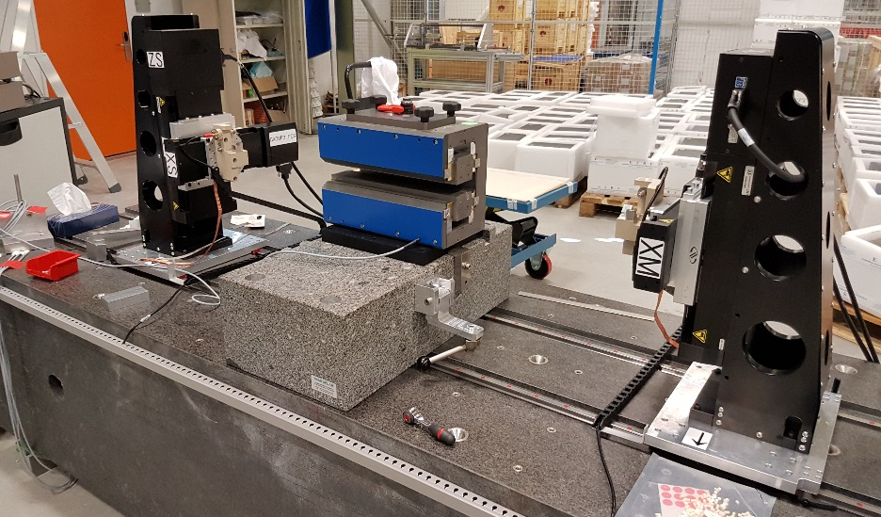
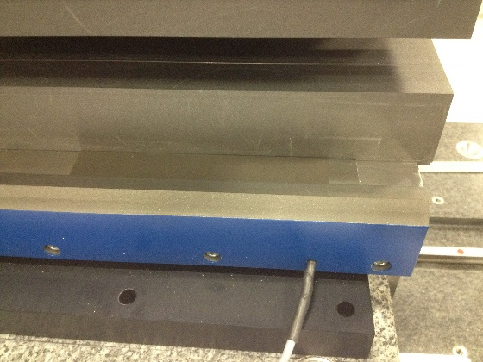
Dipole assembly and magnetic measurements
Modules magnetic measurement and shimming
Installation of the module on the magnetic bench and alignment
Two type of shimming are used, iron shunt for M2, M3 and M4, End iron shunt for M1 and M5
Measurement of the field integral and roll angle
Calculation and installation of the magnetic shims to reach the targeted field integral
Measurement for shims efficiency control, new shimming iteration if needed
Iron shunt
Page 20

Slide 21
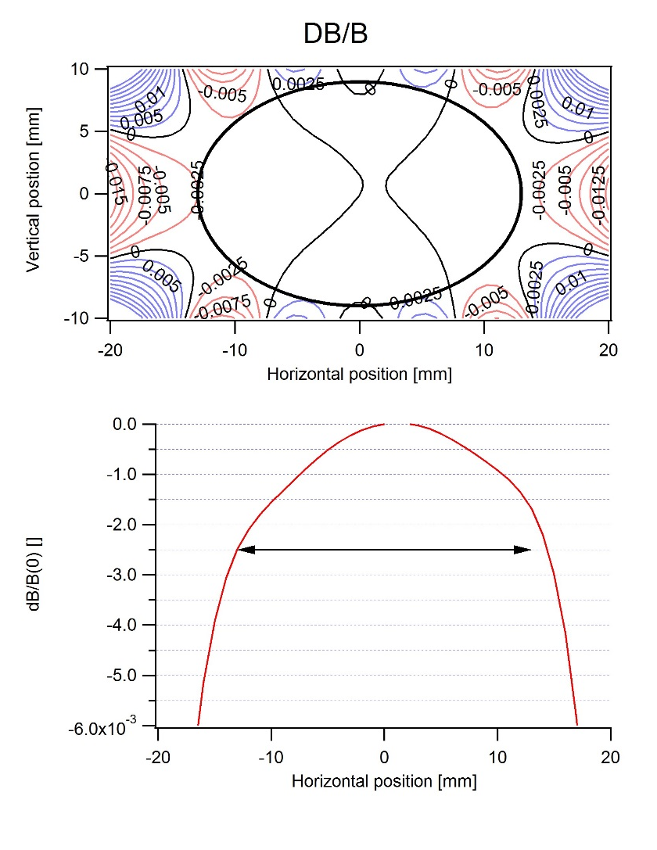
Dipole assembly and magnetic measurements
Module: DL1_5_18
Vertical Integral Target : -253.5954 T.mm
Vertical Integral : -253.6065 T.mm
Horizontal Integral : 0.0634 T.mm
DB/B | Tolerance | Measured
-13 mm | -0.0025 | -0.0024719
13 mm | -0.0025 | -0.0016835
Page 21

Slide 22
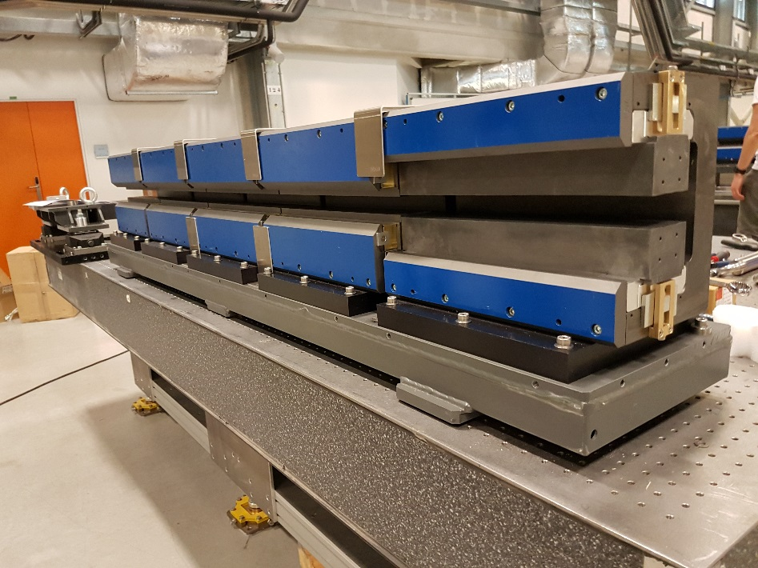
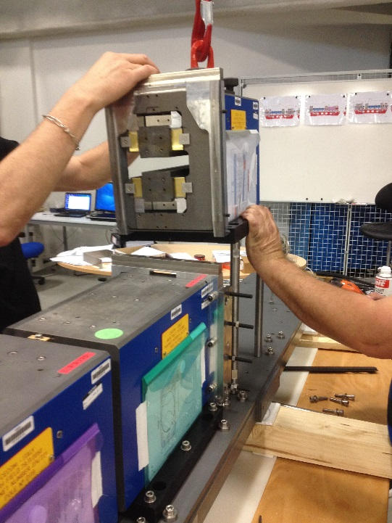
Dipole assembly and magnetic measurements
DL assembly
Installation of the module on the top plate after the magnetic measurements using an assembly tool
The position of each module on the top plate is done with 3 pins
Page 22

Slide 23
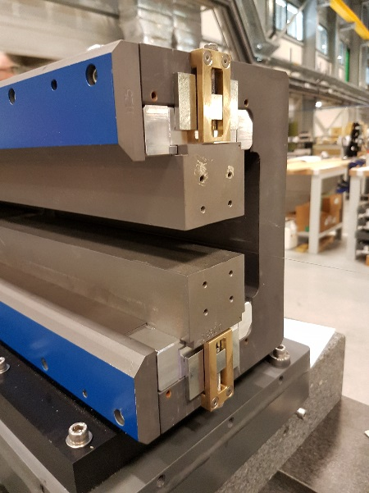
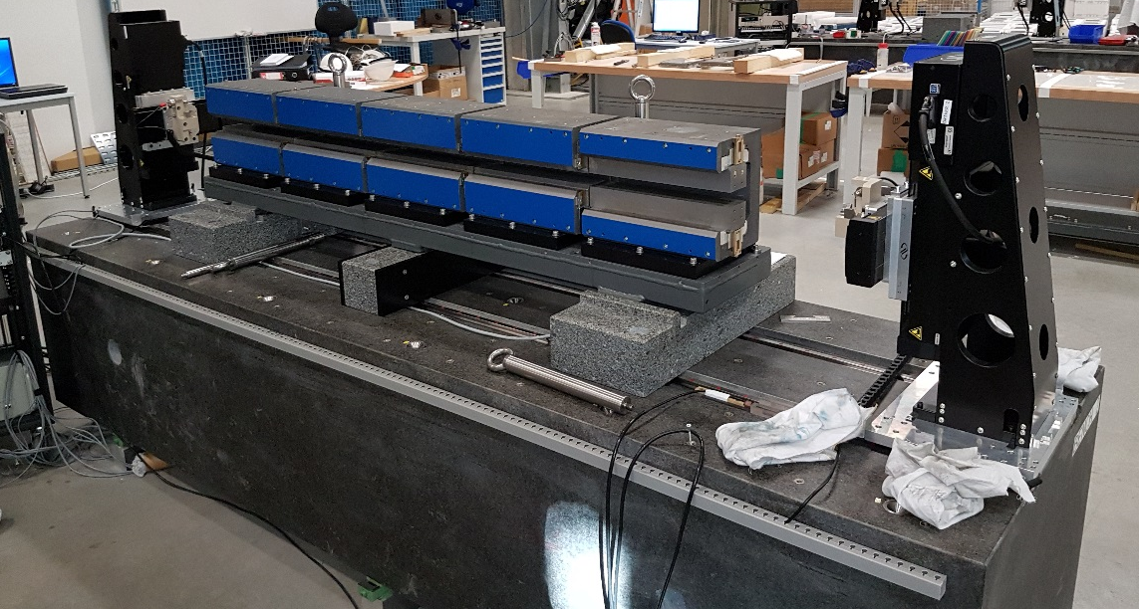
Dipole assembly and magnetic measurements
DL magnetic measurement and shimming
Installation of the DL on the magnetic bench and alignment
Only End iron shunt (shims) on M1 and M5 are used
Measurement of field integrals and roll angle
Calculation and adjustment of the magnetic shims
Control the shims efficiency.
End iron shunt
Page 23
Page 23

Slide 24
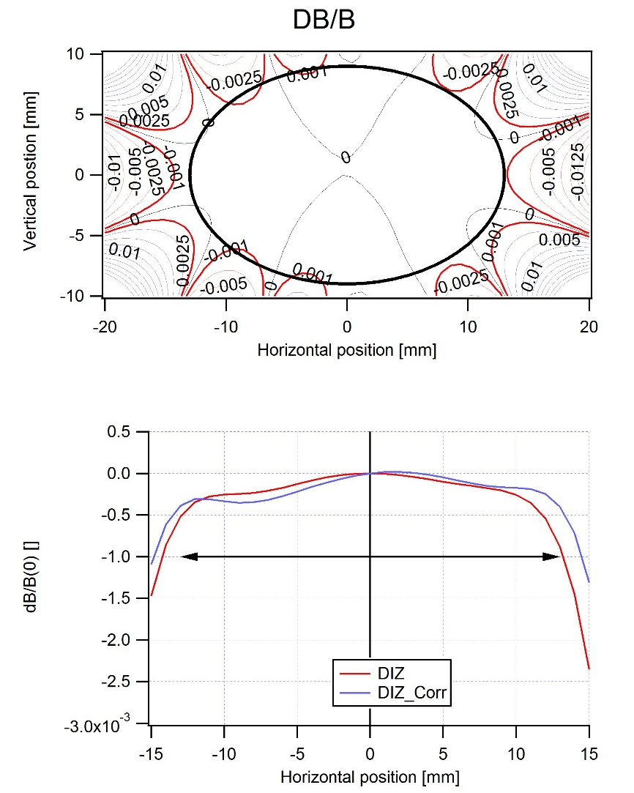
Dipole assembly and magnetic measurements
Dipole: DL1E_13_12
Roll angle : -0.072076 mRad
Vertical Integral Target : -637.3030 T.mm
Vertical Integral : -637.2902 T.mm (2.10⁻⁵ of full DL)
Horizontal Integral : -0.0472 T.mm
Horizontal double Integral Target : -0.56324 T.mm²
Horizontal double Integral : -0.56326 T.mm²
Vertical double Integral : -5.018 10⁻⁵ T.mm²
DB/B | Tolerance | Measured
-13 mm | -0.0012 | -0.00051
13 mm | -0.0012 | -0.00087
Page 24

Slide 25
Dipole assembly and magnetic measurements
Page 25

Slide 26
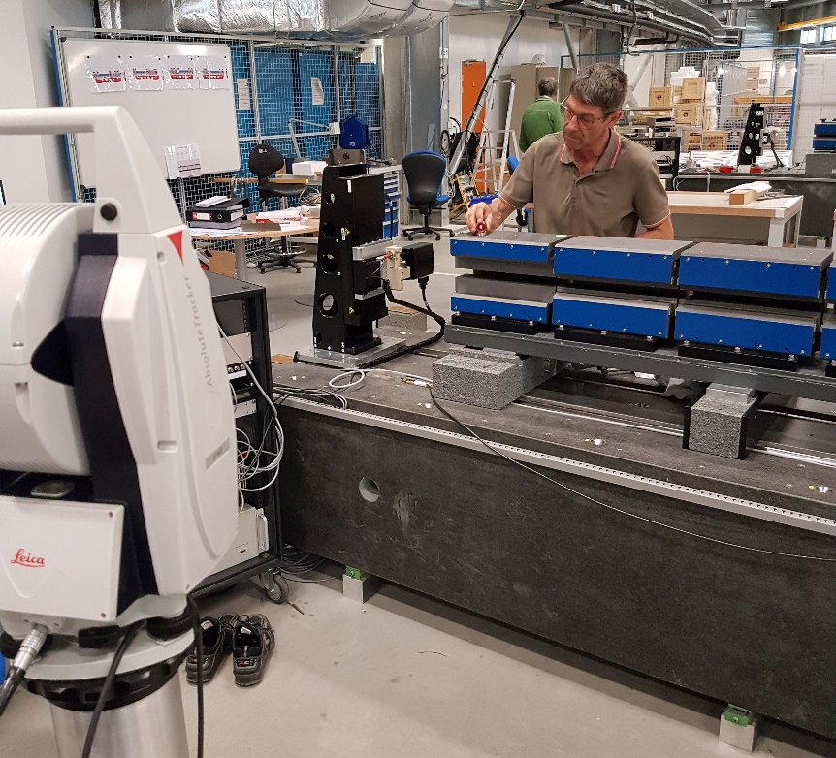
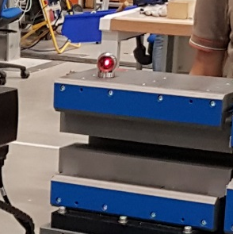
Dipole assembly and magnetic measurements
DL fiducialisation
Fiducialisation is done on each dipole using a Laser tracker
Point | X mes | Y mes | Z mes
 | (mm) | (mm) | (mm)
module1 E | -815,27 | -134,51 | 358,61
module1 S | -615,21 | -131,42 | 358,55
module2 E | -457,77 | -129,79 | 358,42
module2 S | -257,76 | -128,54 | 358,43
module3 E | -100,01 | -128,09 | 358,48
module3 S | 100,01 | -128,14 | 358,49
module4 E | 257,71 | -128,56 | 358,48
module4 S | 457,73 | -129,52 | 358,46
module5 E | 615,42 | -130,55 | 358,46
module5 S | 815,43 | -132,21 | 358,49
Page 26

Slide 27
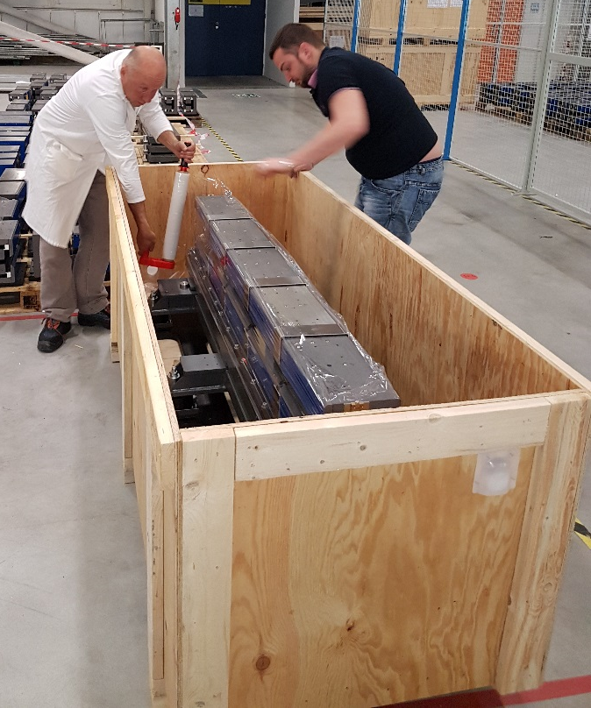
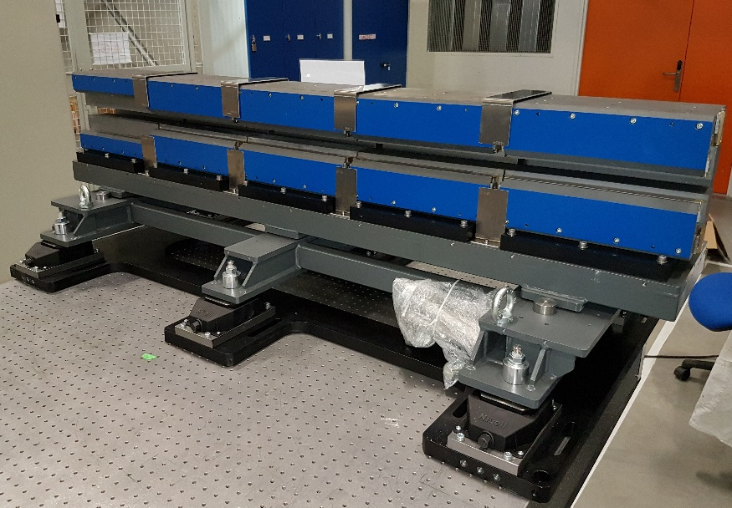
Dipole assembly and magnetic measurements
DL assembly on mechanical support and packaging
Installation of the DL on the mechanical support
Scan and storage of all the quality documents
Plastic protection on the modules
Packaging in the wooden box
Storage in the Hall Chartreuse and ID14
Page 27

Slide 28
OUTLINE
Introduction
Motivation
Design and Prototype
Procurement of PM and mechanical parts
Dipole assembly and magnetic measurements
Commissioning and Operation
Conclusion

Slide 29
Commissioning and operation
Large discrepancies between model and real lattice at the restart
Errors in the calibration of the quadrupole magnets
Cross talk between magnets generation quadrupole errors
Quadrupole errors modeled by a thin lens with opposite polarity
No change of the lattice performance at the end
Calibration coefficients
for one magnet family
Page 29

Slide 30
Commissioning and operation
All ingredient for a cross-talk between magnets
PM DL
4.7 cm
Quadrupole yoke
7.5 cm
Sextupole yoke
Quadrupole yoke
6 cm
Octupole yoke
Quadrupole yoke
Short distance between magnet yokes
Less than 1 cm between sextupole and quadrupole coils
and between octupole and quadrupole coils
Saturated magnets
Page 30

Slide 31
Commissioning and operation
Dipole to quadrupole Cross-talk
Dipole to quadrupole cross talk done in 2017
Needed for PM dipole tuning
Reduction in the integrated field of DL by 1%
Quadrupole to dipole cross talk not investigated
Quadrupole to dipole Cross-talk
Quadrupole to Dipole cross talk done 2020
0.9 % reduction in the integrated gradient
Effect localized at the dipole edge
Almost no change in the quadrupole
(G Le Bec, LER2020, Frascati, 2020)
Page 31

Slide 32
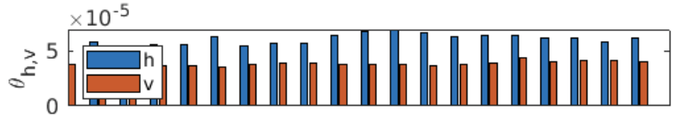
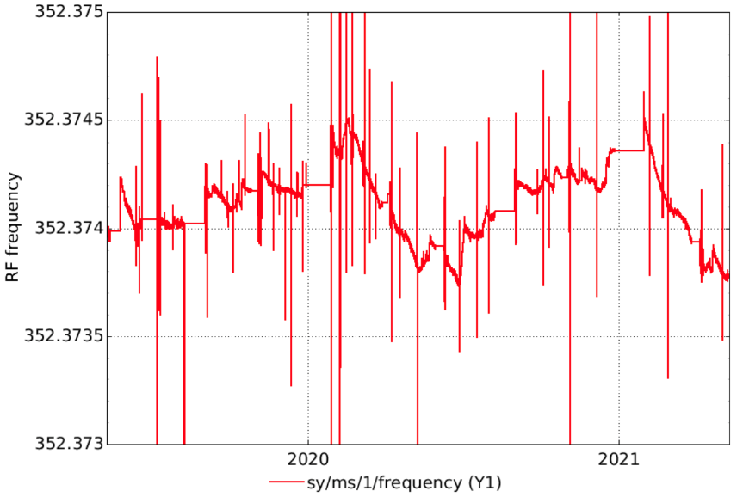
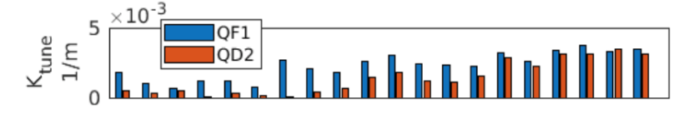
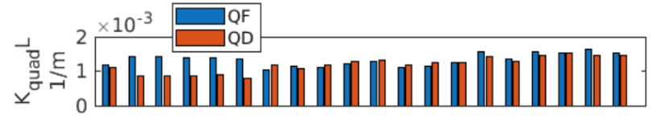
Commissioning and operation
Horizontal steerers strengths not drifting, average is kept to zero to use RF frequency for SR length variations
RF frequency shift is following seasonal almost-reproducible variations.
Imagine the SR as a VERY SLOW BOOSTER RAMPING DOWN in ENERGY. RF will not change. Beam ENERGY would reduce to adapt to the lower dipole fields in the SR.
We may then look at the AVERAGE QUADRUPOLE correction strengths (sextupoles are modified often for lifetime optimization and chromaticity setting).
Winter SD
Summer SD
Winter SD
Summer SD
After 3 years of operation it is not possible to observe clearly any loss of field in the permanent dipoles.
Courtesy of S.M Liuzzo
Page 32

Slide 33
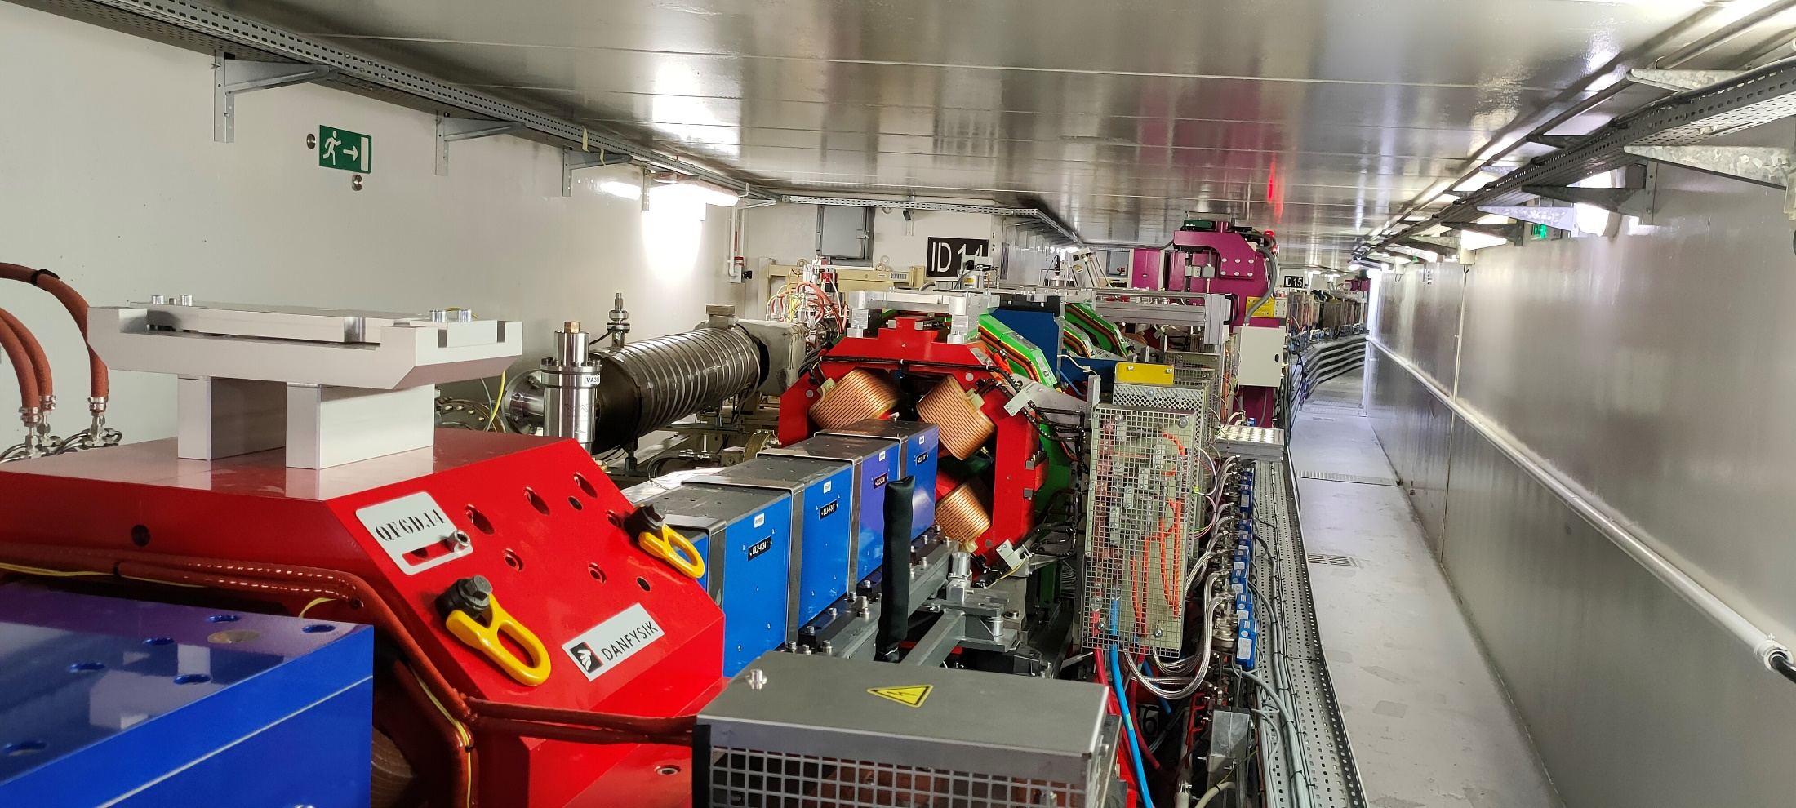
Commissioning and operation
DLs in operation since almost 3 years without any intervention
Page 33

Slide 34
OUTLINE
Introduction
Motivation
Design and Prototype
Procurement of PM and mechanical parts
Dipole assembly and magnetic measurements
Commissioning and Operation
Conclusion

Slide 35
Conclusion
Simple magnetic structure, no electrical power and no cooling
Prototypes to solve all technical issues (assembly, measurement, tuning)
Procurement of all the parts including row material
Development of methods and technics for a large scale production
Quasi-industrial organization for the series production (workflow, procedures, quality insurances,…..)
Assembly of all the DLs in less than one year
3 years of operation without any intervention
Page 35

Slide 36

Many thanks for your attention
Page 36

