Slide 1




PTI+ TRANS-ENER+
Transición Energética Sostenible
Activities within CSIC PTI+ TransEner:
example of ALBA National Partnership in the field of Green Energy
M. Rosa Palacín
rosa.palacin@icmab.es
ALBA II Symposium
UAM, 18th-19th January 2024

Slide 2
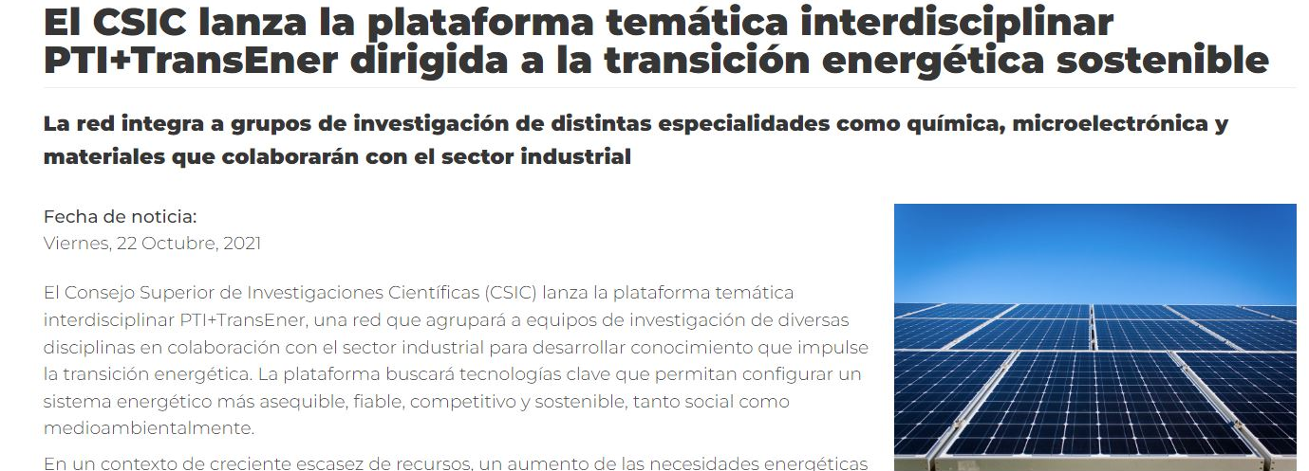

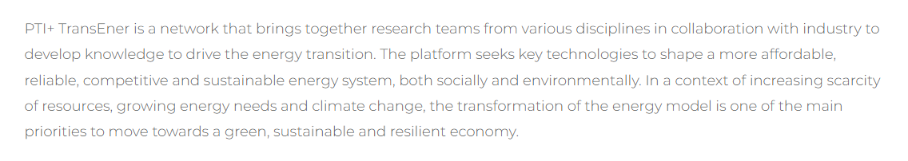
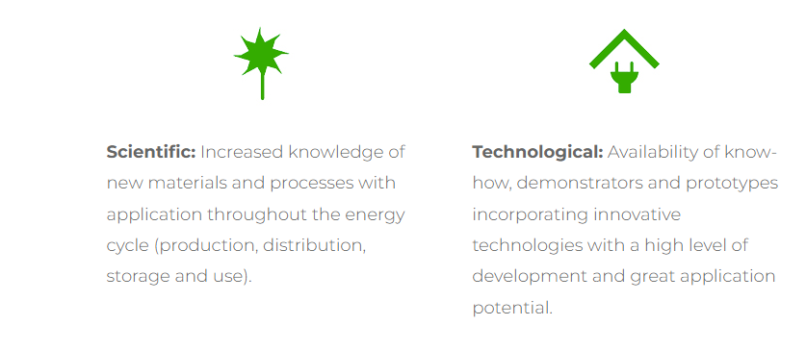
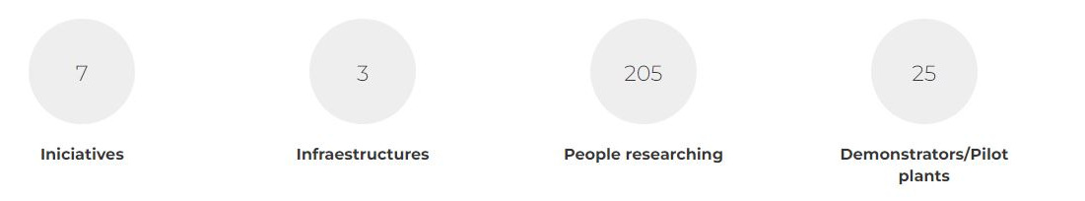
PTI+ TRANS-ENER+
Transición Energética Sostenible
Coordinators:
Clara Blanco Rodríguez (INCAR, Oviedo)
Antonio Chica Lara (ITQ, Valencia)
https://pti-transener.csic.es/en/pti/

Slide 3

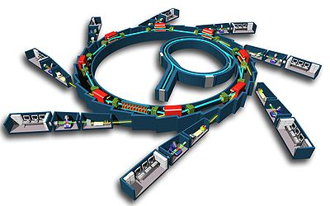


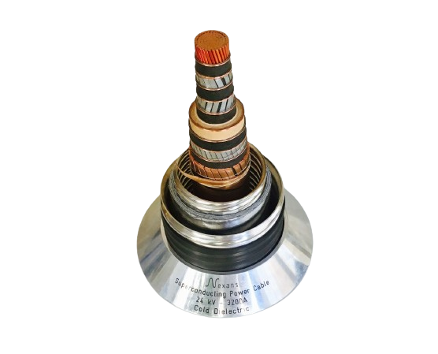
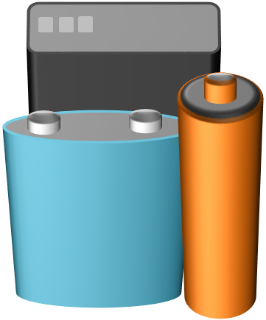
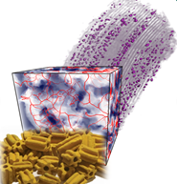
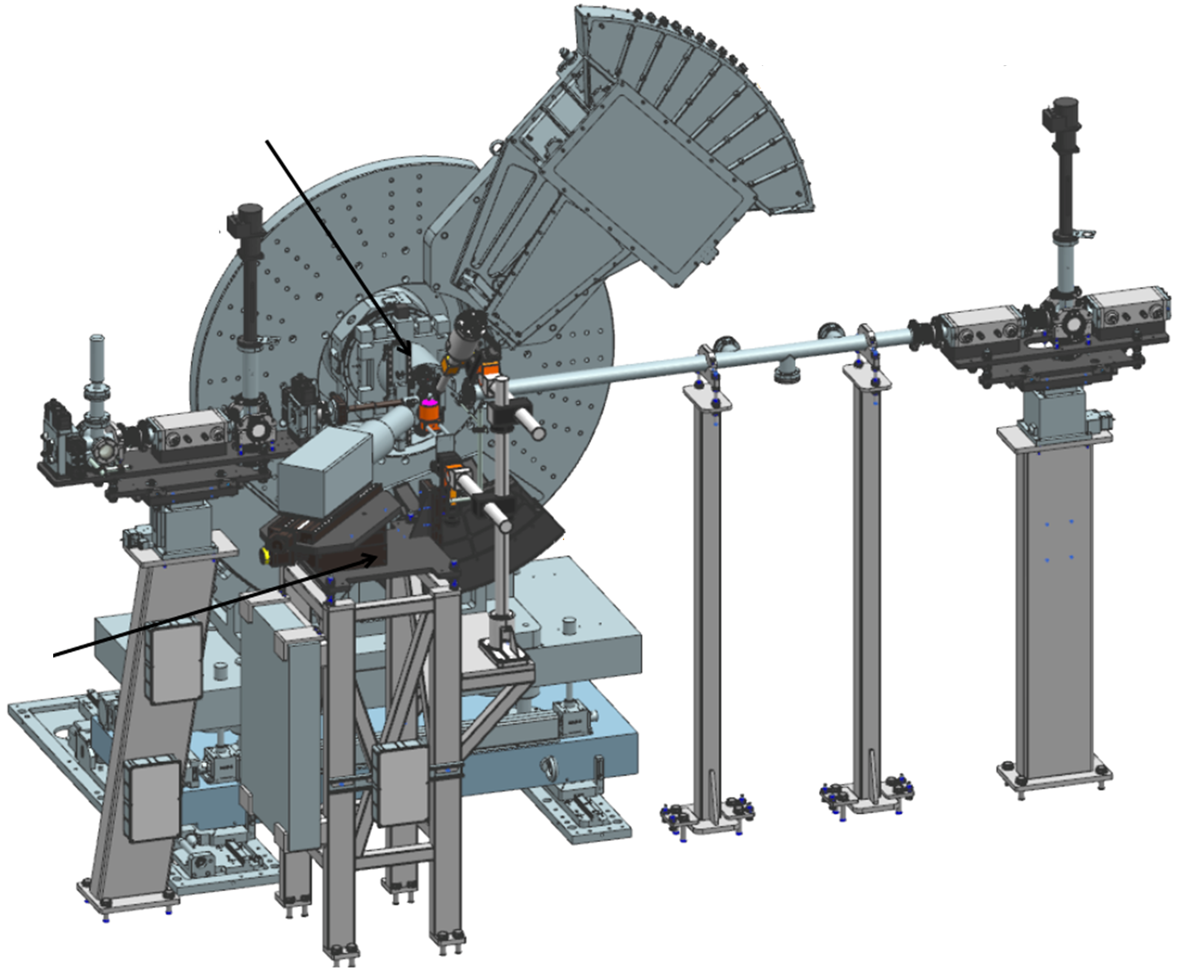
PTI+ TRANS-ENER+
Transición Energética Sostenible
Synchrotron radiation for Green Energy Applications
SP1: Superconducting Materials
(Dra. Teresa Puig, Dr. Xavier Obradors, Dr. Elzbieta Pach, ICMAB-CSIC)
SP2: Electrochemical Energy Storage
(Dra. M. Rosa Palacín, Dr. Dino Tonti, Dr. Alexandre Ponrouch, Dr. Ashley Black, ICMAB-CSIC)
SP3: Catalysis in energy related processes
(Dra. Cristina Martínez, Dra. Susana Valencia, ITQ-CSIC)
SP4: Design and fabrication of cells for studies of catalytic processes
(Dr. Gonzalo Prieto, Dr. Fernando Rey, ITQ-CSIC)
https://pti-transener.csic.es/en/alba-test-bench/

Slide 4
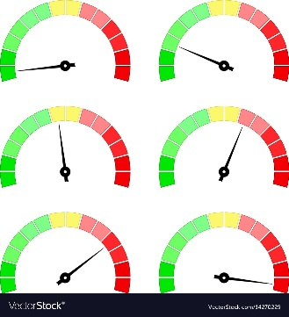
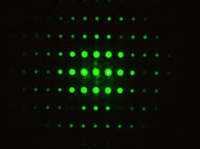
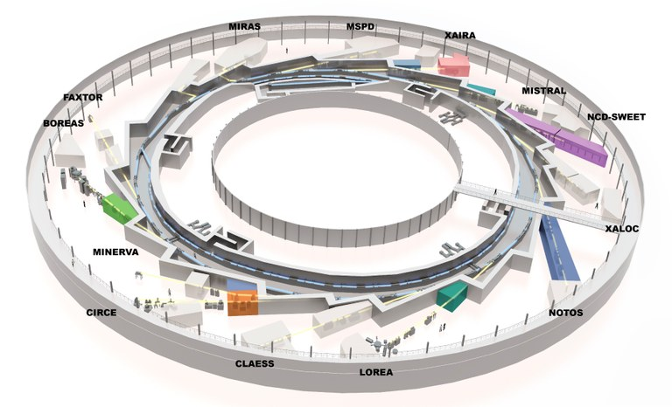


PTI+ TRANS-ENER+
Transición Energética Sostenible
Dynamic effects in functional materials studied in operation conditions with synchrotron radiation
Strengthen
capabilities at national level basing on previous ALBA & CSIC background

Slide 5
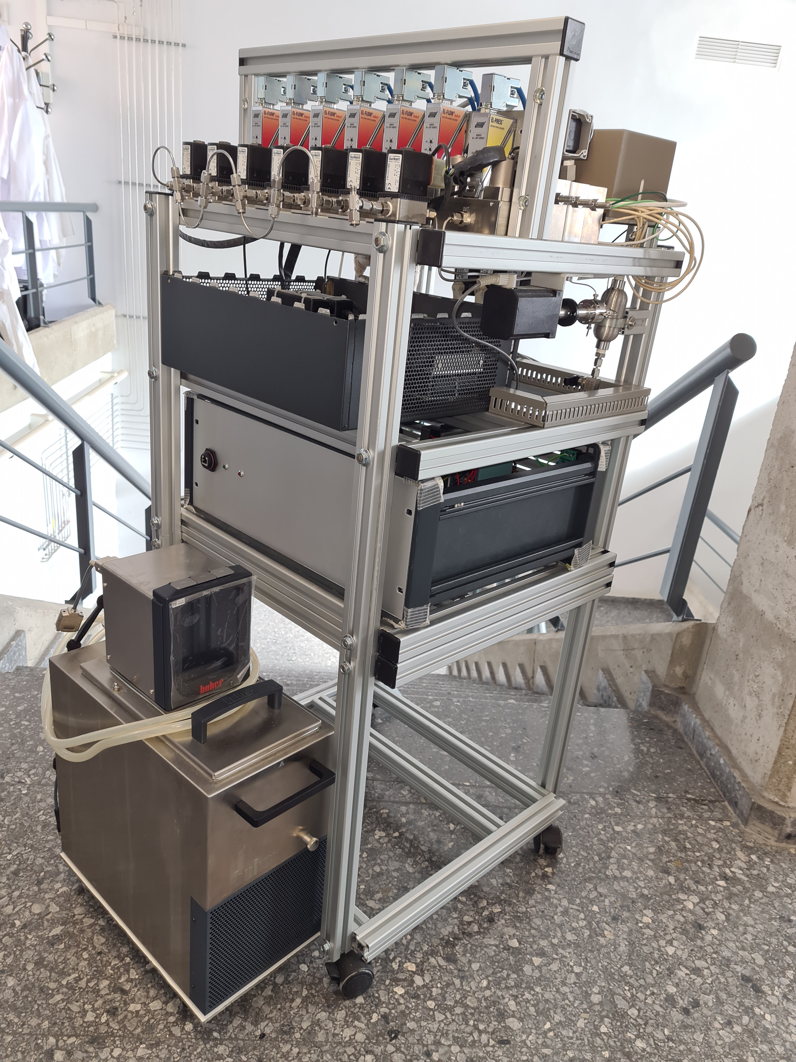
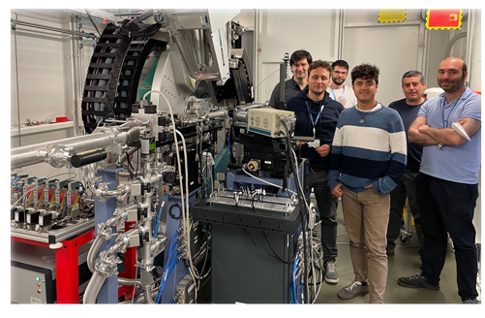
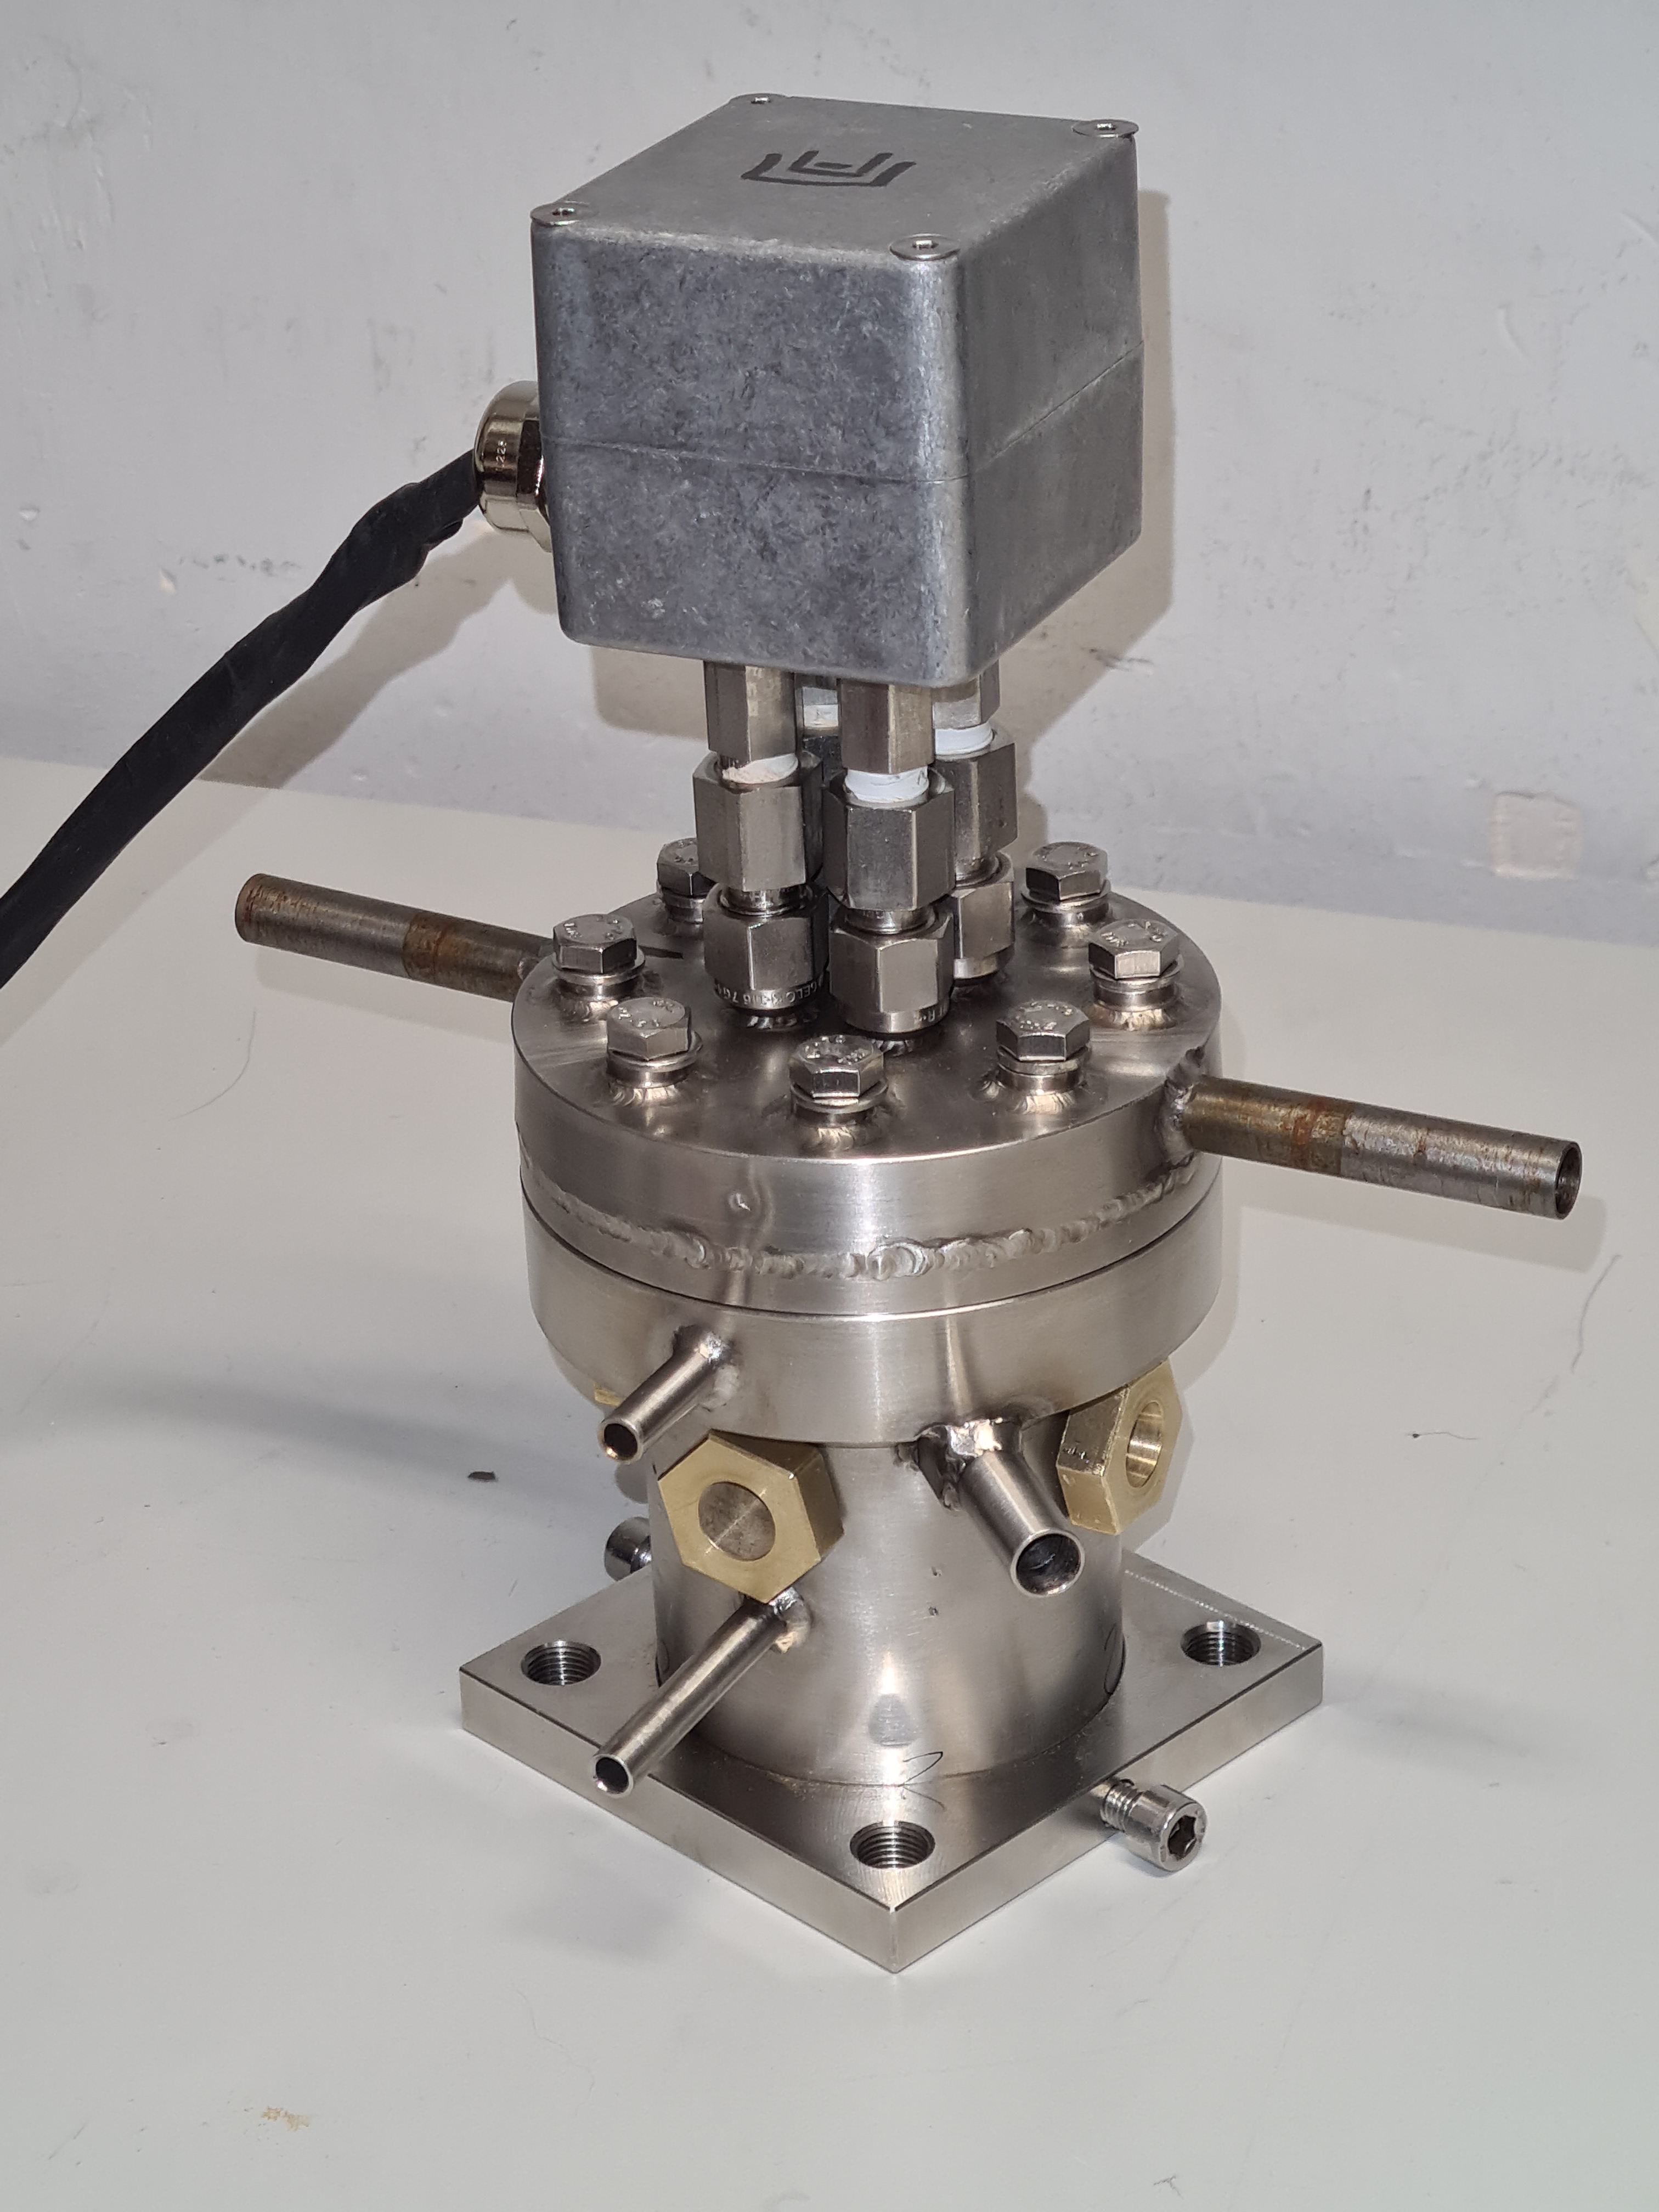
PTI+ TRANS-ENER+
Transición Energética Sostenible
SP3 & SP4 - Catalysis
XAS-XRD to track short- and long-range atomic ordering in catalyst materials operando
(bulk, intermetallics, nanoclusters, “single-atoms”, etc)
Dual microreactors/spectroscopic cells for G/S and G/L/S processes, high T, high P and
application-relevant fluid-solid hydrodynamics
Cell PT1: capillary system for
high-P vapor feeding
Cell PT2: High-P (20 bar),
high-T (700 °C) XAS cell
NOTOS August 2023
Angew Chem (2023)
https://www.albasynchrotron.es/en/media/news/towards-greener-chemical-processes-wth-a-new-catalyst-for-ethylene-hydroformylation

Slide 6
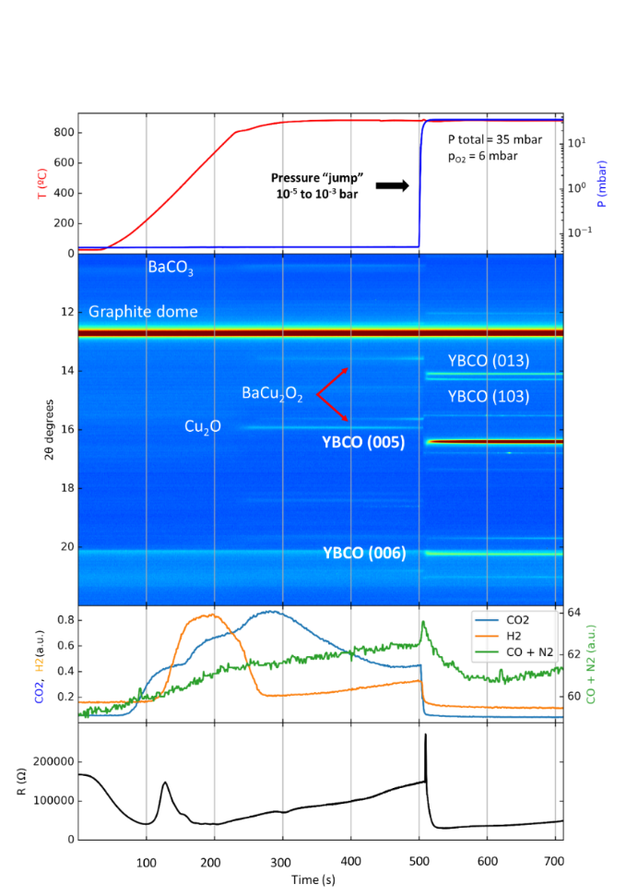
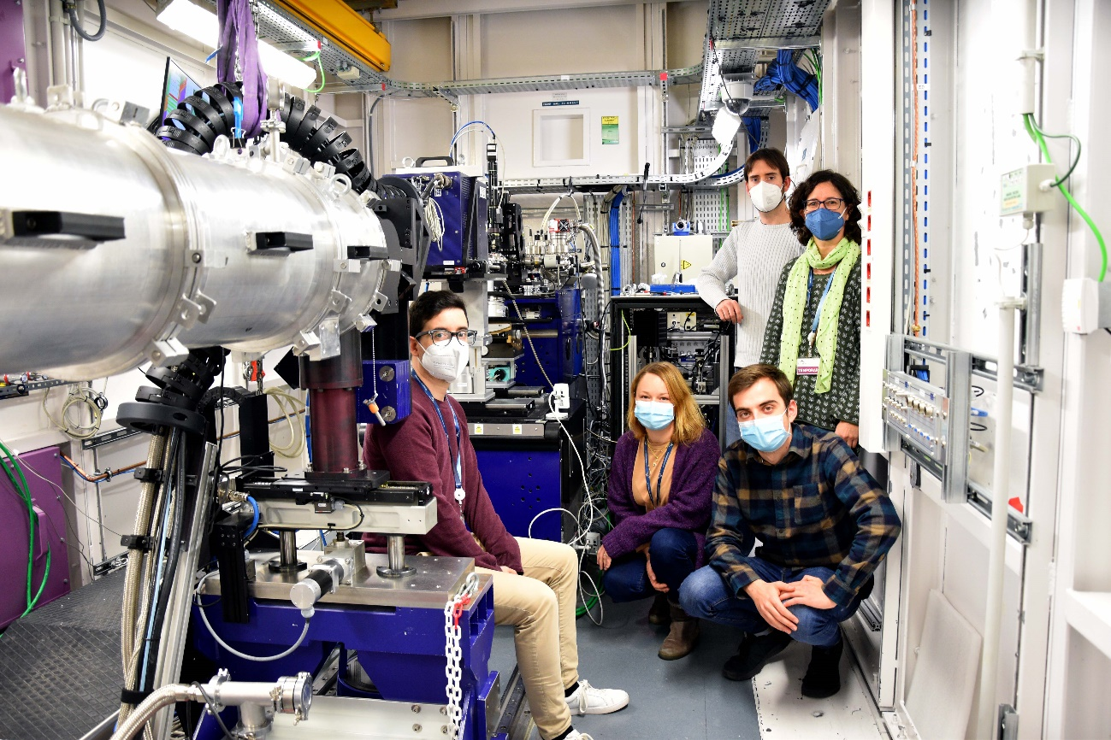
PTI+ TRANS-ENER+
Transición Energética Sostenible
SP1 – Superconductors
1. Experiment conditions
NCD-Sweet beamline
Simultaneous analysis of ultrafast growth of superconducting layers (100-1000 nm/s)
2. Synchrotron XRD
3. Mass spectroscopy
4. Electrical Resistivity
1-4 March 2022
https://www.cells.es/en/media/news/alba-and-icmab-together-for-developing-green-energy-applications-more-efficiently

Slide 7

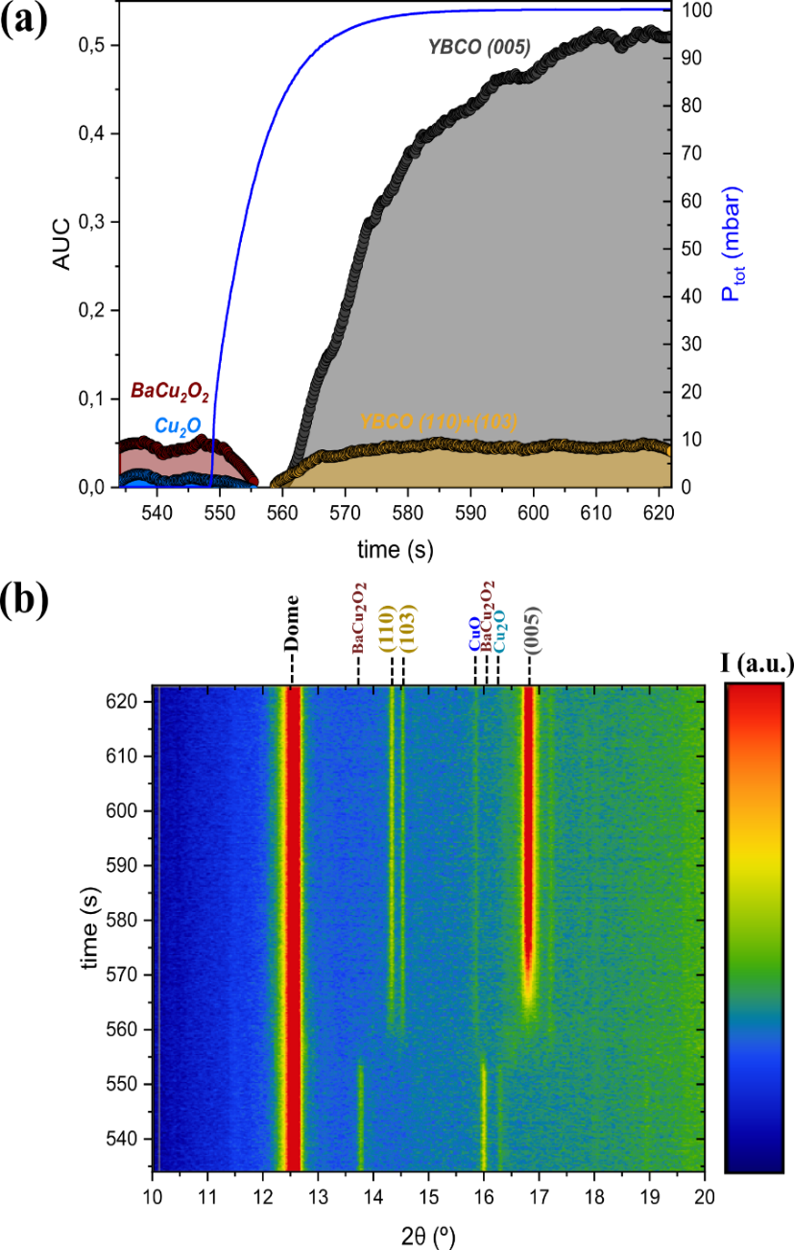
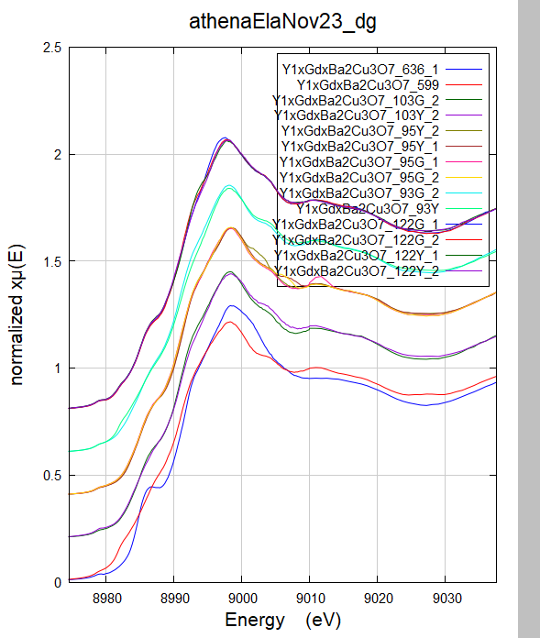
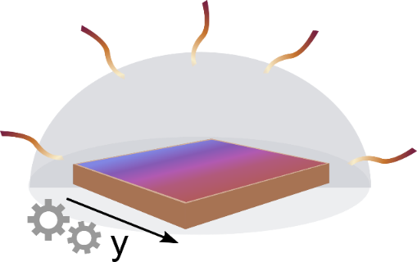

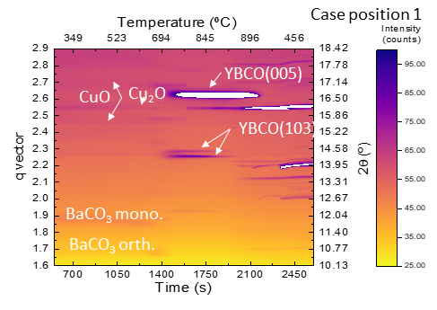
PTI+ TRANS-ENER+
Transición Energética Sostenible
SP1 – Superconductors
Study of the ultrafast non-equilibrium TLAG growth process developed at ICMAB (ERC- Adv Grant)
TLAG- Transient Liquid Assisted Growth of Chemical solution deposited layers
NCD-Sweet diffraction beamline
CLAESS absorption beamline
Compositional gradient layers for fast screening
Expanding to
Transient liquid
Cu K-edge
In fluorescence at 45 deg
Gradient sample
Y_{1-x}Gd_{x}Ba₂Cu₃O_{7-δ}
Adv Science (2022)
Nature Reviews Physics (2023)

Slide 8
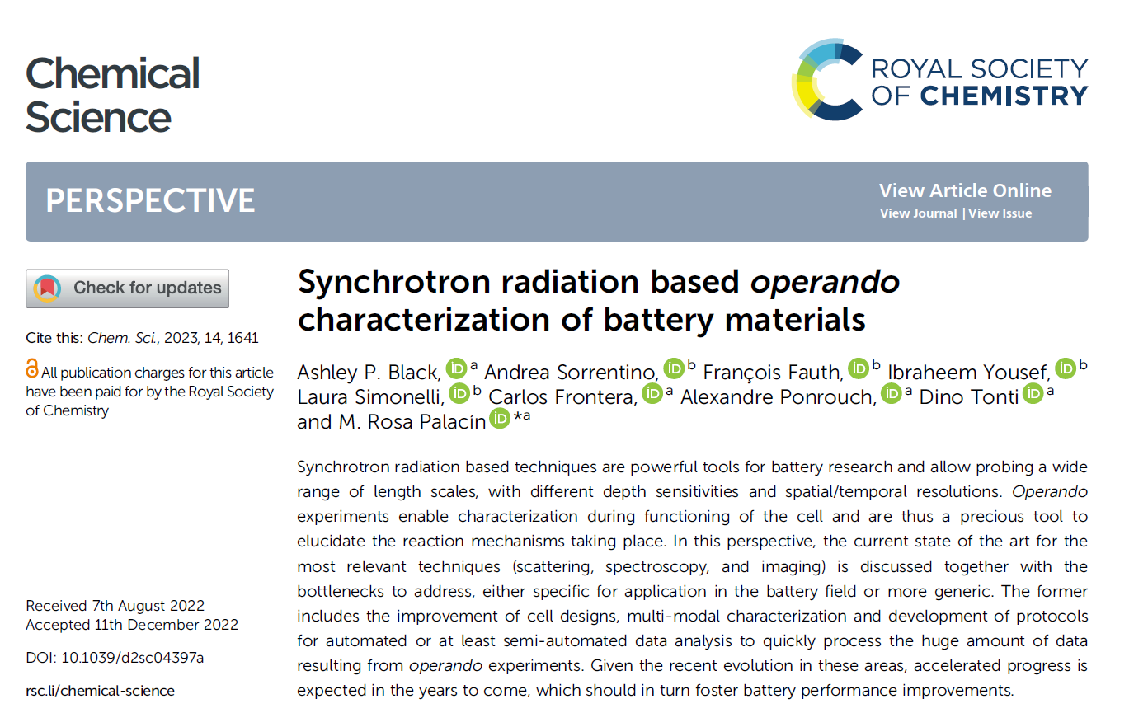
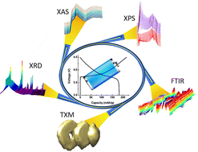
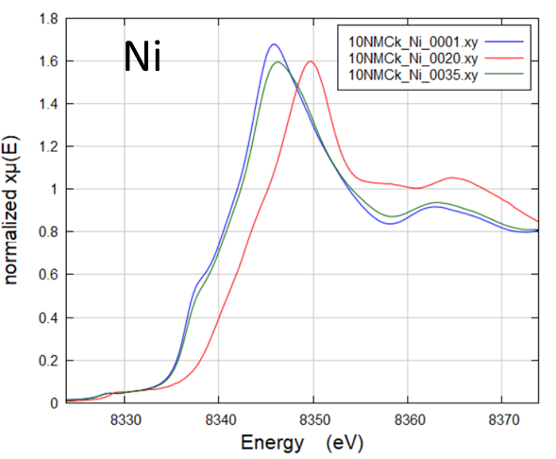
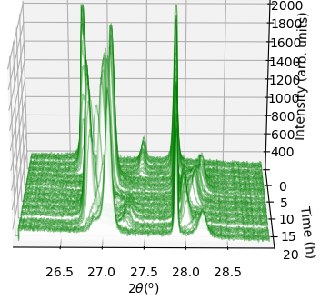
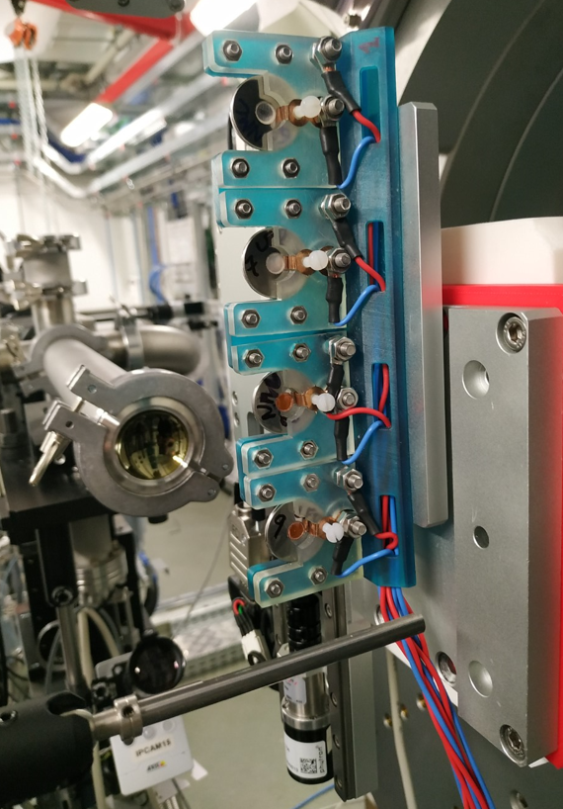
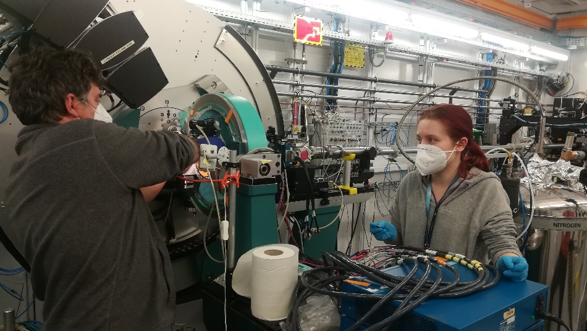
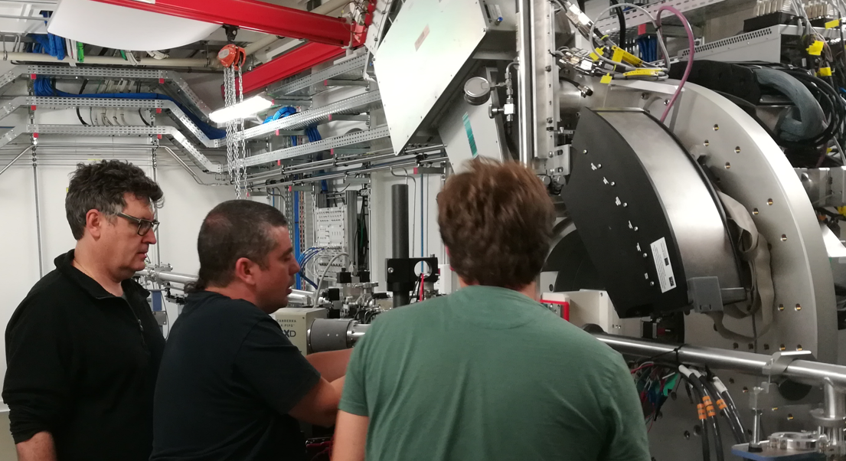
PTI+ TRANS-ENER+
Transición Energética Sostenible
SP2 – Electrochemical Energy Storage
Expand ALBA battery operando capabilities
MSPD
CLAESS
NOTOS
MIRAS
MISTRAL
….
April 2022: 1st experiment at NOTOS!!
proof-of-concept with selected scientific cases
https://icmab.es/notos-beamline-at-alba-synchrotron-hosts-its-first-experiment-with-icmab-researchers

Slide 9
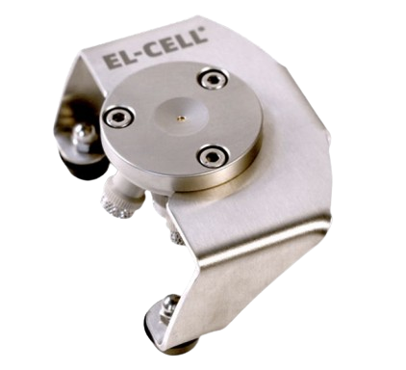
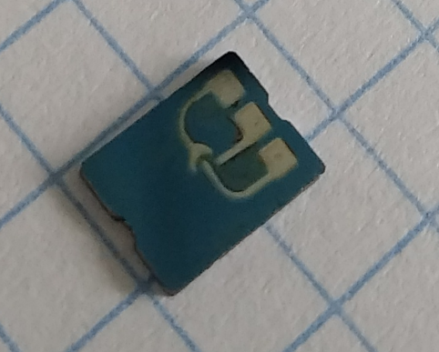

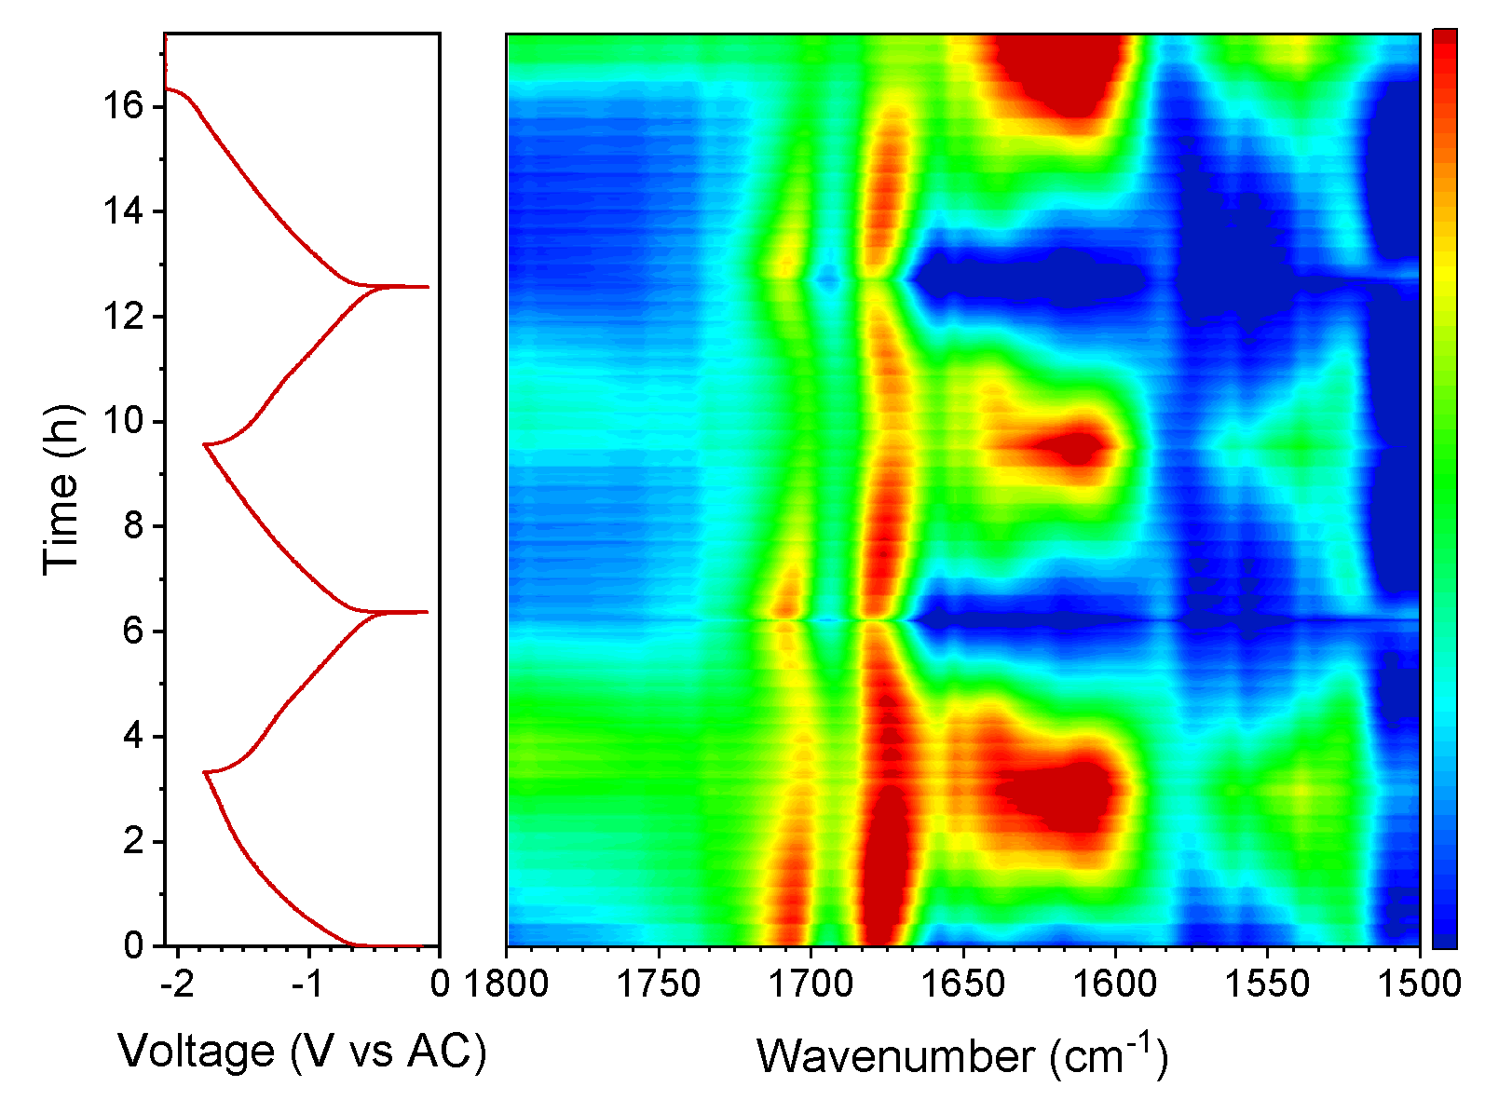

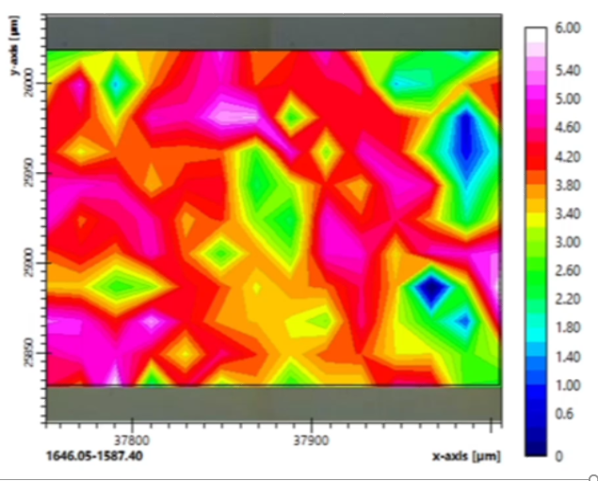
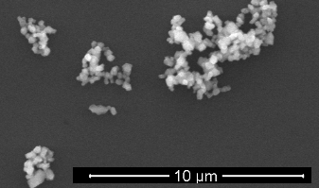
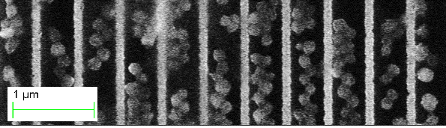
PTI+ TRANS-ENER+
Transición Energética Sostenible
SP2 – Electrochemical Energy Storage
MIRAS
Commercial cell adapted for operando IR
MISTRAL
Microelectrodes on Chips
∼ x 100 nm, thicker than TEM (10 nm)
CE
25-100nm Si₃N₄ window
REF
WE
100-500 nm spacers
0
comercial active particles on Si₃N₄-coated chips
Perspectives: microspectroscopy
mapping
Perspectives: operando Transmission Soft X ray
microscopy, TEM, SPM (InCAEM project)
ACS Appl. Energy Mat. (2023)

Slide 10
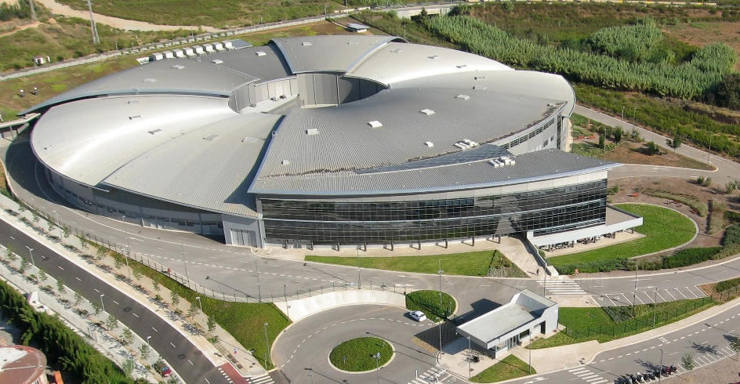

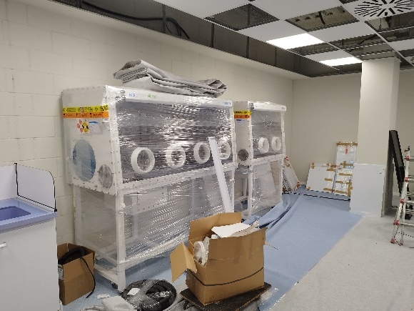
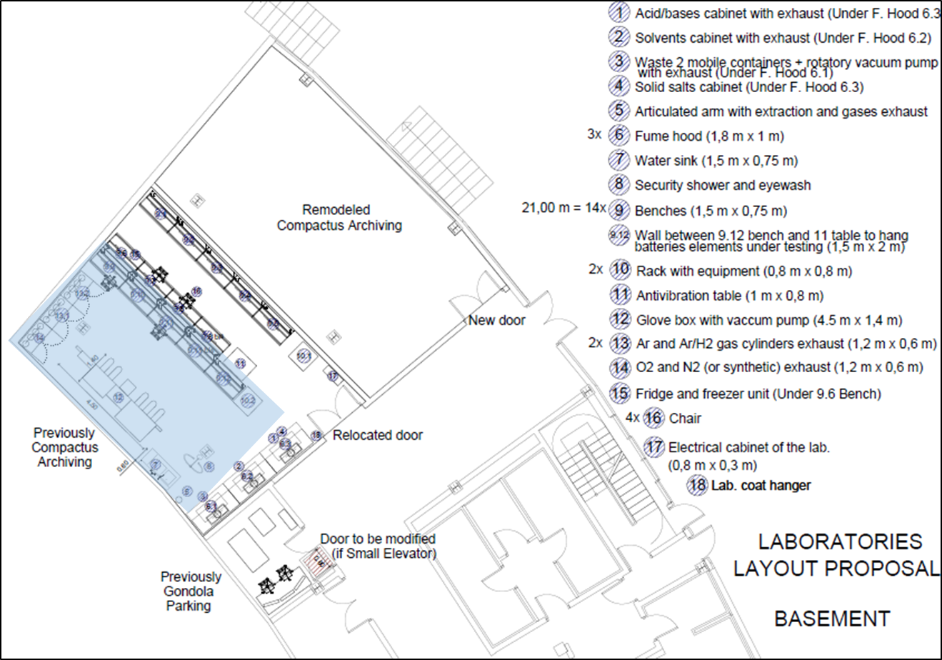
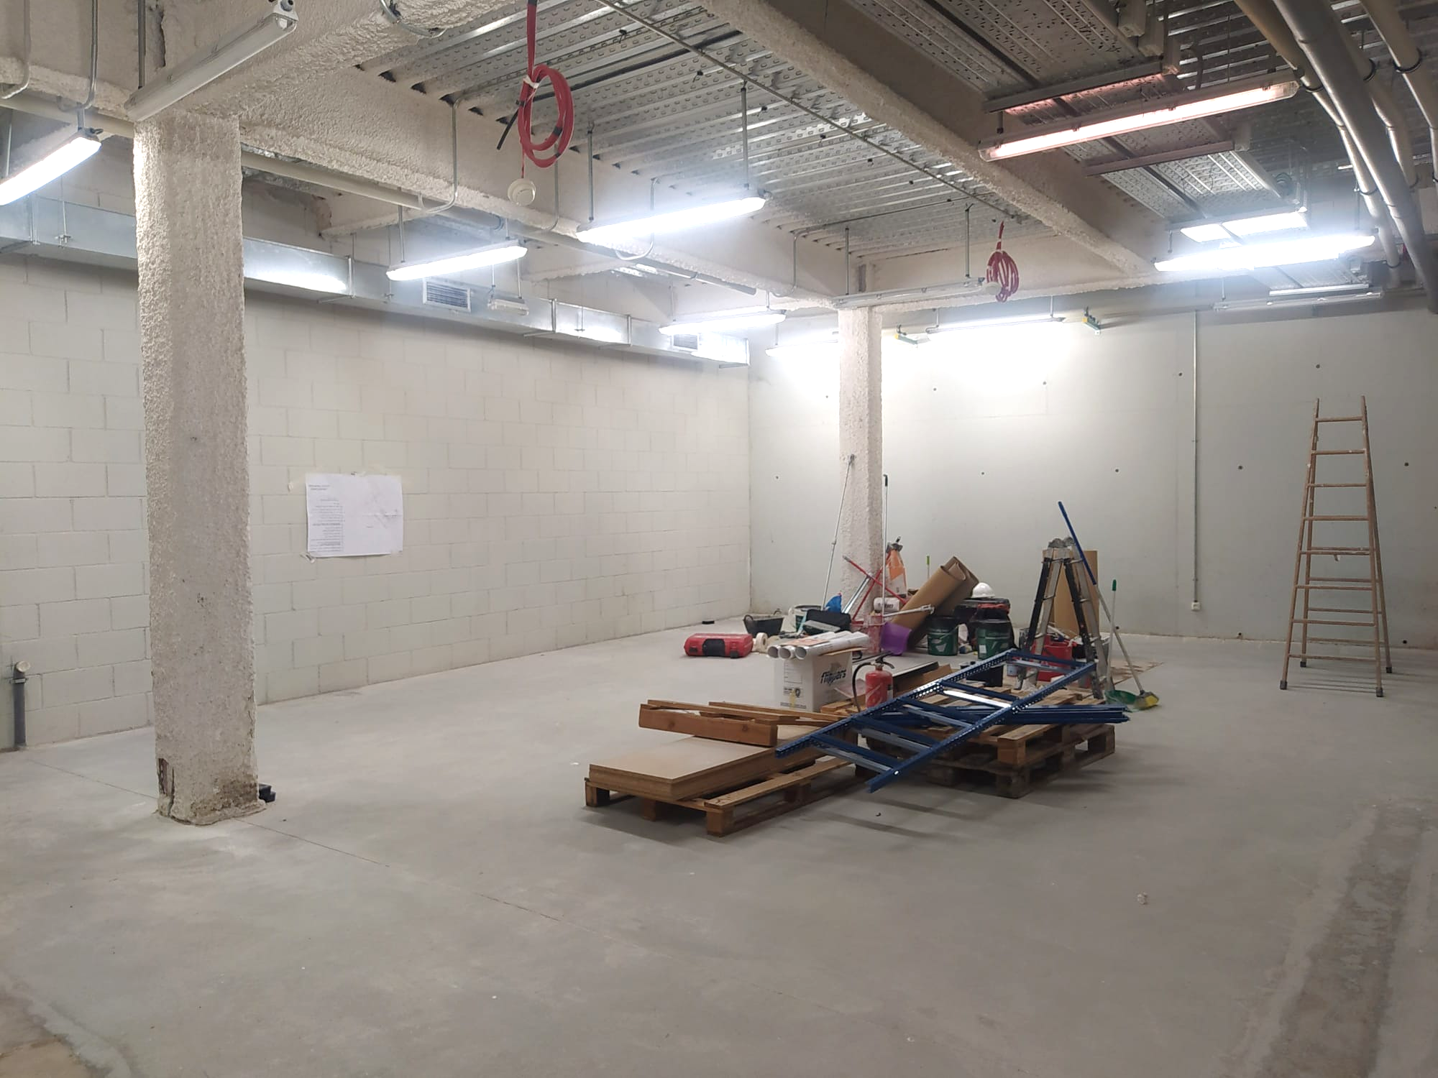
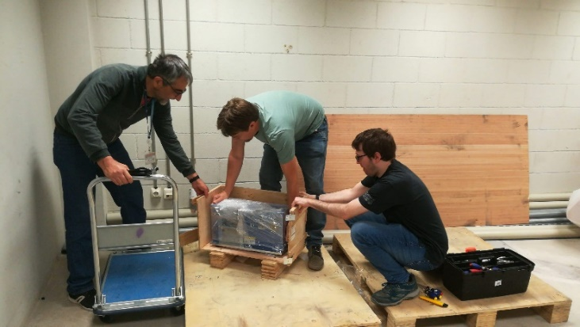
PTI+ TRANS-ENER+
Transición Energética Sostenible
Joint ICMAB – ALBA laboratory
2021 - 2022
Joint laboratory design
ALBA infrastructure – CSIC equipment + personnel
Call for tenders, planning etc.
Construction work initiated / First equipment received
2023
Laboratory comissioning
Signature of CSIC – ALBA agreement
50 m²

Slide 11
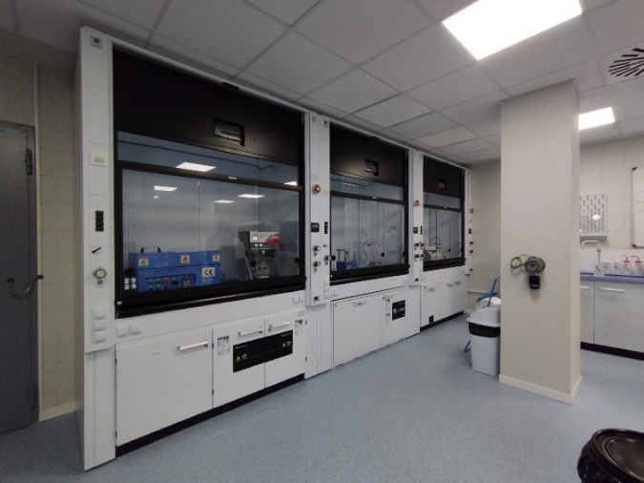
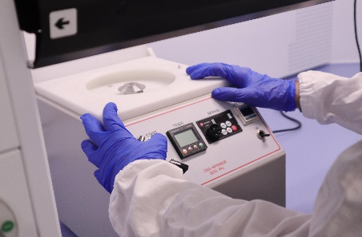
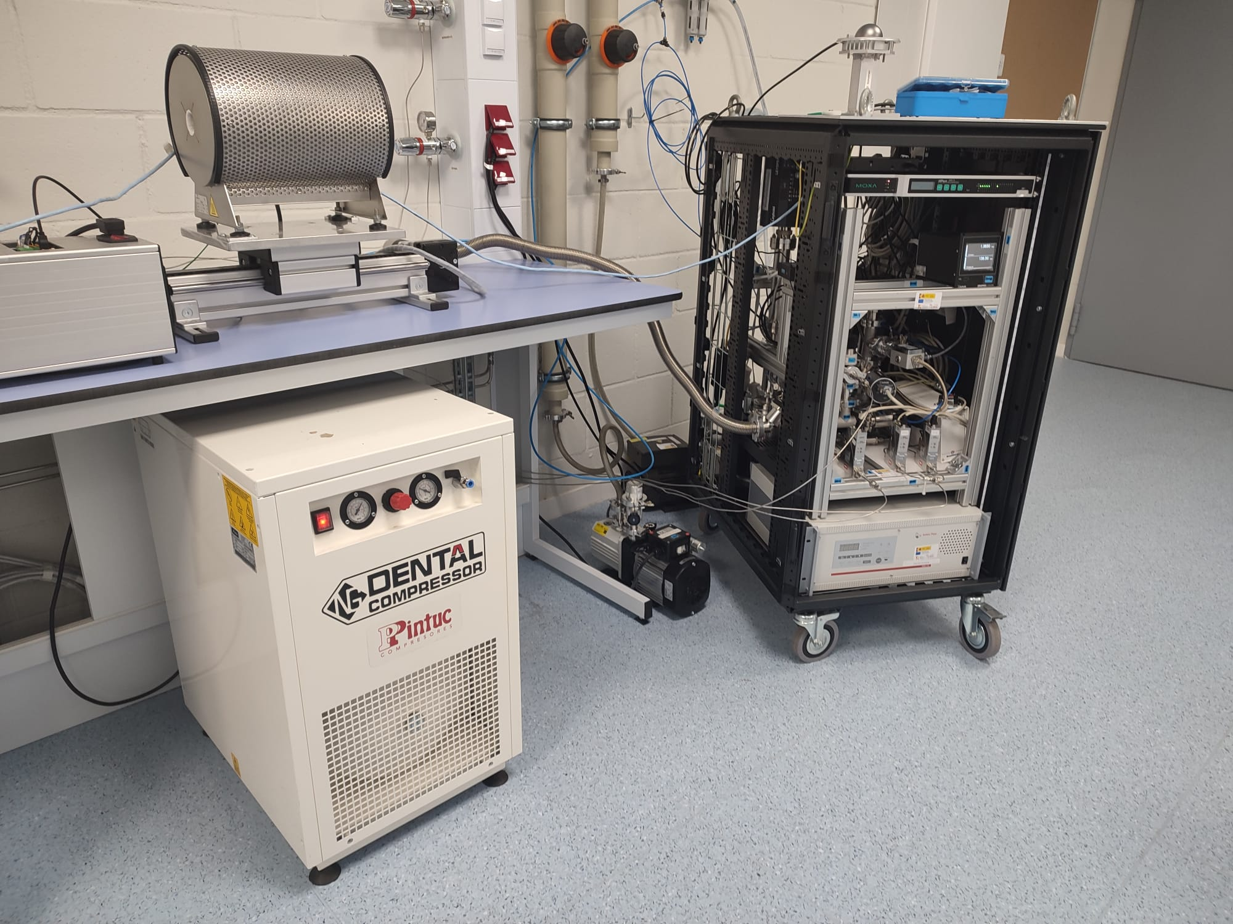
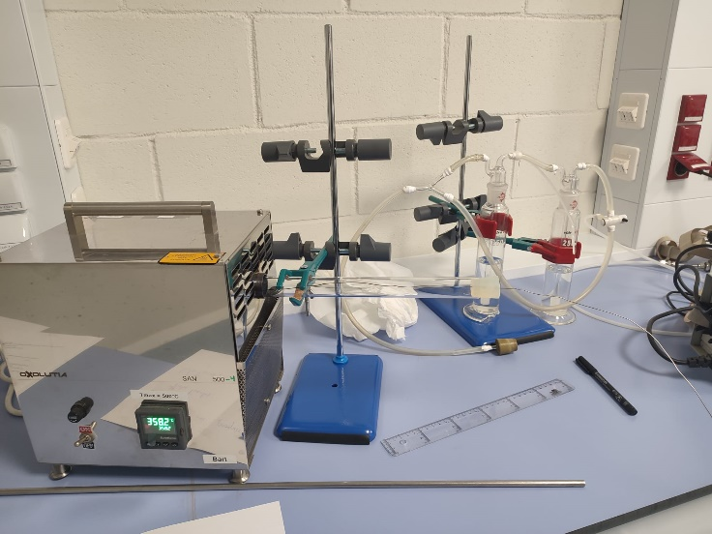
PTI+ TRANS-ENER+
Transición Energética Sostenible
Foster operando studies on energy-related materials : superconducting films
Study of the kinetic growth mechanisms of superconducting films grown at ultrafast rates
1. Chemical solution synthesis and deposition
3. Growth system (with temperature, atmosphere and pressure control) adapted to experiments at beamlines and off-beamlines in a mobile rack
2. Pyrolysis furnaces, optical observation of the precursor layers

Slide 12

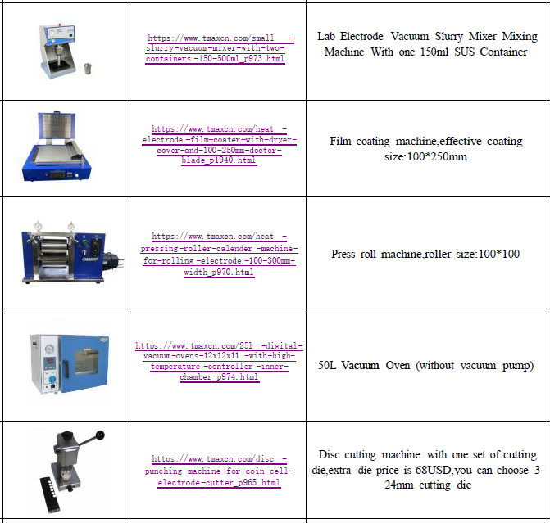
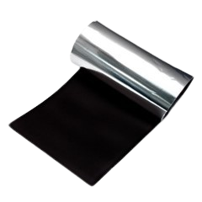
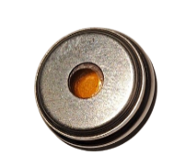
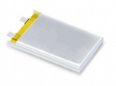
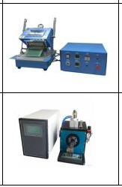
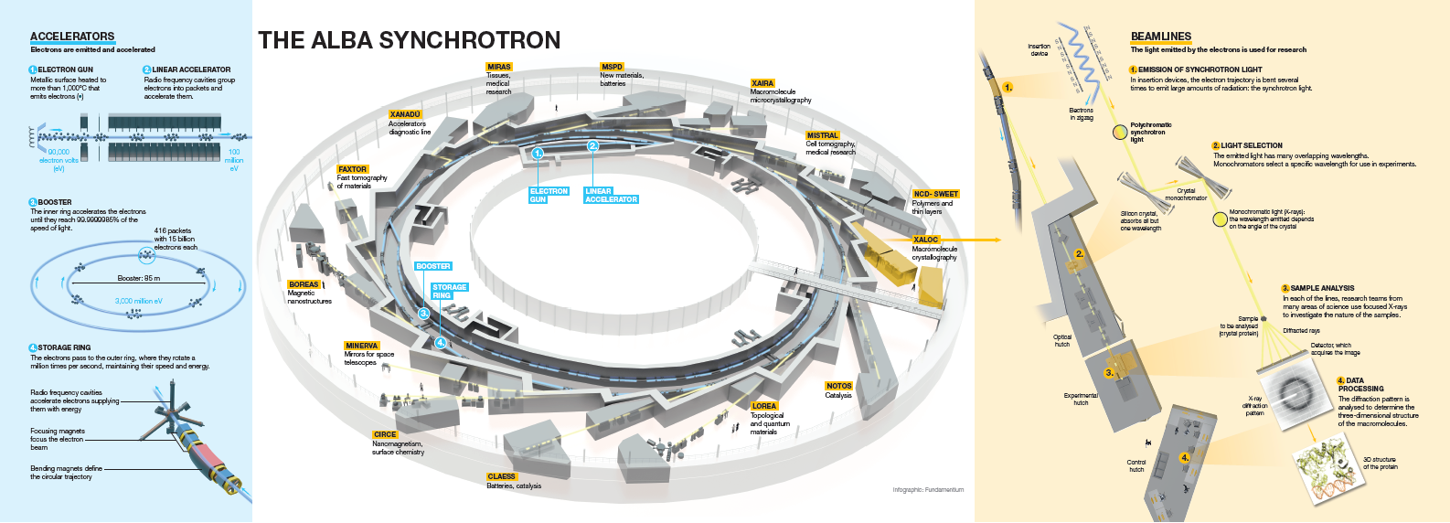
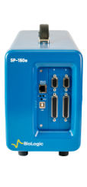

PTI+ TRANS-ENER+
Transición Energética Sostenible
Foster operando studies on energy-related materials: batteries
Battery assembly and testing : electrode fabrication & custom/coin/pouch cells & potentiostats
coin cells
mixing
casting
drying
electrodes
cutting
hood
customization
calendering
pouch cells
welding
sealing
glove box
16 channels
2 channels
Low current
beamlines
testing

Slide 13







PTI+ TRANS-ENER+
Transición Energética Sostenible
Finishing comissioning
Already open to all ALBA users
Inauguration soon….

Slide 14


PTI+ TRANS-ENER+
Transición Energética Sostenible

