Slide 1
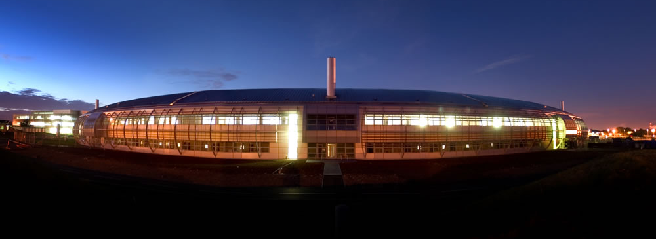
Overview of the Diamond Light Source
Ian Martin
ALBA Synchrotron Visit
5th October 2017

Slide 2
Talk Outline
Diamond Light Source
general introduction to the facility
different operating modes
top up, low alpha operation
Facility Upgrades / New Beamlines
increasing beam brightness
double mini-beta straight sections
exotic insertion devices
DDBA upgrade
Future developments
DIAD beamline
Diamond II?
Diamond Light Source
general introduction to the facility
different operating modes
top up, low alpha operation
Facility Upgrades / New Beamlines
increasing beam brightness
double mini-beta straight sections
exotic insertion devices
DDBA upgrade
Future developments
DIAD beamline
Diamond II?
Ian Martin, ALBA Visit, Oct 2017

Slide 3
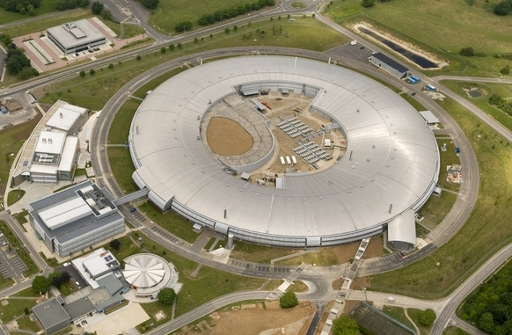
Diamond Light Source
Diamond is a 3rd generation synchrotron light source
Located at Rutherford Appleton Laboratory, Oxfordshire, UK
Join Venture between UK Government and Wellcome Trust
Largest UK investment in science for 30 years
Ian Martin, ALBA Visit, Oct 2017

Slide 4
Diamond Light Source
1993 Woolfson Review: SRS to be replaced by a new medium energy machine
1997 Feasibility Study (“Red Book”) published 3 GeV, 16 cells, 345 m circumference, 14 nm rads
1998 Wellcome Trust joins as partner
Mar. '00 Decision to build Diamond at Rutherford Appleton Lab.
Oct. '00 3 GeV, 24 cells, 560 m circumference design approved
Apr. '02 Joint Venture Agreement signed (UK Govt./Wellcome Trust)
Diamond Light Source Ltd. Established
Design Specification Report (“Green Book”) completed by CCLRC
Jan. '07 Start of Operations
Ian Martin, ALBA Visit, Oct 2017

Slide 5
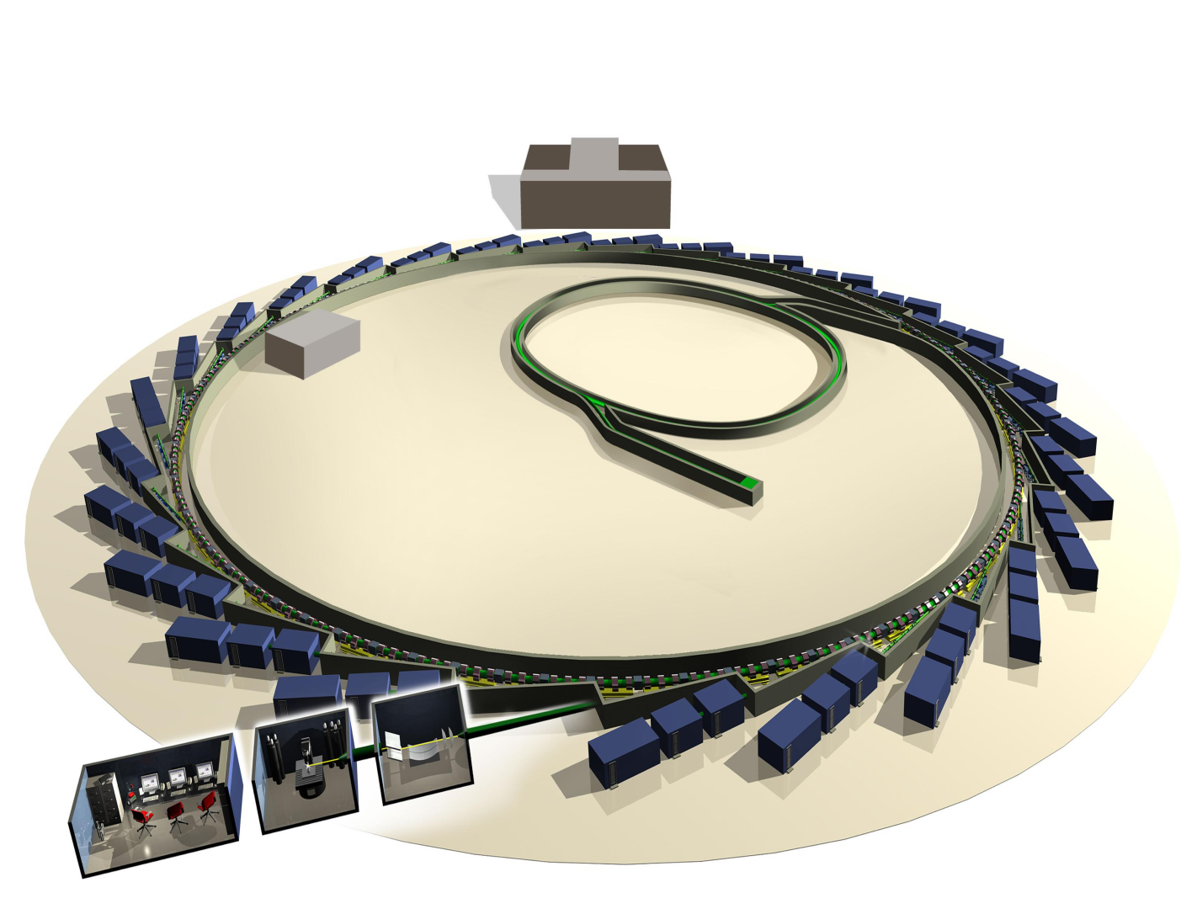
Facility Layout
Booster to Storage ring (3GeV)
Booster (100MeV to 3GeV)
Linac to Booster (100MeV)
Linac (0 to 100MeV)
Storage Ring (3GeV)
Beam Line
180m
Ian Martin, ALBA Visit, Oct 2017

Slide 6
Main Parameters
Lattice Double Bend Achromat
Structure 24 cell
Symmetry 6
Straights 18 × 5m / 6 × 8m
Energy 3 GeV
Length 561.6 m
Lifetime >10h
Current 300mA
Emittance 2.7nm.rad
Bunch Length 10ps (3MV)
Energy Spread 9.6x10⁻⁴
Ian Martin, ALBA Visit, Oct 2017

Slide 7
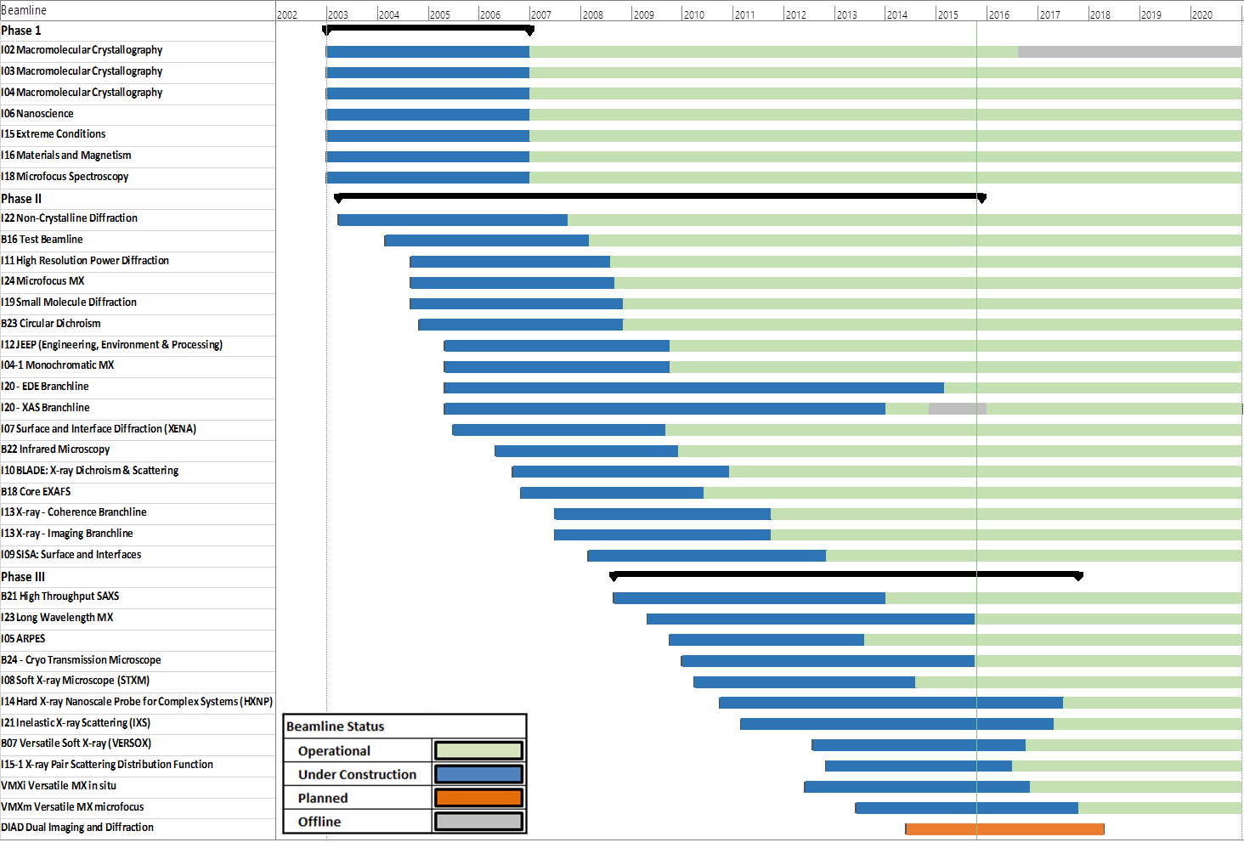
Overview of Diamond
Beamline Installation
Beamline Installation
35 Beamlines:
29 installed IDs
7 BM beamlines
All straights now occupied
Ian Martin, ALBA Visit, Oct 2017

Slide 8
Operational Modes
Injector allows a very flexible fill pattern control, but bunch length limited to >10ps and increases with bunch current.
Several different modes of operation on offer:
1) Multibunch: bunches spaced by 2 ns, filling 70-90 % of the ring
total current: 300 mA
bunch current: 0.35-0.5 mA (depending on fill pattern)
2) Hybrid: combination of multibunch and single bunch
e.g. 300 mA in consecutive bunches in
2/3rd of the ring + 3.0 nC single bunch
3) 156 bunch mode: bunches evenly spread
average current: ~136 mA
bunch spacing: 12 ns
312 ns
312 ns
Ian Martin, ALBA Visit, Oct 2017

Slide 9
Top-up
Diamond has operated in top-up mode since end Oct 2008 with many benefits:
Higher average brightness
Higher average current, constant flux
Improved stability
Constant heat load, beam current dependence of BPMs
Flexible operation
Smaller ID gaps, lower coupling
2008
Single-bunch top up application:
every 10 minutes with ~30-50 shots
current stability few 10⁻³
Injection efficiency 70-80% (~85% without IDs)
2011
Ian Martin, ALBA Visit, Oct 2017

Slide 10
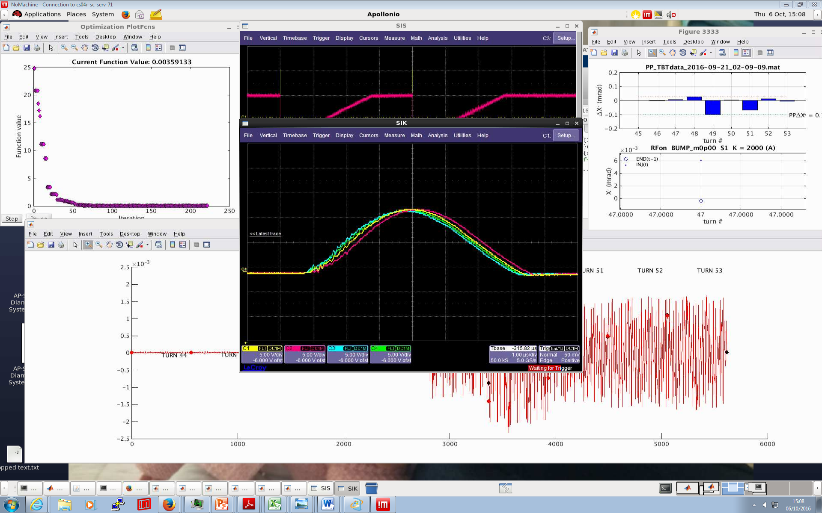
Top-up
Four-kicker injection scheme
6 μs half-sine pulses
Stored beam kicked at least 3 times
Aligning current traces on scope produced poor injection efficiency
Best injection efficiency requires shift of kicker 2 timing (magenta)
Virtually impossible to match the pulses over the full train
Stored beam
Injected beam
1.87us
means 900/936 fill
Ian Martin, ALBA Visit, Oct 2017
Notes:
10
Wiggle is noise on pickups
K2 vessel resistance shows open

Slide 11
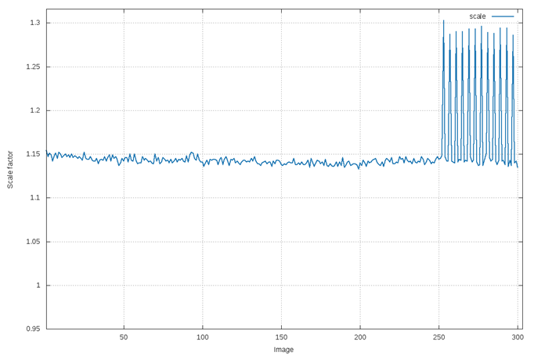
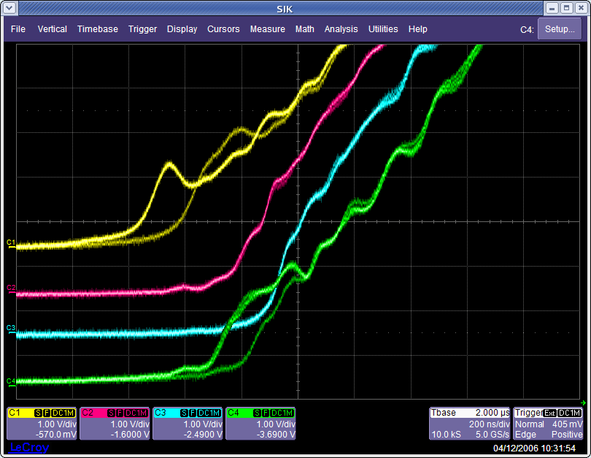
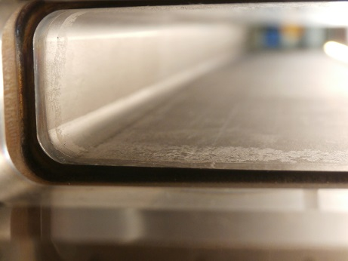
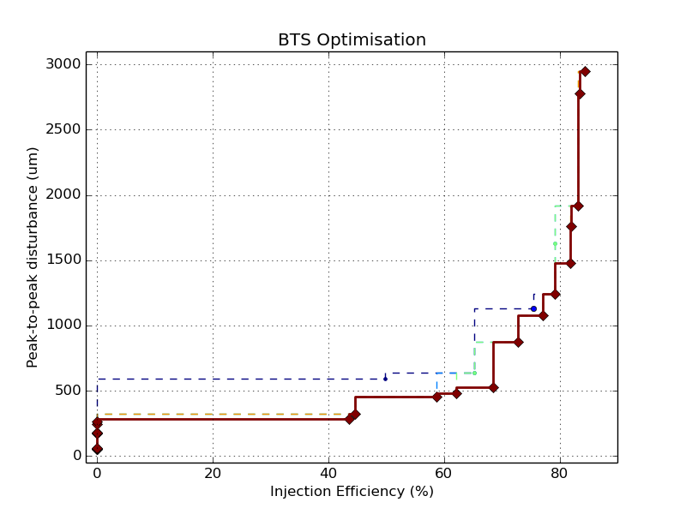
Top-up
Kicker pulses not identical
10-15% intensity fluctuation
Kicker-01 vessel coating damage
courtesy C. McAuley, I03
Transient clearly visible by the beamline
Gating signals supplied to beamlines (not ideal)
Chop data measured during injection
Pause scan where possible
Re-normalise data where possible
Reduction of injection transient is an active area of study
Trade-off between injection efficiency and stored beam oscillation
  Best achieved:
  H: +/- 150 μm
  V: +/- 75 μm
Ian Martin, ALBA Visit, Oct 2017

Slide 12
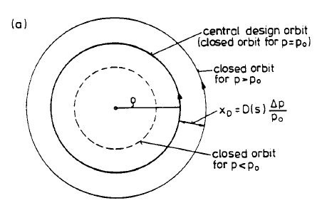
Low Alpha
4) Low Alpha: Special mode generating very short electron bunches. Storage ring is made quasi-isochronous
Momentum compaction factor
(change in path length with energy)
Bunch length
Intrinsic energy spread
(due to SR)
Synchrotron frequency
(osc. in long. plane)
Momentum compaction factor altered by changing the focussing strength of the quadrupoles.
Bunch length can be reduced from few×10 ps to few×1 ps in this way
Ian Martin, ALBA Visit, Oct 2017

Slide 13
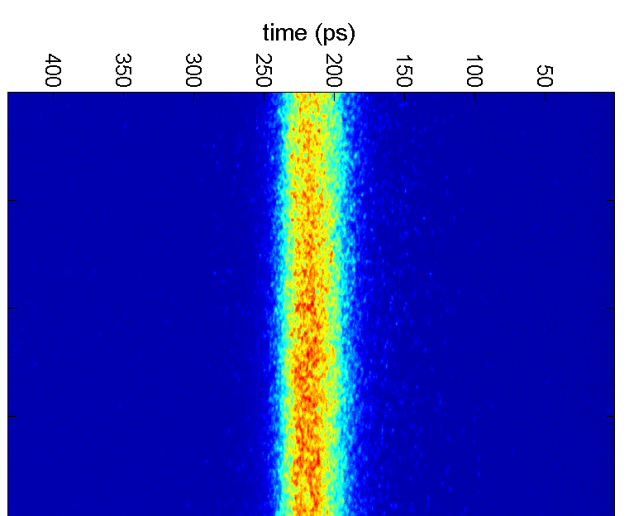
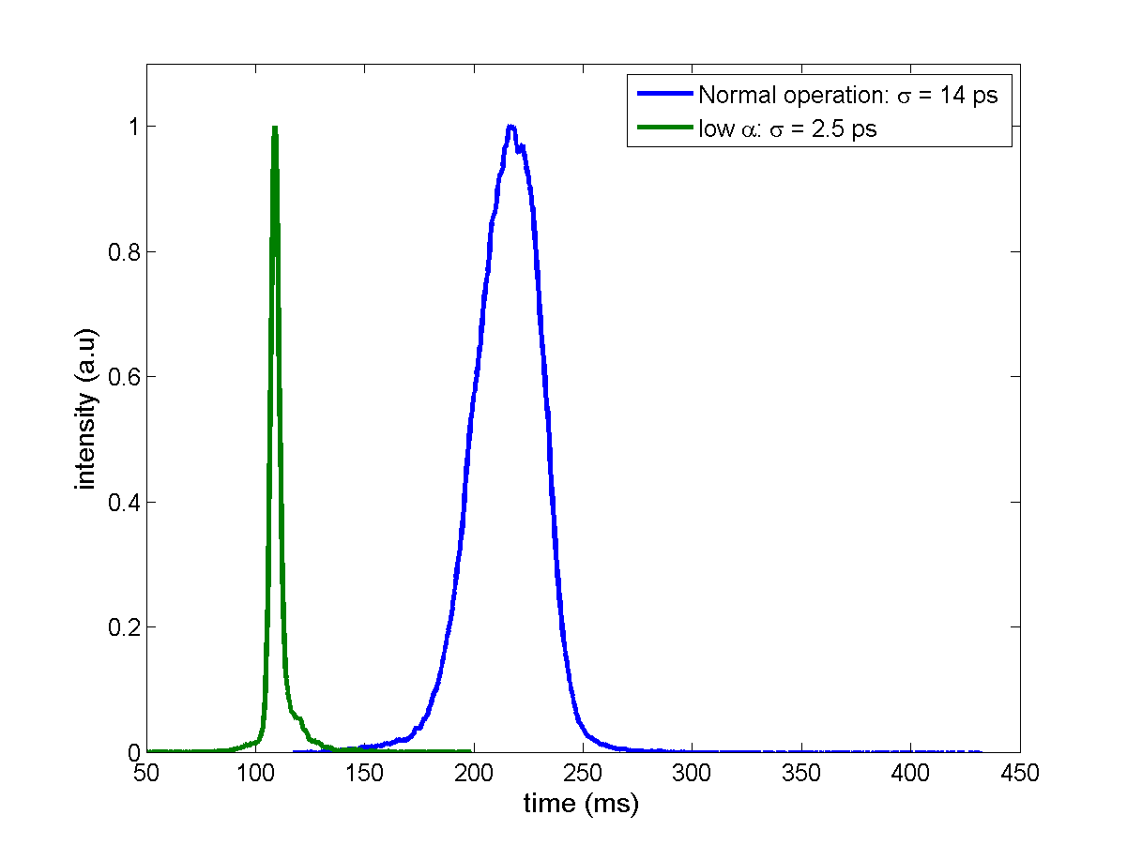
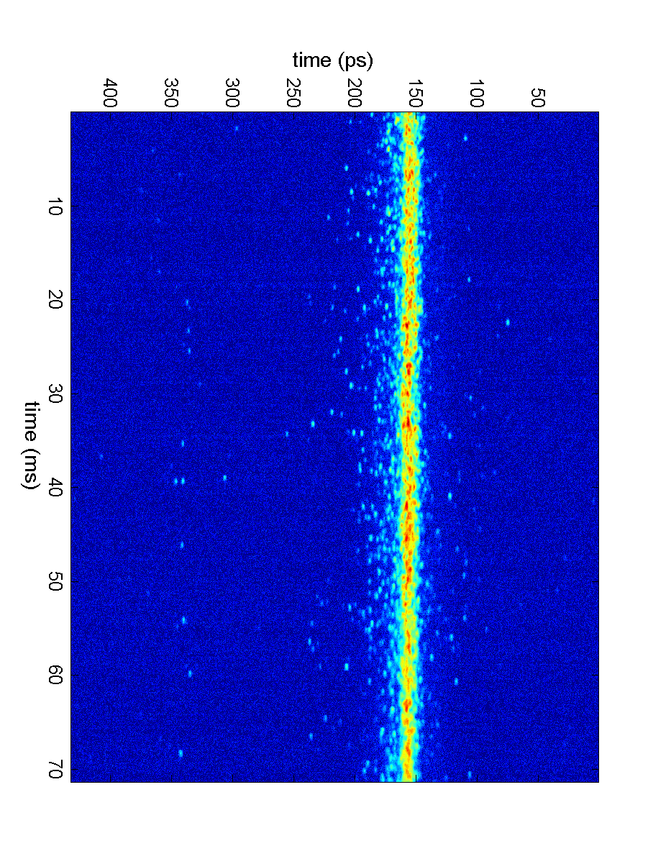
Low Alpha – Short Pulses
15 mm
~15ps
normal operation
~2ps
“low-alpha” mode
Bunch charge ~10μA
Ian Martin, ALBA Visit, Oct 2017

Slide 14
Low Alpha – Coherent Emission
Low Alpha – Coherent Emission
Ian Martin, ALBA Visit, Oct 2017

Slide 15
Low Alpha – User Modes
The Diamond storage ring is run in a dedicated ‘low alpha’ mode 2-3 times per year Since Oct 2012, this has been in top-up with hourly injection cycles
Short pulse mode (NANOSCIENCE beamline I06):
Single bunch for time-resolved science
Electron bunch length reduced to ~3.5 ps
Priority on increased single bunch charge over minimum pulse duration (stable!)
THz mode (MIRIAM beamline B22):
Above bursting threshold to increase CSR gain in THz region
Priority to extend CSR spectrum towards 100cm⁻¹
 | Short Pulse Mode | THz Mode
Momentum Compaction Factor | -1×10⁻⁵ | -4.5×10⁻⁶
Number of bunches | 400 + 1 | 200
Bunch current | 50 µA (93 pC) | 50 µA (93 pC)
Emittance coupling ratio | 0.3% | 1%
Lifetime | ~20h | ~20h
Injection efficiency (IDs open) | 30-40% | 15-20%
V_{RF} | 3.4MV | 3.4MV
Micro-bunching instability threshold (SB) | ~30-35 µA | ~15 µA
Bursting threshold (SB) | ~55-60 µA | ~25-30 µA
Ian Martin, ALBA Visit, Oct 2017

Slide 16
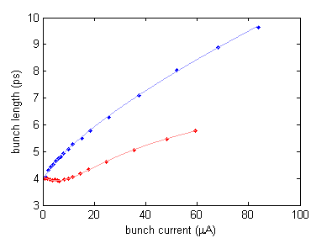
Low Alpha
Negative alpha operation benefits both short pulse and THz users:
  Bunch lengthening with current reduced
  ‘Sharper’ longitudinal profile
  Measured instability thresholds similar
α₁ = -1x10⁻⁵
V_{RF} = 1.5MV
I_{bunch} = 25µA
α₁ = +1x10⁻⁵
V_{RF} = 1.5MV
I_{bunch} = 25µA
α₁ = +1x10⁻⁵ / 1.5MV
α₁ = -1x10⁻⁵ / 1.5MV
Ian Martin, ALBA Visit, Oct 2017

Slide 17
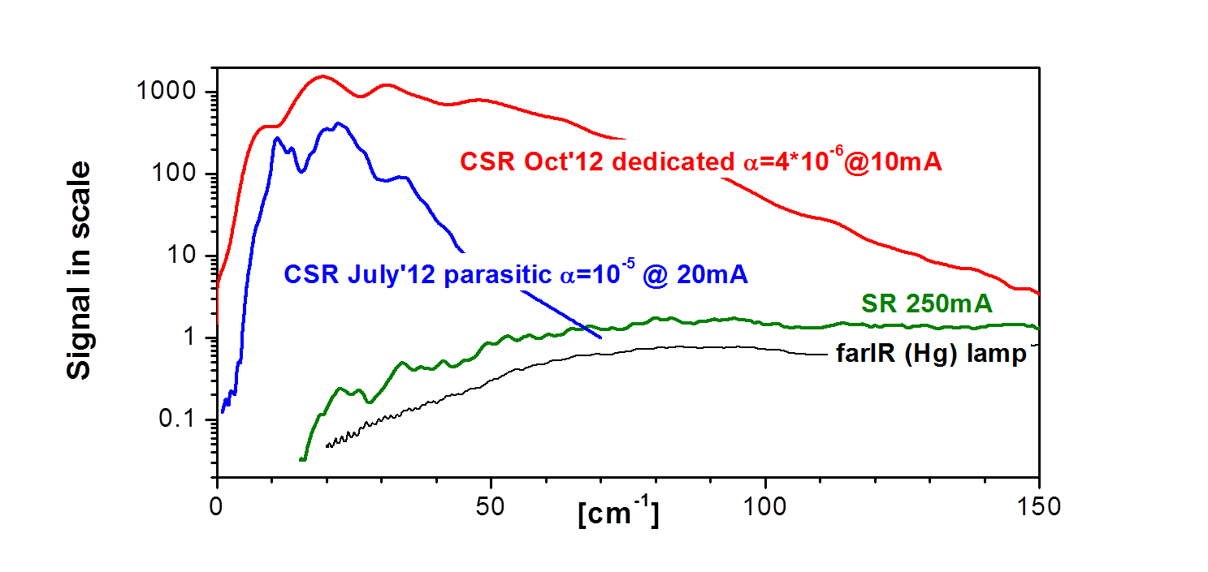
Low Alpha
03/10/2012
04/10/2012
05/10/2012
THz Optics (10 mA/200 bunches)
Short Pulse Optics (20 mA/400 bunches)
Nominal Optics
(250mA/686 bunches)
courtesy G. Cinque
Ian Martin, ALBA Visit, Oct 2017

Slide 18
Talk Outline
Diamond Light Source
general introduction to the facility
different operating modes
top up, low alpha operation
Facility Upgrades / New Beamlines
increasing beam brightness
double mini-beta straight sections
exotic insertion devices
DDBA upgrade
Future developments
DIAD beamline
Diamond II?
Ian Martin, ALBA Visit, Oct 2017

Slide 19
Beam Current
Cavity 1A replaced by refurbished cavity 2B
Cavity 2B fails again, replaced with cavity 2D
Cavity 2D fails, replaced with cavity 1A
Cavity 2B failure
Top-up operation
Cavity 3C installed
Increases photon beam brightness:
Issues with components heating up, vacuum condition, RF trip reliability, ...
SC RF cavities now being supplemented by 2 EU HOM-damped NC RF cavities
Possibility to further increase beam current towards 500mA. Feasibility studies are under way - requires an additional RF cavity + HHC?
Ian Martin, ALBA Visit, Oct 2017

Slide 20
Reduced Vertical Emittance
In response to request from Science Division, emittance coupling has been reduced from 1% to 0.3% for user operation (27 pm.rad to 8 pm.rad)
Initially confined to machine development periods
Two week period from 17th October to 1st November 2012
Standard operational mode since 6th March 2013
Benefits include increased brightness / transverse coherence, smaller spot size
1% coupling
0.3% coupling
Ian Martin, ALBA Visit, Oct 2017

Slide 21
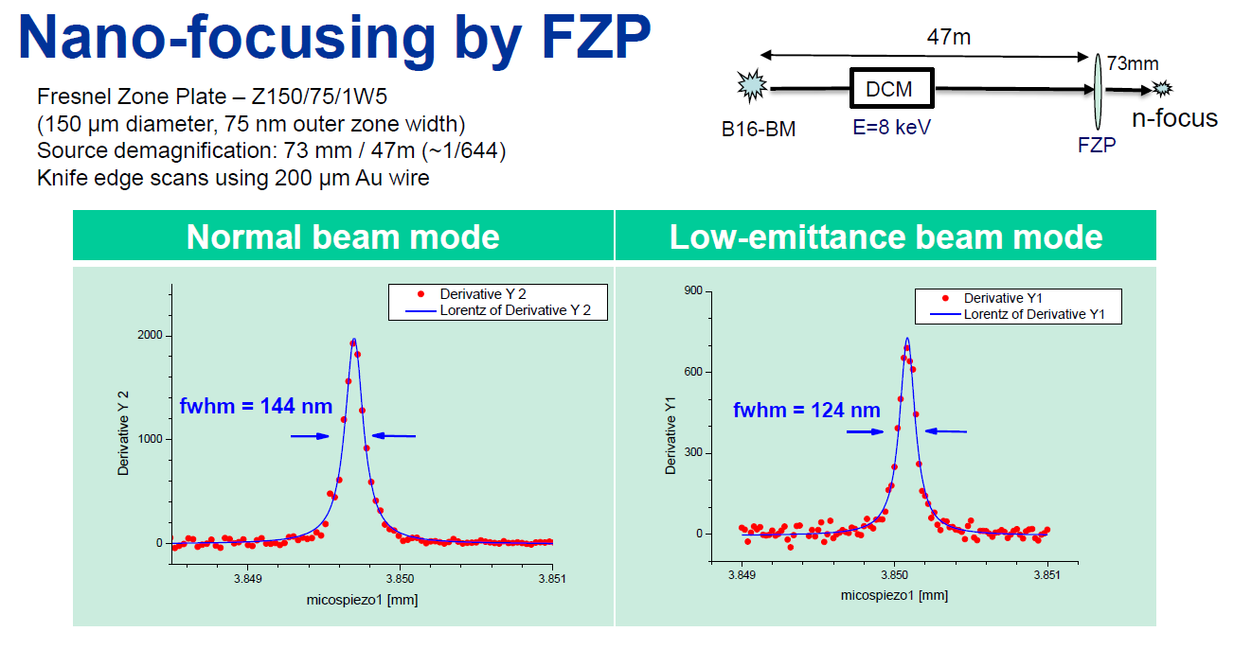
Reduced Vertical Emittance
courtesy K. Sawhney
Reducing vertical emittance leads to small focus on sample
Ian Martin, ALBA Visit, Oct 2017

Slide 22
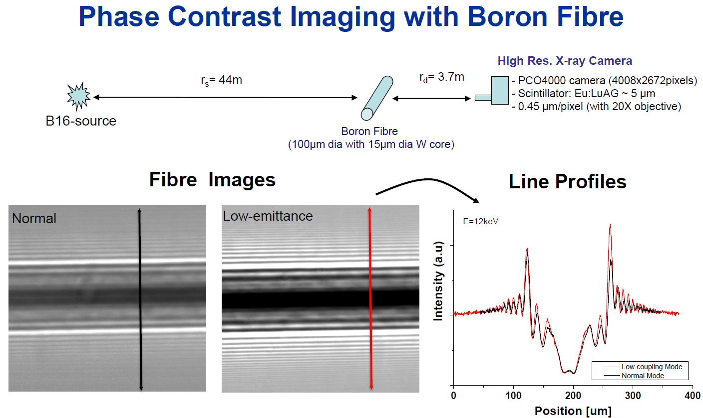
Reduced Vertical Emittance
courtesy K. Sawhney
Reducing vertical emittance leads to higher spatial coherence
Ian Martin, ALBA Visit, Oct 2017

Slide 23
Double Mini-beta Optics
Introduced quadrupole doublets into long straights – reduces vertical beta function and allows 2 independent beam lines with in-vacuum IDs
Additional horizontal focussing allows the long beam line to have transverse coherent beam without losing flux
Ian Martin, ALBA Visit, Oct 2017

Slide 24
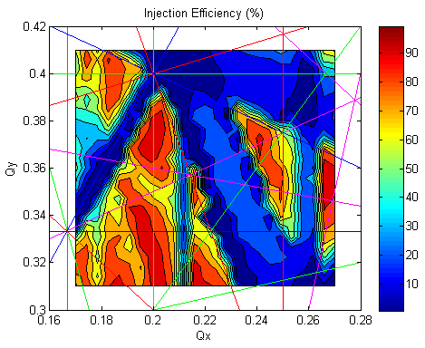
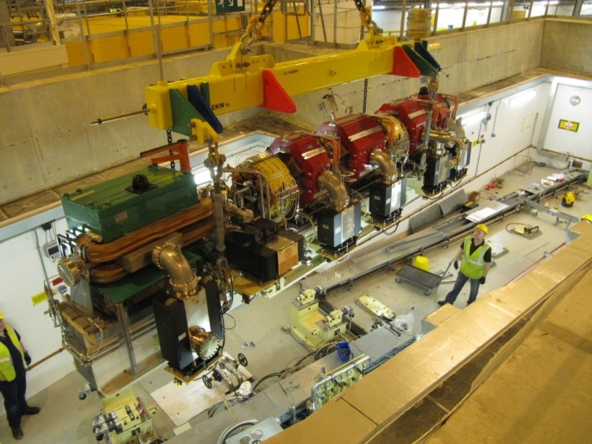
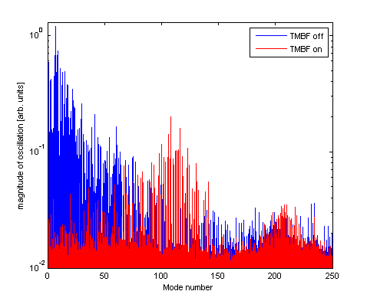
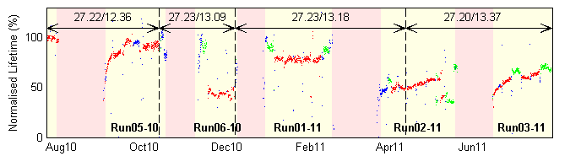
Double Mini-beta Optics
Challenges:
new girders required
Strong instabilities (resistive wall)
Injection efficiency and lifetime degraded at some tune points
Ian Martin, ALBA Visit, Oct 2017

Slide 25
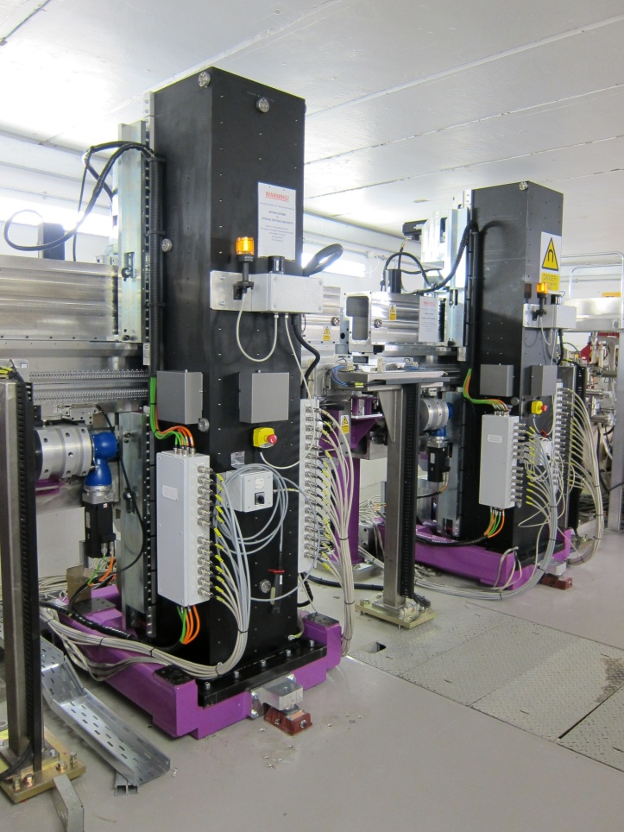
I10 (BLADE) Polarisation Switching
Two APPLE-II IDs in single standard straight
Linear/circular/elliptically polarised light
Chicane magnets deflect electron beam at 10Hz
Allows beam line to rapidly switch polarisation
2 mrad photon beam separation
Ian Martin, ALBA Visit, Oct 2017

Slide 26
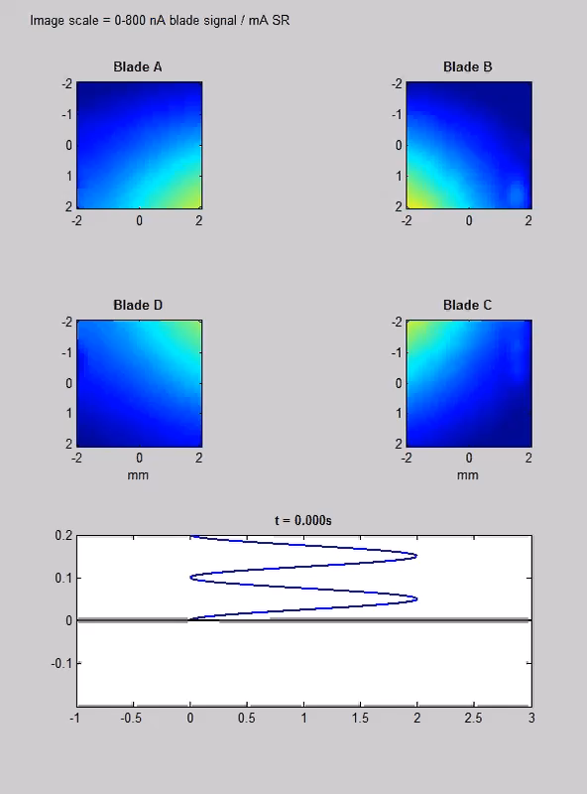
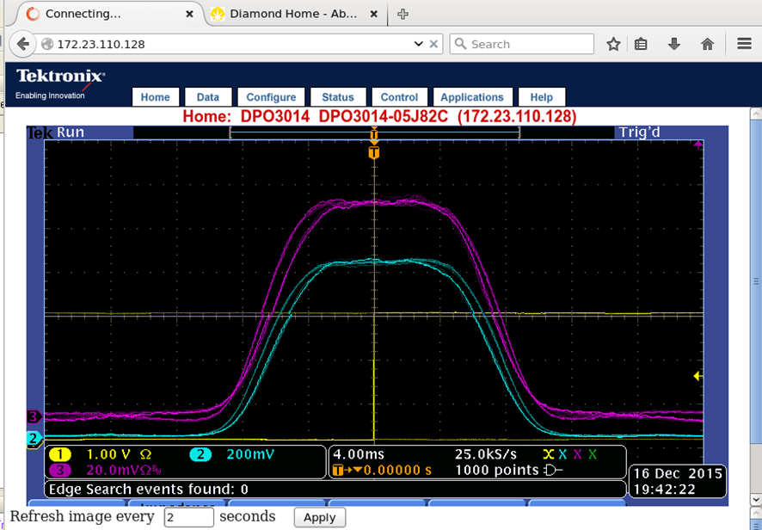
I10 (BLADE) Polarisation Switching
Chicane deliberately ‘over-steered’ to produce flat-top profile
ID detuned to give similar intensity from upstream and downstream devices
Sample-point diode
Upstream intensity monitor
courtesy C. Bloomer
Ian Martin, ALBA Visit, Oct 2017

Slide 27
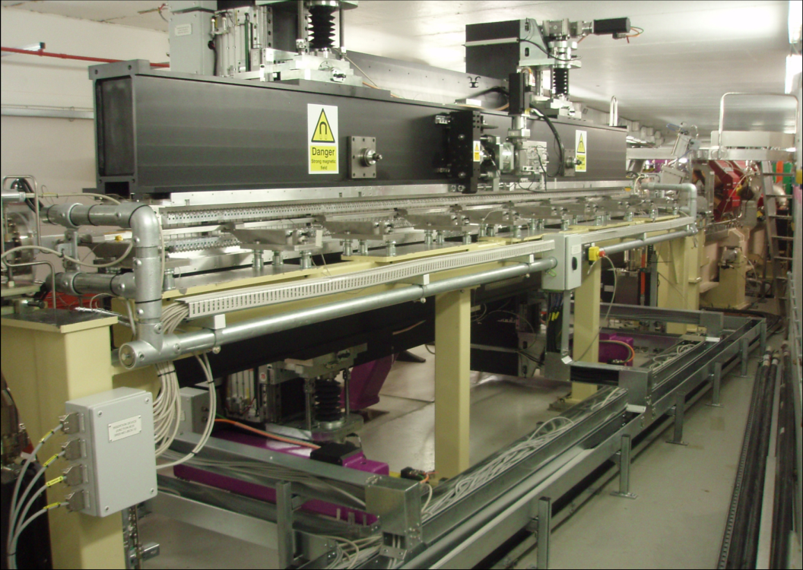
I05 (ARPES) Beamline
For the ARPES beamline, a 5m long APPLE-II device was installed in Nov 2012:
Long straight section, beta functions larger than standard
Large tune-shifts in both planes that need to be compensated
Significant impact on the machine (reduction in dynamic aperture, lifetime)
Photon Energy | 18-240 eV
Device Period | 140 mm
Number of Periods | 34
Nominal Length | 4.995 m
Technology | APPLE-II
Minimum Gap | 23.5 mm
Peak Field | 0.9T (H) / 0.53T (C) / 0.63T (V)
Magnetic Material | NdFeB
Ian Martin, ALBA Visit, Oct 2017

Slide 28
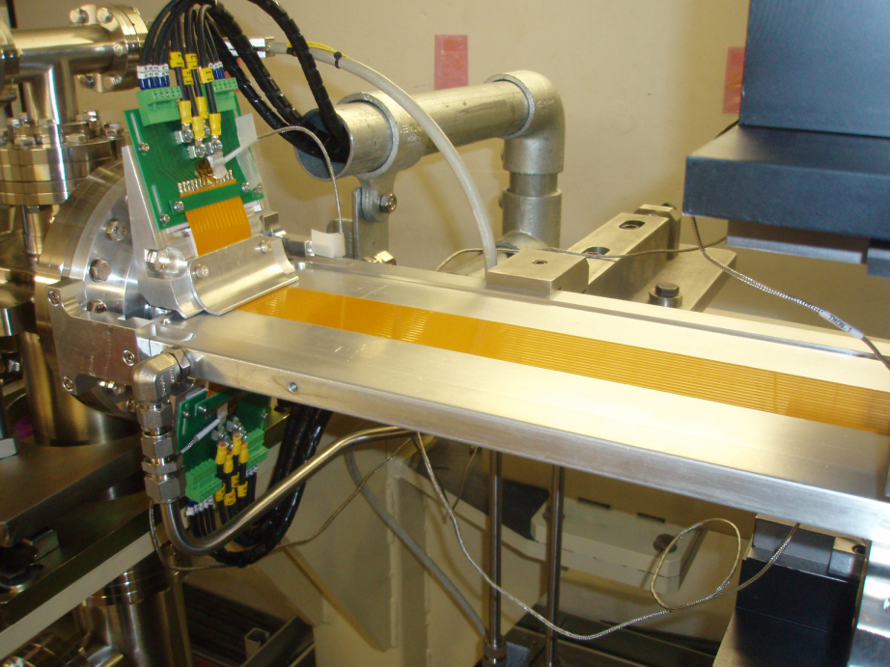
I05 (ARPES) Beamline
Dynamic multipole fields compensated using active shim wires (c.f. BESSY II)
 |  | Tune Shift (ΔQ_{x} / ΔQ_{y}) | Beta Beat (x / y)
Vertical Polarisation | Uncorrected | -0.043 / 0.032 | 33% / 32%
 | Corrected | 0.003 / 0.003 | 3% / 3%
Circular Polarisation | Uncorrected | -0.030 / 0.026 | 22% / 23%
 | Corrected | 0.005 / 0.004 | 2% / 2%
Horizontal Polarization | Uncorrected | -0.003 / 0.015 | 2% / 13%
 | Corrected | 0.008 / 0.008 | 5% / 6%
Active shim wires
Insertion device
Residual kick
Ian Martin, ALBA Visit, Oct 2017

Slide 29
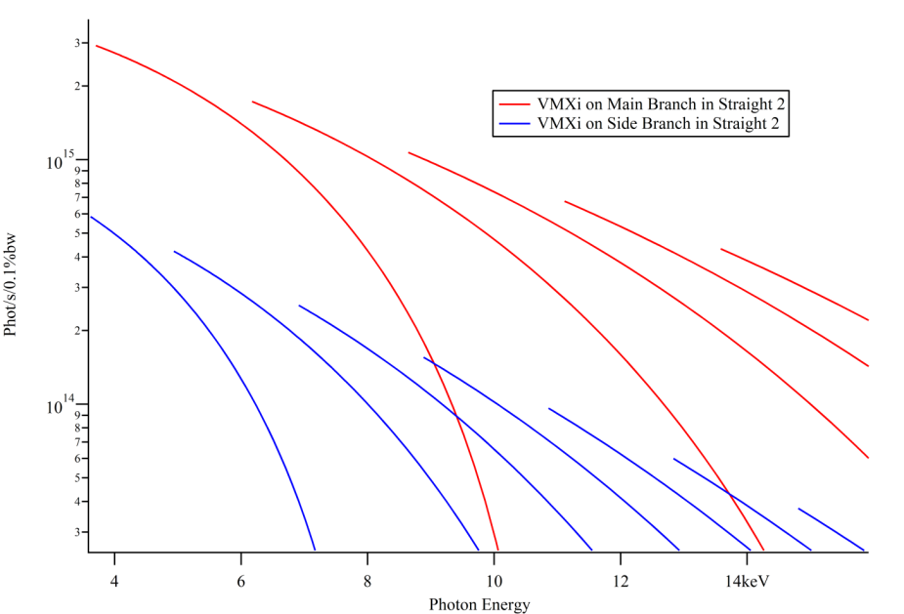
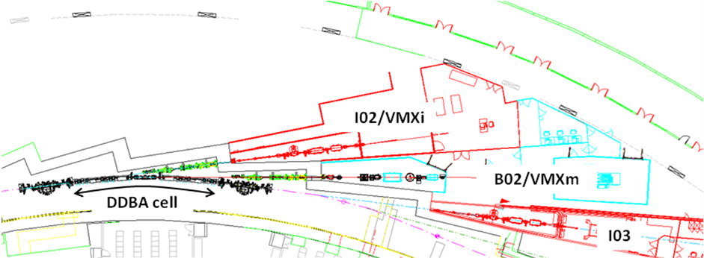
VMX Beamline
Phase III micro/nanofocus MX beamline for atomic structure determination
Could be served by a short ex-vac undulator at the end of existing straight ….
…. but much better performance would be possible with a 2m long in-vac device!
2 m U21 in-vac
0.7 m U30 ex-vac
courtesy E. Longhi
Ian Martin, ALBA Visit, Oct 2017

Slide 30
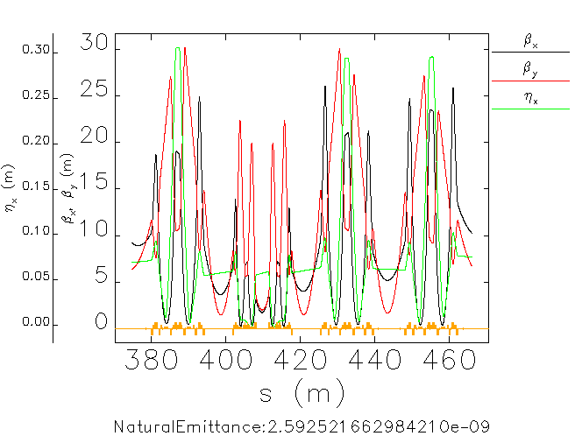
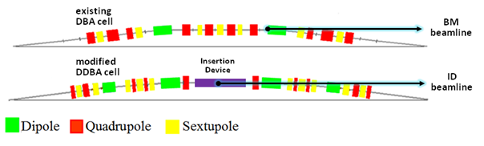
VMX Beamline: DDBA Cell
New concept: Replace existing DBA cell with a modified 4BA cell (Double-DBA)
Introduces an additional straight section
Complete break of machine symmetry
Serves as a prototype for low emittance lattice upgrade
Lots of R&D required
DDBA cell
courtesy T. Pulampung
Additional straight
Ian Martin, ALBA Visit, Oct 2017

Slide 31
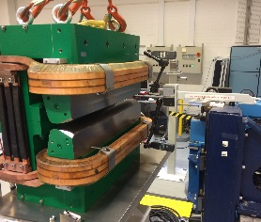
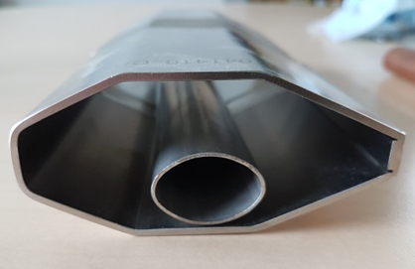
DDBA Cell Design Issues
Main Issues
Magnet Design (Danfysik):
  sector bend gradient dipole (0.8 T with 14 T/m)
  small bore quadrupoles (30 mm diameter, 70 T/m)
  high-gradient sextupoles (1600 T/m²)
Much reduced vacuum chamber in the arc (FMB)
octagonal 84×38 mm => elliptical 27×18 mm
Initial investigation of NEG coating chamber abandoned
too complex geometry for coating
systems of localised bumps to absorb radiation
Mix of stainless steel and copper
Engineering integration
standardisation of magnet lengths (one type of quads and sexts)
clashes between elements (space for coils overhang, flanges, …)
Ian Martin, ALBA Visit, Oct 2017

Slide 32
DDBA Project Timeline
Preliminary AP lattice studies begun Jan 2013
Engineering design work started May 2013
External Review Committee approves design Nov 2013
Preparatory cabling work started Mar 2014
Magnets contract awarded to Danfysik Jun 2014
Vacuum pipe contract awarded to FMB Aug 2014
VMX optics frozen by end July 2014
Magnet delivery Jan 2016 onwards
First vacuum vessels delivered Feb 2016
Installation complete Nov 2016
Storage ring commissioned in 2 weeks Nov/Dec 2016
ID installed Mar 2017
First Light Apr 2017
Ian Martin, ALBA Visit, Oct 2017

Slide 33
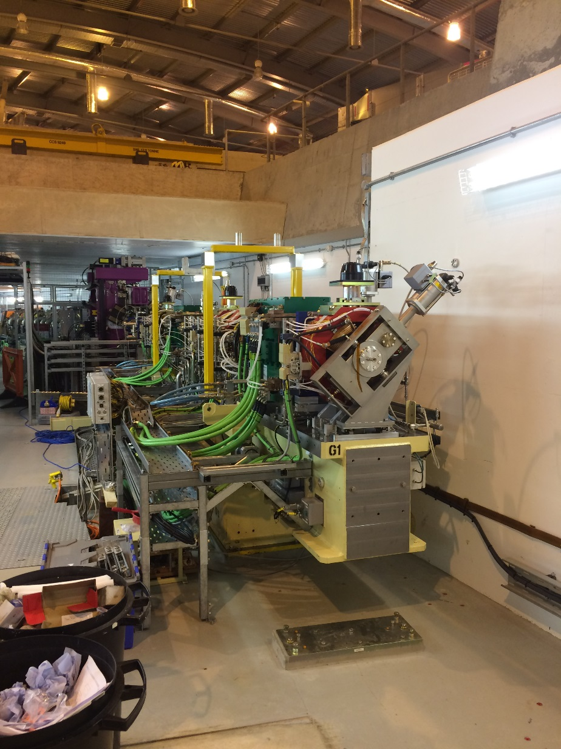
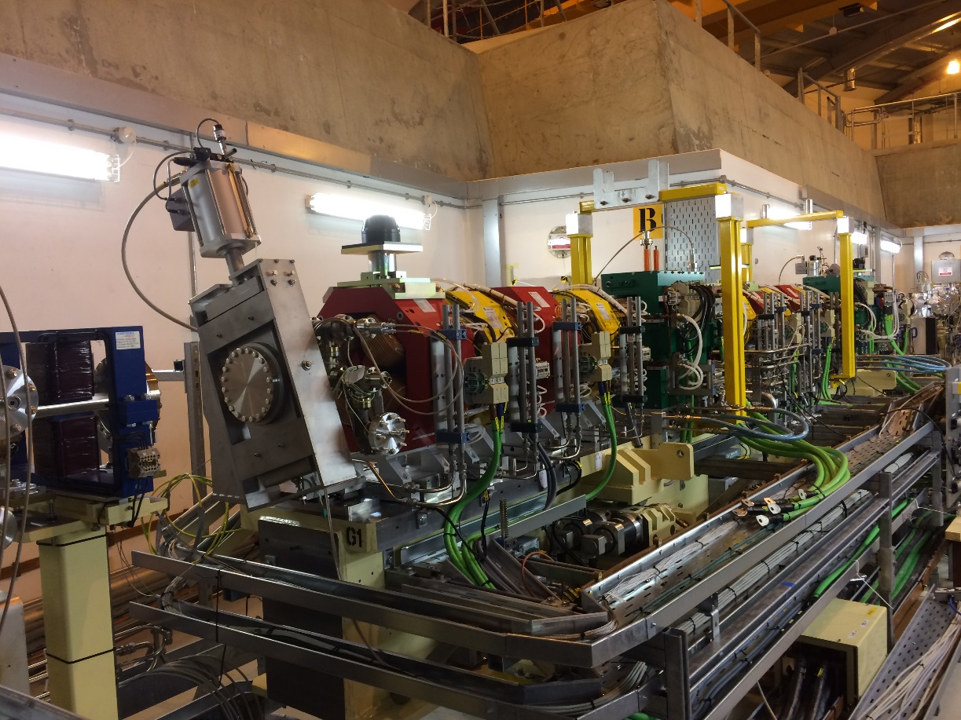
DDBA Cell Installation
3 DBA girders replaced with 2 DDBA girders in a single 6 week shutdown
Ian Martin, ALBA Visit, Oct 2017

Slide 34
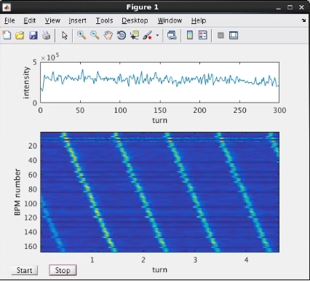
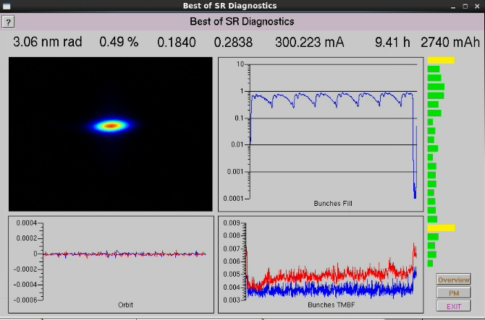
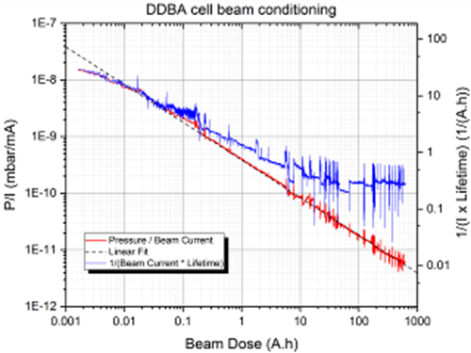
DDBA Cell Commissioning
beam accumulation in the SR
(17/11/2016)
Beam current = 300mA
(24/11/2016)
Beam current = 300mA
(24/11/2016)
10 mA, initial orbit / optics correction on first day
Dipoles realigned to reduce correctors
All feedbacks / high-level software working
300 mA in 1 week
Vacuum conditioned in ~70 Ah
courtesy M. Cox
Ian Martin, ALBA Visit, Oct 2017
Notes:
Loco tells us that the gradient is correct but the correctors tell us that the dipole is too weak – solution: move gradient dipole outwards

Slide 35
DDBA Cell Remaining Issues
Injection efficiency: ~85-90% => ~75-80%
Lifetime: 14.5 h => 13 h
Increase in vertical beam motion
Impact of SCW on emittance
Low alpha lattice
beam accumulation in the SR
17/11/2016)
Ian Martin, ALBA Visit, Oct 2017
Notes:
Loco tells us that the gradient is correct but the correctors tell us that the dipole is too weak – solution: move gradient dipole outwards

Slide 36
Talk Outline
Diamond Light Source
general introduction to the facility
different operating modes
top up, low alpha operation
Facility Upgrades / New Beamlines
increasing beam brightness
double mini-beta straight sections
exotic insertion devices
DDBA upgrade
Future developments
DIAD beamline
Diamond II?
Ian Martin, ALBA Visit, Oct 2017

Slide 37
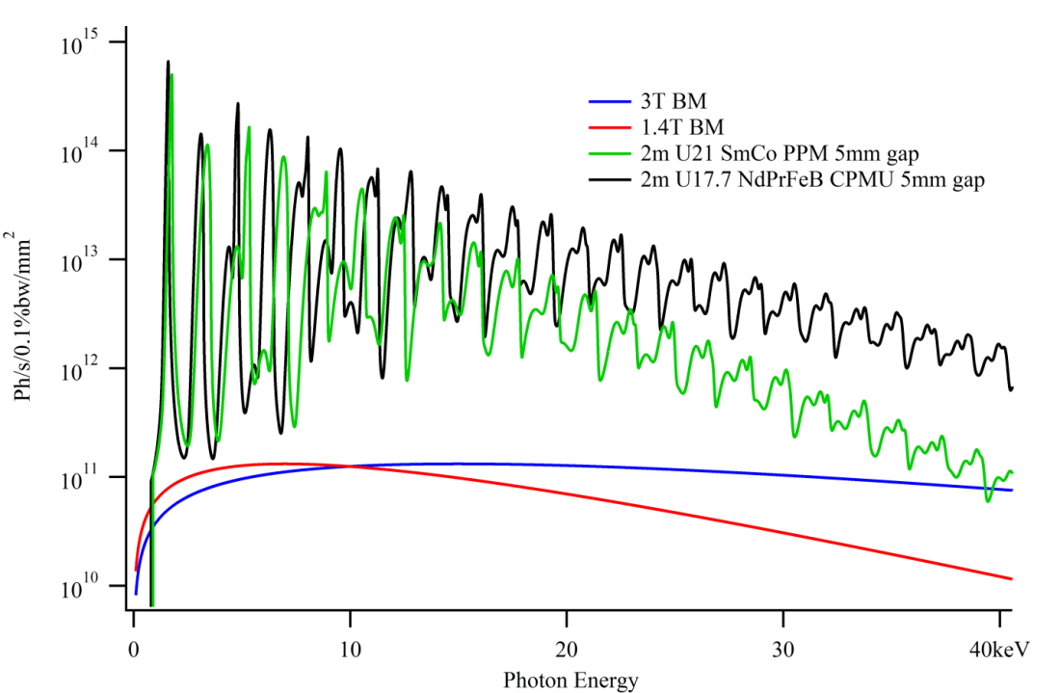
DIAD Beamline
Dual Imaging and Diffraction beamine
7-37 keV, 1 μm resolution
Several options investigated:
  Standard dipole source
  3T super-bend
  2nd DDBA cell?
Simulations for the second DDBA are showed further and significant degradation of dynamic aperture and especially lifetime
Decision taken not to proceed (for now)
An alternative proposal was put forward to remove one chromatic sextupole and insert a short miniwiggler (0.7 m) in its place
Simulations show this can work, local chromaticity correction deferred to the nearby sextupole
A project was launched in autumn 2016 for installation in 2018
Ian Martin, ALBA Visit, Oct 2017

Slide 38
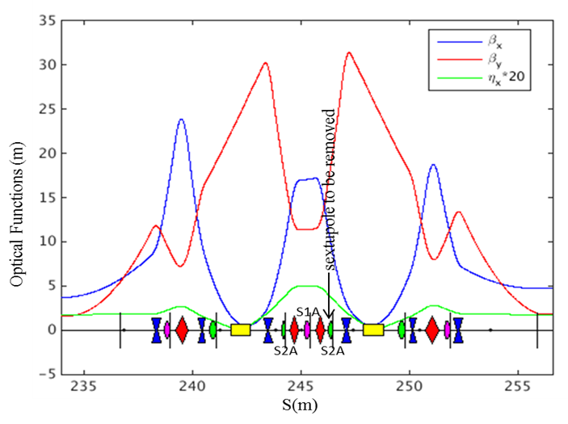
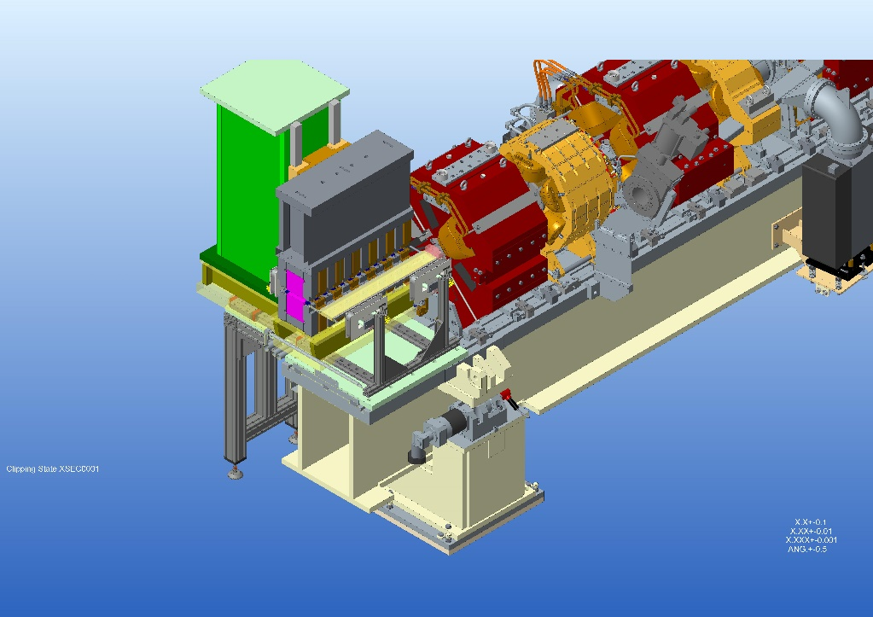
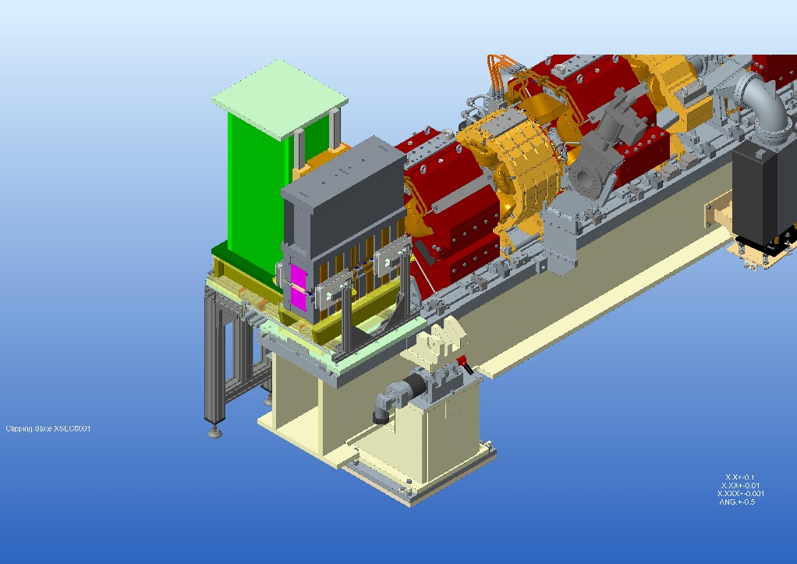
DIAD
courtesy B. Singh
Missing sextupole compensated by doubling strength of partner
Permanent magnet wiggler 0.7 m placed in gap
V/H steerer, skew sextupole and BPM also removed
Lattice already tested with minimal impact on lifetime and injection efficiency
Girder construction underway
Due for installation first half of 2018
Ian Martin, ALBA Visit, Oct 2017

Slide 39
Lattice Upgrade
Diamond operates since 2007 with nominal parameters
  (2.7 nm H emittance, 8pm V emittance, 300 mA)
However:
  2010 Petra-III was commissioned → 1 nm H emittance
  2011-12 SLS and ASP ~1 pm V emittance (best achieved)
  2012 ESRF et al. operate with 8pm V emittance
  2013 ALS upgraded to a 2 nm H emittance lattice
  2014 NSLS-II started operation → 0.5 nm H emittance
  2014 Petra III has tested a 160 pm lattice at 3GeV
  2016 MAX IV 300 pm H emittance lattice
  2018 SIRIUS 250 pm H emittance lattice
  2019 ESRF II 140 pm H emittance lattice
  APS, SPRING-8, ALS, BAPS, SLS, ELETTRA, SOLEIL, ANKA, ... are looking at lattice upgrades
Ian Martin, ALBA Visit, Oct 2017

Slide 40

Lattice Upgrade
Reducing the emittance
Theoretical Minimum Emittance (TME) achieved by shaping dispersion and beta-functions to have a waist in the centre of the bending magnets.
Practical techniques:
increase number of dipoles (MBA)
control Jx with trans. gradient dipoles
use long. gradient dipoles
reverse bending magnets
courtesy R. Bartolini
Lowering the emittance is not the only goal: increasing the capacity for IDs also desirable
Ian Martin, ALBA Visit, Oct 2017
Notes:
40

Slide 41
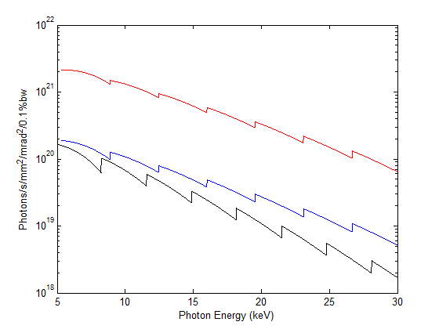
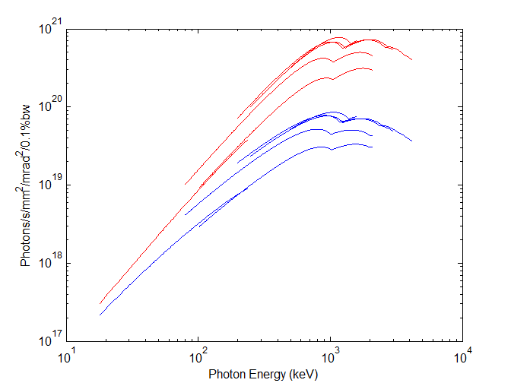
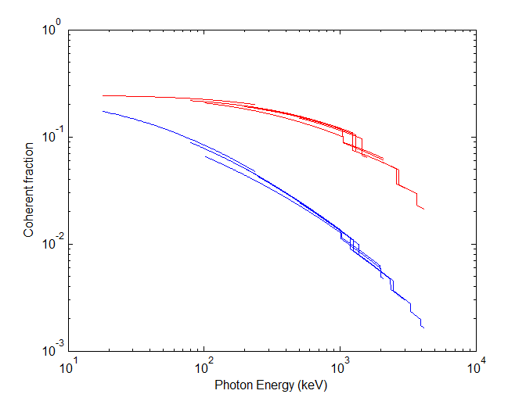
Lattice Upgrade
(Enabling a...) Stronger science case based on
higher brightness
higher transverse coherence
small photon beam size / divergence
cleaner spectral flux
Growing confidence (and first experience!) with MBA lattices
linear optics, nonlinear optics, instabilities
Growing confidence (and first experience!) with technolgical subsystems
magnets, vacuum, diagnostics, feedback
Hard X-ray CPMU
Soft X-rays APPLE-II
Transverse coherence fraction
120 pm.rad
300 mA
1 % coupling
courtesy R. Bartolini
Ian Martin, ALBA Visit, Oct 2017
Notes:
41

Slide 42
Lattice Upgrade
Wish-list:
Emittance reduction to below 300 pm.rad (~100 pm.rad)
Reuse tunnel, beamlines and hardware (where possible)
Maintain mini-beta straight sections
Maintain short pulse capabilities (low alpha)
Phased installation (avoid long shutdown)
Minimise technology risks
Different options under study:
Initial studies of modified 4 Bend Achromat, (but also pure 5BA, 7BA, ...)
More beamlines vs. lower emittance
ESRF 7-bend HBMA Lattice => modified 6-bend HBMA solution
8-bend lattice? Reverse bends?
Ian Martin, ALBA Visit, Oct 2017

Slide 43
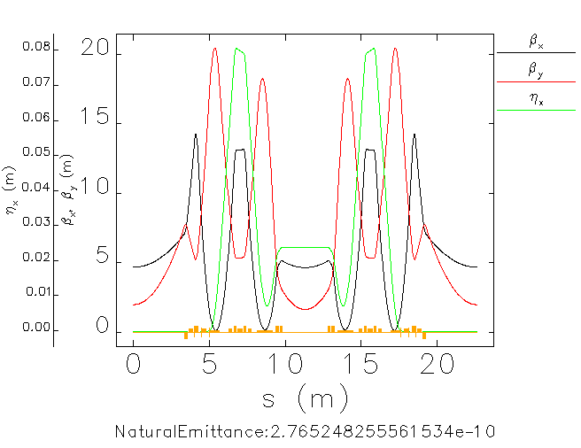
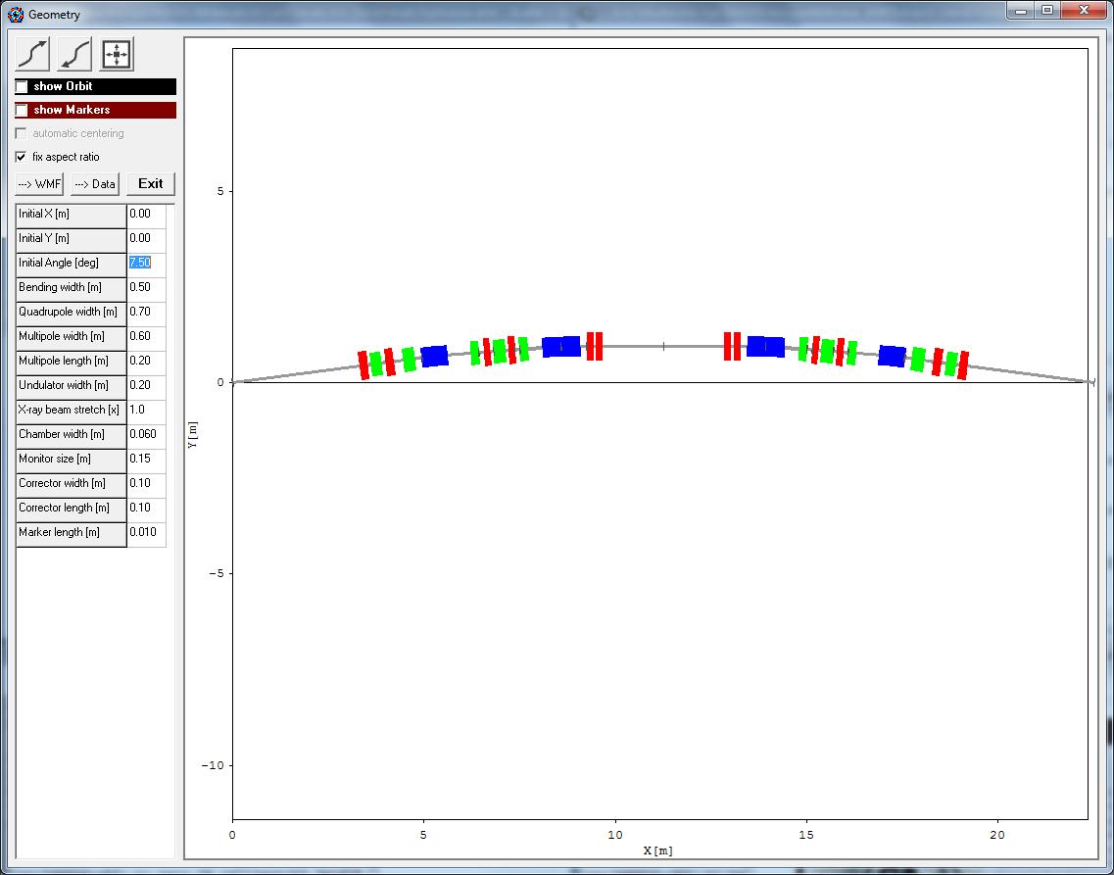
Modified 4BA (DDBA)
Original DBA
3.35m
Modified 4BA
3.35m
4BA
courtesy T. Pulampong
Pros:
Magnet arrangement allows 24 additional short straight sections
Natural emittance 275 pm.rad (factor 10 reduction on present lattice)
Design utilises gradient bending magnets
Cons:
Emittance reduction judged too small
Difficult to achieve satisfactory lifetime and injection efficiency
Ian Martin, ALBA Visit, Oct 2017

Slide 44
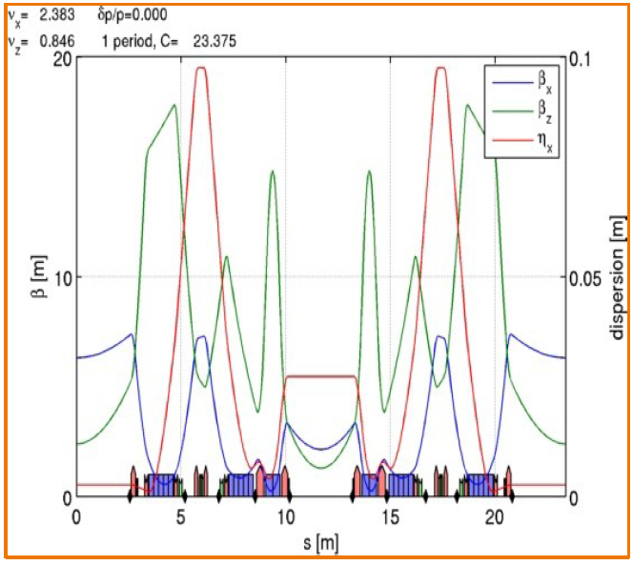
6-bend HBMA (DTBA)
A more aggressive design proposed that merges the ESRF HMBA concept with the Diamond DDBA mid straight section taking the best of both
Use the ESRF cell (7BA with longitudinal gradient dipoles) – removing the mid dipole to make it a 6BA with a straight at the centre
Promising design:
Emittance 120 pm
~ 10mm DA
~ 3 h lifetime
short straight sections ~5m
long straight sections ~8 m
mid-straight section ~3 m
Control phase advance between dispersion bumps to cancel sextupole effects
courtesy A. Alekou
Ian Martin, ALBA Visit, Oct 2017

Slide 45
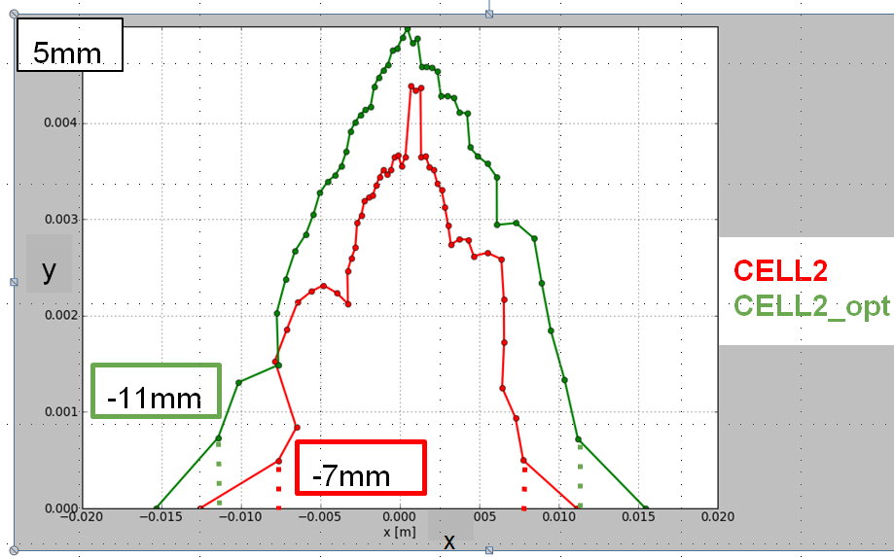
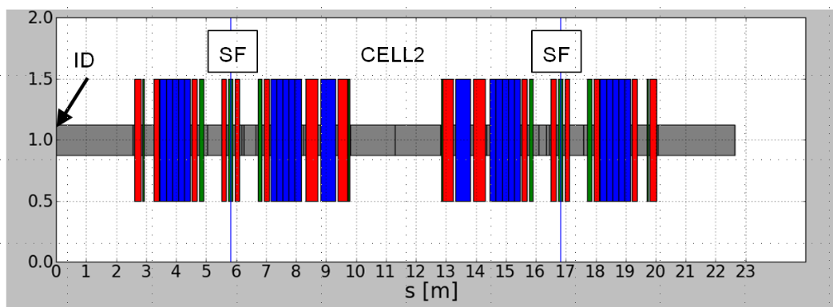
DTBA: Cell Optimisation
Two kinds of cell used to reproduce the 6-fold structure of the present lattice (1 long and 3 standard straights per super-period)
Cell 1 is an asymmetric cell, +1.5 m longer than Cell 2
CELL 1
CELL 2
CELL 2
-CELL 1
long straight
standard straight
new straight
Diamond II Super-Period
Dynamic aperture optimised by scanning linear optics parameters at fixed chromaticity
Ian Martin, ALBA Visit, Oct 2017

Slide 46
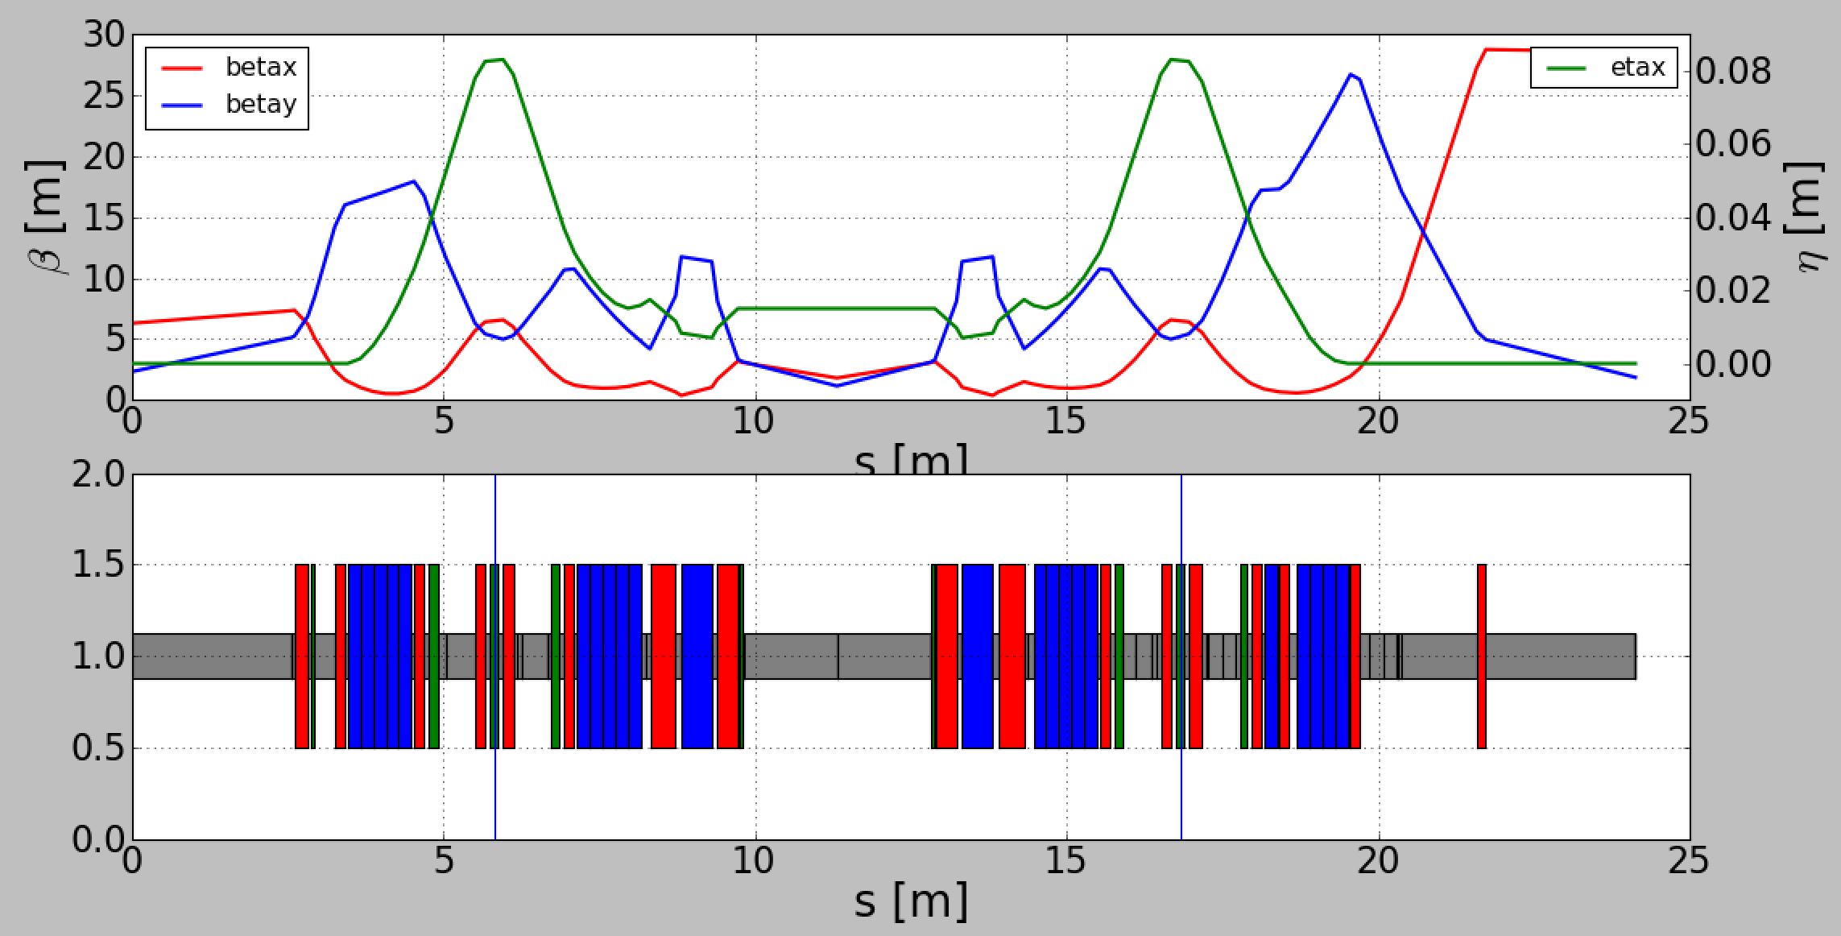
DTBA: Injection Cell
Add additional quadrupole to increase beta-function at injection point
Dynamic aperture at injection point can be increased without affecting other cells
Momentum acceptance (lifetime) better without the cell …
courtesy A. Alekou
Ian Martin, ALBA Visit, Oct 2017

Slide 47
DTBA: Open problems
I09/I13 vertical double mini-beta and horizontal focussing optics:
difficult to maintain in 8 m straight section
however these are “flagship beamlines” at Diamond
I13 is ~200 m long to an external building
Few other beamlines cannot be maintained:
I10 fast polarisation switching – does not fit in standard straight
I08 4.5 m ID is too long
I06 2×2.1 m APPLE-II plus phase units is too long
Bending magnet sources:
very likely they will be all replaced in the additional straight sections
B22 IR/THz radiation extraction from smaller pipe
Strong interest in maintain some kind of time-resolved capability
Ian Martin, ALBA Visit, Oct 2017

Slide 48


Further lowering of the emittance?
Other options presently under study:
modified 8BA?
DQBA?
reverse bends, similar to SLS-II design?
accumulator ring for on-axis injection?
courtesy P. Raimondi
Ian Martin, ALBA Visit, Oct 2017

Slide 49
Possible Timeline for Diamond II
Event | Date
Outline case approved by SAC and Board | April / June 2016
Board approves working on CDR and developing science case | Oct 2016
Internal / external science workshops | Mar-Sept 2018
Lattice frozen | Dec 2018
CDR ready | Mar 2019
Review of CDR (SAC, MAC, DISCo, etc) | Apr/May 2019
Board approves CDR and gives go-ahead for TDR and recruitment | Jun 2019
Draft TDR ready (including costs) | Mar 2020
Draft TDR reviewed by MAC and SAC | Apr/May 2020
Board approves seeking final approval | June 2020
Final TDR published | Sept 2020
Diamond II project approval | Dec 2020
Start calls for tender | Jan 2021
Start shutdown | Apr 2024
Resume full User operations | Oct 2025
Ian Martin, ALBA Visit, Oct 2017

Slide 50
Conclusions
Diamond Light Source is a world-class facility for science:
Range of beam lines, each tailored to particular requirements of users
High brightness, stable, tuneable photons beams
Dedicate special modes (Short pulses, Coherent IR/THz radiation)
‘10-Year Plan’ aims to keep Diamond competitive:
Develop science case and technical design study for Diamond II
  Factor 10-20 × reduction of emittance, increased capacity for insertion devices
Reliability: RF improvement (solid state amplifiers, normal conducting cavities)
Photon Beam Stability (100Hz-1kHz), electron beam and photon beam at sample
Higher Current (>300mA), 3rd Harmonic Cavity + additional fundamental RF cavity
Undulator technology (CPMU / Superconducting Undulator)
Ian Martin, ALBA Visit, Oct 2017

