Slide 1

Is the production of UHV feedthroughs a mystery?
Indeed, sometimes it is the case
Vilcins, Silke, MDI, DESY Hamburg, Germany
2024_12_11

Slide 2
Guideline
Indeed, sometimes it is the case
01 History of UHV Feedtroughs@DESY
Homemade for HERA
P3
Homemade idea for XFEL
XFEL
Other
02 From Scratch to real parts
Illustration of the development process
What can be checked and how?
RF Aspects
03 Some Material Parameter
Glass or ceramic
Stainless Steel, Titanium or …
04 Challenges UHV Feedthroughs for P4
P4 vacuum pipe
Challenges of mechanical precisions
NEG heating options
Ready for mass production?
05 Summary
All rights to the content, images and drawings are the exclusive property of DESY, disclosure to third parties is prohibited! Use is subject to approval by DESY ITT group!

Slide 3
History of UHV Feedtroughs@DESY

Slide 4
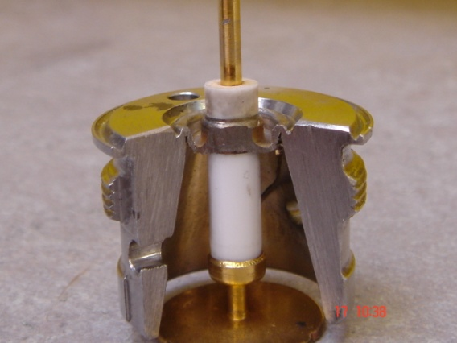
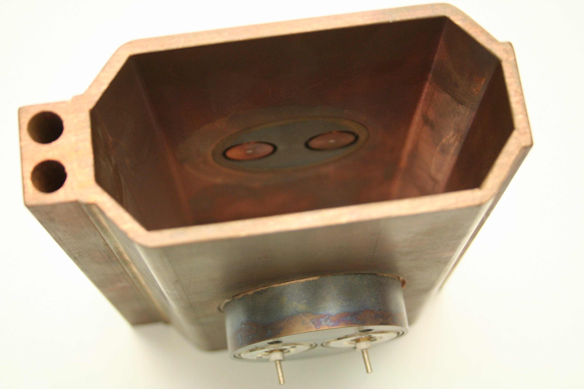
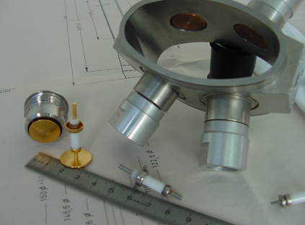
Homemade for HERA
Indeed, sometimes it is the case
  HERA electron ring: Consisting of approx. 400 vacuum chambers with a length of approx. 9m, one BPM per chamber consisting of two special flanges and 2 feedthroughs each
    1600 UHV Feedthroughs inhouse production
    1600 Stainless steel AISI 316 L Feedthrough shell
    Conductor standard part Frialit F96 Alumina Oxid Ceramic with Kovar pin; inhouse modification
    Copper Button 17 mm; inhouse production and later Gold plated (Seen next to it)
    Conductor and Button brazed together; inhouse production and welded together with Feedthrough shell
    Quality Check steps:
      Leaktest, electrical test, check final dimensions and cleanliness check
      Each feedthrough was then measured in a special measurement setup and pairs were then formed from all the feedthroughs
    Final step welding of each pair of two Feedthroughs in one flange (316 L ), with was brazed into the copper vacuum chamber before
Notes:
Button 17 mm is the diameter, right? What is the gap? 1 mm
QC: Quality Check?
What was the measurement: capacitance, resistance, S-parameter? Die Messungen wurden mit einer Lanze durchgeführt, die in einen Testkammer steckte, diese Lanze bekam so weit ich mich erinnerte einen Puls, die Durchführungen jeweils immer eine wurde getauscht. Die Messwerte in einer Datei gespeichert und hinterher wie bei dir Gruppen zu viert aufgegeben. Ich denke S-Parameter, oder wonach klingt das?

Slide 5
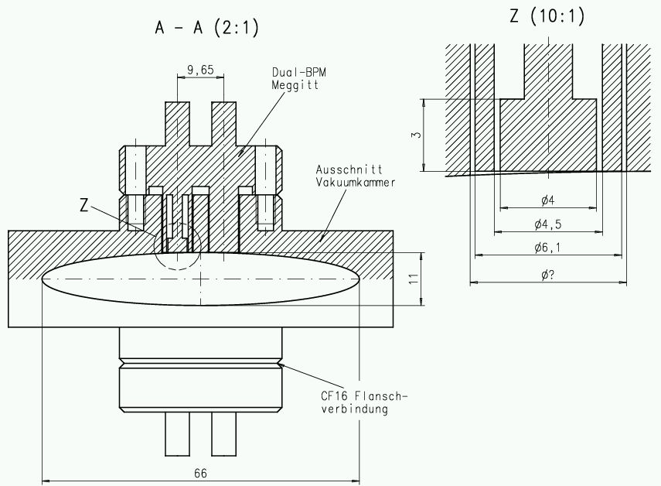
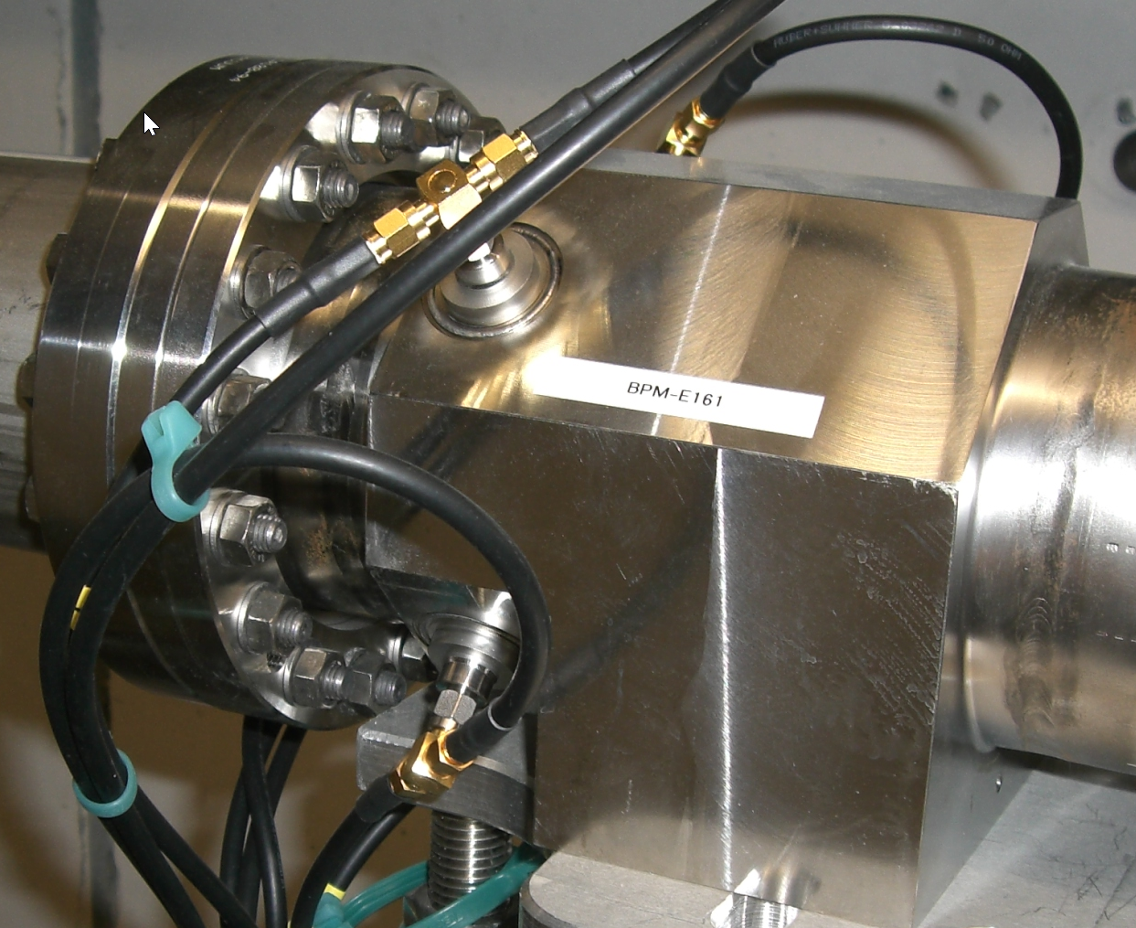
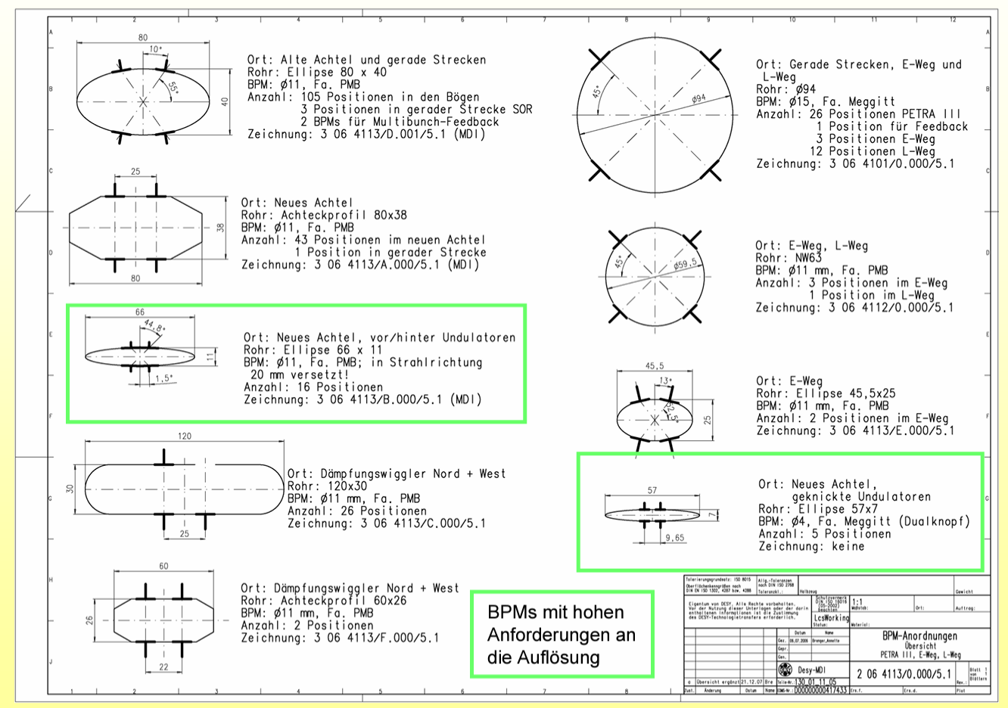
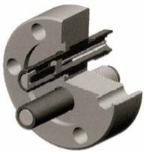
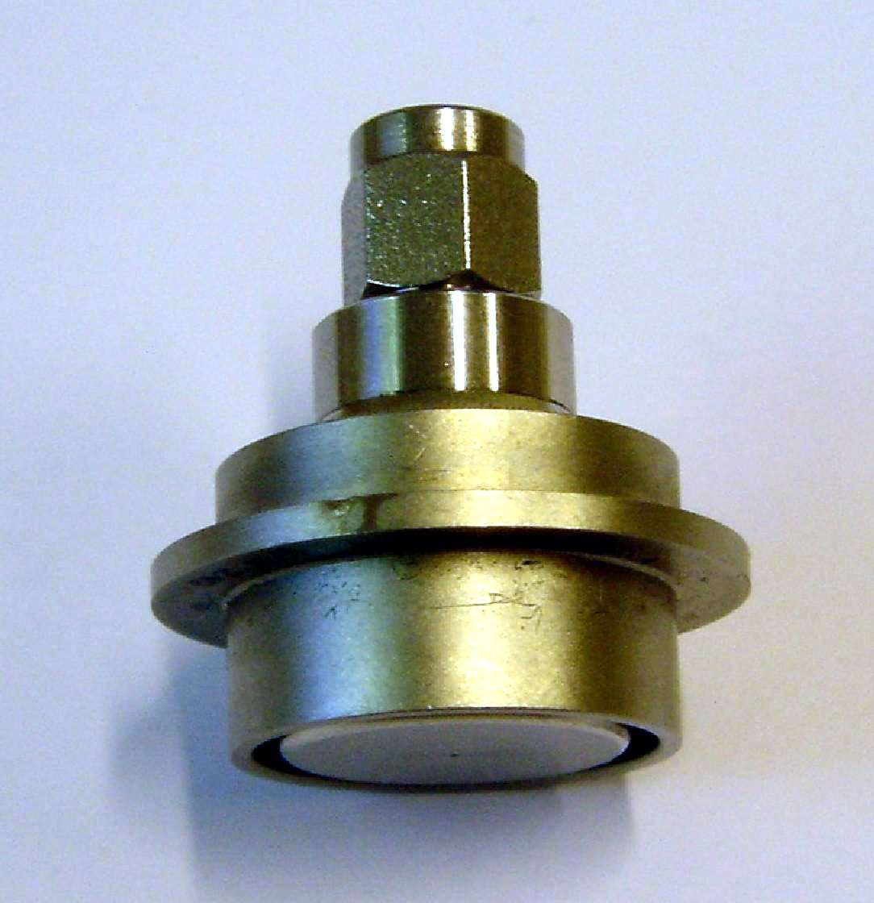
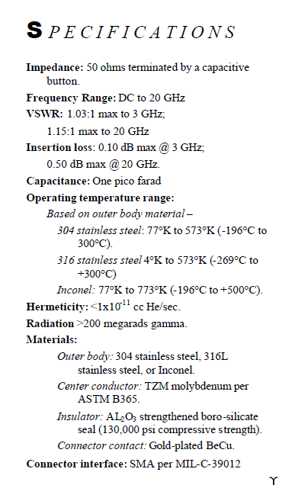
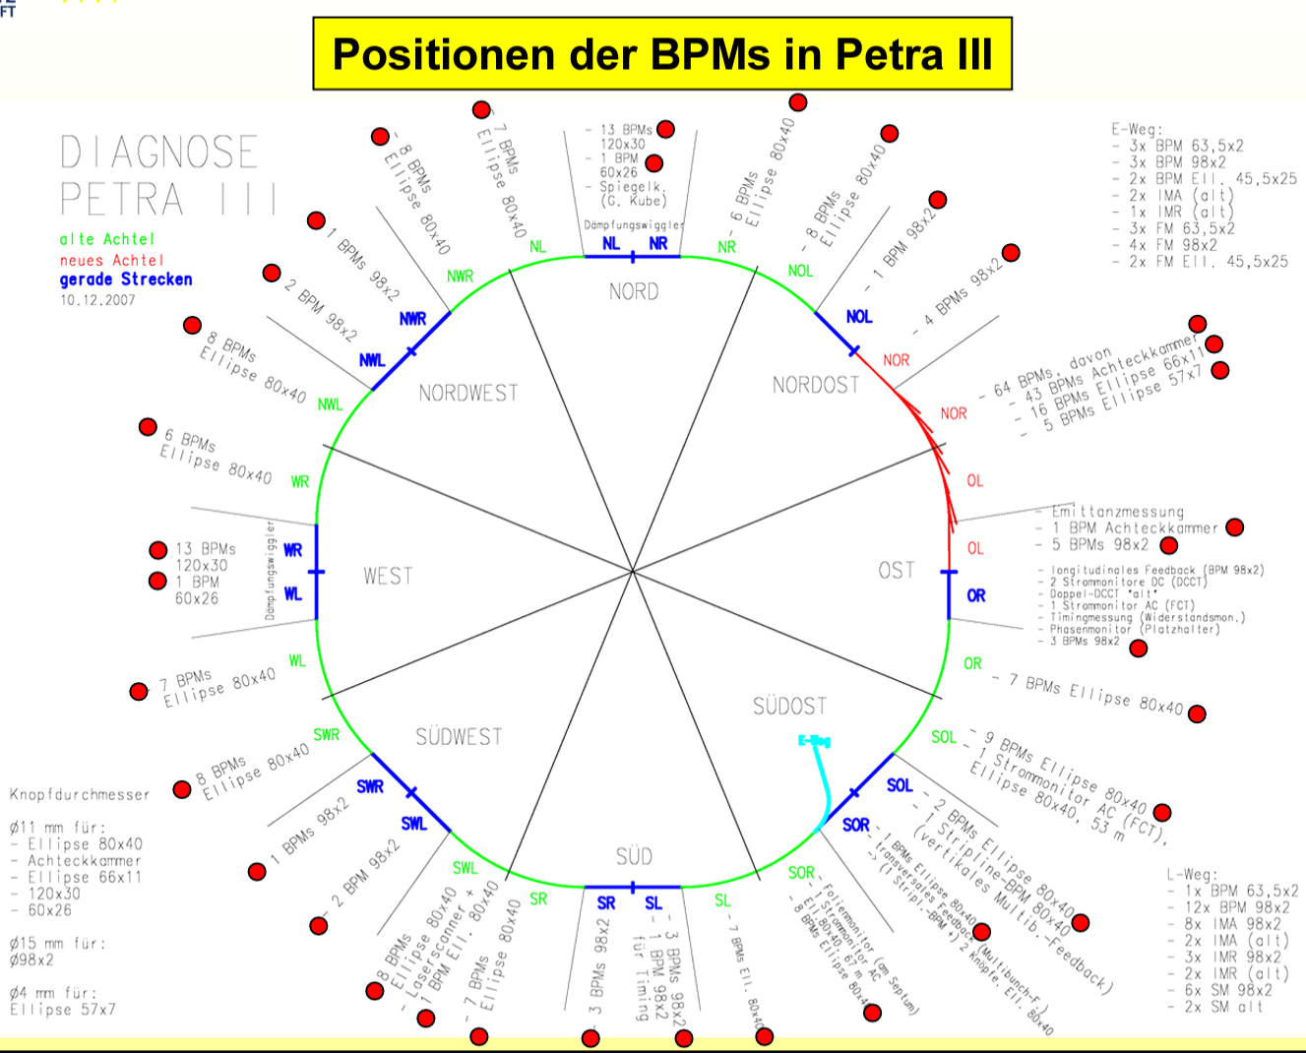
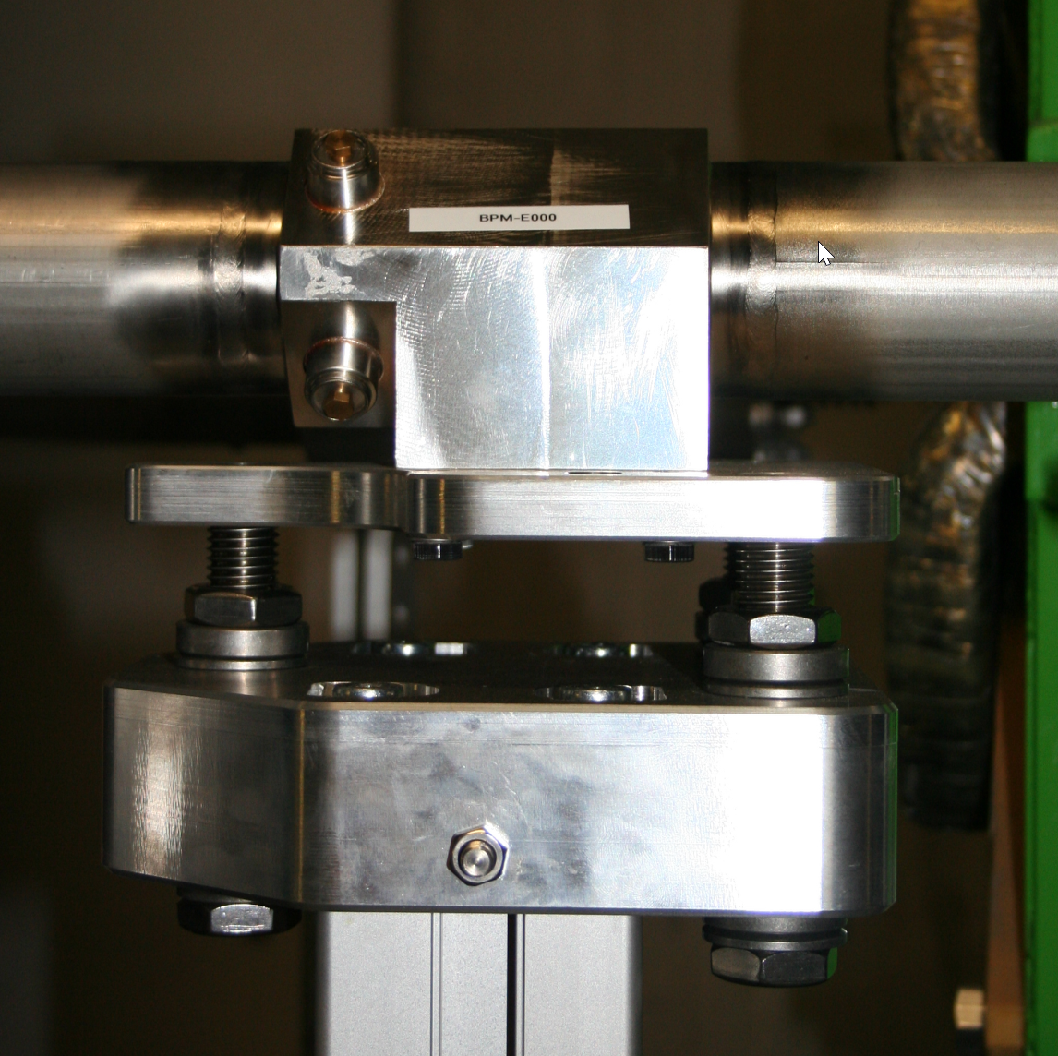
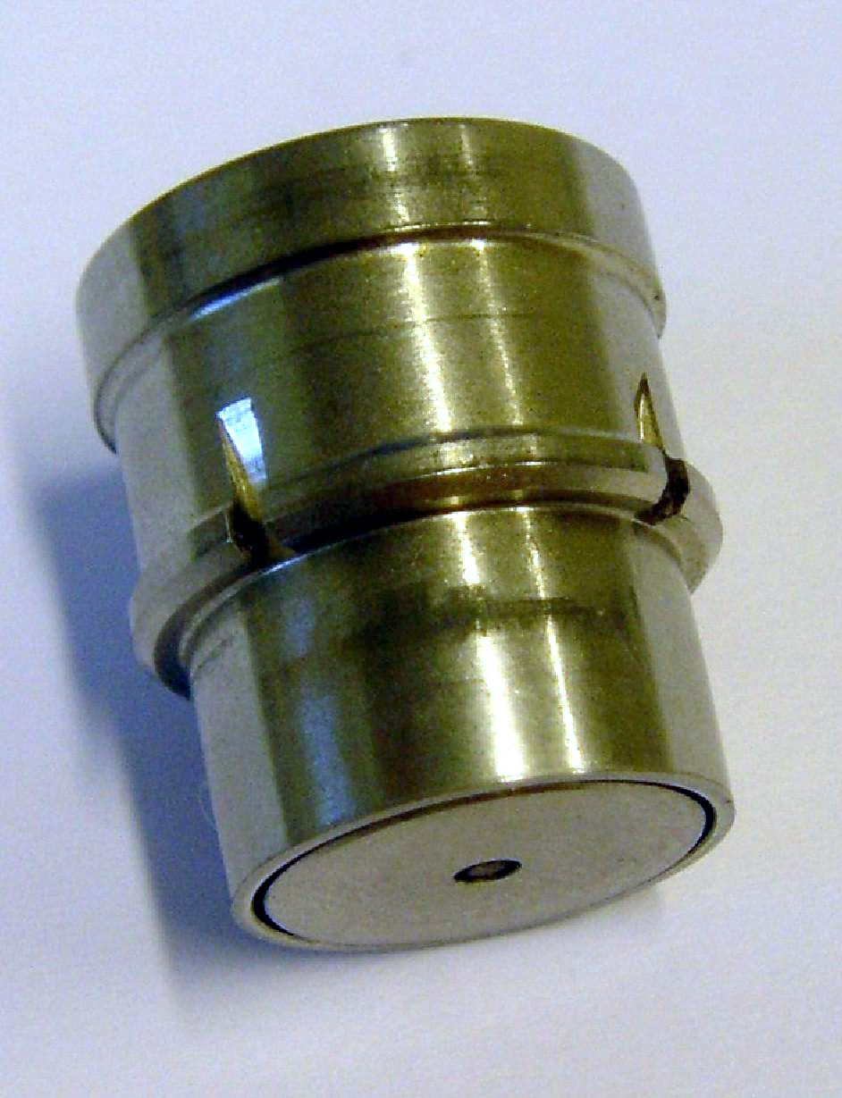
P3
Three different versions of Feedthroughs are in use at P3
Button diameter 4, 11 and 15 mm
Indeed, sometimes it is the case
Company Meggitt, USA
Company Meggitt, USA
Over the years, Meggitt has always used a glass called Corning 7052...glass to metal sealed technology
Alumina Oxid Ceramic, brazing technology
Company PMB, France
Graphics courtesy by Annette Delfs (DESY,ZM1)
Notes:
What is the gap at P3? Kannst Du auf den Fotos erkennen…Ich denke zwischen 0,25 (Dual Knopf) bis 1,0 mm Meggit 15 mm Knopf
Had PMB problems with tightness like at ESRF? Ich dnek bei P3 nicht, must Du Gero fragen…es war damals Annettes Projekt, ob ich als LL alles erfahre habe, weiß ich nicht

Slide 6
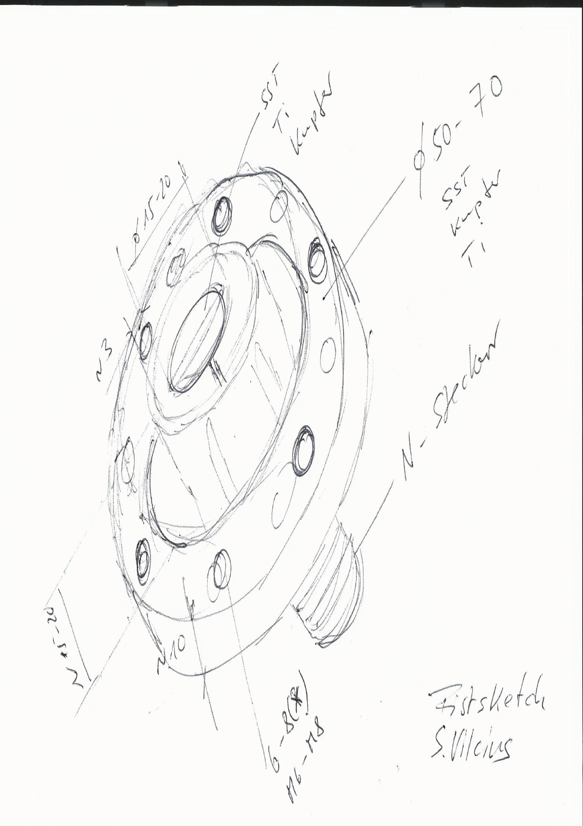
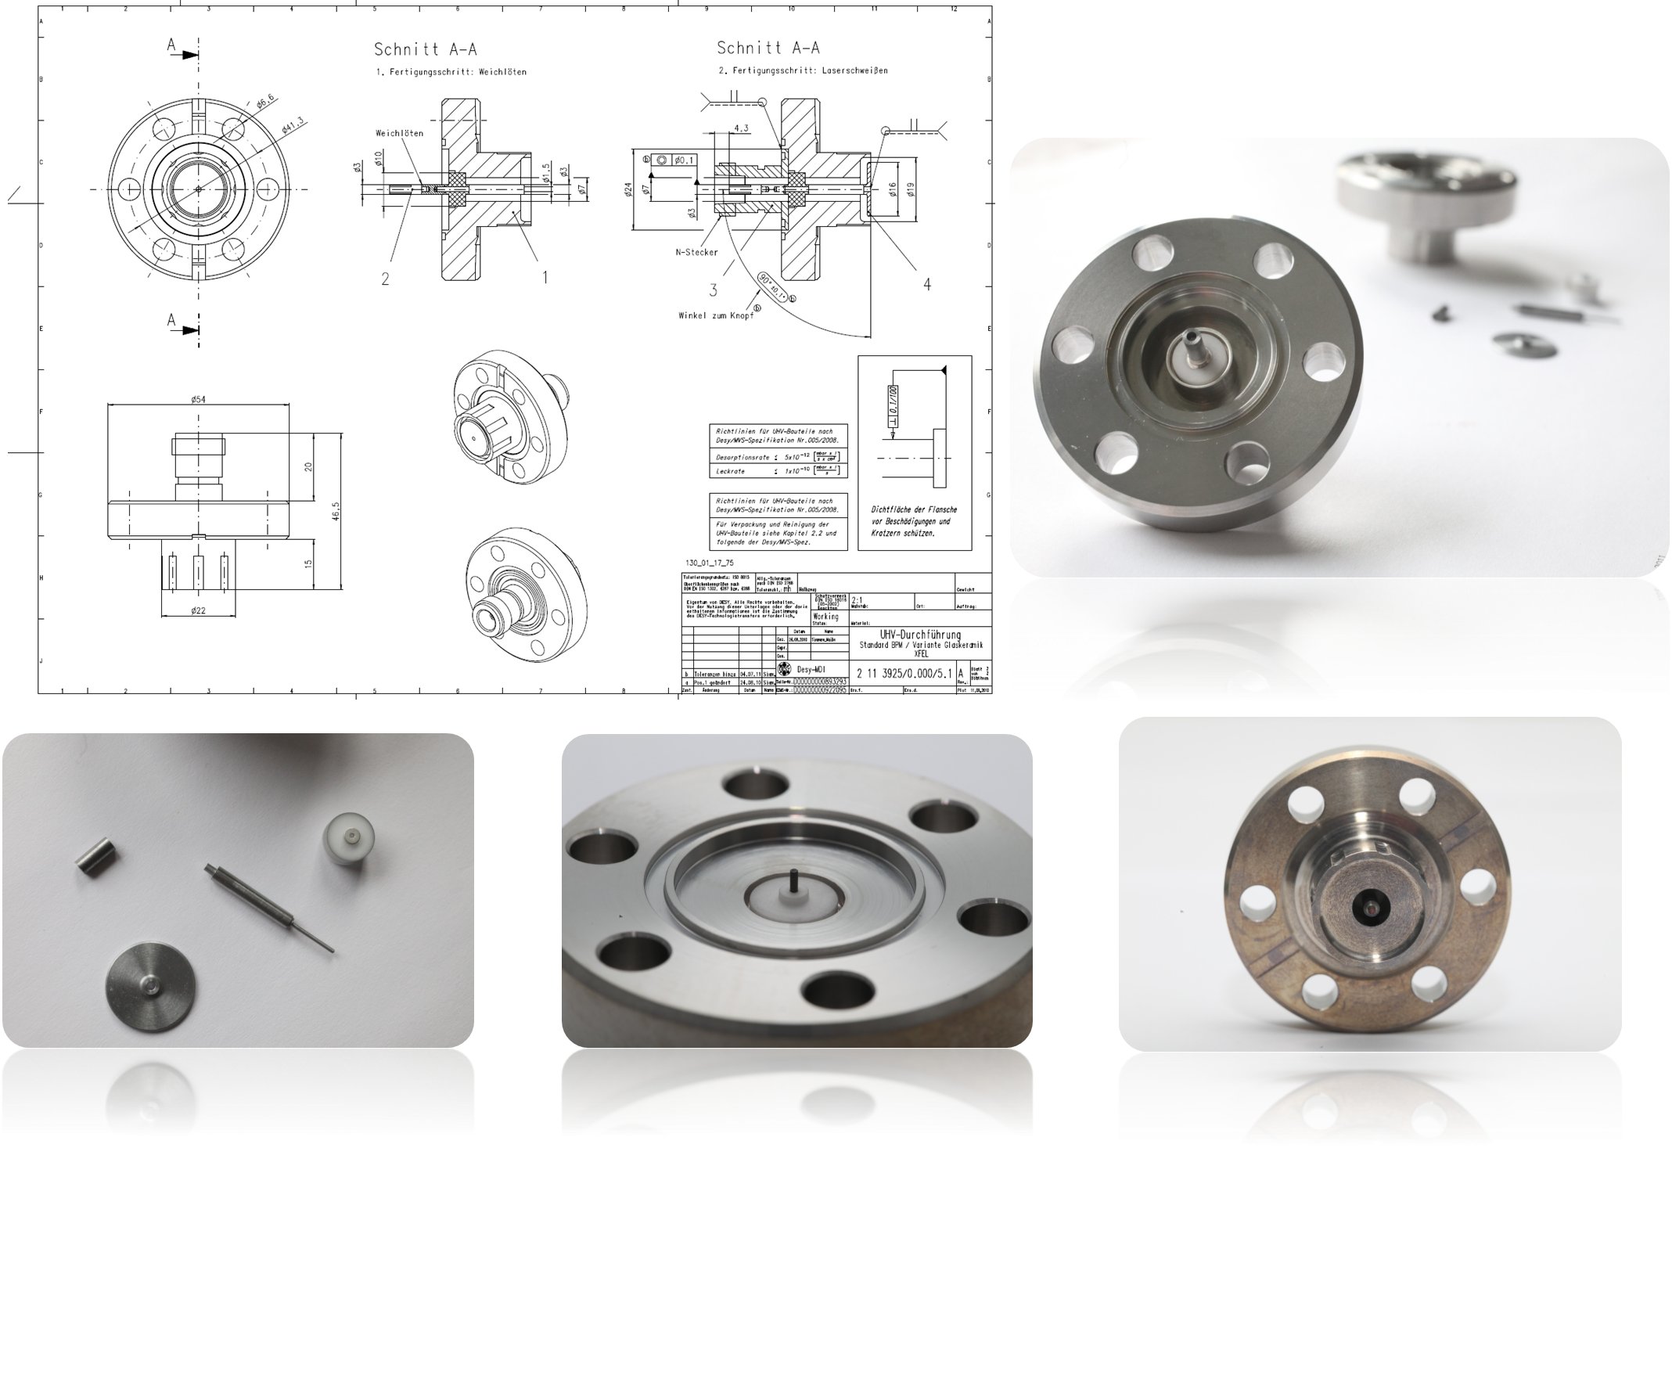
Homemade idea for XFEL
Indeed, sometimes it is the case
  HERA's idea of starting internal production for XFEL was taken up very early on
    Development of an idea
    Manufacture of metalized ceramic isolator
    Production of all metal parts (stainless steel, molybdenum)
    Order of filler material
    Preparing for brazing
    Brazing under vacuum @ DESY workshop
  The prototyping was successful, but the DESY workshop was not be able to complied and brazed nearly 1400 feedthroughs…
    So we went to the market and purchased these feedthroughs
Notes:
“Oder”?

Slide 7
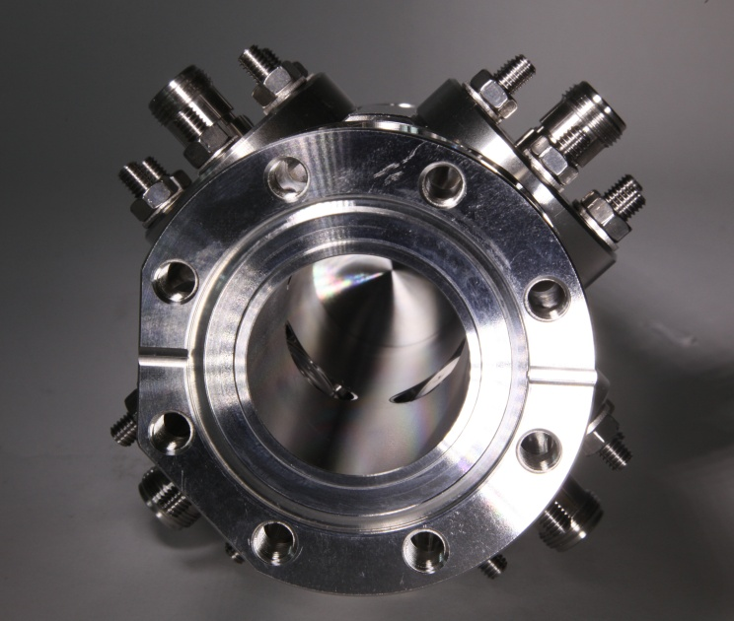
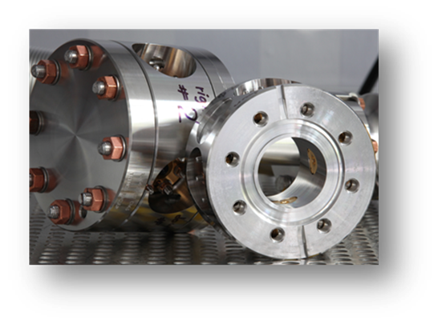
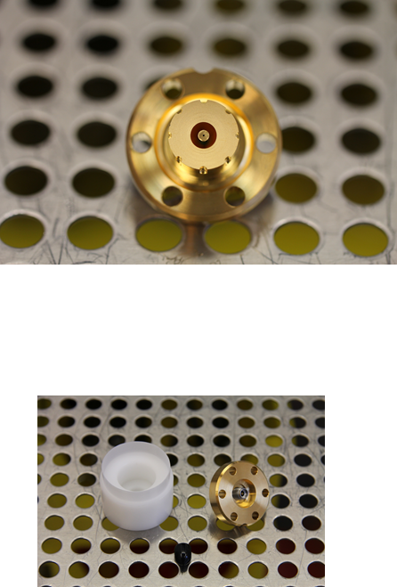
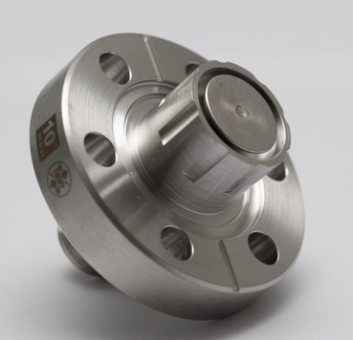
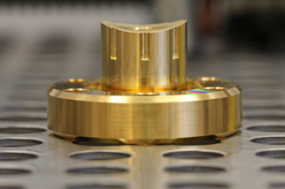
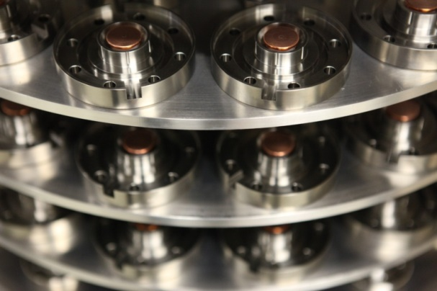
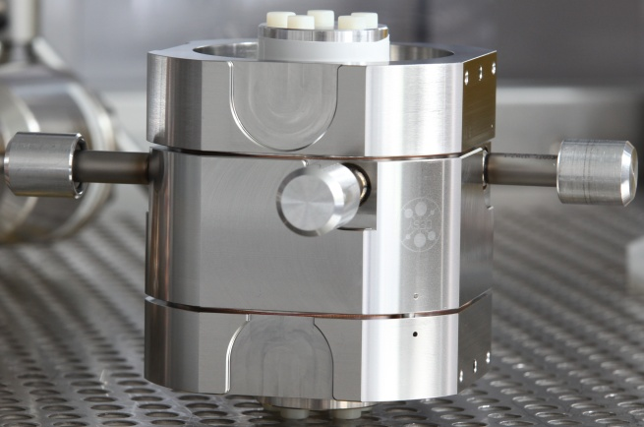
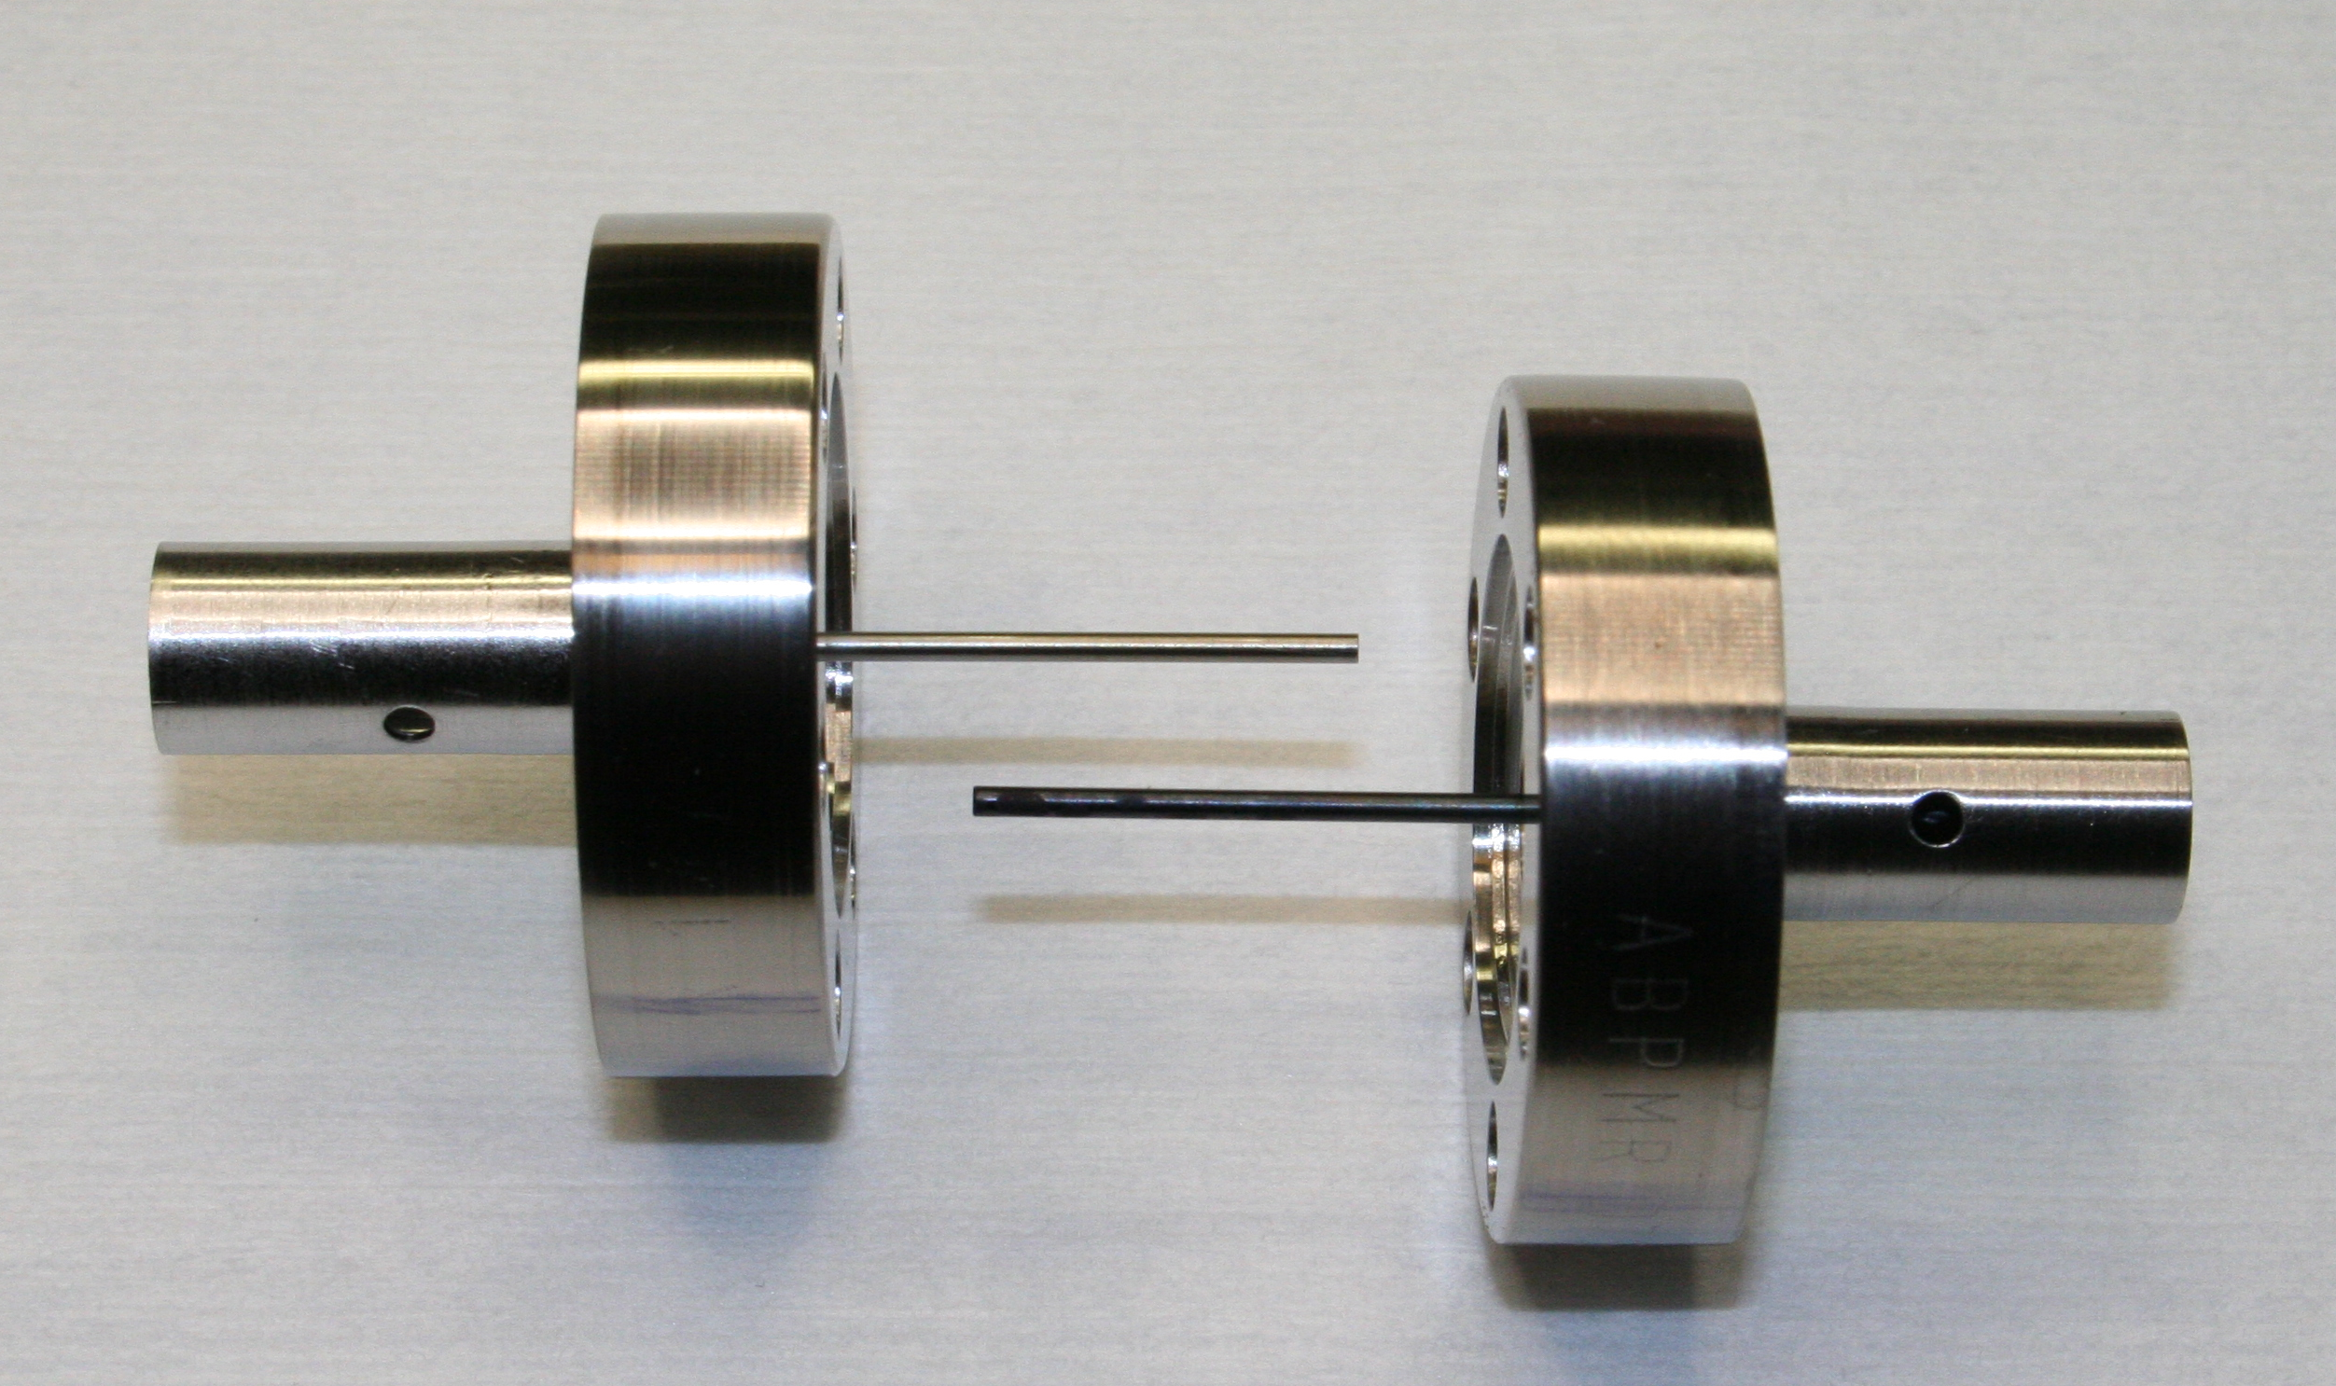
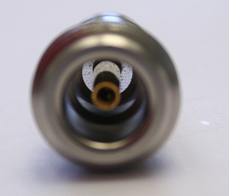
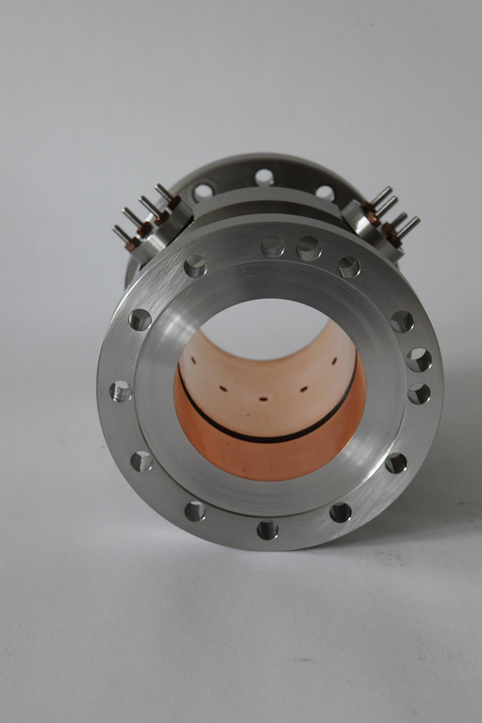
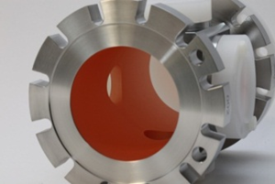
XFEL
Indeed, sometimes it is the case
One accelerator, six different feedthrough designs
  XFEL Standard BPM Feedthrough
  Feedtroughs for Cavity BPMs
  Feedthroughs for BAMs
  Feedthroughs for Cold BPM
  Feedthroughs XFEL Gun BPM
  Feedthrough for Rentrant BPM (Saclay)
For each Feedthrough, the production and quality assurance process must be developed and tested
Company VACOM, Germany
Company PMB Alcen, France
Company OMC (SEMIC), Japan
Company Solcera, France
Courtesy by Claire Simon, Saclay
Company OMC (SEMIC), Japan, series were delivered by company Meggitt, USA
Notes:
Auch Saclay hatte eigene Durchführungen für BPMR.
XFEL Gun und Standard waren meiner Meinung dieselben Durchführungen. nein
Loop Design von mir wurde nur in FLASH eingebaut; wenn Du den Loop für den Cavity meinst, der wurde in Regae eingebaut.

Slide 8
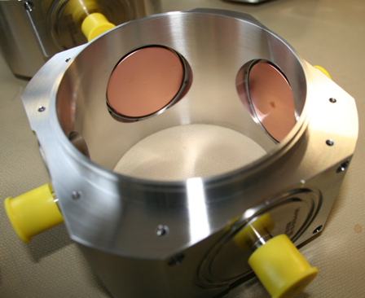
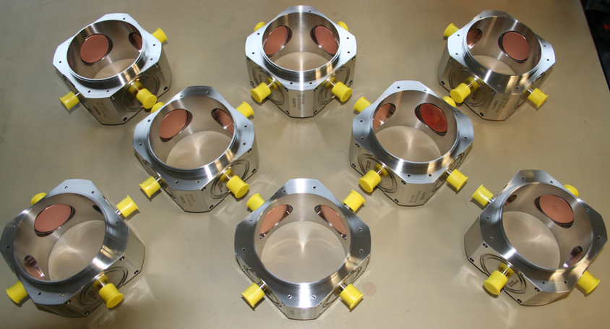
Other
Indeed, sometimes it is the case
Series production for ESS Lund of Feedthrough with a very large knob (28 and 46 mm) and low thickness (0,9 mm) (two types nearly 400 and 100 parts…)
Stressless heat treatments of materials
Precise manufacturing
Bakeable at 125°C and designed ramp procedure 6h up 125°C and 6h cold down
Suitable for UHV applications
Mechanically robust construction (e.g. transports between Germany/England/Sweden)
Radiation resistant
Easy way of particle reducing in complex structural
Company BC Tech, Swiss
Notes:
Durchmesser waren 28 und 46 mm.
All with glass ceramic

Slide 9
From Scratch to real parts

Slide 10

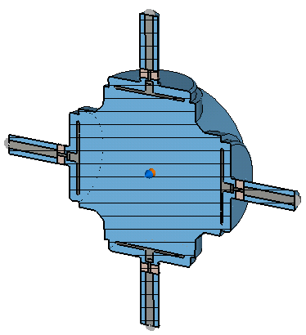
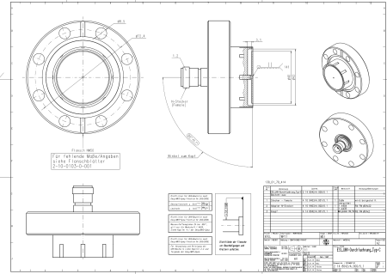
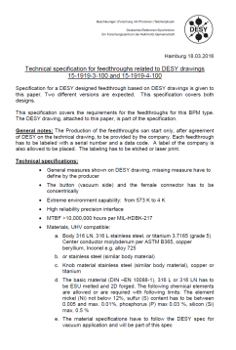

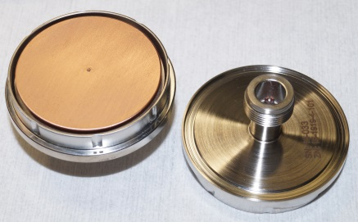
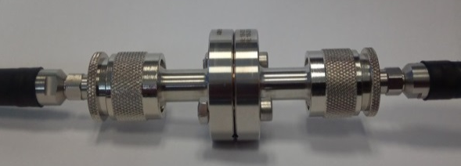

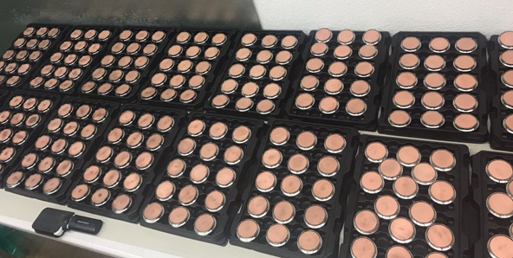
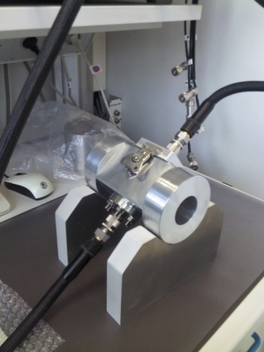



Illustration of the development process
Indeed, sometimes it is the case
Requirements
Simulations
and Design
Construction
Discussion with companies
Prototyping
Laboratory Tests
Maybe Redesign
Series production
Lab measurements
2 Feedthroughs under test head on
Button BPM feedthrough transmission measurement with reference
Sorting
Final check

Slide 11
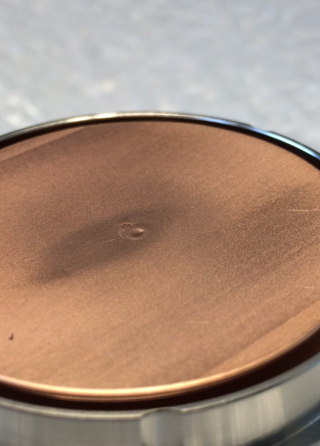
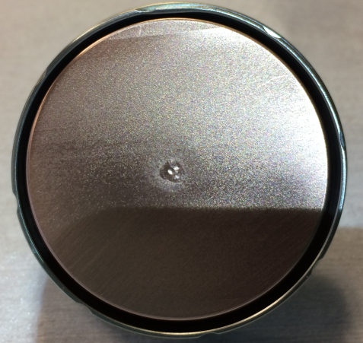
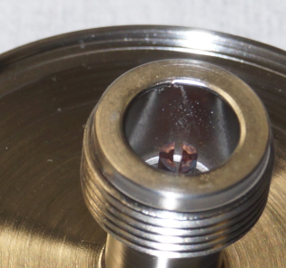

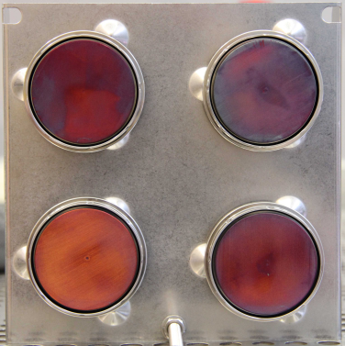
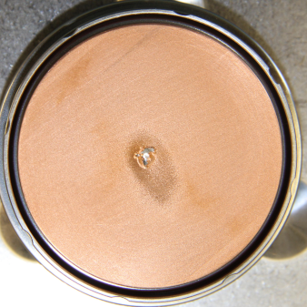
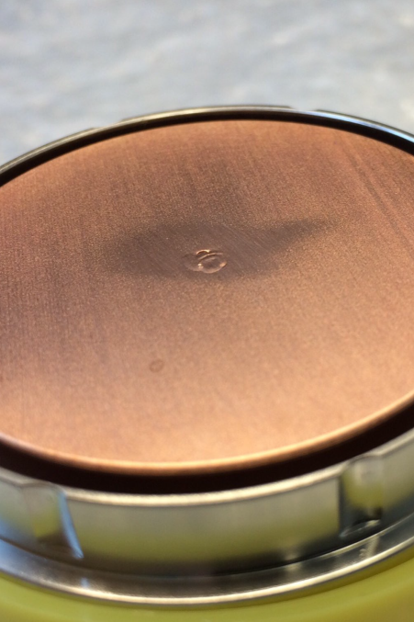
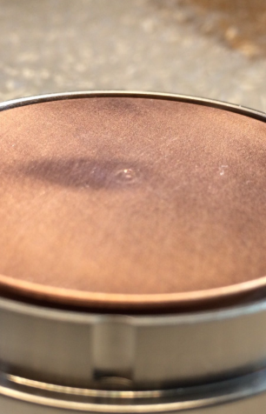
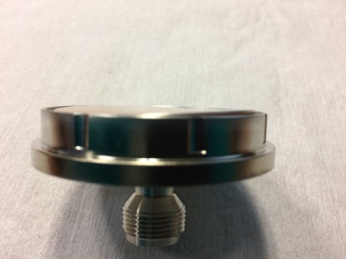
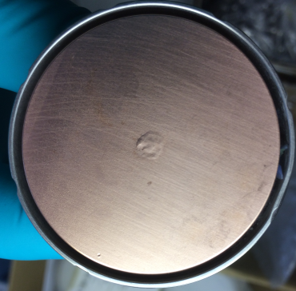
What can be checked and how?
Indeed, sometimes it is the case
Photo taken by DESY

Slide 12
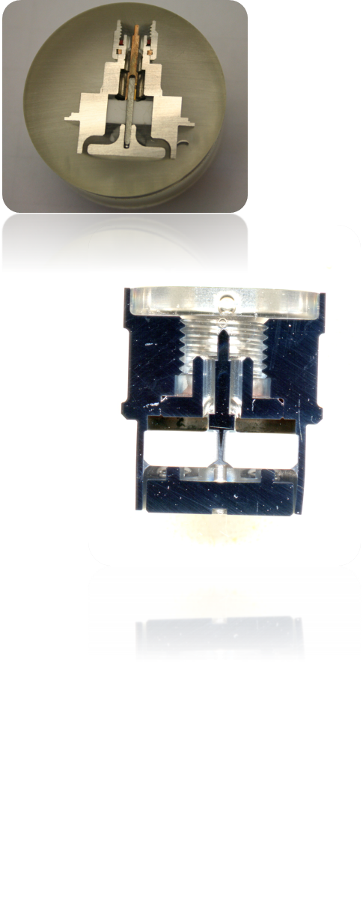
What can be checked and how?
Indeed, sometimes it is the case
Dimensions can be measured conventionally or without contact
Surface coatings can be tested with an adhesive, sticking tests or on suitable test samples that run in series production (Warm up test)
Visual inspection
Vacuum tightness test
Cleanliness test (particle measurement, RGA or wipe test)
Non-destructive testing using CT (test samples and series production)
RF Properties have to be checked
Production of micrographs (test samples)

Slide 13
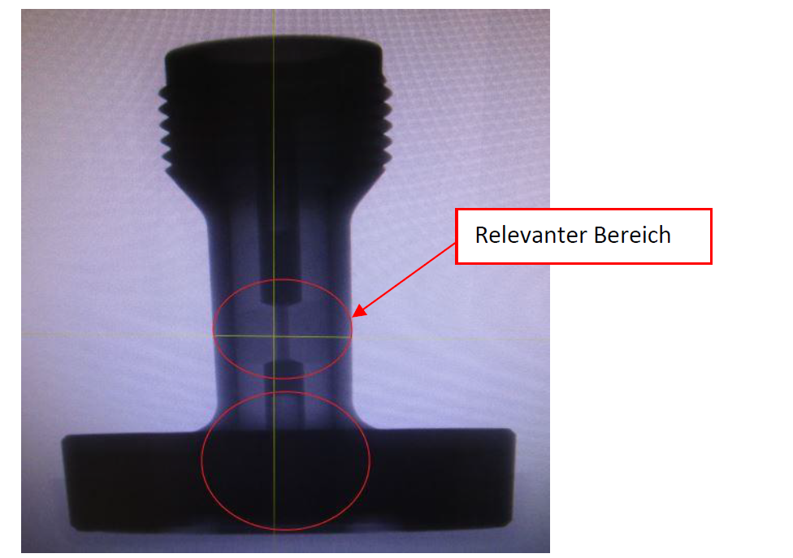
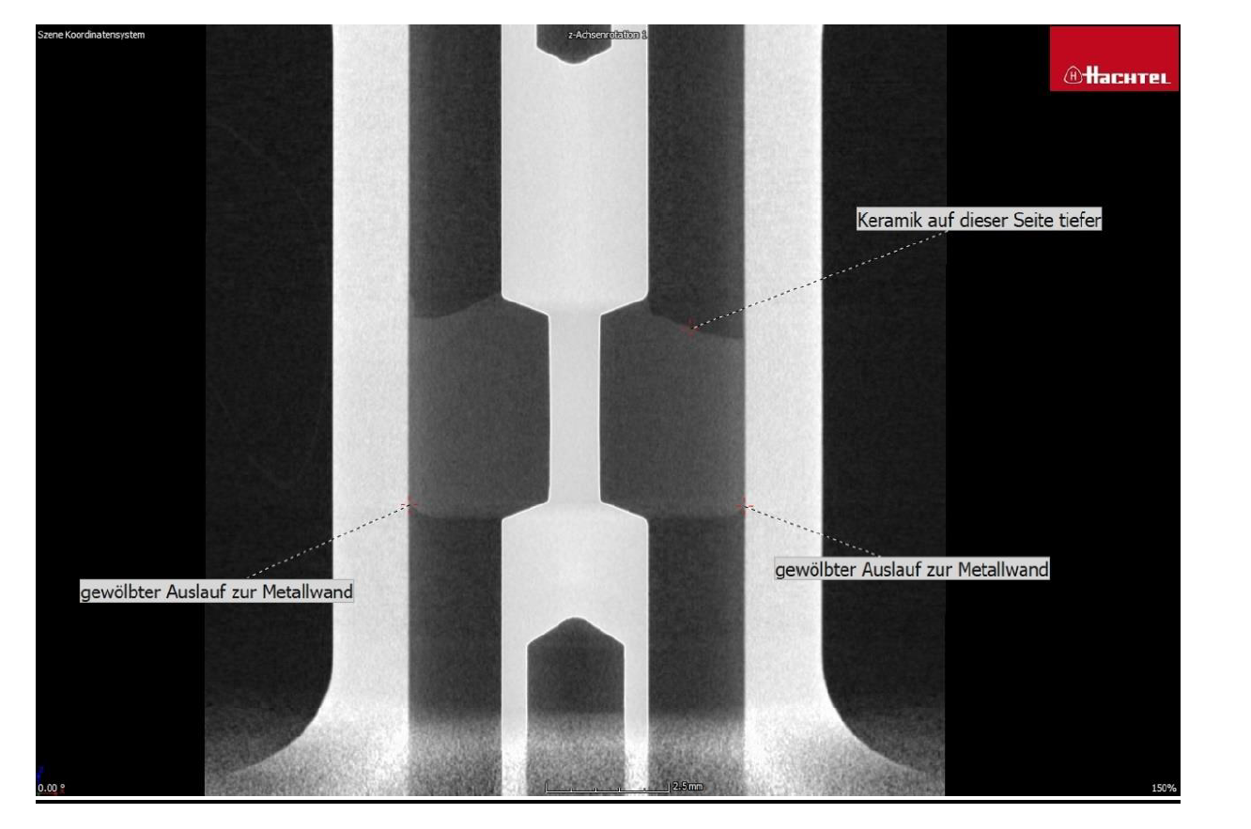
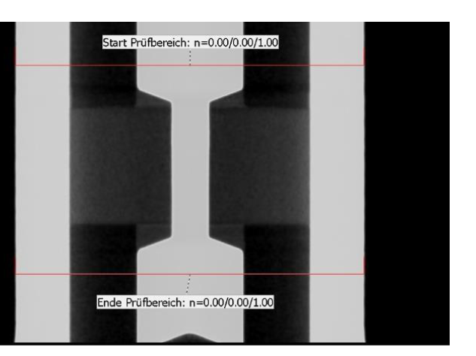
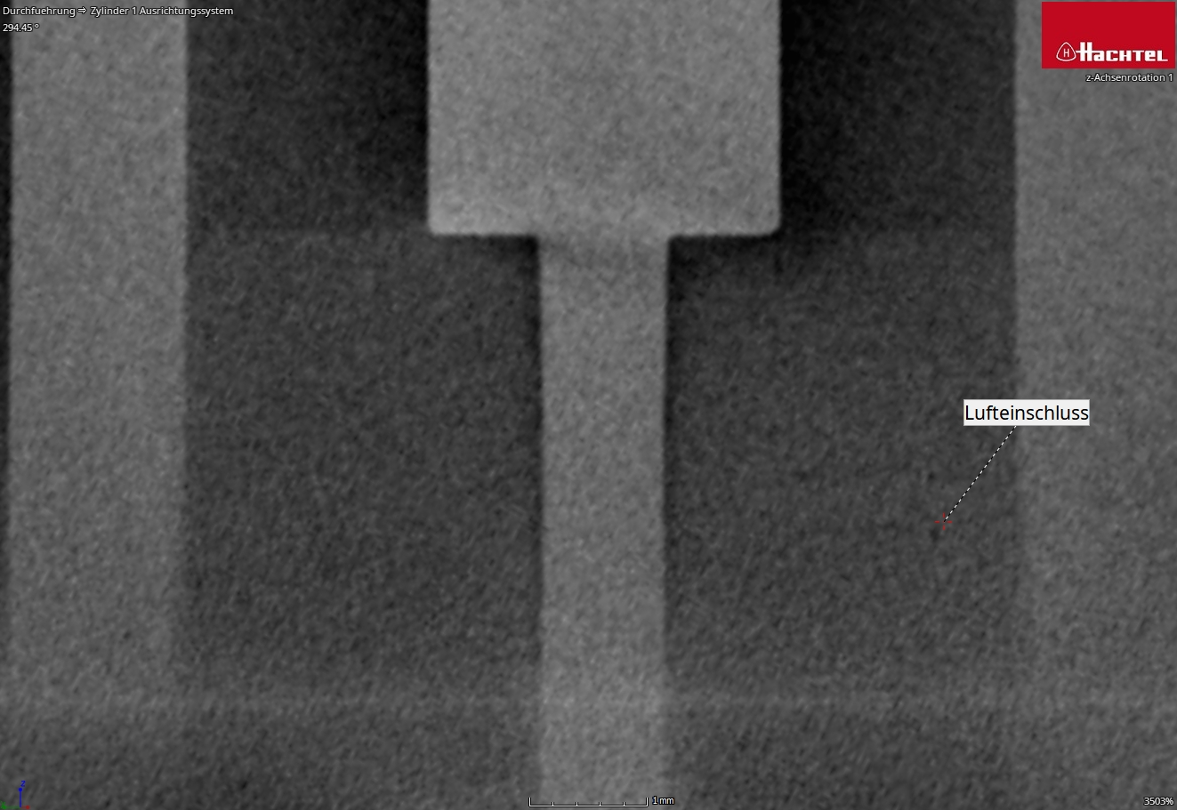
What can be checked and how?
Indeed, sometimes it is the case
Non-destructive testing using CT (test samples and series production)
Courtesy by company Hachtel, Germany

Slide 14
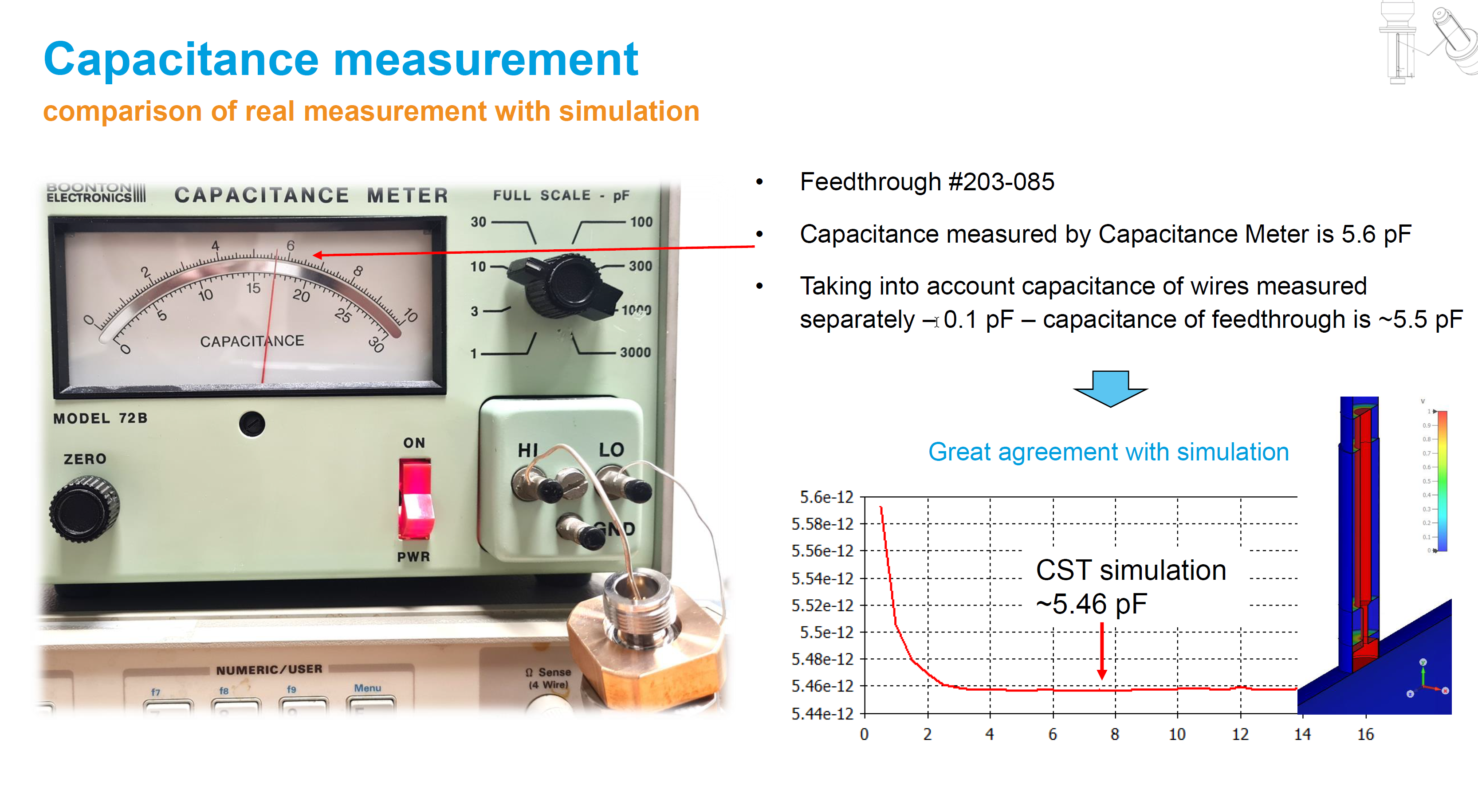
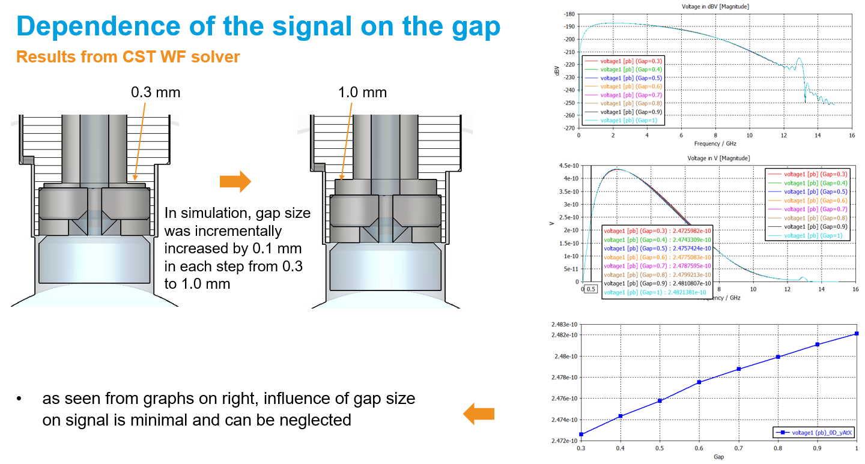



RF Aspects
Indeed, sometimes it is the case
Courtesy by Sergey Strokov DEELS 2023 and internal summary
European XFEL cavity BPM, photo D. Nölle
Measurement adapter for matching resonator side with a network analyzer to measure reflection
Working frequency
Lower reflection with company 1
Lower reflection does not change the external quality factor fortunately, when the feedthroughs from company 1 are taken (only for Cavity BPM Feedthroughs)
Therefore: Influence of feedthrough to the BPM signal has to be observed before the design is finished
Notes:
Hier erwähnen, dass die Durchführungen unten und links für Cavity BPMs vorgesehen sind, darum externe Güte. Bei Knöpfen gibt es keine exerne Güte.

Slide 15
Some Material Parameter

Slide 16

Glass or ceramic
In principle, there are two different manufacturing processes:
  Thermal joining in a continuous furnace under inert gas (Glas to metal sealed technology)
  High-temperature brazing in a vacuum furnace (Alumina Oxid Ceramic brazing technology)
Indeed, sometimes it is the case
Glass to metal sealed:
  Borosilicate
    CTE from 3.2 to 4.5*10 ⁻⁶ K⁻¹ 20°C
    ε_{r} (dielectric constant) 4.6 (Corning 7070 Borosilicate glass)
  Fuced Silica (Quarzglass)
    CTE from 5.0*10 ⁻⁶ K⁻¹ 20°C
    ε_{r} 3.9
  Sapphire
    CTE from 13*10 ⁻⁶ K⁻¹ 20°C
    ε_{r} 9,0 to 11.5
  SiO₂
    CTE 5 to 14*10 ⁶ K⁻¹ 20°C
    ε_{r} 3.9 to 4.5
New: Ultra-low-k-materials, with permittivity less than 2,4
  Borosilicate glass, Schott
Key Properties of HEATAN®
Long-term durability, with thermal cycling stability of up to 300.000 km (180,000 miles), HEATAN® demonstrates excellent suitability for use in automotive systems.
Superior gas-tightness:
Glass-ceramic sealing achieves a leak rate of less than 10⁻⁸ mbar l/s, even at very high operating temperatures over 300°C.
https://www.schott.com/en-gb/products/heatan-p1000279/technical-details
Notes:
Hier könnte erwähnt werden Dein Test mit BC-Tech, dass das Glas nicht mit Edelstahl verschmilzt, sondern nur durch Druck beim Einschmelzen das Vakuum später halten kann.
Weiterhin ist es schade, dass Schott kein Interesse hat, mit uns zusammen zu arbeiten.

Slide 17
Stainless Steel, Titanium or…
Indeed, sometimes it is the case
Materials:
For outer Shell and inner conductor
Material: 316 L(N), titanium, tungsten; molybdenum, Alloy C22 and Kovar ( Iron-Nickel-Cobalt alloy)
CTE (SST): 14,4 – 16 * 10 -6 K ⁻¹ 20°C
CTE (Ti): 10,8 * 10 -6 K ⁻¹ 20°C
CTE (W): 4,5 * 10 -6 K ⁻¹ 20°C
CTE (Mo): 5,2 – 5,5 * 10 -6 K ⁻¹ 20°C
CTE (C22): 12.4 * 10 -6 K ⁻¹ 20°C
CTE (Alloy K): 3 – 11.5 * 10 -6 K ⁻¹ 20°C
Notes:
Sind die verschiedenen Ausdehnungskoeffizienten für die oben stehenden Materialien? Wirst Du die beim Vortragen zuordnen oder kennzeichnen, welches welchen Wert hat?

Slide 18
Challenges UHV Feedthroughs for P4

Slide 19






P4 vacuum pipe
Indeed, sometimes it is the case
Courtesy by Max Holz, MDI 7, DESY

Slide 20

Challenges of mechanical precisions
Indeed, sometimes it is the case
Challenges of mechanical precisions:
Very low tolerances of a few hundredths of a millimeter
Mechanically stable feedthrough
Insensitive to vibrations
Non-magnetic materials, 316 LN was specified
UHV compatible materials
Easy cleaning
Easy evacuation, low outgassing rate
Radiation resistant
Bakeable up to 200°C
Long life time
No maintenance
RF properties optimized
No negative feedback on the beam
Suitable for series production
Low scattering of RF parameters
Robust design (handling and operation…)
Precise assembly or welding due to corresponding geometry (welding collar or dowel pins…)
Courtesy by Max Holz, MDI 7, DESY

Slide 21



NEG heating options
Indeed, sometimes it is the case
Challenges of operation activities:
NEG bake-out over several days at a temperature above 200°C
Discussion about possible NEG coating of the BPM body and Feedthroughs (what influence does it have on RF properties...)
Courtesy by Dirk Lipka, MDI7, DESY
Test Stands for Warm-up BPMs with Feedthroughs:
First test with heating tapes designed for up to 400°C...under vacuum
  we did not reach the temperature
Second trail in the coupler stand of the Vacuum group brought results:
  30% did not reach 200°C
  50% reach 200°C
  20% reach 250°C
Courtesy by Ralph Boespflug, MVS, DESY
Notes:
Niemand ausserhalb kennt “MVS”, besser “Vacuum group”.

Slide 22





Ready for mass production?
Indeed, sometimes it is the case
…good parts…
Picture taken by BC Tech; Pre-Series for P4
XFEL Button BPM with feedthroughs (~280 bodies made inhouse @ DESY/Okuma)
Picture taken by Dirk Nölle and group MDI3 (DESY)
Photo taken by company BC Tech, ESS Button Feedtroughs

Slide 23



Ready for mass production?
Indeed, sometimes it is the case
All process are written down and well communicated
Lessons learned from prototype to serial production finished
Every mistake or problem described and solved
Each production step is monitored
“Best practice” meets “new technologies”
We speak to each other, short ways also to companies (Jour fix are defined)
…then you are ready for series
Illustration of different processes and instructions

Slide 24
Summary

Slide 25


Summary
Indeed, sometimes it is the case
Test a sufficiently large quantity in advance as a pre-series
Lessons learned, documented all results
Use different measurement methods to determine all requirements
Make reviews by third parties
Select tolerances as imprecise as possible
Monitor the entire manufacturing process (create technical specifications and workplace instructions)
Glass to metal sealed is more suitable for lower temperature than for high temperature
Glass has lower permittivity
Aluminum Oxide Ceramic is more suitable for high temperatures due to the filler material used, which act like a seal
FEM simulation can be helpful; however, precise material data must be available for the corresponding temperature ranges
Manufacture feedthroughs with as few individual parts as possible
Do not use 316 LN for the feedthrough housings; the reason has not yet been fully understood by us, a possible cause could be a different wetting of the 316 L and 316 LN stainless steels

Slide 26
Summary
Indeed, sometimes it is the case
Documented quality assurance of all processes in pre-series as well as in series production, lack of time is NOT an argument and certainly always takes “you”…
In-house production can be an alternative if the necessary infrastructure is available, risk of capacity failure
Plan of spare parts
The closer you look, the more sources of error can emerge
Errors must be understood in order to eliminate them
RF parameter (e.g. S parameter) are measured before and after welding or brazing or assembling
100% leak (RGA) checked, after each critical step
100% visual checked after every production step
...indeed it is, my experience shows that the more closely you specify and look to, the more you realize...sometimes getting problems…and never change a running system, think to improve it…

Slide 27


Thanks a lot to you and all my colleagues…
...any questions

Slide 28


Silke Vilcins
MDI 7
silke.vilcins@desy.de
0049 40 8998 3902
0049 175 934 62 60

Slide 29
Back up

Slide 30
Alloy 50, a new material for high temperature application
316 LN ESR unlimited material?
A 316 LN is trimmed to the limits of technical and physical feasibility -after heat treatment you will have a complete different material with change of properties-
Another way can be a “new” materials, such Alloy 50 XM 19 (1.3964), not a cheap material but has a lot of better material properties and so much more advantages for higher treatment applications…

