Slide 1
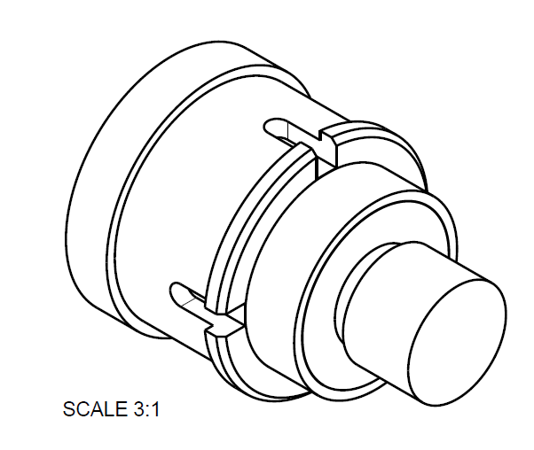

Procuring EBPM buttons

Slide 2
Why run a button prototype project?
Previous workshop had identified that there were more manufacturers than originally thought who had done BPM buttons of one type or another.
https://www.diamond.ac.uk/dam/jcr:6d64554f-f50a-4191-806d-cad60bdd63ba/BPM_workshop_discussion_summary.pdf
However
The tolerances and gaps were only getting ever tighter with new machines.
Just because a company had made buttons in the past is no guarantee that they can make them now.
We needed some buttons for studies in any case
We had some additional goals
See if the material problems seen by the EBS could be avoided
Get experience so we would know where best to put our attention for the full contract
Upskill more companies to have more choice for the final tender.
See if there were significant differences in the installation of the buttons from different vacuum suppliers.
Notes:
Asked for quotes and timescales. Ranked them based on that information. Picked the top 4 (2 known 2 unknown), everyone was having problems so extended to the next two in the list (1 known, 1 unknown). One wildcard at the end.
Individual button assessments were done on all. Welding into test blocks for further assessment was only done on the original 4. Although all buttons are now installed in one test vessel or another.

Slide 3
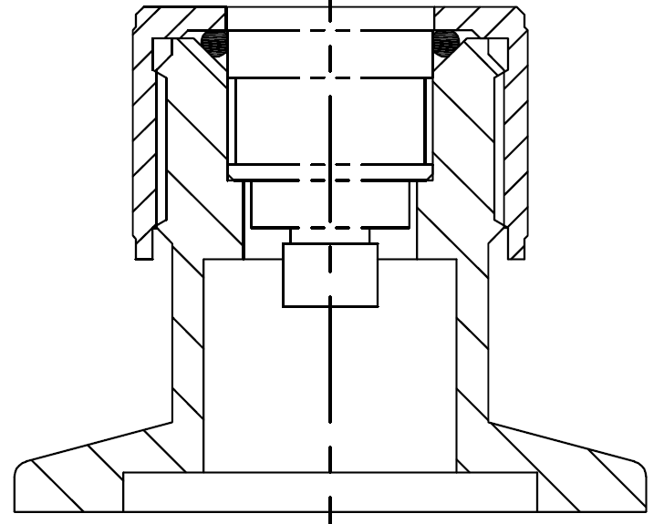
Leak checking
All the buttons were checked for leak tightness upon arrival.
Very few failures as they were checked at the factory before delivery.
(You need to be able to cross check the manufactures claims)

Slide 4
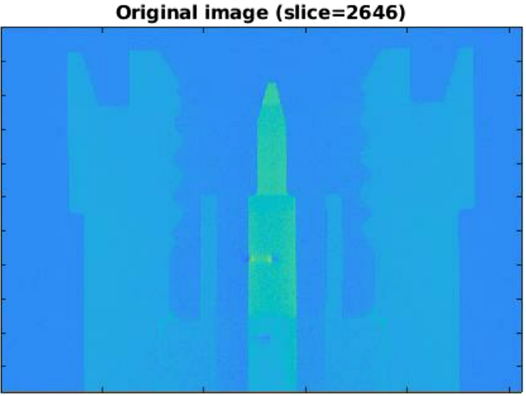
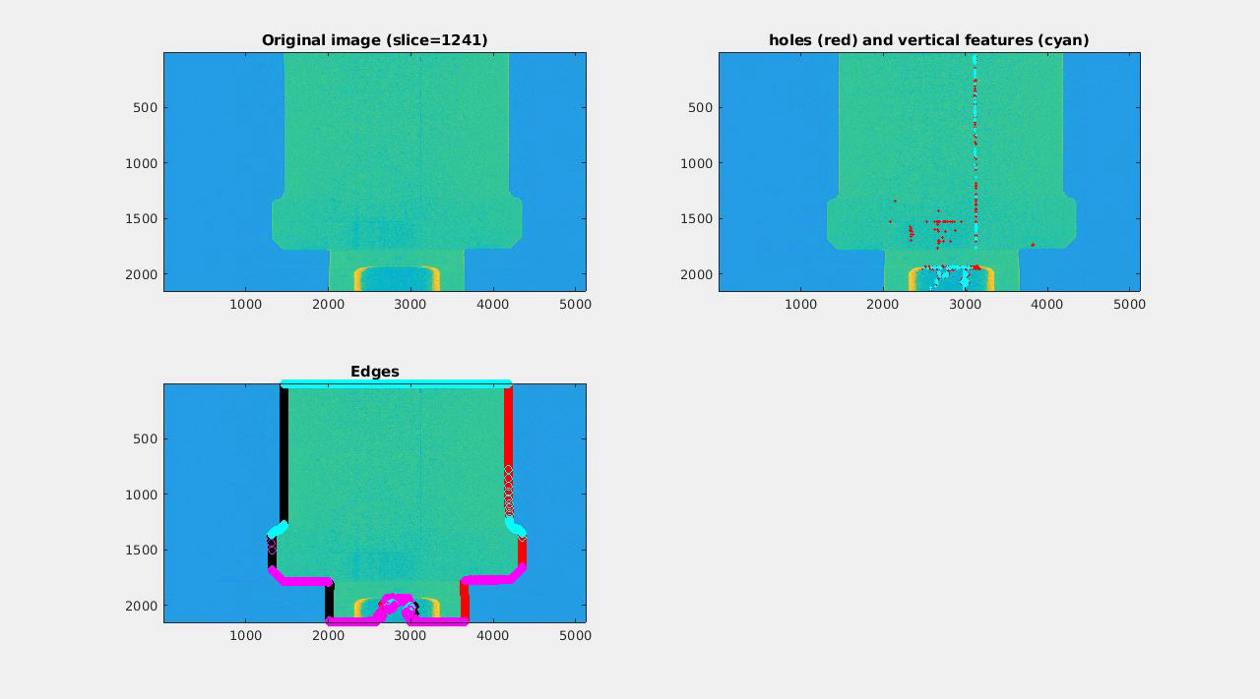
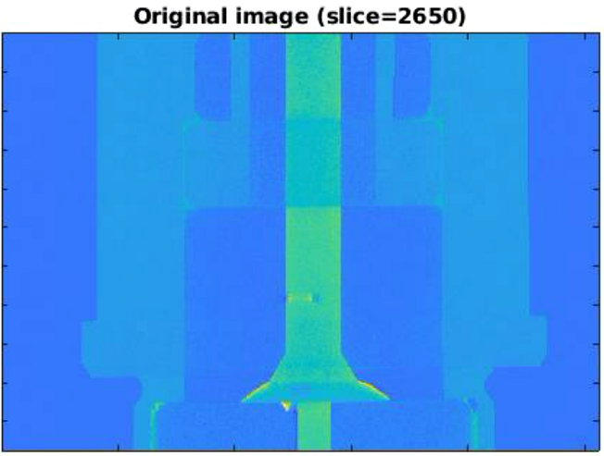
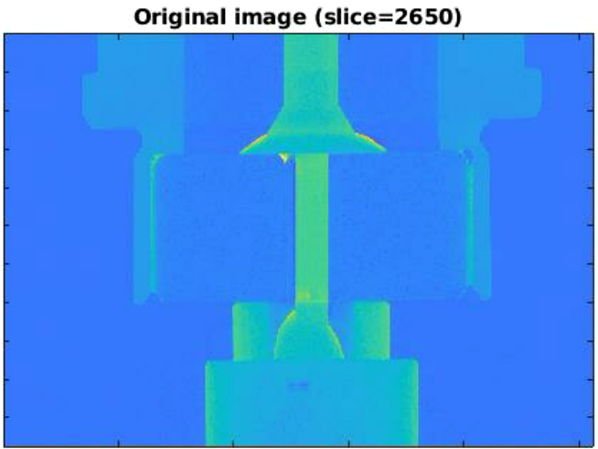
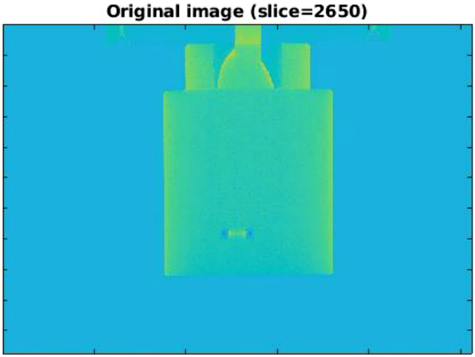
Checking the bulk material for filament holes
Example prototype button
DDBA Failed button
You need to be able to measure what you ask for
(big take away from the first workshop)
Tomography scans to assess bulk material quality. We tested all the prototypes and some remaining DDBA diamond buttons
All prototype buttons passed.
Some DDBA buttons did not pass

Slide 5
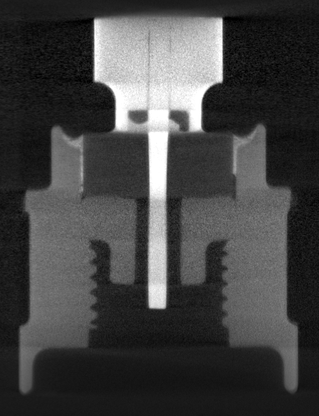
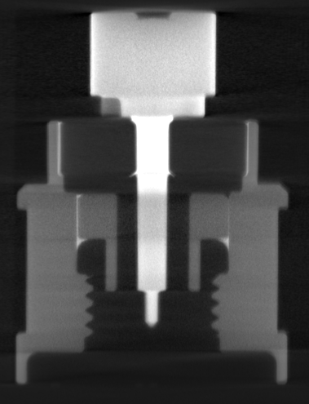
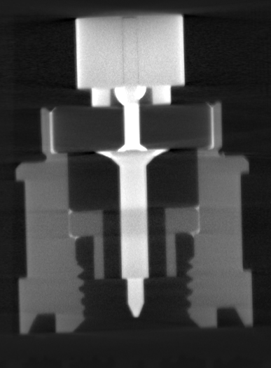
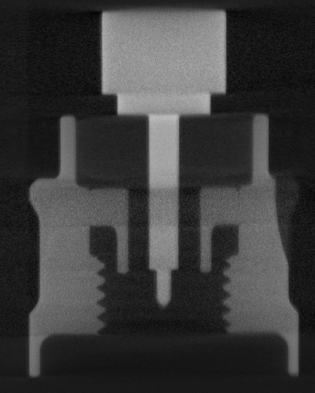
CT scanning to assess brazing
We are also CT scanning our pre-series buttons to validate the expectation of the manufacturer

Slide 6
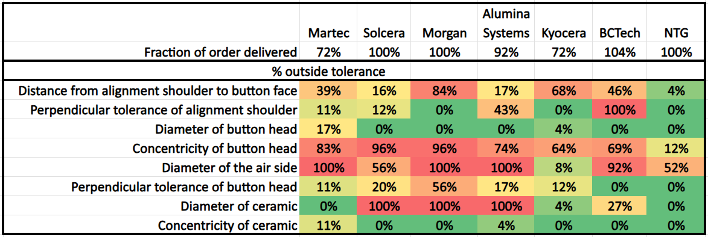
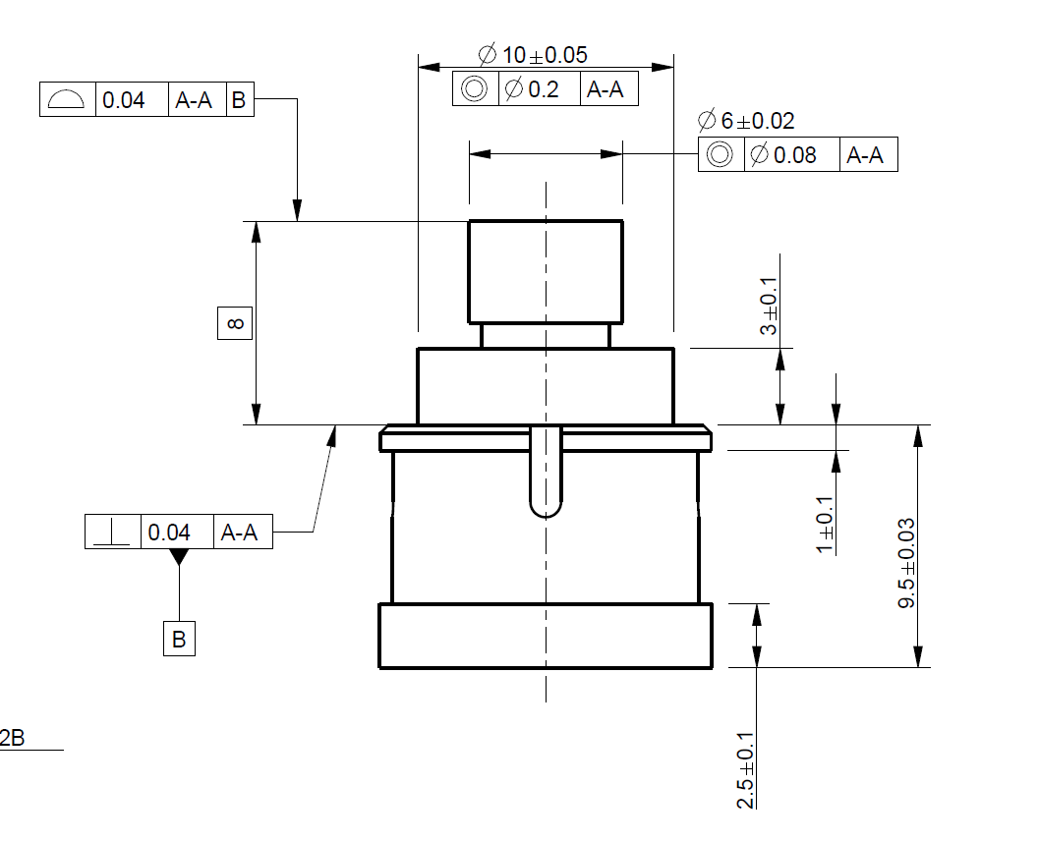
Checking geometric tolerances
We sent all the delivered prototype buttons for external geometric measurement.
Button face
Button head
Ceramic
Alignment shoulder
Ideally, we will test all the Diamond-II buttons. However, timescales may dictate that we only measure a subset.
Air side

Slide 7
We are particularly concerned with the location of the button head
Button dimensions
Hole dimensions
Minimum gaps with worst case concentricity
10.5±0.1
6±0.02
6.5
+0.05
-0.0
0.05
250um
300um
78um
8.4
+0.0
-0.15
8
Alignment
shoulder
3±0.1
3.5±0.1
75um
T
0.04
T
17um
9.5±0.03
0.04
9.5±0.08
12±0.1
+0.00
-0.011
-0.006
-0.017
13 H6
13 G6
Nominal translational space available is 250µm
Max translational head movement: 10µm + 17µm + 80µm + 50µm + 15µm = 172µm
Dimensional errors
Concentricity errors
Error due to rotation around the alignment shoulder

Slide 8
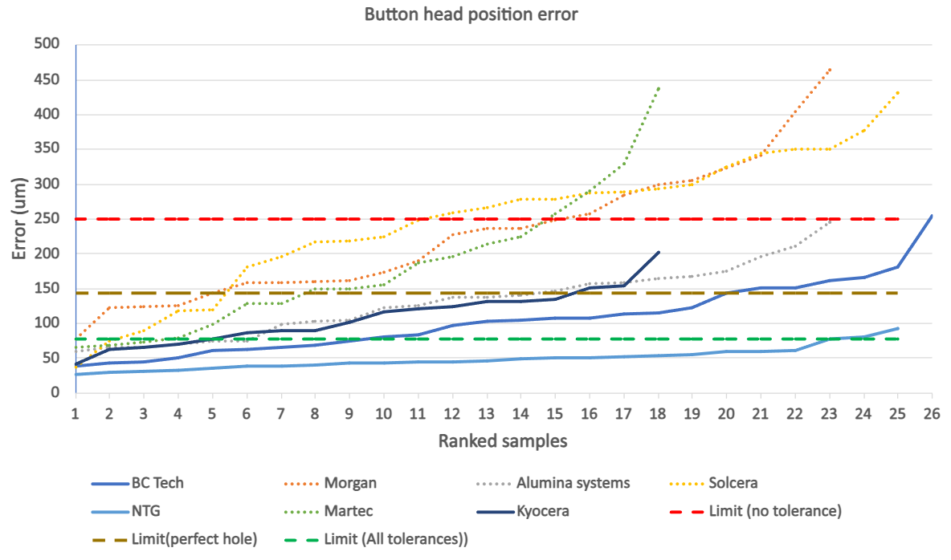
Dotted – Inexperienced button manufacturers
Solid – Experienced button manufacturers
Absolute limit of button head movement
Limit of button head movement when taking all other tolerances into account

Slide 9
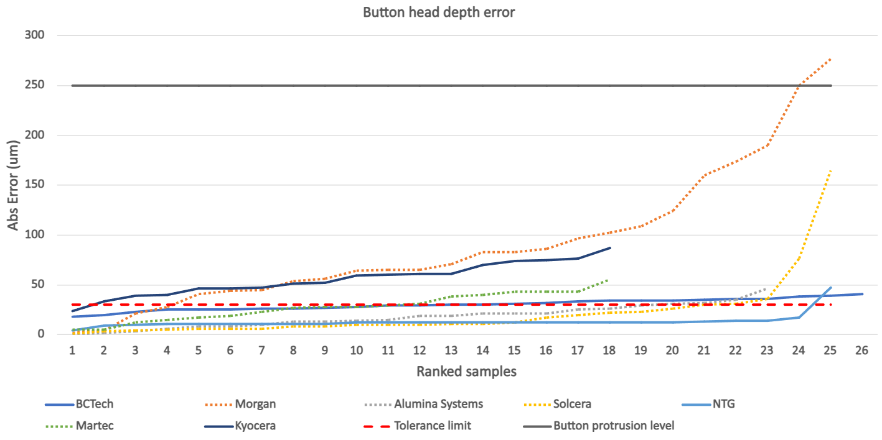
Dotted – Inexperienced button manufacturers
Solid – Experienced button manufacturers
Beam pipe surface
Tolerance limit

Slide 10
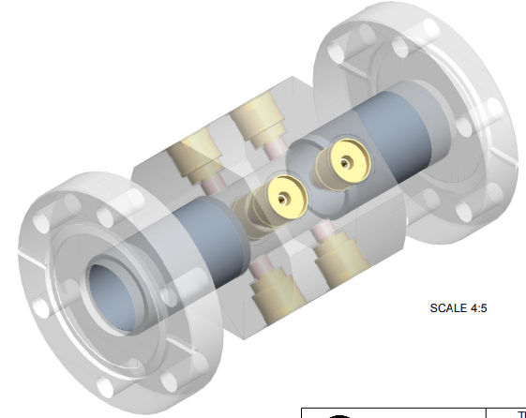
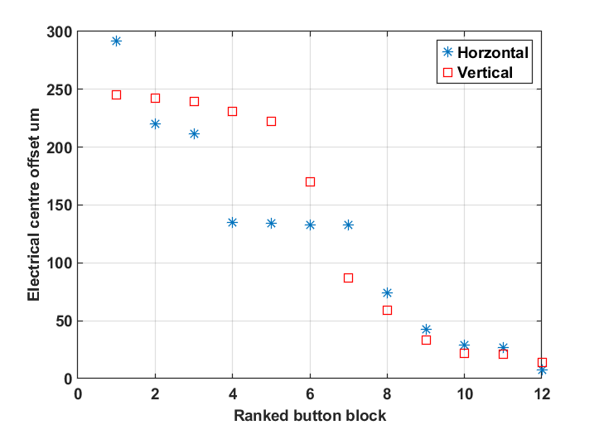
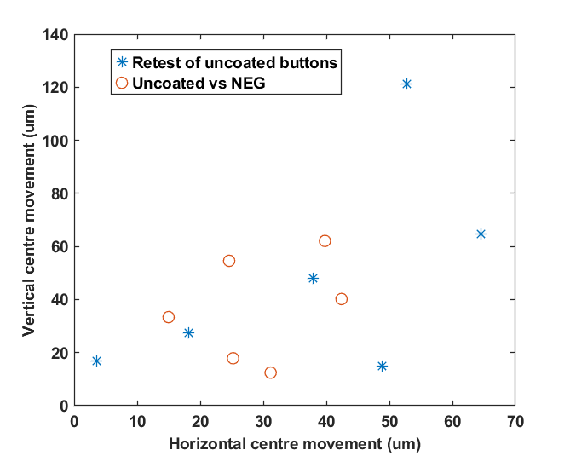
Assessing Electrical centres and NEG coating impacts
Half of the test blocks were sent to be NEG coated.
NEG coating was not detrimental to button performance.

Slide 11
Where are we now?
Final contract placed
Pre-series buttons received – undergoing testing
First series batch expected end Jan
Discussing small modifications to the details of the buttons construction to help move things to scale.
Button tracking / marking (another key point from the previous workshop)
All buttons should be marked from the manufacturer. However, we also have the capability to use a
laser marker to give each button a permanent vacuum compatible label
Planned external measurements
Geometric conformance – also allows sorting
Planned in house measurements
Capacitance from TDR measurements for the individual buttons.
This will allow us to sort the buttons into groups of similar behaviour
https://indico.synchrotron-soleil.fr/event/76/contributions/476/attachments/219/324/2024_06_10_BPM_Fedthroughs_Evaluation.pdf
Next steps - make jigs for testing
Lambertson (NA) for the block so that we can provide our accelerator physics team with the electrical
offsets as this should help with commissioning
Notes:
There is no point putting all this effort into testing the buttons if it can all be lost if someone mixes up the buttons in the tray.
Things we applied from the last workshop
Need to be able to measure things
Need to be able to track things
Need to have open productive conversations with suppliers.

