Slide 1
Development of High-Precision Beam Position Monitor for the Korea-4GSR project
Siwon Jang
4GSR Beam Diagnostics Group, PAL
2024/12/11

Slide 2
Contents
Introduction
Consideration of BPM design
Prototype of Korea 4GSR Button BPM
Beam test results @ PLS-II
Summary

Slide 3

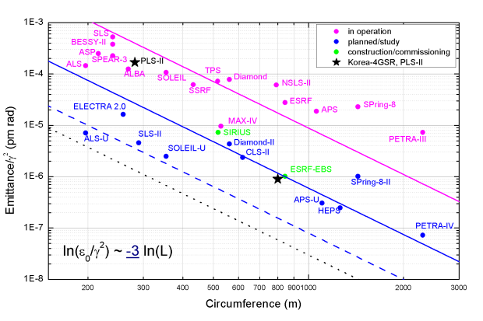

Introduction
A requirement of High-Precision Beam Position Monitor system for Korea 4GSR
Seoul
Pohang
(PAL)
200km
Ochang
(K-4GSR)
100times smaller emittance than PLS-II
High brilliance
Small beam size
Precise & stable orbit control
Project Management: KBSI (Korea Basic Science Institute)
Korea 4GSR Accelerator Design & Construction: PAL
Construction is expected to be completed by 2029.

Slide 4
Consideration of BPM design
Which type BPM is suitable for Korea 4GSR projects?
4GSR Site | Beam pipe size (mm x mm) | Beam pipe Shape | N of BPM | Insulator Type | Assemble Chamber/Insulator
Korea 4GSR | 24 x 18 | Octagonal | 288 | SiO₂ (Al₂O₃) | 1. TIG/ HT Sealing 2. Screw + TIG/ Brazing
PETRA IV | Φ20 | Round | 800 | SiO₂ | TIG/ HT Sealing
SLS-2 | 21 x 21 | Octagonal | 116 | SiO₂ | TIG + Screw/ HT Sealing
ESRF-U | 12.5 x 9.6 / 23 x 13.4 | Octagonal | 320 | Al₂O₃ | TIG/ Brazing
SIRIUS | Φ24 | Round | 160 | BN/AlN -> Al₂O₃ | Screw + TIG/ Brazing
NSLS-II | 38 x 25 / 38 x 10 | Ellipse | 180 | SiO₂ | Flange/ HT Sealing
APS U | Φ22 | Round | 480 | Al₂O₃ | TIG/ Brazing

Slide 5
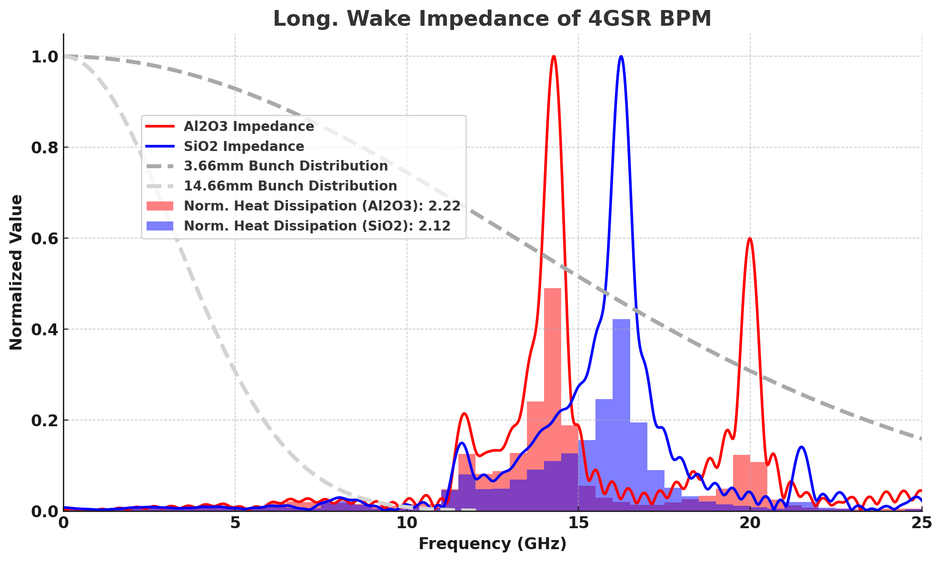
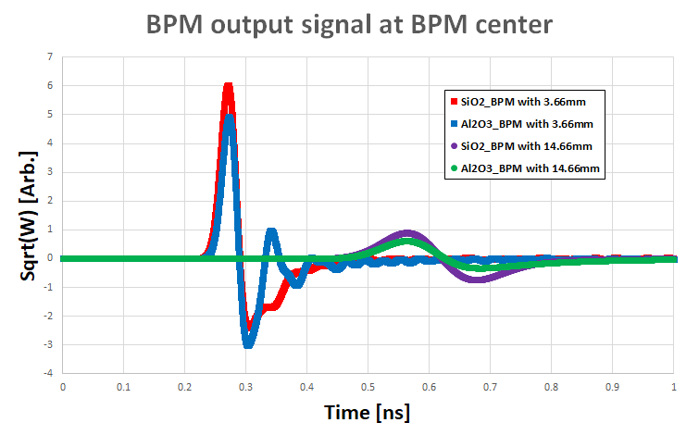
4GSR Button BPM
Why Two Types of BPM Designs?
To minimize wake impedance in the compact vacuum chambers of the 4GSR storage ring, two common button pickup designs and insulators were compared to achieve an optimized solution:
1. SiO₂ Glass Insulator (Innovative & New Technology)
• Shifts wake impedance to higher frequency bands, reducing its overall impact.
• Easier to manufacture while ensuring excellent electrical performance.
• Significantly more expensive than Al₂O₃ insulators.
2. Al₂O₃ Ceramic Insulator (Traditional & Proven Technology)
• Provides superior thermal stability and mechanical strength.
• Cone-shaped design achieves low wake impedance comparable to SiO₂ glass but involves a more complex fabrication process.
• More cost-effective for standard precision requirements, but costs become similar for high-precision mass production to ensure concentricity.
Note: Under normal operation, the bunch length in the 4GSR storage ring with the 3rd harmonic cavity is 14.66 mm, resulting in negligible wake impedance issues. However, during the initial commissioning, the 3rd harmonic cavity may not function as intended. Therefore, the BPM design needed to account for extreme scenarios with 3.66mm bunch length to ensure reliability in all possible operating conditions.
P_{loss} [ W ] = M Q [nC]² f₀ [kHz] 10⁻³ k_{loss}
k_{loss} = ∫ ds W_{L}(s) λ(s)
M : Bunch number
Q : Bunch charge
F₀ : Rev. frequency

Slide 6
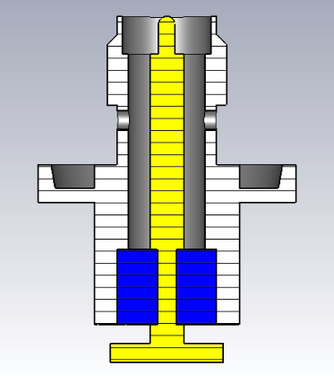
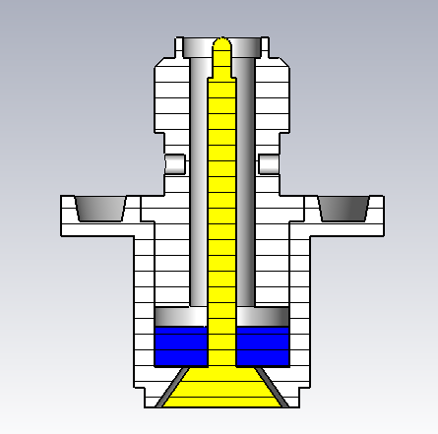
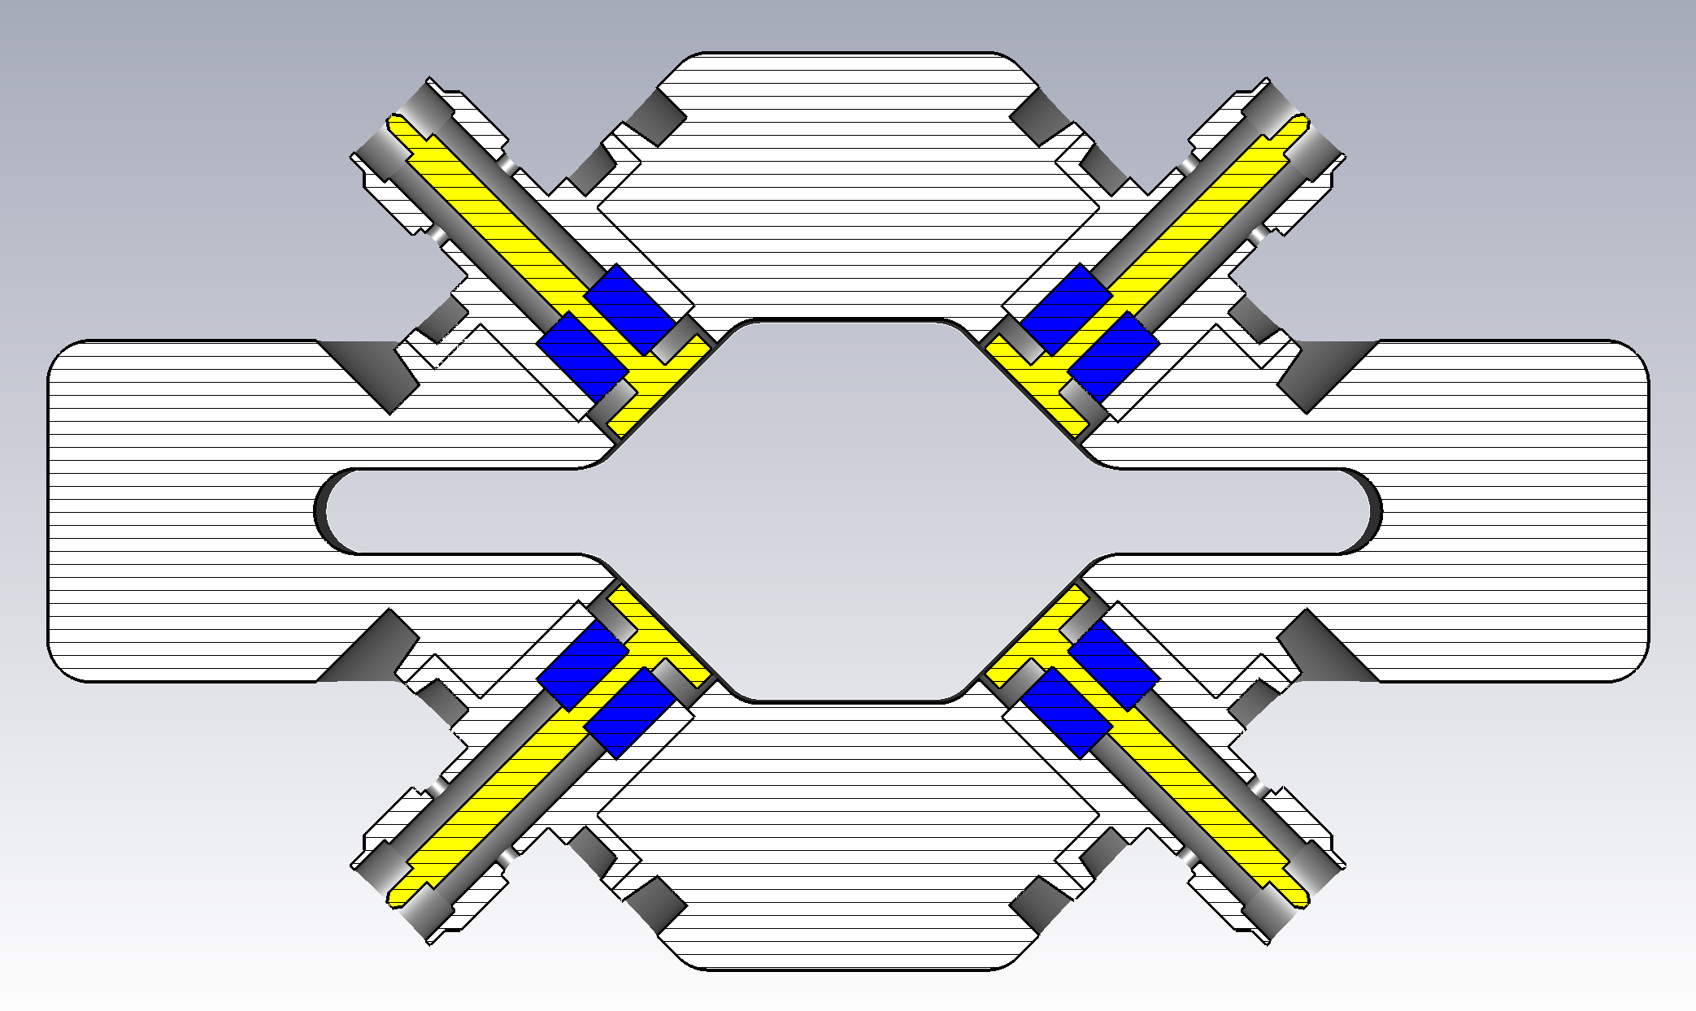
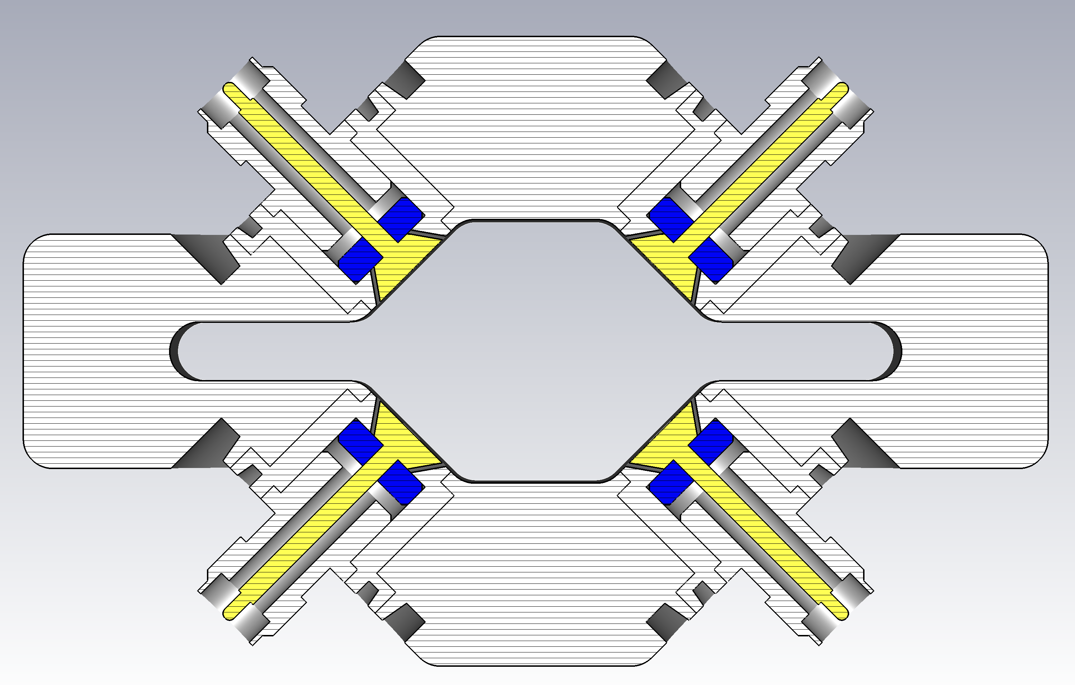
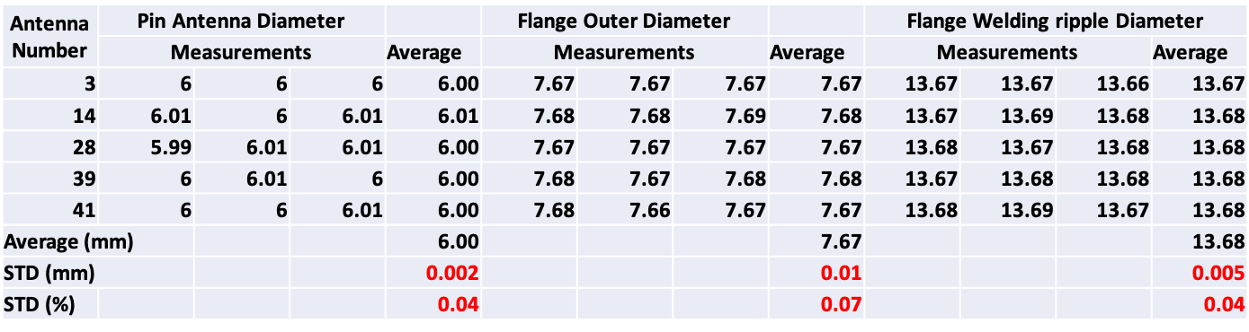

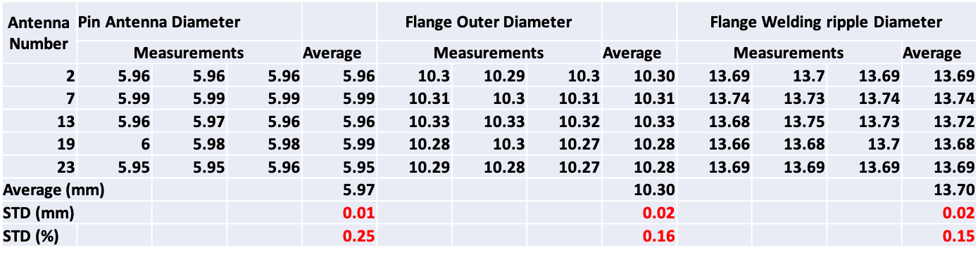
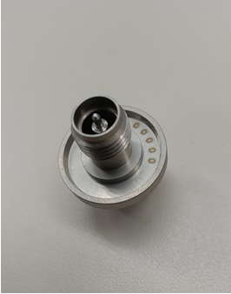
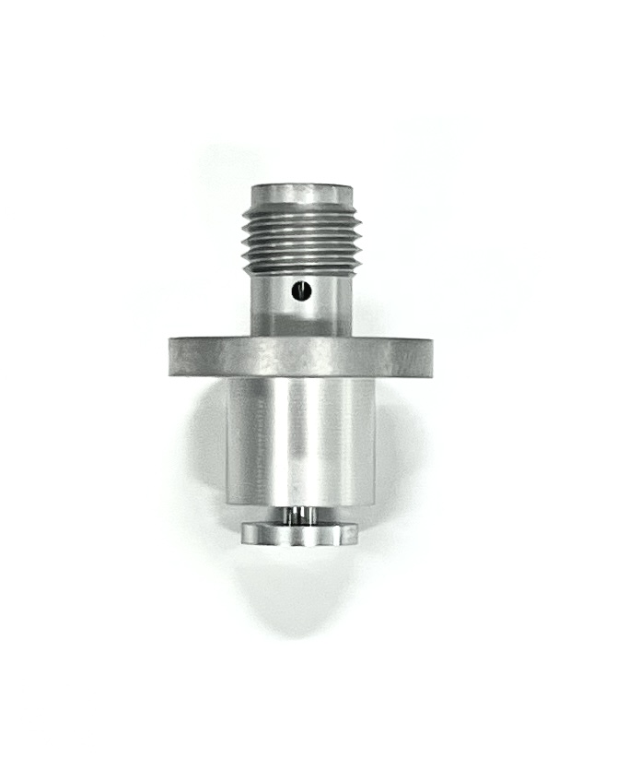
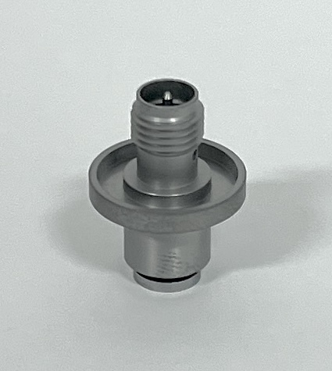
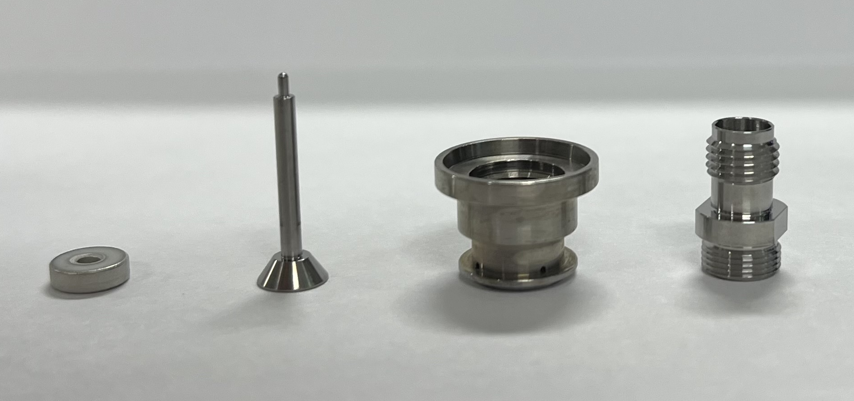
Prototype of Button
Why Two Types of BPM Designs?
RF Pick-up (Linac. to SR: All button type)
Two prototype of buttons were fabricated and tested at PLS-II
SiO2 pick-up shows more good quality and easy for mass production
Reviewing production processes and quotations for mass production
TDR & tolerance measurements of pick-up have been complete.
Challenges include ceramic thickness constraints and maintaining Al2O3 pickup concentricity during brazing
Type-A (SiO₂ Glass)
Type-B (Al₂O₃ Alumina)
24mm x 18mm
SiO₂
Type-A (SiO₂ Glass)
Type-B (Al₂O₃ Alumina)
Al₂O₃

Slide 7
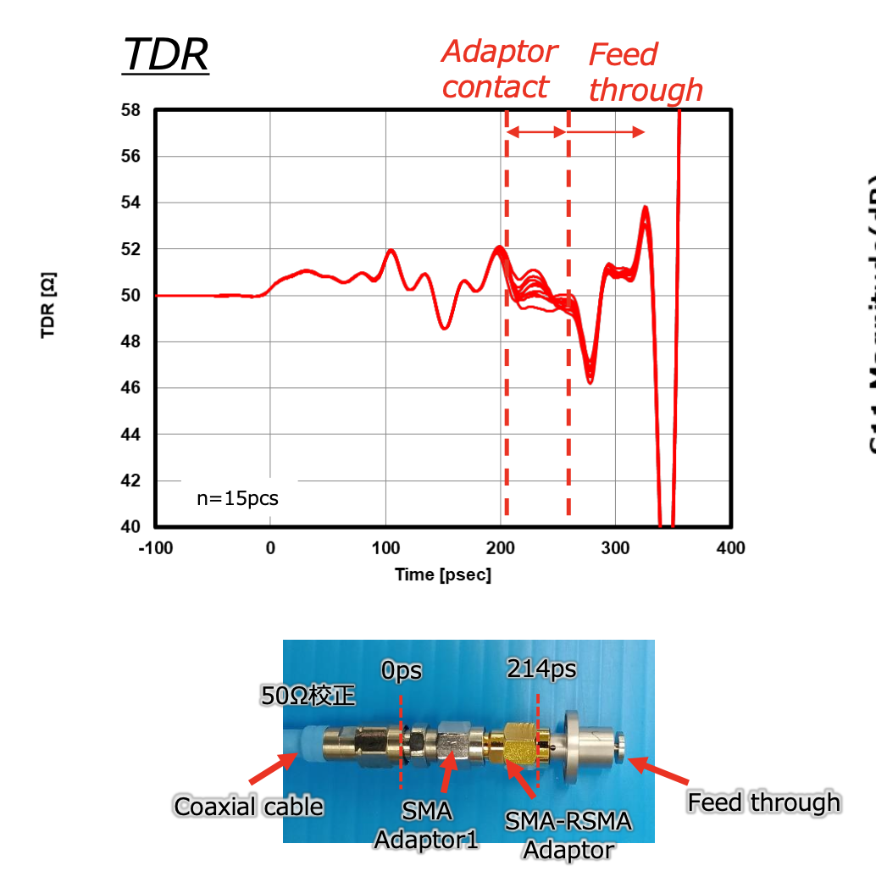
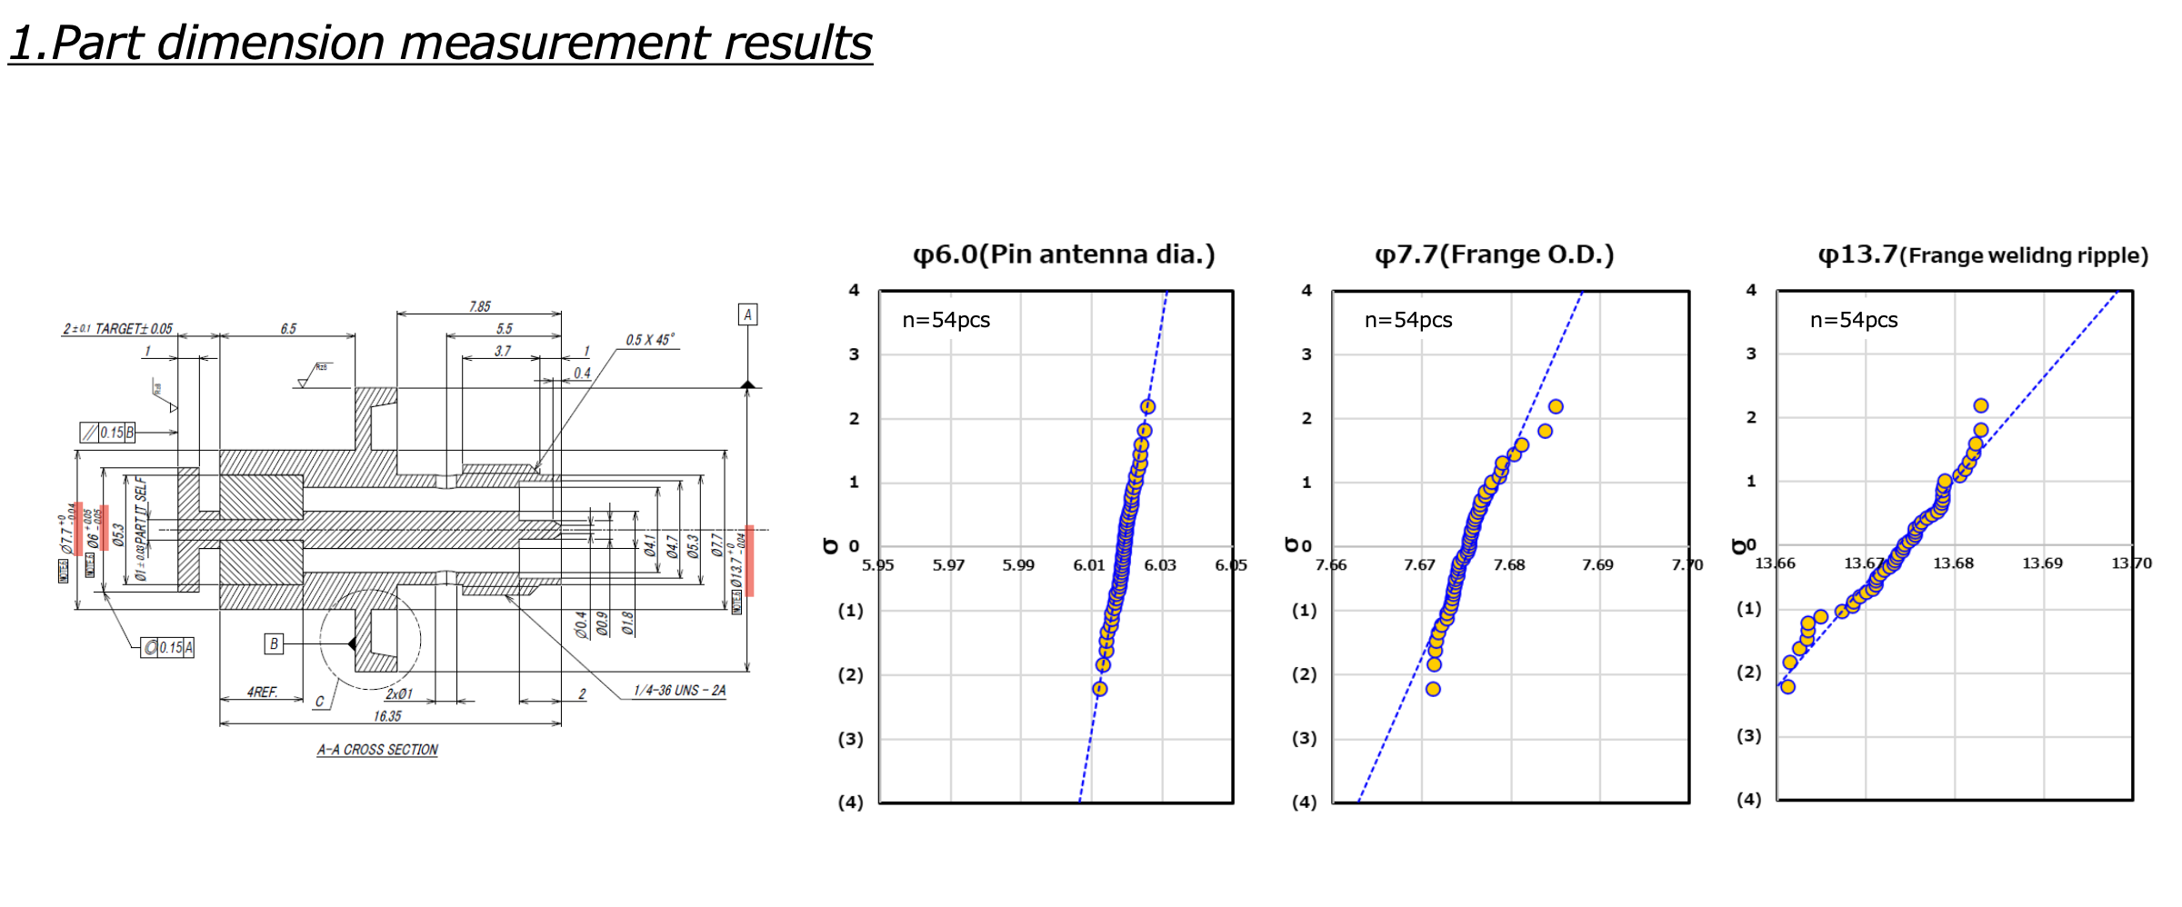
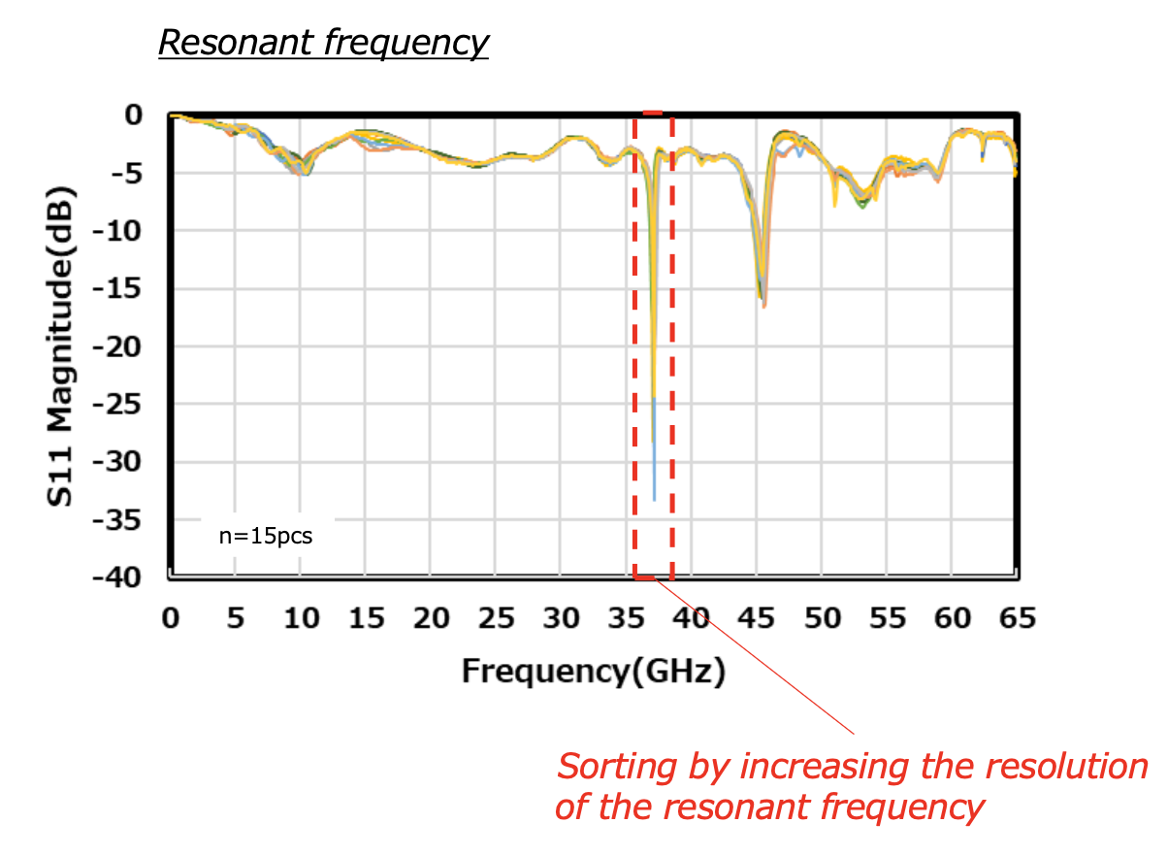
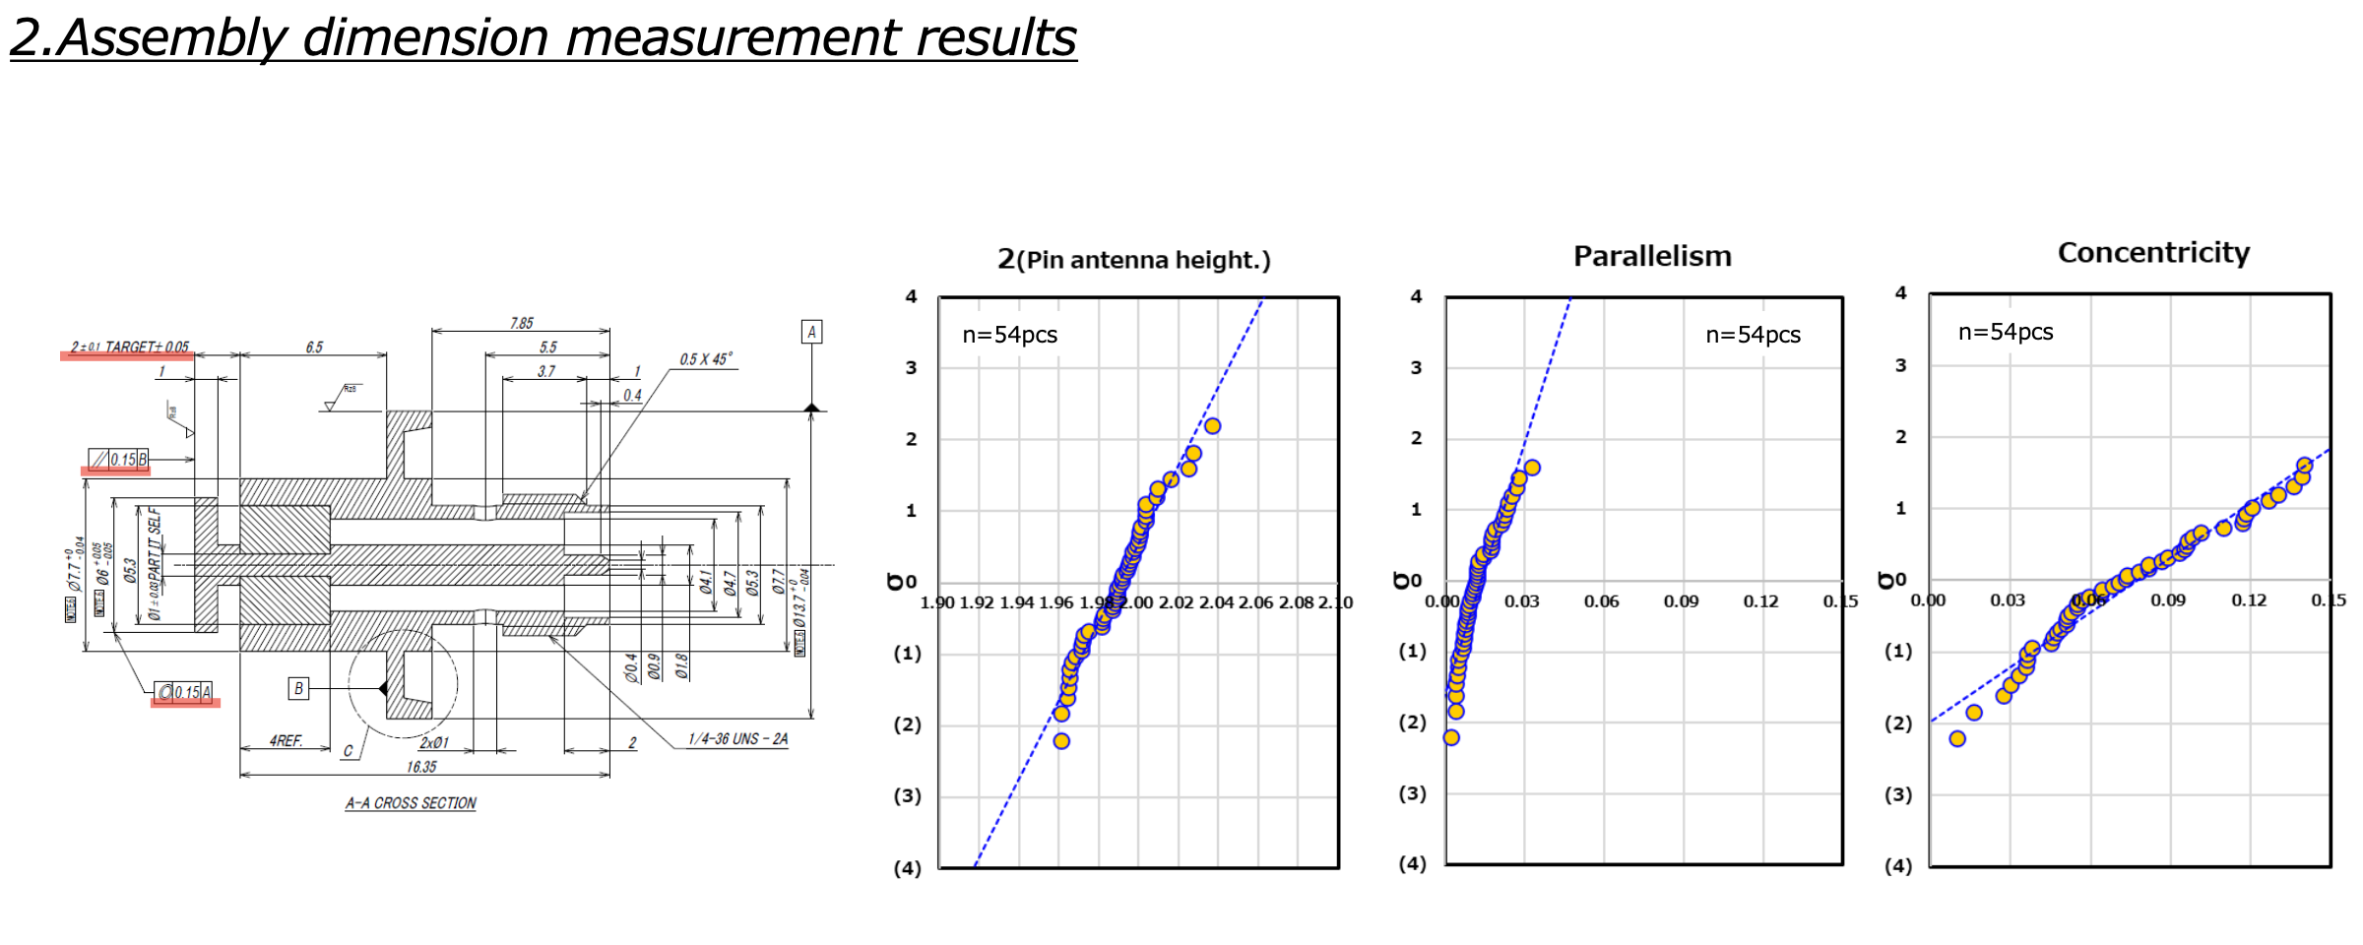
Prototype of SiO2 Button
Sorted packaging with similar capacitance
Fabricated by Kyocera JAPAN
Long term Vacuum test: 10^-11 Pa・m3/s
Baking test with 250∘C during 48 hour
All parts measurement before & after sealing
TDR measurement for packaging
The sealing jig plate will be redesigned for mass production.

Slide 8
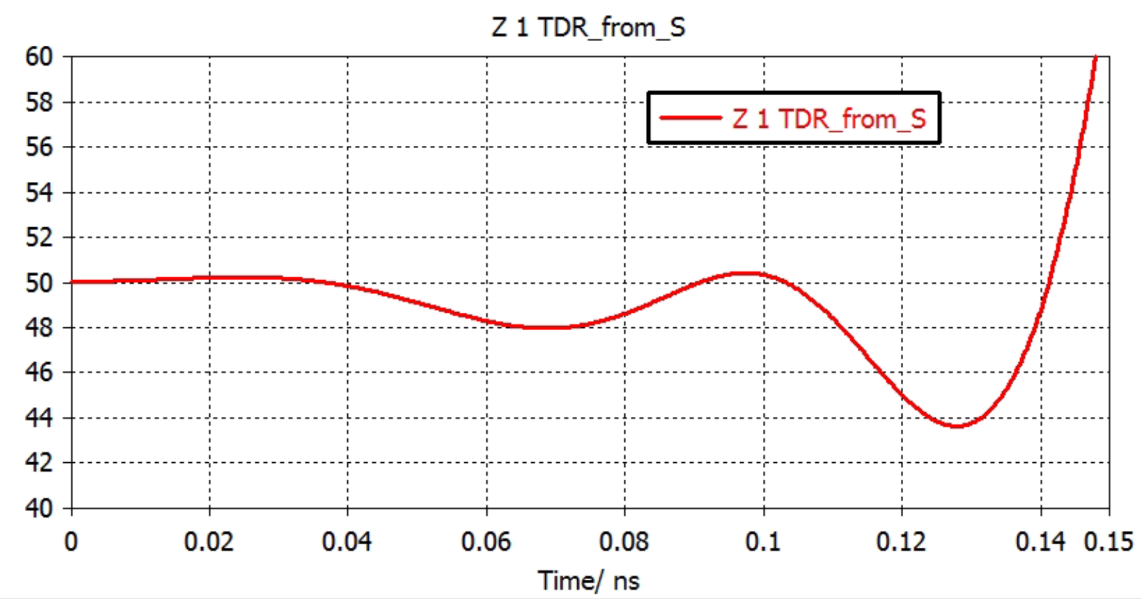
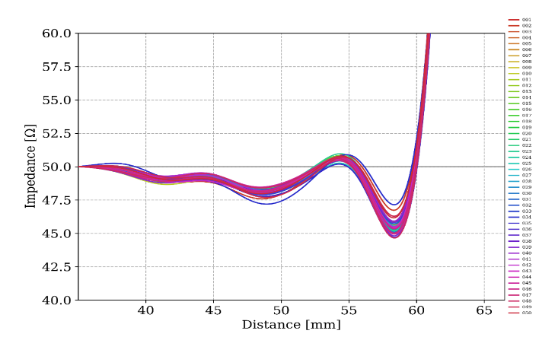
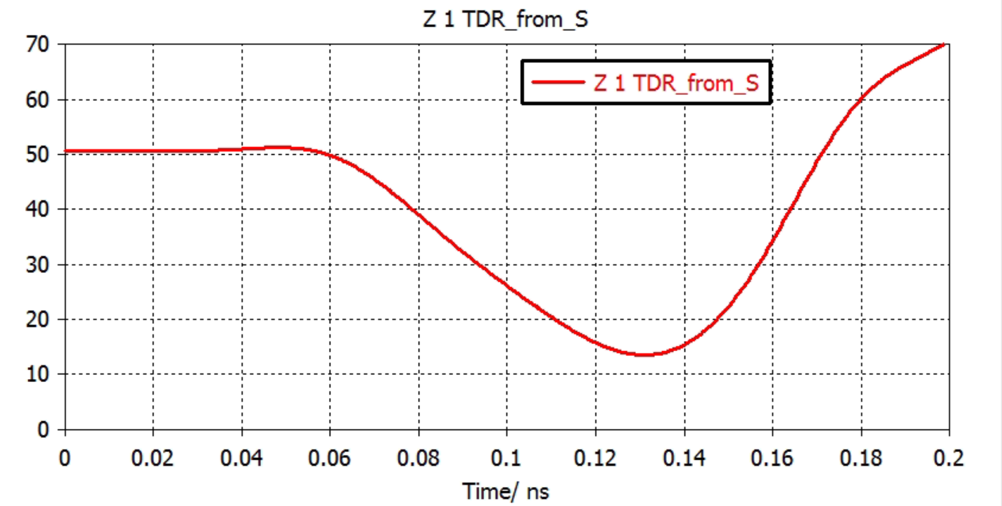
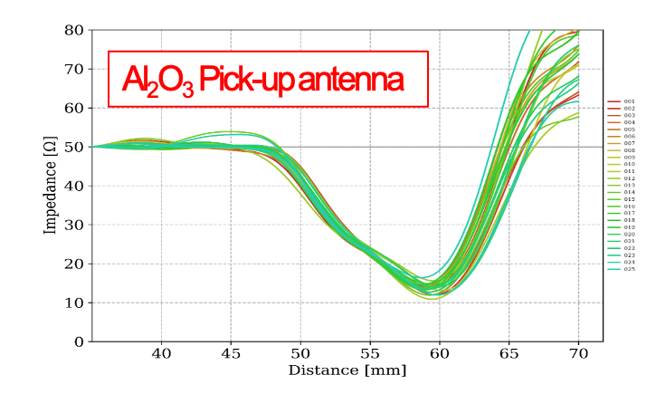
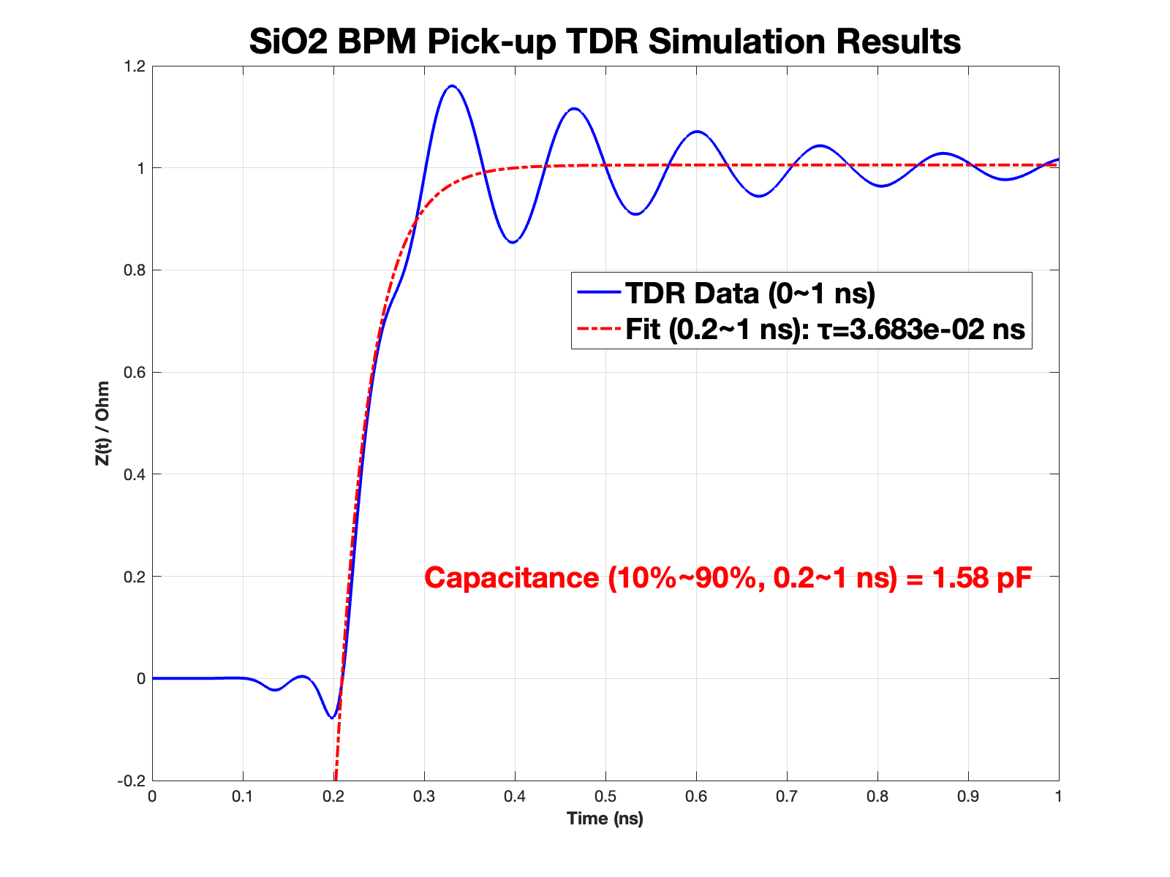
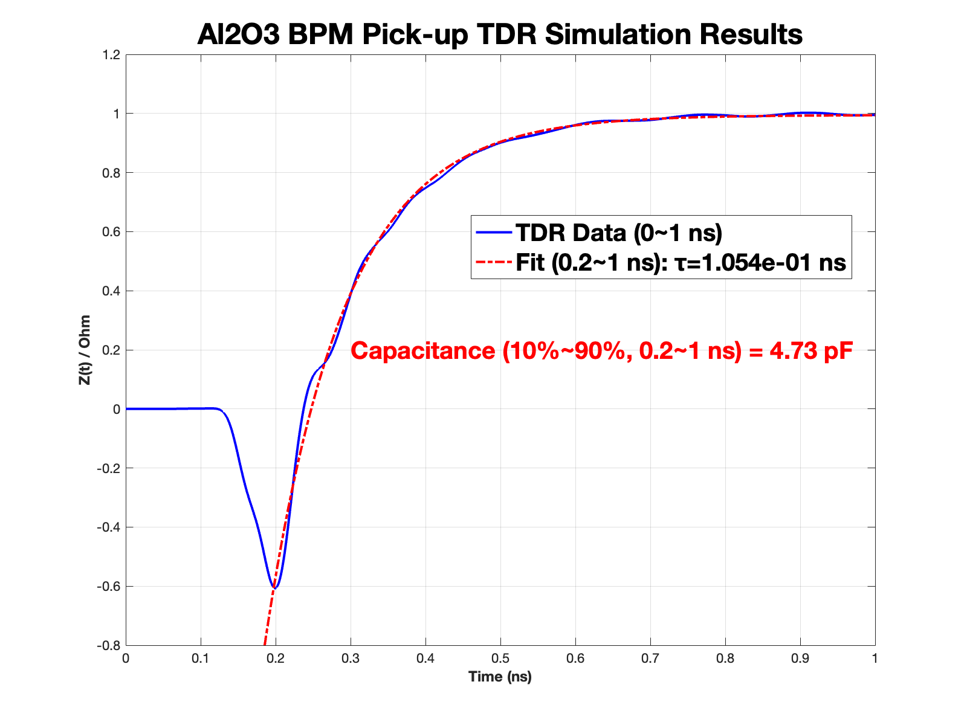
Prototype of Button
TDR meas. of SiO₂
Sim. TDR of SiO₂
Why Two Types of BPM Designs?
RF Pick-up (Linac. to SR: All button type)
Two prototype of buttons were fabricated and tested at PLS-II
SiO2 pick-up shows more good quality and easy for mass production
Reviewing production processes and quotations for mass production
TDR & tolerance measurements of pick-up have been complete.
Challenges include ceramic thickness constraints and maintaining Al2O3 pickup concentricity during brazing
TDR meas. of Al₂O₃
Sim. TDR of Al₂O₃
Type-A (SiO₂ Glass)
Type-B (Al₂O₃ Alumina)
V~1/C, C=𝜏/Z₀

Slide 9
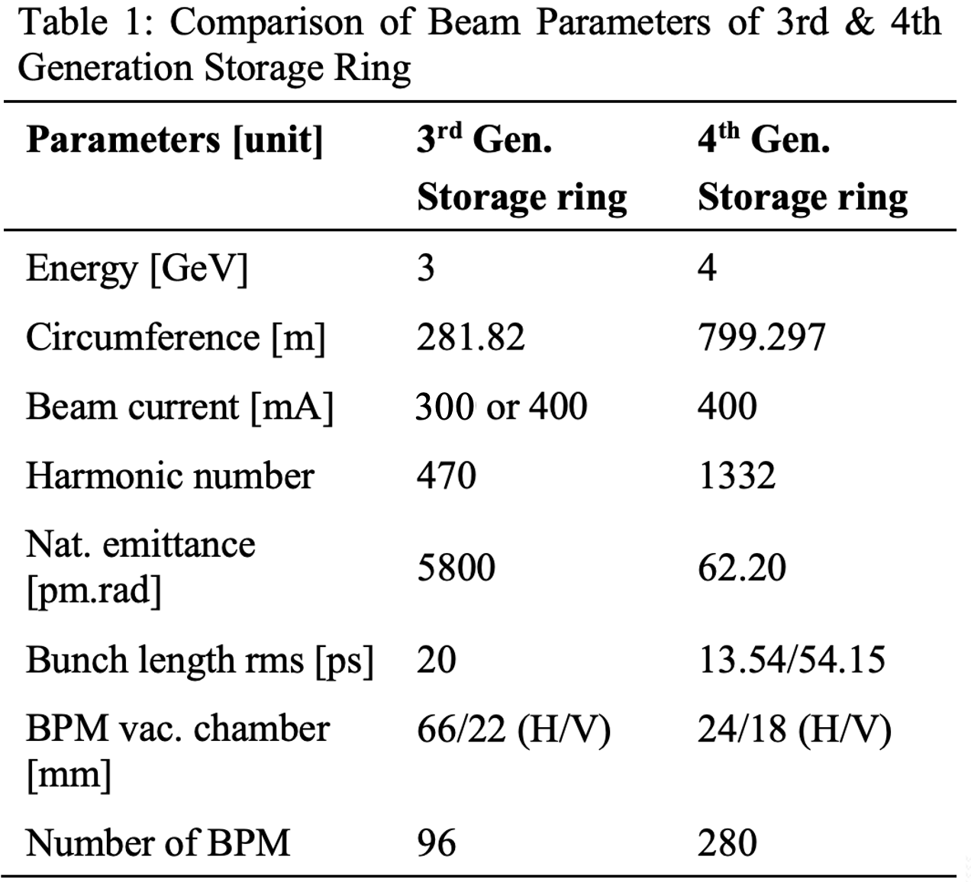
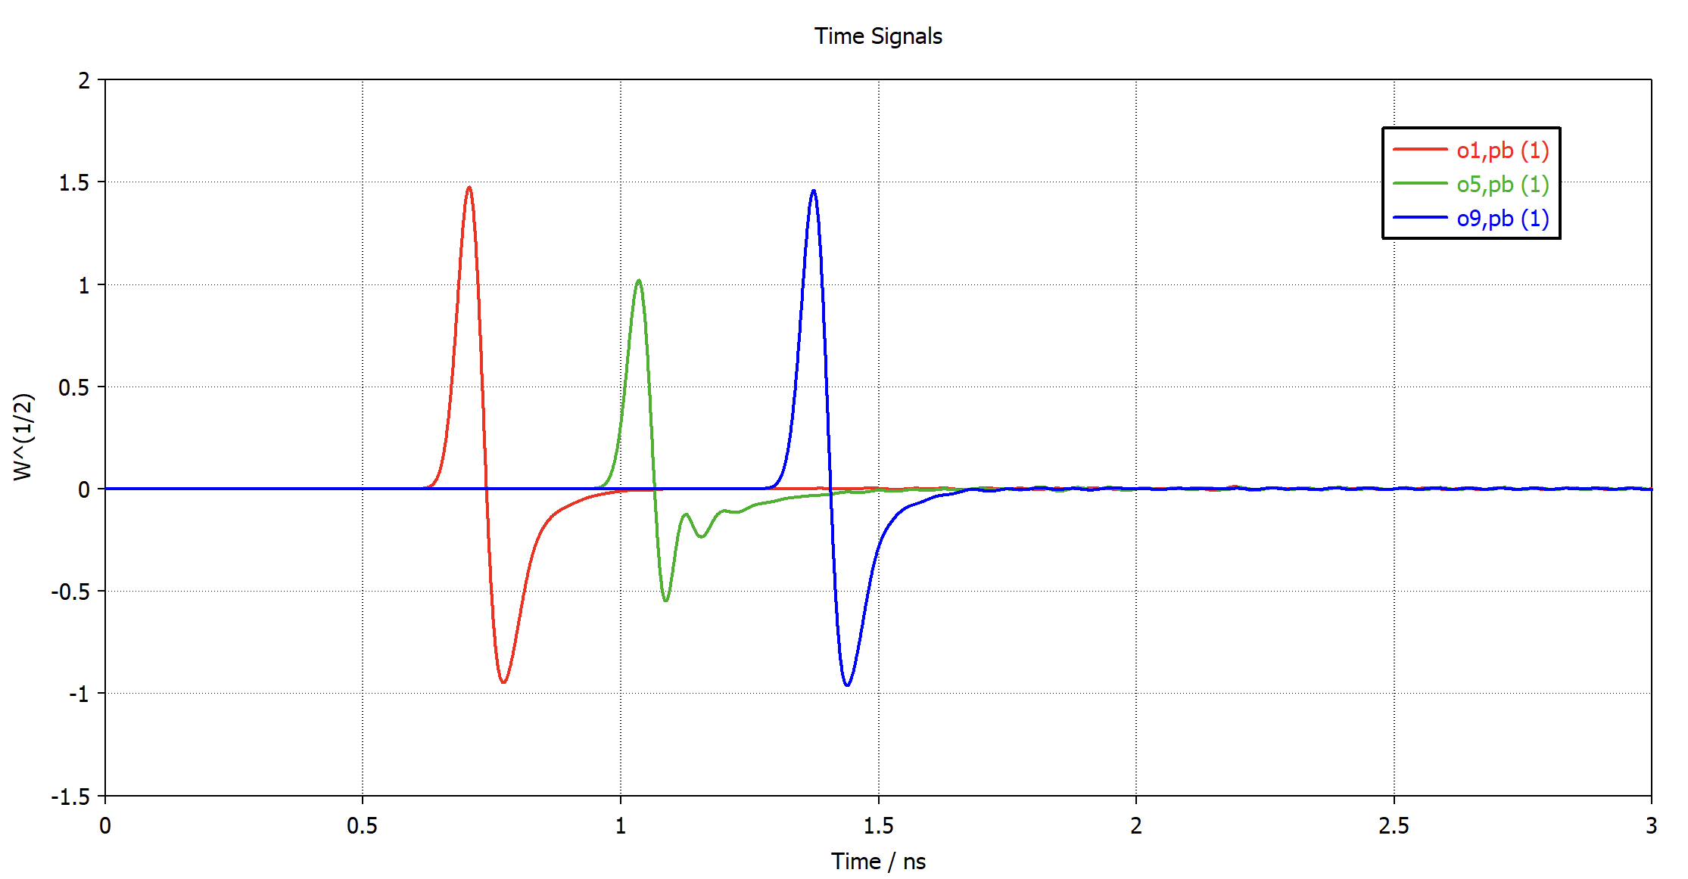
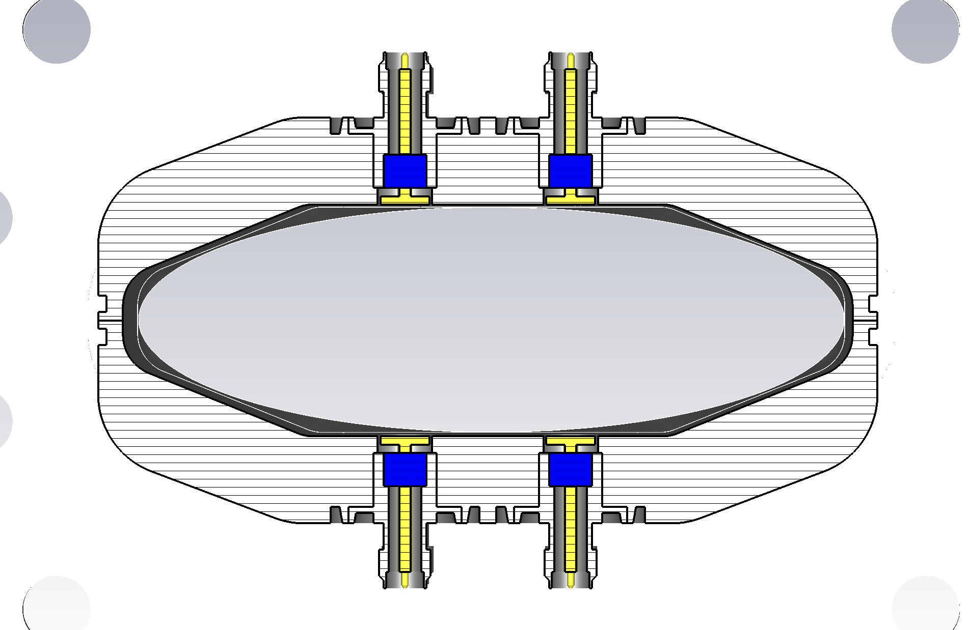
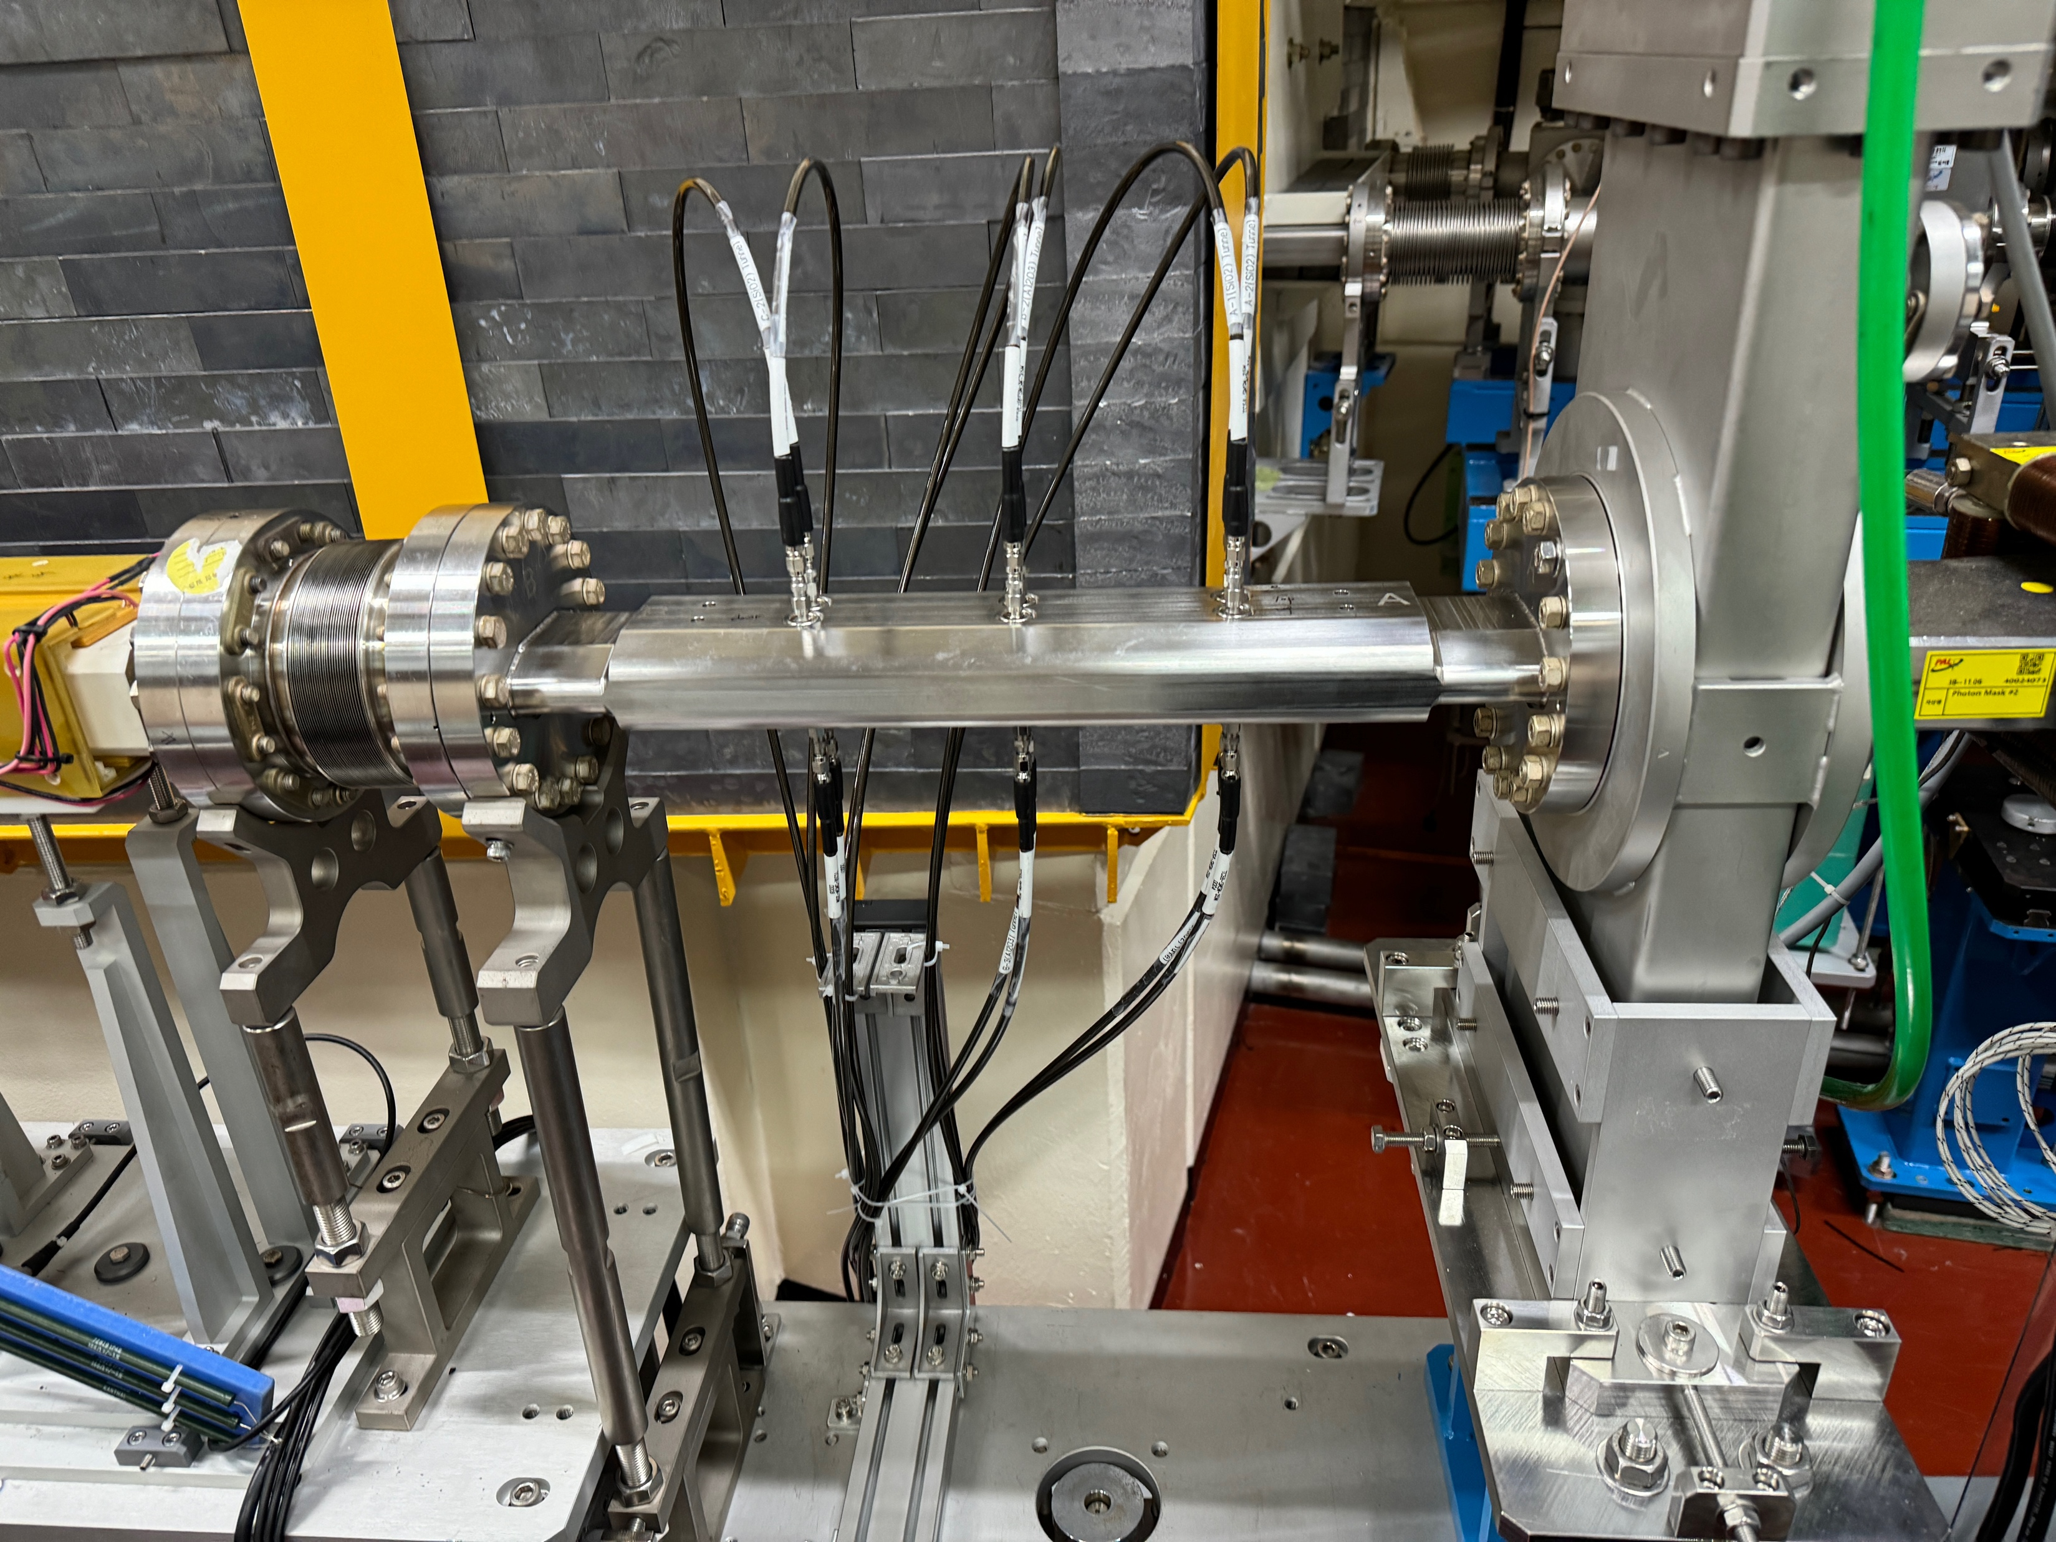
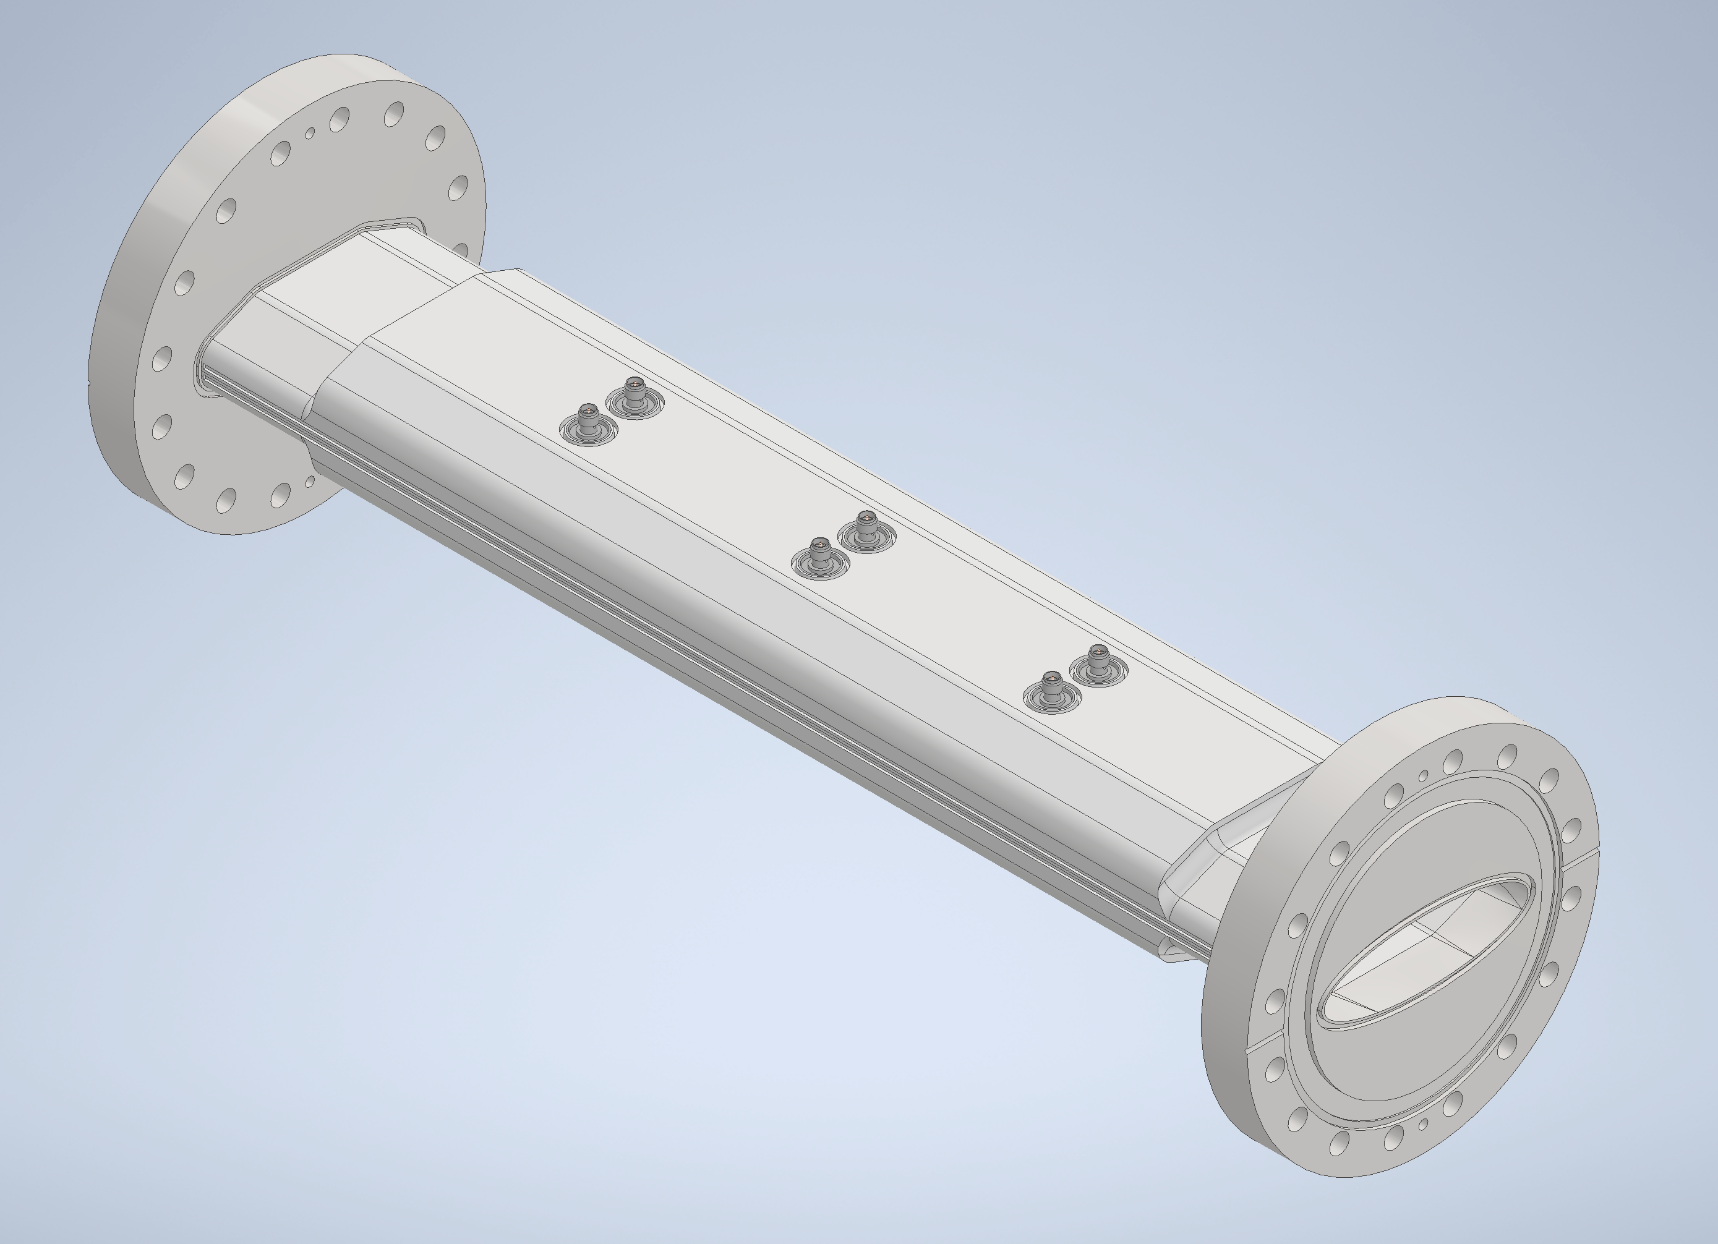
4GSR BPM test results at PLS-II
3D simulation of Test BPM for the beam test at PLS-II storage ring.
Test BPM for beam test @ PLS-II storage ring
SiO₂ BPM-A
Al₂O₃ BPM-B
• Purpose: To compare simulation results with actual measurements and indirectly predict how closely the simulation aligns with the 4GSR case.
• Test BPMs installed in the ID straight section of Cell 7 in the PLS-II storage ring @Pohang Accelerator Laboratory.
• Configuration: SiO₂ BPMs on both sides, Al₂O₃ BPM in the center (3 BPM pick-ups in total).
• Output signals (16 GHz bandwidth) observed without loss using a 50 GS/s high-performance oscilloscope.
• Turn-by-turn beam position resolution measured with I-Tech’s Libera Brilliance+ system.
SiO₂ BPM-C
PLS-II bunch parameters
Bunch length 1 sigma 7.5 mm
Max. beam frequency (-20 dB) 13.6522 GHz
Beta 1
Charge 1e-009 C
88*28mm
for ID section
Installation of Test BPM for the beam test at PLS-II storage ring.

Slide 10
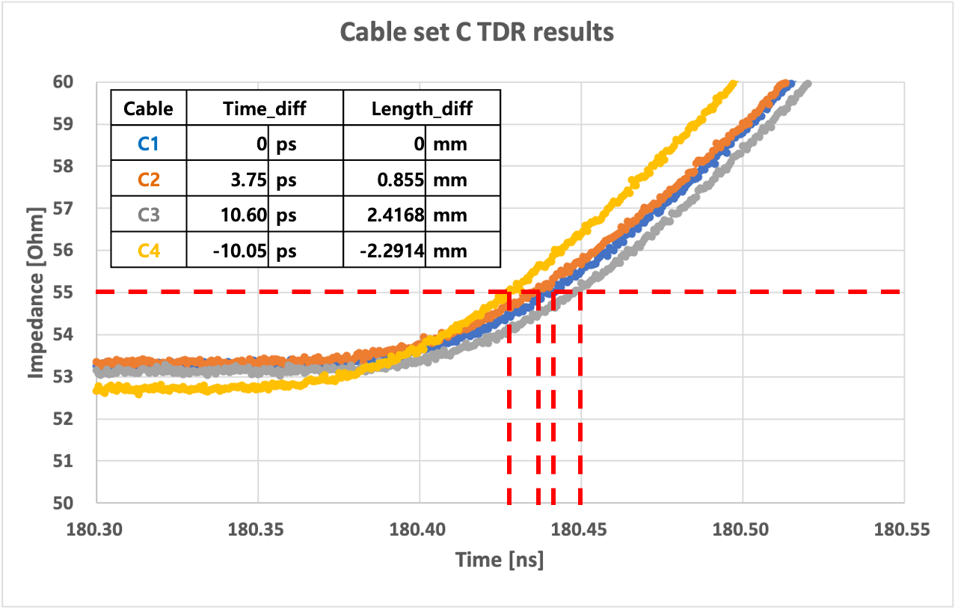
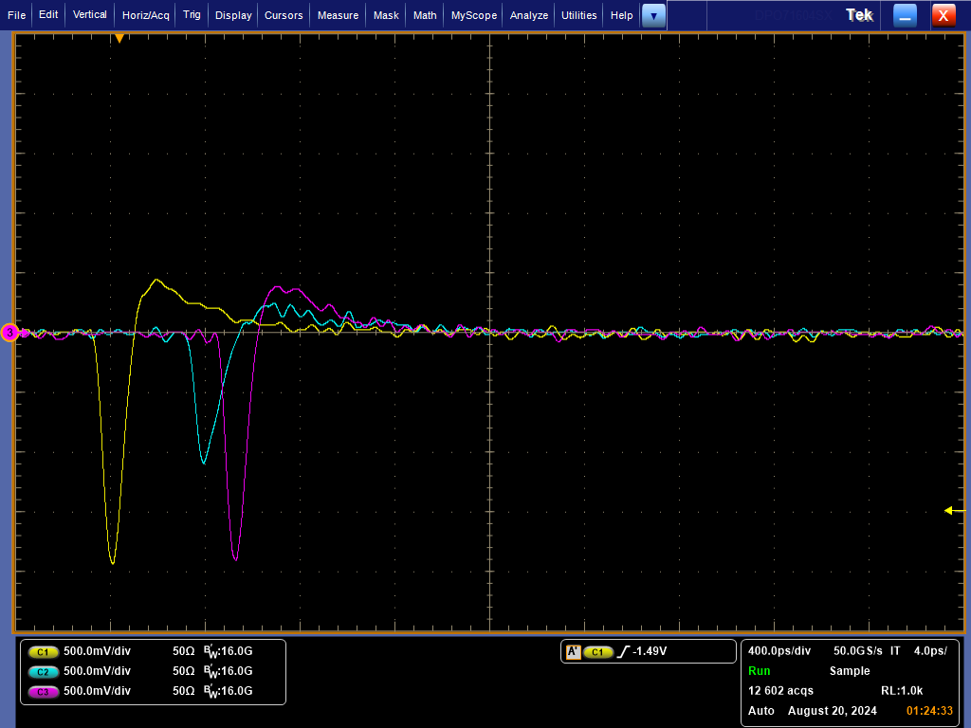
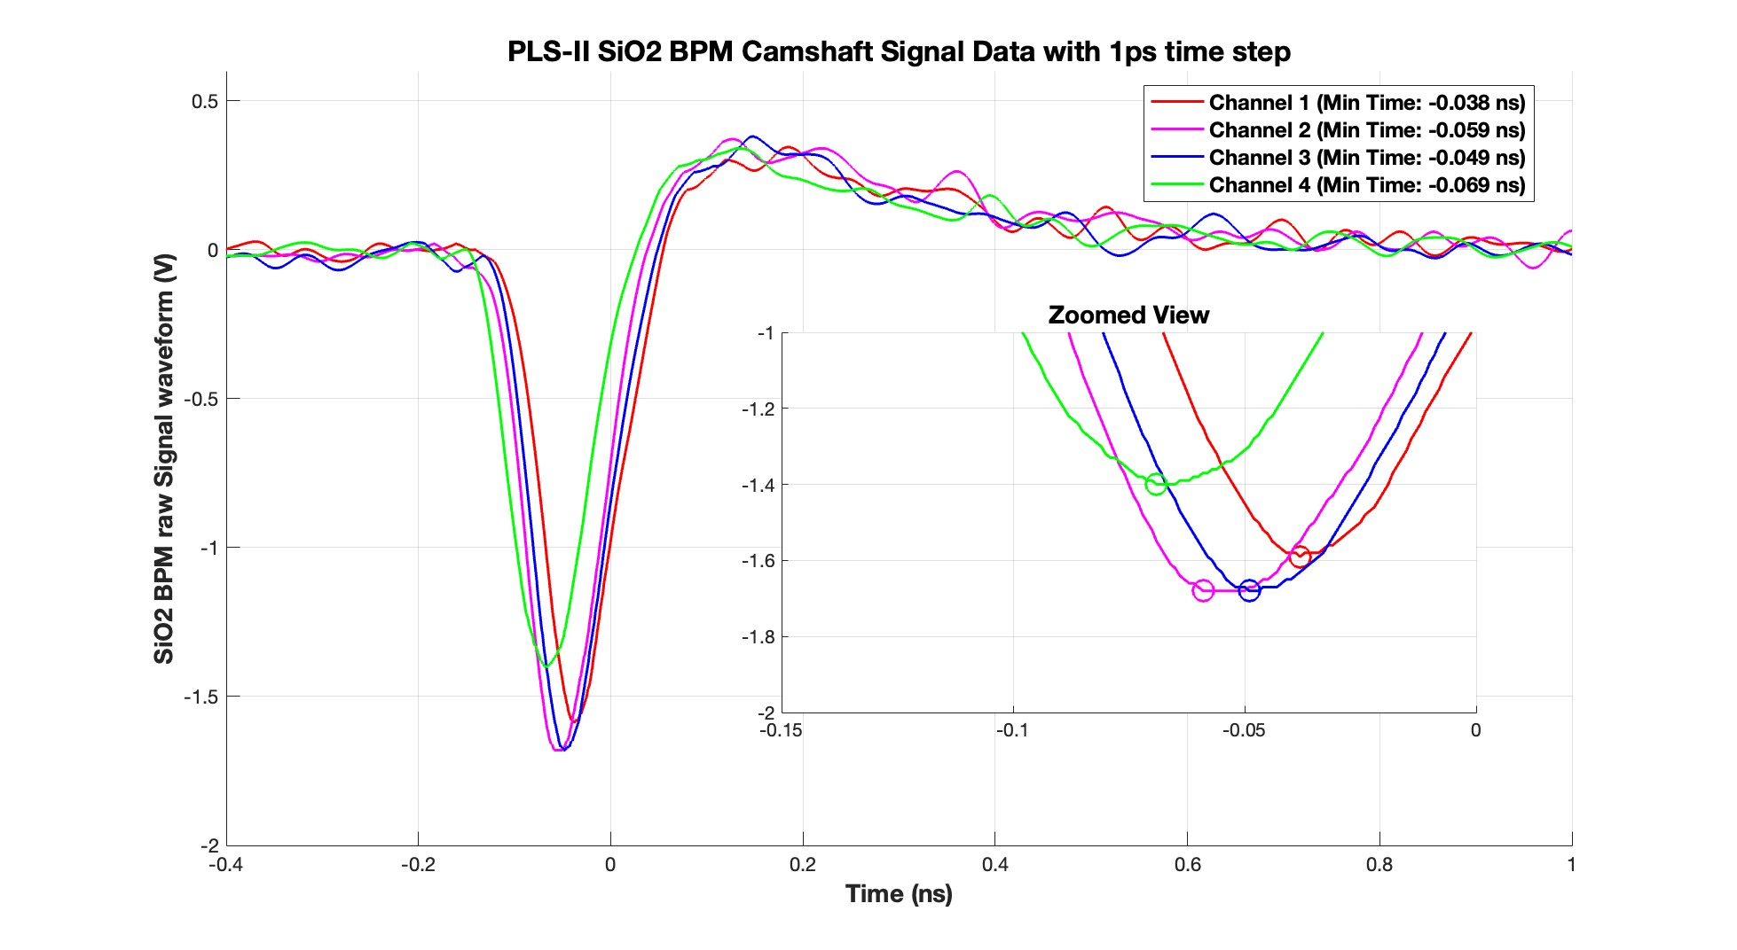
4GSR BPM test results at PLS-II
Output signal level comparison between SiO₂ & Al₂O₃ BPM
RF Pick-up beam test at PLS-II 7 Cell straight section
Three BPMs were installed and test at PLS-II
SiO₂ pick-up shows more higher sensitivity
Phase of 4 BPM cables for 4GSR are well matched within 30ps with beam.
BPM position resolution also measured by using there BPMs.
SiO₂ BPM shows more precise beam position resolution rather than Al₂O₃ BPM.
SiO₂ BPM: ~1um TbT resolution, Al₂O₃ BPM: ~1.9um TbT resolution @ 300mA
LH18 OSI cable
BPM1 – port 2 signal (SiO2)
Al₂O₃
BPM2 – port 2 signal (Al2O3)
SiO₂
BPM3 – port 2 signal (SiO2)
Camshaft signal
SiO₂
BPM3 – 4CH signal (SiO2)

Slide 11
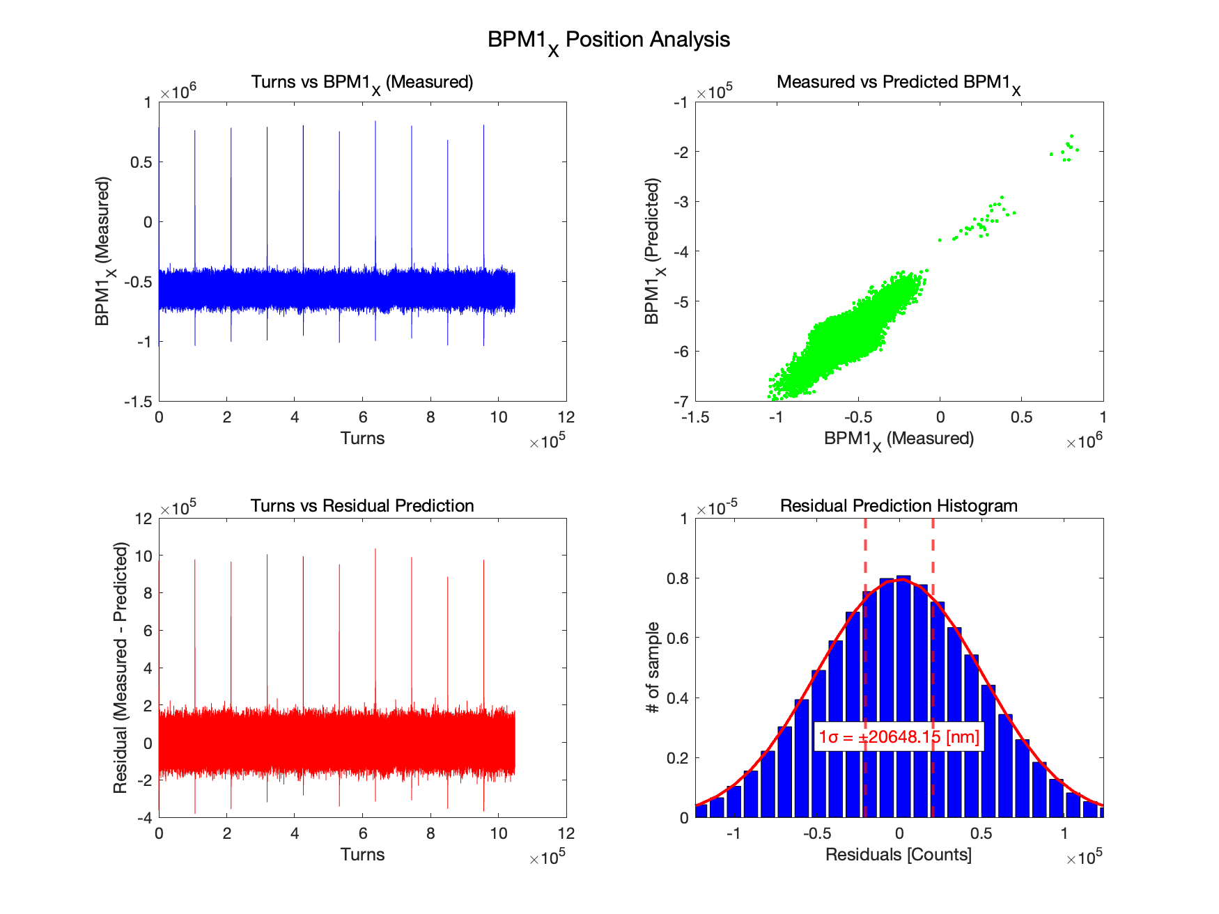
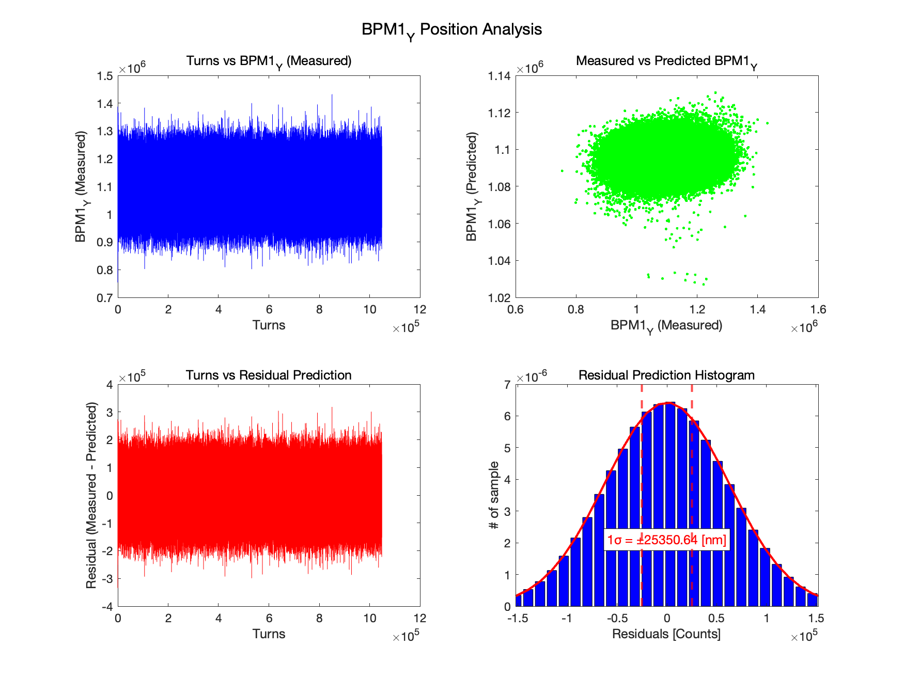
4GSR BPM test results at PLS-II
Single Bunch Position Resolution Measurement
Single bunch resolution | BPM-A | BPM-B | BPM-C
X_resol | 20um | 43um | 19um
Y_resol | 25um | 53um | 24um
Precise Single bunch/Single turn resolution is important for initial beam commissioning
PLS-II 0.8mA/bunch = 4GSR 1nC single bunch
20um beam position resolution with 60um RMS beam stability

Slide 12
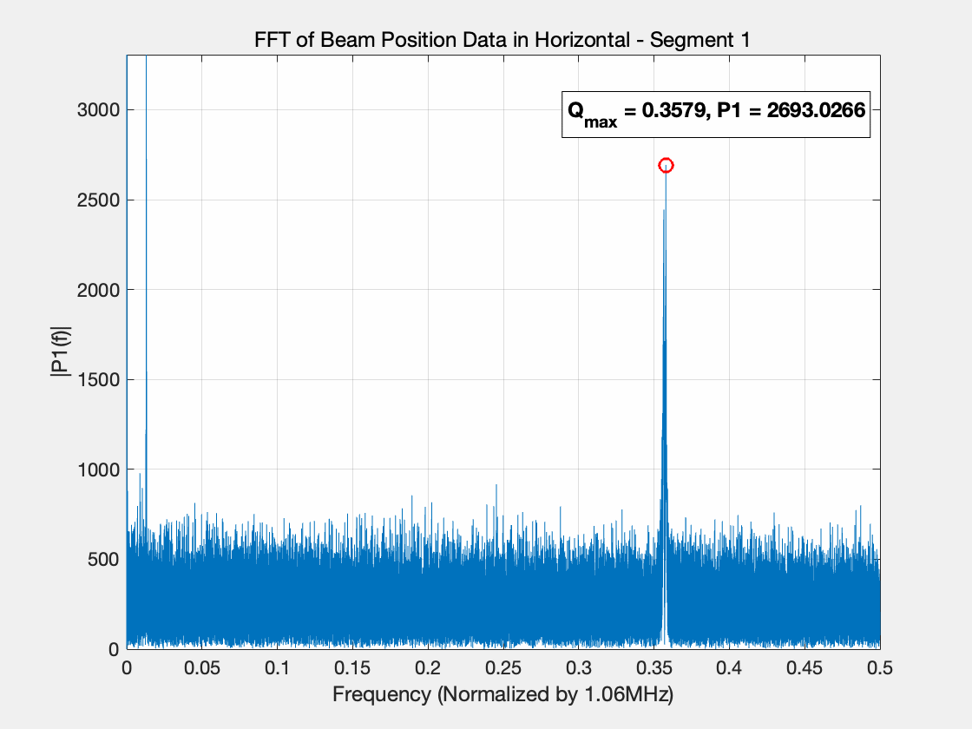
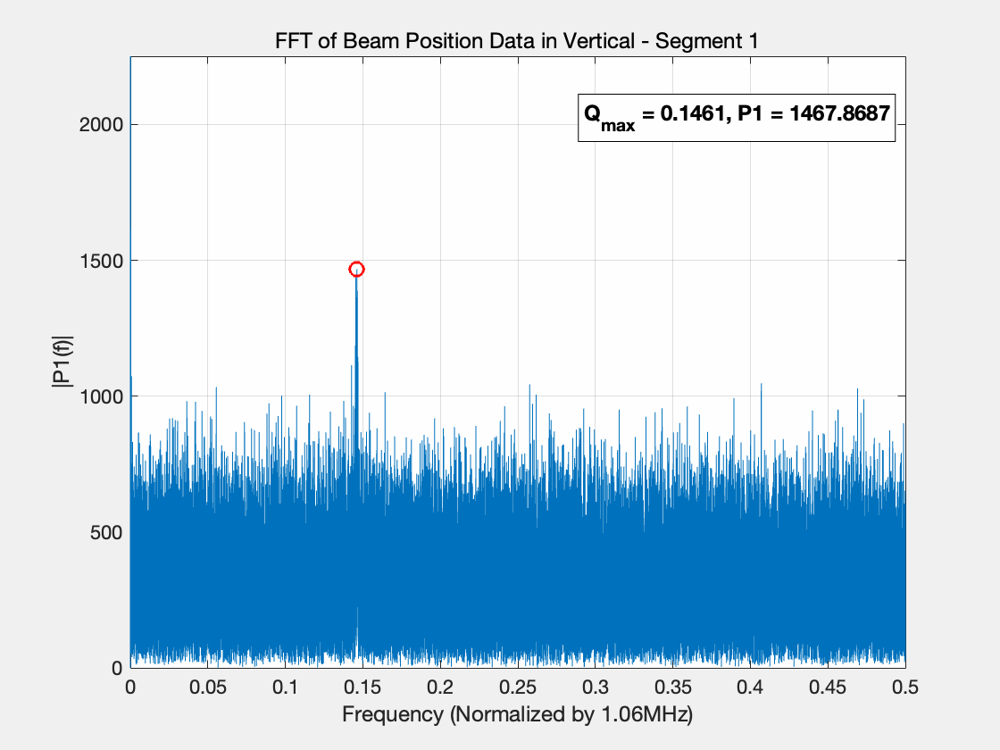
4GSR BPM test results at PLS-II
Tune measurement with single bunch operation mode
Analog Tune monitor was not working with single bunch, But TbT data can measured
It can be very useful for the initial beam commissioning with low current beam operation

Slide 13
4GSR BPM mass production plan
Potential mass production companies at present
1. Kyocera JAPAN: A prototype manufacturer with a high understanding of all mass production processes.
2. BC-Tech: A company with extensive experience in Europe, currently in contact.
3. Times Microwave: A US-based company with experience producing SiO₂ BPM for NSLS-II; however, its production capability is not fully verified.
4. SMG (Domestic company) : A Korean company with extensive experience producing materials with a dielectric constant up to 5, but no experience with dielectric constant 4 glass feedthroughs.
4GSR BPM pick-up Mass Production Process:
1. Component machining
2. Dimensional measurement of components
3. Sorting by tolerance, followed by sealing
4. Dimensional measurement after sealing
5. TDR measurement and sorting based on capacitance values
6. Number engraving on antenna wings
7. Packaging in sets of 4, starting from No. 1
8. Delivery with all datasheets included

Slide 14
Summary
1. Project Overview:
- The 4GSR project requires a high-precision BPM system to handle ultra-small emittance beams.
- Two BPM designs (SiO₂ and Al₂O₃) were developed to minimize wake impedance in the compact vacuum chambers.
2. Prototype Testing:
- BPM prototypes were tested at PLS-II with SiO₂ pick-ups demonstrating better sensitivity and resolution. (1 µm for SiO2 &. 1.9 µm for Al₂O₃)
- Key performance metrics like beam position resolution and TDR measurements were validated.
3. Mass Production:
- Reviewed potential companies for manufacturing BPMs, including Kyocera JAPAN and BC-Tech.
- A systematic production process was designed, including component machining, sealing, and data verification.

Slide 15
Thank you !

Slide 16
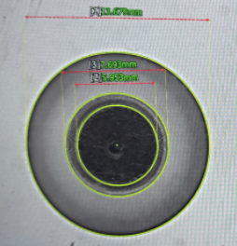
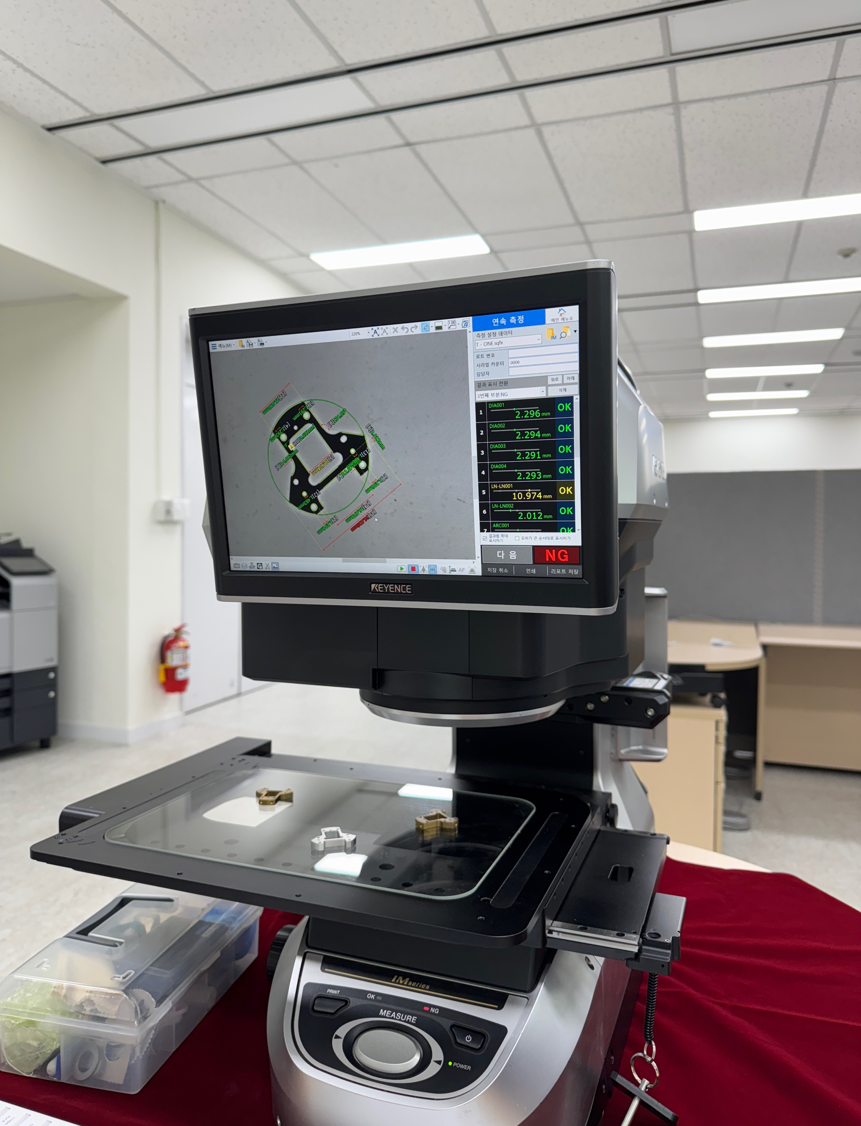
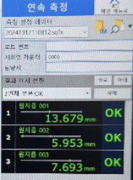
Button BPM measurement equipment
Keyence IM-8030 with 1um resolution
Optical image method measurement
Automatic measurement within 1s
1um measurement resolution
Automatic judgement for outside of tolerance
Automatic measured parameter list to Doc.

Slide 17
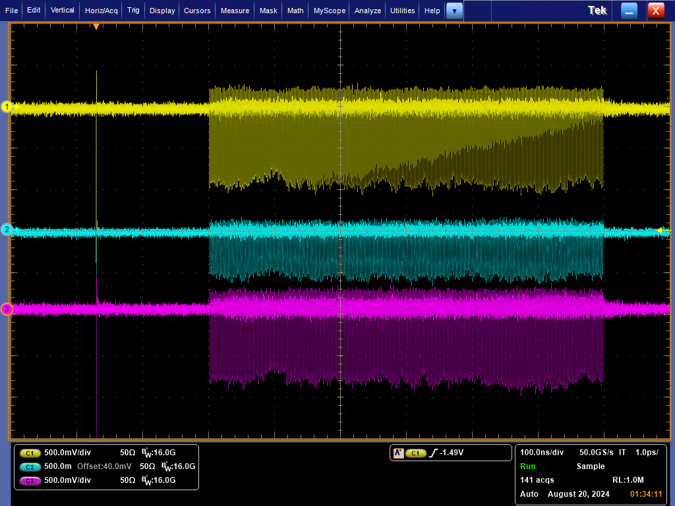
4GSR BPM test results at PLS-II
RF cable phase matching with camshaft signal
RF Pick-up beam test at PLS-II 7 Cell straight section
Three BPMs were installed and test at PLS-II
SiO₂ pick-up shows more higher sensitivity
Phase of 4 BPM cables for 4GSR are well matched within 30ps with beam.
BPM position resolution also measured by using there BPMs.
SiO₂ BPM shows more precise beam position resolution rather than Al₂O₃ BPM.
SiO₂ BPM: ~1um TbT resolution, Al₂O₃ BPM: ~1.9um TbT resolution @ 300mA
BPM1 – port 2 signal (SiO2)
SiO₂
Al₂O₃
BPM2 – port 2 signal (Al2O3)
SiO₂
BPM3 – 4CH signal (SiO2)
BPM3 – port 2 signal (SiO2)

Slide 18
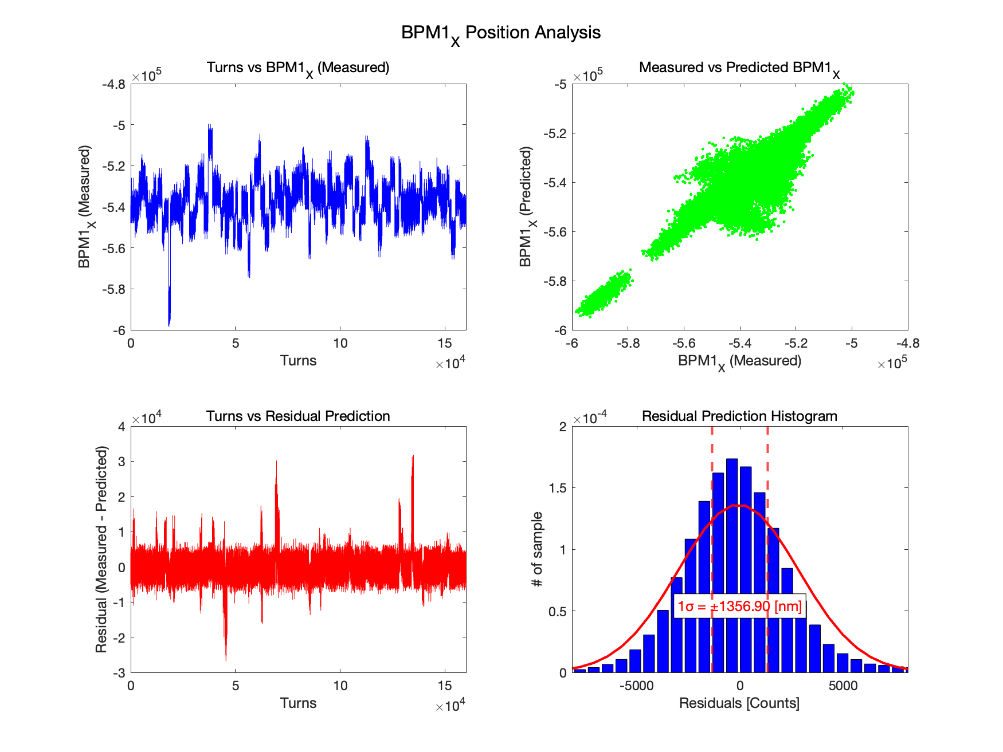
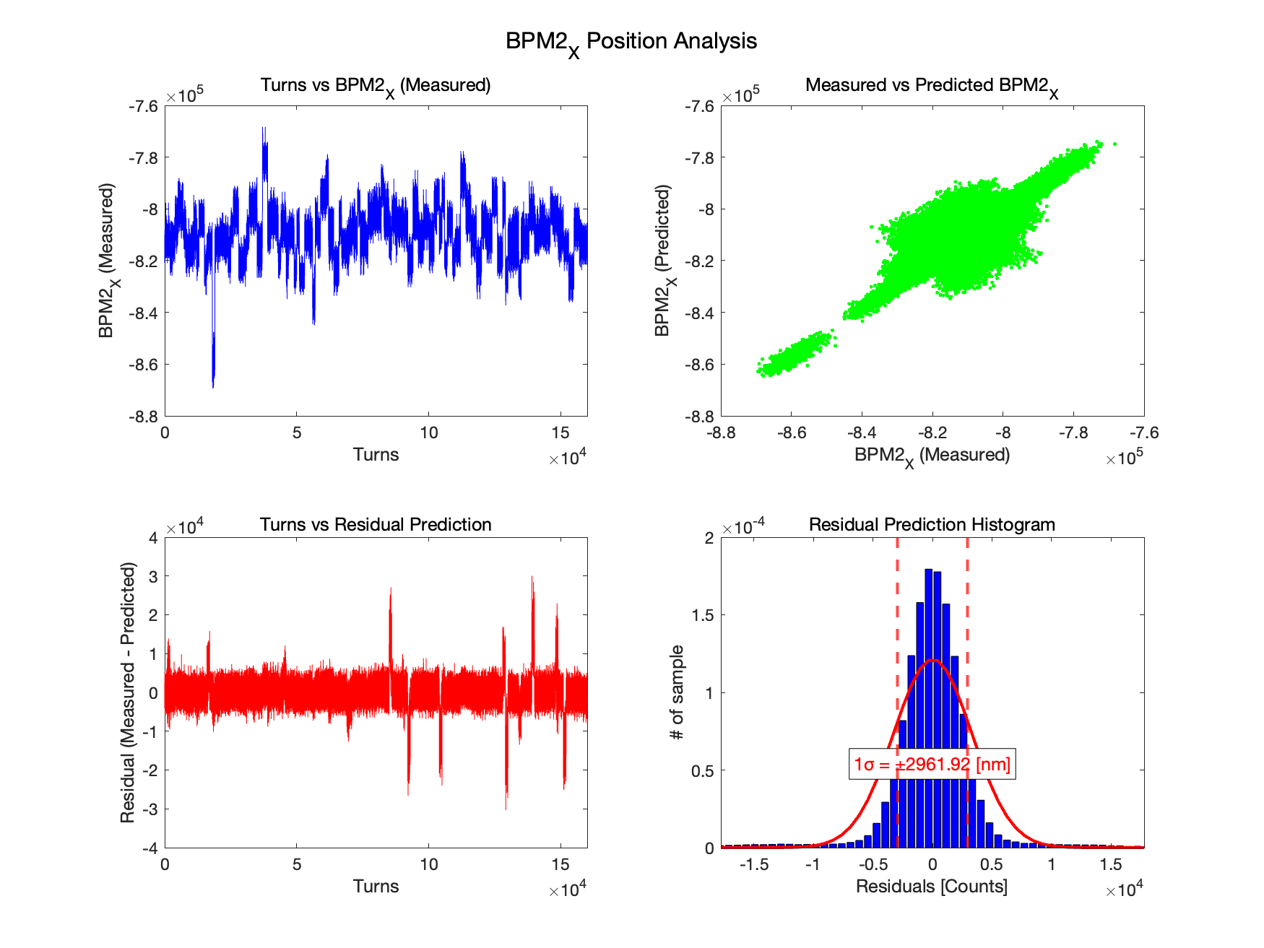
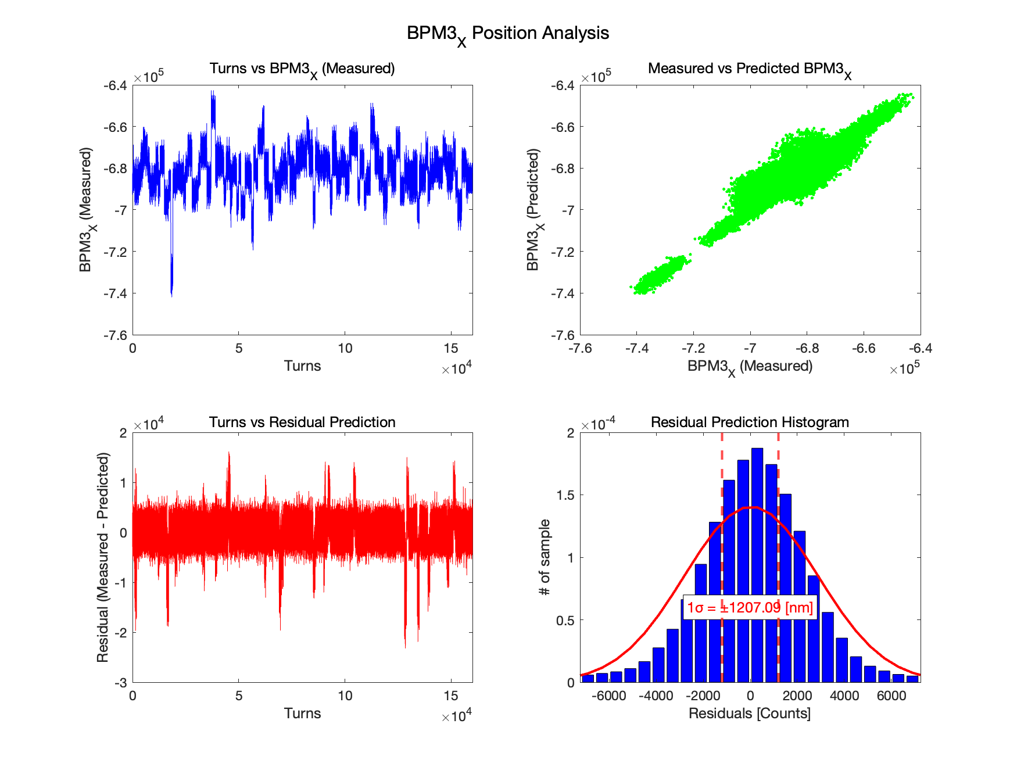
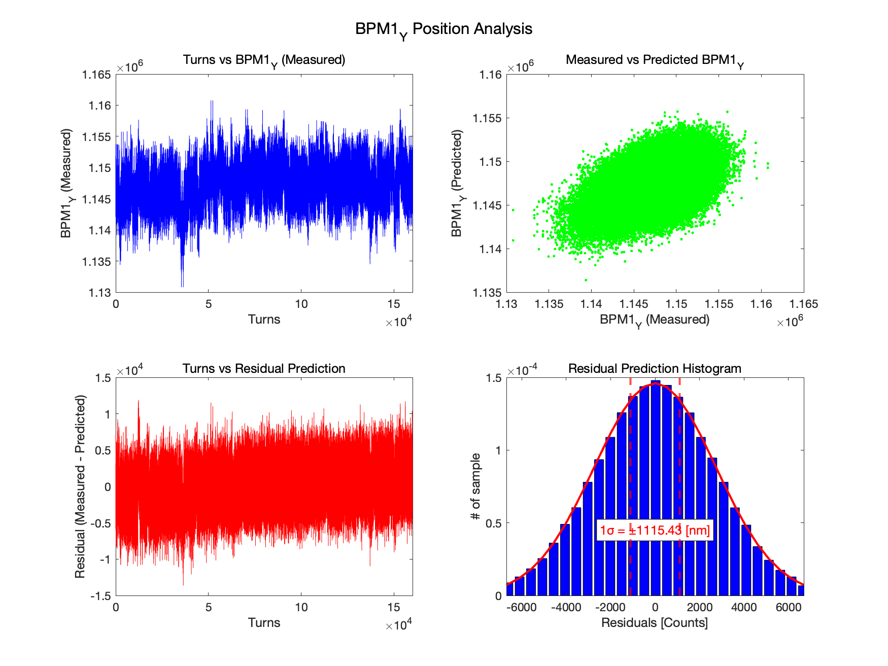
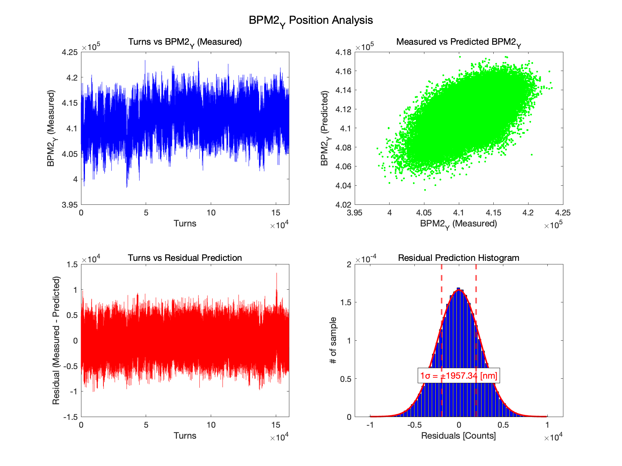
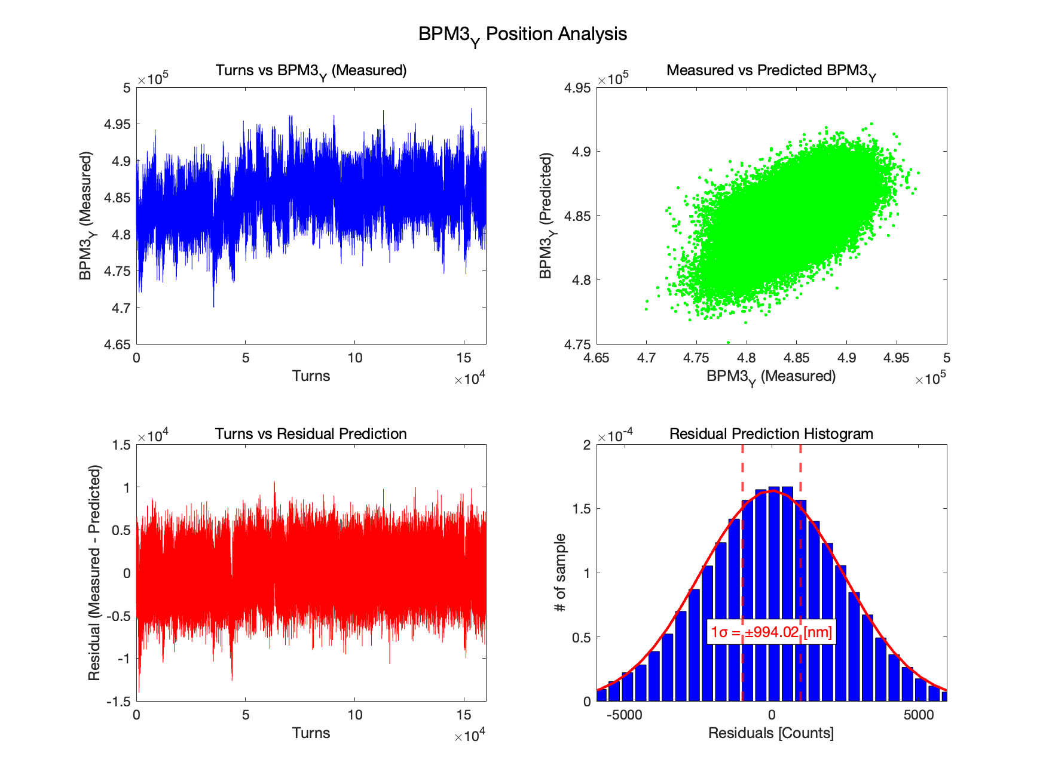
160K turn BPM resolution
- BPM-AX (predict) = α1·BPM-AY+α2·BPM-BX+α3·BPM BY+α4·BPM-CX+α5·BPM-CY
+α6·BPM-A_SUM+α7· BPM-B_SUM +α8· BPM-C_SUM
- Residual = BPM-AX(meas.) - BPM-AX (predict.)
- BPM resolution = RMS of residual x Geo. factor
Top-up mode 300mA stored beam orbit data

