Slide 1
Progress of the EIC HSR cold BPM mechanical design and integration
F. Micolon, D. Gassner, K. Matsushima and others
fmicolon@bnl.gov
Workshop on button BPMs for synchrotron and light sources
Dec 11-12 2024

Slide 2
Introduction
The EIC will be the next collider to be built in the USA to probe the nucleon structure by shooting high-energy electrons (up to 18 GeV) on a high energy hadron nucleus (up to 275 GeV).
The hadron storage ring (HSR) is a reuse of the RHIC infrastructure (superconducting hadron collider) from the late-90s. The EIC beam parameters are not compatible with the RHIC stripline BPMs (designed for long hadron bunches)
The present talk will review some of the mechanical engineering challenges of the HSR BPM button design
We are looking for feedback from those who “have been there before”
Disclaimer
I am a humble mechanical engineer, not a BPM system expert
We are not a light source…but still a synchrotron !
Workshop on button BPMs
F.Micolon

Slide 3
Outline
BPM system environment and requirements
Button design
Button and coax cable heating
Workshop on button BPMs
F.Micolon

Slide 4
BPM system environment and requirements
Workshop on button BPMs
F.Micolon

Slide 5

System requirement
The system is nested in a superconducting magnet environment and is at Lhe temperature (4 K)
A BPM is placed adjacent to each quad (every $\frac{π}{4}$ of betatron phase)
Electron-hadron synchronicity impose very large beam radial offsets compared to the aperture
Various operating mode with large bunch length variation (from 1500mm to 60mm)
Requirements
Requirement | Pilot bunch | Injection | Store
Max Bunch charge (nC) | 5 | 44 | 30.6
Beam current (mA) | 40 | 1000 | 690
Bunch length RMS (mm) | 1500 | 1500 | 60
Working range H (mm) | +/- 5 mm | +/- 5 mm | +/- 23 mm
% aperture | +/- 16 % | +/- 16 % | +/- 72 %
Resolution integrated 1s (mm rms) | 0.2 | 0.1 | 0.02
Workshop on button BPMs
F.Micolon

Slide 6
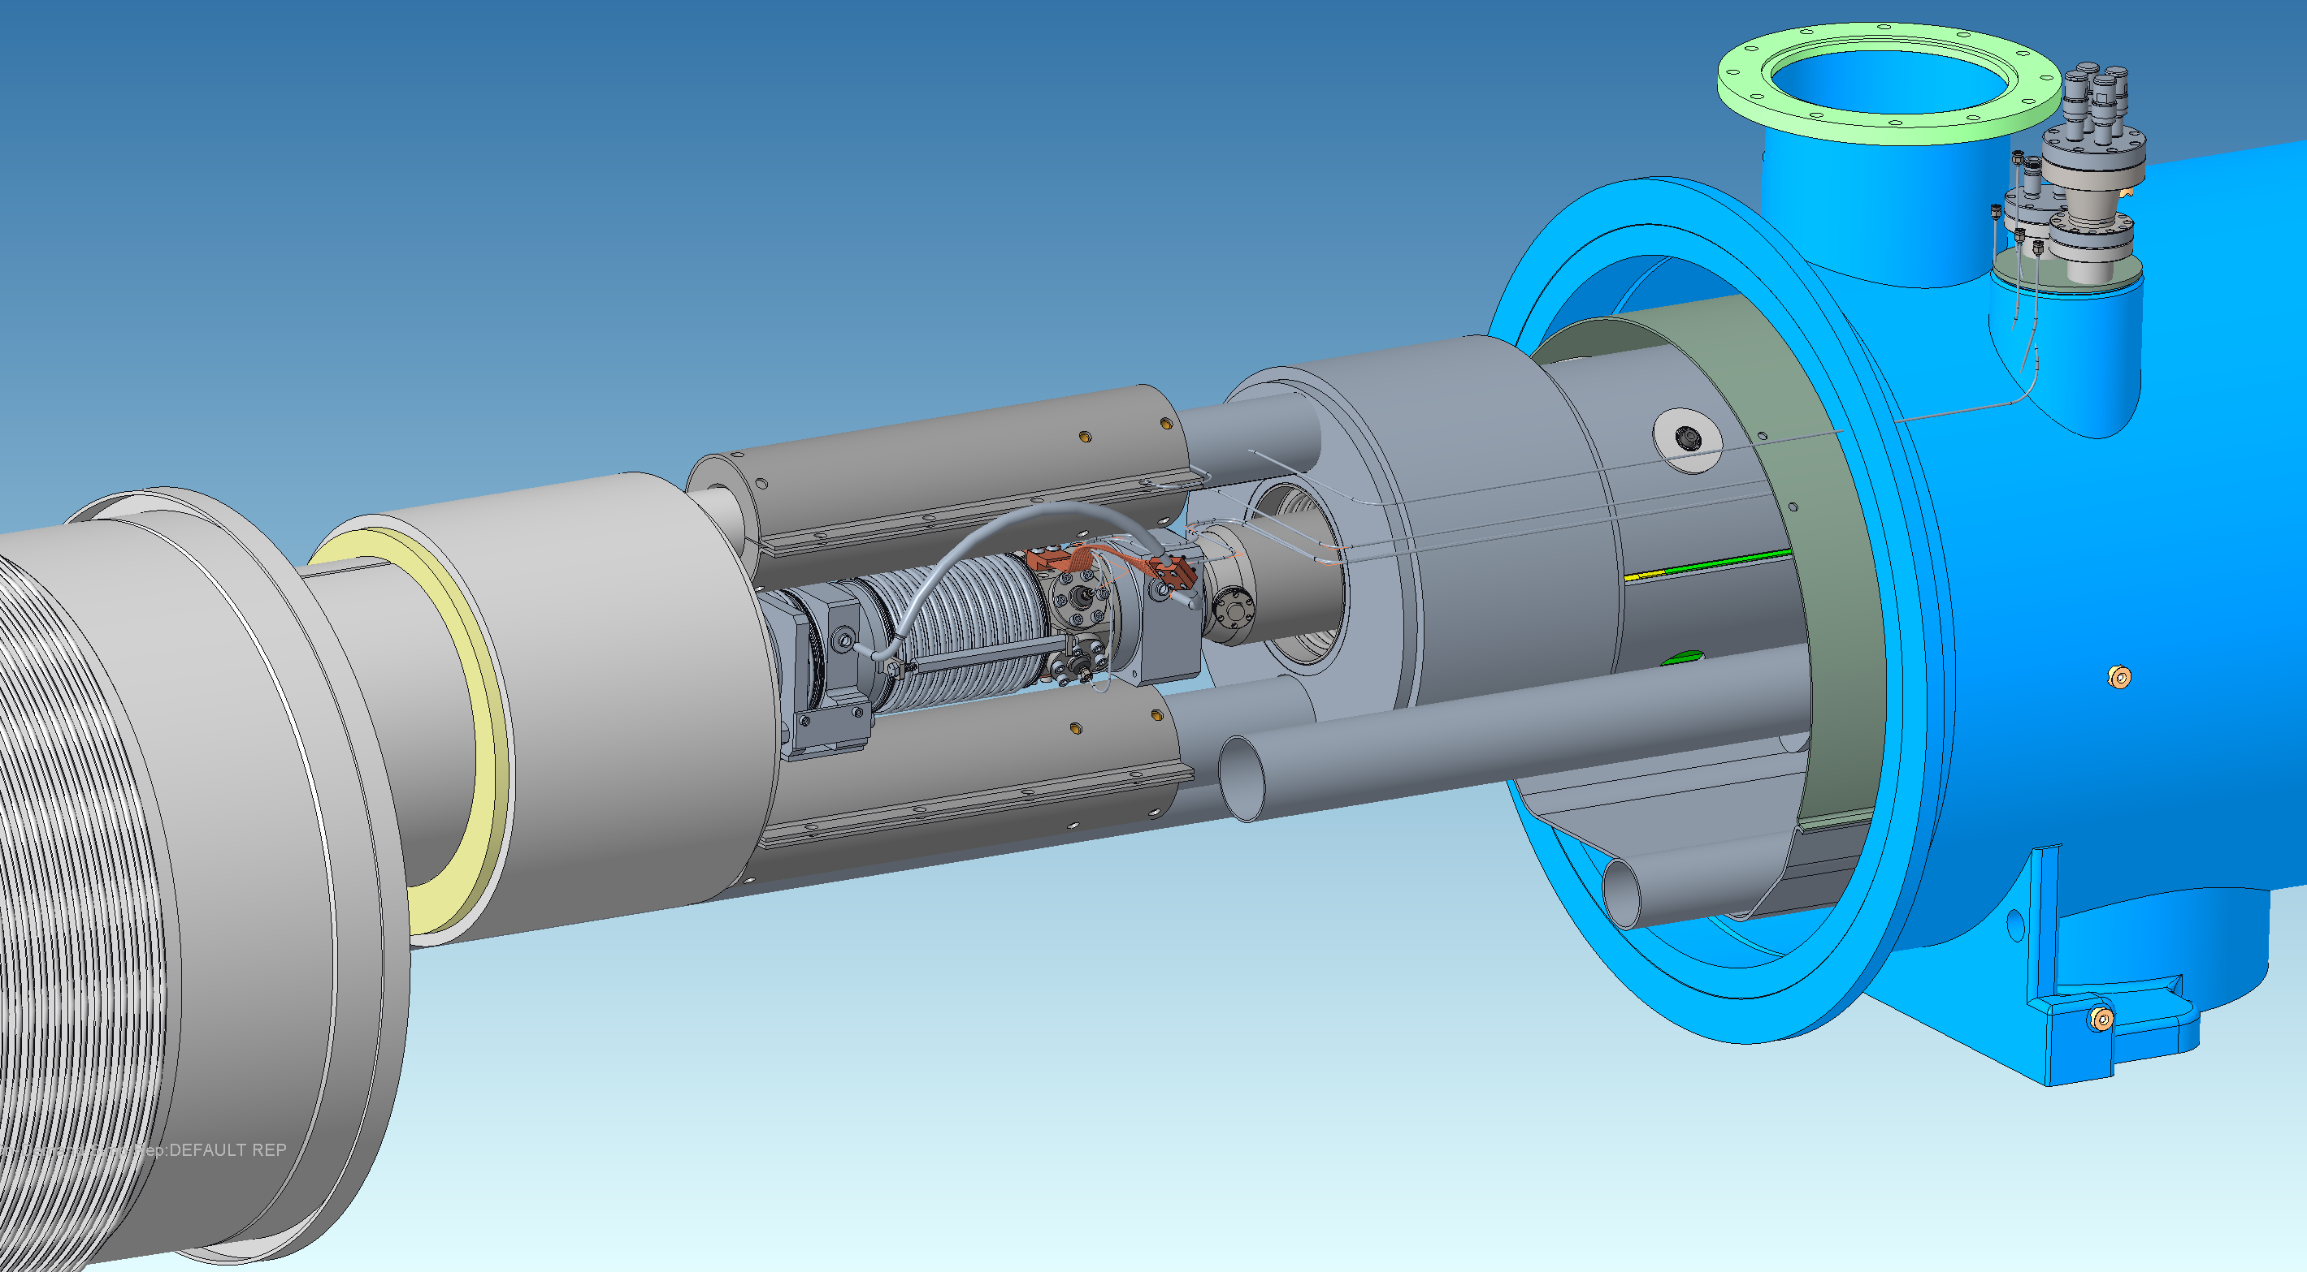
System integration
Helium lines + superconducting bus
Magnet vacuum vessel
Magnet helium vessel (cold mass)
SiO2 signal cables
(in insulation vacuum)
New BPM buttons
Beamline bellow
Decommissioned RHIC BPMs (striplines)
Quadrupole
Dipole
Workshop on button BPMs
F.Micolon

Slide 7
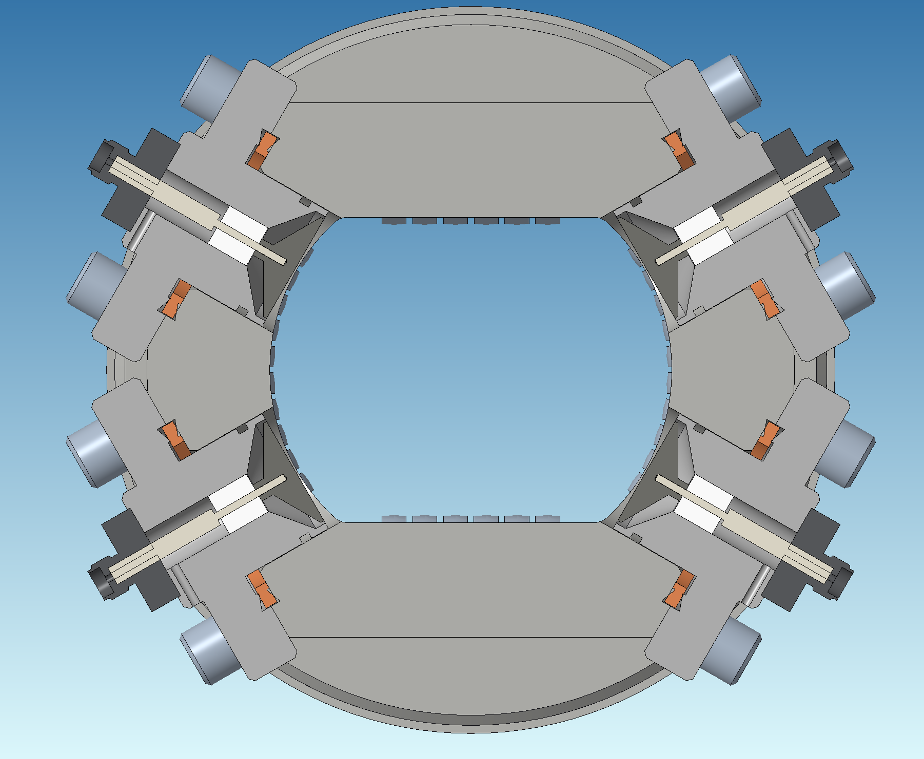
System integration
The beam aperture has a “racetrack shape” through the superconducting magnets.
The beam excursion at store is a large proportion of the total aperture.
Challenging dynamic range for the button signal
Heating of the high side button and coax
The 30° corner button arrangement has been selected based on :
Overheating of the high side button if located in the horizontal plane
Integration of the rigid coax cabling
Helium lines + superconducting bus
30°
Magnet vacuum vessel
Magnet helium vessel (cold mass)
Allowed beam excursion
At store
+/-23 mm
+/-2 mm
48 mm
+/-5 mm
Allowed beam excursion
At injection/ramp
New BPM buttons
Beamline bellow
Decommissioned RHIC BPMs
30°
64 mm
Workshop on button BPMs
F.Micolon

Slide 8
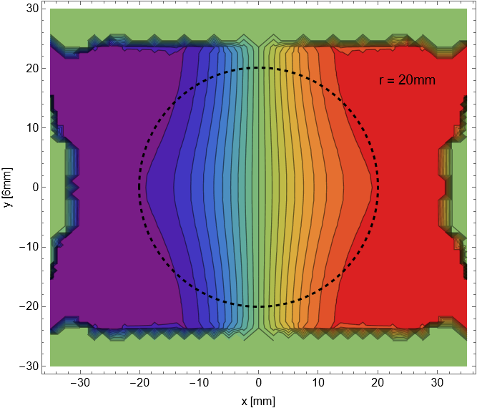
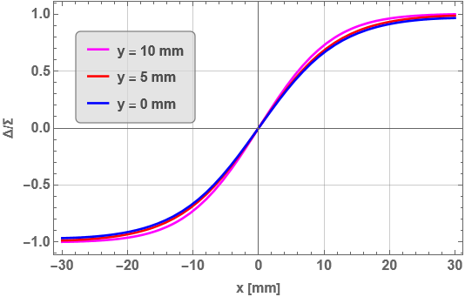
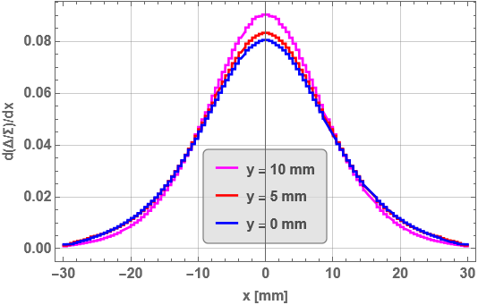
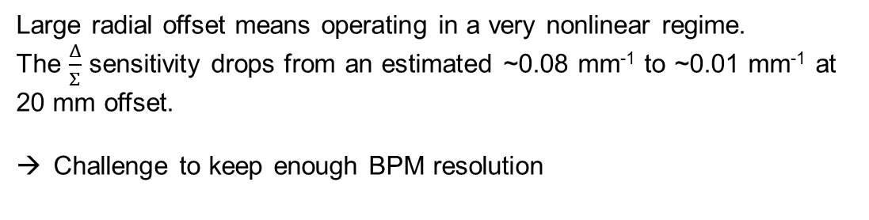
Challenges of operating at large transverse offset
Planned operation at store
Courtesy of Manfred Wendt
~0.08 mm⁻¹
Large radial offset means operating in a very nonlinear regime.
The $\frac{Δ}{Σ}$ sensitivity drops from an estimated ~0.08 mm⁻¹ to ~0.01 mm⁻¹ at 20 mm offset.
Challenge to keep enough BPM resolution
>0.01 mm⁻¹
Workshop on button BPMs
F.Micolon

Slide 9
BPM alignment strategy
Workshop on button BPMs
F.Micolon

Slide 10
BPM alignment strategy
The RHIC quadrupole are powered in series with no shunt (expect a few quads) → No BBA possible
We don’t currently plan to wire scan the BPM aperture.
Requirement | Electrical center wrt quadrupole axis
Vertical (mm RMS) | 0.3
Horizontal (mm RMS) | 0.6
We plan to rely on BPM fiducialisation and Lambertson method to position the BPM electrical center to the quadrupole center (reference used for beam orbit control).
Alignment steps :
Step 1. BPM mechanical center-to-housing fiducialization
Step 2. Housing-to-cold mass coordinate system fiducialization
Step 3. Cold mass fiducials to quadrupole magnetic center
Step 4. Lambertson method to get the as-installed BPM electrical center offset
The following accuracy number are guesses - we will refine as we make our first alignment testing. We welcome your feedback !
Workshop on button BPMs
F.Micolon

Slide 11
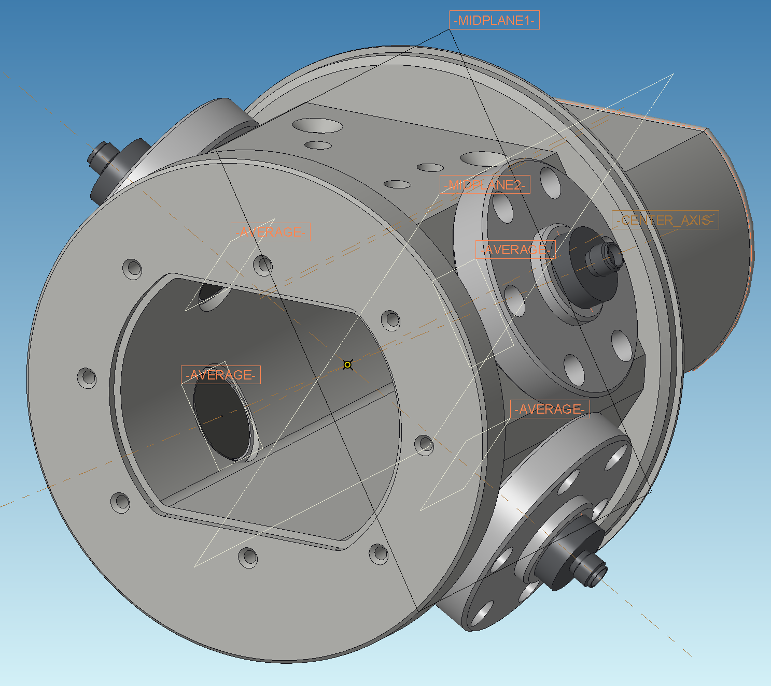
1. BPM center-to-housing fiducialization
3x fiducial holder
(top and bottom)
We plan to use a 3D scanner to position the BPM mechanical center in the BPM fiducials coordinate system.
The datasheet accuracy of the 3D scanners we have been given is ~25-50 µm.
…But in our case the measurement will be done at an angle.
Estimated accuracy ~+/- 100 µm (?)
We plan to compare with a CMM measurement on a blank assembly (dummy buttons) to estimate the real accuracy.
If you have tried 3D scan before and have a feedback let us know !
1. Button face average plane
2. Project opposite button midplanes
3. Define center axis
(Intersection of midplanes)
4. Define BPM mechanical center
(intersection of axis and BPM centroid plane)
5. Reference BPM center in fiducials coordinate system
Workshop on button BPMs
F.Micolon

Slide 12
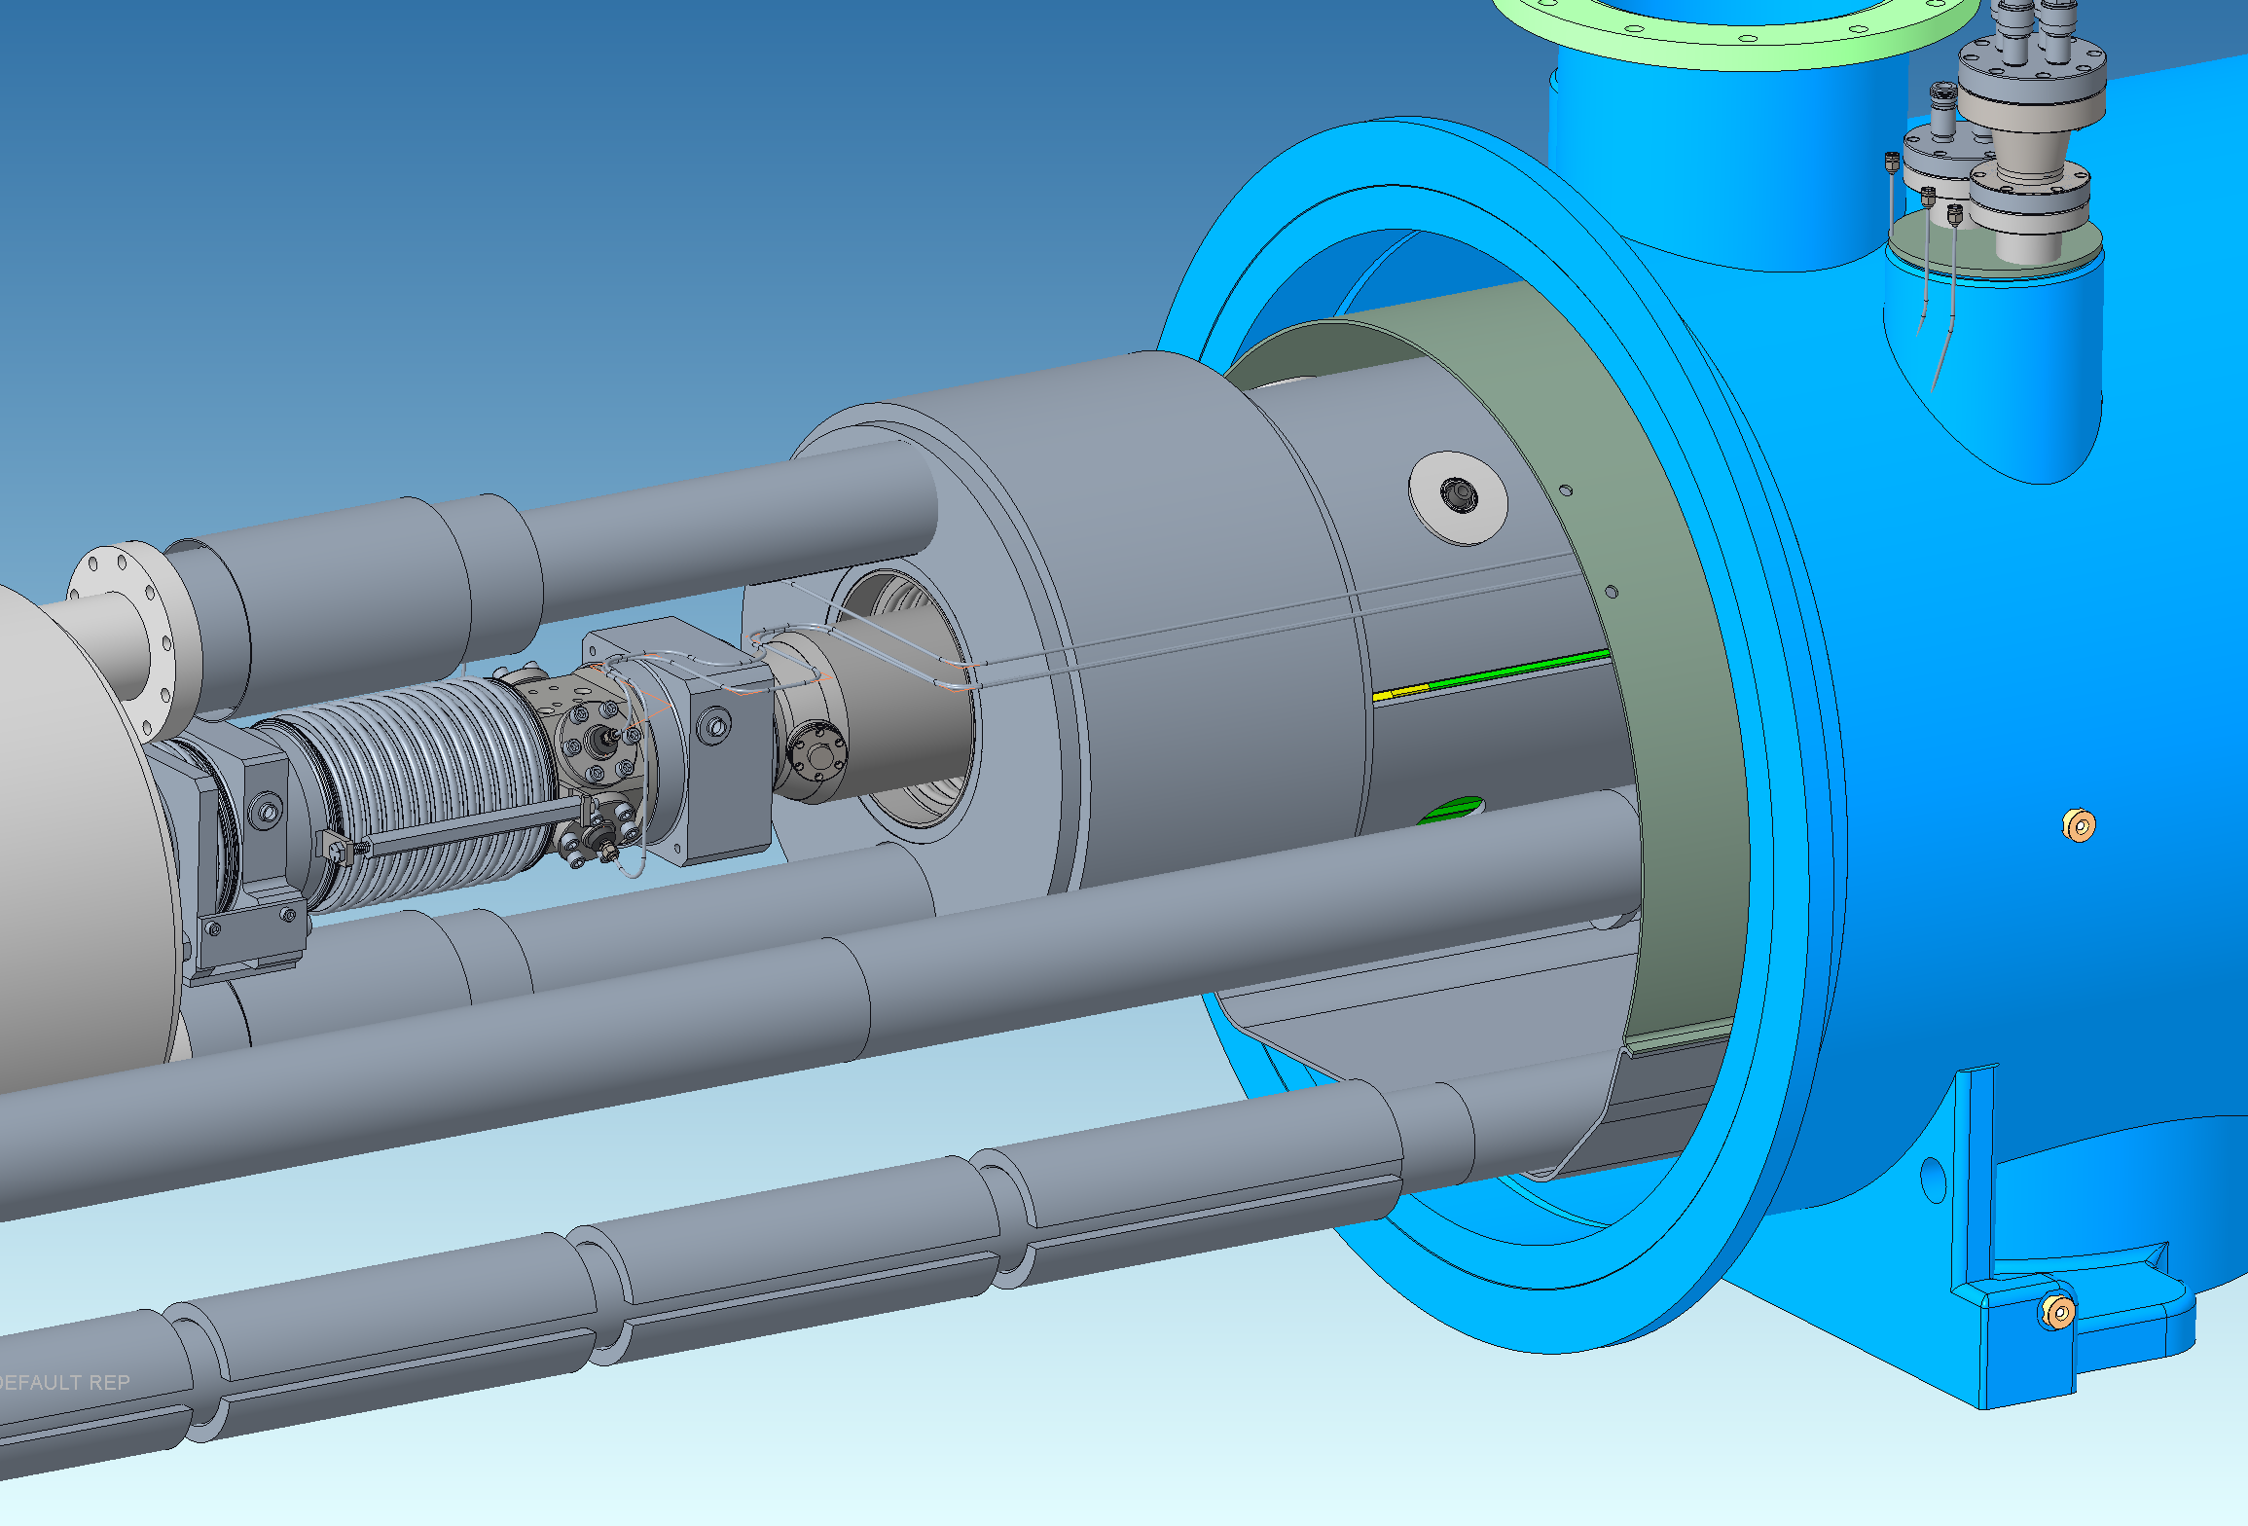
BPM housing-to-magnet fiducialization
We will use a laser tracker to relate the BPM fiducials to the cold mass fiducials.
Estimated accuracy ~50 µm
The position of the quadrupole center has been measured for each SC quadrupole during construction.
Estimated accuracy ~ +/- 100 µm
We will use the Lambertson method to extract the electrical-to-mechanical center offset as-installed.
We have a wide bunch length variation from injection to store with varying frequency spectrum - can be a challenge for the Lambertson electrical center reference ?
Estimated accuracy ~ +/- 100 µm (?)
Magnet cold mass fiducials
BPM module fiducials
Workshop on button BPMs
F.Micolon

Slide 13
BPM center-to-housing fiducialization
Our approximate tolerance budget :
Magnet cold mass fiducials
Tolerance stack-up | Tolerance
BPM mechanical center fiducialization (3D scan) | +/- 100 µm TBC
BPM housing-to-cold mass fiducialization (Laser tracker) | +/- 50 µm TBC
BPM cold mass-to quad center fiducialization | +/- 100 µm TBC
Electrical center offset determination (Lambertson) | +/- 100 µm TBC
Polynomial fitting error at high offset | TBD
BPM position distortion in operation | +/- 30 µm
SiO2 coax cable attenuation variation | TBD
Total tolerance RMS | < 300 µmTBC
BPM module fiducials
Looks like the budget can be help, but everything is still TBC pending a mockup of the whole alignment sequence and work on error estimation.
Workshop on button BPMs
F.Micolon

Slide 14
BPM button design
Workshop on button BPMs
F.Micolon

Slide 15
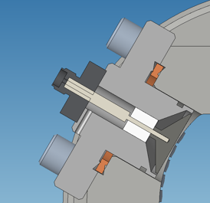
Button design
We have come up with a proposal button design that “fits the bill” but freedom is given to prospective vendor to propose variations depending on their fabrication techniques.
Ø51mm flange OD
RP SMA connector
SiO₂ insulator or Al₂O₃ (better for thermal)
Stem (Inconel or 316L)
RF spring seal
(trapped mode in annular gap)
Limited button radial clearance to avoid trapped mode
Stainless steel housing
ø18 mm
Solid copper button
Needs carbon coating for e- clouds
Conflat gasket
Workshop on button BPMs
F.Micolon

Slide 16
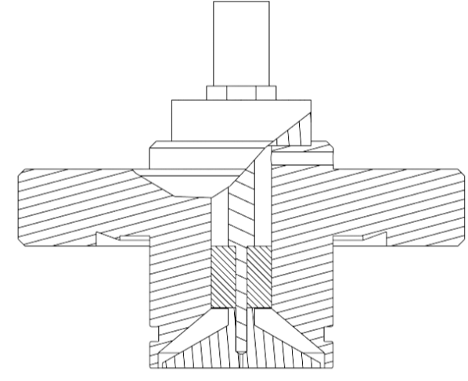
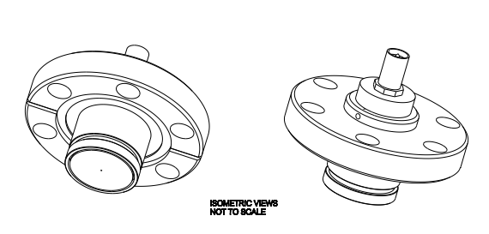




Button design
Venting hole (to insulation vacuum)
Brazed Al₂O₃ or SiO₂
A tight radial gap is requested (0,5 mm to 0,25 mm)
And a good concentricity
Button face is recessed inside housing (between 0 and 0.1mm)
The button is laser welded or brazed to the stem
Planarity to be sure we can define 4x BPM planes that cross on a line
Workshop on button BPMs
F.Micolon

Slide 17
Thermal aspects
Workshop on button BPMs
F.Micolon

Slide 18
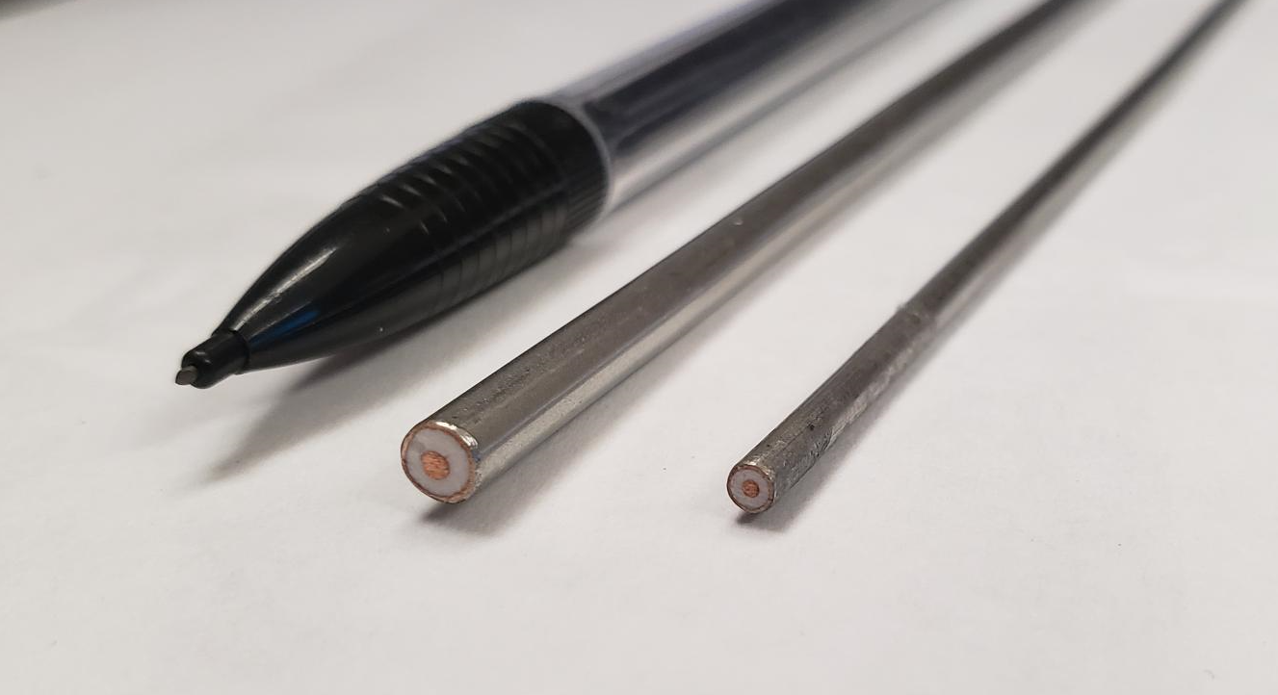
SiO2 cable heating
Cryostat feedthrough
T = 293 K
Outside pressure
Heat conducted from RT
SiO2 cable
Approx length 1.5 m
0.090”
(ø2.29mm)
SiO₂ cable
0.141” (ø3,6mm) SiO₂ cable
Heat shield intercept block
T = 50 - 80 K
RF signal attenuation heating
SiO2 insulator
Magnet line T = 4.5 K
Insulation vacuum (~10e-6 mbar)
Beamline vacuum (UHV)
Beam resistive wall heating
+ electron cloud heating
Workshop on button BPMs
F.Micolon

Slide 19
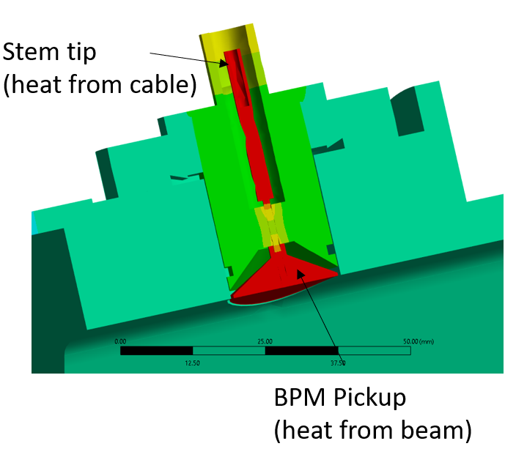
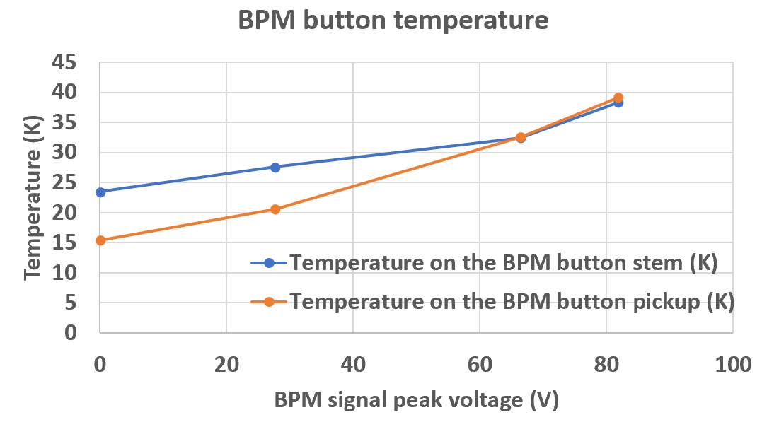
Pickup heating
Max allowable temperature = 40 K
The button temperature is expected below 40 K in all cases.
This will be low enough to avoid significant H₂ desorption.

Slide 20
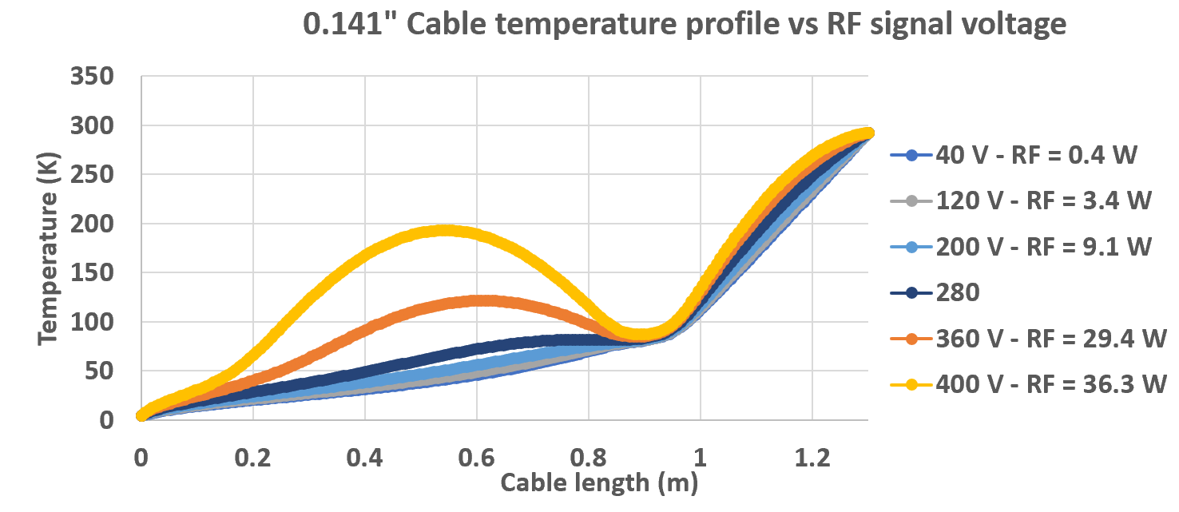
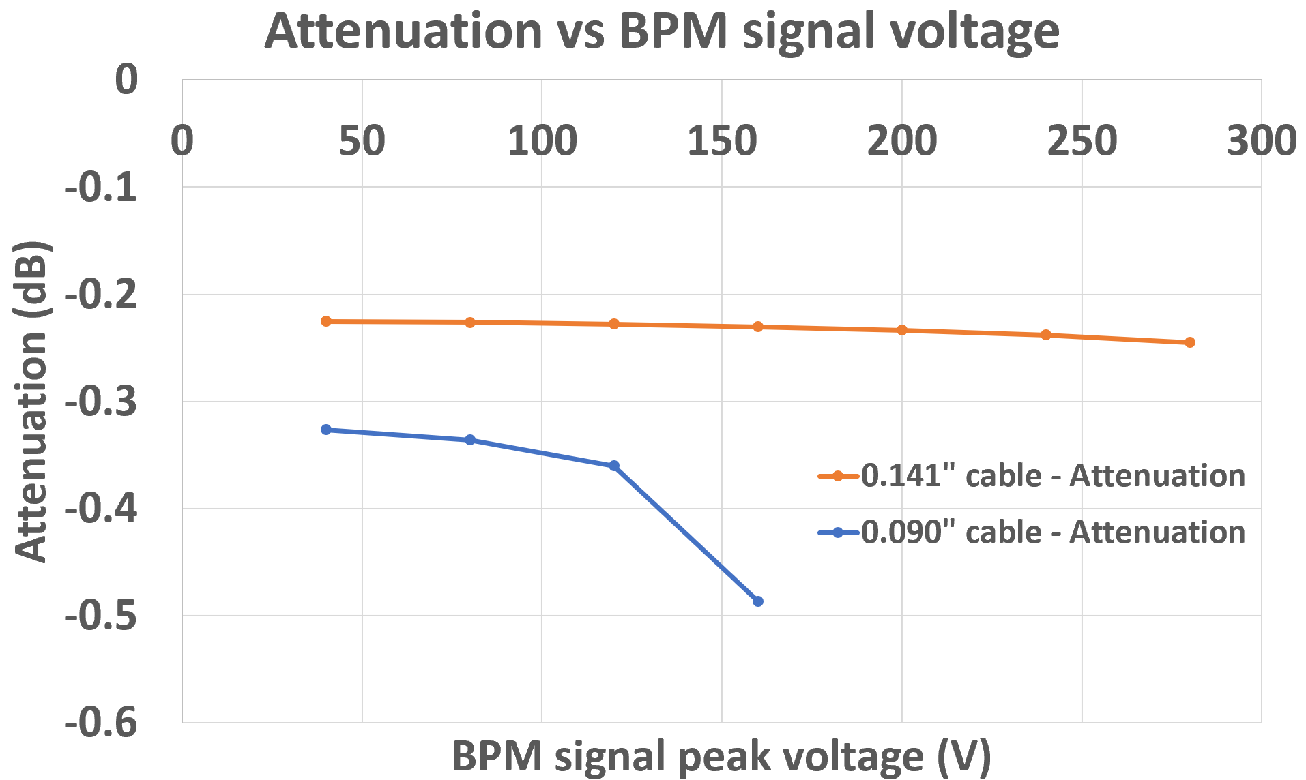
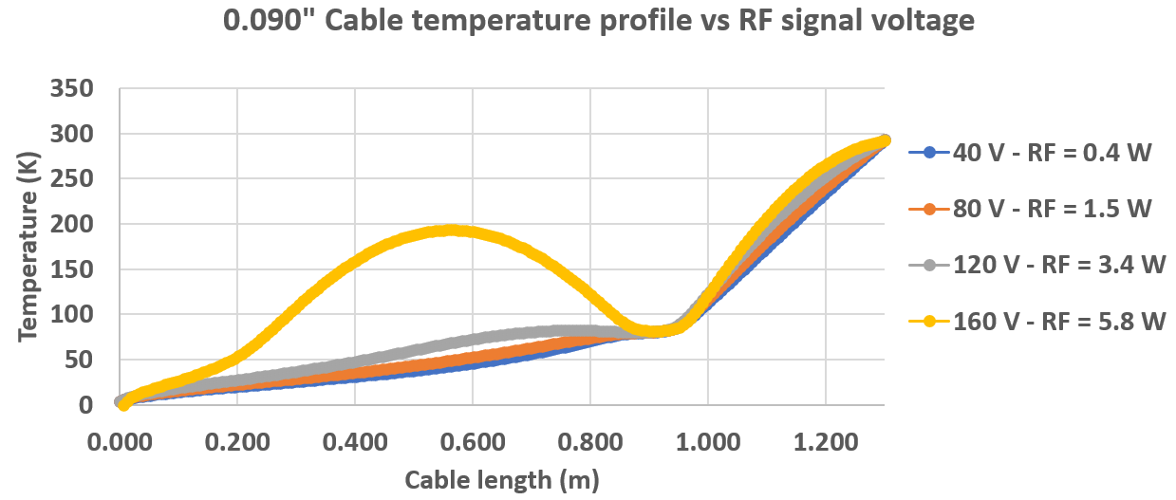
SiO2 cable heating
Max expected peak voltage = 82 V
80K heat intercept
The 0.090” cable is more susceptible to attenuation variations (because higher dissipated power and less conduction).
However, in the signal voltage range expected, the attenuation is still stable for both cables.

Slide 21
Conclusion
We have done the “easy” part – defining what we want.
We have done the “less easy” part – keeping potential bidders in the loop to make sure someone is going to bid.
Now we need to do the “hard part” – negotiating with the vendors as they come up with what they can/cannot do
And the “harder part” – dealing with what gets delivered to us and its deviations to the plan
We also need to start prototyping the actual alignment sequence to make sure we haven’t been too optimistic…
For us, this workshop is an opportunity to get a feedback from the community and save time and costly mistakes.
So please raise any concern or reservation you may have with the plan or the design laid out !
Workshop on button BPMs
F.Micolon

Slide 22
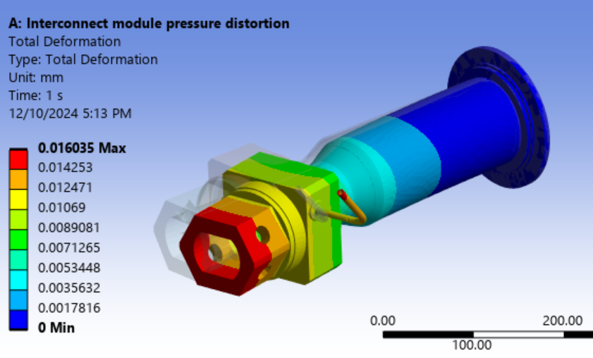
BPM module operational distortion
The interconnect below can pull transversely and displace the BPM module. This was reviewed.
60 N – max bellow sideway force’
Deflection = 16 µm
First vibration mode – 780 Hz

Slide 23
Will the Additional Heat Load be Acceptable for the Cryogenic System ?
Charge #2, #5
Heat going to the 4.5 K circuit for 4x cables:
Power (W) | RHIC | EIC – 0.141” cable | EIC – 0.090” cable
Heat to the 4.5K circuit | 0.22 W | 0.5 – 0.8 W | 0.1 – 0.35 W
The heat can be directed to the beam screen cooling circuit or the magnet cooling circuit.
Using the 0.141” cable :
For the magnet cooling lines, EIC cryogenics agreed that +10W between recoolers will be acceptable. This is 3.2 W.
For the new beamscreen cooling circuit, the design heat load is ~80 W (per 150m). The addition of BPM cooling is + 4%.
Using the 0.090” cable the heat generated would be about halved and almost identical to the RHIC status.
Regardless of the cable choice, the additional heat load is reasonable for the planned cryogenic circuits.

Slide 24
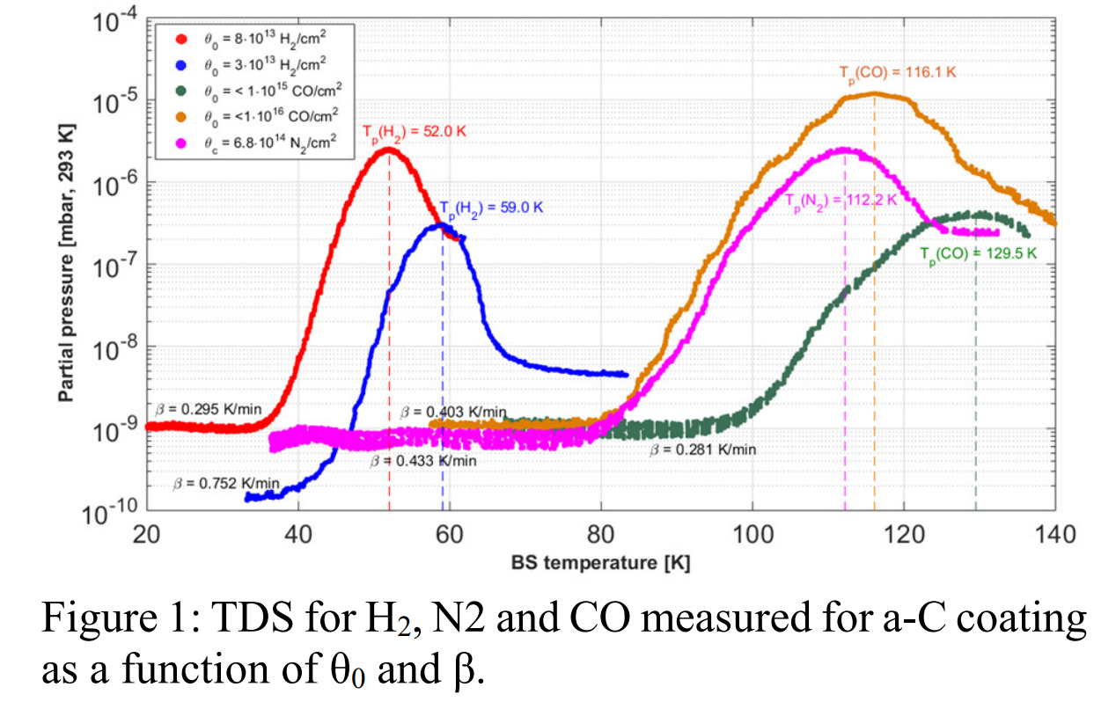
Will the Vacuum Chamber Temperature be Consistent with UHV Operation?
Charge #2, #5
EIC vacuum agrees that at this stage, keeping beam wall temperature below 40 K will keep us clear of significant gas desorption (and associated vacuum degradation).
In all cases simulated, the beam chamber wall and BPM button temperature is below 43 K and can with simple measures be reduced below 40 K (strapping).
More analysis will be required but overall, the BPM module temperature is consistent with UHV operation.
Desorption of gas from an aC coated surface vs temperature - Source : R. Salemme et al . Link

Slide 25
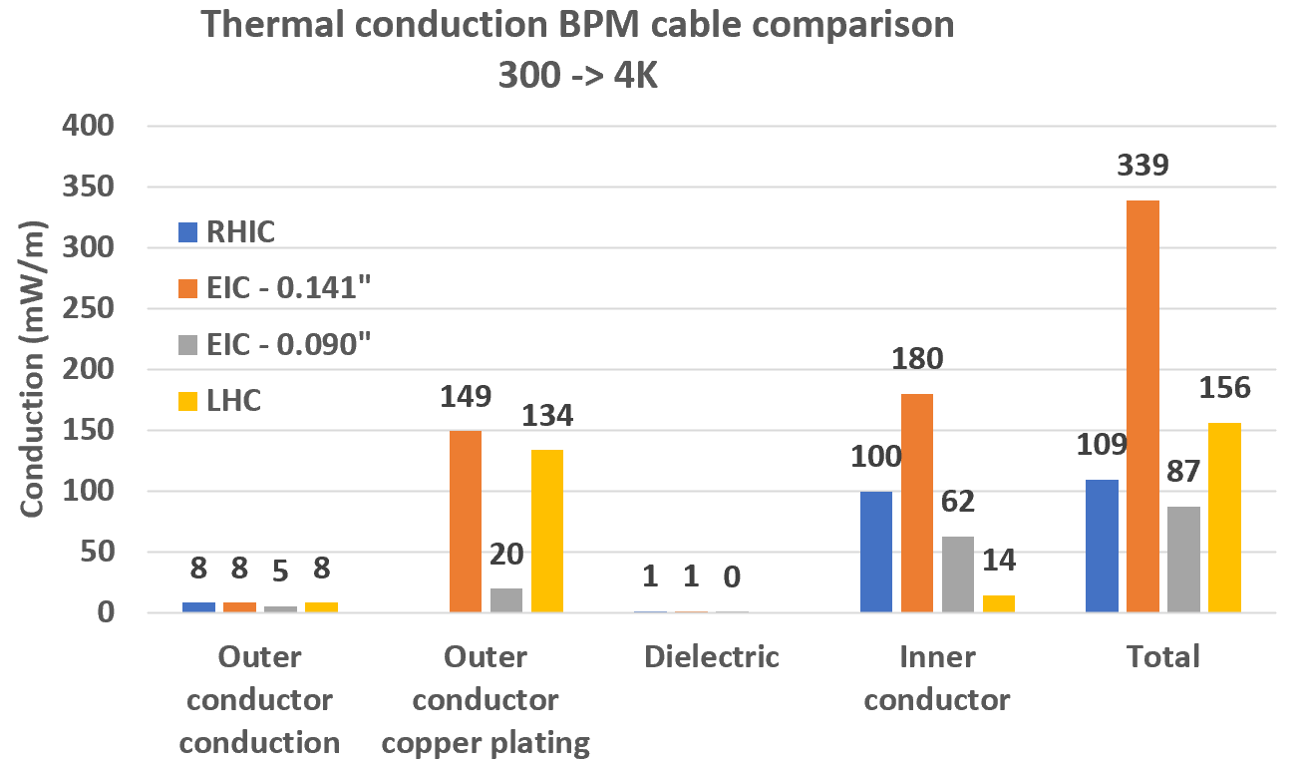
Possible Coax Cryo-Cable Options
The plan is to use rigid coaxial cables with a low density SiO₂ dielectric material.
The inner conductor will be bulk copper. The outer conductor will be a stainless-steel jacket with an inner copper coating.
Sample cables
Low density SiO₂ dielectric
0.141” cable
0.090” cable
RHIC today
Compared to the current RHIC BPM cables :
~3x bigger thermal conductivity for the 0.141” cable
~lower thermal conductivity for the 0.090” cable
RF attenuation is expected ~1.5x higher with the 0.090” cable.
The final choice of cable is pending the cost and the system performance study.

Slide 26
Tech Note Link
More details on the simulation and results can be found in the BNL technical note published earlier this year :
https://www.osti.gov/servlets/purl/1969913

Slide 27
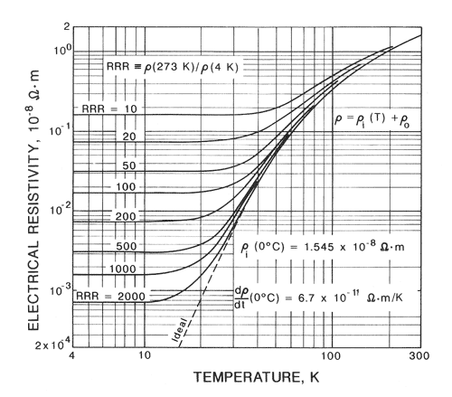
Copper Electrical Resistivity
Assumption for Cu conductivity
=5E+8
50K

Slide 28
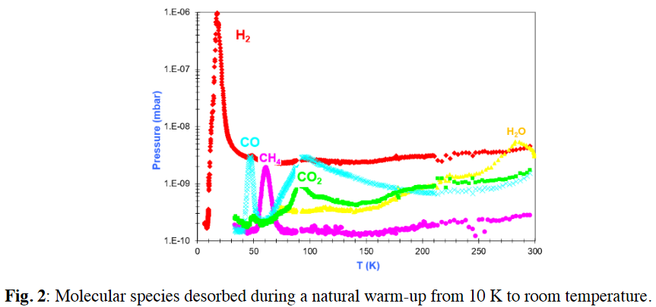
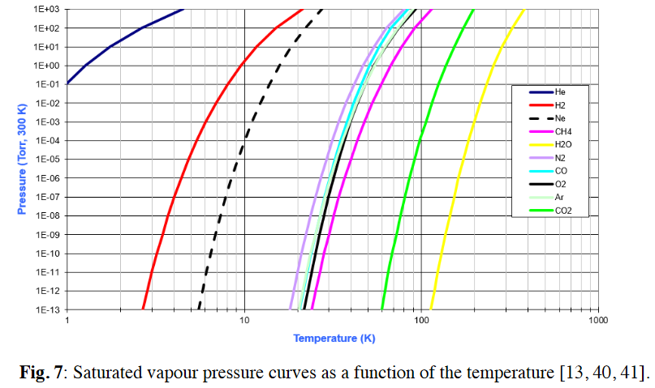
Impact on Vacuum
From V.Baglin lecture on cryopumping
Desorption of gas from an aC coated surface vs temperature - Source : R. Salemme et al . Link

Slide 29
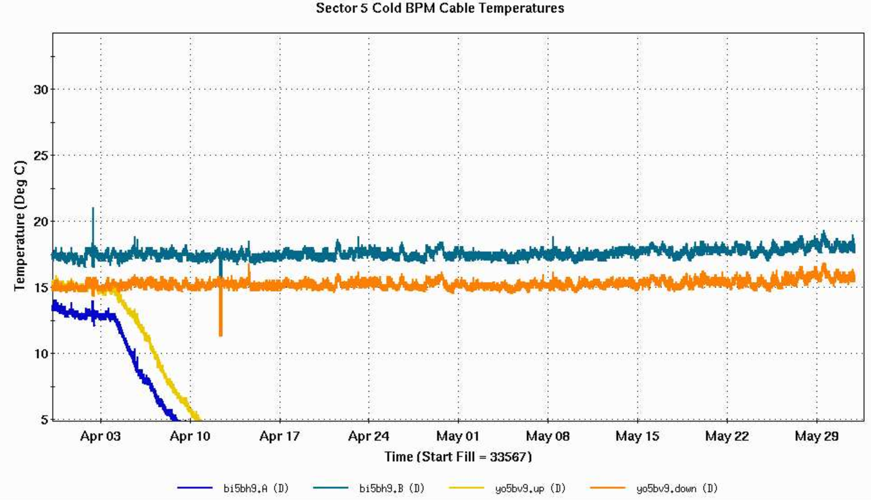
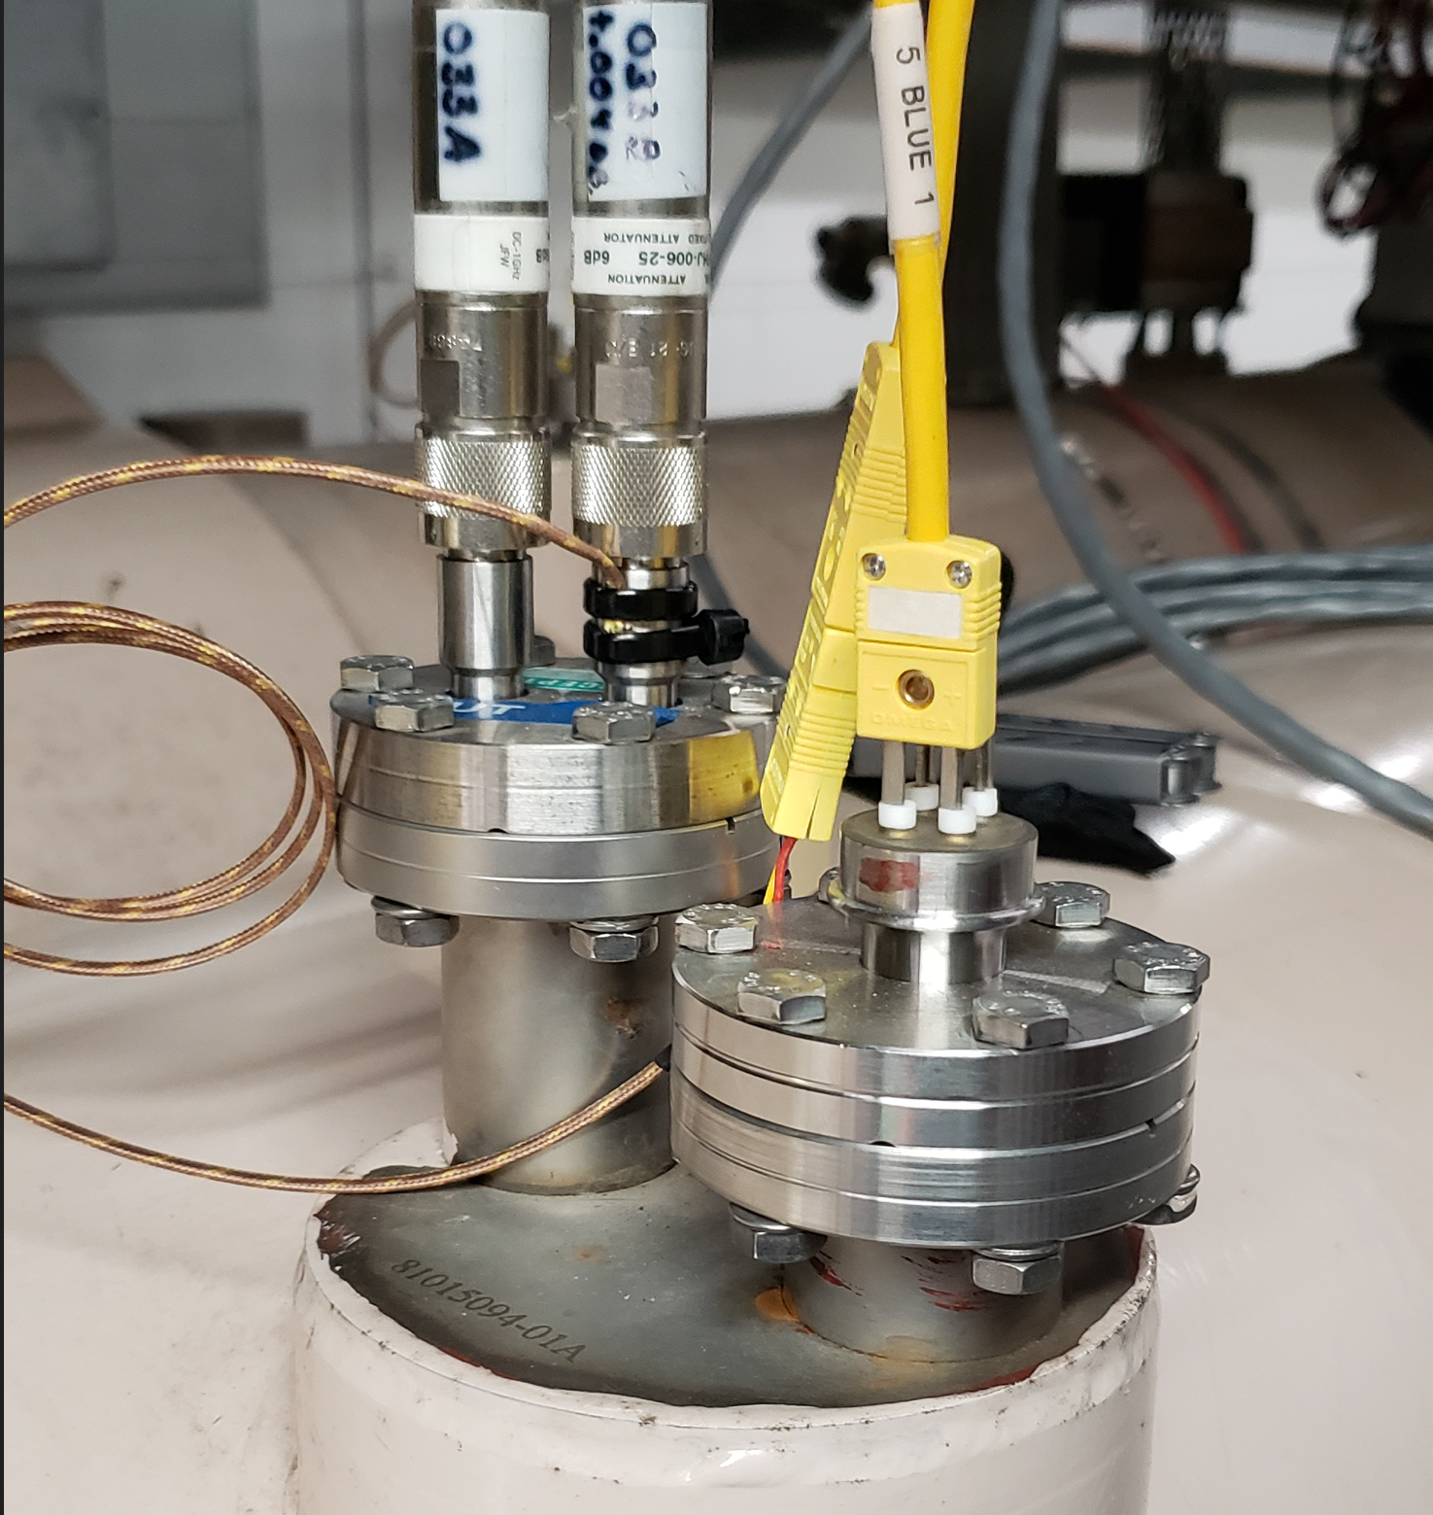
BPM Air Feedthrough Temperature
RHIC cold fill
A measurement campaign with thermocouples on the BPM feedthrough has started this year to validate the temperature of the warm end.
During the cold fill the feedthrough temperature has not evolved.

