Slide 1

Button BPMs for Synchrotron Light Sources

Slide 2
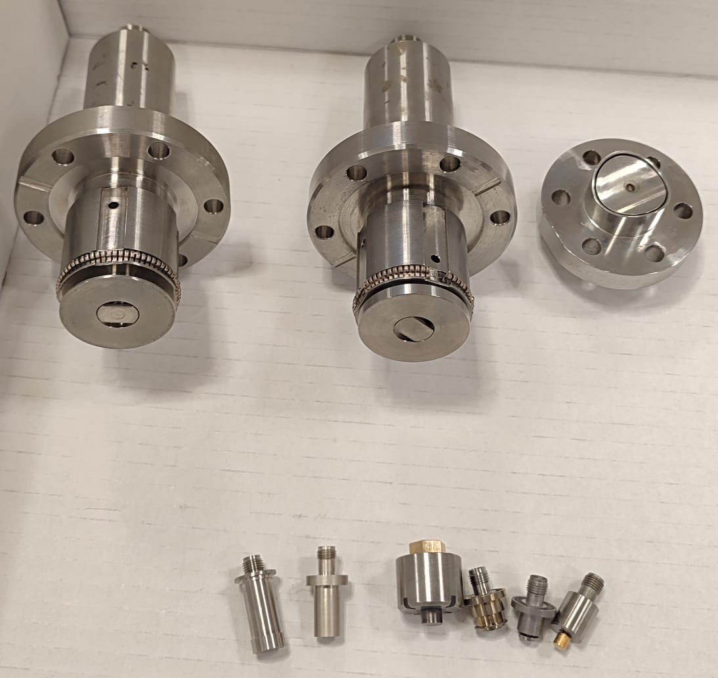
28 Participants - 25 in person + 3 remote - 21 men (75%) and 7 women (25%) - 21 european and (75%) and 7 intercontinental (25%) - 21 light sources (75%) and 7 other machines (25%)
18 contributions - 14 men (78%) and 4 women (22%) - 10 light sources, 6 other facilities, 2 codes
1 guided discussion - loads of unguided discussions :)

Slide 3
Thank you!

