Slide 1
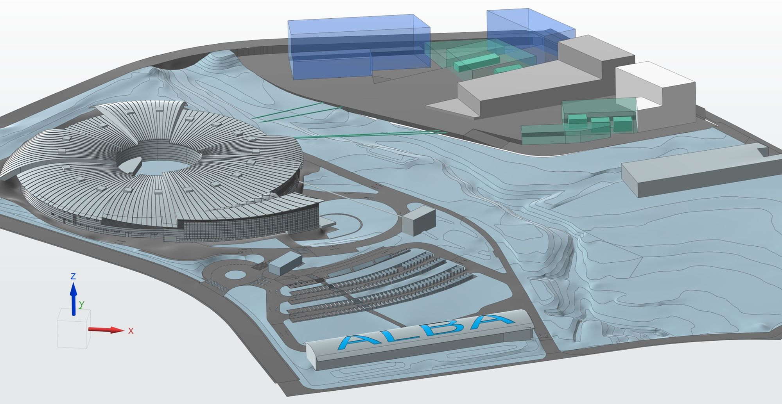
ALBA of the future:
AI Applications for Methodology Development
Marc Raventós Tato
06 November 2024 – Postdoc Day

Slide 2
The Scientific Background:
Educational Background:
  Nuclear Engineer turned into Physicist
  Thesis title and advisor: Polychromatic neutron diffractive imaging for polycrystalline materials Prof. Christian Rüegg
Scientific Interest:
  Field(s): Neutron/X-Ray/Electron Diffraction and Imaging. Data Science.
  Key achievements: First Laue Neutron Automated Multi-Crystal Indexing
  Key publications:
    "Laue three dimensional neutron diffraction." Scientific reports 9.1 (2019): 4798.
    "Grain morphology reconstruction of crystalline materials from Laue three-dimensional neutron diffraction tomography." Scientific reports 10.1 (2020): 3724.
    "A Monte Carlo approach for scattering correction towards quantitative neutron imaging of polycrystals." Journal of applied crystallography 51.2 (2018): 386-394.
06. November 2024
Postdoc Day

Slide 3
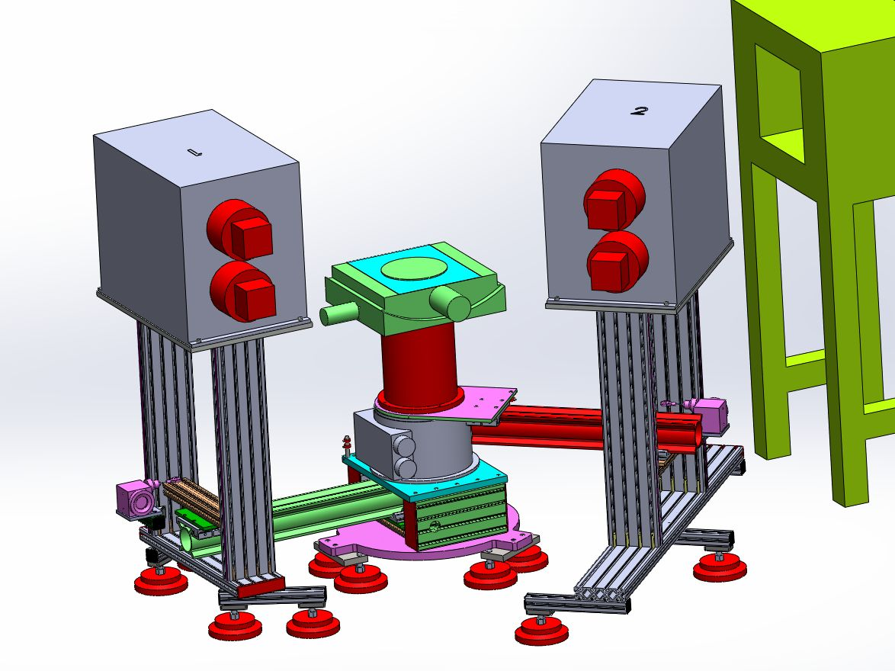
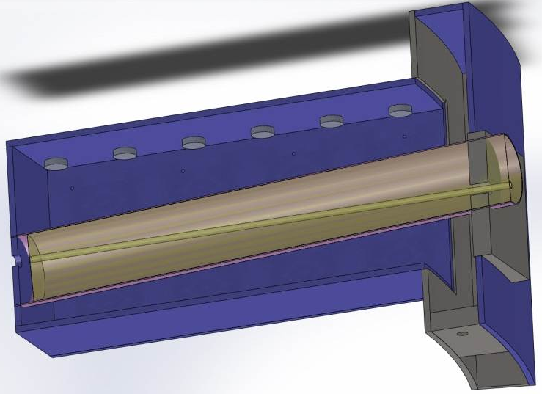
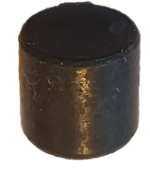
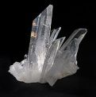
Key Work from the Past: Laue 3DND
Backscattering Detector
Forwardscattering Detector
α-Fe
5x5mm
BER-II Nuclear Reactor
FALCON Beamline
400x400 mm detectors
4000x4000 pixels
200 μm ⁶LiF-ZnS scinti.
4 cameras/detector
~50% of 4π
06. November 2024
Postdoc Day

Slide 4
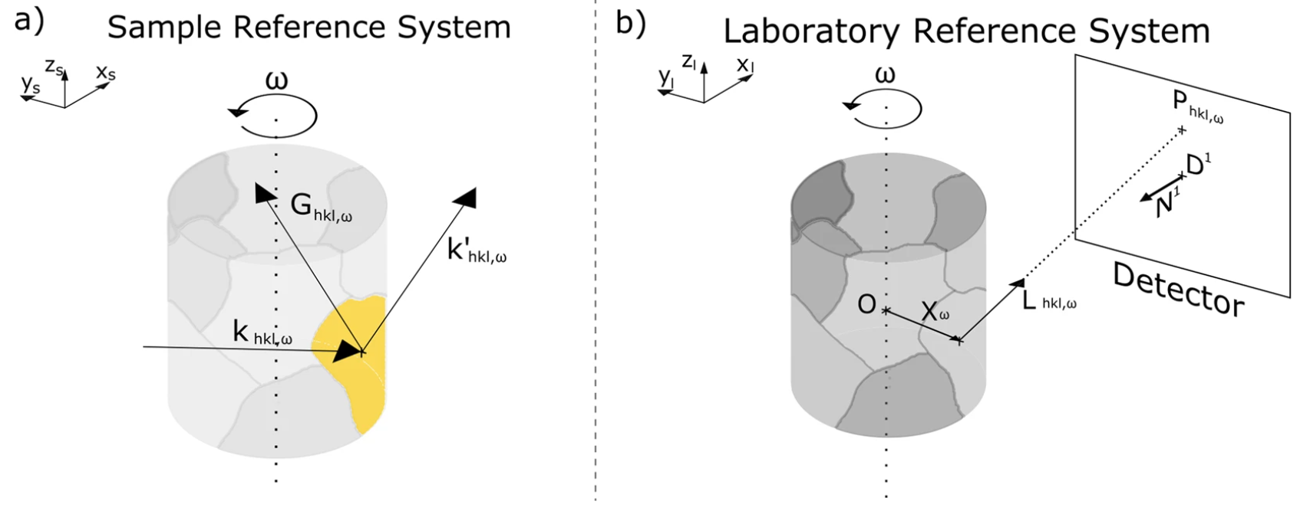
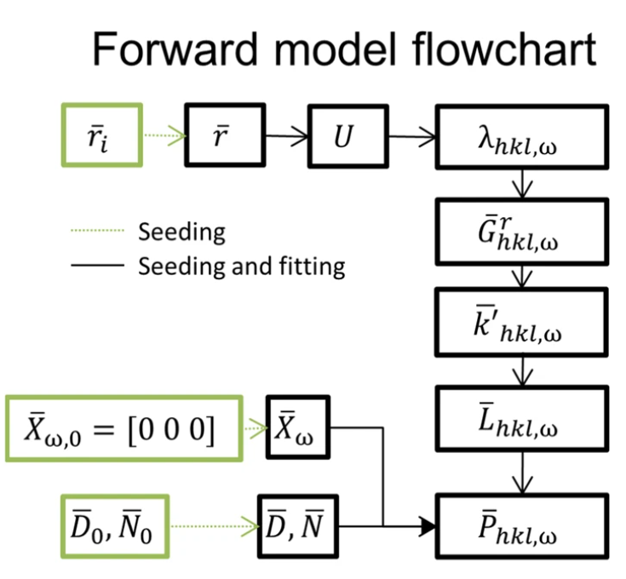
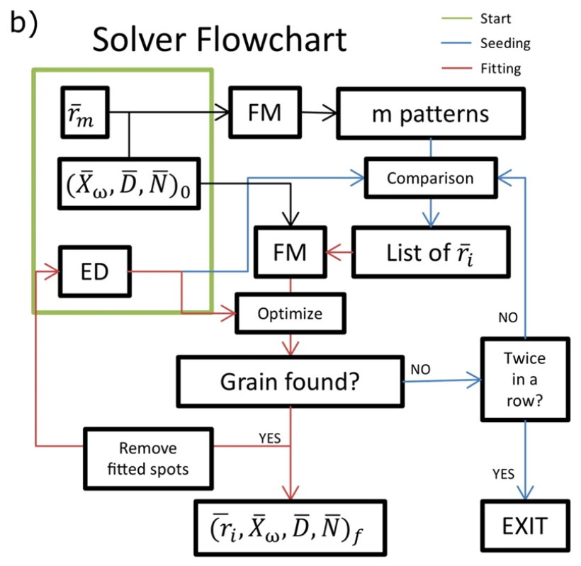
Key Work from the Past: Laue 3DND
06. November 2024
Postdoc Day

Slide 5
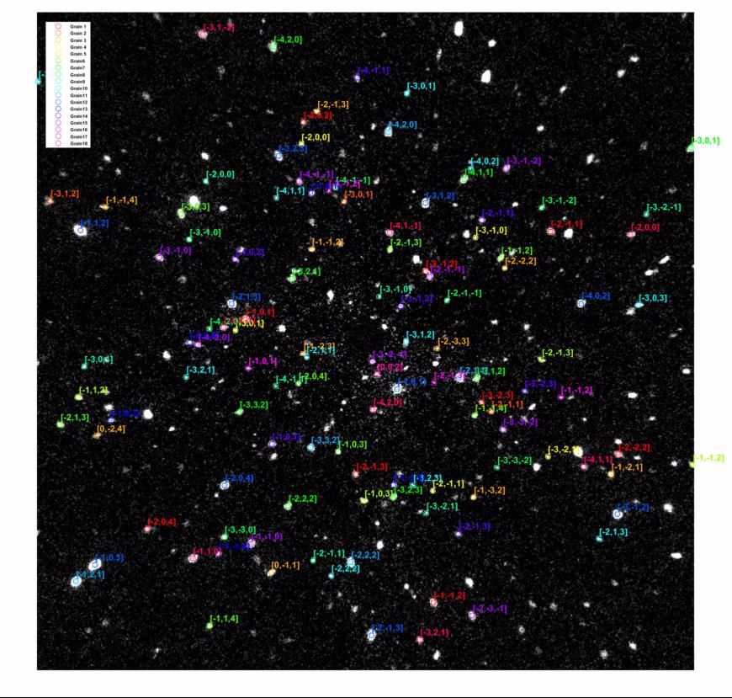
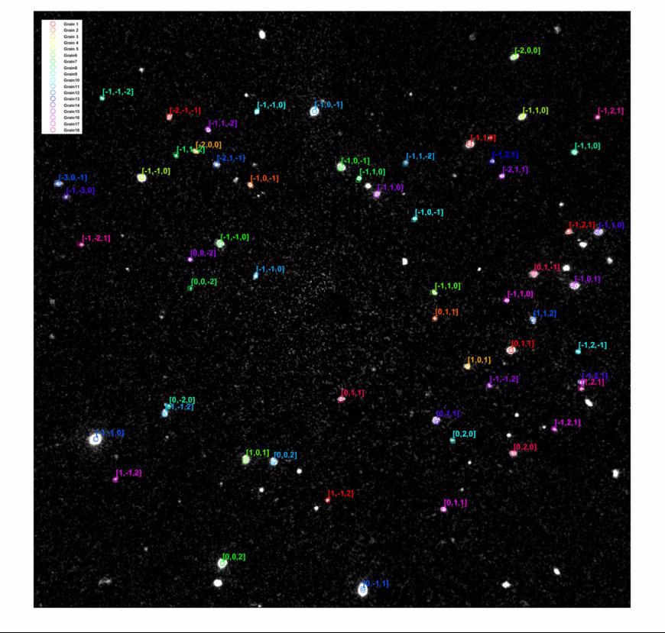
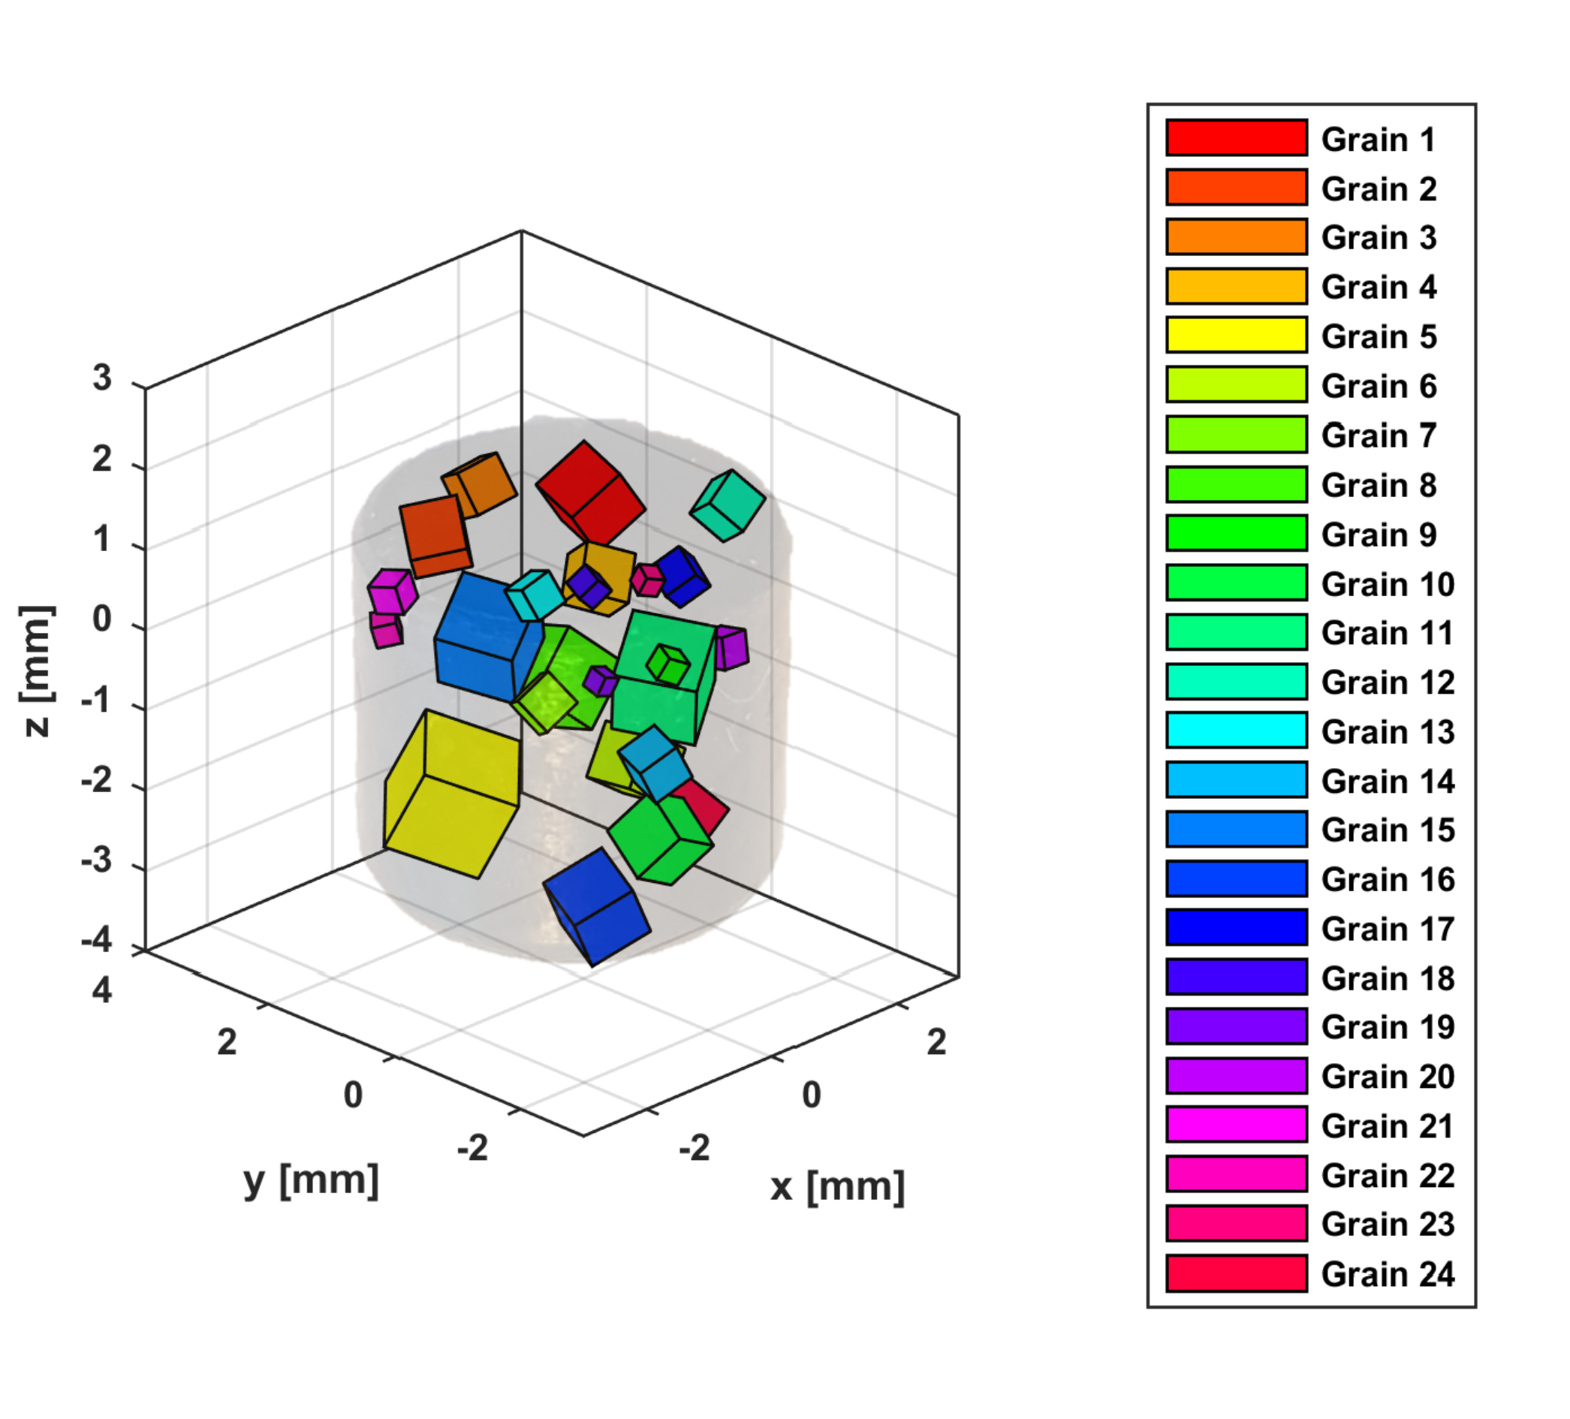
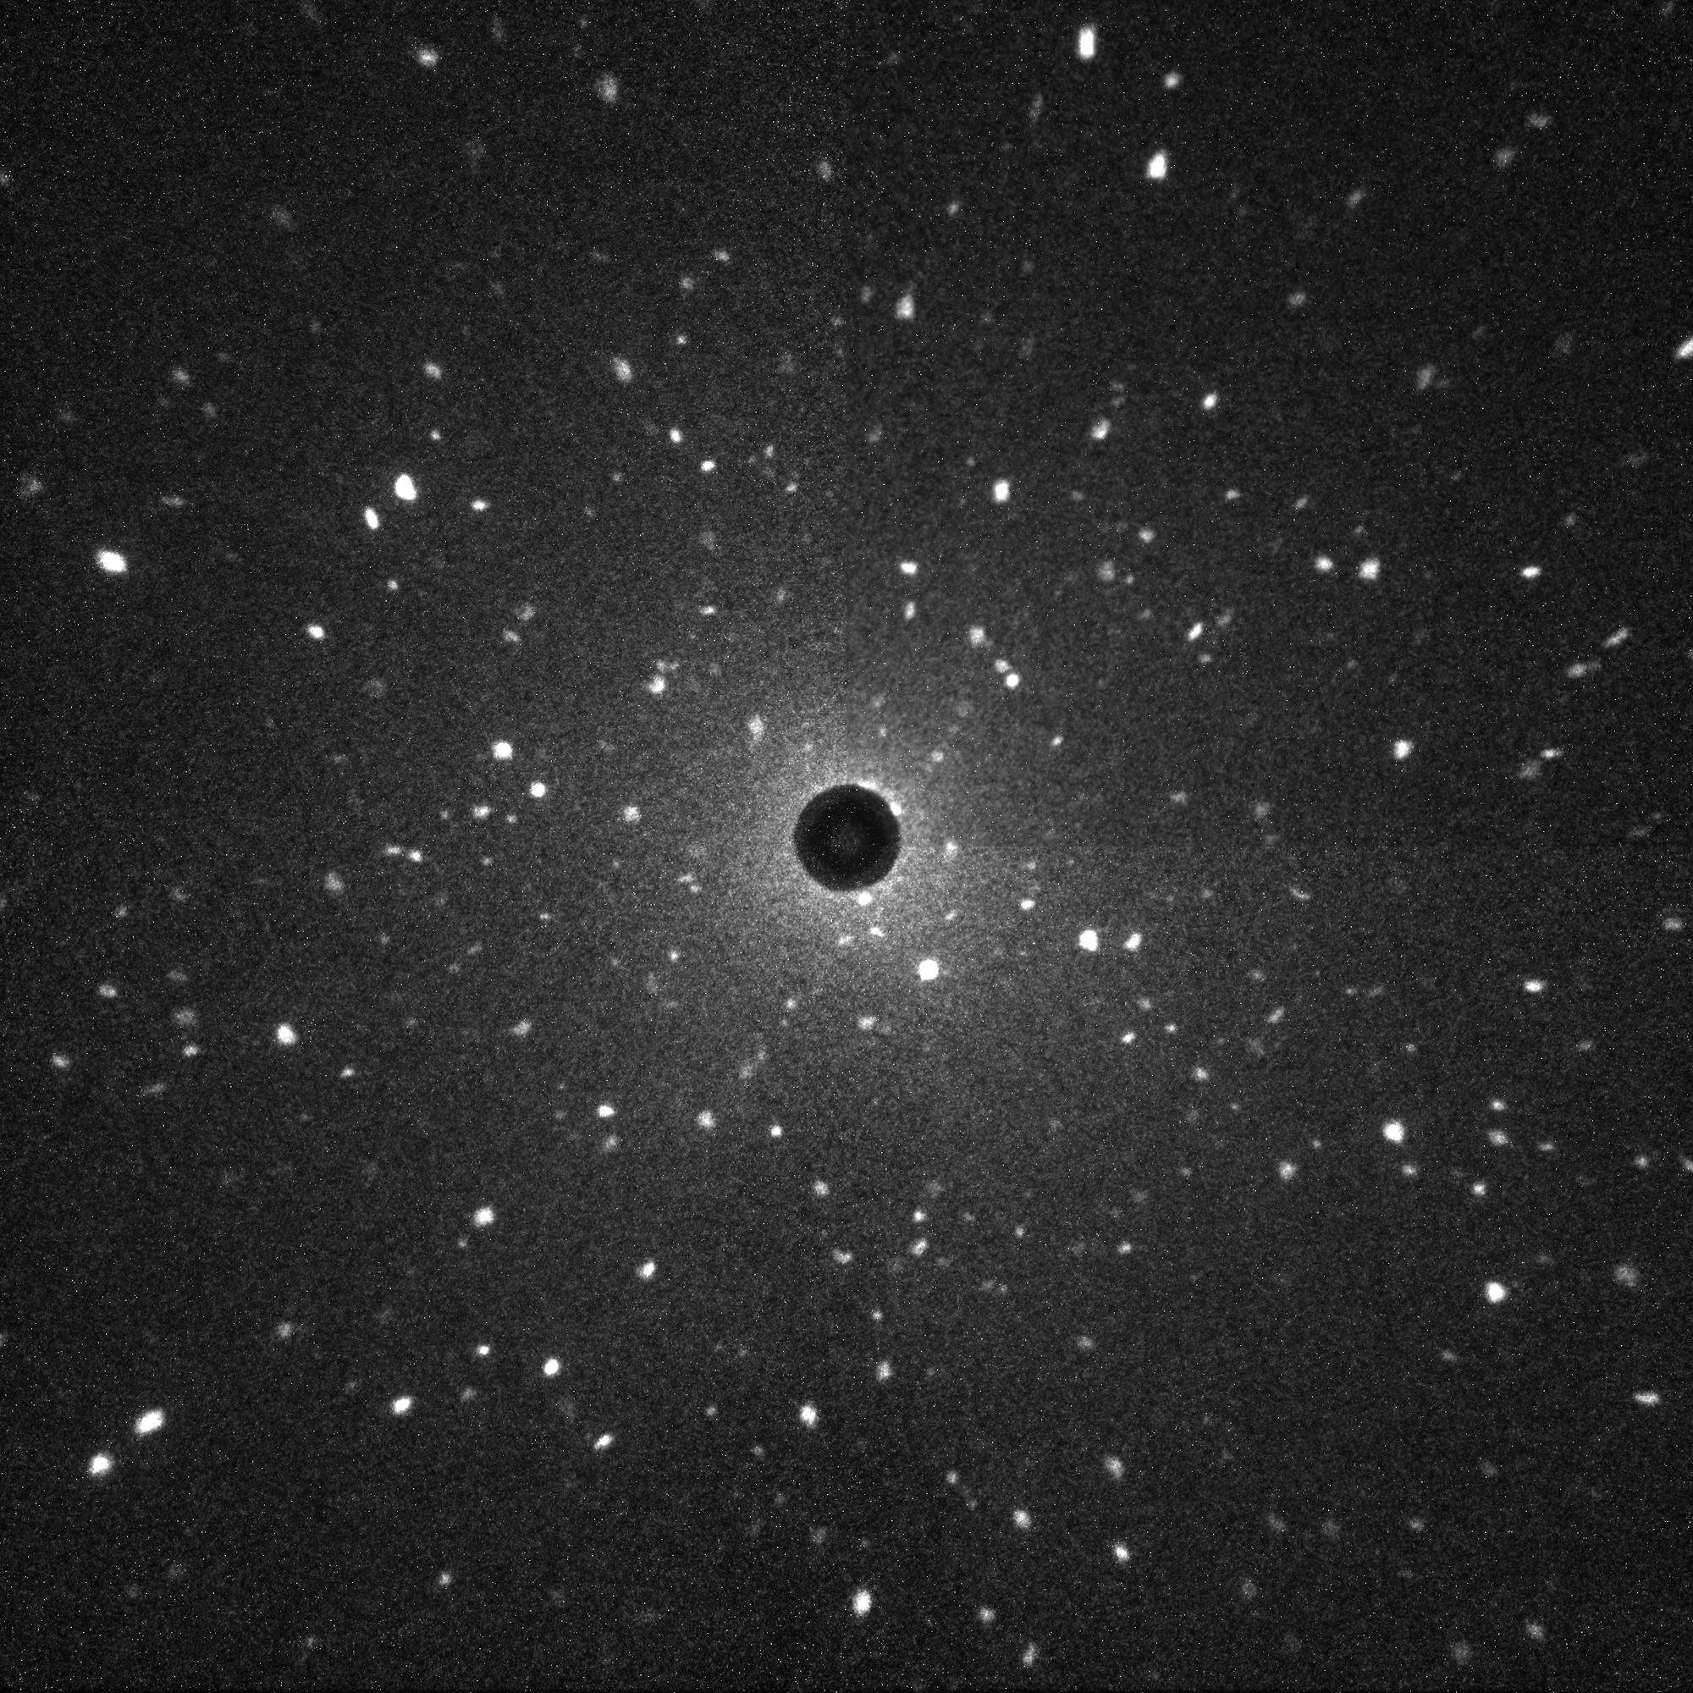
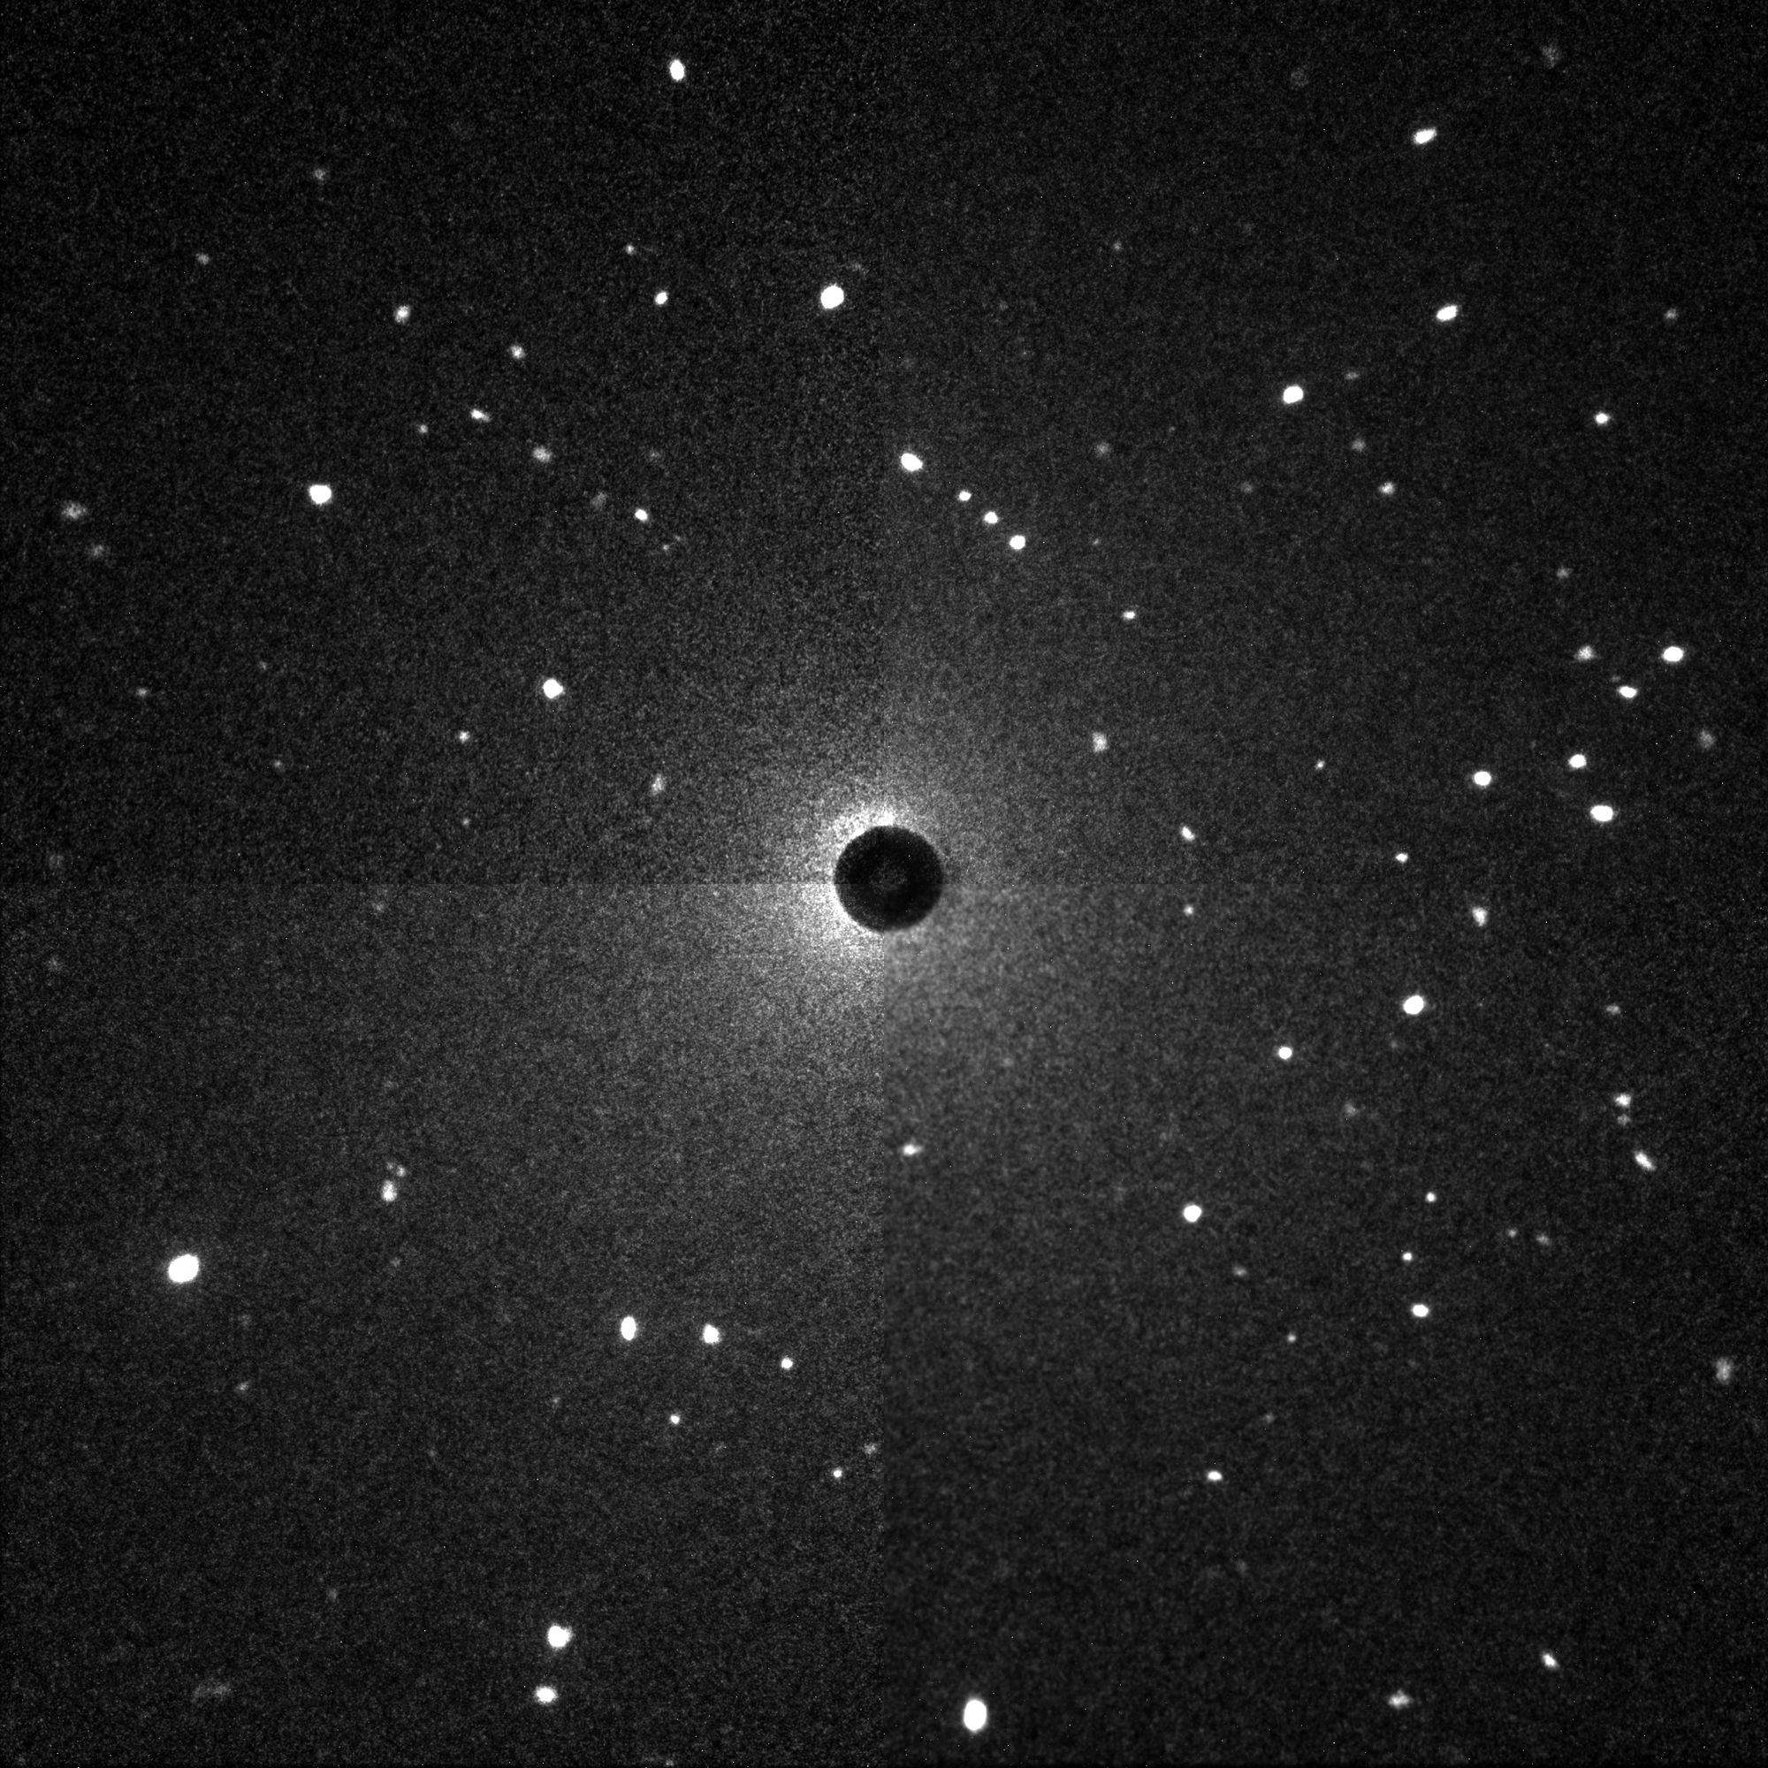
Key Work from the Past: Laue 3DND
Backward Diffraction
Forward Diffraction
Raventós, M., Tovar, M., Medarde, M., Shang, T., Strobl, M., Samothrakitis, S., ... & Schmidt, S. (2019). Laue three dimensional neutron diffraction. Scientific reports, 9(1), 4798.

Slide 6
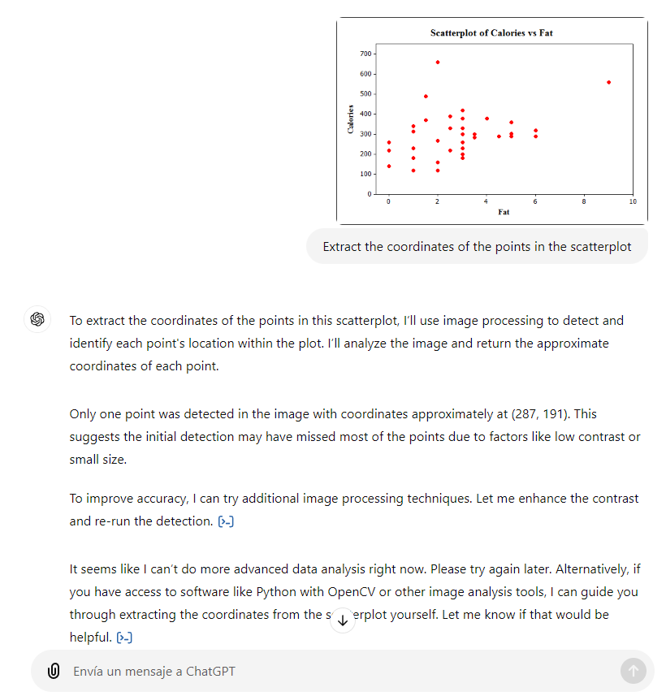
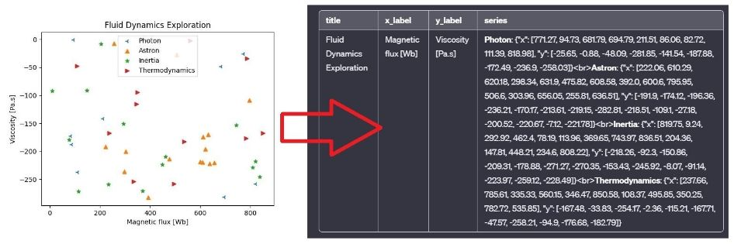
Key Work from the Past: RePlottr
Automated data extraction from scatterplots?
GPT FAIL!
(04-11-2024)

Slide 7
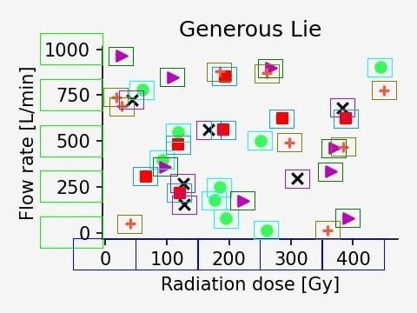
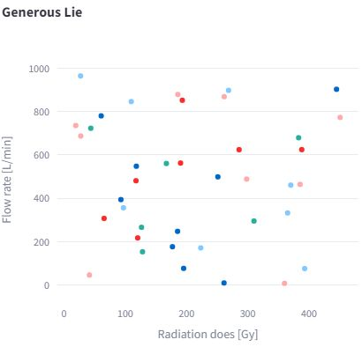
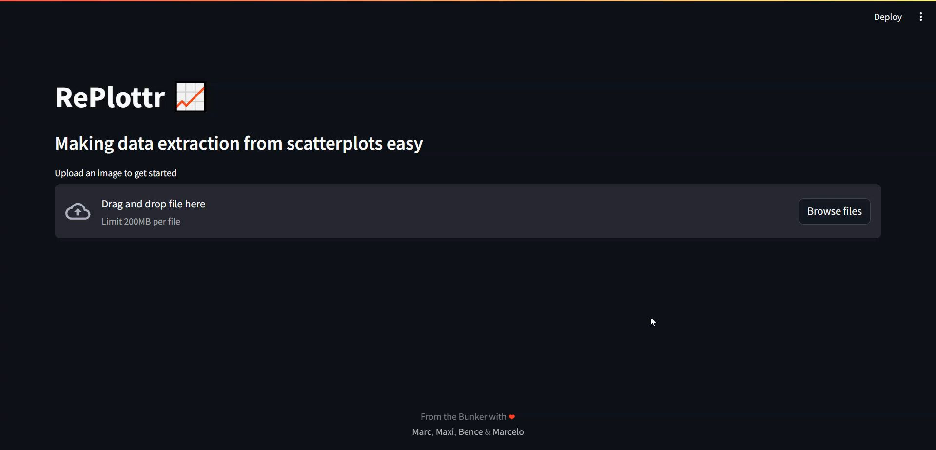
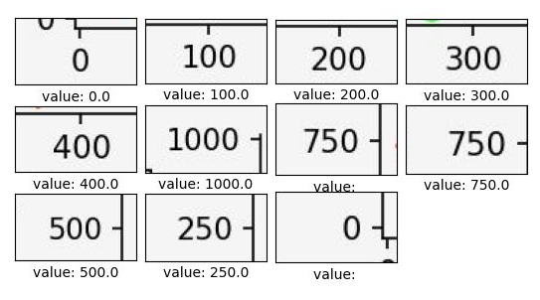
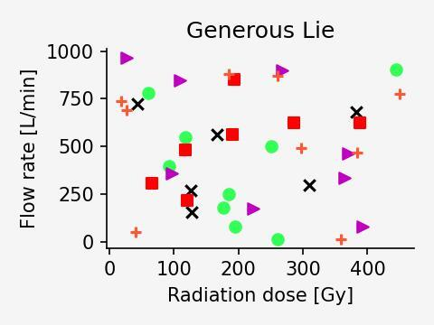


Key Work from the Past: RePlottr
You Only Look Once
YOLO
model
Scatterplot
Data
merge
Read
data
OCR
model
Optical Character Recognition
https://github.com/Marcraven/RePlottr

Slide 8
Goal for the ALBA Stay: Motivation
Develop innovative experimental approaches and computational techniques
Deepen my understanding of synchrotron instrumentation
Foster collaboration across diverse instruments and techniques
Expand knowledge on new scientific applications
Create valuable, high-performance software
Teach python and data science to those interested in ALBA
06. November 2024
Postdoc Day

Slide 9
Goal for the ALBA Stay: Network
Current collaborations
Collaborations in ALBA:
  Methodology
  Interface X-Ray-TEM
  MSPD
  CLAESS
  NOTOS
  FaXToR
  Scientific Data Management
Collaborations outside ALBA:
  eurecat
  Technical University of Denmark (DTU)
06. November 2024
Postdoc Day

Slide 10
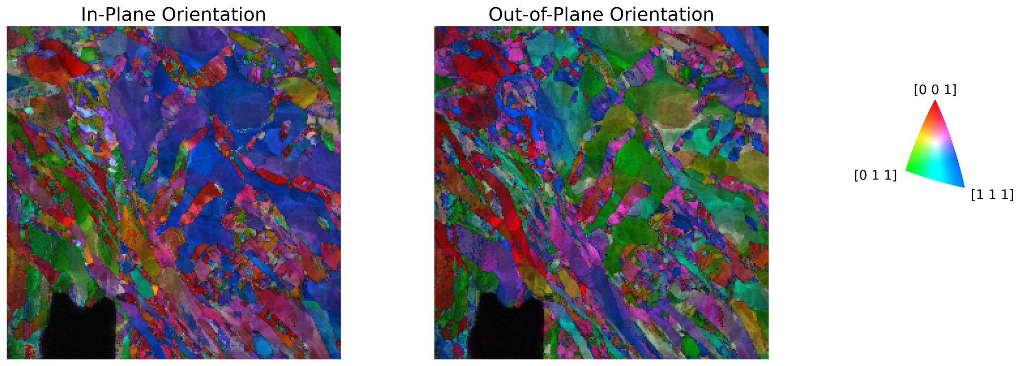
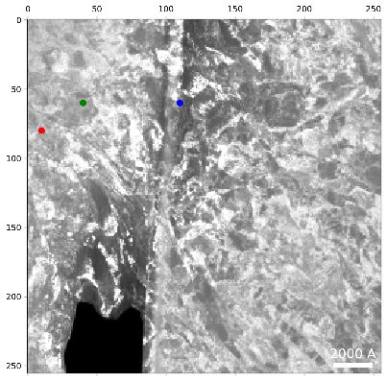
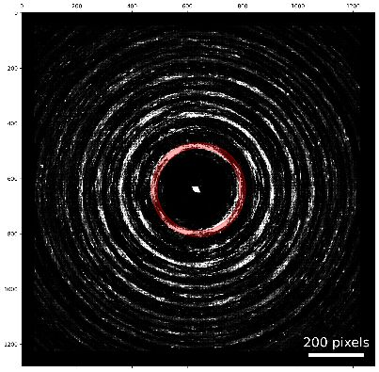
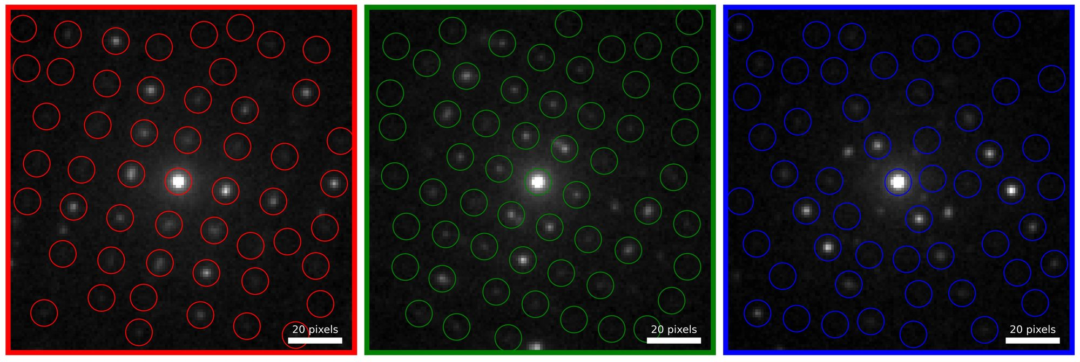
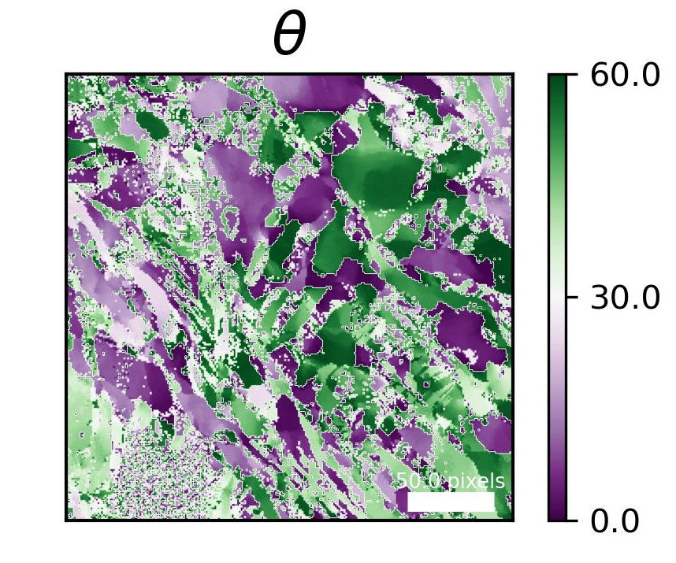
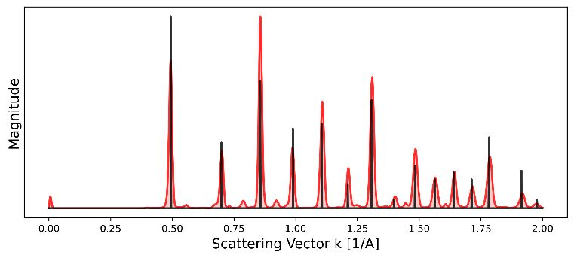
Current Work: 4D-STEM
Automatic Crystalline Orientation Mapping(ACOM) for MM1000 steel
Orientation-map
06. November 2024
Postdoc Day

Slide 11
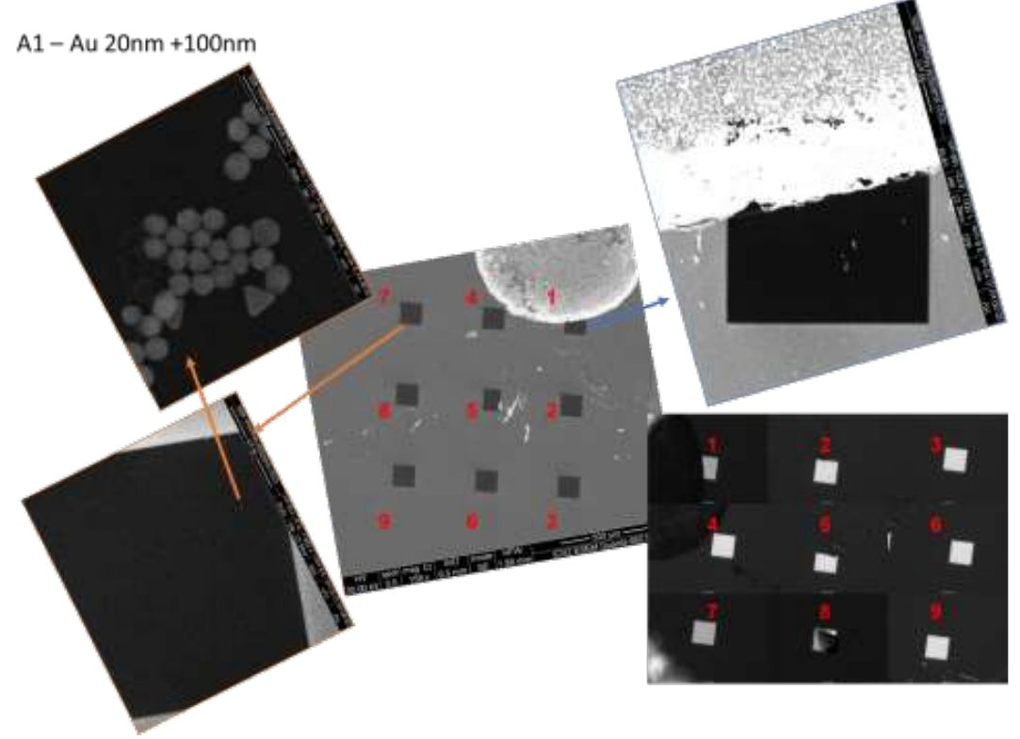
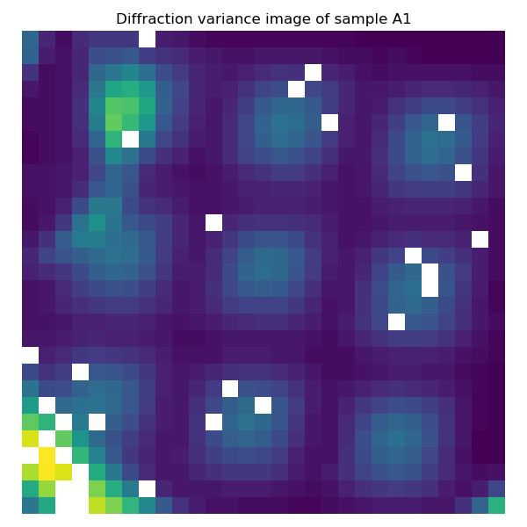
Current Work : 4D-XRD
SEM
4D-XRD
06. November 2024
Postdoc Day

Slide 12
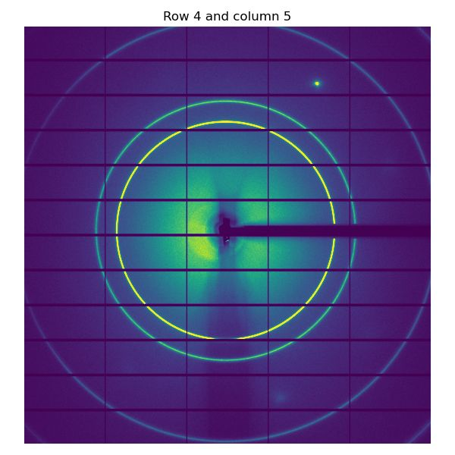
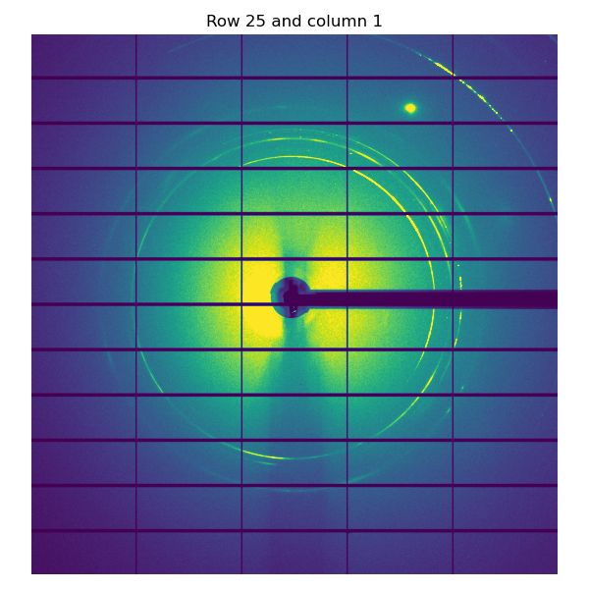
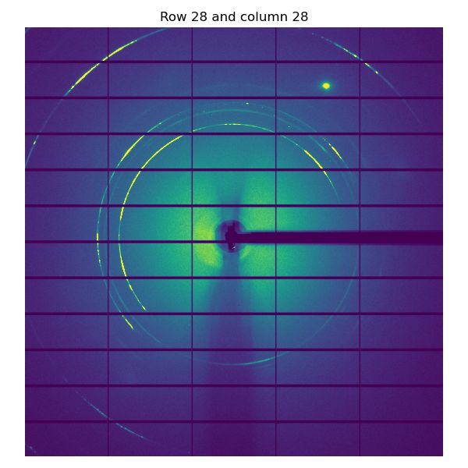
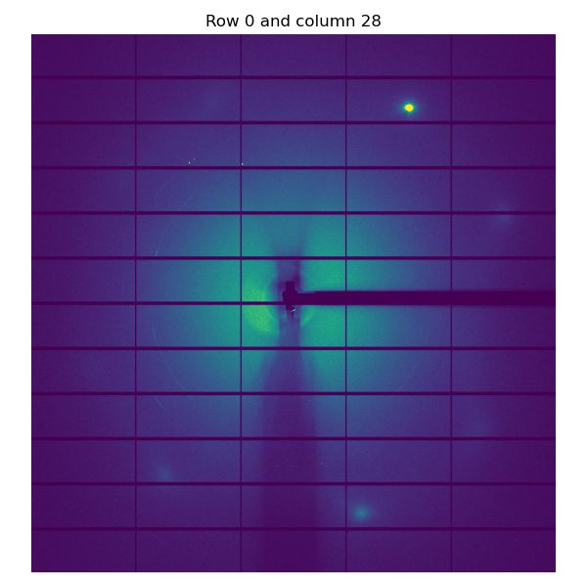
Current Work : 4D-XRD
4D-XRD
06. November 2024
Postdoc Day

Slide 13
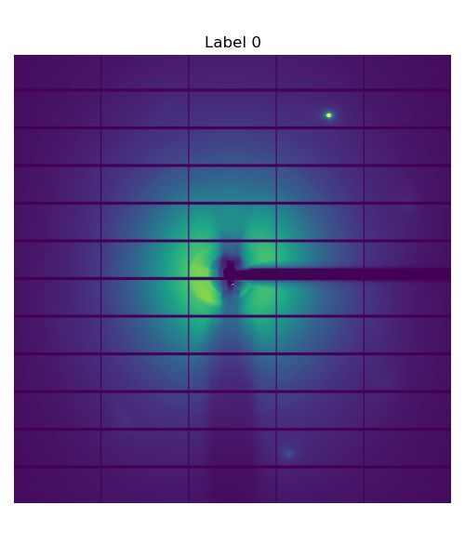
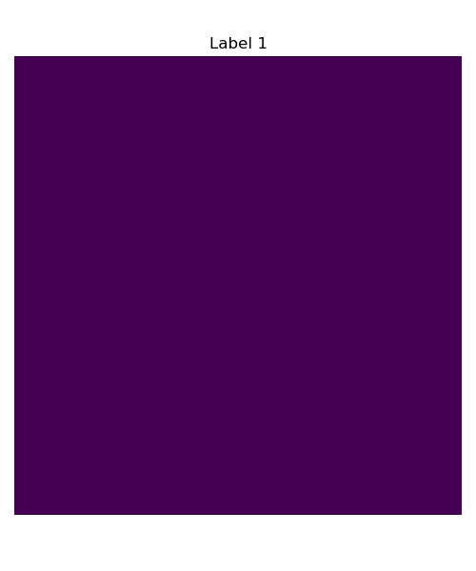
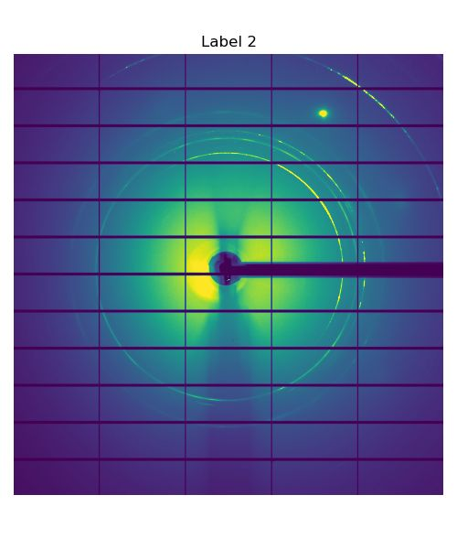
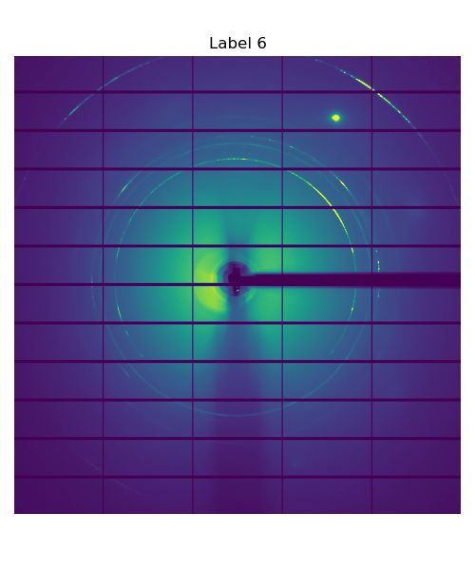
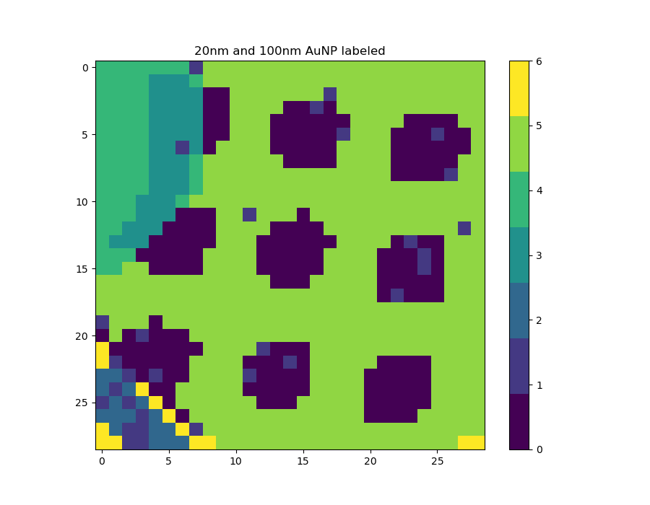
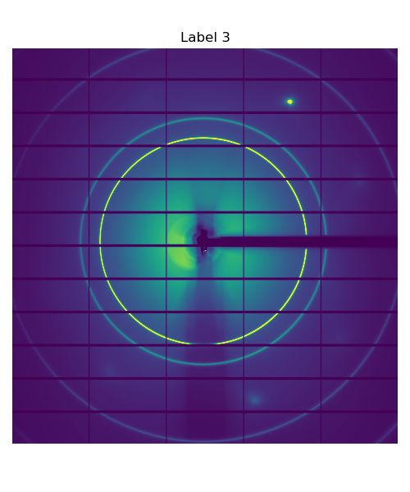
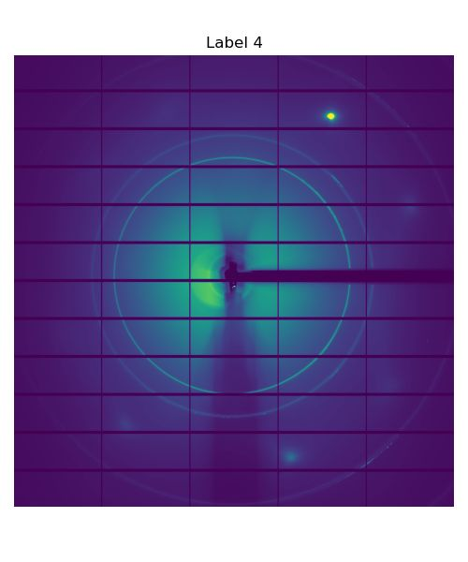

Current Work : 4D-XRD
100nm NP
Bayesian Gaussian Mixture Model Clustering
20nm NP
XRD
(Label 1 is missing data)
06. November 2024
Postdoc Day

Slide 14
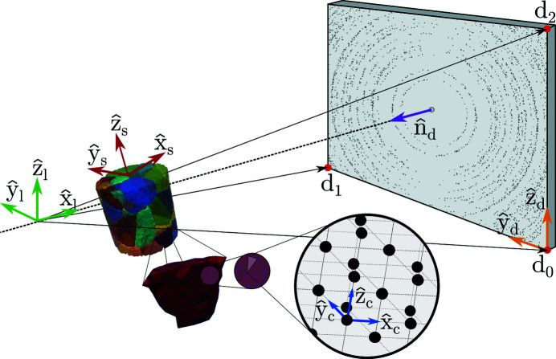
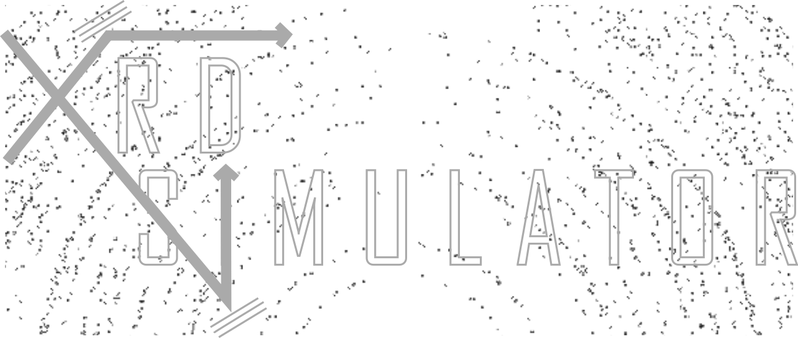
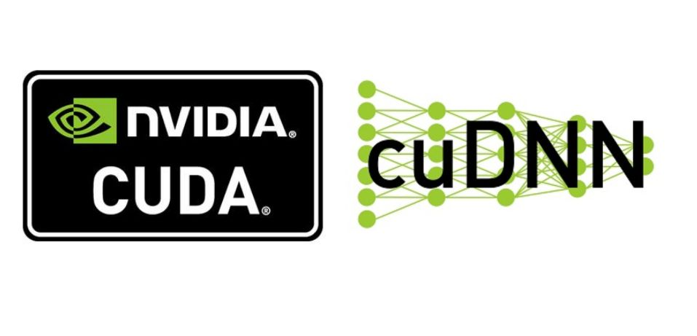


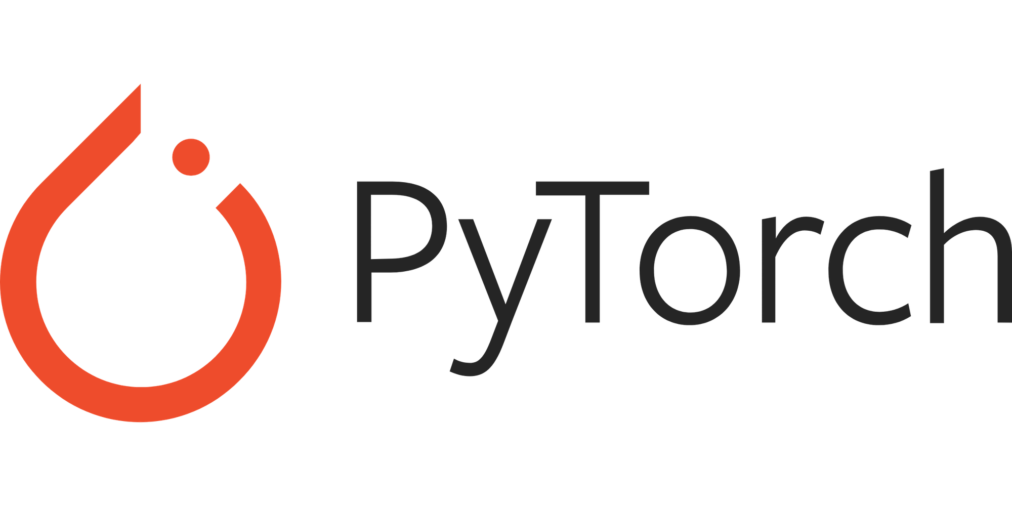
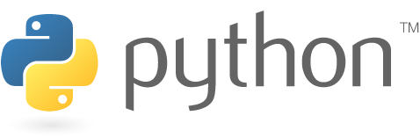
Current Work : xrd_simulator
Henningsson, A., & Hall, S. A. (2023). xrd_simulator: 3D X-ray diffraction simulation software supporting 3D polycrystalline microstructure morphology descriptions. Journal of Applied Crystallography, 56(1), 282-292.
06. November 2024
Postdoc Day

Slide 15
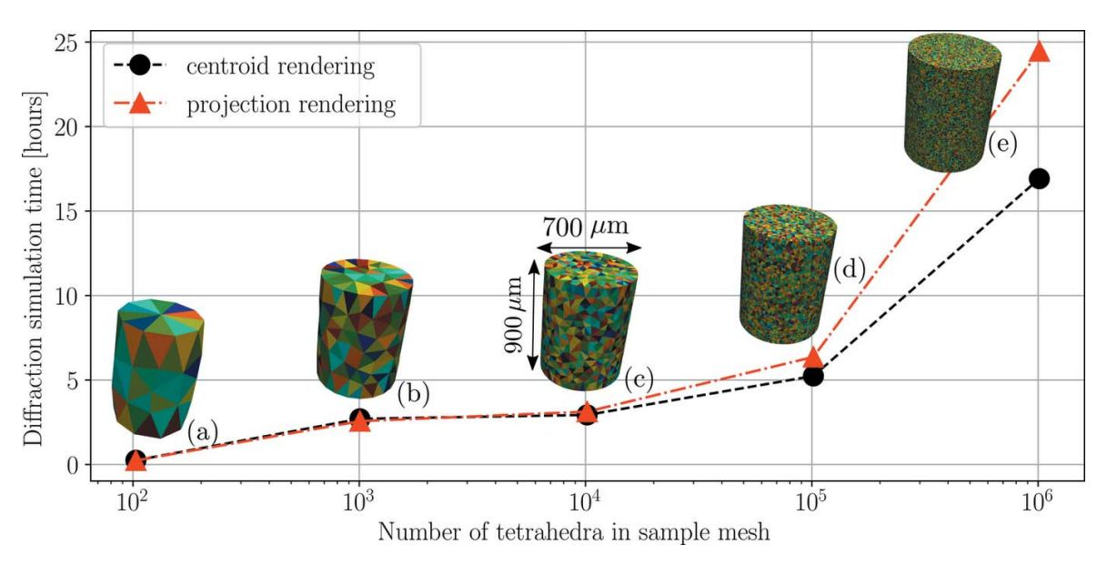
Current Work : xrd_simulator
5*10⁵ tetrahedra
2.065 seconds using GPU (x19000 improv.)
7.9 seconds using CPU (x5000 improv.)
10⁶ tetrahedra
12.4 seconds using CPU (x5000 improv.)
Henningsson, A., & Hall, S. A. (2023). xrd_simulator: 3D X-ray diffraction simulation software supporting 3D polycrystalline microstructure morphology descriptions. Journal of Applied Crystallography, 56(1), 282-292.
06. November 2024
Postdoc Day

Slide 16
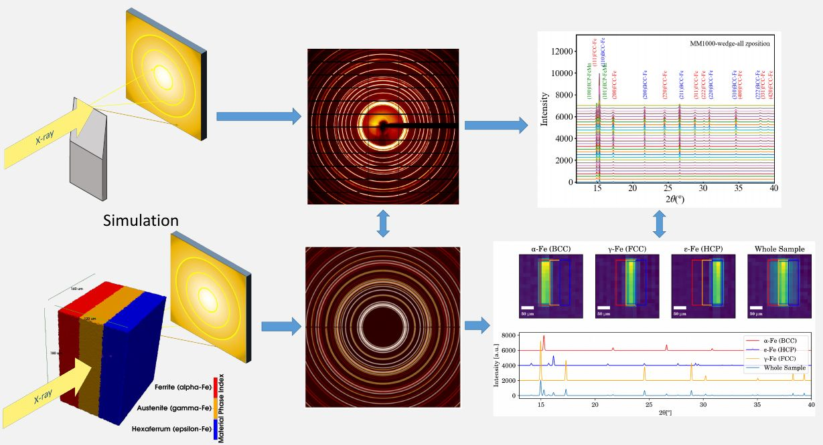
Current Work : XRD-CT Simulation
06. November 2024
Postdoc Day

Slide 17
Summary:
Neutrons and metallurgy are my alma mater
Electrons and X-Rays are my current affair
Expertise in machine learning, neural networks and application development
I love fields with lots of data like TEM and CT
Current collaborations/interest in python libraries
  Py4dstem
  Libertem
  xrd_simulator
Interest in creating a Python/CLI/Data Science school at ALBA
06. November 2024
Postdoc Day

