Slide 1
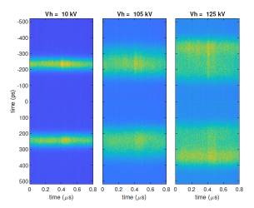

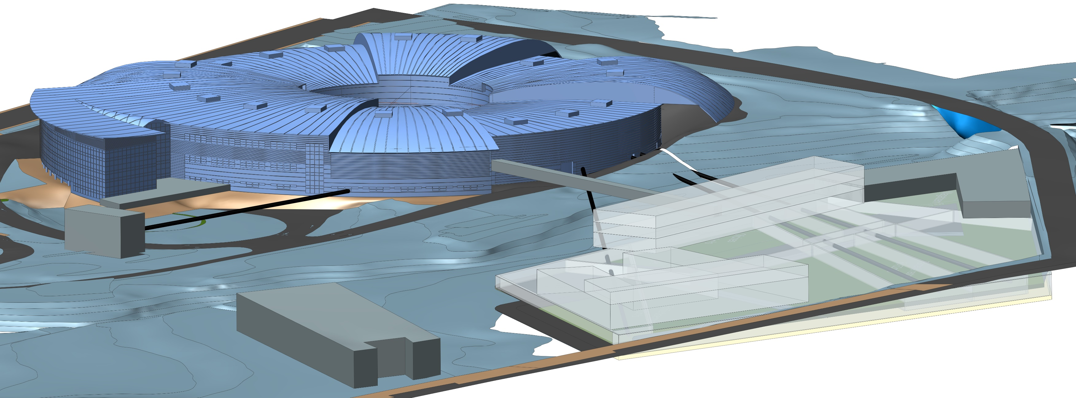


ESLS RF & HarmonLIP Workshops
Welcome
Francis Perez
Head Accelerator’s Division
October 22nd, 2025

Slide 2

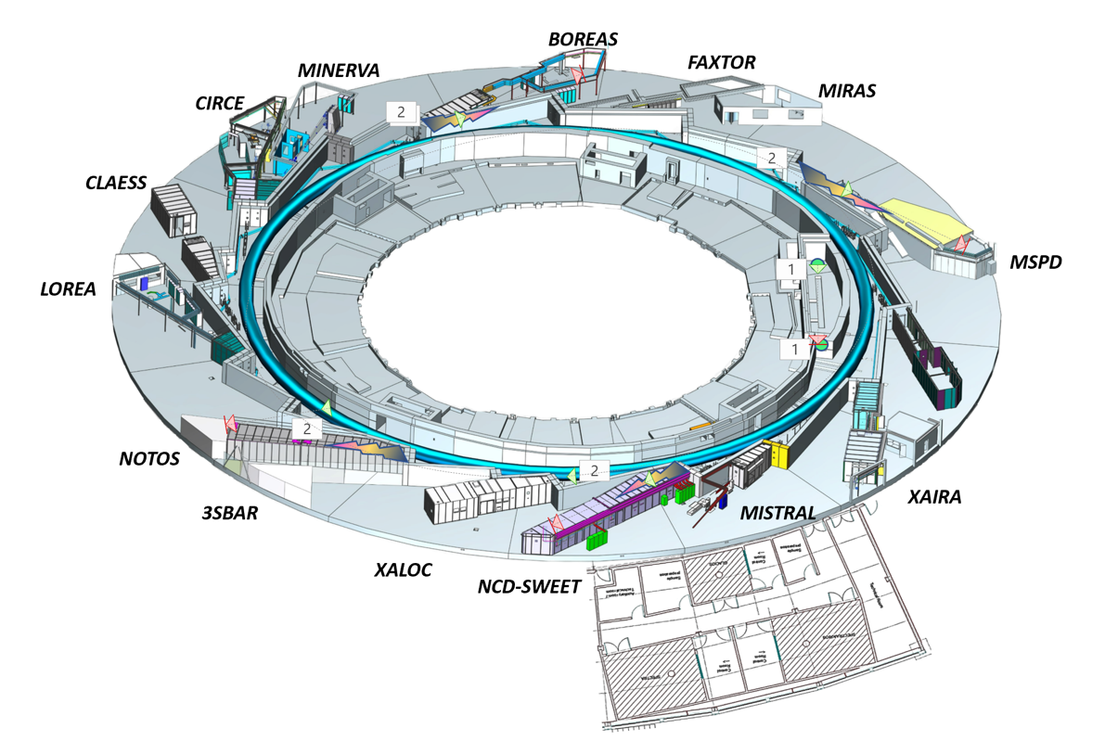
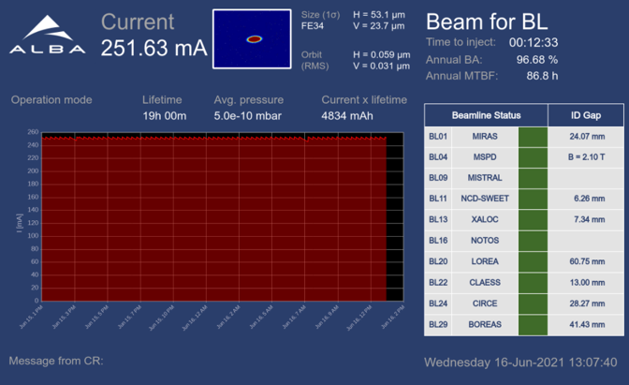
ALBA key parameters
e- Energy = 3 GeV
C = 268.8 m
Emittance = 4.4 nmrad
13 operating BLs
1 in construction
2 for acc. diagnostics
ALBA
JEMCA
Top-up operation
Joint Electron Microscope Center at ALBA
50% Funded through Catalan ERDF, and
50% co-funded by different partners

Slide 3



+ 3500 yearly user visits
+450 yearly experiments
+ 4500 national and + 4500 international users
+3800 publications
ALBA
key numbers
+3500 public experiments
<IF> >9
+700 industrial experiments
+1100
Proteins in PDB
+270 staff

Slide 4
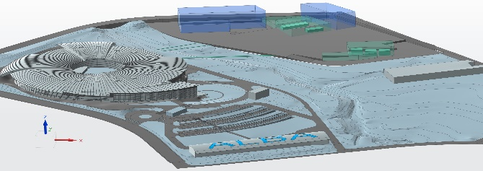
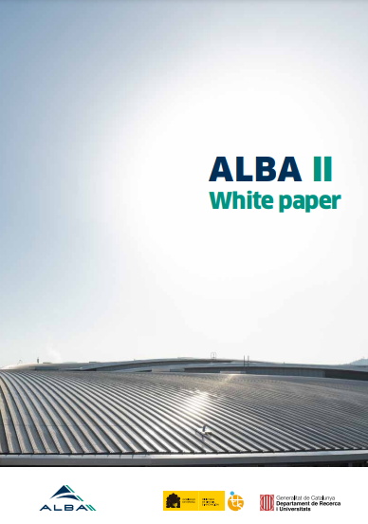
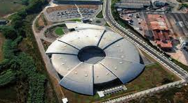
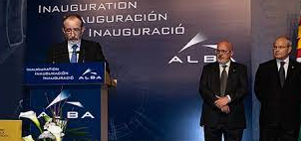
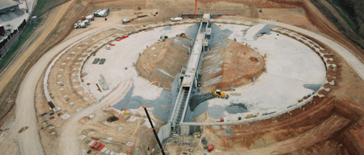
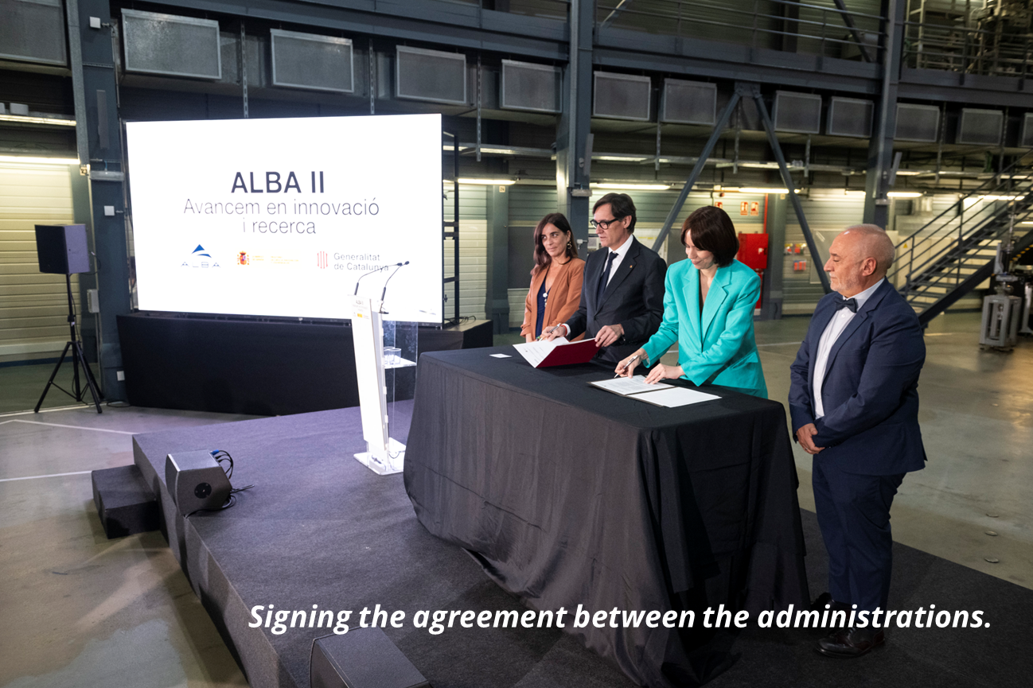
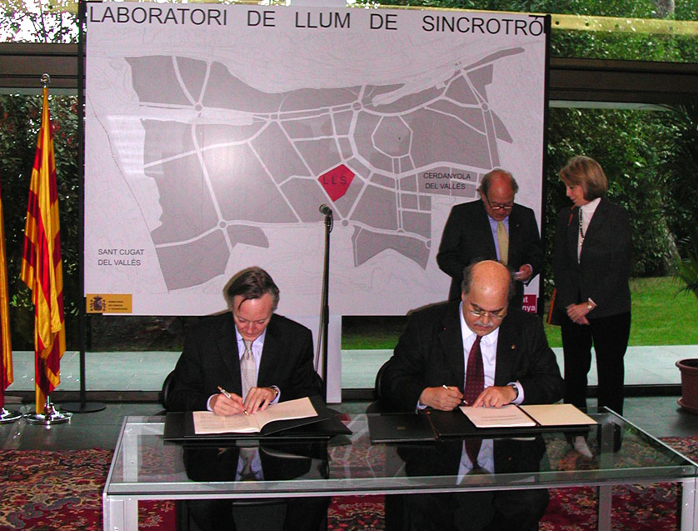
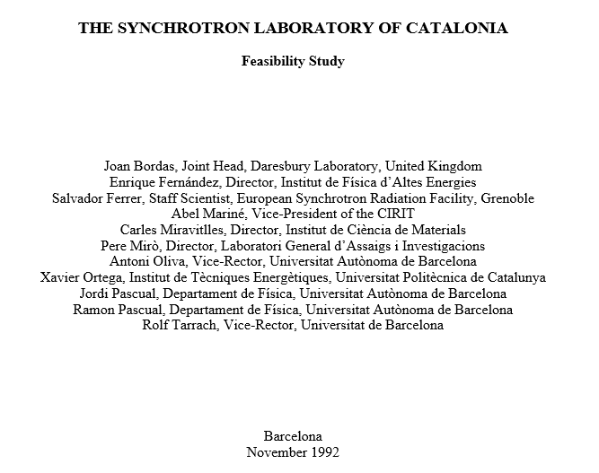
ALBA: past, present and future
2003 – Creation of CELLS Consortium (Spanish Government and regional Catalan Government).
2003 ALBA Approval
2012
Starting ALBA Operation
2020
Starting ALBA II design
2025
ALBA II Approval
2032
ALBA II Operation
9/9/2025
2006
Starting ALBA construction
1993 Initial concept

Slide 5
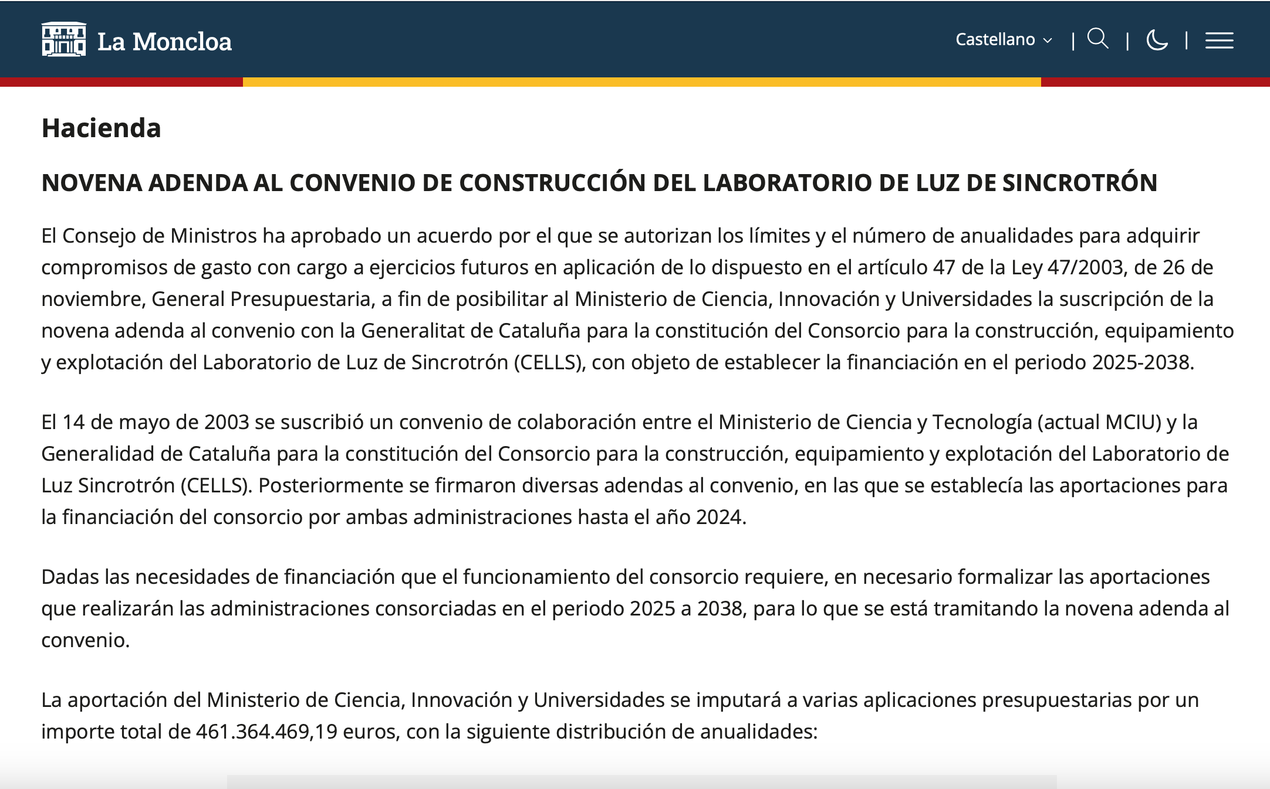
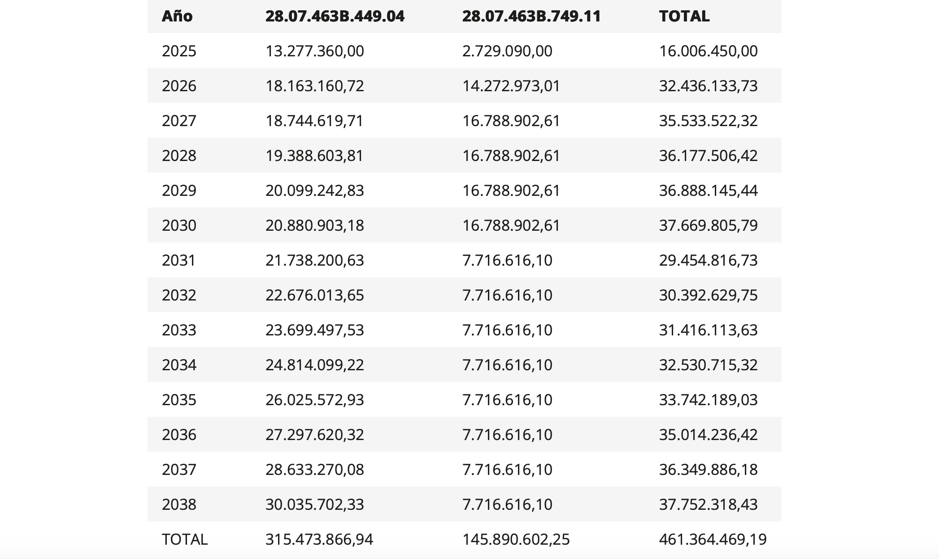
YESTERDAY!
October 21st, 2025

Slide 6
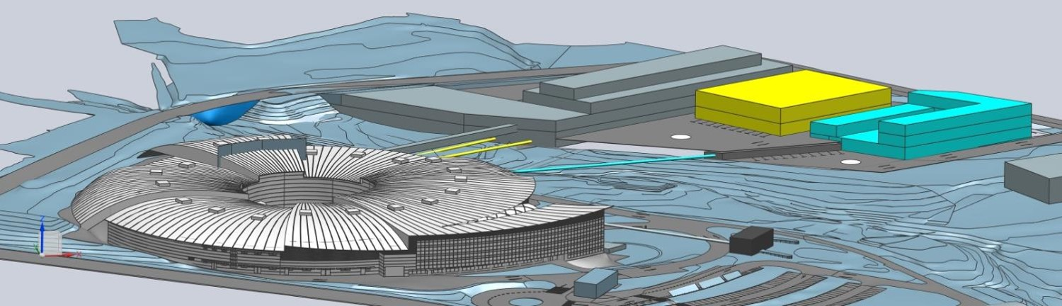
ALBA II Project
The upgrade ALBA II includes:
Upgrade of the storage ring.
Renovation of the existing beamlines.
Expansion of the infrastructure.
Construction of up to three new long beamlines.
Synergy to create a scientific and technological pole in the area.

Slide 7
Enjoy the Workshop!

