Slide 1
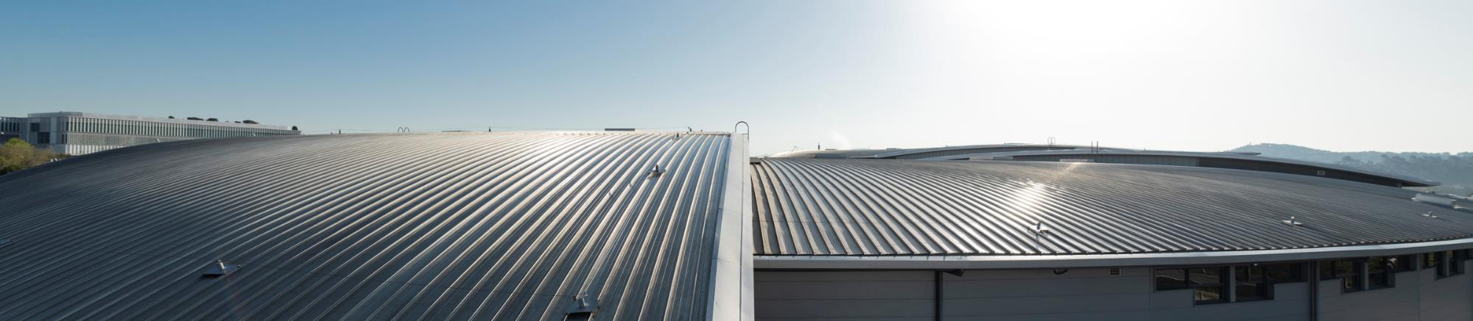
ESLS RF & HarmonLIP 2025

Slide 2
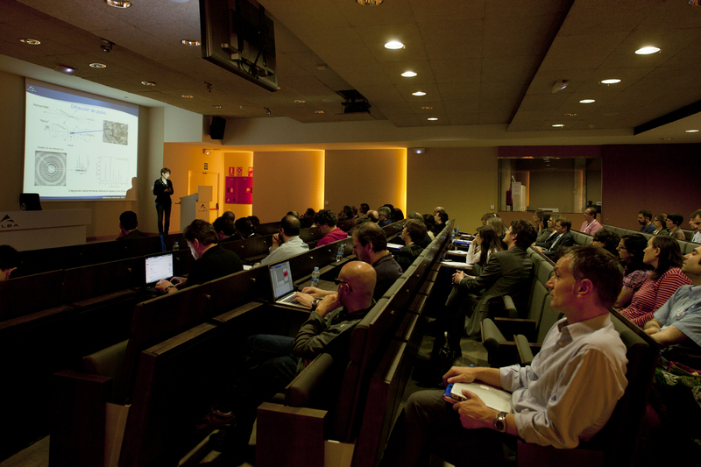
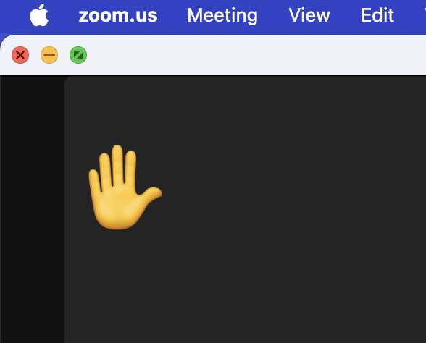
Introduction
ESLS RF workshop started in SRS, Daresbury in 1997 dedicated to RF operation issues and developments for RF systems.
HarmonLIP started in 2022 in MAX-IV, Lund dedicated to harmonic RF systems.
This edition combines both workshops in one single edition for the first time in hybrid mode: on site and remote.
Talk to microphone if on site and rise your hand for remote questions.
Let’s keep these workshops alive!
ALBA Maxwell auditorium
Remote participation

Slide 3
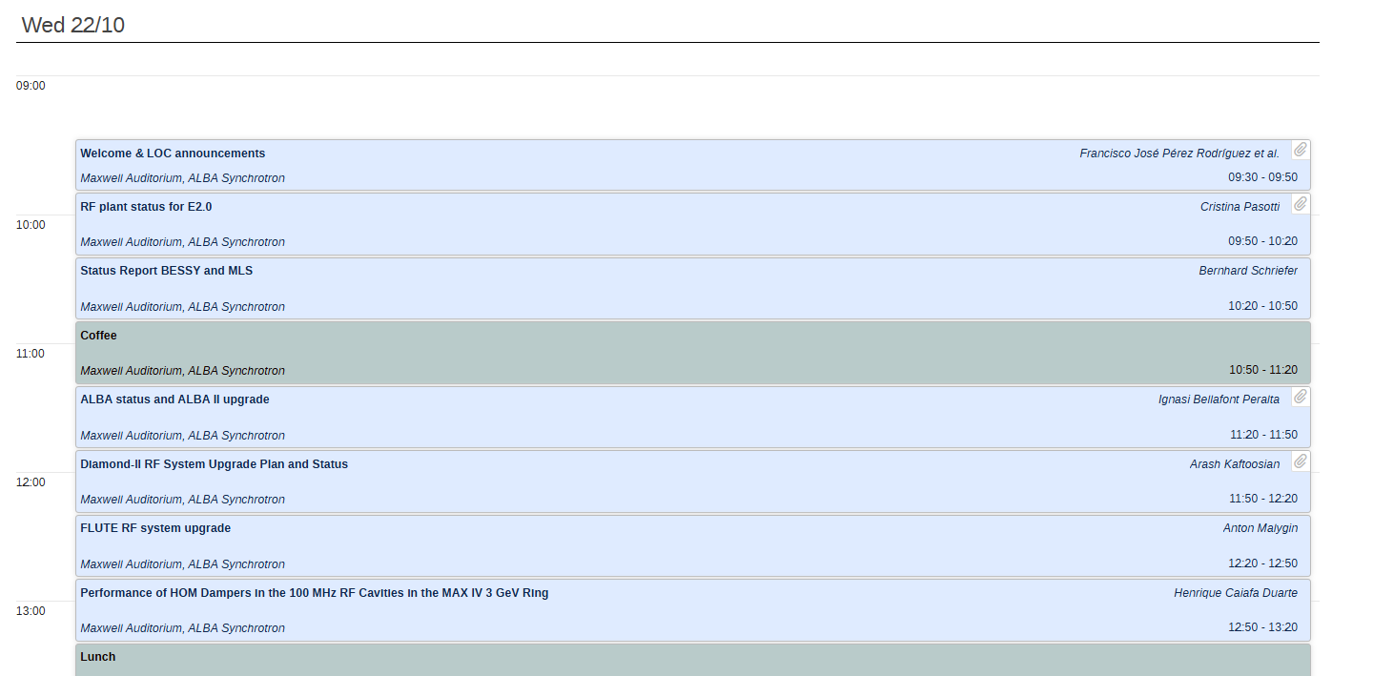
Timetable
Every speaker is provided with 30 min talk.
Chairman is asked to keep the time in control, with flexibility if needed.
Discussion are very welcome and is the goal of the workshop
Monday morning timetable

Slide 4
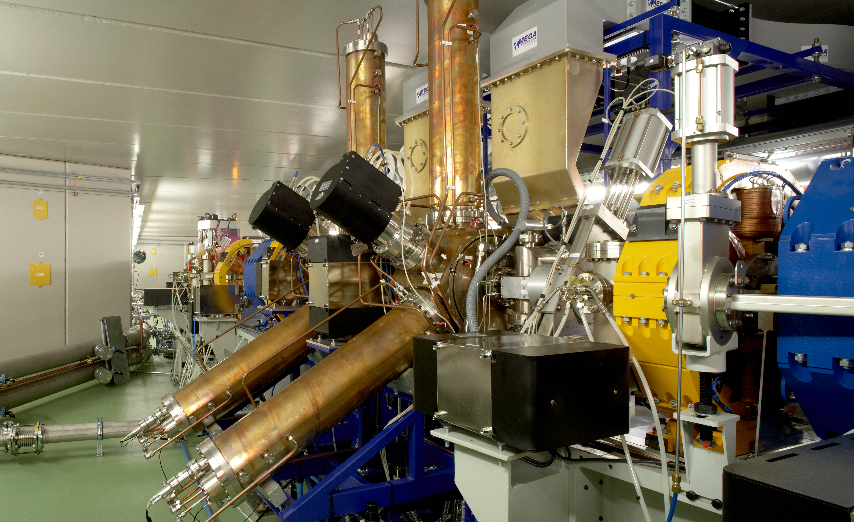
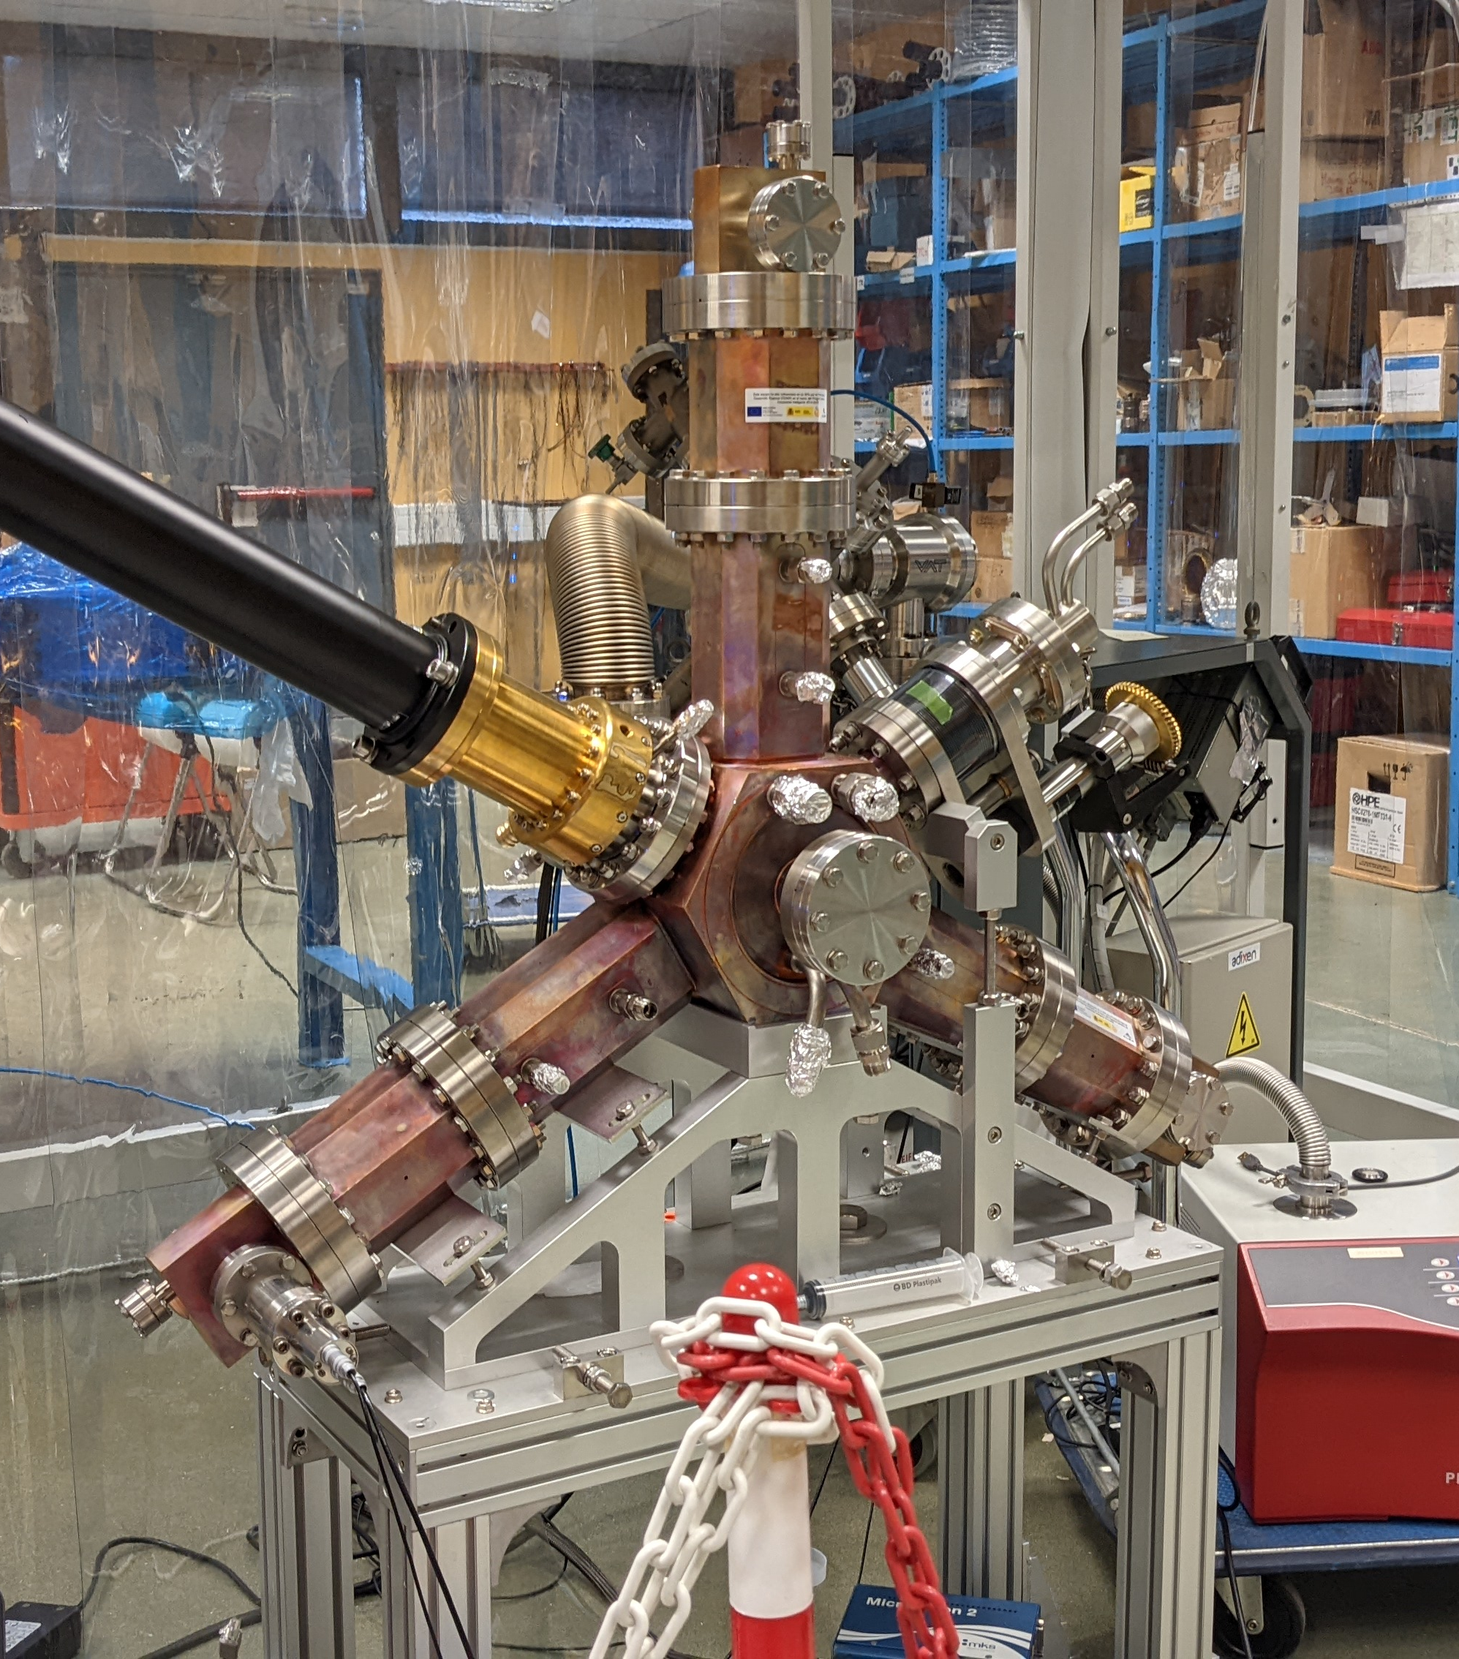
ALBA visit
Unfortunately ALBA is in operation.
3HC cavity prototype has not yet arrived.
The visit entails SA from catwalk and girder + cavity demonstrator.
Two groups for the visit will be made.
ALBA tunnel
Harmonic EU cavity

Slide 5
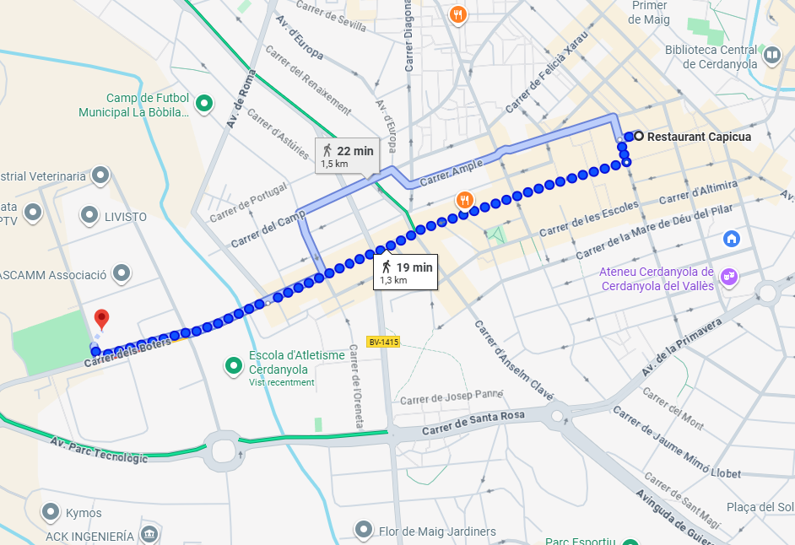
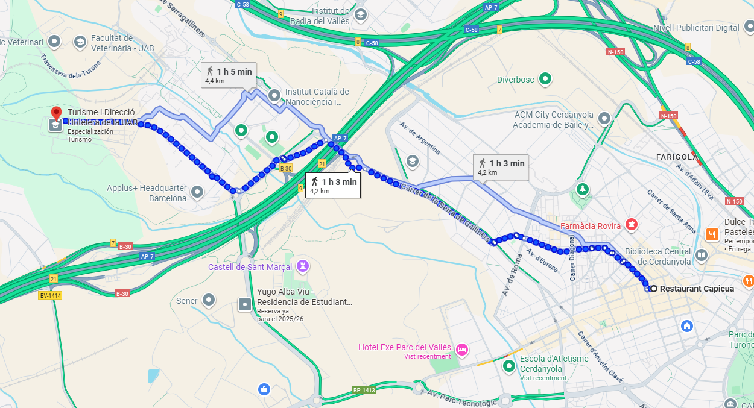
Dinner
Dinner takes place in “Restaurant Capicua”.
E3 or taxi from EXE Campus.
From EXE Valles
From EXE Campus

Slide 6
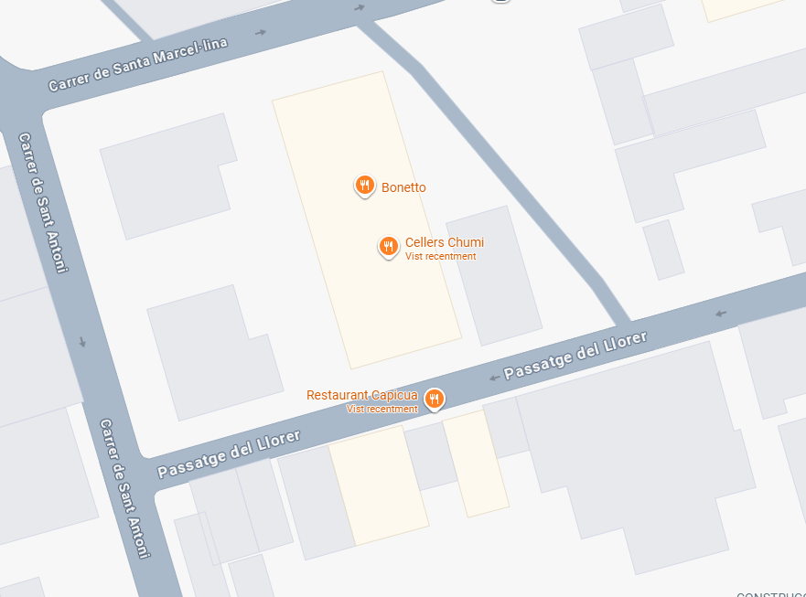
Pre-dinner activity
Meeting at 19h00 for cold drink in “Cellers Chumi” (not included in workshop budget).

