Slide 1
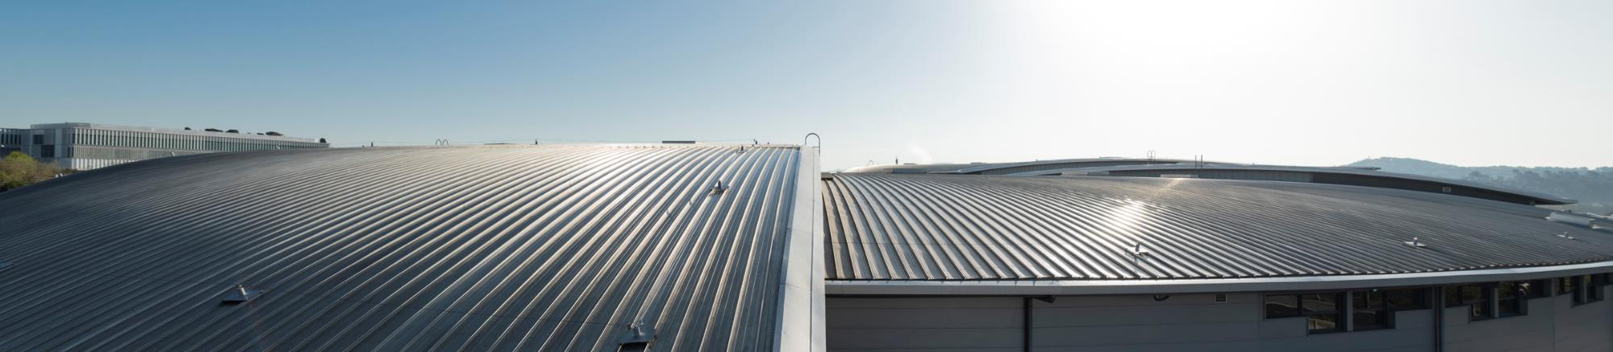
ALBA STATUS AND ALBA II UPGRADE
ESLS RF meeting 2025 – Cerdanyola del Vallès, Spain
22/10/2025
Ignasi Bellafont on behalf of the ALBA RF group

Slide 2
OUTLINE
Introduction: ALBA Light Source
Operation: Statistics and issues
New Developments: 3rd HC, 1.5 GHz SSPA, DLLRF, IC3, arc detectors, DRFF
ALBA II upgrade: General overview, stability studies, TBL, trip compensation system
Summary

Slide 3
OUTLINE
Introduction: ALBA Light Source
Operation: Statistics and issues
New Developments: 3rd HC, 1.5 GHz SSPA, DLLRF, IC3, arc detectors, DRFF
ALBA II upgrade: General overview, stability studies, TBL, trip compensation system
Summary

Slide 4
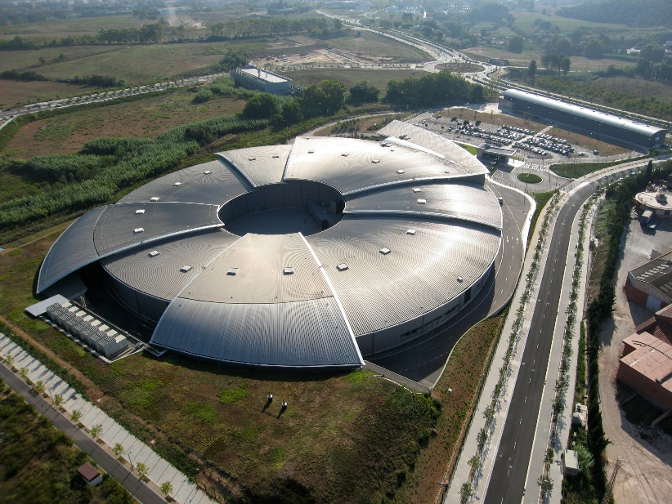
INTRODUCTION - ALBA
ALBA is a 3 GeV, 3rd generation synchrotron light source located in Barcelona, Spain
User operation since 2012
13 beamlines currently in operation, dedicated to life and material science, solid-state physics. 2 more under construction
Upgrade towards 4th generation planned for 2030, ALBA II
Parameter | Value | Unit
Energy | 3.0 | GeV
Beam current | 250 | mA
Circumference | 268.8 | m
Emittance | 4.5 | nm·rad
Loses per turn | 1.1 | MeV
Momentum compaction factor | 8.9·10⁻⁴

Slide 5
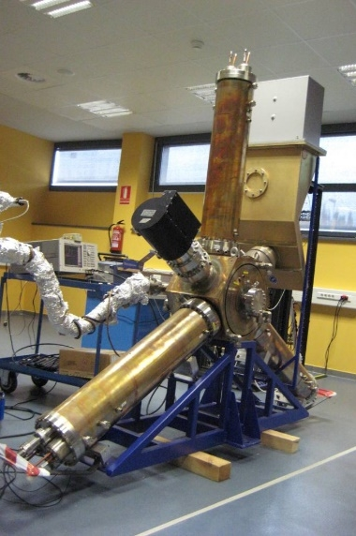
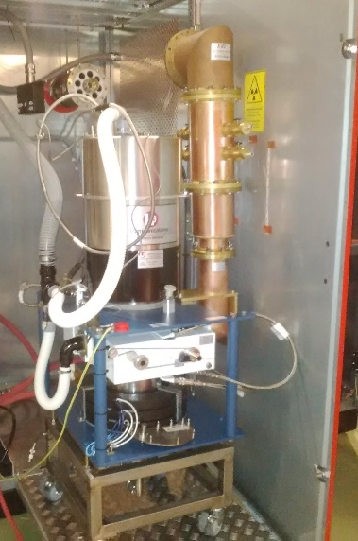
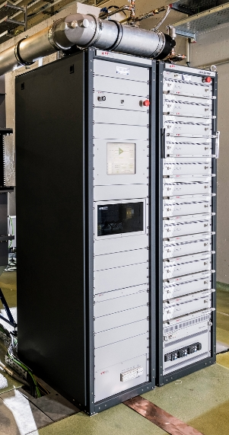
INTRODUCTION - ALBA
Booster: 1 x 5-cell PETRA type cavity, V_{max} 1.1 MV, fed with a 50 kW BTESA SSPA
Storage Ring: 6 x EU HOM damped NC cavity, V_{max} 600 kV, fed with 2 x 80 kW L3 IOT amplifiers
Parameter | Value | Unit
RF frequency | 500 | MHz
Number of cavities | 6
Total voltage | 3.0 | MV
Shunt impedance | 3.3·10⁶ | Ω
Unloaded quality factor | 29500
Coupling factor | 2.6
Total beam power | 275 | kW
EU HOM damped cavity
IOT transmitter
BO SSPA

Slide 6
OUTLINE
Introduction: ALBA Light Source
Operation: Statistics and issues
New Developments: 3rd HC, 1.5 GHz SSPA, DLLRF, IC3, arc detectors, DRFF
ALBA II upgrade: General overview, stability studies, TBL, trip compensation system
Summary

Slide 7
STATISTICS - RF Operation
Failures: beam losses due to RF
Failure = beam loss
RUN1 and RUN2, we could not condition the IOTs as usual
In RUN4, IOT conditioning was improved
*Data until 08/10/2025
2024 was a good year for the RF, with the lowest total machine downtime due to RF ever recorded
This year, 2025, we have experienced an extraordinary amount of failures, and consequently downtime, mostly due to:
IOT degradation following a deliberate change in settings, which was intended to improving power efficiency (explained with more details in the next slide)
Aging of several electronic components that monitor system parameters and trigger interlocks

Slide 8
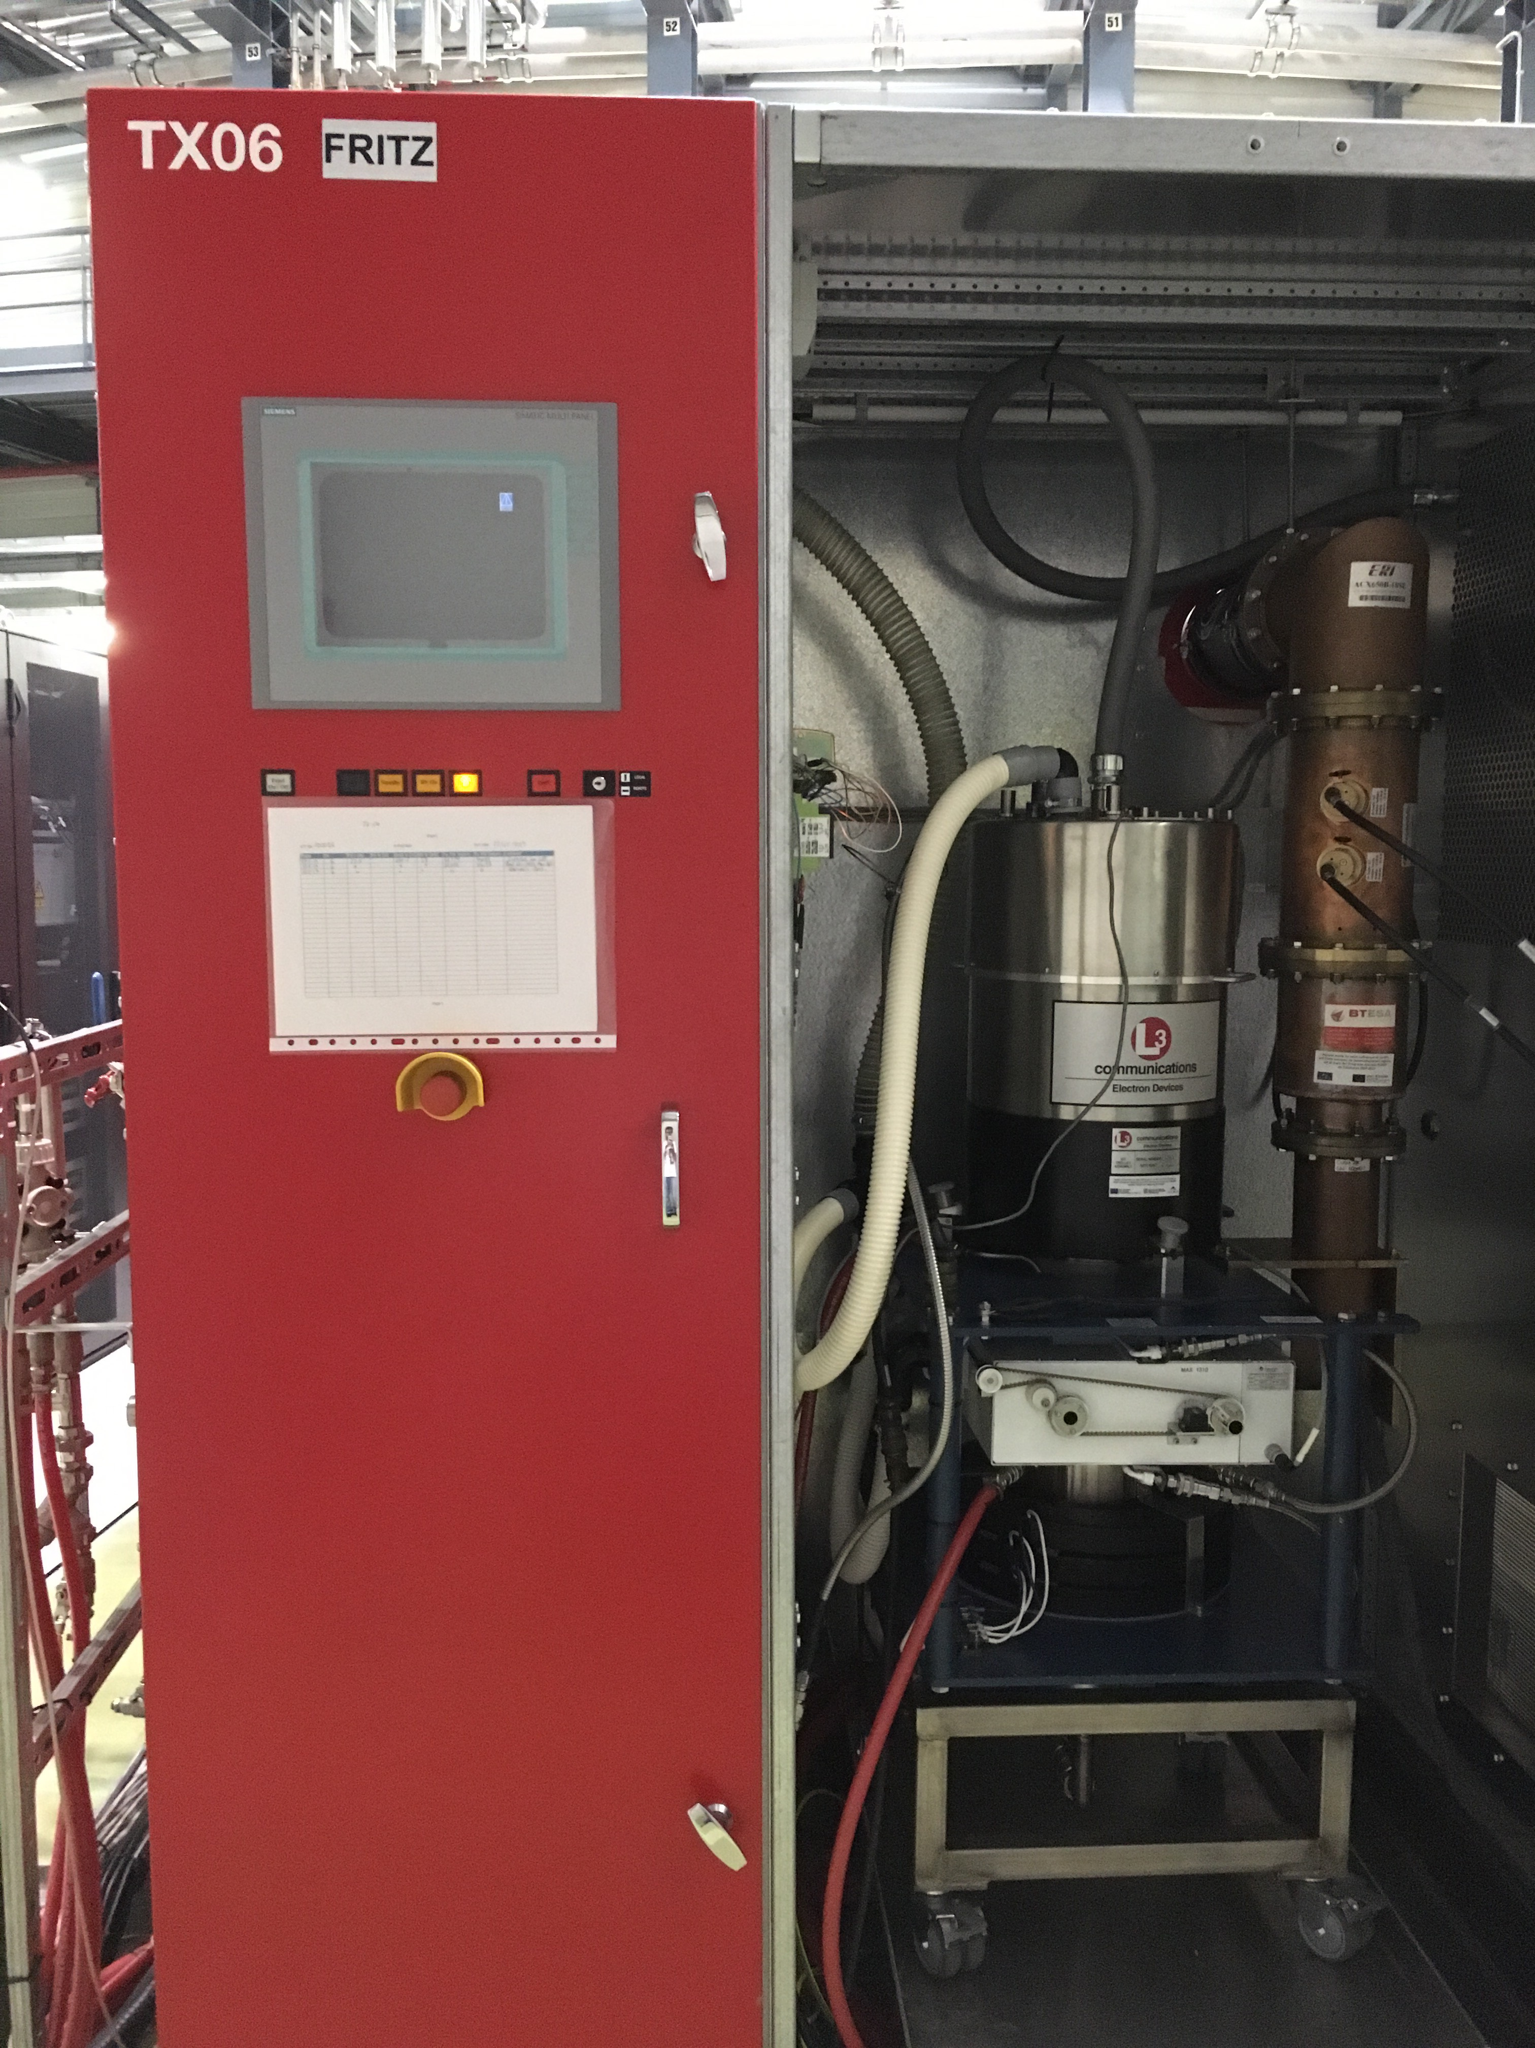
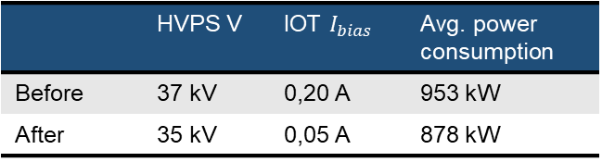
ISSUES - IOT body currents spike
In 2023 and 2024, the IOT operation settings were changed in order to lower the energy consumption and extend the IOT lifetime
 | HVPS V | IOT $I_{bias}$ | Avg. power consumption
Before | 37 kV | 0,20 A | 953 kW
After | 35 kV | 0,05 A | 878 kW
Final power savings were around 7.8 %
However, the low HVPS voltage and I_{bias} current drove the IOTs into a non-optimal region, worsening beam focus and increasing electron interception on internal surfaces, which triggers the body currents
The reduced beam power and internal loading at low operating points made the surface stabilization to be significantly slower, resulting in uncomplete conditionings between RUNs
L3 IOT at ALBA

Slide 9
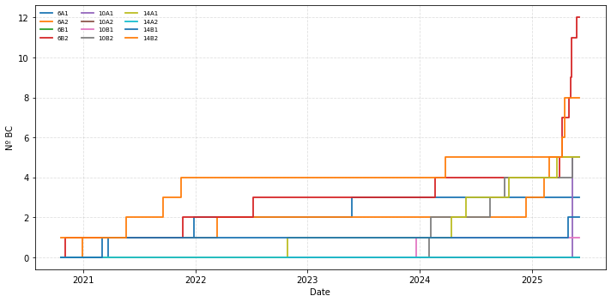
ISSUES - IOT body currents spike
In the figure below the increase in body currents can be observed after the change of settings
It was therefore decided to revert to the previous settings
IOTs are now being conditioned between runs with higher efficiency, and we are recovering their good performance
HVPS to 35 kV
I_{bias} to 0.05 A

Slide 10
STATISTICS - RF Operation
Incidences: RF plant interlocks, but no beam loss
Incidence = Plant interlock without beam loss
2024-2025
Mean time between incidences (MTBI) [h]
*Data until 08/10/2025
After improving the conditioning process and replacing faulty components, the MTBI returned to normal levels during the last RUN
In most RUNs, the majority of incidents are arcs, which can account for more than 70% of the total occurrences. Further analysis showed that over 90% of these arcs were fake. To address this, a new arc detection system has been acquired, capable of filtering out such false events

Slide 11
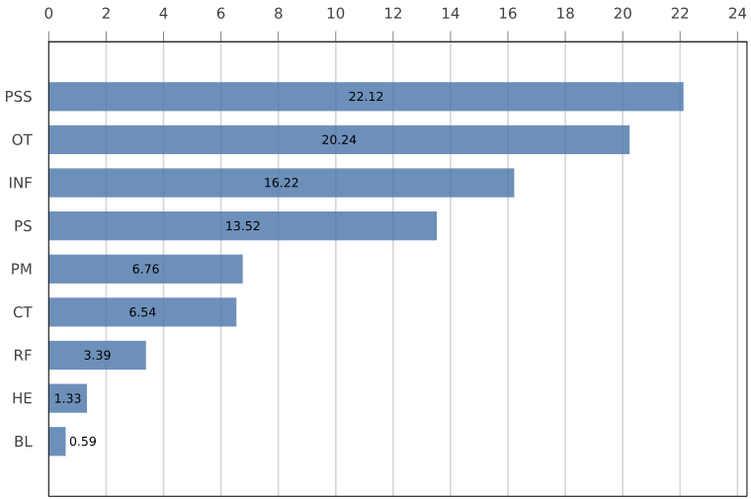
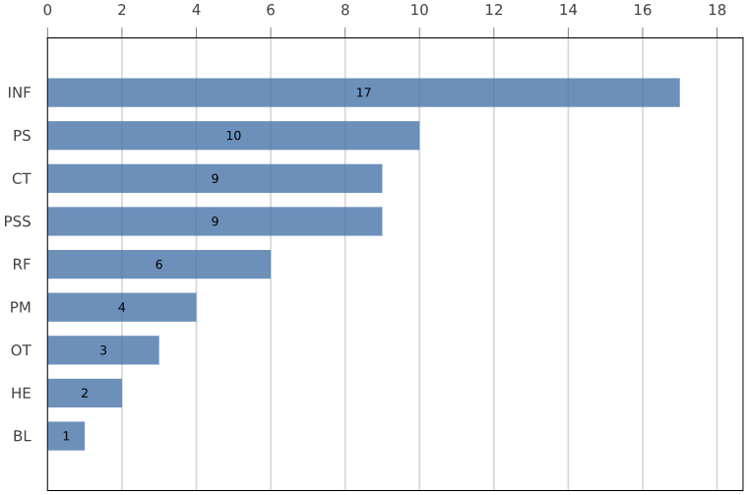
STATISTICS - RF Operation
No-beam events per subsystem in 2024
Downtime duration (90.7h)
Number of trips (61)
In 2024, only 3.7% (3.4 h) of the total downtime (90.7 h) was due to the RF
RF beam losses are usually easy to recover, taking less than 20 min to solve

Slide 12
OUTLINE
Introduction: ALBA Light Source
Operation: Statistics and issues
New Developments: 3rd HC, 1.5 GHz SSPA, DLLRF, IC3, arc detectors, DRFF
ALBA II upgrade: General overview, stability studies, TBL, trip compensation system
Summary

Slide 13
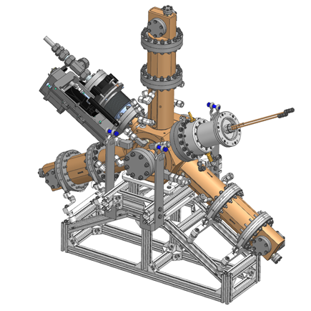
NEW DEVELOPMENTS - 3rd harmonic cavity
In order to increase the beam lifetime of its 4th generation upgrade, ALBA designed a new 3rd harmonic cavity, based on the EU HOM Damped 500 MHz cavity
A prototype was tested during 2023-2025 at BESSY II, in a collaboration of three institutions (ALBA, HZB and DESSY)
Manufacturing of the definitive cavities is ongoing (5 cavities). Contract was awarded to RI (Research Instruments)
Cavities 1 and 2 tuned. Final vacuum testing ongoing. Delivery expected for November 2025
Cavities 3, 4 and 5 ready to tune. Delivery expected for January 2026
3HC model
P. Solans et al., DOI: 10.18429/JACoW-IPAC25-WEBD2
Resonant frequency and Q₀ vs plunger position before final brazing

Slide 14
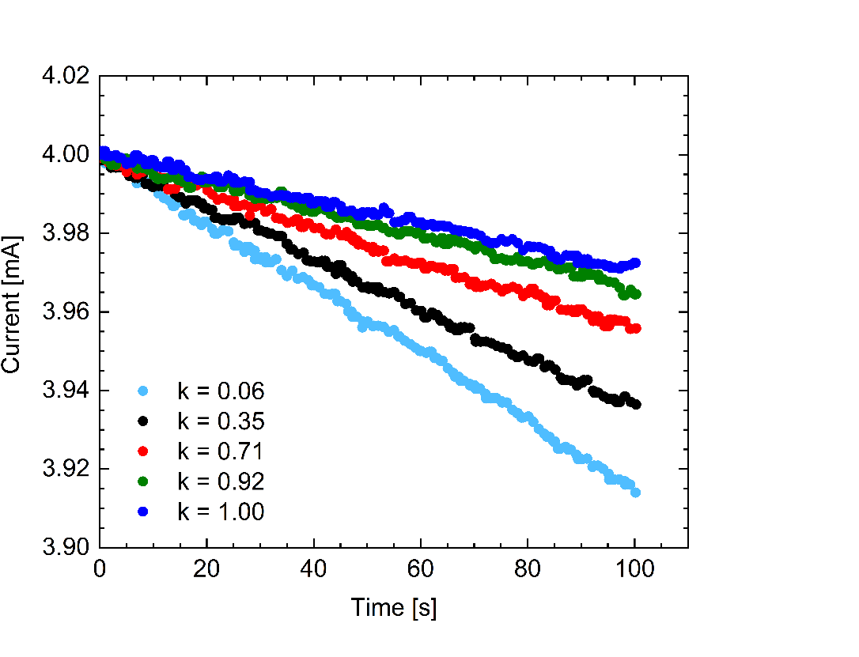
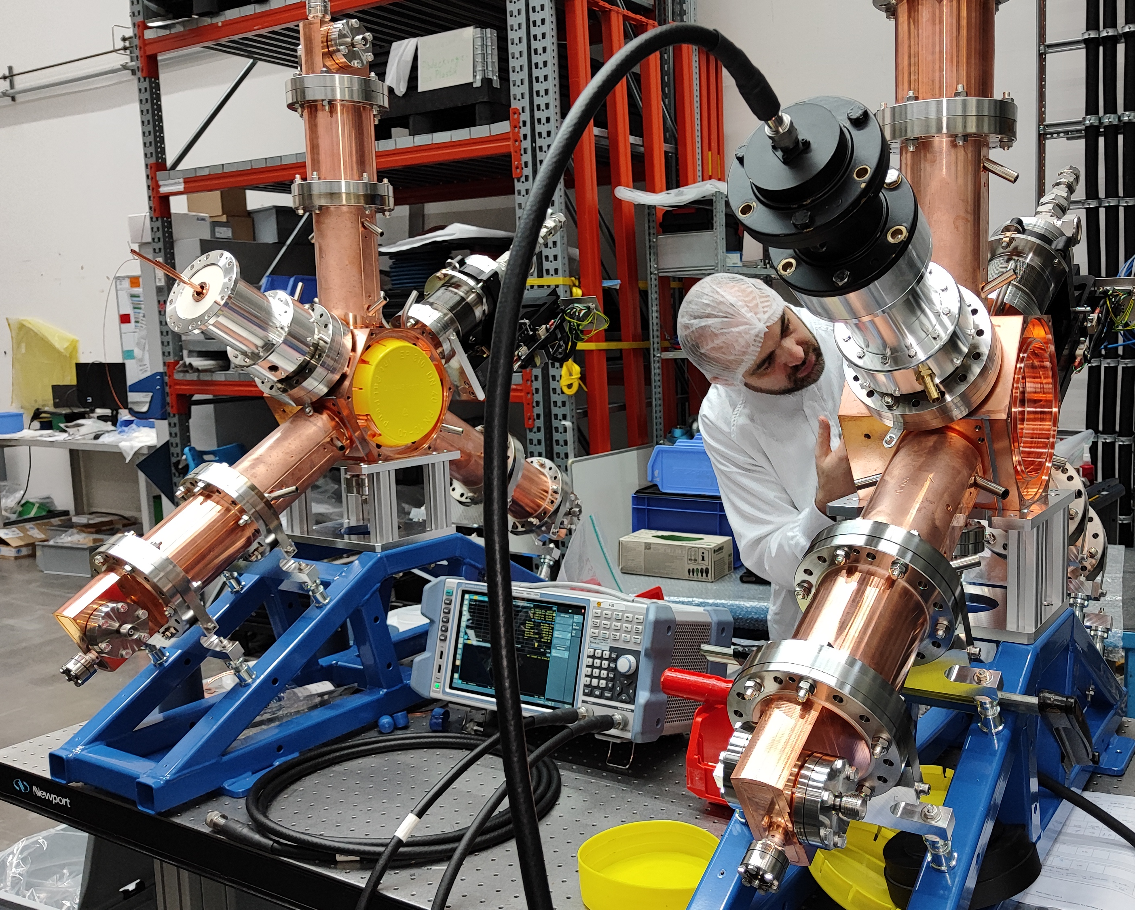
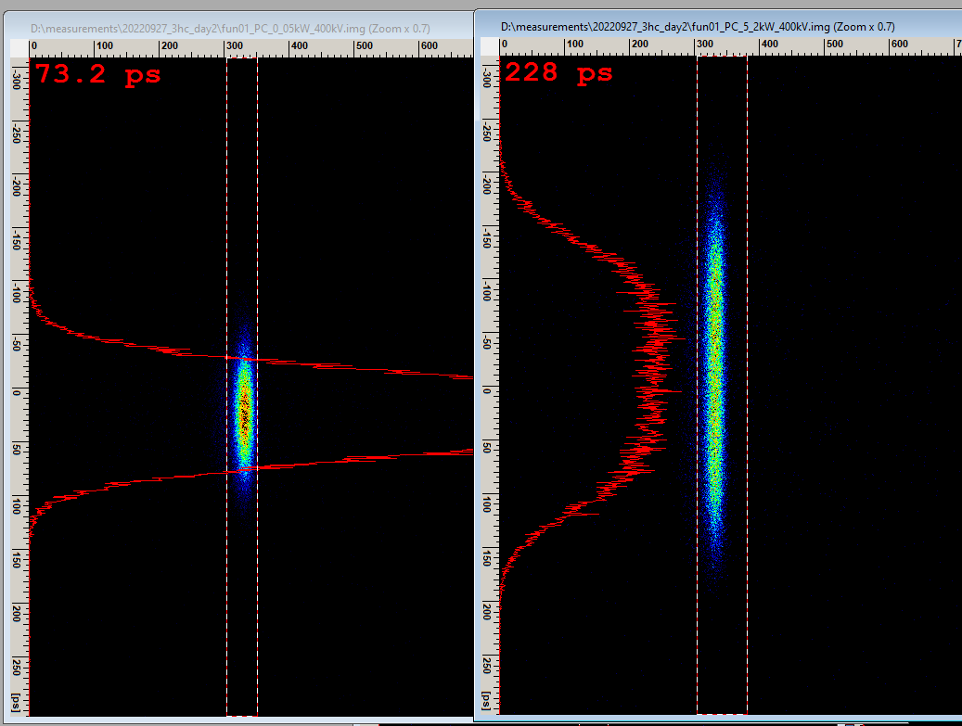
NEW DEVELOPMENTS - 3rd harmonic cavity
1.5 GHz
Main mode
Single bunch
τ_{T} =4.31 h
90% reduction
99% reduction
τ_{T} =3.62 h
τ_{T} =2.66 h
80% reduction
94% reduction
τ_{T} =1.79 h
τ_{T} =1.36 h
Cavity voltage spectrum before and after HOM damping activation
Lifetime measurements with different ratios of optimal 3HC voltage at BESSY II
3HC Research Instruments factory test
ALBA-HZB-DESY 3HC commissioning

Slide 15
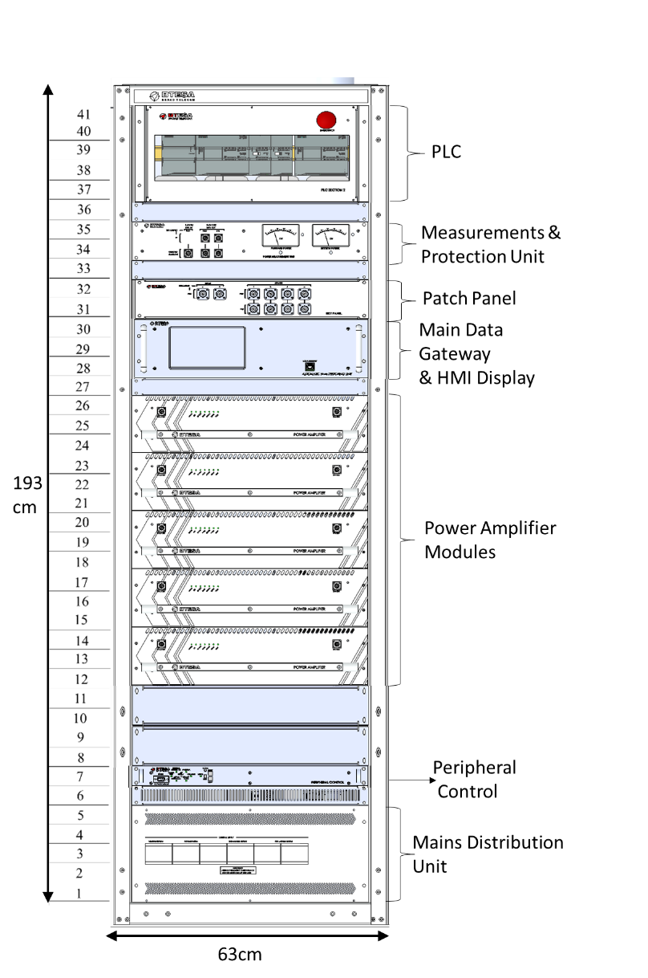
NEW DEVELOPMENTS – 3rd Harmonic SSPA
Call for tender (CFT) was published at beginning 2024 for 4 x 1.5 GHz 20 kW SSPA, to fed the active 3HC
Contract awarded to BTESA
Each amplifier rack will consist of six modules
Assembly of the prototype for the first amplifier module is already in progress
The Site Acceptance Test (SAT) is scheduled for September 2026
Parameter per amplifier module | Value | Unit
P1dB | 67 | dBm
Module Gain | 80.4 | dB
BW | 5 | MHz
SNR | 72 | dB
Water Flow | 9.55 | l/min
Early-stage schematic view of the SSPA from the CFT
15

Slide 16

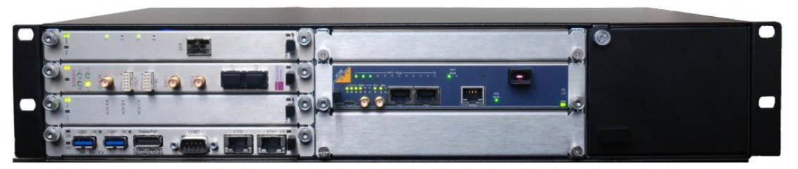
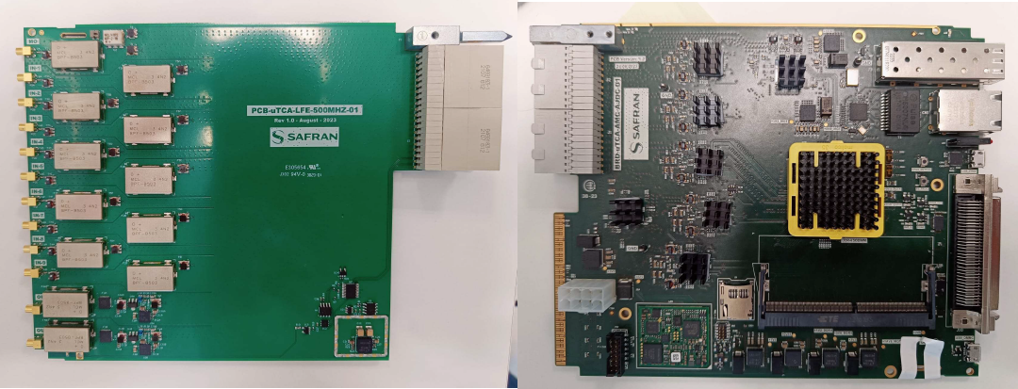
NEW DEVELOPMENTS - 500 MHz DLRFF
SAFRAN produced and delivered custom made design of the fundamental LLRF system. It includes:
uTCA platform NATIVE-R2 Chassis
SoC Zynq UltraScale+ FPGA from Xilinx
20x ADC: 250 MSPS and 16 bit (PIN, MAX: 10 dBm)
4x DAC: 2.5 GSPS and 16 bit (POUT, MAX: 8 dBm )
64x GPIO
2 GB DDR4 memory for postmortem analysis: 32 bits @ 160 MHz
No down/up conversion: Direct sampling
External reference: Master oscillator
MO
uTCA chassis
RTM Board (Analogue)
AMC Board (Digital)
S. Shaker et al., doi:10.18429/JACoW-IPAC25-THPS133

Slide 17
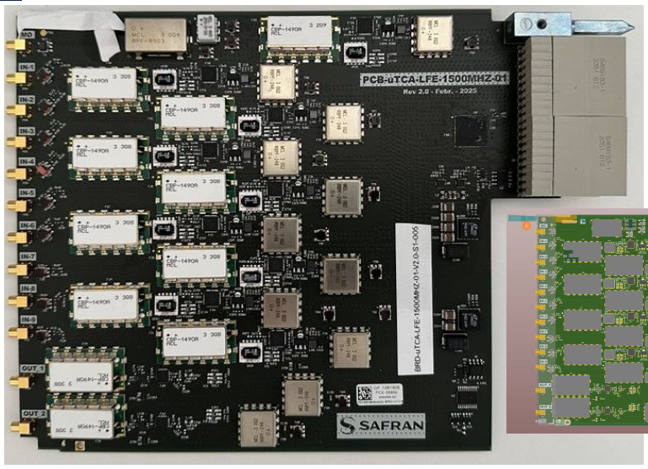
NEW DEVELOPMENTS - 1500 MHz DLRFF
SAFRAN produced and delivered custom made design of the harmonic LLRF system. It includes:
uTCA platform NATIVE-R2 Chassis
SoC Zynq UltraScale+ FPGA from Xilinx
20x ADC: 250 MSPS and 16 bit (PIN, MAX: 10 dBm)
4x DAC: 2.5 GSPS and 16 bit (POUT, MAX: 8 dBm )
64x GPIO
2 GB DDR4 memory for postmortem analysis: 32 bits @ 160 MHz
Down/up conversion: IF = 250 MHz
External reference: Master oscillator
MO
uTCA chassis
RTM Board (Analogue)
AMC Board (Digital)
S. Shaker et al., doi:10.18429/JACoW-IPAC25-THPS133

Slide 18
NEW DEVELOPMENTS - 3rd harmonic system
Complete harmonic system installation foreseen for ALBA in 2026
We are here

Slide 19
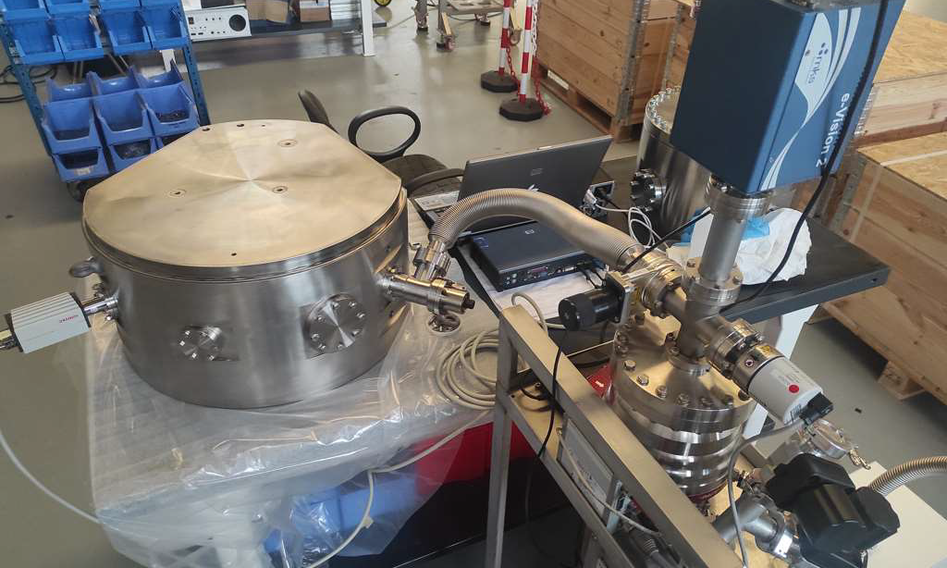
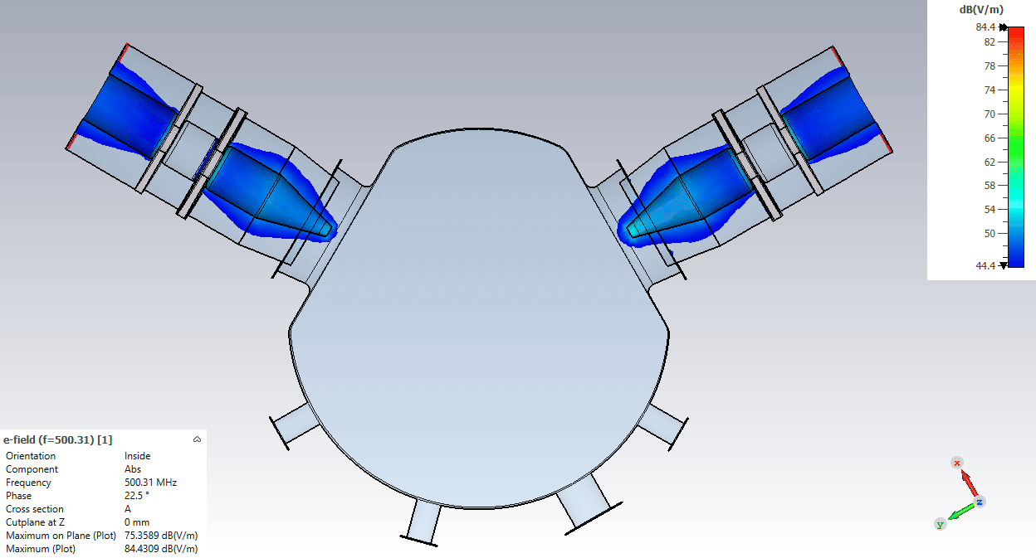
NEW DEVELOPMENTS – IC3 Conditioning Cavity
IC3: Input Coupler Conditioning Cavity. Designed to condition 2 input couplers at the same time. This need was identified after several IC failed during these 13 years of operation
Pillbox-like cavity with dual coupler ports
Corners chamfered to maximize coupling (minimize losses)
Maximum design power is 160 kW CW
Manufactured by AWGE
Manufactured in stainless steel with a copper layer grown by electrodeposition (cost ½ or even 1/3 than traditional manufacturing)
IC3 cavity being tested for leaks
Simulation of RF power entering the cavity
19

Slide 20
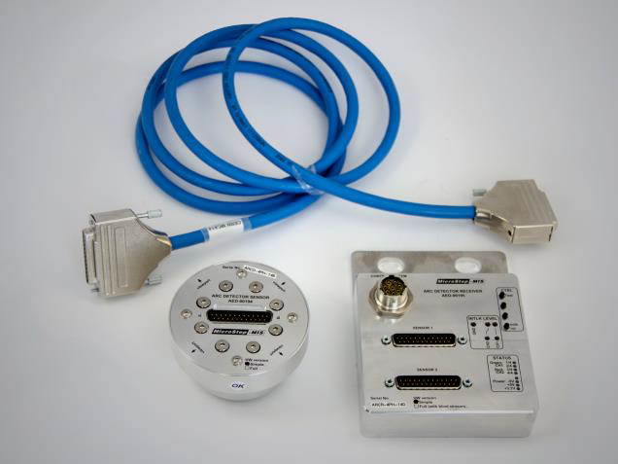
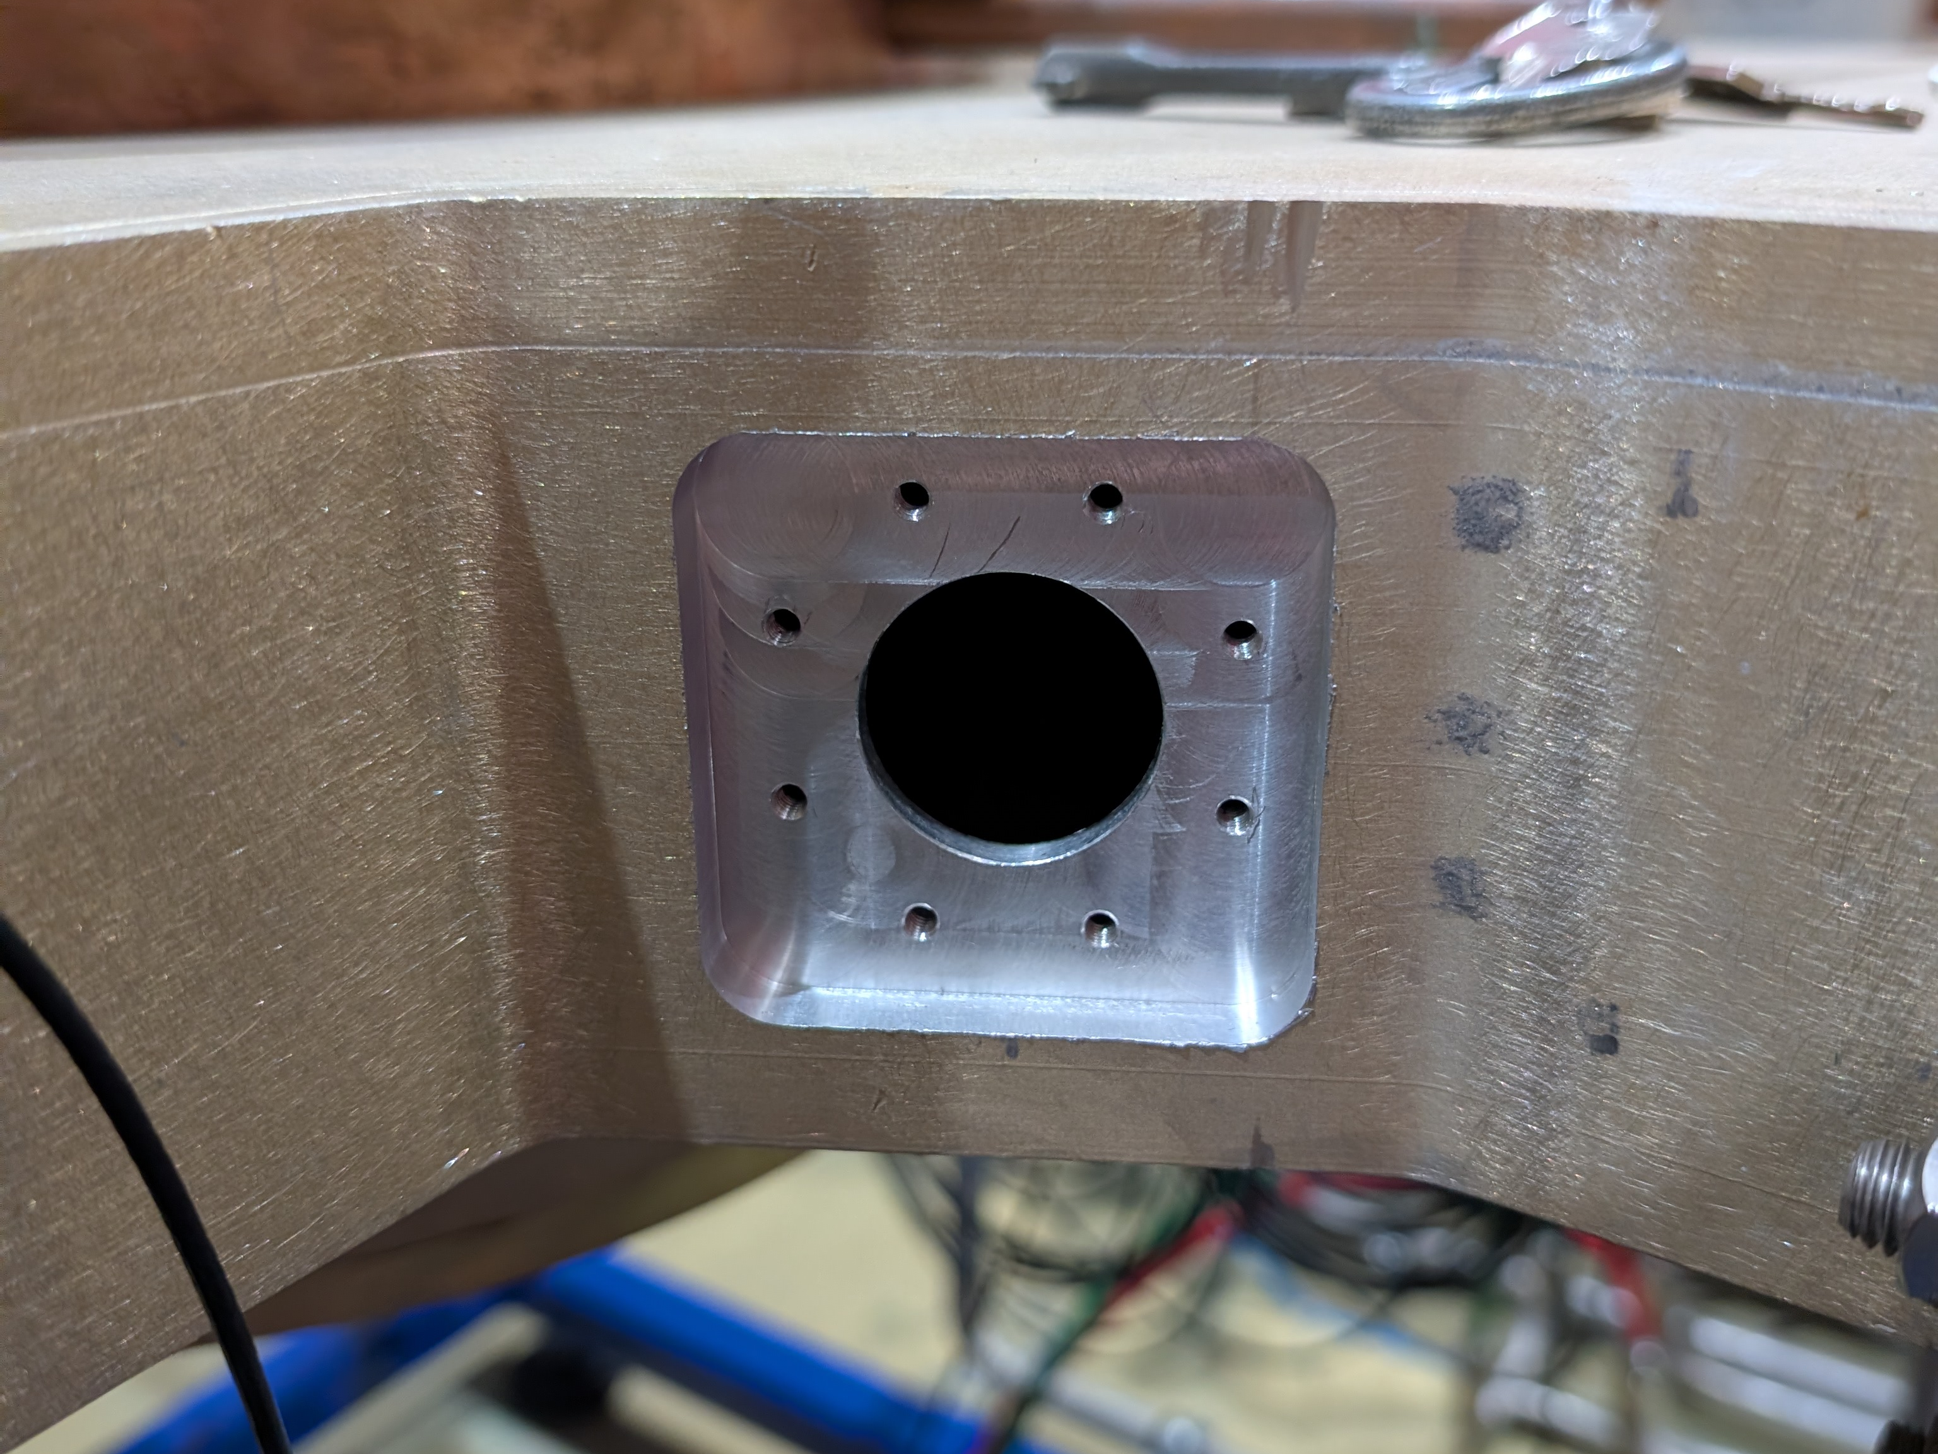
NEW DEVELOPMENTS- Arc Detectors
In ALBA, we got around 4-7 arcs per month
It was discovered that around 90% of them were fake arcs, caused by scintillation, electrical noise, etc.
In order to filter out the fake ones, a new arc detector system, designed by CERN, was acquired from MicroStep-MIS, which has 4 photodiodes and an algorithm to differentiate fake from real arcs. It has also been used in the ESRF, with positive results
Installed in one plant as a test. No more arcing in waveguide components
Arcs still present in the cavity at voltage above 500 kV when there is beam, so we believe they are real
Fake arcs detected when the beam is lost, in all the detectors placed inside the tunnel, but in this case it does not matter since the beam is already lost
Main components of the new arc detector system
Hole in the circulator drilled to install the new arc detector

Slide 21
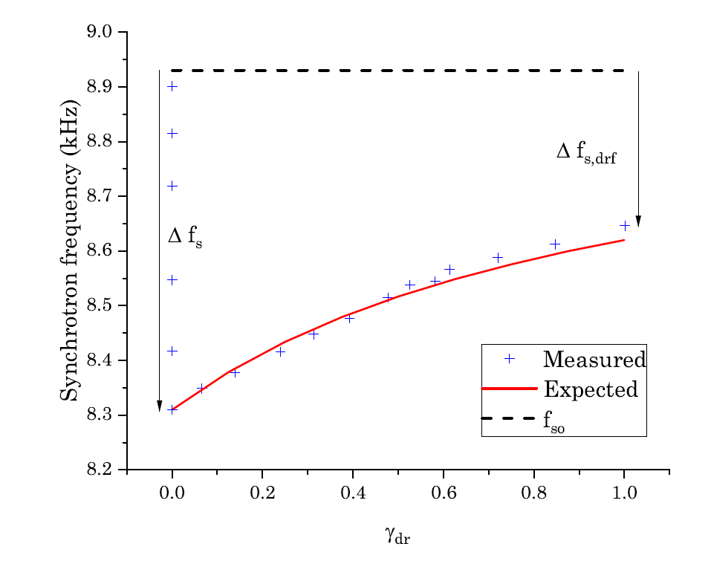
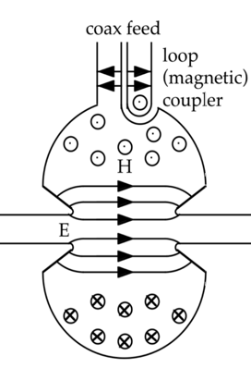



NEW DEVELOPMENTS - DRFF
We are studying the use of a Direct RF Feedback (DRFF) to improve the bunch lengthening performance of the harmonic system in ALBA II, by virtually lowering the R/Q ratio and then mitigate the Periodic Transient Beam Loading (PTBL) instability
We have already implemented and tested a digital DRFF in the main cavities achieving virtual R/Q reductions [1]
We plan to implement a DRFF module in elegant, the simulation software we use to simulate and predict the double RF system stability, to predict its efficacy in our upgrade
Voltage setting
$${\tilde{I}}_{g}={\tilde{I}}_{PI}+{\tilde{I}}_{FB}$$
+
$${\tilde{I}}_{PI}$$
PI loop
+
RF amplifier
RF power
-
Error
+
$${\tilde{I}}_{FB}=G_{fb}{\tilde{V}}_{c}$$
(G is complex)
Direct RF Feedback (DRFF)
Cavity voltage reading
1. P. Solans et al., DOI: 10.18429/JACoW-IPAC2024-WEPR76
Feedback and trip compensation diagram

Slide 22
OUTLINE
Introduction: ALBA Light Source
Operation: Statistics and issues
New Developments: 3rd HC, 1.5 GHz SSPA, DLLRF, IC3, arc detectors, DRFF
ALBA II upgrade: General overview, stability studies, TBL, trip compensation system
Summary

Slide 23
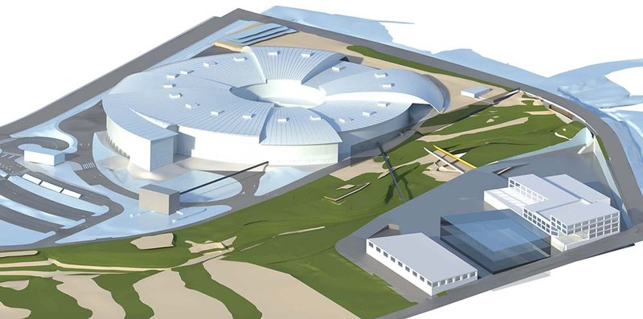
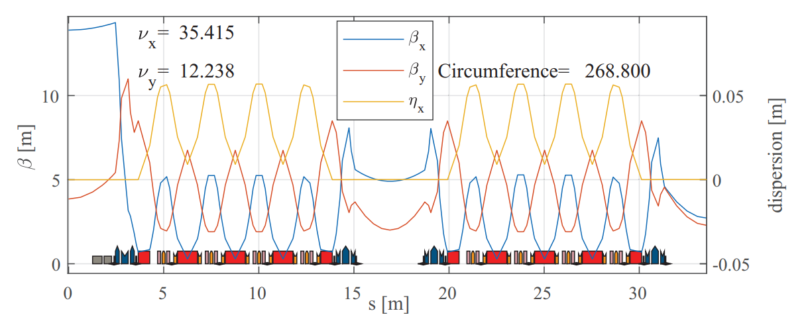
ALBA II – General overview
ALBA II will be the upgrade of ALBA, aimed at having a much lower beam emittance (around 23 times lower)
The storage ring will be replaced, while the booster ring and LINAC will remain unchanged.
Installation and commissioning planed for 2030, operation expected in 2032
ALBA II facilities
Parameter - vA2L005D | Value | Unit
Energy | 3.0 | GeV
Beam current | 300 | mA
Circumference | 268.8 | m
Emittance | 200.5 | pm·rad
Loses per turn | 1.07 | MeV
Momentum compaction factor | 1.0·10⁻⁴
ALBA II optical functions for half a quadrant of the SR
F. Pérez et al., DOI: 10.18429/JACoW-IPAC2024-TUPG02

Slide 24
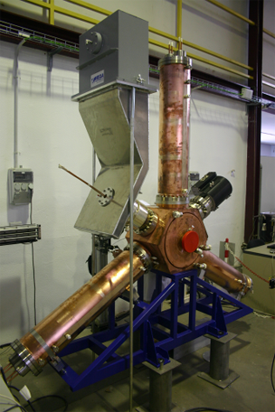
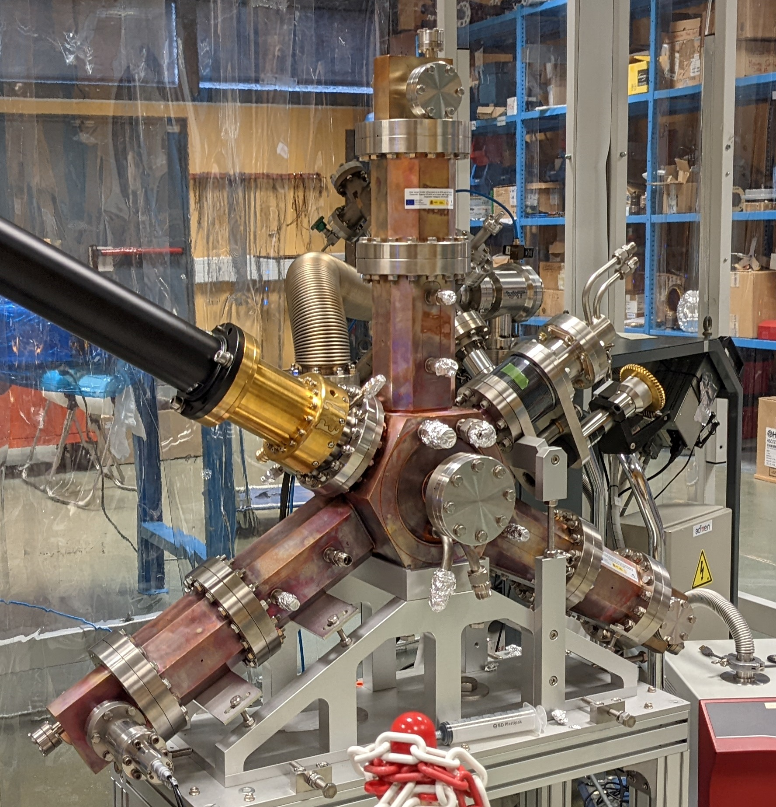
ALBA II – General RF overview
Booster RF: Same as in ALBA, 1 x 5-cell PETRA type cavity, fed with a 50 kW BTESA SSPA
Storage Ring: 6 x EU HOM damped NC cavity + 4 x New EU HOM damped NC 3H cavity
Parameter | Value | Unit
Main RF voltage | 2.4 | MV
Harmonic RF voltage | 680 | kV
Number of cavities (MC / HC) | 6 / 4
Main cavity voltage | 400 | kV
Harmonic cavity voltage | 170 | kV
Main RF frequency | 500 | MHz
Harmonic RF frequency | 1500 | MHz
Bunch lengthening HFP | 3.9
Bunch length HFP | 31.6 | ps
4x Harmonic NC active RF cavity
170 kV - 1500 MHz
ALBA II RF system vA2L005D
6x Main NC RF cavity
400 kV - 500 MHz

Slide 25
ALBA II – General RF overview
vA2L005D

Slide 26
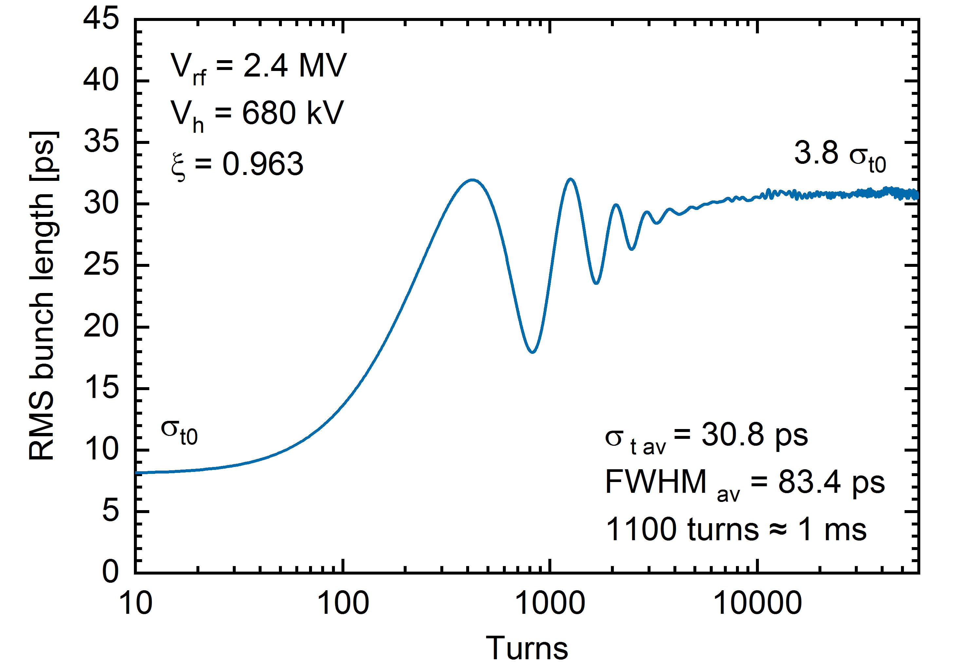
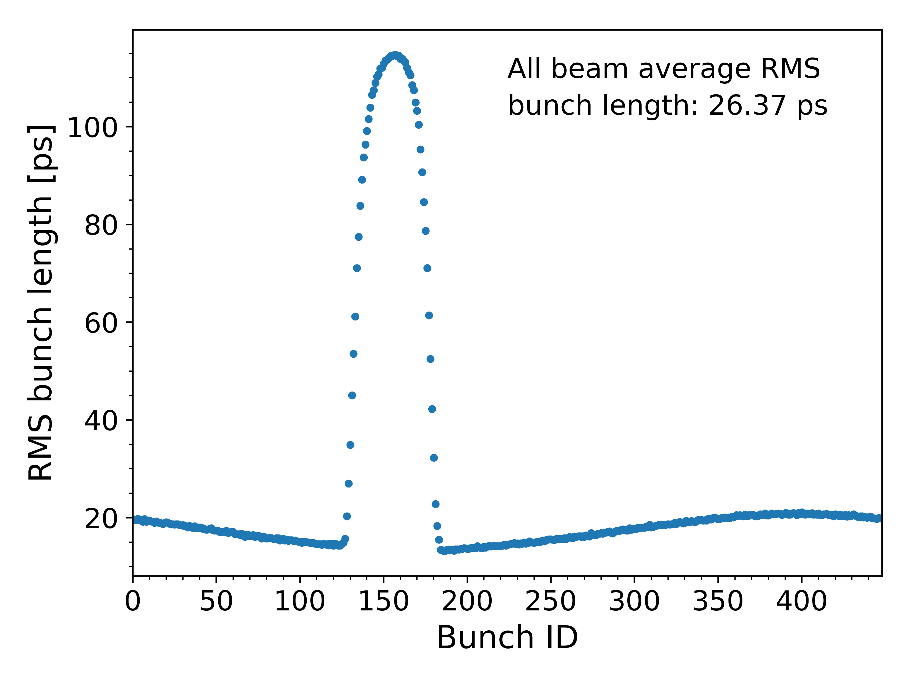
ALBA II – Stability studies
To evaluate the system stability, several particle tracking simulations have been carried out using elegant
The simulations include the RF cavities’ impedance, synchrotron radiation damping, a PI control loop, a linear transformation matrix and quantum fluctuations. At this stage, no additional impedance sources are considered
Each simulation tracks 10,000 particles per bunch over 200,000 turns, corresponding to approximately 0.2 s of real time.
The simulation, the bunch shape and phase, cavity voltage, beam energy, and emittances are monitored and used to assess the overall system stability
The simulations predict the onset of PTBL instabilities for flatness factors above ξ = 0.963. The HC voltage is therefore limited to 680 kV, with 705 kV corresponding to the flat potential (FP) condition.
Simulation of the bunch length convergence after the HCs are activated
PTBL instabilities example, using FP settings and HFP

Slide 27
ALBA II – General RF overview
With a homogeneous filling pattern (HFP), and the 4 x 3HCs, we expect to reach a bunch lengthening factor of 3.9, increasing the default 8.08 ps length to approximately 31.6 ps
Under these conditions, the Touschek lifetime would be then raised from 1.7 h (vA2L006A, assuming 50% emittance coupling) to about 6.6 h
By implementing DRFF, this lifetime enhancement factor could be further improved from 3.9 to close to 4.9, which corresponds to the theoretical maximum

Slide 28
ALBA II – Transient beam loading studies
A 1.8% gap in the bunch train is foreseen for ALBA II for ion trapping mitigation. We are planning to use the active capabilities of our 3HC to compensate for the related transient beam loading (TBL) and mitigate the loss of bunch lengthening attributed to the TBL
More information will be provided in the talk “Harmonic EU cavity commissioning operation and TBL compensation” of the HarmonLIP workshop
Flat potential HFP
PTBL threshold (680 kV without DRFF)
x 1.8
No HC HFP
ALBA II baseline (1.8%)

Slide 29




ALBA II – Trip compensation system
Good beam availability is an essential goal for ALBA II, as it is for ALBA
The RF system of ALBA currently has around 10 RF interlocks per month. So 10 potential beam losses due to RF
When there is a sudden loss of 400 kV on RF voltage, combined with additional losses from an unexpected parasitic cavity, the beam transitions from one equilibrium phase to another. The resulting oscillation reduces the total voltage due to increased beam loading, which, at sufficiently high currents, can lead to beam loss
At ALBA, we have a dedicated Trip Compensation System (TCS) which raises automatically the RF power and phase delivered to the cavities after a beam loss to counter the large beam oscillations. To mathematically simulate a trip, we have a Simulink model which includes longitudinal dynamics equations and a RLC cavity model. It has been compared with experimental results at ALBA, resulting in a good match
$${\dot{V} }_{r}+\frac{ω}{2 Q_{l}}V_{r}+\left(ω − ω_{rf}\right)V_{i}=\frac{ωR_{l}}{2 Q_{l}}{\left( \tilde{I_{g}}+ \tilde{I_{b}}\right)}_{r}$$
$$\frac{d^{2}ψ}{dt^{2}} +2α_{γ}\frac{dψ}{dt}− \frac{Ω_{s0}^{2}}{\cos{φ_{s}}}(\sin{φ −\sin{φ_{s}})}=0$$
$${\dot{V} }_{i}+\frac{ω}{2 Q_{l}}V_{i}−\left(ω − ω_{rf}\right)V_{r}=\frac{ωR_{l}}{2 Q_{l}}{\left( \tilde{I_{g}}+ \tilde{I_{b}}\right)}_{i}$$
$$φ=\frac{π}{2}−ψ+{ψ_{V}}_{t}$$

Slide 30
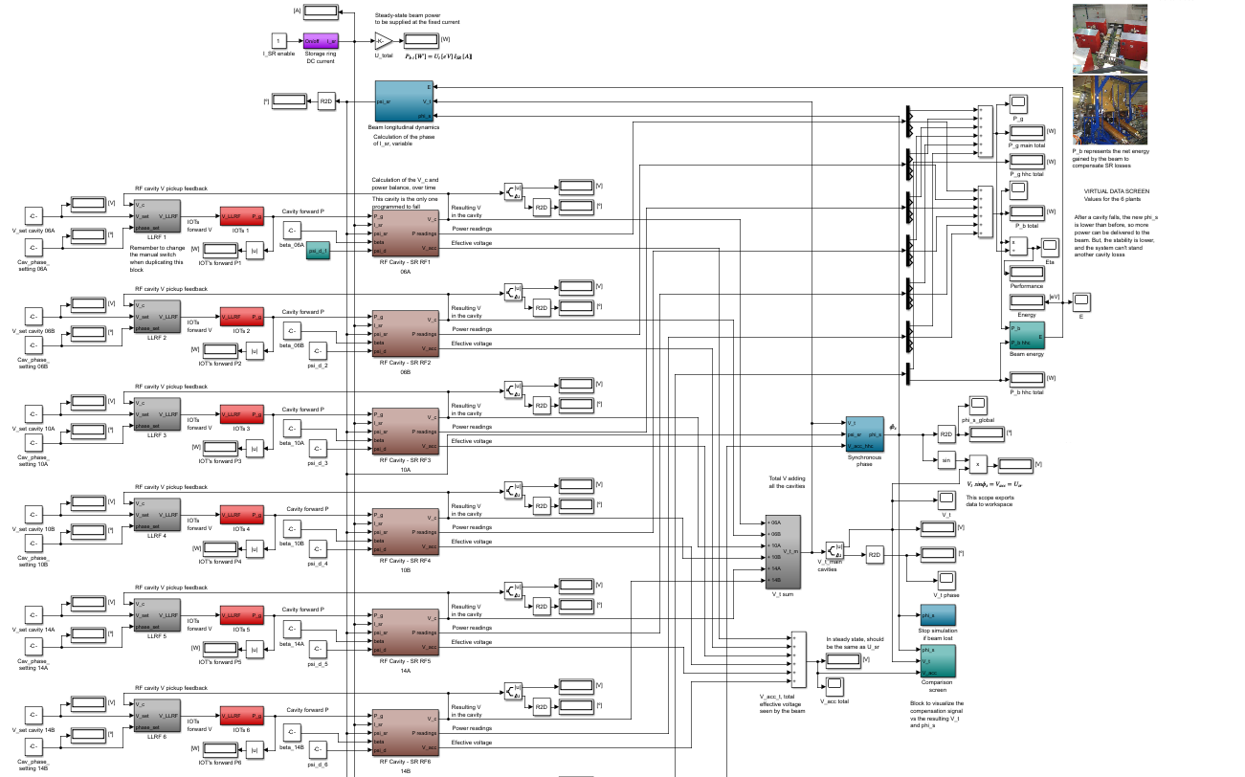
ALBA II – Trip compensation system

Slide 31
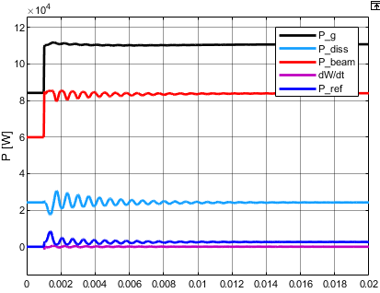
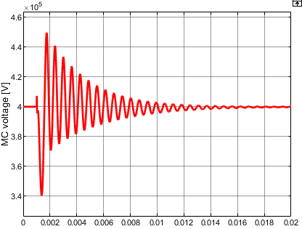
ALBA II – Trip compensation system
With the addition of the 3HCs to the system, surviving a main cavity (MC) trip becomes considerably more difficult:
After a trip, the 3HCs experience increased losses due to the beam phase change, which in turn amplifies the phase shift and further destabilizes the system
If the 3HCs do not change anymore, the previous ratio of V_{HC}/V_{MC} ratio is no longer preserved, leading to a ξ > 1 and the appearance of PTBL
Therefore, we plan to use the generator power to immediately lower the 3HC voltage, countering its beam loading and keeping the system’s below the PTBL threshold
In case Robinson DC instability arises due to the temporarily low MC voltage, DRFF for mode 0 would help to mitigate it (already proven experimentally at ALBA)
Active MC power balance after a MC trip
Active MC voltage amplitude after a MC trip

Slide 32
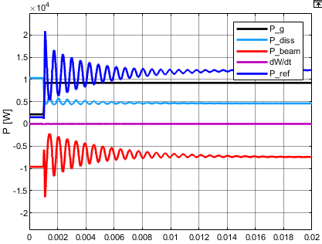
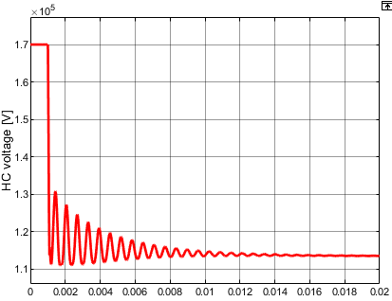
ALBA II – Trip compensation system
With the addition of the 3HCs to the system, surviving a main cavity (MC) trip becomes considerably more difficult:
After a trip, the 3HCs experience increased losses due to the beam phase change, which in turn amplifies the phase shift and further destabilizes the system
If the 3HCs do not change anymore, the previous ratio of V_{HC}/V_{MC} ratio is no longer preserved, leading to a ξ > 1 and the appearance of PTBL
Therefore, we plan to use the generator power to immediately lower the 3HC voltage, countering its beam loading and keeping the system’s below the PTBL threshold
In case Robinson DC instability arises due to the temporarily low MC voltage, DRFF for mode 0 would help to mitigate it (already proven experimentally at ALBA)
HC power balance after a MC trip
HC voltage amplitude after a MC trip

Slide 33
OUTLINE
Introduction: ALBA Light Source
Operation: Statistics and issues
New Developments: 3rd HC, 1.5 GHz SSPA, DLLRF, IC3, arc detectors, DRFF
ALBA II upgrade: General overview, stability studies, TBL, trip compensation system
Summary

Slide 34
SUMMARY
During 2024 ALBA’s RF system achieved the best performance ever recorded in the facility, thanks to the continuous improvements
An increase in RF failures during 2025 was investigated and linked to IOT degradation from new power-saving settings and aging electronic devices. These issues are now understood, and performance is recovering after reverting the settings and replacing the aged components
A significant portion of periodic RF incidents were identified as fake arcs. The new arc detection system has been tested and deemed successful in filtering these false events
The ALBA II RF upgrade is progressing well within its expected schedule. Key components are already being manufactured. After summer 2026 we expect to perform the firsts tests of the 3HCs in passive mode. ALBA II operation expected for 2032.
TBL compensation and DRFF for PTBL mitigation are being studied. We expect to increase the lengthening performance of the harmonic RF system thanks to them, reaching around 6.6 - 8.3 h (vA2L006A) of Touschek lifetime

Slide 36
EXTRA SLIDES

Slide 37
ALBA II – General RF overview

