Slide 1
DIAMOND-II RF SYSTEM Upgrade Plan and Status
Arash Kaftoosian
ESLS-RF and HarmonLIP Workshop
October 22nd-24th 2025

Slide 2
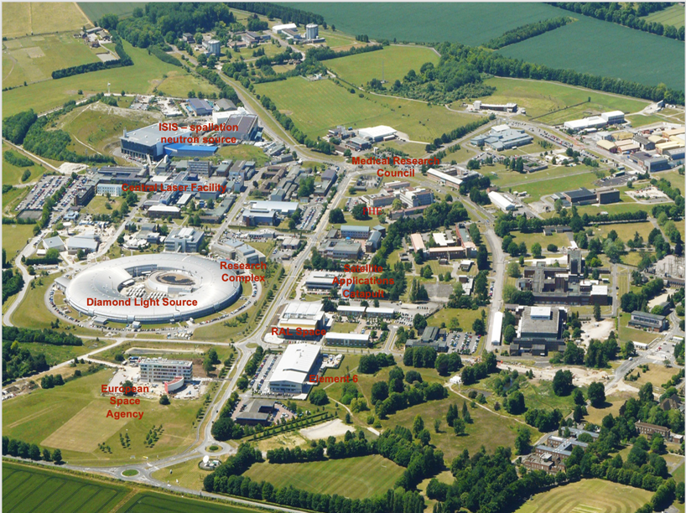
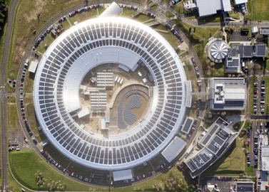
Diamond Site
Harwell Science and Innovation Campus
South Oxfordshire

Slide 3
Diamond-II RF System Overview
Linac
The linac will continue to operate at 100 MeV, with minimal changes.
Current linac structures will be preserved.
Frequency tuning to Diamond-II will be achieved through temperature adjustments.
Internal load inspections will be conducted to confirm their reliability.
The linac RF system will remain the same, utilizing two Thales TH2100 Klystrons powered by thyratron-triggered PFN modulators.
RF redundancy and availability will be enhanced by using the SLED cavity.
​
Booster
Booster will continue using two existing five-cell Petra-type cavities.
Each cavity will have an 80 or 120 kW amplifier.
Digital LLRF will be implemented.
Storage Ring
Eight HOM-damped cavities will be used from day one.
Each cavity will be driven by a 120 kW solid-state amplifier, supported by digital LLRF.
The cavities will be positioned in the mid-straight sections at K05, K09, K10, and K15.
A superconducting third harmonic passive cavity will be installed in cell 17. (see Pengda’s presentation on Friday)

Slide 4
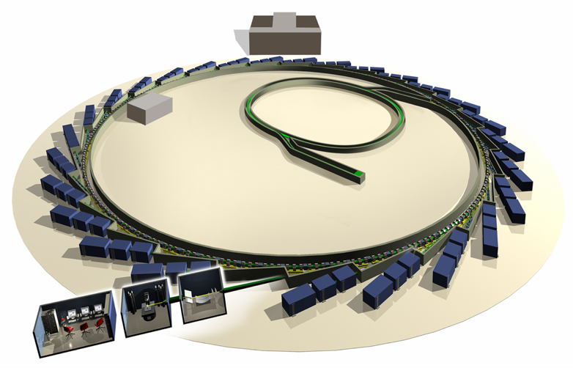
Diamond RF System Overview
Storage ring: 500MHz
2 x 1 cell SC Cornell cavities
3 x NC cavities installed 3 x 300kW IOT combined amplifiers
1 x 120 kW Cryoelectra SSA
Booster: 500MHz
2 x 5 cell Cu PETRA cavity 1 x 80kW IOT
1 x 60kW Ampegon SSA
Diamond RF is concentrated in one area
Amplifiers in RF hall
Cavities in single RF straight
Linac: 3GHz
2 x 5.2m Cu DESY structures
2 x 35MW klystrons
3 GeV 300 mA 3rd generation light source
NC Linac and full energy Booster, SC storage ring RF
Operating for users since 2007

Slide 5
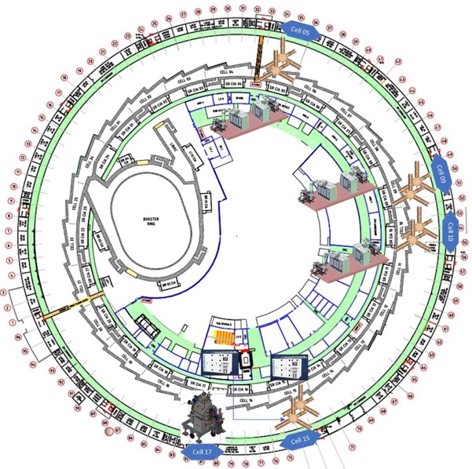
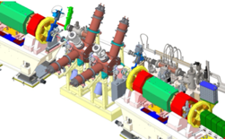
Diamond-II RF System Overview
RF cavities’ locations:
Fundamental RF cavities in pairs: K05, K09, K10, K15
Super-conducting 3rd Harmonic cavity in K17
Amplifiers’ locations:
Three double platforms for K05, K09 and K10 to accommodate 6 amplifiers.
A single platform already in use for K15.
One amplifier inside the RF Hall to be used for K15 cavity or the RF Test Facility
Cavity Location | SSA/Circulator/Load Location | SSA/Cavity qty. | Platform Required
K05 | Between CIAs 4 & 5 | 2 | Double
K09 | Between CIAs 8 & 9 | 2 | Double
K10 | Between CIAs 10 & 11 | 2 | Double
K15 | RF Hall & Single platform | 2 | None

Slide 6
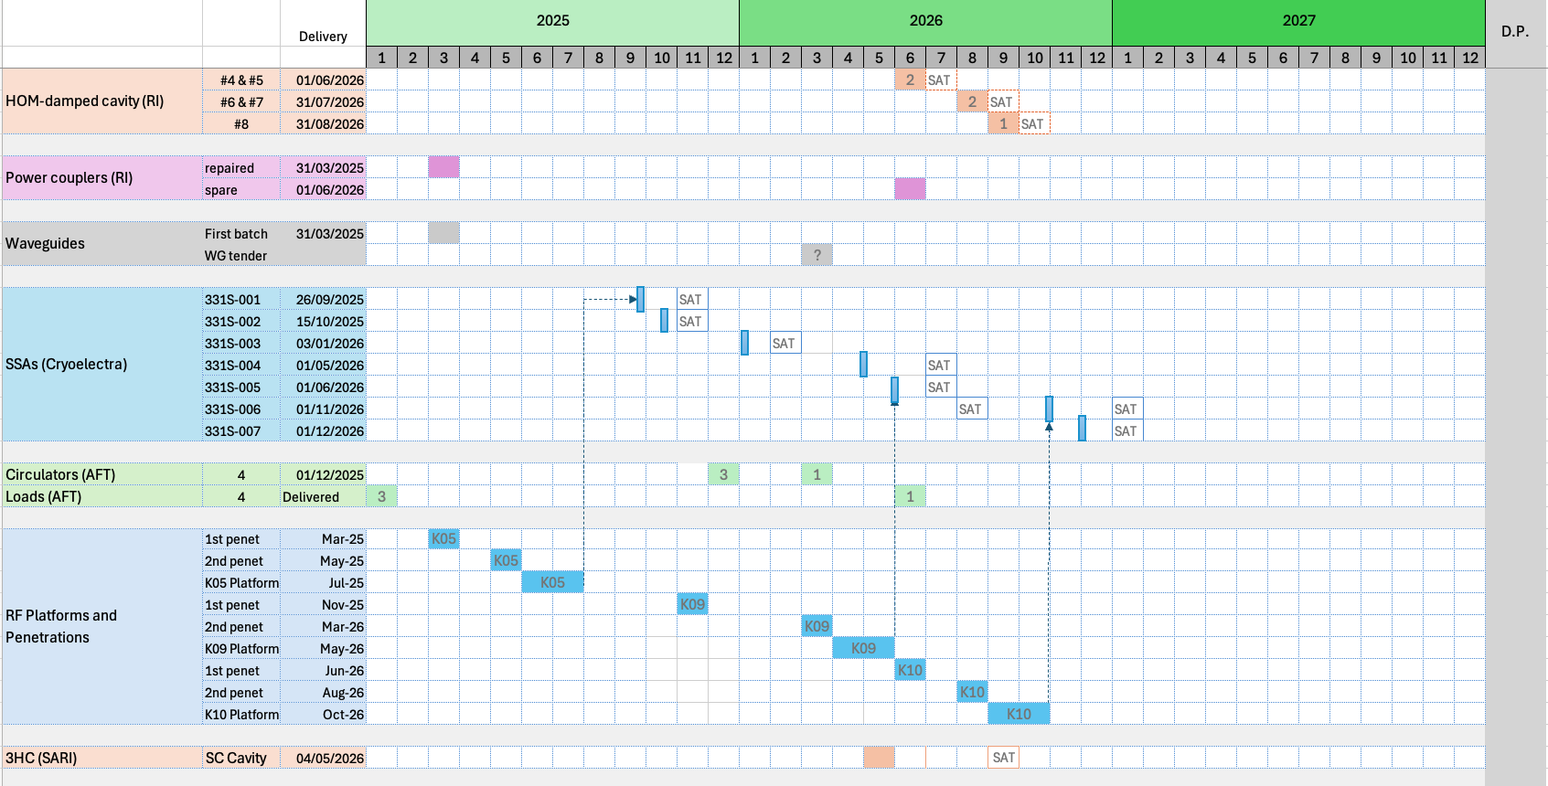
RF Systems Delivery and SAT Plan
Ongoing RF contracts:
Five HOM-Damped cavities plus couplers, tuners, supports and water distribution (RI), delivery scheduled for mid 2026
Waveguides: Preparing tender documents
Solid-State Amplifiers (Cryoelectra), two delivered, 5 more to be delivered before end of 2026 (one year ahead of the original schedule)
Circulators and loads (AFT) , January to June 2026
RF platforms, penetrations and shielding, local companies, to be completed before end of 2026
Superconducting 3rd Harmonic Cavity, SARI (SSRF), mid 2026

Slide 7
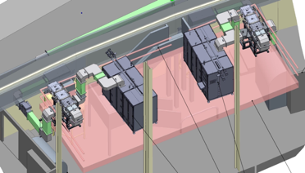
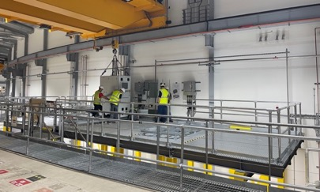
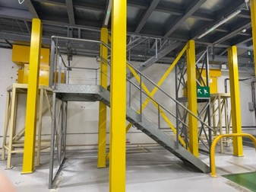
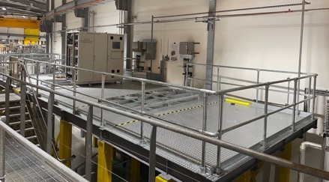
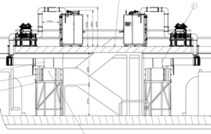
RF Platforms and Amplifiers
Amplifiers:
Two 120 kW amplifiers have been delivered after successful FAT at supplier (Cryoelectra)
Installation is ongoing on the K05 platform
Site Acceptance Tests for the first two SSAs is scheduled for 17th November 2025.
K05 platform:
Both penetrations implemented and their shielding with support structures installed.
Platform is ready
Electrical and mechanical services installation ongoing.
K09 platform:
The first penetration is being drilled.
The shielding will be installed during this shutdown
The second penetration and the platform will be ready in March and May/June 2026, respectively.
K10 platform:
Design stage to be started shortly.

Slide 8
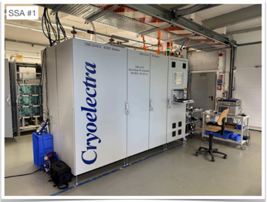
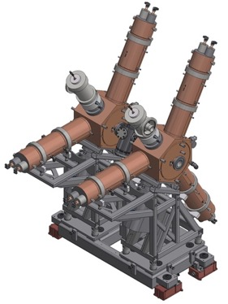
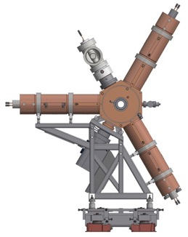
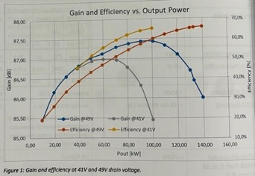
RF Amplifiers and NC Cavities
The contract with Cryoelectra for seven 120kW Solid-State Amplifiers is in progress.
Cryoelectra proposed to complete delivery of all 7 amplifiers by the end of 2026 (the initial delivery plan was by end of 2027).
%65 AC to RF efficiency: @ 130kW /49V or @100kW /41V
Contract for design, manufacturing and delivery of 5 HOM-Damped cavities is progressing with Research Instruments GmbH (RI)
Delivery schedule: from 31st May 2026 to 31st August 2026
Cavities will be assembled in pairs at DLS and will be tested (including their couplers) inside RF Test Facility using 120kW amplifier.
HOM measurements will be done based on CST simulation results of R/Q up to 2.4 GHz
Courtesy of Cryoelectra GmbH
Courtesy of Research Instrument (RI) GmbH

Slide 9
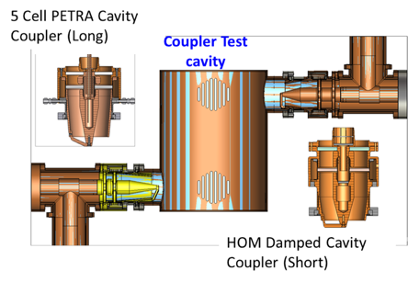
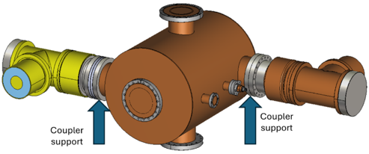
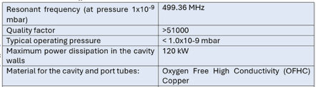
Power Coupler Test Cavity Project
Major Considerations
Rated Coupler power/voltage test capability
Uniformity of field / power dissipation on the surface
Ease of cooling
Ease of pumping
Tunability
Ease and cost of manufacturing
Pill Box (cylindrical) geometry – TM010 mode
Two Port structure – Excitation at one port and load at the other
Single coupler test, full power dissipation in the structure
Variable coupling by the coupler rotation
With PETRA Cavity tuner, tunability >±750 kHz
RF design and simulations have been finalized.
Outsourced for thermal and mechanical design and manufacturing.
The expected delivery timeframe is 9 months.
Design parameters

Slide 10
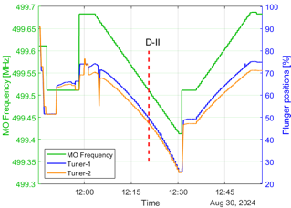
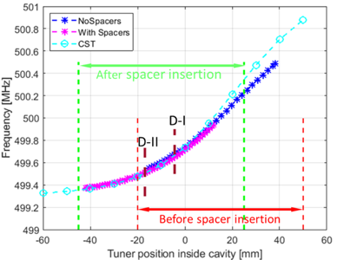
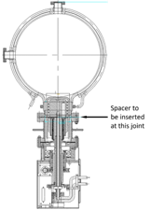
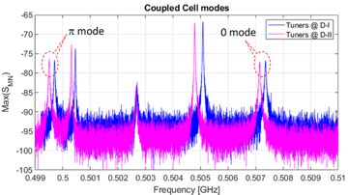
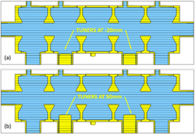
Diamond-II Booster Synchrotron
Diamond II Booster synchrotron will use two Petra type 5-cell cavities.
D-II frequency is achieved by adding spacers to the tuners
One 80kW IOT (old) and one 80kW solid state amplifier will feed cavities.
Each cavity voltage can reach to 1.3MV using 80kW amplifier. D-II booster loss per turn will be ~1MeV
Tests are planned to measure the minimum required voltage in Diamond Booster (with ~600KeV loss per turn) and extrapolate it to estimate the D-II Booster voltage requirement.
Based on the results, decision will be made if one or both amplifiers must be replaced with 120kW amplifiers to ensure redundancy in D-II Booster RF system.
PETRA 5-cell cavities
Spacers of 25 mm thickness were installed on both the tuner ports
The measured frequency versus tuner position matches well with the simulations

Slide 11
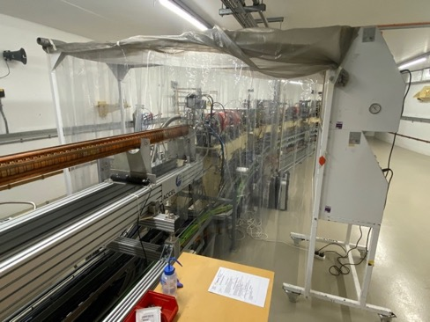
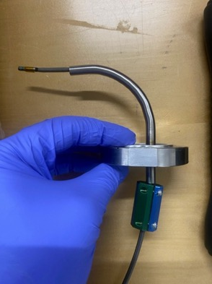
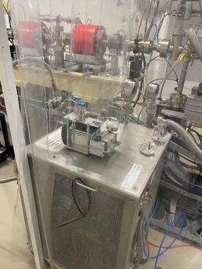
Linac Inspection
The final objective is to ensure the internal loads (last 7 cells of each structure) are in good shape and reliable for D-II injector operation.
Vacuum intervention and inspection by sending an endoscope inside the structure has been carried out on Accelerator structure #2
Opening from end as the last 7 cells have SiC coating (internal RF load)
Special adapters were developed to support endoscope movement inside the structure

Slide 12
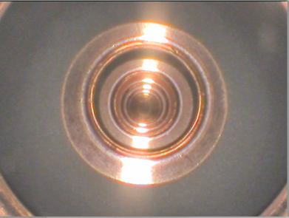
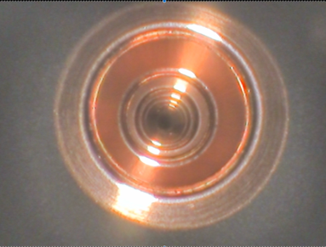
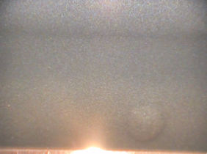
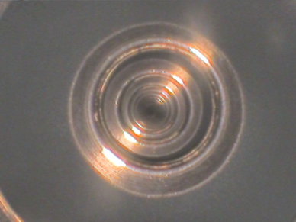
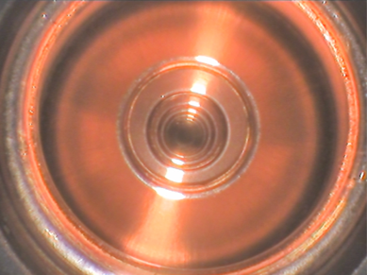
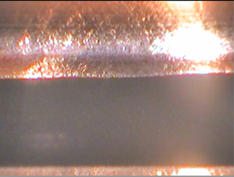
Linac Inspection
Vacuum level recovered after closing the structure. No bake-out required.
The final 7 cells of AS#2 showed no signs of damage.
The experiment will be repeated for AS#1
Ensuring good cleanliness, > ISO 8
Pictures taken inside the last cells

Slide 13
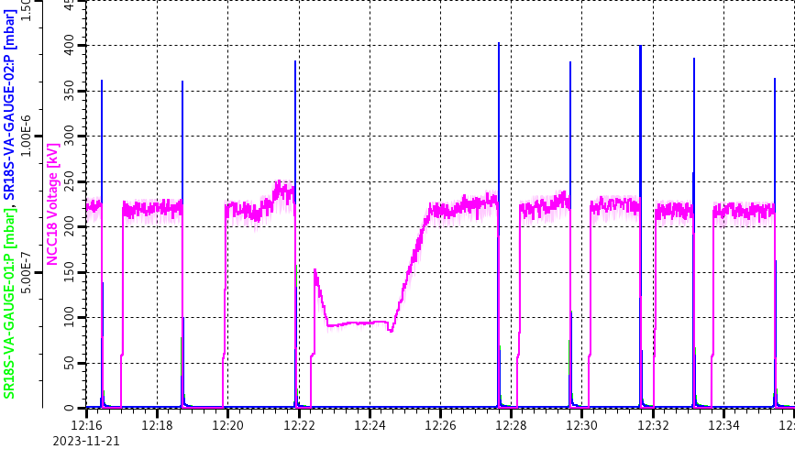
Diamond-II experience in Diamond SR
Normal conducting HOM-damped cavity and SSA experience in Diamond SR
A complete system including 120kW Cryoelectra SSA, HOM-damped cavity and digital LLRF has been in user mode operation since September 2023, with 250 – 300 MV accelerating voltage in cell 15
Only one amplifier trip due to false drip tray sensor activation, which appeared to be an RF/EM interference. They will be replaced with more robust (mechanical) ones.
A few load/circulator arcs. The single-channel arc detectors will be relaced with dual channels to avoid any false alarm.
NCC18 (HOM-damped cavity installed in cell 18) was in operation for user run 2 in 2023 but from November 2023, NCC18 started demonstrating strange vacuum behaviour for accelerating voltage > ~250kV showing pressure spikes after a few minutes.
Investigation and visual inspection done by removing the coupler to check inside the cavity.
One ferrite tile was found inside the cavity fallen from vertical HOM absorber.
Arcing and burn marks were observed on internal surface caused by the object burned by RF power
The object was removed, and cavity internal surface cleaned properly.
After installing the coupler, vacuum leak detected from the window area.
Coupler was replaced and the cavity was conditioned successfully.

Slide 14
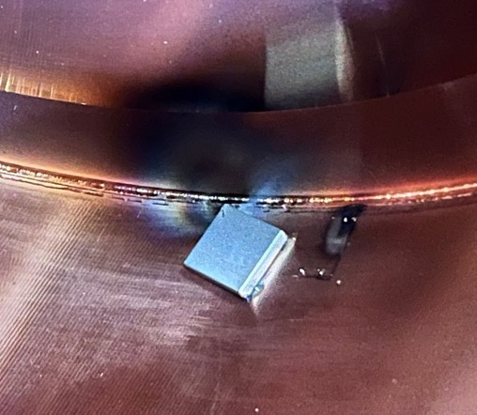
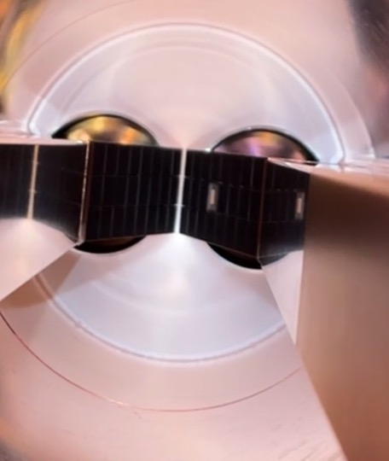
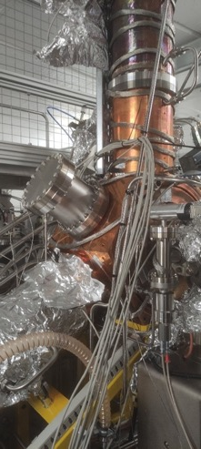
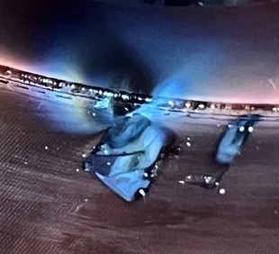
HOM-damped cavity (NCC18) Issue
Ferrite tile found inside NCC18 with burn marks.
The tile was detached from vertical HOM absorber

Slide 15
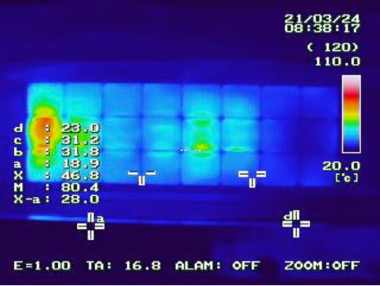
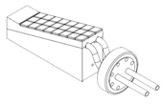
Ferrite Tiles Issue
HOM absorber test at factory: A 600w CW magnetron at 2.45GHz will be used with a sliding short to form a standing wave voltage that will be moved along the ferrite tiles. Any temperature above 100°C will not be acceptable
Using SiC absorbers might be considered in the future to replace the ferrite type

Slide 16
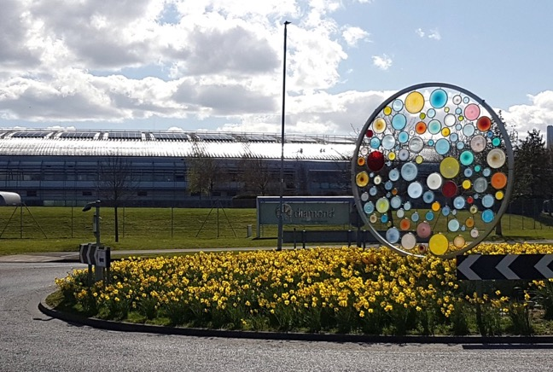

Thanks for your attention
On Behalf of the RF Team:
Pengda Gu Anton Tropp
Adam Rankin Marco Marziani
Shivaji Pande David Child
Amir Mogheyseh

