Slide 1
DESY rf-dept.
Operation of PETRA III over the past 2 years
Ruediger Onken DESY
23rd October 2025

Slide 2

Outline
Bigger DESY issues
Fire in the central booster electronics room / Oct. 2024
Water in the transmitter hall and tunnel / Apr. 2024 & Aug 2025
Petra – III Operation
Error statistics (PETRA-III)
Failures of focus power supplies
Reactivation of old klystrons
Operation of prototype SSA & HOM-damped cavity
Overview of operation
Light at the input-coupler
Plunger – problems
Fluff in the cavity?
Plunger- movement causes drop in cavity- voltage

Slide 3
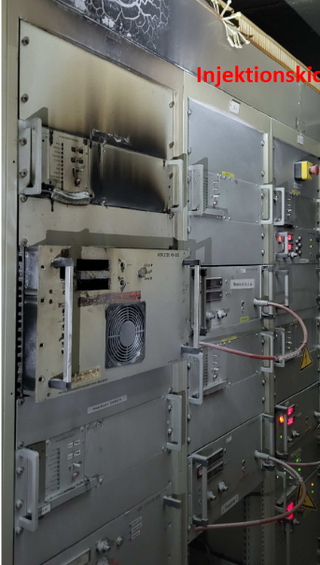
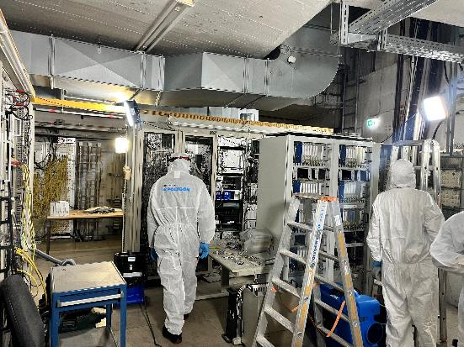
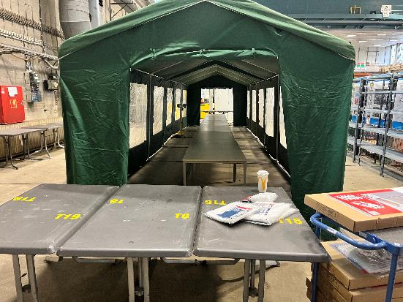
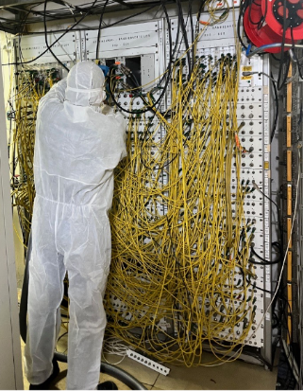
Fire in the central booster electronics room / Oct. 2024
Septum power supply burned out
Entire central electronics room was heavily contaminated
The entire ER had to be cleaned
All electronic components had to be removed and cleaned / washed
After three weeks of hard work, operations could resume

Slide 4
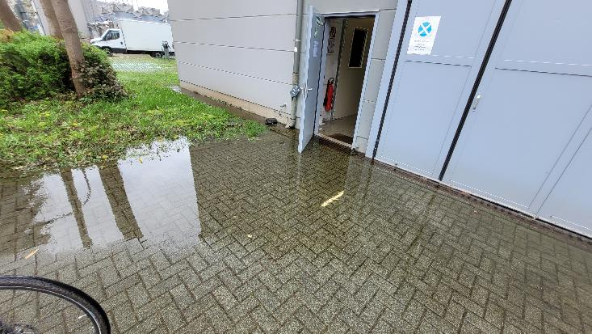
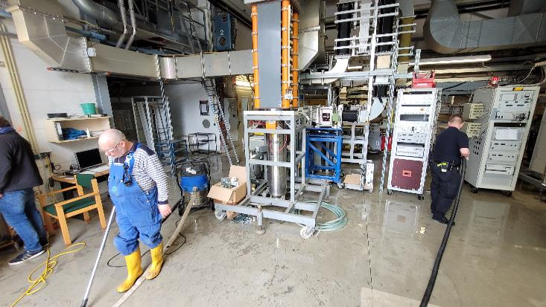
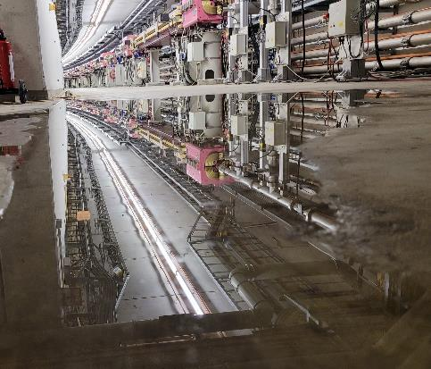
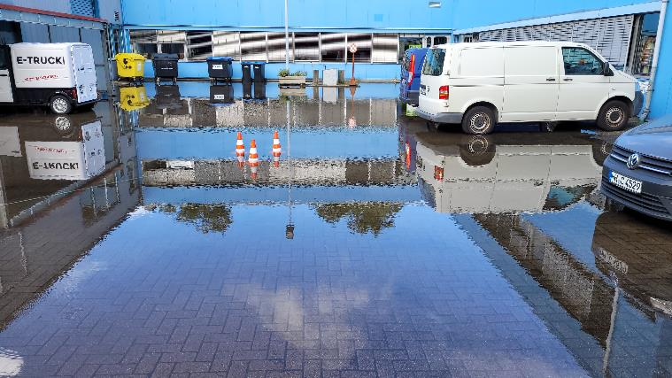
Water in the transmitter hall and tunnel / Apr. 2024 & Aug 2025
Two incidents involving large amounts of water in the HF area
Water pipe burst in the osmosis system Only the hall and the high-voltage room were affected we changed the distribution of power => 3 hours of downtime
Heavy rainfall Event occurred during shutdown

Slide 5
Error statistics (PETRA-III)
Explanation and preventive activities
Power glitches dominate
often both TX systems trip=> only one beam loss
On average, 12 power glitches/year of different strengths
At severe HV drops, the LLRF control system fails However, an advance control measure has problems with interferences
SSA seems to be more robust
2022 LLRF Signal interference on fast interlock loop caused many errors
Cavity arcing Reduction of error rates due to stable cavity temperatures, but we will never come to zero ☹
23.10.2025

Slide 6
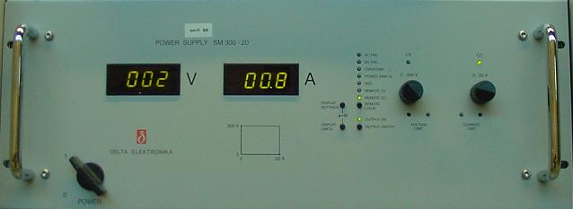
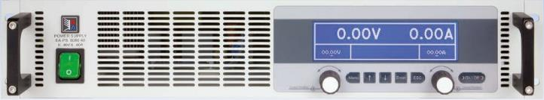
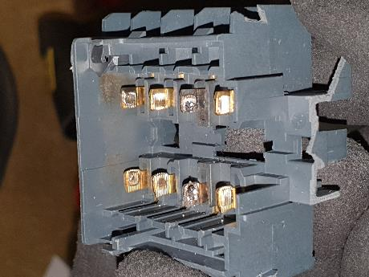
Failures of focus power supplies
Sometimes our focus power supplies fail
The power supply dies in steady state operation - not during switching on or off
The fuse for the entire rack always trips
High current is flowing, see picture with burnt contacts in the upstream switch-on contactor
In most cases, the devices are dead afterwards, but sometimes they still work after the event
Circumstances/scenarios:
In steady state operation – No switching
Often in maintenance period or service days
Mitigation measures:
Using a different manufacturer (Delta / EA- Electronics)
Compensation circuit for inductive load
Mains voltage filter
Grounding
23.10.2025

Slide 7
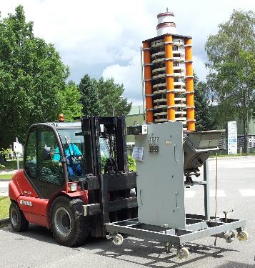
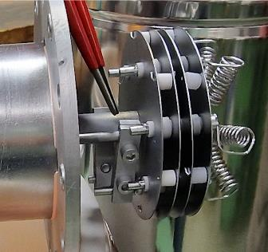
Reactivation of old klystrons
PETRA III will run until end of 2029
The rf has to work reliably until the end
No further refurbishment work on rf- system (except personal interlock)
Use up klystrons from the HERA era (older than 20 years / not brand new / stored in TX- halls)
5 tubes in constant use, 3 of which have more than 50,000 operating hours
Approximately 10 usable tubes (according to our records)
Recently, “heating filament failure” after switching off the heating
Clamp slips off heating terminal
Only reduce the heating current
Water leaks due to flushing/corrosion
Usually transport to the transmitter hall, set up, commissioning, operation
23.10.2025

Slide 8
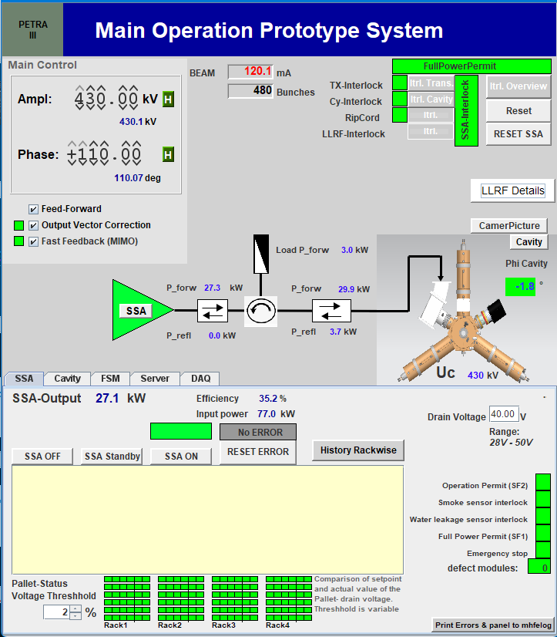
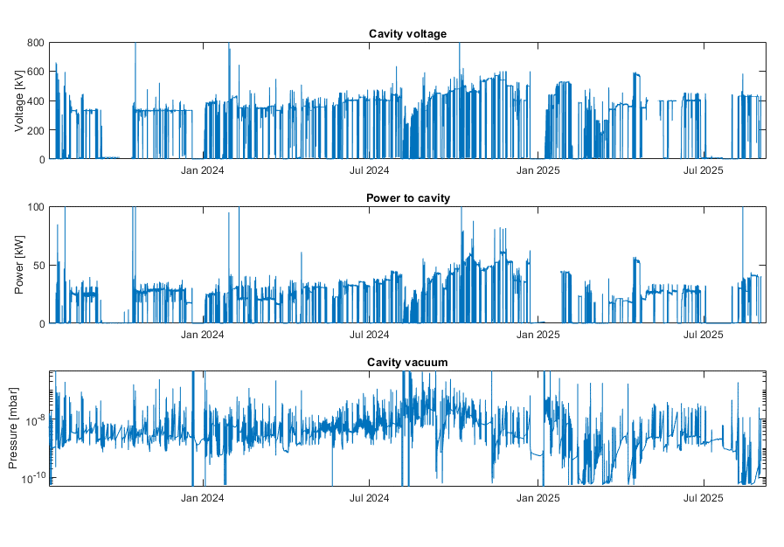
SSA & HOM-damped cavity
23.10.2025

Slide 9
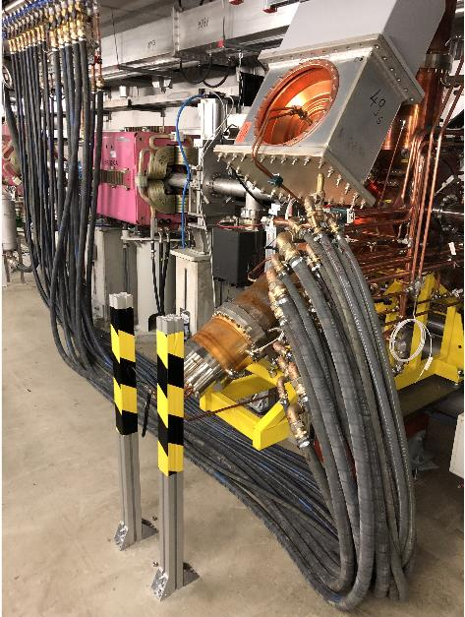
SSA & HOM-damped cavity / Overview of operation
Cavity has run reliable at PETRA IV voltage levels:
January 2023: Installation of the cavity in PETRA III
July 2023: Installation of the SSA
Stable for extended periods at voltages above 330 kV (PETRA IV nominal voltage)
Conservative increments to protect PETRA III operation
Operated up to PETRA IV power level:
Powers up to 50 kW – 60 kW
Increasing levels over time
Protecting PETRA III operation
Observing coupler appearance as power increases
Cavity has been vented for observations , coupler/plunger changes:
Dec 23: Inspection: burning marks on cavity surface
Jul 24: Input Power Coupler changed
Jan 25: Plunger changed: Discoloration on uncooled surfaces
Vacuum has recovered after each opening
Cavity conditioning rate determined by vacuum level
Year | Operating hours
2023 (Jun-Dec) | 2160 h
2024 | 7046 h
2025 (Jan-Jul) | 2916 h
23.10.2025

Slide 10
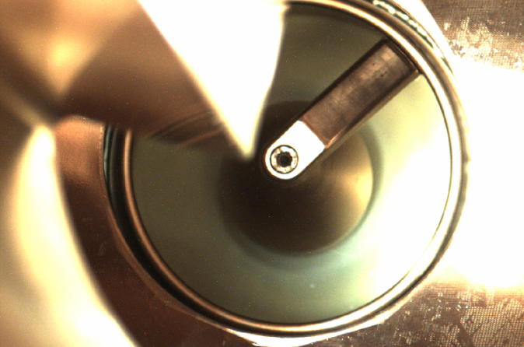
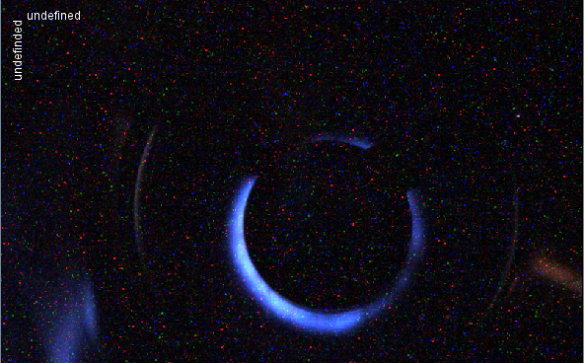
SSA & HOM-damped cavity Light at the input-coupler
<= We have a camera that will allow us to look through the HOM damper onto the input - coupler (IPC)
From approx. 360 kV, we observe luminous phenomena around the inner conductor of the IPC
The brightness depends on the gradient and the tuning of the cavity
In our IPC test bench, we can send 200 kW through the coupler without lights
The glow has no effect on the vacuum pressure or the performance of the cavity
Titanizing the ceramic suppresses the phenomenon
Conditioning shifts the performance limit at which luminescence begins upward, but proceeds more slowly the higher the gradient increases
23.10.2025

Slide 11
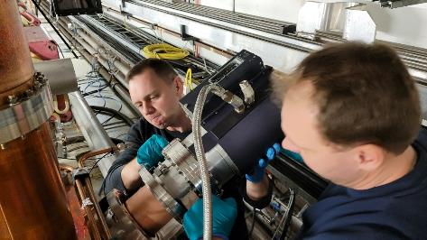
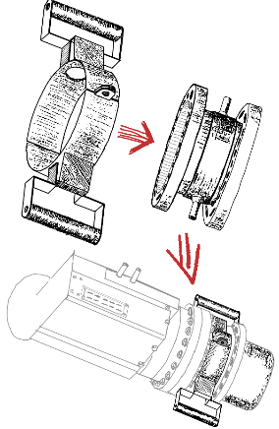
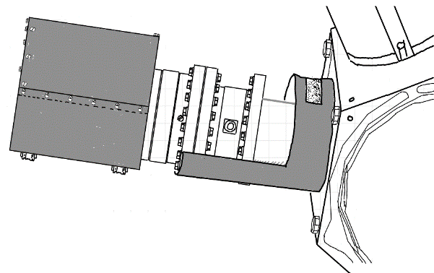
SSA & HOM-damped cavity Plunger - problems
In the PETRA cavities, the plungers could have been the reason for arc- events
We have many plungers that show discoloration on the piston after several years of operation
However, it is not possible to inspect the affected areas without causing damage
So the follow-up has another flange to enable the piston to be examined all around
To make it easier to install the plunger, we have designed an “insertion aid”
But what do we see?
23.10.2025

Slide 12
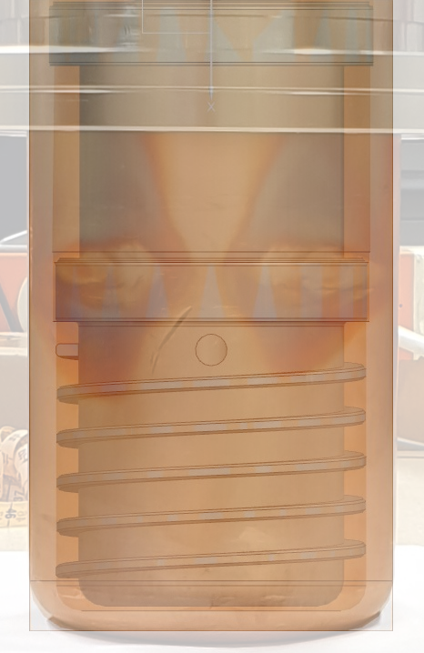
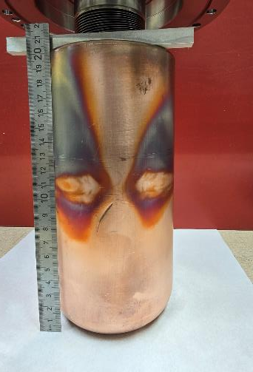
SSA & HOM-damped cavity Plunger - problems
There is likely to be discoloration where there is no water cooling
It is possible that they were created during conditioning at high gradients
23.10.2025

Slide 13
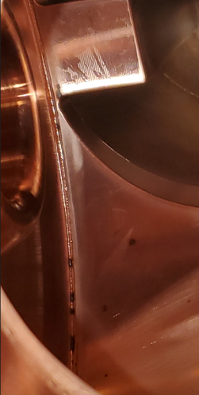
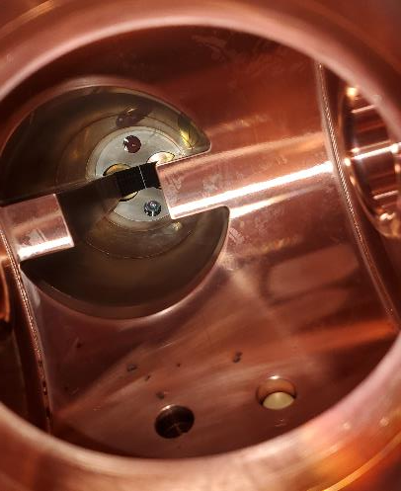
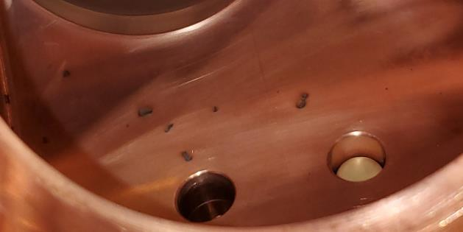
SSA & HOM-damped cavity Fluff in the cavity?
During a cavity inspection, “burn marks” were noticed on the cavity body
We planned an inspection with Research Instrumnets and colleagues from PSI for December 23
No obvious cause could be found
Analysis of swab samples also showed no results
Research Instruments: Fluff (e.g., from heating elements) may have entered the inside
It seems recommendable to inspect the cavity thoroughly upon receipt and, if necessary, clean the inner surface
23.10.2025

Slide 14
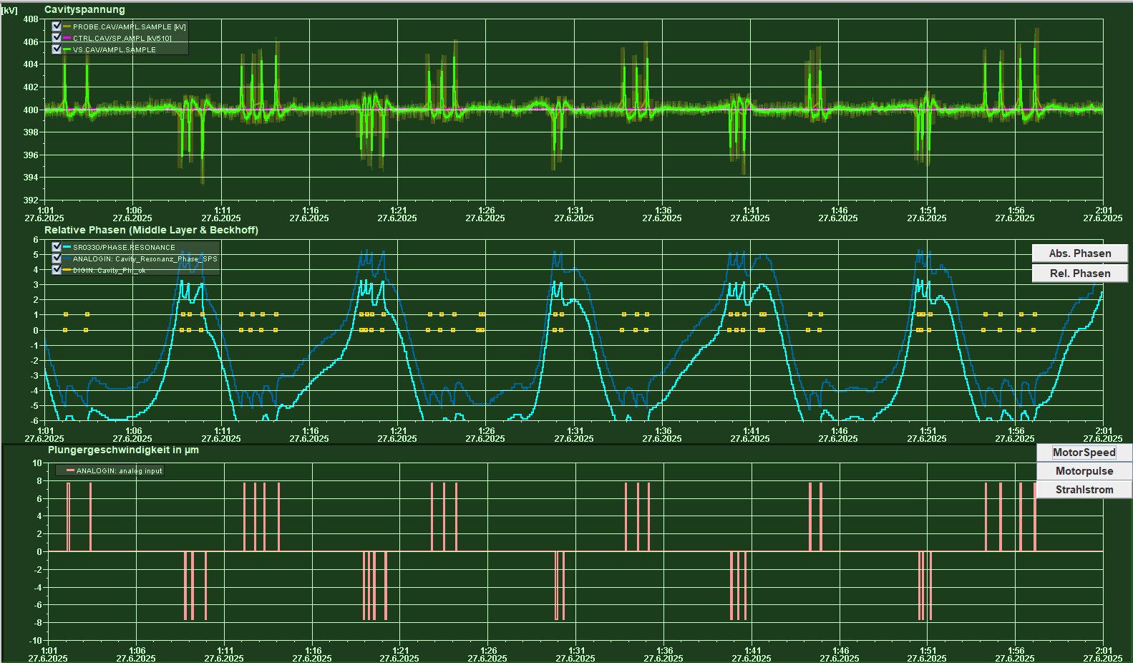
SSA & HOM-damped cavity Plunger- movement causes drop in cavity- voltage
Observations:
With slow cavity control, there are significant discontinuities in the cavity voltage during plunger movements as soon as the plunger moves.
Possible causes:
Shock-like movement caused by bearing play
23.10.2025

Slide 15
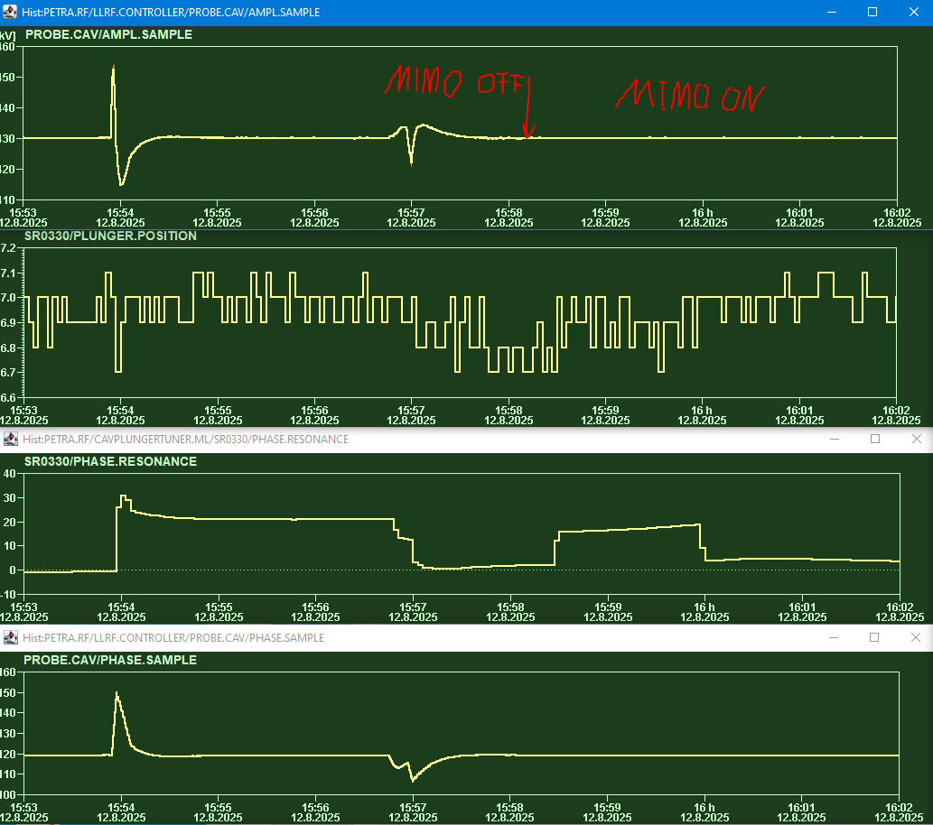
Fast loop in LLRF corrects plunger movement effects
Observations:
Without fast Multiple-In-Multiple-Out feedback correction plunger movement is visible in cavity amplitude and phase.
With fast feedback loop closed the plunger movement has no effect on cavity voltage or phase
23.10.2025

Slide 16
Kontakt
Ruediger Onken Telefon: +49 (0)40 8998-3453 E-Mail: ruediger.onken@desy.de
Deutsches Elektronen-Synchrotron DESY
Abteilung MHF
Notkestraße 85 22607 Hamburg www.desy.de

