Slide 1
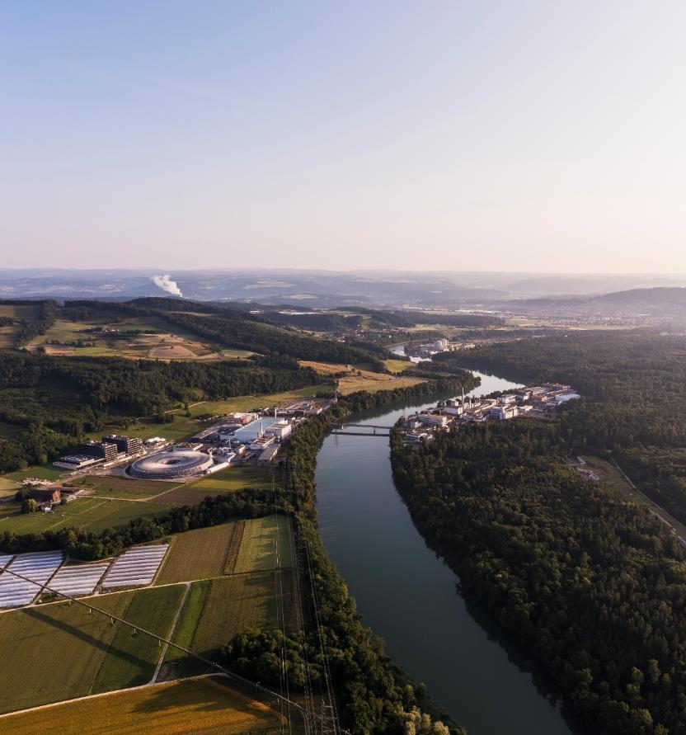
Operation and Upgrade of the SLS RF Systems
ESLS RF & HarmonLIP Workshops
Lukas Stingelin for the SLS RF-team
ALBA Synchrotron, Spain, 22nd -24th October 2025

Slide 2
Work on the SLS Storage Ring:
Done:
Preconditioning of 5 new, HOM-damped cavities in the teststand, inspected in clean-room and coupler rotated.
Commissioned 4 new solid state amplifiers, got ProkW funding for efficiency > 58%
Modified tunnel-shielding for new location and waveguide-run
Installed 4 new cavities in the storage-ring
Apprentice⁺ project gave cooling controller.
Commissioned new 500MHz master-oscillator.
Commissioned new digital LLRF-System
Upgraded tuning-system of Super-3HC, commissioned prototype fast Interlock-System
To be completed:
Consolidate and optimize RF-Systems, improve post-mortem tool.
System characterization of storage-ring 500MHz RF-system, upgrade of LLRF-feedbacks
Better handling of beam-dumps
Complete design and test prototype vertical HOM-damper.
Install and commission new LLRF-system for Super-3HC.
Procurement of spare-parts.
Circulator TCU6 do not start after power-cycle when interface is connected.

Slide 3
RF-Failures During Commissioning
Failure of Teststand-KSU VME-crate power supply caused fire-brigade dispatch.
Booster SSA controller communication failure
Communication fault to Storage-Ring SSA Module controller: → bad BNC-cable replaced.
Failures of the Storage-Ring SSA Pilz-Safety controller: noise problem? → installed ferrites, still under investigation.
During shutdown: Communication fault do Storage-Ring SSA-Predriver
LINAC: 2x burnt cable of LINAC PFN charging unit
LINAC: Failure of the Gun-HVPS.

Slide 4
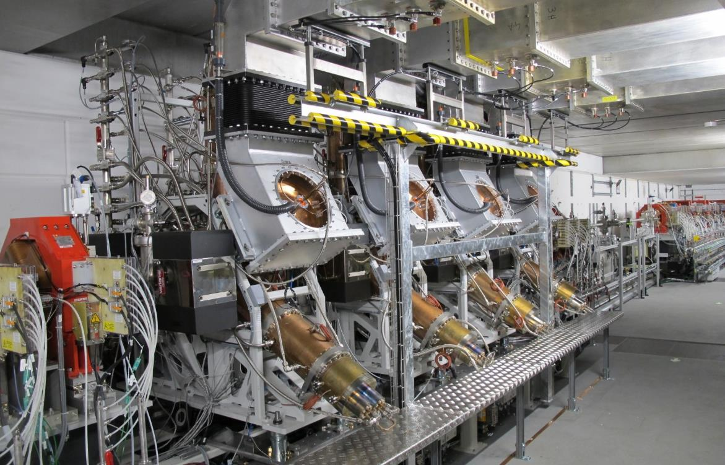
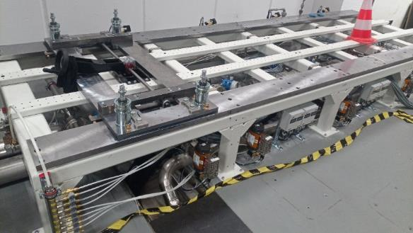
The Four HOM-Damped Cavities from Research-Instruments
PETRA-type coupler and waveguide-transition, modified tuner
β=4.1, currently: 440kV, ~100kW per cavity
Only 1 bellow per cavity. Sliding mechanics help to install cavity.

Slide 5
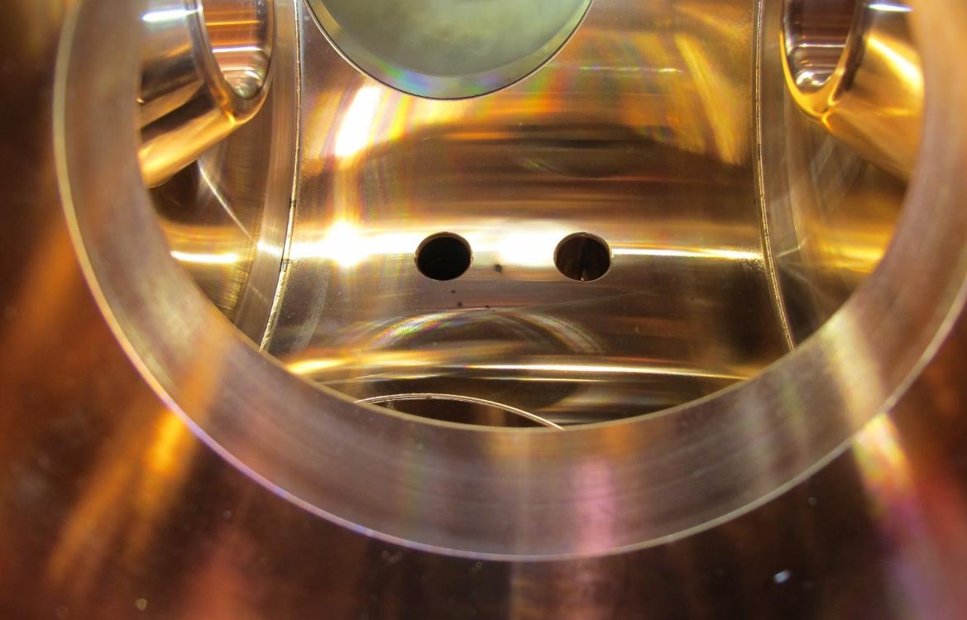
Observations During Inspection after Conditioning
As indicated during power-tests on the coupler camera:
Found loose screw at power-coupler.
Black Spots in Cavities:
No spots found on upper part of cavities
In this cavity, there are about two spots with crater like shape, one spot has like a halo around it

Slide 6
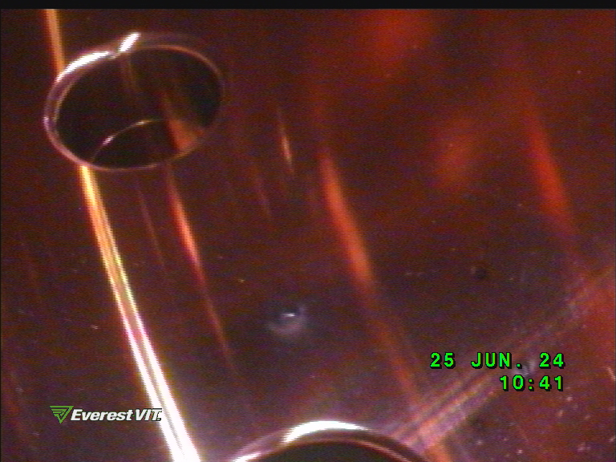
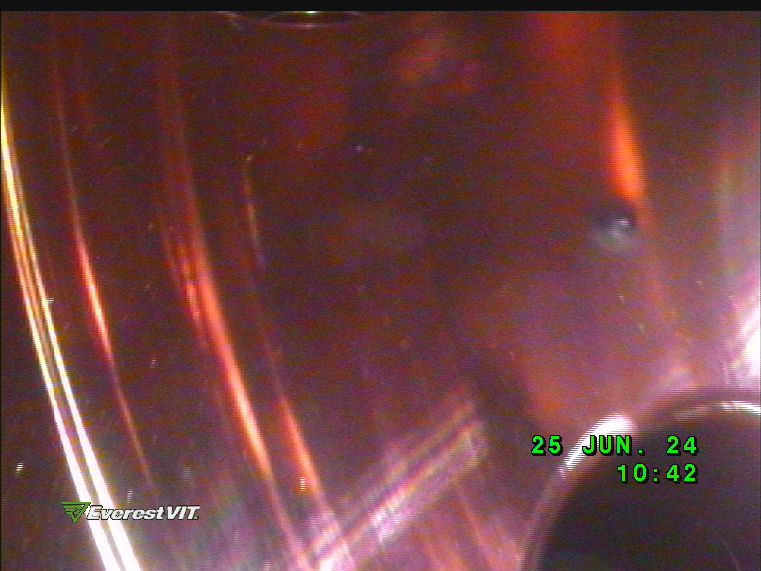
Close-up Pictures from Endoscope on Black Spots (picture rotation arbitrary…)

Slide 7

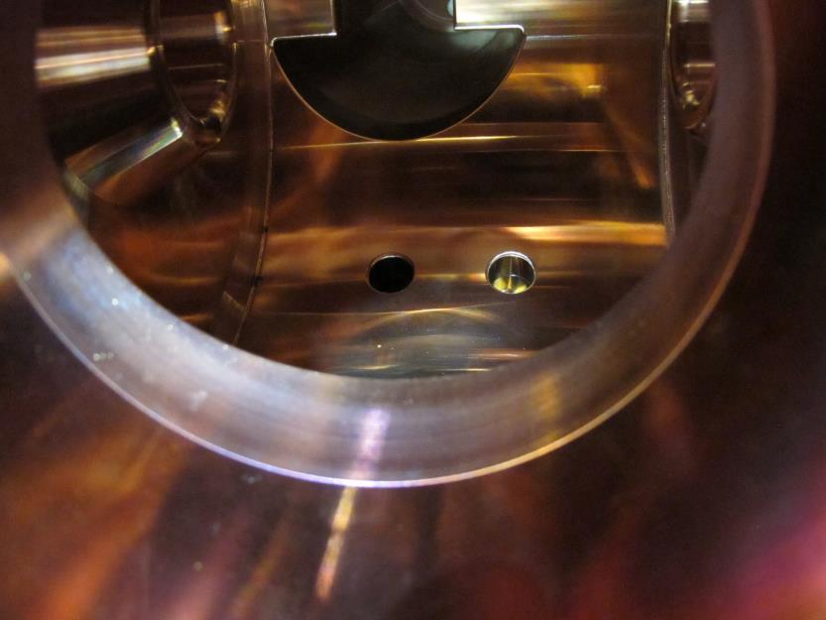
Before- and after Cleaning with Ethanol on First Cavity
Maybe, the black spots were caused by fibres from glass-isolation of bake-out jackets?

Slide 8
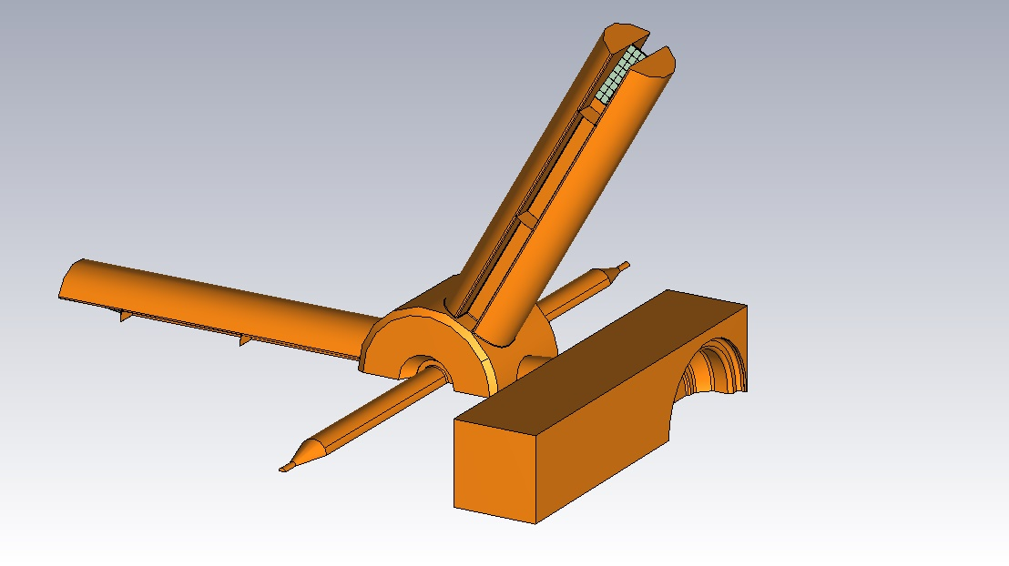
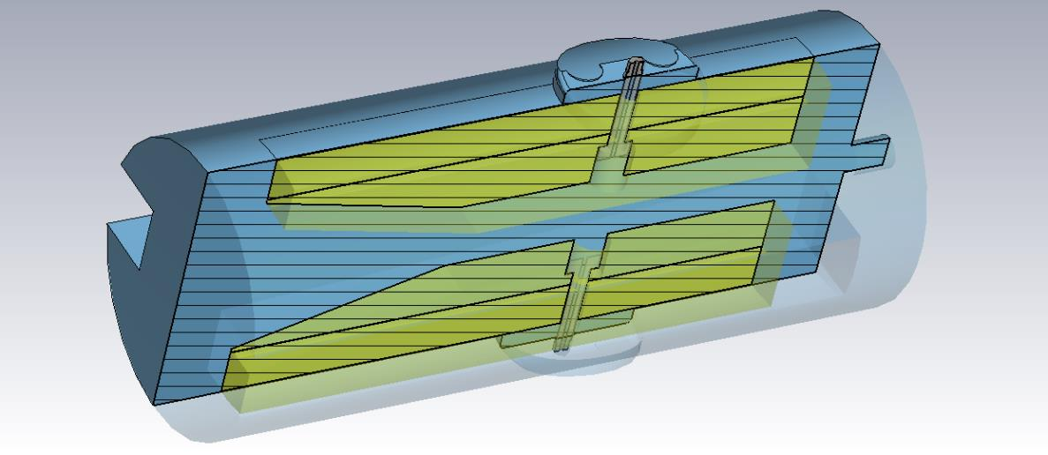
An alternative HOM load design for the RI cavity
Concept:
A pair of SiC blocks slowly transitioning from the sides of the ridged waveguide towards the main field region between the ridges to match the incoming wave into the SiC
A short piece of cylindrical waveguide at the end to give a pseudo magnetic termination at the end and optimize damping
Radial pumping port
Optical viewport looking towards cavity
Find a ‘plug in’ replacement of Ferrite
Based load of cavity
Slide: M. Dehler, 15.10. 2025
Towards cavity
Optical viewport

Slide 9
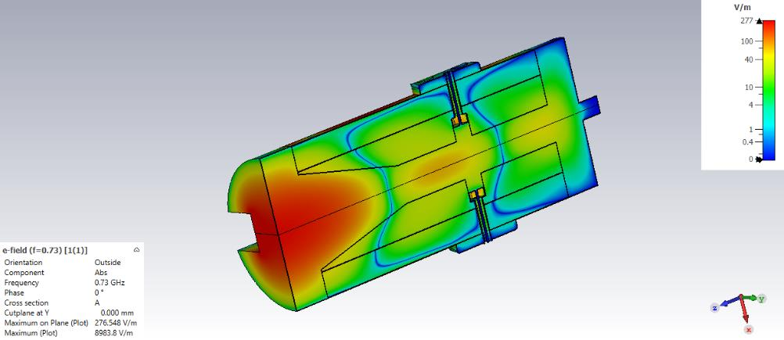
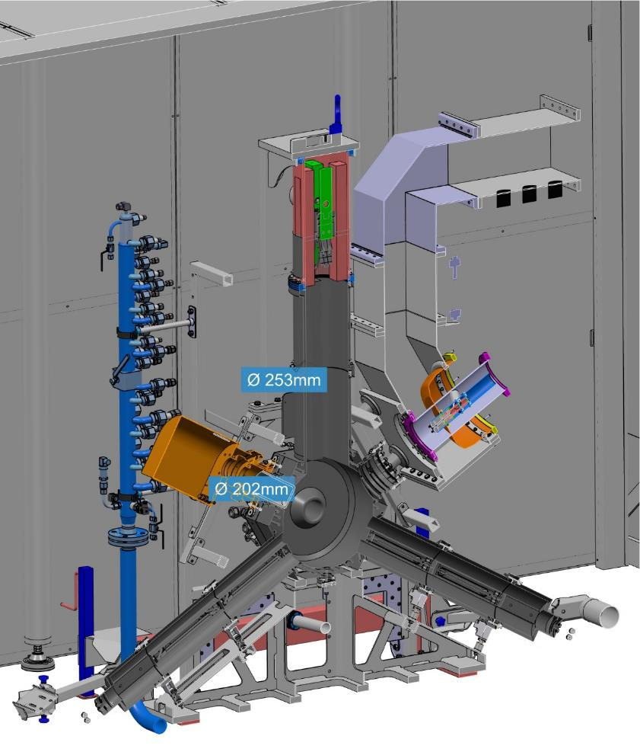
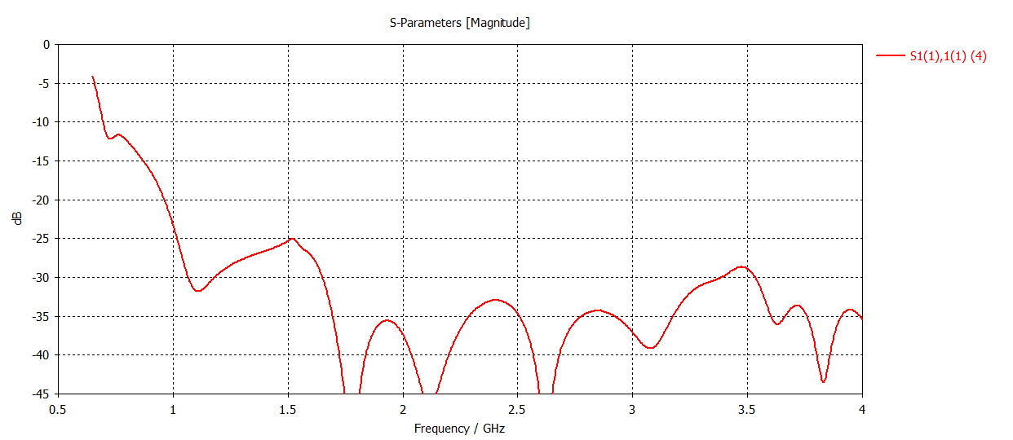
Mechanical Concept Together With Cavity and Full Infrastructure
S11< -10 dB near first HOM
< -20 dB else
Slide: M. Dehler, 15.10. 2025

Slide 10
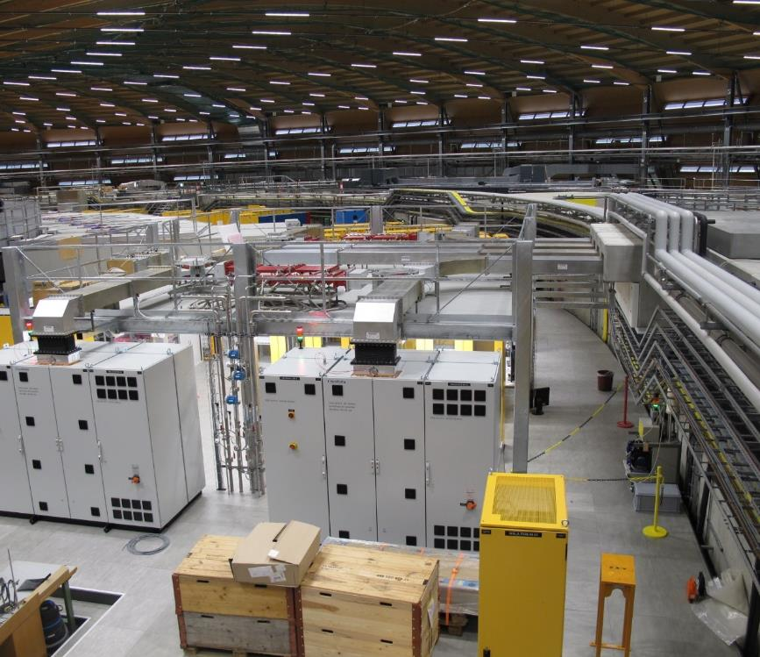
Waveguide, Platform and Layout of 500MHz RF-Systems
Cut- and re-welded waveguide pieces to new length.
New concrete bricks, additional polyethylene shielding for wave-guide passage.
New platform for waveguide, circulator and load supports.
In principle, the new amplifiers should be fine for direct connection to cavities. But old circulators installed as additional protection. Replacement bypass piece is in production.
LLRF-Racks are below the platform
Cooling water distribution under the raised flooring between the LLRF-Racks
Circulators get relatively warm, since no air-cooling in waveguides anymore.

Slide 11
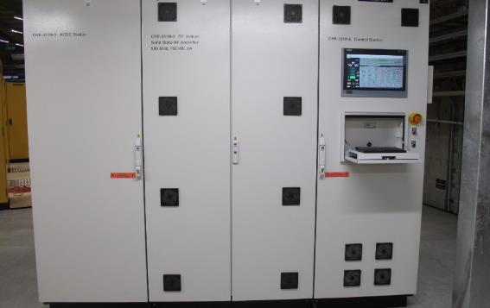
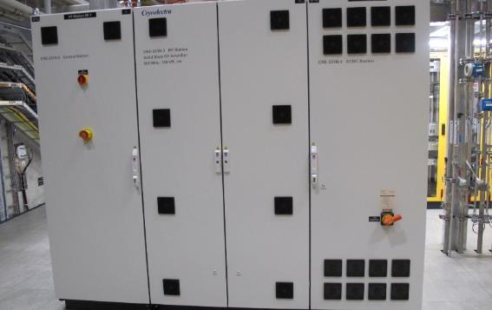
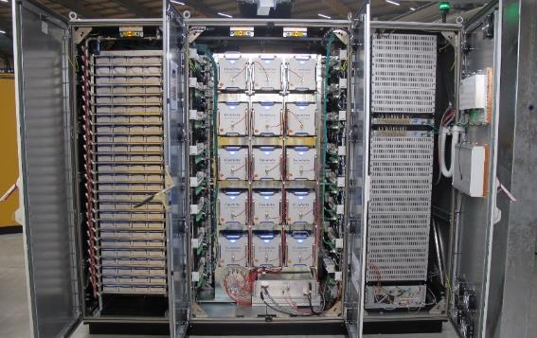
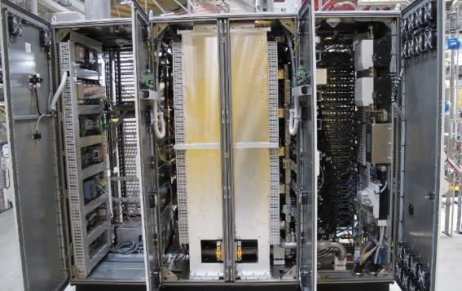
Four New Cryoelectra Amplifiers for the Storage Ring
Each Amplifier Specified for 150kWcw, 500MHz
Manufacturing got delayed because issues with welding quality of cooling pipes.
15x Tower Modules
100x ACDC converter
Connected to PSI smoke-detection system.
Control-interface mirrored on EPICS, errorlog, kibana.

Slide 12
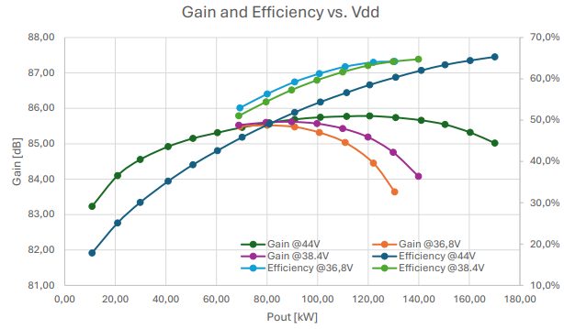
New Solid State Amplifiers from Cryoelectra
Pilz-safety controller for critical subsystems
→ 3x fake interlocks, filter-ferrites installed, still under investigation
Efficiency at 120kW > 62%, received full ProkW funding.
Ordering of spare-parts almost completed.

Slide 13
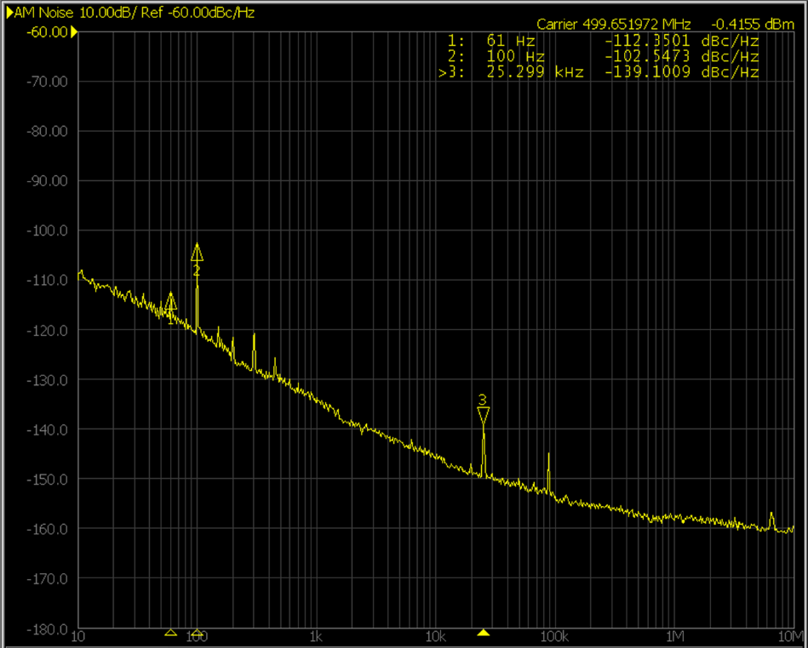
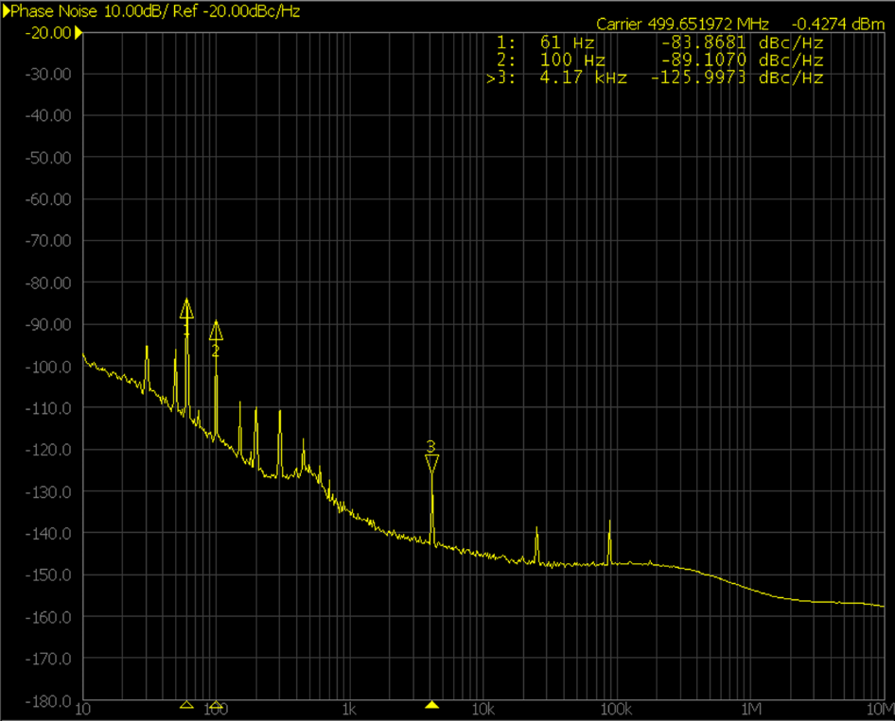
Noise Measurements of the new 500MHz Solid State Amplifiers
Satisfies PSI specifications,
Cryoelectra improved noise by upgrade of the pre-amplifier power supply.

Slide 14
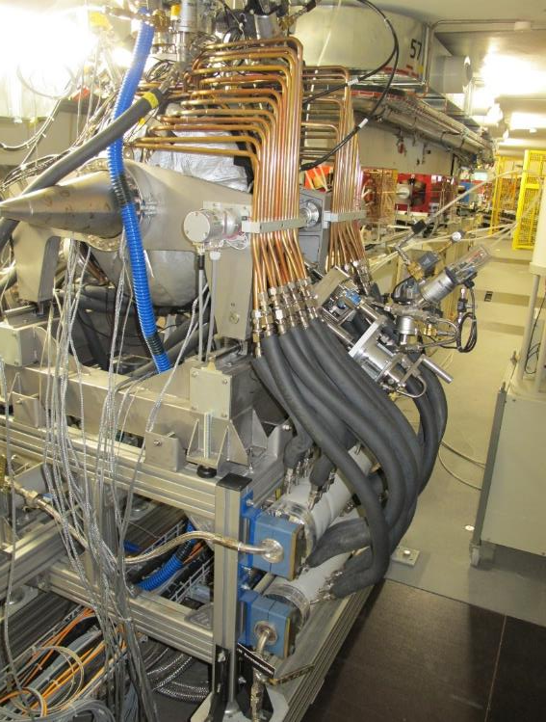
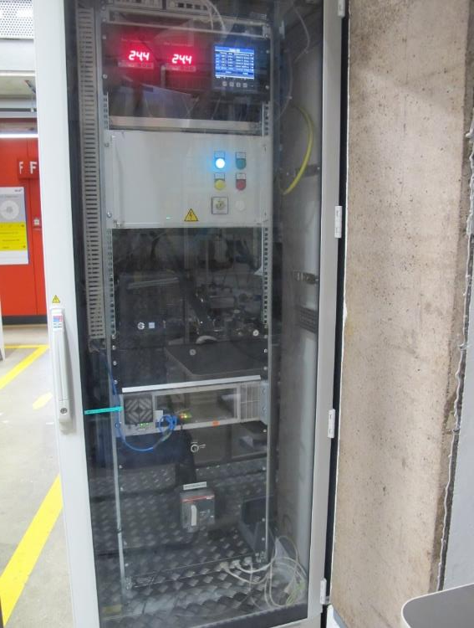
Work on the Booster RF-System
ELETTRA-cavity replaced:
Because of several water leaks, the cavity was replaced by SLS1 storage-ring cavity.
New resonance tuning system based on stepper motor.
RF-radiation perturbed the Storage-Ring BPM-system → additional shielding.
Safety upgrade:
SSA and KSU needed additional safety-box

Slide 15
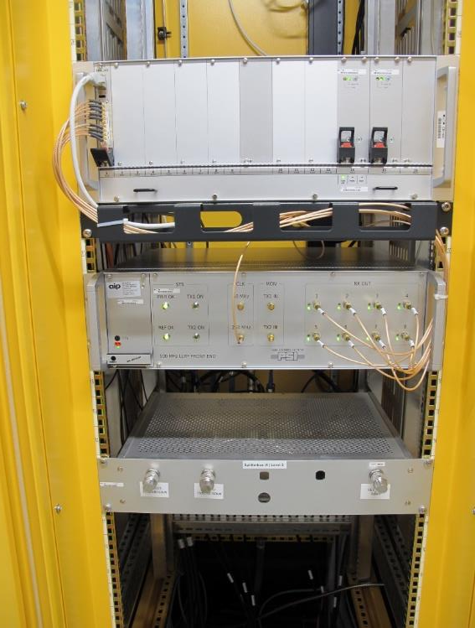
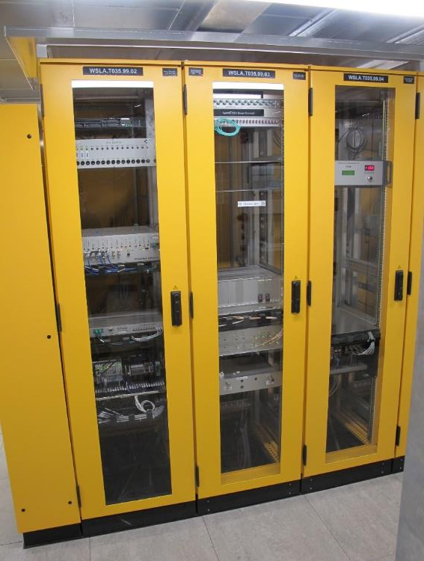
New Digital 500MHz LLRF-Systems
Digital LLRF-System based on Compact PCI
Compatible with LLRF-Systems at other PSI-Accelerators.
Turn synchronous waveforms,
Beam-dump synchronized postmortem acquisition
Dipole-oscillation visible on beam when band-widths are increased
Separated Interlock System based on Spartan-Type FPGA
Prefl. thresholds depend on drive-power and beam-current
Coincidence-arc detection
ECMC based Tuner Control

Slide 16
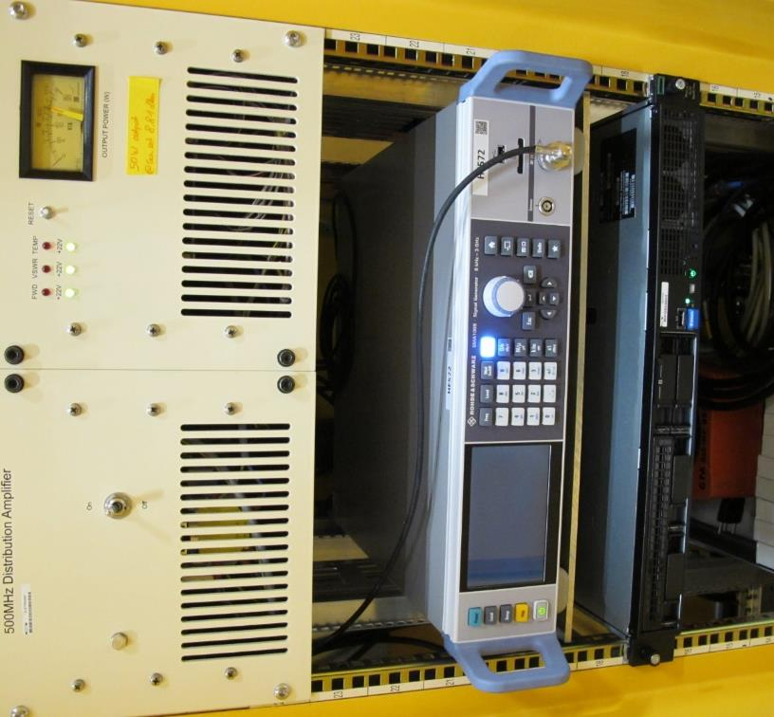
New 500MHz Master Signal Generator
SMA 100B RF generator
with USB remote control interface
operates at 100 Hz command-rate.
Failure because NaN input signal, drove generator out of range of RF-systems.
1x failure of blocked interface → improved.
Improved distribution amplifier
with new power supply, removes many spurs

Slide 17
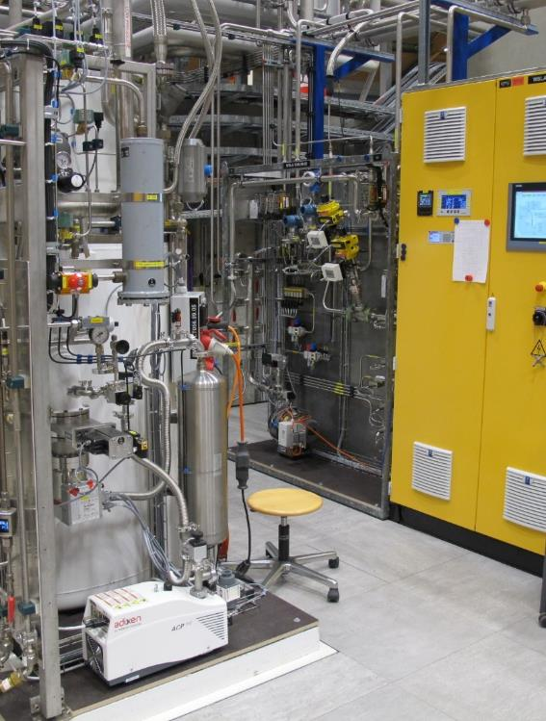
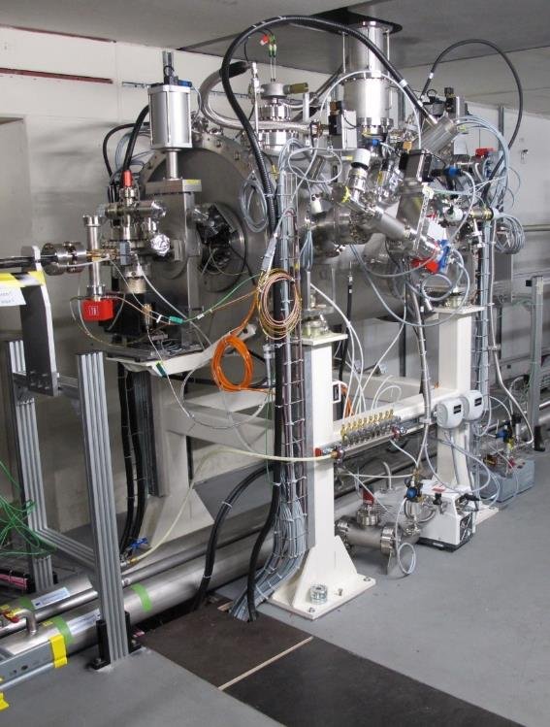
Super-3HC Relocated to Long Straight 09, 2x 250kV
Cryogroup made a new control-rack, valve-panel and –box got refurbished etc.
Pressure fluctuations affected voltage-stability → Cryogroup managed to improve pressure stability.
Slow voltage-asymmetry drift observed at SLS1 does not appear anymore.
Alignment of taper in front of Super-3HC was insufficient → replaced by taper with bellow

Slide 18
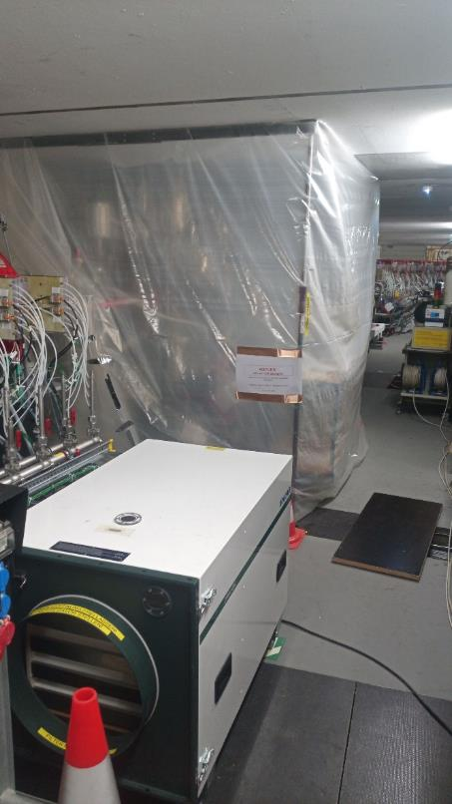
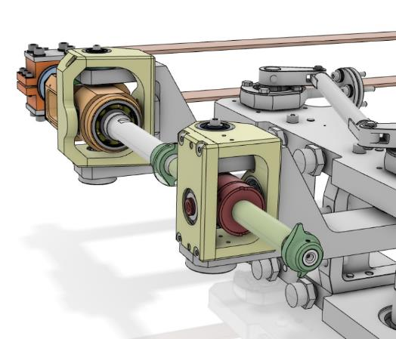
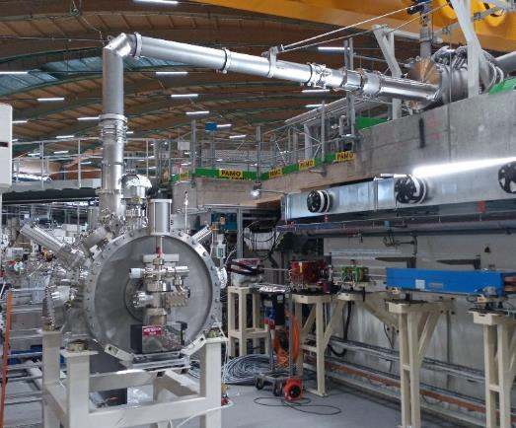
Super-3HC Relocated with Upgraded Tuning System
1st problem (tuner upgrade): 3d-file from CEA was different from reality
Last minute modification of the fixation
2nd problem (tuner motor): 1 motor did not move anymore at cold cavity
Replaced tuner motor and gearbox in an improvised clean-room
Lab-cryo tests were not conclusive, ordered one more spare
3rd problem (taper alignment): upstream synchrotron-radiation taper was completely misaligned to beam
Got new taper-piece with bellow.

Slide 19
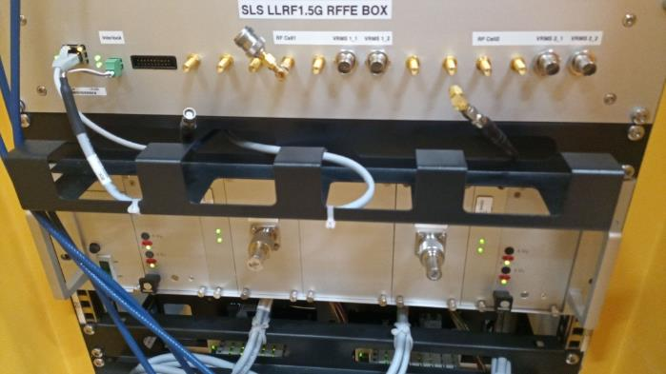
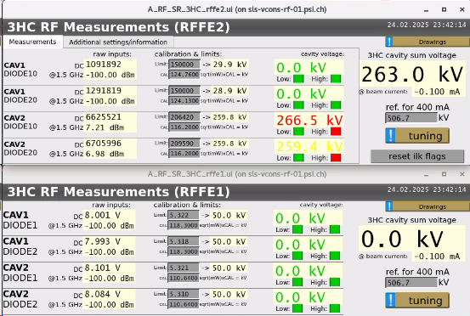
ILK/(LLRF) 1500 MHz for the Super-3HC
Status
Installed and initially calibrated both LLRF/ILK frontends
RFFE1 from SLS-1: RFFE1 → analog signal → MIS PLC → BDC
RFFE2 protoype: RFFE2 → BDC
Large ch-to-ch drift: 0.24 dB after 1 day (screenshot top left)
Requirements:
Reaction on faults longer than 5 us (5 turns). (=inhibit/filter shorter faults)
Max. latency: 50 us. Measured 25 us.
Beam-based calibration at 400mA
Outlook
Revise protoype, goal is to install the series version in SD2026.
Same measurement and protection functionality
Added internal self-calibration
Added 1.5 GHz to 500 MHz downconverter, for beeing able to install a standard type 500 MHz LLRF to allow turn-by-turn DAQ of the voltage and the phase of the Super-3HC cavities.
Slide: R. Kalt, group 8417, 22.02.2025

Slide 20
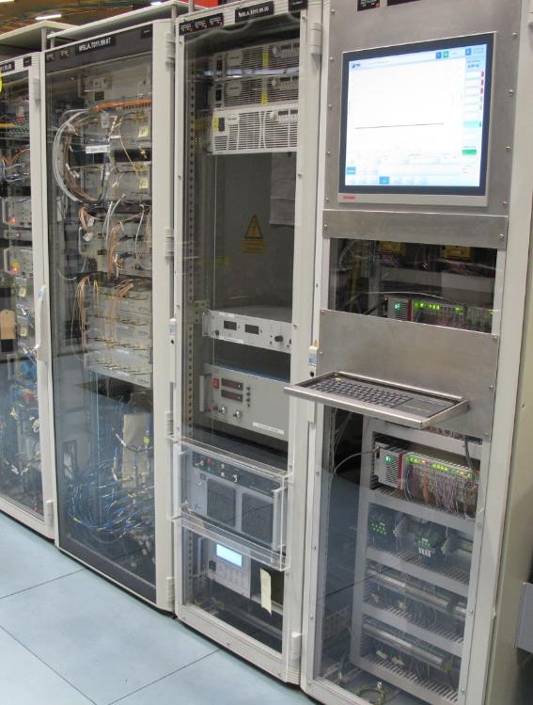
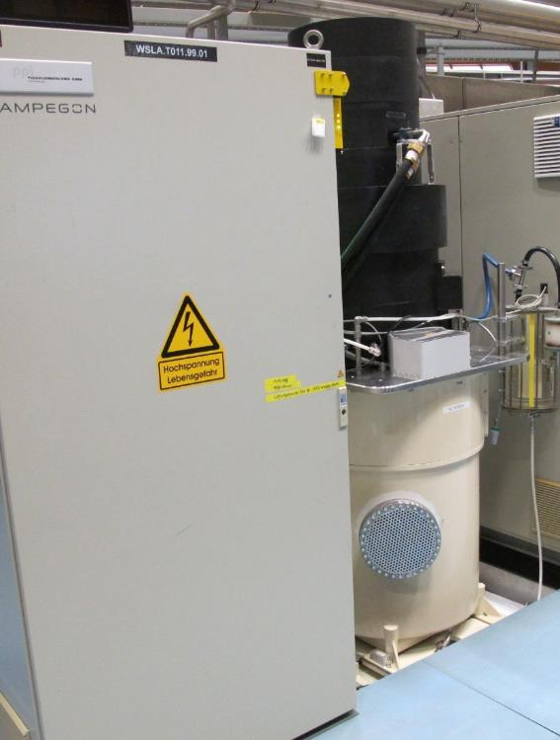
Upgrade of ACCEL-LINAC
Safety relevant components replaced and upgraded (beam-blocker, door-switches, Personal-Safety-System.
Pilz controller for safety components.
PLC replaced by Beckhoff-PLC
New Klystron-solenoids+PS, shielding
Operation optimized for reduced set of LINAC solenoides
In 2026: Replacement of LINAC solenoids+PS and upgrade of waveguide-run, evtl. adaptation of Klystronplate to Canon-Klystrons.

Slide 21
Special Challenges
Covid19 during design-phase, procurement-system transfer to SAP, upgrade of CAD-system, new telephone-solution…
Water-leaks from the roof during civil engineering.
Super-3HC tuning-system upgrade: Geometry was not as expected from 3D-drawings, tuning motor got stuck.
LLRF-System: bandwidths of amplitude- and phase-feedback loops had to be reduced to reduce longitudinal oscillation. → Advanced characterization and upgrade of feedback loops (mode 0-damper).

Slide 22
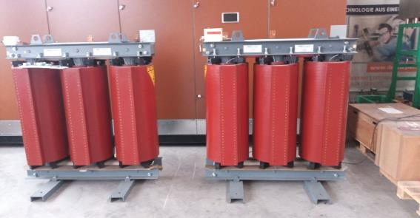
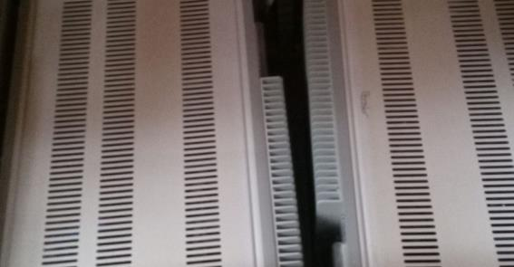
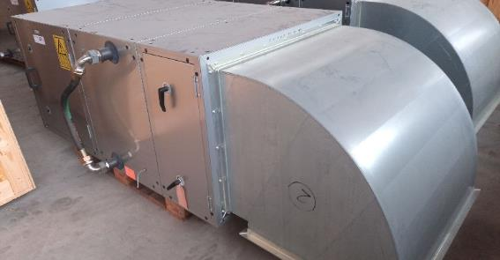
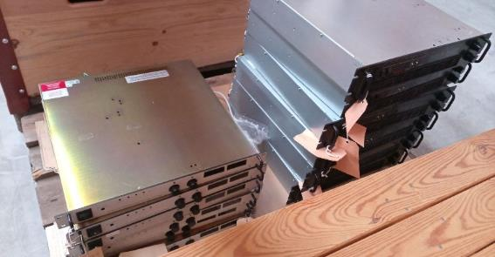
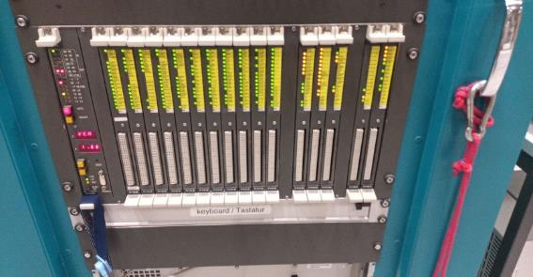
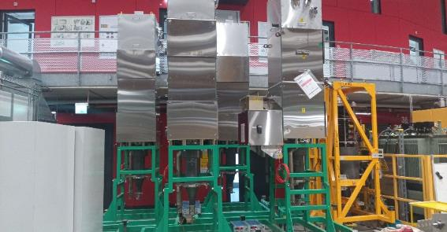
Second Hand from 4x 500MHz Ampegon KSUs. Interested?
Transformators for Klystron Supply Unit
Old AFT Circulator Temperature Control Unit TCU3
Air-Cooling Unit for Klystron Supply Unit
Klystron Auxiliar Power Supplies
Ampegon Klystron control-system components
500MHz Klystrons from EEV or Thales

Slide 23
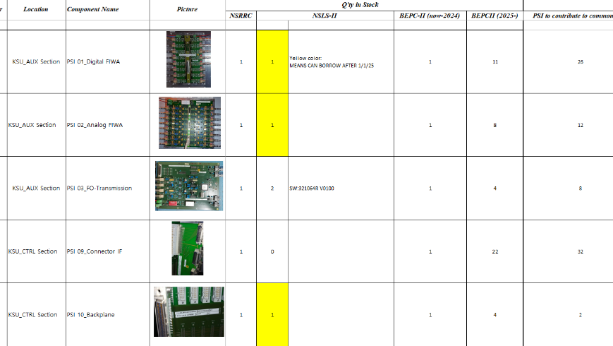
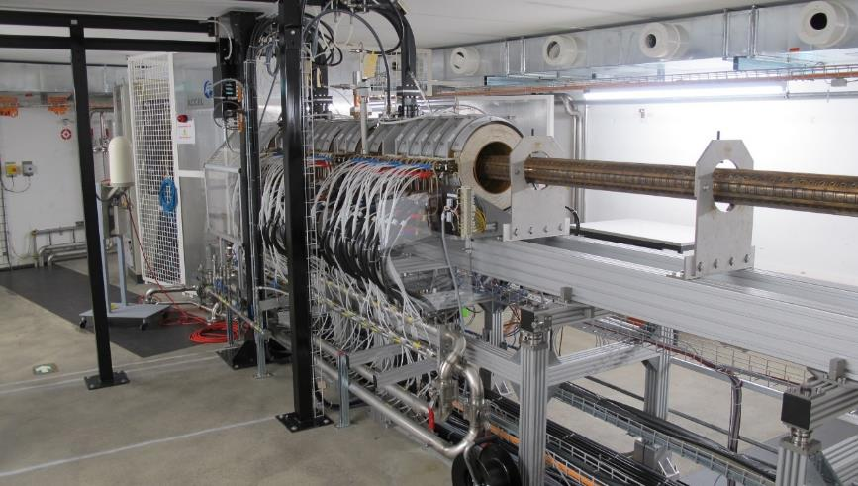
Spare-Part Table for AMPEGON KSUs, Extension for LINAC
https://drive.google.com/drive/folders/1Mm6sxhJcHU8-c7NWd_mLzV-8obGov-Hy
From online workshop for «Ampegon RF Transmitter for Operating Light Source» organized by NSRRC
We would like to extend the table to ACCEL-RI-LINAC compatible components. At PSI, contact person is Carl Beard.

Slide 24
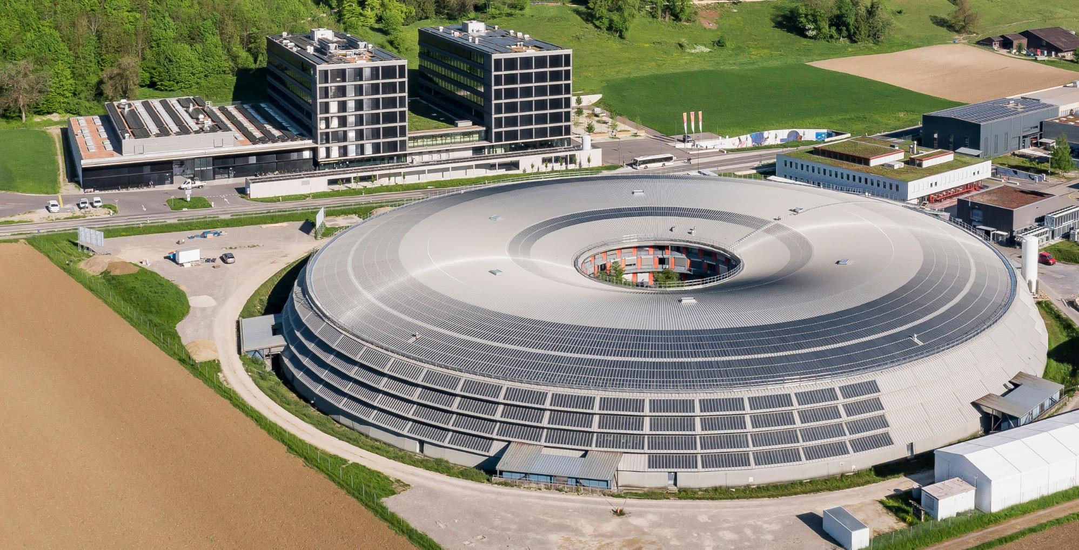
Thank you for your attention
Energy saving of 35%, → about 8.3GWh/a → about 1.4 M€$/a

