Slide 1
Design of the 3.5th-Harmonic Active Cavity for the BESSY II Storage Ring
Dr. Andranik Tsakanian, on behalf of BESSY II Teams
ESLS RF & HarmonLIP Workshops 2025
22 - 24 October 2025
ALBA Synchrotron, Barcelona, Spain
HarmonLIP 2025
Workshop

Slide 2
Outline
Introduction to BESSY II storage ring
BESSY II Plus: normal conducting 3rd & 3.5rd harmonic cavities
Design of 3.5rd harmonic cavity
HOM power levels.
Outlook
2

Slide 3
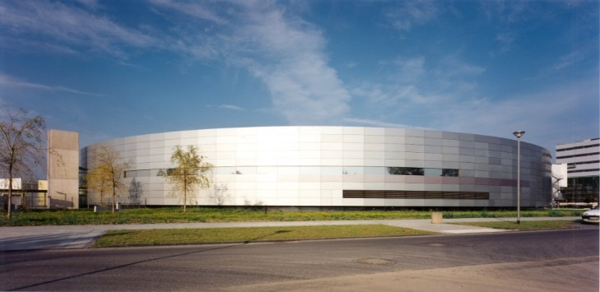
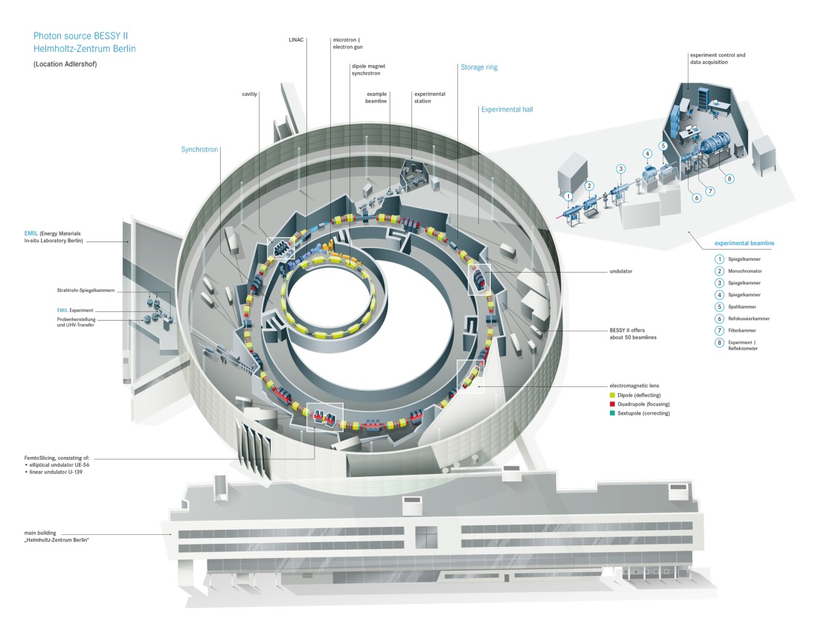
BESSY II Storage Ring
BESSY II is a 1.7 GeV synchrotron radiation source operating for 20 years in Berlin
Core wavelength in the range from Terahertz region to hard X rays
BESSY II Parameters
Lattice | DBA
Circumference | 240 m
Energy | 1.7 GeV
Current | 300 mA
RF Frequency | 500 MHz
RF Voltage | 1.5 MV
Bunch Length | 15 ps
Emmitance | 6 nm rad
2

Slide 4
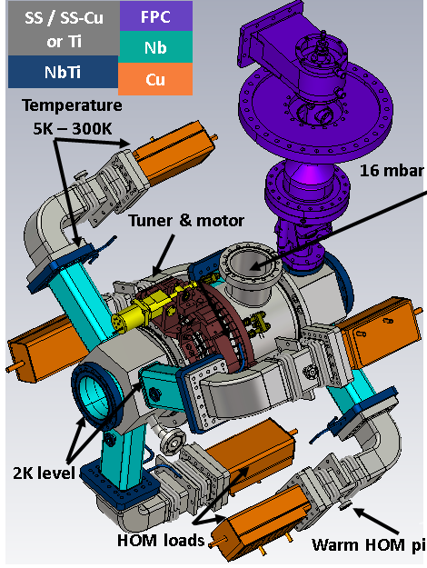
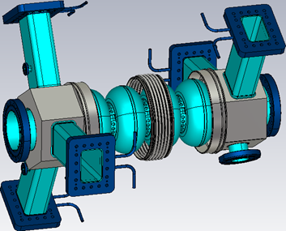
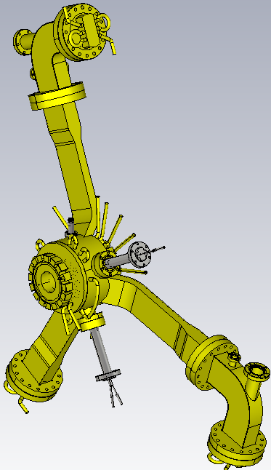
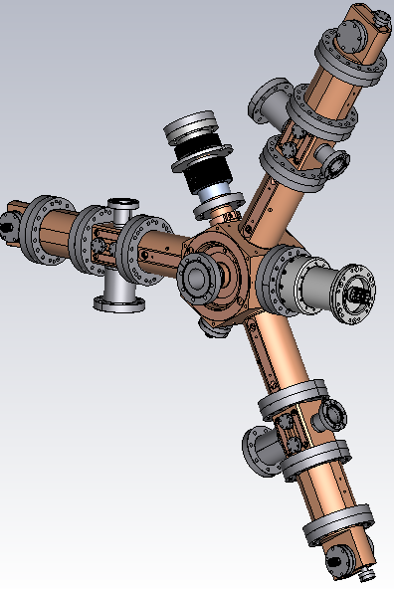
3rd & 3.5rd Harmonic Cavities
Superconducting HOM Damped cavities BESSY VSR DEMO
Normal Conducting HOM Damped Cavities
1.5 GHz EU-HOM Damped Cavities (Active)
1.5 GHz Landau Cavities (Passive)
3

Slide 5
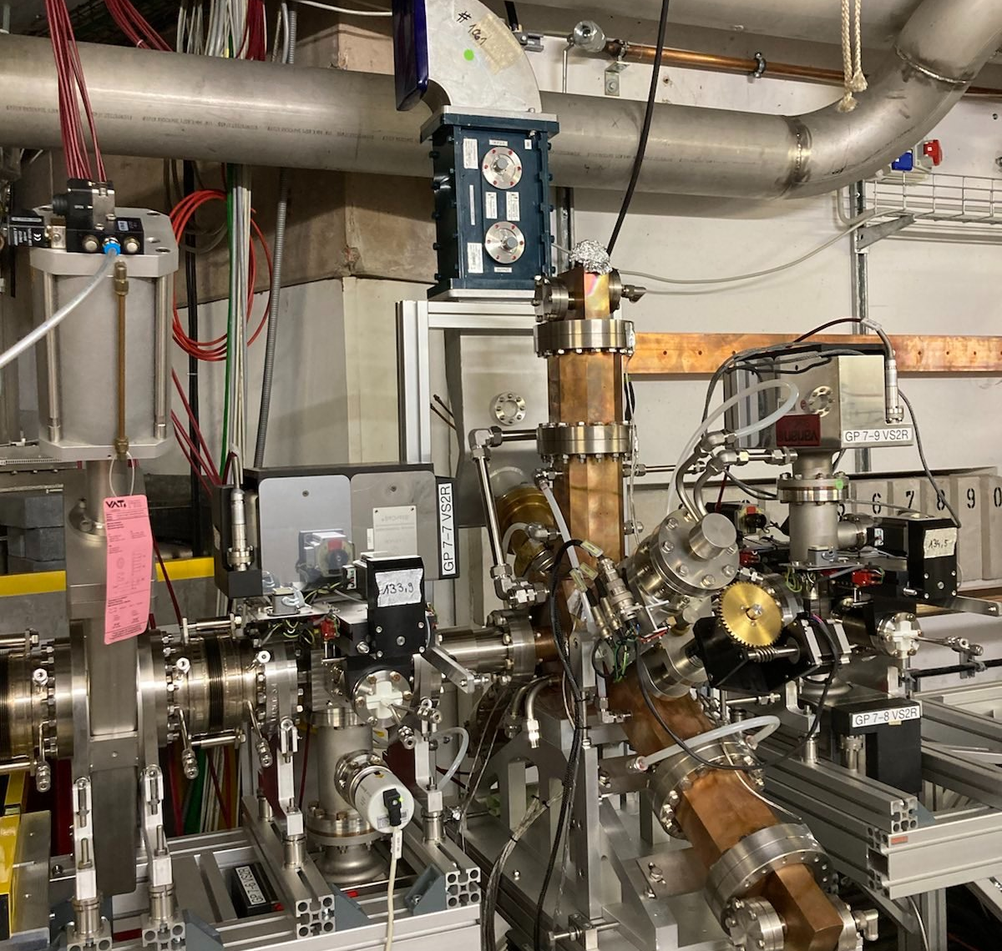


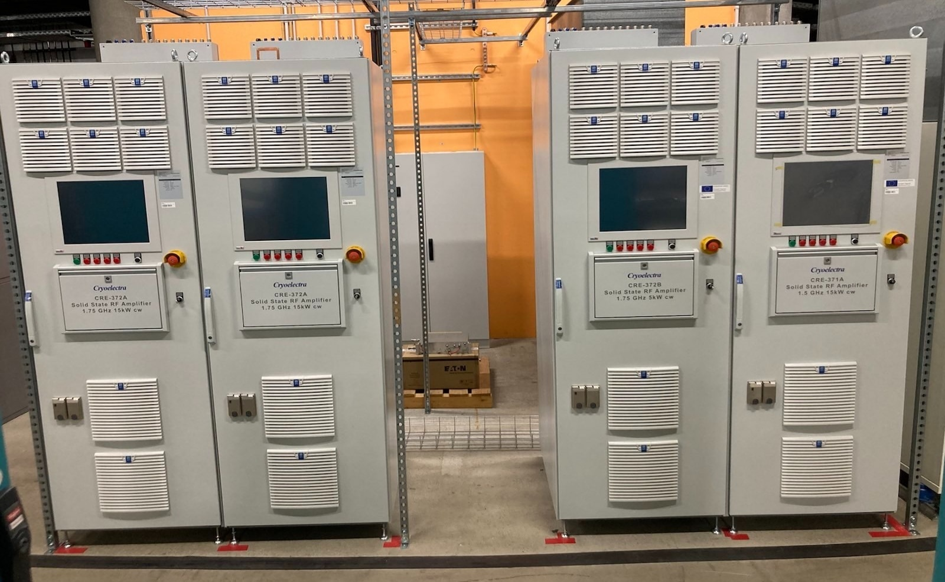
BESSY II Plus: Normal Conducting 3rd & 3.5rd Harmonic Cavities
Prototype by ALBA Installed in BESSY II 2022 → 2025
EU Level Collaboration
5 x 1.5 GHz EU-HOM Damped Cavities are in Fabrication Stage. First cavity is delivered.
4 x 1.75 GHz EU-HOM Damped Cavities are ordered with delivery in 2026.
15 kW CW Solid-State Amplifiers 1.5 & 1.75GHz are in House

Slide 6
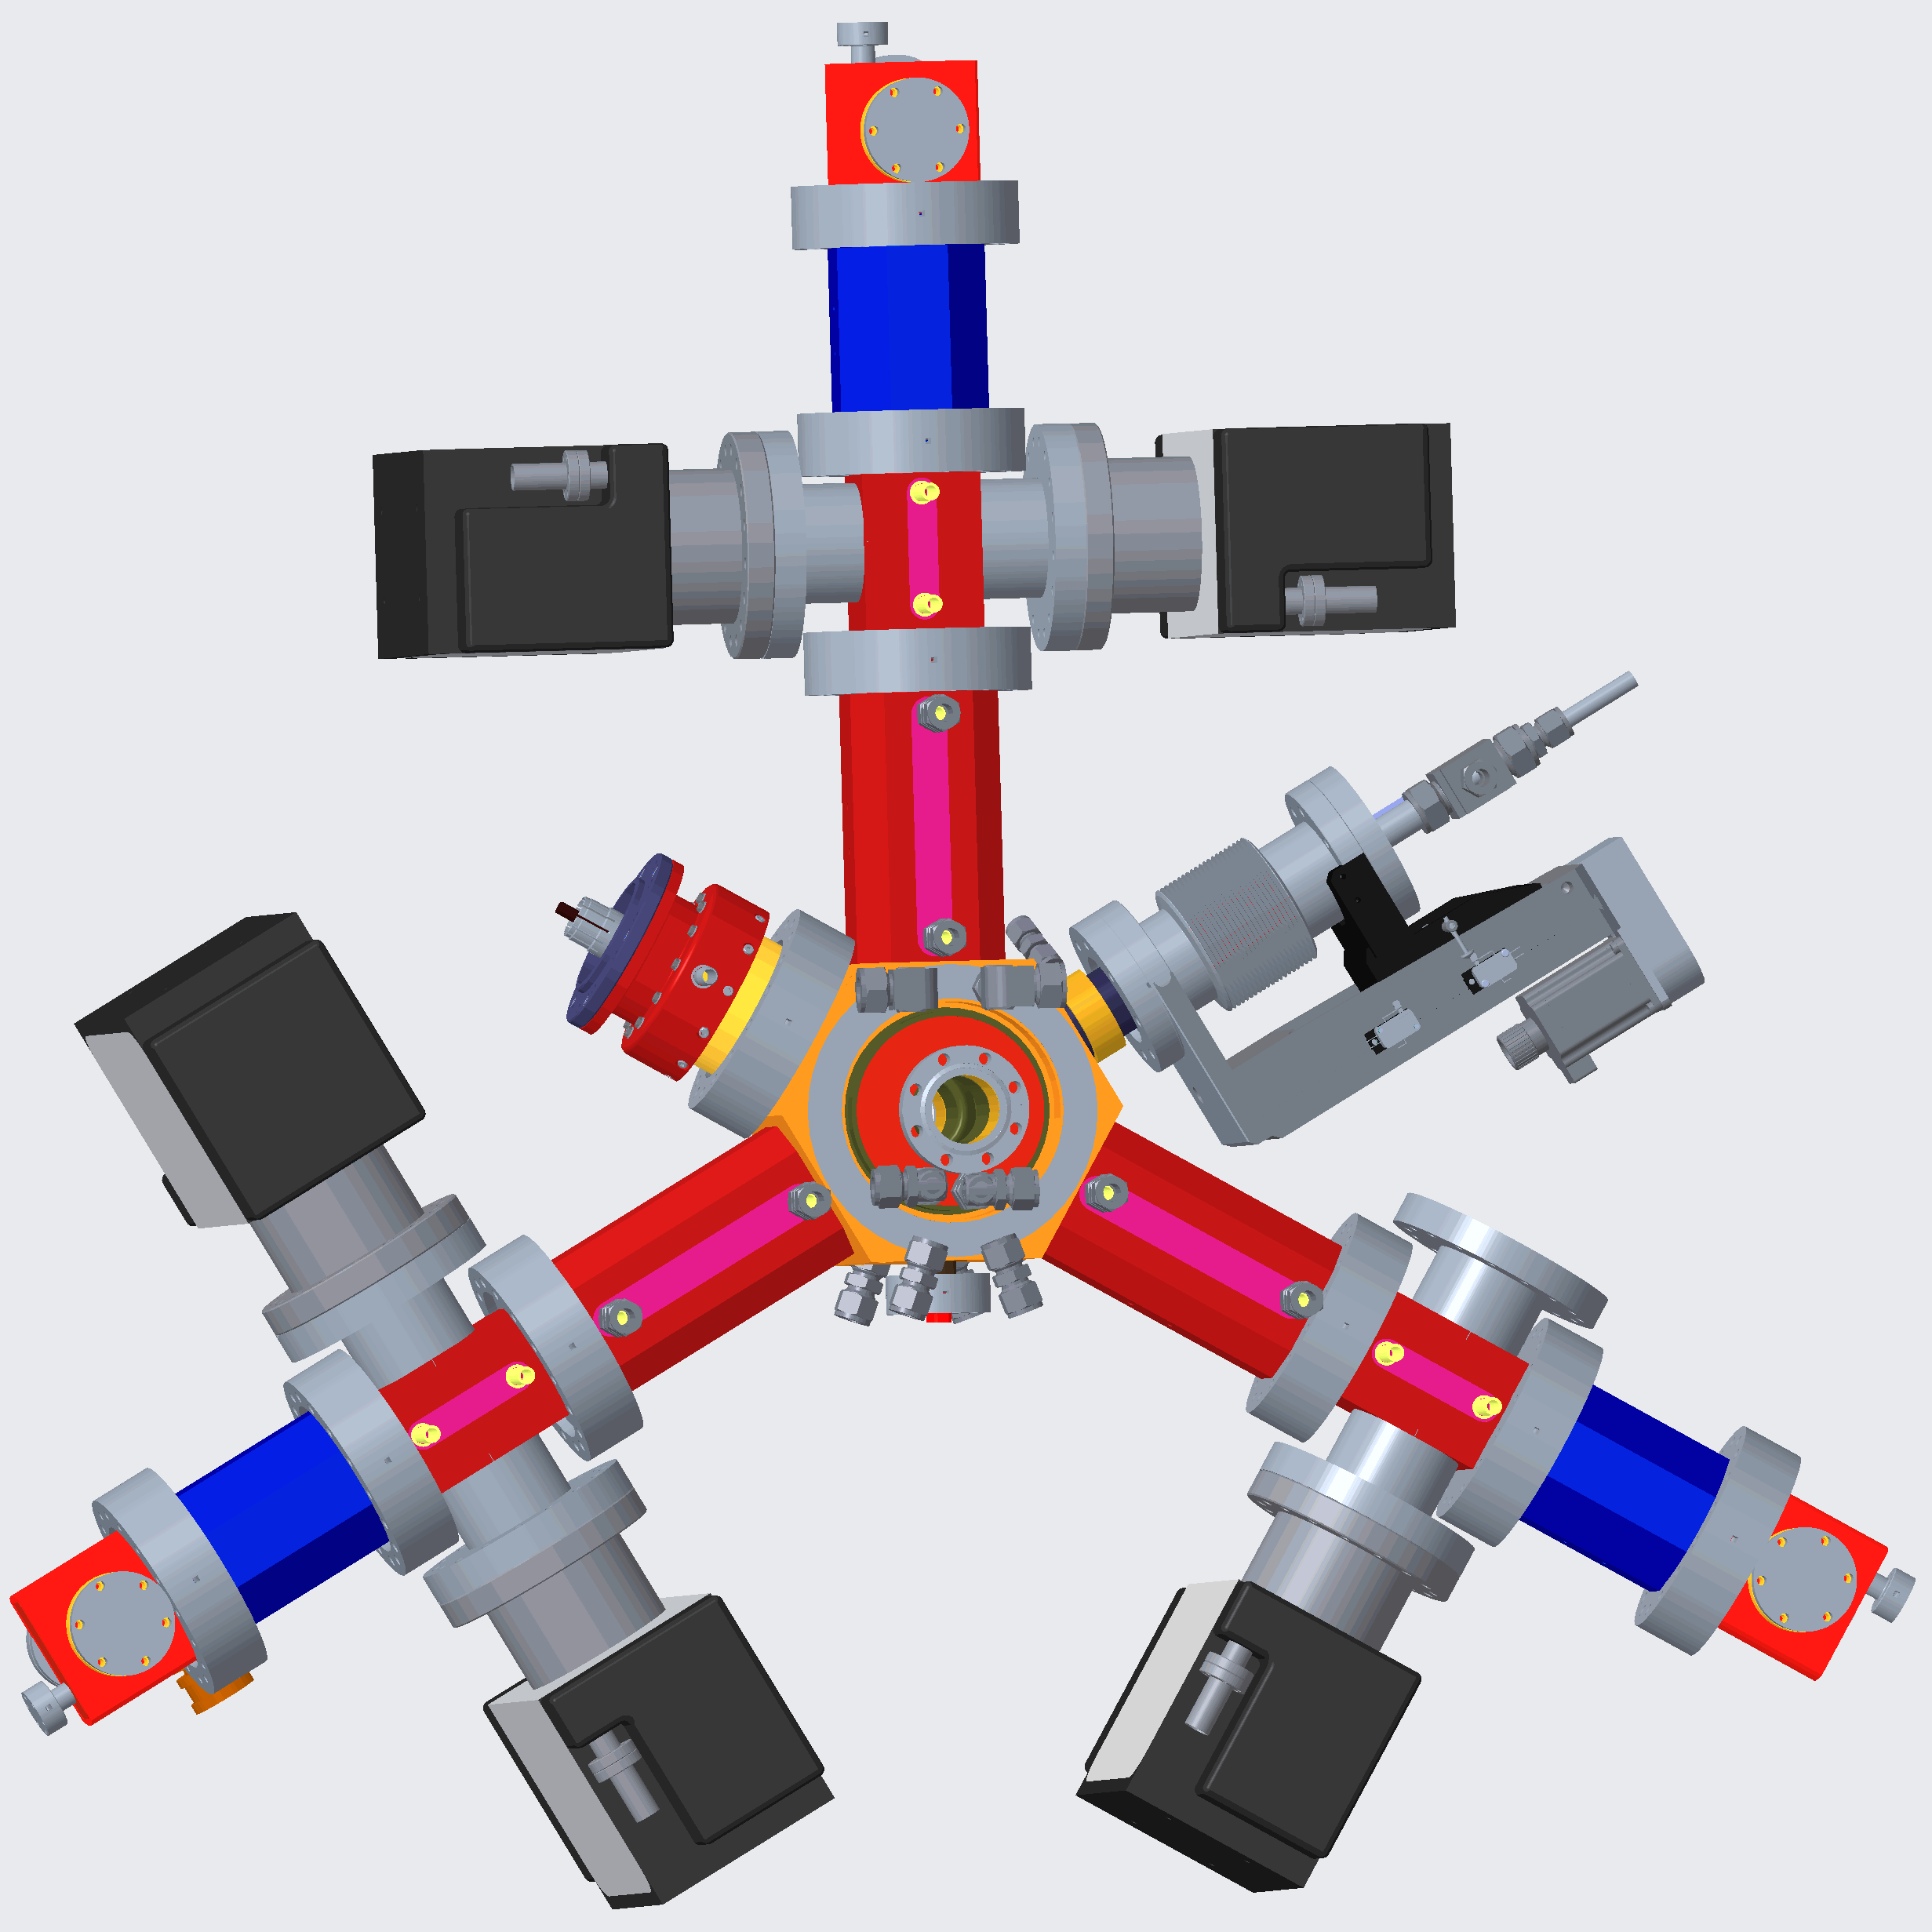
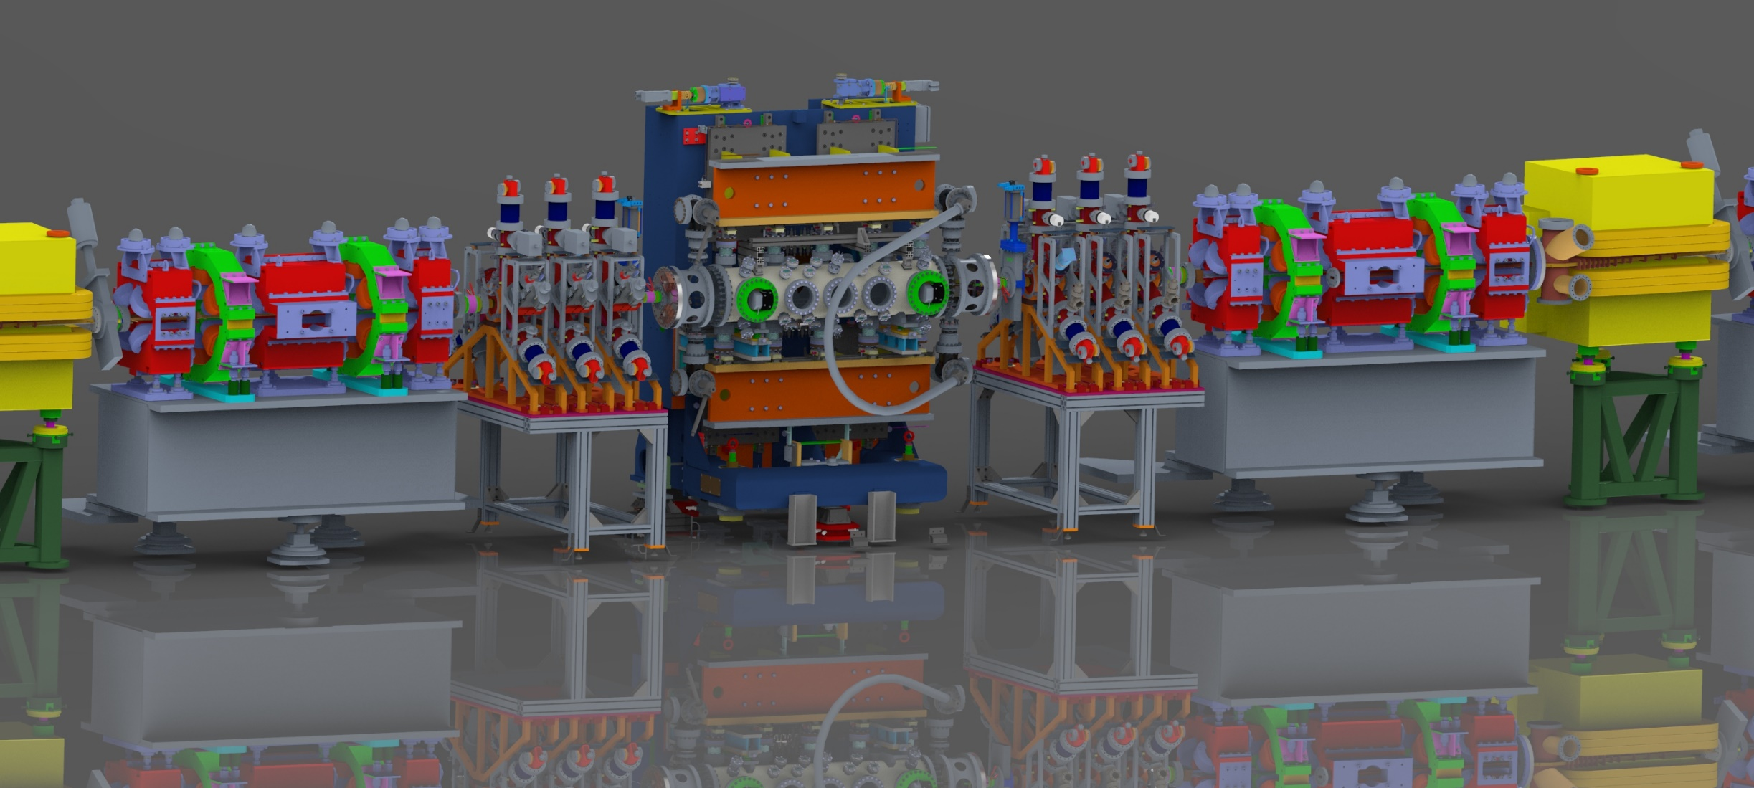
BESSY II Plus: Normal Conducting 3rd & 3.5rd Harmonic Cavities
Prototype by ALBA Installed in BESSY II 2022 → 2025
EU Level Collaboration
5 x 1.5 GHz EU-HOM Damped Cavities are in Fabrication Stage. First cavity is delivered.
4 x 1.75 GHz EU-HOM Damped Cavities are ordered with delivery in 2026.
15 kW CW Solid-State Amplifiers 1.5 & 1.75GHz are in House

Slide 7
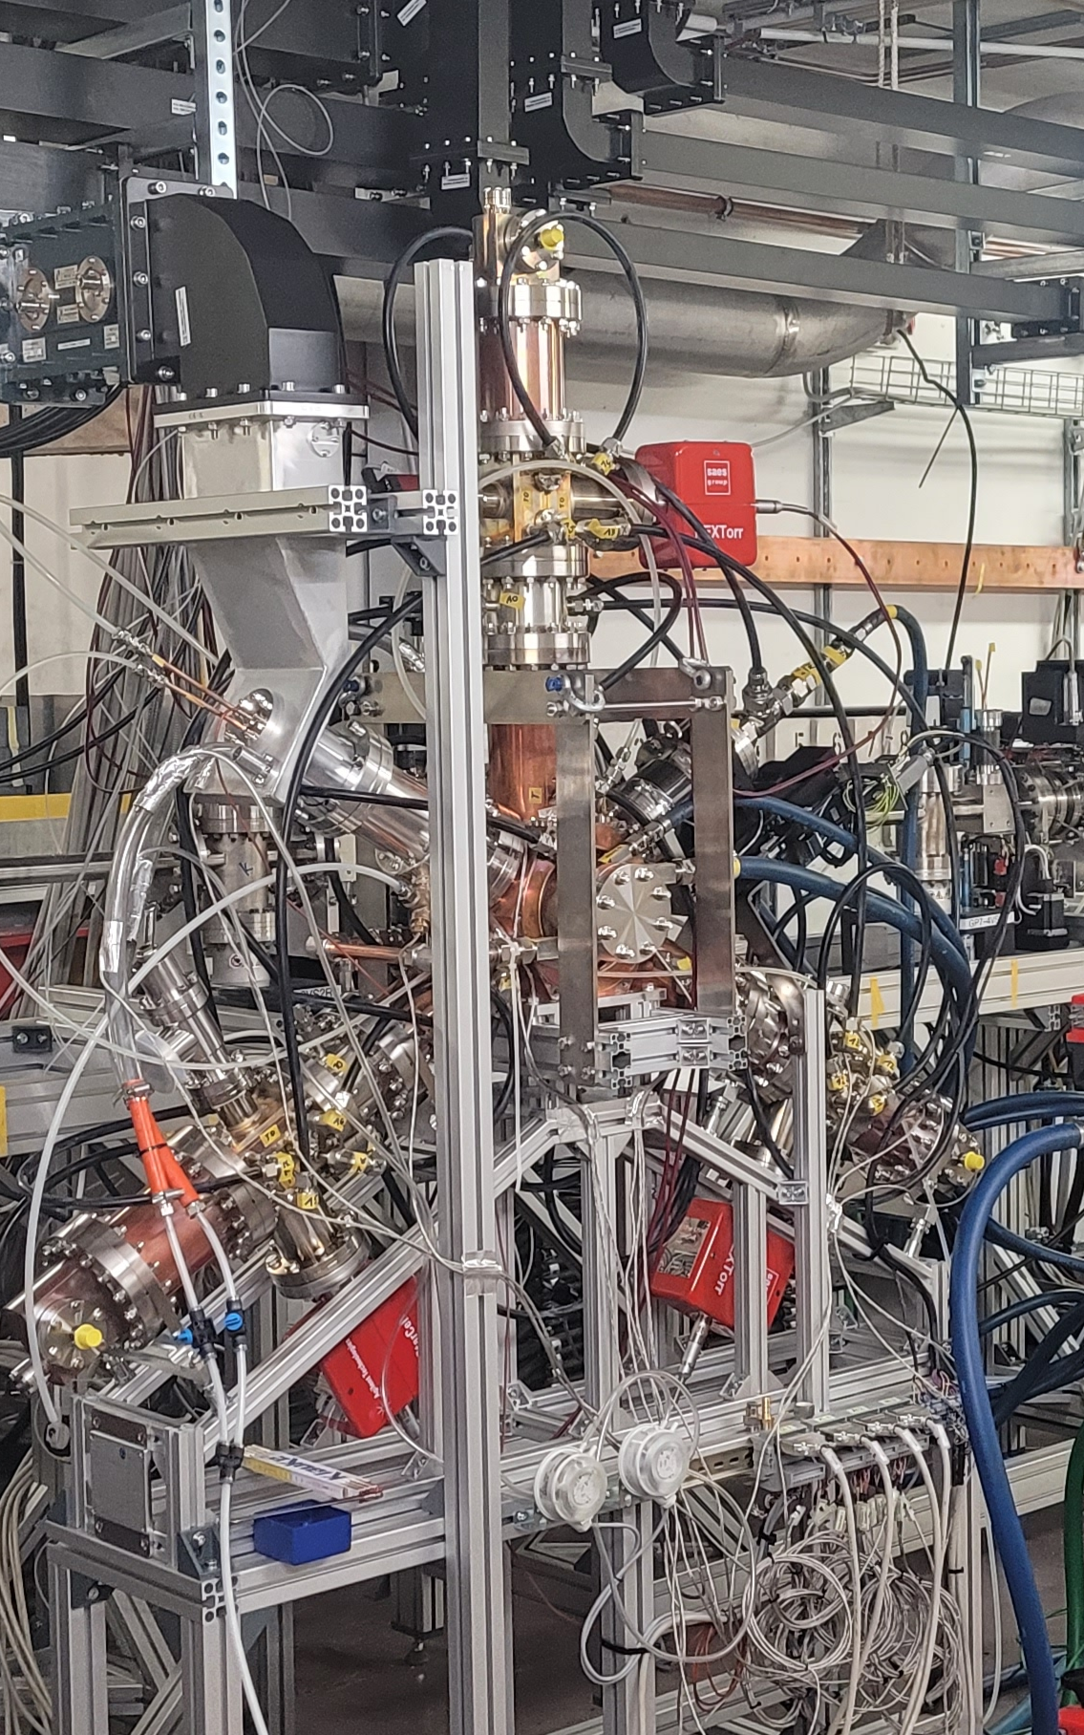
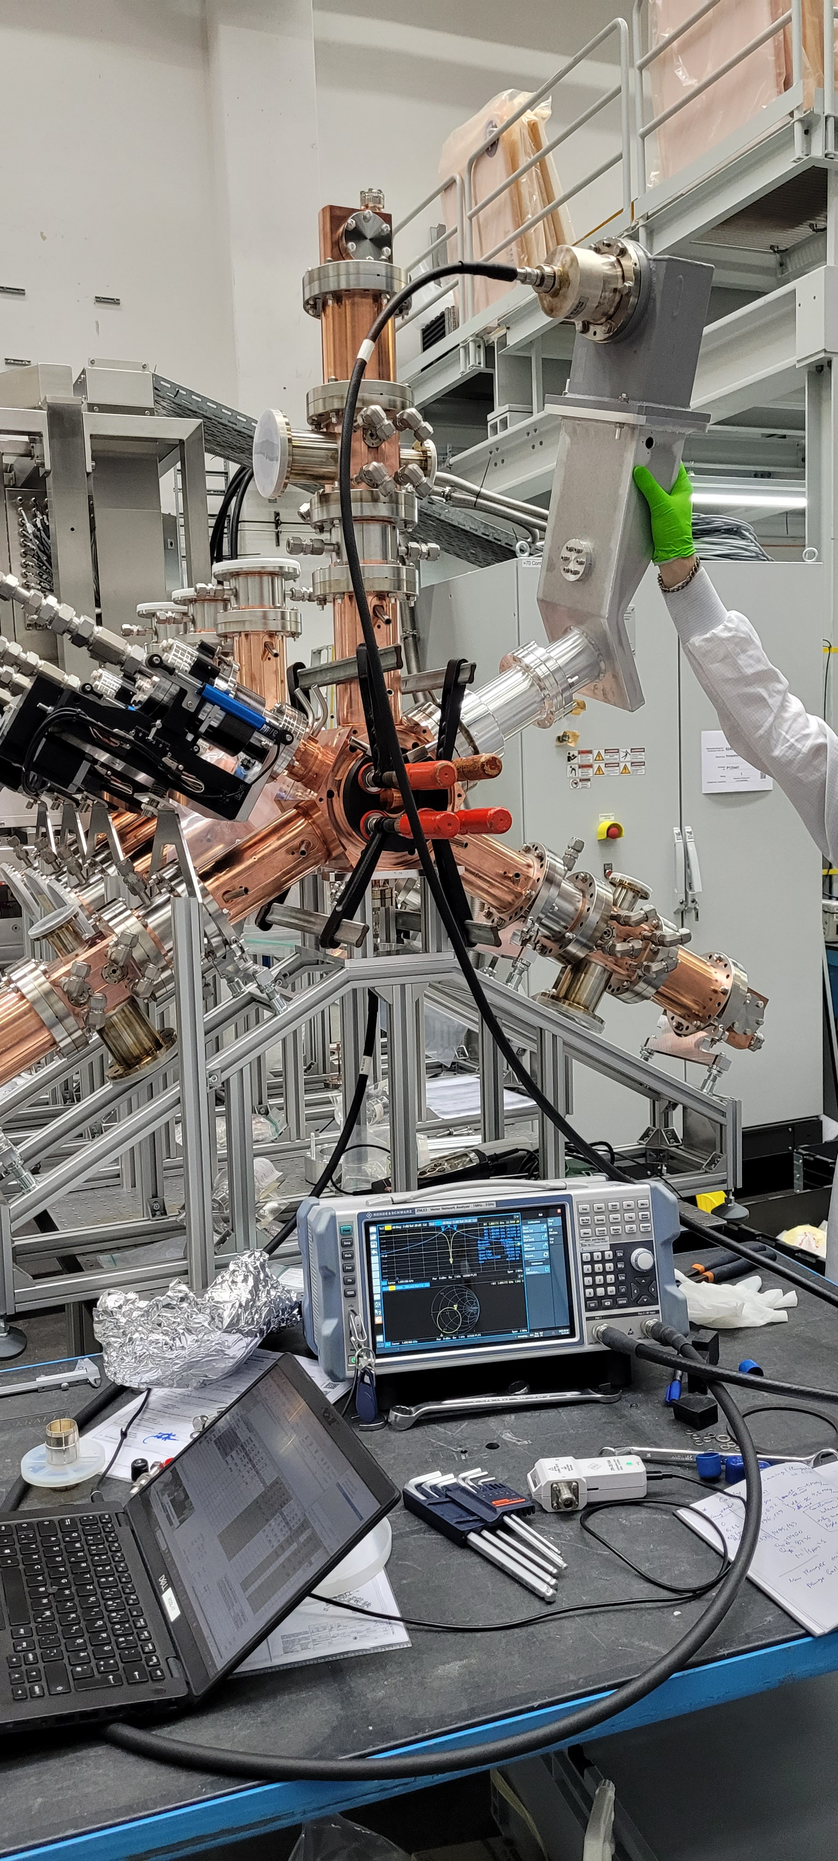

3rd Harmonic Cavities
Cavity tuning at RI
Cavity installed at HZB for high power test.
First series cavity arrived & is prepared for high power conditioning.
Factory acceptance is successful and remaining 4x cavities will be delivered this year.

Slide 8
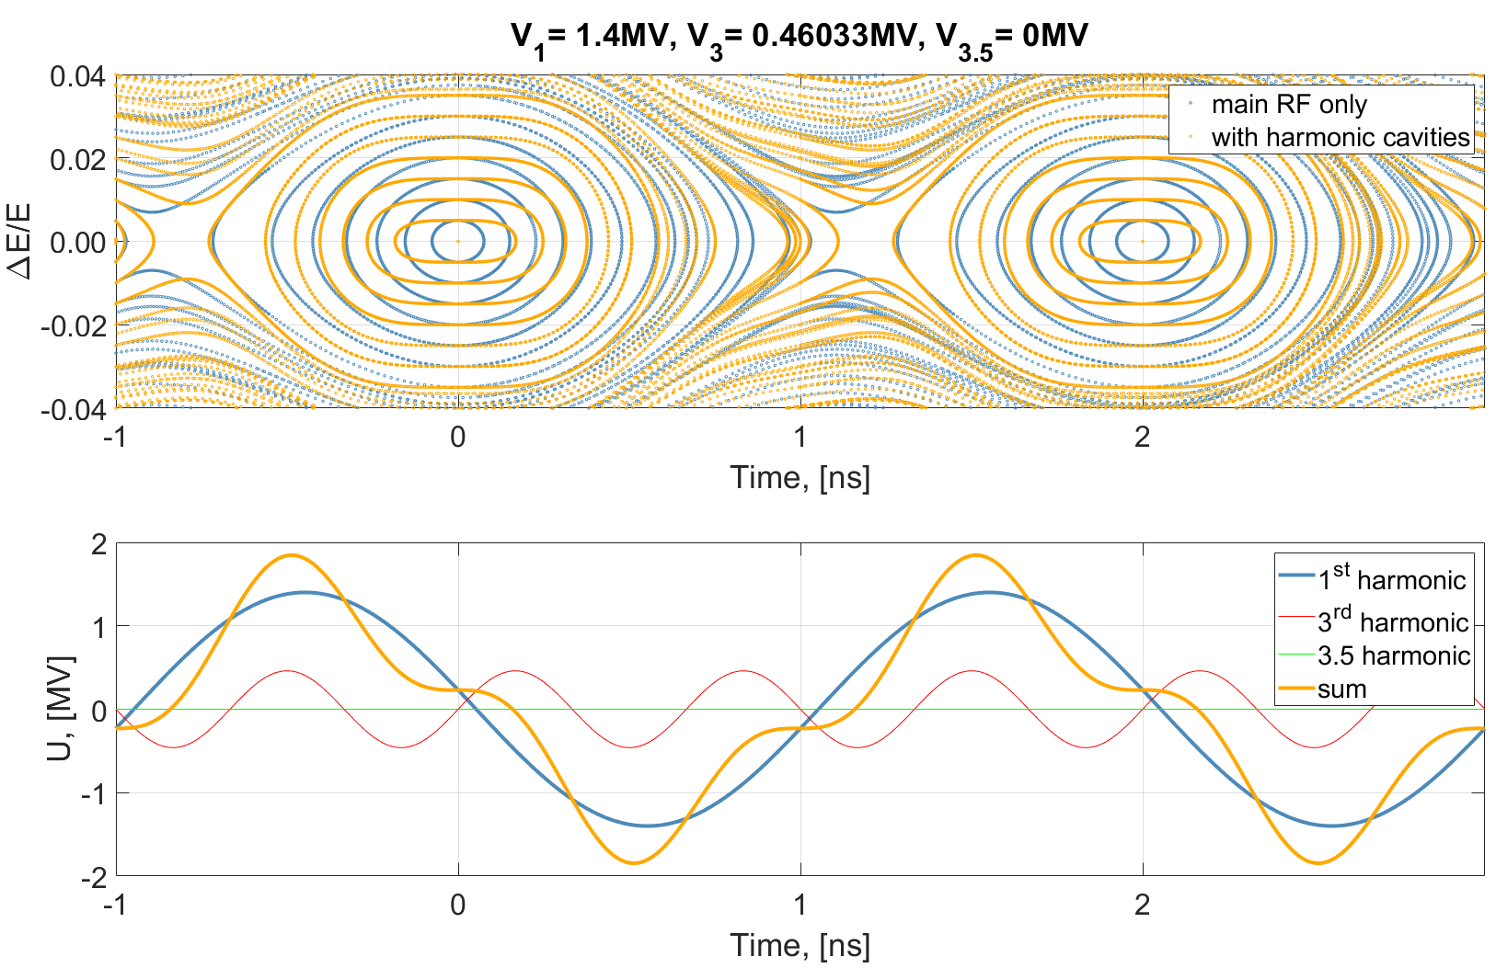
Energy Acceptance Lengthening Mode
Quartic Potential
9
Courtesy of A. Matveenko

Slide 9
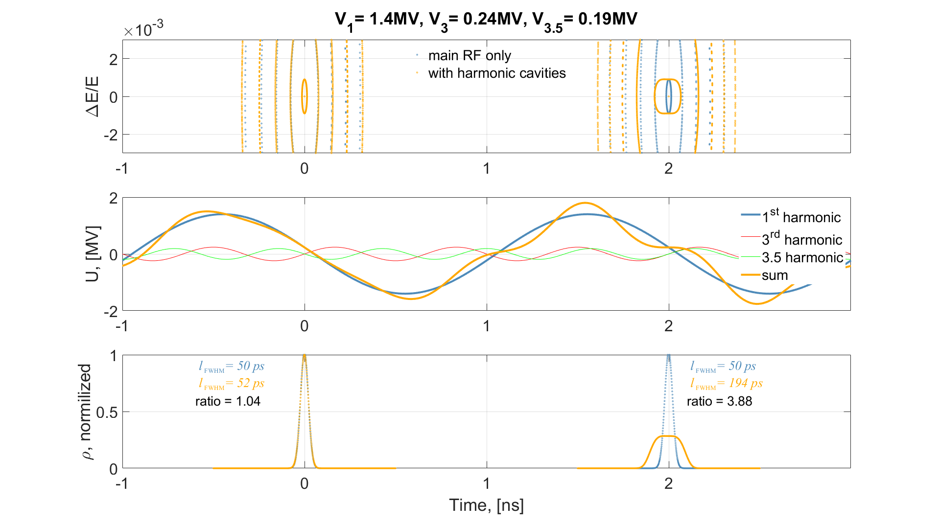
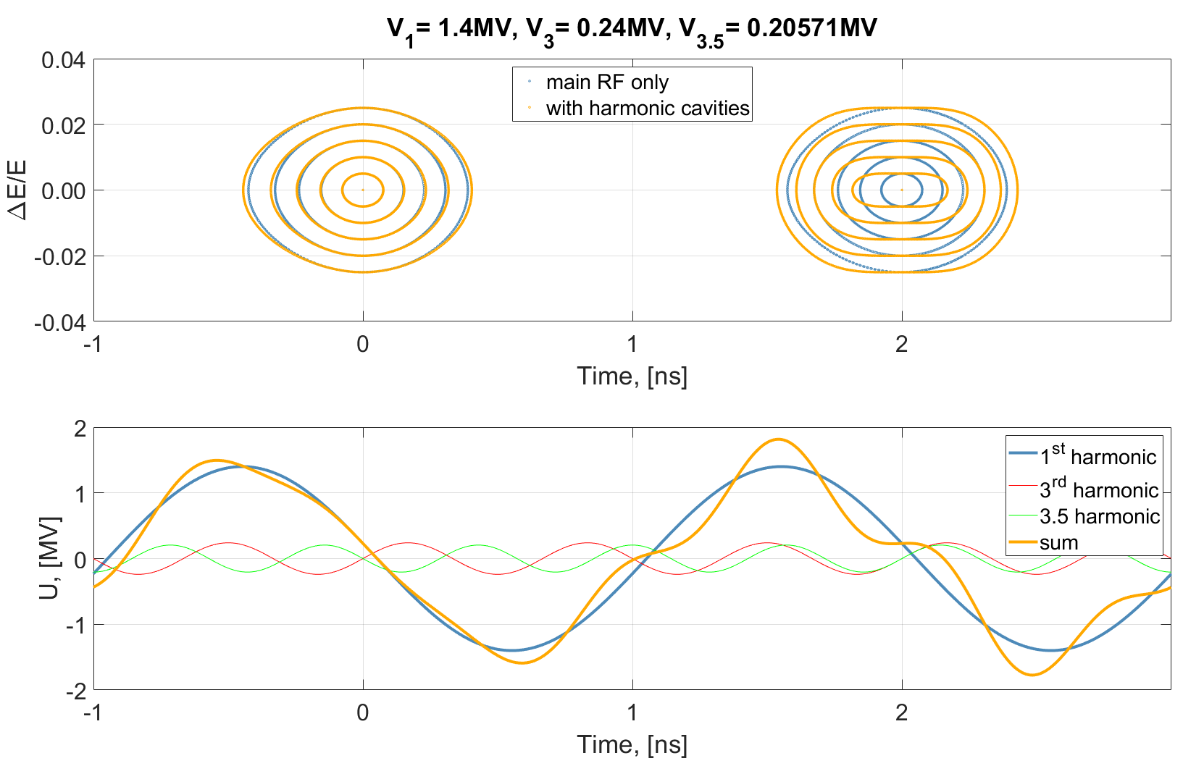
Energy Acceptance Normal-Lengthening Mode
∆E/E~ 10⁻³
∆E/E~ 10⁻³
Natural ∆E/E~ 10⁻³
Quartic Potential
10
Courtesy of A. Matveenko

Slide 10
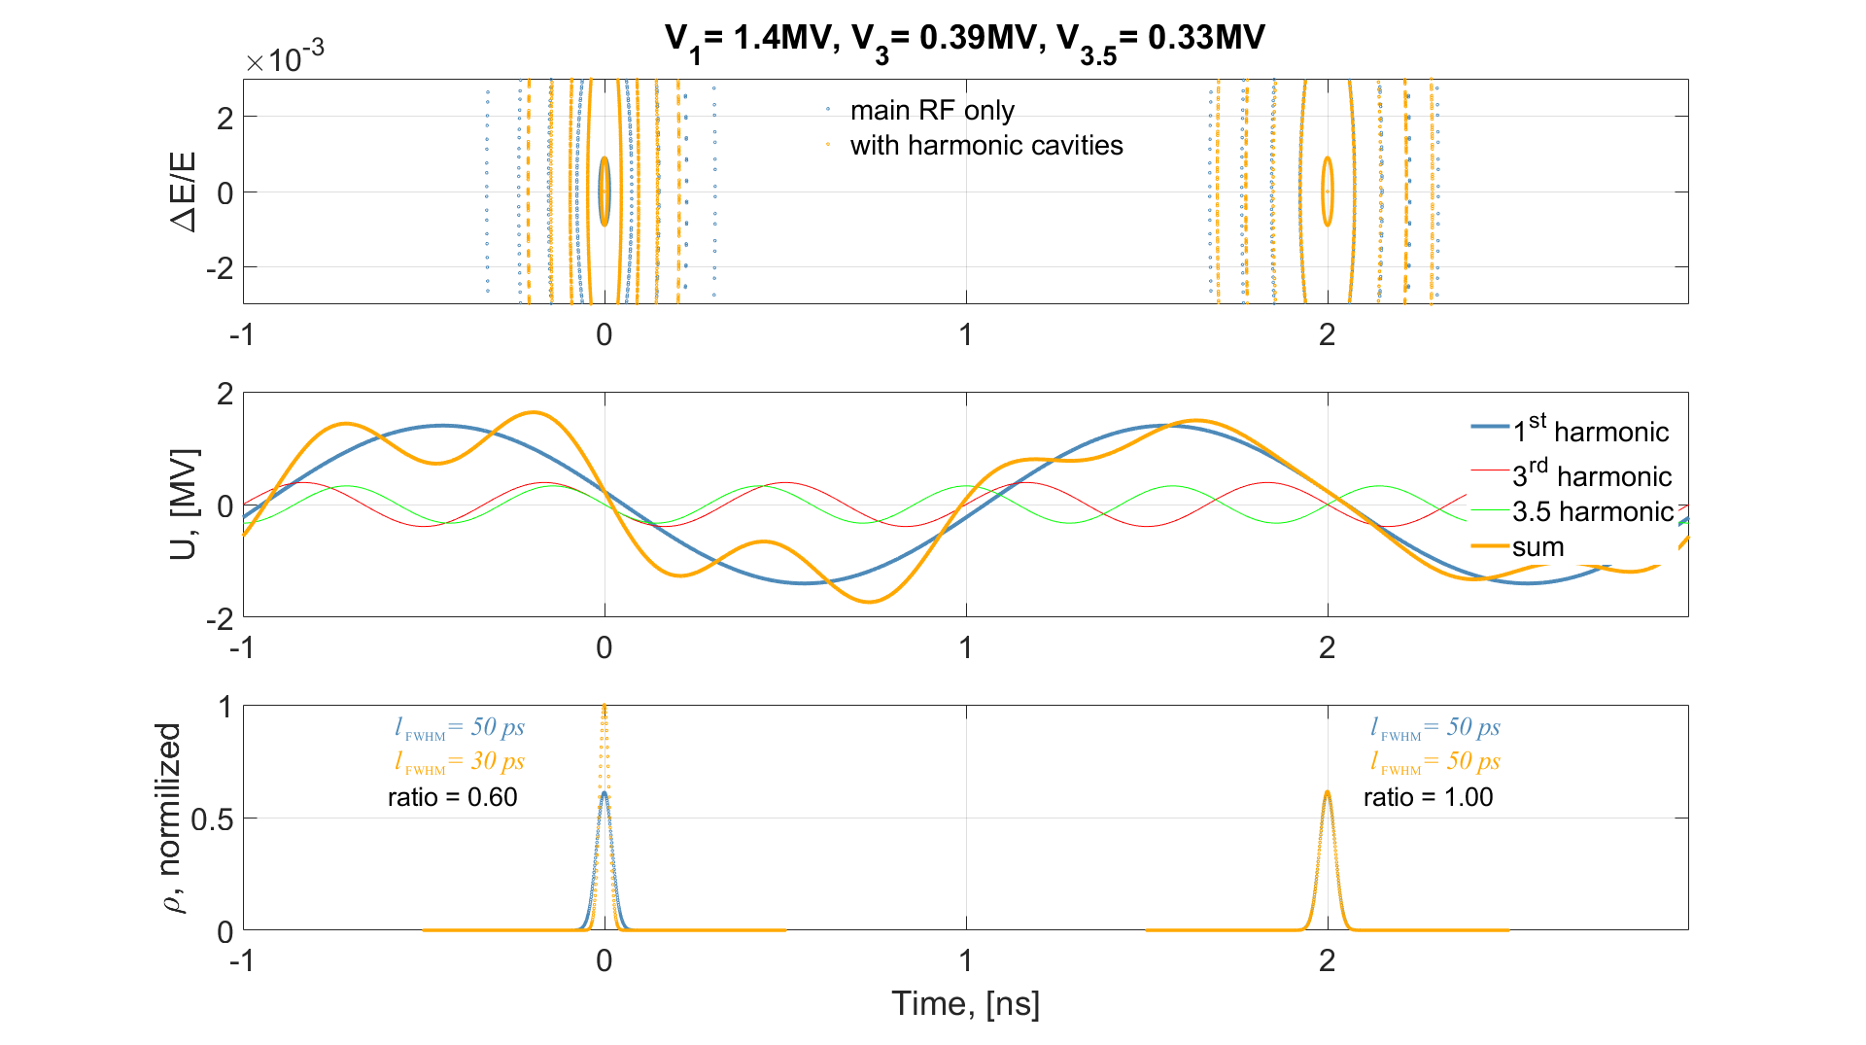
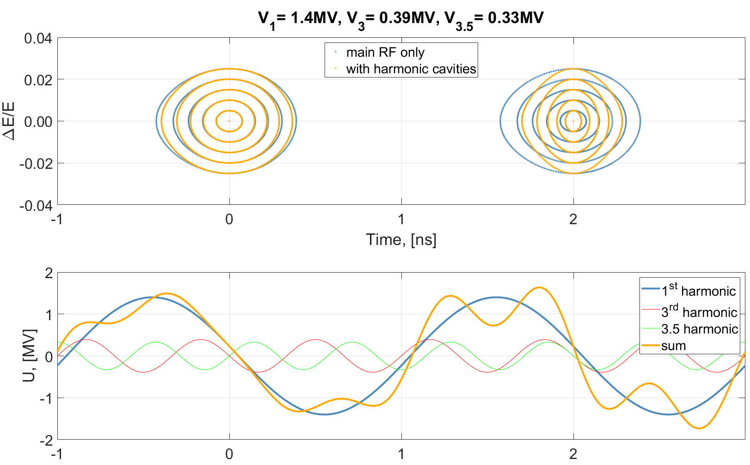
Energy Acceptance Normal-Shortening Mode
∆E/E~ 10⁻³
∆E/E~ 10⁻³
Natural ∆E/E~ 10⁻³
11
Courtesy of A. Matveenko

Slide 11
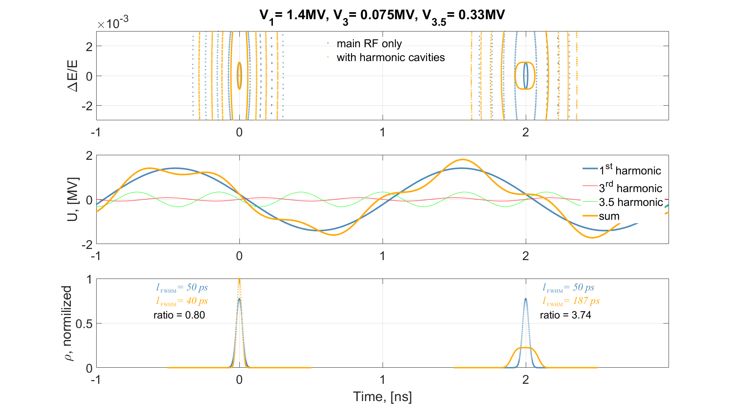
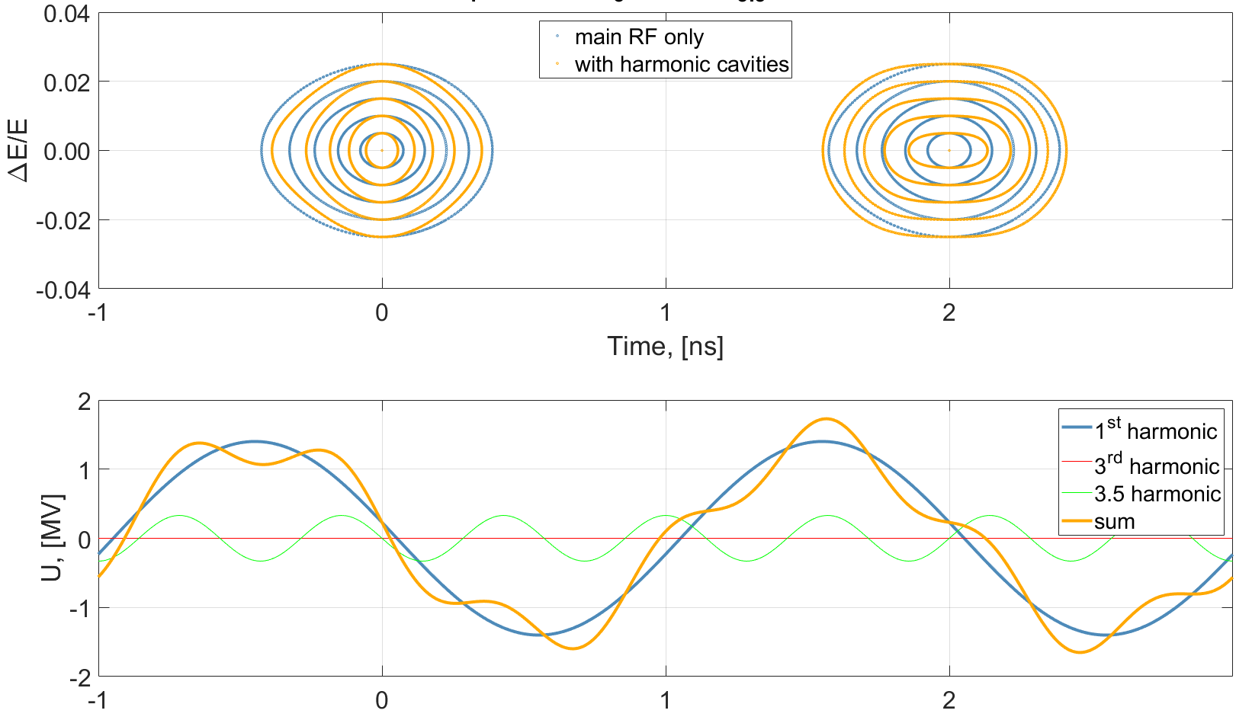
Energy Acceptance Shortening-Lengthening Mode
∆E/E~ 10⁻³
∆E/E~ 10⁻³
Natural ∆E/E~ 10⁻³
Quartic Potential
12
Courtesy of A. Matveenko

Slide 12
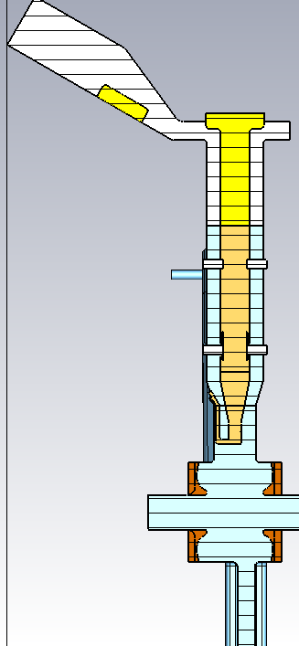
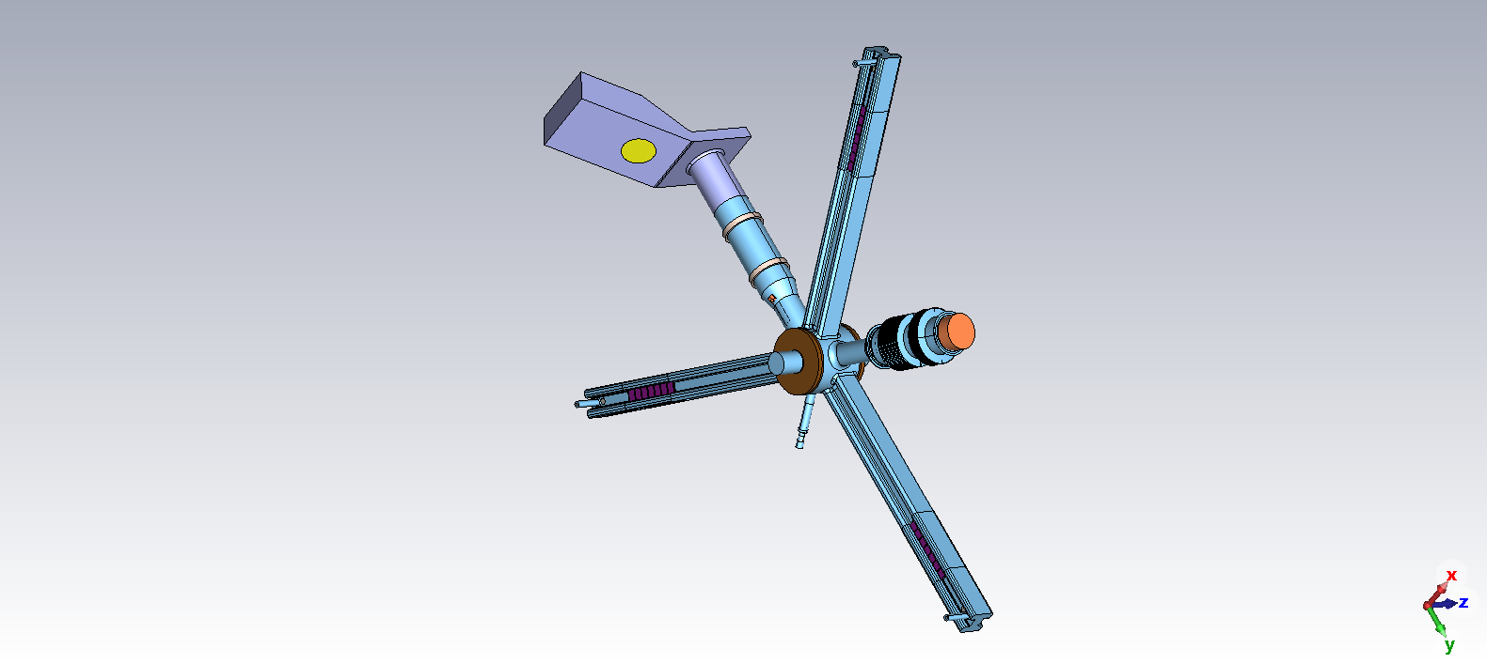
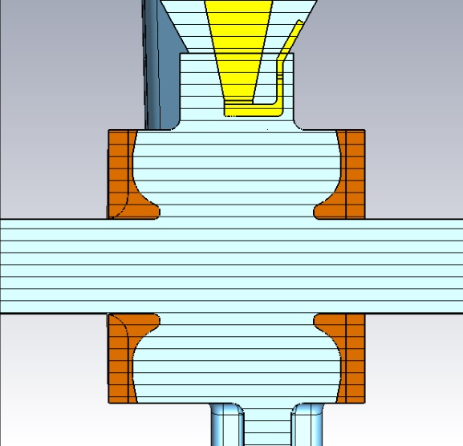
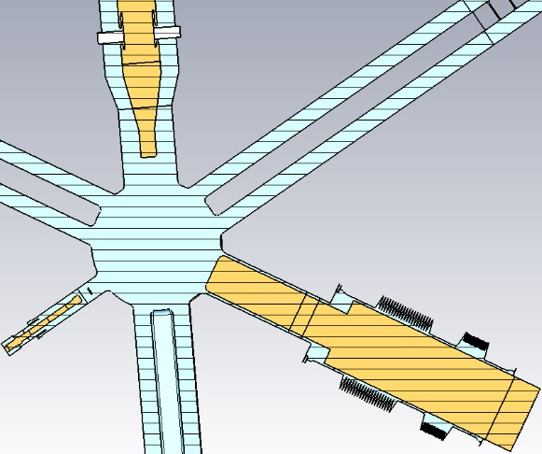
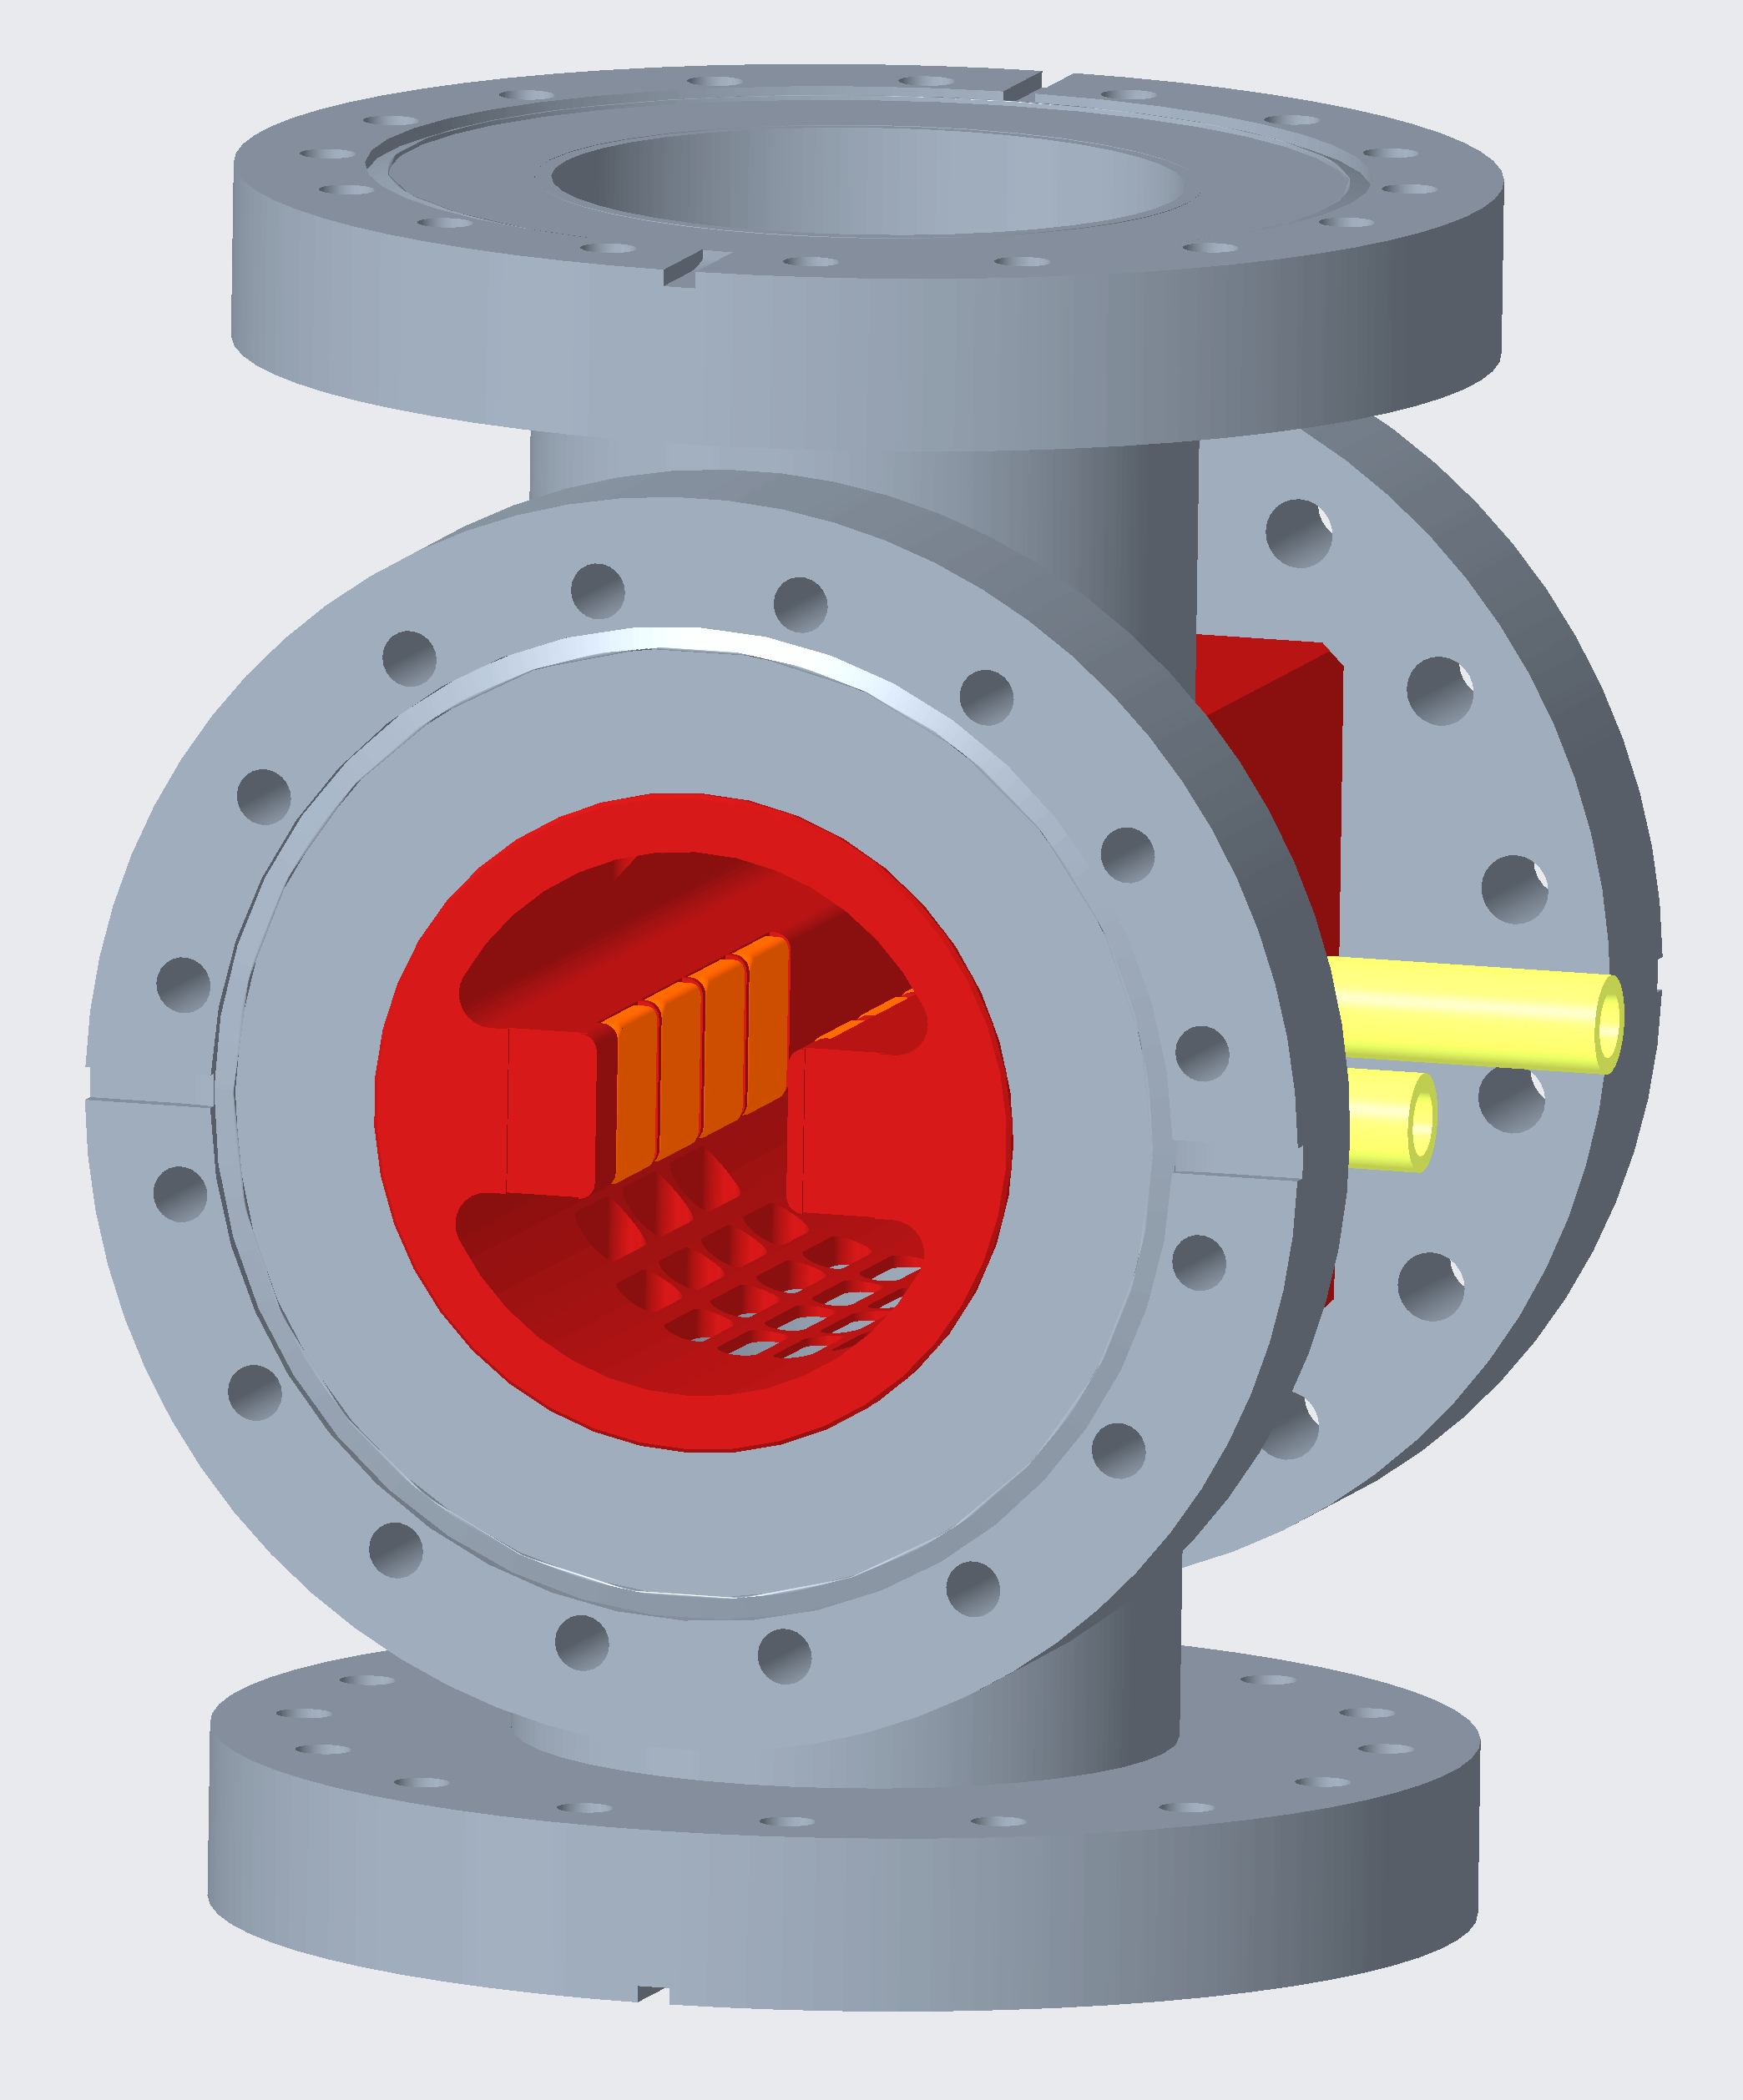
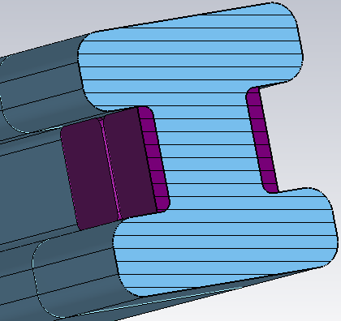
1.75GHz Cu Cavity Design– Overview
1.5GHz Cavity
WATRAX
Coupler
(Inner conductor same as for 1.5GHz Cavity)
Body
Plunger
(Same as for 1.5GHz Cavity)
Ferrite Teils
(Same as for 1.5GHz Cavity)
Pickup Antenna
(same as for 1.5GHz Cavity)
HOM-Damper

Slide 13
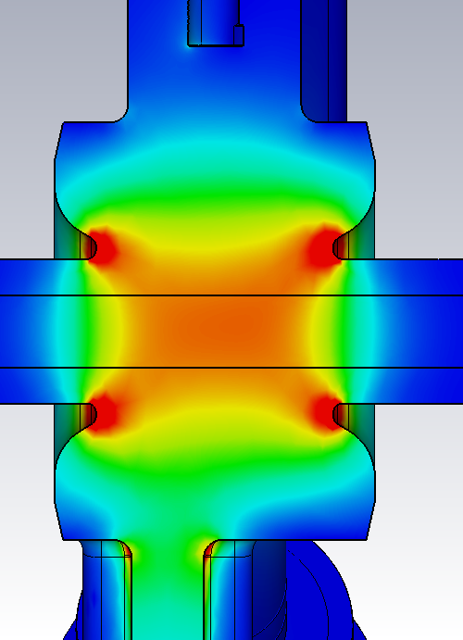
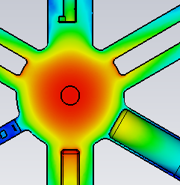
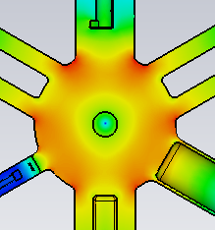
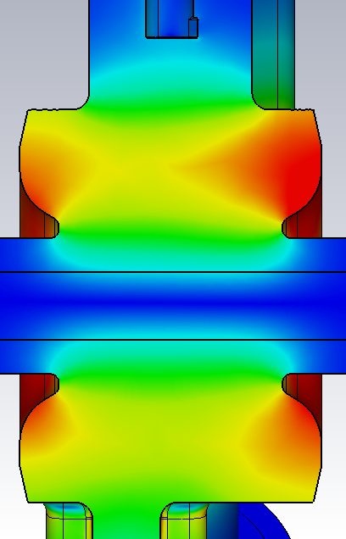
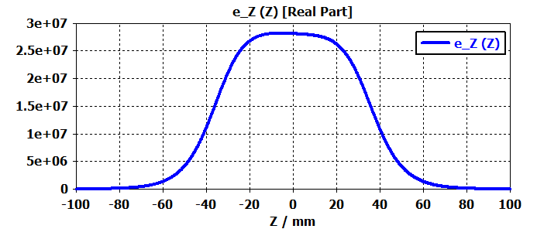
Accelerating mode
E field
H field
H field
E field
High E-field around the in inner gap corners could be limitation for gradient – discharge issue. E_{D} < 30 MV/m (Kilpatrick)
High B-field at connection of cavity body & attached elements – heat issue. Local losses < 1.2 W/mm² , fulfilled.
Field has asymmetry due to the FPC etc. – field map tracking is required (Beam dynamic)
RF parameters
R/Q=168.5 Ω
Q0=1.61*1e4
QL=8345, β=0.8

Slide 14
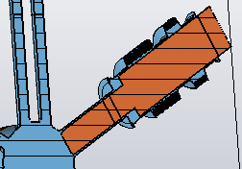
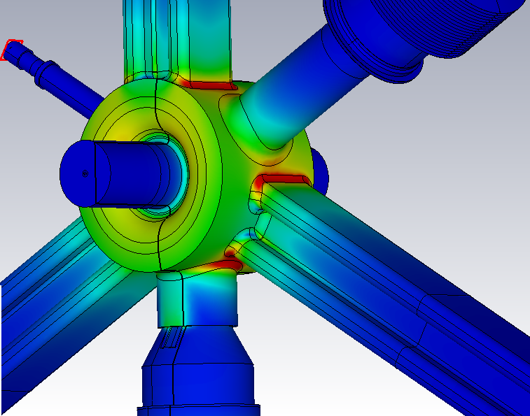
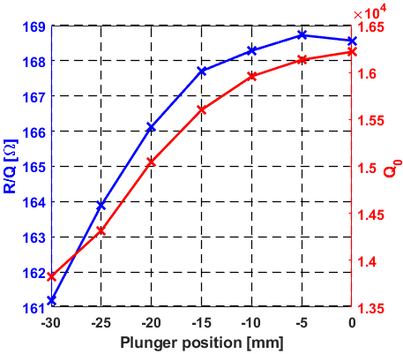
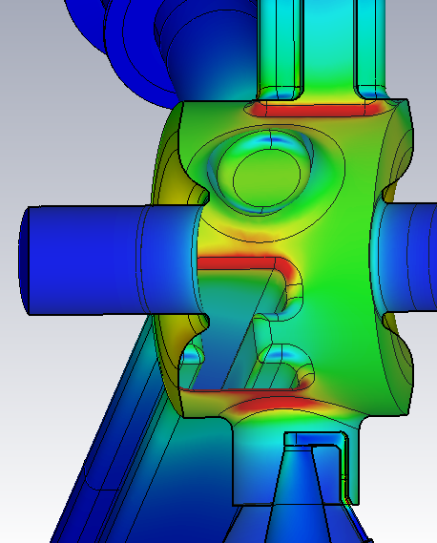
1.75GHz Cu Cavity – Plunger
Successfully integrated plunger from 1.5GHz EU-HOM-Damped cavity.
+9.6 +7.1 +2.9 -1.3 -4.2 -5.8 -6.6
Δf [MHz] (f0=1748.79MHz)
Max. Plunger Losses (pos=-25mm) – inner conductor Q=1.8e5 (Below <10% of Q0).
Fundamental mode losses in HOM waveguide end Qext ≥ 2.5e7 (0.1% of Q0) each.
Highest loss density < 1.1 W/mm^2 (at 200kV accelerating voltage).
Off-resonance of plunger localised modes with cavity acc. mode is fulfilled for entire tuning range. Plunger mode is at ~1770 MHz.

Slide 15
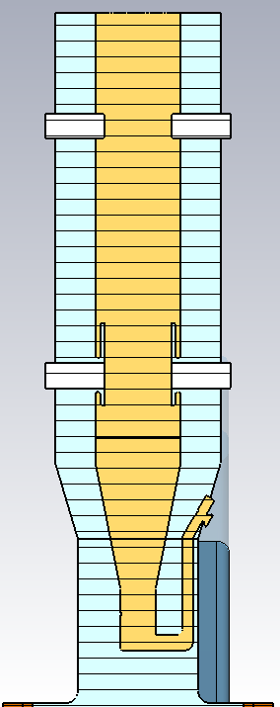
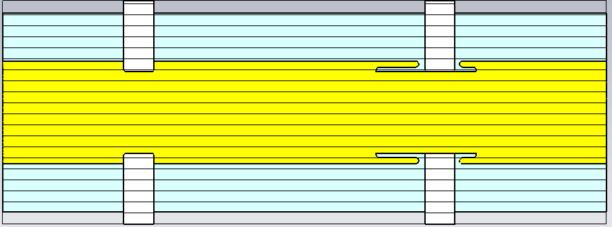
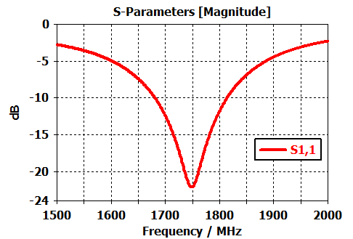
1.75GHz Coupler
Coax diamters 33.35 x 66mm
Cut-off 1.937 GHz
Ceramic – Diam. 27 x 74 mm, Thickness 10 mm
89.4 mm
FPC Inner conductor is same as for 1.5GHz FPC.
Both ceramics are same with 10mm thickness.
The outer diameter is decrease (compare to 1.5GHz FPC) to increase the cut-off frequency of coax TE mode.

Slide 16
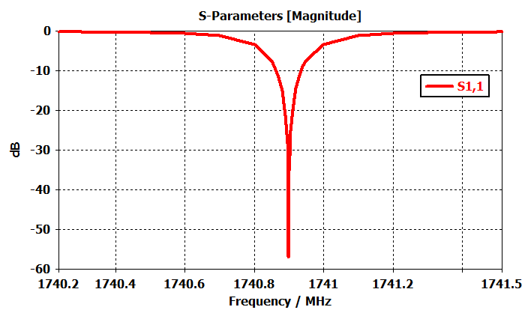
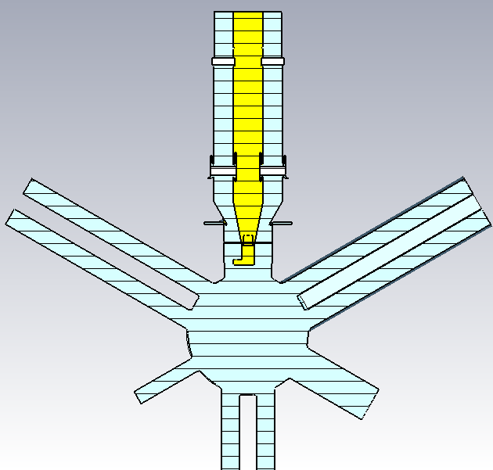
1.75GHz Coupler
F-Solver
FPC rotated by 46° for β=1
Optimised FPC with cavity at critically coupling has S11 < -50dB. This indicates that power is transmitted to the cavity fully and is not reflected from FPC 2xCeramic regions (if considered as transmission line).
The FPC tip is same as for 1.5GHz FPC. Small adaption to be done – mechanical design & final cross check is foreseen including frequency correction.
This area should be considered as part of coupling adjustment.

Slide 17
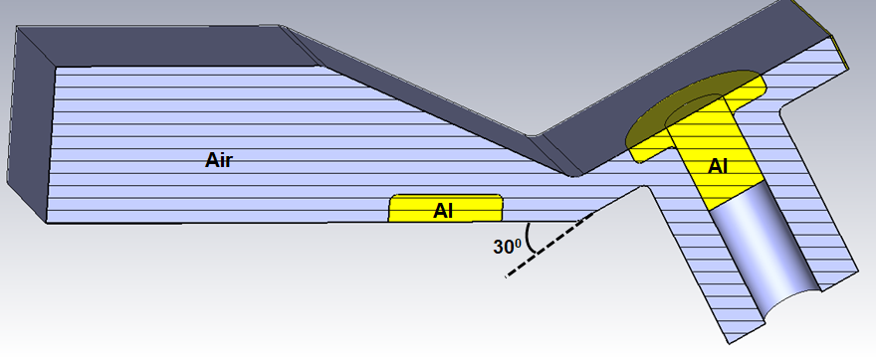
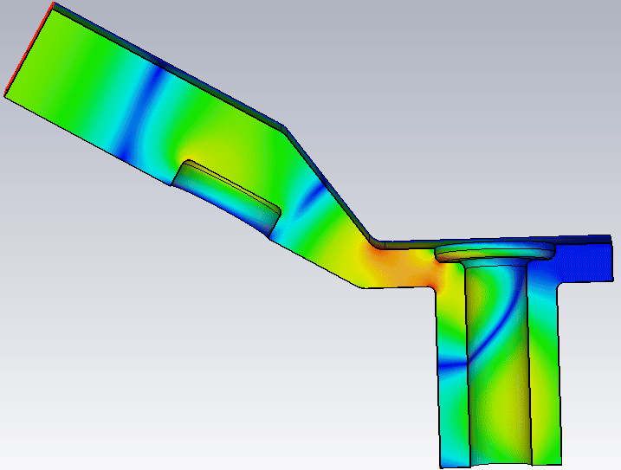
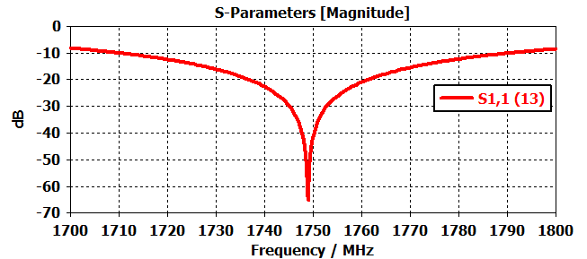
WATRAX 1750 MHz
Coax Diameters
33.35 x 66 mm
Cut-off = 1.937 GHz
Rect. Waveguide - WR430
Tuning Flange
Geometry has symmetry plane as shown in picture.
Frequency range is at least 1748.9 ± 6 MHz (S11< -30dB)
Frequency tuning is done by tuning flange only ! i.e. adjusting the position 132 ± 4mm & thickness 17.8 ± 1.5mm.
Fabrication tolerances ±1mm can be compensated by tuning flange & proofed in dedicated tolerance studies.
H =17.8 mm
Δx = -0.3 mm

Slide 18
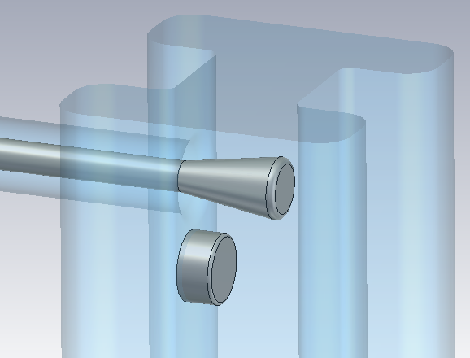
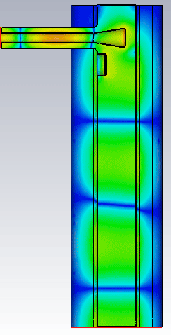
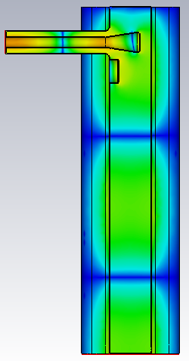
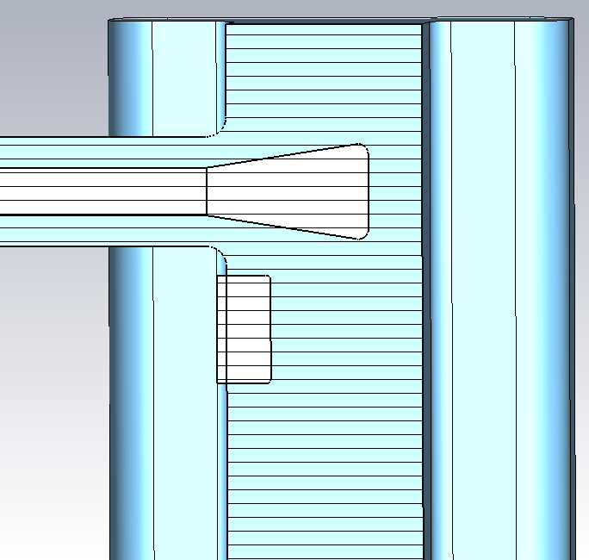
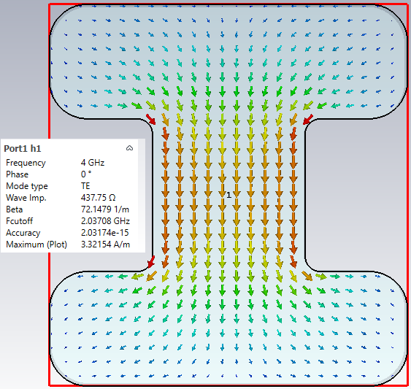
HOM-Damper for 1.75 GHz Cavity
Trans-damper design is based on adding antenna & tuning flange on ridged-waveguide of 1.75GHz cavity, i.e. no transition piece needed.
Antenna tip dimensions allows outside mounting with feedthrough & installation through coax pipe.
Damper is optimised for TE1 mode of R-waveguide up to 5 GHz. At higher frequencies other waveguide modes are excited that are not damped.
HOM Antenna Tip
Tuning Flange
f=4 GHz
f=3 GHz
H-field
Excitation Port, mode TE1

Slide 19
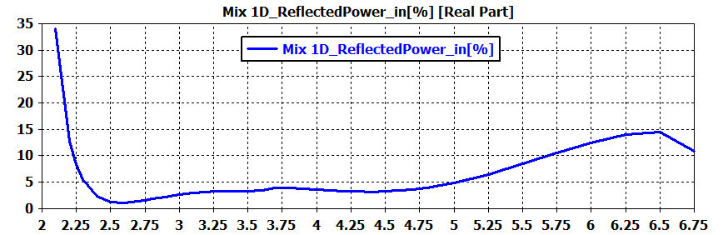
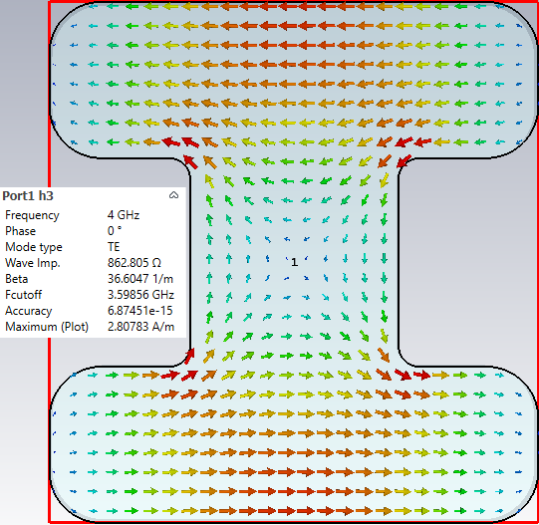
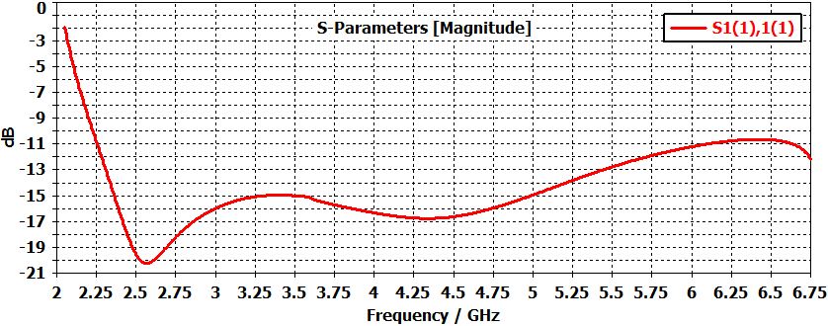


HOM-Damper for 1750 MHz Cavity
TE1 - Fc~2.037GHz
TE3 - Fc~3.598GHz
S11 ≤ -15dB (Excitation TE1 mode)
H-field
H-field
TE2 - Fc~3.554GHz
As the cavity beampipe (diameter 40mm) cut-off frequency is ~4.4GHz, the trans-dumpers are optimised to damp up to 5GHz.
For fundamental waveguide mode (Fcut~2.037GHz) broadband damping (≤ -15dB) between 2.4-5GHz is reached.
Higher waveguide modes are not damped & if required additional HOM antenna might be needed. There are two other waveguide TE modes with cut-off frequencies below 5GHz & the Fcut~3.5GHz.
H-field

Slide 20





1.75GHz Cu Cavity EM Design – HOM WGs
Transmission Port
350mm
H field, Fcut=2.037GHz
(same as scaled from 1.5GHz cavity)
Power [W]
Ferrite C48: Dimensions 19.6 x16.6 x2.7 mm
Frequency [GHz]
Same 1.5GHz Ferrite tiles can be used.
Ridged-WG length from cavity axis should be min. 350mm
Excitation Port

Slide 21



Mode Atlas
Eigenmode Simulations
Plunger is tuned to 1748.8 MHz for acc. Mode.
Eigenmodes are computed for fixed plunger position.
The eigenmode solver gives accurate results up to 3.5GHz. At higher >3GHz frequencies the resonant modes spectrum becomes very dense & sensitive on port boundaries.
For broader frequency range up to 10GHz long-range wakefield simulation are required.

Slide 22


Mode Atlas – Wakefield Simulations
Long Range Wakefield Simulation
(Off-axis XY=2.1mm, 9mm bunch, 20m wake length)

Slide 23


Mode Atlas – Wakefield Simulations
Long Range Wakefield Simulation
(Off-axis XY=2.1mm, 9mm bunch, 20m wake length)
Pole-fitting accuracy is not satisfactory and requires additional analyses. Especially the modes that are contributing in the wake potential up to 5m.
The FFT / impedance of the wake captures the TM011 mode and is in good agreement with Eigenmode computation.
Generally the results above 5 GHz should be cross checked as the wake simulation accuracy seems to be poor, i.e. the model is to heavy & with many small details in FPC & Plunger.
For accurate HOM damping analyses an equivalent simplified model to be constructed.

Slide 24







Signal Spectral Weighting Technique
Bunch Train
$${\tilde{I}}_{b}\left(ω\right)=f_{rev}\sum_{n}{q_{n}{∙e}^{−0.5∙ω^{2}σ_{n}^{2}}∙}e^{j ω t_{0,n}}$$
FFT
Spectral weighting of port signal & Power per freq. bins (FFT)
∆f =250 MHz
$$P\left(ω\right)={\left|\frac{{\tilde{I}}_{b}}{{\tilde{I}}_{0}}𝓕(ω)\right|}^{2}$$
${\tilde{I}}_{0}$ - Simulated single bunch
12

Slide 25


HOM Power Levels & Spectrum
HOM Power [W] for Baseline Filling
Port | Power [W]
1 – Damper 1 | 77.8
2 – Damper 2 | 64.5
3 - Damper 3 | 58.5
4 – Beampipe 1 | 107
5 – Beampipe 2 | 113
6 - FPC | 105
Sum - Coherent | 527
Sum – None-Coherent | 464
In this simulation the cavity is exactly tuned to the 1.75GHz , i.e. is hitting beam harmonic multiple to 250MHz and causing increase of coherent HOM power. In this setup HOMs are off resonance with circulating beam.
Additional studies should be performed on HOM spectrum sensitivity on fundamental mode tuning (plunger), taking into account different operating scenarios.
Each HOM damper is prepared for min. 200W broadband-absorption.

Slide 26
Outlook
The design of 3.5rd –harmonic active cavity is finished and is in fabrication stage.
The integration of different sub-components and common parts from 1.5 GHz cavity is succesful, i.e. same plunger, FPC inner conductor, ferrites etc.
New HOM damper design with antenna integrated in ridged-waveguide.
Accurate wakefield simulations are required for HOM analyses at higher frequencies.
HOM analyses for 3 x cavity chain are planned. Requires development of equivalent simplifyed model for wakefield simulations.

Slide 27
Outlook
The design of 3.5rd –harmonic active cavity is finished and is in fabrication stage.
The integration of different sub-components and common parts from 1.5 GHz cavity is succesful, i.e. same plunger, FPC inner conductor, ferrites etc.
New HOM damper design with antenna integrated in ridged-waveguide.
Accurate wakefield simulations are required for HOM analyses at higher frequencies.
HOM analyses for 3 x cavity chain are planned. Requires development of equivalent simplifyed model for wakefield simulations.
Thank You for Your Attention !

Slide 28


BESSY II Filling Patterns
BESSY II Filling
∆f =500 MHz
Baseline - VSR
∆f =250 MHz
4

