Slide 1
Experimental demonstration of the compensation of the transient beam loading caused by a long bunch gap in the KEK-PF 2.5 GeV ring
ESLS RF & HarmonLIP Workshop 2025
Oct.24, ALBA Synchrotron
Naoto Yamamoto, D. Naito, S. Sakanaka,
T. Takahashi, A. Motomura
RF-Group, ACC 6th division, KEK
30 minutes, including questions
Notes:
Thank you for introduction. I’m Naoto Yamamoto from KEK Japan
I would like to talk about “Experimental demonstration of the compensation of the transient beam loading caused by a long bunch gap in the KEK-PF 2.5GeV ring”

Slide 2
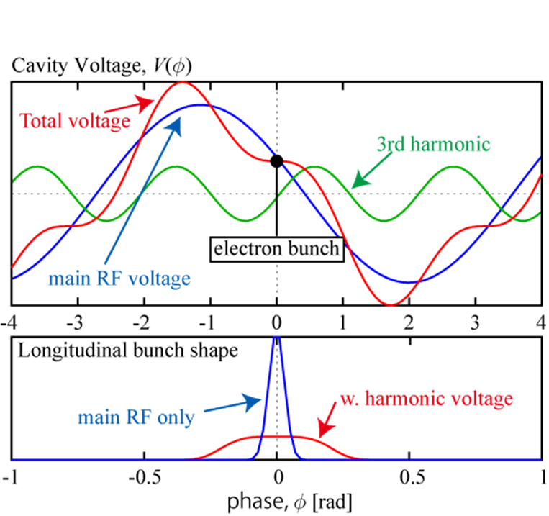
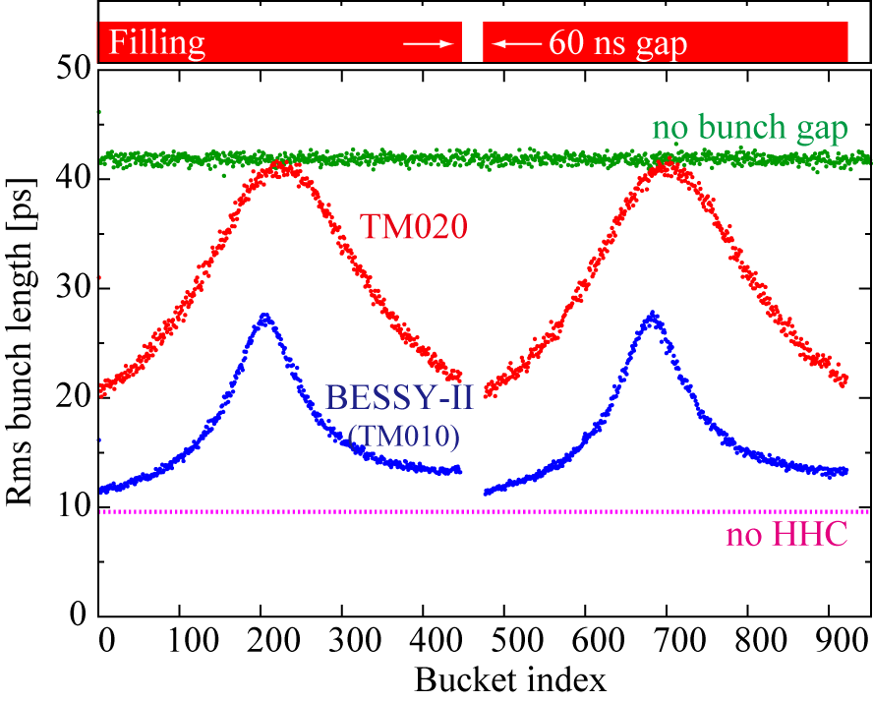
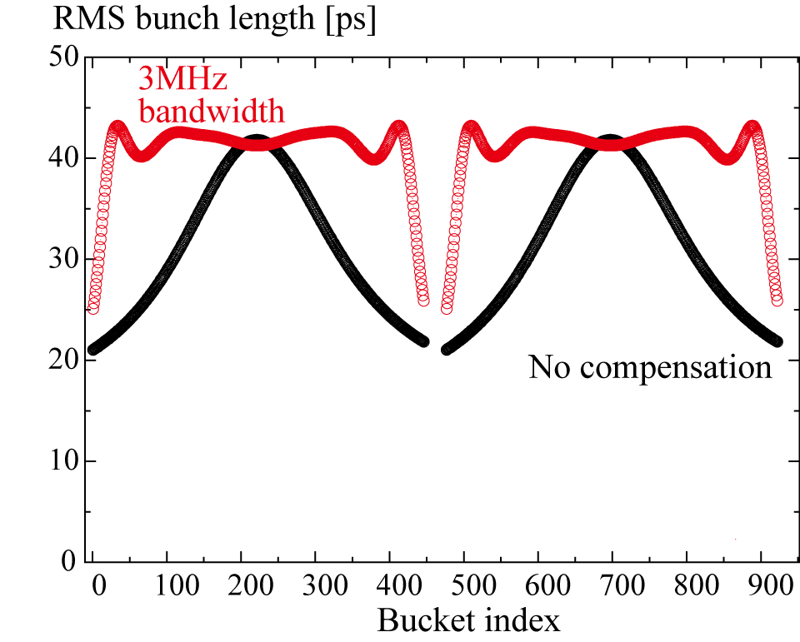
Introduction
The transient beam loading effect affects the bunch lengthening performance with harmonic rf system.
A compensation method using the fundamental/harmonic cavity or a broadband longitudinal kicker cavity are one method to recover the bunch lengthening performance (PRAB 21, 012001, 2018).
Fig.1 Schematic of bunch lengthening by using harmonic cavity with the flat potential.
Fig.2 TBL Mitigation with NC TM020 cavity
Fig.3 TBL compensation with a broadband kicker cavity.
Notes:
Here, I would like introduce our HC R&DS.
Fig1.
A harmonic voltage cancels the slope of the longitudinal focusing force at the synchronous phase in keeping the longitudinal acceptance.
Fig2. shows the effect of the TBL.
So, the TBL reduce the bunch lengthening performance at the both side of bunch train.

Slide 3
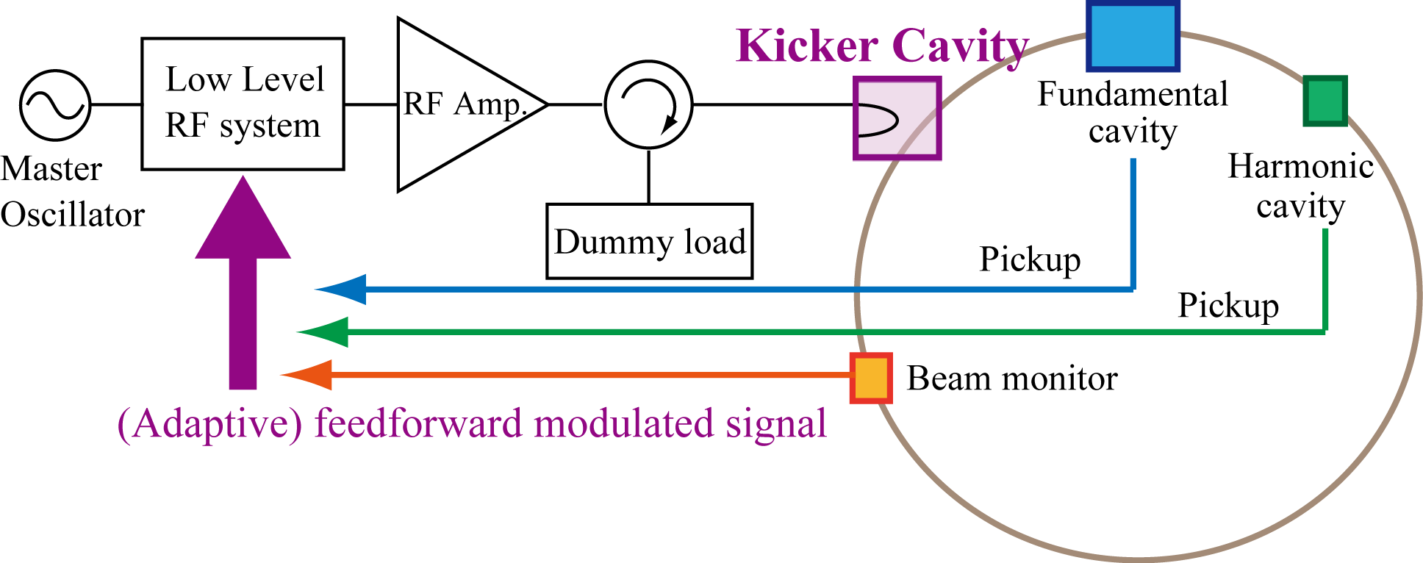
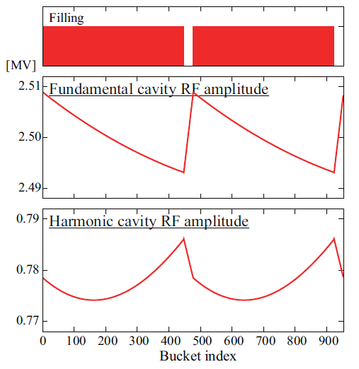
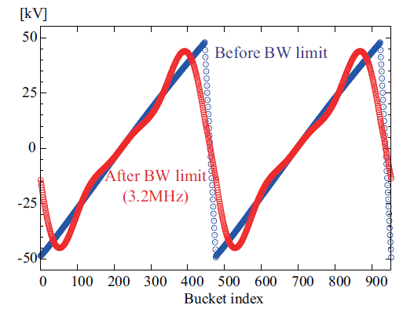
Concept of TBL compensation
Tab. Kicker cavity parameter
b)
c)
Fig. Concept of active compensation for TBL
[Proc. of MCBI2019]
Frequency | 500 MHz
R/Q | 175 Ω
Unloaded-Q | 40000
Cavity number | 1
Cavity coupling | 199
Loaded-Q | 200
3dB bandwidth | 2.5 MHz
a)
c) Bunch length along the train
w/wo. Compensation signal
a) Monitor Signal from pickup/BPM
b) Input signal to Kicker cavity
Notes:
This slide shows a concept of TBL compensation.
Here we assume the use of a broadband kicker cavity as shown the parameter in this table.
In this scheme,
At first, the cavity voltage and bunch information are monitored.
Second, the input signal for kicker cavity is outputted form LLRF system.
By using the kicker cavity, the variation of the cavities are compensated, and the improvement of bunch lengthening performance is expected.

Slide 4
Concept of TBL compensation
Tab. Kicker cavity parameter
b)
c)
Fig. Concept of active compensation for TBL
[Proc. of MCBI2019]
Frequency | 500 MHz
R/Q | 175 Ω
Unloaded-Q | 40000
Cavity number | 1
Cavity coupling | 199
Loaded-Q | 200
3dB bandwidth | 2.5 MHz
a)
c) Bunch length along the train
w/wo. Compensation signal
a) Monitor Signal from pickup/BPM
b) Input signal to Kicker cavity
In the calculation, the improvement using fundamental/harmonic cavities instead of the kicker cavity is expected although the effect is limited.
Then, we decided to confirm the feasibility of this method at the PF ring.

Slide 5
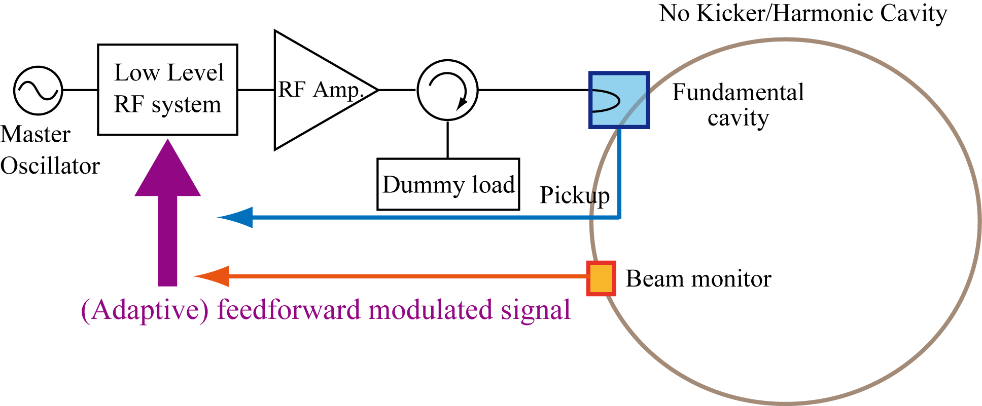
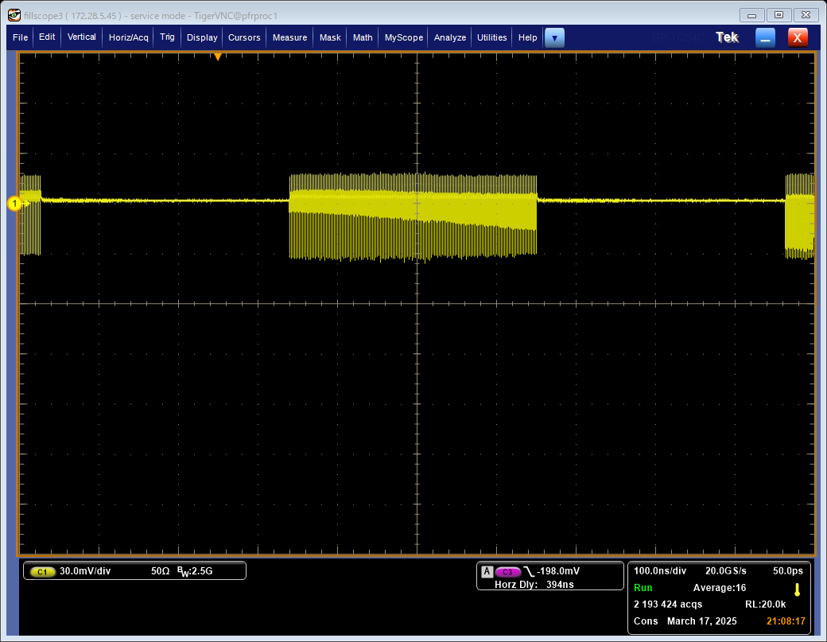
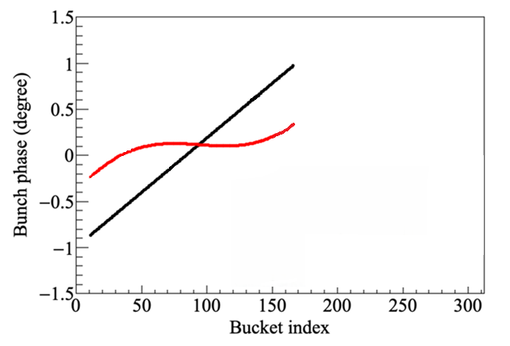
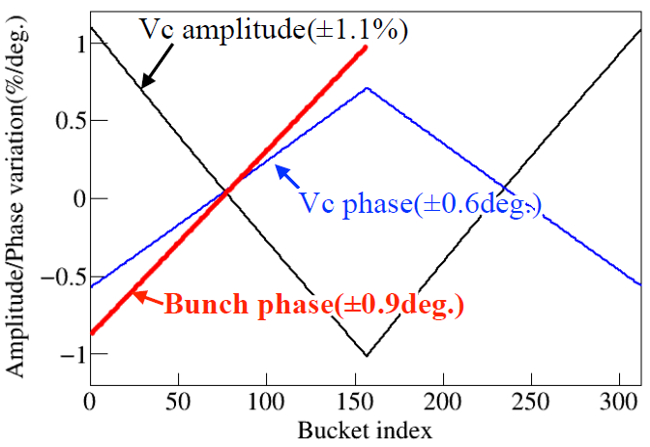
Concept of TBL compensation at PF ring
D. Naito et al., IPAC2025, WEFN1
No kicker or Harmonic cavity at the PF ring!!
Tab. PF ring parameter
Fig. Concept of active compensation for TBL at PF ring
b)
a, c)
Introduce the TBL bunch phase
shift using large bunch gap
b) Added modulation signal from the input of the Fundamental cavity
c) Bunch phase along the train
w/wo. Compensation signal
1 revolution, 624 ns
w. Compensation
wo. Compensation
Notes:
However, we doesn't have harmonic cavity. Then we considered a different approach.
We try to demonstrate the control of the bunch phase shift by using of the fundamental cavity and Digital LLRF system.
As a preparation, we introduce a bunch phase shift along the bunch index by introducing the large bunch gap.
Then, the modulation signal is inputted to the fundamental cavity in monitoring the bunch phase shift.

Slide 6
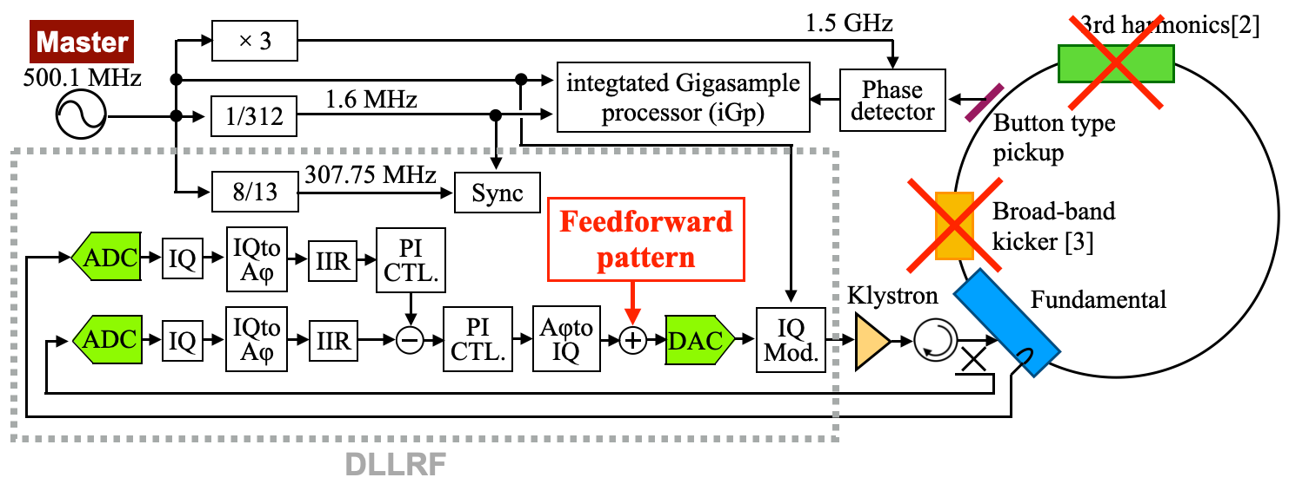
Setup of the experimental “demonstration”
D. Naito et al., IPAC2025, WEFN1
Tab. PF ring parameter
Fig. Schematic of LLRF feedback system at PF ring
Use of the fundamental cavity and it’s Digital LLRF system
  The DLLRF system was introduced to the PF ring in 2023.
Bunch signal monitored by button-type pickup is processed using the integrated Giga-sample processor (iGp) as an average of 40,000 turns bunch by bunch (R.Takai, DIPAC09, pp. 59-61).
The FPGA-based Digital LLRF system was used to modulate the rf generator signal.
Notes:
This slide shows “Setup of the experimental “demonstration” “

Slide 7
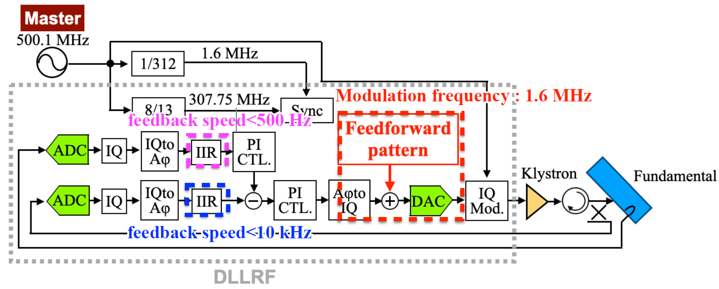
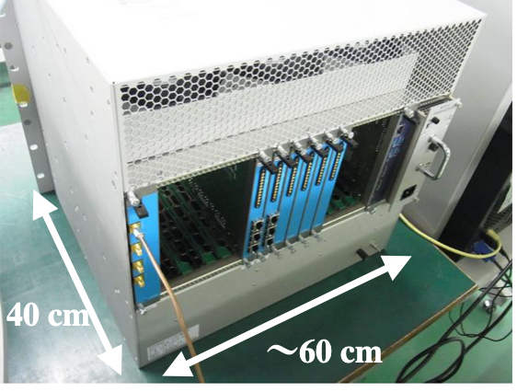
FPGA-based Digital LLRF system
D. Naito et al., IPAC2024, THPG71
Fig. Schematic of Digital LLRF system at PF ring
The cavity voltage is controlled by a double feedback loop.
A FPGA-based Digital system is used to modulate the rf generator signal.
Arbitrary feedforward pattern of the generator voltage synchronized with the beam revolution can be outputted.
Thanks to IIR filters in the loop, the feedforward modulation does not affect the feedbacks.
Notes:
At first, I would like to introduce what is the TBL compensation.

Slide 8
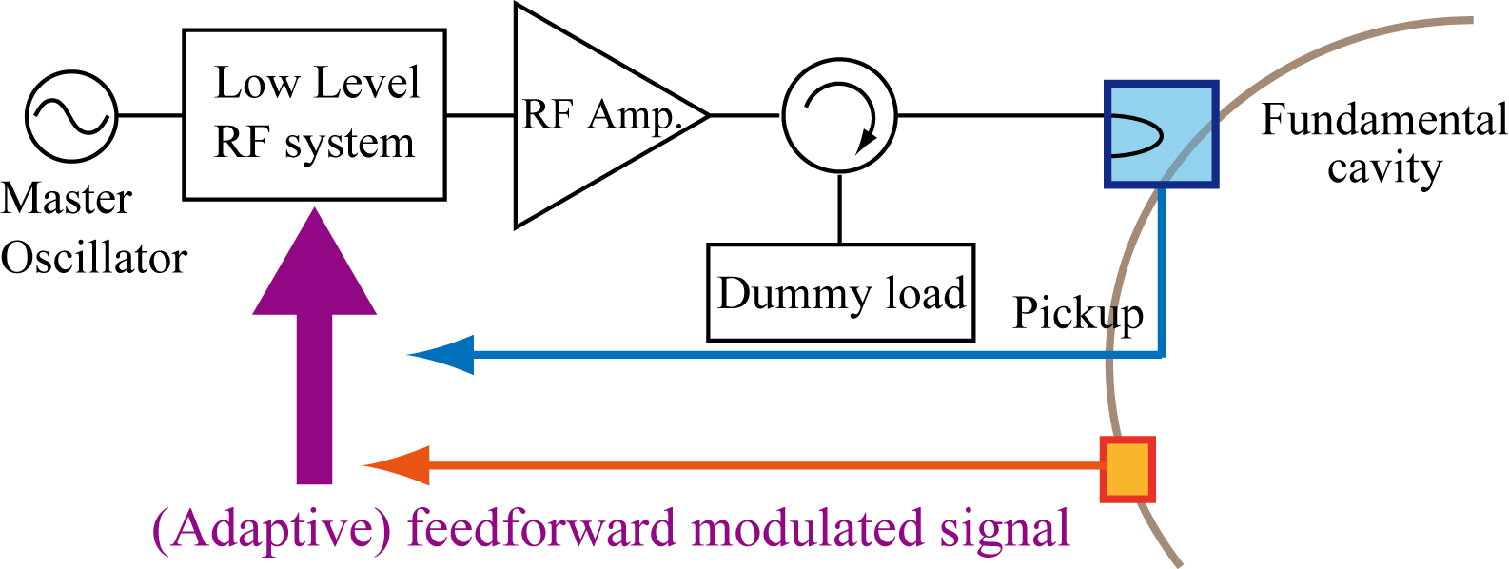
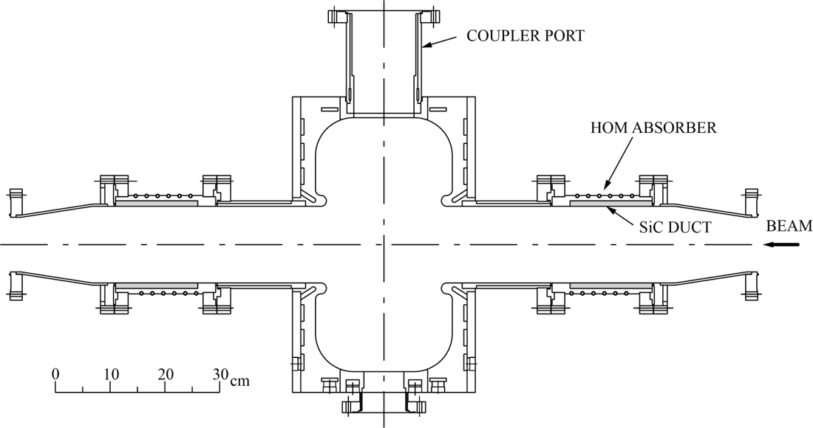
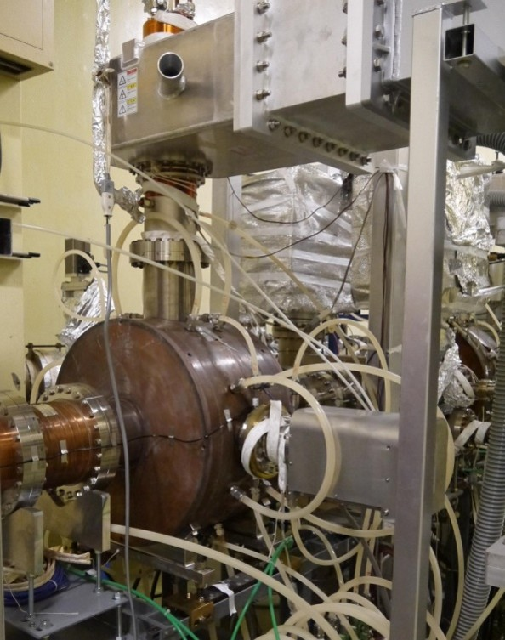
Fundamental cavity
T. Koseki et al., RSI, 66, 1926-1929, 1995
Parameter | Value
Cavity number | 4
R/Q, R=Vc²/P_{C} | 174 Ω
Unloaded Q | 39,000
Loaded Q | 11,818
3dB Bandwidth | 21.2 kHz
Filling time | 7.5 µs
Enlarged beam tube structure for HOM damping (higher than cutoff frequency)
4 cavities are installed and used for user operation
3dB-band width is 21.2 kHz, while the revolution frequency is 1.6 MHz for PF ring
→ When the 1.6MHz modulated signal is inputted, almost power is reflected.
attenuation of the cavity is ~ 32 dB at 1.6 MHz.
modulation amplitudes are limited by the dummy load, ~30 kW.
Notes:
At first, I would like to introduce what is the TBL compensation.
Cutoff, dia=90mm -> 2.55GHz, 1.95GHz; dia=140mm -> 1.64GHz, 1.26GHz

Slide 9
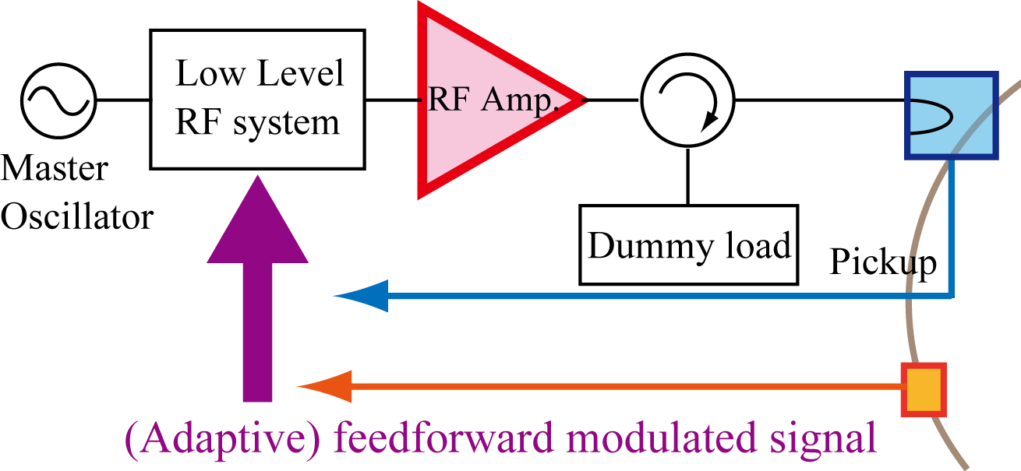
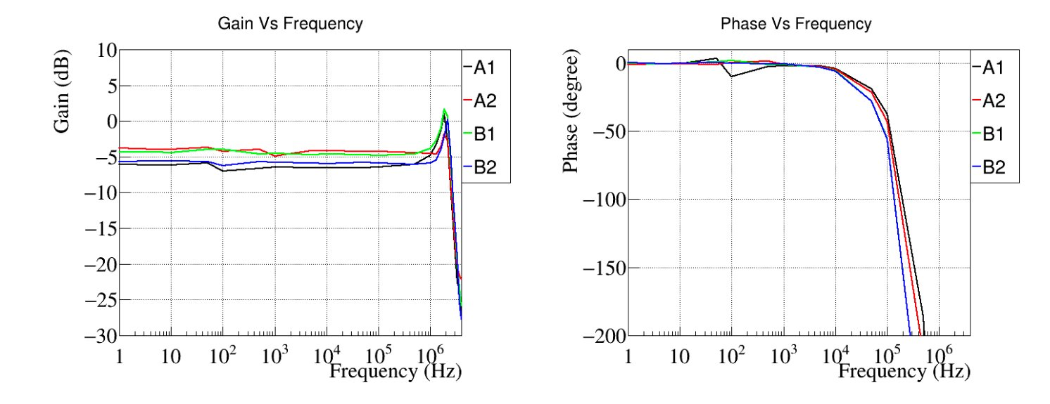
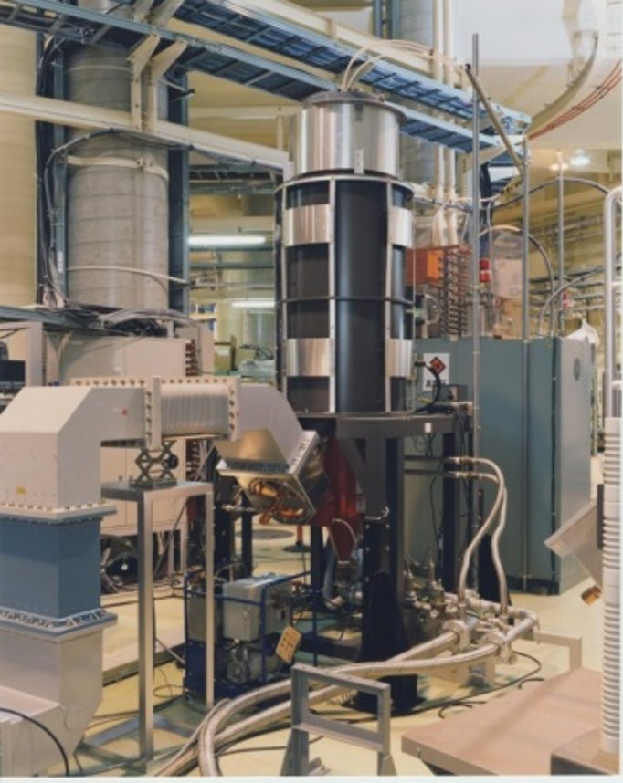
RF amplifier; Klystron
Fig. Klystron responses as a function of input signal frequency
→
1.6MHz
(Frev)
Canon E3774 Klystron
500MHz, 180kW
4 x 180kW klystrons are used for user operation
There is an amplitude resonance around 2MHz ( due to the resonant frequency of one of the middle cavity of the klystron)
→ An 1.6MHz modulated signal is used for the TBL compensation.
The klystron response should be taken in account.
Notes:
At first, I would like to introduce what is the TBL compensation.

Slide 10
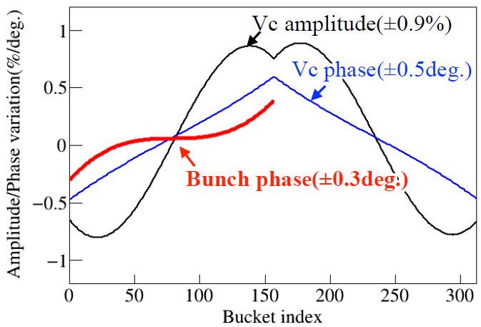
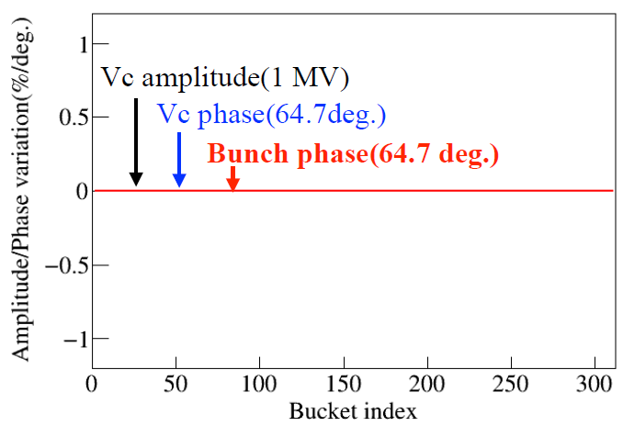
Analytical estimation of Modulation signal for generator
Fig.1 Cavity voltage and bunch phase
with uniform filling
Fig.2 With 156 unoccupied bunch.
Fig.3 With mod. signal (Amod, θdelay) = (0.014,0) .
Introducing
unoccupied 156 buckets
Apply
Modulation signal for generator voltage
Feedforward signal to modulate the amplitude of the generator induced voltage
  Add cosine wave with a revolution frequency ( f_{rev} = 1.6 MHz )
  Clock of the FPGA, resolution of t, is 13 ns ( 76.94 MHz = 500.1 MHz x 2 / 13 )
Notes:
Here, I would like introduce our HC R&DS.
We also proposed the TBL compensation with a broadband kicker cavity.

Slide 11
Analytical estimation of Modulation signal for generator with Klystron
Feedforward signal to the generator induced voltage
Fig.3 With mod. signal (Amod, θdelay) = (0.014,0) .
At the exit of the LLRF system , responses of the cavity and klystron should be considered.
  Attenuation due to bandwidth of the cavity (32 dB)
  Amplitude-to-Phase conversion in the klystron
Notes:
Here, I would like introduce our HC R&DS.
We also proposed the TBL compensation with a broadband kicker cavity.

Slide 12
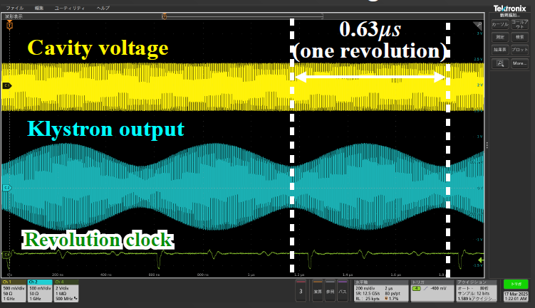
Experimental result
Selected To enhance the TBL effect
Nominal values are
0.45 A and 1.7MV.
To increase power margin of the input signal and to reduce the cavity reflection power
Notes:
Here, I would like introduce our HC R&DS.
We also proposed the TBL compensation with a broadband kicker cavity.

Slide 13
Experimental result
As predicted by the semi-analytical calculation, the bunch phase shift along the bunch index can be successfully mitigated by adding the modulation signal.
Fig.1 Observed bunch phase shift w/wo. modulation signals
Fig.2 RMS bunch phase within 40 and 150 buckets
Notes:
Here, I would like introduce our HC R&DS.
We also proposed the TBL compensation with a broadband kicker cavity.

Slide 14
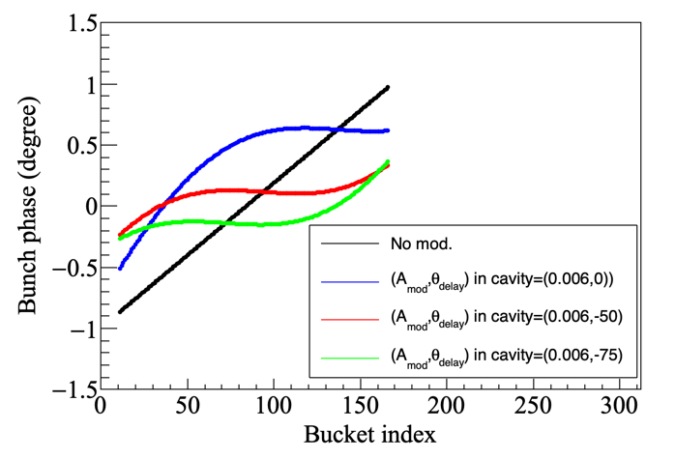
Experimental result vs Analytical estimation
The analytical calculation reproduce the observed results well.
Fig.1 Observed bunch phase shift w/wo. modulation signals
Fig.2 Analytical calculation w/wo. modulation signals
Notes:
Here, I would like introduce our HC R&DS.
We also proposed the TBL compensation with a broadband kicker cavity.

Slide 15
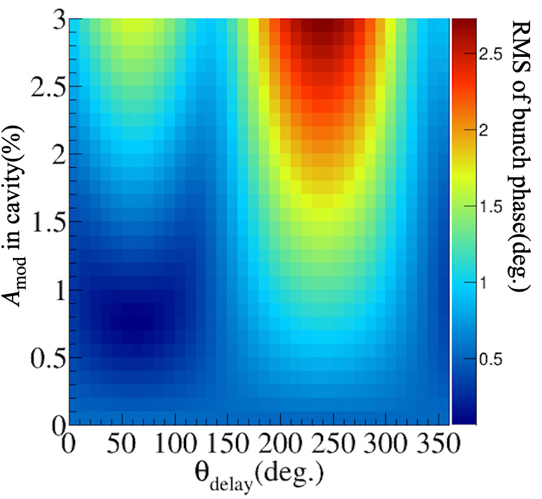
Experimental result vs Analytical estimation
The analytical calculation suggests better results.
However, it could not be tested due to the limitation of the dynamic range of the LLRF output and the power of cavity reflection.
Fig.2 Rms bunch phase dependence on the parameter of the signals (analytical calculation)
Fig.1 Analytical calculation w/wo. modulation signals
?
Notes:
Here, I would like introduce our HC R&DS.
We also proposed the TBL compensation with a broadband kicker cavity.

Slide 16
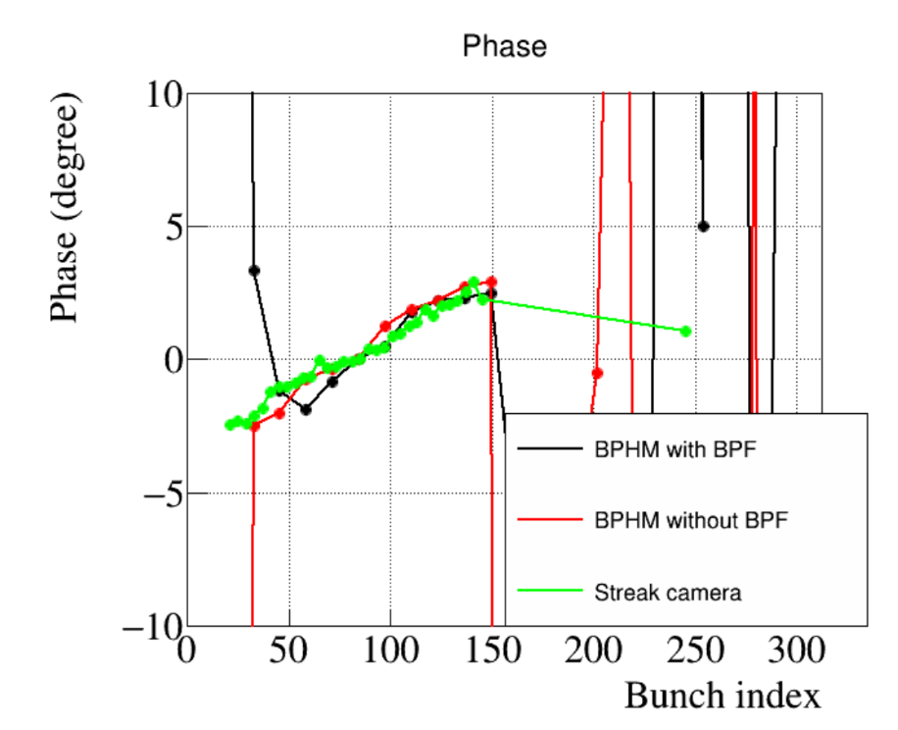
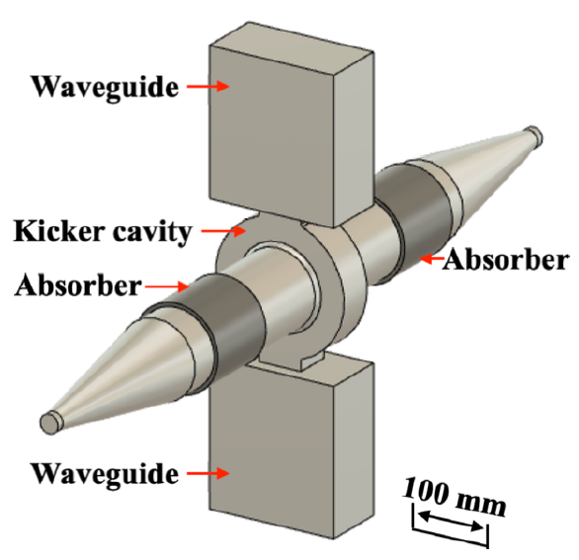
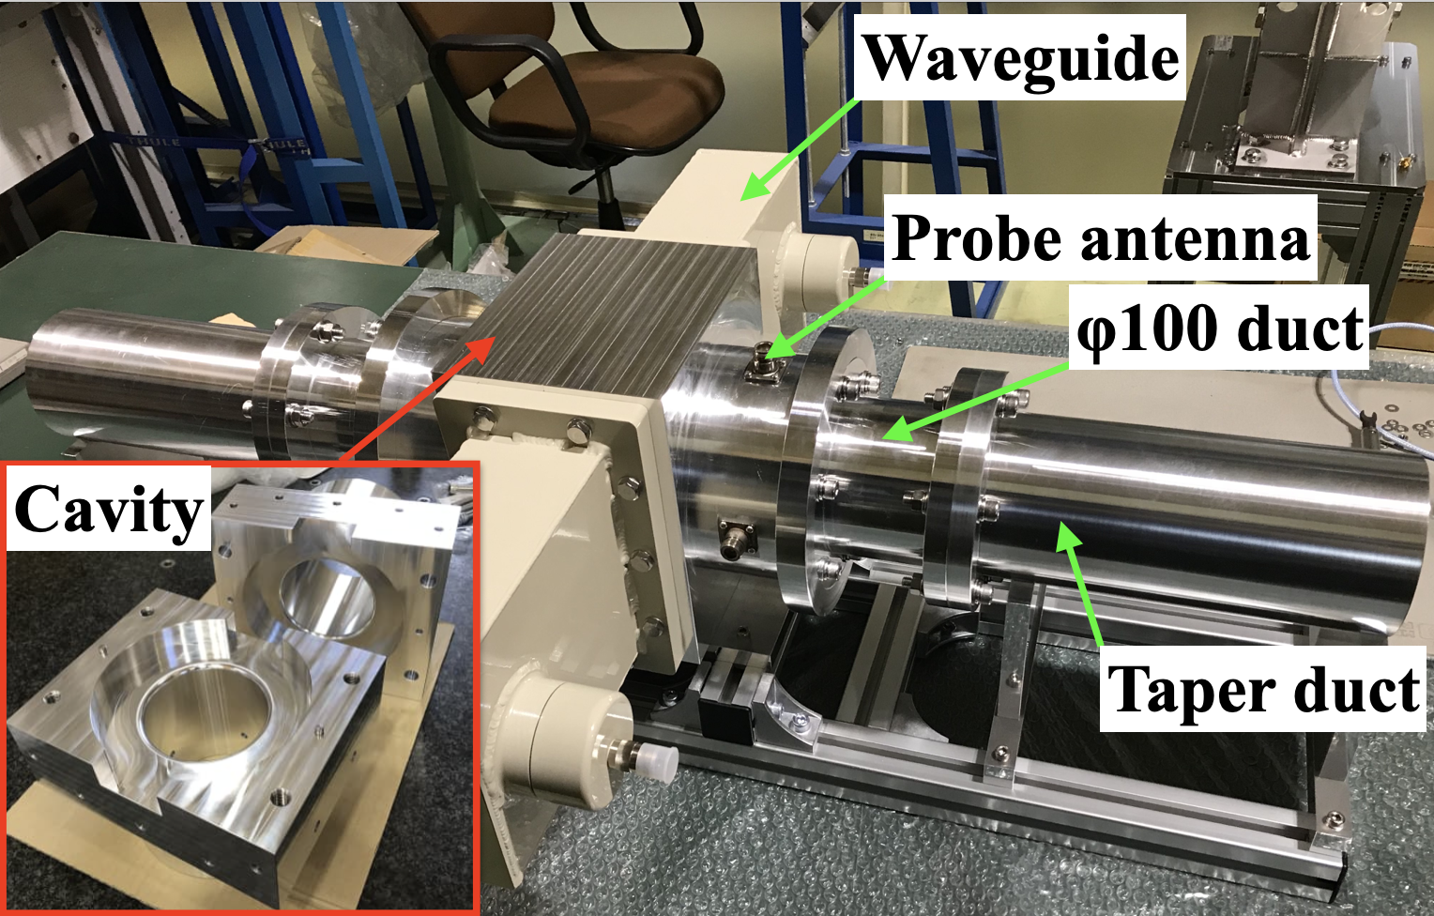
Toward further improvement
TBL mitigation with a harmonic cavity having low R/Q and high Q.
A broadband kicker cavity
Advanced LLRF system with integrated bunch phase monitor
Fres = 1.500GHz
R/Q = 60Ω
Q0 = 17,937
QL = 292
Integrated Bunch Phase Monitor (iBPhM)
Low power model
Configuration of KEK-PF Digital LLRF system
μTCA.4 technology
Non-IQ Direct Sampling method
Sampling frequency = 307.75 MHz, F_{rf} x 8/13
Synchronized to Revolution clock (1.6MHz, PF)
BPhM Data rate = ~ 1kHz (average 100-turn)
~990mm
D. Naito et al., PRAB, (accepted on 2025 Oct 22)
D. Naito et al., PASJ2021, THOA01.
Notes:
To realize the TBL compensation,
We developed a broadband kicker cavity and bunch phase monitor.
Today, I skip the detail.

Slide 17
Summary
To improve the bunch lengthening performance, TBL compensation method by using an adaptive feedback are considered.
As a first step, feasible study using a fundamental cavity and FPGA-based LLRF was performed at the PF 2.5 GeV ring.
  The TBL compensation was successfully demonstrated, and the bunch phase variation was reduced from ±1.5˚ to ±0.4˚.
  Considering the klystron and cavity responses, the behaviors can be reproduced by analytical calculations.
A broad band kicker cavity, fast bunch phase monitor and harmonic cavity having low R/Q are also being developed.
Notes:
Ok, that’s all.
I summarized my talk.

Slide 18

Gracias por su atención.

Slide 19

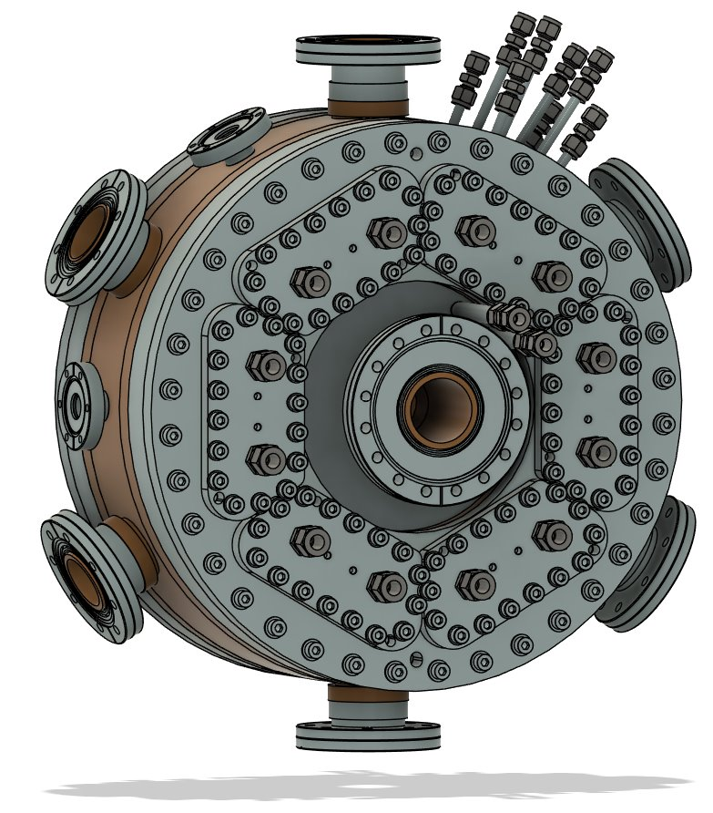
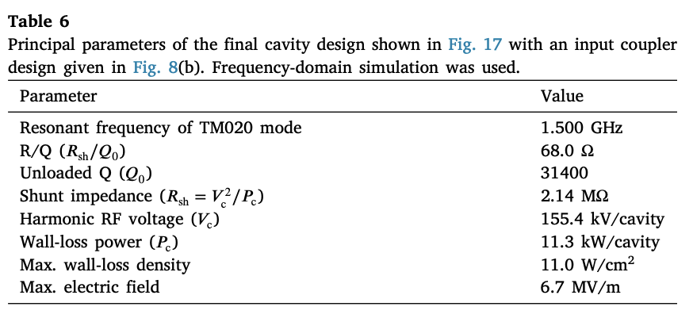
TM020 cavity
The design of the cavity is almost finished.
The detail of the design is reported in the following paper.

