Slide 1


RF plans for PETRA IV
ESLS RF & HarmonLIP Workshops 2025
Chris Christou on behalf of DESY-MHF
24th October 2025, ALBA Synchrotron

Slide 2

Agenda
DESY site and accelerators
The PETRA IV upgrade
Project schedule
RF details and recent developments
Prototyping in PETRA III
Harmonic cavity options
Low level RF requirements
Stability issues and strategy

Slide 3
The DESY accelerators
PETRA III
6 GeV
2304 m circumference
120 mA current
20 MV voltage
LINAC II 450 MeV preinjector
PIA accumulator
DESY II booster
FLASH
1.2 GeV
315 m length
XFEL
Up to 16.5 GeV
3.4 km length
200 m injector
2 km linac
1.2 km undulator/experiments

Slide 4
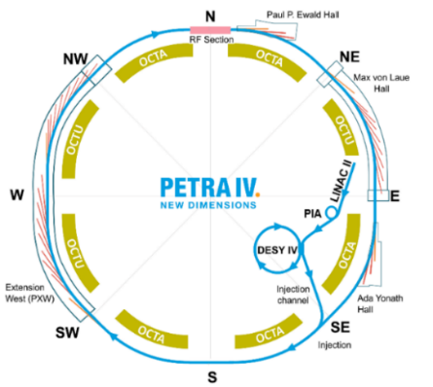
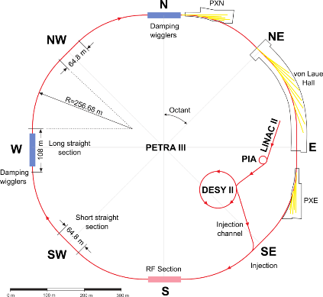
Basic design and infrastructure overview
1300 pm → 20 pm
New extension hall PXW under public park
RF moves from South to new building in North
DESY injector complex upgrade
New low-emittance booster
R Bartolini 9th General Low-Emittance Rings Workshop, 14th February 2024

Slide 5
PETRA IV parameters
Parameter | Brightness mode | Timing mode
Beam energy | 6 GeV
Beam current | 200 mA | 80 mA
Circumference | 2304 m
Revolution frequency | 130.121 kHz
RF frequency | 499.665 MHz
Harmonic number | 3840
Bunch spacing | 4 ns | 96 ns
Number of bunches | 1920 | 80
Energy loss per turn | 4.2 MeV
RF voltage | 8 MV

Slide 6
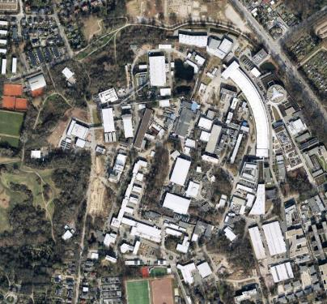
PETRA IV project schedule
2025 | FLASH upgrade and XFEL Long Installation and Maintenance Period Installation of new XFEL gun PETRA IV Preparation Project ongoing Design and manufacture of third harmonic cavity and suitable amplifier Publication of Engineering Design Report
2026 | PIA renovation PETRA IV approval expected End of Preparation Project
2027 | Procurement begins
2028
2029 | End of PETRA III operation
2030 | 2.5 year dark- time begins
2031
2032 | PETRA IV starts operation

Slide 7
RF parameters
 | Fundamental RF | Harmonic RF
RF frequency | 499.665 MHz | 1498.995 MHz (third harmonic)
RF voltage | 8 MV | 2.2 MV
Number of cavities | 24 | 24
Shunt impedance per cavity | 3.4 MΩ | 1.5 MΩ
Unloaded quality factor | 29000 | 17000
Cavity coupling factor | 3.3 (critical) | 3 (overcoupled)
Total forward power to cavity | 1340 kW | 71 kW
Total reverse power | 0 kW | 34 kW
Power per RF station | 56 kW plus losses | 3 kW plus losses
Number of cavities follows analysis of capital and running costs
Use EU/HOM damped cavities for fundamental system
Third harmonic cavity parameters satisfy flat bunch parameters
Baseline design uses Alba scaled HOM-damped cavity

Slide 8
DESY IV booster and options
Parameter | Value
Circumference | 304.8 m
Harmonic number | 508
Injection energy | 450 MeV
Extraction energy | 6 GeV
Repetition rate | 5 Hz
Energy loss per turn | 6.67 MeV (at extraction)
RF voltage | 10 MV
Cavity type | 5-cell HERA
Shunt impedance | 15 MΩ
Number of cavities | 9 (8 active)
Power per cavity | 62 kW
Use 9 * 5-cell cavities
8 operational cavities and one standby
HERA cavities can be reused
Each cavity is powered independently by solid-state amplifier
Lattice has 8-fold symmetry
Distribute cavities around ring
8 cavities in pairs in 4 straights
9th cavity installed in own straight
Alternatives are under consideration
Retain DESY II
Emittance high for injection into PETRA IV
Laser plasma injector
Initial results are promising
Test injection into DESY II in 2026

Slide 9
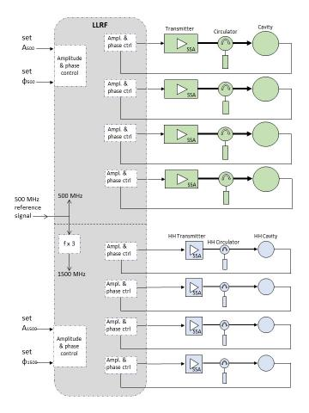
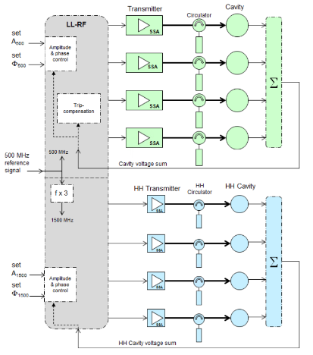
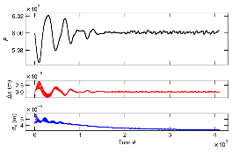
Reduction of installed RF capacity in PETRA IV
ELEGANT simulation
S. Antipov
Beam survives cavity loss
Cavities in groups of 4
Vector sum control compensates cavity loss
Three cavities must compensate loss
Independent cavity control
Fast reaction not necessary
23 cavities available to correct voltage
Significant reduction of installed RF capacity

Slide 10
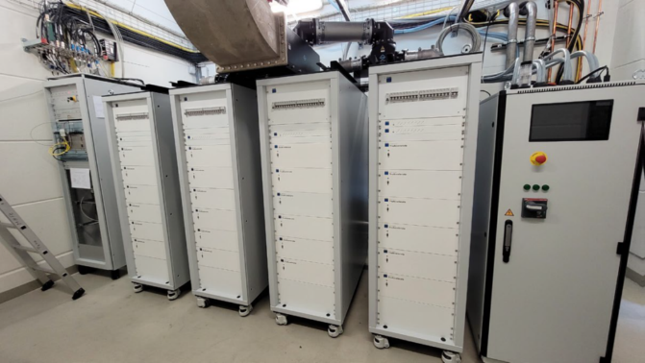
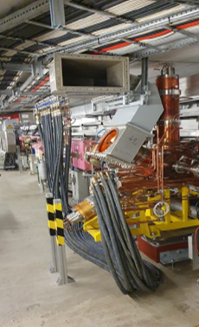
PETRA IV prototype in PETRA III
Single EU HOM-damped cavity has been in PETRA III ring since January 2023
Passive conditioning with beam until July 2023
120 kW solid-state amplifier installed in July 2023
Routinely operated up to 400 kV and to 50 kW
Using DESY MicroTCA-based LLRF
No major problems have been encountered

Slide 11
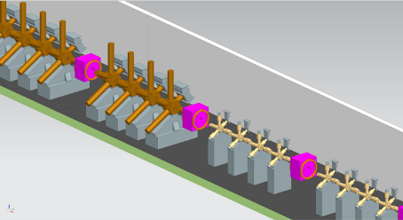
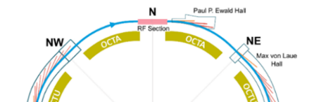
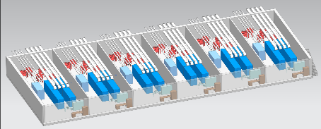
Layout of RF straight and RF hall
RF straight will be relocated to ring North
Tunnel is above ground All cavities in single RF straight with new RF hall built alongside
Hall houses transmitters, cooling infrastructure, power supplies, LLRF…
Cavities grouped to minimise number of beam-tube tapers arising from cavity inner diameter differences
RF straight infrastructure requirements
Total wall-plug power for RF: 2.8 MW
Total cooling water flow for RF: 216 m³/hr

Slide 12
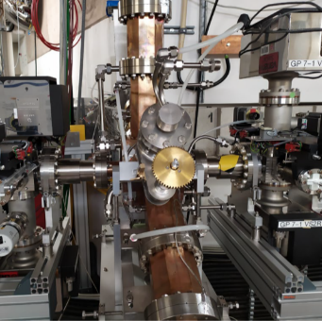
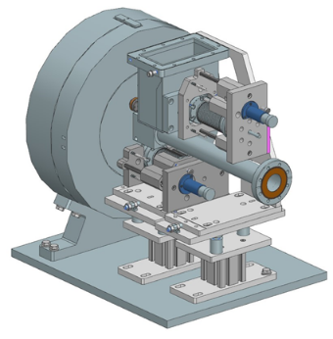
Harmonic cavity options
Baseline
Scaled HOM-damped cavity
Proven at BESSY
Option
Choke mode cavity
In production
Manufacturing complete in 2026
Test and decision in 2027
Cavity Parameter | Scaled HOM Damped Cavity | Choke Mode Cavity
Shunt Impedance R_{S} | 1.1 MΩ | 1.6 MΩ
Unloaded Quality Factor Q₀ | 14000 | 19000
Coupling Factor | Fixed at installation: 3.5 | Variable from 0.1 to 5

Slide 13
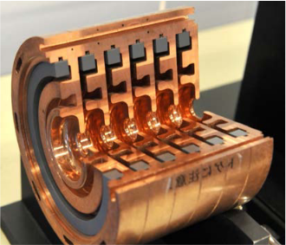
Choke-mode cavity
The TM010 mode is rejected by the choke. Due to the distance of l/2 between the short circuit of the choke and the annular output of the cavity, the TM010 mode "sees" a short circuit
Silicon carbide absorber rings are fixed in position with a titanium spring
Tsumoru Shintake: “The Choke Mode Cavity”, 1992 Jpn. J. Appl. Phys. 31 L1567
T. Inagaki et al.: “High-gradient C-band linac for a compact x-ray free-electron laser facility”, PRSTAB, 17, 080702 (2014)

Slide 14
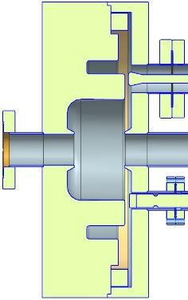
DESY “Shintake” choke mode harmonic cavity variant
 | Arguments
Advantages | The HOM damper capabilities are not frequency limited
 | Mechanical construction is simple
 | Only a small number of cooling circuits required
 | High power coupling factor can be varied from 0 to 5
Disadvantages | Frequency of the cavity body and the choke must be precisely matched to each other
Cavity construction status
Design is complete
Manufacturing drawings have been produced
First components have been delivered
Construction complete in late 2026
Test in 2026/27
Single cell design
Adjustable coupler and tuner

Slide 15
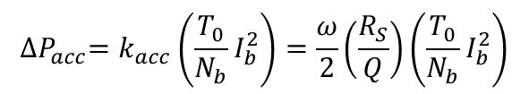
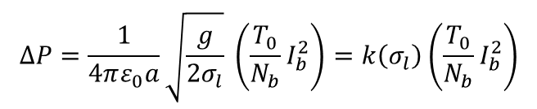
Analytic estimation of power dissipated in HOM-loads
Application of the analytical approach of R. B. Palmer (1989)
Parameters of the 500MHz HOM Damped Cavity
Gap width g | 226 mm
Beam pipe radius a | 37 mm
Shunt impedance R_{S} | 3.4 MΩ
Unloaded quality factor Q₀ | 29910
Frequency f_{RF} | 499.665 MHz
Power loss in all Modes:
$$∆P=\frac{1}{4πε_{0}a}\sqrt{\frac{g}{2σ_{l}}} \left(\frac{T_{0}}{N_{b}}I_{b}^{2}\right)=k\left(σ_{l}\right)\left(\frac{T_{0}}{N_{b}}I_{b}^{2}\right)$$
Power loss into the fundamental mode only:
Parameters of PETRA III
Circumference of PETRA III | 2304 m
Revolution time T₀ | 7,69 ms
Number of circulating bunches N_{b} | 40 (timing mode)
Electron beam current | 100 mA
Longitudinal bunch length s_{l} | 13,2 mm
$${∆P}_{acc}=k_{acc}\left(\frac{T_{0}}{N_{b}}I_{b}^{2}\right)=\frac{ω}{2}\left(\frac{R_{S}}{Q}\right)\left(\frac{T_{0}}{N_{b}}I_{b}^{2}\right)$$
Power loss into the HOM damper:
$${∆P}_{HOM}=\left(k(σ_{l})−k_{acc}\right)\left(\frac{T_{0}}{N_{b}}I_{b}^{2}\right)=\frac{5,33∙{10}^{11}\frac{V}{C}∙7,69∙{10}^{−6}s}{40}∙{\left(100∙{10}^{−3}A\right)}^{2}=1025 W$$
Each HOM-damper of the cavity has to dissipate 342 W during the PETRA III timing mode

Slide 16
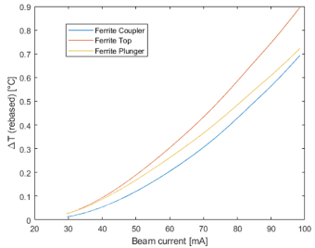
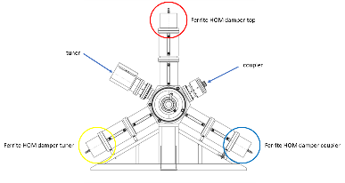
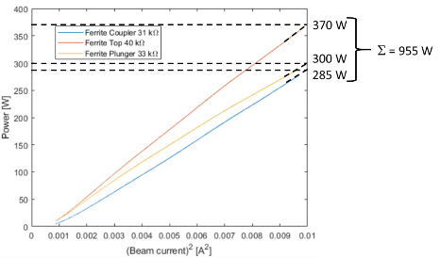
Measurement of HOM-load in PETRA III
40 bunches, beam current decreases slowly from 100 mA to 29 mA
Measurement of the HOM power loss by observing the temperature of the cooling water temperature leaving the ferrite HOM dampers
Beam current was decreased from 100 mA to 29 mA within 2.8 h which keeps the HOM dampers in an equilibrium at all beam currents.
Constant gap voltage keeps the heat contribution due to heat conduction from the fundamental mode in the HOM damper constant.
Observation: The HOM load is different for all three HOM dampers.
The arrangement of the tuner and coupler forces the dipole HOM modes to polarize into an upright position.
This means that the HOM load is highest for the upright HOM damper waveguide.
The measurement and analytical calculation are remarkably close to each other:
Energy loss into HOM`s calculate by theory: 1025W
Measurement has delivered: 955 W

Slide 17
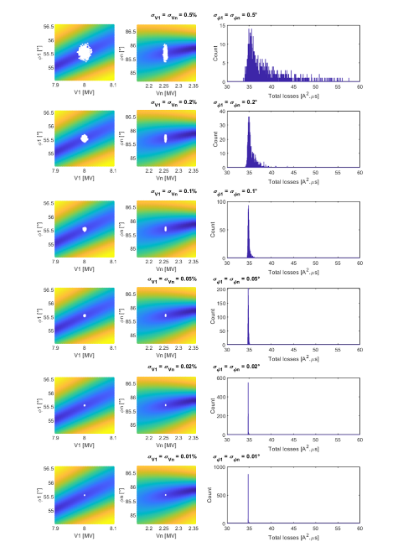
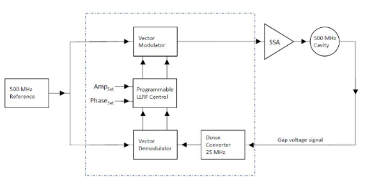
Low-level RF: design and tolerances
MicroTCA-based digital LLRF
Development of XFEL system applicable to CW operation
Four cavities controlled independently per µTCA crate
LLRF controls Beckhoff PLC plunger driver
Required tolerances 10 x looser than XFEL values
0.1% rms amplitude stability
0.1° rms phase stability
Prototype has been running successfully in PETRA III since 2023

Slide 18
Stability issues with harmonic cavities
Flat potential
Detuned
Very high coupled bunch mode driving impedances
Low rotation frequency and broad cavity impedance combine to destabilise beam
There are many problematic modes
Initial analytic estimates are confirmed by ELEGANT simulation (Y-C Chae & C Li)

Slide 19
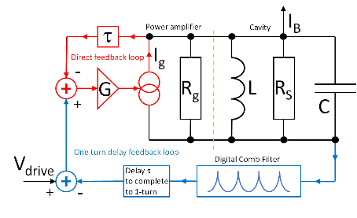
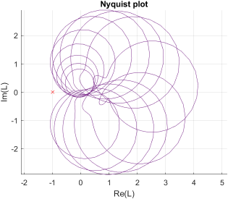
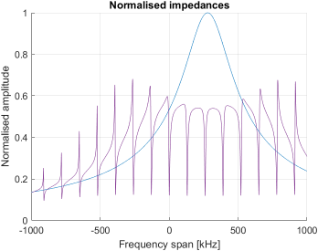
Instability control with direct RF feedback and one-turn delay
Reduce driving impedance with direct RF feedback
Successfully implemented at CERN and PEP II (Pederson 1975, Minty 1996)
Previously used in HERA at DESY with amplifier in tunnel (Gamp 2011)
Requires development of sophisticated comb filter in one-turn delay line (Mastoridis 2012 )

Slide 20
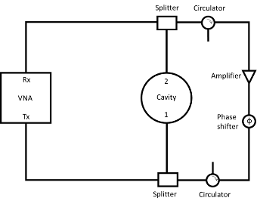
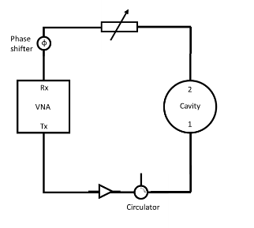
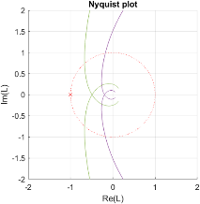
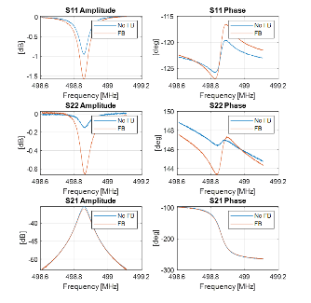
Initial tests of direct RF feedback
Proof of principle measurements on test cavity and HOM-damped cavity
Impedance (and HPA gain) change with feedback gain (attenuation)
Feedback gain calculated from S21 measurements
Also from Fano profile of S11 and S22
Feedback loop stability
Quantified by gain and phase margin
Consistent with theory

Slide 21
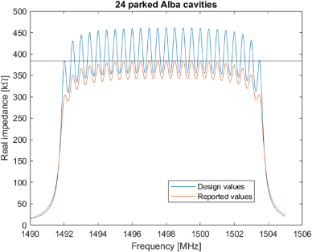
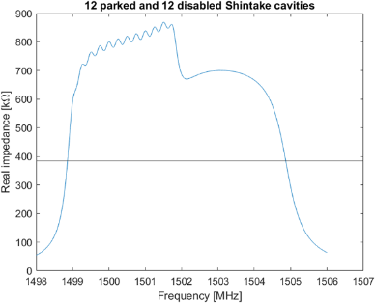
Parking the harmonic cavities
 | Number of cavities | R0 | Q0 | Coupling factor | Tuning range
Choke-mode (Shintake) cavity | 24 | 1.7 MΩ (design) 170 kΩ (design, shorted) | 19300 (design) 2010 (design, shorted) | Variable, can be disabled by shorting the input coupler | 3 MHz, with shorted frequency 3 MHz above active frequency
Alba cavity | 24 | 1.5 MΩ (design) 1.05 MΩ (measured) | 17000 (design) 13200 (measured) | Fixed (nominally β = 4) | 12 MHz
Summed impedance of 24 harmonic cavities breaches the longitudinal instability threshold
Detuning and differential tuning reduces the effect
Limited tuning range of Shintake cavity leads to more pronounced effects

Slide 22
Summary
PETRA IV upgrade is an ambitious programme involving new storage ring and booster plus considerable civil development
Hoping for funding approval in 2026 and a 2½ dark period for upgrade beginning in 2030
RF design is largely fixed
Fundamental cavity, solid state amplifier and digital LLRF have been tested in PETRA III
Baseline harmonic cavity is ALBA active 3rd harmonic design and “Shintake” choke mode cavity is being developed as an alternative
Stability is a considerable challenge and will be addressed by feedback impedance control
Thank you for your attention
Any questions?

