Slide 1

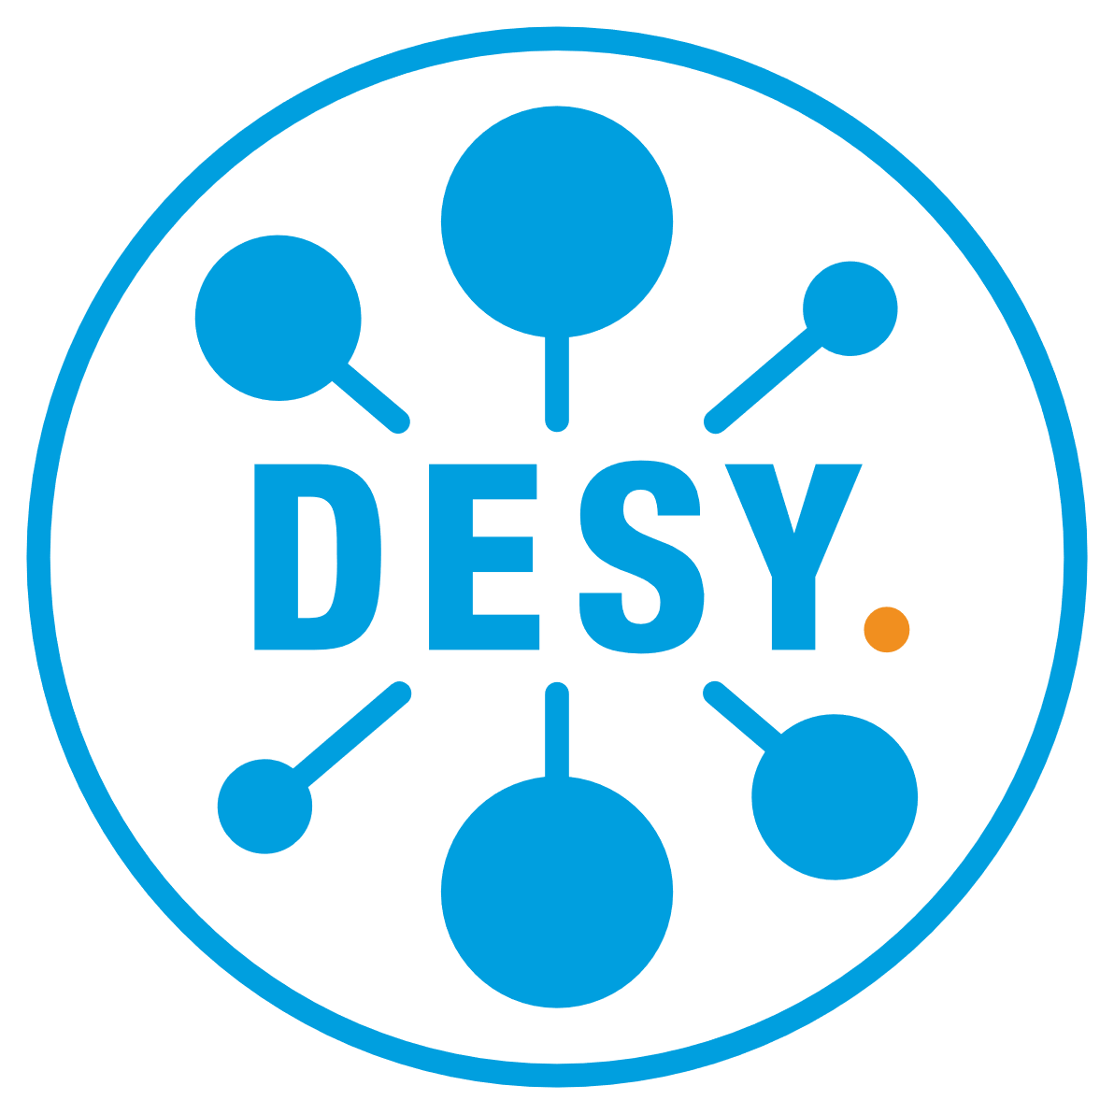

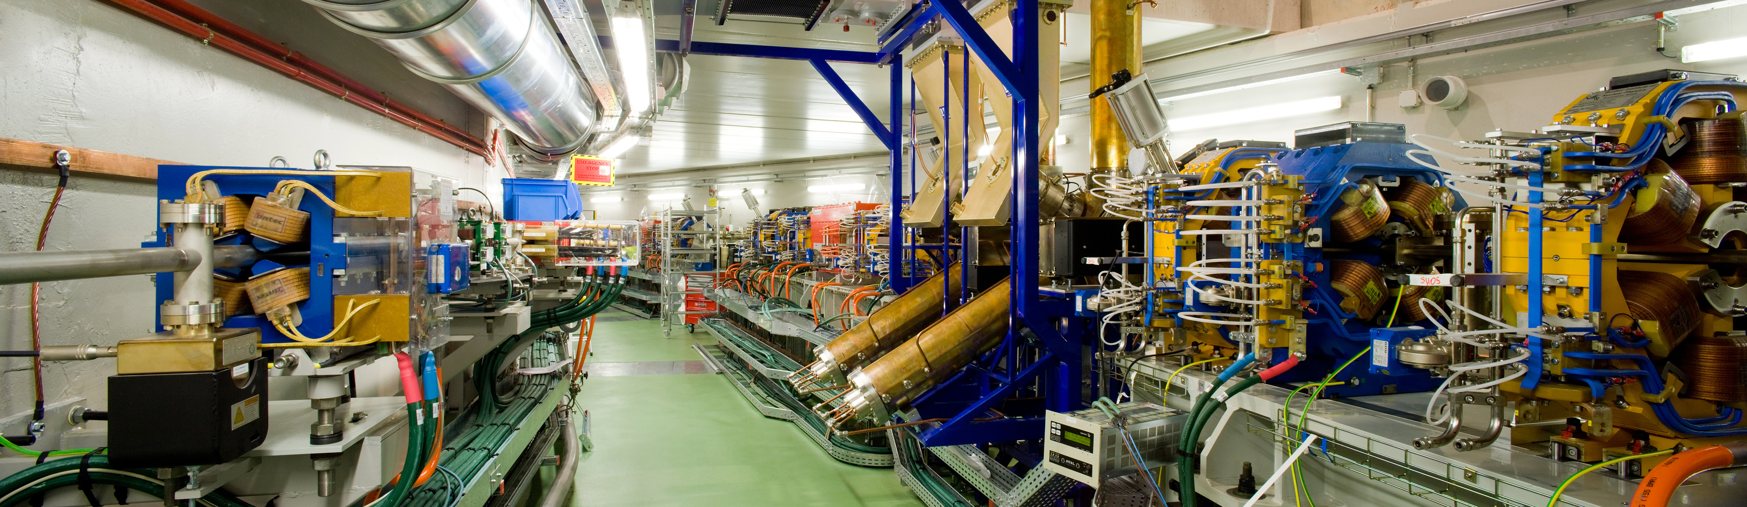
HARMONIC EU CAVITY COMISSIONING: OPERATION AND TBL COMPENSATION
HarmonLIP 2025 - Cerdanyola del Vallès, Spain
24/10/2025
Hamed Shaker on behalf of 3HC Collaboration

Slide 2
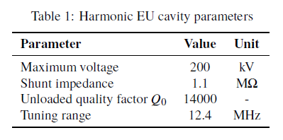
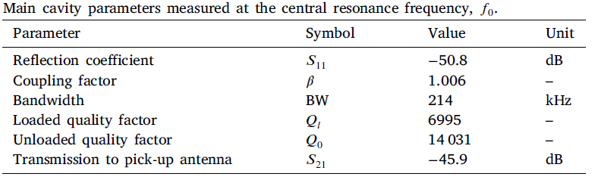
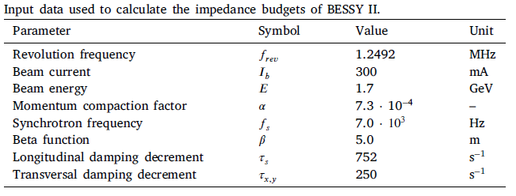
ALBA 3HC at BESSY-II
Active harmonic EU cavity: Commissioning and operation with beam, F. Perez et al., Nuclear Instruments and Methods in Physics Research A 1072 (2025) 170195
And Summary of the commissioning of the active harmonic EU cavity, F. Perez et al., IPAC24, US
Notes:
170kV (14kW) without beam, 200kV in passive mode with beam

Slide 3
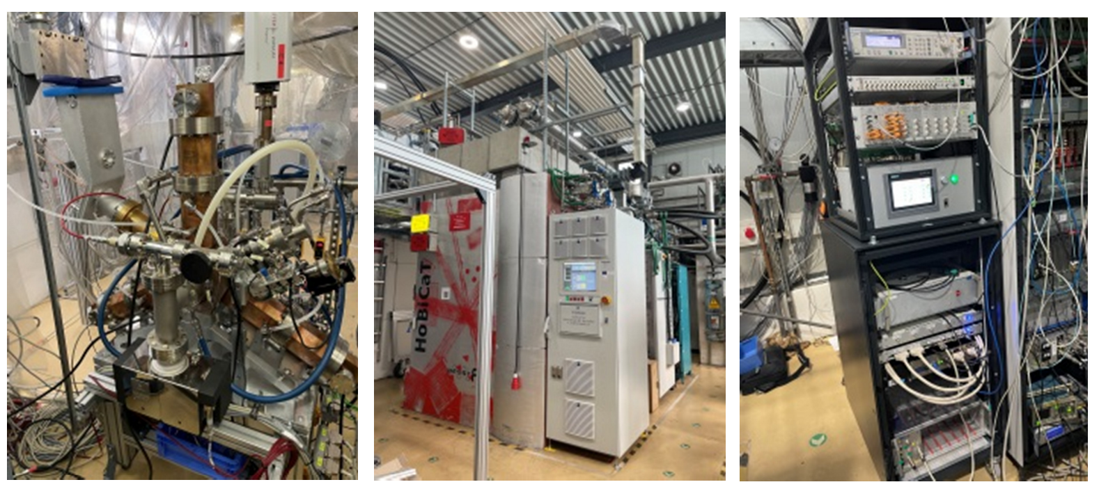
3HC collaboration
A collaboration between ALBA, HZB and DESY. ALBA 3HC cavity and LLRF installed in BESSY-II since 2022 and dismantled on August 2025. Some recent achievements:
TBL compensation
Near flat potential operation
Passive loop operation

Slide 4
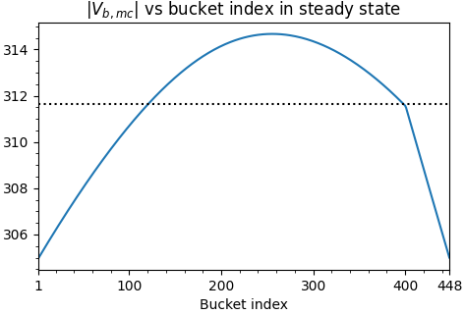
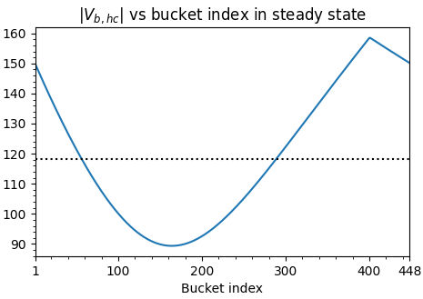

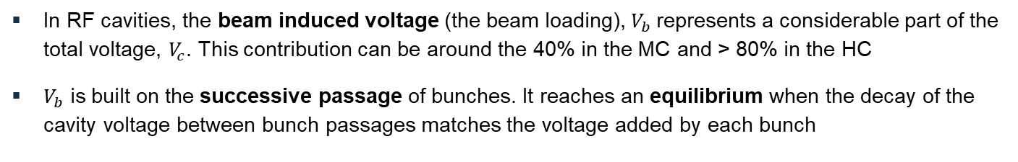
TRANSIENT BEAM LOADING (TBL)
In RF cavities, the beam induced voltage (the beam loading), $V_{b}$represents a considerable part of the total voltage, $V_{c}$. This contribution can be around the 40% in the MC and > 80% in the HC
$V_{b}$ is built on the successive passage of bunches. It reaches an equilibrium when the decay of the cavity voltage between bunch passages matches the voltage added by each bunch
$$V_{b}=−\left(\frac{1}{2} V_{b0}+V_{b1} e^{−\frac{t_{1}}{τ_{f}}} e^{iψ_{1}}+V_{b2} e^{−\frac{t_{2}}{τ_{f}}} e^{iψ_{2}}+…\right)=−\frac{1}{2} V_{b0} − \sum_{l=1}^{N}{{V_{b0} e}^{l(−δ + iψ)}}$$
Uneven charge distribution in the buckets, such as gaps, break the homogeneous build-up causing a periodic modulation in the cavity voltage with a period equal to the revolution time
gap
gap
$$|V_{b}| [kV]$$
$$|V_{b}| [kV]$$

Slide 5
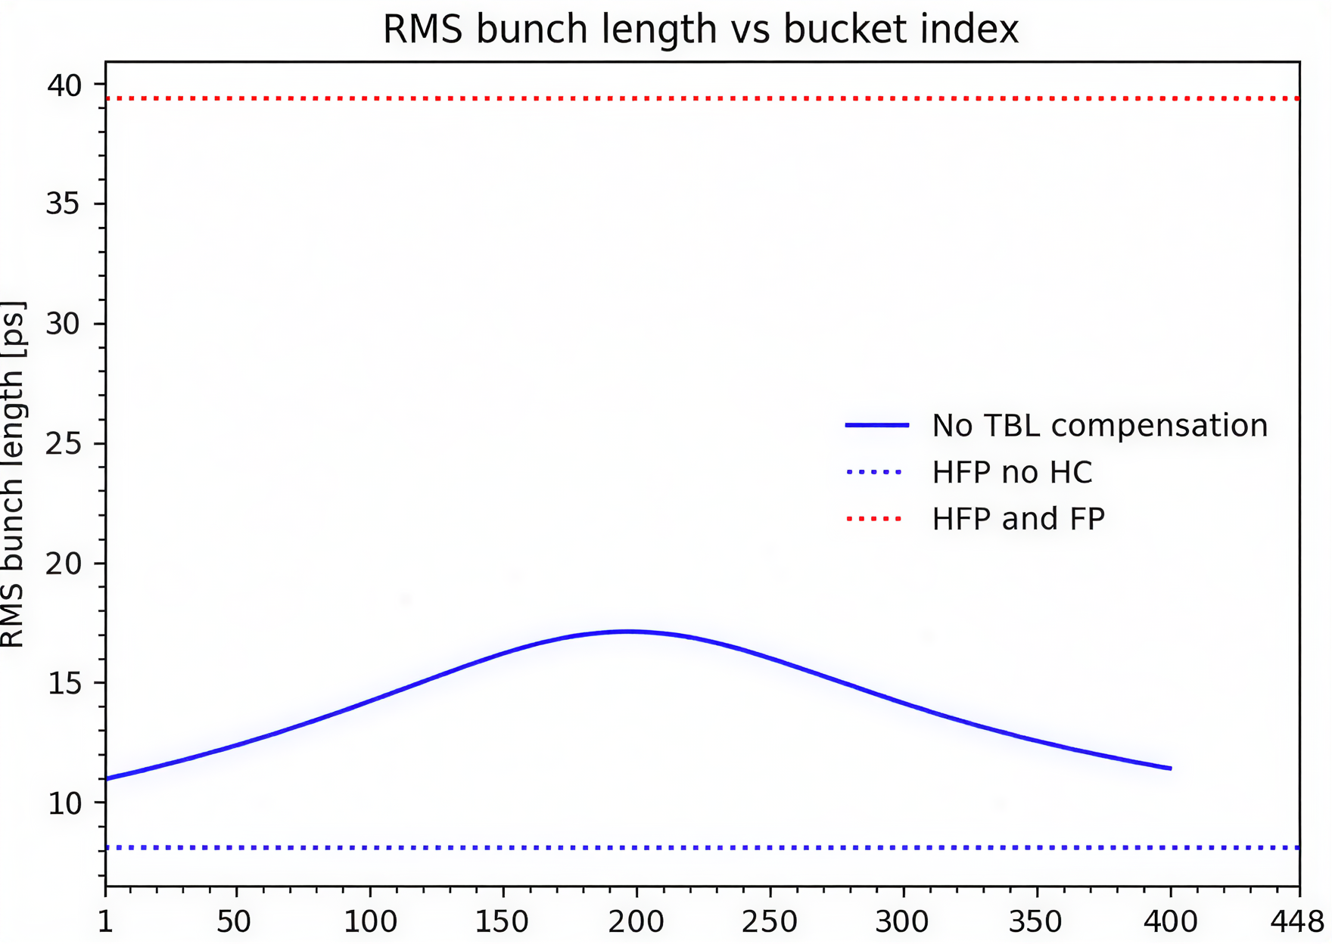



TRANSIENT BEAM LOADING (TBL)
$$σ_{z} FP= 39.3 ps$$
PTBL threshold (680 kV without DRFF)
$σ_{z} 11\% gap= 14.2$ ps
No HC
$$σ_{z} no HC= 8.1 ps$$
ALBA II baseline (1.8%)
The different MC and HC voltages seen by the bunches cause different bunch properties (synchrotron frequency, bunch length, phase, etc.) along the bunch train
The bunch length, and thus the Touschek beam lifetime, is specially affected in the case of a double NC RF system tuned to maximize them
Just a 2% gap can lead to Touschek lifetime reductions of about 45%
Transient beam loading (TBL) compensation is therefore highly recommended in case a gap in the beam is foreseen

Slide 6



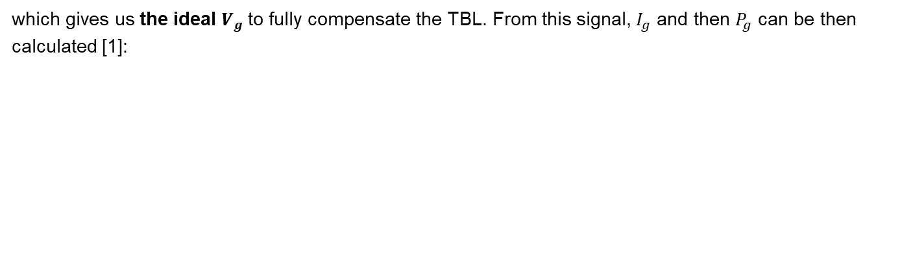
TBL COMPENSATION - METHODOLOGY
Taking advantage of the active HCs, it is possible to modulate the generator induced voltage $V_{b}$, to counter the modulation induced by the beam and get a flatter cavity voltage ($V_{c}$) :
$V_{c}(t) −V_{b}(t)=V_{g} (t)$
which gives us the ideal $V_{g}$to fully compensate the TBL. From this signal, $I_{g}$ and then $P_{g}$ can be then calculated [1]:
$$I_{g}(t)=\frac{1}{k}\left[\frac{dV_{g}(t)}{dt}+\frac{1}{τ_{f}}\left[1−i\tan{ψ_{d}}\right]{ V}_{g}(t)\right]$$
$$P_{g}(t)=\frac{R_{s}{\left|I_{g}(t)\right|}^{2}}{8β}$$
However, RF cavities have a narrow bandwidth and do not accept well the high frequency components of the modulated power required to fully compensate the TBL. A very high generator power is required for some buckets, far exceeding the available one, resulting in a high reflected power, as well
Following the strategy proposed by [1], we can filter out most of the high frequency components to effectively mitigate the TBL effects with reasonable amounts of additional generator power
1. Yamamoto et al., DOI: 10.1103/PhysRevAccelBeams.21.012001

Slide 7
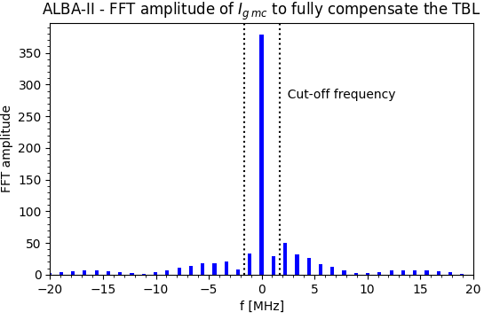
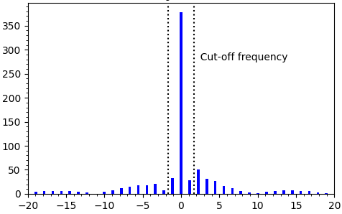
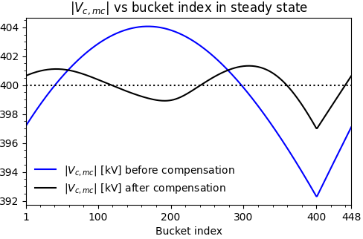
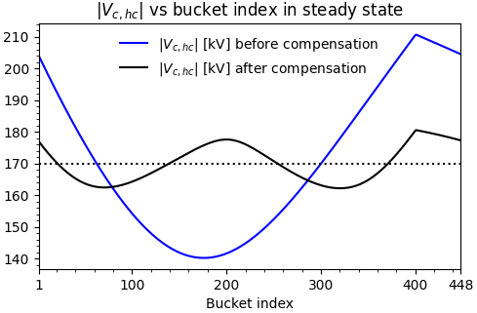
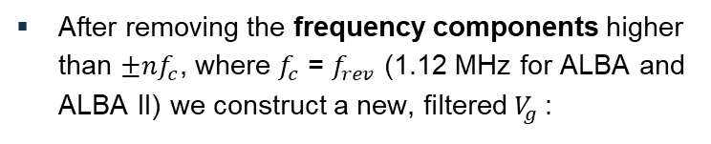
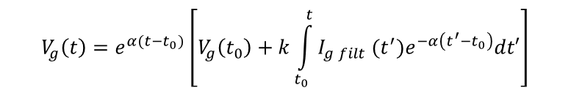
TBL COMPENSATION - METHODOLOGY
After removing the frequency components higher than ${±nf}_{c}$, where $f_{c}$ = $f_{rev}$ (1.12 MHz for ALBA and ALBA II) we construct a new, filtered $V_{g}$:
Revolution frequency harmonics
$$V_{g}\left(t\right)=e^{α(t−t_{0})}\left[V_{g}\left(t_{0}\right)+k\int_{t_{0}}^{t}{I_{g filt} (t^{′})e^{−α\left(t^{′}−t_{0}\right)}dt′}\right]$$
The result is a flatter cavity voltage signal, both in amplitude and phase, for both the MCs and HCs, without requiring so much power:
gap
gap

Slide 8
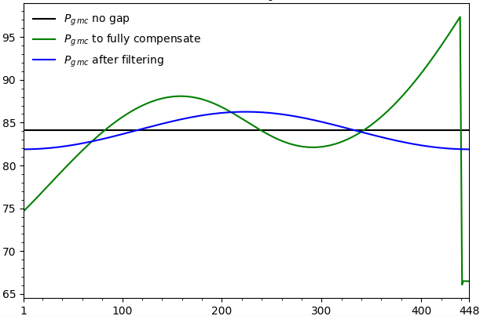
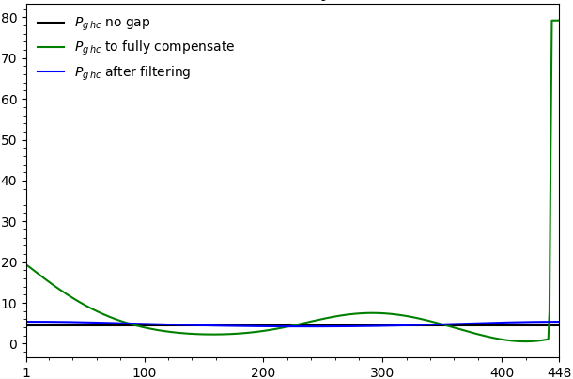
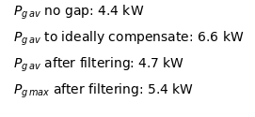
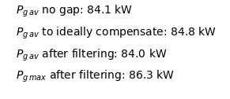
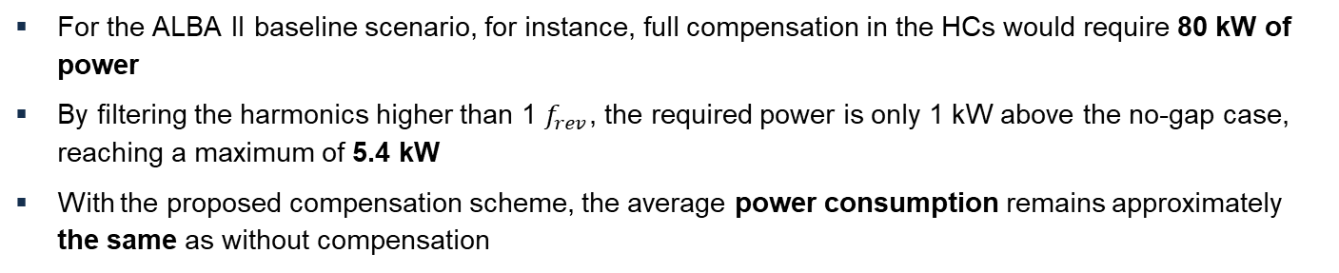
TBL COMPENSATION - METHODOLOGY
For the ALBA II baseline scenario, for instance, full compensation in the HCs would require 80 kW of power
By filtering the harmonics higher than 1 $f_{rev}$, the required power is only 1 kW above the no-gap case, reaching a maximum of 5.4 kW
With the proposed compensation scheme, the average power consumption remains approximately the same as without compensation

Slide 9
TBL COMPENSATION - ALBA II CASE
Even if just a 2% of gap has a heavy impact on the average bunch length, further increasing it does not seem to worsen it much
For gaps < 2%, compensations higher than 97% should be easily achieved
Tracking simulations for the compensation case are in progress

Slide 10
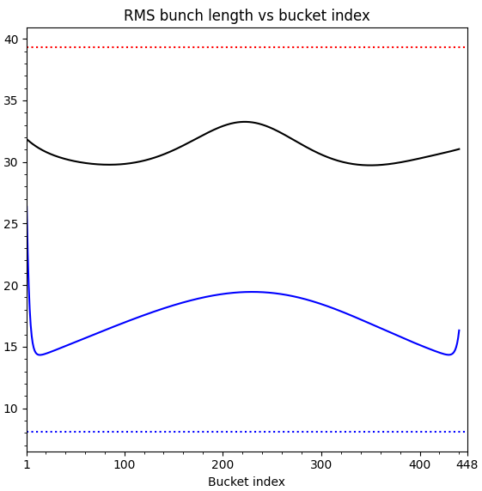
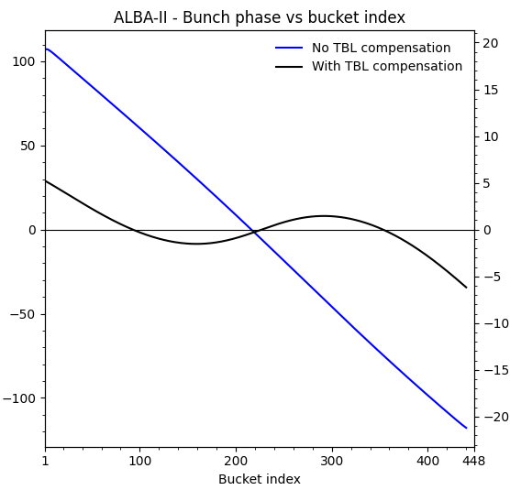
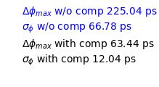
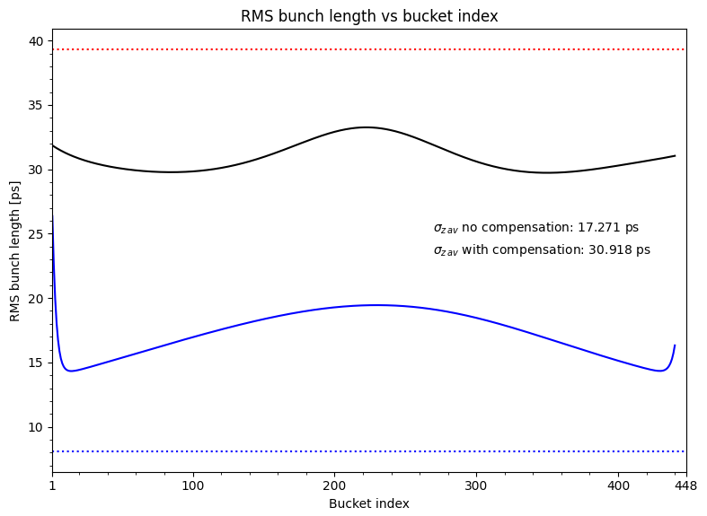
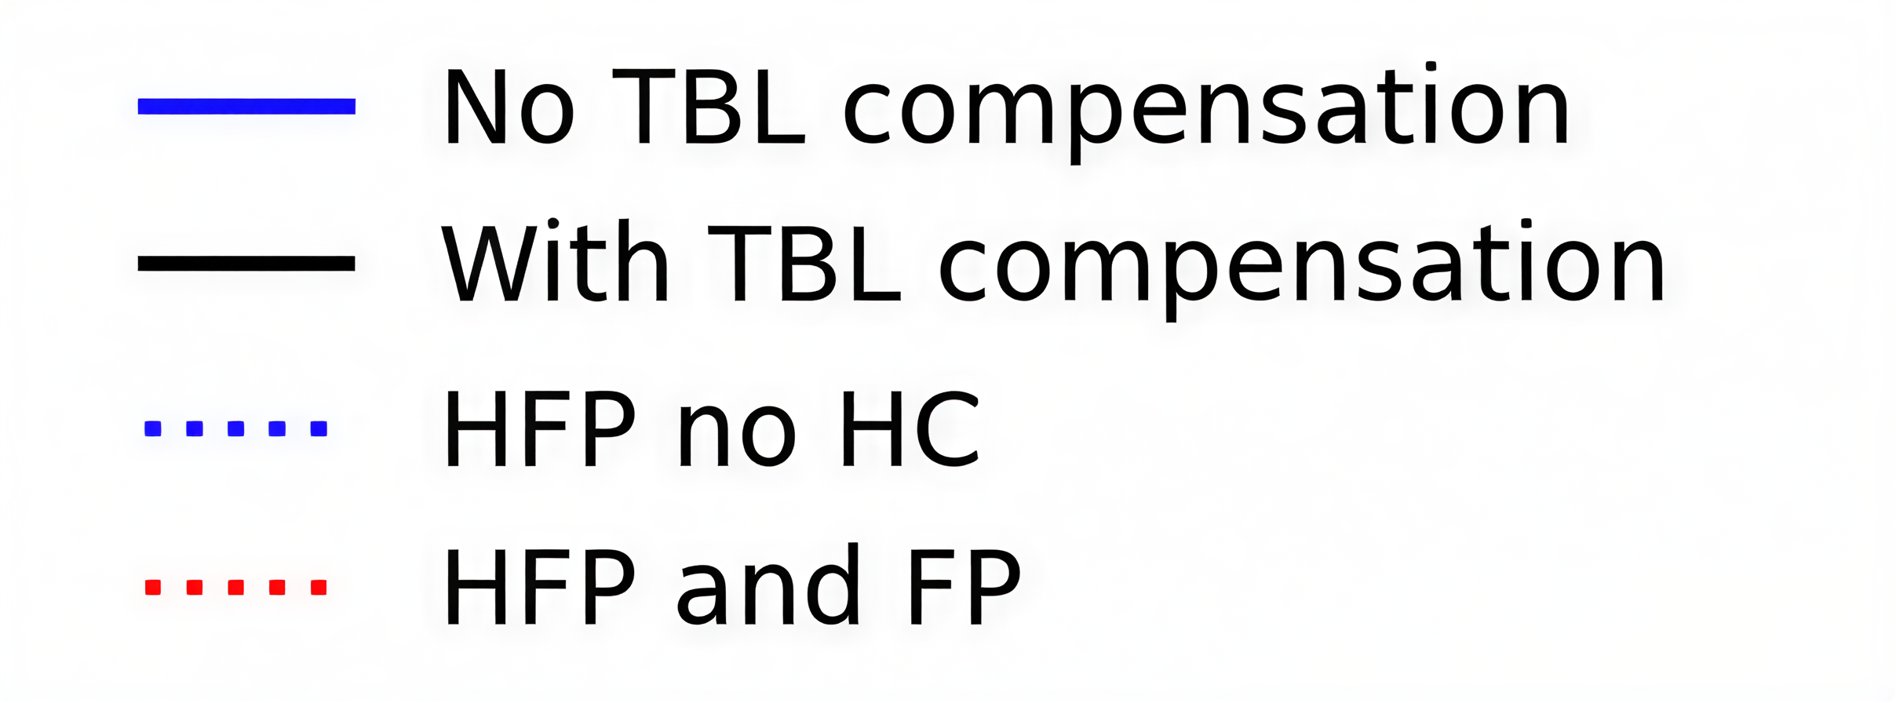


TBL COMPENSATION - ALBA II CASE
In the ALBA II baseline scenario (with only a 1.8% gap), correcting only the 1st revolution harmonic would yield a very high compensation efficiency, with an average bunch length of 30.92 ps, around 98% of the no-gap case, 31.6 ps.
$σ_{z}$ FP = 39.3 ps
$σ_{z}$ no HC = 8.1 ps

Slide 11
TBL COMPENSATION - ALBA II CASE
The bunch form factor and bunch phase have been included in the TBL calculation. Convergence is achieved after approximately 10-15 iterations
Tracking simulations have been performed with elegant to cross-check the semi-analytical results, showing good agreement between both approaches within the linear region
Flat potential HFP
PTBL threshold (680 kV without DRFF)
No HC HFP
ALBA II baseline (1.8%)

Slide 12
TBL COMPENSATION - ALBA II CASE
Even if just a 2% of gap has a heavy impact on the average bunch length, further increasing it does not seem to worsen it much
For gaps < 2%, compensations higher than 97% should be easily achieved
Tracking simulations for the compensation case are in progress
Flat potential HFP
PTBL threshold (680 kV without DRFF)
x 1.8
No HC HFP
ALBA II baseline (1.8%)

Slide 13
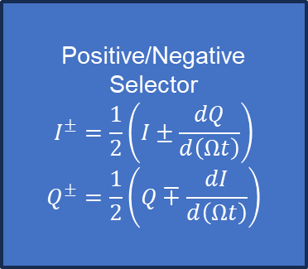
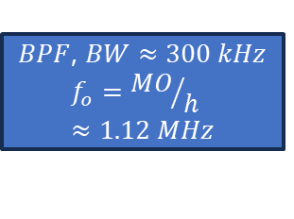
Implementation on the LLRF system
Implemented a new control module includes IIR bandpass-filter and positive/negative frequency separator modules.
Feedforward/feedback drive allows to send revolution harmonic content to cavities.
Source can be chosen between:
      External reference (Feedforward)
      Cavity voltage: Mode +-1 (Feedback)
PI+TC
Positive/Negative
Selector
$$I^{±}=\frac{1}{2}\left(I±\frac{dQ}{d\left(Ωt\right)}\right)$$
$$Q^{±}=\frac{1}{2}\left(Q∓\frac{dI}{d\left(Ωt\right)}\right)$$
+
To cavity
+
$BPF$, $BW≈300 kHz$
$$f_{o}={MO}/h≈1.12 MHz$$
+
MUX
From cavity
External
S. Shaker et al., "Development of a 500 MHz direct RF sampling low-level RF system for ALBA and ALBA-II", in Proc. IPAC'25, Taipei, Taiwan
Harmonic feedback diagram

Slide 14
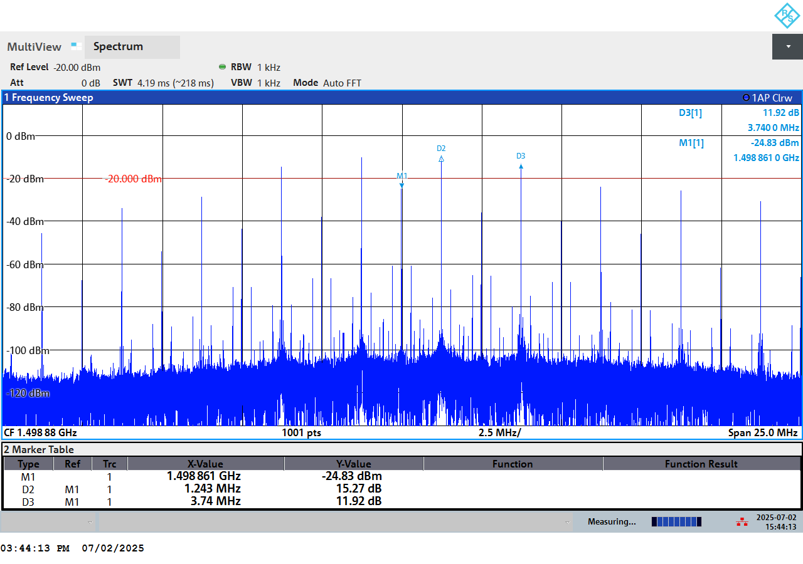
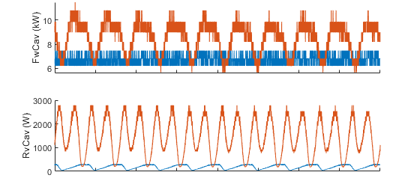
TBL Compensation: Setup
3x MO=1,5 GHz
HFB OFF, HFB ON
Rev. Freq.~1 MHz
External reference
experimental setup
Forward and reflected power
with and w/o compensation measurements
External reference harmonic content
Compensation applied during 3HC commissioning in BESSY II.
  Current: 300 mA, Main RF Voltage: 0.7 MV (2 cavities parked, 2 with detuning -25 deg.), Landau cavities: parked, Fill pattern: 25% gap, 3HC: 130 kV (detuning 0 deg).
External reference built with analogue mixer and filtered using digital harmonic resonant feedback.

Slide 15
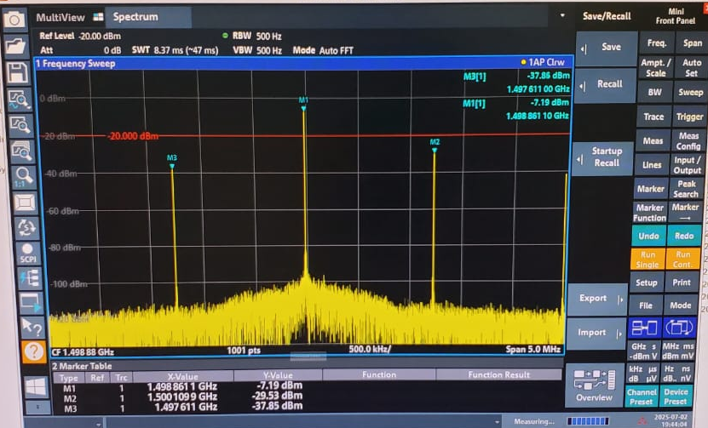
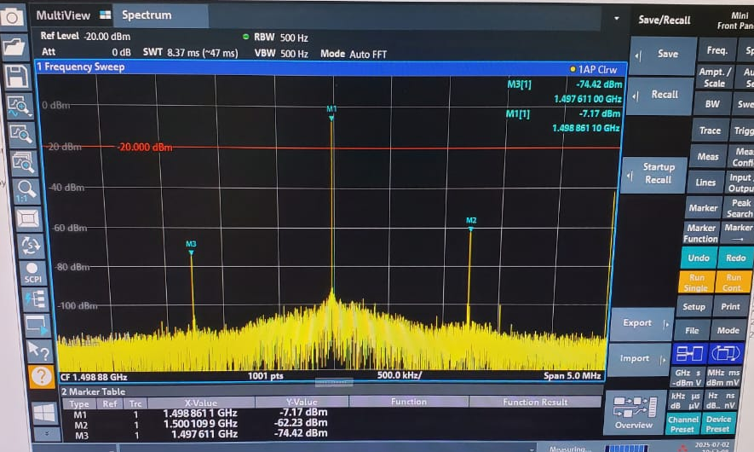
TBL Compensation – Harmonic Reduction
Cavity harmonic content w/o compensation
Cavity harmonic content with compensation
Compensation applied during 3HC commissioning in BESSY II.
  Current: 300 mA, Main RF Voltage: 0.7 MV (2 cavities parked, 2 with detuning -25 deg.), Landau cavities: parked, Fill pattern: 25% gap, 3HC: 130 kV (detuning 0 deg).
Harmonic content of the cavity is reduced by ~ -30 dB.

Slide 16
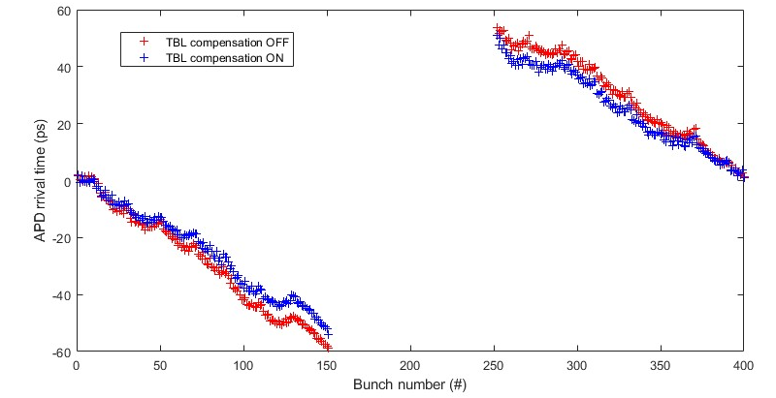
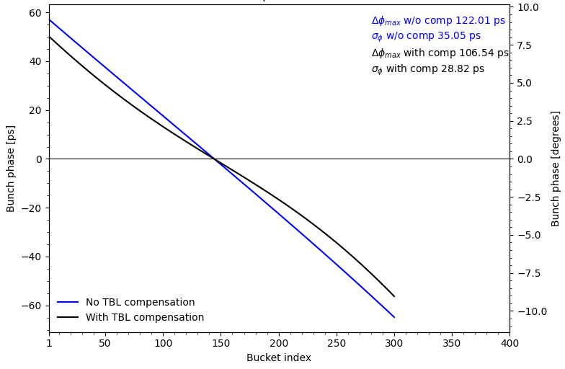
TBL Compensation : Result
Avalanche Photo Diode arrival time
with and w/o compensation measurements
Bunch phase arrival time
with and w/o compensation simulation
Compensation applied during 3HC commissioning in BESSY II.
  Current: 300 mA, Main RF Voltage: 0.7 MV (2 cavities parked, 2 with detuning -25 deg.), Landau cavities: parked, Fill pattern: 25% gap, 3HC: 130 kV (detuning 0 deg).
TBL compensated from 114 ps to 102 ps: -10,5 %.

Slide 17
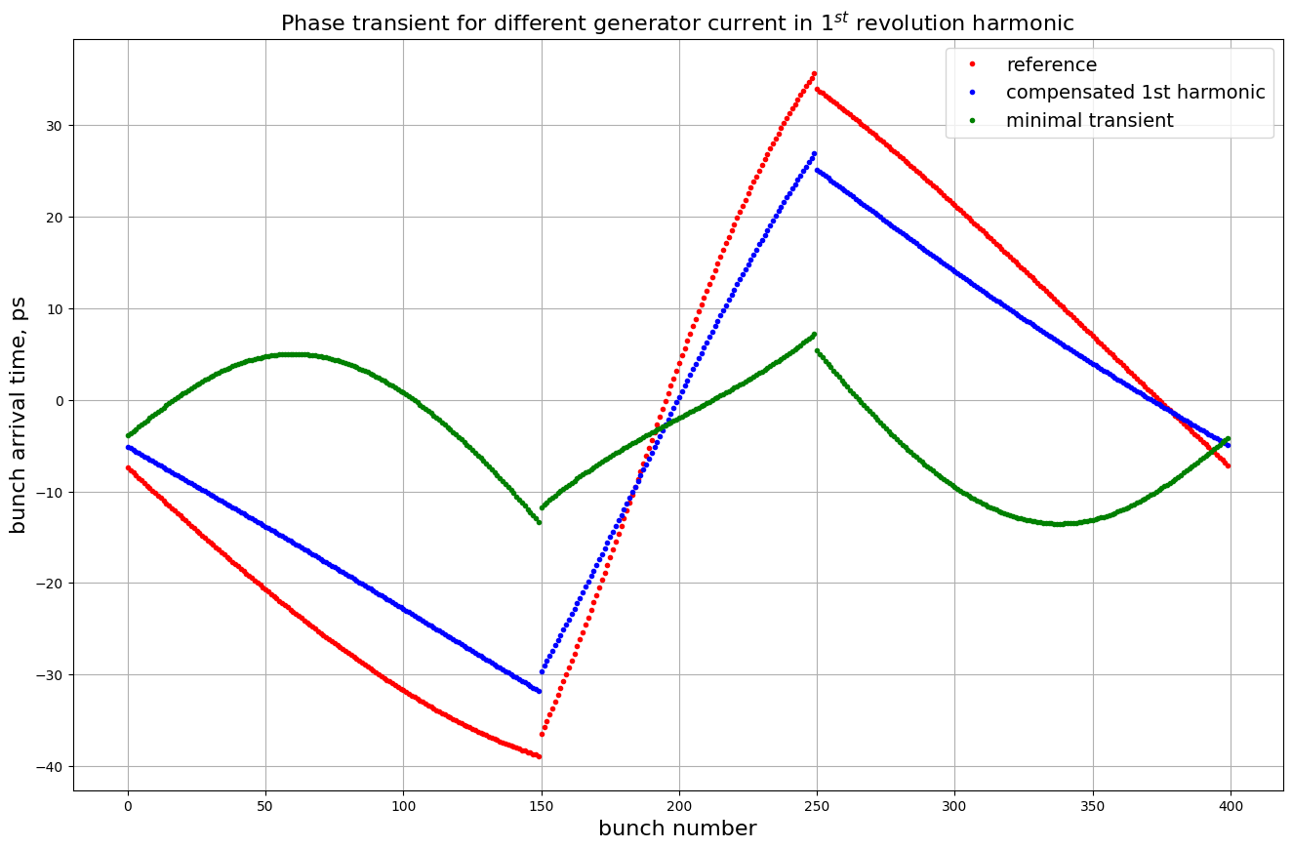
TBL Compensation : Analysis
ALBA 3hc | Reference | Full compensation | Minimal phase transient
Generator current on 1st rev. harmonic, (A) | 0 | 0.0702+0.0039j | 0.250-0.034j
Phase transient (max-min, ps) | 72.89 | 56.99 | 18.97
model reproduces the numbers for reference case (blue) and for the case of compensated 1st harmonic (red)
Transient for the case of compensated 1st harmonic is achieved at generator current I_{gen}=-(-0.070-0.0039j)
minimal phase transient amplitude is predicted for I_{gen}=-(-0.250+0.034j) (green)
This last case was not observed

Slide 18
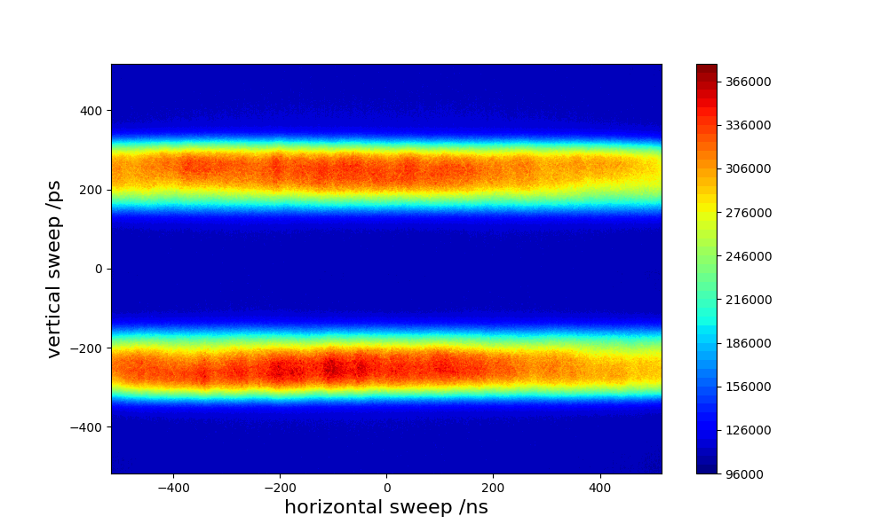
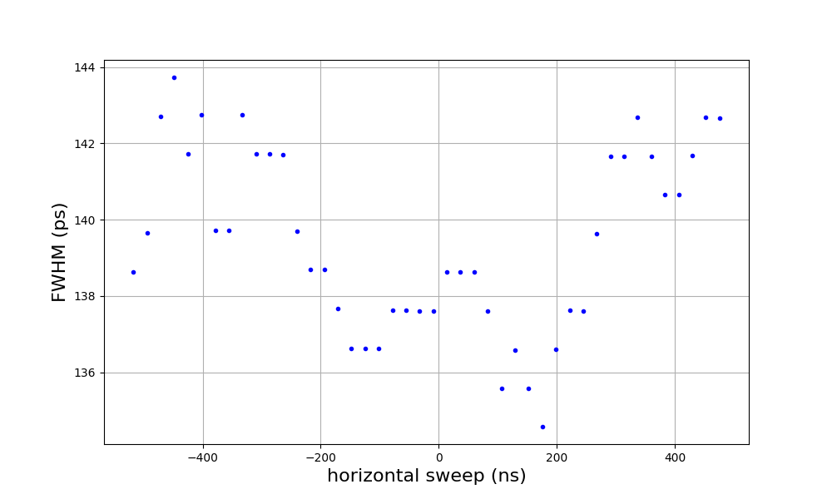
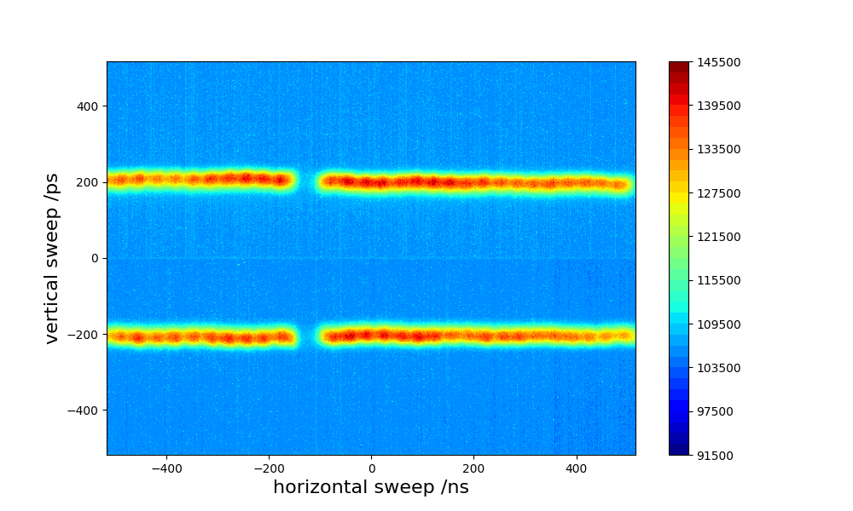
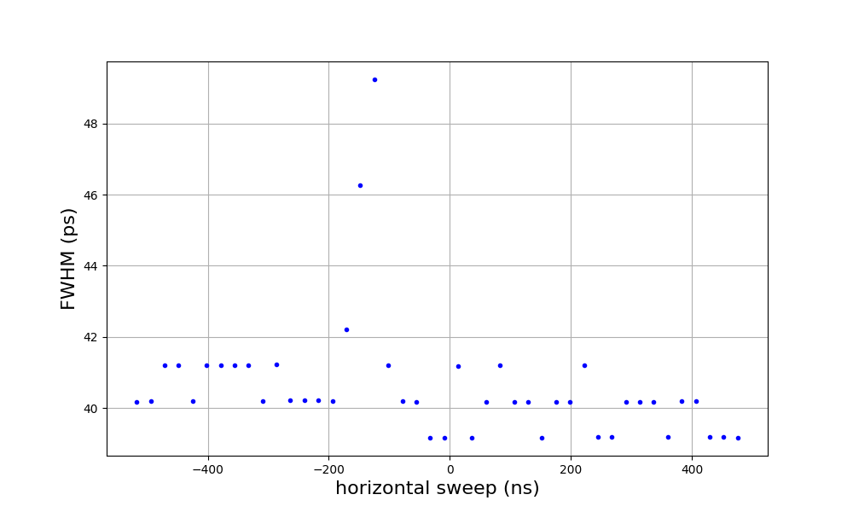
Flat Potential Operation
300mA homogeneous filling pattern beam close to flat longitudinal potential at BESSY II
30-bunchs gap, 1.0MV main RF Harmonic cavities parked

Slide 19
Flat Potential Operation - Steps
 | Main RF | Passive 3hc | Active 3hc | Fill pattern | Current achieved | transient/ bunch length (FWHM) | Life time | Comments
1 | 1400kV (4x350kV) | 4x3kW (=270kV), lengthening (l) | 120kV | Gap 100 bunches | 300mA | 250ps/ ? | 5.9H | We already new it is a stable state, however lifetime improvement is small due to the transient
2 | 1400kV | 4x3kW, (l) | 70kV, 120kV | Homogeneous | 250mA | ~15ps/ ? | 11.9H | 4 tries with beam losses at current from 254mA to 267mA Increasing active 3hc amplitude does not make it better…
3 | 1400kV | Park-lengthening (+0.5 F_rev) | 70kV, 120kV | Homogeneous | 242mA, 211mA |  |  | Reduced threshold advises it could be mode 1 coupled bunch instability. To stabilize it additional impedance at -1 revolution harmonic would help -> park something there!
4 | 1400kV | 4x3kW, (l) | parked (-0.5 F_rev) | Homogeneous | 300mA |  | 8.9H | It works! Stable for 40 min during lunch break. -> Reduce main RF.
5 | 950kV | 4x3kW, (l) | parked (-0.5 F_rev) | Homogeneous | 300mA |  | 12.5H | Unstable at lower main RF amplitudes, but it is a different kind of instability, the beam does not get lost. -> Park a passive 3hc at ~-0.6 F_rev and activate ALBA 3hc.
6 | 1400kV | 3x3kW, (l) LC3 at ~-0.6 F_rev | 100kV | Homogeneous | 300mA |  | 9.44H | Stable! -> Reduce main RF.
7 | 1040kV | 3x3kW, (l) LC3 at ~-0.6 F_rev | 115kV | Homogeneous | 300mA | ~9ps/ 140ps | 15.6H | Stable! Close to quartic potential!

Slide 20
Passive Loop Operation – 200kV & 210kV
For the stability test over night:
switch OFF 3hc SSA
set water flow of the RF load after circulator to ~27 (l/min)
set slow interlock reflected power level to 20kW (73.0 dBm)
inject 200mA and go to passive loop on the shortening side at 200kV (~18.3 kW cavity dissipated power)
Long stability test for this setup - overnight.
Maximum stable 210kV was achieved.

Slide 21
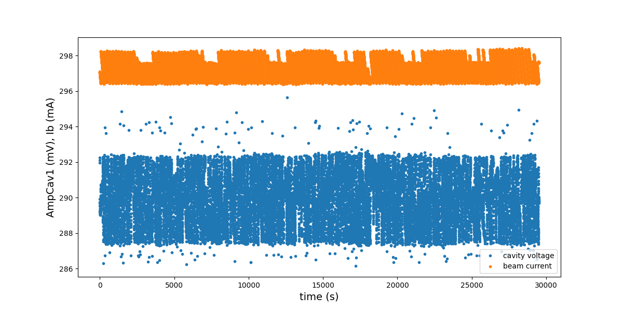
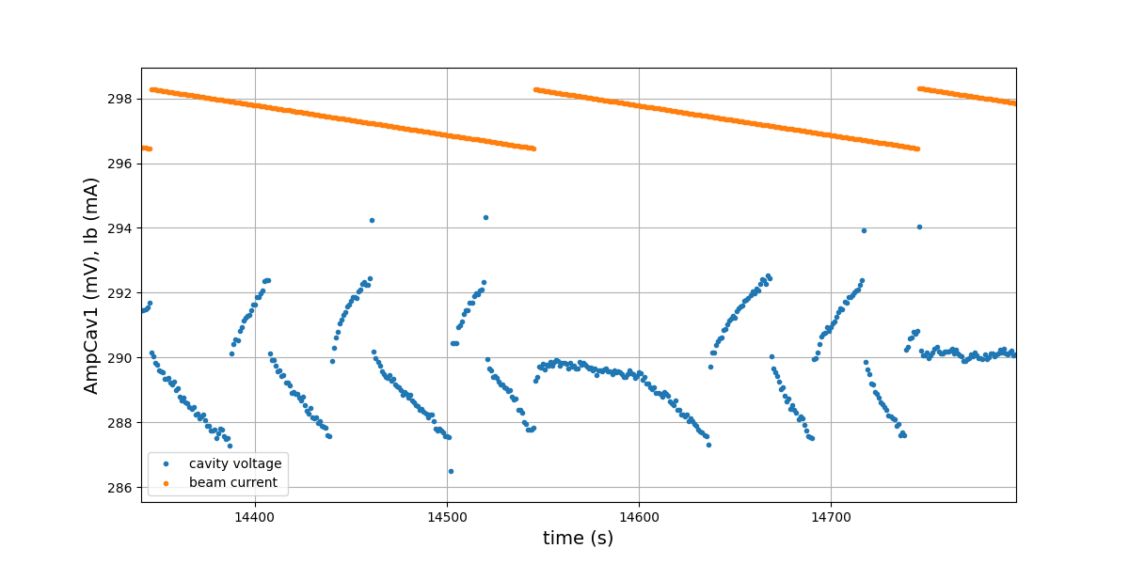
Passive Loop Operation - 100 kV

Slide 22
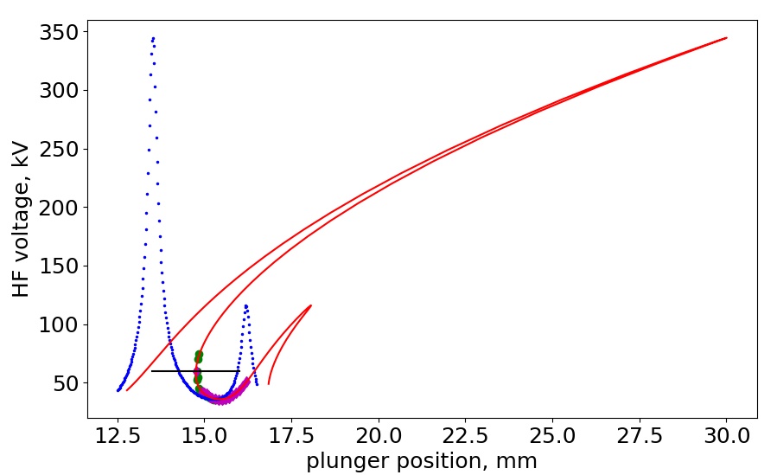
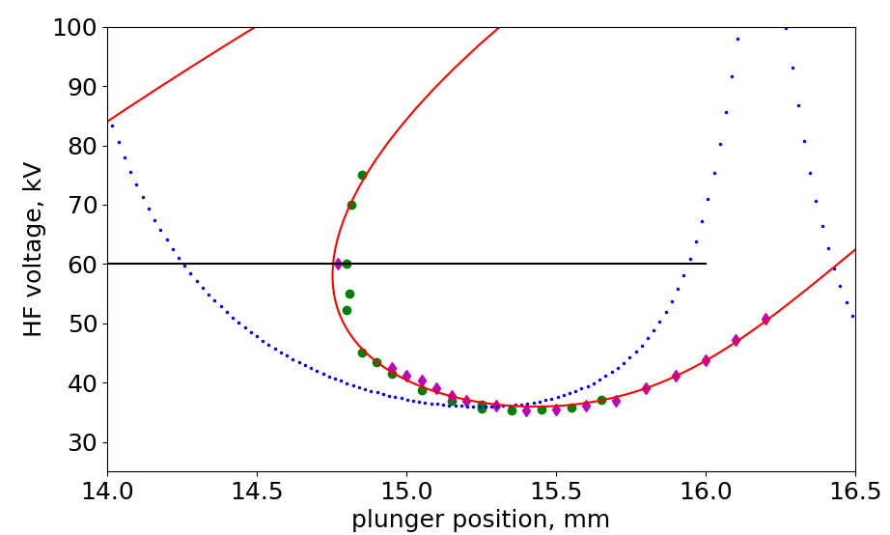
Passive Loop Operation - Thermal instability
Cavities are on thermally unstable arm in lengthening
Picture for a passive 3hc (BESSY-II Landau cavity)
Blue arrows – LLRF passive loop operation

Slide 24
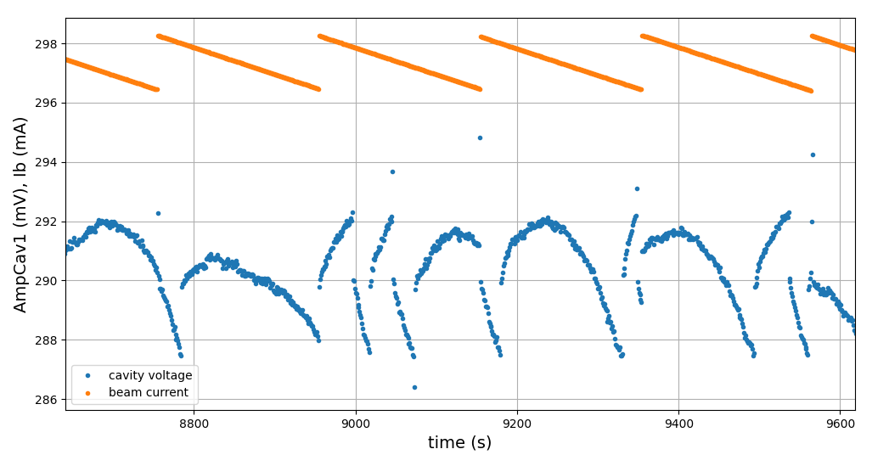
Passive Loop Operation
Outliers by plunger movement or injection
Both by plunger movement up and down
injection
Injection and plunger movement
plunger movement

Slide 25
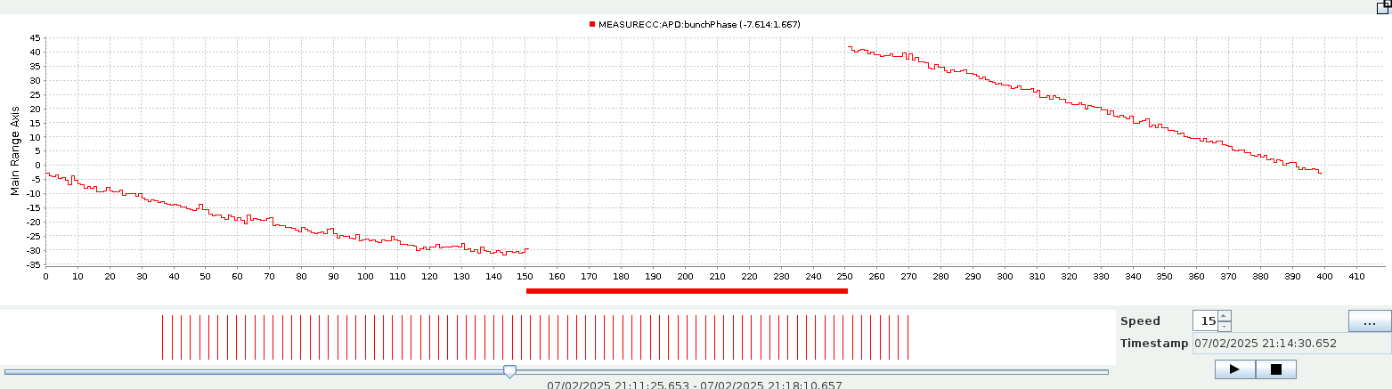
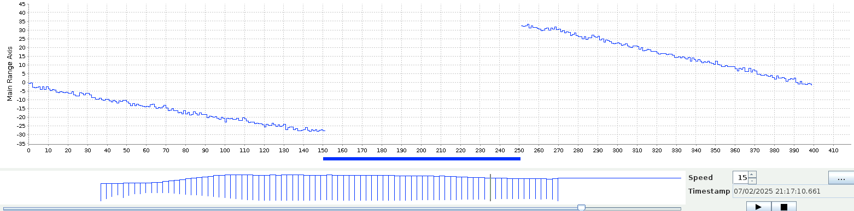
Test at BESSY-II
The revolution signal mixed with the master Oscillator signal and fed to the LLRF system for the feed-forward system
Machine state: current 170mA, amplitude main RF - 1.4MV, Landau cavities – lengthening, fill pattern - 25% gap, ALBA 3hc – “parked” close to +1 rev. harmonic (plunger pos. 4.39).
Two transients recorded on 02.07.2025 overlayed: timestamps 21:14:25 (red, without compensation) and 21:17:10 (blue, with compensation). Transient reduction according to E_log from 73ps to 57ps, or about 20%.

Slide 26
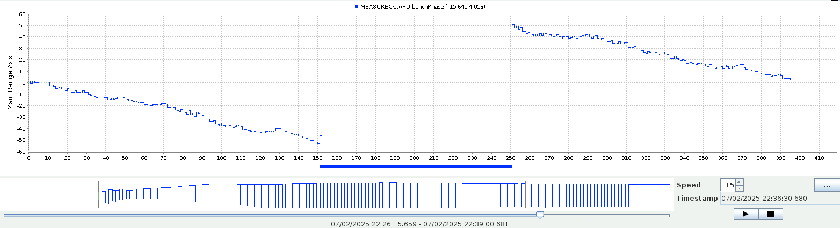
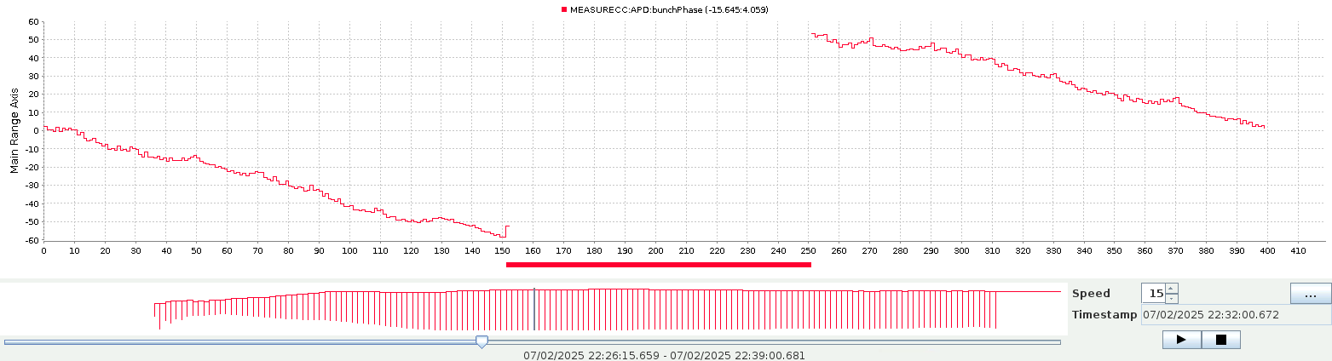
Test at BESSY-II
Machine state: current 300mA, main RF - 0.7MV (2 cavities parked, 2 with detuning -25 deg.), Landau cavities – parked, fill pattern - 25% gap, ALBA 3hc – at 130 kV, 0 deg.
Two transients recorded on 02.07.2025 overlayed: timestamps 22:32:00 (red, without compensation) and 22:36:30 (blue, with compensation). Transient reduction according to E_log from 114ps to 102ps, or about 10%.

